Slide 1
Study of Forward J/ψ Production vs Event Multiplicity in p+p/A Collisions at PHENIX
Ming X. Liu
Los Alamos National Laboratory
(for the PHENIX Collaboration)
CIPANP 2022

Slide 2
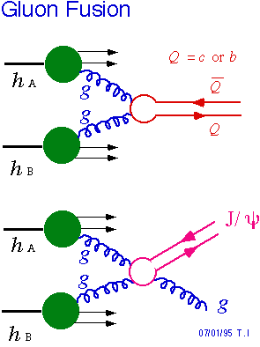
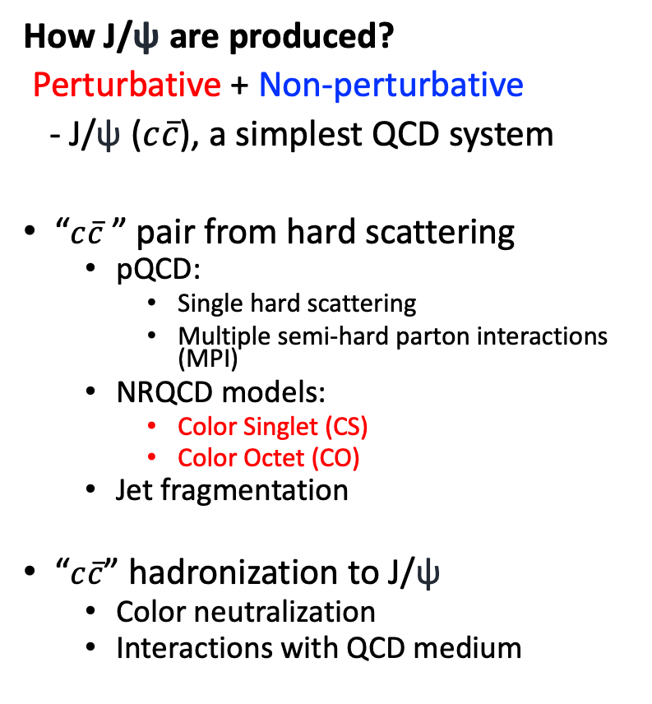
J/ψ Production in High Energy p+p/A Collisions
How J/ψ are produced?
Perturbative + Non-perturbative
- J/ψ ($c\overline{c}$), a simplest QCD system
“$c\overline{c}$ ” pair from hard scattering
  pQCD:
    Single hard scattering
    Multiple semi-hard parton interactions (MPI)
  NRQCD models:
    Color Singlet (CS)
    Color Octet (CO)
  Jet fragmentation
“$c\overline{c}$” hadronization to J/ψ
  Color neutralization
  Interactions with QCD medium
CS:
Gluon fusion dominates
at RHIC energy
CO:

Slide 3
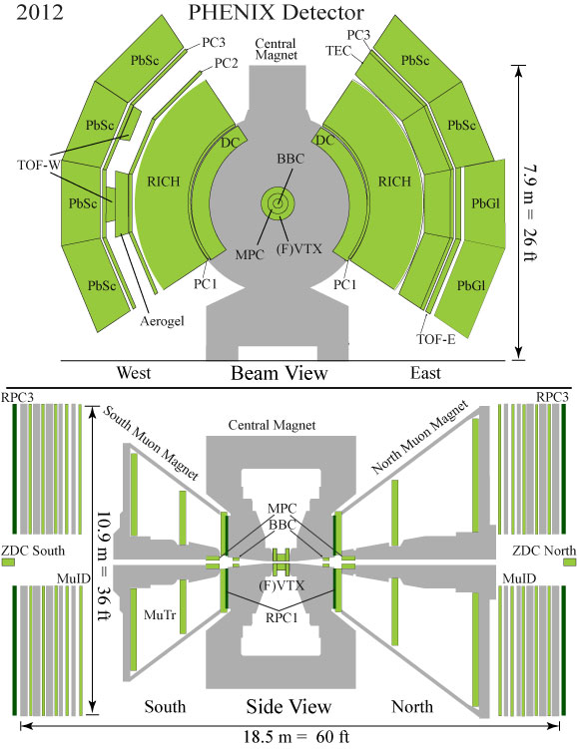

PHENIX Detector at RHIC
Central Arms | η | < 0.35
Identified charged hadrons
Neutral Pions
Direct Photon
J/ψ
Heavy Flavor
Event Multiplicity
Measurements:
SVX: Silicon Vertex Det.
| η | < 1
Muon Arms 1.2 < | η | < 2.4
J/ψ
Unidentified charged hadrons
Heavy Flavor
FVTX: Forward Silicon
Vertex Det.
1.2< | η | < 2.4
J/ψ -> $μ^{+}$ $+μ^{−}$
BBC/MPC 3.1 < | η | < 3.9
Neutral Pion’s
Eta’s
BBC: MB Trigger
3.1< | η | < 3.9
ZDC |η| ~ 5.9
Neutrons
4
Notes:
3

Slide 4


J/ψ Yields vs Event Multiplicity - Topology
- Multi-Parton Interactions (MPI)
Final State Interactions (FSI)
Local event multiplicity: N_{ch}
J/ψ -> $μ^{+}$ $+μ^{−}$
MPI, local energy density?
(J/ψ)
(J/ψ)
N_{ch}
N_{ch}
J/ψ
MPI, local energy density?
MPI, FSI, all
N_{ch}
(J/ψ)
N_{ch}
(J/ψ)
J/ψ
J/ψ

Slide 5
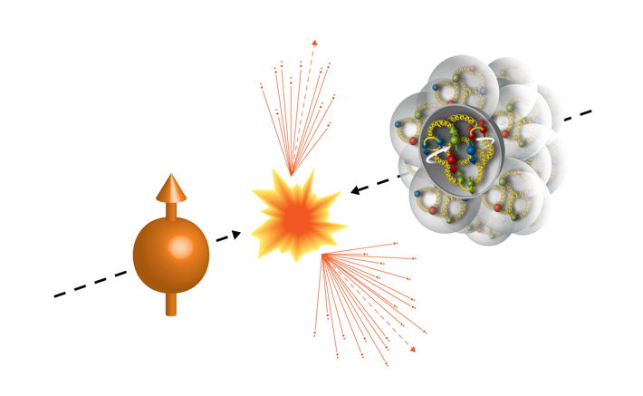
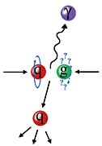
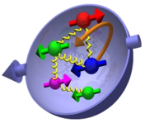
PHENIX Experiment in 2015 Run, 200GeV pp and pA
Transversely polarized p+p, p+Au and p+Al collisions at RHIC
  p+p: L_{NN} ~ 200 pb⁻¹
  p+Au: L_{NN} ~ 130 pb⁻¹
Run15 (2015)
100GeV/nucleon
100GeV
Au, Al
Polarized Proton

Slide 6
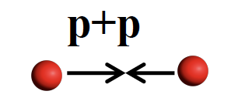
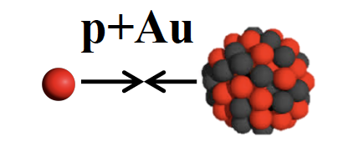
J/ψ Production in pp and pAu Collisions at PHENIX

Slide 7
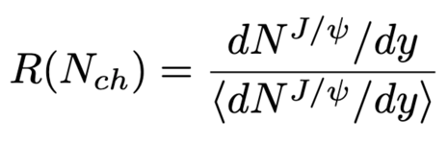
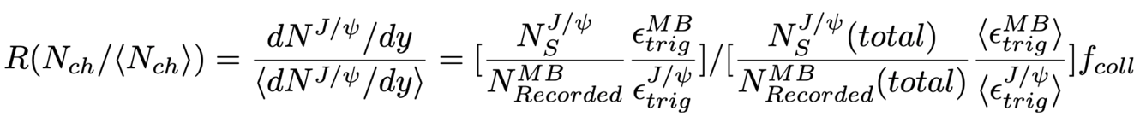
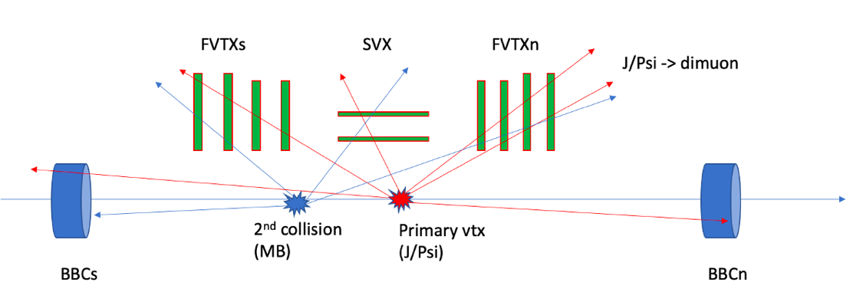

Our Measurements at PHENIX
J/ψ Relative Yields vs Normalized Event Multiplicity from FVTX and SVX
J/ψ -> $μ^{+}+μ^{−}$
Event Multiplicity Measurements: FVTXs, SVX, FVTXn

Slide 8
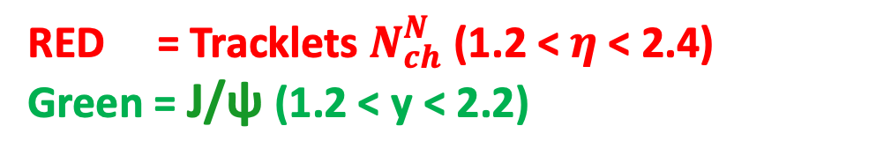


J/ψ Production: same kinematic region
RED = Tracklets $N_{ch}^{N}$ (1.2 < $η$ < 2.4)
Green = J/ψ (1.2 < y < 2.2)
$N_{ch}^{N}$
J/ψ -> $μ^{+}$ $+ μ^{−}$
Multiplicity: MPI, FSI contributions to the forward J/ψ production?

Slide 9


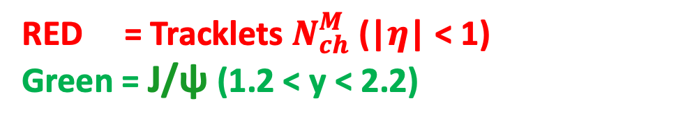
J/ψ Production vs Multiplicity at Midrapidity
RED = Tracklets $N_{ch}^{M}$(|$η$| < 1)
Green = J/ψ (1.2 < y < 2.2)
$N_{ch}^{M}$
J/ψ -> $μ^{+}$ $+ μ^{−}$
expect less co-mover type FSI at high multiplicity

Slide 10


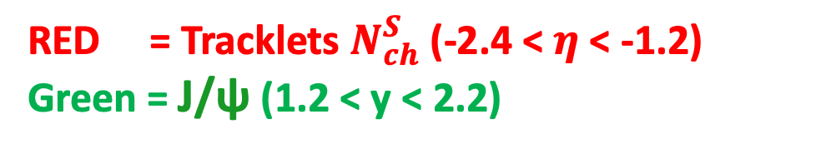
J/ψ Production: far-off kinematic region
RED = Tracklets $N_{ch}^{S}$(-2.4 < $η$ < -1.2)
Green = J/ψ (1.2 < y < 2.2)
J/ψ -> $μ^{+}$ $+ μ^{−}$
$N_{ch}^{S}$
Expect much less co-mover type FSI at high multiplicity

Slide 11



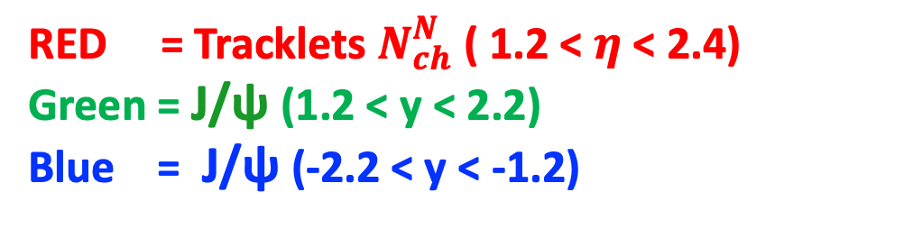
J/ψ Yields vs Event Multiplicity
RED = Tracklets $N_{ch}^{N}$( 1.2 < $η$ < 2.4)
Green = J/ψ (1.2 < y < 2.2)
Blue = J/ψ (-2.2 < y < -1.2)
$N_{ch}^{N}$
J/ψ -> $μ^{+}$ $+μ^{−}$
J/ψ -> $μ^{+}$ $+{ μ}^{−}$

Slide 12



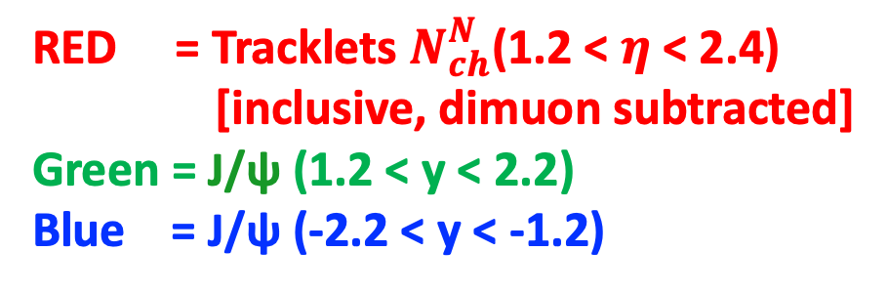
J/ψ Yields vs Event Multiplicity: All Together
RED = Tracklets $N_{ch}^{N}$(1.2 < $η$< 2.4)
[inclusive, dimuon subtracted]
Green = J/ψ (1.2 < y < 2.2)
Blue = J/ψ (-2.2 < y < -1.2)
J/ψ -> $μ^{+}$ $+{ μ}^{−}$
J/ψ -> $μ^{+}$ $+{ μ}^{−}$
$N_{ch}^{N}$
- Less MPI contribution to the forward J/ψ production?

Slide 13
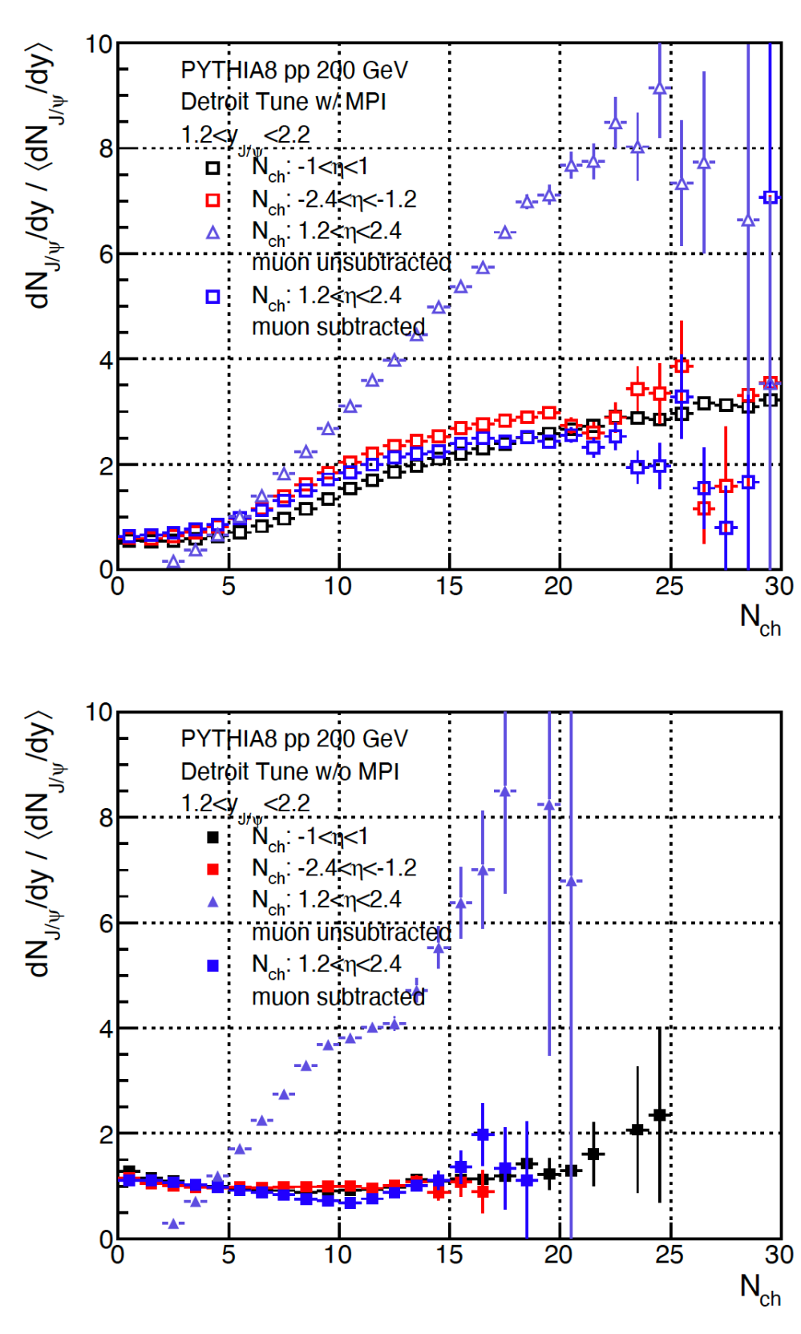

PYTHIA 8 p+p Simulations
Detroit Tune (RHIC) pp 200GeV
  MPI ON/OFF
  PHENIX acceptance
MPI ON
J/ψ -> $μ^{+}$ $+ μ^{−}$
MPI OFF

Slide 14
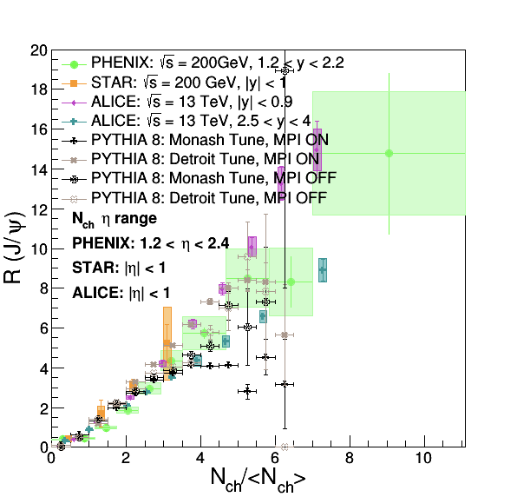
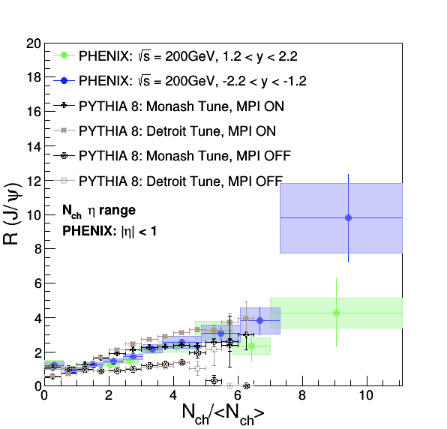
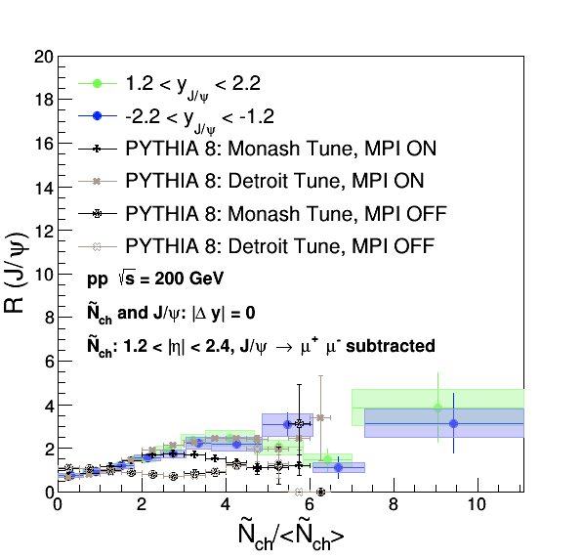
PYTHIA vs Data (RHIC and LHC)
(same arm, inclusive)
(dimuon subtracted)

Slide 15
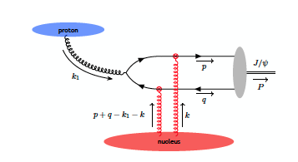
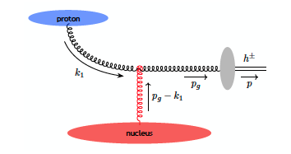
Probe CGC in pAu?
Farid Salazer, Bjorn Schenke and Alba Soto-Ontoso
arXiv:2112.04611; Private Comm.

Slide 16
Summary and Outlook
First measurements of the relative J/ψ yields R in the forward rapidity vs normalized event charged particle multiplicity N_{ch}/< N_{ch} > in pp at 200GeV
  Strong N_{ch} dependence observed when signal and N_{ch} in the same kinematics
  N_{ch} dependence reduced significantly if dimuon contribution removed
  Dimuon subtracted N_{ch} dependence similar to the ones from N_{ch} determined in a far kinematic region from the signal
Physics discussions
  “c-cbar” favors CS state, at low pT?
  R depends on not only MPI but also other effects/production mechanisms
  Comparison with PYTHIA, favors MPI
  More theoretical inputs welcome
p+Au analysis in progress, stay tuned!
  Very interesting CGC motivated model predictions
J/ψ
J/ψ

Slide 17



Slide 18
Backup slides

Slide 19
J/ψ Yields vs Event Multiplicity: All Together
RED = Tracklets (1.2 < eta < 2.4)
[dimuon subtracted]
Green = J/ψ (1.2 < y < 2.2)
[inclusive tracklets]
Blue = J/ψ (-2.2 < y < -1.2)
- Less MPI contribution to the forward J/Psi production?

Slide 20





Comparation with other Results (I)
J/ψ -> $e^{+}$ $+{ e}^{−}$
J/ψ -> $μ^{+}$ $+{ μ}^{−}$
ALICE:
STAR:
J/ψ -> $e^{+}$ $+{ e}^{−}$
$$N_{ch}^{N}$$
J/ψ -> $μ^{+}$ $+{ μ}^{−}$
PHENIX:

Slide 21
Comparation with other Results (II)
ALICE:
STAR:
PHENIX:

Slide 22



Comparation with other Results (III)
ALICE:
STAR:
$$N_{ch}^{N}$$
J/ψ -> $μ^{+}$ $+{ μ}^{−}$
J/ψ -> $μ^{+}$ $+{ μ}^{−}$
PHENIX:

Slide 23


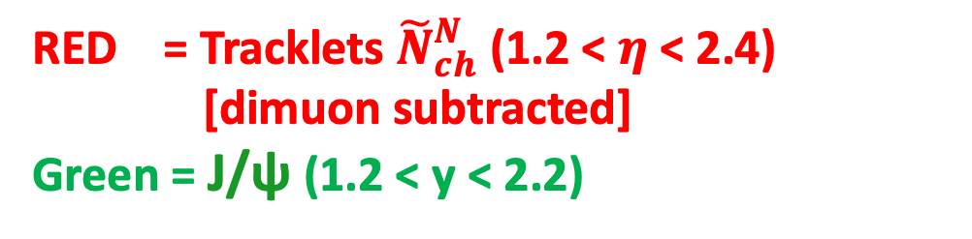
J/ψ Yields vs Event Multiplicity
- subtract J/ψ dimuon contributions
RED = Tracklets ${\tilde{N}}_{ch}^{N}$ (1.2 < $η$ < 2.4)
[dimuon subtracted]
Green = J/ψ (1.2 < y < 2.2)
J/ψ -> $μ^{+}$ $+ μ^{−}$
$${\tilde{N}}_{ch}^{N}$$
“better estimation” of UE activity ?

Slide 24
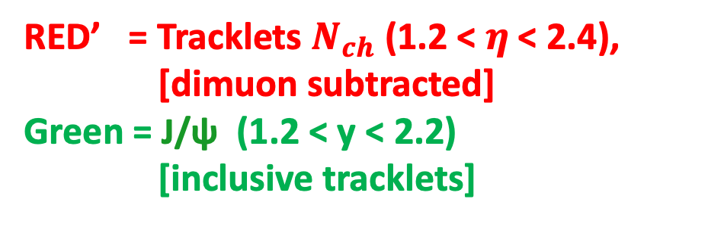

J/ψ Yields vs Event Multiplicity
- subtract J/ψ dimuon contributions
RED’ = Tracklets $N_{ch}$ (1.2 < $η$< 2.4),
[dimuon subtracted]
Green = J/ψ (1.2 < y < 2.2)
[inclusive tracklets]
(Before)
(After)
$N_{ch}^{N}$
J/ψ -> $μ^{+}$ $+{ μ}^{−}$

Slide 25


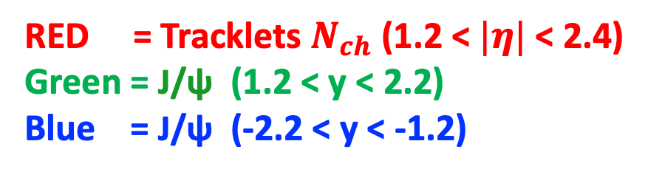


Consistency Check: North vs South Arms (I)
RED = Tracklets $N_{ch}$ (1.2 < $|η|$< 2.4)
Green = J/ψ (1.2 < y < 2.2)
Blue = J/ψ (-2.2 < y < -1.2)
J/ψ -> $μ^{+}$ $+{ μ}^{−}$
J/ψ -> $μ^{+}$ $+{ μ}^{−}$
$N_{ch}^{S}$
$N_{ch}^{N}$

Slide 26


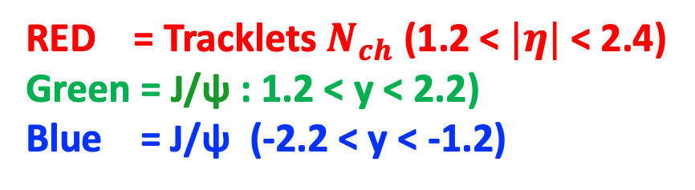
Consistency Check: North vs South Arms (II)
RED = Tracklets $N_{ch}$ (1.2 < $|η|$< 2.4)
Green = J/ψ : 1.2 < y < 2.2)
Blue = J/ψ (-2.2 < y < -1.2)
J/ψ -> $μ^{+}$ $+{ μ}^{−}$
J/ψ -> $μ^{+}$ $+{ μ}^{−}$
$N_{ch}^{N}$
$N_{ch}^{S}$

Slide 27


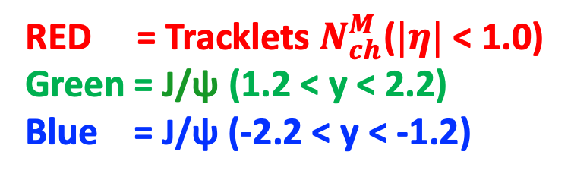
Consistency Check: North vs South Arms
RED = Tracklets $N_{ch}^{M}$($|η|$< 1.0)
Green = J/ψ (1.2 < y < 2.2)
Blue = J/ψ (-2.2 < y < -1.2)
$N_{ch}^{M}$
J/ψ -> $μ^{+}$ $+{ μ}^{−}$
J/ψ -> $μ^{+}$ $+{ μ}^{−}$

Slide 28
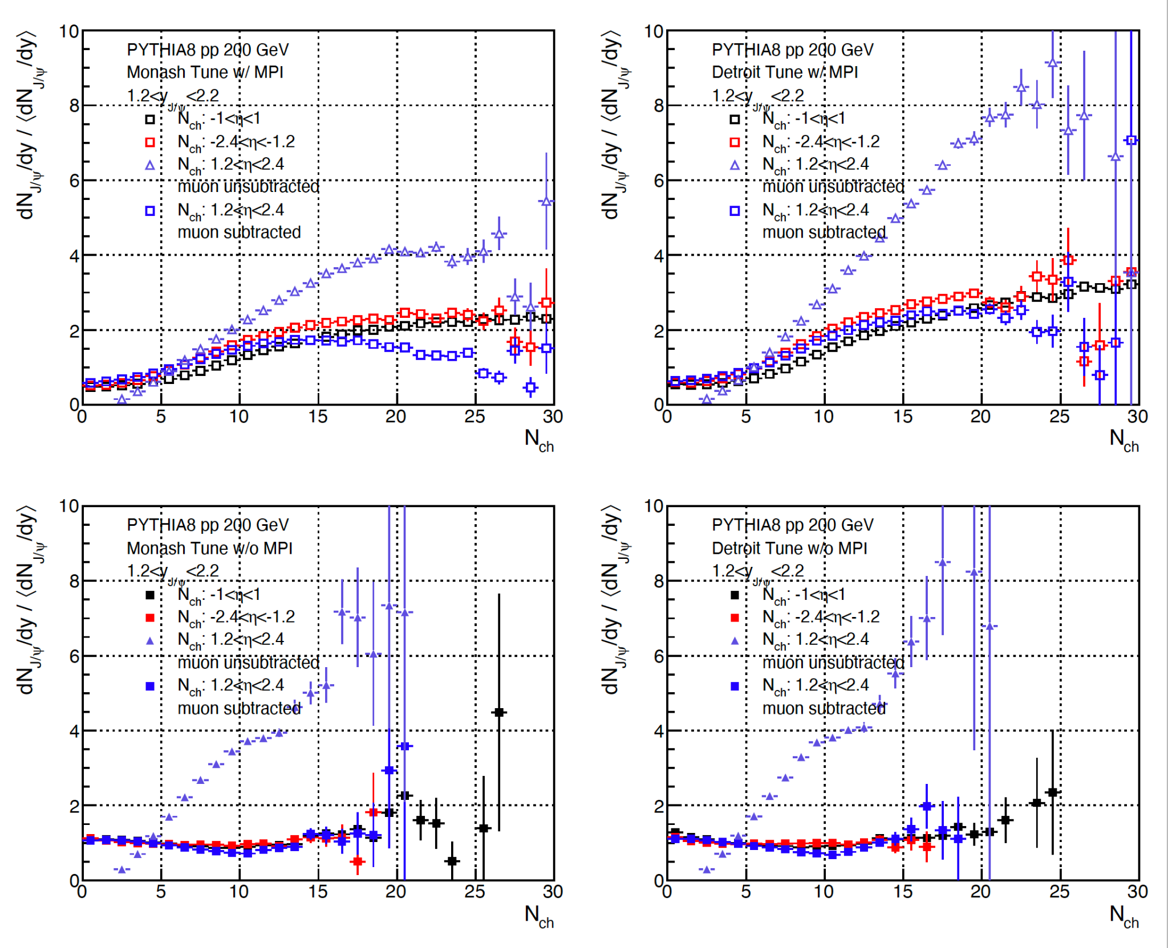


PYTHIA Simulations
$$μ^{+}$$
$$μ^{−}$$

Slide 29
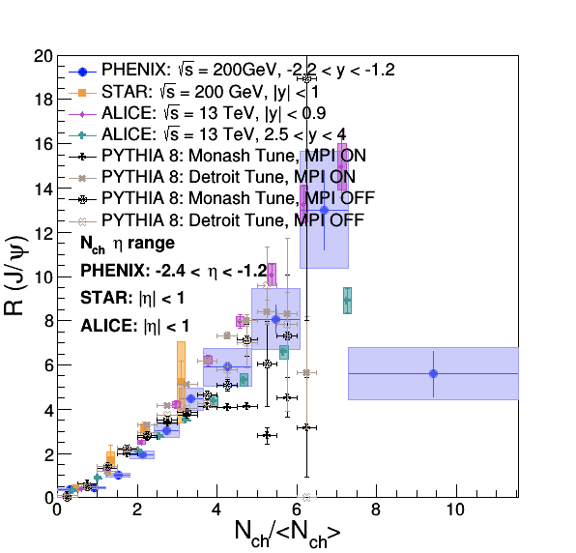
PYTHIA and Data – Same Arms

Slide 30
PYTHIA and Data – Dimuon subtracted

Slide 31
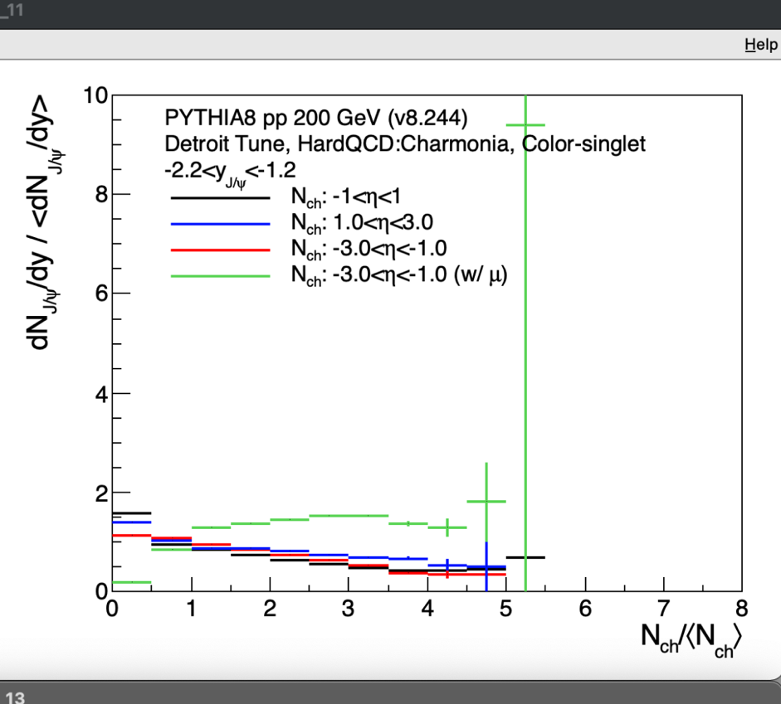
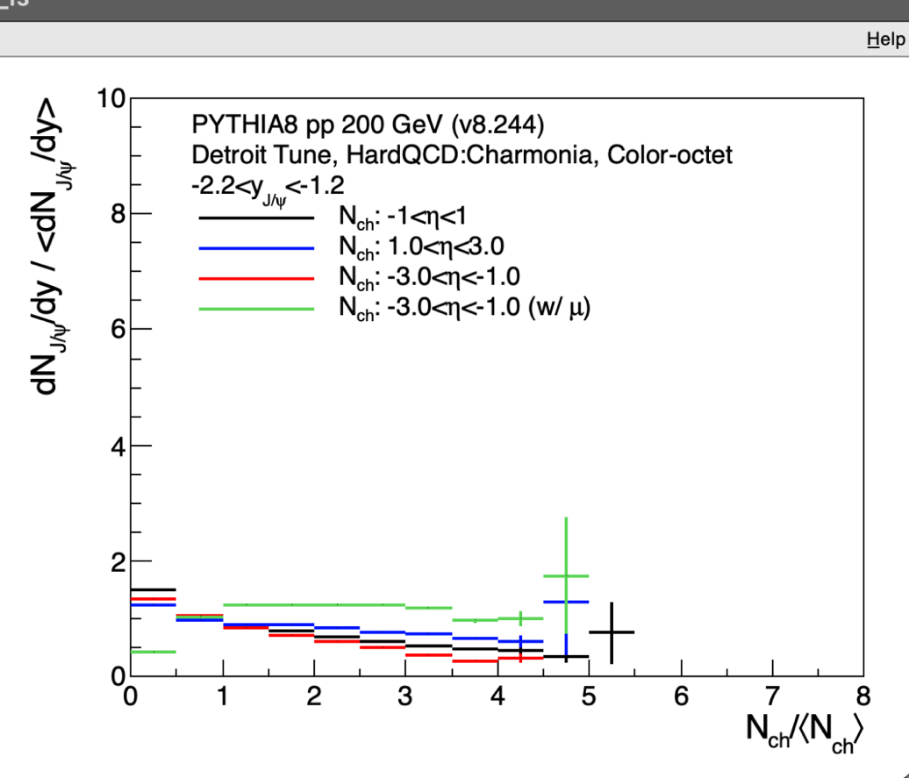
PYTHIA sim with CS and CO, MPI ON

Slide 32
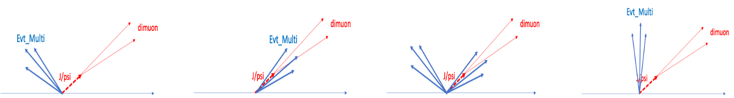
J/Psi Production and QCD Underlying Events

Slide 33
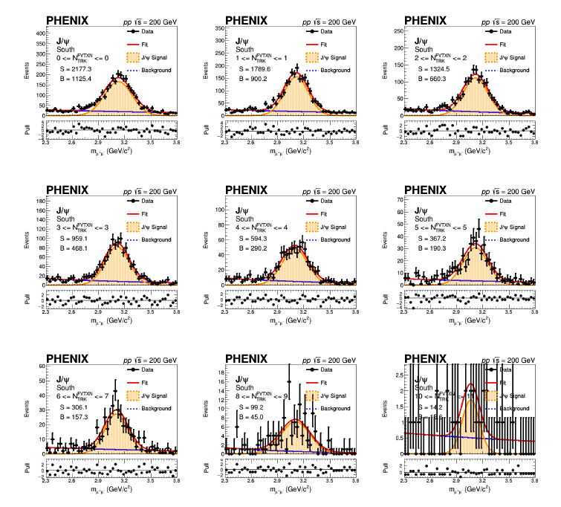
J/ψ Dimuon Mass Fits

Slide 34
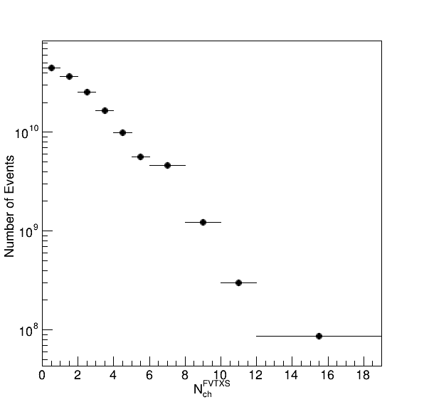

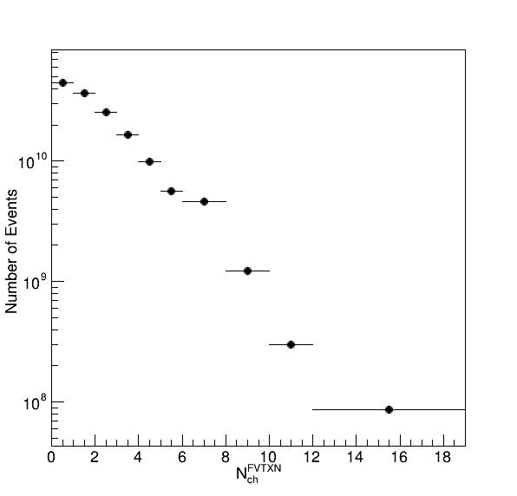
MB Events’ FVTX and SVX Tracklet Raw Distributions

Slide 35
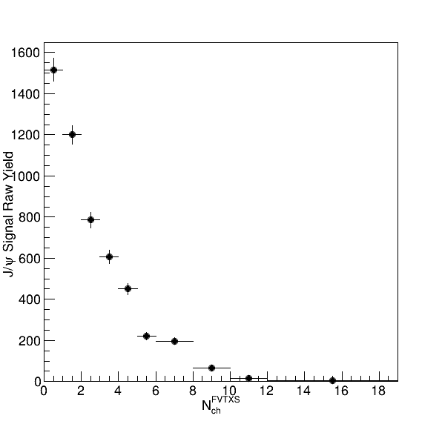
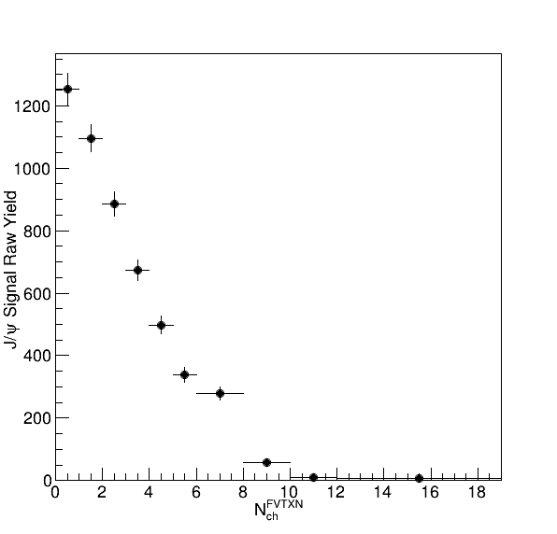
Raw J/ψ Counts vs FVTX and SVX
FVTXS
VTX
FVTXN

Slide 36
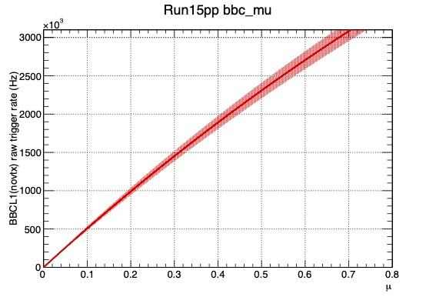
Multiple Collision Probability Table
BBCLL1_Eff = 55 +/ 5 % for run15 pp MB; 79 +/-2 % for hard scattering
BBC Rate kHz | Mean_Mu | Prob. to have 2+ collisions
250 | 0.05 | 0.12%
500 | 0.1 | 0.47% <pAu>
1,000 | 0.2 | 1.8% <pp>
1,500 | 0.31 | 3.9%
2,000 | 0.43 | 6.9%
2,500 | 0.55 | 10%

Slide 37
FVTX Track Multiplicity Correlations

Slide 38
FVTX Track Multiplicity Correlations: MB
FVTXS_MB
SVX_MB

Slide 39
FVTX Track Multiplicity Correlations: MB
FVTXS_MB, SVX>4
FVTXS_MB, SVX>6
FVTXS_MB, SVX>2

