Slide 1
Overview of RHIC Longitudinal Spin Physics Program
Ming Liu
Los Alamos National Laboratory
CIPANP 2018, CA
Many thanks to the PHENIX and STAR collaborations for providing the latest results

Slide 2
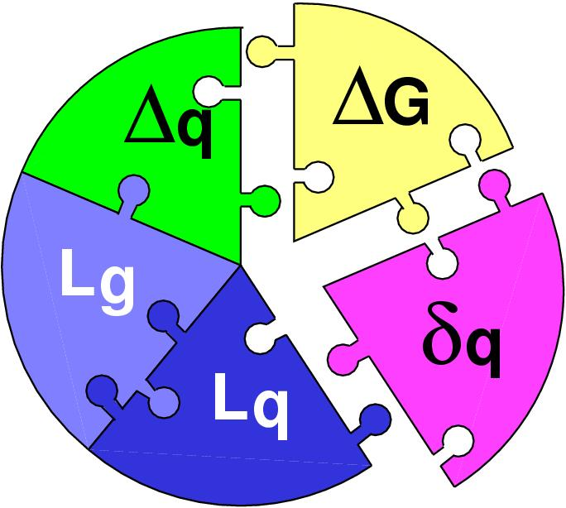
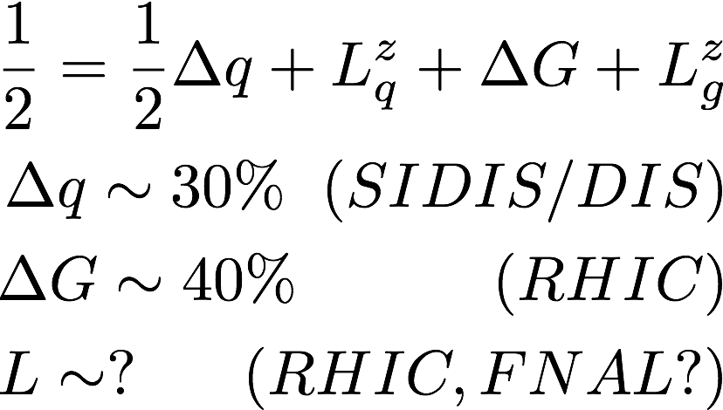
Three Decades of the Proton Spin Puzzle
Early expectation: large gluon polarization
 | Quark Spin | Gluon Spin
SLAC -> 2000 | E80 – E155
CERN ongoing | EMC, SMC, COMPASS
DESY ->2007 | HERMES
JLab ongoing | Hall A,B,C
RHIC ongoing | (BRAHMS), (PHENIX), STAR
Axial anomaly
Cheng & Li, PRL (1989)
EMC, 1980s
 | SIDIS/DIS
 | Polarized p+p

Slide 3
Outline
Longitudinal spin physics program at RHIC
Gluon polarization
Flavor identified sea-quark polarization
Outlook

Slide 4
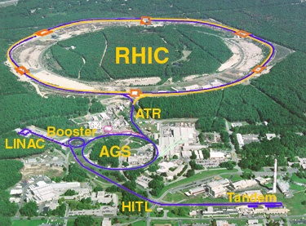
Polarized Proton Collider at RHIC
Absolute Polarimeter (H↑ jet)
RHIC pC Polarimeters
PHOBOS
polarized p+p collisions
62 ≤ √s ≤ 500 GeV
Siberian Snakes
BRAHMS
Siberian Snakes
PHENIX
STAR
Spin Rotators
(longitudinal polarization)
Spin Rotators
(longitudinal polarization)
Pol. H⁻ Source
LINAC
BOOSTER
Helical Partial Siberian Snake
200 MeV Polarimeter
AGS
AGS pC Polarimeter
Strong AGS Snake

Slide 5
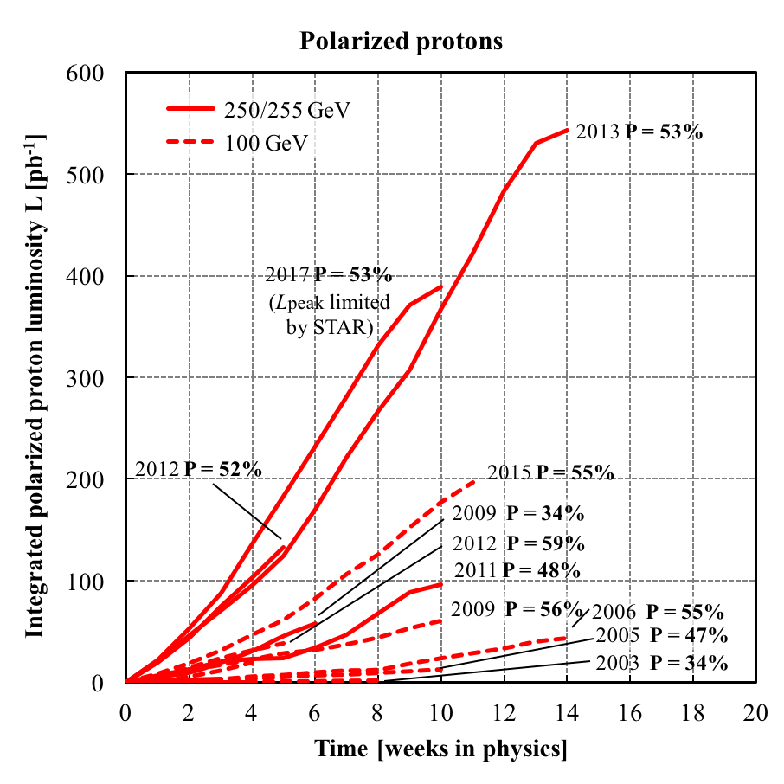
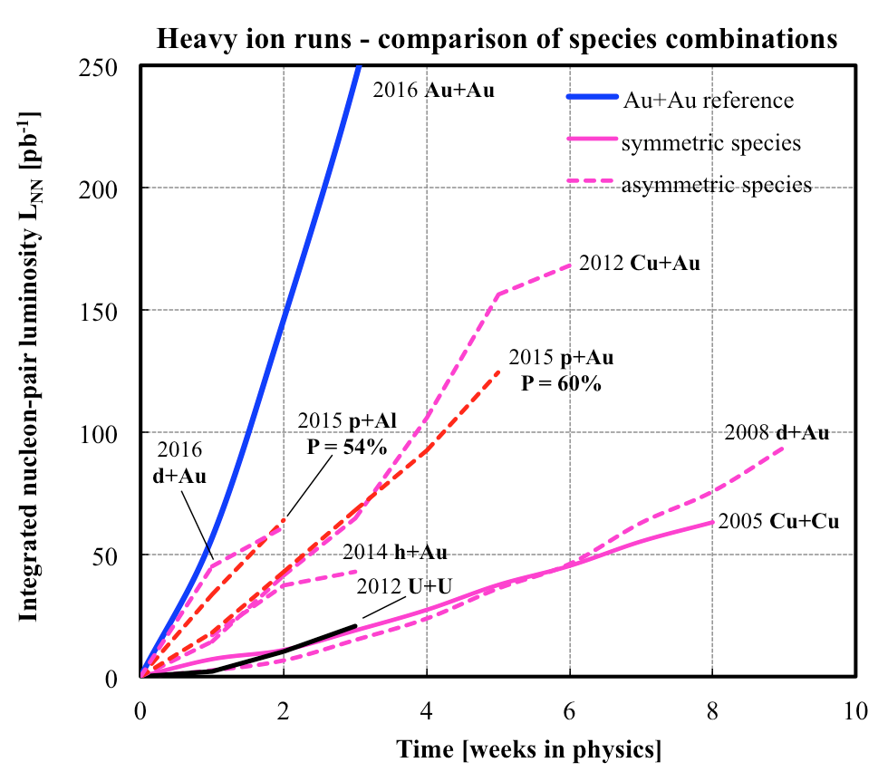
History of RHIC Spin Runs
RHIC is capable of delivering the polarized p+p/A for precision spin physics
A very challenging task to deliver polarized p+p, excellent performance from 2012+
Longitudinally and transversely polarized p+p,
Transversely polarized p+Au and p+Al, in 2015
10/13/14
Notes:
Our physics analysis efforts are closely tied to the RHIC beams operations
Took “BNL” 10 years to reach the mechine performanvec goals ..
5

Slide 6
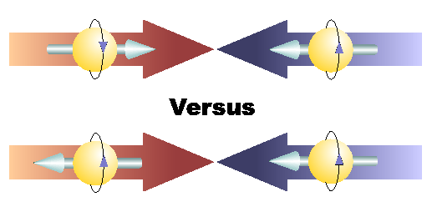
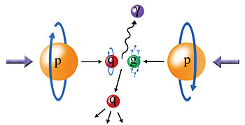
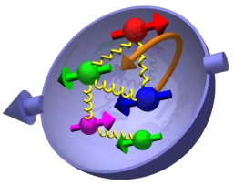
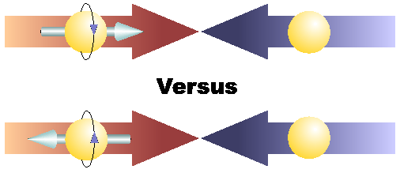
Physics with Longitudinally
Polarized p+p Collisions
A_{LL}
A_{L}

Slide 7
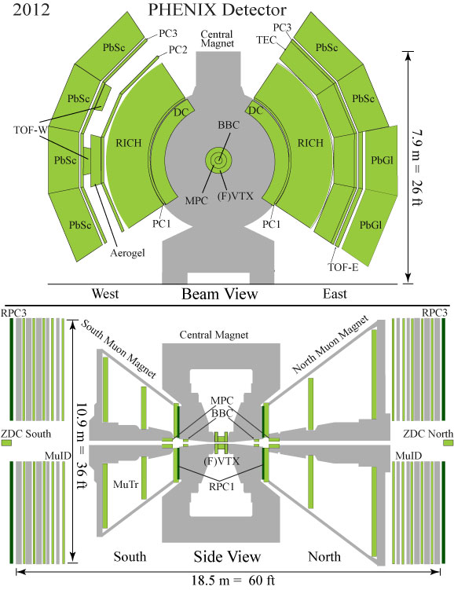
PHENIX Detector at RHIC
Central Arms | η | < 0.35
Identified charged hadrons
Neutral Pions
Direct Photon
Heavy Flavor
Muon Arms 1.2 < | η | < 2.4
J/Psi
Heavy Flavor
Charged hadrons
MPC 3.1 < | η | < 3.9
Neutral Pion’s
Eta’s
BBC (Relative) luminosity
ZDC
Notes:
7

Slide 8
The STAR Experiment
Large acceptance:
Tracking: TPC+TOF, : -1.3 < eta < 1.3
Central EMCal: -1 < eta < 2
Forward EMCal(FMS): 2.5 < eta < 4.2
BBC, ZDC
Jets
Pi0 and (identified)charged hadrons
Electrons & Muons

Slide 9
Gluon Polarization

Slide 10
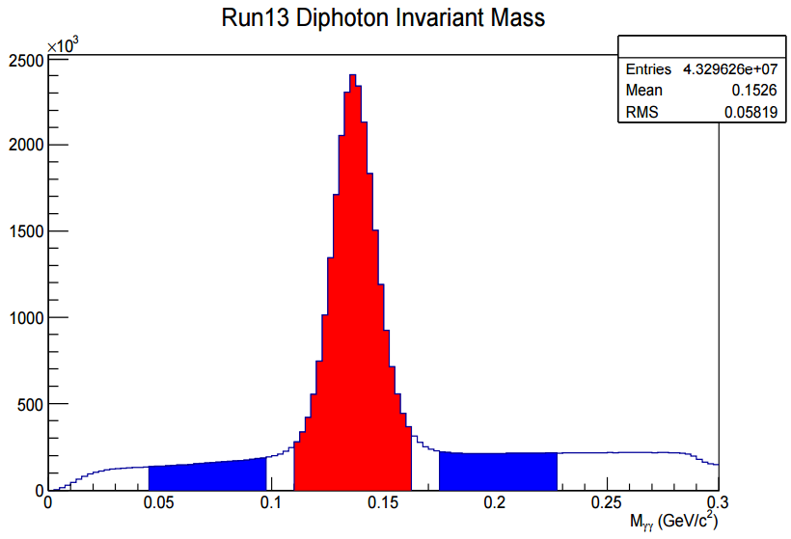
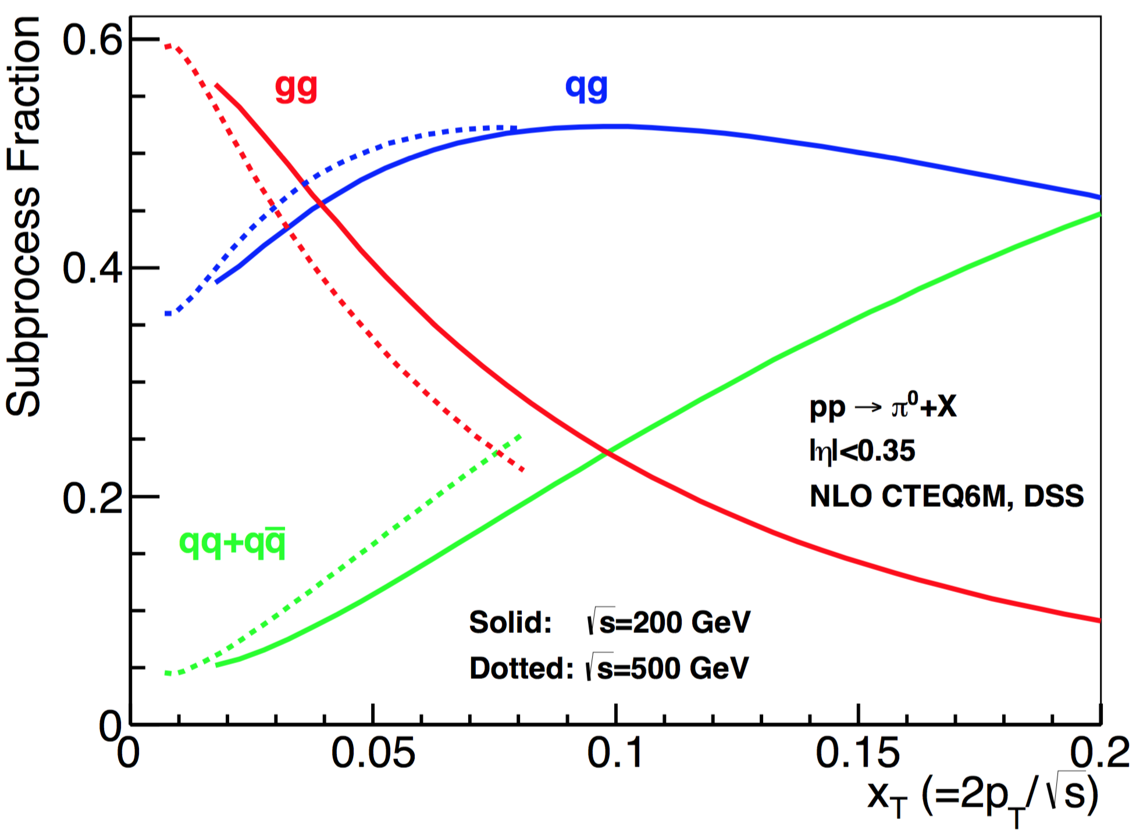

Gluon Polarization and 𝜋⁰ (or jet)A_{LL}
A_{LL}=(N⁺⁺-N⁺⁻)/(N⁺⁺+N⁺⁻)
    -- Parton distribution functions
    -- Partonic hard scattering rates
    -- Fragmentation functions
DIS
?
pQCD
e+e-
Relative fractions
Di-photon mass: 𝜋⁰ peak

Slide 11
First Precision Measurements of Longitudinal Double-Spin Asymmetry A_{LL} from 2009 RHIC Run
STAR: PRL 115, 092002 (2015)
PHENIX: PRD 90, 012007 (2014)
PRL 115, 092002 (2015)

Slide 12
First Hint of Non-zero Gluon Polarization from RHIC
PHENIX and STAR A_{LL} data
@ Q² = 10 GeV²
PRL 113, 012001 (2014), DSSV
Run 2009
p+p@200GeV

Slide 13
More Recent Results from RHIC
“RHIC Cold QCD Plan for 2017-2023”, arXiv:1602.03922

Slide 14
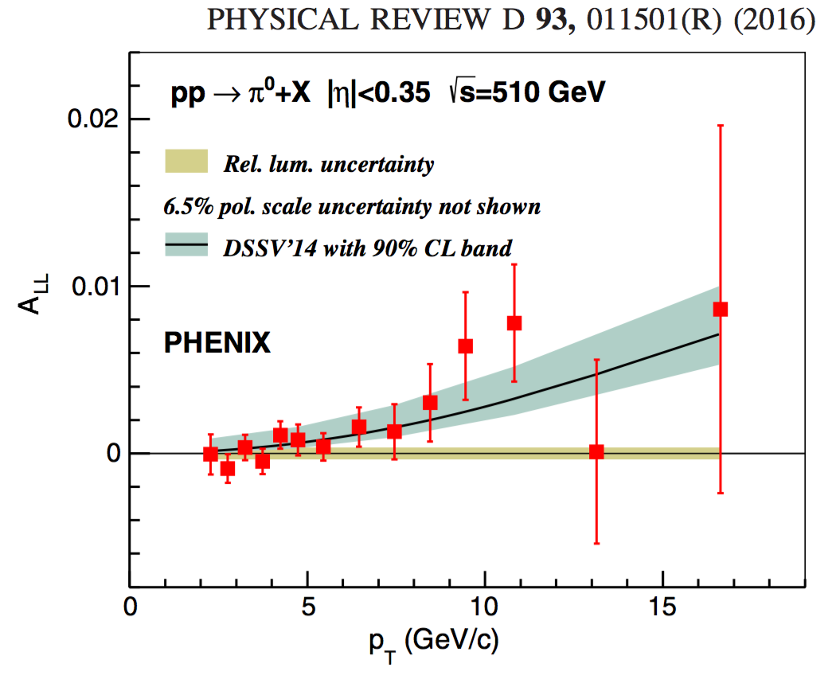
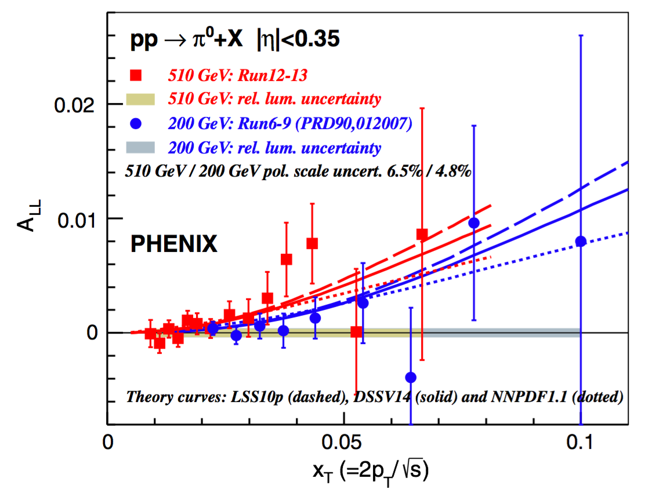
PHENIX: 𝜋⁰ A_{LL} at central rapidity (|𝜂|<0.35)
Access gluon at moderate x ~ 0.01 - 0.2
PRD 93, 011501 (2016)
ALL vs xT for pp 200GeV and 510GeV

Slide 15
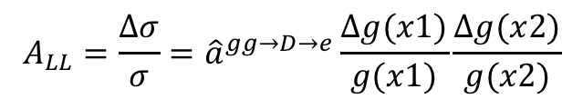
PHENIX h^{+/-} and HF e^{+/-} A_{LL}
Sensitive to polarized u and d quark as well as gluon distributions through charge sign
  Statistically limited due to lack of effective triggers
Use HF decay electrons to probe gluon polarization
  Statistically limited
PRD 91, 032001 (2015)
PRD 87, 012011 (2013)
$$A_{LL}=\frac{Δσ}{σ}={\hat{a}}^{gg→D→e}\frac{Δg(x1)}{g(x1)}\frac{Δg(x2)}{g(x2)}$$

Slide 16
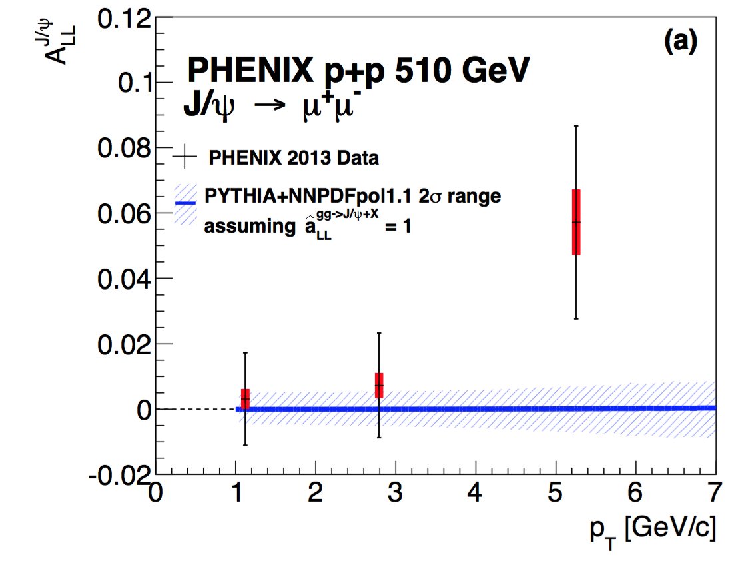
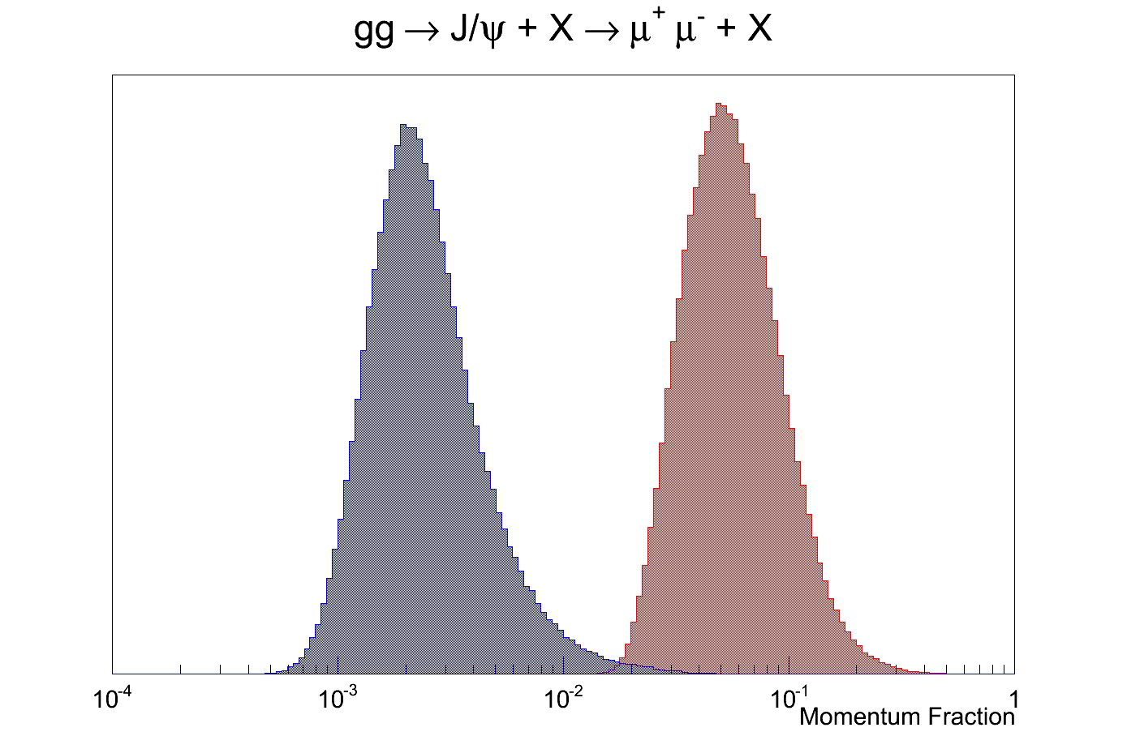
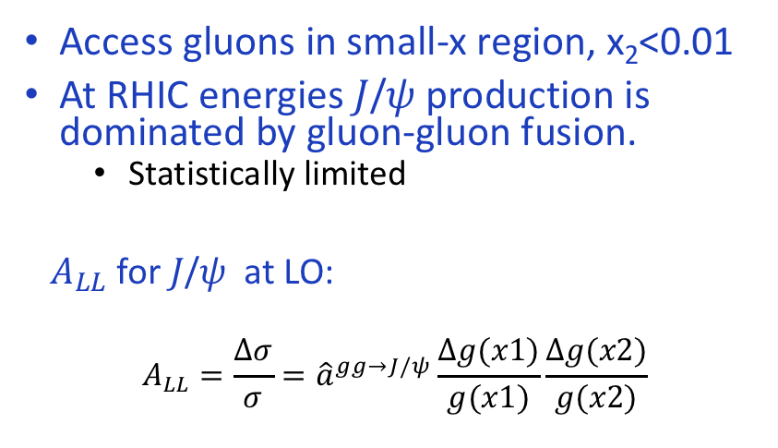
PHENIX: 𝐽/𝜓 A_{LL} at Forward Rapidity
Access gluons in small-x region, x₂<0.01
At RHIC energies 𝐽/𝜓 production is dominated by gluon-gluon fusion.
  Statistically limited
$A_{LL}$ for 𝐽/𝜓 at LO:
$$A_{LL}=\frac{Δσ}{σ}={\hat{a}}^{gg→J/ψ}\frac{Δg(x1)}{g(x1)}\frac{Δg(x2)}{g(x2)}$$
PRD 94, 112008 (2016)
x₂
x₁

Slide 17
STAR: Di-Jet A_{LL}, pp 200GeV
arXiv:1805.09742
Probed parton x1 and x2 distributions
di-jet mass

Slide 18
In Progress: 200 GeV Inclusive Jet A_{LL}
Projected combined Jet A_LL from STAR: run2009 + 2015
Expect 2x improvement over 2009 results

Slide 19
STAR: 510 GeV pp Jet A_{LL}
pp510
Preliminary 2012/2013 pp510 A_{LL} results
  Access smaller x_{g} than pp200
  Agree with recent pol PDF predictions
  Consistent with published pp200 data

Slide 20
STAR: pp510 Di-jet A_{LL}
Run13 pp510 di-jet A_{LL}
Run12 pp510 di-jet A_{LL} measured |eta|<0.9
- consistent with STAR pp200GeV results

Slide 21
STAR: Forward pi0 ALL in pp 510GeV access small-x gluons
arXiv:1805.09745

Slide 22
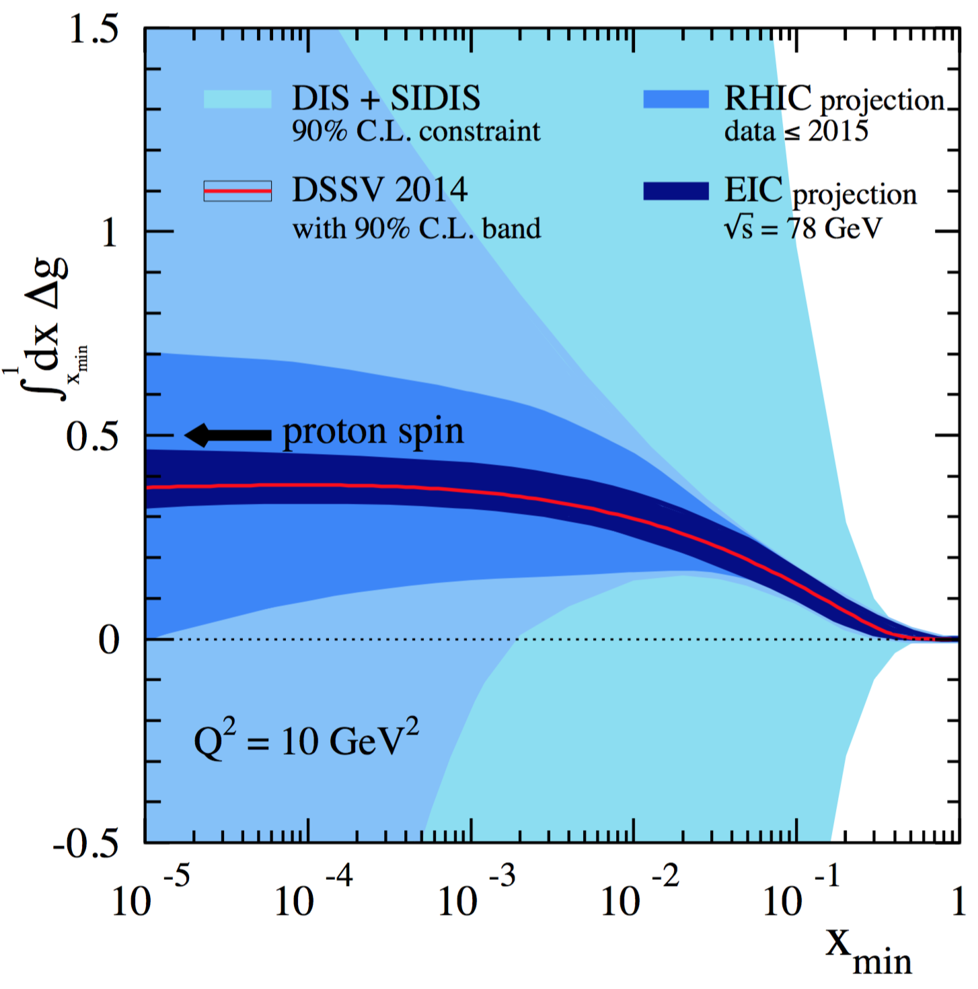
Projected Impact of RHIC data on Gluon Polarization
Favors positive gluon polarization
  PHENIX/STAR data:
  62GeV 𝜋⁰ A_{LL}
  200GeV 𝜋⁰ A_{LL}
  510GeV 𝜋⁰ A_{LL}
  200/510GeV (di)jets A_{LL}
  Statistically limited but could be improved in the future high luminosity program:
  200/510GeV charged hadron A_{LL}
  200/510GeV HF A_{LL}
  200/510GeV 𝐽/𝜓 A_{LL}
EIC future, 2025+
“RHIC Cold QCD Plan for 2017-2023”, arXiv:1602.03922

Slide 23
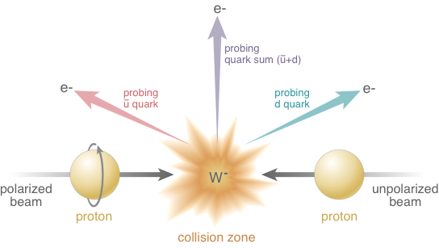
Electroweak Probe for Sea Quarks at High Energy at RHIC

Slide 24


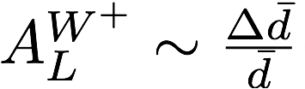

First Direct Measurements of Flavor Identified Sea Quark Polarization
RHIC has unique access to flavor identified sea-quarks via real W^{+/-}
STAR: PRL 113, 072301 (2014)
arXiv:1406.7122

Slide 25
Latest W^{+/-} A_{L} from STAR and PHENIX
arXiv:1702.05077
arXiv:1804.04181

Slide 26
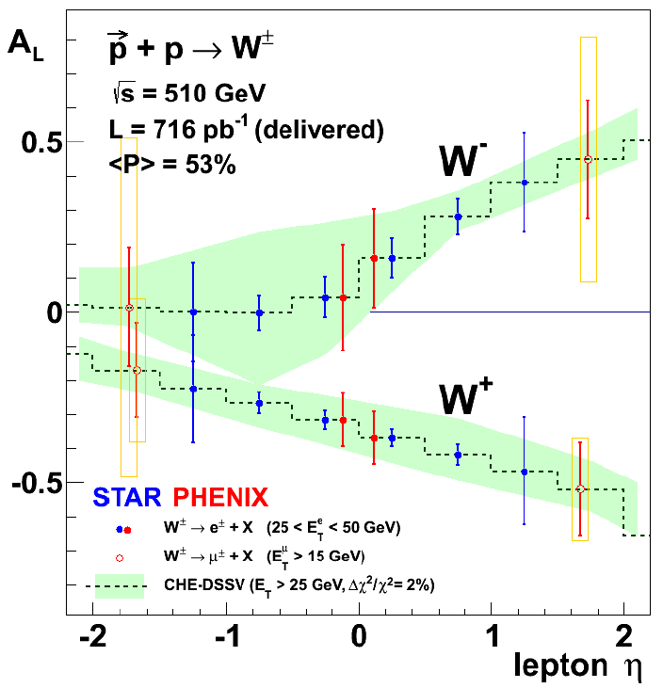
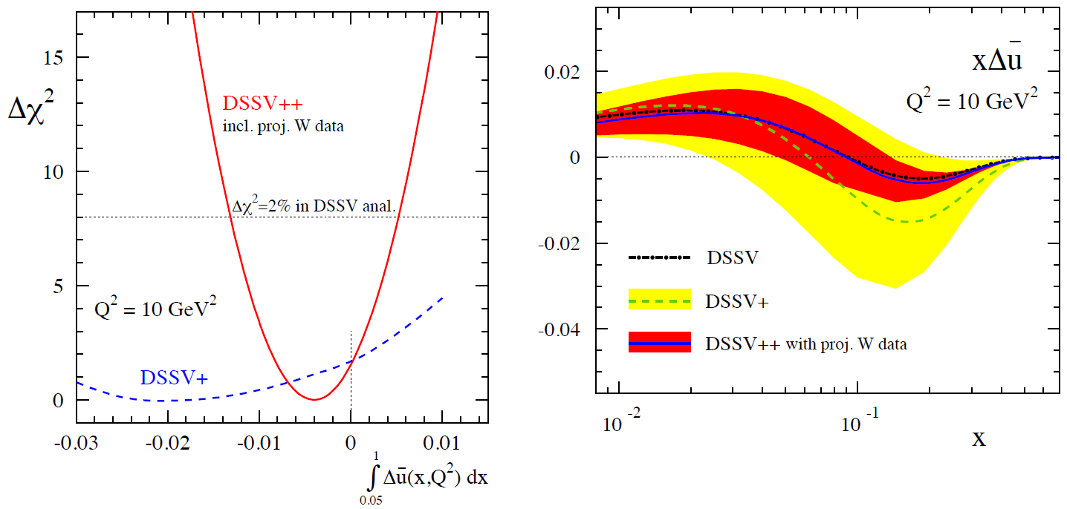
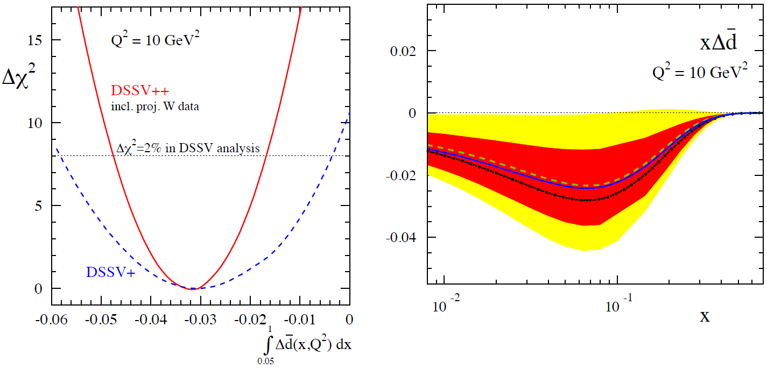
Projected RHIC 𝑊± → 𝑙± data Impact on Sea Quark Polarization Determination
Expect significant improvement of flavor identified sea quark distributions
The RHIC Spin Program, arXiv: 1501.01220

Slide 27

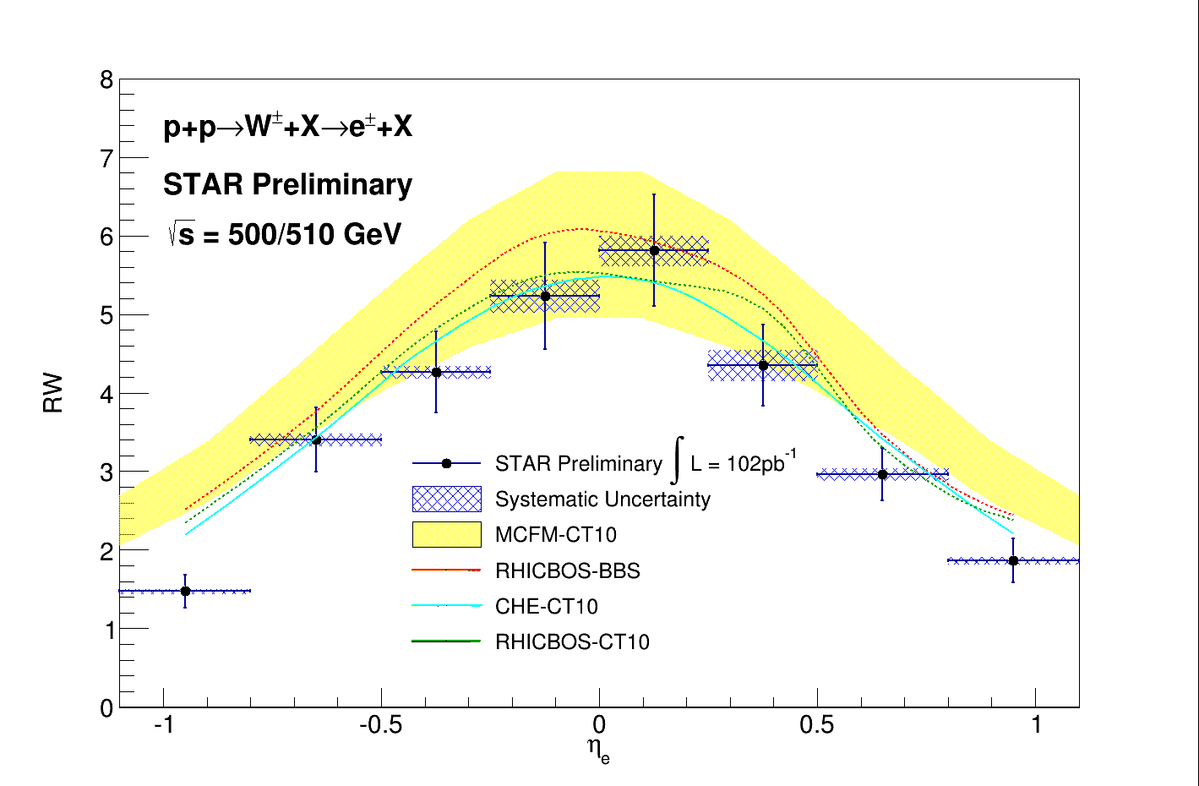

Unpolarized Sea Quark Distributions
Sea quark flavor asymmetry and
pion cloud model
SeaQuest/E906 @Fermilab
0.1 < x < 0.3

Slide 28
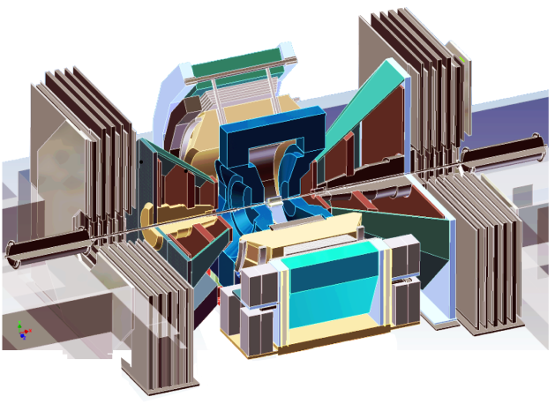
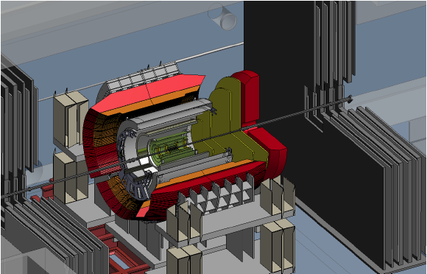
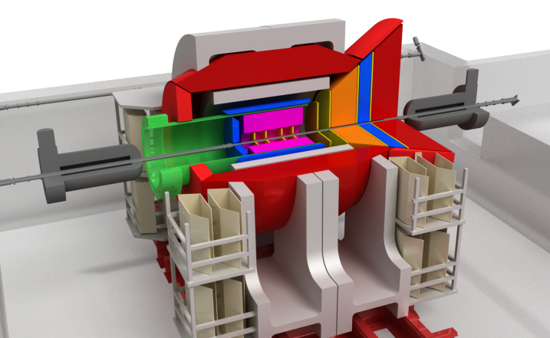
Future: PHENIX -> sPHENIX -> EIC@RHIC
Current PHENIX
f/sPHENIX
An EIC detector
PHENIX completed 2016
16y+ work
100+M$ investment
130+ published papers to date
Comprehensive central upgrade based on BaBar magnet
fsPHENIX: forward tracking, HCal and muon ID
Key study of transverse spin
New collaboration/new ideas
Path of sPHENIX upgrade leads to a capable EIC detector
Large coverage of tracking, calorimetry and PID
New collaboration/new ideas
~2000
2017→2020
~2025
Time
RHIC: A+A, polarized p+p, polarized p+A
eRHIC: e+p, e+A

Slide 29
sPHENIX at RHIC
Large acceptance, high rate next generation experiment at RHIC
  QGP and Cold QCD physics with,
    Jets
    Heavy quarkonia
    Open heavy flavor
  Study p+p, p+A and Au+Au collisions at top energy 200GeV
    Central barrel: |eta|<1, 2pi coverage
      EMCal & HCal
      MVTX/INTT/TPC
    Forward upgrade being developed
    DAQ rate: 15kHz
Project Status
  Granted DOE CD-0, 10/2016
  CD-1 reviewed, 5/2018
  Construction: 2018-2022
  Day-1 physics, ~1/2023

Slide 30
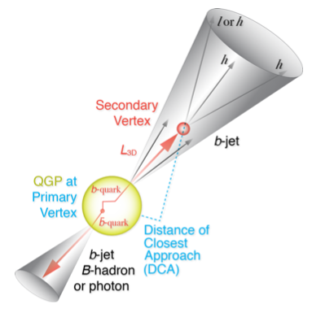
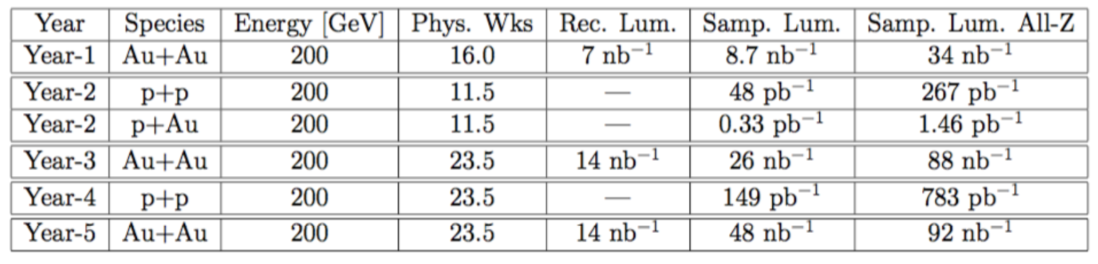
RHIC Multi-Year Plan: sPHENIX 2023-2027+
(Cold QCD plan under development now)
Jets, hadrons and heavy flavor and more
RHIC 2015 pp200
Recorded lumi ~50pb⁻¹

Slide 31
Proposed STAR Forward Upgrade
Access small-x Gluons
To install a Forward Calorimeter System (FCS)
in early 2020s:
EMCal
Hcal
Tracking, charge separation
Di-jet in the forward region (2.8<eta<3.7)
Access gluon polarization at low x:
X ~ 5x10^-3 (central + forward)
X~ <1x 10^-3 (forward - forward)

Slide 32
EIC Future @RHIC

Slide 33
Summary and Outlook
First evidence of non-zero gluon polarization
  PHENIX: pi0 A_{LL}
  STAR: 200/510GeV inclusive jets and di-jet A_{LL}
First direct measurements of sea-quark polarization with W^{+/-}
  PHENIX: W->e, mu
  START: W->e
Cold QCD plan being developed
  Exciting long-term polarized pp/pA 2020+
    sPHENIX
    STAR/Forward upgrade proposal
EIC future 2025+

Slide 34
Backup slides

Slide 35
Latest Pol NNPDFPol Global Fit
arXiv:1702.05077
-SI/DIS data
-RHIC data

Slide 36
Relative contributions
RHIC Spin Program, arXiv:1501.01220

Slide 37
Access sea-quark with W+/-
Bourrely & Soffer, NP B423 (1994) 329-348

Slide 38
W

Slide 39
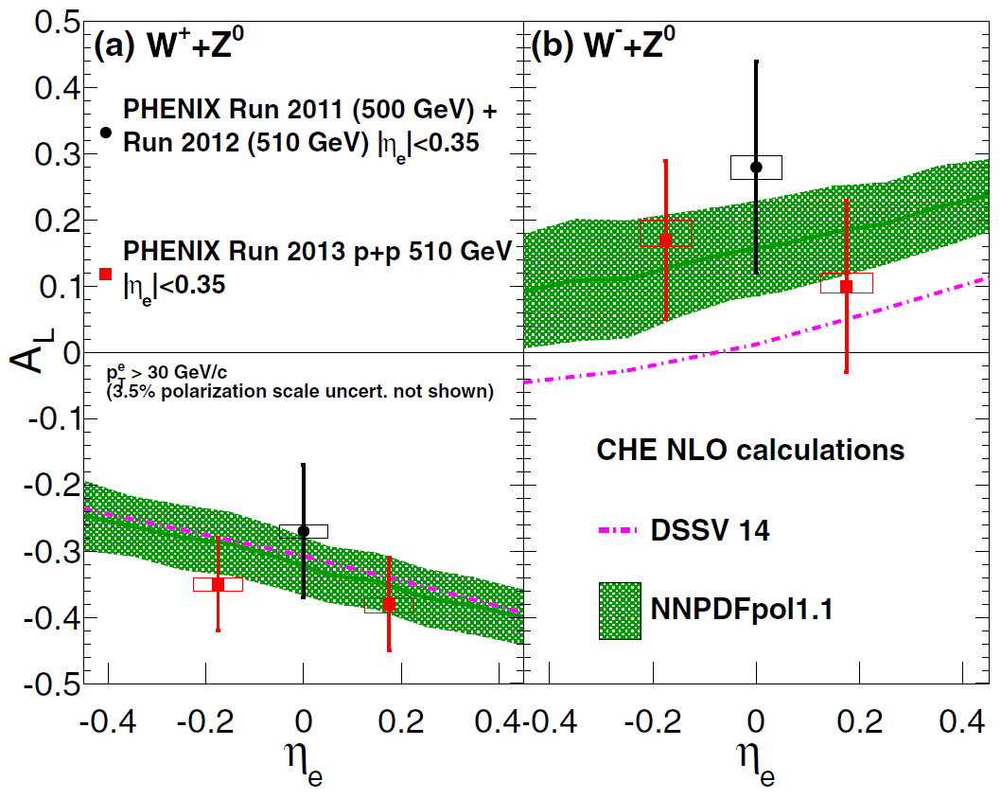
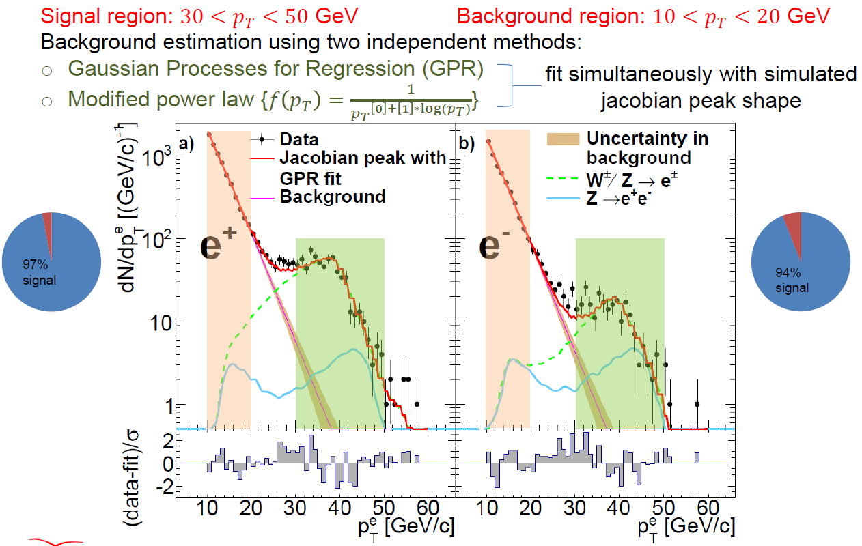
PHENIX: pp510GeV 𝑊± → 𝑒± A_{L}
PRD 93, 051103(R)(2016)
High pT electrons from
W^{+/-} decays

Slide 40
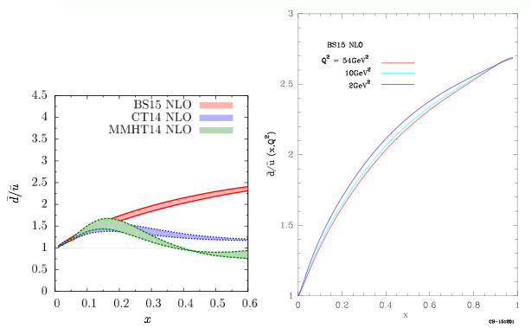
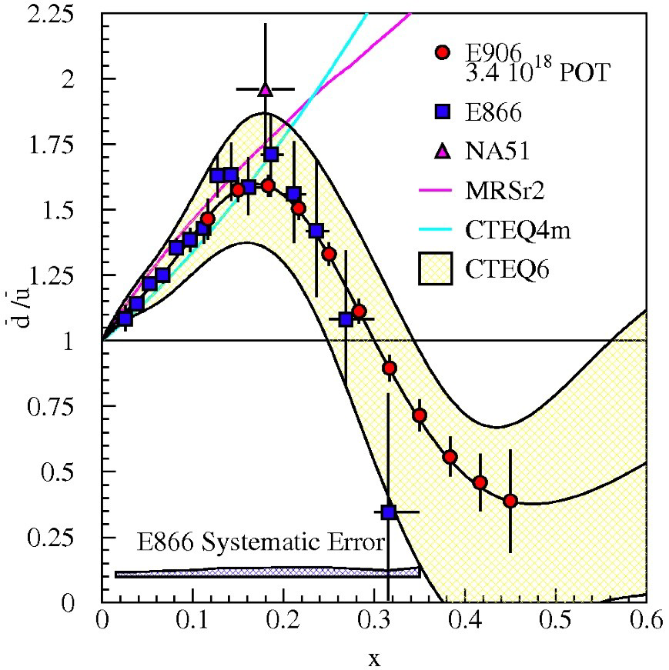
Unpolarized Sea Quark Distributions
C. Bourrely and J. Soffer (2013)
0.1 < x < 0.3
projected

Slide 41
STAR Forward Proposal

