Slide 1
Drell-Yan Production at PHENIX
Status and Plan
Ming X. Liu
Los Alamos National Lab
(for the PHENIX Collaboration)
μ⁺
p
μ⁻
N

Slide 2
The Drell-Yan Process
μ⁺
E866@Fermilab
μ⁻
M²
p_{T}
High Mass Low pT Drell-Yan

Slide 3
Outline
Introduction – a hard probe for soft physics
  Drell-Yan and TMDs in polarized pp collisions
    NOT going to talk about longitudinal W/Z program
  Drell-Yan and small-x physics in p(d)+A collisions
  High msss low pT Drell-Yan @forward rapidity
Opportunities with PHENIX Experiment
  PHENIX Current and Near Future (~5 years)
  sPHENIX proposal and opportunities (>5+ years)

Slide 4
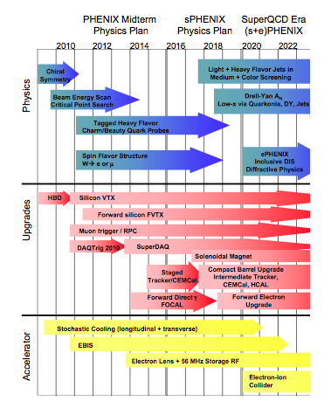
The Timeline
2011-2018
  PHENIX w/upgrades
2018-20XX
  sPHENIX
  Also ready for eRHIC physics

Slide 5
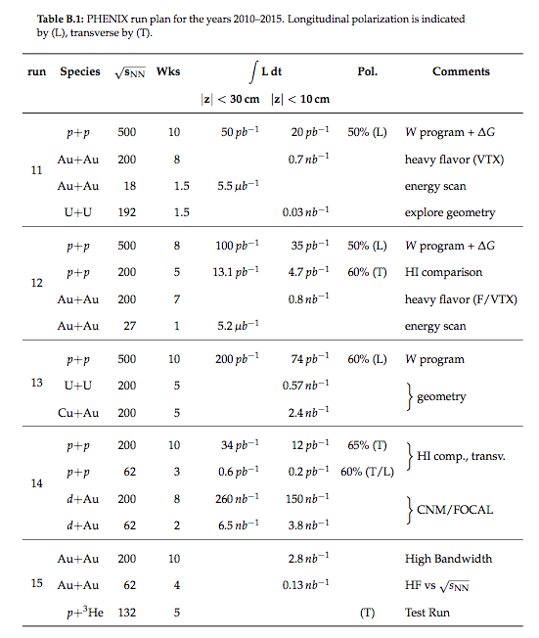
PHENIX Run Plan 2011-2015
500 GeV pp
  300 pb-1
200 GeV pp
  50 pb-1
200 GeV dA
  260 nb-1
  100 pb-1 (“pp”)

Slide 6
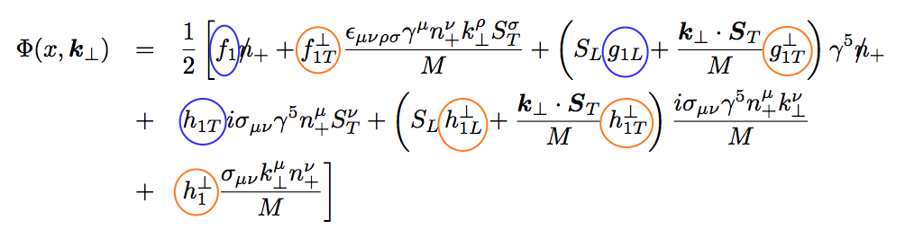
Topic (I): Physics of TMDs
Many talks
@this workshop
No K┴ dependence
K┴ - dependent
T-even
K┴ - dependent
T-odd

Slide 7
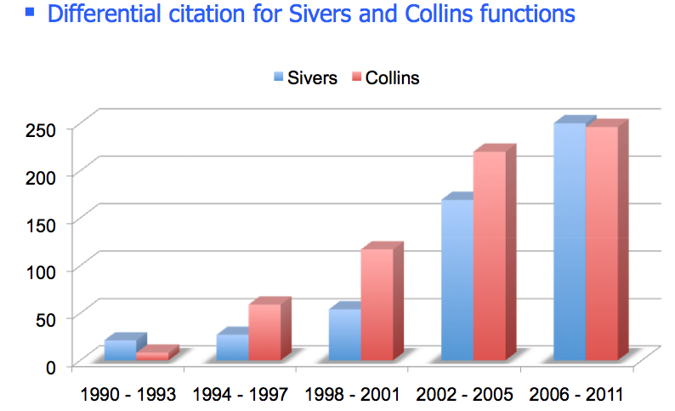
The Excitement about Physics of TMDs
Kang’s talk

Slide 8
TMDs can be probed via DY
J.C. Peng

Slide 9
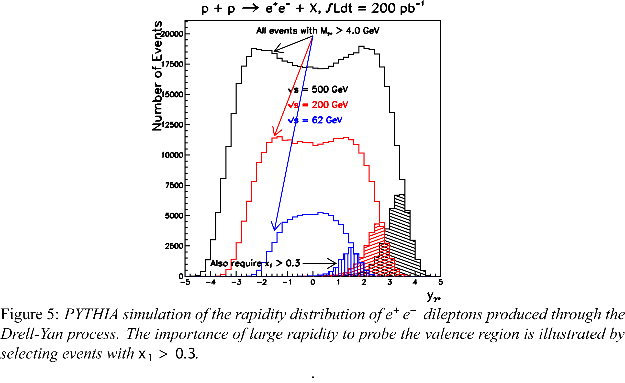
Test the Sign Change at PHENIX
Drell-Yan Production @RHIC

Slide 10
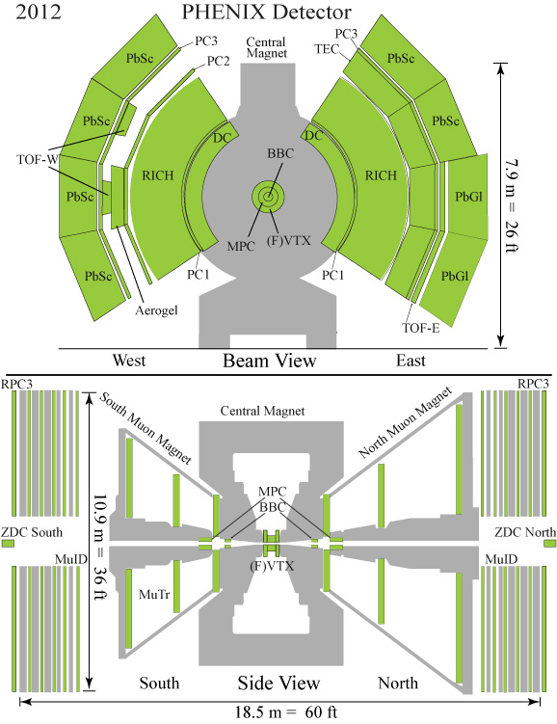
PHENIX: 2011-2018
Multiple upgrades on going
  MuTrig/RPC (2011)
  VTX & FVTX (2011)
  FOCAL
    proposal, (2014)
Central Arms
  |η| < 0.35
  PID
Forward Muon Arms
  1.2 < |η| < 2.4
  P > 2.5 GeV

Slide 11
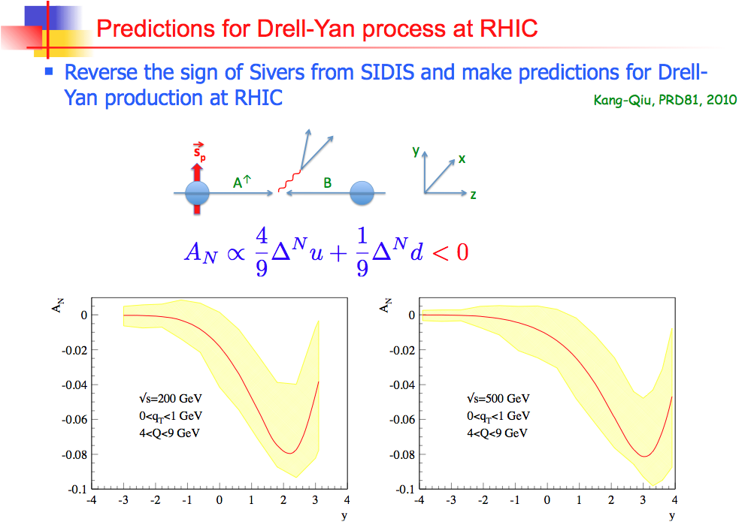
A_{N} @large XF
PHENIX dimuons
1.2 < |y| <2.4
muon p > 2.5GeV

Slide 12
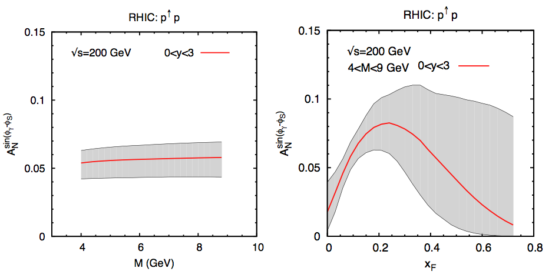
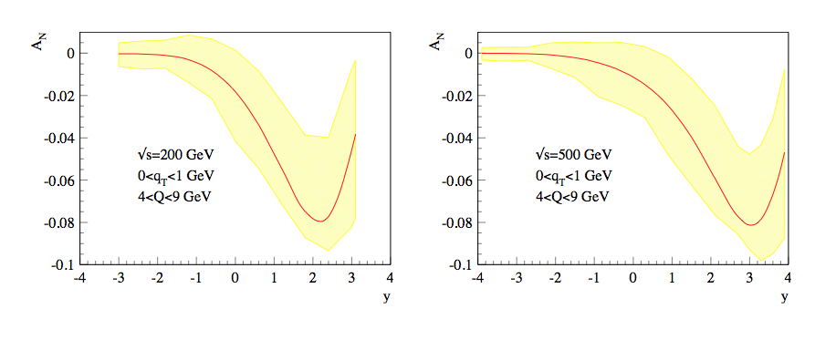
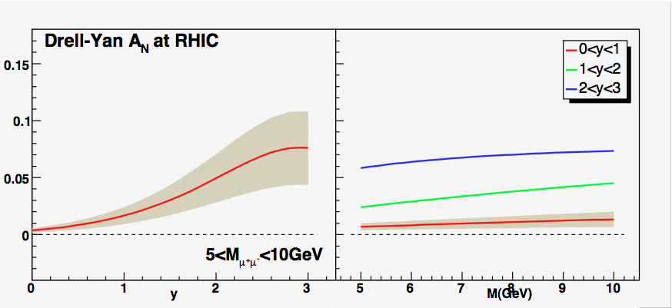
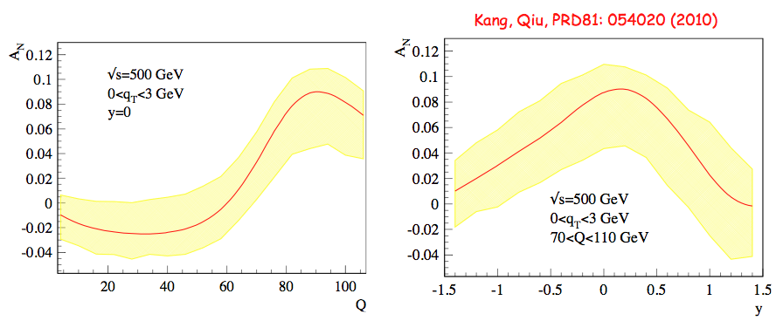
More Predictions of DY Sivers TSSA for RHIC …
Anselmino et. al. PRD 79, 054010 (2009)
Kang and Qiu, PRD81 054020(2010)
Vogelsang and Yuan PRD72 054028 (2005)
Z⁰ @500GeV

Slide 13
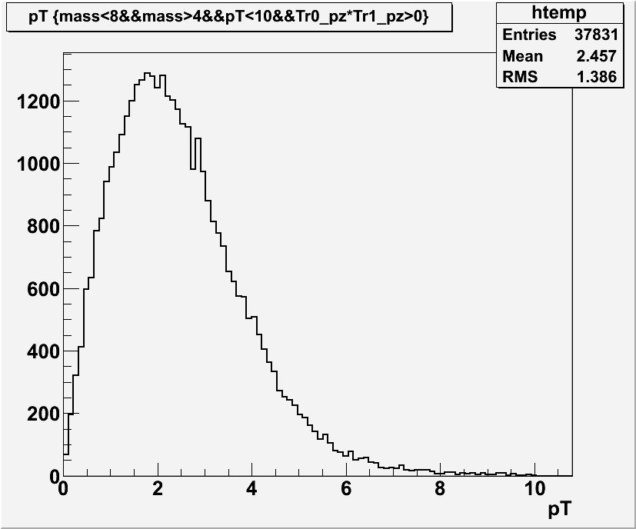
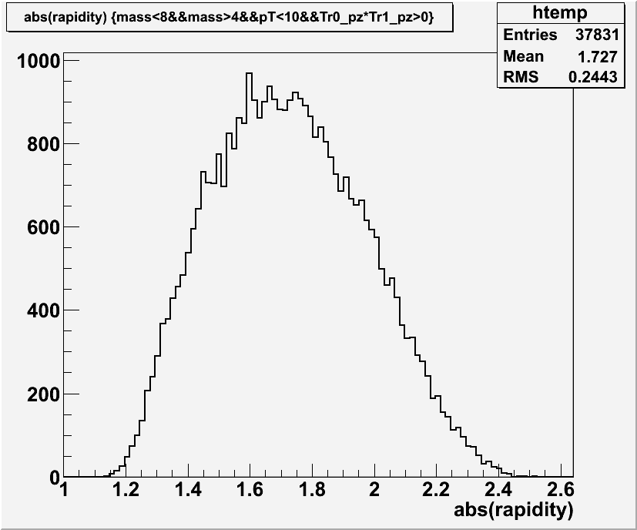
Case Study (I): Drell-Yan pp@200GeV
Accepted Drell-Yan Kinematics in the PHENIX Muon Arms
pT (GeV)
Rapidity
4 < Mass < 8 GeV

Slide 14
PHENIX Dimuon Cocktails pp@200GeV
(PYTHIA Simulations, DY scaled to NLO)
1.2 < y < 2.4
Drell Yan
ϒ-states
J/Ψ
charm
bottom
Ψ’’

Slide 15
The Experimental Challenge of
Drell-Yan A_{N} Measurement
Need to measure both open heavy and DY
  Background fraction
  Background asymmetry
Silicon VTX - a critical tool

Slide 16
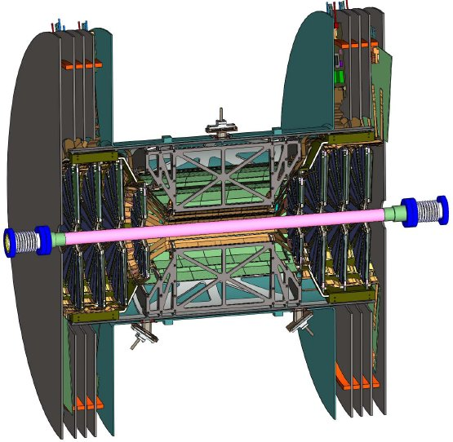
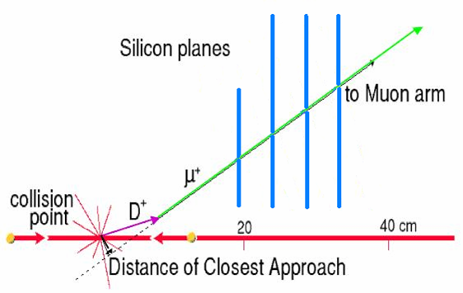
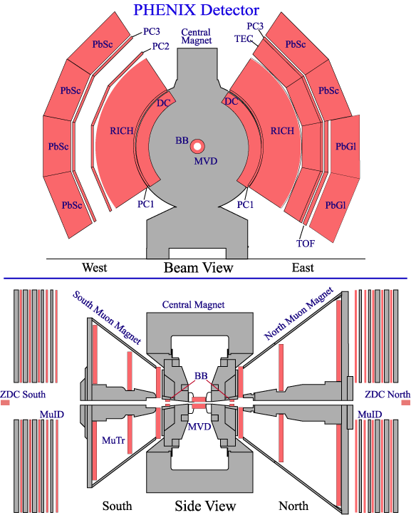
PHENIX Silicon VTX Upgrades
– on going, will be completed in 2011
Precision Charm/Beauty Measurements
B→J/ψ, Drell-Yan, ψ’
Drell-Yan
prompt
π→μ

Slide 17
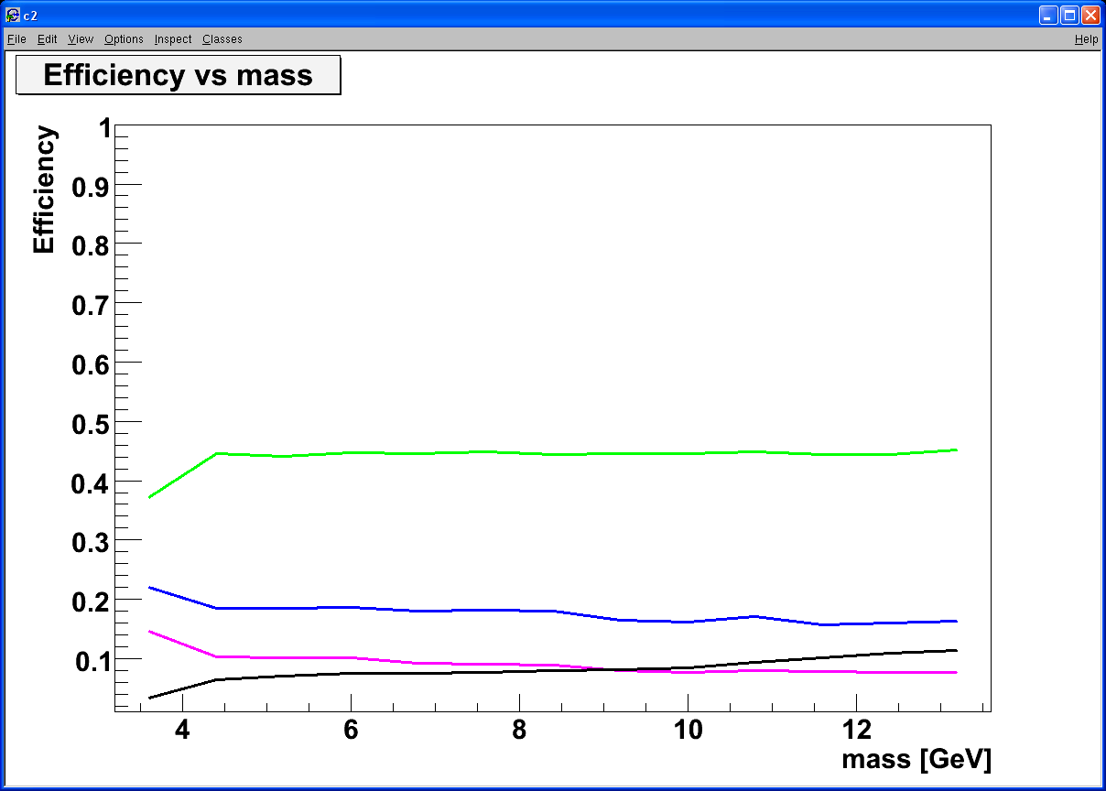
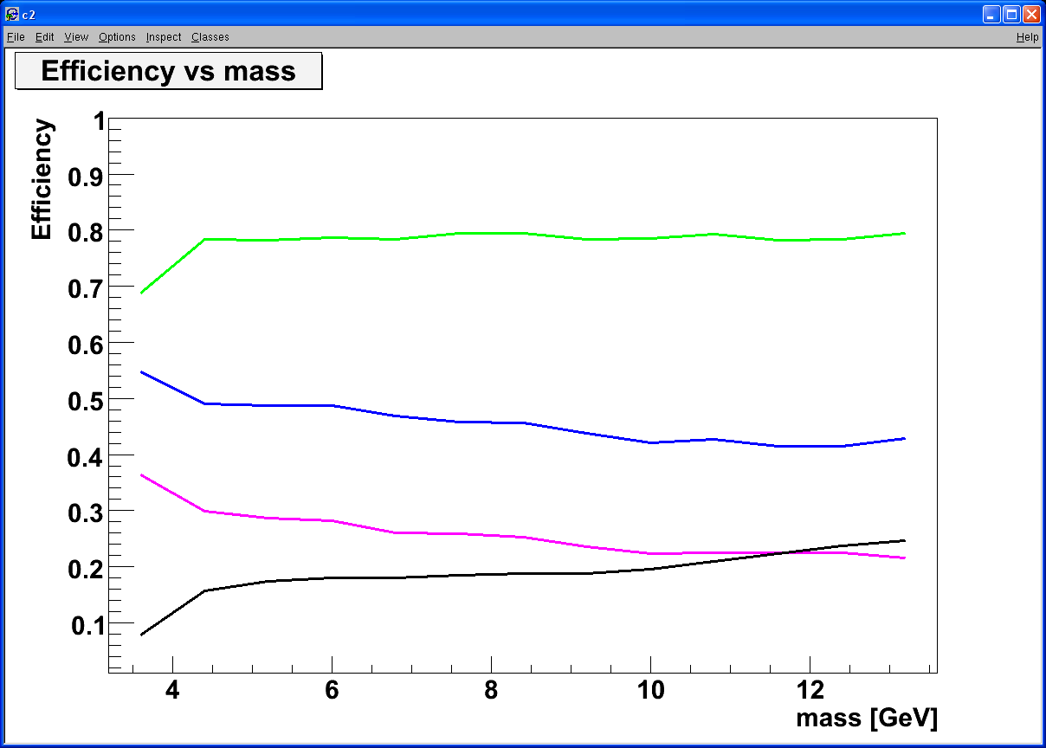
Heavy Quark Background Suppression
- Work in progress
DCA < 1 σ cut:
Increase DY/bb ~ 5
DCA < 2 σ
Increase DY/bb ~ 3
Drell Yan
Drell Yan
charm
bottom
charm
bottom
combinatorial background
combinatorial background

Slide 18
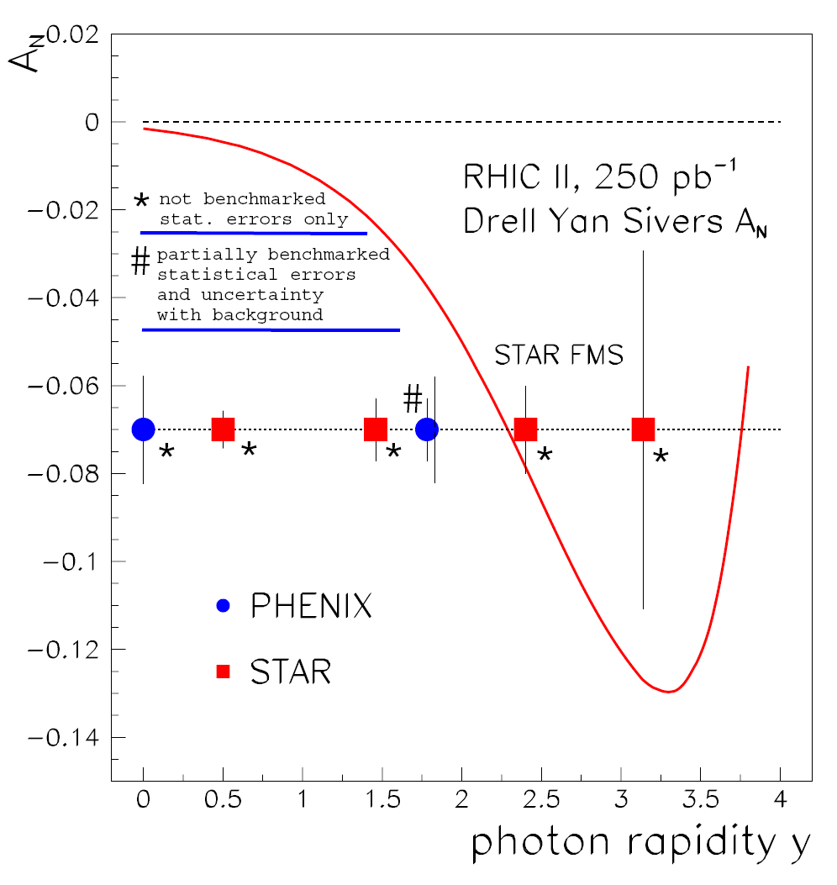
Luminosity Challenged pp@200GeV!
2007 RHIC DY whitepaper
Expected Luminosity by 2015
  ~50pb⁻¹
With upgrade VTX detectors, it is feasible @PHENIX
  Drell-Yan X-section OK
  A_{N} statistically limited
Significant luminosity improvement needed

Slide 19
PHENIX Run Plan 2011-2015
500 GeV pp
  300 pb-1
200 GeV pp
  50 pb-1
200 GeV dA
  260 nb-1
  100 pb-1 (“pp”)

Slide 20
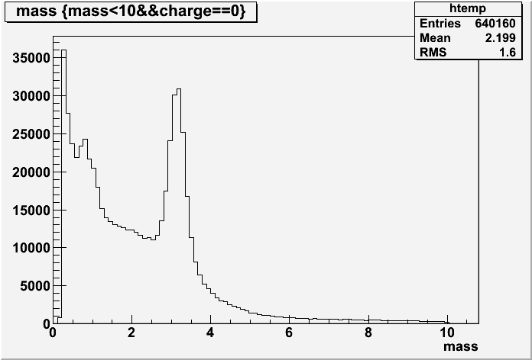
Drell-Yan pp@500 GeV
2012-2018
500GeV pp runs for “Longitudinal W physics” 2011-2015+
Can be used to study and benchmark Drell-Yan production in pp@500GeV
  New VTX/FVTX
  Central arm di-electrons |y|<0.35
  Forward arm di-muons
  1.2 < |y| < 2.4
Possible Boer-Mulders alike asymmetry measurements
Dimuons from
Run11 pp@500GeV
Dimuon mass (GeV)

Slide 21
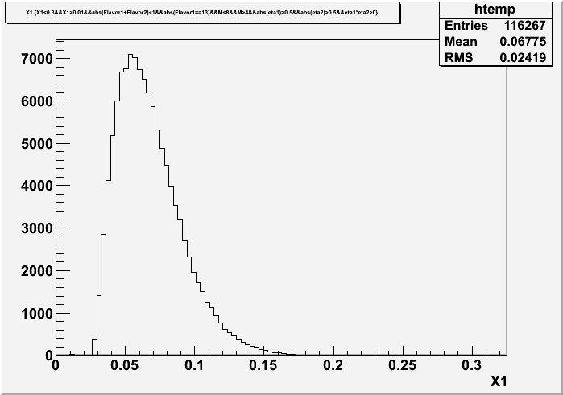
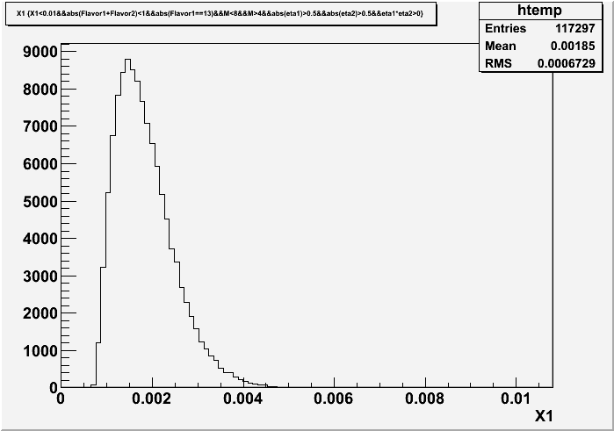
Forward Drell-Yan Kinematics pp@500 GeV
Forward DY Dimuons
  1.2 < y < 2.4
  4<M<8 GeV
Boer-Mulders asymmetry could be small

Slide 22
Azimuthal cos2Φ Distribution in Drell-Yan
E866 PRL 99 (2007) 082301; PRL 102 (2009) 182001
Peng’s talk
Smallνis observed for p+d and p+p D-Y
With Boer-Mulders function h₁┴:
ν(π⁻W→µ⁺µ⁻X)~ [valence h₁┴(π)] * [valence h₁┴(p)]
ν(pd→µ+µ-X)~ [valence h₁┴(p)] * [sea h₁┴(p)]
More data expected
from E906 soon!
Reimer’s talk
Sea-quark BM functions are much smaller than valence quarks
22

Slide 23
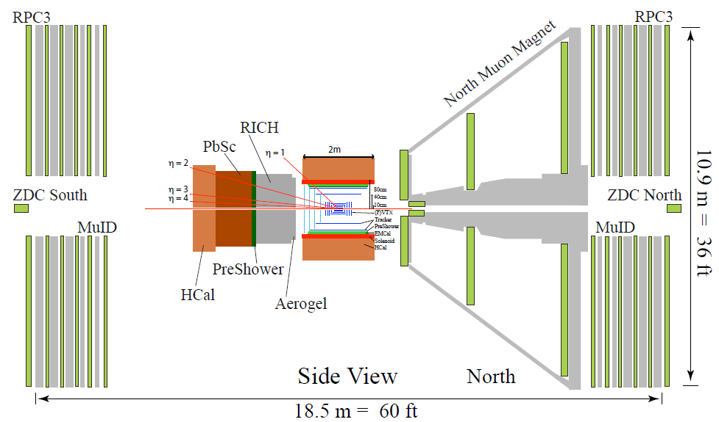

Future Opportunity with sPHENIX
2018 – 20XX

Slide 24
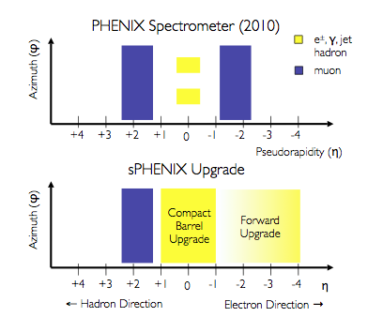
sPHENIX Coverages

Slide 25
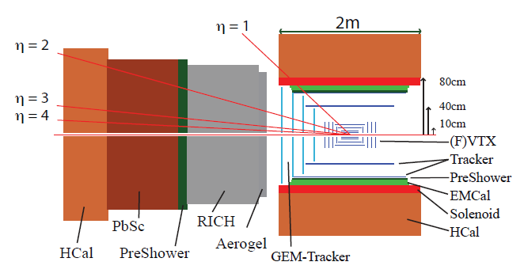
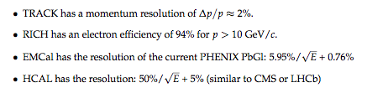
sPHENIX Forward Detectors
Optimized for high energy electrons/photons
  2 < η < 4
  e/photon ID
  Hadron PID
  eRHIC ready
    e+p
    e+A
  DY via dielectons @ very forward rapidity

Slide 26
A_{N} @large rapidity
sPHENIX
1 < y <4
DY via dielectrons

Slide 27
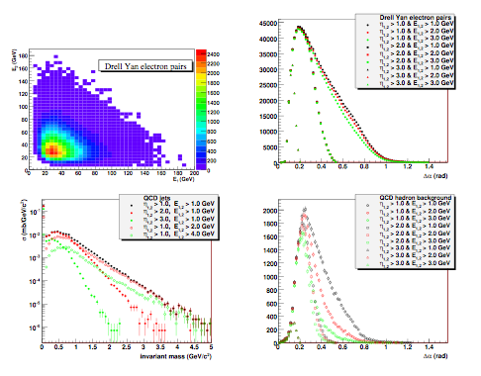
Case Study (II): sPHENIX
e⁺
e⁻
Drell-Yan leptons have large energies
  Expect large A_{N} @forward
Background from QCD
  Decreases with lepton energy
  Decreases with lepton rapidity

Slide 28
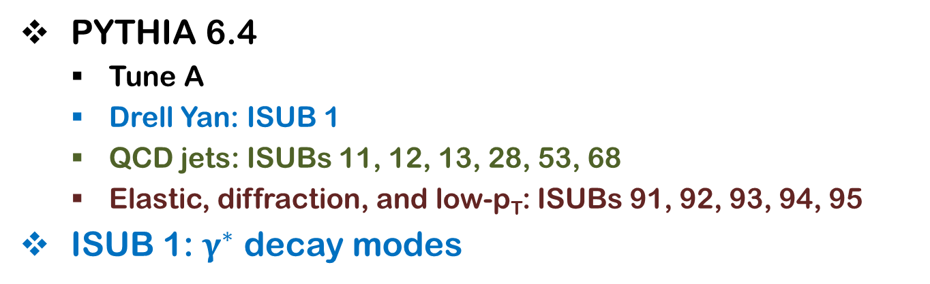
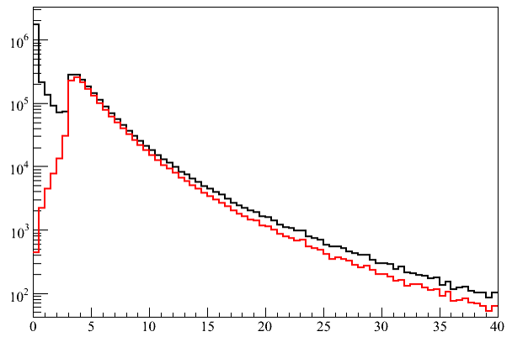
PYTHIA Simulations pp@200/500GeV
10M events for Drell Yan
100M+ event for QCD background
electron pairs from Drell Yan
electron pairs in ISUB 1
M>3GeV
Di-electron mass (GeV)

Slide 29
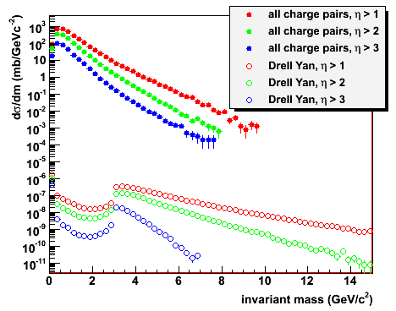
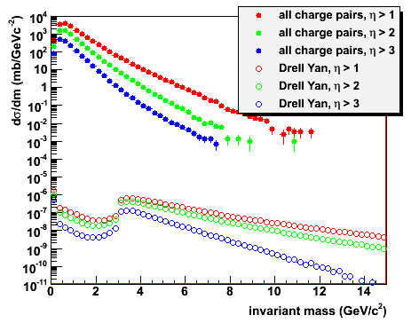
Hadronic Backgrounds
All charged particle pairs between J/Ψ and ϒ
Hadron suppression 10³-10⁴ needed at 500 GeV
  Drell Yan yield reduced more in 200 GeV @forward
√s = 200 GeV
√s = 500 GeV

Slide 30
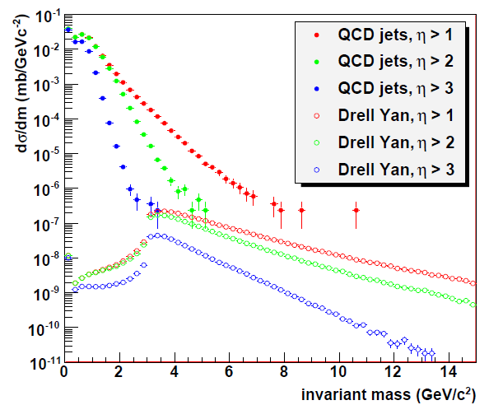
QCD Jet Backgrounds pp@500GeV
Samples
  Drell-Yan dielectrons signal
  Hard QCDs + Diffratives
Energy cut
  E_{1,2} > 2 GeV
Forward rapidities
  Effectively no
  background left @η>3
  Statistically limited

Slide 31
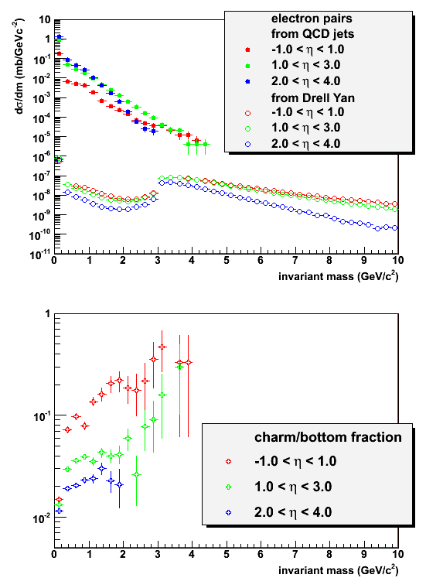
Heavy Flavor Backgrounds
Charm & bottom contributions increase with m_{inv}
Less heavy flavor contributions at larger rapidity
Need designated heavy flavor simulations
  More statistics
Work in progress …

Slide 32
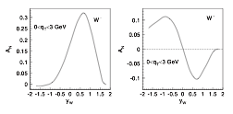
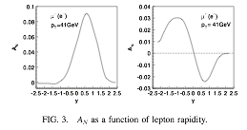
W^{+/-} Transverse SSA @500GeV ?
Kang & Qiu (2009), Zhou & Metz (2010)
W^{+/-}
l⁺
Latest theoretical progress
  Test time-reversal universality of Sivers functions with W/Z
  Expect large asymmetry (from DIS fit)
Flavor-identified Sivers Funs
  Very large Q²
Need high luminosity, ~1fb⁻¹ 500GeV
  W^{+/-} →μ^{+/-} ~20K
  Z⁰ -> μ⁺μ⁻ ~ 1K
  sPHENIX: wider coverage
32

Slide 33
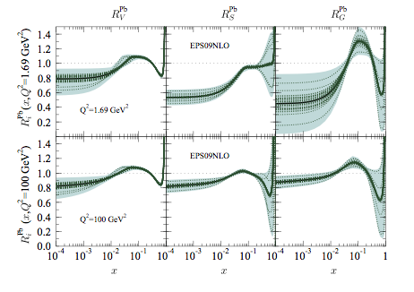
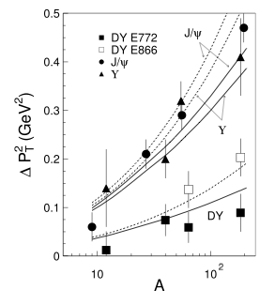
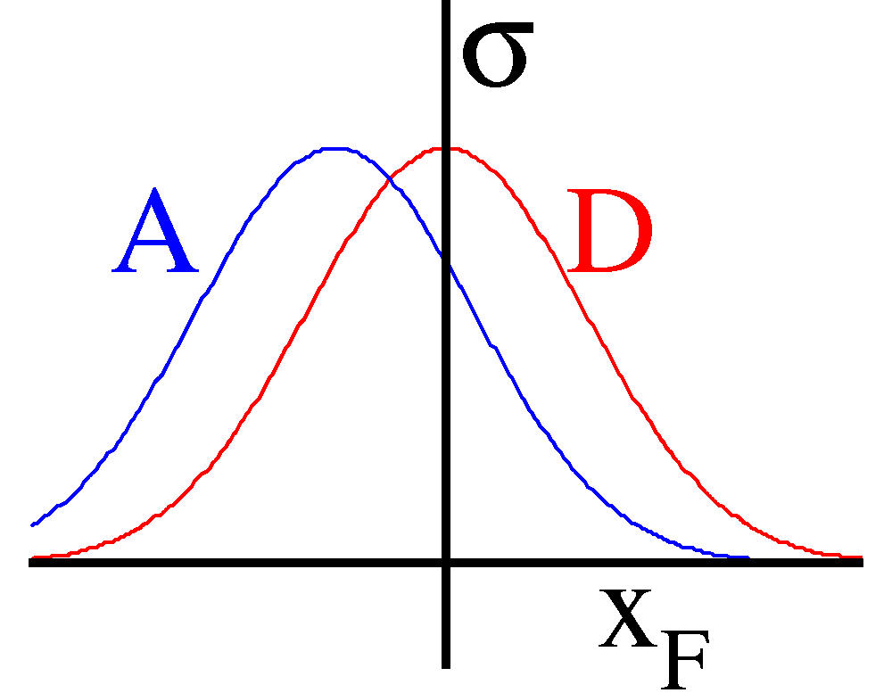
Topic (II): Forward Drell-Yan and Sea Quarks @small-x
Reimer, Peng’s talks
Sea quark distributions at small-x
  kT << M
  Consistency check DIS vs DY
Parton energy loss vs shadowing effects
  pT broadening

Slide 34
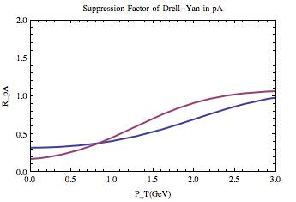

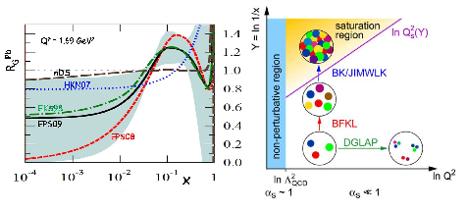
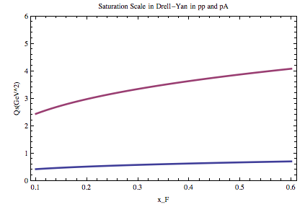
Forward DY and Small-x Saturation Physics
Forward DY at PHENIX
  Saturation effects could be important
  DGLAP probably not enough
  Muon arms: y = 1.2~2.4
  sPHENIX: y= 2~4 (2018+)
Feng, Al, Jamal’s talks

Slide 35
Summary and Outlook
PHENIX VTX/FVTX upgrades make Drell-Yan measurements possible
  Central arms
  Forward muon arms
  Boer-Mulders asymmetry measurement possible from upcoming longitudinally polarized pp @500GeV
Possible Test of Drell-Yan A_{N} sign change @200GeV and @500GeV after longitudinal W program, ~2017 with forward muon arms
  much improved luminosity needed
sPHENIX upgrade (2018+)
  Extend the coverage to very forward rapidity η = 2~4
  Test sign change in Drell-Yan A_{N} via di-electrons at very forward rapidity where significant asymmetry expected
Explore small-x saturation physics at forward rapidity in p(d)A

Slide 36
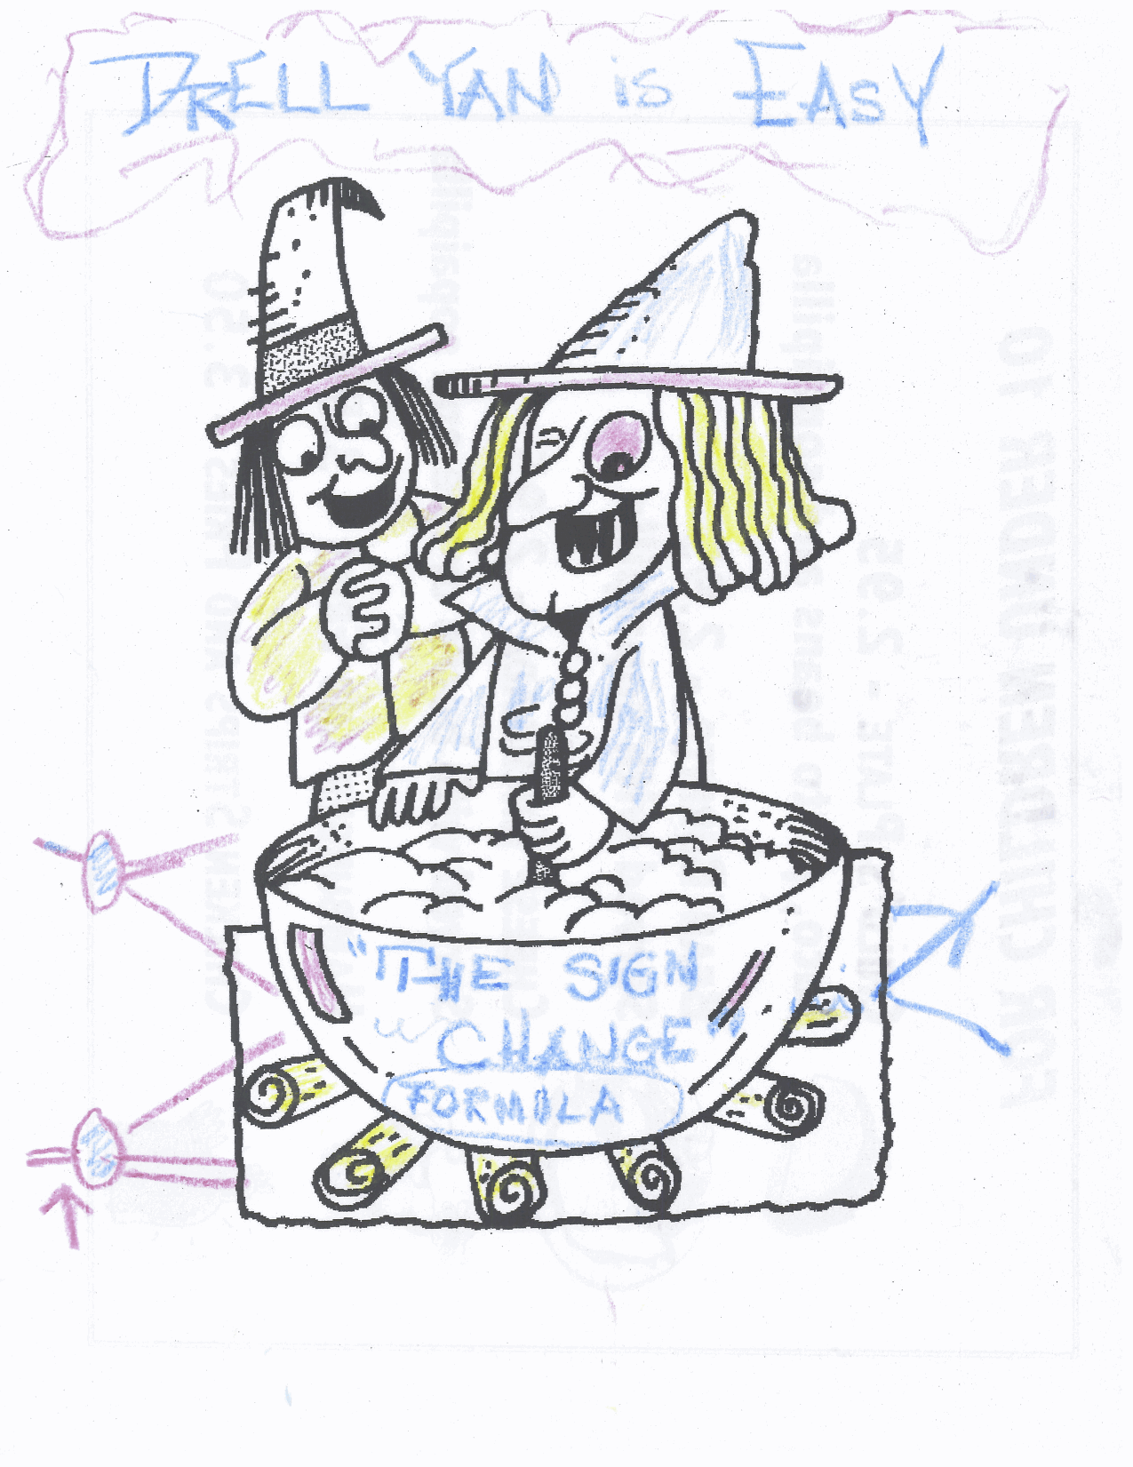

The magic of
sign change
Drawing from D. Sivers @Santa Fe Polarized Drell-Yan Workshop 10/31-11/1, 2010

Slide 37
Backup slides

Slide 38
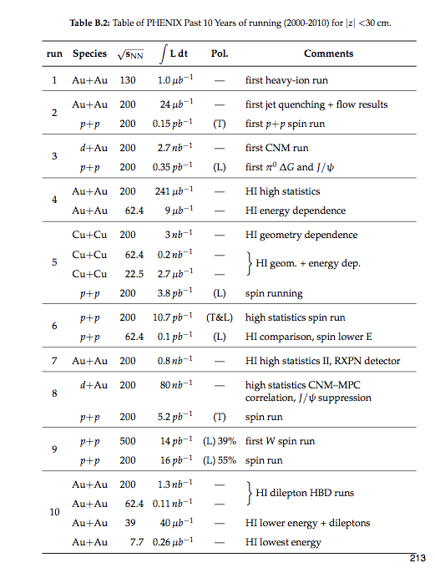

Slide 39
Experiment SIDIS vs Drell Yan: Sivers|_{DIS}= − Sivers|_{DY}
*** Probes QCD attraction and QCD repulsion ***
HERMES Sivers Results
RHIC II Drell Yan Projections
Sivers Amplitude
0.1 0.2 0.3 x

Slide 40
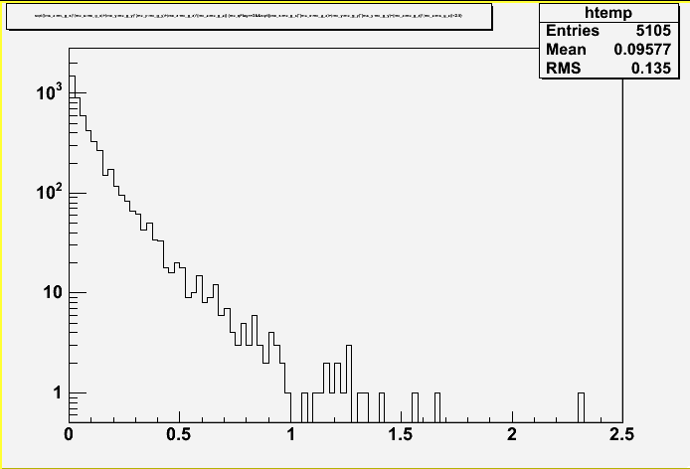
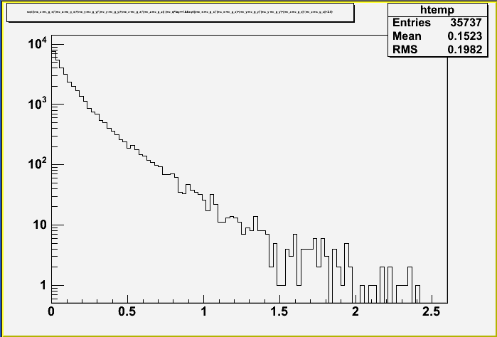
Impact Parameters for muons from D,B and DY
Measuring Charm, Beauty and Drell-Yan
  D, B mesons travel ~1 mm (with boost) before semi-leptonic decay to muons
  By measuring DCA to primary vertex,
  can separate D and B from prompt particles
  and long-lived decays like π, K
prompt
π→μ
D->µ
B->µ
cm
cm

Slide 41
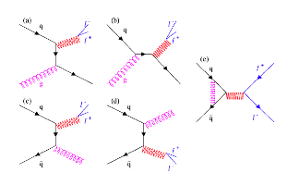

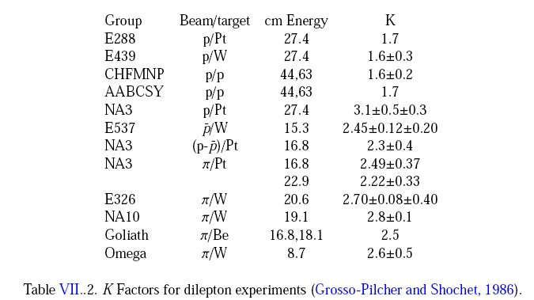
QCD Correction
K factor collection

