Slide 1
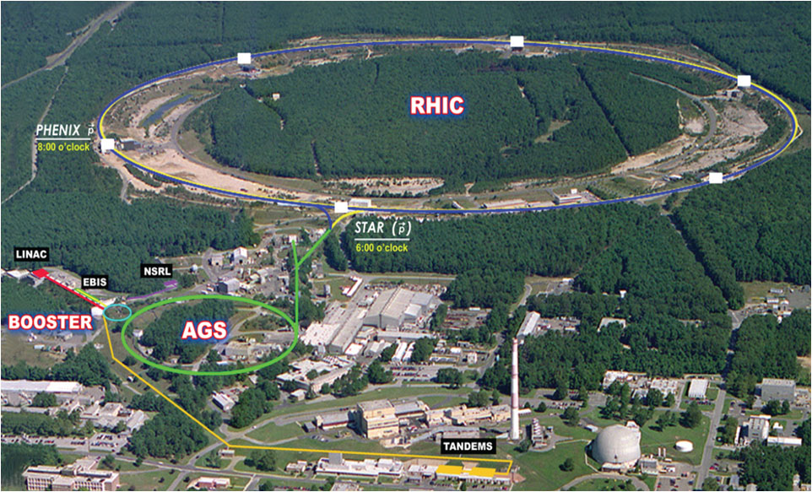
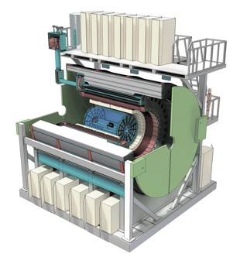

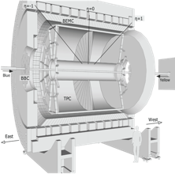
sPHENIX Open Heavy Flavor Physics
Ming Liu
Los Alamos National Lab
for the sPHENIX Collaboration
04/20/2021
APS April Meeting (Online)

Slide 2
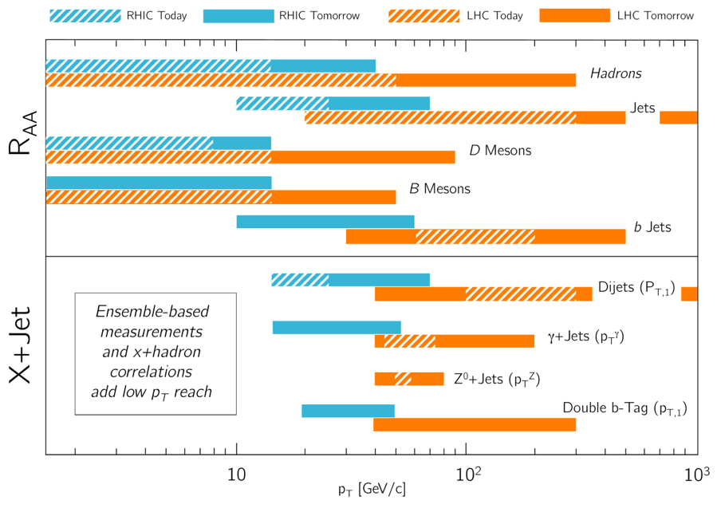
Probing the “Inner Workings” of QGP with HF
Heavy quark energy loss mechanisms in QGP
  Radiative vs collisional
  Mass dependence R_{AA} @transition region, pT ~ M_{Q}
Heavy quark interactions with QGP
  HF diffusion coefficient, “flow”
  QGP properties, RHIC vs LHC
CNM to QGP transition
  pp, pA and AA, RHIC vs LHC
  Event multiplicity dependence, onset of QGP?
Heavy quark hadronization
  Coalescence, non-perturbative QCD at low pT
  Baryon/Meson ratios
  Test pQCD at high pT
sPHENIX projections:
Rich set of observables - hadrons and jets

Slide 3
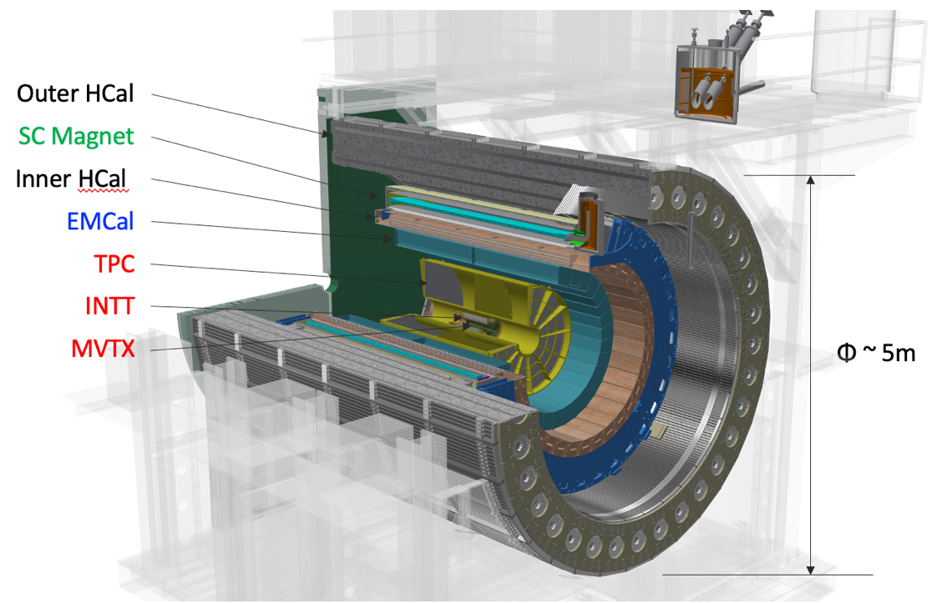
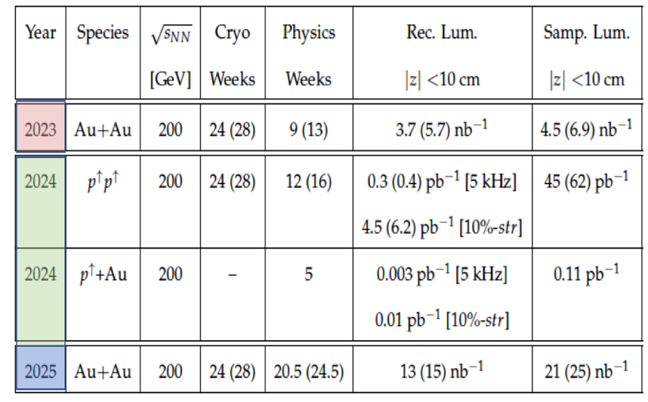
The sPHENIX Experiment
Key capabilities:
Full azimuth, |eta| < 1.1
High trigger rate ~15kHz, collect all central AuAu
EMCal: high pT direct photons
Inner and outer HCals: jets
Precision tracking: HF and more
  0.2 < pT < 40 GeV
  Trigger-less streaming readout, p+p and pAu
B=1.4T
sPHENIX Run Plan
MVTX beam view
R = 2.5 – 4.0 cm

Slide 4
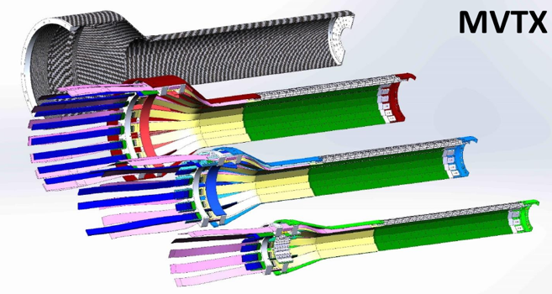
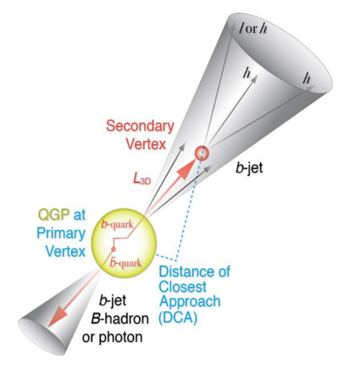
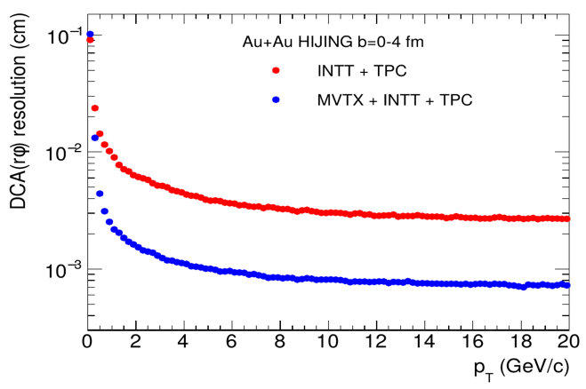
Open HF Tagging with MVTX Upgrade
- Monolithic-active-pixel-sensor based VerTeX detector
MVTX key parameters: (ALPIDE)
pixel size: 27um x 29 um
ultra-thin stave: 0.35%X₀
Integration time: ~5us
Multi-tracks w/ large DCA
2nd vertex mass
Exclusive hadron reconstruction
10um

Slide 5
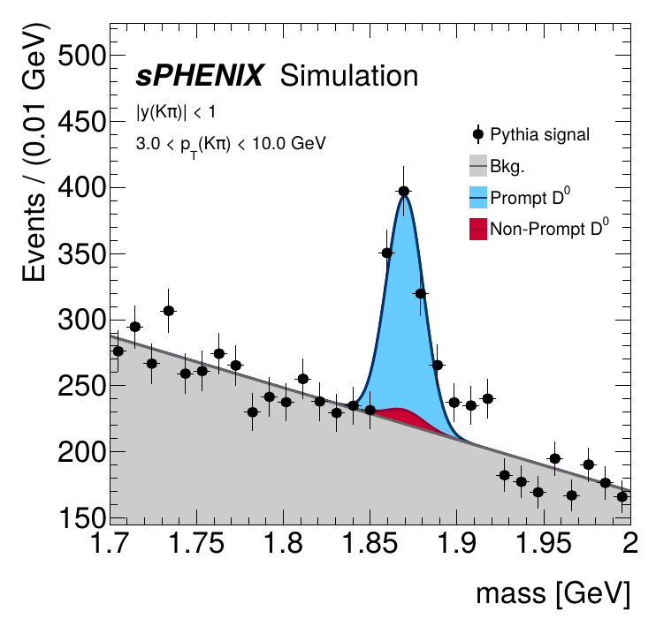
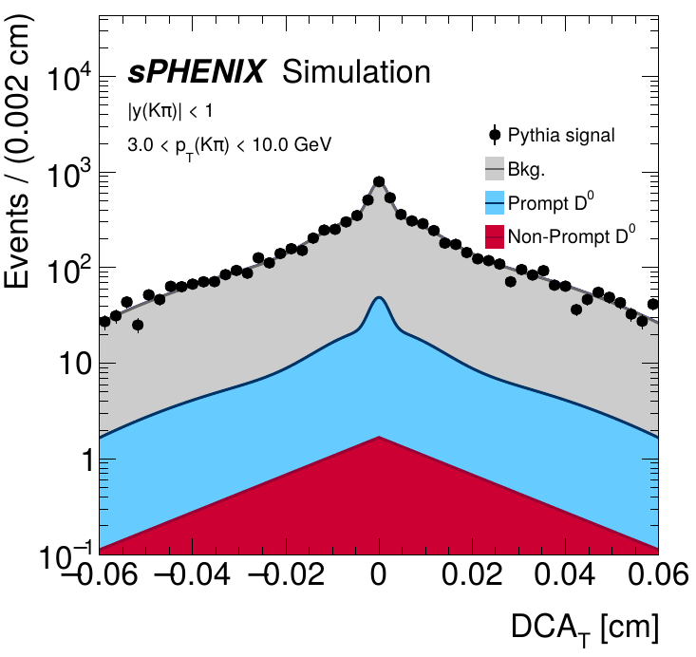
Work in Progress: from Full Monte Carlo Simulations
PYTHIA 8 p+p with full
detector GEANT sim + reco
KFParticle package implemented for exclusive HF hadron reconstruction

Slide 6
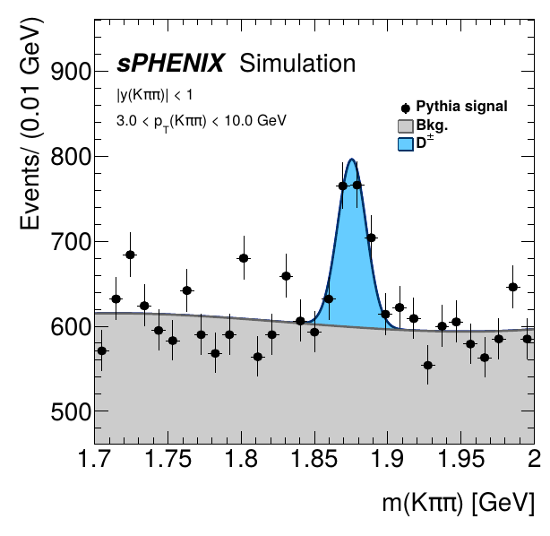
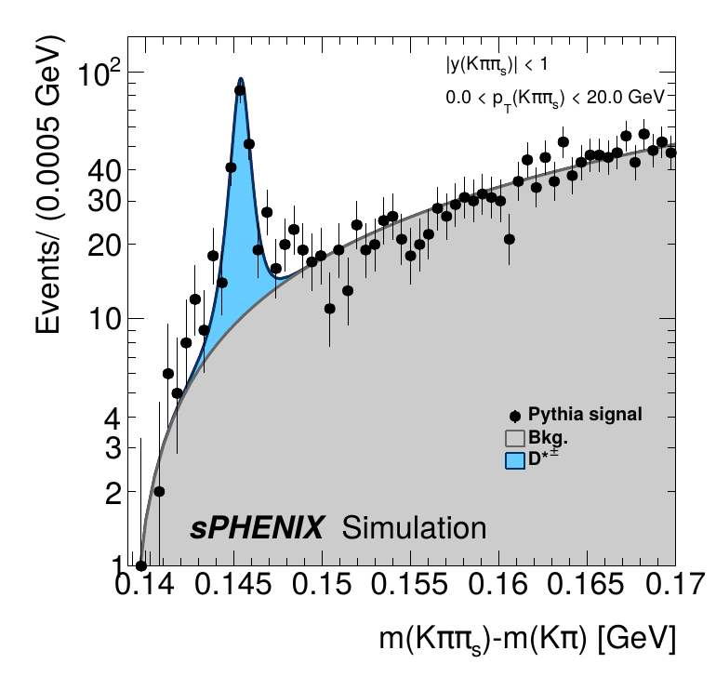
Work in Progress: More from KFParticle Outputs
D⁺→K⁻π⁺π⁺
D*⁺→D⁰π⁺→K⁻π⁺π⁺
For D*, pT ~> 1.5GeV, with soft pion pT > 0.2GeV

Slide 7
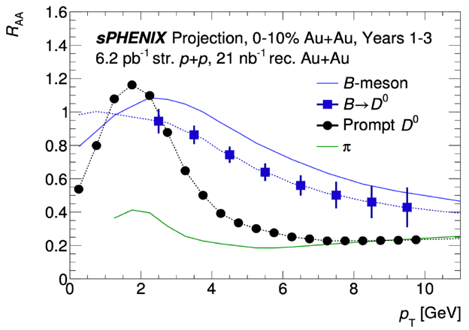
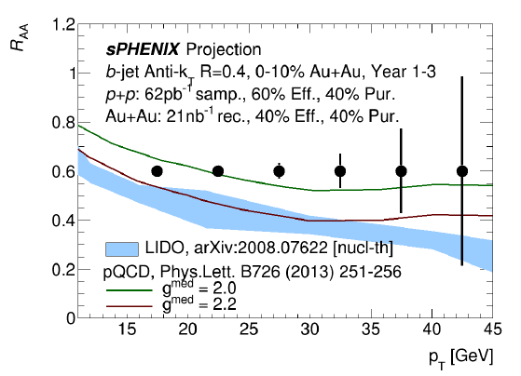
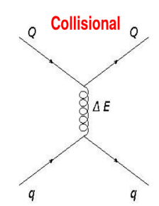
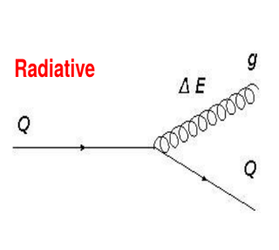
Precision HF Hadron and b-Jet R_{AA}
Many factors affect the HF hadron production:
Heavy quark energy loss in QGP: mass, pT dependence
Heavy quark diffusion in QGP
Heavy quark hadronization in QGP
Also other observables:
- di-b-jet, modification of HF jet structures etc.

Slide 8
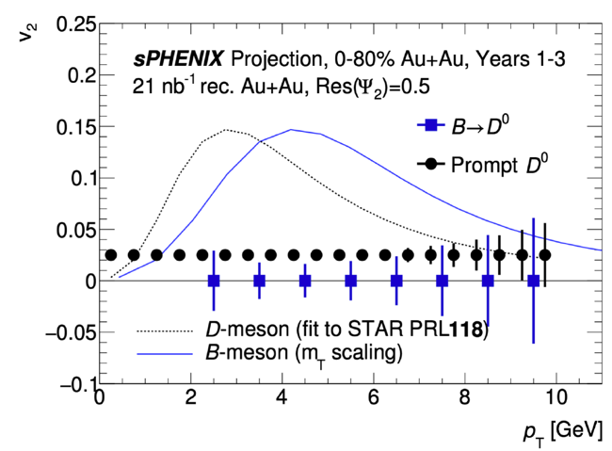
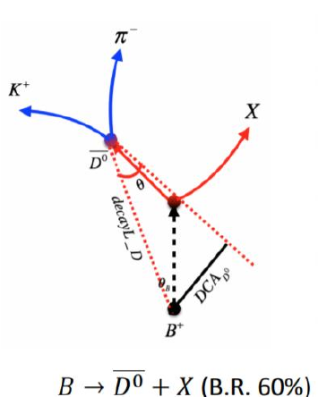
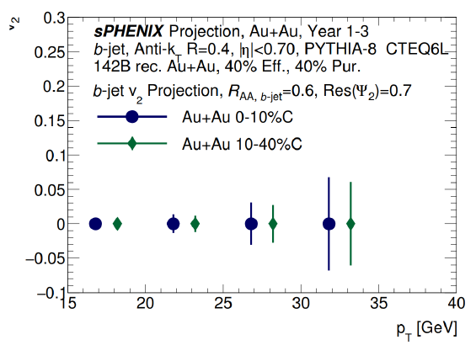
Precision “Flow” Measurements of B-hadron and b-Jets
STAR: D⁰ v2 m_{T} scaling observed
Many factors affect the HF hadron production:
Heavy quark energy loss in QGP
Heavy b-quark diffusion in QGP
Heavy quark hadronization in QGP
b-jet flow, pQCD:
- Energy loss induced v2?

Slide 9
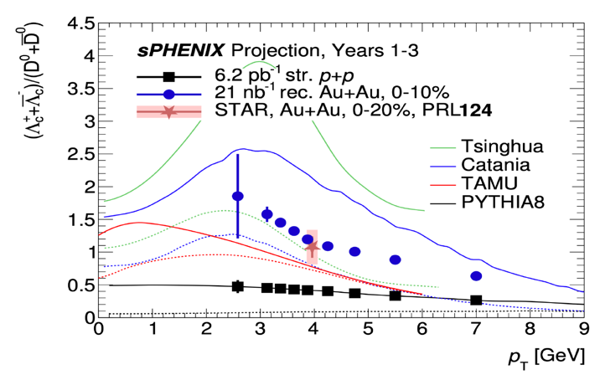
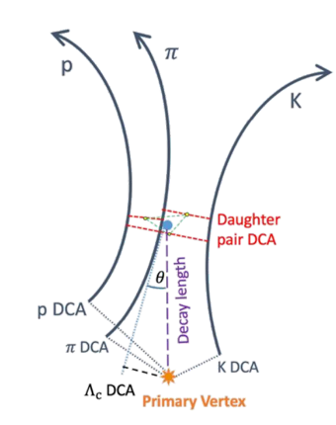
From Quarks to Hadrons in QGP
- Critical to understand the hadronization process
Hadron production strongly affected by the QCD environment
  Non-perturbative process important at low pT, coalescence etc.
  Strong multiplicity dependence observed in p+p, pA and AA … @RHIC and LHC
  Breakdown of pQCD factorization at low pT
High precision measurements of HF meson and baryons in sPHENIX
Clear pT dependence observed: e+e- vs pp

Slide 10
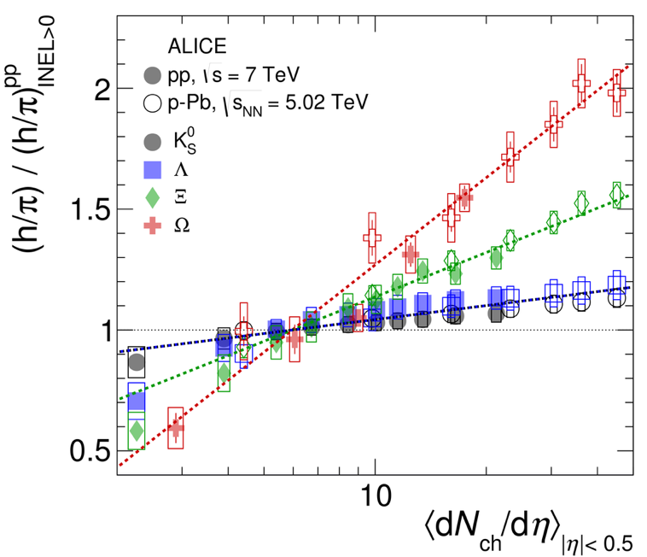

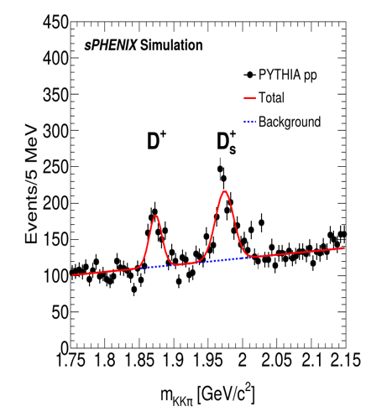
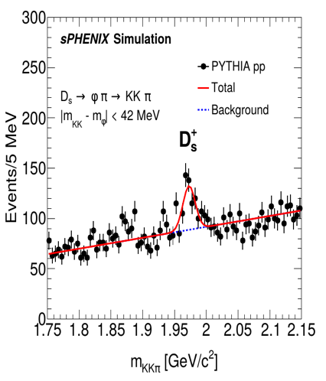
From Quarks to Hadrons (Cont.)
More exclusive HF hadrons – D^{+/-}, Ds, Bs yields etc.
Event multiplicity dependence
Strangeness enhancement in high multiplicity pp
w/ True MC information
Nature Physics 12 (2017) 535-539

Slide 11

Summary and Outlook
Great HF physics opportunity at RHIC
  High precision measurements of HF over a wide pT range, to study “inner workings of QGP”
    Heavy quark energy loss mechanisims
    HF diffusion coefficients
    Jet structure modification in QGP
    Heavy quark hadronization and QCD
  Complimentary to LHC
sPHENIX day-1 physics in early 2023
  Detectors ready by 2022
Other physics not covered here
  Jets and QGP
  Upsilons and QGP
  Spin and cold QCD

Slide 12
Backup slides/plots

Slide 13
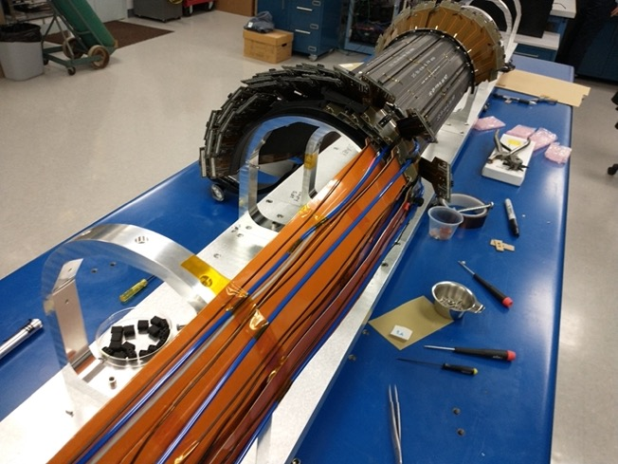
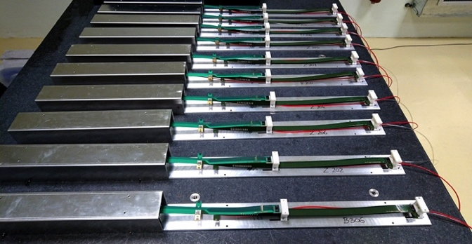
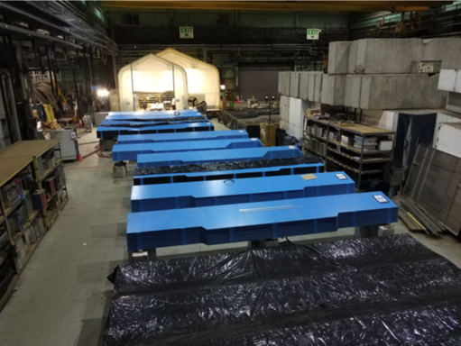
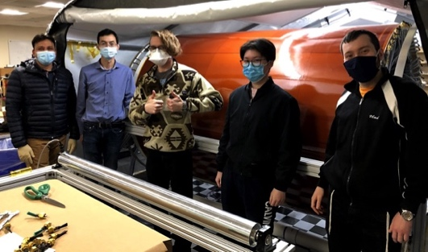
sPHENIX Detector Construction Photos
INTT Assembly @BNL
sPHENIX MVTX Staves
@CERN
TPC Outer Field Cage @SBU
BNL HCal Factory in Bldg 912

Slide 14
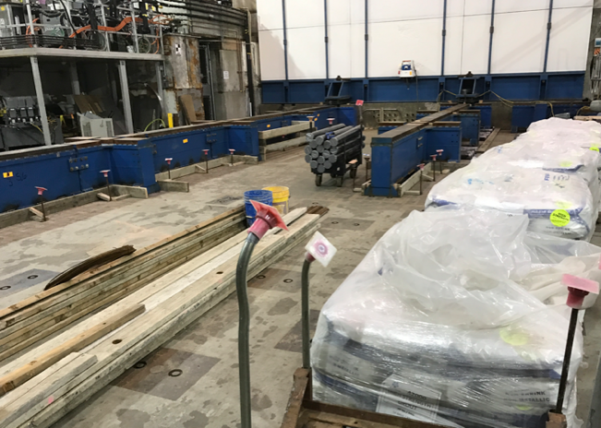
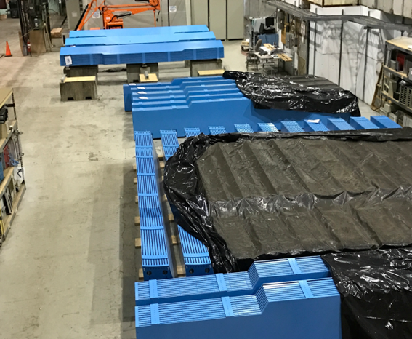
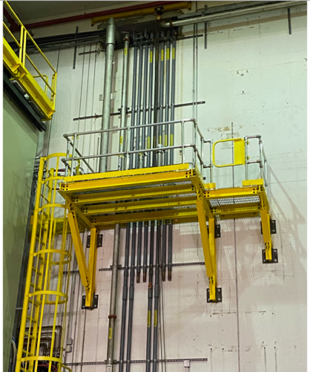
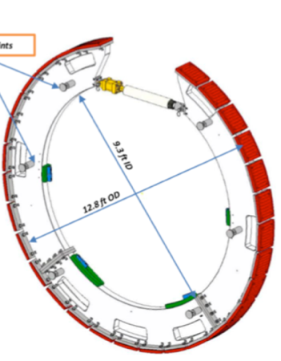
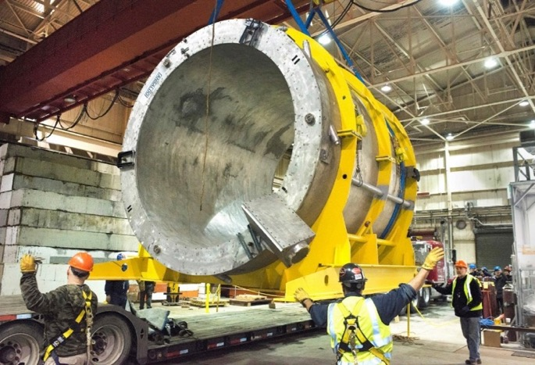
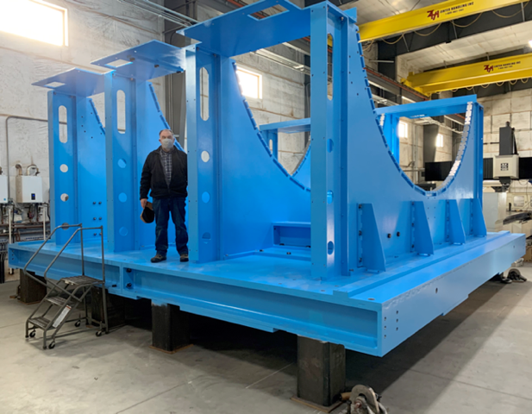
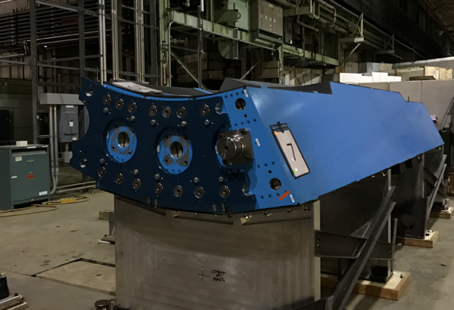
sPHENIX in Progress: 1008 I&F in Photos
Large Support Rings
1008 Cryo Deck &
LHe line
Track Reinforcement in 1008
Magnet Barrel Flux Return
OHCal Assembly
3 OHCal Sector Assembly Test
SC-Magnet @ BNL
Carriage /cradle @ vendor

Slide 15
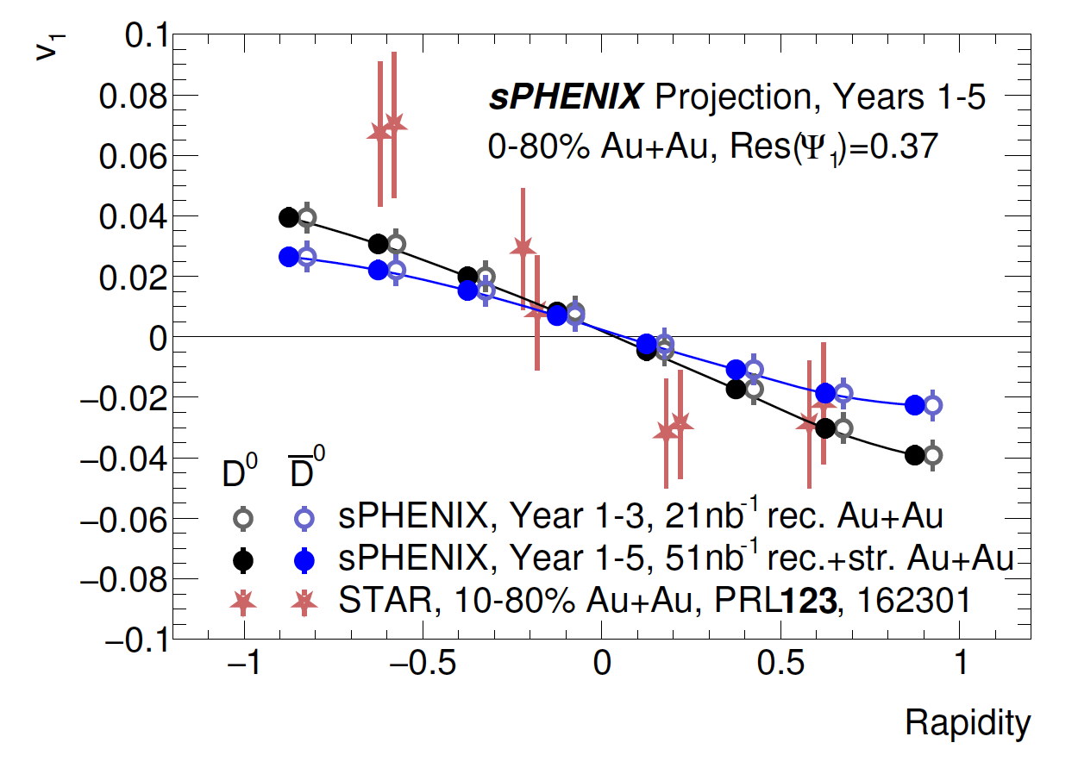
Probe Initial Magnetic Field in HI collisions

Slide 16
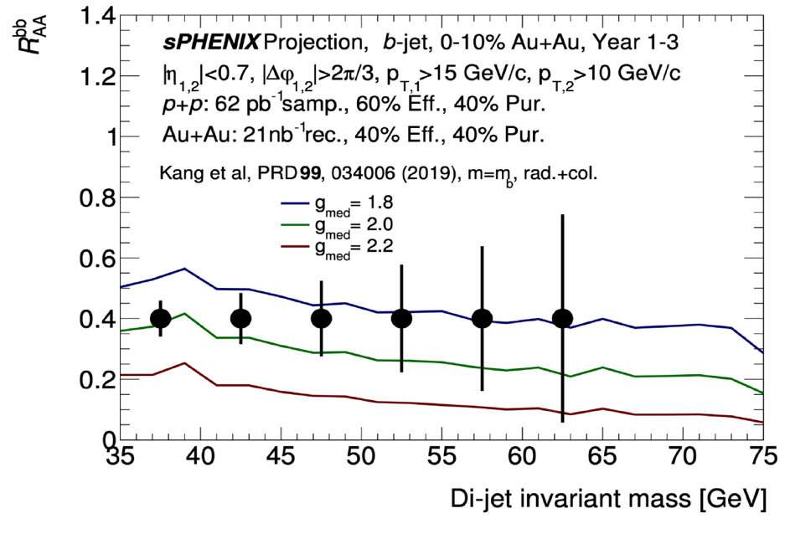
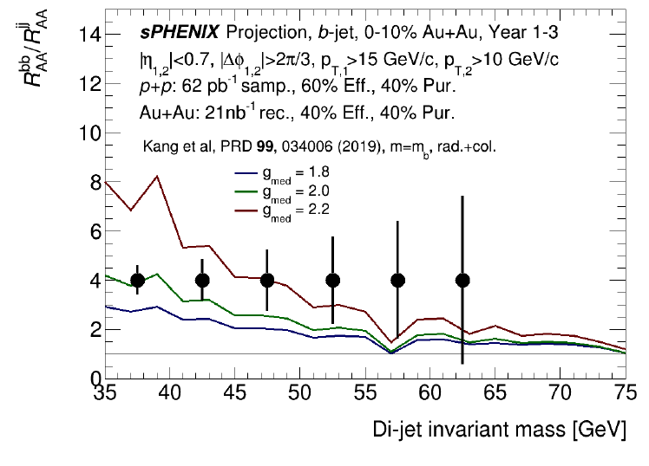
Di-b-Jets in QGP
Kang, Reiten, Vitev, Yoon, PRD 99, 034006 (2019)
- Sensitive to Jet coupling to QGP

Slide 17
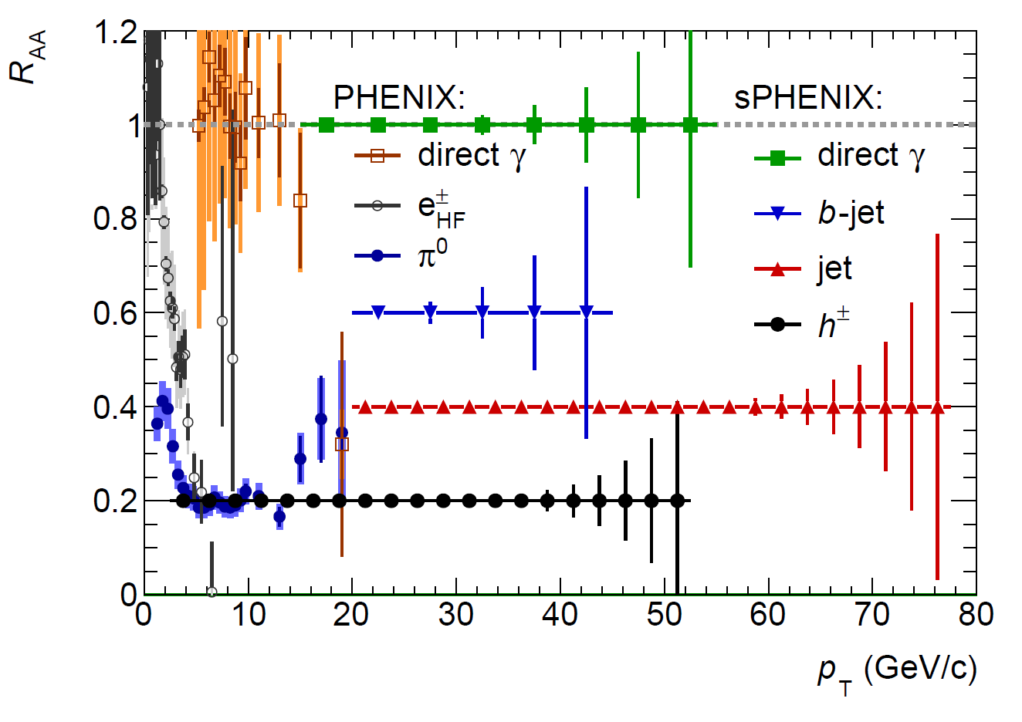
A Broad Physics Program with Hadrons and Jets
Parton Mass and Flavor Dependence of Jet Suppression and more

Slide 18
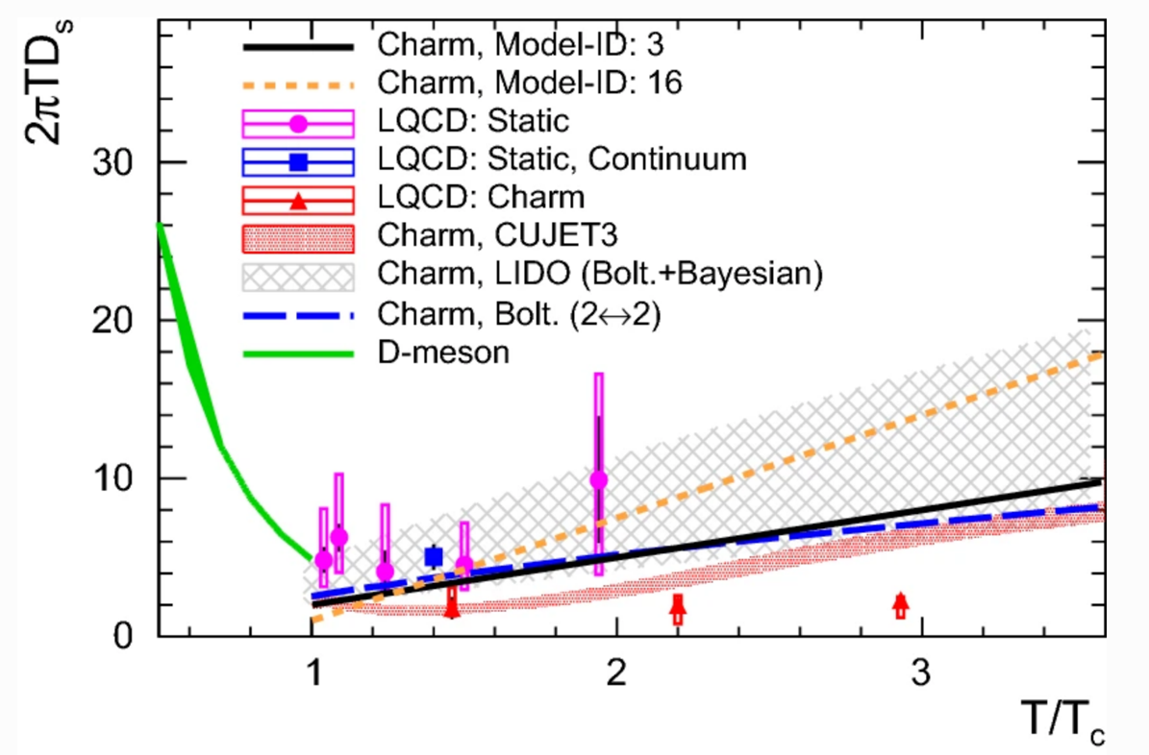

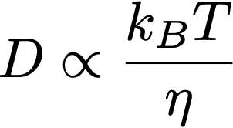
HQ Diffusion in QGP
Shuang Li and Jinfeng Liao, Eur. Phys. J. C (2020) 80: 671
Model calculations
Classical Brownian motion:

Slide 19
Probe Gluon TMD with D⁰
Charm is unique probe of gluon TMD
D⁰ A_{N}→ Tri-gluon correlation functions
sPHENIX projection
PHENIX, DOI:10.1103/PhysRevD.95.112001

Slide 20
Heavy Quark Hadronization

Slide 22
sPHENIX Detector Sub-Systems

Slide 23

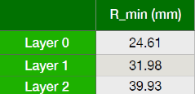
MVTX Detector
Excellent track DCA resolutions in pp, pAu and AuAu
3-layer sensor barrel:
- pixel size: 27 x 29 um
- stave thickness: 0.35%X₀
- Timing resolution: 5us
- 48 staves, 27.1cm long
MVTX beam view

Slide 24
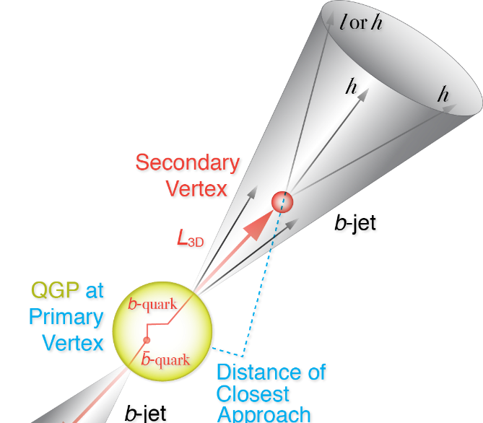
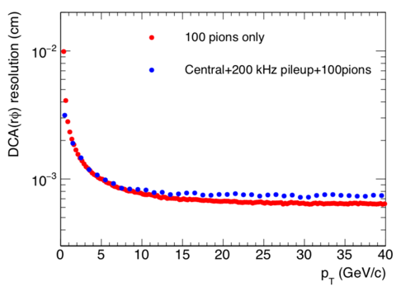
Precision Vertex and Open HF Observables
Precision vertex tracker + high rate capability
→ Precision open charm and bottom over wide scales
10um
Notes:
D_s plot … ?
Shanshan - A multi-scale approach is required for the full picture

Slide 25
Monolithic-Active-Pixel-Sensor based Precision Vertex Detector
-- for Open Heavy Quark Measurements

