Slide 1
Drell-Yan Physics
An Experimental Overview
Ming X. Liu
Los Alamos National Lab

Slide 2
Outline
Introduction – a brief review of history
Recent highlights and future prospects
  quark energy loss dE/dx in pA
  Nucleon and nucleus structure
New opportunity
  Transverse spin physics

Slide 3
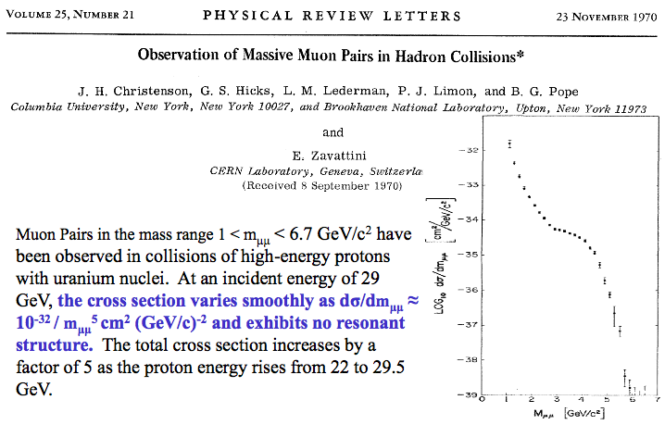
The First Dimuon Measurements
Missed the J/Psi!

Slide 4
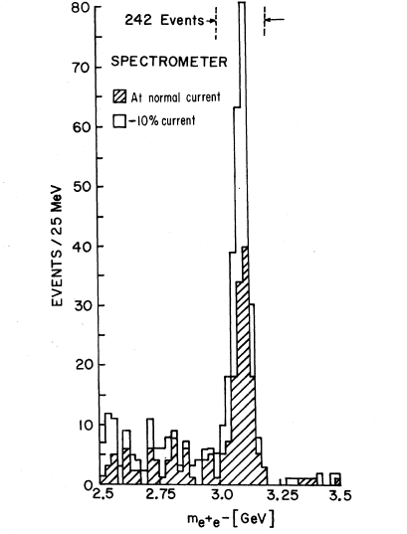
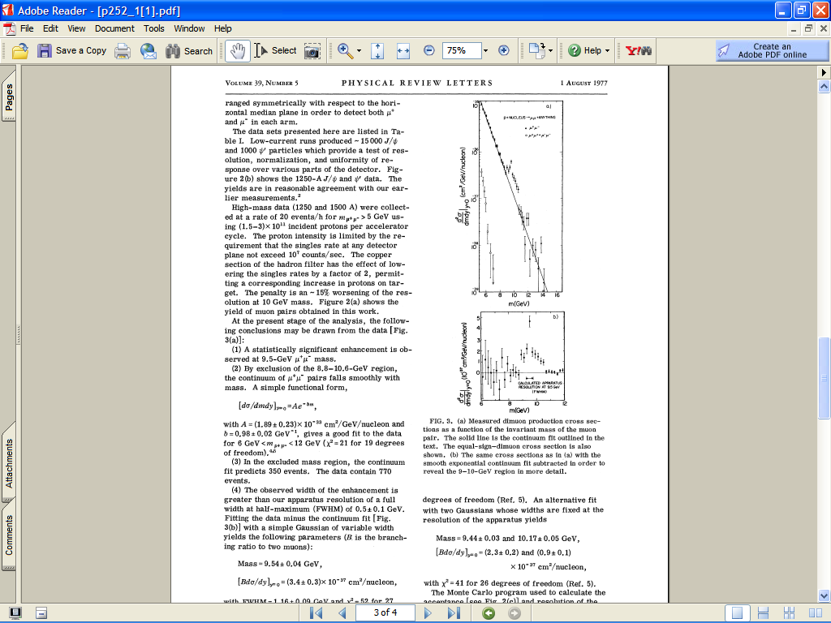
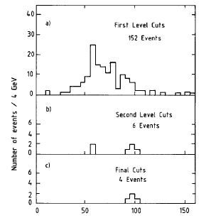
Di-lepton probe: a Powerful Tool for Discovery

Slide 5
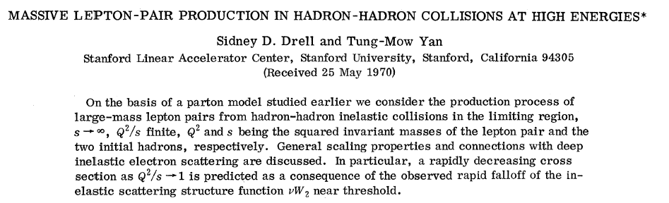
The Drell-Yan Process
μ⁺
μ⁻

Slide 6
Complimentality between DIS and Drell-Yan
DIS
Drell-Yan
McGaughey, Moss, Peng,
Ann.Rev.Nucl. Part. Sci. 49 (1999) 217
Both DIS and Drell-Yan process are tools to probe the quark and antiquark structure in hadrons (factorization, universality)

Slide 7
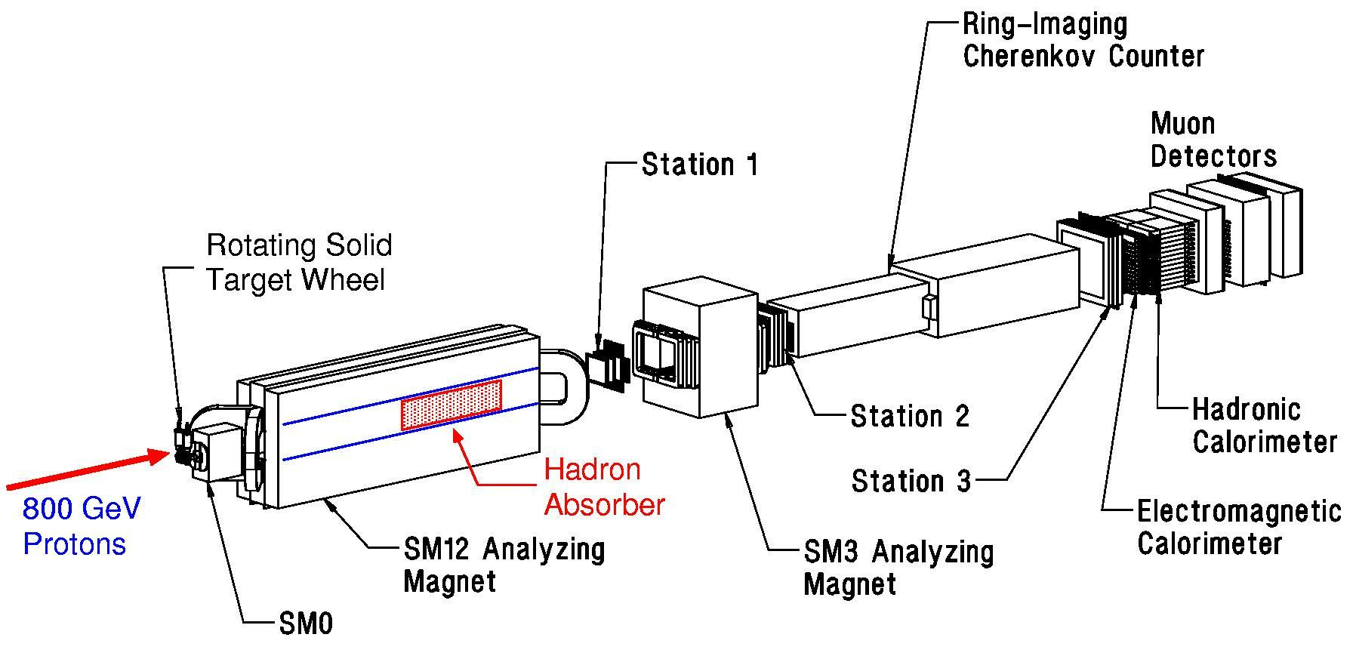
Fermilab Dimuon Spectrometer: Fixed Target Drell-Yan
(E605 / 772 / 789 / 866 / 906)

Slide 8

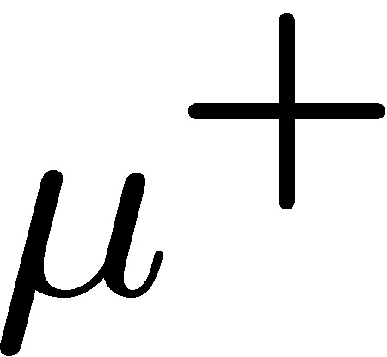

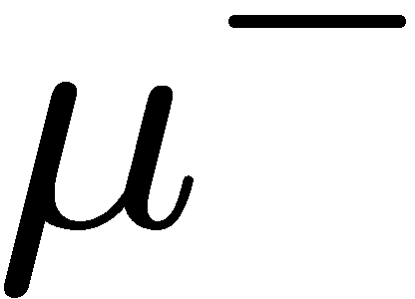
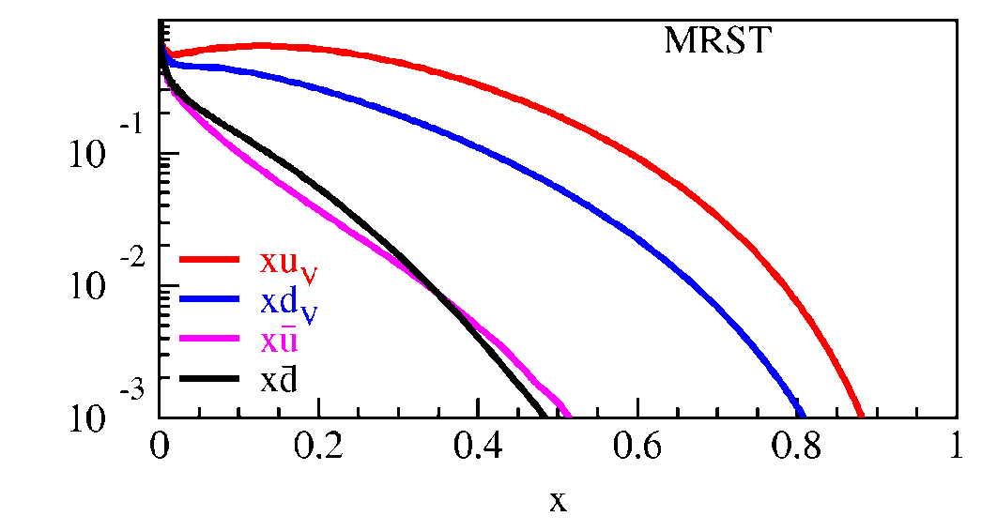
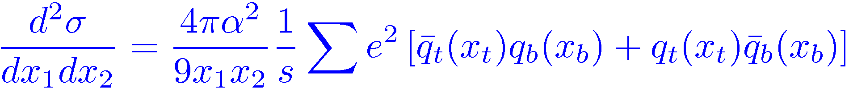
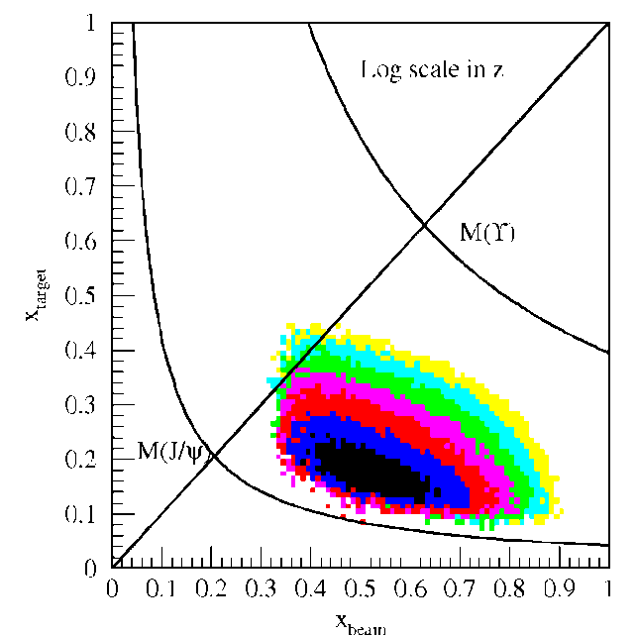
Kinematic of Fixed Target Drell-Yan
Measure yields of μ⁺μ⁻ pairs from
different targets: p+p, p+A
Determine x_{b}, x_{t}
Measure differential cross section
Fixed target kinematics and detector acceptance give x_{b} > x_{t}
  x_{F} = 2p||^{γ}/s^{1/2} ≈ x_{b} – x_{t}
  Beam valence quarks probed at high x
  Target sea quarks probed at low/intermediate x
x_{target}
x_{beam}
E906 Spect.
Monte Carlo
Notes:
Determine mass and momentum of virtual photon
Determine momentum fraction x_b and x_t of partons in beam and target
Measure absolute differential cross section
Sensitivity of D-Y process to anti-quark distribution of target or beam clear from examining diff. cross section
At large x, parton distributions are dominated by valence distributions, at small x by sea distributions
So in limit of large xb and small xt, cross section is dominated by first term -> providing direct sensitivity to antiquark sea of target nuclei
So if we just have to design the right experiment: This is E906.

Slide 9
Highlights of Physics from Fermilab Dimuon Experiments
Quark energy loss in nuclear medium
Sea quarks and gluons in nucleons and nuclei
Transverse spin physics
  Drell-Yan angular distributions
  Transverse Single Spin Asymmetry: DY vs DIS

Slide 10
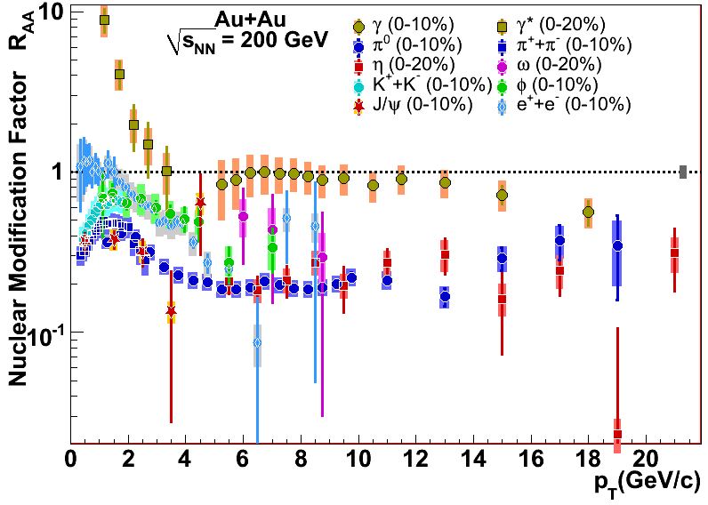
Topic (I): Energy loss in the Nuclear Medium
Parton energy loss has been discovered at RHIC as an excellent probe of the hot/dense matter.
However, order of magnitude uncertainties in dE/dX
Single Hadron Tomography
jet
g
g
T
T
g
Xin-Nian Wang, M. Gyulassy, PRL68(1992)1480
Notes:
As is well known, an interesting property of QCD is confinement, which means that in nature quarks and gluons are confined in hadrons, and we cannot see free quarks and gluons. If we accelerate two heavy nuclei to very high energy and make them collide with each other, we can deposit a huge amount of energy in the colliding center and the confined quarks and gluons may be deconfined to form a new kind of matter: Quark-gluon-plasma, or QGP.
jet quenching is widely regarded as one of the best one to probe the hot/dense matter. Jet quenching tells that when an energetic parton passing through hot and dense nuclear matter, it may suffer multiple scattering with other partons in hot medium and lose a lot of energy. One can get the information of the medium by the lost energy of jets. It is very similar to X-rays tomography used in hospital to detect the intern structure of human body. Jet quenching theory predicted strong suppressions in single hadron production and di-hadron correlation in the hot QGP medium. In single hadron production, because the jet will lose a large amount of energy when propagating in the QGP, when the jet is fragmentated into hadrons, the hadron yield will be significantly suppressed. In di-hadron prod., when a pair of jet produced. There are usually back-to-back. If they are produced near the surface of the QGP, the jet near the surface will travel very short distance in the QGP and lose few energy. Whereas another jet may travel a longer distance and lose a large amount of energy before fragmentation. Therefore If the leading hadron of this jet is chosen as triggered particle, in the opposite direction, the yield of the hadron from another jet will be highly suppressed.

Slide 11
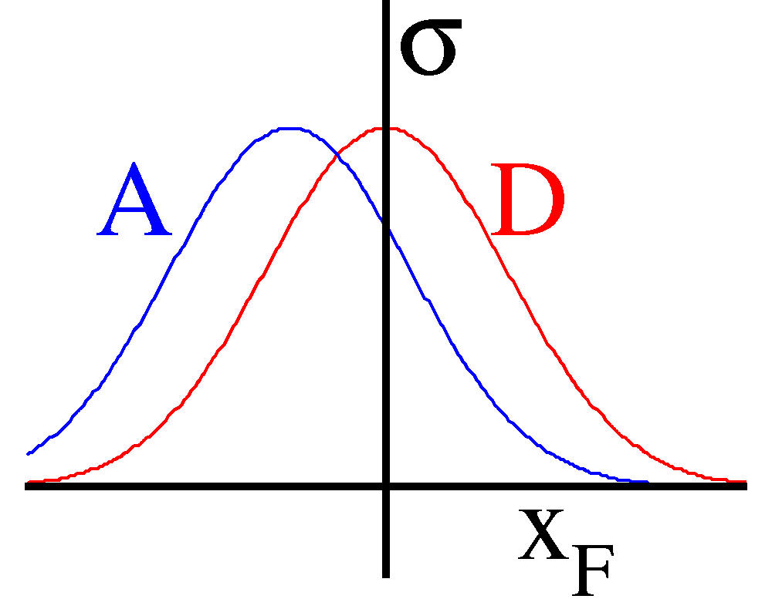
Benchmark with DY: Quark Energy Loss in p+A
High energy p+A collisions:
Relevant D.O.F.: quarks & gluons
Final-state
particles
q, g
Nuclear Target

Slide 12
Energy loss in Electrodynamics
Collisional energy loss
(ionization and atomic
excitation)
Radiative energy loss
(photon bremsstrahlung)
In QCD
PDG, Phys.Lett. B 592, 1-4 (2004)

Slide 13
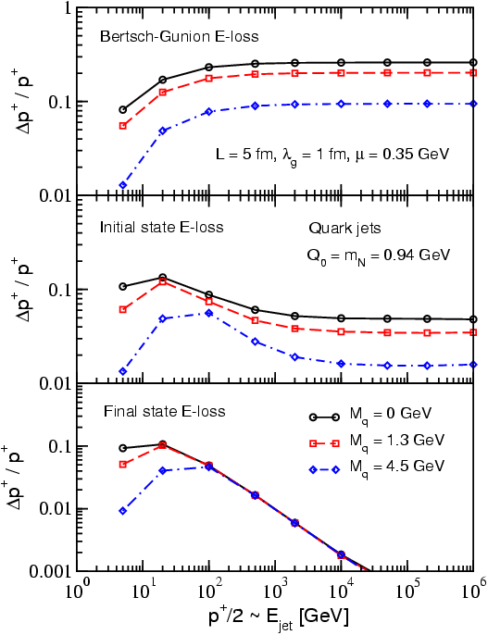
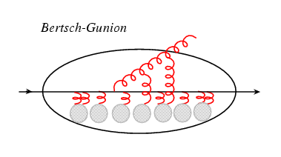
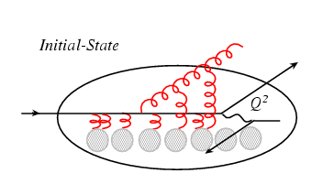
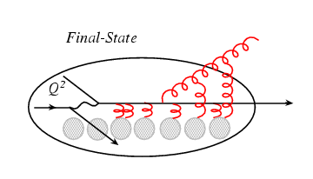
Process Dependence of Parton Energy Loss
E-loss in three cases
Academic case
(probably inapplicable)‏
Initial-state E loss:
DY process
Final-state E loss:
SDIS, QGP
I. Vitev, PRC 75(2007)064906.

Slide 14
Quark Energy Loss in Cold Nuclear Medium
Drell-Yan @E866
(PRL 86 (2001) 4483)
800GeV p + A
5<M<6 GeV
- size of effect ~20%
<dE/dx> depends on shadowing correction
x_{t} ~ 10⁻²
7<M<8 GeV

Slide 15

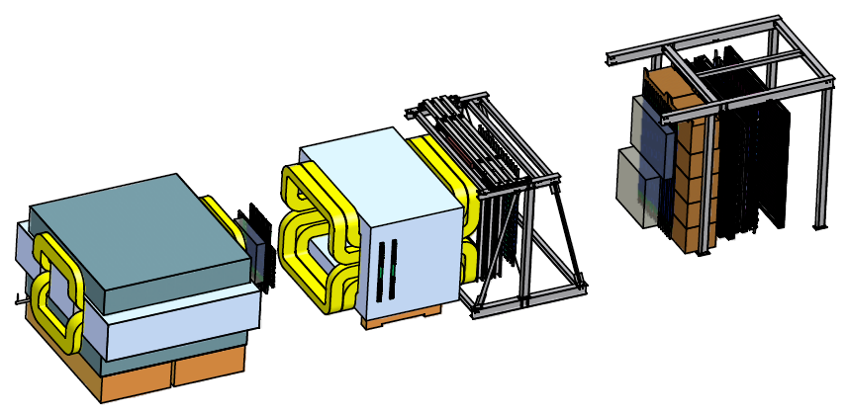
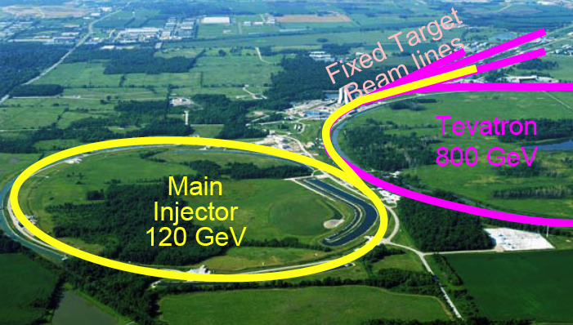
E906 Drell-Yan:2011-2013
X_{Target}
4.9m
X_{Beam}
Polarized DY possibility:
120 GeV proton
p+A: p, d, C, Al, Fe, W
X₁ = 0.3~0.7
X₂ = 0.1~0.3
  free from shadowing effect

Slide 16
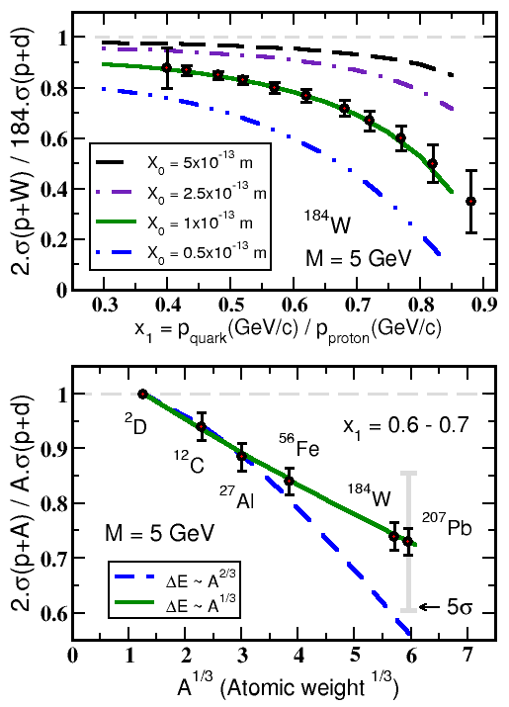


Experimental Sensitivity to Quark Energy Loss
Quark energy loss only
Shortest radiation length in nature X₀ = 1 x 10⁻¹³ m
Clearly distinguish between leading models for L dependence of E-loss
Benchmark dE/dx models

Slide 17
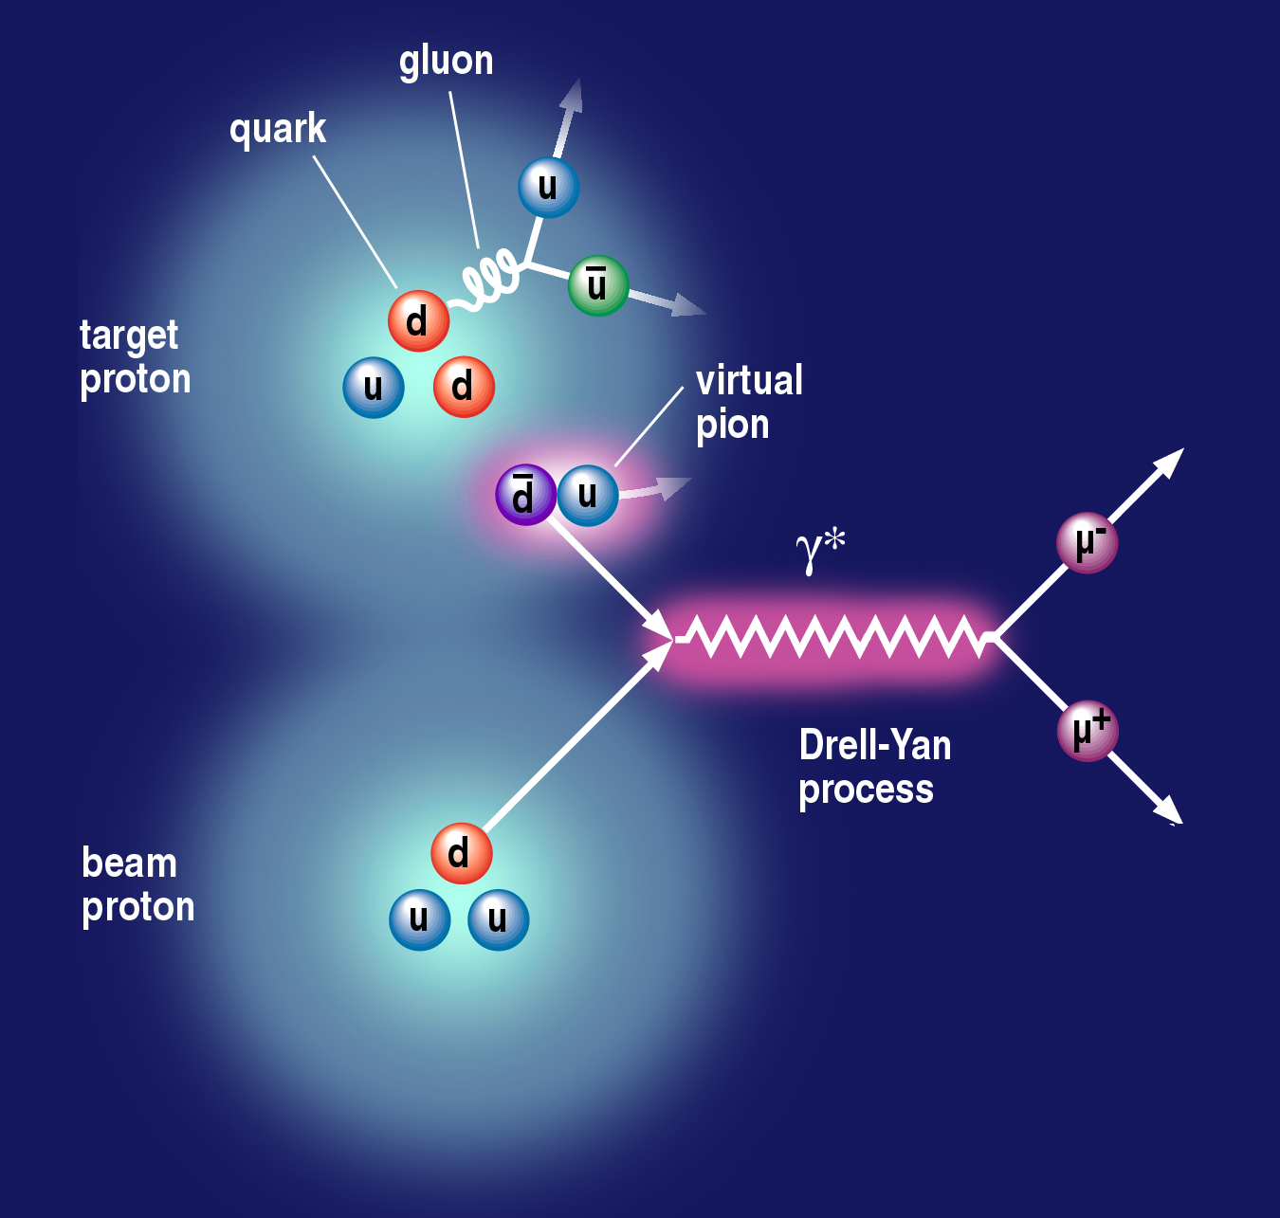
Topic (II): Origin of Sea Quarks
Notes:
Use the nice picture to show that if sea quarks are only from gluon splitting, one will expect dbar = ubar; but if include pion cloud fluctuation, the symmetry is broken. → and E866 showed that is the case. So proton is a very complex system.
So it is interesting to see what happens to polarized case.
It is also a model killer – some predict even larger asymmetry for polarized case.
So understanding the details of nucleon structure will help us better understand the confinement.
So we want to explore the flavor decomposed sea quark distributions.

Slide 18
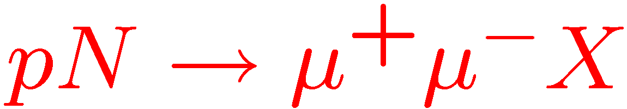
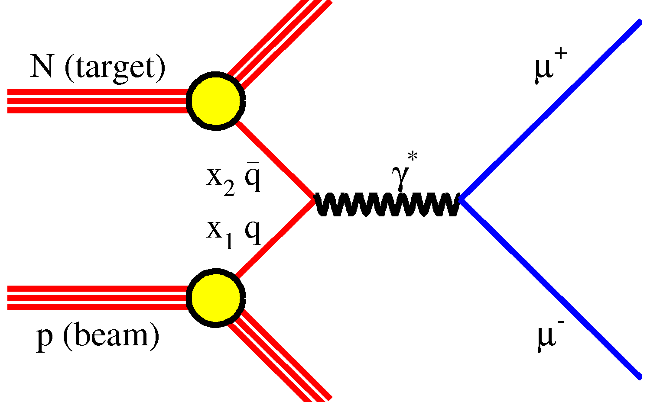
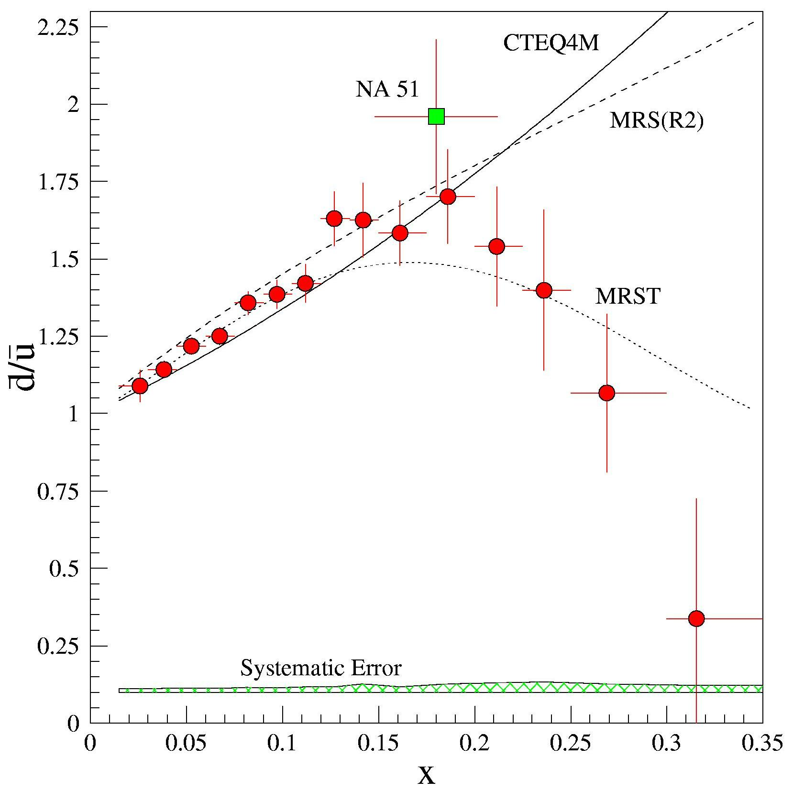
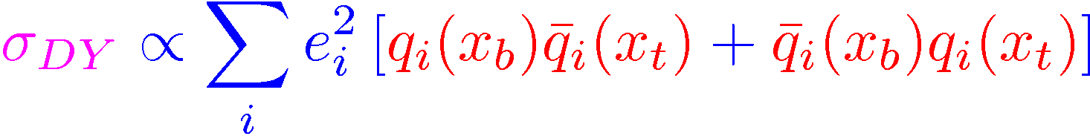
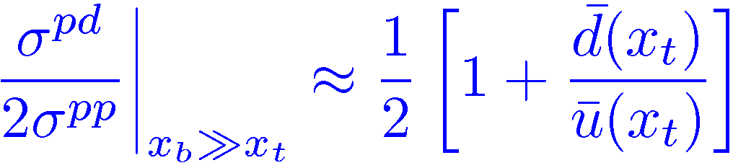
Evidence of Pion Cloud?
E866, Phys.Rev. D64 (2001) 052002
FermiLab/E866
Sea Asymmetry probed by Drell-Yan

Slide 19
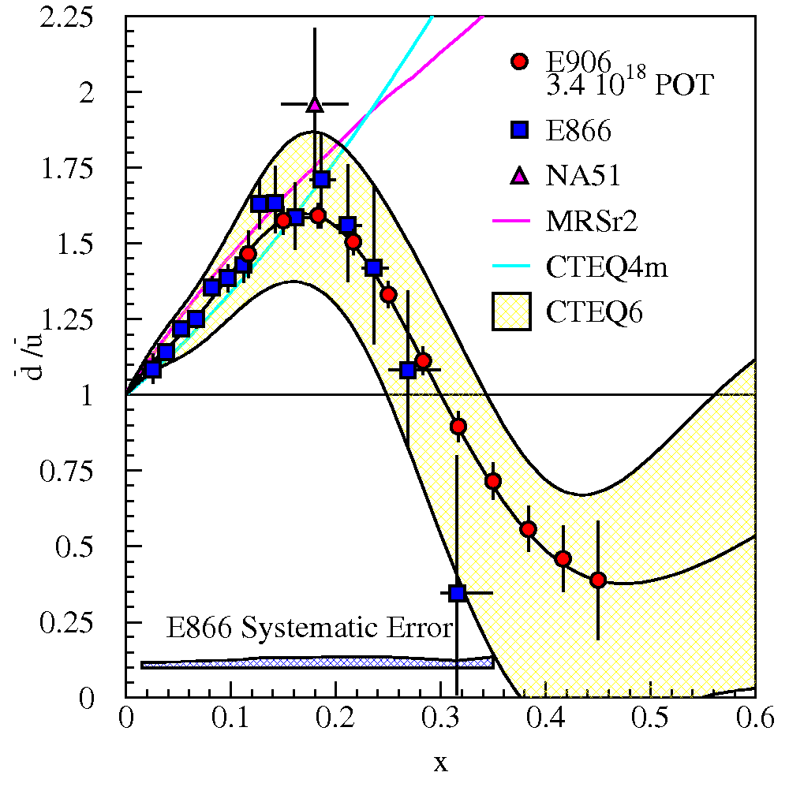
E906 Projections for d-bar/u-bar Ratio
SeaQuest will extend these measurements and reduce statistical uncertainty
SeaQuest expects systematic uncertainty to remain at ≈1% in cross section ratio
5 s slow extraction spill each minute
Intensity:
  2 x 10¹² protons/s
  1 x 10¹³ protons/spill

Slide 20
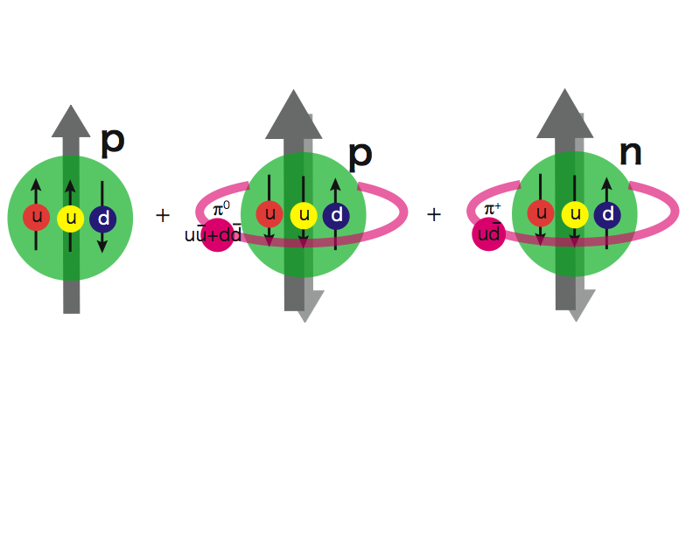
Pion Cloud Model and the
Orbital Angular Momentum?!
Extra dbar in proton
Sea Quarks Carry Major Orbital Angular Momentum Component?

Slide 21
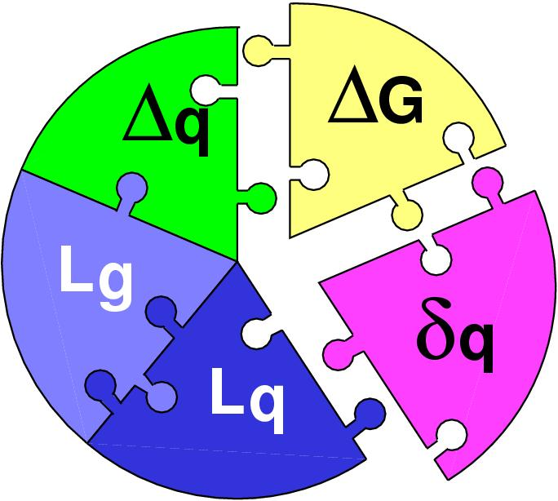
Pion Cloud and Orbital Angular Momentum
Spin puzzle, sea quark flavor asymmetry and L_{Z}
G. Garvey, PRC81:055212,2010.

Slide 22
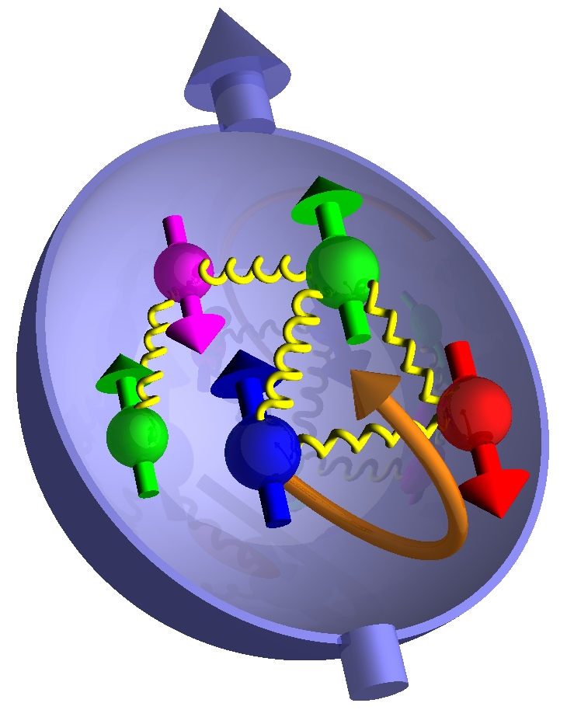
Topics (III): Transverse Spin Physics
TMD and the alike: beyond the collinear approximation
  Sivers functions
  Collins functinos
  and more…

Slide 23
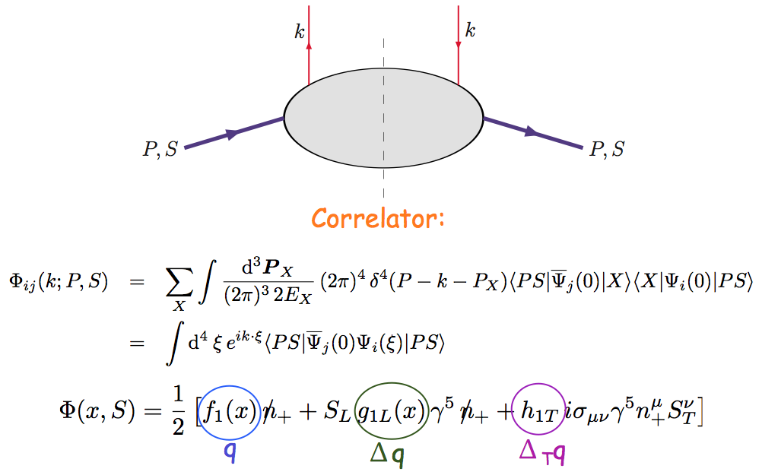
Nucleon Structure @Leading Twist Collinear Approximation (I)
Partonic interpretation of hard scatterings
Universal functions

Slide 24
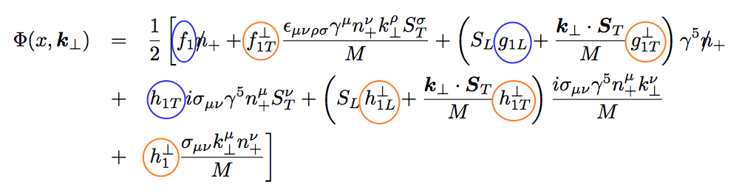
Including k_{T} … 5 more (II)
No K┴ dependence
K┴ - dependent
T-even
K┴ - dependent
T-odd

Slide 25
Drell-Yan Decay Angular Distributions
Θ and Φ are the decay polar and azimuthal angles of the μ⁺ in the dilepton rest-frame
Collins-Soper frame
A general expression for Drell-Yan decay angular distributions:

Slide 26
Transversity and TMDs can be probed via DY

Slide 27
Unpolarized DY and Boer-Mulders Function h₁┴
● Observation of large cos(2Φ) dependence in Drell-Yan with pion beam
●
● How about Drell-Yan with proton beam?
194 GeV/c π + W
Boer, PRD 60 (1999) 014012

Slide 28
Azimuthal cos2Φ Distribution in p+p and p+d Drell-Yan
E866 Collab., Lingyan Zhu et al., PRL 99 (2007) 082301; PRL 102 (2009) 182001
Smallνis observed for p+d and p+p D-Y
With Boer-Mulders function h₁┴:
ν(π⁻W→µ⁺µ⁻X)~ [valence h₁┴(π)] * [valence h₁┴(p)]
ν(pd→µ+µ-X)~ [valence h₁┴(p)] * [sea h₁┴(p)]
Sea-quark BM functions are much smaller than valence quarks
28

Slide 29
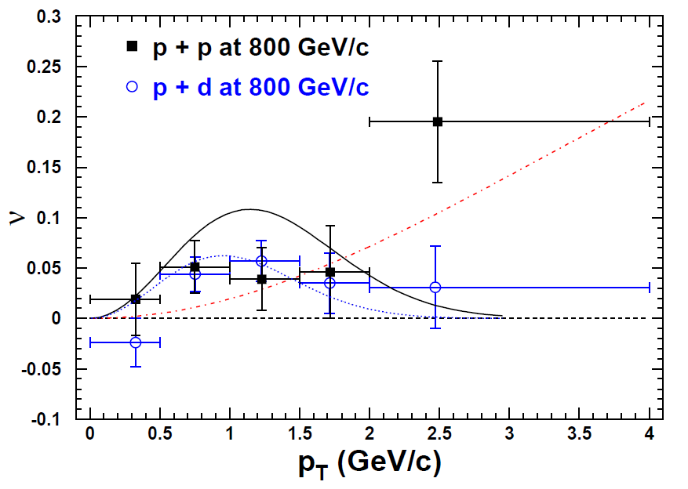
Results on cos2Φ Distribution in p+p Drell-Yan
L. Zhu, J.C. Peng, et al., PRL 102 (2009) 182001
p+p
pQCD
(Boer, Vogelsang; Berger, Qiu, Rodriguez-Pedraza)
p+d
Combined analysis of SIDIS and D-Y by Melis et al.
More data are anticipated from Fermilab E906

Slide 30
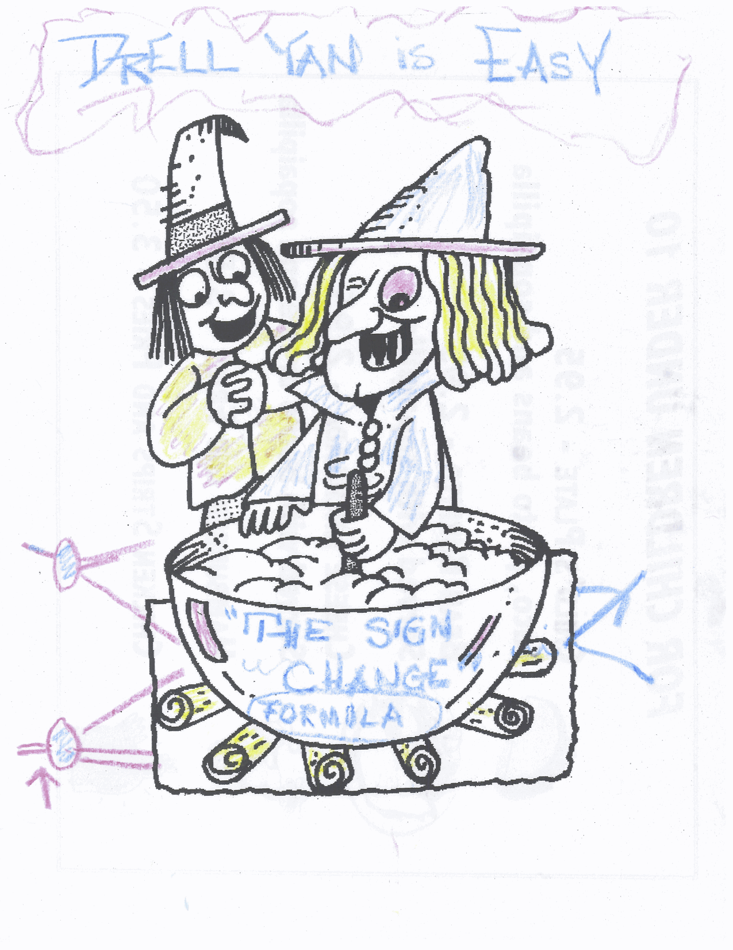

Future: Polarized DY?
The magic of
sign change
Drawing from D. Sivers @Santa Fe Polarized Drell-Yan Workshop Dinner 10/31-11/1, 2010

Slide 31
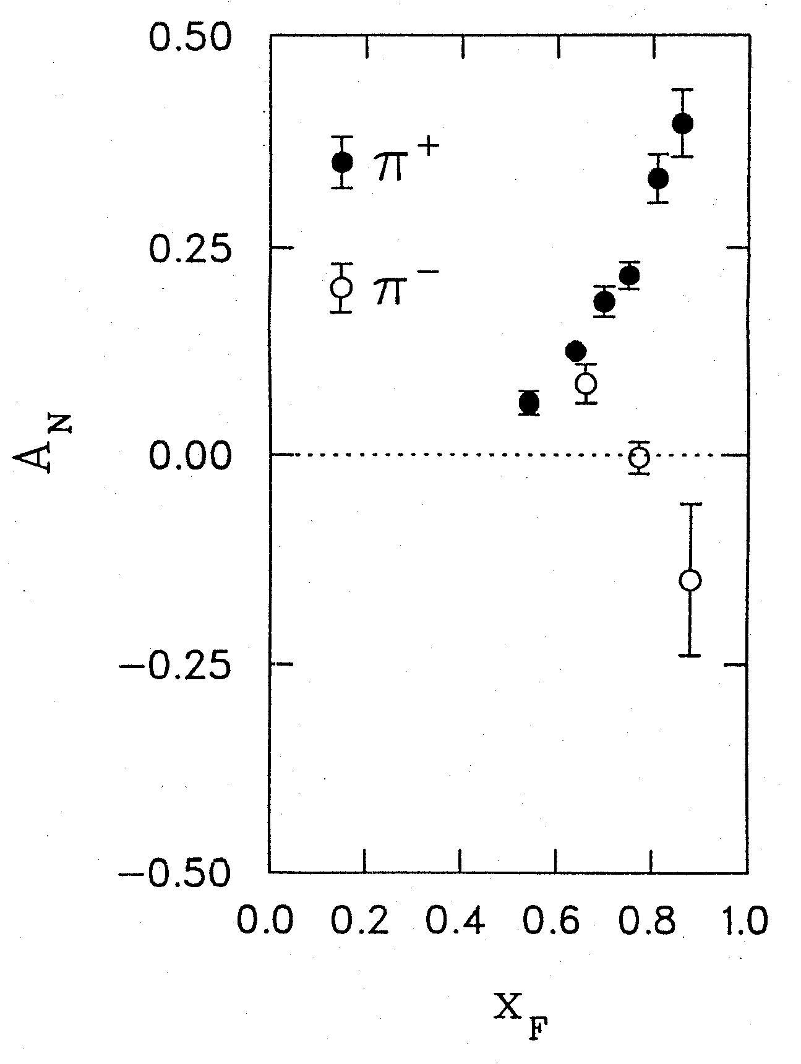
Surprises in Spin Physics the challenge of “Too Big”
Transverse Single Spin Asymmetries A_{N}
Left
Argonne ZGS, p_{beam} = 12 GeV/c
Right
Theory Expectation:
Small asymmetries at high energies
(Kane, Pumplin, Repko, PRL 41, 1689–1692 (1978) )
A_{N}
A_{N} ~ O(10⁻⁴) theory
Experiments:
ZGS, AGS, FERMILAB to RHIC
A_{N} ~ O(10⁻¹) observed
W.H. Dragoset et al., PRL36, 929 (1976)
4/28/11
31

Slide 32
Current Understanding of TSSAs (I)
TMD approach: Transverse Momentum Dependent Distribution Functions
  Sivers fucntion: nucleon spin and parton kT correlation
  Collins function: spin dependent fragmentation function
  and lots of others …
S_{P}
Phys Rev D41 (1990) 83; 43 (1991) 261
Nucl Phys B396 (1993) 161
S_{P}
p
k_{T,q}
S_{q}
p
p
p
S_{q}
k_{T,π}

Slide 33
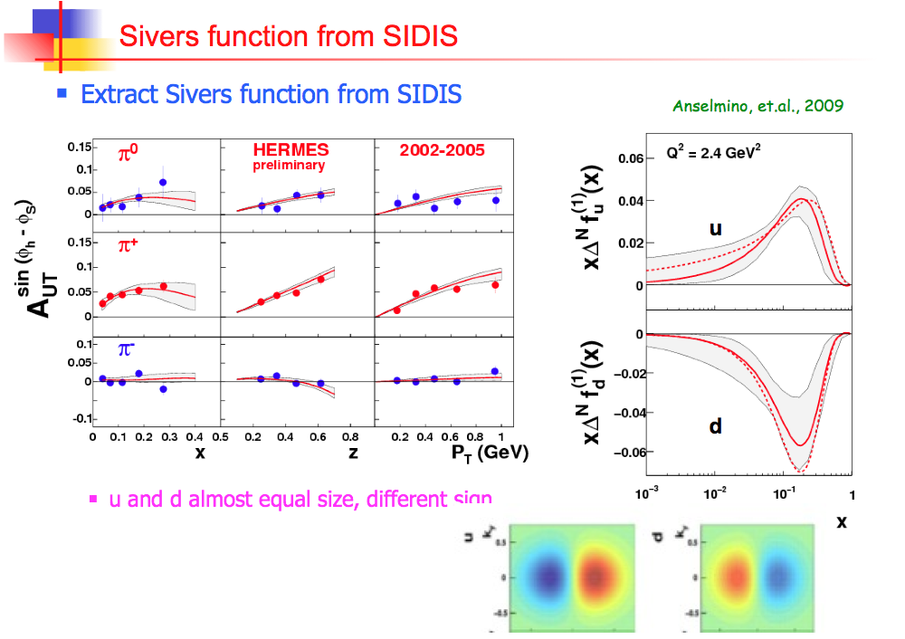

Slide 34
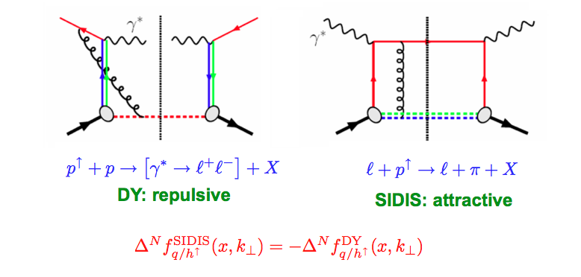
Color Flow in DY and DIS
The sign change – a new fundamental test of color gauge formalism
Collins ‘02
Twist-3: sign change from gluonic-pole in hard parts
In the overlapped region – consistent description
Ji, Qiu, Vogelsang, Yuan ‘06
Bacchetta, Boer, Diehl, Mulders ‘08

Slide 35
Importance of Drell-Yan TSSA
Test the fundamental prediction of sign change in DY TSSA compared to DIS based on our understanding of the origin of TSSA
  Test of gauge formulism
  Test of QCD factorization
Help to resolve the proton spin puzzle?
    One expect the observation of Sivers Asymmetry signals the existence of partonic orbital angular momentum
only ~30% of spin
Beginning to be measured at RHIC
A future challenge

Slide 36
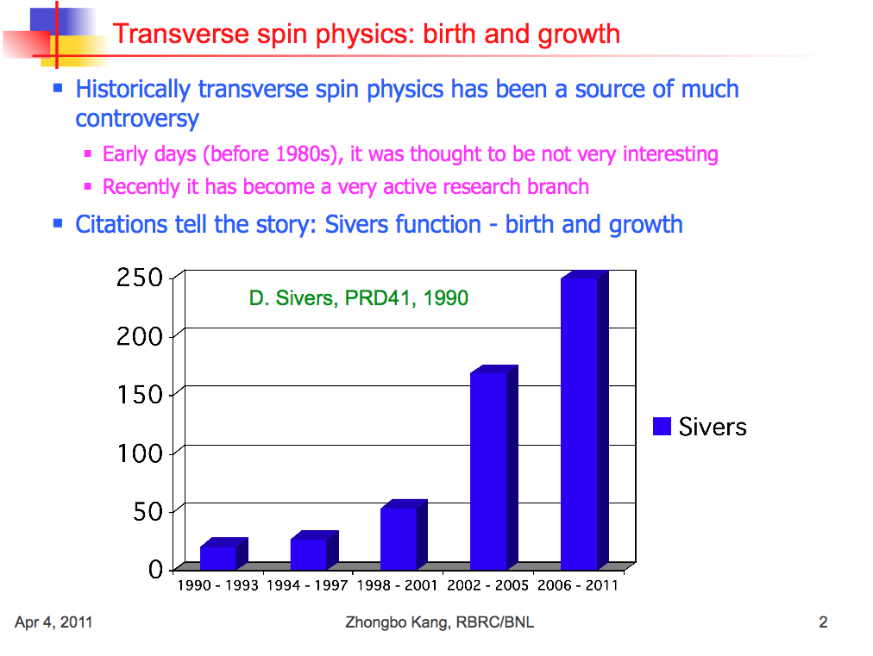

Slide 37
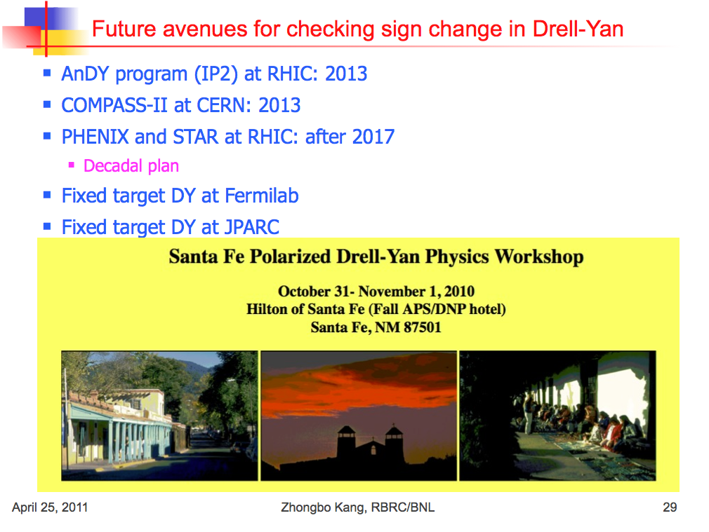

Slide 38
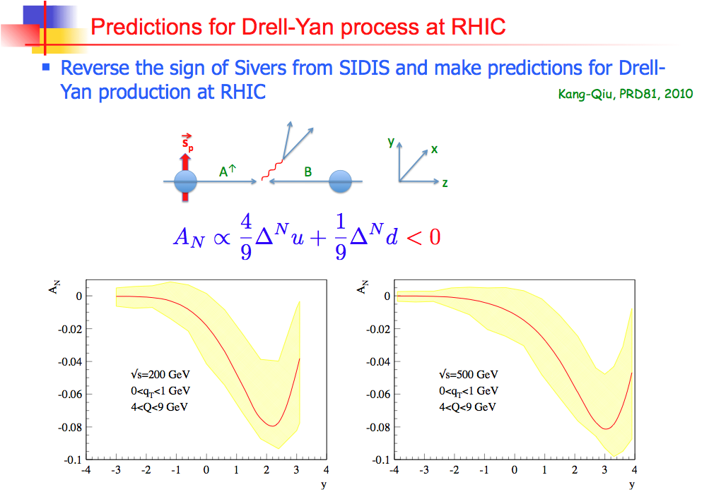

Slide 39
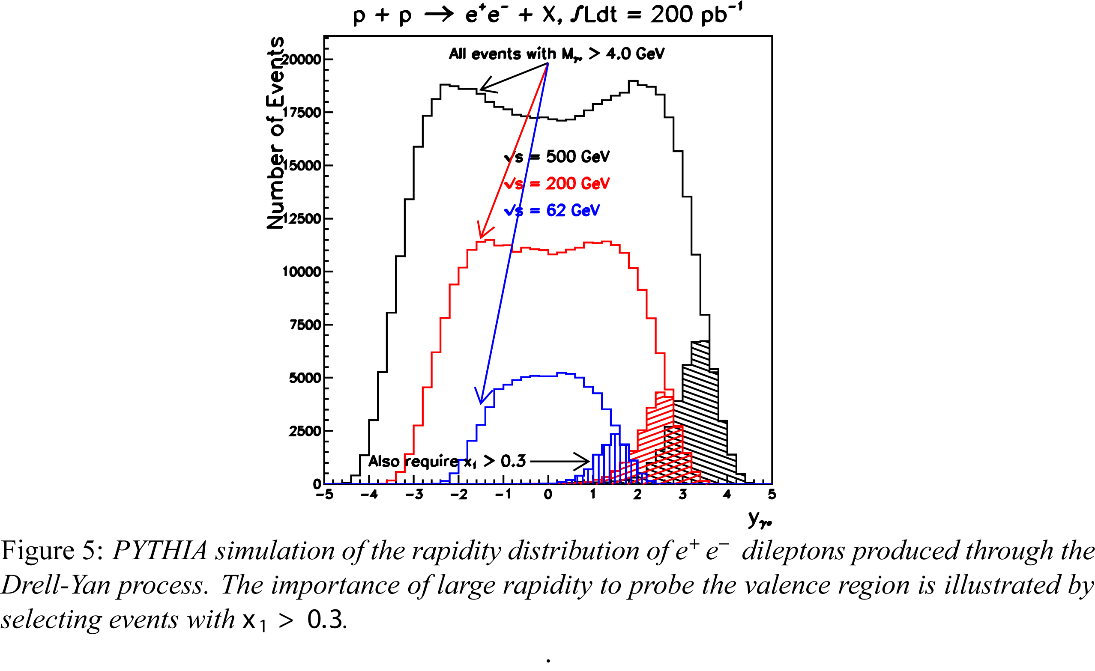

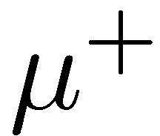

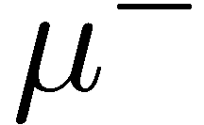
Test the Sign Change
Drell-Yan Production @RHIC

Slide 40

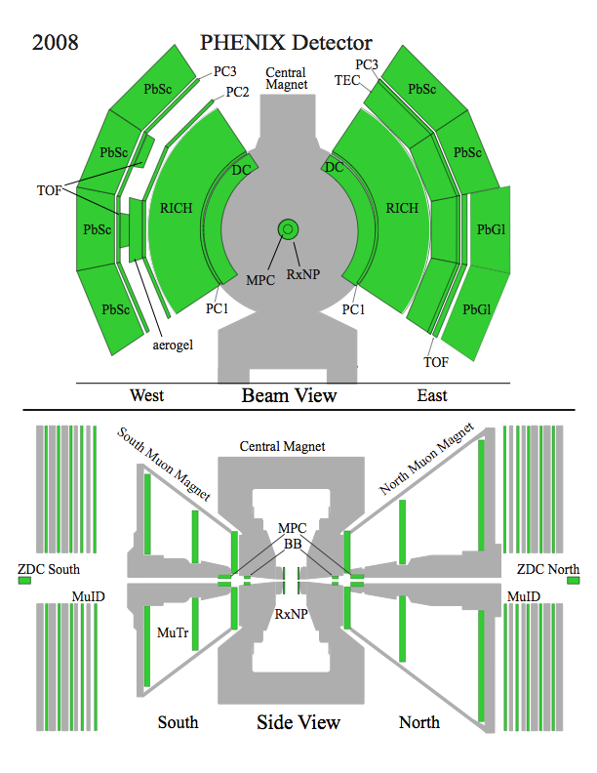
The PHENIX detector
Philosophy:
  High rate capability to measure rare probes,
  limited acceptance.
2 central spectrometers
  Track charged particles and detect electromagnetic processes
2 forward muon spectrometers
  Identify and track muons
2 forward calorimeters (as of 2007!)
  Measure forward pions
Relative Luminosity
  Beam-Beam Counter (BBC)
  Zero-Degree Calorimeter (ZDC)

Slide 41
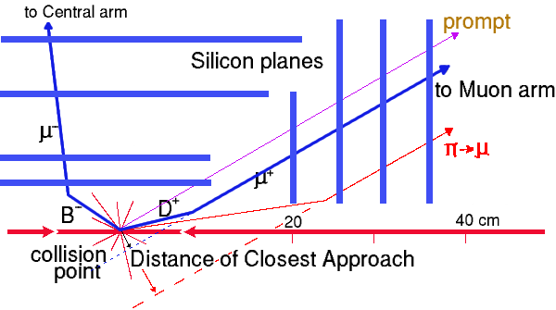
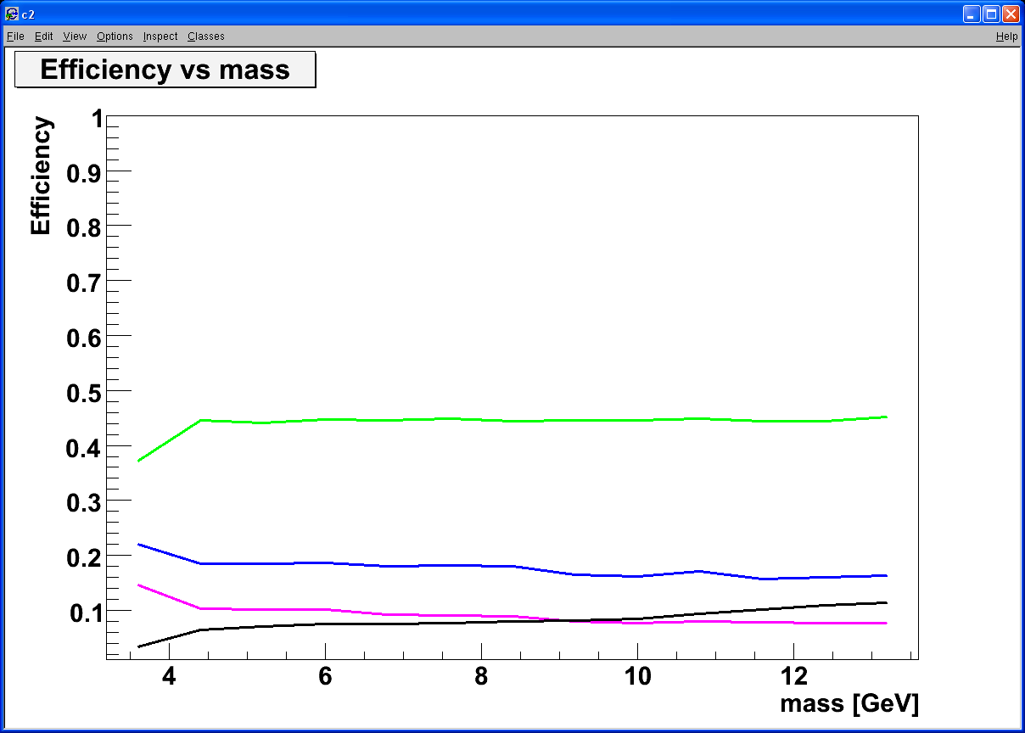
Silicon VTX, Heavy Quark and Drell-Yan
Tracking muons with MuTr+FVTX
  Prompt muons from DY
  Displaced tracks from π/K and heavy quark decays
Drell Yan
DCA < 1 σ cut:
Increase DY/bb ~ 5
ϒ-states
J/Ψ
Drell Yan
charm
beauty
charm
beauty
DY: 4 GeV < M < 8 GeV; B-background: use FVTX
combinatorial background

Slide 42
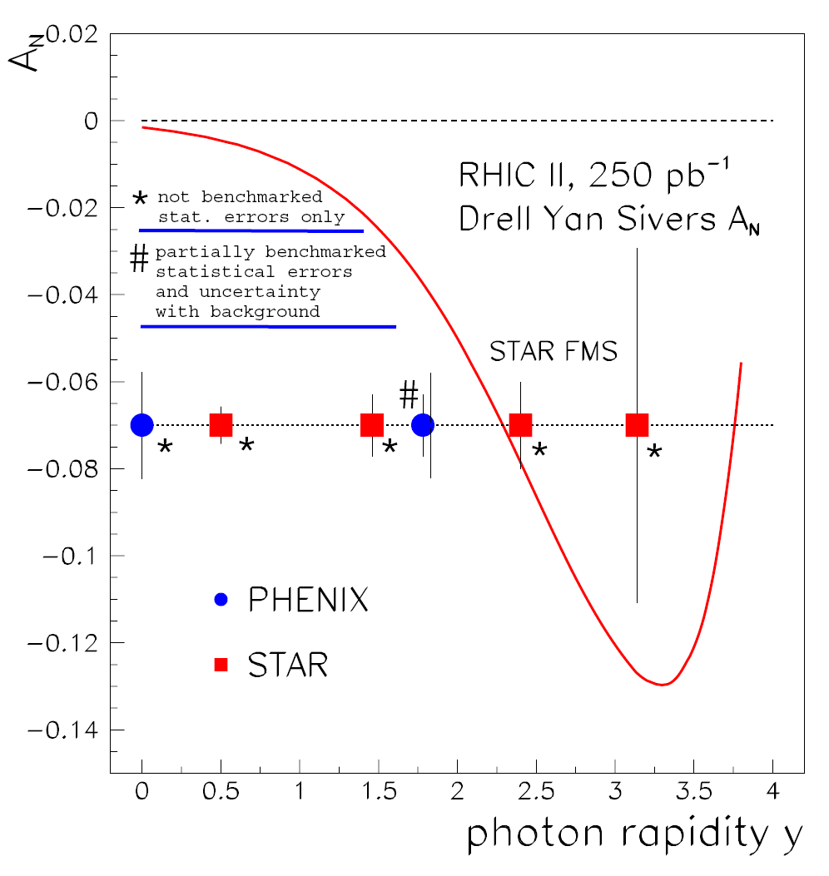
Sivers Asymmetries in SIDIS and DY
“Transverse-Spin Drell-Yan Physics at RHIC” (http://spin.riken.bnl.gov/rsc/write-up/dy_final.pdf)
Important test at RHIC of recent fundamental QCD predictions for the Sivers effect, demonstrating… attractive vs repulsive color charge forces
HERMES
Sivers Amplitude
0.1 0.2 0.3 x
42

Slide 43
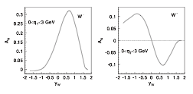
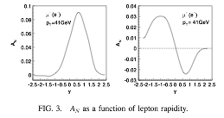
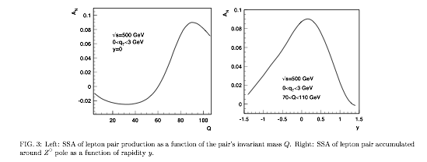
W^{+/-} & Z⁰ Transverse SSA @500GeV ?
l⁺
Kang & Qiu PRL 103, 172001 (2009)
Latest theoretical progress
  Test time-reversal universality of Sivers functions with W/Z
  Expect large asymmetry (from DIS fit)
Flavor-identified Sivers Funs
  Very large Q²
Expected Statistics @1fb⁻¹ 500GeV
  W^{+/-} →μ^{+/-} ~20K
  Z⁰ -> μ⁺μ⁻ ~ 1K
W^{+/-}
Z⁰
Kang & Qiu arX 0912.1319
43

Slide 44

COMPASS facility at CERN (SPS) II

Slide 45



DY@COMPASS projections I

Slide 46
Drell-Yan Spectrometer for E906
Station 3
(Hodoscope array, drift chamber track.)
Station 1
(hodoscope array,
MWPC track.)
4.9m
Iron Wall
(Hadron absorber)
Station 4
(hodoscope
array, prop
tube track.)
KTeV Magnet
(Mom. Meas.)
Solid Iron Magnet
(focusing magnet, hadron absorber and beam dump)
Station 2
(hodoscope array, drift chamber track.)
Targets
(liquid H₂, D₂,
and solid targets)

Slide 47

UVA/J-Lab/SLAC Polarized proton/deuteron target
D. Crabb MENU10
Polarized NH₃/ND₃ targets
Dynamical Nuclear Polarization
Operate at 5 T and 1 K. Pol ~ B/T
Used with high beam intensities – up to ~100 nA
Large capacity pumps
Polarizations:
  p > 90%,
  d ~ 50%
Able to handle high luminosity
  up to ~ 10³⁵ (Hall C)
~ 10³⁴ (Hall B)

Slide 48


Expected DY A_{N} Sensitivity @120 GeV.
Target
  6 cm NH₃
  10¹⁹ proton
Also open charm and J/psi

Slide 49

Polarized DY w/ Fixed Target @RHIC ?
BRAHMS
Polarized fixed target DY exp. with extracted polarized proton beams:
PHENIX
Fixed Target DY Exp.
@Beam Dump
High density LH₂/LD₂ target
High density polarized targets
3 Map out x-dep.
STAR
- 250 GeV proton beams
- Pol up to 70%
49

Slide 50
Fixed Target @RHIC ?
Beam dump experiment: dimuon channel
  Parasitic mode
    Significant beams still left at the end of a store (~50%)
    Cycle time ~8hr
  Dedicated fixed target
    Cycle time ~ 1hr
  Dimu x-section @ 250 GeV (M>4) ~20pb
Targets
  E906-like unpolarized LH₂ target
    51cm LH2 (2.1x10²⁴/cm²)
    Can handle L ~ 1x10³⁶cm⁻²s⁻¹
  Polarized solid target
    UVA/J-Lab/SLAC: L ~10³⁵cm⁻²s⁻¹
Advantages
  Polarized beams
  (polarized) targets
  Higher Energy and large x-coverage
  High luminosity

Slide 51

DY A_{N} Sensitivity @250 GeV Fixed Target
4.5<M<8 GeV
q_{T} < 1 GeV
10 fb⁻¹
50 fb⁻¹
x_{F}

Slide 52

Proposed Future Polarized DY Exp’s
Y. Goto 4/2010 CERN DY
Polarized DY Dimuon Exp. at Fermilab Main Injector: 120GeV
RHIC fixed target possibility: 250 GeV

Slide 53
Summary and Outlook
Drell-Yan is a powerful tool complimentary to DIS for exploring nucleus structure
Very interesting results obtained from DY in the past
Active worldwide programs, current and future Exps will address many critical issues in hadron spin and flavor physics

Slide 54
backup

Slide 55

World Map of QCD Facilities

Slide 56


Slide 57

PHENIX Decadal Plan
Midterm upgrades until 2015
Long term evolution after 2015
Dynamical origins of spin-dependent interactions
New probes of longitudinal spin effects
Measurement with polarized He³ and increased energies
www.phenix.bnl.gov/plans.html

Slide 58



Polarized Drell Yan
Solid factorization
No fragmentation
  Direct correlation of intrinsic transverse quark momentum to the proton spin
Fundamental QCD test
  Sign of asymmetry compared to SIDIS
current Muon arm acceptance
Z. Kang and J. Qiu. Phys. Rev., D81:054020, (2010)

Slide 59

Proposed PHENIX Upgrades

Slide 60


The STAR Detectors
PHOBOS
BRAHMS &PP2PP
PHENIX
RHIC
1.2 km
STAR
Time Projection Chamber |η|<1.6
Forward TPC 2.5<|η|<4.0
Silicon Vertex Tracker |η|<1
Barrel EMC |η|<1
Endcap EMC 1.0< η <2.0
Forward Pion Detector 3.3<|η|<4.1

Slide 61

STAR

Slide 63



Sivers Functions and DY TSSA
Anselmino et al PRD 79 -54010(2009)
Expected A_{N} of DY based on global fit to DIS fit of HERMES and COMPASS

Slide 64



QCD Correction
K factor collection

