Slide 1
Drell-Yan Physics
An Experimental Overview
Ming X. Liu
Los Alamos National Laboratory

Slide 2
Outline
Introduction – a brief review of history
Recent highlights and future prospects
  quark energy loss dE/dx in pA
  Nucleon and nucleus structure
New opportunity
  Polarized Drell-Yan
  Transverse spin physics

Slide 3
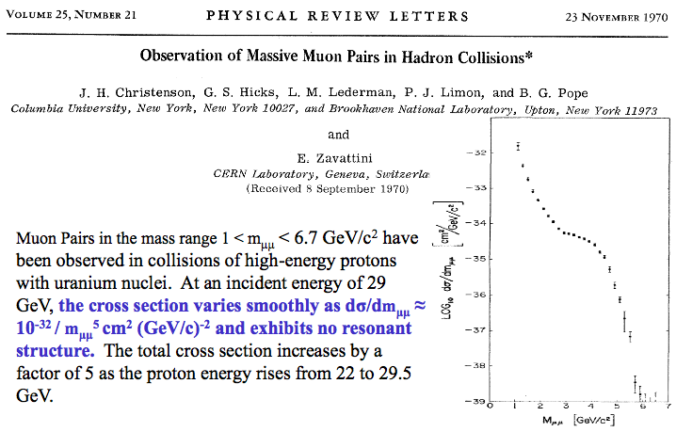
The First Dimuon Measurements
Missed the J/Psi!

Slide 4
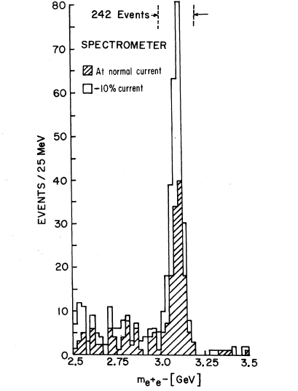
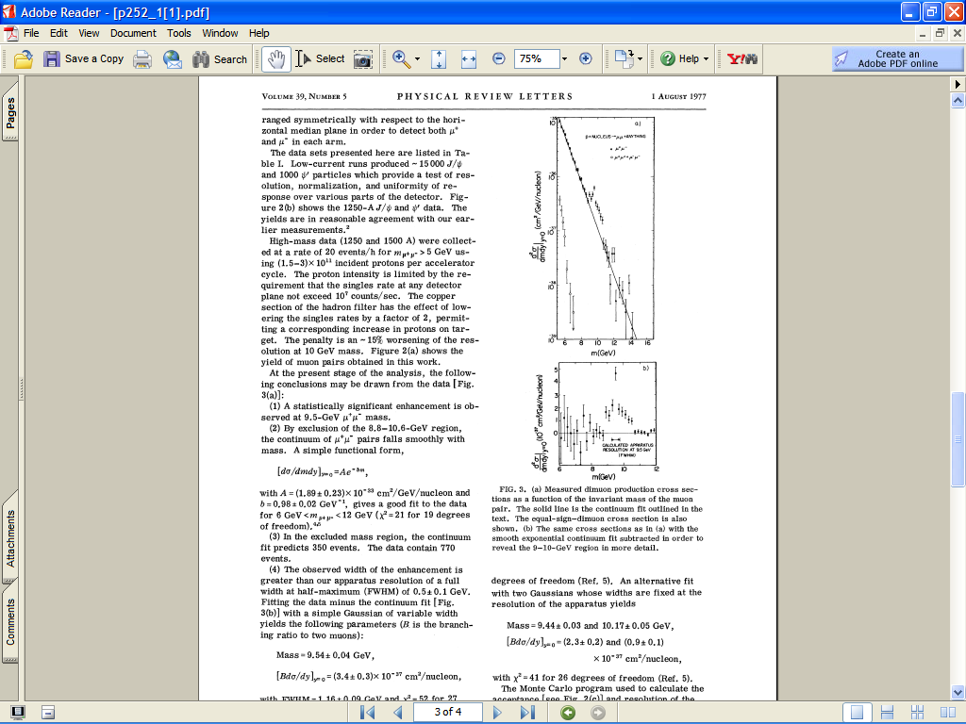
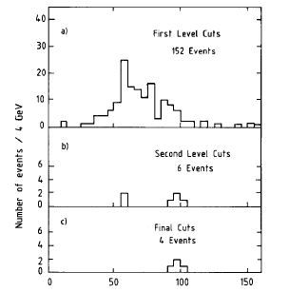
Di-lepton probe: a Powerful Tool for Discovery

Slide 5
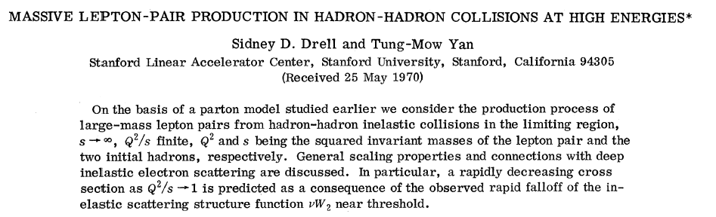
The Drell-Yan Process
E866@Fermilab
μ⁺
μ⁻

Slide 6
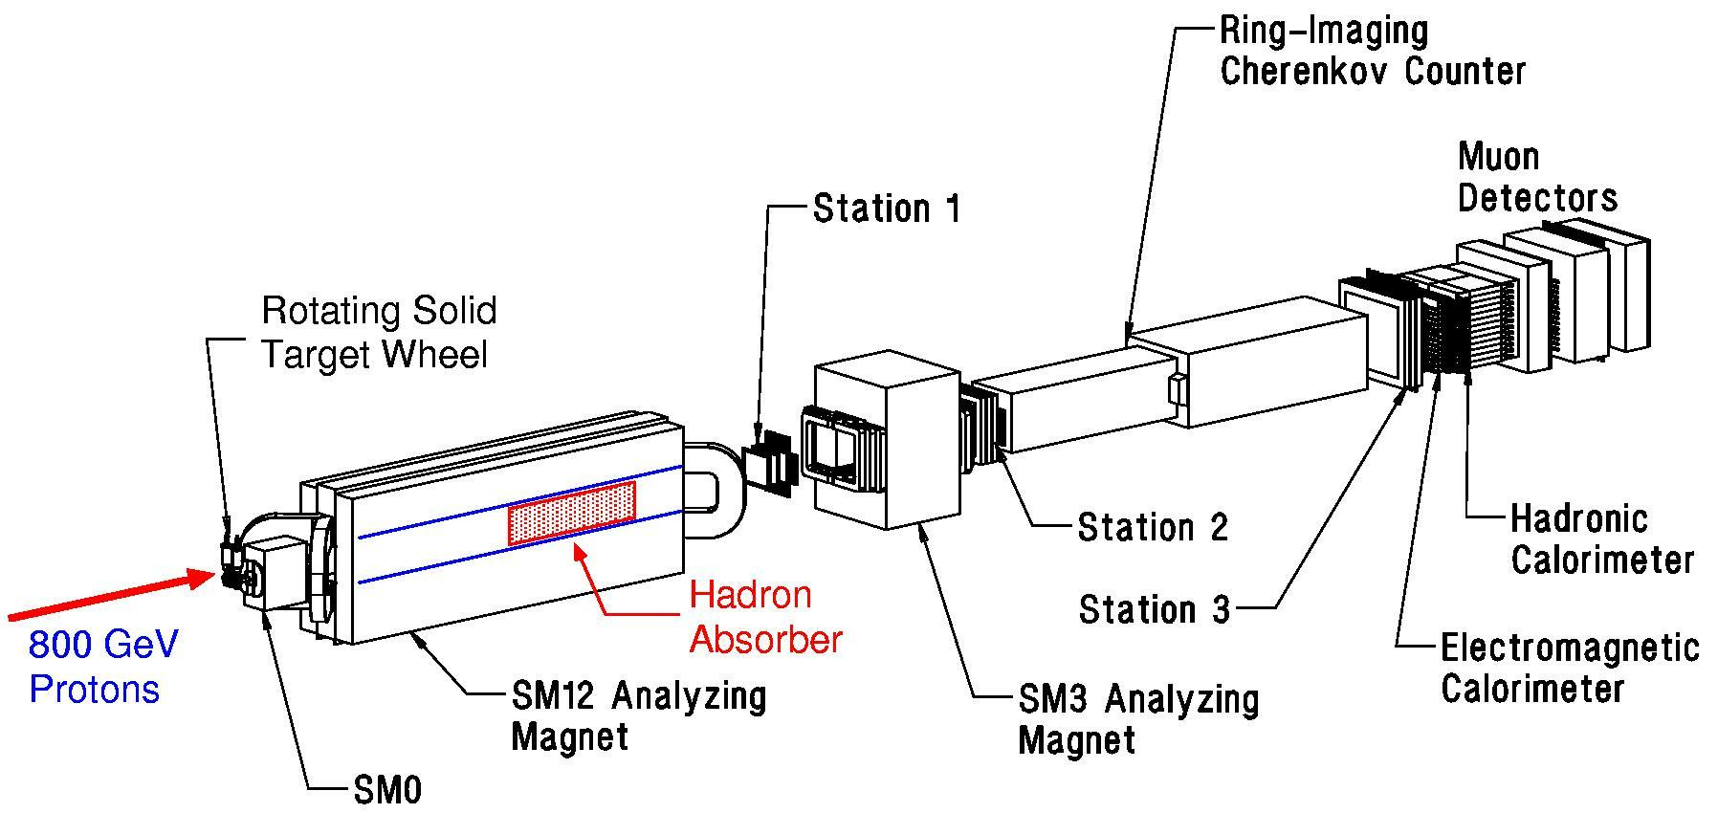
Fermilab Dimuon Spectrometer: Fixed Target Drell-Yan
(E605 / 772 / 789 / 866 / 906)

Slide 7

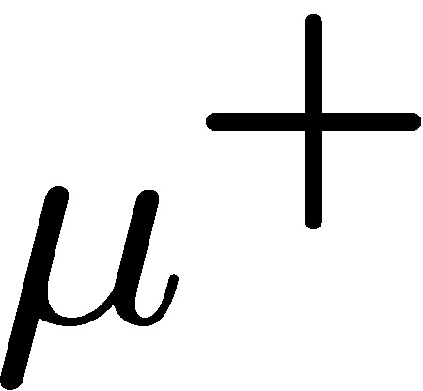


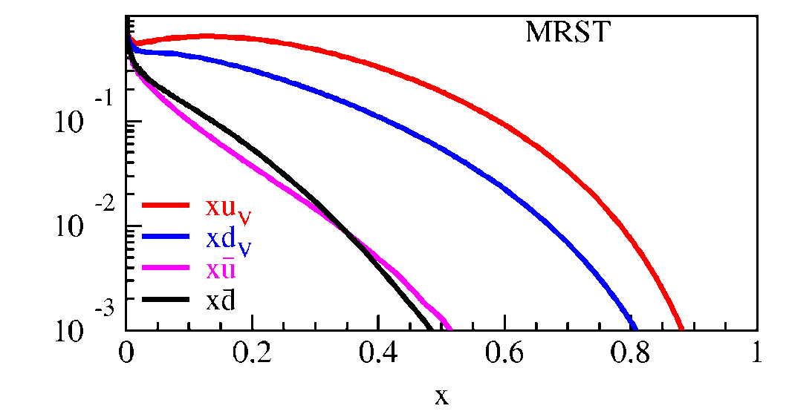
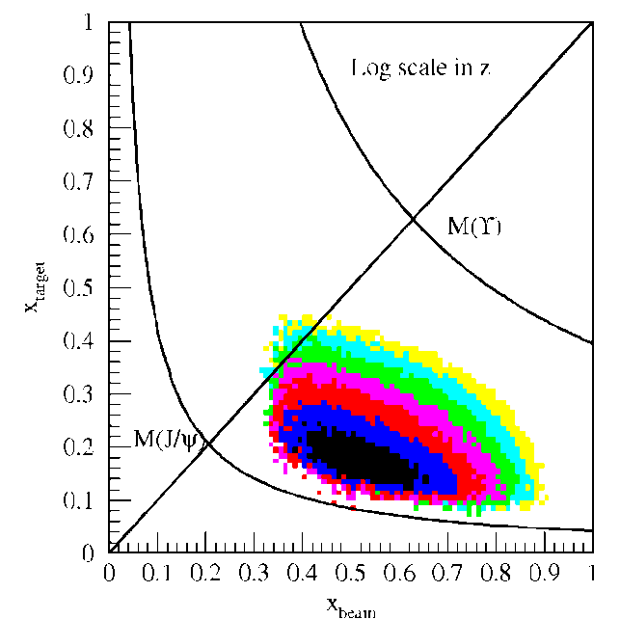
Kinematic of Fixed Target Drell-Yan
E906
Fixed target kinematics and detector acceptance give x_{b} > x_{t}
  x_{F} = 2p||^{γ}/s^{1/2} ≈ x_{b} – x_{t}
  Beam valence quarks probed at high x
  Target sea quarks probed at low/intermediate x
x_{target}
x_{beam}
E906 Spect.
Monte Carlo
Notes:
Determine mass and momentum of virtual photon
Determine momentum fraction x_b and x_t of partons in beam and target
Measure absolute differential cross section
Sensitivity of D-Y process to anti-quark distribution of target or beam clear from examining diff. cross section
At large x, parton distributions are dominated by valence distributions, at small x by sea distributions
So in limit of large xb and small xt, cross section is dominated by first term -> providing direct sensitivity to antiquark sea of target nuclei
So if we just have to design the right experiment: This is E906.

Slide 8
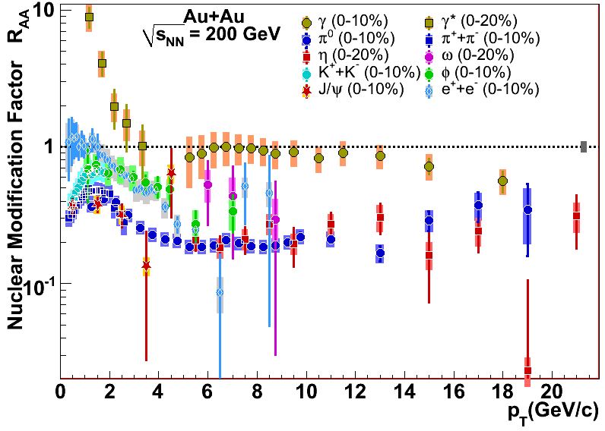
Topic (I): Energy Loss and Jet Quenching
Parton energy loss has been discovered at RHIC as an excellent probe of the hot/dense matter.
However, order of magnitude uncertainties in dE/dX, model dependent
Single Hadron Tomography
jet
g
g
T
T
g
Xin-Nian Wang, M. Gyulassy, PRL68(1992)1480
Notes:
As is well known, an interesting property of QCD is confinement, which means that in nature quarks and gluons are confined in hadrons, and we cannot see free quarks and gluons. If we accelerate two heavy nuclei to very high energy and make them collide with each other, we can deposit a huge amount of energy in the colliding center and the confined quarks and gluons may be deconfined to form a new kind of matter: Quark-gluon-plasma, or QGP.
jet quenching is widely regarded as one of the best one to probe the hot/dense matter. Jet quenching tells that when an energetic parton passing through hot and dense nuclear matter, it may suffer multiple scattering with other partons in hot medium and lose a lot of energy. One can get the information of the medium by the lost energy of jets. It is very similar to X-rays tomography used in hospital to detect the intern structure of human body. Jet quenching theory predicted strong suppressions in single hadron production and di-hadron correlation in the hot QGP medium. In single hadron production, because the jet will lose a large amount of energy when propagating in the QGP, when the jet is fragmentated into hadrons, the hadron yield will be significantly suppressed. In di-hadron prod., when a pair of jet produced. There are usually back-to-back. If they are produced near the surface of the QGP, the jet near the surface will travel very short distance in the QGP and lose few energy. Whereas another jet may travel a longer distance and lose a large amount of energy before fragmentation. Therefore If the leading hadron of this jet is chosen as triggered particle, in the opposite direction, the yield of the hadron from another jet will be highly suppressed.

Slide 9
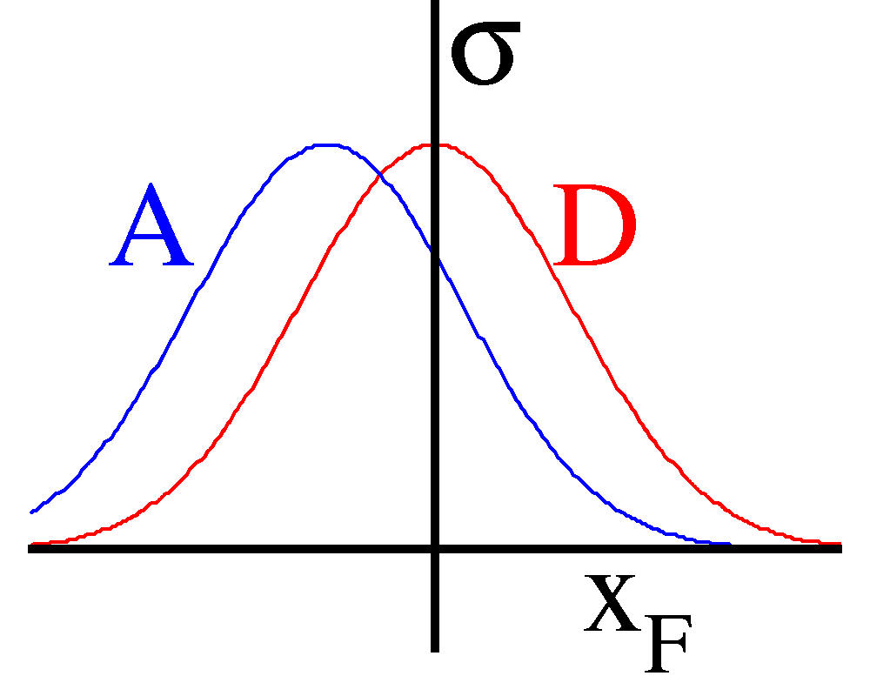
Benchmark with DY: Quark Energy Loss in p+A
High energy p+A collisions:
Relevant D.O.F.: quarks & gluons
Final-state
particles
q, g
Nuclear Target

Slide 10
Quark Energy Loss in Cold Nuclear Medium
Drell-Yan @E866
(PRL 86 (2001) 4483)
800GeV p + A
5<M<6 GeV
- size of effect ~20%
<dE/dx> depends on shadowing correction
x_{t} ~ 10⁻²
7<M<8 GeV

Slide 11

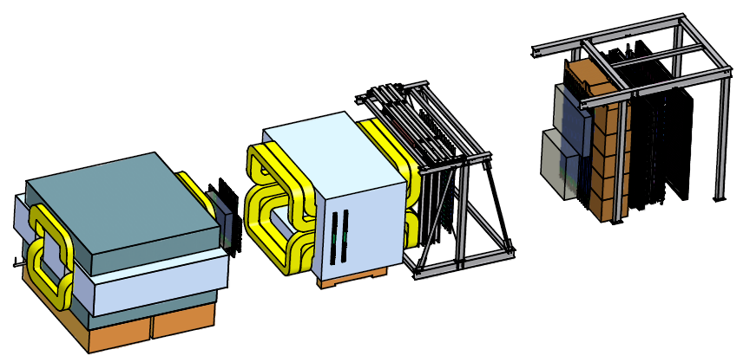
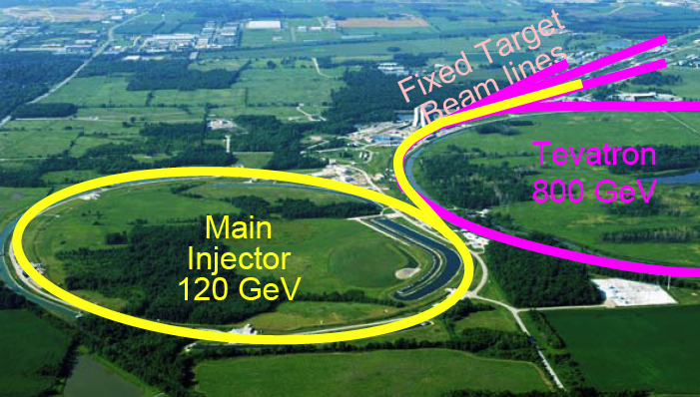
Much Improved dE/dx from
E906 Drell-Yan:2011-2013
X_{Target}
4.9m
X_{Beam}
Polarized DY possibility:
120 GeV proton
p+A: p, d, C, Al, Fe, W
X_{b} = 0.3~0.7
X_{t} = 0.1~0.3
  free from shadowing effect

Slide 12
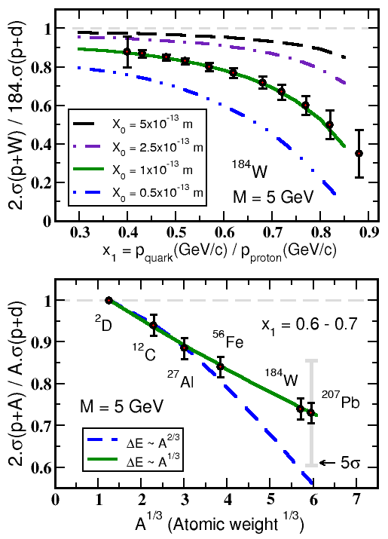


Experimental Sensitivity to Quark Energy Loss
Quark energy loss only I. Vitev et al
Shortest radiation length in nature X₀ = 1 x 10⁻¹³ m
Clearly distinguish between leading models for L dependence of E-loss
Benchmark dE/dx models

Slide 13
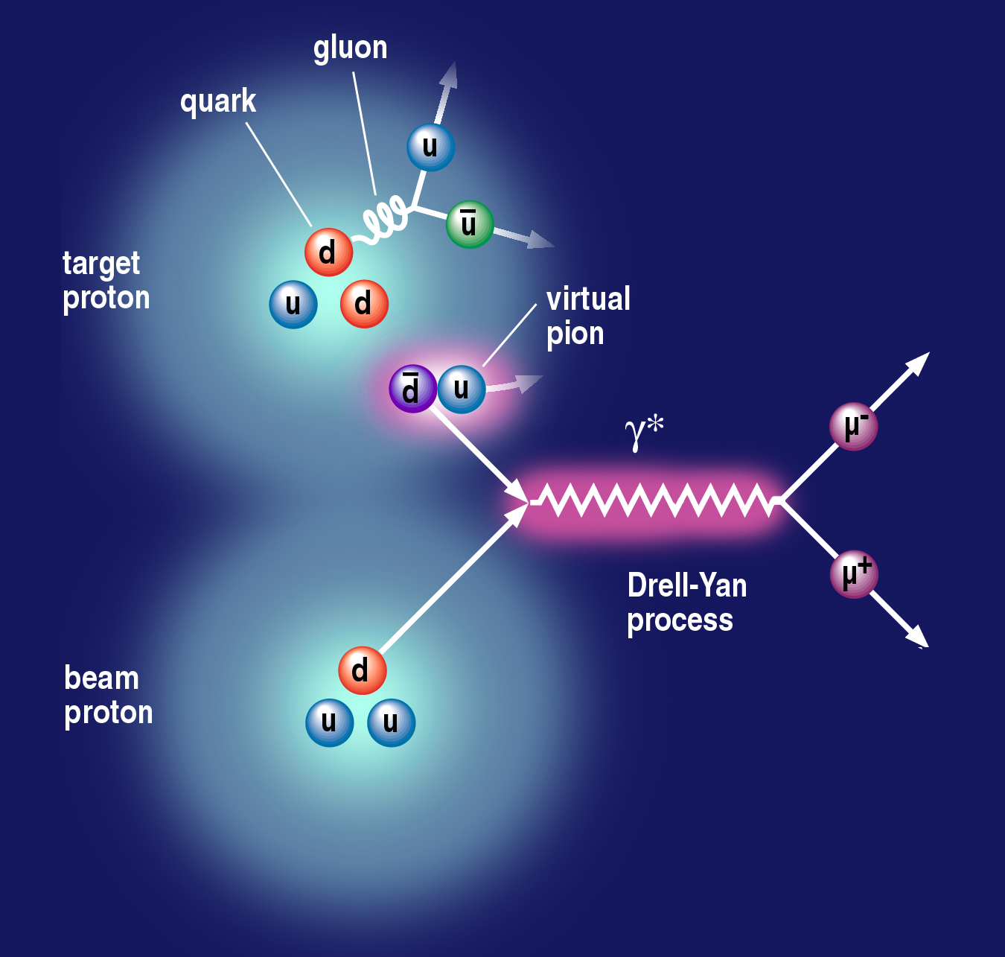
Topic (II): Origin of Sea Quarks
Notes:
Use the nice picture to show that if sea quarks are only from gluon splitting, one will expect dbar = ubar; but if include pion cloud fluctuation, the symmetry is broken. → and E866 showed that is the case. So proton is a very complex system.
So it is interesting to see what happens to polarized case.
It is also a model killer – some predict even larger asymmetry for polarized case.
So understanding the details of nucleon structure will help us better understand the confinement.
So we want to explore the flavor decomposed sea quark distributions.

Slide 14
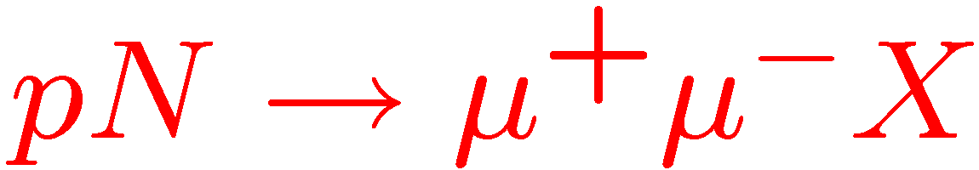
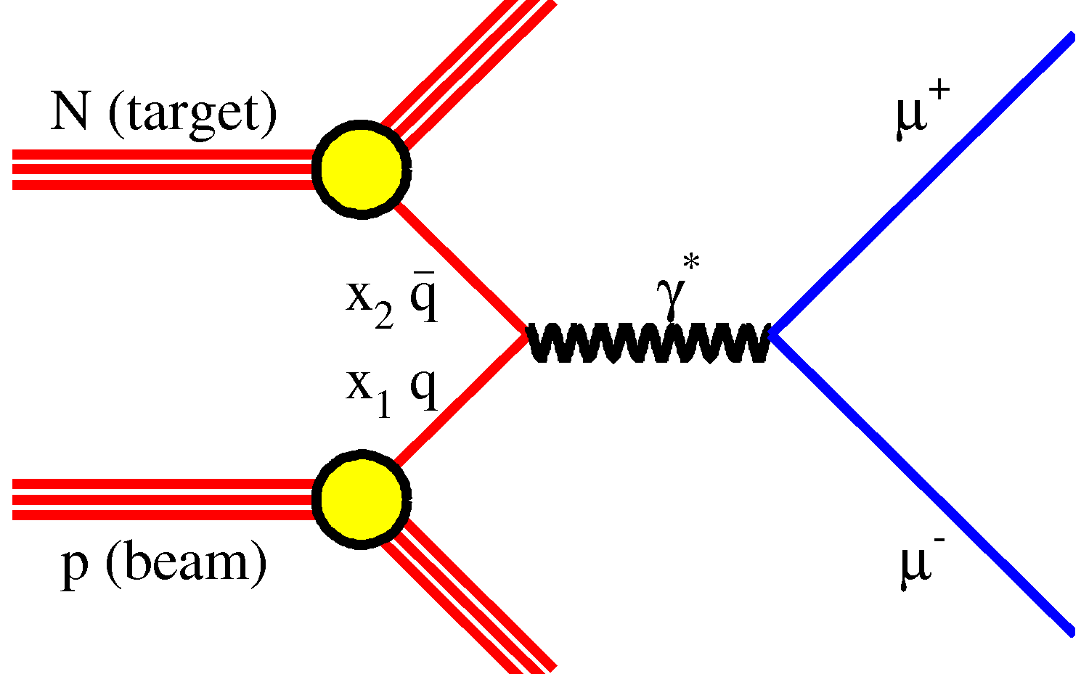
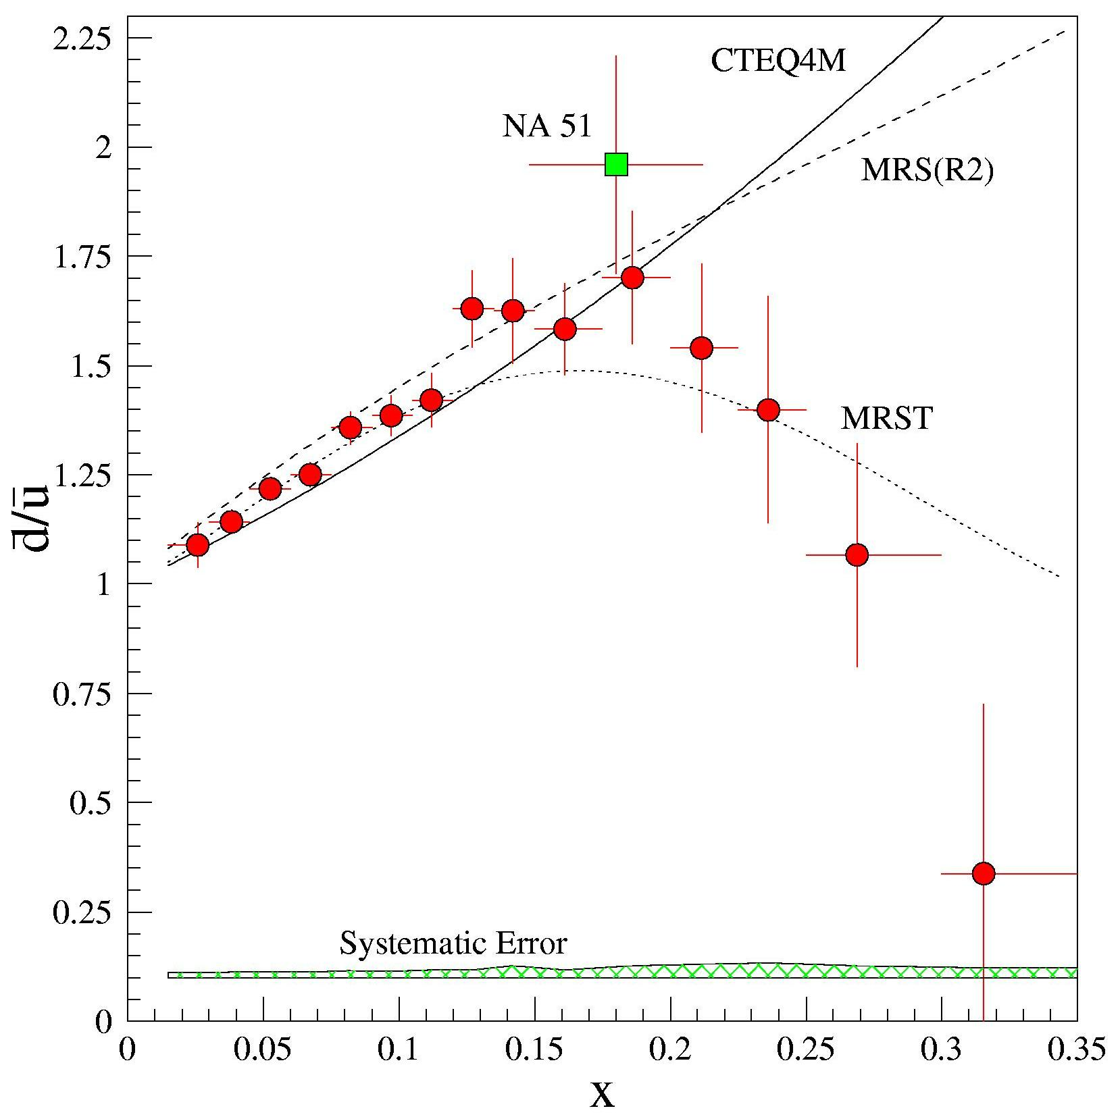
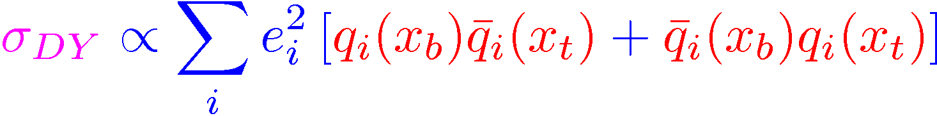
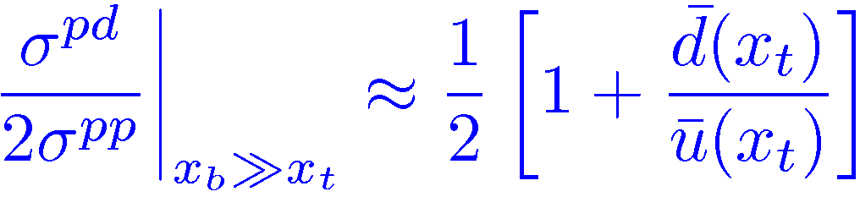
Evidence of Pion Cloud?
E866, Phys.Rev. D64 (2001) 052002
FermiLab/E866
Sea Asymmetry probed by Drell-Yan

Slide 15
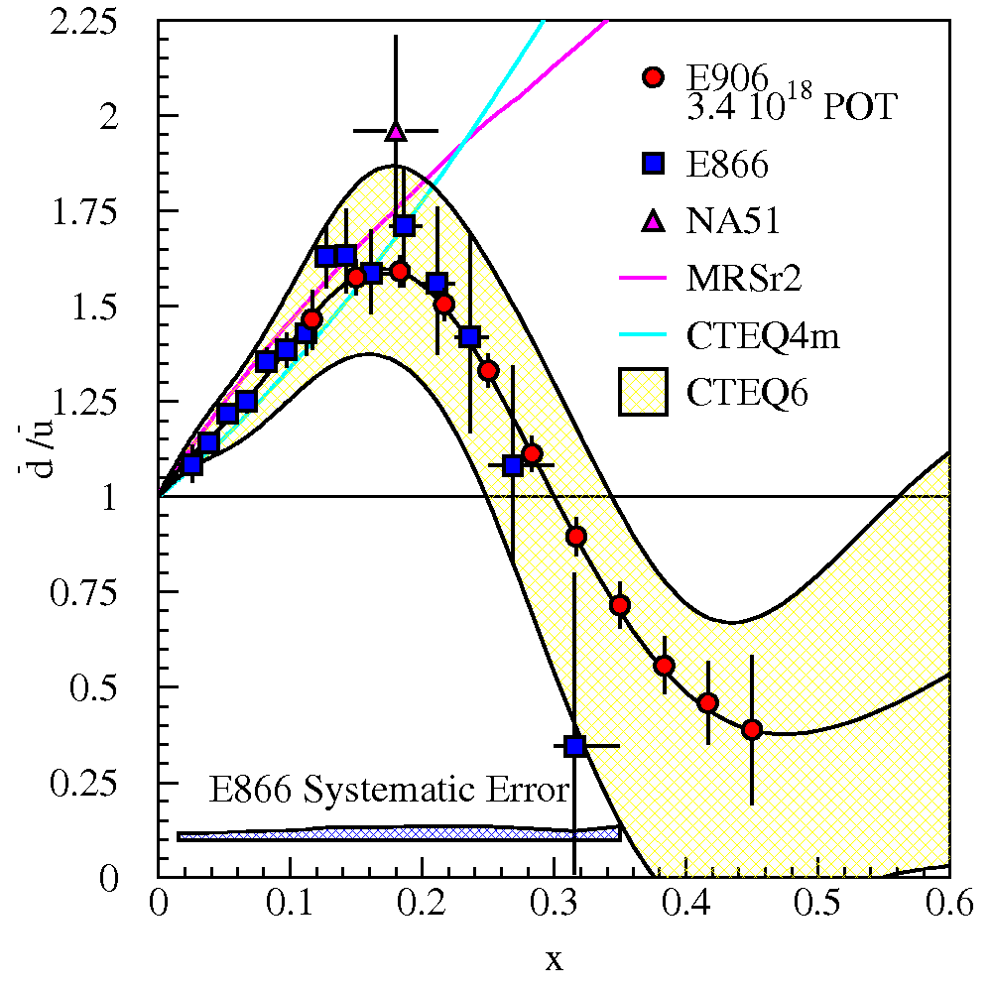
E906 Projections for d-bar/u-bar Ratio
SeaQuest will extend these measurements and reduce statistical uncertainty
SeaQuest expects systematic uncertainty to remain at ≈1% in cross section ratio
5 s slow extraction spill each minute
Intensity:
  2 x 10¹² protons/s
  1 x 10¹³ protons/spill

Slide 16
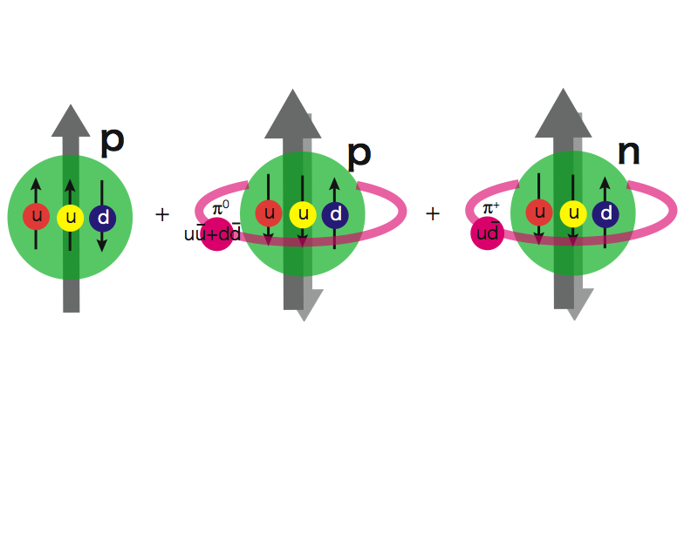
Pion Cloud Model and the
Orbital Angular Momentum?!
Extra dbar in proton
Sea Quarks Carry Major Orbital Angular Momentum Component?

Slide 17
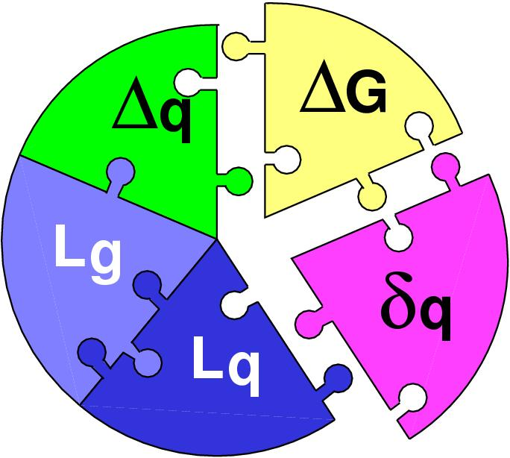
Pion Cloud and Orbital Angular Momentum
Spin puzzle, sea quark flavor asymmetry and L_{Z}
G. Garvey, PRC81:055212,2010.

Slide 18
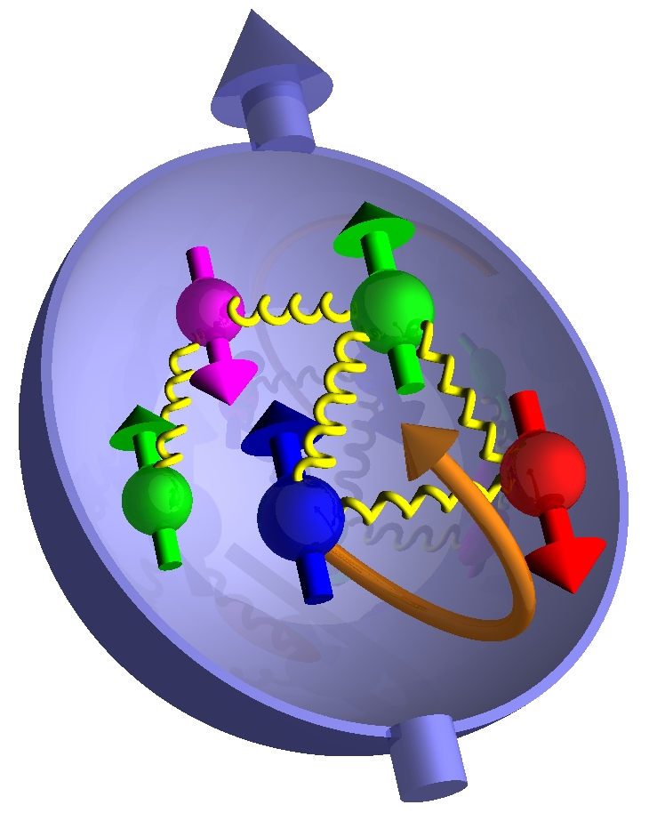
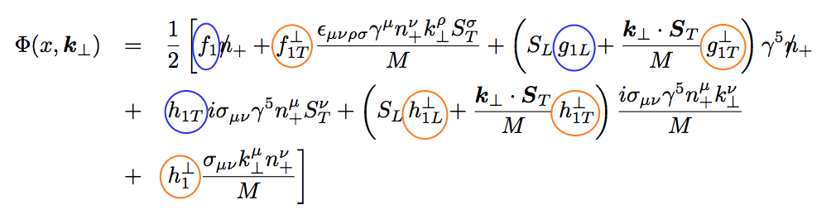
Topic (III): Including k_{T} … TMDs
No K┴ dependence
K┴ - dependent
T-even
K┴ - dependent
T-odd

Slide 19
Transversity and TMDs can be probed via DY

Slide 20
Drell-Yan Decay Angular Distributions
Θ and Φ are the decay polar and azimuthal angles of the μ⁺ in the dilepton rest-frame
Collins-Soper frame
A general expression for Drell-Yan decay angular distributions:

Slide 21
Unpolarized Beam DY and Boer-Mulders Function h₁┴
● Observation of large cos(2Φ) dependence in Drell-Yan with pion beam
194 GeV/c π + W
Boer, PRD 60 (1999) 014012

Slide 22
Azimuthal cos2Φ Distribution in p+p and p+d Drell-Yan
E866 Collab., Lingyan Zhu et al.,
PRL 99 (2007) 082301; PRL 102 (2009) 182001
Smallνis observed for p+d and p+p D-Y
With Boer-Mulders function h₁┴:
ν(π⁻W→µ⁺µ⁻X)~ [valence h₁┴(π)] * [valence h₁┴(p)]
ν(pd→µ+µ-X)~ [valence h₁┴(p)] * [sea h₁┴(p)]
More data expected
from E906 soon!
Sea-quark BM functions are much smaller than valence quarks
22

Slide 23
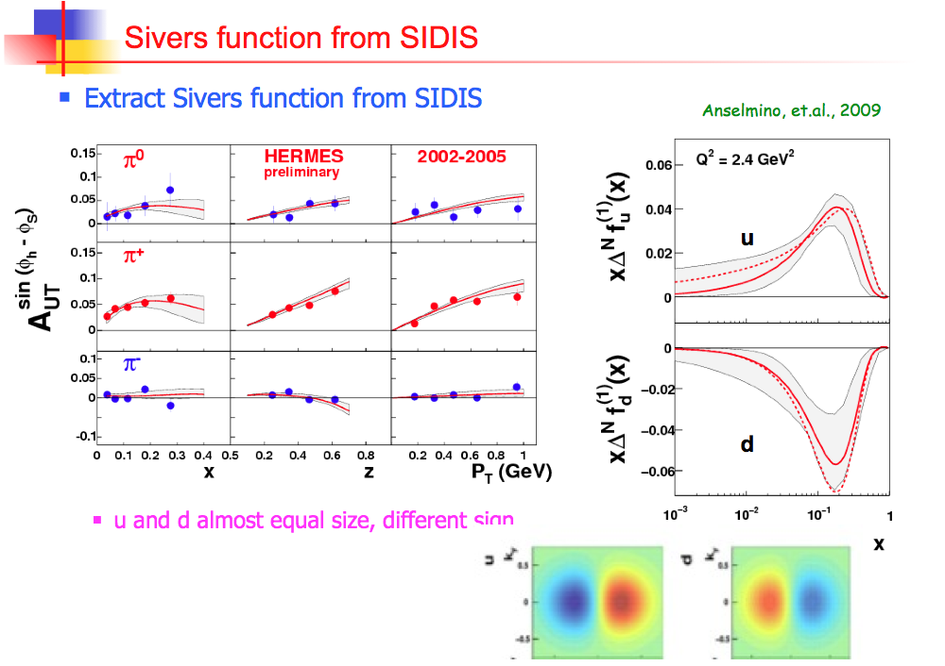

Slide 24
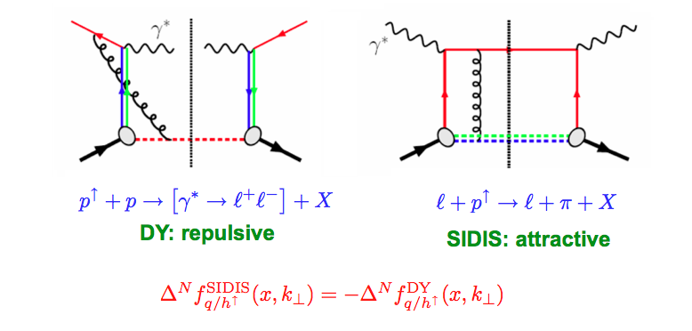
Sivers Functions in DY and DIS
The sign change – a new fundamental test of color gauge formalism
Collins ‘02
Twist-3: sign change from gluonic-pole in hard parts
In the overlapped region – consistent description
Ji, Qiu, Vogelsang, Yuan ‘06
Bacchetta, Boer, Diehl, Mulders ‘08

Slide 25
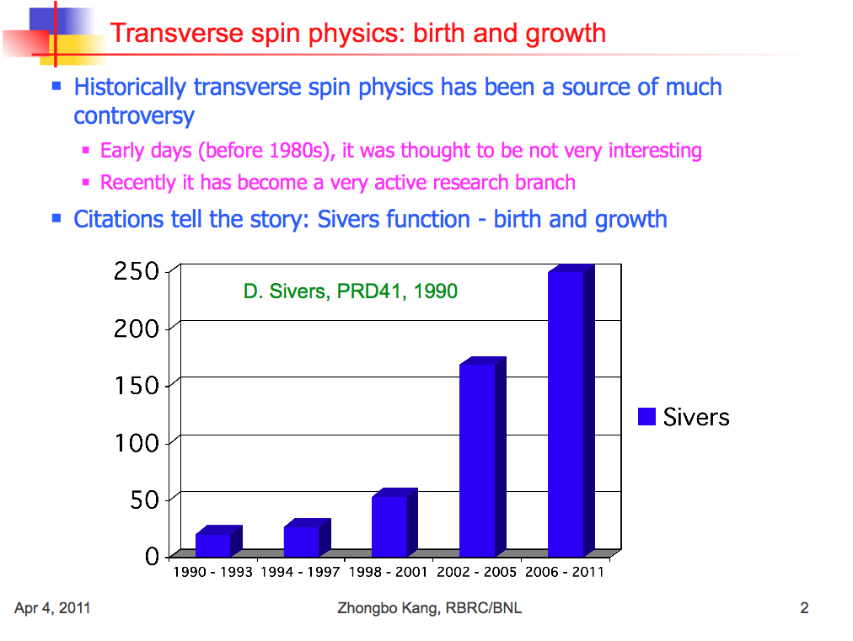
Probe Sivers Functions via Polarized DY

Slide 26
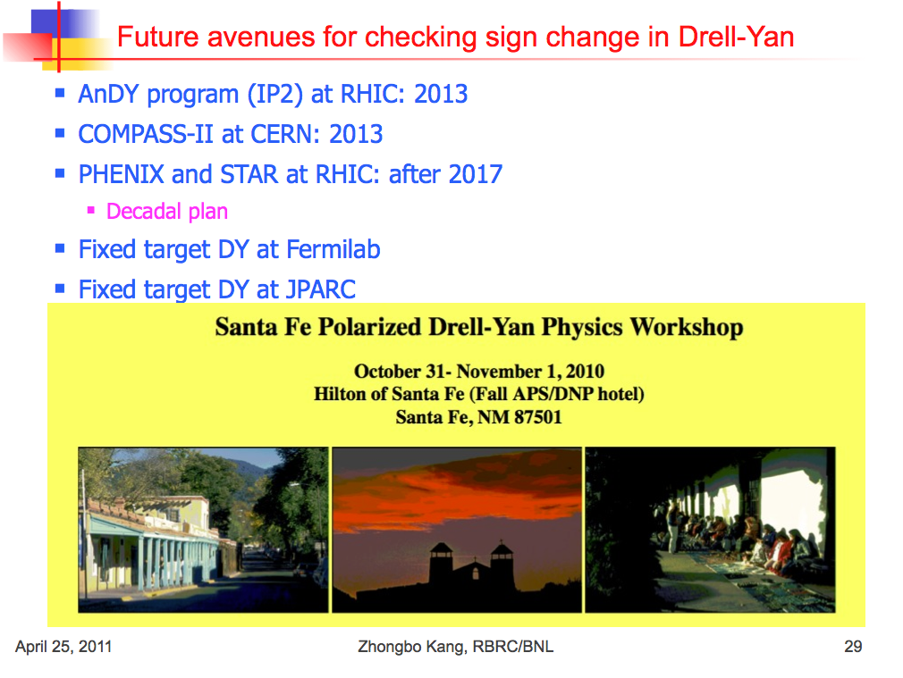

Slide 27
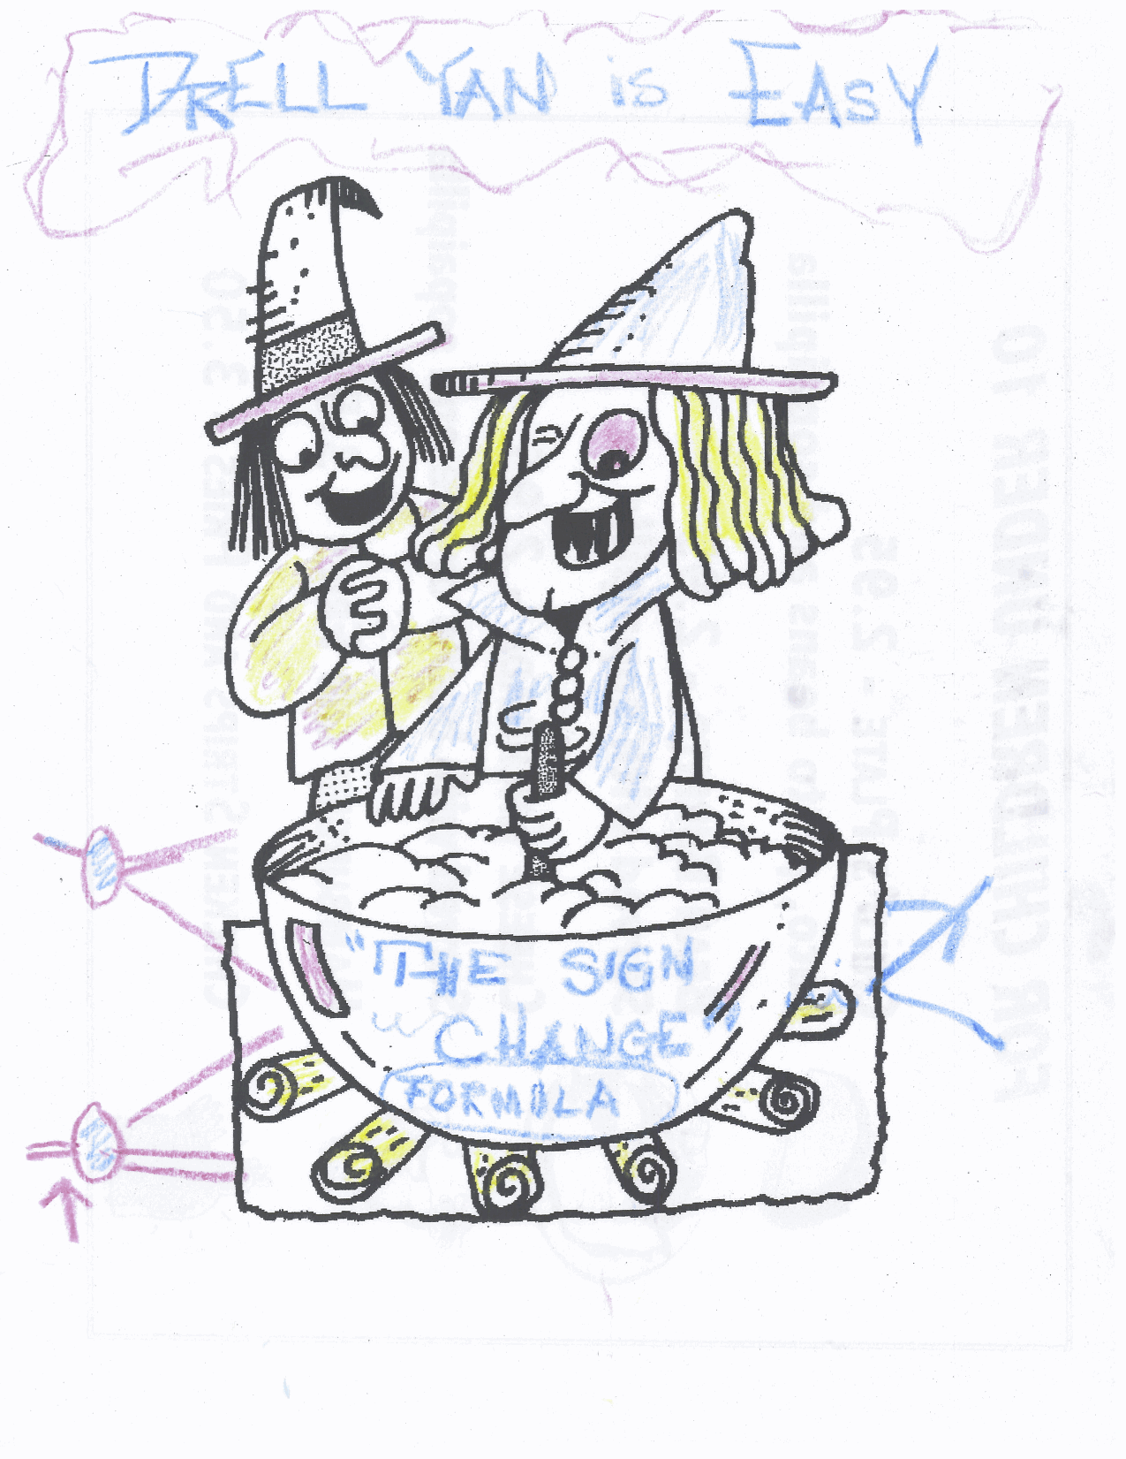

The magic of
sign change
Drawing from D. Sivers @Santa Fe Polarized Drell-Yan Workshop Dinner Table 10/31-11/1, 2010

Slide 28
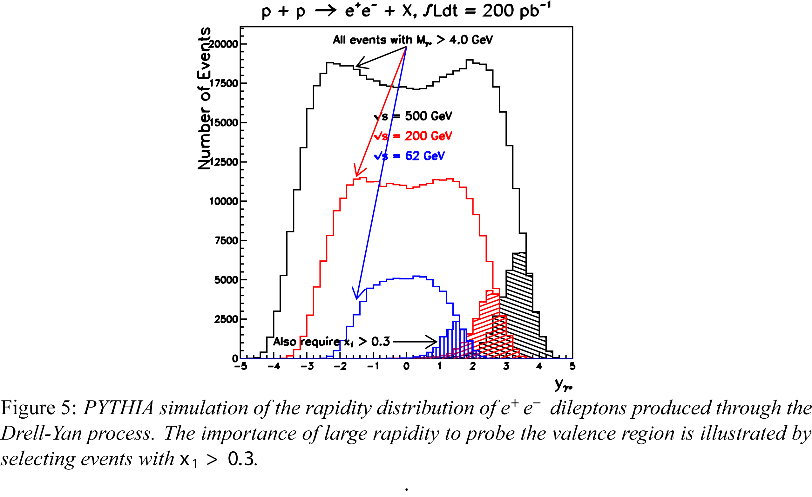

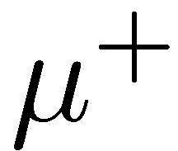

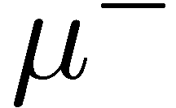
Test the Sign Change
Drell-Yan Production @RHIC

Slide 29
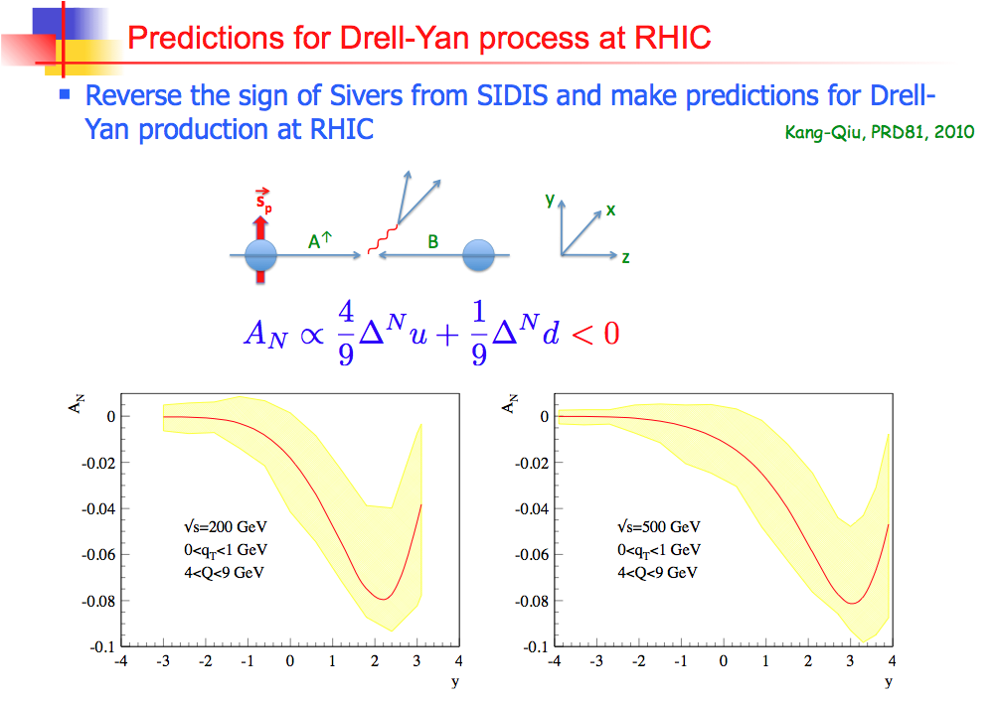

Slide 30

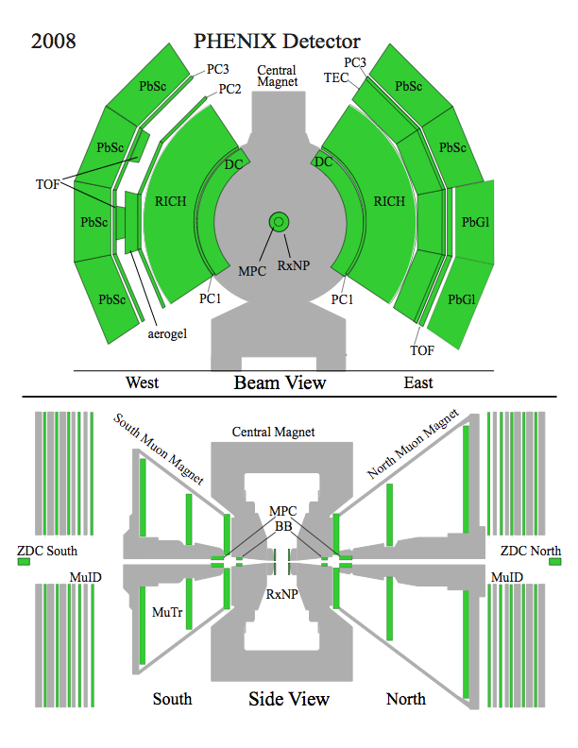
The PHENIX Detector
2 central spectrometers
  Track charged particles and detect electromagnetic processes
2 forward muon spectrometers
  Identify and track muons
2 forward calorimeters (as of 2007!)
  Measure forward pions
Relative Luminosity
  Beam-Beam Counter (BBC)
  Zero-Degree Calorimeter (ZDC)

Slide 31
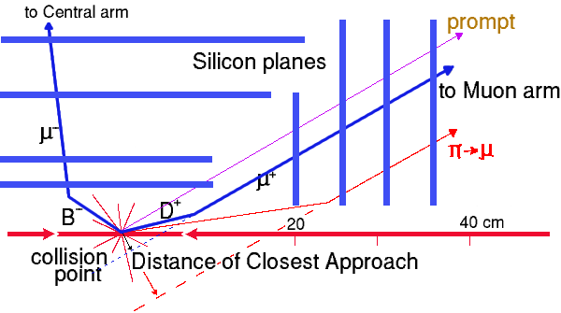
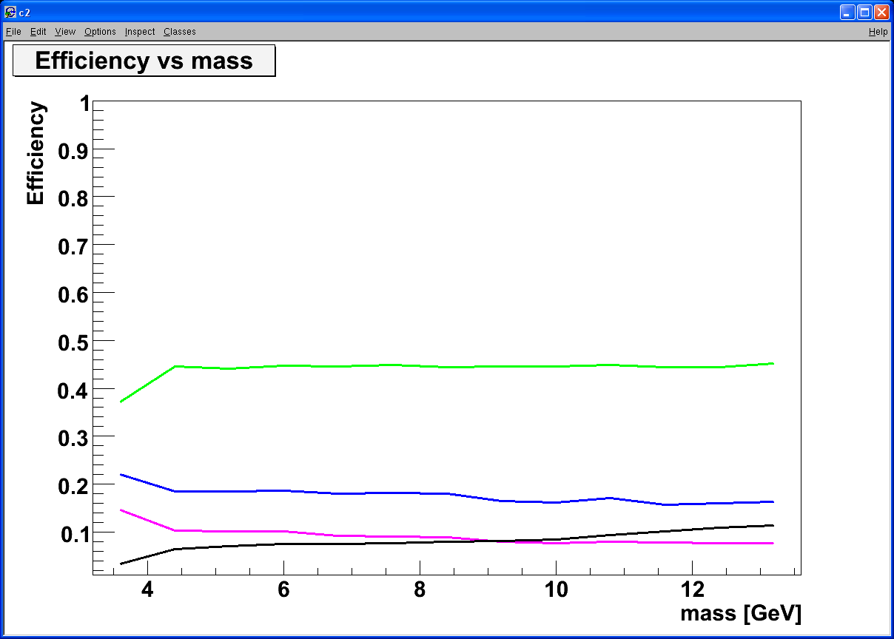
Silicon VTX, Heavy Quark and Drell-Yan
Tracking muons with MuTr+FVTX
  Prompt muons from DY
  Displaced tracks from π/K and heavy quark decays
Drell Yan
DCA < 1 σ cut:
Increase DY/bb ~ 5
ϒ-states
Drell Yan
J/Ψ
charm
beauty
charm
beauty
combinatorial background
DY: 4 GeV < M < 8 GeV; B-background: use FVTX

Slide 32
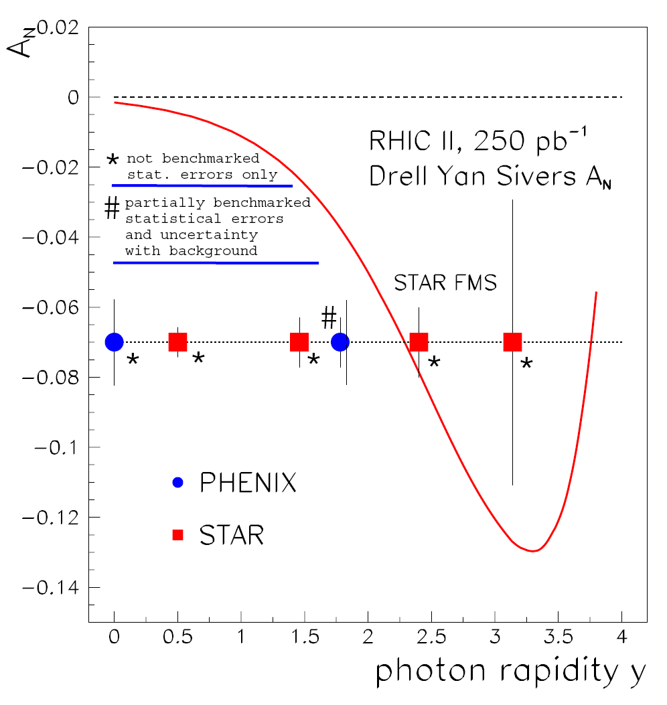
Sivers Asymmetries in SIDIS and DY
“Transverse-Spin Drell-Yan Physics at RHIC” (http://spin.riken.bnl.gov/rsc/write-up/dy_final.pdf)
Important test at RHIC of recent fundamental QCD predictions for the Sivers effect, demonstrating… attractive vs repulsive color charge forces
HERMES
Sivers Amplitude
0.1 0.2 0.3 x
32

Slide 33
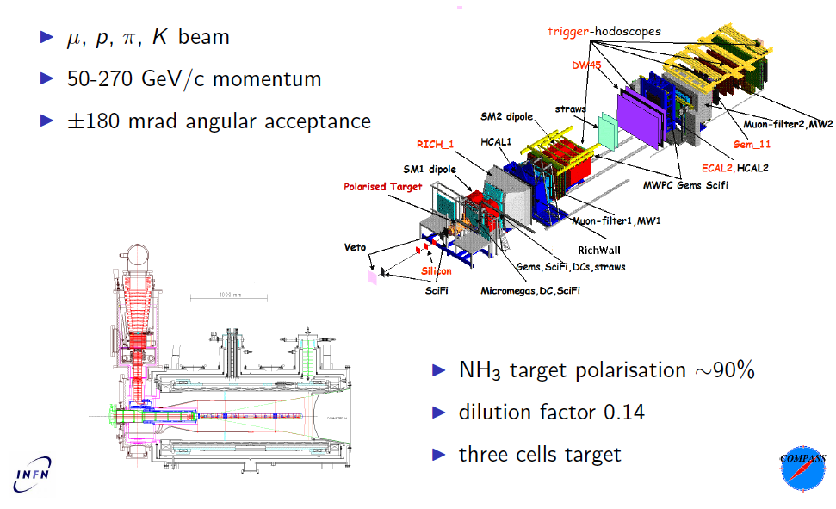
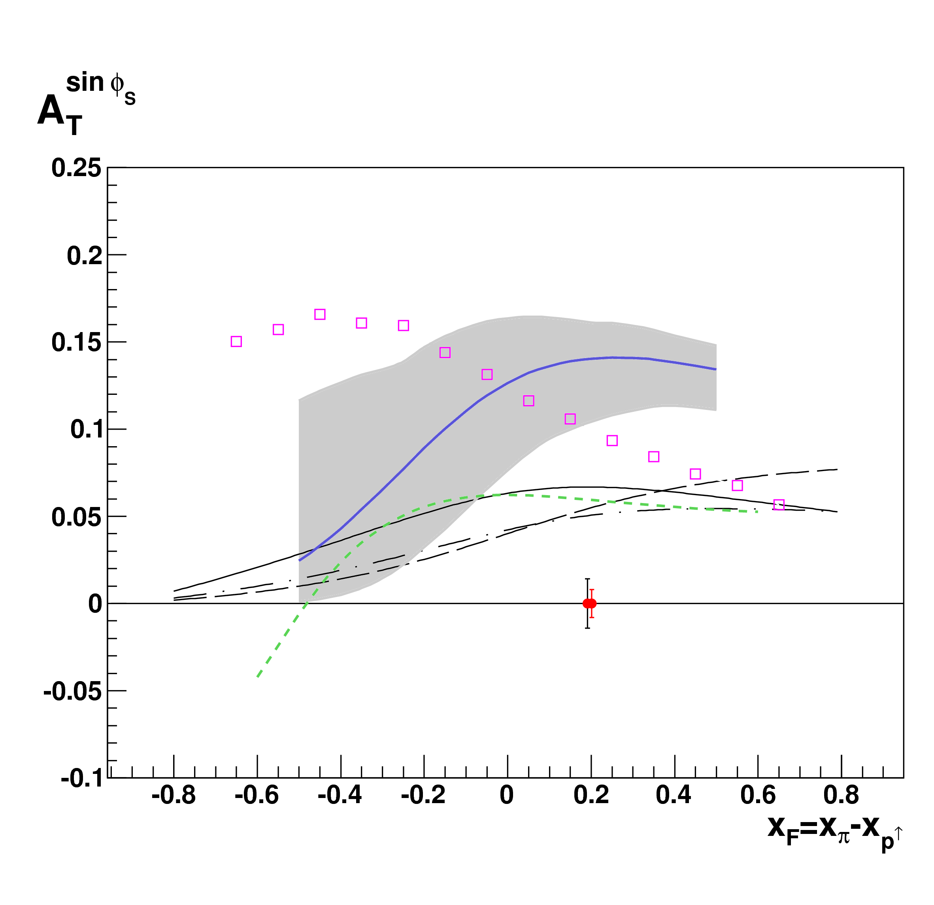
Test the Sign Change
COMPASS facility at CERN
A. Morreale’s talk
4/28/2011

Slide 34
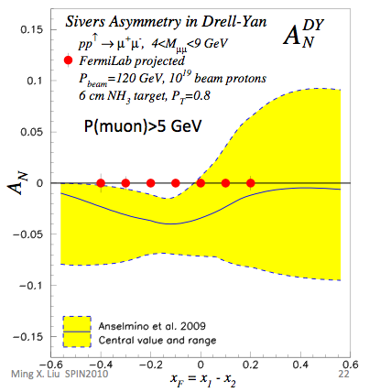
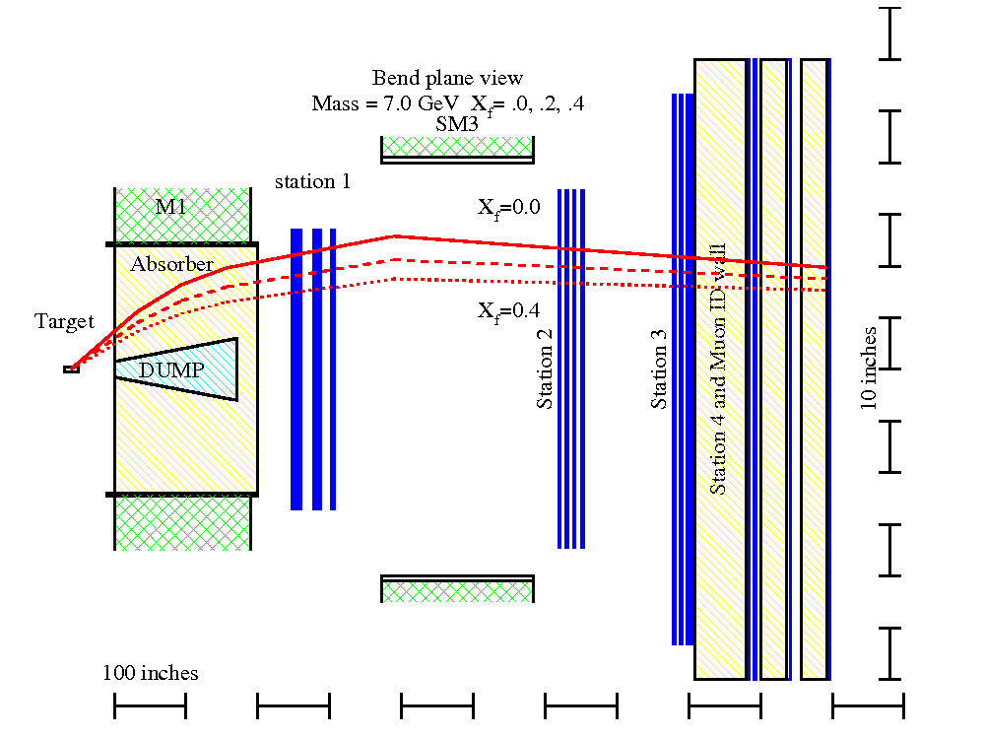
Polarized DY @ E906/Fermilab?
D. Sivers’ talk
4/27/2011
Polarized Target
  6 cm NH₃
  10¹⁹ proton
Also open charm and J/psi

Slide 35
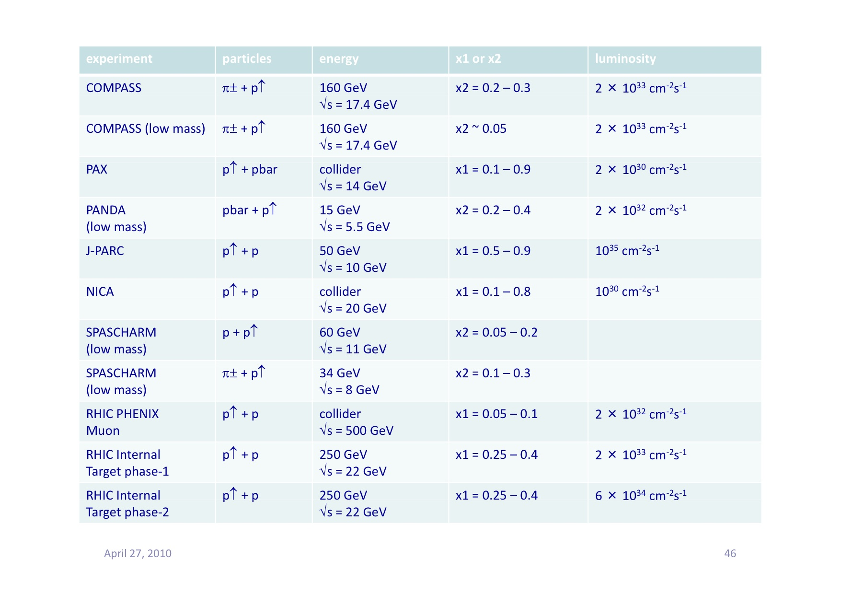
Proposed Future Polarized DY Exp’s
Y. Goto 4/2010 CERN DY
Polarized DY Dimuon Exp. at Fermilab Main Injector: 120GeV
RHIC fixed target possibility: 250 GeV

Slide 36
Summary and Outlook
Drell-Yan is a powerful tool complimentary to DIS for exploring nucleus structure and QCD dynamics
  EIC and DY
Very active worldwide effort, current and future polarized DY Exp’s will address many critical issues in hadron spin and flavor physics
  A new fundamental test of QCD

Slide 37
backup

Slide 38
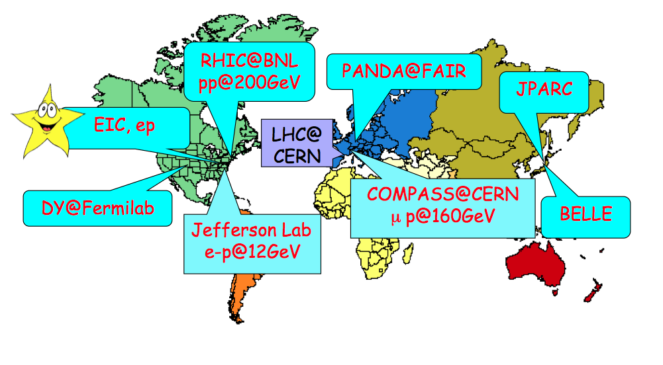
World Map of QCD Facilities

Slide 39
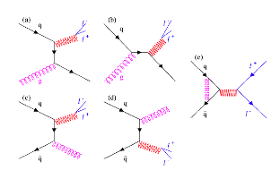

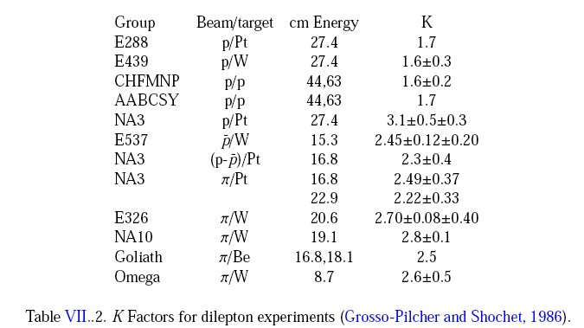
QCD Correction
K factor collection

Slide 40
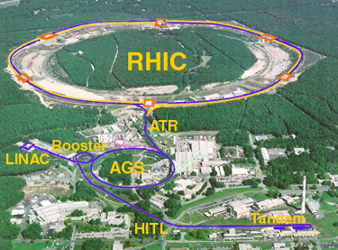
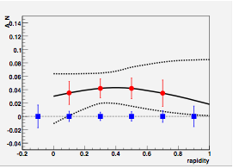
Polarized DY w/ Fixed Target @RHIC ?
BRAHMS
Polarized fixed target DY exp. with extracted polarized proton beams:
PHENIX
Fixed Target DY Exp.
@Beam Dump
High density LH₂/LD₂ target
High density polarized targets
3 Map out x-dep.
STAR
4.5<M<8 GeV
q_{T} < 1 GeV
10 fb⁻¹
50 fb⁻¹
- 250 GeV proton beams
- Pol up to 70%
40

Slide 41
Complimentality between DIS and Drell-Yan
DIS
Drell-Yan
McGaughey, Moss, Peng,
Ann.Rev.Nucl. Part. Sci. 49 (1999) 217
Both DIS and Drell-Yan process are tools to probe the quark and antiquark structure in hadrons (factorization, universality)

Slide 42
Energy loss in Electrodynamics
Collisional energy loss
(ionization and atomic
excitation)
Radiative energy loss
(photon bremsstrahlung)
In QCD
PDG, Phys.Lett. B 592, 1-4 (2004)

Slide 43
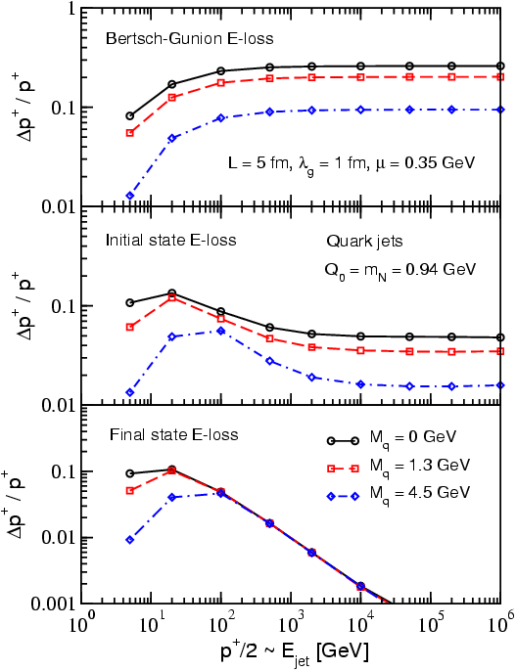
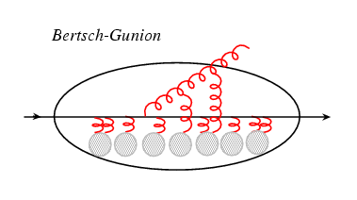


Process Dependence of Parton Energy Loss
E-loss in three cases
Academic case
(probably inapplicable)‏
Initial-state E loss:
DY process
Final-state E loss:
SDIS, QGP
I. Vitev, PRC 75(2007)064906.

Slide 44

Results on cos2Φ Distribution in p+p Drell-Yan
L. Zhu, J.C. Peng, et al., PRL 102 (2009) 182001
p+p
pQCD
(Boer, Vogelsang; Berger, Qiu, Rodriguez-Pedraza)
p+d
Combined analysis of SIDIS and D-Y by Melis et al.
More data are anticipated from Fermilab E906

Slide 45
Current Understanding of TSSAs
TMD approach: Transverse Momentum Dependent Distribution Functions
  Sivers fucntion: nucleon spin and parton kT correlation
  Collins function: spin dependent fragmentation function
  and lots of others …
S_{P}
Phys Rev D41 (1990) 83; 43 (1991) 261
Nucl Phys B396 (1993) 161
S_{P}
p
k_{T,q}
S_{q}
p
p
p
S_{q}
k_{T,π}

Slide 46

UVA/J-Lab/SLAC Polarized proton/deuteron target
D. Crabb MENU10
Polarized NH₃/ND₃ targets
Dynamical Nuclear Polarization
Operate at 5 T and 1 K. Pol ~ B/T
Used with high beam intensities – up to ~100 nA
Large capacity pumps
Polarizations:
  p > 90%,
  d ~ 50%
Able to handle high luminosity
  up to ~ 10³⁵ (Hall C)
~ 10³⁴ (Hall B)

Slide 47
Fixed Target @RHIC ?
Beam dump experiment: dimuon channel
  Parasitic mode
    Significant beams still left at the end of a store (~50%)
    Cycle time ~8hr
  Dedicated fixed target
    Cycle time ~ 1hr
  Dimu x-section @ 250 GeV (M>4) ~20pb
Targets
  E906-like unpolarized LH₂ target
    51cm LH2 (2.1x10²⁴/cm²)
    Can handle L ~ 1x10³⁶cm⁻²s⁻¹
  Polarized solid target
    UVA/J-Lab/SLAC: L ~10³⁵cm⁻²s⁻¹
Advantages
  Polarized beams
  (polarized) targets
  Higher Energy and large x-coverage
  High luminosity

Slide 48


Slide 49

PHENIX Decadal Plan
Midterm upgrades until 2015
Long term evolution after 2015
Dynamical origins of spin-dependent interactions
New probes of longitudinal spin effects
Measurement with polarized He³ and increased energies
www.phenix.bnl.gov/plans.html

Slide 50



Polarized Drell Yan
Solid factorization
No fragmentation
  Direct correlation of intrinsic transverse quark momentum to the proton spin
Fundamental QCD test
  Sign of asymmetry compared to SIDIS
current Muon arm acceptance
Z. Kang and J. Qiu. Phys. Rev., D81:054020, (2010)

Slide 51

Proposed PHENIX Upgrades

Slide 52


The STAR Detectors
PHOBOS
BRAHMS &PP2PP
PHENIX
RHIC
1.2 km
STAR
Time Projection Chamber |η|<1.6
Forward TPC 2.5<|η|<4.0
Silicon Vertex Tracker |η|<1
Barrel EMC |η|<1
Endcap EMC 1.0< η <2.0
Forward Pion Detector 3.3<|η|<4.1

Slide 53

STAR

Slide 54



W^{+/-} & Z⁰ Transverse SSA @500GeV ?
l⁺
Kang & Qiu PRL 103, 172001 (2009)
Latest theoretical progress
  Test time-reversal universality of Sivers functions with W/Z
  Expect large asymmetry (from DIS fit)
Flavor-identified Sivers Funs
  Very large Q²
Expected Statistics @1fb⁻¹ 500GeV
  W^{+/-} →μ^{+/-} ~20K
  Z⁰ -> μ⁺μ⁻ ~ 1K
W^{+/-}
Z⁰
Kang & Qiu arX 0912.1319
54

Slide 55

Nucleon Structure @Leading Twist Collinear Approximation (I)
- Partonic interpretation of hard scatterings
- Universal functions

