Slide 1
Drell-Yan Physics
An Experimental Overview
Ming X. Liu
Los Alamos National Lab

Slide 2
Outline
Introduction – a brief review of history
Recent highlights and future prospects
  quark energy loss dE/dx in pA
  Nucleon and nucleus structure
New development
  Transverse spin physics

Slide 3
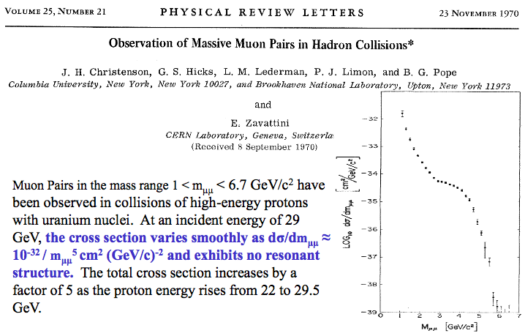
The First Dimuon Measurements
Missed the J/Psi!

Slide 4
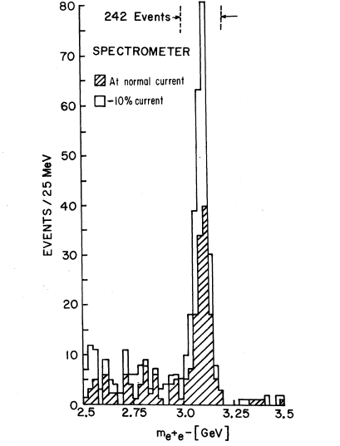
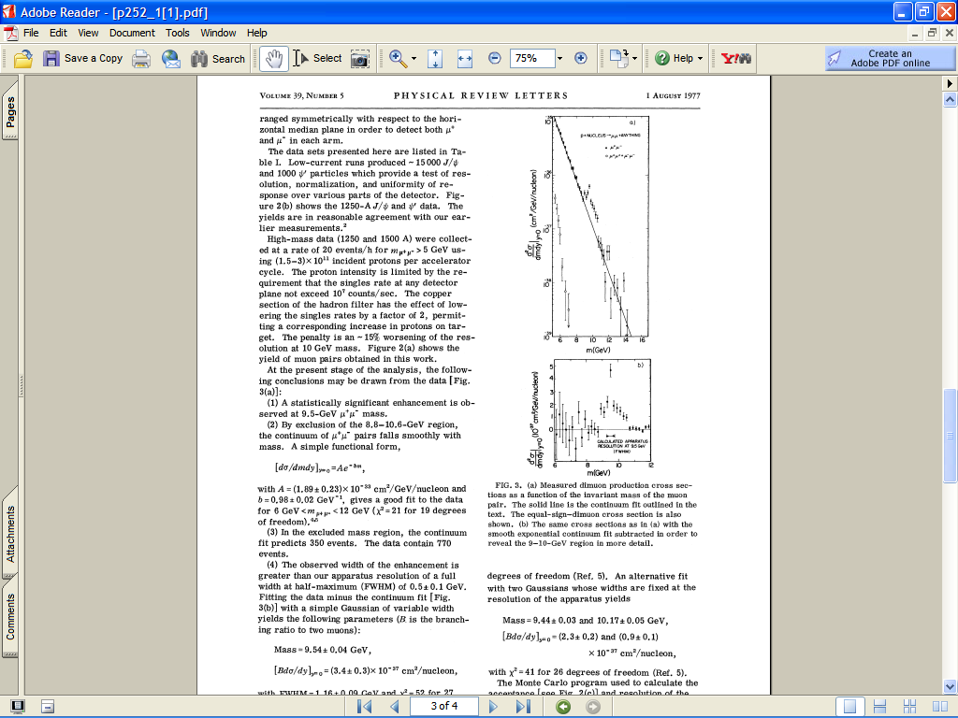
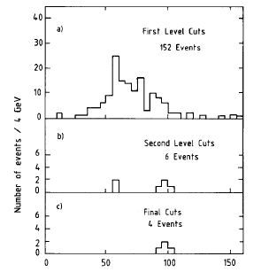
Di-lepton probe: a Powerful Tool for Discovery

Slide 5
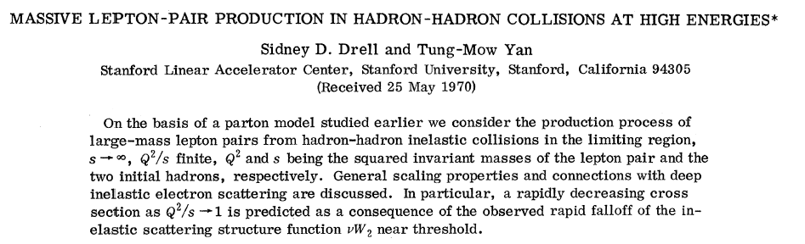
The Drell-Yan Process
μ⁺
μ⁻

Slide 6
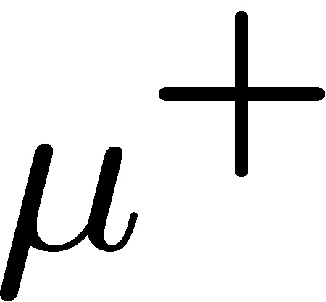


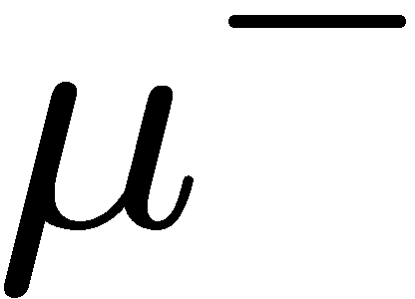
Drell-Yan for Hadron Physics
Current challenges
  E906@FNAL
  PHENIX/STAR/AnDY@RHIC
  COMPASS@CERN
  Others
New directions for the future:
  Transverse Single Spin asymmetry
  RHIC, COMPASS
  FNAL, JPARC, FAIR …
Focus on hadron physics
  DY @ 4 < M < 8 GeV
  W/Z @RHIC
Hadron structure
  pp, pA, …
Parton energy loss dE/dx
  pA
Spin and QCD dynamics
  pp, pA

Slide 7
Complimentality between DIS and Drell-Yan
DIS
Drell-Yan
McGaughey, Moss, Peng,
Ann.Rev.Nucl. Part. Sci. 49 (1999) 217
Both DIS and Drell-Yan process are tools to probe the quark and antiquark structure in hadrons (factorization, universality)

Slide 8
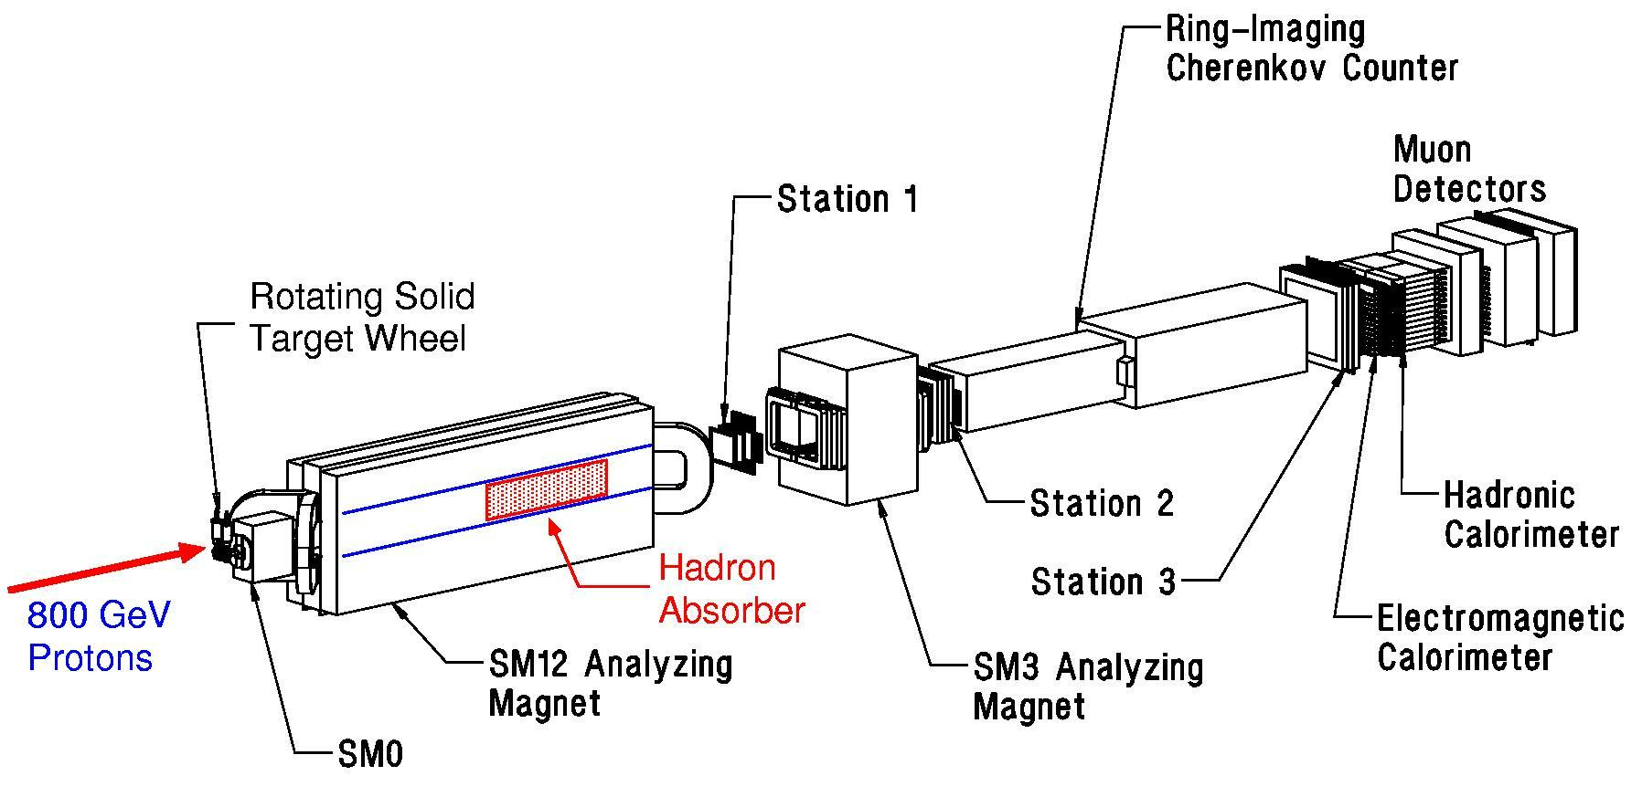
Fermilab Dimuon Spectrometer: Fixed Target Drell-Yan
(E605 / 772 / 789 / 866 / 906)

Slide 9
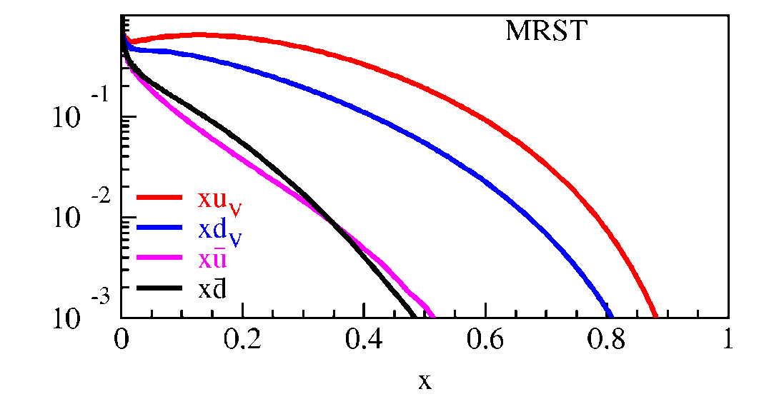
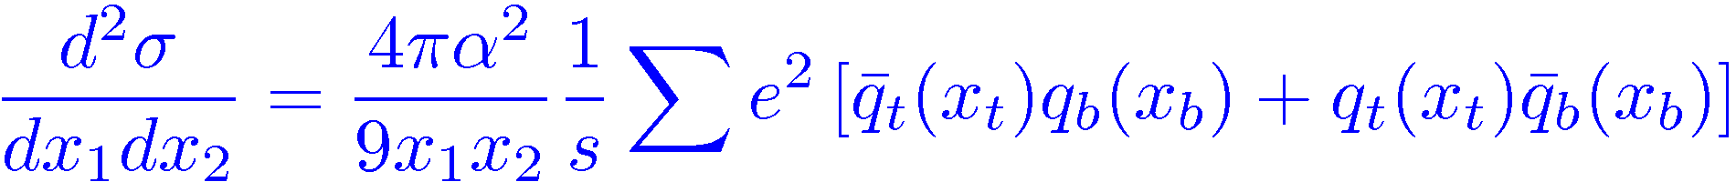
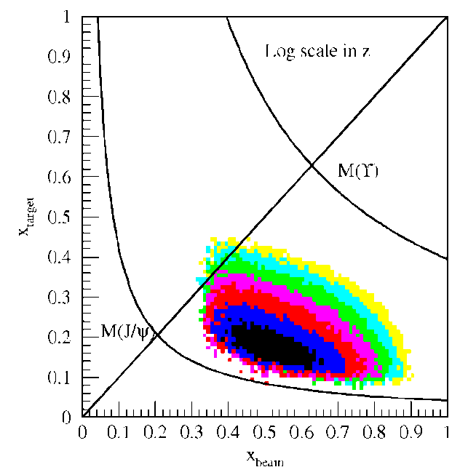
Kinematic of Fixed Target Drell-Yan
Measure yields of μ⁺μ⁻ pairs from
different targets: p+p, p+A
Determine x_{b}, x_{t}
Measure differential cross section
Fixed target kinematics and detector acceptance give x_{b} > x_{t}
  x_{F} = 2p||^{γ}/s^{1/2} ≈ x_{b} – x_{t}
  Beam valence quarks probed at high x
  Target sea quarks probed at low/intermediate x
x_{target}
x_{beam}
E906 Spect.
Monte Carlo
Notes:
Determine mass and momentum of virtual photon
Determine momentum fraction x_b and x_t of partons in beam and target
Measure absolute differential cross section
Sensitivity of D-Y process to anti-quark distribution of target or beam clear from examining diff. cross section
At large x, parton distributions are dominated by valence distributions, at small x by sea distributions
So in limit of large xb and small xt, cross section is dominated by first term -> providing direct sensitivity to antiquark sea of target nuclei
So if we just have to design the right experiment: This is E906.

Slide 10
Highlights of Physics from Fermilab Dimuon Experiments
Quark energy loss in nuclear medium
Sea quarks and gluons in nucleons and nuclei
Transverse spin physics
  Drell-Yan angular distributions
  Transverse Single Spin Asymmetry: DY vs DIS

Slide 11
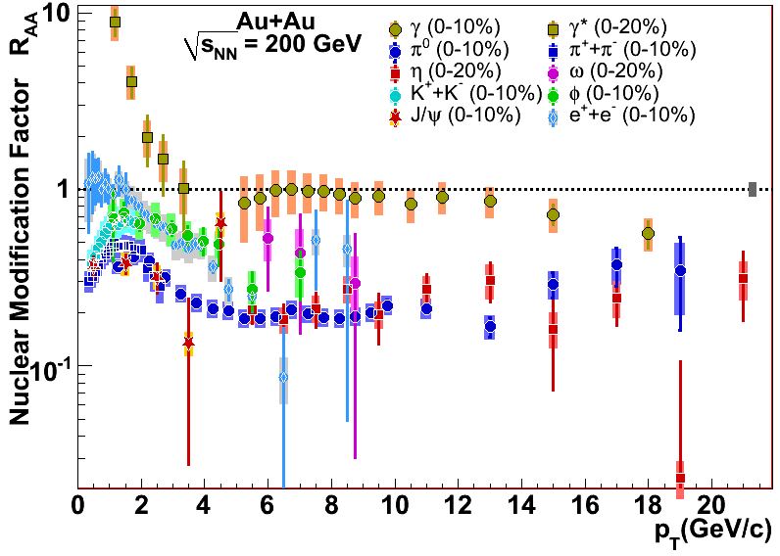
Topic (I): Energy loss in the Nuclear Medium
Parton energy loss has been discovered at RHIC as an excellent probe of the hot/dense matter.
However, order of magnitude uncertainties in dE/dX
Single Hadron Tomography
jet
g
g
T
T
g
Xin-Nian Wang, M. Gyulassy, PRL68(1992)1480
Notes:
As is well known, an interesting property of QCD is confinement, which means that in nature quarks and gluons are confined in hadrons, and we cannot see free quarks and gluons. If we accelerate two heavy nuclei to very high energy and make them collide with each other, we can deposit a huge amount of energy in the colliding center and the confined quarks and gluons may be deconfined to form a new kind of matter: Quark-gluon-plasma, or QGP.
jet quenching is widely regarded as one of the best one to probe the hot/dense matter. Jet quenching tells that when an energetic parton passing through hot and dense nuclear matter, it may suffer multiple scattering with other partons in hot medium and lose a lot of energy. One can get the information of the medium by the lost energy of jets. It is very similar to X-rays tomography used in hospital to detect the intern structure of human body. Jet quenching theory predicted strong suppressions in single hadron production and di-hadron correlation in the hot QGP medium. In single hadron production, because the jet will lose a large amount of energy when propagating in the QGP, when the jet is fragmentated into hadrons, the hadron yield will be significantly suppressed. In di-hadron prod., when a pair of jet produced. There are usually back-to-back. If they are produced near the surface of the QGP, the jet near the surface will travel very short distance in the QGP and lose few energy. Whereas another jet may travel a longer distance and lose a large amount of energy before fragmentation. Therefore If the leading hadron of this jet is chosen as triggered particle, in the opposite direction, the yield of the hadron from another jet will be highly suppressed.

Slide 12
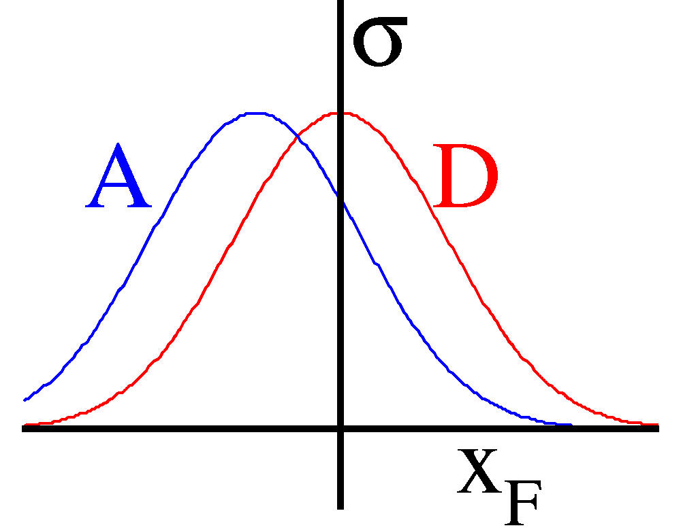
Benchmark with DY: Quark Energy Loss in p+A
High energy p+A collisions:
Relevant D.O.F.: quarks & gluons
Final-state
particles
Incident Proton
q, g
Nuclear Target

Slide 13
Energy loss in Electrodynamics
Collisional energy loss
(ionization and atomic
excitation)
Radiative energy loss
(photon bremsstrahlung)
In QCD
PDG, Phys.Lett. B 592, 1-4 (2004)

Slide 14
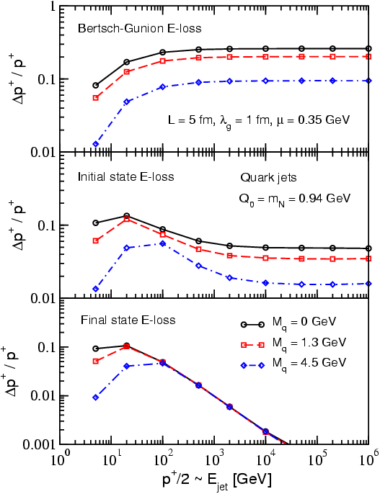
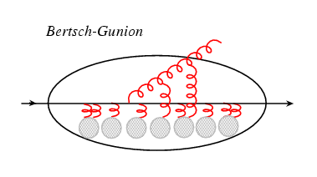
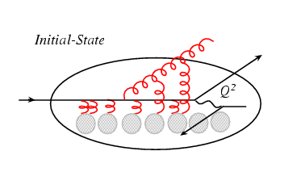
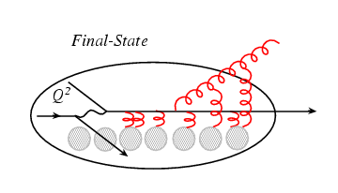
Process Dependence of Parton Energy Loss
E-loss in three cases
Academic case
(probably inapplicable)‏
Initial-state E loss:
DY process
Final-state E loss:
SDIS, QGP
I. Vitev, PRC 75(2007)064906.

Slide 15
Quark Energy Loss in Cold Nuclear Medium
Drell-Yan @E866
(PRL 86 (2001) 4483)
800GeV p + A
5<M<6 GeV
7<M<8 GeV
(depends on shadowing correction)

Slide 16

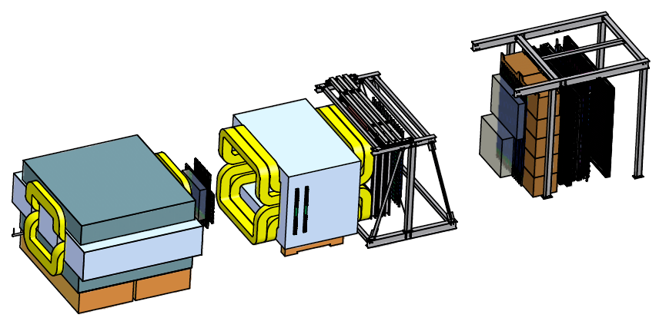
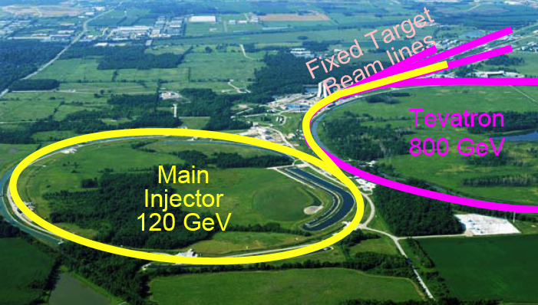
E906 Drell-Yan:2011-2013
X_{Target}
4.9m
X_{Beam}
Polarized DY possibility:
120 GeV proton
p+A: p, d, C, Al, Fe, W
X₁ = 0.3~0.7
X₂ = 0.1~0.3
  free from shadowing effect

Slide 17
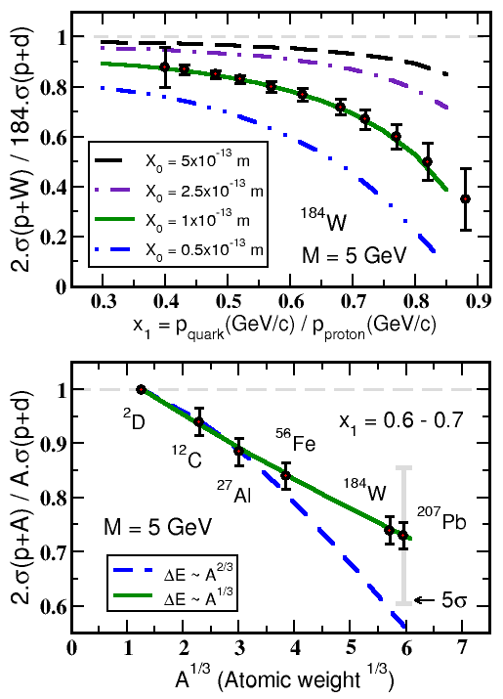


Experimental Sensitivity to Quark Energy Loss
Quark energy loss only
Shortest radiation length in nature X₀ = 1 x 10⁻¹³ m
Clearly distinguish between leading models for L dependence of E-loss
Benchmark dE/dx models

Slide 18
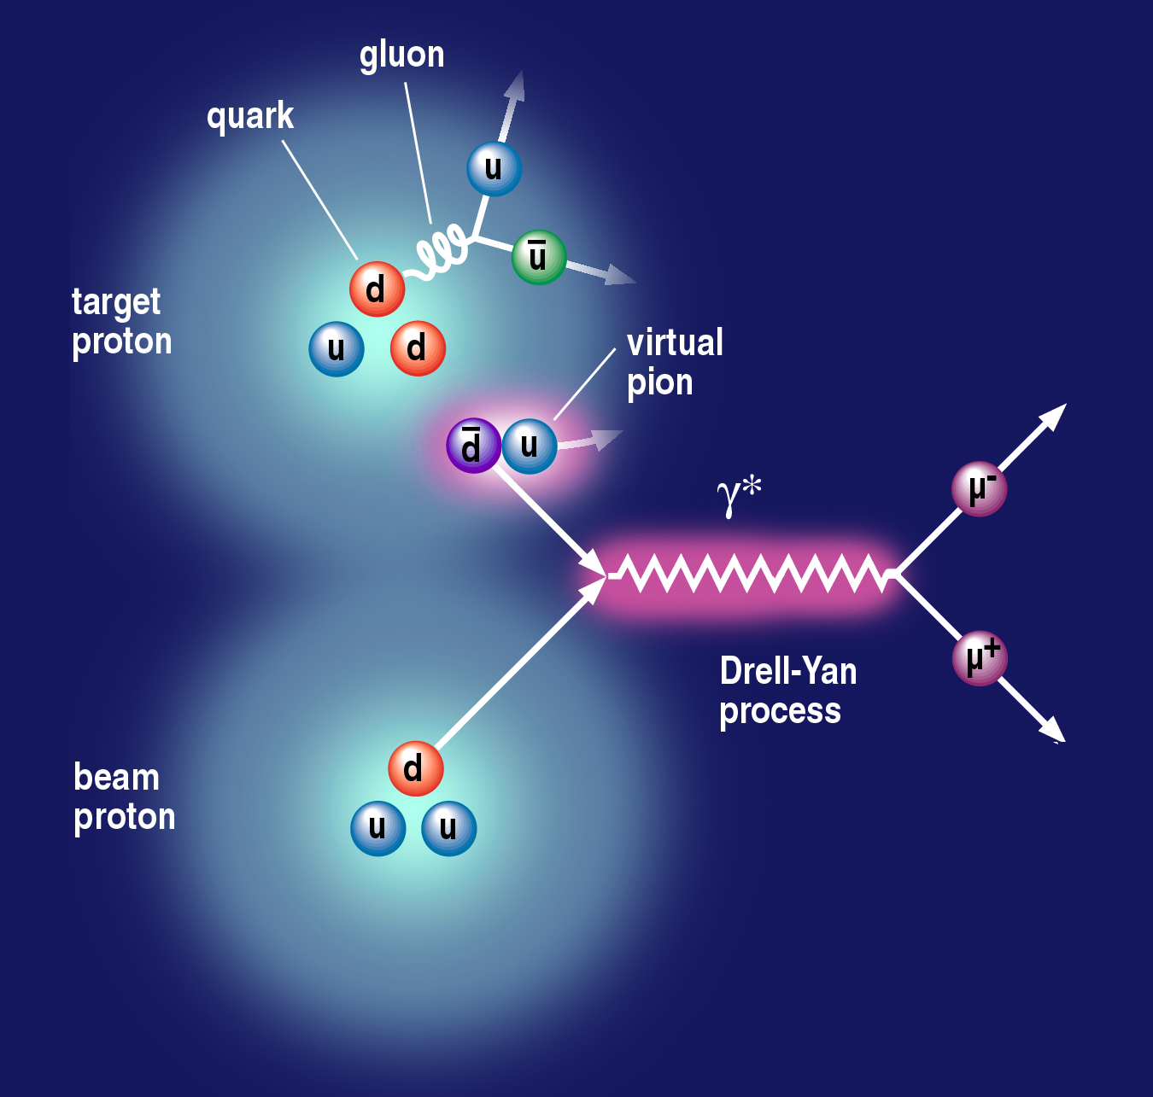
Topic (II): Nucleon is a Complex System
Origin of Sea Quarks
Notes:
Use the nice picture to show that if sea quarks are only from gluon splitting, one will expect dbar = ubar; but if include pion cloud fluctuation, the symmetry is broken. → and E866 showed that is the case. So proton is a very complex system.
So it is interesting to see what happens to polarized case.
It is also a model killer – some predict even larger asymmetry for polarized case.
So understanding the details of nucleon structure will help us better understand the confinement.
So we want to explore the flavor decomposed sea quark distributions.

Slide 19
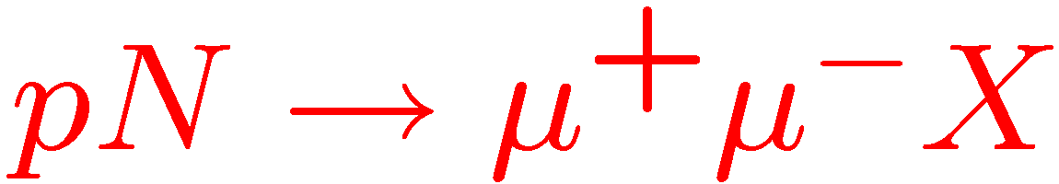
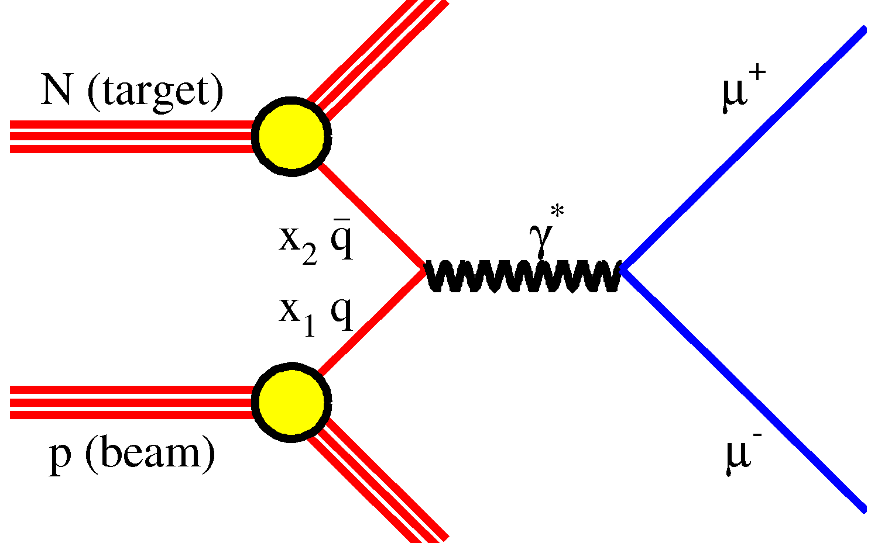
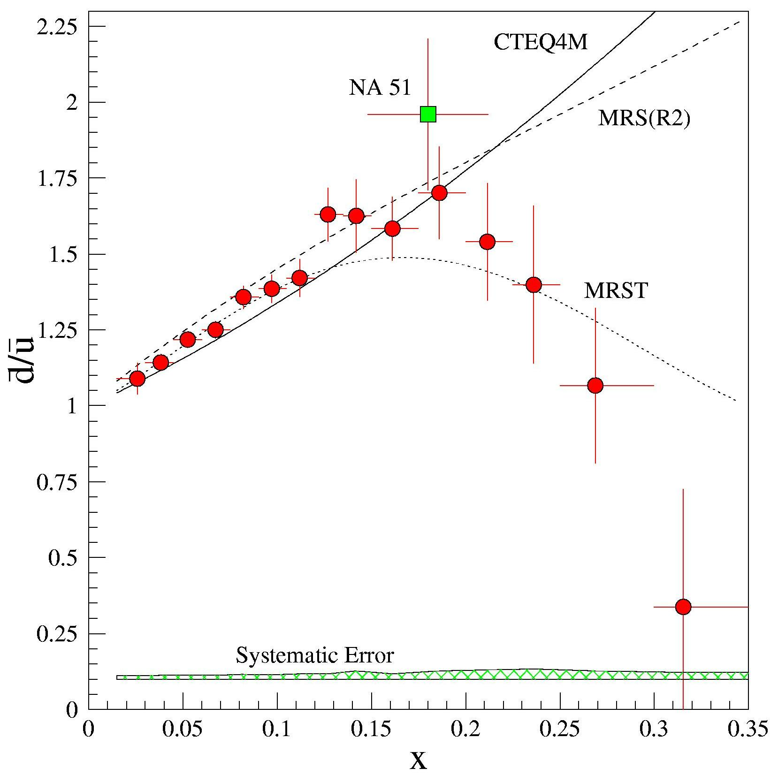
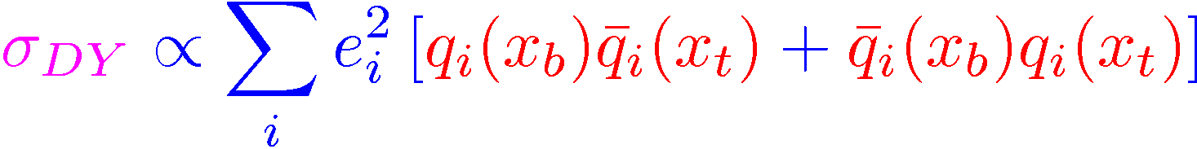
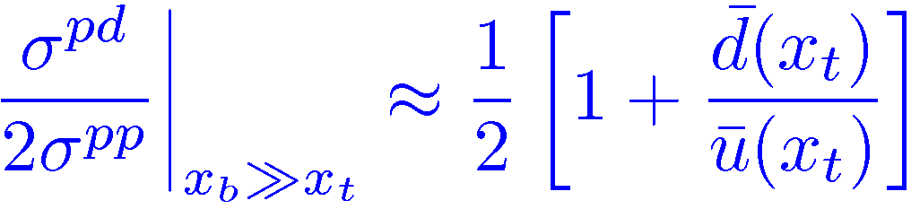
Evidence of Pion Cloud?
E866, Phys.Rev. D64 (2001) 052002
FermiLab/E866
Sea Asymmetry probed by Drell-Yan

Slide 20
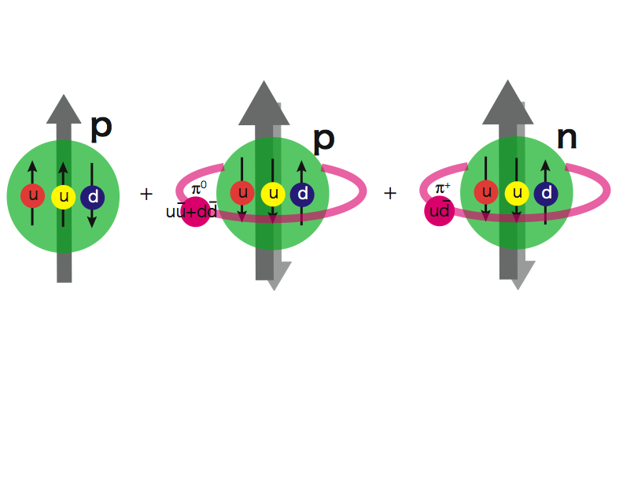
Pion Cloud Model and the
Orbital Angular Momentum?!
Extra dbar in proton g.s.
Sea Quarks Carry Major Orbital Angular Momentum Component?

Slide 21
Pion Cloud and Orbital Angular Momentum
Sea quark flavor asymmetry and L_{Z}
G. Garvey Phys.Rev.C81:055212,2010.

Slide 22
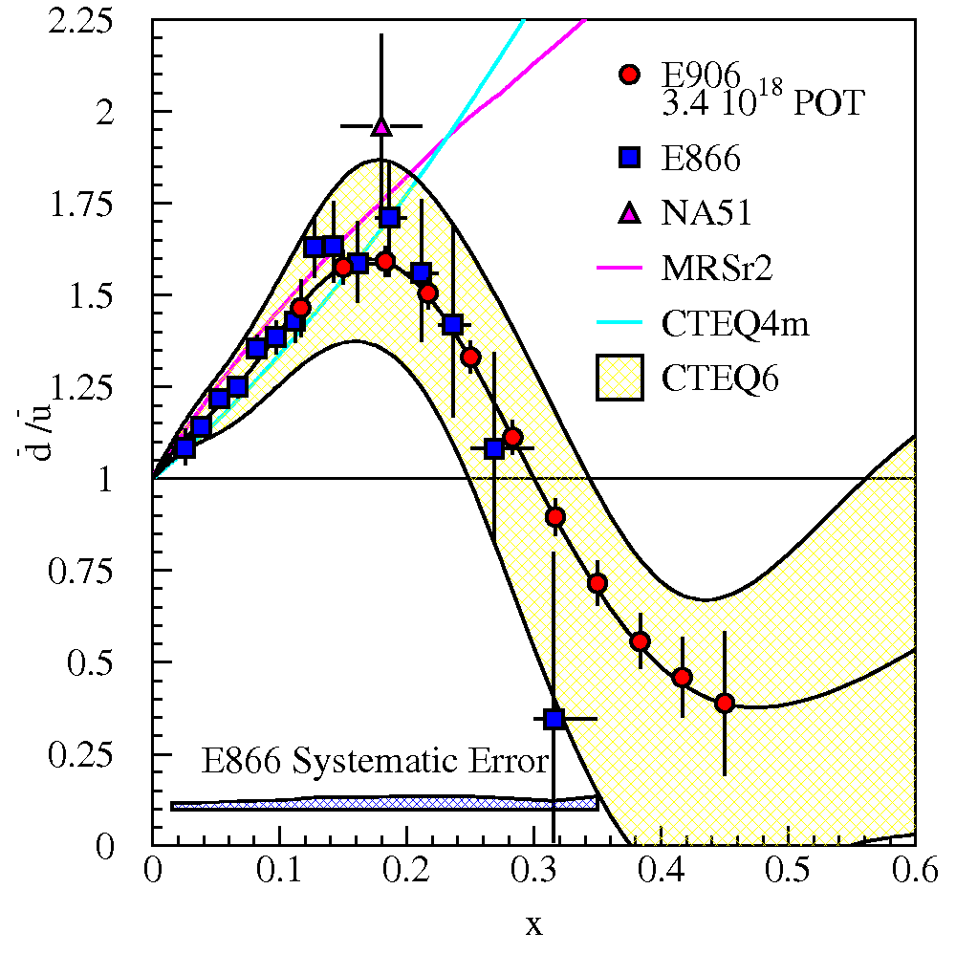
SeaQuest Projections for d-bar/u-bar Ratio
SeaQuest will extend these measurements and reduce statistical uncertainty
SeaQuest expects systematic uncertainty to remain at ≈1% in cross section ratio
5 s slow extraction spill each minute
Intensity:
  2 x 10¹² protons/s
  1 x 10¹³ protons/spill

Slide 23
Topics (III): Transverse Spin Physics
TMD and alike
  Sivers functions
  Collins functinos
And more…

Slide 24
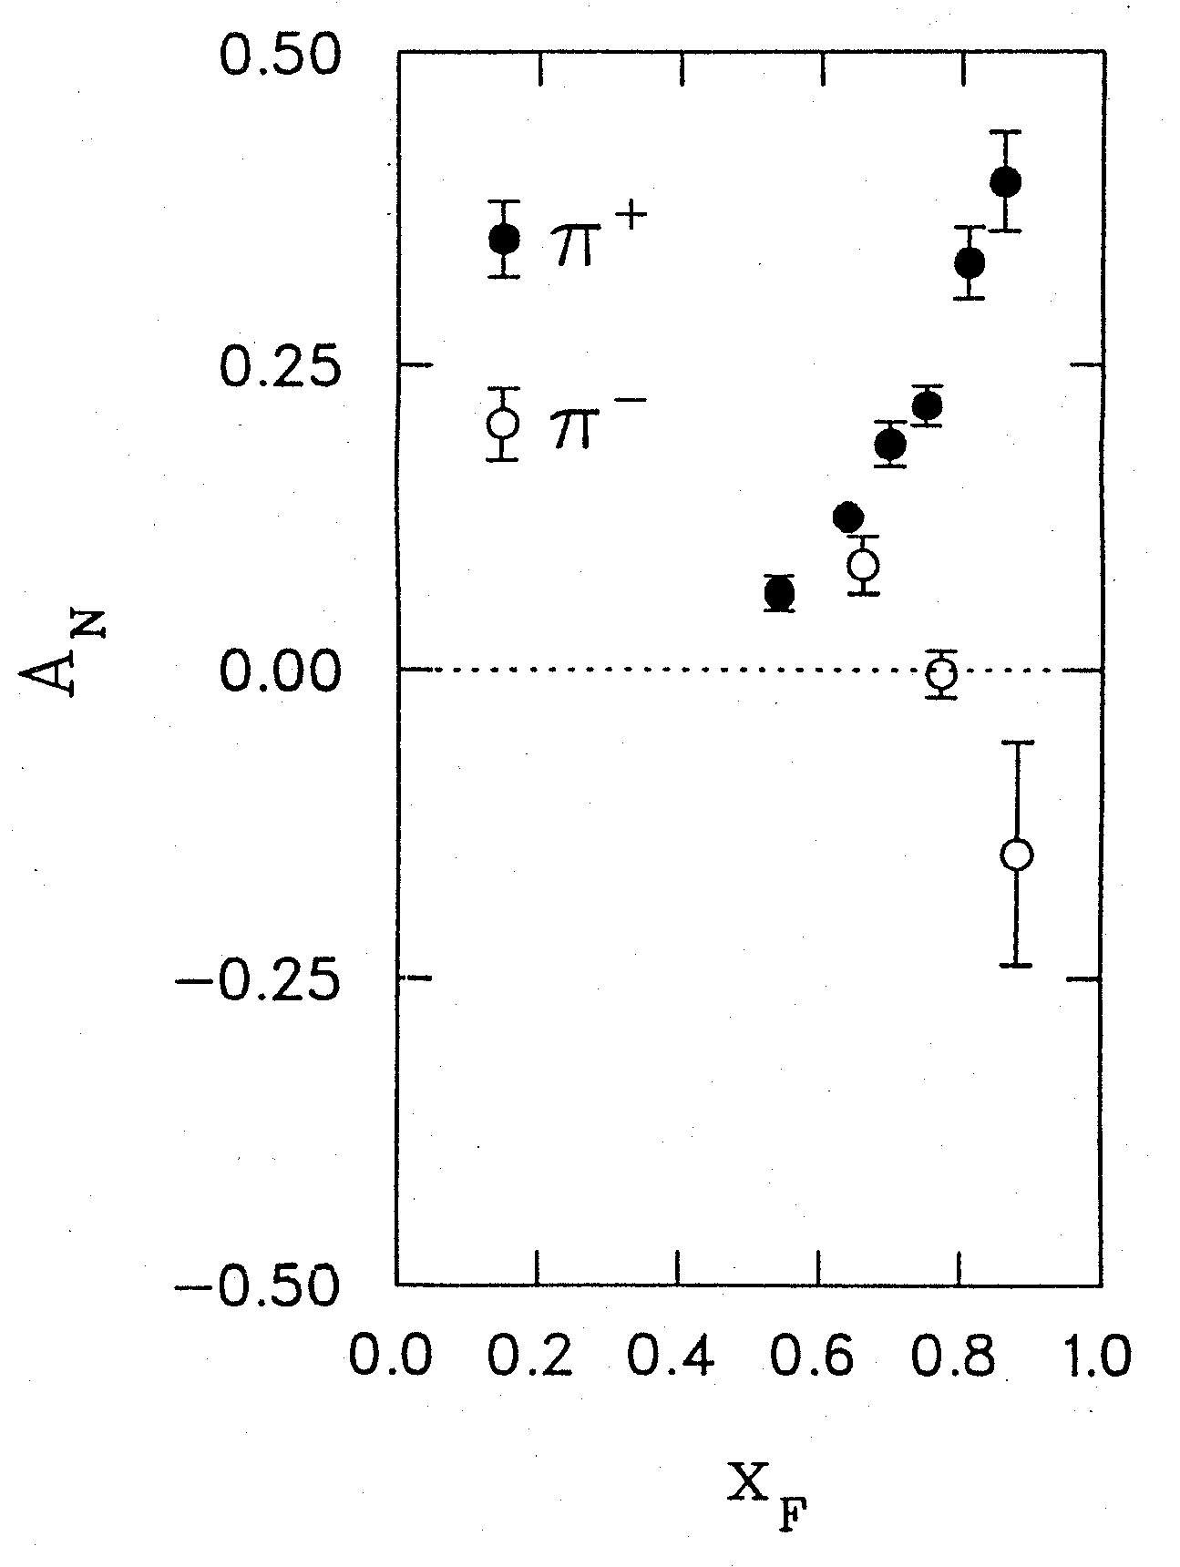
Surprises in Spin Physics the challenge of “Too Big”
Transverse Single Spin Asymmetries A_{N}
Left
Argonne ZGS, p_{beam} = 12 GeV/c
Right
Theory Expectation:
Small asymmetries at high energies
(Kane, Pumplin, Repko, PRL 41, 1689–1692 (1978) )
A_{N}
A_{N} ~ O(10⁻⁴) theory
Experiments:
ZGS, AGS, FERMILAB to RHIC
A_{N} ~ O(10⁻¹) observed
W.H. Dragoset et al., PRL36, 929 (1976)
4/27/11
24

Slide 25
Current Understanding of TSSAs (I)
TMD approach: Transverse Momentum Dependent Distribution Functions
  Sivers fucntion: nucleon spin and parton kT correlation
  Collins function: spin dependent fragmentation function
  and lots of others …
S_{P}
Phys Rev D41 (1990) 83; 43 (1991) 261
Nucl Phys B396 (1993) 161
S_{P}
p
k_{T,q}
S_{q}
p
p
p
S_{q}
k_{T,π}

Slide 26
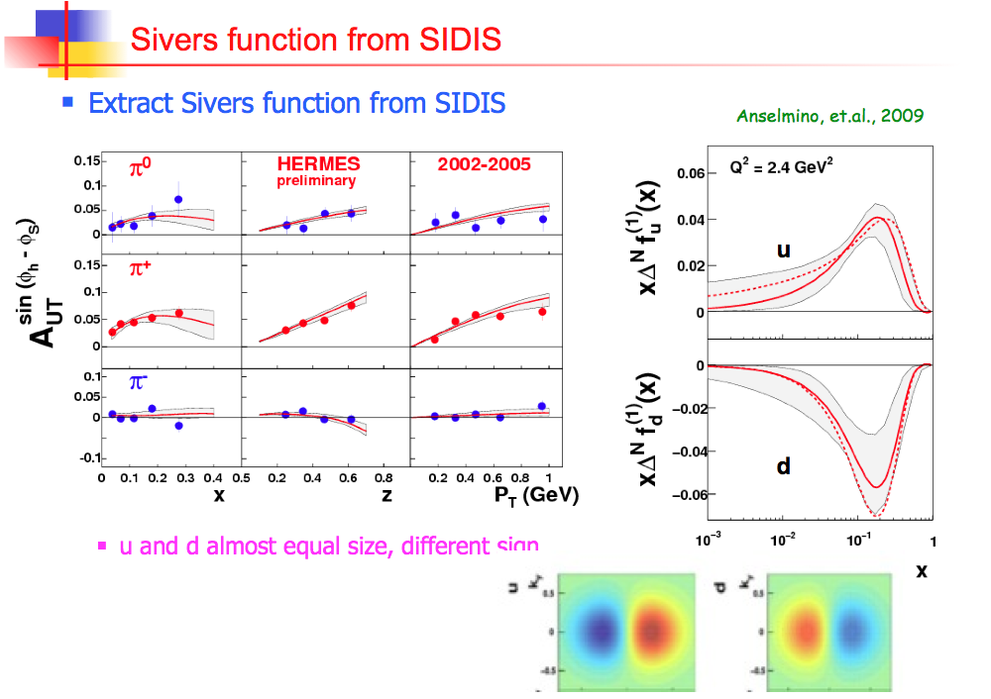

Slide 27
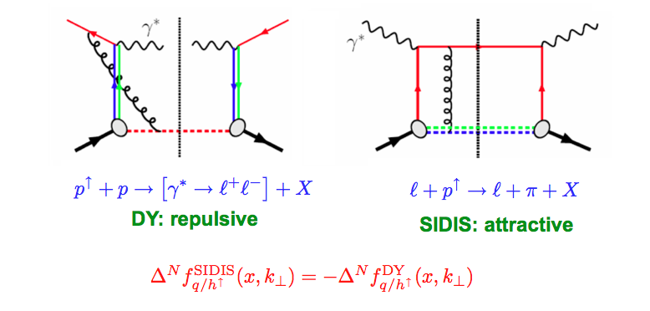
Color Flow in DY and DIS
The sign change – a new fundamental test of color gauge formalism
Collins ‘02
Twist-3: sign change from gluonic-pole in hard parts
In the overlapped region – consistent description
Ji, Qiu, Vogelsang, Yuan ‘06
Bacchetta, Boer, Diehl, Mulders ‘08

Slide 28
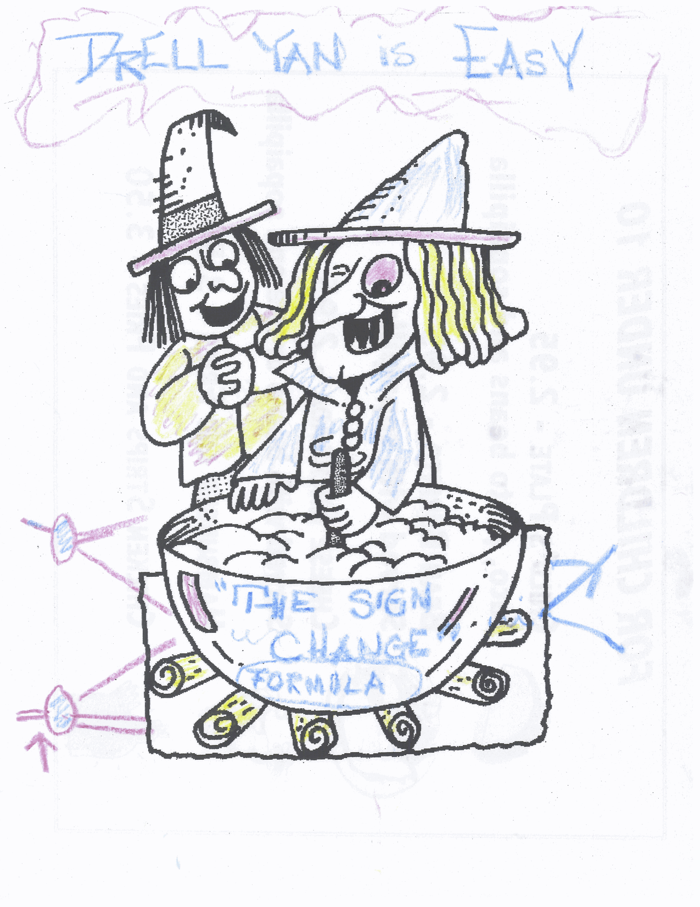

The magic of
sign change
Drawing from D. Sivers @Santa Fe Polarized Drell-Yan Workshop Dinner 10/31-11/1, 2010

Slide 29
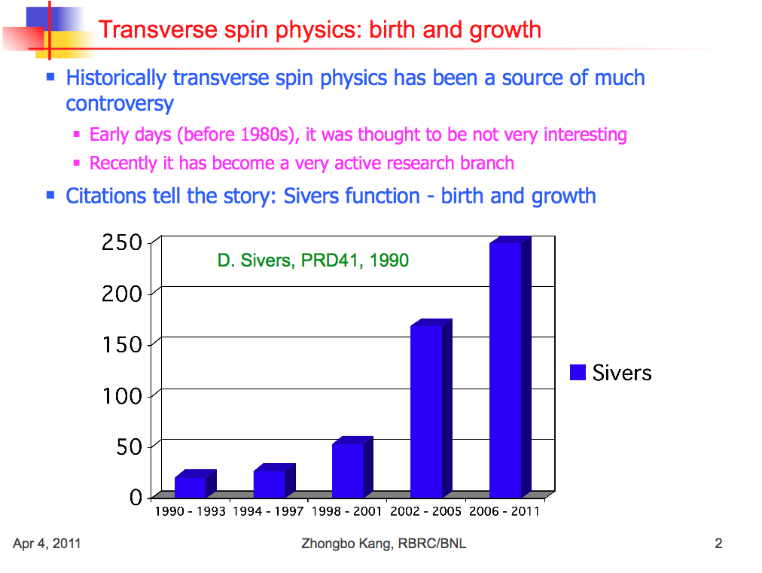

Slide 30
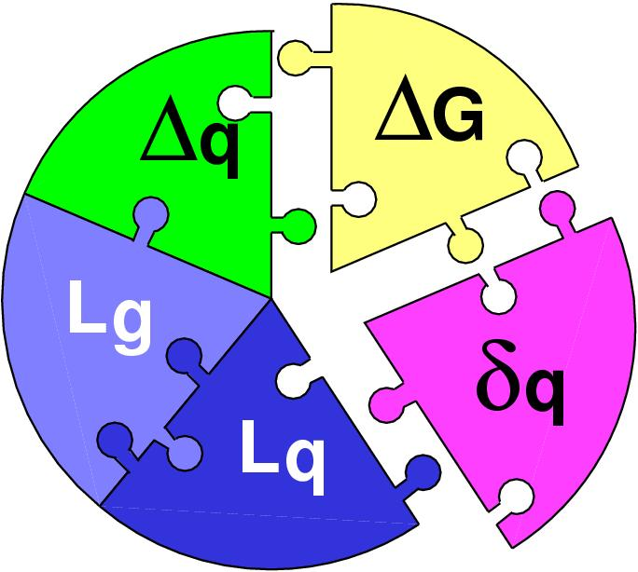
Importance of Drell-Yan TSSA
Test the fundamental prediction of sign change in DY TSSA compared to DIS based on our understanding of the origin of TSSA
  Test of gauge formulism
  Test of QCD factorization
Help to resolve the proton spin puzzle?
    One expect the observation of Sivers Asymmetry signals the existence of partonic orbital angular momentum
only ~30% of spin
Beginning to be measured at RHIC
A future challenge

Slide 31
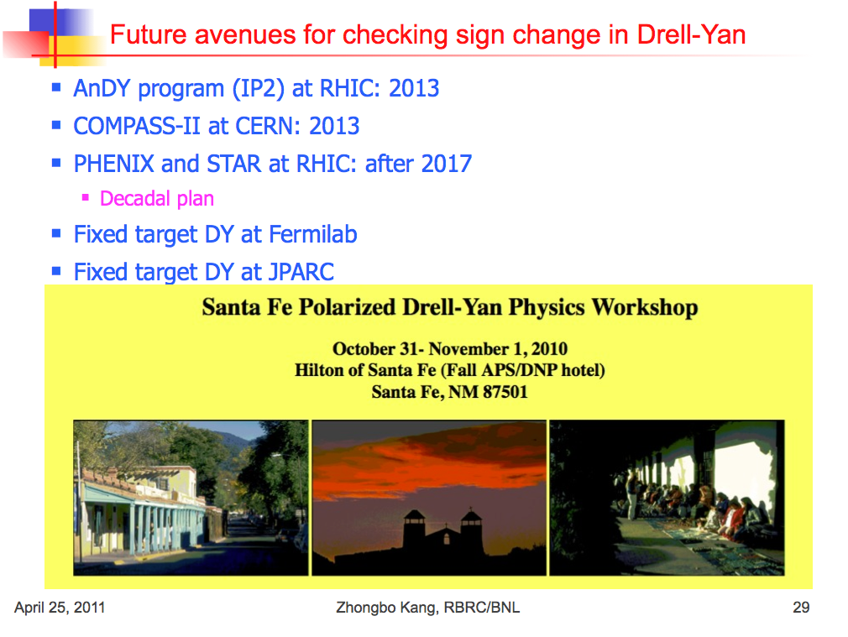

Slide 32
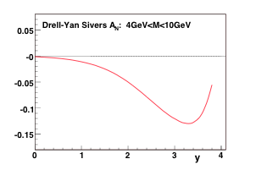
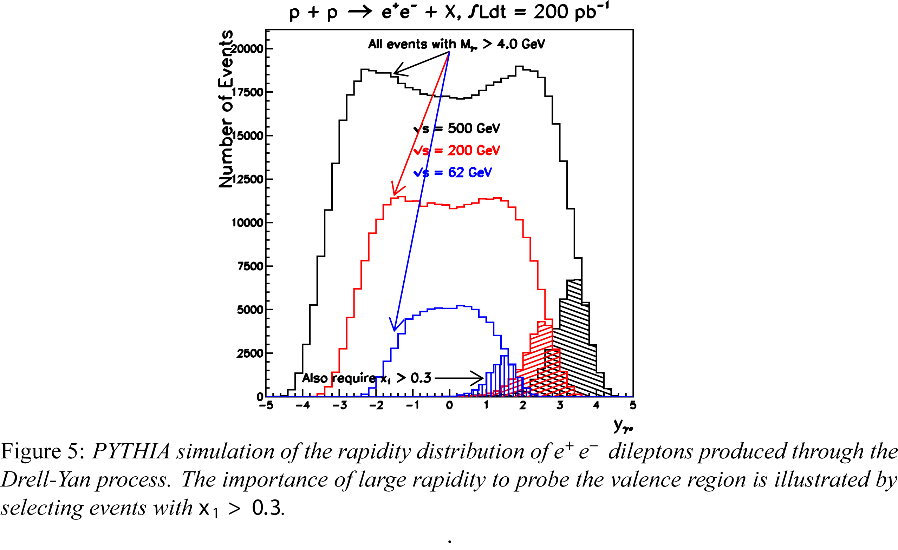

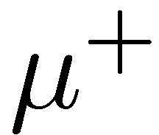

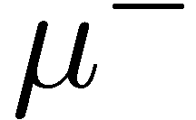
Drell-Yan Production @RHIC
A_{N} @large XF
PHENIX muon acceptance
1.2 < |y| <2.4
muon p > 2.5GeV

Slide 33

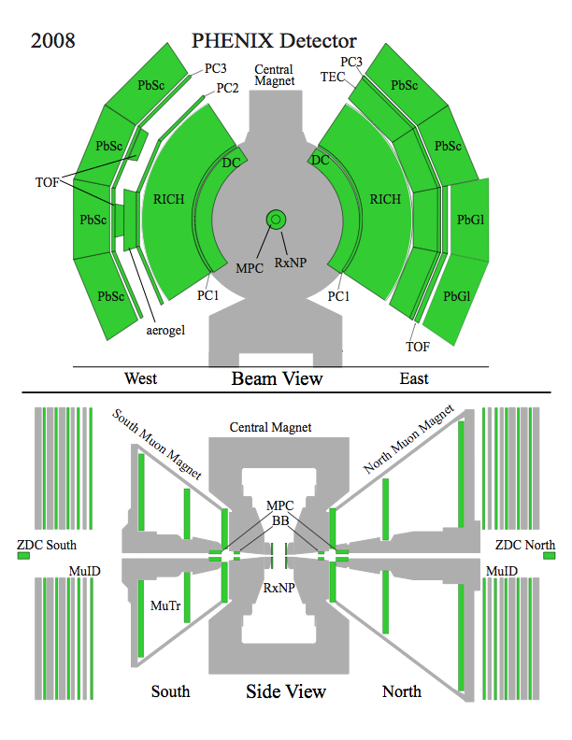
The PHENIX detector
Philosophy:
  High rate capability to measure rare probes,
  limited acceptance.
2 central spectrometers
  Track charged particles and detect electromagnetic processes
2 forward muon spectrometers
  Identify and track muons
2 forward calorimeters (as of 2007!)
  Measure forward pions
Relative Luminosity
  Beam-Beam Counter (BBC)
  Zero-Degree Calorimeter (ZDC)

Slide 34
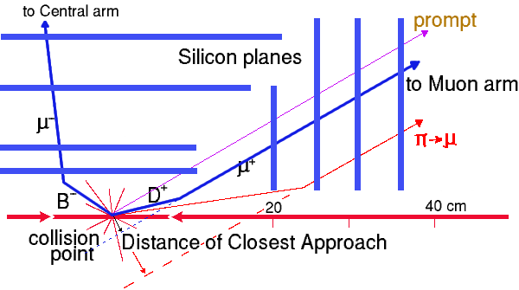
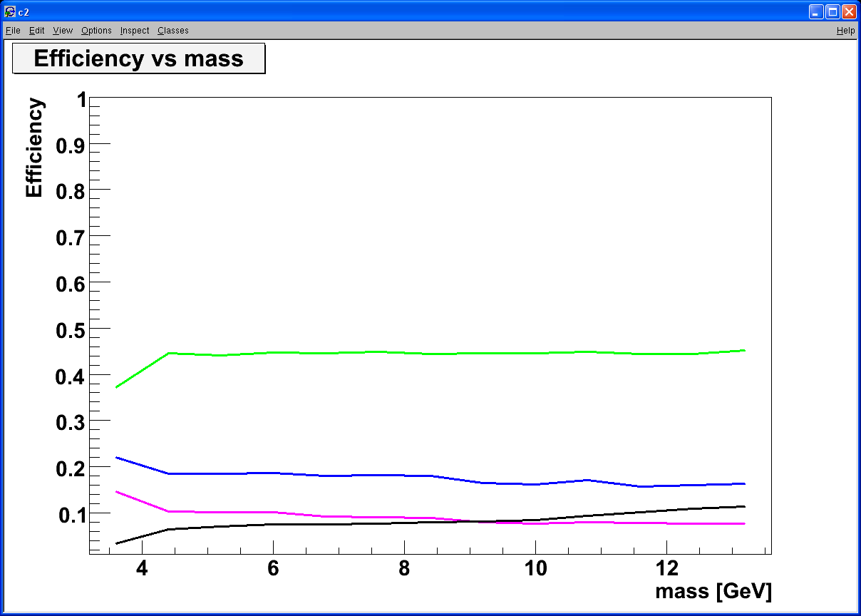
Silicon VTX, Heavy Quark and Drell-Yan
Tracking muons with MuTr+FVTX
  Prompt muons from DY
  Displaced tracks from π/K and heavy quark decays
Drell Yan
DCA < 1 σ cut:
Increase DY/bb ~ 5
ϒ-states
J/Ψ
Drell Yan
charm
beauty
charm
beauty
DY: 4 GeV < M < 8 GeV; B-background: use FVTX
combinatorial background

Slide 35
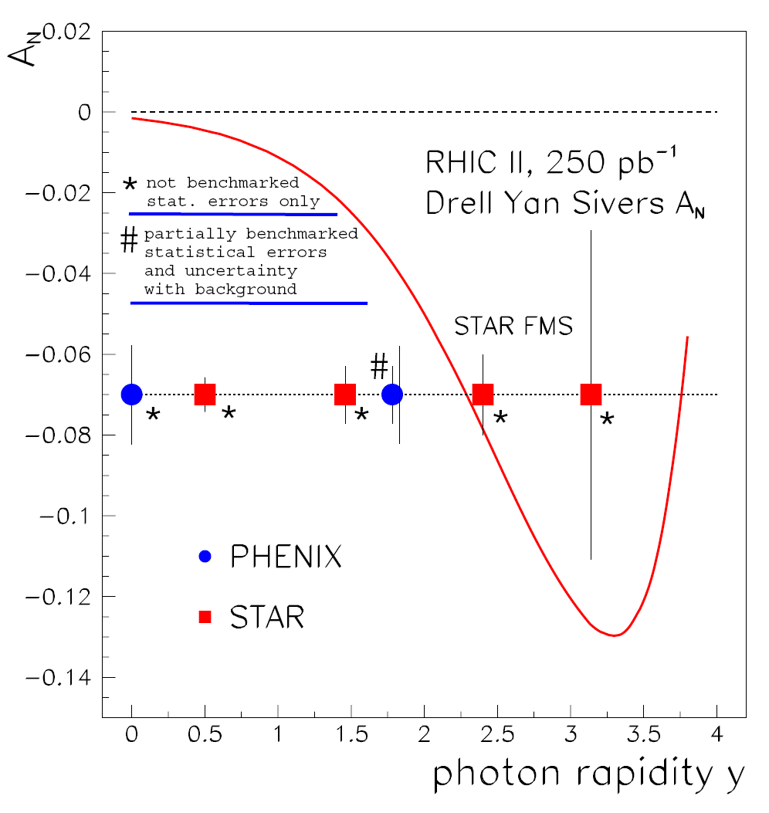
Sivers Asymmetries in SIDIS and DY
“Transverse-Spin Drell-Yan Physics at RHIC” (http://spin.riken.bnl.gov/rsc/write-up/dy_final.pdf)
Important test at RHIC of recent fundamental QCD predictions for the Sivers effect, demonstrating… attractive vs repulsive color charge forces
HERMES
Sivers Amplitude
0.1 0.2 0.3 x
35

Slide 36
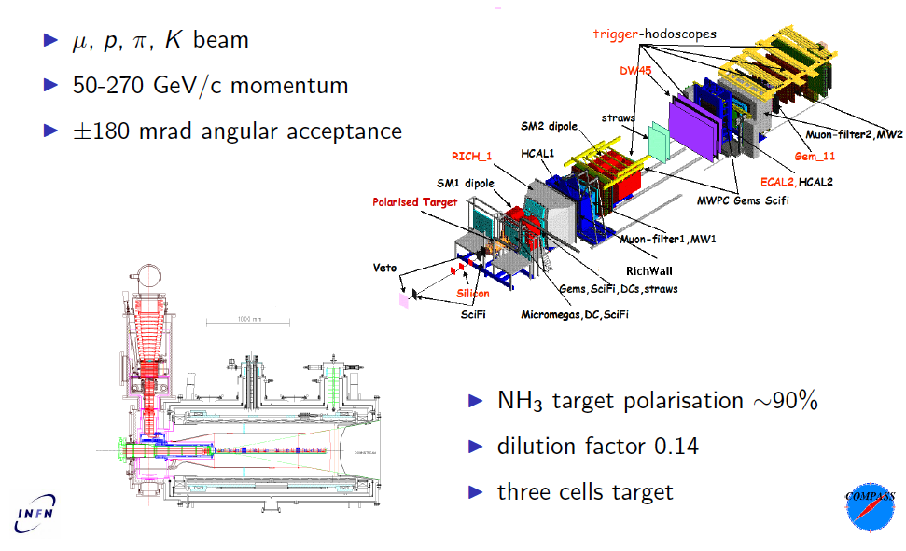
COMPASS facility at CERN (SPS) II

Slide 37
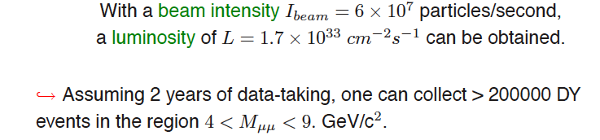
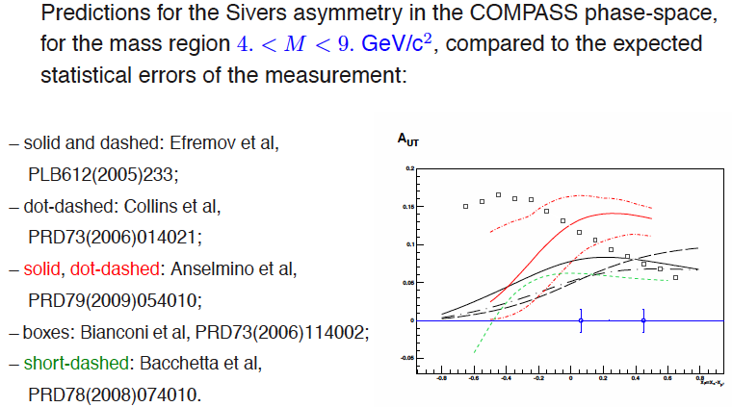
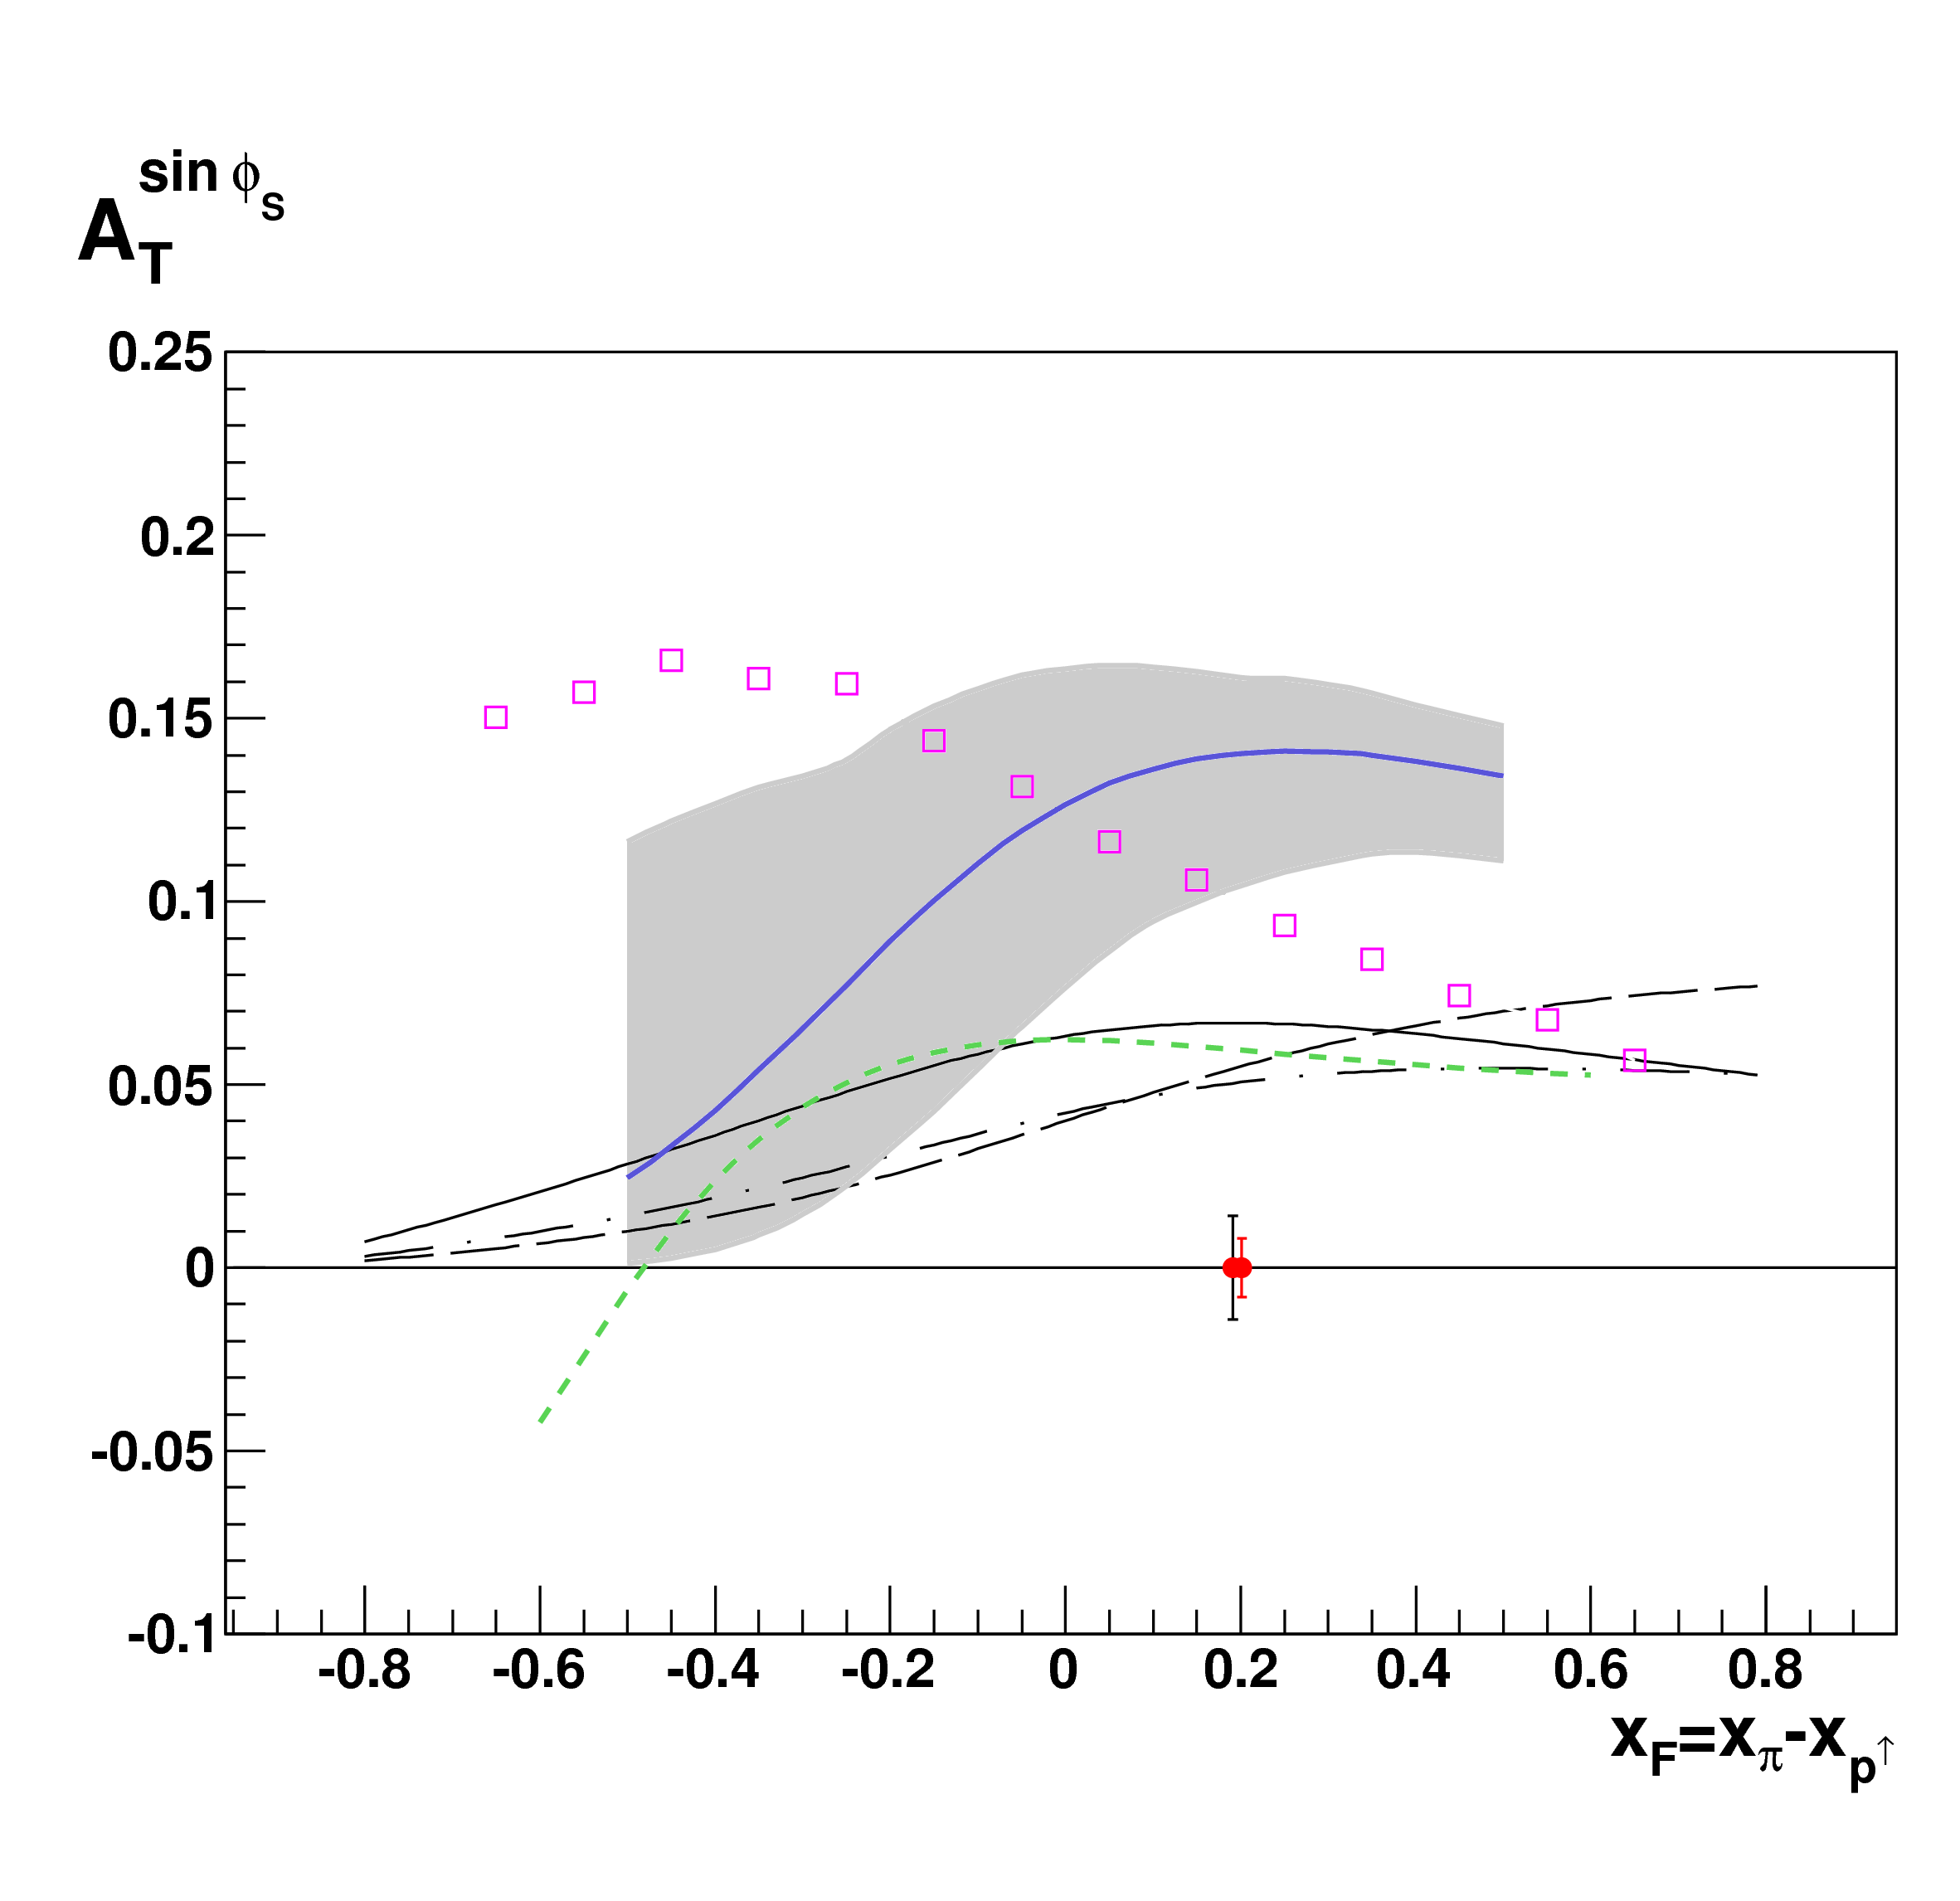
DY@COMPASS projections I

Slide 38
Drell-Yan Spectrometer for E906
Station 3
(Hodoscope array, drift chamber track.)
Station 1
(hodoscope array,
MWPC track.)
4.9m
Iron Wall
(Hadron absorber)
Station 4
(hodoscope
array, prop
tube track.)
KTeV Magnet
(Mom. Meas.)
Solid Iron Magnet
(focusing magnet, hadron absorber and beam dump)
Station 2
(hodoscope array, drift chamber track.)
Targets
(liquid H₂, D₂,
and solid targets)

Slide 39
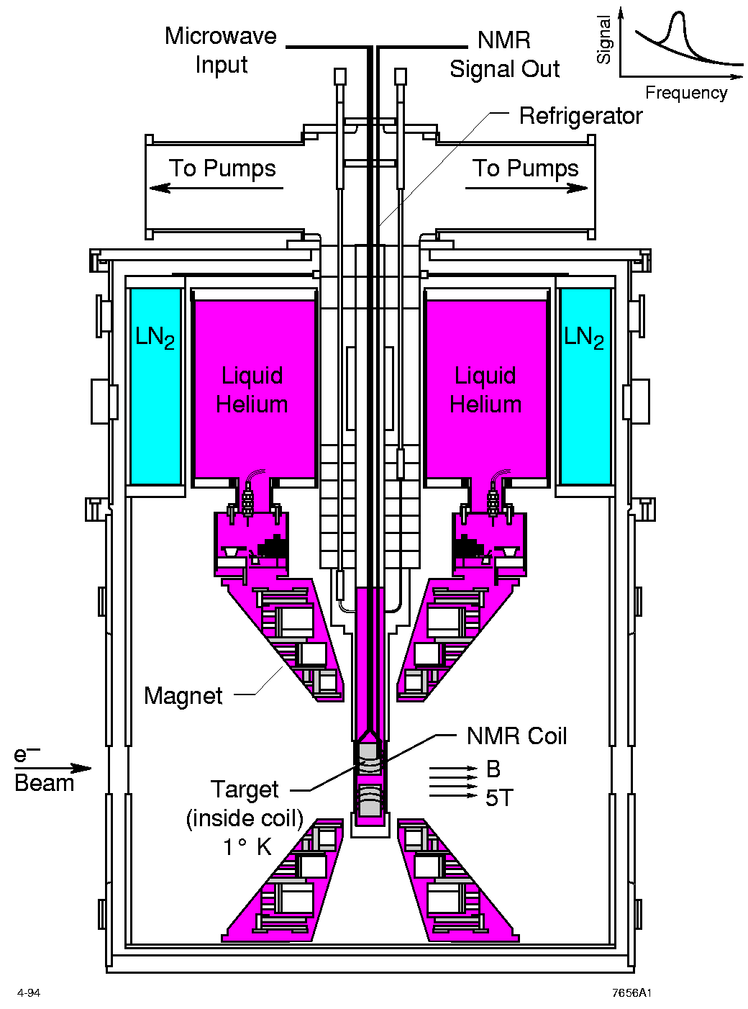
UVA/J-Lab/SLAC Polarized proton/deuteron target
D. Crabb MENU10
Polarized NH₃/ND₃ targets
Dynamical Nuclear Polarization
Operate at 5 T and 1 K. Pol ~ B/T
Used with high beam intensities – up to ~100 nA
Large capacity pumps
Polarizations:
  p > 90%,
  d ~ 50%
Able to handle high luminosity
  up to ~ 10³⁵ (Hall C)
~ 10³⁴ (Hall B)

Slide 40
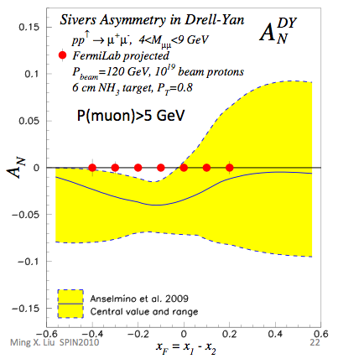
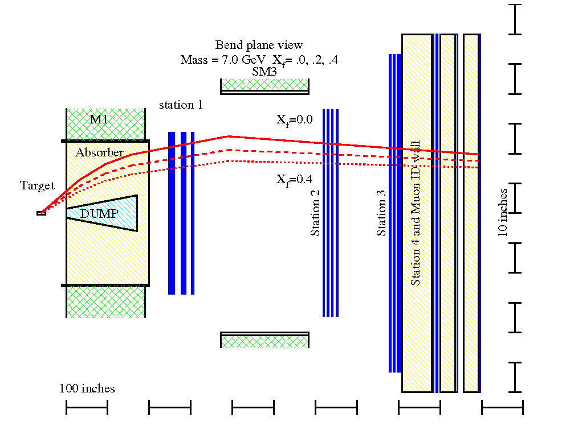
Expected DY A_{N} Sensitivity @120 GeV.
Target
  6 cm NH₃
  10¹⁹ proton
Also open charm and J/psi

Slide 41

Example (II): Polarized DY w/ Fixed Target @RHIC ?
BRAHMS
Polarized fixed target DY exp. with extracted polarized proton beams:
PHENIX
Fixed Target DY Exp.
@Beam Dump
High density LH₂/LD₂ target
High density polarized targets
3 Map out x-dep.
STAR
- 250 GeV proton beams
- Pol up to 70%
41

Slide 42

DY A_{N} Sensitivity @250 GeV Fixed Target
4.5<M<8 GeV
q_{T} < 1 GeV
10 fb⁻¹
50 fb⁻¹
x_{F}

Slide 43



W^{+/-} & Z⁰ Transverse SSA @500GeV ?
l⁺
Kang & Qiu PRL 103, 172001 (2009)
Latest theoretical progress
  Test time-reversal universality of Sivers functions with W/Z
  Expect large asymmetry (from DIS fit)
Flavor-identified Sivers Funs
  Very large Q²
Expected Statistics @1fb⁻¹ 500GeV
  W^{+/-} →μ^{+/-} ~20K
  Z⁰ -> μ⁺μ⁻ ~ 1K
W^{+/-}
Z⁰
Kang & Qiu arX 0912.1319
43

Slide 44

Proposed Future Polarized DY Exp’s
Y. Goto 4/2010 CERN DY
Polarized DY Dimuon Exp. at Fermilab Main Injector: 120GeV
RHIC fixed target possibility: 250 GeV

Slide 45
Summary and Outlook
Drell-Yan is a powerful probe complimentary to DIS for exploring nucleus structure
Very interesting results obtained from DY in the past
Active worldwide programs, address many critical issues in hadron spin and flavor physics
Many thanks
  J.C Peng, Y. Goto, P. Reimer, W. Lorenzon, X. Jiang, Z. Kang, I. Vitev, B. Zhang and more …
  PHENIX, STAR, AnDY and E906 collaborations

Slide 46
backup

Slide 47

World Map of QCD Facilities

Slide 48
Transversity and TMDs can be probed via DY

Slide 49
Drell-Yan decay angular distributions
Θ and Φ are the decay polar and azimuthal angles of the μ⁺ in the dilepton rest-frame
Collins-Soper frame
A general expression for Drell-Yan decay angular distributions:

Slide 50
Boer-Mulders function h₁┴
● Observation of large cos(2Φ) dependence in Drell-Yan with pion beam
●
● How about Drell-Yan with proton beam?
194 GeV/c π + W
Boer, PRD 60 (1999) 014012

Slide 51
Azimuthal cos2Φ Distribution in p+p and p+d Drell-Yan
E866 Collab., Lingyan Zhu et al., PRL 99 (2007) 082301; PRL 102 (2009) 182001
Smallνis observed for p+d and p+p D-Y
With Boer-Mulders function h₁┴:
ν(π⁻W→µ⁺µ⁻X)~ [valence h₁┴(π)] * [valence h₁┴(p)]
ν(pd→µ+µ-X)~ [valence h₁┴(p)] * [sea h₁┴(p)]
Sea-quark BM functions are much smaller than valence quarks
51

Slide 52

Results on cos2Φ Distribution in p+p Drell-Yan
L. Zhu, J.C. Peng, et al., PRL 102 (2009) 182001
p+p
QCD (Boer, Vogelsang; Berger, Qiu, Rodriguez-Pedraza)
p+d
Combined analysis of SIDIS and D-Y by Melis et al.
More data are anticipated from Fermilab E906

Slide 53


Slide 54
PYTHIA Parameters (I)
Open Charm:
  tuned to PHENIX single electron pT spectrum at y=0
  Charm mass and intrinsic kT
Open Beauty: similar to charm
Open Charm/Beauty Ratio:
  Fixed to FONLL
Heavy quarkonia relative ratios expect not dependent on collision energy so fixed to low energy experimental data:

Slide 55


Accepted Drell-Yan Kinematics
pT (GeV)
Rapidity
4 < Mass < 8 GeV

Slide 56
The Benchmarked Values
NLO Drell-Yan with 250 pb⁻¹ (K=1.3)
Full PHENIX detector simulations
If Drell-Yan only w/o background
If Drell-Yan w/ background, S/B~1

Slide 57

PHENIX Decadal Plan
Midterm upgrades until 2015
Long term evolution after 2015
Dynamical origins of spin-dependent interactions
New probes of longitudinal spin effects
Measurement with polarized He³ and increased energies
www.phenix.bnl.gov/plans.html

Slide 58



Polarized Drell Yan
Solid factorization
No fragmentation
  Direct correlation of intrinsic transverse quark momentum to the proton spin
Fundamental QCD test
  Sign of asymmetry compared to SIDIS
current Muon arm acceptance
Z. Kang and J. Qiu. Phys. Rev., D81:054020, (2010)

Slide 59

Proposed PHENIX Upgrades

Slide 60


The STAR Detectors
PHOBOS
BRAHMS &PP2PP
PHENIX
RHIC
1.2 km
STAR
Time Projection Chamber |η|<1.6
Forward TPC 2.5<|η|<4.0
Silicon Vertex Tracker |η|<1
Barrel EMC |η|<1
Endcap EMC 1.0< η <2.0
Forward Pion Detector 3.3<|η|<4.1

Slide 61

STAR

Slide 62


Slide 63


Slide 64


Slide 65



l⁺
PHENIX can make observations in forward, central, and backward rapidity.
NLO Calculation

Slide 66


Slide 67


Nucleon Structure @Leading Twist Collinear Approximation (I)
Partonic interpretation of hard scatterings
Universal functions

Slide 68

Including k_{T} … 5 more (II)
No K┴ dependence
K┴ - dependent
T-even
K┴ - dependent
T-odd

Slide 69



Sivers Functions and DY TSSA
Anselmino et al PRD 79 -54010(2009)
Expected A_{N} of DY based on global fit to DIS fit of HERMES and COMPASS

Slide 70


Forward Detectors
Forward direction: 1.0 < |$η$| < 4.0
Momentum / charge identification
Optimized for electron / photon identification
Hadron rejection (identification)
Tracking
  Good resolution with small radiation length
  Displaced vertex from heavy flavor <100 µm
    VTX & FTVX in use before 2013
  R&D for CMOS MAPS
    Severe material constraints for
    e+p / e+A

Slide 71



Simulation settings
10M events for Drell Yan
100M+ event for QCD background
PYTHIA 6.4
  Tune A
  Drell Yan: ISUB 1
  QCD jets: ISUBs 11, 12, 13, 28, 53, 68
  Elastic, diffraction, and low-p_{T}: ISUBs 91, 92, 93, 94, 95
ISUB 1: $γ^{∗}$ decay modes
m_{inv} > 3 GeV/c²
electrons
muons
electron pairs from Drell Yan
electron pairs in ISUB 1
m_{inv} < 3.0 GeV/c² is not physical
Virtual photon decay
m_{inv} (GeV/c²)

Slide 72


Hadron rejection
All charged particle pairs between J/Ψ and ϒ
Hadron suppression 10³-10⁴ needed at 500 GeV
  Drell Yan signal reduced in 200 GeV forward
√s = 200 GeV
√s = 500 GeV

Slide 73

QCD jet background
2G PYTHIA events for hard QCD and diffractive processes
Drell Yan signal
  3 – 10 GeV/c²
Energy cut
  E_{1,2} > 2 GeV
Forward rapidities
  Effectively no
  background left
  Statistically limited
  Drell Yan
  for m_{inv} < 3 GeV/c² not physical (PYTHIA settings)

Slide 74

Heavy flavor contributions
More low mass heavy flavor in central directions
Charm & bottom contributions increase with m_{inv}
Need designated heavy flavor simulation
Comparison at m_{inv} < 3 GeV/c² needs more studies
  See previous slide
  Smaller energy cut

Slide 75


“New Probes”- W± Production and A_{L} @500GeV
Bunce G. et al, hep-ph/0007218
μ⁺
ν
μ⁻
ν
LO Calculation
Notes:
Forward moving W+ measures du/u
Backward moving W+ measure dd/d
The magnitude of parton level PV asymmetry is large ~1
…

Slide 76


Slide 77


Slide 78
Fixed Target @RHIC ?
Beam dump experiment: dimuon channel
  Parasitic mode
    Significant beams still left at the end of a store (~50%)
    Cycle time ~8hr
  Dedicated fixed target
    Cycle time ~ 1hr
  Dimu x-section @ 250 GeV (M>4) ~20pb
Targets
  E906-like unpolarized LH₂ target
    51cm LH2 (2.1x10²⁴/cm²)
    Can handle L ~ 1x10³⁶cm⁻²s⁻¹
  Polarized solid target
    UVA/J-Lab/SLAC: L ~10³⁵cm⁻²s⁻¹
Advantages
  Polarized beams
  (polarized) targets
  Higher Energy and large x-coverage
  High luminosity

Slide 79
From Y. Goto
PAC recommends preparation of full proposal

Slide 80
Future prospect for Drell-Yan experiments
Fermilab p+p, p+d, p+A
  Unpolarized beam and target
RHIC
  Doubly and singly polarized p+p collision
COMPASS
  π-p and π-d with polarized targets
FAIR
  Polarized antiproton-proton collision
J-PARC
  Possibly polarized proton beam and target
JINR
  NICA with polarized target
IHEP
  SPASCHARM with polarized target p-p and π-p

Slide 81
Beyond SeaQuest
Polarized Drell-Yan Experiment
  Not yet done!
  transverse momentum dependent distributions functions
  (Sivers, Boer-Mulders, etc)
  Transversely Polarized Beam or Target
    Sivers function in single-transverse spin asymmetries (SSA) (sea quarks or valence quarks)
      − sea quark effects might be small
    − valence quark effects expected to be large
    transversity Boer-Mulders function
  Beam and Target Transversely Polarized
    flavor asymmetry of sea-quark polarization
    transversity (quark anti-quark for pp collisions)
      − anti-quark transversity might be very small

Slide 82
Summary
The Drell-Yan process is a powerful experimental tool complimentary to the DIS for exploring quark structures in nucleons and nuclei.
Unique information on flavor structures of sea-quark has been obtained with Drell-Yan experiments. First results on TMD have also been extracted.
On-going and future Drell-Yan experiments at various hadron facilities can address many important unresolved issues in the spin and flavor structures of nucleons and nuclei.

Slide 83



QCD Correction
K factor collection

Slide 84


Experimental Signature
PDF - Multiplicity density for quarks and gluons
to carry a fraction of the proton momentum
Will lose energy
Stopping power of large nuclei:
- suppressed cross sections
CTEQ6
x
Sensitivity in the large-x region
Unambiguous experimental signature

Slide 85

Suppressing shadowing effect
Uncertainty of the nuclear shadowing
20 – 30% effect comparable in magnitude to the effect of energy loss that we want to study
S
E-L
S
E-L
M. B. Johnson et al., Phys. Rev. Lett. 86 (2001)
Sufficiently low C.M. energy outside of the shadowing region
J.W.Qiu, I.Vitev., PRL 93 (2004)

Slide 86






Initial-state energy loss
Partons may also lose energy by interacting with other partons in cold nuclei before hard scattering.
I. Vitev, PRC 75(2007)064906
due to energy fluctuations
Notes:
The reason that final-state energy loss has been found to play a dominant role in AA collisions in the large density of the QGP co-moving with the jet. Moreover, the effect of final-state energy loss is amplified by the steeply falling spectra of outgoing partons with an inverse power of pT.

Slide 87

From Nicole D'Hose (CEA/IRFU Saclay) at CERN “New Opportunities” Workshop
Flavor asymmetry of the polarised light sea
With Semi-Inclusive Hadron Asymmetries
COMPASS Projection
with 1 additional year of proton
HERMES
???
χQSM
Actual RHIC range
Meson cloud
Separation between extreme models
enters in NLO global fits
They can do this in the next few years if approved!

Slide 88


Fixed Target Drell-Yan: What we really measure - II
Measure cross section ratios on Hydrogen, Deuterium
(and Nuclear) Targets

Slide 90



Do we understand the physics?
The Challenge of “Too Large”
RHIC 20,000 GeV beam
Large Transverse Single Spin Asymmetry (SSA) in forward meson production persists up to RHIC energy.
FNAL 200 GeV beam
AGS 22 GeV beam
ZGS 12 GeV beam
PRL (2004)
PLB261, 201 (1991)
PLB264, 462 (1991)
PRD65, 092008 (2002)
PRL36, 929 (1976)
Non-Perturbative cross section
Perturbative cross section

Slide 91

Future Possibilities
Transversely Polarized Target
  Single spin asymmetries → Sivers distribution
  Check:
  Transversely polarized beam at JPARC???
Pionic Drell-Yan
  Measure high-x pionic parton
  distributions
  Test charge symmetry violation
    π⁺π⁻ comparison on deuterium target
    Difficulty producing pure π⁺ beam

Slide 92




Drell-Yan fixed target experiments at Fermilab
What is the structure of the nucleon?
  What is ?
  What is the origin of the
  sea quarks?
  What is the high x
  structure of the proton?
What is the structure of nucleonic matter?
  Where are the nuclear pions?
  Is anti-shadowing a valence effect?
Do colored partons lose energy in cold nuclear matter?
SeaQuest: 2010 - 2012
  significant increase in physics reach
Beyond SeaQuest
  Polarized Drell-Yan
  Pionic Drell-Yan
Notes:
While providing direct input to the parton distributions fits, the ultimate impact of E906 will be to provide a better understanding on the physical mechanism which generates the sea of the proton.

Slide 93
Gluon distributions in proton versus neutron?
Lingyan Zhu et al., PRL, 100 (2008) 062301 (arXiv: 0710.2344)
Gluon distributions in proton and neutron are very similar

Slide 94
Drell-Yan on nuclear targets
The x-dependence of can be directly measured
PRL 64 (1990) 2479
PRL 83 (1999) 2304

Slide 95

Neutron production at very forward region
Large negative SSA discovered for x_{F}>0
Diffractive physics, meson-cloud model
Used for local polarimetry at PHENIX/STAR
neutron
Notes:
95

Slide 96

Stopping power of nuclear matter for fast partons
E772, E866 Collaborations, PRL(1999), PRL(2001)
M. Gyulassy, I. Vitev, X.N. Wang and BWZ, QGP3(2004)

