Slide 1
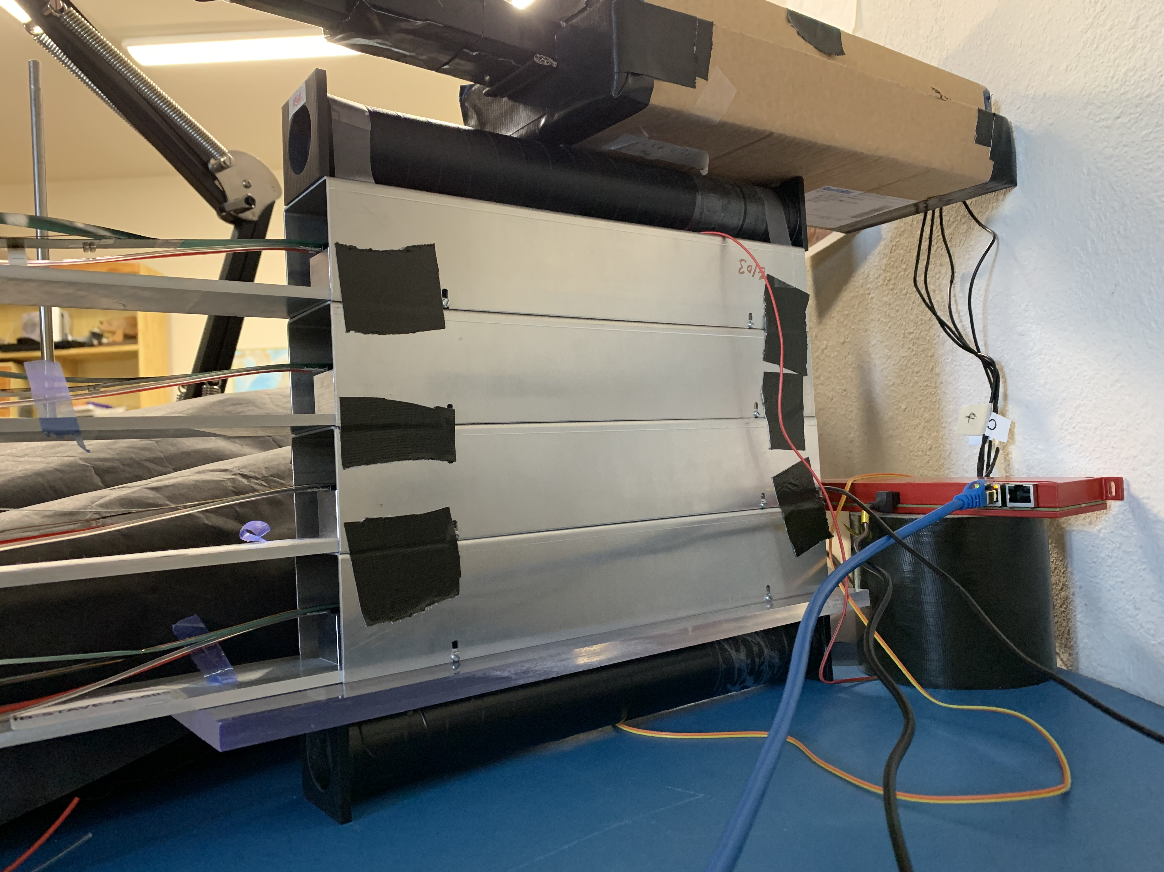
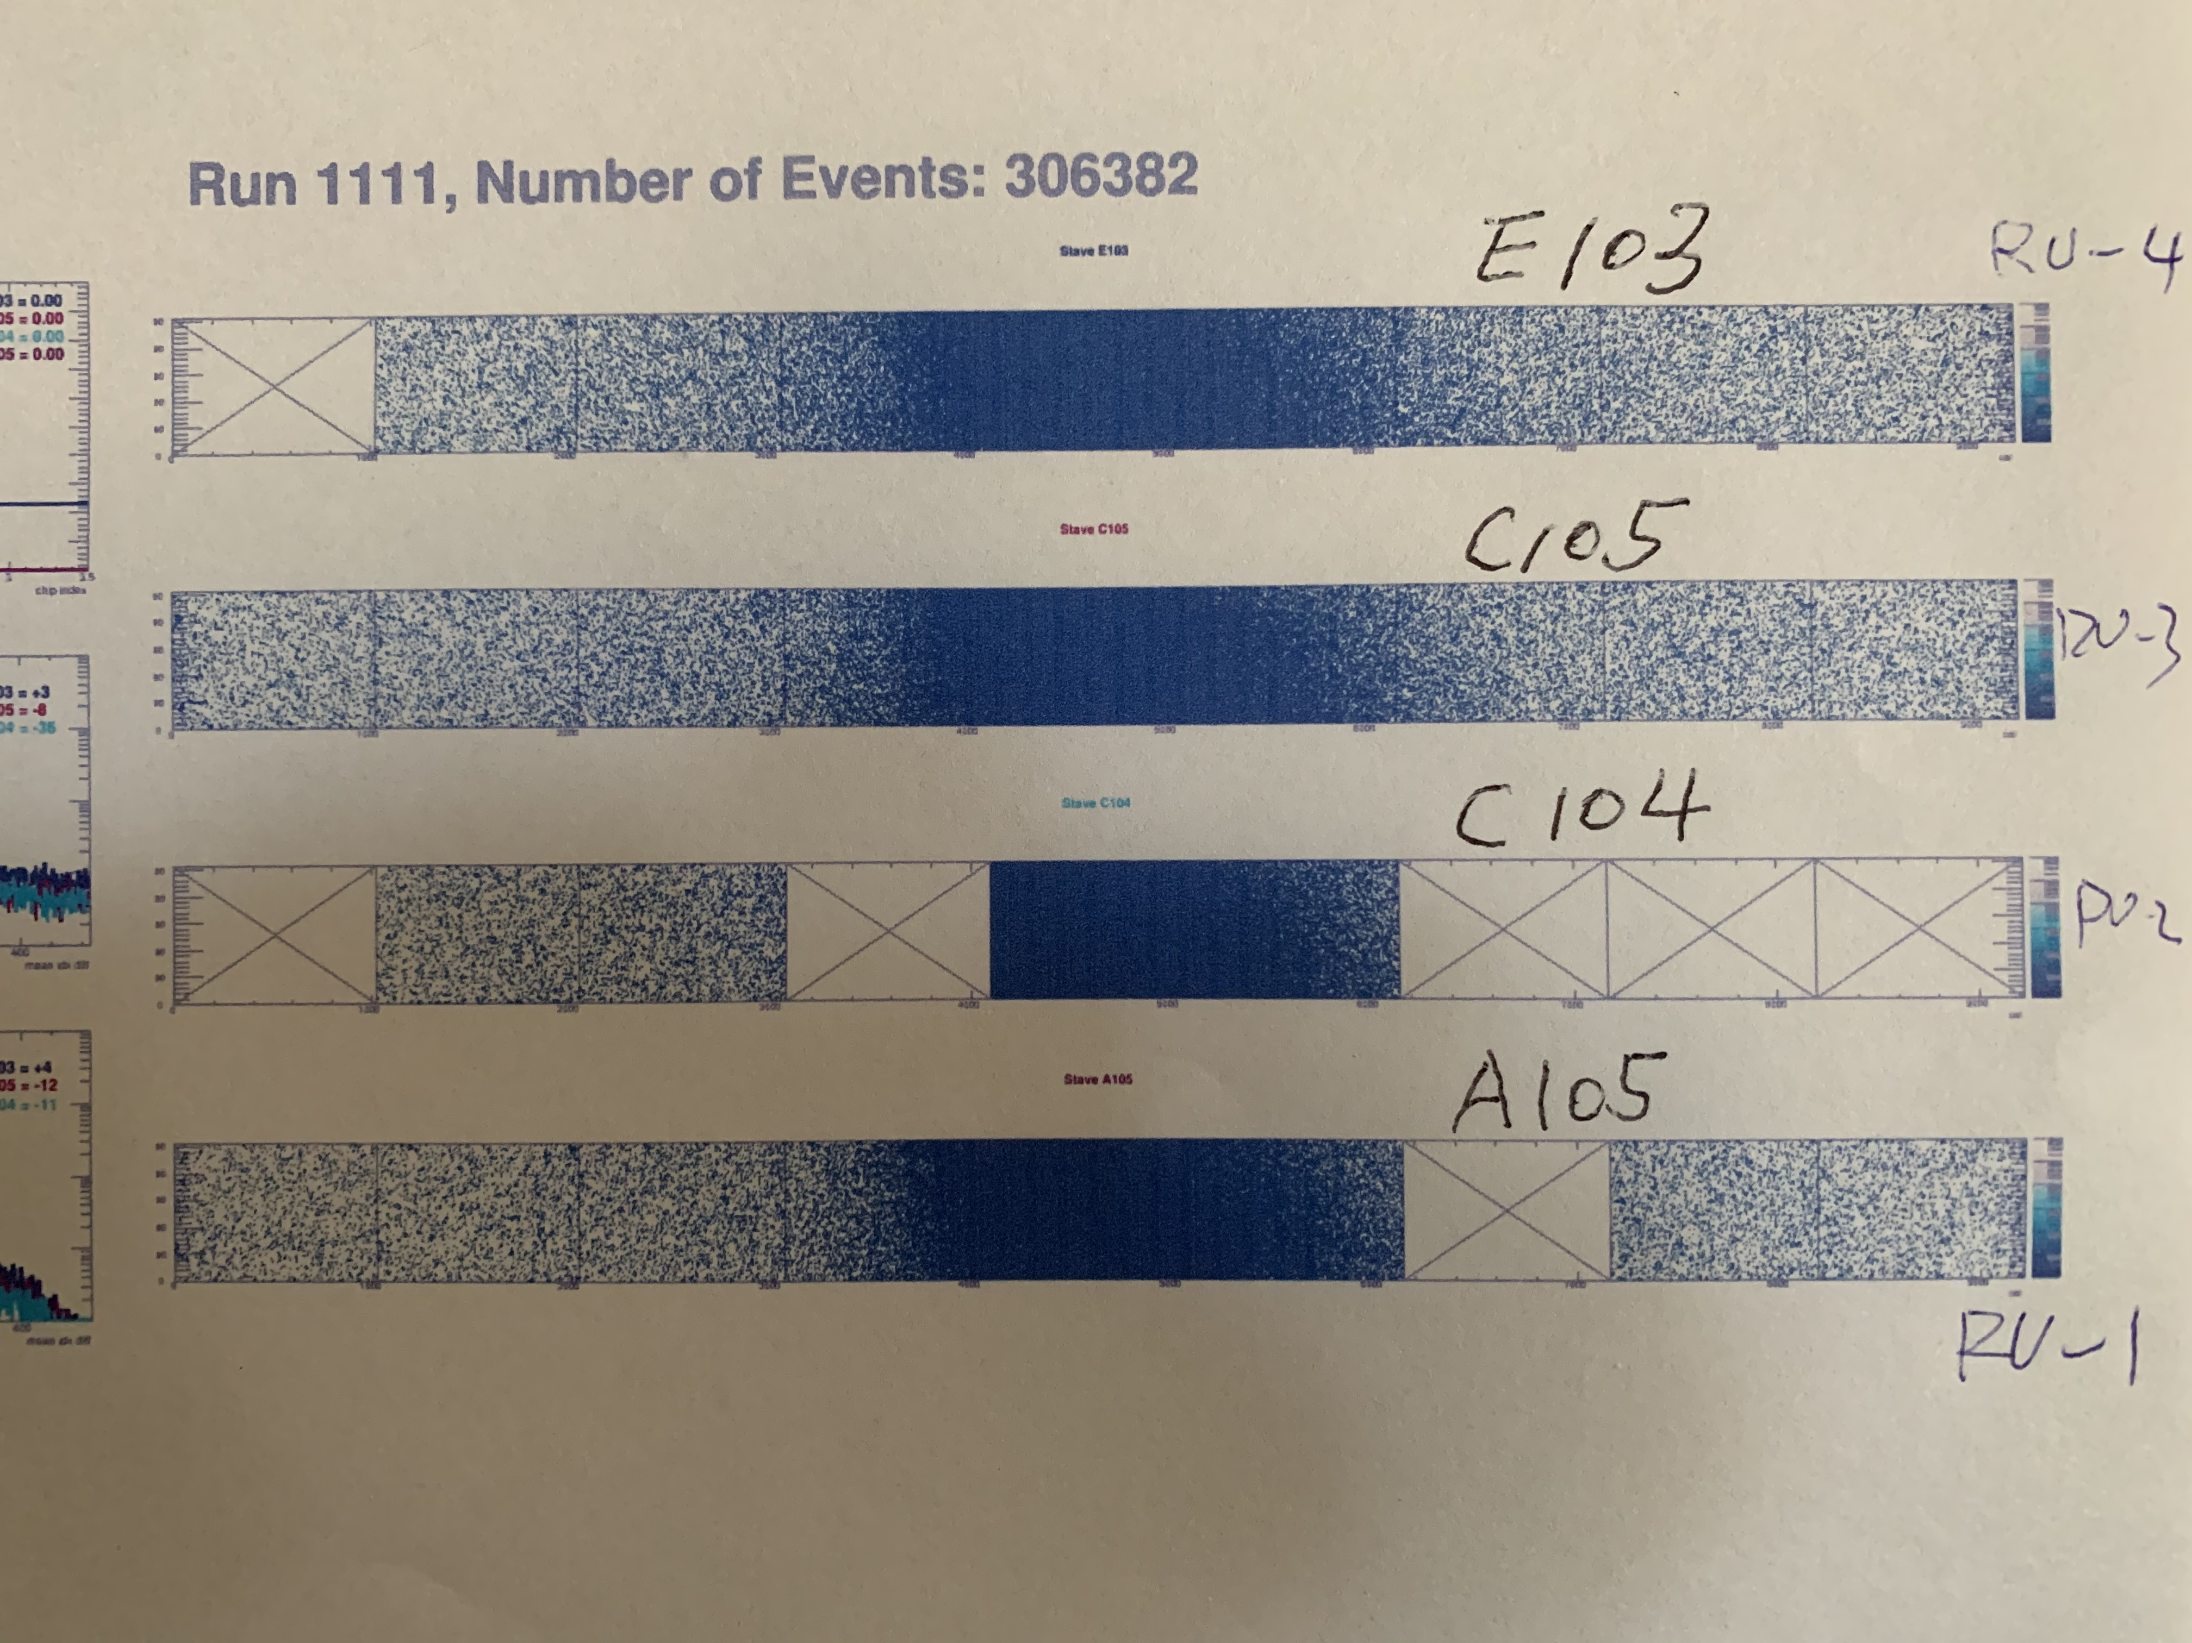
Cosmic Run with 4-stave Setup 4/2020
Cosmic shower detectors (4 scintillator bars, 2x2cm)
Two Cosmic Trigger detectors
RU4: E103
4 staves:
RU3: C105
RU2: C104
Trigger Detector
Readout
CAEN DT5702
RU1: A105
(Plot from 5/2019 Fermilab Test Beam Data)

Slide 2
Cosmic Trigger and Shower Detectors
Trigger: C8 & C9
Shower: C0 + C2 + C4 + C5
Cosmic ray
A short scitillaltor
C5
C0
C4
C1
RU4: E103
RU3: C105
C8
RU2: C104
Trigger = C8 & C9
4-stave Telescope
Trigger Detector
Readout
CAEN DT5702
RU1: A105
C9

Slide 3
Cosmic Data Run 1453: 4223 triggered events
RCF:
/gpfs/mnt/gpfs02/sphenix/user/mxliu/telescope/Cosmic-2020/ test_00001453-0000.prdf
Also: https://www.phenix.bnl.gov/WWW/publish/mxliu/sPHENIX/Telescopes/cosmic-2020/test_00001453-0000.prdf
Online Monitoring
RU-3
RU-1: A105
RU-1
RU-4
RU-2
RU-2:
C104
RU-3:
C105
RU-4:
E103

Slide 4
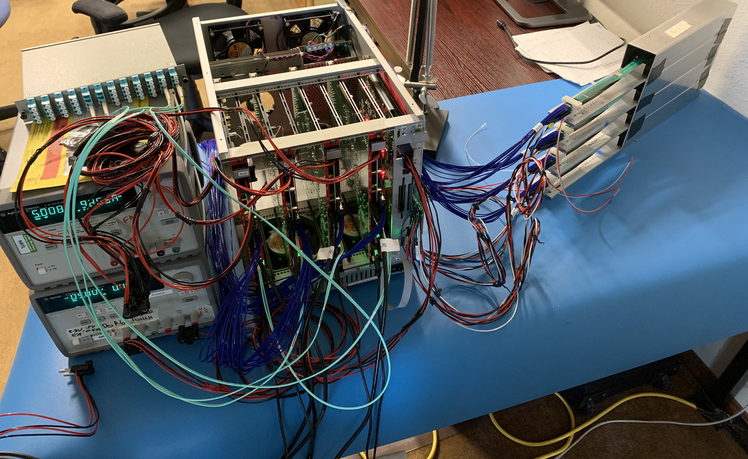
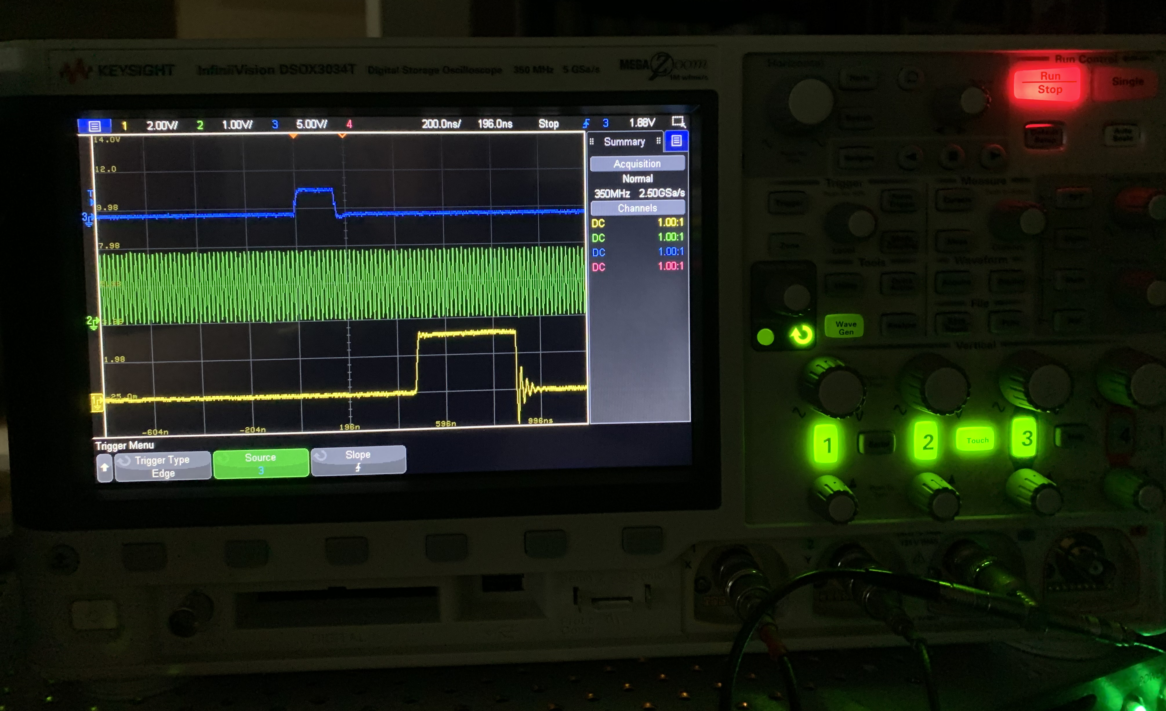
Readout: 4 RUs + 4 Staves
Cosmic trigger
from CAEN
GTM LVL-1 Accept

