Slide 1
Update History: e/mu/h Identification
06/14/2021, created after sPHENIX HF meeting
06/16/2021, included tracks w/o EMCal, Hcal hits, set dE = 0
Electron identification
Muon identification

Slide 2
Follow up on ML on e/mu/h identification 06/16/2021
Assigned dE =0 if there is no EMCal, iHCal or oHCal hit information
Track selection: 3 < p < 20 GeV

Slide 3
Electrons: 3< p<20 GeV, 20 ML models used

Slide 4
Electrons: p> 3GeV, from RandomForest
Purity: 932/1047=89.0%
Eff. = 932/2858 = 32.6%
FoM = Purity* Eff = 29.0%

Slide 5
Features’ Impacts: electron ID, from RandomForest Classifier

Slide 6
Electrons: p> 3GeV, from AVG Blender
Purity: 789/901=87.6%
Eff. = 789/2287 = 34.5%
FoM = Purity* Eff = 30.2%

Slide 7
Electrons: p> 3GeV, from Keras Slim NN
Purity: 530/573= 92.5%
Eff. = 530/2287 = 23.2%
FoM = Purity* Eff = 21.5%

Slide 8
Muon Identification
3 < p < 20 GeV
has hits in EMCal

Slide 9
Muons: 3 < p <20 GeV, 20 models
Purity: 530/573= 92.5%
Eff. = 530/2287 = 23.2%
FoM = Purity* Eff = 21.5%

Slide 10
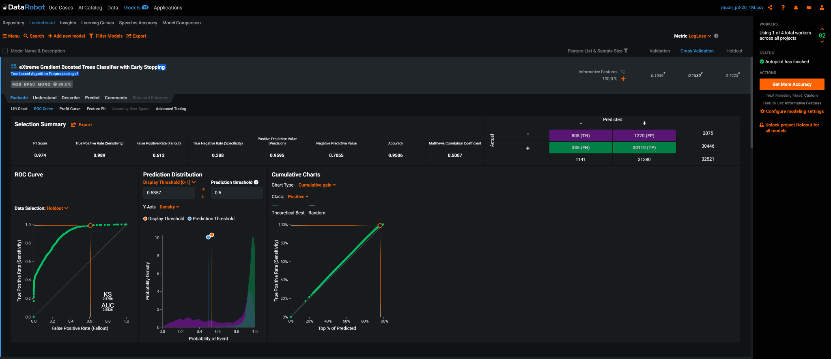
Muons: 3 < p <20 GeV, Extreme Gradient Boosted Tree Classifier with Early Stopping
Purity: 805/2075= 70.6%
Eff. = 530/2287 = 38.8%
FoM = Purity* Eff = 27.4%
Purity: 530/573= 92.5%
Eff. = 530/2287 = 23.2%
FoM = Purity* Eff = 21.5%

Slide 11
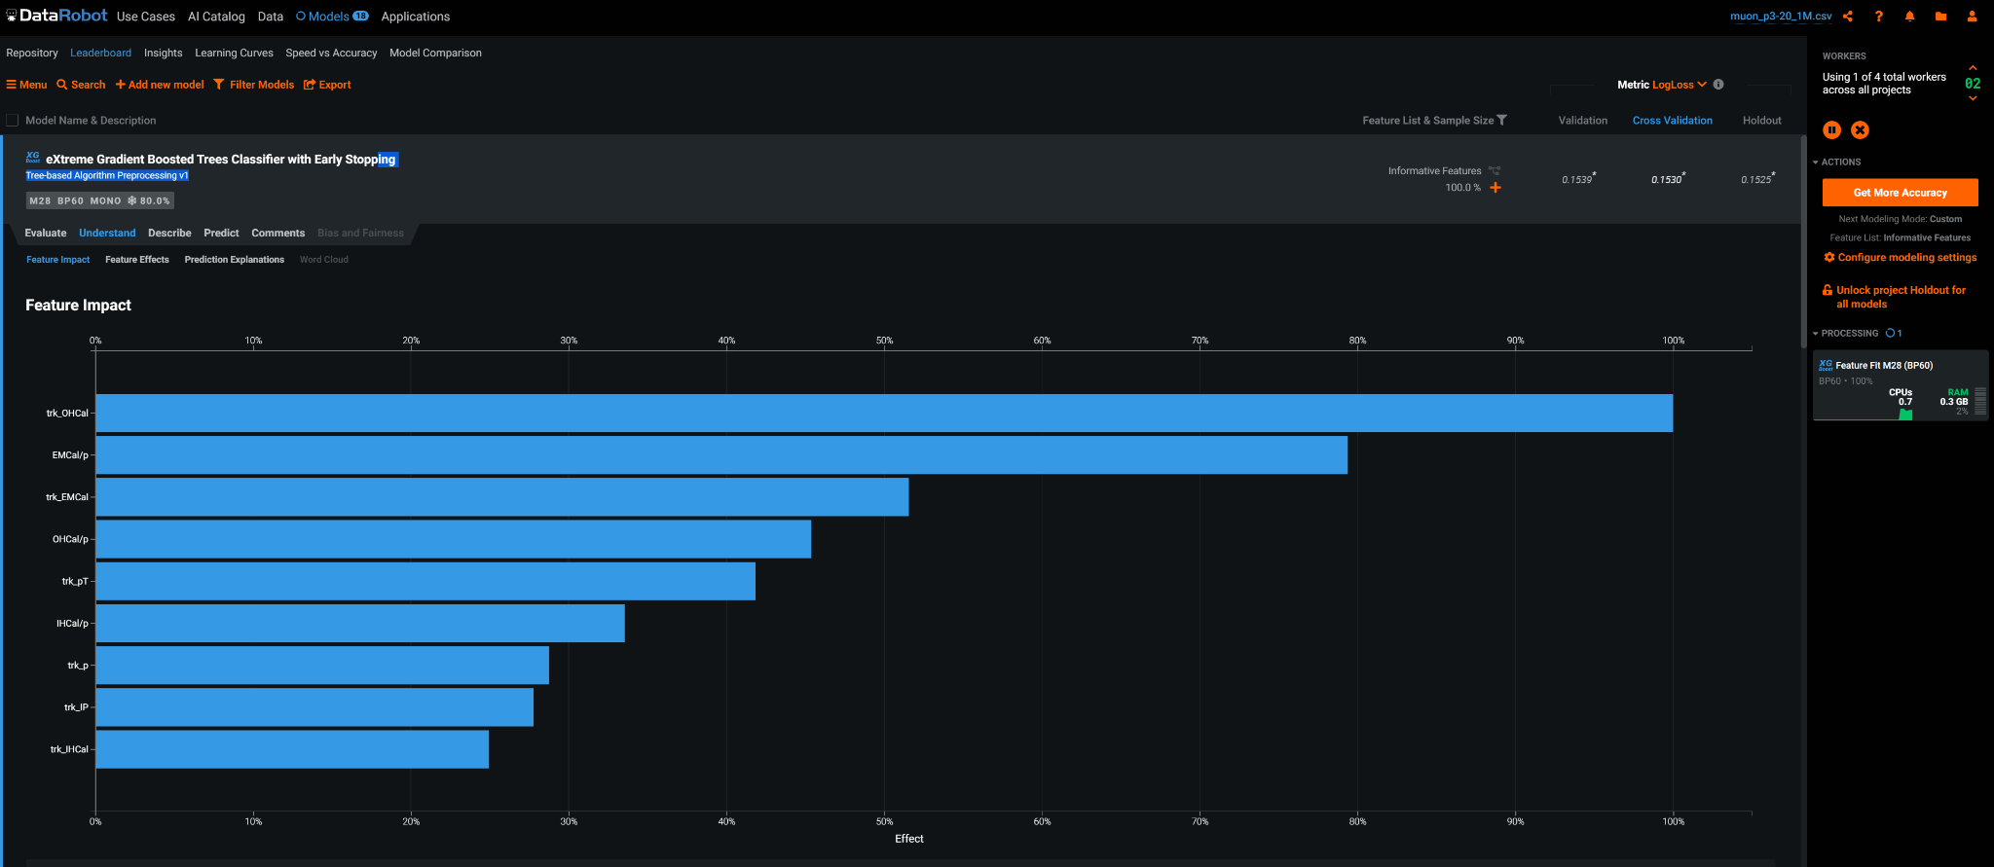
Key features: Extreme Gradient Boosted Trees
Purity: 530/573= 92.5%
Eff. = 530/2287 = 23.2%
FoM = Purity* Eff = 21.5%

Slide 12
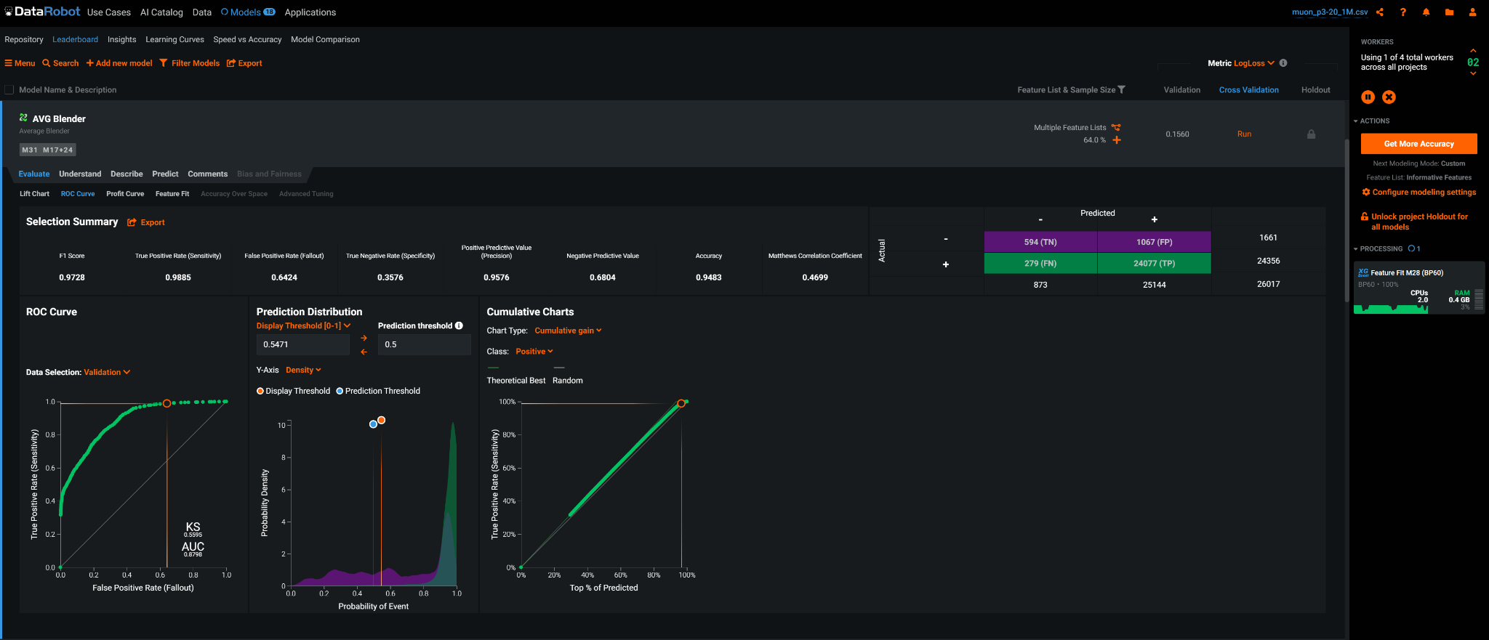
Muons: 3 < p <20 GeV, AVG Blender Model
Purity: 594/873= 68.0%
Eff. = 594/1661 = 35.8%
FoM = Purity* Eff = 24.3%
Purity: 530/573= 92.5%
Eff. = 530/2287 = 23.2%
FoM = Purity* Eff = 21.5%

Slide 13
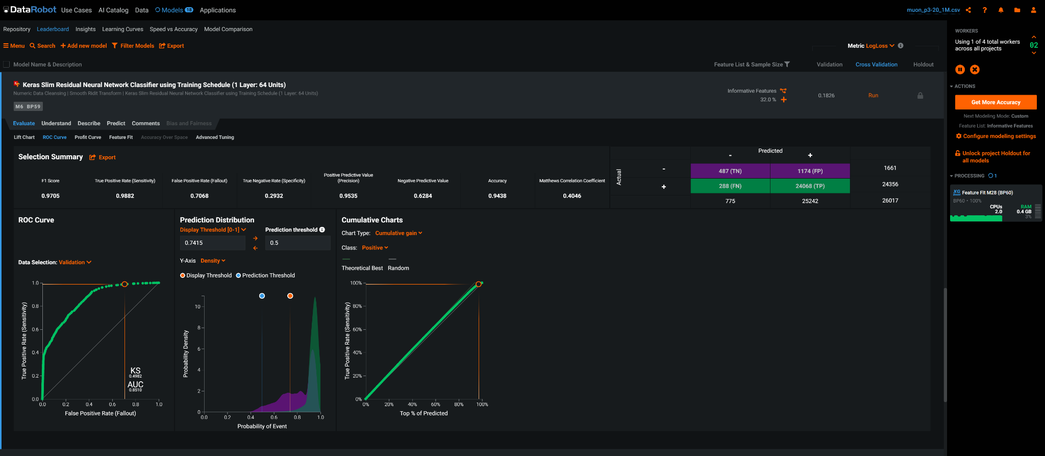
Muons: 3 < p <20 GeV, Keras Slim Residual Neural Network
Purity: 487/775= 62.8%
Eff. = 487/1661 = 29.3%
FoM = Purity* Eff = 18.4%
Purity: 530/573= 92.5%
Eff. = 530/2287 = 23.2%
FoM = Purity* Eff = 21.5%

Slide 14
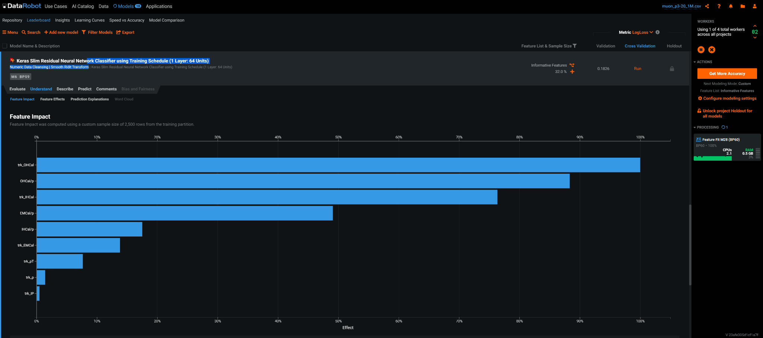
Key features: Keras Slim Residual Neural Network
Purity: 530/573= 92.5%
Eff. = 530/2287 = 23.2%
FoM = Purity* Eff = 21.5%

Slide 15
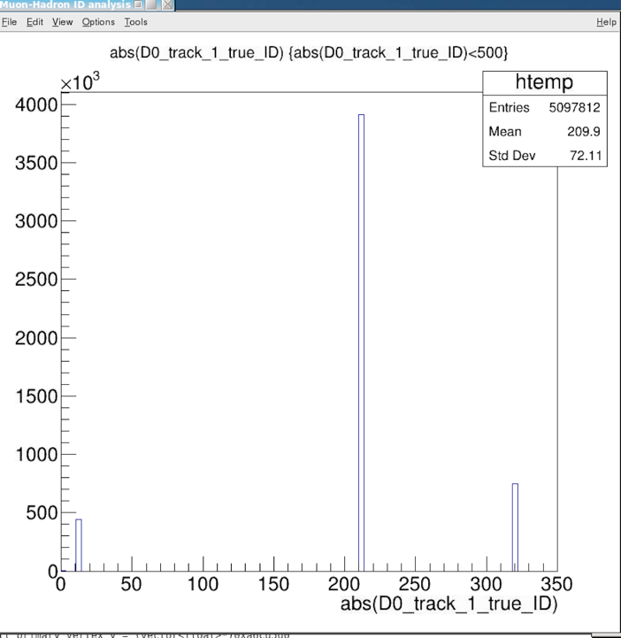
Muon Identification with ML - Cameron, Ming 06/14/2021
Tracks’ true ID
Tracking information, p, DCA, chi2 etc.
Mostly hadrons, ~5% muons
dE and matchings in dPhi, dEta, E/p
EMCal
IHCal
OHcal
The correlation is quite complicated, a good example where ML could help
Training/Testing samples (mostly muons, pi/K)
Cameron’s KFParticle output for J/Psi analysis, from bbbar events
Track p> 3GeV
EMCal>0, iHCal >0, oHCal > 0
Similar results observed for p >2GeV samples
DataRobot package provides 20+ Machine Learning Models for classification
Identify “muons” from the training samples
Selected top performers
Pi+/-
K+/-
e,mu

Slide 16
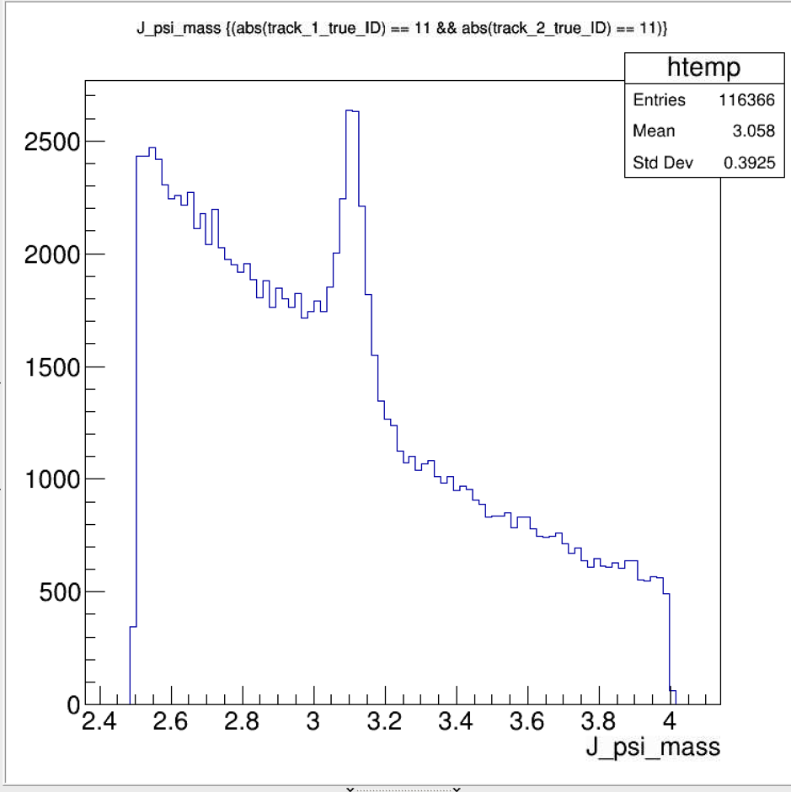
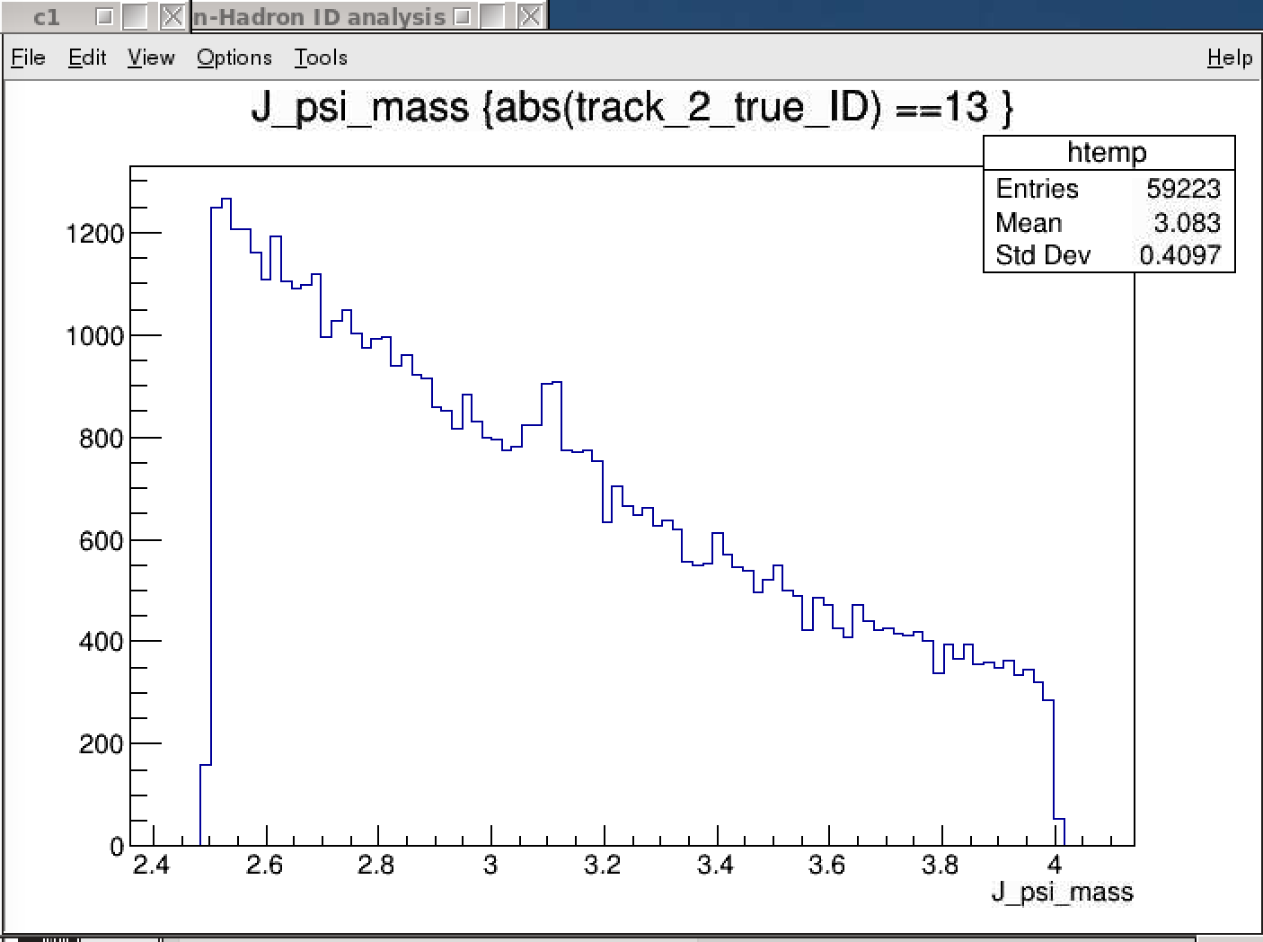
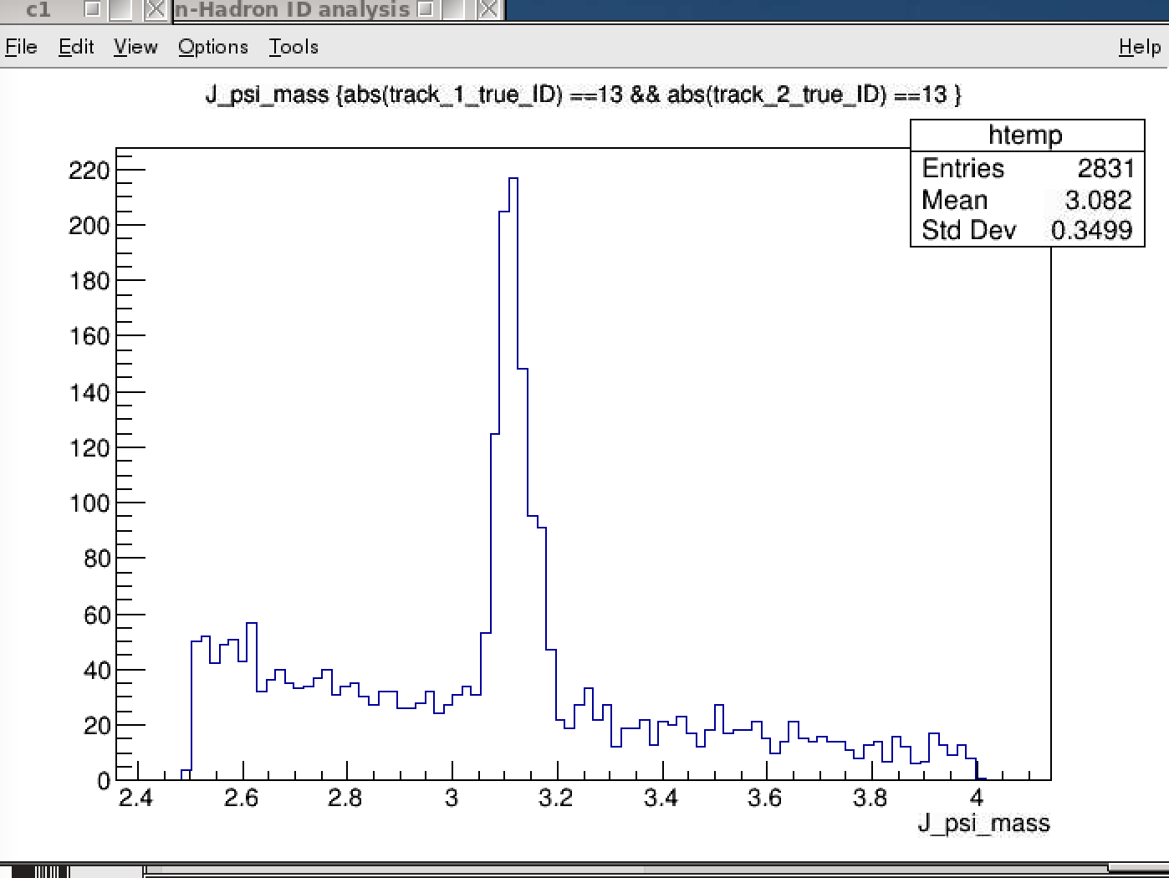
J/Psi Candidates with “di-muons” - later also for di-electrons, possibably
Two electrons identified
– note the high background
One muon identified
Two muons identified

Slide 17
Muon Identification
Study the EMCal, iHCal and oHCal responses to muon, electron and hadrons

Slide 18
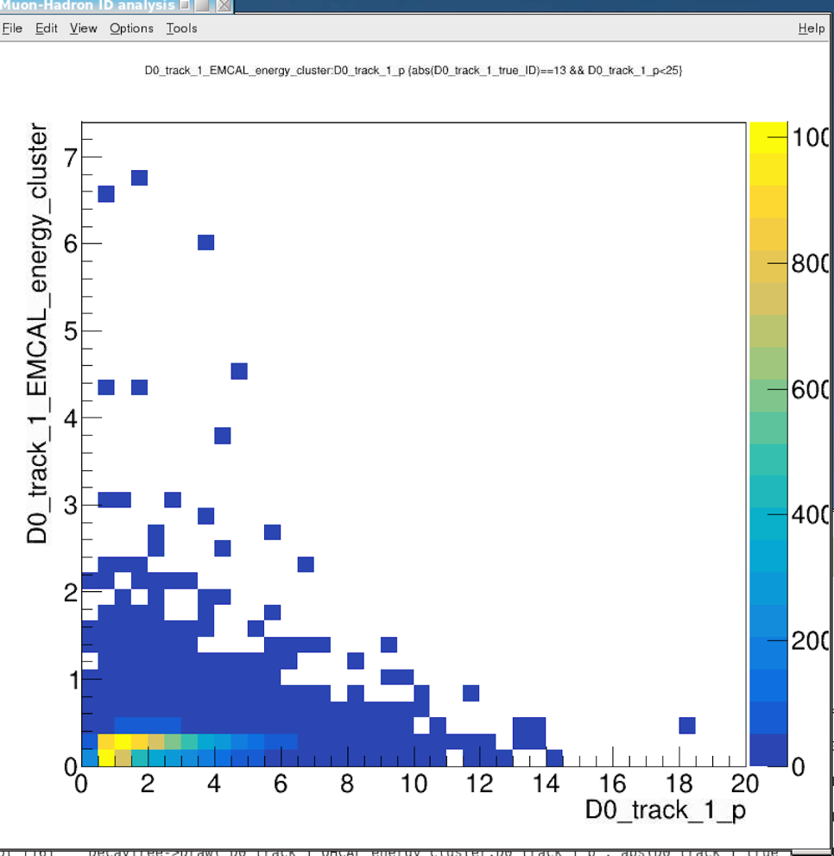
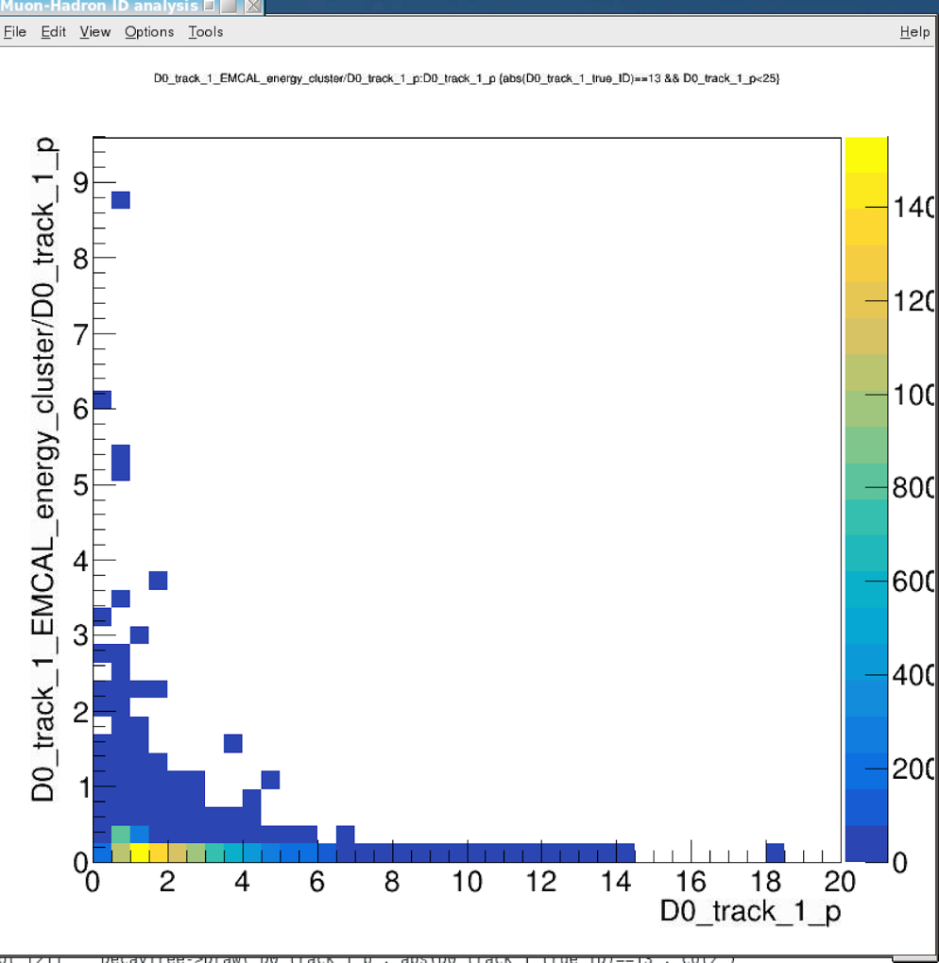
BBbar -> J/Psi, KFParticle Outputs
EMCal_energy_cluster vs p: Muons
E vs P
E/p vs p

Slide 19
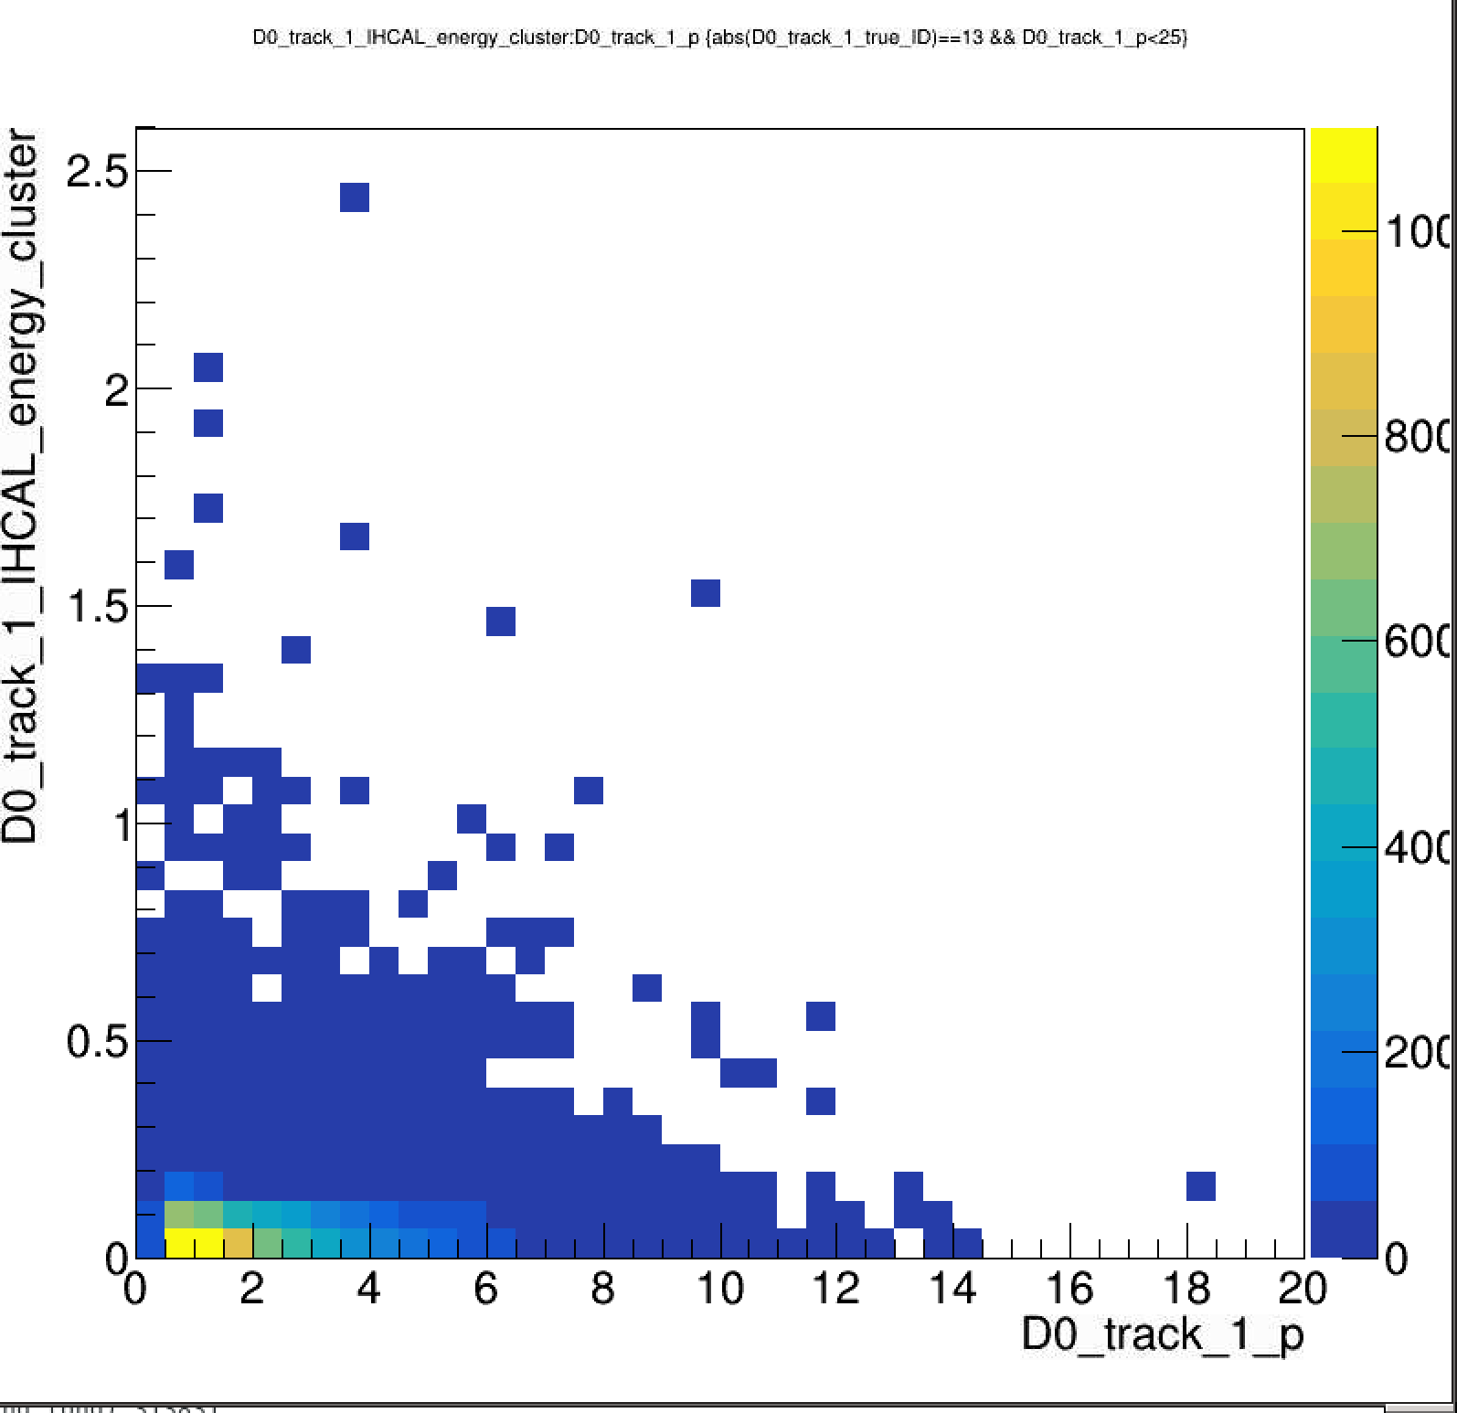
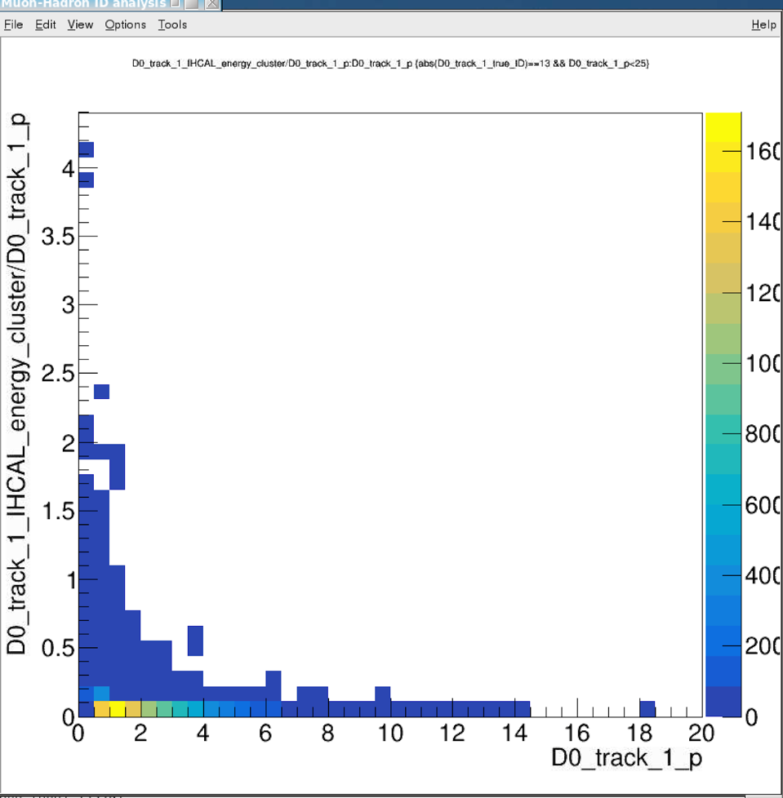
BBbar -> J/Psi, KFParticle Outputs
IHCal_energy_cluster vs p: Muons
E vs P
E/p vs p

Slide 20
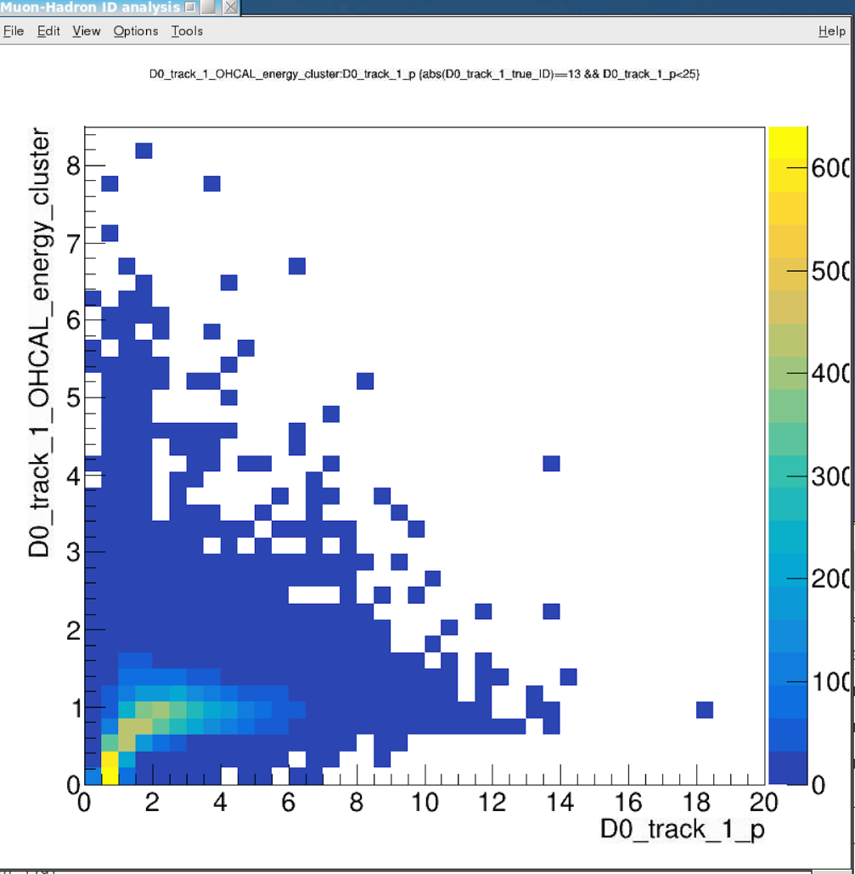
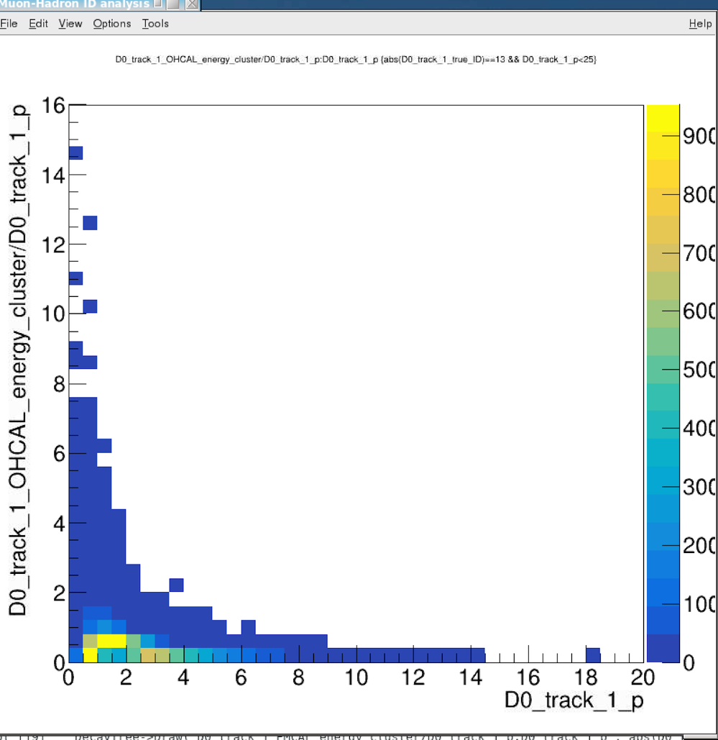
BBbar -> J/Psi, KFParticle Outputs
OHCal_energy_cluster vs p: Muons
E vs P
E/p vs p
MIP signal
from muons

Slide 21
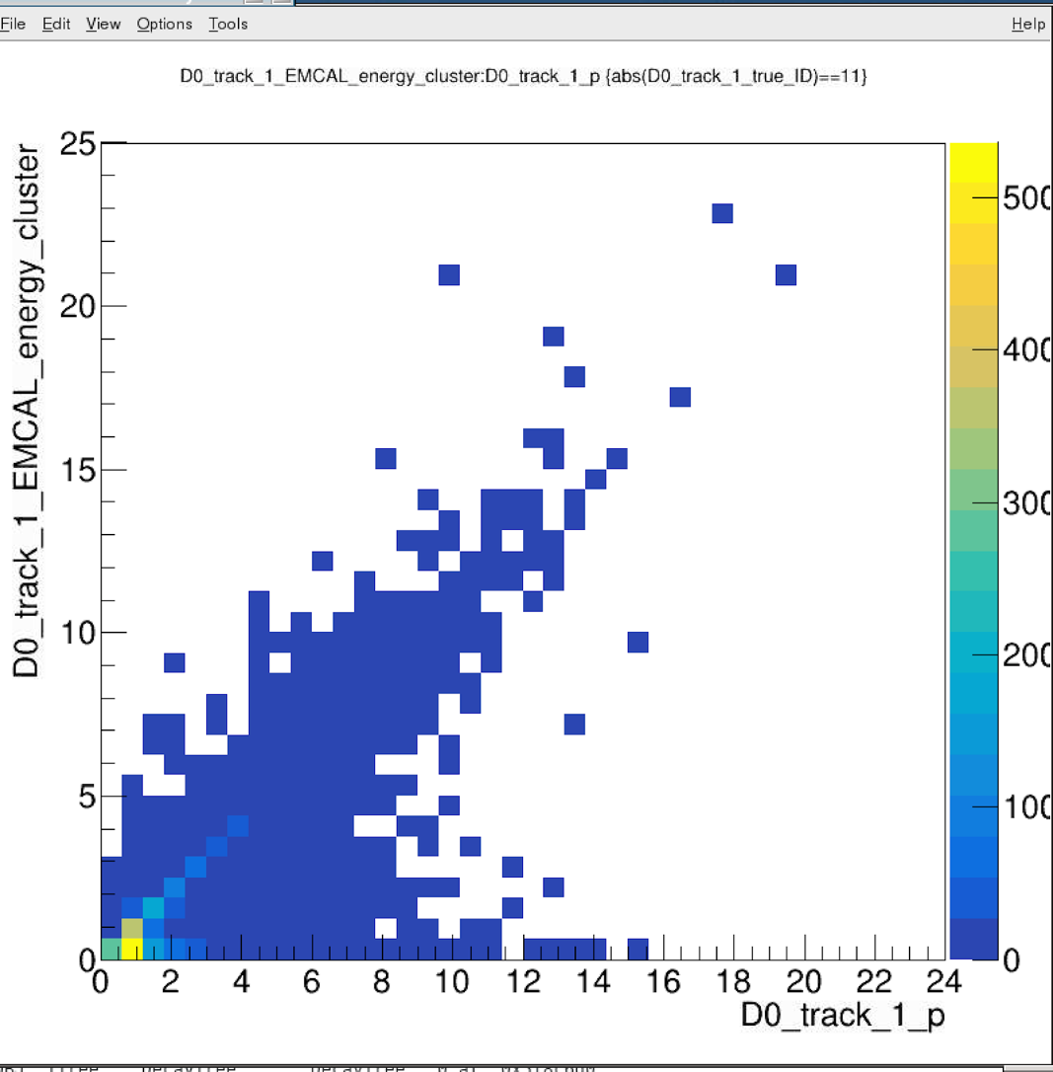
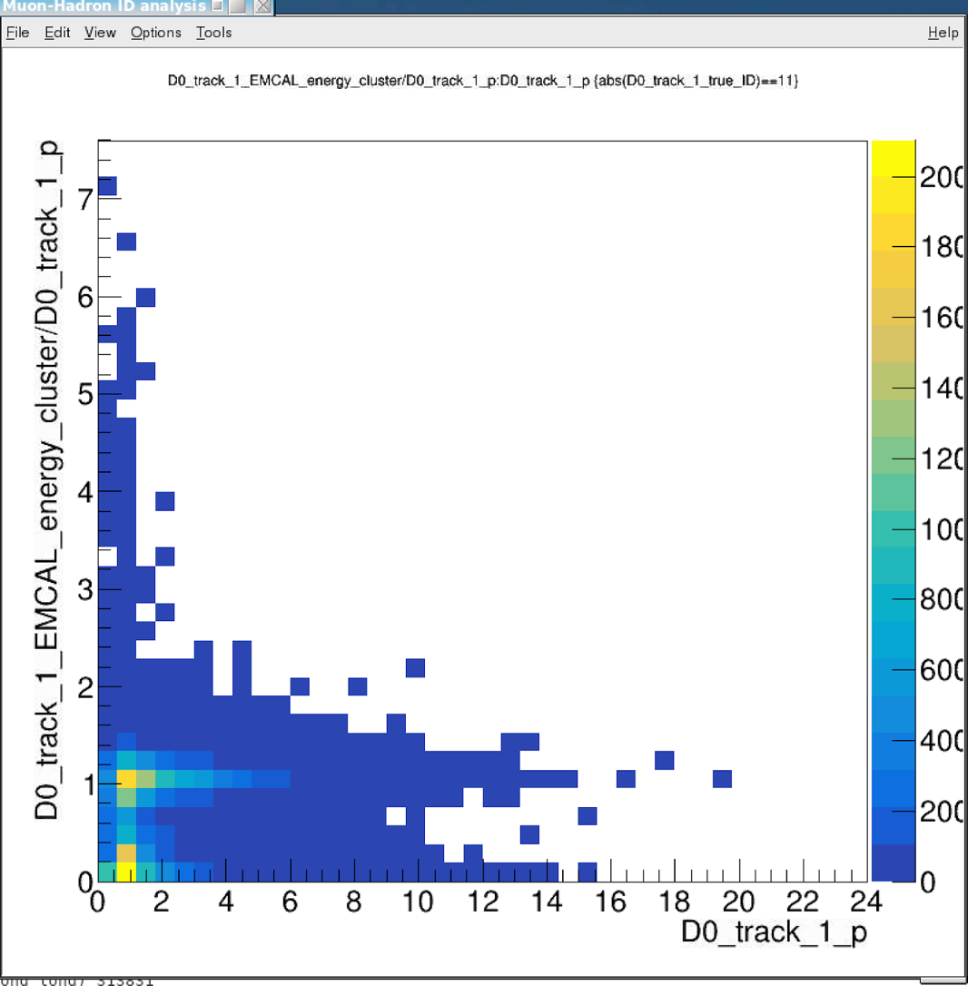
BBbar -> J/Psi, KFParticle Outputs
EMCal_energy_cluster vs p: electrons
E vs p
E/p vs p

Slide 22
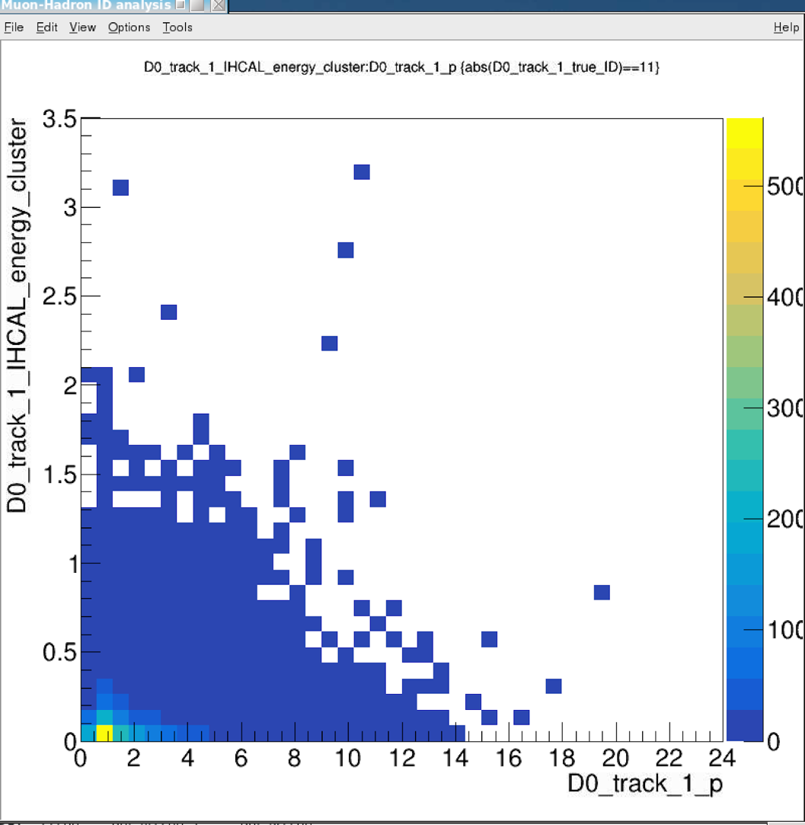
BBbar -> J/Psi, KFParticle Outputs
IHCal_energy_cluster vs p: electrons
E vs p
E/p vs p

Slide 23
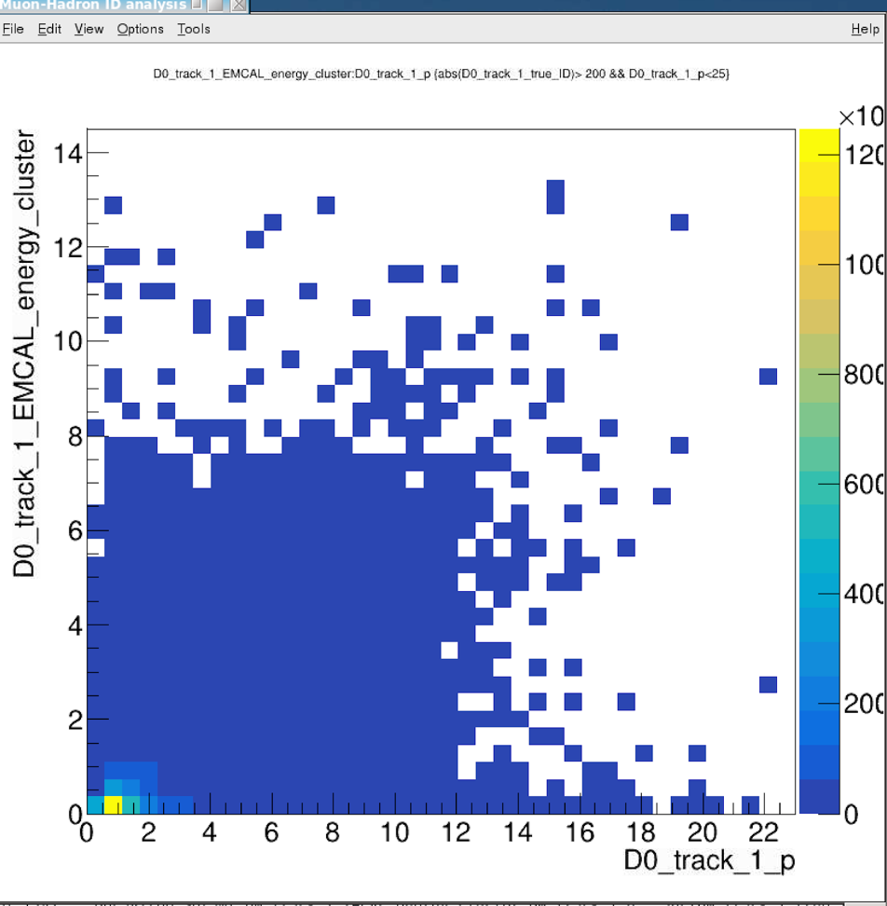
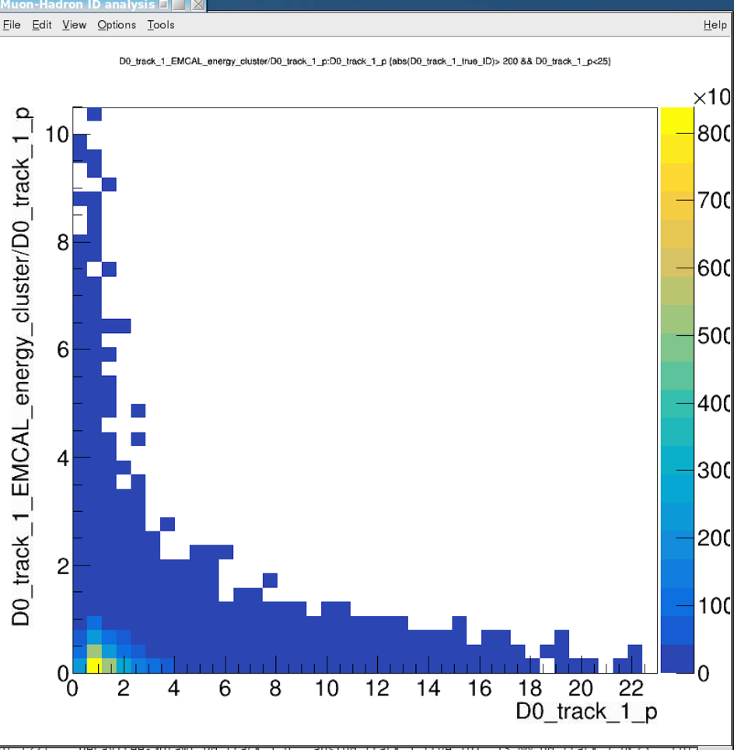
BBbar -> J/Psi, KFParticle Outputs
EMCal_energy_cluster vs p: pi+/- & K+/-
E vs p
E/p vs p

Slide 24
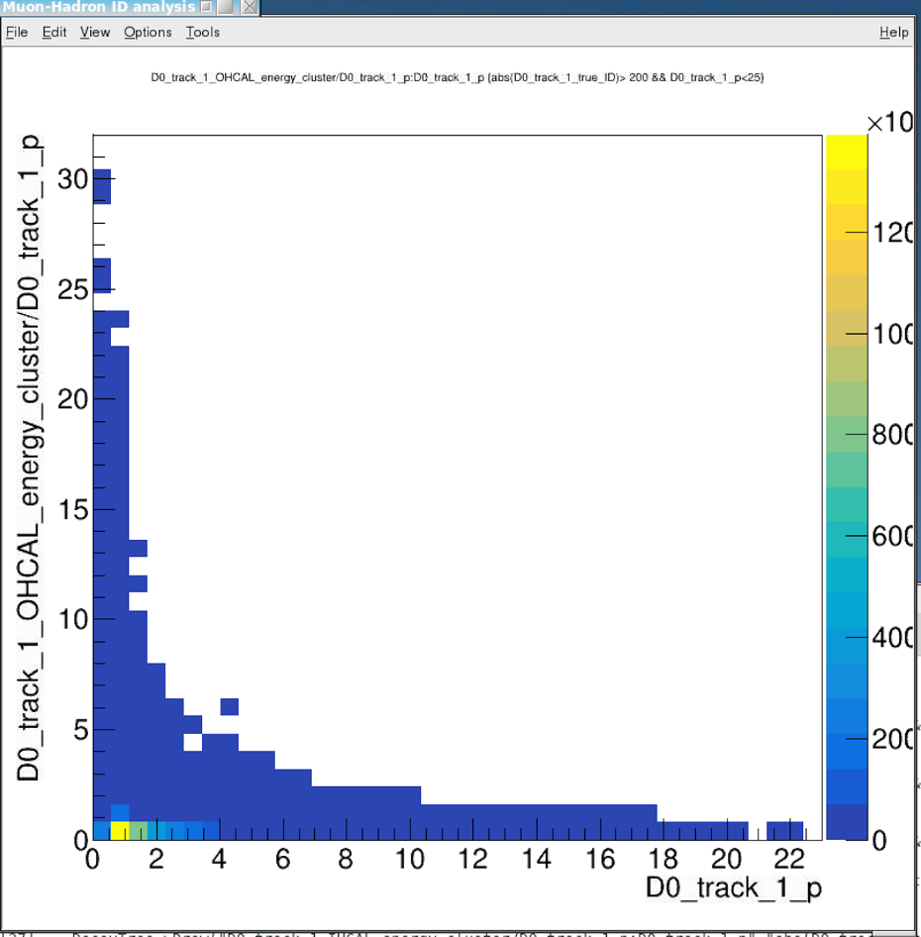
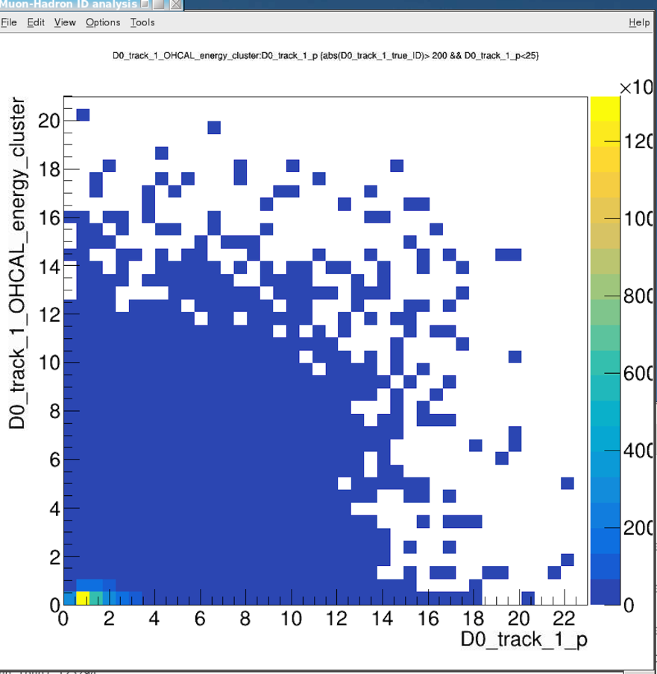
BBbar -> J/Psi, KFParticle Outputs
OHCal_energy_cluster vs p: pi+/- & K+/-
E vs p
E/p vs p

Slide 25
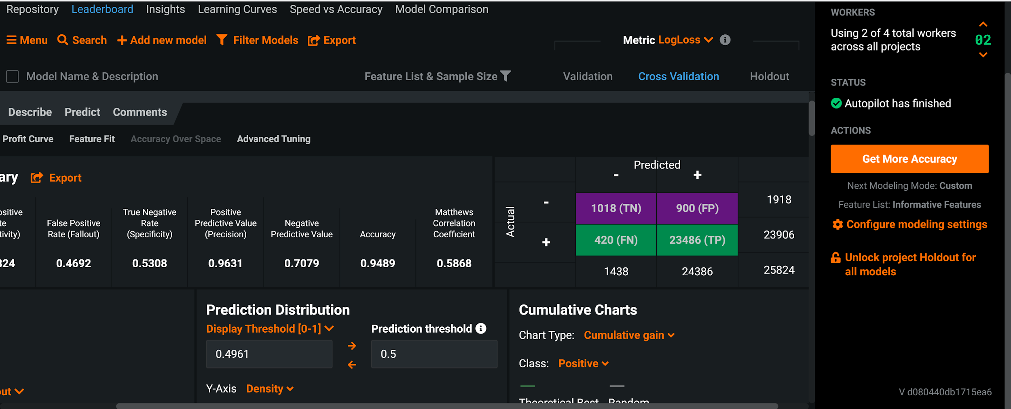
Random Forest Model: - 71% purity and 53% Eff for Muons

Slide 26
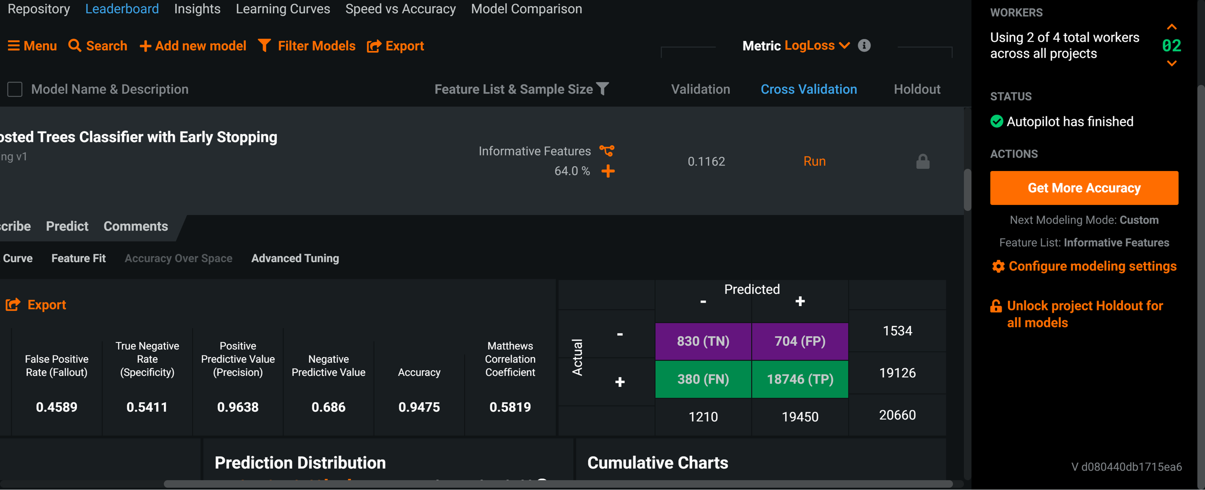
Boosted Tree with Early Stopping - 69% Purity and 54% Eff. for Muons

Slide 27
Summary and Todo List
It seems very feasible to tag high energy muons ~> 2GeV
More detailed study in progress
Test with ROOT/TMVA, PyTorch and other NNs for improvements
New experimental probes with “muons”, “electrons” etc,
Track DCA seems not fully utilized/realized in the models in the ML
HF Physics motivated improvement possible in NN
B->J/Psi +X, B+ -> J/Psi +K; Bs -> J/Psi + Phi
J/Psi -> dimuon (di-electron)
B-> high pT muon (electron), semi-leptonic decay channels etc.

