Slide 1
MVTX Scope & Overview
Ming Liu, for the MVTX Group
Los Alamos National Laboratory
MVTX Interim Design Review
November 19, 2018

Slide 2
Today’s Agenda
13:00 → 13:20 Scope and Overview, 20’
  Speaker: Ming Liu (Los Alamos)
13:20 → 13:40 Electronic Components, 20’
  Speaker: Sho Uemura (Los Alamos National Laboratory)
13:40 → 14:20 Mechanical Components and Installation, 40’
  Speaker: Walter Sondheim (Los Alamos National Laboratory)

Slide 3
Outline
Document: sPH-HF-2018-001
https://indico.bnl.gov/event/4072/
Submitted to BNL ALD 2/2018
MVTX technology
MVTX project scope
Design and R&D progress
Near term plan

Slide 4

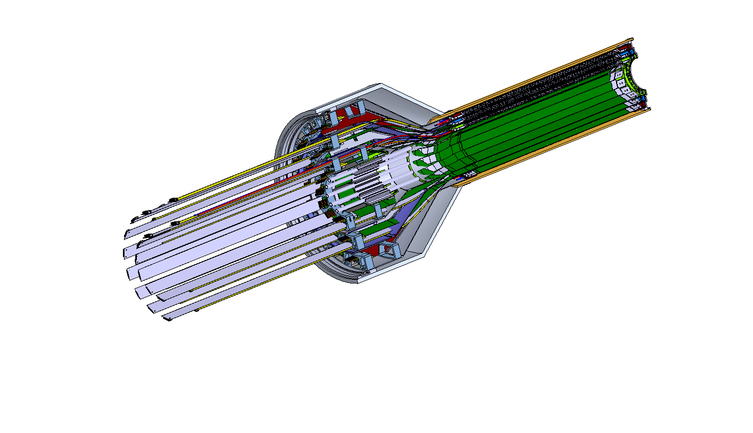
MVTX Detector
Service cone: signal, power, cooling
and mechanical support
CYSS: Cylindrical Shell Structure
End-Wheel
Extended power FPC
3-layer sensor barrel
- 48 staves, 432 chips
MVTX
parameters
MVTX RUs, PUs & other services

Slide 5
Scope of the MVTX Project
MAPS Staves & Electronics
  Readout Integration R&D by LANL LDRD
  Frontend: ALICE/ITS, RU
    Backend: ATLAS FELIX
    Reprogram RU & FELIX for sPHENIX
  Production:
    84 ALICE/ITS-IB staves from CERN
      Acceptance test @LBNL
      48+spares(36)
    60 ALICE/ITS-RU from CERN
      Acceptance test @UT-Austin, 48+spares(12)
    sPHENIX production, 8 ATLAS/FELIX
      Acceptance test @LANL
    Final detector assembly in US
      LBNL and BNL
  Ancillary systems, “adopt” ALICE system
Mechanics & Cooling
  Changes to ALICE/ITS inner tracker mechanical structures,
    End Wheels
    Cylindrical structure shells
    Detector half barrels
    Detector and Service half barrels
  Mechanical Integration,
    Conceptual design by LANL LDRD
    Prototype by sPHENIX R&D, MIT/LANL
    Design integration frames
    Composite structures, LBNL
    Installation tooling etc.
  Adopt ALICE cooling plant design
    Modifications to fit sPHENIX
    Much smaller heat load than ALICE ITS
Sho Uemura
Walt Sondheim
Walt Sondheim

Slide 6
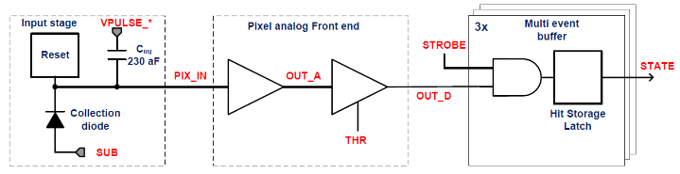
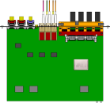

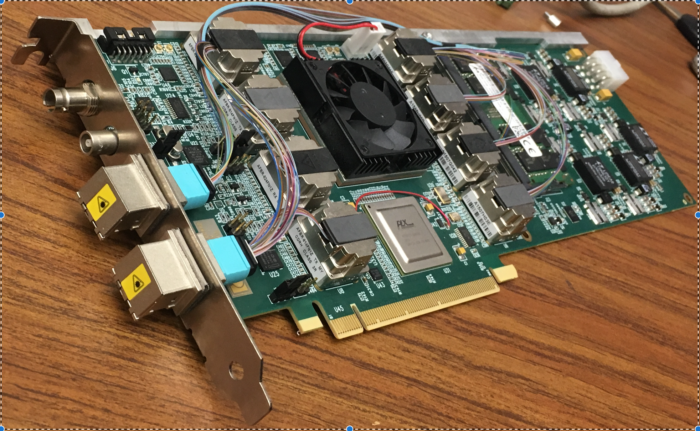
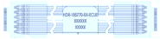
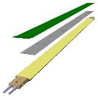

MVTX Readout, Power and Controls
CAN bus
DCS
Trigger & Clock
Readout Unit
Front End
GBT Optical Links
one pixel
9 Data (1.2Gbps)
1 Clock, 1 Control/Trigger
Control
Data (9.6 Gb/s max)
Trigger
9-sensor Stave
Samtec Twinax “FireFly”
FELIX
Back End
FPC
Power
ATLAS Front-End Link eXchange (FELIX):
sPHENIX Data Aggregation Module(DAM)
Alpide Sensors
Power
Filtering Capacitors
regulators
Power supplies
Cold Plate
Regulated Power
ALPIDE pixel:
Shaping
Digitization
Zero-suppression
3x buffer
Power Board
Interaction Region
Experimental Hall
Counting House
MVTX Detector Electronics consists of three parts
Sensor-Stave (9 ALPIDE chips) | Front End-Readout Unit | Back End-FELIX/DAM

Slide 7
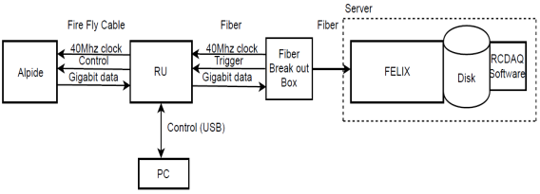
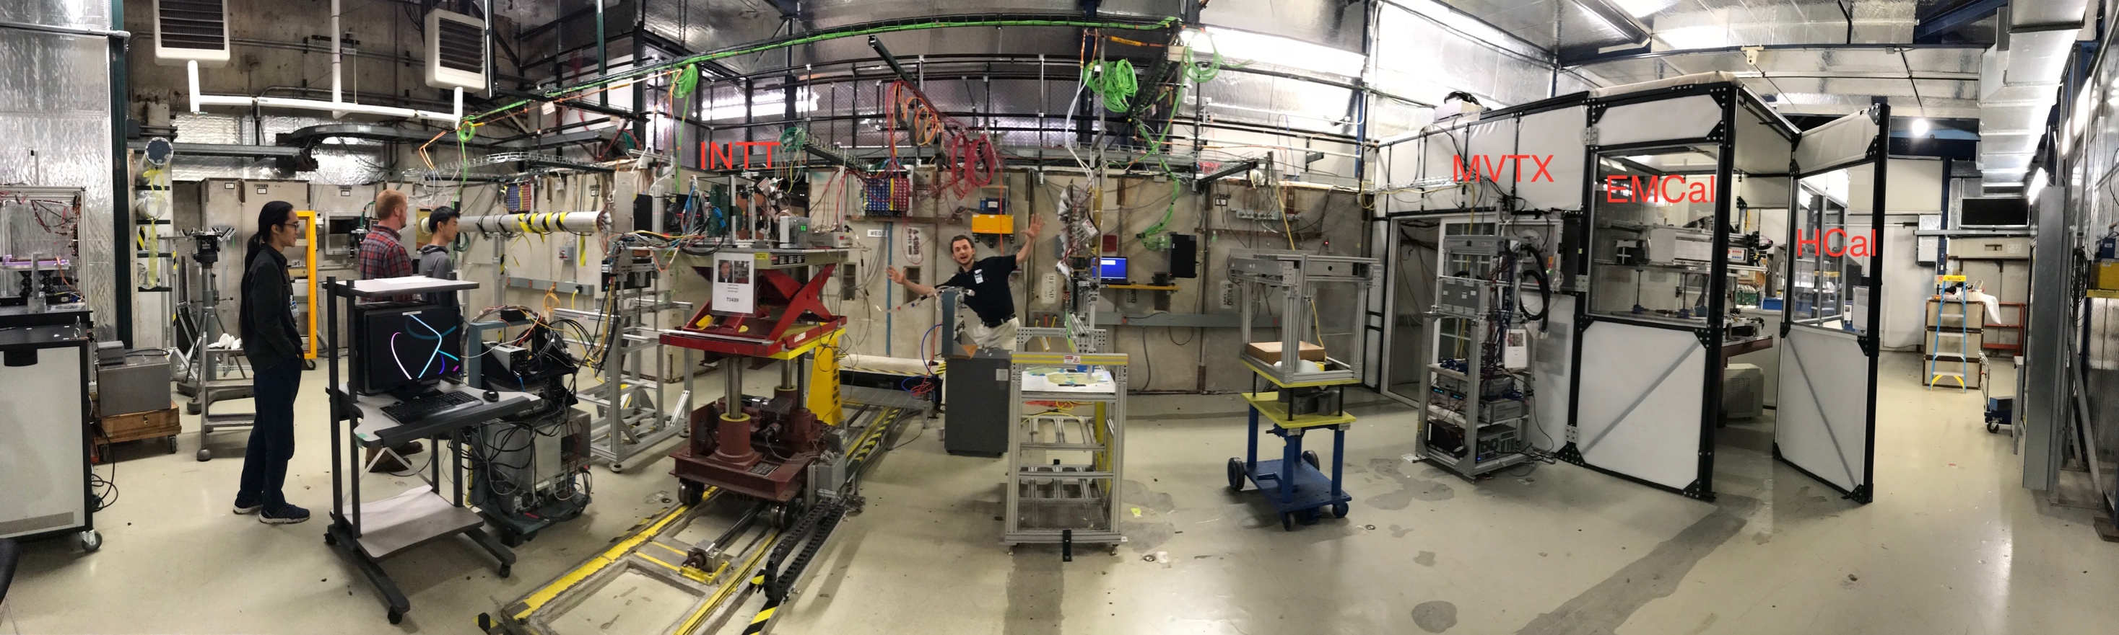
MVTX Full Readout Chain Demonstrated
4-MAPS
telescope
Fermilab Test Beam: Feb-Mar, 2018
Tracking spatial resolution
achieved: <5 um
120 GeV proton
beam
4-hit track
4-MAPS telescope

Slide 8
Updated MVTX Model with Extended Power FPC
Walt’s talk
This model shown with 38 and 40cm flat power extension cables
PP-1a: signal cables
PP-1b: power cables

Slide 9
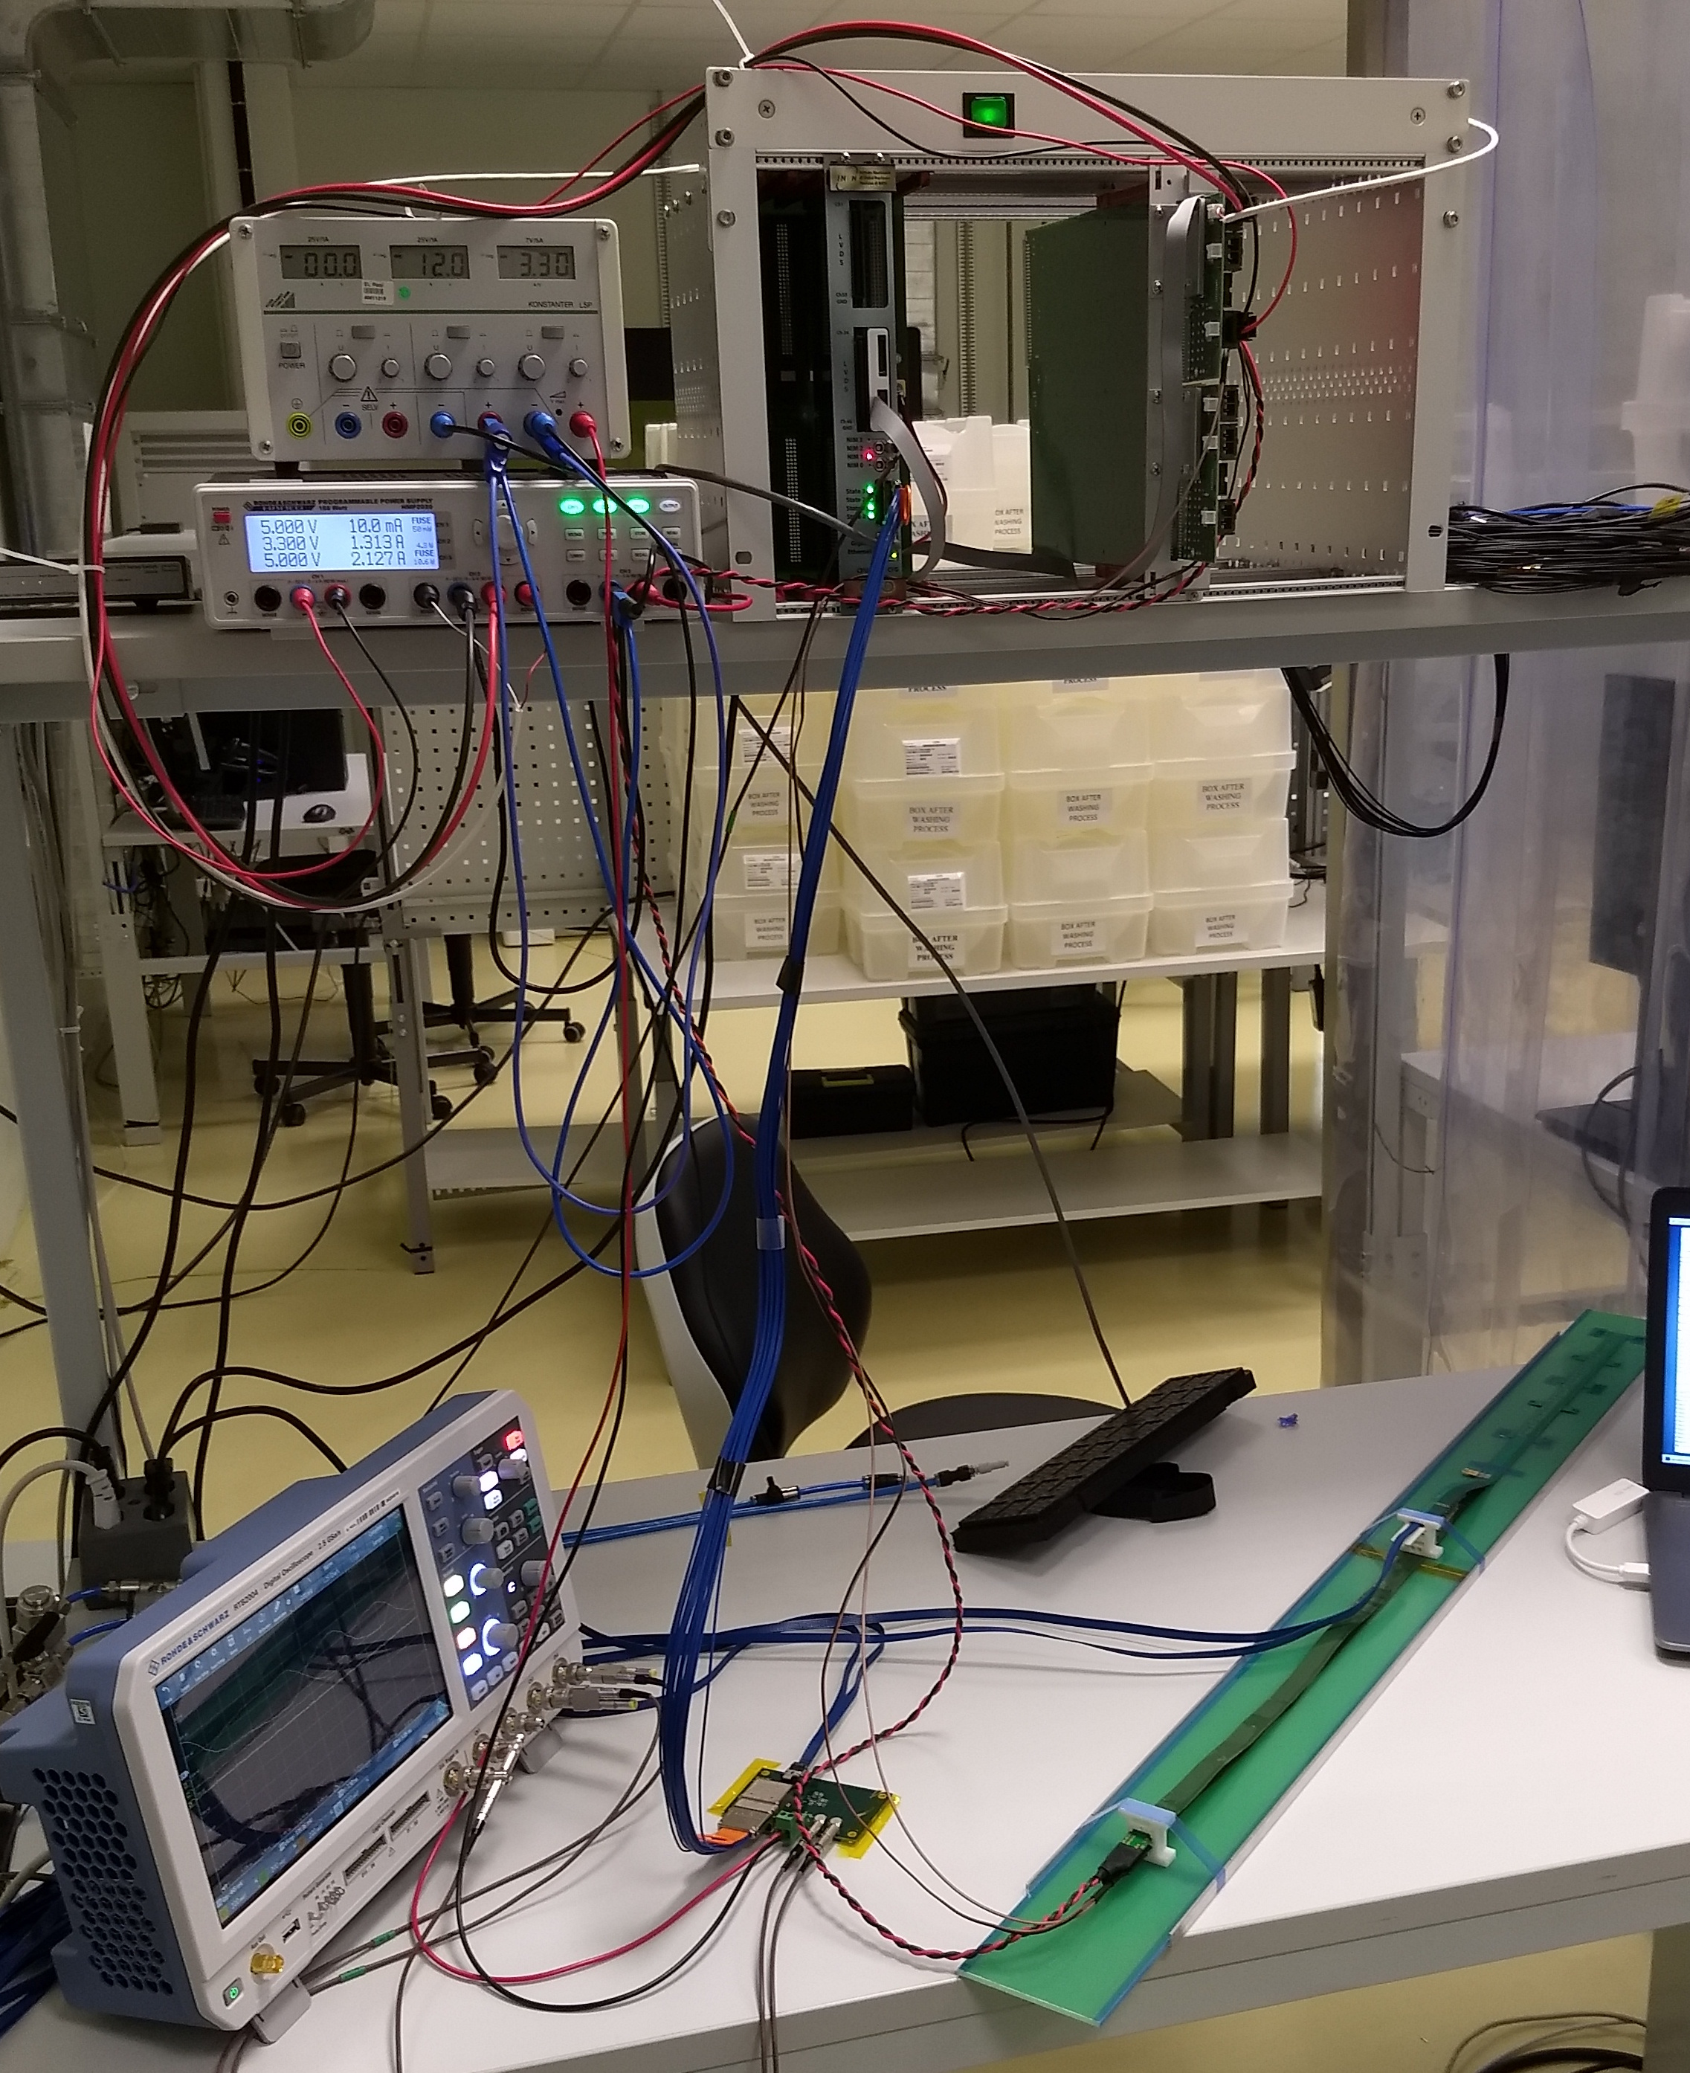
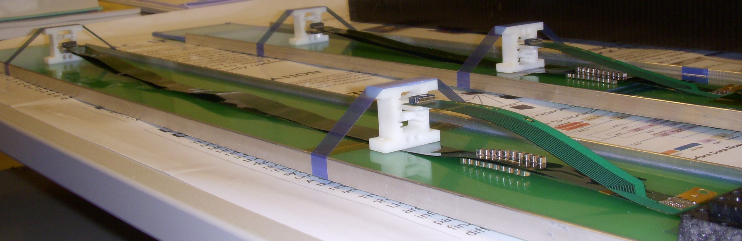
Confirmed HIC with Extended Power FPC
Sho’s talk
Built and tested two HICs at CERN in the week of 9/17/2018
  No change in sensor performance (noise, threshold) observed, as expected;
More details presented by Dr. Sho Uemura at last Friday’s sPHENIX general meeting 9/23/2018
40cm PWR FPC
60cm PWR FPC
ALICE: 15cm PWR FPC
Followed identical
ALICE IB QA test procedure,
with a 8m SamTec cable!

Slide 10
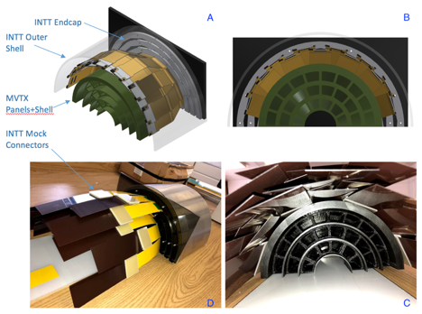
MVTX + 4-layer INTT 3-D Mockup: OK
MVTX and INTT
Space conflict resolved!

Slide 11
ALICE HS SamTec Signal Cables: ~8m!
Two cables per IB stave: 2.65m + 5.30m
Sho’s talk
HDR-203194 (Type B)
HDR-206142 (Type A)
PP-2
PP-1
Two
RUs
Two
Staves
L: 5300 mm
L: 2650 mm
(for sPHENIX, this one could be longer,
optimization in progress)
The total length of readout cable < 8m, from stave to RU
(for sPHENIX, this one could be shorter, ~1m,
optimization in progress)

Slide 12
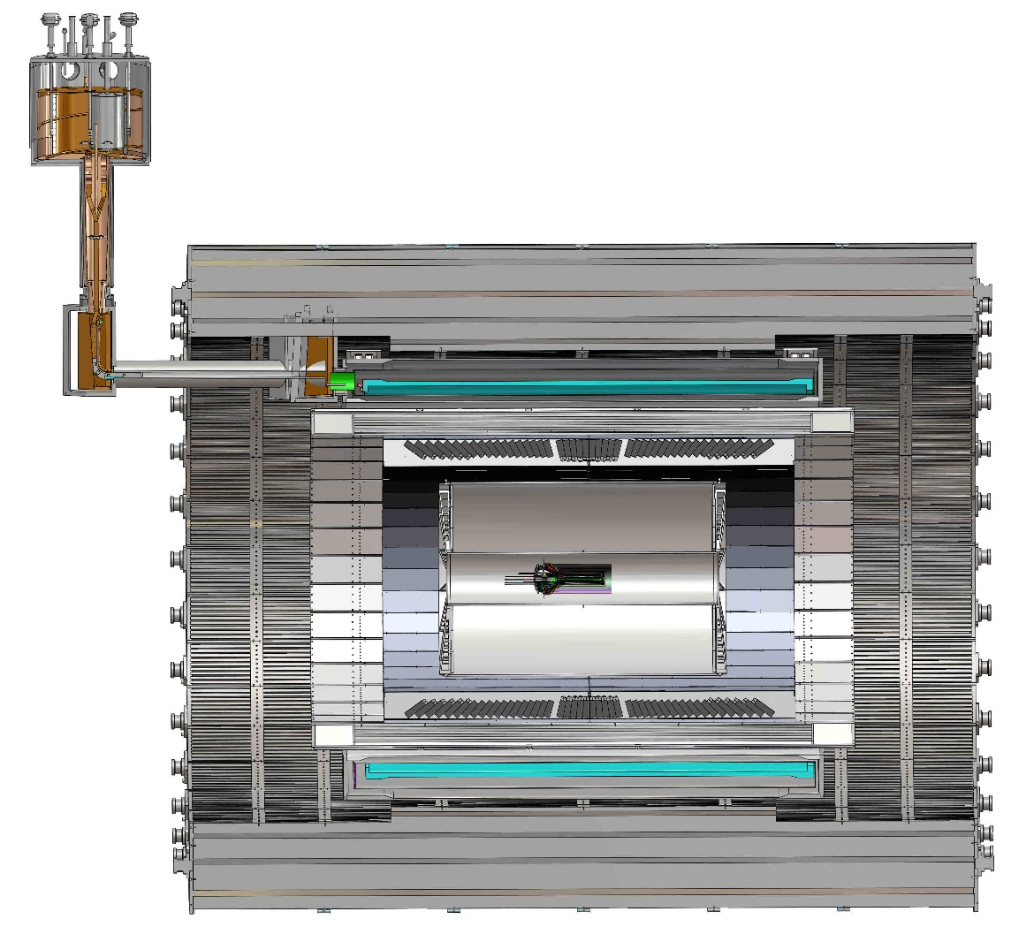
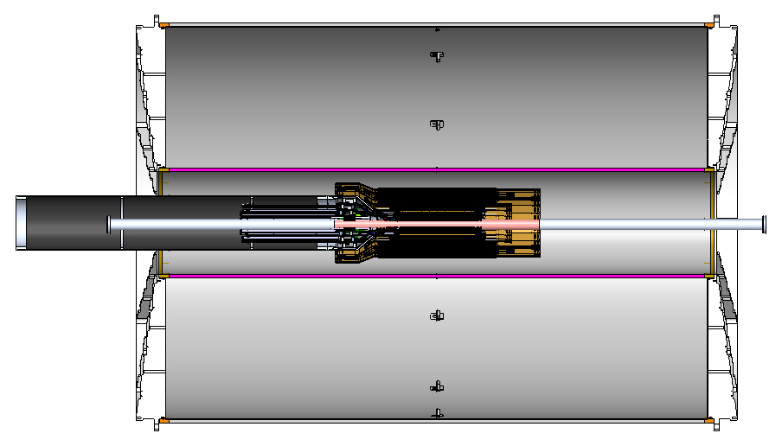
Global Mechanical Integration
MVTX, INTT and TPC/HCal
  MVTX/INTT detector designs modified
  Global interface being developed
  Office of System Integration
Walt & Sho
Service Barrel
TPC
TPC
INTT
MVTX
PP-1a:
short signal cables
PP-2:
Signal and power cables
R= 209.6cm
PP-1b:
power cables
L = 350.0 cm

Slide 13
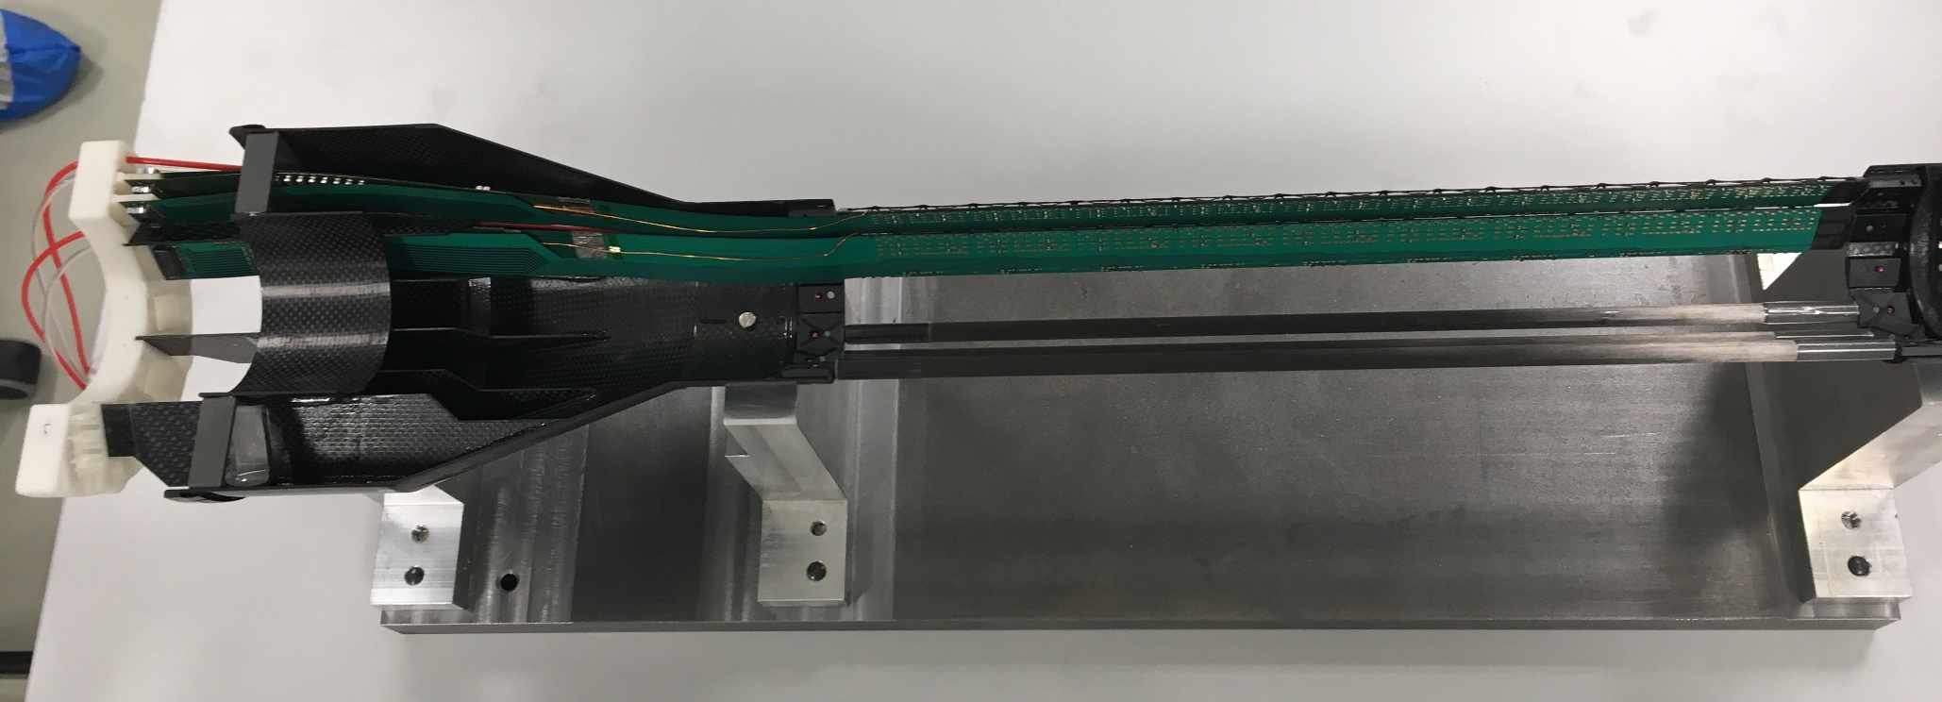
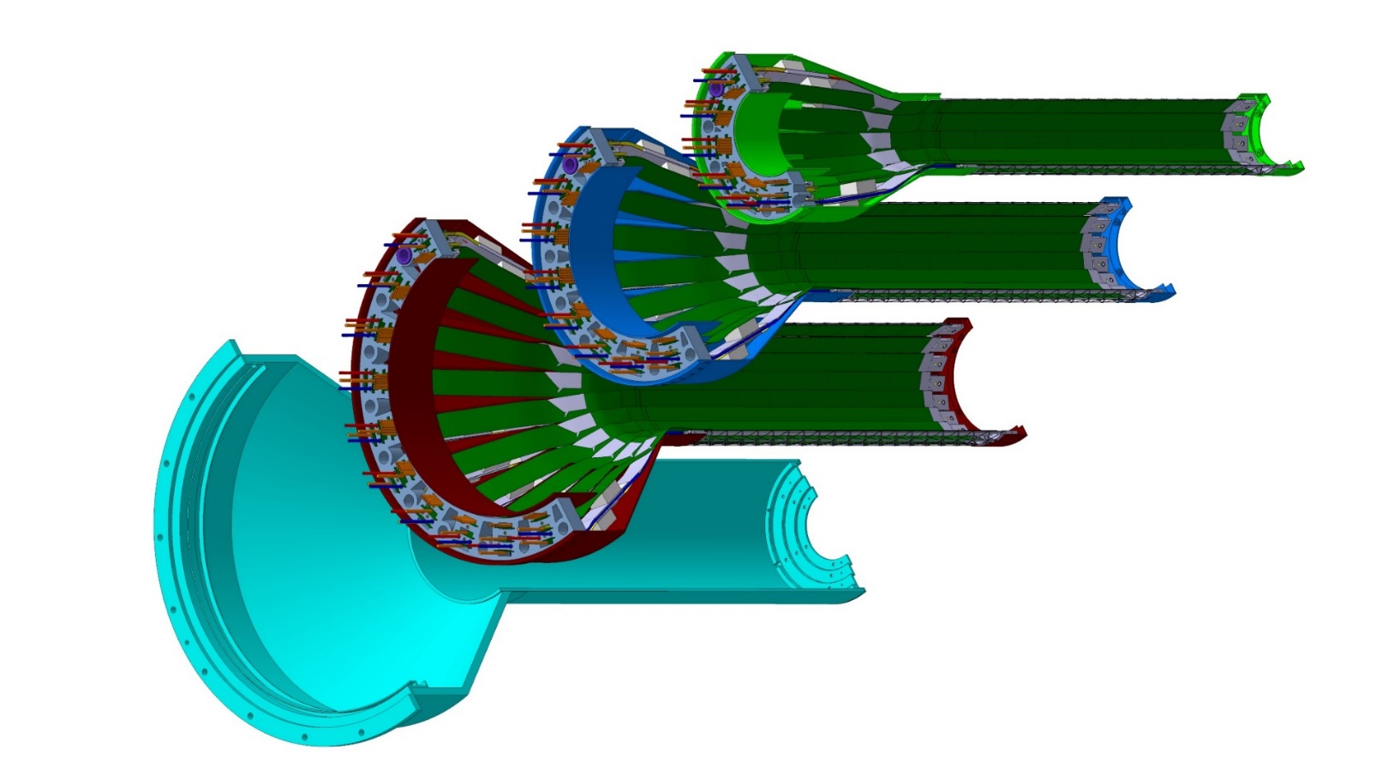
Detector Assembly Plan at LBNL
staves
Precision positioning and installation of staves on end-wheels
ALICE 1st half inner layer being assembled
6/2018@CERN
Layer 0
Layer 1
Follow ALICE IB assembly procedures to build half-detectors for MVTX
QA records in DB, travelers
Modified jigs for MVTX
Build two full half-barrel detector with the service structures
Layer 2
IB CYSS
Install SamTec & power cables during half-barrel assembly with the service barrel at LBNL(?,TBD)

Slide 14
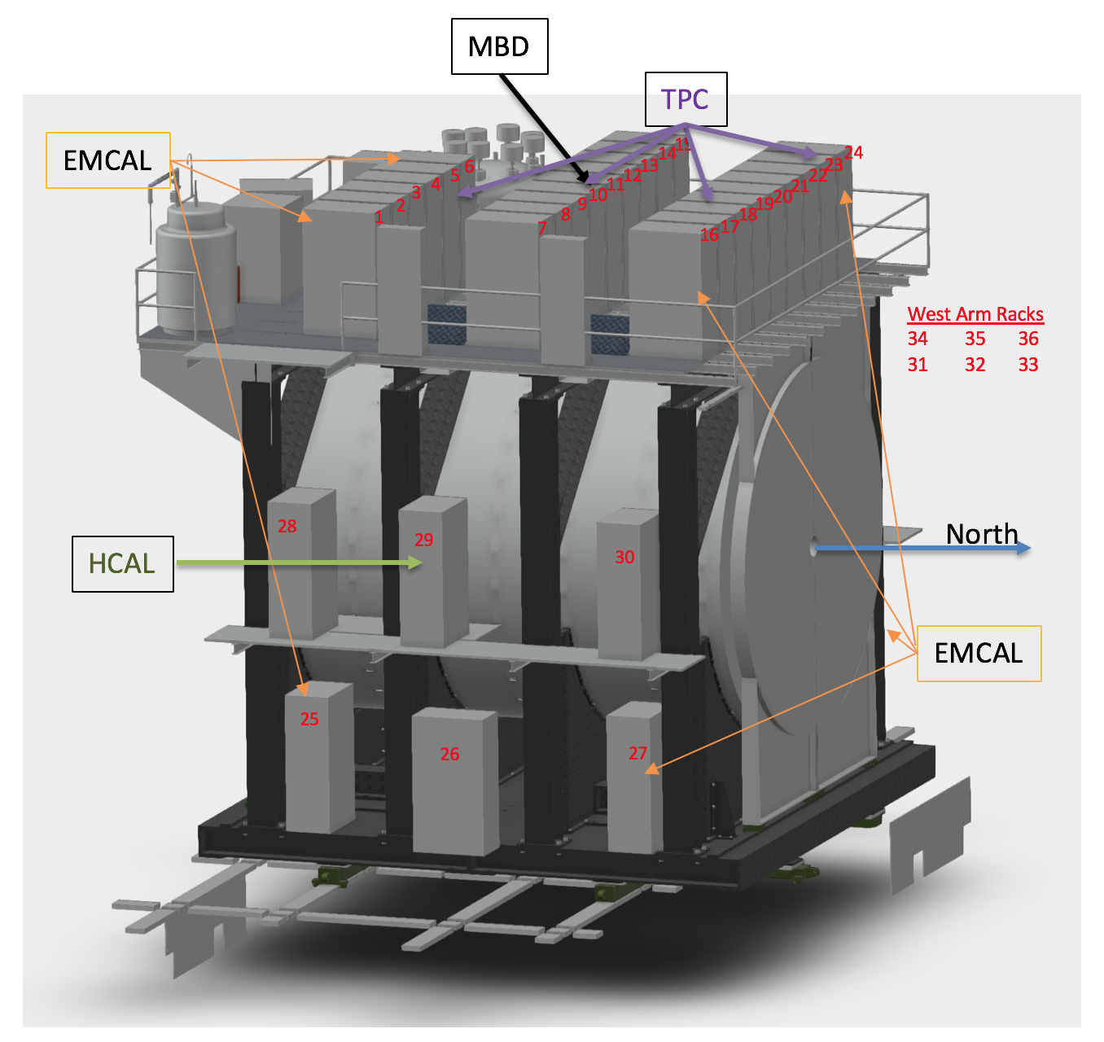
MVTX Services
MVTX Service rack located close to MVTX detector
  RU
  PU
  “Minimal cable length”, < 800cm
48 RU and 24 PU
RU and power units located inside the same crate
  1PU ->2RU
CAEN bulk power supply located on the top platform or on the ground
MVTX
RU/PU
& PS

Slide 15
Near Term Task & Schedule
RU production through ALICE: 60 RUs
  Being started at CERN, first batch of ALICE production ~ Dec., 2018
  sPHENIX RUs available: ~Summer 2019
  Acceptance test and QA at UT-Austin: starting ~summer 2019
    Good opportunity for training and contribution
Stave production through ALICE: 84 staves (ALICE Gold/Silver QA)
  sPHENIX sensor production ~Dec. 2018
    3 months (wafer production) + 1 month (dicing & testing)
    Stave assembly starts @CERN, ~ April 2016, will take 6~12 months to finish
    Training & contribution at CERN, Stave test and QA
  Acceptance test and QA at LBNL, ~Summer 2019
    Hand-carrying staves to LBNL, ~4 trips, ~20 staves each trip
Mechanical system integration design
  In good progress, under OSI
Carbon and non-composite structure design and fabrication
  Design – LANL/MIT/LBNL
  Carbon structures fabrication @LBNL
  Non-composite structure fabrication @MIT

Slide 16
Schedules and Milestones
sPHENIX: CD1/3a CD2
Installation
1st collisions
CY-2018 | 2019 | 2020 | 2021 | 2022 | 2023
MVTX
ALICE IB stave done;
Facilities available for
sPHENIX production;
A window of opportunity:
Low technical risk
Cost saving
Stave & RU
production
FELIX
production
Detector mechanics design & production, global interface to sPHENIX
End Wheels
CYSS
Global integration
/interface design?
Service barrel
design & production
Ready for beam;
sPHENIX day-1 run
Barrel Assembly & Testing @LBNL
Install half barrels
@sPHENIX IR
Half barrel #1
Power system
production
Half barrel #2
To be finalized @FSU 12/2018
Work in progress:
LANL/MIT/LBNL
Design and fabrication
Half barrels
arrive @BNL
design & procure
interface to
sPHENIX rails
Design & procure
sPHENIX rails
MVTX installation & commissioning @BNL
RU, FELIX, PS, cables etc.

Slide 17
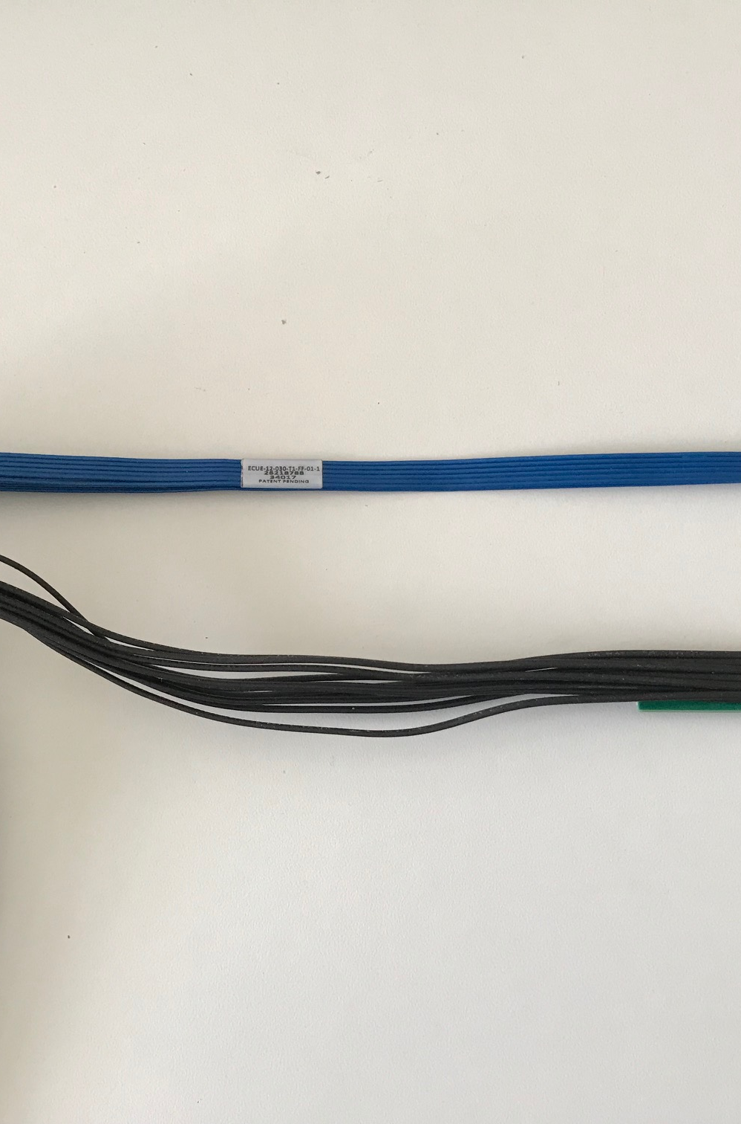
Recent Progress - I
Completed sensor/HIC/stave evaluations at CERN
  Built and tested two HICs with 40cm and 60cm long power FPC
    Confirmed sensor performance same as the ALICE default configuration
  Sensors irradiated up to 2.7MRad, no problem (updated 9/18/2018).
  Addressed all recommendations on stave/sensor R&D from recent BNL review
Technical specs document completed for production
  Cost are set for staves/RU, UTK has started purchase paperwork
  RUs, production starts soon as part of ALICE production
  Staves, sPHENIX production starts ~ January 2019, expect to last 6-12 months
MVTX/INTT integration
  Mechanical design being updated and mockup done
  Inner tracking task force completed evaluation, preferred INTT-layer < 4
  SamTec readout cables
    ALICE confirmed signal performance with 8m long readout cables
Cables
  BNL approved the use of SamTec blue cables
    Electrically better & mechanically compact
  Signal and power cable samples ordered for mechanical global system integration mockup

Slide 18
Progress & Plan - II
ALICE ITS IB
Preliminary design from CERN for stave transportation plates
  To get quote soon for production at CERN
MVTX/Tracking workfest @FSU, 12/5, 8,9
  Project update, task, schedule & plan
  Tracking and simulations
  Update physics plots
Extended design from CERN
for MVTX

Slide 19
sPHENIX MVTX Group: Institution Roles
Major institutions lead key tasks

Slide 20
Summary: MVTX - WBS 3.2
MS Project being updated, now moved into P6
  Stave and RU production through ALICE, moved out of the scope
  The rest of tasks, being optimize for cash flow and schedule
Early procurements of staves and readout units (RU) through US-Alice
  DOE and BNL agreed, DOE directly pays UTK/US-ALICE
  Received signed letter from CERN on the cost of 60 RUs and 84 Stave, ~$1.36M
  Purchase paperwork in progress at UTK, aiming to complete by ~ December 2018
About $5M to be added to the sPHENIX Management Portfolio
  Open MVTX accounts in progress
  As a separated project from the MIE, for the rest of MVTX tasks
    Mechanical system design and fabrication
    Monthly report to sPHENIX and BNL upper management
    Update baseline cost and schedule by January 2019
  Will NOT be part of CD-2/3 DOE review
    Prepared for a separate DOE review in FY19

Slide 21
Backup slides

Slide 22
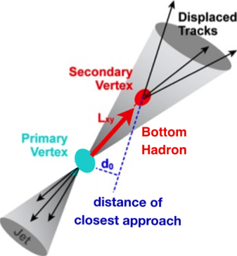

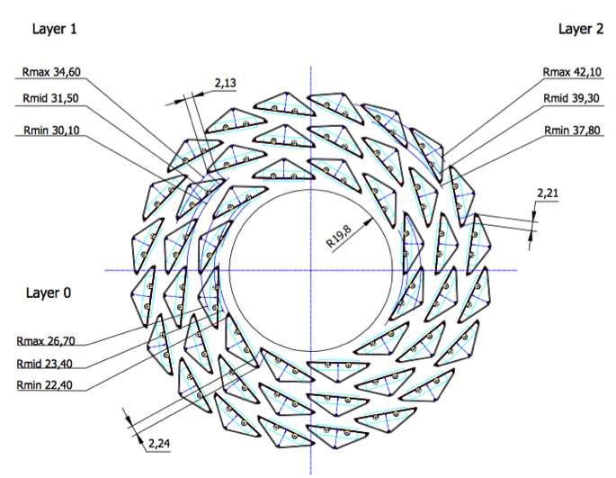
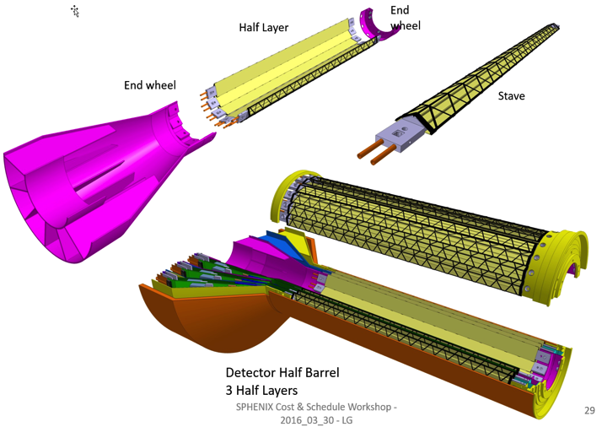
MVTX: MAPS-based VerTeX Detector
sPHENIX@RHIC
(2023+)
Key integration tasks:
Readout
Mechanics
ALICE ITS Upgrade @CERN;
Inner Tracker System (2021+)
sPHENIX Inner Tracking: MVTX
“Adopt” ALICE ITS/IB:
- Minimum risk
- Maximum physics
Leveraging on extensive R&D and design work by ALICE

Slide 23


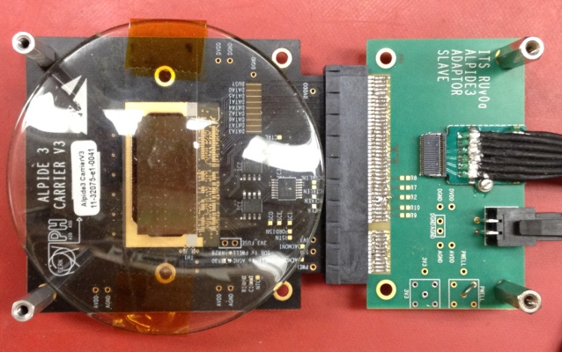
Monolithic Active Pixel Sensors (MAPS)
The Next-Generation, State-of-the-Art Pixel Tracker
Advantages of ALICE PIxel DEtector (ALPIDE) sensor:
Very fine pitch (27μm x 29μm), for superb spatial resolution
High efficiency (>99%) and low noise (<10⁻⁶), for excellent tracking
Time resolution, as low as ~5 μs, for less pileup
Ultra-thin/low mass, 50μm (~0.3% X₀), for less multiple scatterings
0.5M channels with on-pixel digitization, for zero-suppression and fast readout
Low power dissipation, 40mW/cm², for minimal service materials
An ideal detector for QGP physics!
Flexible Printed Circuit(FPC)
9 Chips
Cold plate
A 9-chip MAPS stave, 1.5cm x 27cm
ALPIDE design
ALPIDE sensor:
1.5cm x 3.0cm, 0.5M channels
50 μm
~28 μm

Slide 24
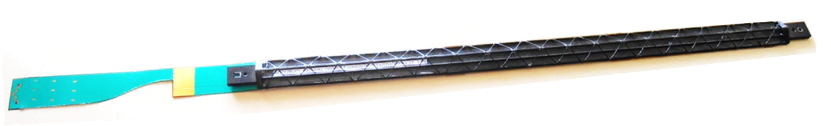
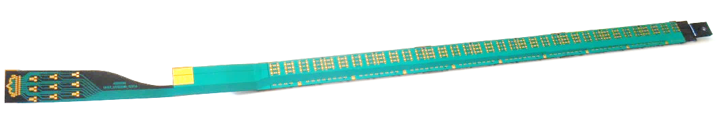
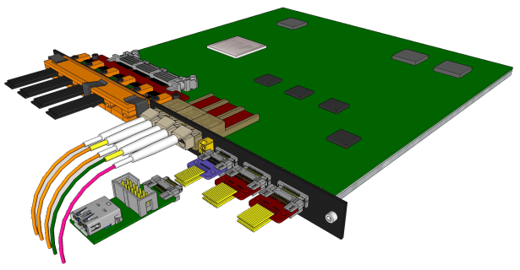
MVTX Sensors and Electronics Production
Major hardware:
  48 ALICE ALPIDE Staves + Interface Cables
  48 Front End Electronics (ALICE RUv2)
  6 Back End Electronics (ATLAS FELIX v2)
  6 EBDC Linux servers
  24 Power Boards + CAEN Supplies + Cables
  48 Stave to RU cables
  144 data fiber optic cables (3 fibers x 48 FEE)
Stave production: total 84, 75% spares
  Two inner layers: 12+16=28
  10% spares: 8 staves
RU production: 60 in total, 25% spares
ALICE ITS/IB stave
ALICE ITS RU

Slide 25
sPHENIX vs ALICE
 | ALICE (Run3) | sPHENIX (Max) | Ratio of data rates sPHENX/ALICE
Pb+Pb / Au+Au | 50kHz | 200 kHz | 0.3
p+p | 200kHz | 13 MHz | (1.6)
Trigger/Readout | 50 kHz/(C.R.) | 15 kHz | -
MB Event track multiplicity dN/dη
  sPHENIX = 1/3 ALICE (pp)
  sPHENIX = 1/5 ALICE (AA)
sPHENIX triggered data rate fits well within ALICE readout hardware specs

Slide 26
Sensor Irradiation Test – OK at 2.7MRad
Continuous effort by ALICE (@NPI, Czech)
BNL review recommendation: test sensor up to 1MRad
https://indico.cern.ch/event/758048/

Slide 27
Projected Radiation Level after 5-year Runs
sPH-TRG-2018-001
Projected sPHENIX integrated luminosities after 5-year operation
  AuAu: Lum. = 214 nb⁻¹
  pp+pAu: Lum. = 1340 pb⁻¹
PHENIX study
arXiv: 0710.2676 [nucl-ex]
Projected sPHENIX MVTX L0 fluence:
Outer layers:
L1 = 0.6 x L0; L2 = 0.4 x L0
TID = 1060krad
NIEL = 6x10¹² N_{eq}/cm²
Sensors tested to full MVTX NIEL and ~3x TID @ALICE

Slide 28
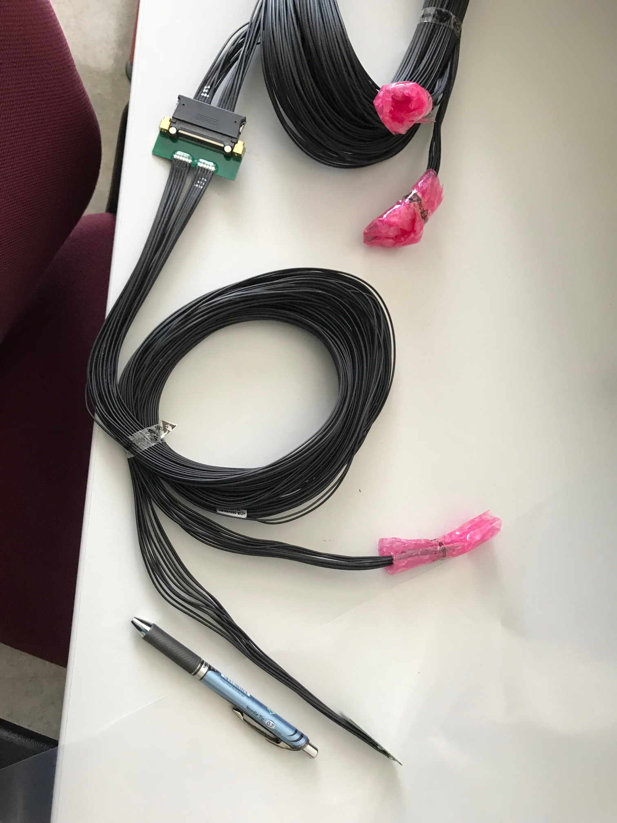
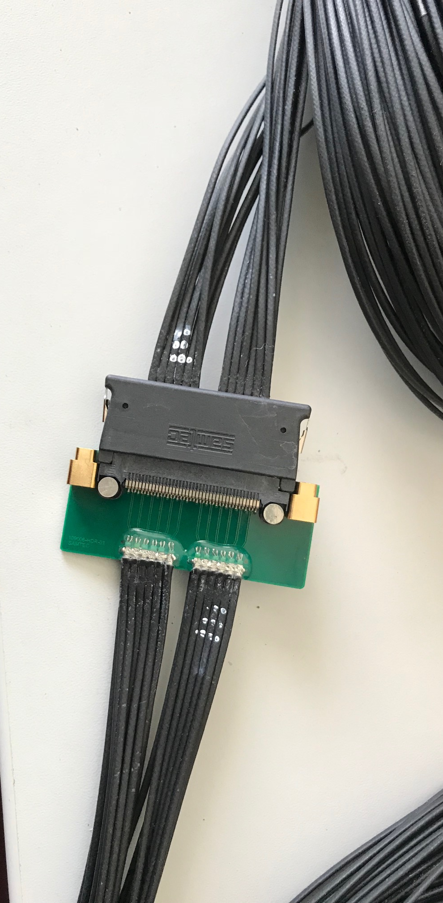
Type-A
Type-B
Type-A

Slide 29
Stave and RU Production QA Plan
Staves
Purchase 84 staves from ALICE/CERN
  48 + 28(spares for 2 inner layers) + 8 spares
  Production following the completion of ALICE ITS/IB
  Starting ~Oct. 2018, will last 6-12 months
  Fully tested at CERN before shipping to US
    All Gold/Silver staves (same as ALICE IB)
    A LANL postdoc (Dr. Yasser Morales) oversees production QA at CERN
Acceptance QA at LBNL
  Full test and QA
    Electrical
    Mechanical
  Detector assembly at LBNL
Readout Units
Purchase 60 RUs from ALICE/CERN
  48 + 12 spares(20%)
  To be part of ALICE production
    Cost saving
    Minimize technical risks
  Initial test at CERN
Acceptance QA at UT-Austin
  Full test
  LANL as the 2nd test site

Slide 30
sPHENIX/MVTX IB Stave Assembly
Procedure at CERN by ALICE ITS Group
Prepare sensors and FPC
Glue 9 sensors to FPC
Wire bonding 9 sensors to FPC
Solder power flex PCB to FPC
Glue HIC to coldplate/carbon space frame
A stave is ready for QA
CMM

Slide 31
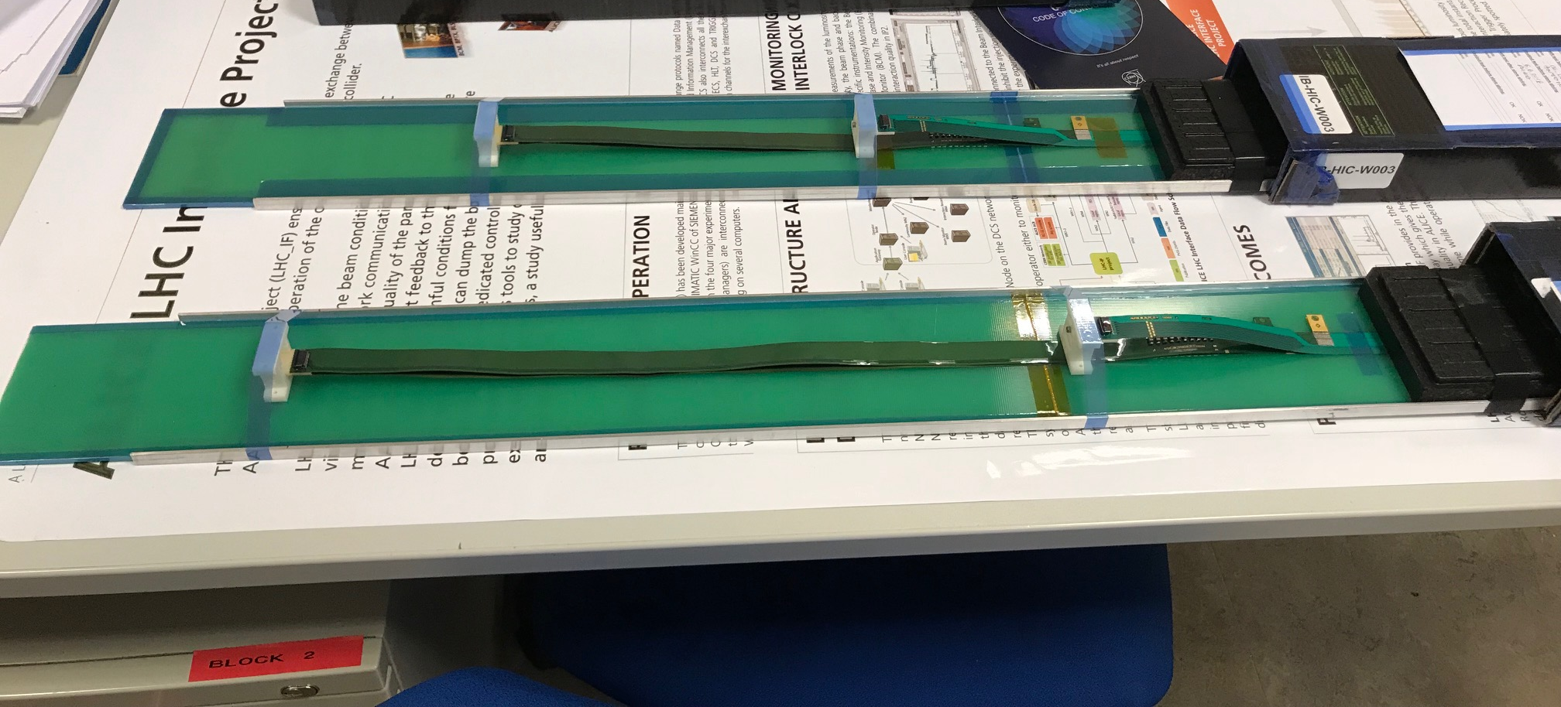
Two HICs Produced and Tested at CERN w/ Extended Power Cables
NO noticeable difference in sensor performance, as expected
MVTX: 40cm flex power PCB
MVTX: 60cm flex power PCB
ALICE IB: 15cm

Slide 32
HICs Test Results from CERN
After: same ALICE HICs, replaced power FPCs
Before: 2 ALICE IB HICs
Thr.
HIC1
Noise
Thr.
Noise
HIC2
Noise level: ~4 e’s; Threshold: ~180e’s; MIP: ~1000 e’s
Chip-8
Chip-0

Slide 33
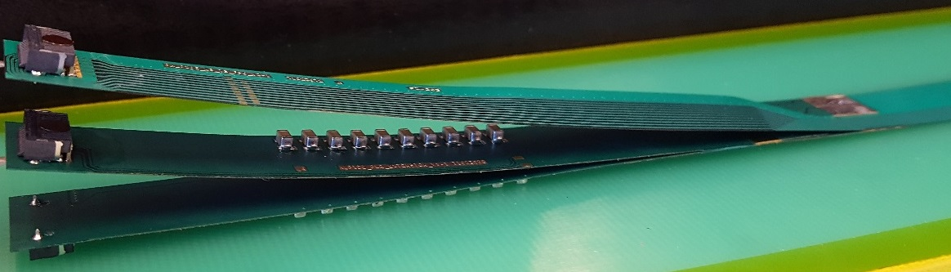
FPC Extension for Connection to Electrical Services
From Antonello Di Mauro
The connection to the service cables is achieved by a double FPC extension which is soldered to the HIC
x-section at interconnection between FPC and extensions
AVDD
AVDD
AVDD
AVDD
DVDD
FPC
AVDD
DVDD
AGND
AGND
Flex power extension
AVDD
DVDD
AGND
FPC
AGND
DGND
DVDD
DVDD
AGND
DGND
DVDD
AGND
DGND
FPC
DGND
DGND
Flex power extension
DGND
signal lines (FPC)
Modified for sPHENIX:
15cm -> 40cm
digital power
analogue power

Slide 34
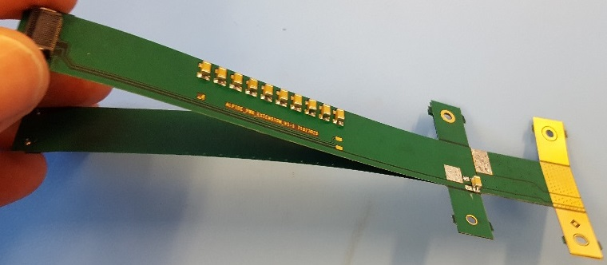
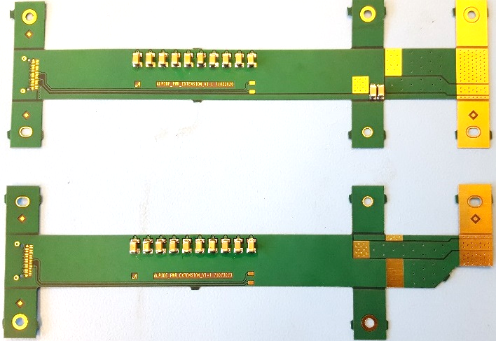
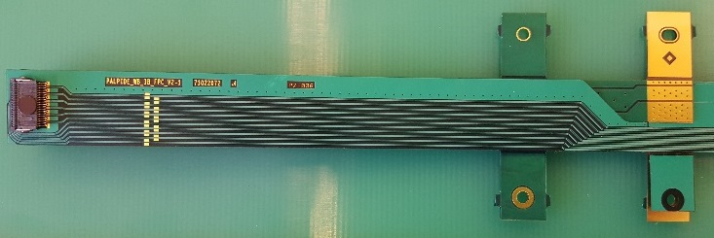
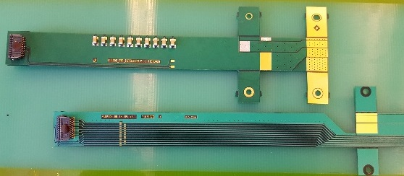
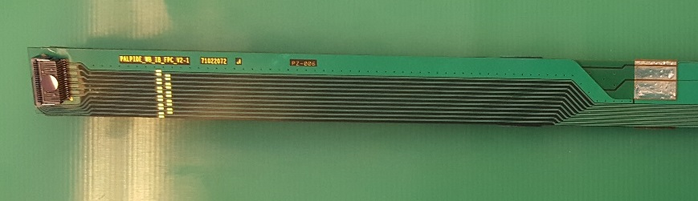
From Antonello Di Mauro
FPC Extension for Connection to Electrical Services
2-layer flex, PI: 50 µm, Cu: 35 µm, solder mask: 20 µm
analogue
analogue
Unchanged
digital
DGND
AGND
Longer copper traces ~30cm
for sPHENIX, no other components
digital
The two flexes are connected together, AVDD is transferred from top to bottom
digital
AVDD
DVDD
The PWR extension is connected to the FPC by iron soldering and wings are cut.

Slide 35
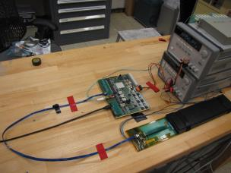
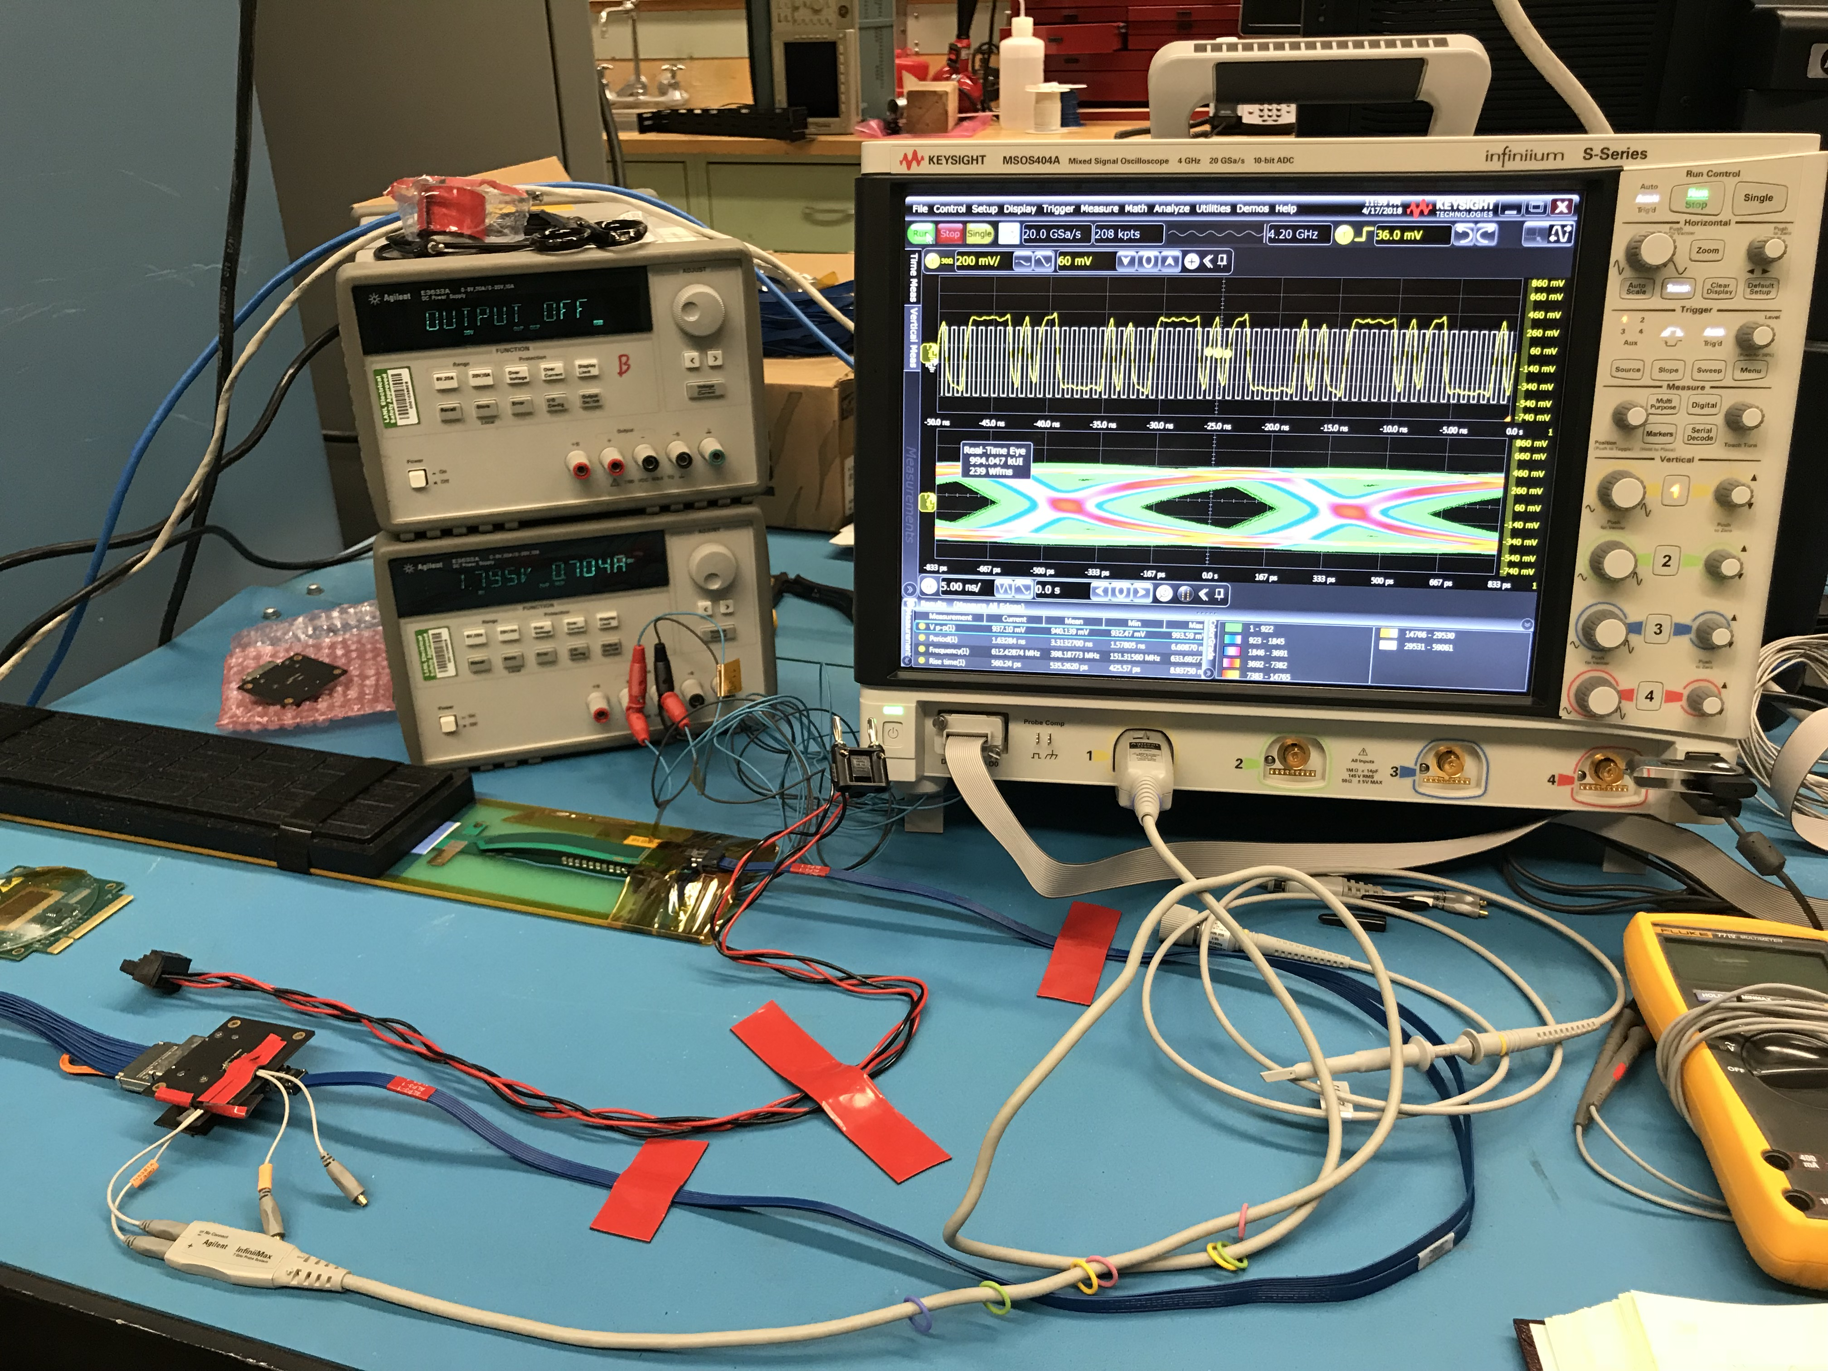
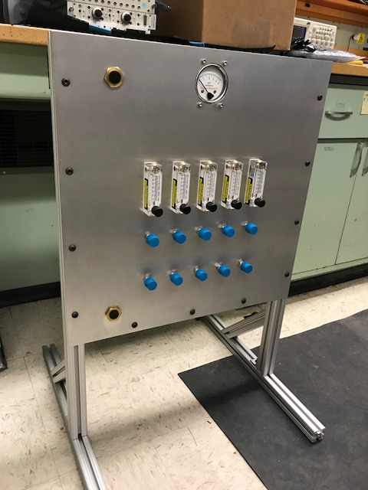
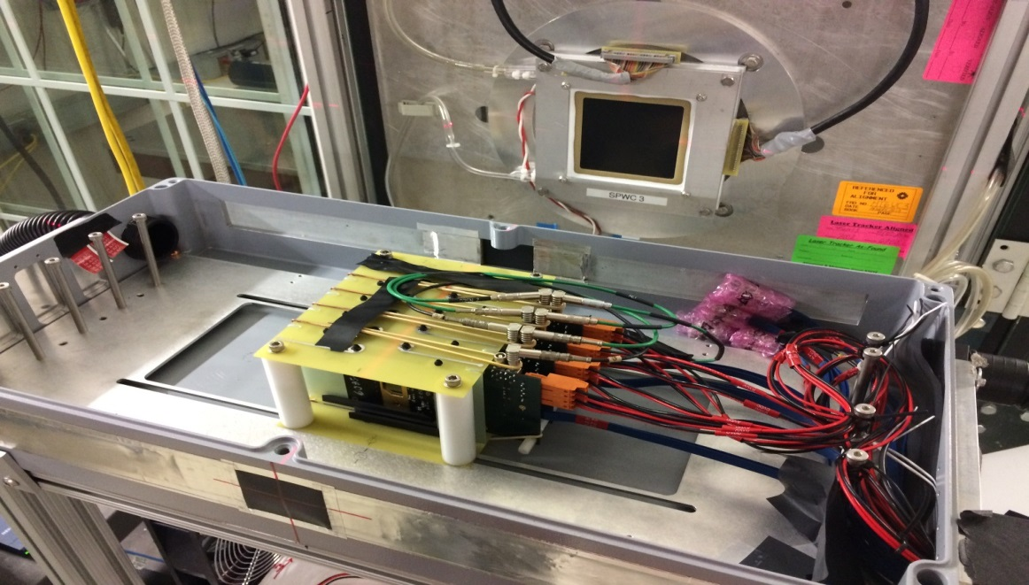
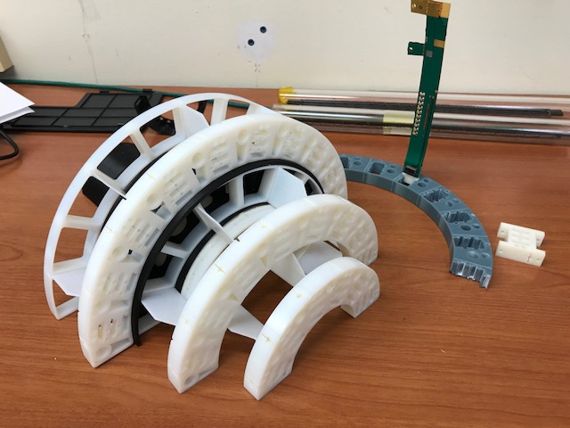
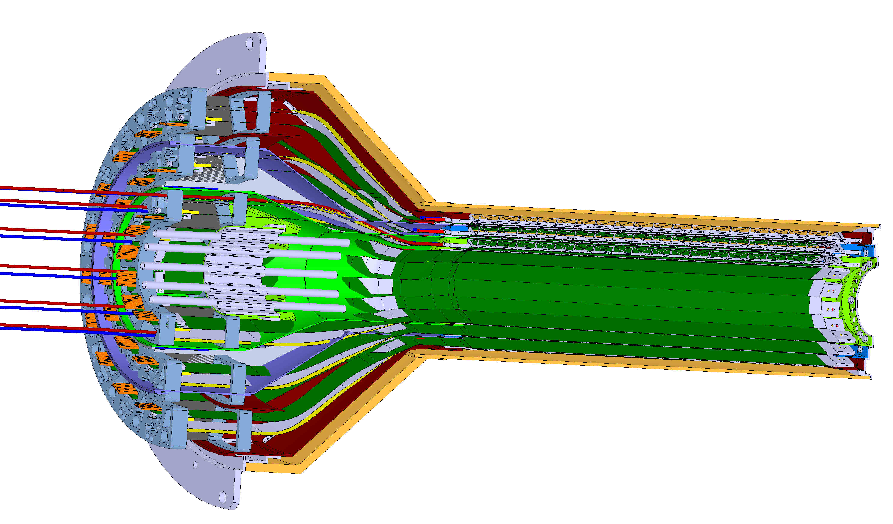
LANL LDRD Activity Highlights
MAPS evaluation
Readout integration
4-sensor telescope
Test beam at Fermilab
Mechanical & cooling
Readout R&D
Signal integrity & cables
RU
Cooling system
prototype
stave
4-ALPIDE Telescope;
5m-long SamTec cables
Service cone R&D
Sensor source test
FPC power extension R&D

