Slide 1
MAPS project: Organization
Cesar Luiz da Silva
Los Alamos National Lab

Slide 2
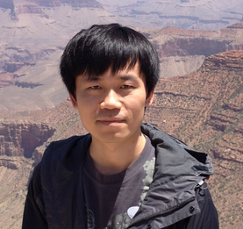
LANL Participation
Kun Liu
Simulation
offline reconstruction
Ming Liu (PI)
Pat McGaughey
Cesar da Silva
Walt Sondheim
Future hires for sPHENIX project:
One or two post-docs and a staff scientist
Plan to have people resident at CERN during ALICE and sPHENIX production

Slide 3
Organization Chart
Ming Liu (PI)
Mike McCumber
deputy
Stave Production
Cesar da Silva
Eletronics
Mark Prokov
Mechanics
Walt Songheim

Slide 4
Possible Collaborators
CERN
Talking with Luciano Musa (ALICE ITS leader)
Provided our first MAPS prototype board for free
Advanced conversation in provide access to staves assembly

Slide 5
Possible Collaborators
LBNL
Developing MAPS technology for almost 15 years
Plans to have MAPS for a future eIC detector
LDRD proposal for sPHENIX tracking mechanics
Provided support on our LDRD project and sent experts to LANL to help on the MAPs prototype

Slide 6
Possible Collaborators
UC Consortium:
UC Universities
LANL, LBNL, LLNL
Trying to forma collaboration to build a major detector for eIC

Slide 7
Possible Collaborators
MIT hadron group
Big group
Long interest in eIC w/ MAPS
Big player with sPHENIX

Slide 8
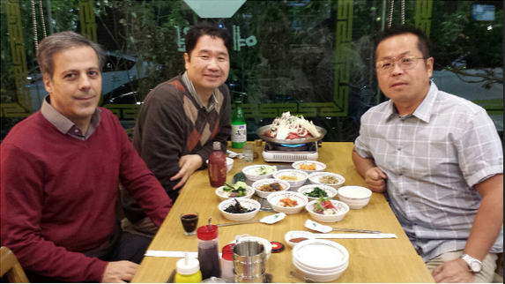
Possible Collaborators
Korean Institutions
Yonsei University, Korea University and others
Possible collaboration with ALICE/Korea to produce/test more sensor/chips for sPHENIX
Recent collaboration with MuTr and MPC-ex

Slide 9
Possible Collaborators
BNL
Rachid volunteer to participate on stave production at CERN
STAR HFT collaborators depending on the situation of HFT upgrade
BNL
University of Texas – Austin
Additional support from LBNL

Slide 10
Possible Collaborators
New Mexico Institutions: UNM, NMSU
Traditional supporters of big LANL projects
MuTr and FVTX
Columbia University
recent support on FVTX design/assembly
University of Colorado

