Slide 1
MVTX Production Readiness Review
Overview
Ming Liu (LANL)
Camelia Mironov (MIT) and Grazyna Odyniec (LBNL)
12/15/2020

Slide 2
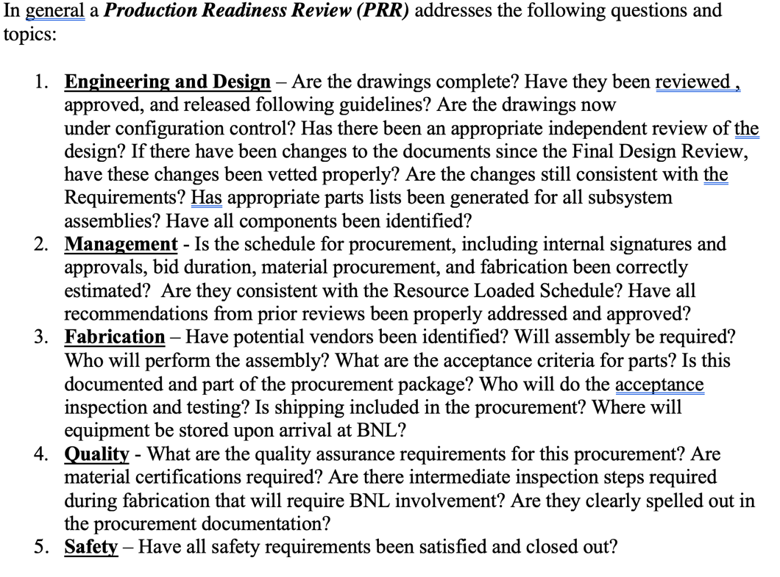
Outline
MVTX detector design
  Design changes
MVTX CFC Production
  Vendor selection
  Test article qualification
  Full production plan
  CFC QA plan
Responses to the previous FDR report recommendations

Slide 3

MVTX Detector Design
CFC: EW, CYSS, SB
Cylindrical Shell
Structure (CYSS)
North
North
→
End-Wheels (EW)
Service Barrel (SB)
MVTX parameters: L = 271 mm
3-layer sensor barrel
- 48 staves, 432 chips
R (mm) | min | mid | max
Layer 0 | 24.61 | 25.23 | 27.93
Layer 1 | 31.98 | 33.35 | 36.25
Layer 2 | 39.93 | 41.48 | 44.26
New BP

Slide 4
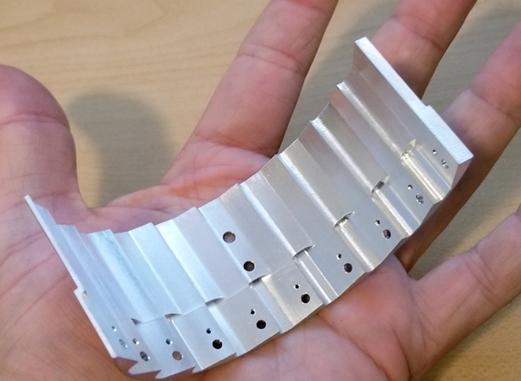
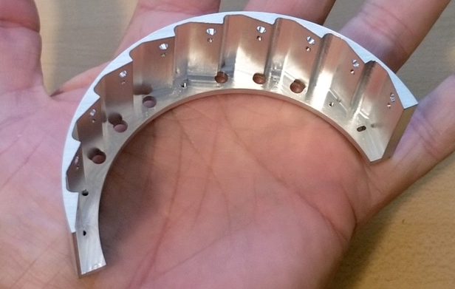
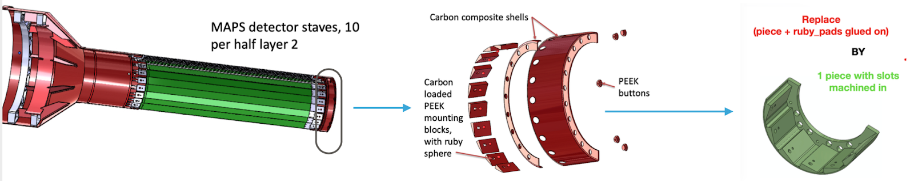
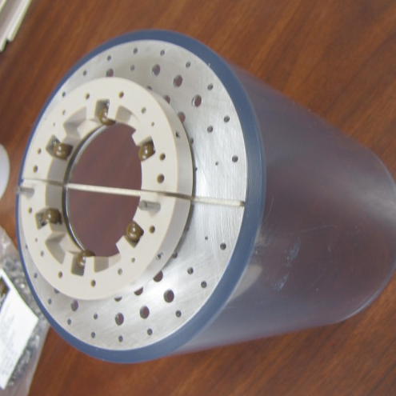
Engineering and Design
NOTE: all these covered in detail in Jason’s presentation.
Are the drawings complete? - Yes
  Have they been reviewed , approved, and released following guidelines?
  Are the drawings now under configuration control?
Has there been an appropriate independent review of the design?
  Yes. LBNL (while updating the lbnl production cost)
If there have been changes to the documents since the Final Design
  2 design changes:
  EndWheels: a simple 1-piece design
  Lock-and-roll system on the nose of detector → to protect against crushing into the BP
Review, have these changes been vetted properly?
  Yes, meetings/review with LBL+CERN, LINK to discussions
  Are the changes still consistent with the Requirements?
  Yes (link to the CMM for EW (when available) )
Has appropriate parts lists been generated for all subsystem assemblies?
  Yes
Have all components been identified?
  Yes
mockup

Slide 5
Management
Is the schedule for procurement, including internal signatures and approvals, bid duration, material procurement, and fabrication been correctly estimated?
  Yes
  Pre-peg fabrication: 6-8 weeks
    → for test article, small amount on stock.
    → for the remaining work: order placed in advance (October?--double check)--> ready to go in Dec/early January
Are they consistent with the Resource Loaded Schedule?
  Fabrication costs: well within the budget :
    EW: $197K → in P6 $311K + 60% contingency
    CYSS: $54K → in P6 $201K + 40%
    SB: $53K → in P6 $266K + 40%
  Manpower costs/schedule:
    4~5months delay, still within schedule contingency
    still within budget
Have all recommendations from prior reviews been properly addressed and approved?
  yes
    → only 1 suggested modification requested in the January design : the lock-and-roll nose system

Slide 6
Fabrication
Have potential vendors been identified? Yes
  CarbonFiber: CYSS, SB, EW Layers
    Designs completed in July 2020
    Package (drawings+SOW) sent to 4 potential vendors on July 27th (Workshape in France, 3 in CA-including LBNL)
    Received feedback and revised the drawings accordingly: v2 of the package sent on Aug 13th
    Received 3 responses by the end of August deadline (see back-up for price/schedule comparison)
  One-piece EndWheel: Aluminum -- mostly affected by the pandemic (schedule wise)
    design finalized beginning of April
    prototype1 ready end of April: made by Xometry -- failed → weeks to get scheduled for CMM
    prorotype2 sent in August to a 2nd shop in MA → delivered mid-Octb → (other weeks to schedule CMM) CMM failed
    prototype3 (present): made of Al, sent to MIT shop in end of Octb → back in November→ CMM acceptable
Will assembly be required?
  Yes; fixtures and steps designed by MIT/Bates&LANL → see Joe’s talk
Who will perform the assembly?
  LBNL will do it.
What are the acceptance criteria for parts? Is this documented and part of the procurement package?
  - All specified in Sec .2. of the SOW here
Who will do the acceptance inspection and testing?
  - Shops in US (MIT for test article; LBNL for remaining parts)
Is shipping included in the procurement?
  Yes. Costs from vendor include shipping to US, and there are money allocated for transport from LBNL to BNL
Where will equipment be stored upon arrival at BNL?
  The shipping box will act also as a storage cradle, before the detector can be put on the insertion rails

Slide 7
Quality
What are the quality assurance requirements for this procurement?
  Mechanical dimensions and tolerances
Are material certifications required?
  No. The prepeg change, from the originally requested to a more expensive, also better one, was OK-ed by the MIT/LANL/LBNL engineers
Are there intermediate inspection steps required during fabrication that will require BNL involvement?
  No
Are they clearly spelled out in the procurement documentation?
  N/A

Slide 8
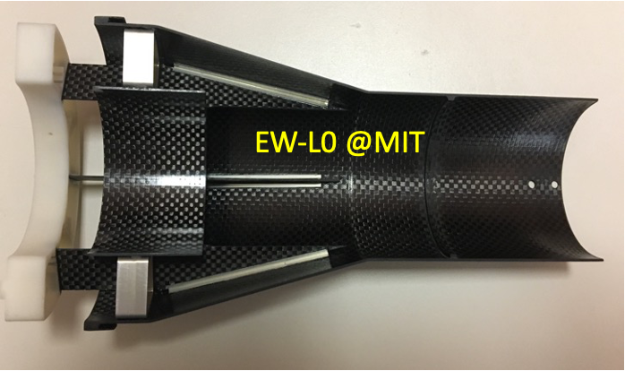
Summary: Mechanical Design and Vendor Selection
Final design developed based on ITS/IB concept, with inputs from MIT, LANL, CERN, LBNL and BNL engineers
  Designs completed in July 2020 and sent to 4 potential vendors with SOW on 7/27/2020
    modification of EW, with one-piece-EW
    Lock-and-roll system
  Received feedbacks and revised the drawings accordingly: final package on Aug 13th
  Received 3 responses by the end of August deadline
Changed vendor selection plan to optimize the production cost and COVID-19 schedule challenge
  Inputs from LBNL CFC production experience: select and work with the final vendor to make the CFC
  The winner selected based on their experience/qualifications, cost and delivery schedule
WorkShape (France) won the competition
  Started working on detailed fabrication for test article in September 2020
  The first test article produced and qualified
  Full production and delivery plan
First test article from WorkShape
Notes:
Slide 5, add LANL engineer, Workshape bullet - “Started working on detailed fabrication for test article”

Slide 9
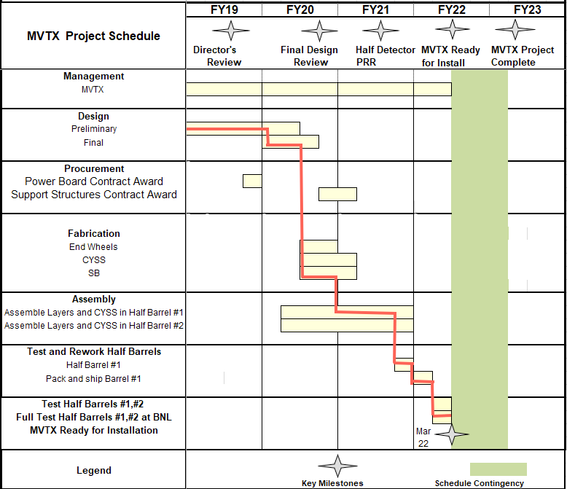
Summary: CFC Production and Detector Assembly Schedule
Pre-COVID19 Schedule
Mechanical support structures
  CFC test article production and QA
    1st test article, Layer-0 EW CMM etc.
    PRR: Dec. 15, 2020 (Today)
  CFC full production starts ~ Jan. 2021
    1st half CF(EW+CYSS+SB) available in ~March 2021
    2nd half CF available in April
  Insertion system design & mockup
    System integration review: ~Jan 2021
Stave production at CERN
  Shipping and QA at LBNL, Jan -> Mar in 2021
Half-detector assembly at LBNL
  Assembly fixture production ~Feb 2021
  CFC and stave test fitting ~March 2021
  Half-detector assembly review, ~May 2021
  Complete the 2nd Half-detector by 12/2021
Tight schedule to meet the installation dates
- ready for installation at IR ~Mar 2022
  Original (pre-2020) schedule: start assembly in Dec 2020
  Present schedule: start assembly in March/april 2021 (3-4 months delay)
Today
Assembly review

Slide 10
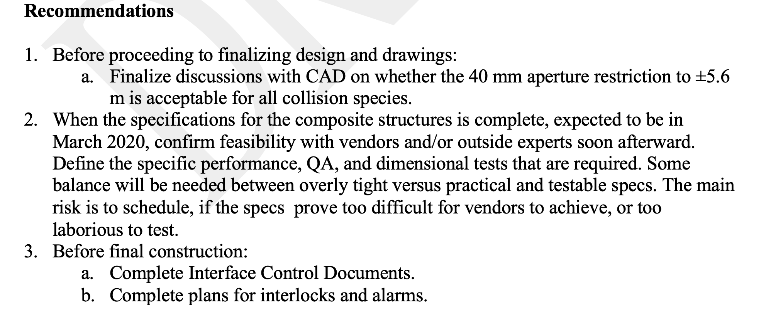
Recommendations from last FDR
Beampipe modification done (BNL)
Worked with selected vendors on the final design and tolerances. A test article was produced and qualified
Completed ICD documents; Completed plans for interlocks and alarms

Slide 11
Backup slides

Slide 12
3 Vendors’ Bids Received (one didn’t responded)

Slide 13
Cost from WorkShape
1 EU$ =. 1.2 US$
Total cost = EU$271K x 1.2 = US $325K
EWs: EU $164.1 => US $197K
CYSS: EU $44.65K => US $54K
SB: EU $44.15K => US $53K
Shipping: US $21K

Slide 14
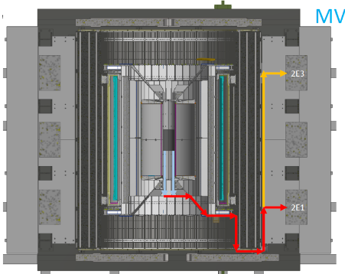
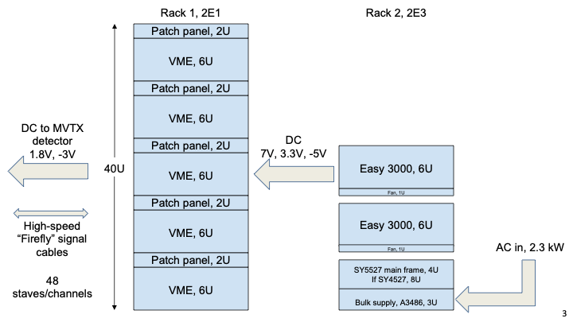
MVTX Detector and Interface
sPHENIX-SE-ICD-042 Document:
https://docs.google.com/spreadsheets/d/1hHUhxZOZv8WEs3FH361_gN6McVU4Zhy60sGtYotRHMs/edit?usp=sharing
Power and safety interlock

Slide 15
Project Management Plan
Draft PMP document completed
  Project baseline
    Physics
    Functional requirements/KPP
    Technical scope
    Cost breakdown
    Schedule
    Funding profile
    Planned BNL funding
    Baseline change control
  Management structure
    Organization and team
    Management responsibilities
    Participating institutions
  Project management and oversight
    Risk management
    Project reporting
    Engineering and technology readiness
    Quality assurance and configuration/document management
    Operation readiness plan
    ESSH plans and fabrication
    Project closeout
Project fully integrated into sPHENIX P6
  Costs, schedules and risk register
Deliver MVTX on schedule/budget for day-1 physics!

Slide 16
MVTX Milestones and Key Tasks
MVTX PMP

Slide 17
Scope of the MVTX Project – WBS 3.02
Mechanical system (3.02.03, 3.02.04)
  MVTX detector mechanical structures
    Design & simulations
    End Wheels
    Cylindrical support structure
    Service barrels
  Mechanical system integration
    Service barrel support & interface to sPHENIX
    Installation tooling etc.
    Adopt ALICE cooling parameters
    Detector safety
  Detector assembly
    Stave QA & detector assembly @LBNL
Electronics (3.02.02)
  Readout Integration
    RU QA & assembly
    Backend: ATLAS FELIX
    Frontend RU services: daughter cards, transition boards, cables etc.
  Ancillary systems - “adopt” ALICE ITS system
    Power, slow control & monitoring etc.
BNL provides Staves & RUs, w/o cost to MVTX project:
- 84 ALICE/ITS-IB (modified) staves from CERN;
48+spares(2-inner layers+10%)
- 60 ALICE/ITS-RU from CERN
48+spares(12, 25%)

Slide 18
MVTX High Level Cost

Slide 19
MVTX Carbon Structure Cost(July 2019)
60%
Changed to 60%,
following review
recommendations

Slide 20
Schedules & Milestones (July 2019)
Technically driven schedule
  Day-1 physics
  CERN production
  Fund available as needed
Funding delay
  R&D
  Production
  Preparation
Low schedule contingency
Early R&D by LANL LDRD

