Slide 1
MVTX Production Readiness Review
Overview
Ming Liu (LANL)
Camelia Mironov (MIT) and Grazyna Odyniec (LBNL)
12/15/2020

Slide 2
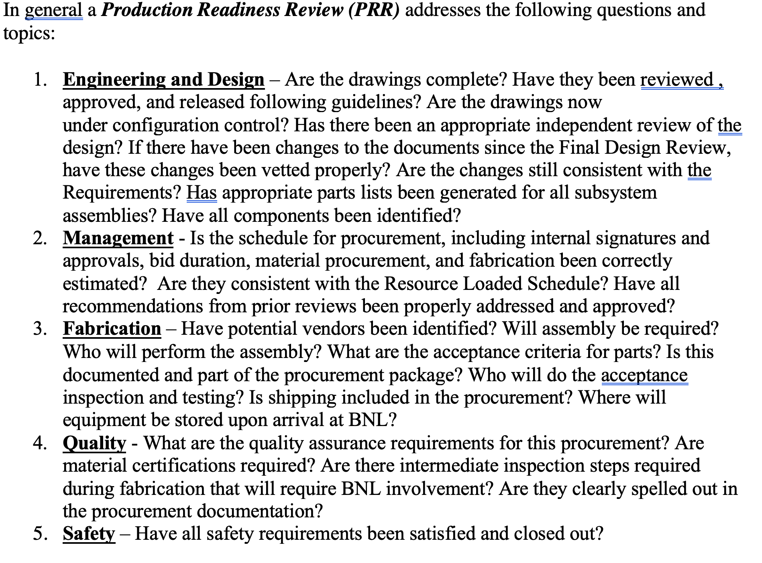
Outline
MVTX detector design
MVTX CFC Production
  Vendor selection
  Test article qualification
  Full production plan
  CFC QA plan
Responses to the previous FDR report recommendations

Slide 3

MVTX Detector Design
CFC: EW, CYSS, SB
Cylindrical Shell
Structure (CYSS)
North
North
→
End-Wheels (EW)
Service Barrel (SB)
MVTX parameters: L = 271 mm
3-layer sensor barrel
- 48 staves, 432 chips
R (mm) | min | mid | max
Layer 0 | 24.61 | 25.23 | 27.93
Layer 1 | 31.98 | 33.35 | 36.25
Layer 2 | 39.93 | 41.48 | 44.26
New BP

Slide 4
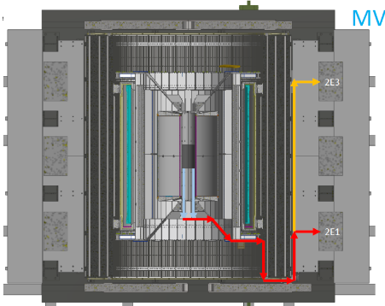
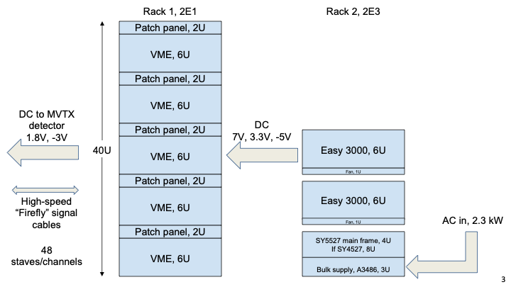
MVTX Detector and Interface
sPHENIX-SE-ICD-042 Document:
https://docs.google.com/spreadsheets/d/1hHUhxZOZv8WEs3FH361_gN6McVU4Zhy60sGtYotRHMs/edit?usp=sharing
Power and safety interlock

Slide 5
Mechanical Design and Vendor Selection
Final design developed based on ITS/IB concept, with inputs from CERN, LBNL and BNL engineers
  Designs completed in July 2020 and sent to all potential vendors with SOW on 7/27/2020
  Received feedbacks and revised the designs
  Received 3 responses by the end of August deadline
Changed vendor selection plan to optimize the production cost and COVID-19 schedule challenge
  Inputs from LBNL CFC production experience: select and work with the final vendor to make the CFC
  The winner selected based on their experience/qualifications, cost and delivery schedule
WorkShape (France) won the competition
  Started working work them on detailed plan
  Produced a test articles before the PRR
  Full production and delivery plan

Slide 6
3 Vendors’ Bids Received (one didn’t responded)

Slide 7
CFC Production and Detector Assembly Schedule
Pre-COVID19 Schedule
Mechanical support structures
  CFC test article production and QA
    1st test article, Layer-0 EW CMM etc.
    PRR: Dec. 15, 2020 (Today)
  CFC full production starts ~ Jan. 2021
    1st half CF(EW+CYSS+SB) available in ~March 2021
    2nd half CF available in April
  Insertion system design & mockup
    System integration review: ~Jan 2021
Stave production at CERN
  Shipping and QA at LBNL, Jan -> Mar in 2021
Half-detector assembly at LBNL
  Assembly fixture production ~Feb 2021
  CFC and stave test fitting ~March 2021
  Half-detector assembly review, ~May 2021
  Complete the 2nd Half-detector by 12/2021
Power, readout and controls
  - Ready in summer 2021
Tight schedule to meet the installation dates
- ready for installation at IR ~Mar 2022
Today
Assembly review

Slide 8
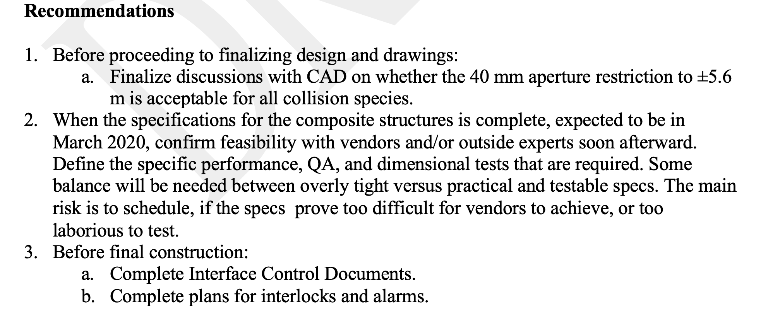
Recommendations from last FDR
Beampipe modification done (BNL)
Worked with selected vendors on the design and tolerances. A test article was produced and qualified
Completed ICD documents; Completed plans for interlocks and alarms

Slide 9
Backup slides

Slide 10
Project Management Plan
Draft PMP document completed
  Project baseline
    Physics
    Functional requirements/KPP
    Technical scope
    Cost breakdown
    Schedule
    Funding profile
    Planned BNL funding
    Baseline change control
  Management structure
    Organization and team
    Management responsibilities
    Participating institutions
  Project management and oversight
    Risk management
    Project reporting
    Engineering and technology readiness
    Quality assurance and configuration/document management
    Operation readiness plan
    ESSH plans and fabrication
    Project closeout
Project fully integrated into sPHENIX P6
  Costs, schedules and risk register
Deliver MVTX on schedule/budget for day-1 physics!

Slide 11
MVTX Milestones and Key Tasks
MVTX PMP

Slide 12
Scope of the MVTX Project – WBS 3.02
Mechanical system (3.02.03, 3.02.04)
  MVTX detector mechanical structures
    Design & simulations
    End Wheels
    Cylindrical support structure
    Service barrels
  Mechanical system integration
    Service barrel support & interface to sPHENIX
    Installation tooling etc.
    Adopt ALICE cooling parameters
    Detector safety
  Detector assembly
    Stave QA & detector assembly @LBNL
Electronics (3.02.02)
  Readout Integration
    RU QA & assembly
    Backend: ATLAS FELIX
    Frontend RU services: daughter cards, transition boards, cables etc.
  Ancillary systems - “adopt” ALICE ITS system
    Power, slow control & monitoring etc.
BNL provides Staves & RUs, w/o cost to MVTX project:
- 84 ALICE/ITS-IB (modified) staves from CERN;
48+spares(2-inner layers+10%)
- 60 ALICE/ITS-RU from CERN
48+spares(12, 25%)

Slide 13
MVTX High Level Cost

Slide 14
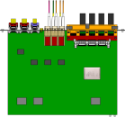

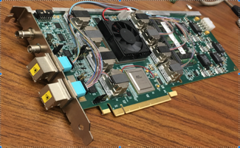

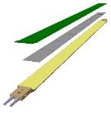
Sensors and Readout Electronics in Production
CAN bus
DCS
Trigger & Clock
Sensors
Readout Unit
Front End
GBT Optical Links
9 Data (1.2Gbps)
1 Clock, 1 Control/Trigger
Control
Data (9.6 Gb/s max)
Trigger
9-sensor Stave
Samtec Twinax “FireFly”, ~10m
FELIX
Back End
FPC
Power
ATLAS Front-End Link eXchange (FELIX):
sPHENIX Data Aggregation Module(DAM)
Alpide Sensors
Flex PCB Filtering Capacitors
regulators
Power
Regulated Power
CAEN Power supplies
Cold Plate
Power Board
Interaction Region
Experimental Hall
Counting House
84 staves in production at CERN
complete by ~3/2021
60 RUs produced;
30 PUs produced;
8 FELIX to be produced with TPC in 2021
Yuan and Jo’s talks

Slide 15
Schedules & Milestones (July 2019)
Technically driven schedule
  Day-1 physics
  CERN production
  Fund available as needed
Funding delay
  R&D
  Production
  Preparation
Low schedule contingency
Early R&D by LANL LDRD

Slide 16
MVTX Carbon Structure Cost(July 2019)
60%
Changed to 60%,
following review
recommendations

