Slide 1
MVTX Production Readiness Review
Overview
Ming Liu (LANL)
Camelia Mironov (MIT) and Grazyna Odyniec (LBNL)
For the MVTX Team
MVTX Production Readiness Review (Remote Meeting)
12/15/2020
Notes:
I would like to thank all reviewers for your time and effort for helping us, and MVTX team’s heroic effort to bring us to this point, during this challenging year due to COVID shutdown/

Slide 2
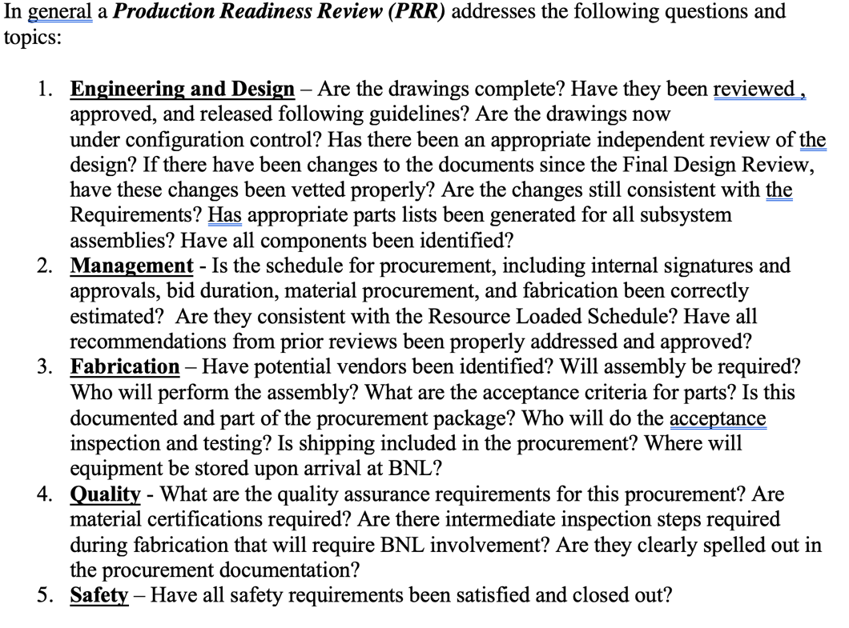
Outline
MVTX detector design
  Design updates
Review questions
  MVTX status
Recommendations from previous FDR
  All implemented
Mechanical structure production and detector assembly plan
  Updated schedule
Notes:
This purpose of this review is to addres …. For this, I will highlight progress in MVTX design and prototyiing, and answer review Q;s based on our current statuts.. And the end, I will show the project updated plan/schedule for the Mech production and detector assembly work

Slide 3

MVTX Detector Design
Carb. Fib. Comp./CFC = EW, CYSS, SB
Total Weight: ~24 kg
(sensor part: ~3 kg)
Cylindrical Shell
Structure (CYSS)
North
North
→
End-Wheels (EW);
- 3 layers
Service Barrel (SB)
MVTX parameters: L = 271 mm
3-layer sensor barrel
- 48 staves, 432 chips
R (mm) | min | mid | max
Layer 0 | 24.61 | 25.23 | 27.93
Layer 1 | 31.98 | 33.35 | 36.25
Layer 2 | 39.93 | 41.48 | 44.26
New BP
Notes:
A quick reminder of the MVTX overall design -

Slide 4
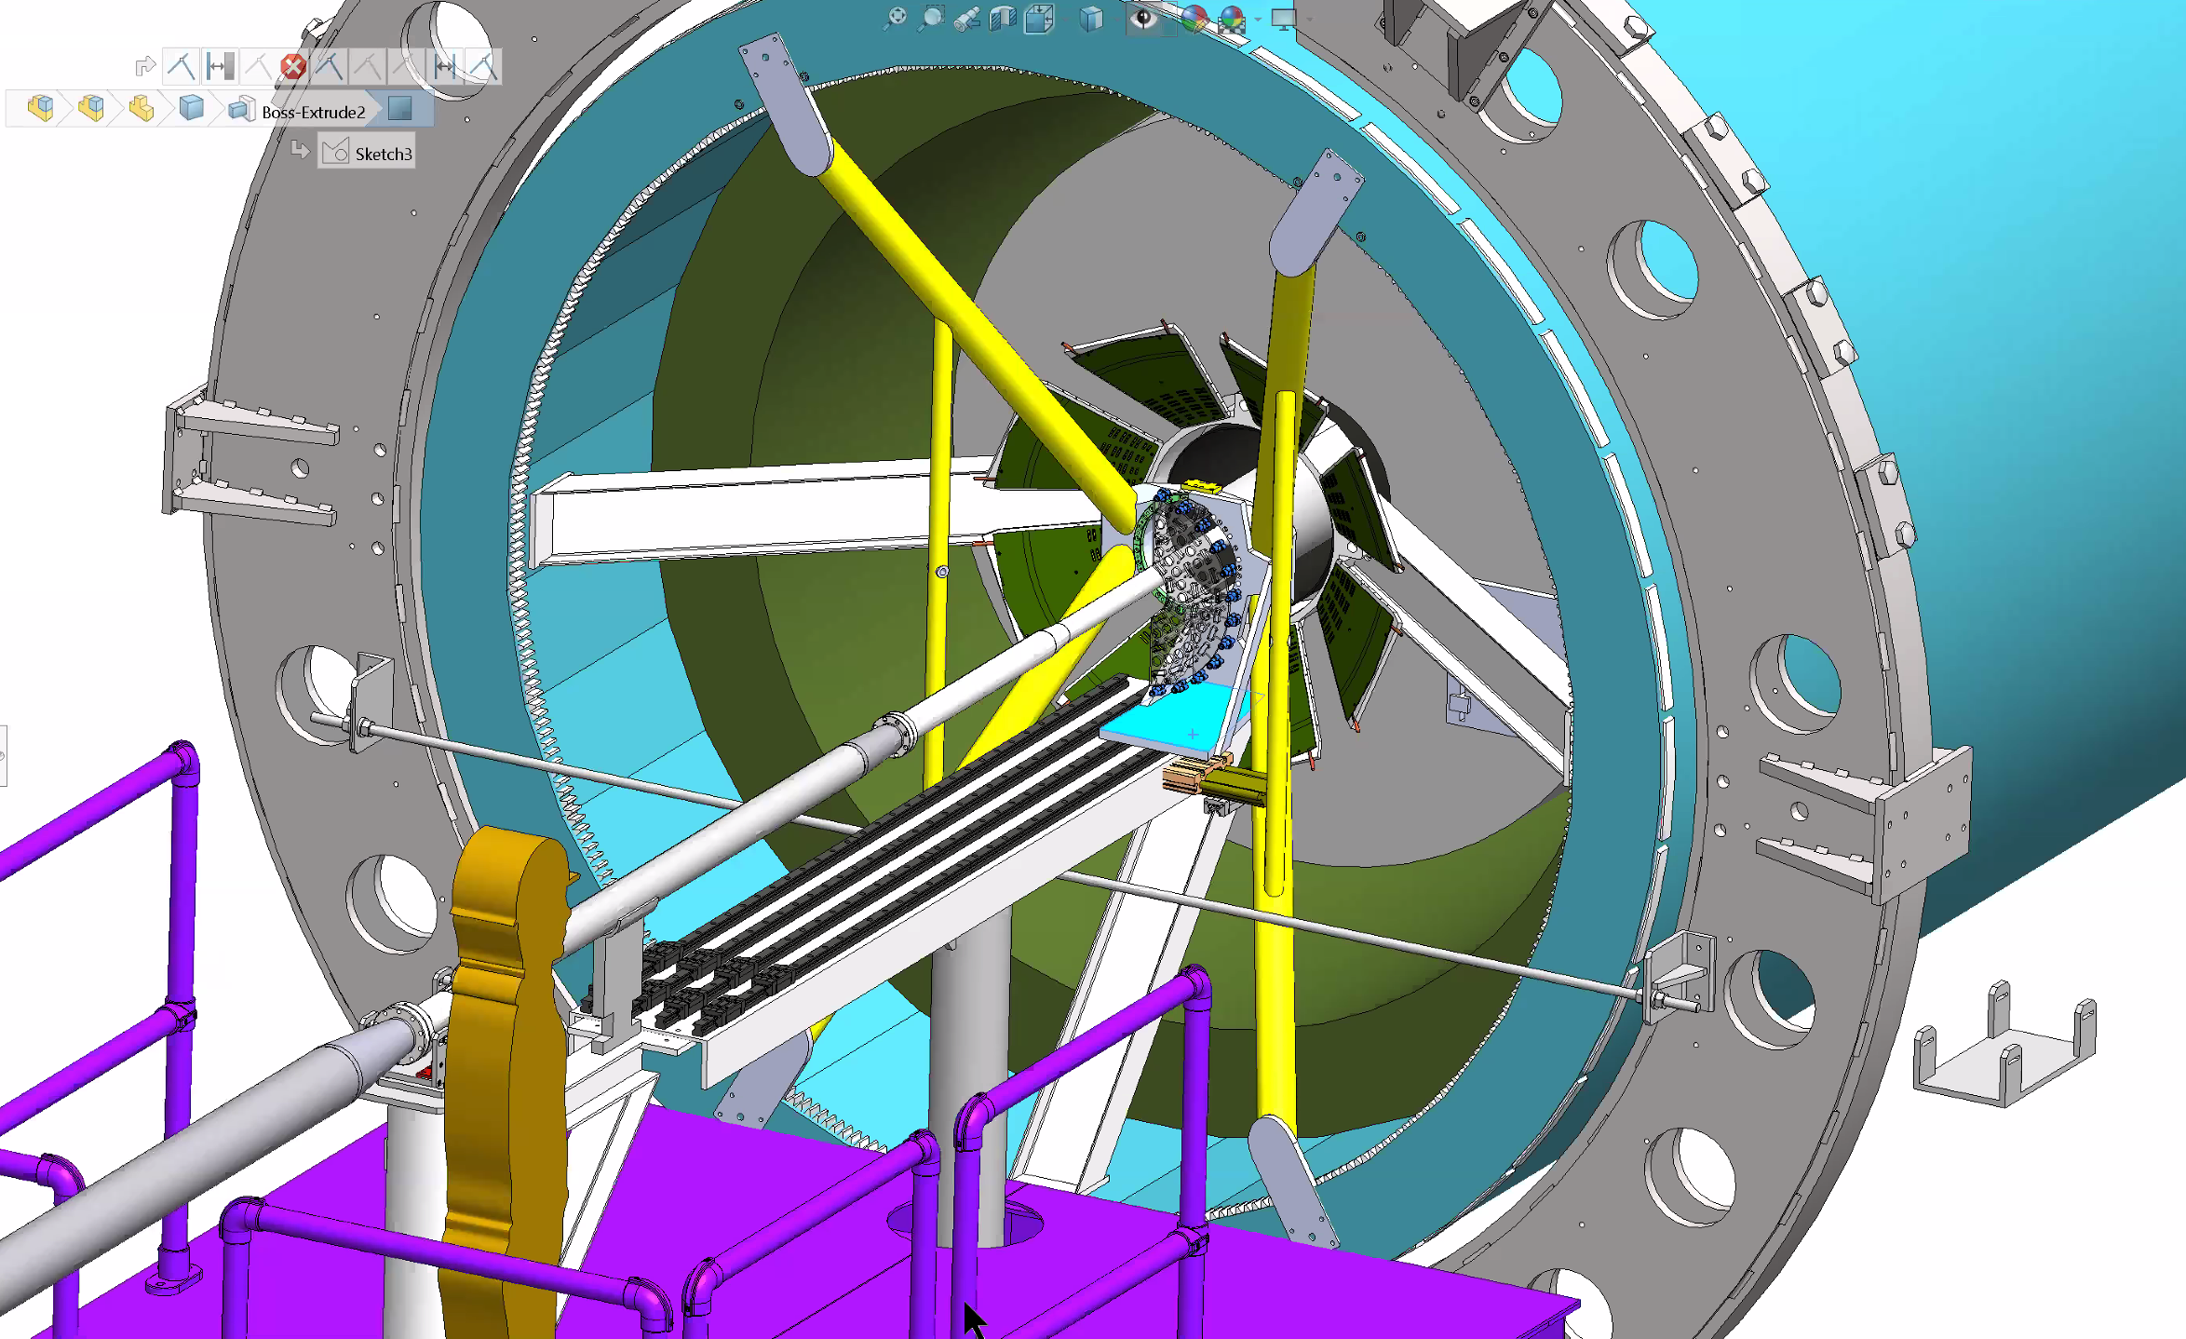
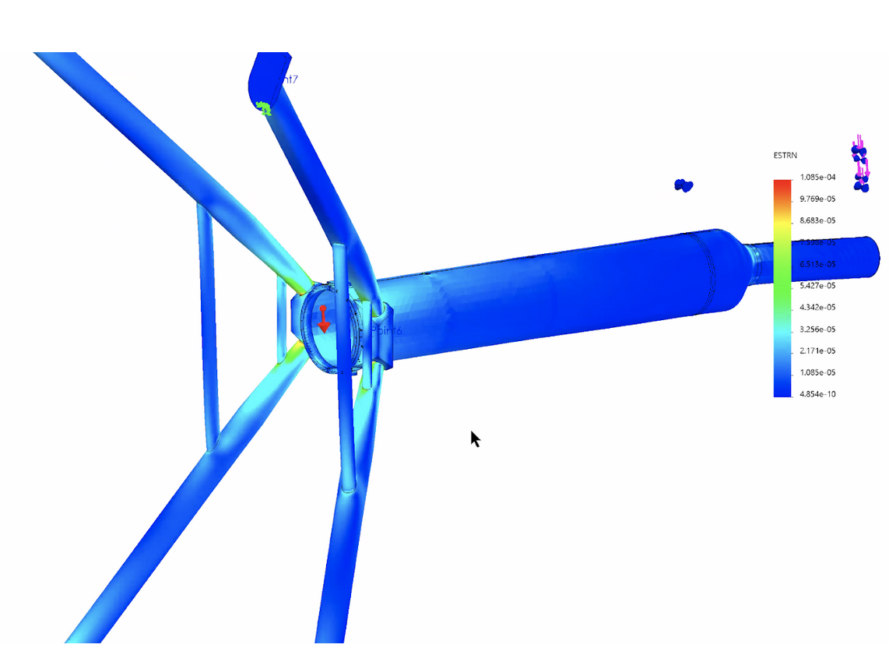
Detector Support Structure: X-Wing
Jason’s talk
X-Wing
Notes:
And the detector is supported through X-wing that is attached to iHCal supporting structure s..

Slide 5
Detector Assembly Fixtures
Joe’s talk
Notes:
Special assembly jigs are required to put staves on the EW on exact locations to provide prevision tracking measuremetns

Slide 6
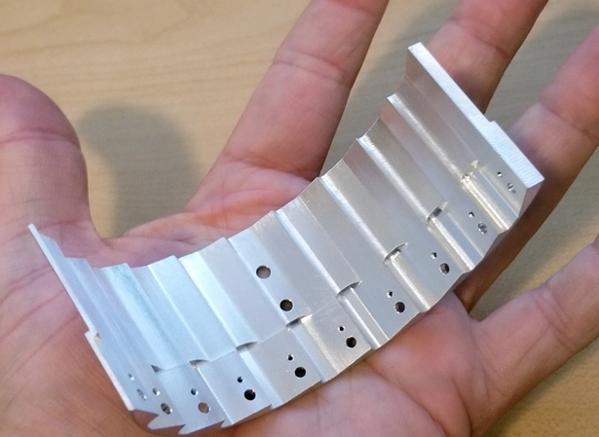
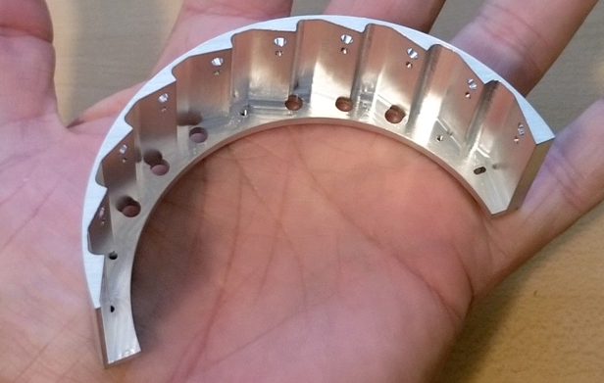
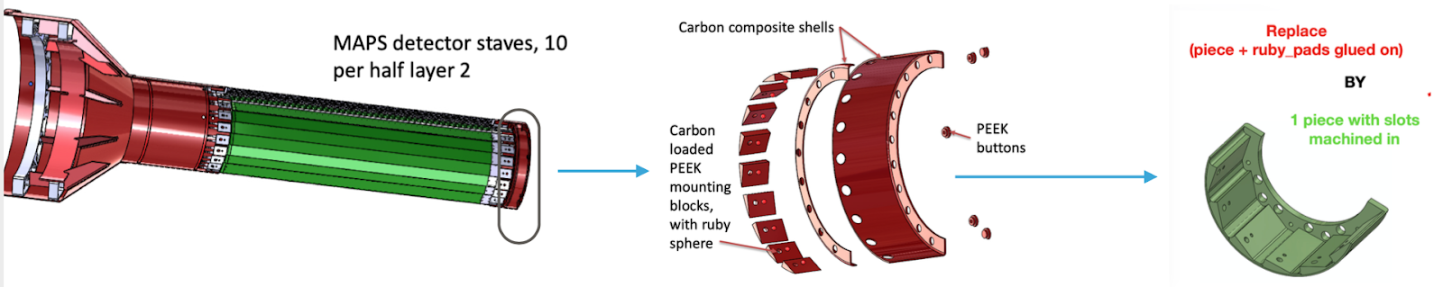
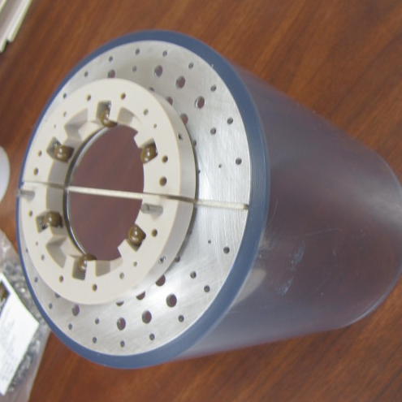
1. Engineering and Design
NOTE: all these covered in detail in Jason’s presentation.
Are the drawings complete? - Yes
  Have they been reviewed , approved, and released following guidelines?
  Are the drawings now under configuration control?
Has there been an appropriate independent review of the design?
Yes, LBNL (while updating the LBNL production cost)
Here is the link to the summary
If there have been changes to the documents since the Final Design Review, have these changes been vetted properly?
Yes, meetings/reviews with LBNL+CERN, LINK to discussions
  2 design changes:
  End-Wheels: a simple 1-piece design, made of Al, ~$10K/pair
  Lock-and-roll (nose roller) system on the nose of detector
  to protect against crushing into the Beam Pipe
  Are the changes still consistent with the Requirements?
  Yes (link to the EW discussions )
Has appropriate parts list been generated for all subsystem assemblies?
  Yes
Have all components been identified?
  Yes
Prototype
qualified!
1-piece Al End-Wheel
CFC-EW
Nose-Roller mockup
Nose roller
Notes:
In the following, I will answer review charge questions – shown in “dark-red” color on the slides. I will not go through each of them, but just highlights the important points …

Slide 7
2. Management
Is the schedule for procurement, including internal signatures and approvals, bid duration, material procurement, and fabrication been correctly estimated?
  Yes.
  Prepreg carbon fiber fabrication long lead time: 6-8 weeks
    for test article, small amount in stock.
    for the production work: order placed in advance (October)
    --> expected ready to go for full production in Dec/early January
Are they consistent with the Resource Loaded Schedule in P6? - Yes
  Mechanical structure fabrication costs: well within the budget :
    3-layer CFC-EW: $197K → in P6 $311K + 60% (contingency)
    One-piece Al-EW: ~$50K
    CYSS: $54K → in P6 $201K + 40%
    SB: $53K → in P6 $266K + 40%
  Manpower cost/schedule:
    4~5 months delay, still within cost & schedule contingencies
Have all recommendations from prior reviews been properly addressed and approved?
  yes
    only 1 suggested design modification from the January FDR: the lock-and-roll (nose roller) system

Slide 8
3. Fabrication
Have potential vendors been identified? -Yes.
  Carbon Fiber: CYSS, SB, EW Layers
    CAD designs completed in July 2020
    Design package (drawings + SOW) sent to 4 potential vendors on July 27th (WorkShape in France, 3 in CA, including LBNL)
    Received feedbacks and revised the drawings accordingly: v2 of the package sent out Aug. 13th, 2020
    Received 3 responses by the end of August deadline (see back-up for price/schedule comparison)
  One-piece End-Wheels: Carbon loaded PEEK -> Aluminum -- mostly affected by the pandemic (schedule wise)
    CAD design finalized early April, 2020
    Prototype-1 ready end of April: made by Xometry -- failed → weeks to get scheduled for CMM due to COVID shutdown
    Prorotype-2 sent in August to a 2nd shop in MA → delivered mid-Oct. → (other weeks to schedule CMM) CMM failed
    Prototype-3 (present): made of Al, sent to MIT shop in end of Oct. → back in November→ CMM acceptable
Will assembly be required?
  Yes. Fixtures and assembly steps designed by MIT/Bates, LANL and LBNL → see Joe’s talk
Who will perform the assembly?
  LBNL will do it.
What are the acceptance criteria for parts? Is this documented and part of the procurement package?
  All specified in Sec .2. of the SOW here
Who will do the acceptance inspection and testing?
  Shops in US (MIT for test articles; LBNL for production parts)
Is shipping included in the procurement?
  Yes. Costs from vendor include shipping to US, and there are money allocated for transport from LBNL to BNL
Where will equipment be stored upon arrival at BNL?
  Setup a clean tent at BNL in late 2021 for receiving & commissioning
  The shipping box will also act as a storage cradle, before the detector put on the insertion rails in the IR
-> see Jason’s talk

Slide 9
4. Quality
What are the quality assurance requirements for this procurement?
  Mechanical dimensions and tolerances
Are material certifications required?
  No. The prepreg carbon fiber change, from the originally design (ITS) to a better (and more expensive) one, was approved by the MIT/LANL/LBNL engineers.
Are there intermediate inspection steps required during fabrication that will require BNL involvement?
  No
Are they clearly spelled out in the procurement documentation?
  N/A

Slide 10
5. Safety
Have all safety requirements been qualified and closed out?
- Yes.
Requirements ~same for all sPHENIX systems
  Are there aspects of the MVTX unit design or operation that present a safety hazard like high voltage or flammable gas, etc...?
    No.
  2. Are there aspects of MVTX fabrication, assembly and testing at Bates, LBNL and BNL that present safety hazards?
    No.
  3. Are there aspects of the MVTX installation at BNL that present any unusual hazards like heavy weight, ergonomic issues, etc...?
    No. → see Russ and Jason’ talks
    sPHENIX will also have a design review for the integrated Beam Pipe, MVTX, INTT and MBD installation and tools that will address installation safety, planed for ~early 2021

Slide 11
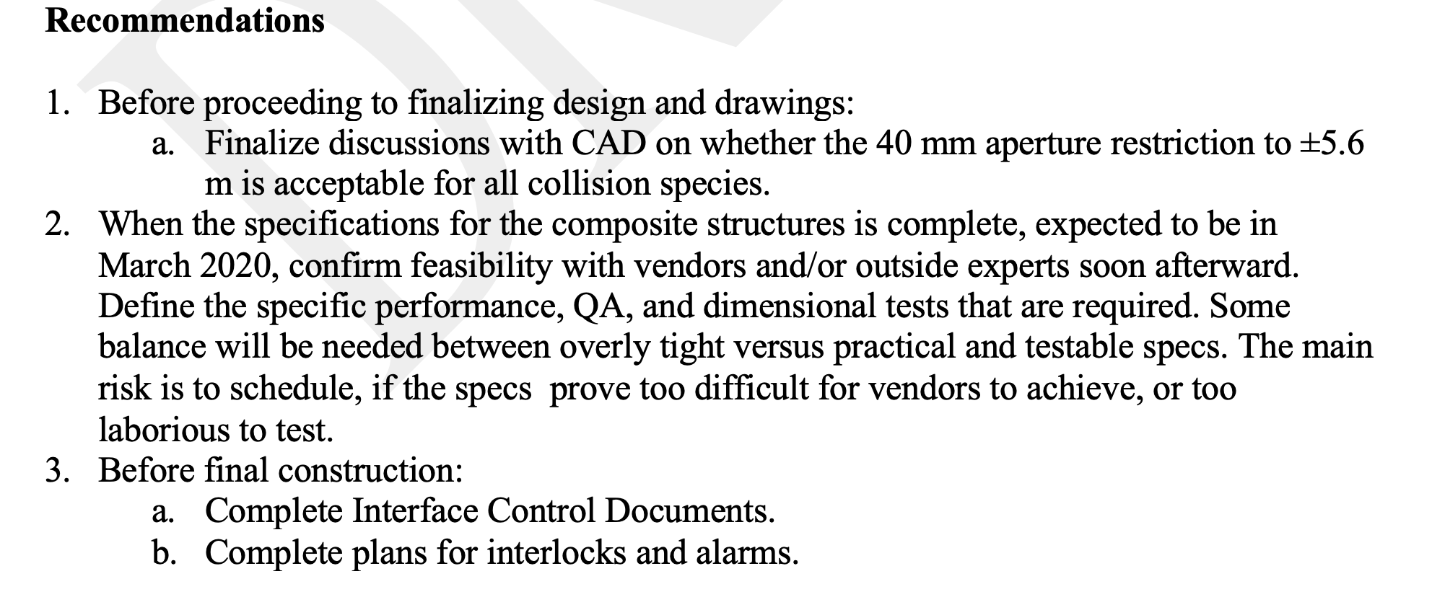
Addressed all Recommendations from last FDR
Beam pipe modification reviewed and approved, work in progress at Materion (BNL, Russ’ talk)
Worked with vendors on the final designs and tolerances. A test article (most challenging piece, MVTX Layer-0 EW) was produced and qualified with the selected vendor (WorkShape)
a) Completed ICD documents, and
b) preliminary plans for interlocks and
alarms (BNL, Russ’ talk)

Slide 12
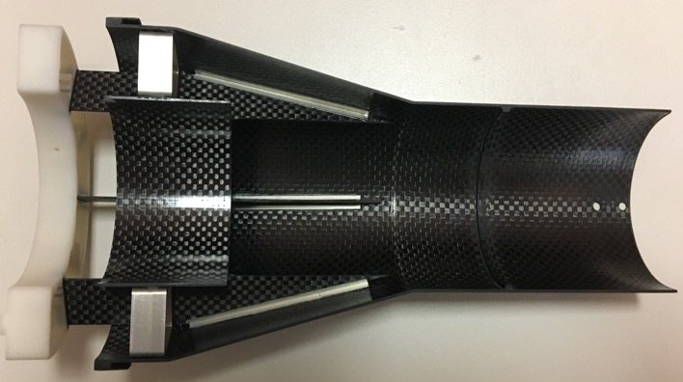
Summary I: Mechanical Design and Vendor Selection
Final designs developed based on ITS/IB concept, with inputs from MIT, LANL, CERN, LBNL and BNL engineers
  CAD designs completed in July 2020 and sent to 4 potential vendors with SOW on 7/27/2020
    modification of EW, with one-piece-EW
    Lock-and-roll system
  Received feedbacks and revised the drawings accordingly: final package sent out Aug. 13th
  Received 3 responses by the end of August deadline
Changed vendor selection process for the production cost and COVID-19 schedule challenge
  Advise from LBNL CFC production experience: skip the round-1 competition, provide detailed designs & SOW
  for vendor selection, then work with the selected vendor to fabricate the production CFC
WorkShape (France) won the competition
  Experience/qualifications, cost and delivery schedule
  Started fabrication of the test article in September 2020
  The first test article produced in Nov. and qualified in Dec. at MIT!
    (links to the US CMM measurements and also from WorkShape)
  Full production and delivery plan developed
First test article qualified!
(MVTX Layer-0)
Notes:
Slide 5, add LANL engineer, Workshape bullet - “Started working on detailed fabrication for test article”

Slide 13
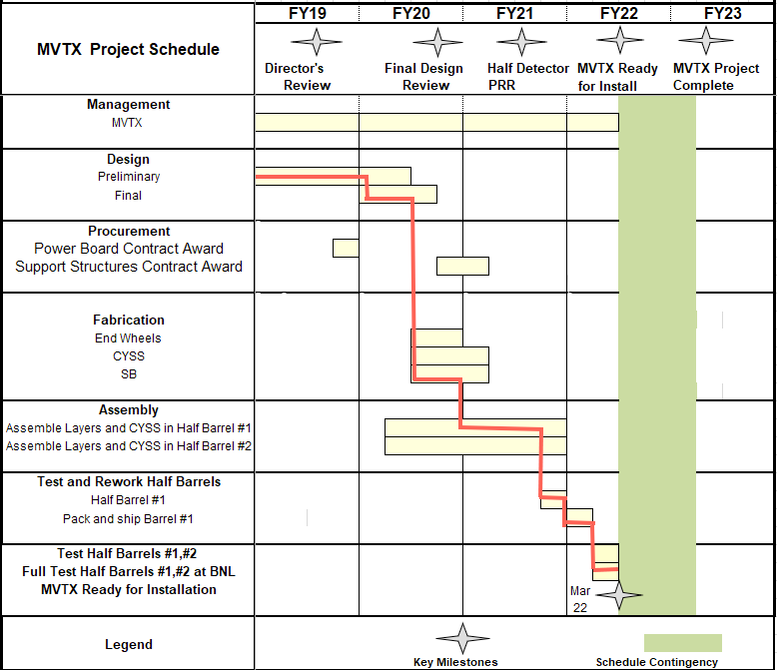
Summary II: CFC Production and Detector Assembly Schedule
Mechanical support structures
  Test article production and QA
    1st test article, Layer-0 EW qualified
    PRR: Dec. 15, 2020 (Today)
  CFC full production starts ~Jan. 2021
    1st half CFC(EW+CYSS+SB) available in ~March 2021
    2nd half CFC finish in April 2021
  Assembly fixtures designed (Joe’s talk)
  Insertion system designed & mockup in progress (Jason’s talk)
    System integration review: early 2021
Stave production in good progress at CERN
  Shipping and QA at LBNL, Jan -- Mar in 2021
Half-detector assembly at LBNL
  Assembly fixture production, ~Jan/Feb 2021
  CFC CMM & test fitting, March~April, 2021
  Half-detector assembly review, ~May 2021
  Complete the 2nd Half-detector by 12/2021 (orig. schedule)
Aim to meet the original MVTX installation dates
- ready to install in sPHENIX IR, ~March, 2022
- IR available for MVTX installation, ~Sept., 2022
MVTX has ~6 months schedule float
NB:
Original (pre-COVID19) schedule:
- start assembly in Dec 2020
Current schedule:
- start assembly in March/April 2021 (3-4 months delay)
Pre-COVID19 Schedule in MVTX PMP
Today
Assembly review
Notes:
Following the approval from this review, we will start CFC production from Jan 2021 …. We have 40+ gold staves at CERN waiting for shipping .. Need 48 for the final detector

Slide 14
Backup slides

Slide 15
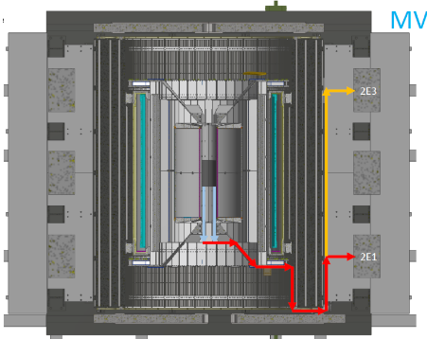
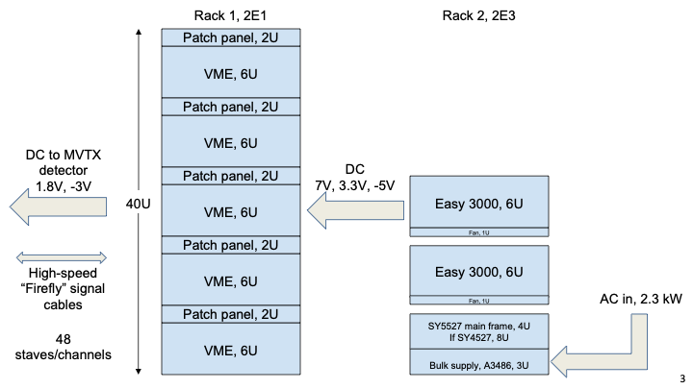
MVTX Detector and Interface
sPHENIX-SE-ICD-042 Document:
https://docs.google.com/spreadsheets/d/1hHUhxZOZv8WEs3FH361_gN6McVU4Zhy60sGtYotRHMs/edit?usp=sharing
Power and safety interlock

Slide 16
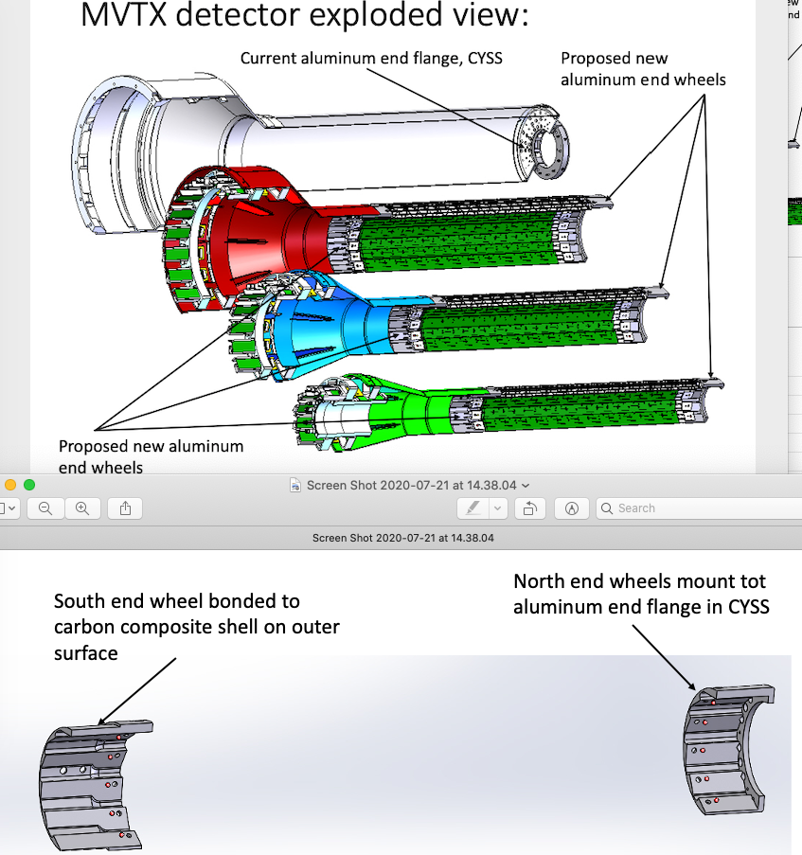
MVTX Detector: End-Wheels

Slide 17
3 Vendors’ Bids Received (one didn’t responded)

Slide 18
Cost from WorkShape
1 EU$ = 1.2 US$
Total cost = EU$271K x 1.2 = US $325K
EWs: EU $164.1 => US $197K
CYSS: EU $44.65K => US $54K
SB: EU $44.15K => US $53K
Shipping: US $21K

Slide 19
Project Management Plan
Draft PMP document completed
  Project baseline
    Physics
    Functional requirements/KPP
    Technical scope
    Cost breakdown
    Schedule
    Funding profile
    Planned BNL funding
    Baseline change control
  Management structure
    Organization and team
    Management responsibilities
    Participating institutions
  Project management and oversight
    Risk management
    Project reporting
    Engineering and technology readiness
    Quality assurance and configuration/document management
    Operation readiness plan
    ESSH plans and fabrication
    Project closeout
Project fully integrated into sPHENIX P6
  Costs, schedules and risk register
Deliver MVTX on schedule/budget for day-1 physics!

Slide 20
MVTX Milestones and Key Tasks
From MVTX PMP
12/2019

Slide 21
MVTX High Level Cost

Slide 22
MVTX Carbon Structure Cost(July 2019)
60%
Changed to 60%,
following July 2019 review
recommendations

Slide 23
MVTX Material Distribution
Signal Cables Load | 2226 g
Signal Cables Type | Distributed Force, per side
Location | SB inside face
Power Cables | 3612.3 g
Type | Distributed Force, per side
Location | SB inside face
L0 | 261.26 g
Type | Remote mass, per side
Location | CYSS Clamp ring and Nose Plate
L1 | 312.9 g
Type | Remote mass, per side
Location | CYSS Clamp ring and Nose Plate
L2 | 418.9 g
Type | Remote mass, per side
Location | CYSS Clamp ring and Nose Plate
Cooling tubes 4mm + Air Tubes | 1122.054 g
Type | Distributed Force, per side
Location | SB Inside face
Nose rollers | 30 g
Type | Distributed Force, total
Location | Nose Plates
Total weight = ~24kg
Sensors parts (CYSS+EWs+Staves+noseroller)= ~3 kg
Cables of detector = ~12kg
Cooling tubes = ~1.1kg
sensors
service barrel

