Slide 1
MVTX Overview
Ming Liu
Los Alamos National Laboratory
For the sPHENIX MVTX Upgrade Group
BNL Director’s Review
August 2-4, 2017

Slide 2
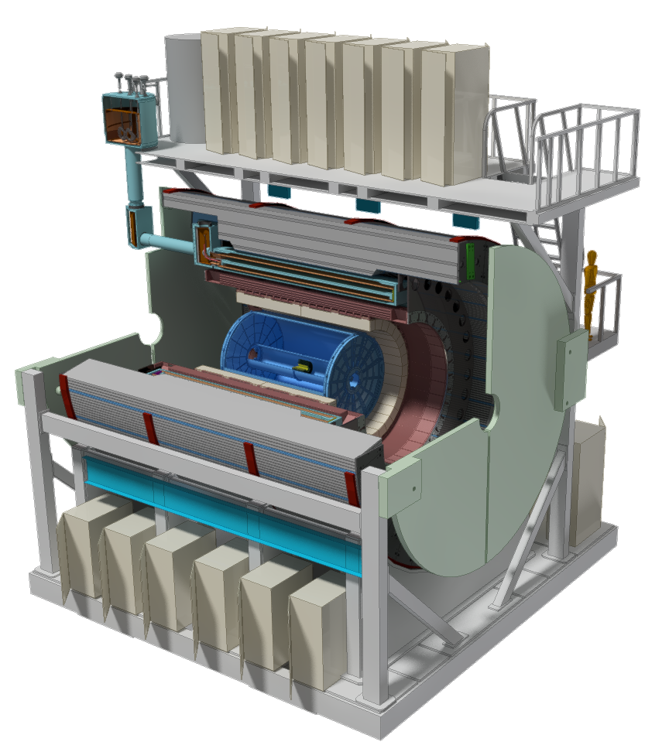
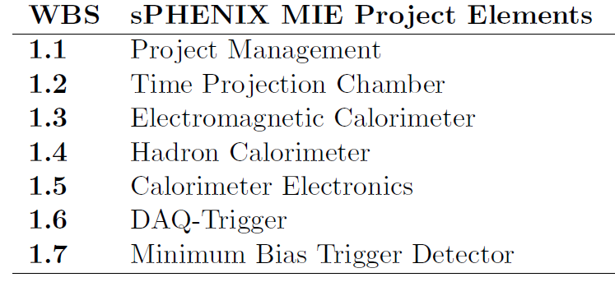
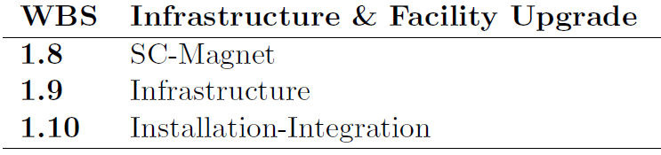
MVTX: MAPS-based Vertex Detector for sPHENIX
A separate upgrade project for the baseline sPHENIX experiment, with
Compelling Science
Feasible Cost & Schedule
MVTX BNL Director’s Review: July 10-11, 2017
Parallel Activities
MAPS-based Vertex Detector (MVTX)
Intermediate Silicon Strip Tracker (INTT)

Slide 3
Outline
Science of MVTX detector
Scope of MVTX project
  Readout
  Integration
  Cost & schedule
Organization & plan

Slide 4
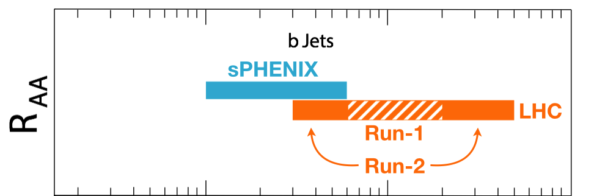
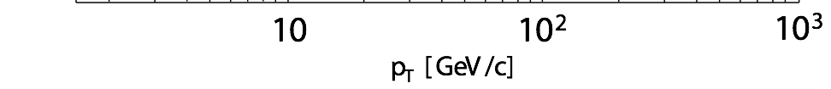
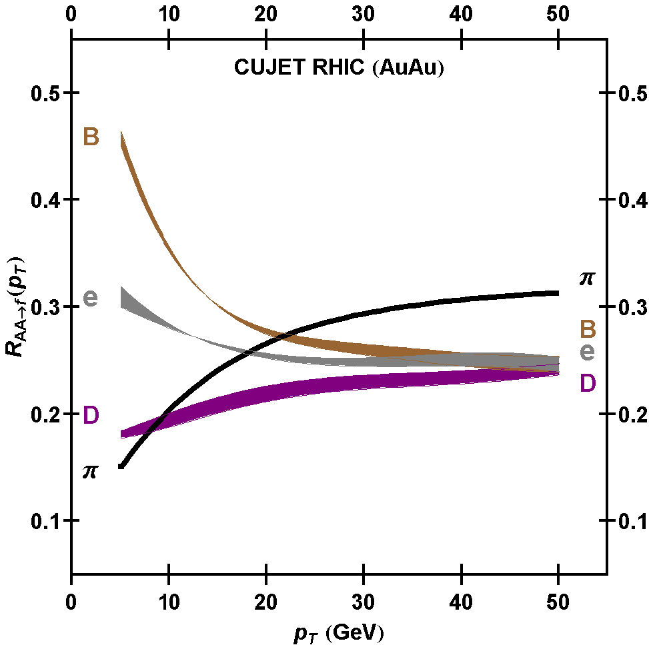
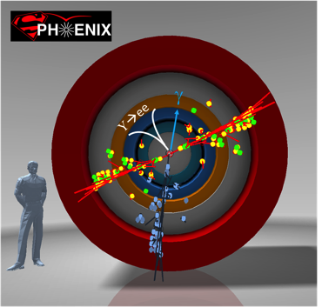
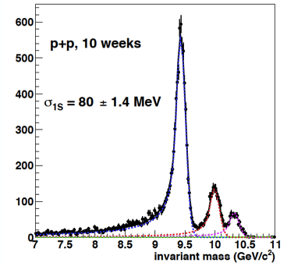
Exciting Science
sPHENIX is the next flagship heavy ion physics experiment in the US (NSAC LRP2015)
  Jets
  Upsilons
  B-jets and B hadrons
MVTX will complete QGP heavy flavor physics
  Precision study of the “inner workings of QGP”(LRP15)
  Unambiguous determination of key parameters of QGP properties and interactions
complement & extend current and future RHIC and LHC QGP programs
sPHENIX 3 Physics Pillars
http://arxiv.org/pdf/1501.06197v1.pdf
Jets
Upsilons
PRL 108 (2012) 022301
B
D

Slide 5
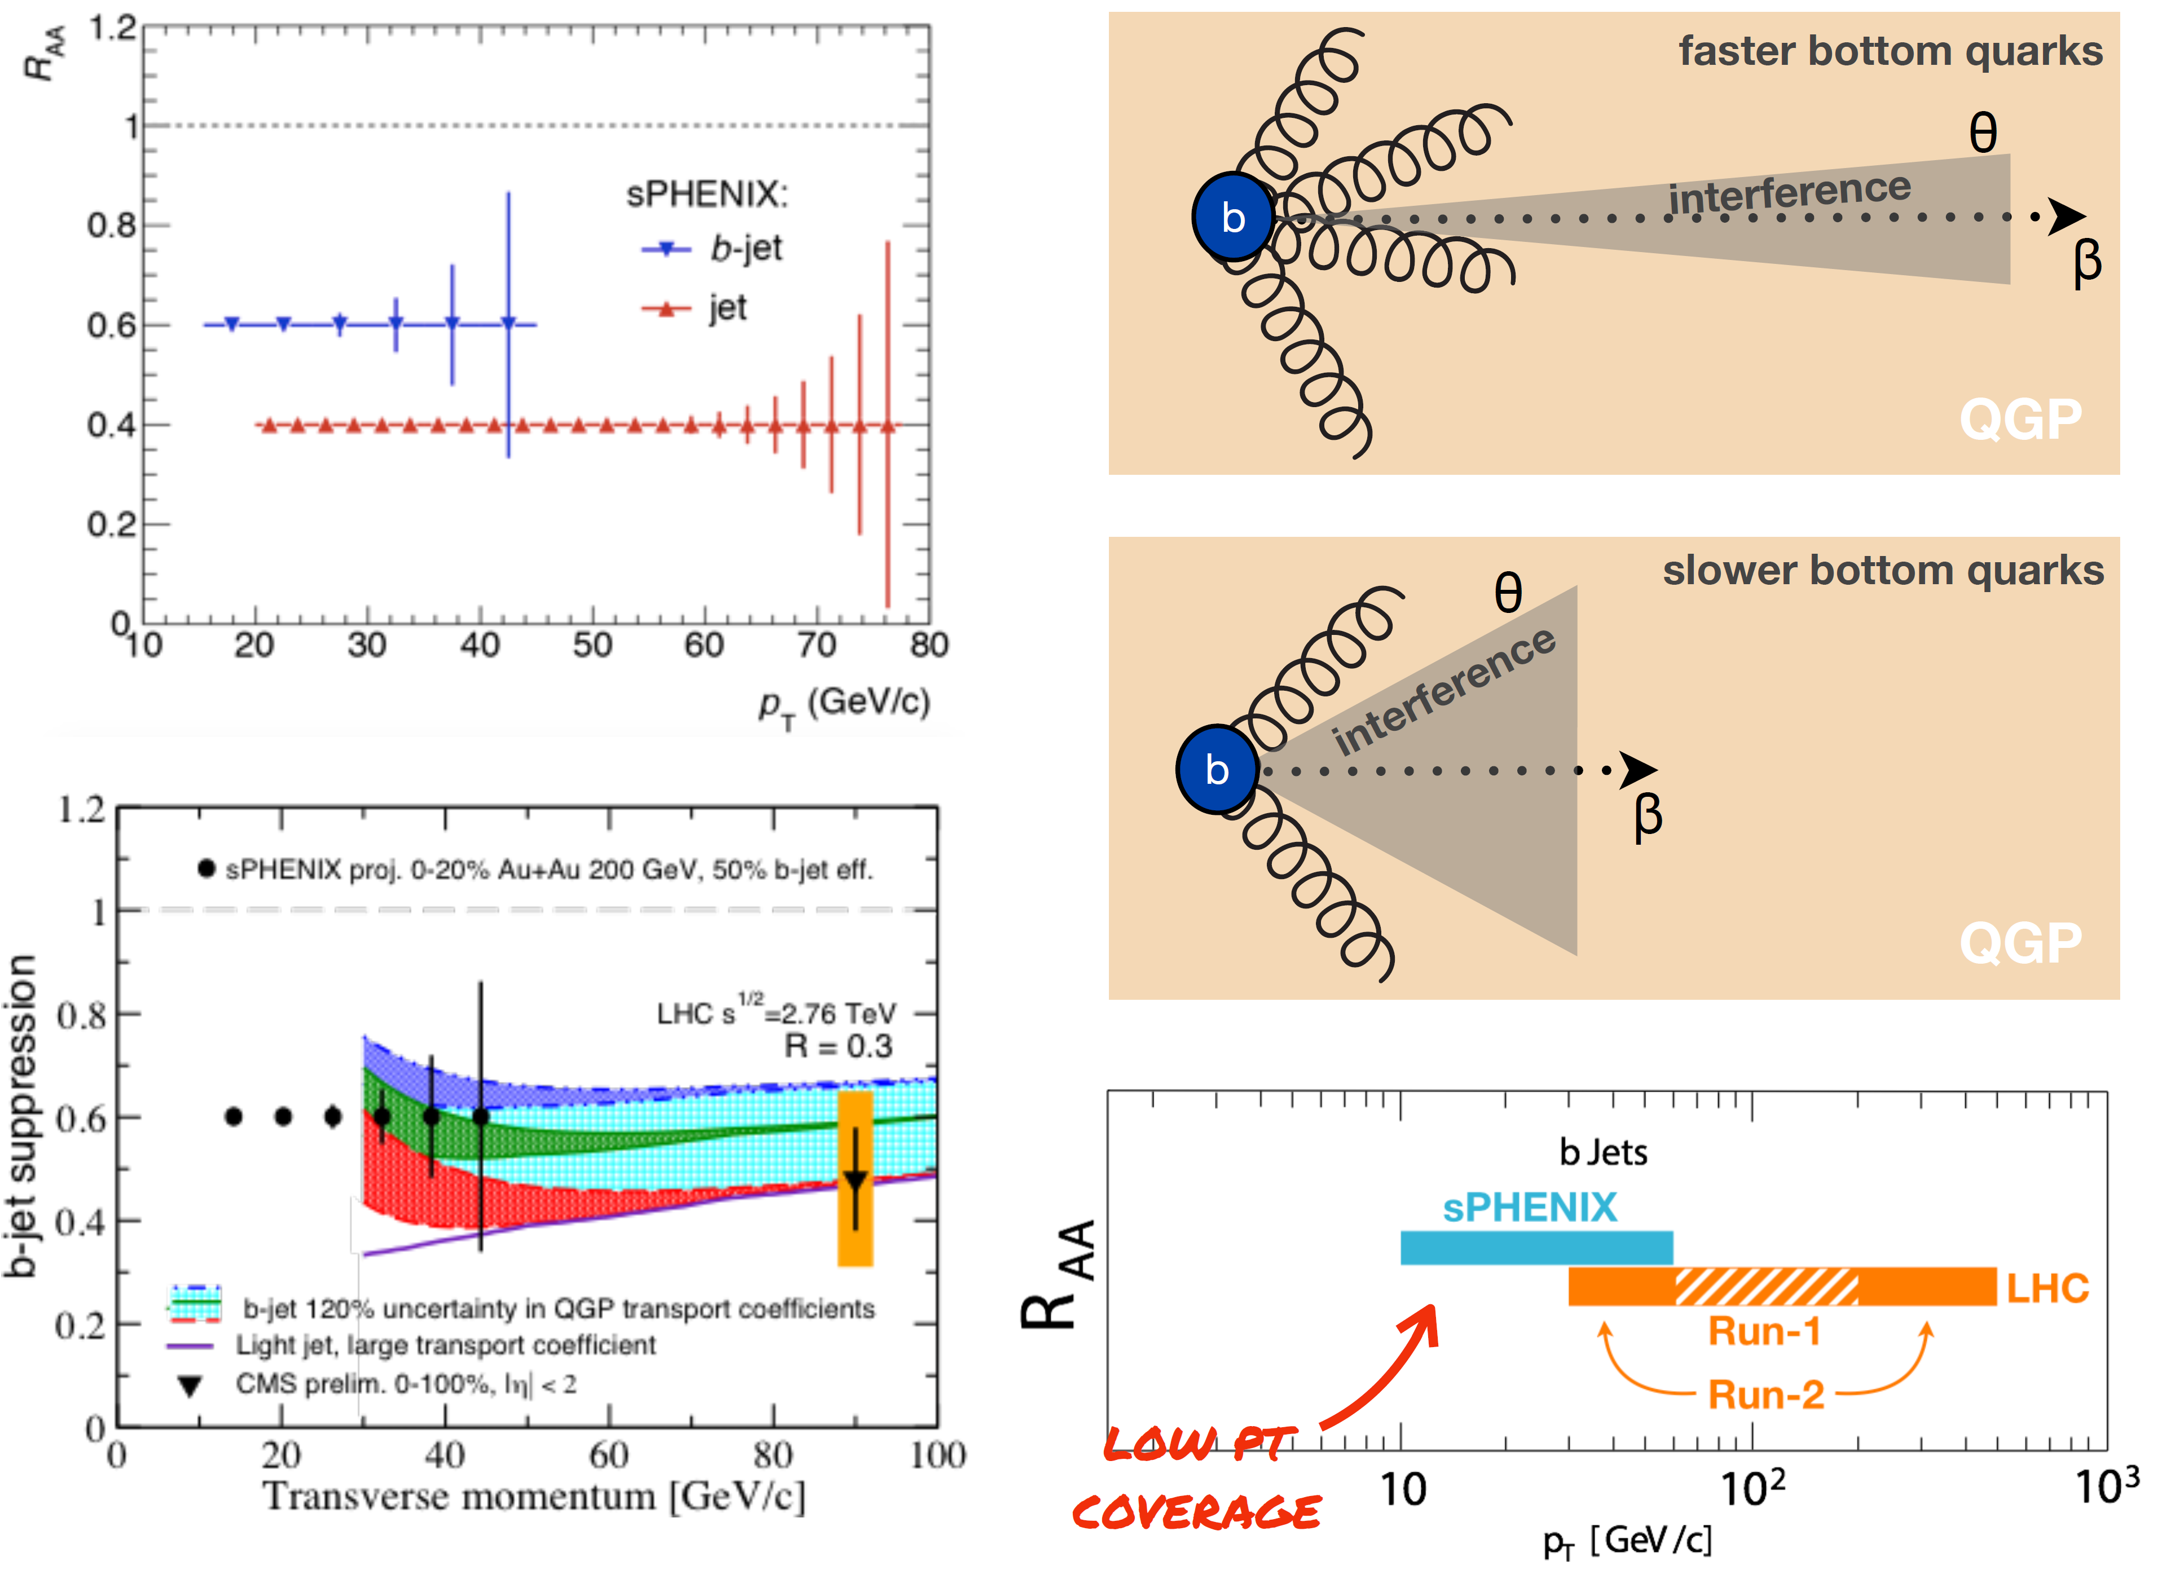
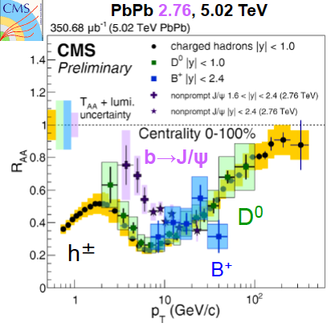
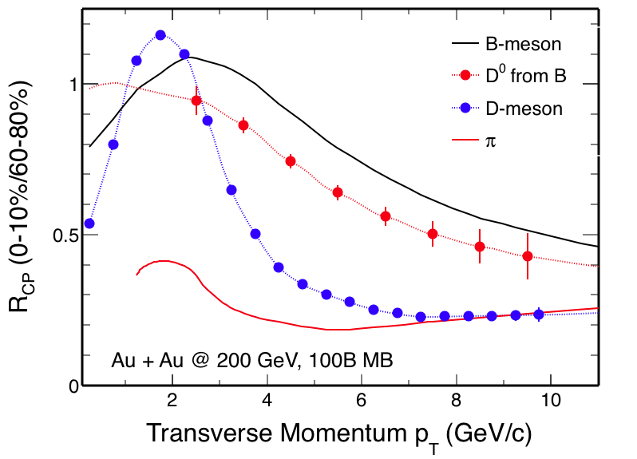
MVTX – Bring sPHENIX to a New Horizon
Unambiguously determine quark energy loss mechanisms, particularly over the interesting transition region, pT ~ M
  Radiative dE/dX
  Collisional dE/dX
  Other effects
pT >> M
pT << M
Expectations @sPHENIX
Learned @CERN
sPH-HF-2017-002
sPH-HF-2017-001
QM’17
B-hadron
sPHENIX
sPHENIX
B-jet

Slide 6

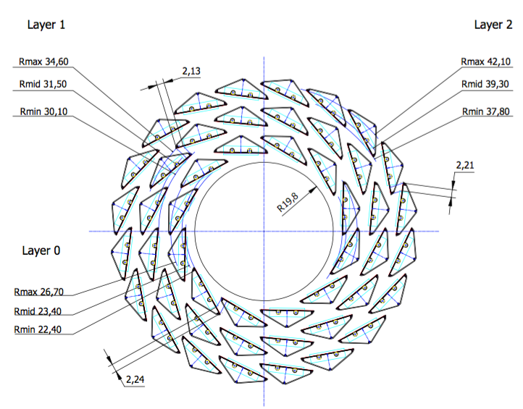
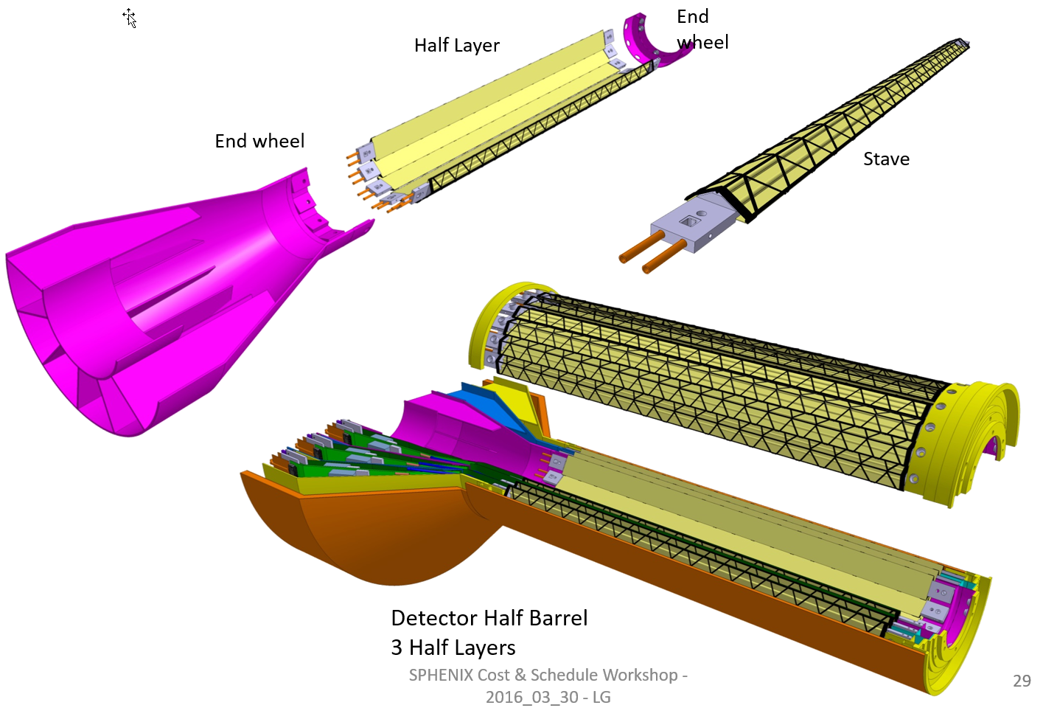
Our Approach: MVTX
J. Phys. G 41 (2014) 087002
ALICE ITS Upgrade:
Inner Barrel Tracker
Major challenges:
- Readout
- Mechanics
R = 23/32/39 mm
Z = 271 mm
sPHENIX Inner Tracking
Adapt ITS/IB:
- Min. Risks
- Max. Phys.

Slide 7


Monolithic-Active-Pixel-Sensors (MAPS)
The next Generation State of the Art Pixel Tracker
Advantages of ALICE MAPS/ALPIDE:
  Very fine pitch (28x28 μm)
  High efficiency (>99%) and low noise (<10⁻⁶)
  Time resolution, as high as ~5 μs
  Ultra-thin/low mass, 50μm (~0.3% X₀)
  On-pixel digitization, low power dissipation
An ideal detector for QGP physics!
FPC
9 Chips
Cooling plate
A 9-chip MAPS stave, 1.5 x 27cm²
ALPIDE design
50 μm
28 μm

Slide 8
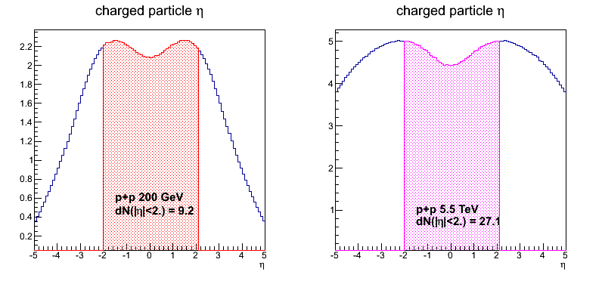
sPHENIX MVTX vs ALICE ITS/IB
 | ALICE (Run3) | sPHENIX (Max Collis.)
Pb+Pb / Au+Au | 100 kHz (50kHz) | 200 kHz
p+p | 400 kHz (200kHz) | 13 MHz
Trigger/Readout | >50 kHz | 15 kHz
Event track multiplicity dN/dη: sPHENIX = 1/3 ALICE (pp), 1/5 ALICE(AA)
sPHENIX
ALICE

Slide 9
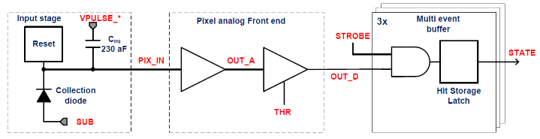
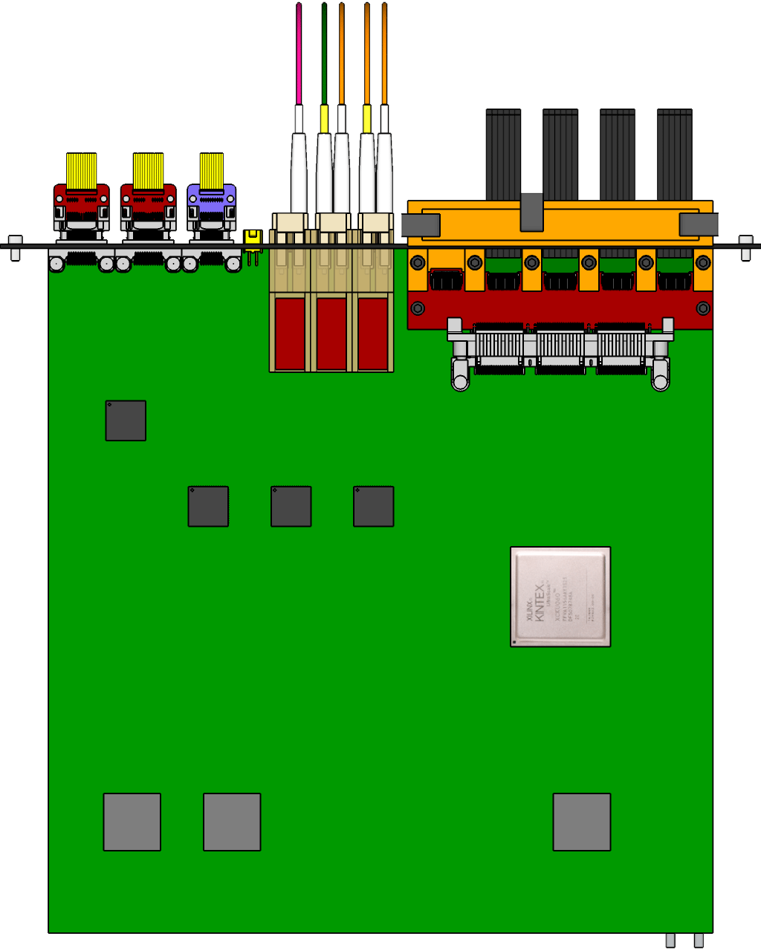

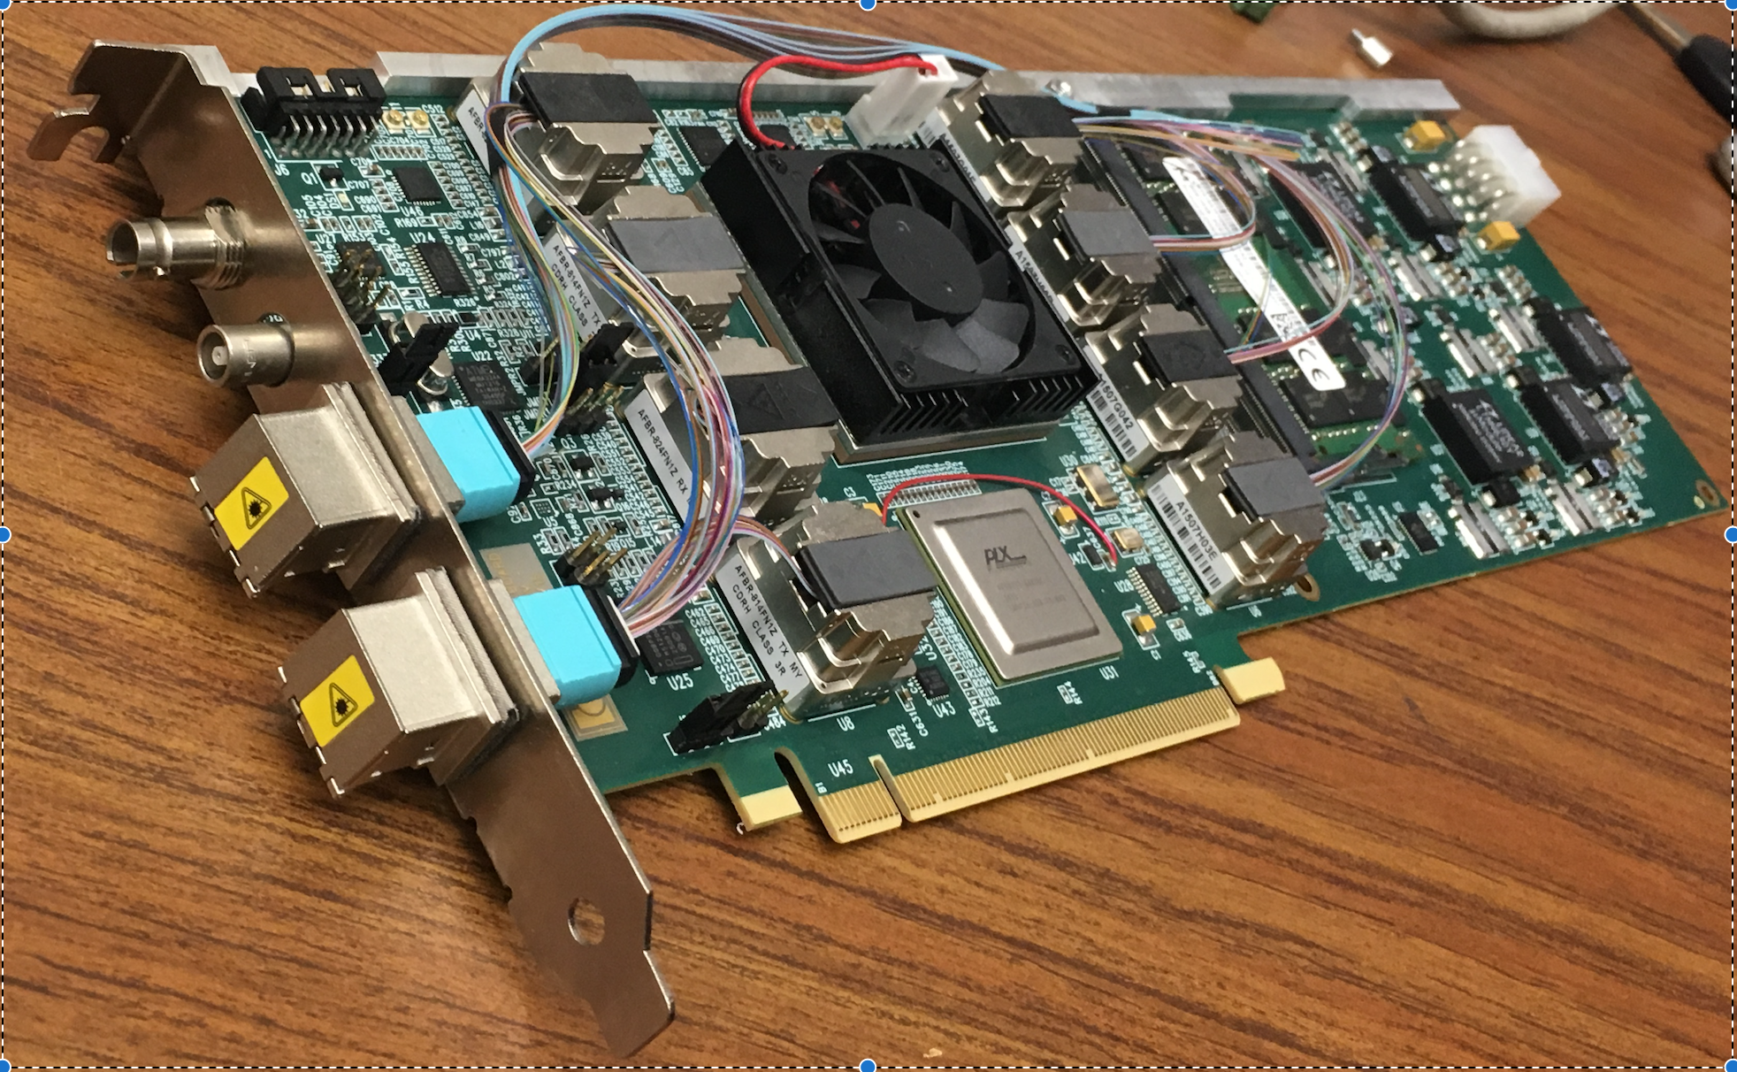
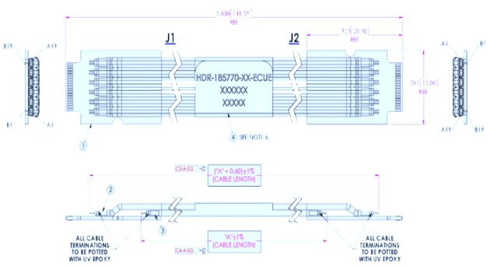

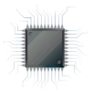
MVTX Readout and Control System
sPHENIX GL-1 & GTM
ALPIDE Sensor
CAN bus
DCS
5~10 m
Trigger & Clock
Readout Unit
GBT Optical Links
9 Data (1.2Gbps)
1 Clock, 1 Control/Trigger
Control
9-sensor Stave
Data (9.6 Gb/s max)
Trigger
Samtec Twinax “FireFly”
FELIX
FPC
Power
9 ALPIDE Sensors
Power
Filtering
Capacitors
regulators
Power supplies
Cold Plate
Regulated Power
Power Board
LANL, UT-Austin, LBNL, BNL, ALICE/ITS …

Slide 10
MVTX Pre-proposal Submitted!
Pre-proposal submitted to DOE, 2/2017
  Follow-up discussions with DOE and BNL managers
  Weekly proj. leaders’ meeting, BNL/LANL/LBNL/MIT
Plan to update proposal to DOE, late 2017
  Expanded science + Cost & Schedule
  Assumed funding starts in FY18
  BNL Director’s Review, 7/10-11, 2017
A growing collaboration
  15+ institutions from US and abroad
Adapt ALICE ITS Upgrade Inner Barrel 3-layer MAPS detector
  Mini. risk, Max. Physics
Precision vertexing for b-jet/B-hadron tagging in HI with high efficiency and high purity
B-jet modification in QGP at low-medium pT to determine QGP properties, study mass-dependence on collisional vs radiative energy loss, flow etc.
Early R&D by LANL LDRD, $5M, FY17-19, readout, mechanical design and physics; established LANL-ALICE MoU for joint R&D and training

Slide 11
Scope of the MVTX Project
MAPS Staves & Electronics
  Produce 68 ITS inner Barrel Staves
    No modification
  Readout Electronics R&D (LANL LDRD)
    Frontend: ALICE/ITS, RU
    Backend: ATLAS FELIX
    Modify/reprogram RU & FELIX for sPHENIX
  Production:
    Extend ALICE/ITS MAPS stave production
      WBS 1.5.3.1, LANL
      sPHENIX personnel help at CERN
    Reproduce additional ALICE/RU & ATLAS/FELIX
      WBS 1.5.2.1, UT-Austin
      WBS 1.5.2.2 , LANL
    Final assembly and test in US
      WBS 1.5.3, LBNL
  Ancillary systems, “adopt” ALICE system
    Power distribution, cables, crates, racks etc.,
      WBS 1.5.2.3, LBNL
    Slow control, safety and monitoring
Mechanics & Cooling
  Some changes to ALICE/ITS inner tracker mechanical structures, WBS 1.5.3
    End Wheels
    Cylindrical structure shells
    Detector half barrels
    Detector and Service half barrels
  Mechanical Integration, WBS 1.5.4
    Conceptual design by LANL LDRD
    Prototype by sPHENIX R&D, MIT/LANL
    Design integration frames
    Carbon frames etc., LBNL
    Installation tooling etc.
  Adopt ALICE cooling plant design
    Minor modification to fit sPHENIX
    Smaller heat load than ALICE ITS
  Metrology and Survey

Slide 12
LDRD – MVTX Key Tasks/Milestones
7/17
10/17
10/18
10/19
Today
RUv1.0/FELIX1.5 Integration
40MHz, 7/17-12/17
LDRD
RUv1.x/FELIX2.0, 10MHz,
10/17 – 6/18
MVTX Design Review 7/2018
System test, cosmic & source
6/18 - 1/19
Test Beam, tracking performance
analysis, physics sim, NIM paper etc.
1/19 – 9/19
MVTX: 2018 – 2021
Stave Production, procure FPGA, GBT etc.
8/18-4/19
BNL Director Review
7/10-11, 2017
Electronics Production
1/19-6/19

Slide 13
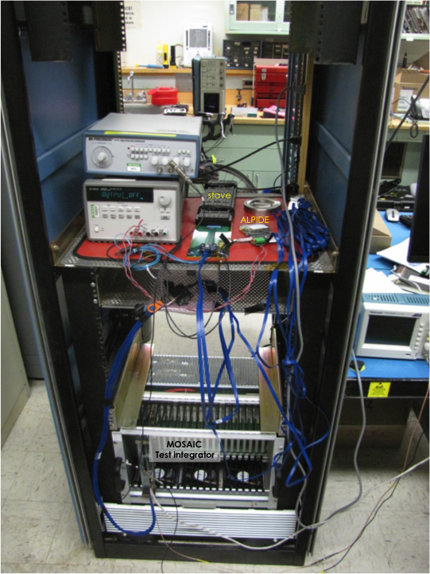
LANL LDRD Progress Highlights
LDRD Goals:
Complete MVTX readout design and development
Preliminary conceptual design of mechanical system integration
R&D status:
MOSAIC test bench in operation
  Single MAPS chip high-speed readout
  9-chip HIC/”stave” readout
  External trigger, cosmic and source
  Test data readout performance
    0.4, 0.6, 1.2Gb/sec
Firefly cable performance test
  5m (ALICE default)
  7m, 10m (favored for sPHENIX)
  Short extension cables, 20~30cm (share space with INTT), for mechanical system integration
Back end FELIX board installed & being tested
Front end Readout Unit boards available soon
9-chip
stave
A MAPS
chip
FireFly cables
MOSAIC test bench

Slide 14
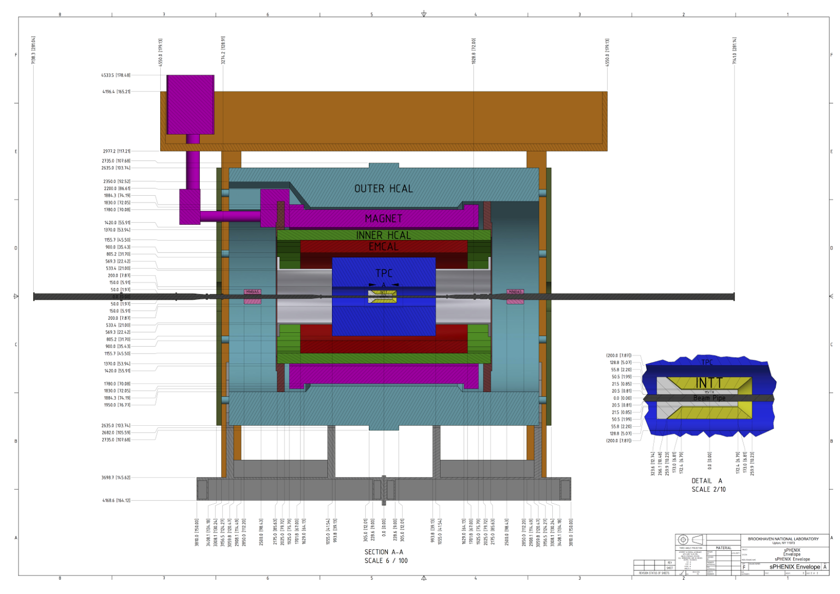
System Integration
MVTX+INTT

Slide 15
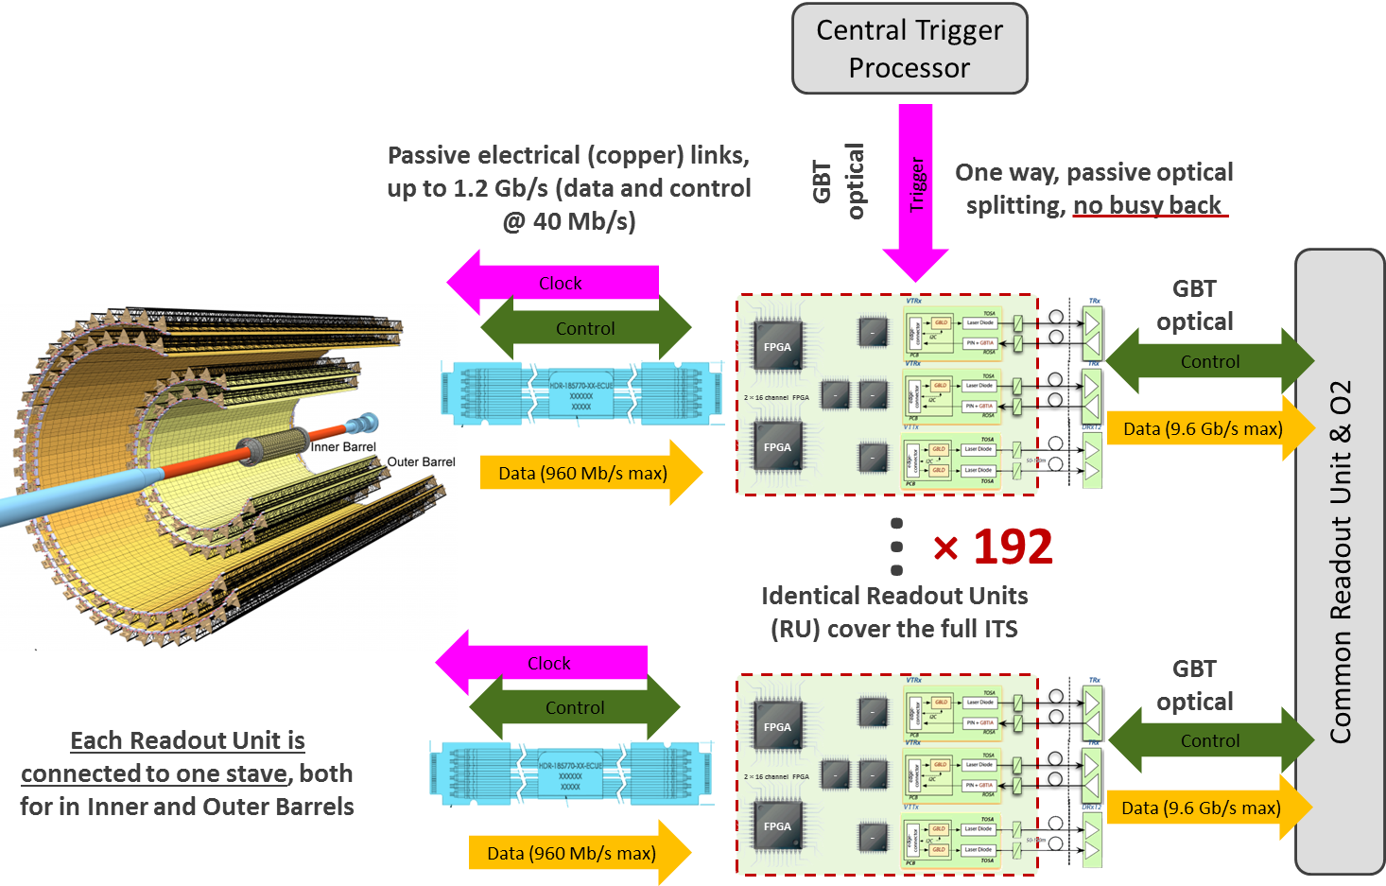
Cost Basis – Major Items
Electronics (WBS 1.5.2): $1,285K
  ALICE ITS RU & PS
  ATLAS FELIX
  Power system and controls
  PHENIX/STAR/ALICE experience
MAPS and Detector (WBS 1.5.3): $2,900K
  ALICE ITS/IB production
  PHENIX/ALICE/STAR experience
Mechanical integration (WBS 1.5.4): $910K
  ALICE ITS inner tracker design modification
  FVTX/PHENIX, HFT/STAR experience
Total project cost: $5.7M, w/ 35% Cont.
x48
Updated material and labor cost and contingency from pre-proposal
- latest quotes on electronics and other R&D items

Slide 16
MVTX
Principal Investigator: M. Liu (LANL)
Lead Coordinator: M. Chamizo-Llatas (BNL)
Co-investigators: G. Odyniec (LBNL),R. Redwine(MIT)
ES&H Liason: W. Sondheim (LANL)
sPHENIX DAQ
sPHENIX integration
Electronics
LANL
WBS - 1.5.2
Mechanics & Detector Assembly
LBNL - WBS 1.5.3
Integration & Infrastructures
MIT - WBS 1.5.4
Readout Units
UT Austin WBS 1.5.2.1
Staves
LANL WBS 1.5.3.1
Cooling
MIT WBS 1.5.4.2
Back-end
LANL WBS 1.5.2.2
Carbon Structures
LBNL WBS 1.5.3.2
Safety System
MIT WBS 1.5.4.3
Power systems
LBNL WBS 1.5.2.3
Barrel Assembly
LBNL WBS 1.5.3.3
Global Support
MIT WBS 1.5.4.4
Major institutions lead key tasks
Installation & Commissioning
LBNL/BNL WBS 1.5.4.6

Slide 17
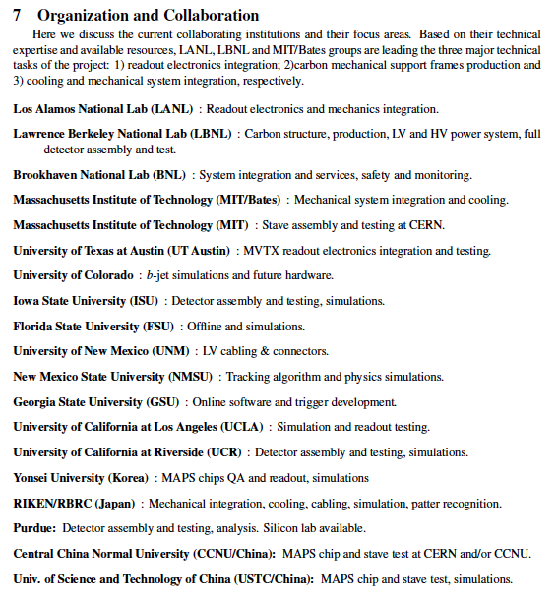
A growing collaboration!
new sPHENIX/MVTX members:
Czech groups: Charles Univ. and Inst. of Phys. of the Czech Academy of Sciences
  Stave production at CERN
CCNU – MAPS lab
  HICs assembly and test
  Mechanic integration
Potential collaborators:
USTC
  Physics simulations w/ LBNL
Peking Univ.
  Physics and detector simulations w/LANL
NCU, Taiwan
From MVTX pre-proposal

Slide 18
Status, Plans and Issues
LANL- ALICE MoU
  Associate member of ALICE ITS Upgrade project
  Obtained ALICE readout test stand, MAPS sensors, staves and electronics for early R&D
  Obtained design files, electronics and mechanics
  Training sPHENIX personnel
High Level Agreement with ALICE – on going discussions
  Produce 68 staves for sPHENIX using ALICE/CERN facilities
Potential schedule/funding gap of stave production
  ITS/IB production: 7/2017 - 6/2018
  If funding significantly delayed, concerns over the availability of CERN facilities
  Risk Mitigation:
    Early training through LDRD effort, maintain activity at low level
    External foreign funding, CCNU Pixel Lab etc.
    Possible “mortgage” for sPHENIX production from ALICE/CERN with “Agreement”
sPHENIX readout and mechanical integration R&D
  Schedule risks due to unavailability of key R&D elements like staves and readout electronics
  MVTX/INTT integration
  Risk mitigation:
    Early joint R&D with ALICE as associate members
    Early R&D with prototype staves, RU and FELIX
    Early mechanical system integration R&D

Slide 19
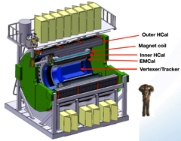
Project Tasks and Timeline
FY2016
FY2017
FY2018
FY2019
FY2020
FY2021
sPHENIX
baseline
CD-0
9/2016
CD-1?
Ready for
Beam, 2022?
ALICE ITS/IB
prod. ends
  Readout R&D
  Mech. design
  @LANL/ALICE/UT-A
Key R&D
LDRD@LANL
Mech. Integr.
& Prototype
@LANL/MIT/LBNL
A schedule driven project!
Stave prod.&test @CERN;
C-Stru. Prod. @LBNL
“RU” & “FELIX”
Prod. @US
Production
MAPS Prod. & QA
@ALICE
Detector Assembly
& Test @LBNL
Det. Install.
@BNL

Slide 20
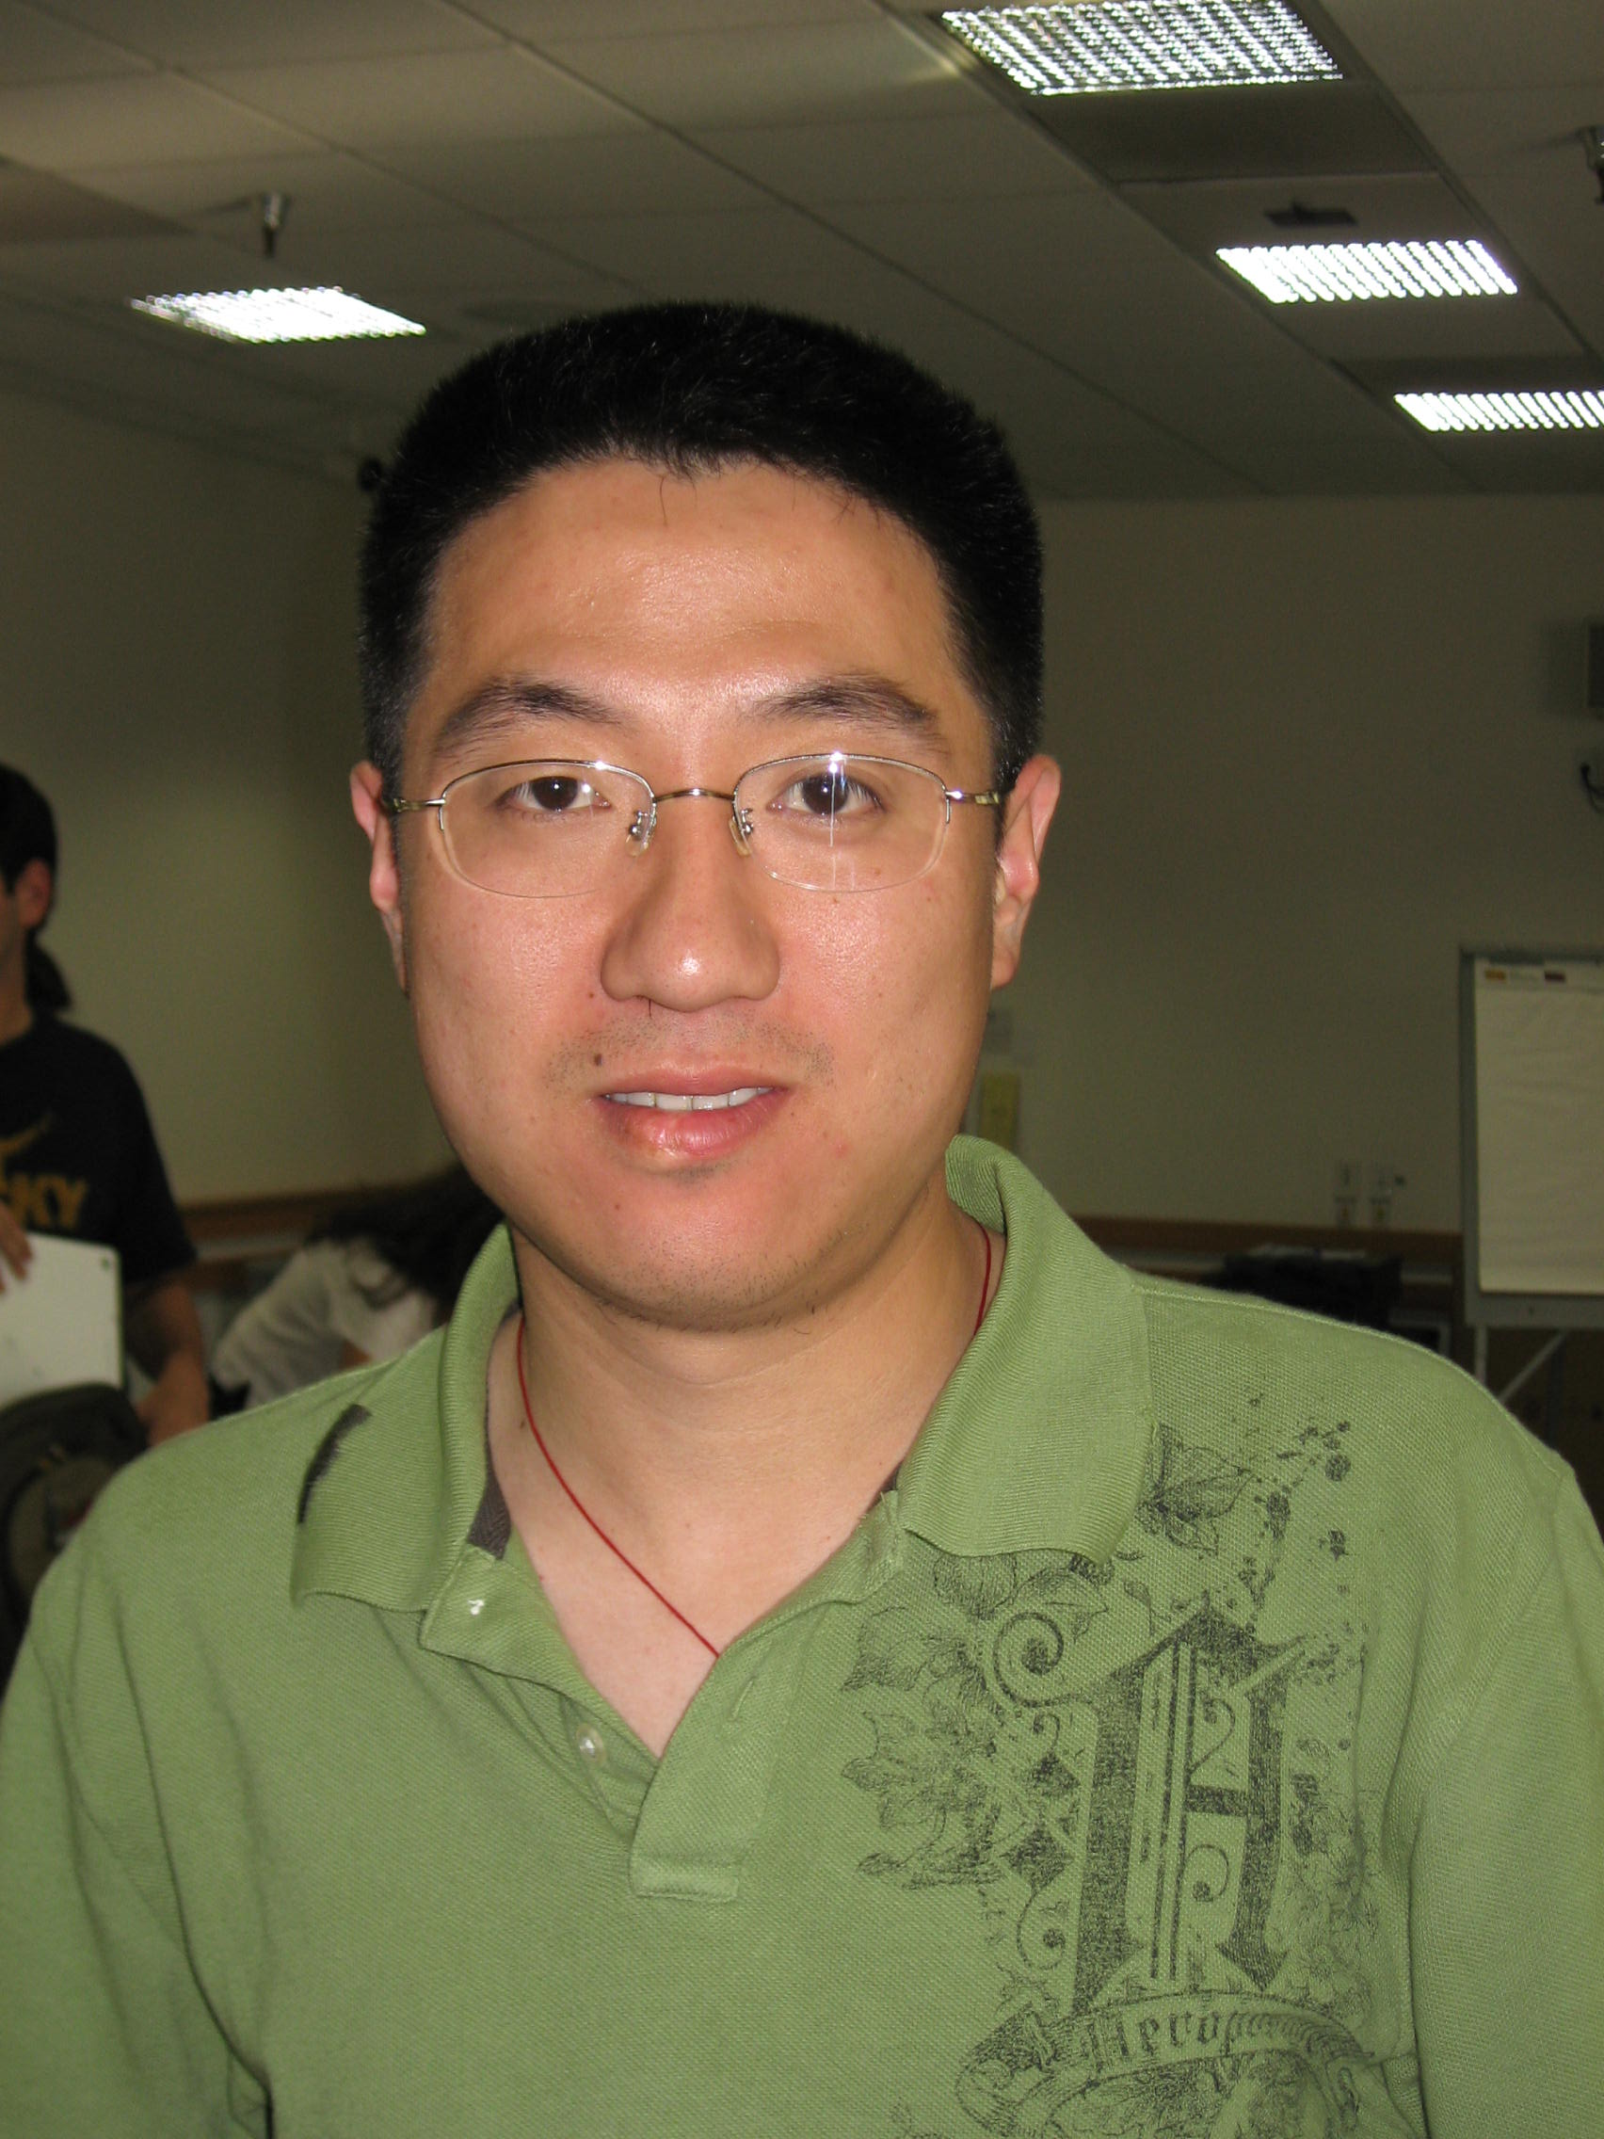

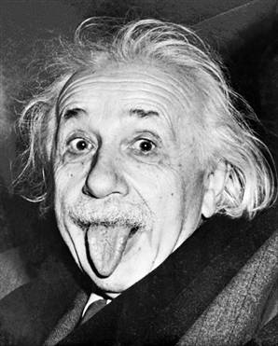
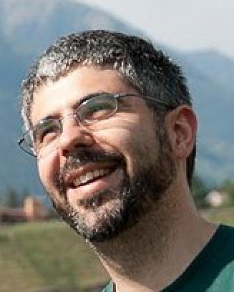


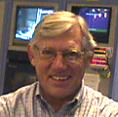
Summary from July 2017 MVTX BNL Directors Review
Exciting science - Xin
  New B-physics program @RHIC
Early ALICE & ATLAS R&D investment
  Reduce technical risk and R&D cost
LANL LDRD critical - Cesar
  mitigate risks and minimize contingency
No high risk R&D – Mark, Giacomo, Walt
  Readout
  Mechanics
  MVTX integration
Ready for sPHENIX Day-1 – Ed, Dave
  sPHENIX integration
  Cost & Schedule

Slide 21
Backup

Slide 22
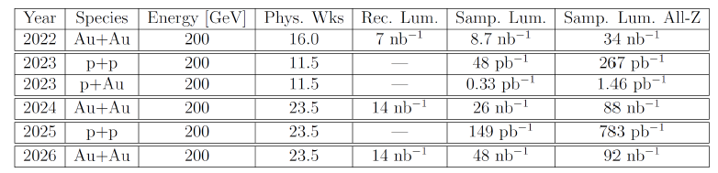
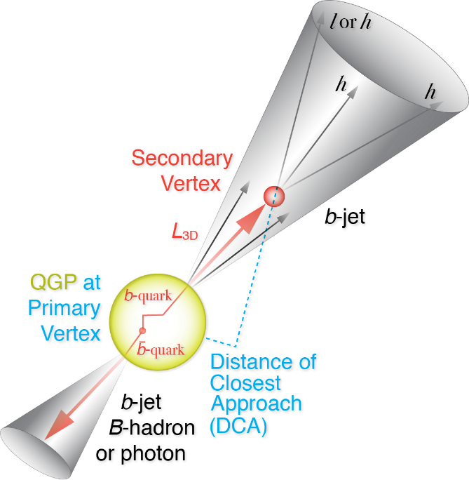
A Multi-Year Plan: sPHENIX 2022-2026
Projected maximum collision rates:
  Au+Au: 200 kHz ( ~50 kHz, |Z|<10cm)
  p+p: 13 MHz ( ~3 MHz, |Z|<10cm)
  p+A: 2.8 MHz ( ~0.7 MHz,|Z|<10cm)
  sPHENIX DAQ: 15kHz
Precision vertexing for B-tagging w/ MVTX:
  Tracking resolution better than 60um @pT=1GeV
  High multiplicity HI collisions
  Low multiplicity but high rate p+p collisions
  Tag B w/ high efficiency and high purity
B hadrons/pT<15GeV: O(1M)
b-jets/pT>15GeV: O(100K)

Slide 23
Assumptions about Funding & Schedule
Tied to sPHENIX and ALICE schedule
  Stave production
  Readout electronics
  To minimize technical risk and cost
Funding available when needed, no manpower smoothing
Cost based on ALICE/ITS and recent STAR & PHENIX upgrade projects at RHIC
  STAR HFT
  PHENIX FVTX

Slide 24

Overall ITS Planning (Simplified Global View)
ALICE ITS Upgrade
2016
2017
2018
2019
2020
PRR
Sensor Series Production
CMOS processing, thinning & dicing, test
From L. Musa, 4/27/2017
Stave PRR Presentation
Stave Develop
PRR
Stave Mechanics
HIC Production
HIC and Stave
Stave Production
Mechanical Support Structures
Dry Assembly Test
Development
Production
EDR
PRR
Readout Electronics
Global Assembly
Commissioning @ Surface
Design & Prototyping
Design & Prototyping
Production & Test
Installation
EDR
PRR
Commissioning
11 months
Commissioning in ALICE
2016
2017
2018
2019
2020

Slide 25
Project Review Milestones
ALICE ITS Upgrade
From L. Musa, 4/27/2017
  Pixel Sensor Chip - EDR (Oct’ 15)
  Stave - EDR (May’ 16)
  Detector Barrel Mechanics - EDR (Jul ’16)
  Cooling – EDR (Jul ’16)
  Pixel Sensor Chip - PRR (Nov ’16)
  Detector Barrel Mechanics - PRR (Dec ’16)
  Service Barrel Mechanics - EDR (Dec ‘16): done
  Cooling – PRR (Dec ’16): done
  Readout Electronics – EDR (Jan ‘17): done
  Stave - PRR (Apr ‘17)
  Service Barrel Mechanics – PRR (May ‘17)
  Readout Electronics – PRR (Dec ’17)
Stave Production Readiness Review:
4/27/2017
Stave production starts ~May/June;
1st set of IB by Jan 2018;
2nd set of IB by July 2018
LANL people + others/MVTX work on stave production from May 2017 at CERN, prototype available soon at LANL
Fully working staves for R&D available ~Jan 2018;
Near final readout RU/CRU: ~12/2017

Slide 26
ALPIDE/MAPS Timing & Operation
Well fit sPHENIX/RHIC environment, 10MHz Clock (LHC 40MHz)
shaping time: 2, 5, 10 … μs
v
PIX_IN
v
OUT_A
~5-6 μs
t_{f}~= 10 ns
OUT_D
ΔV=Q/C
threshold
t_{r}> 100 μs
~5-6 μs
STROBE
t
t
sPHENIX trigger latency: ~4 μs

Slide 27
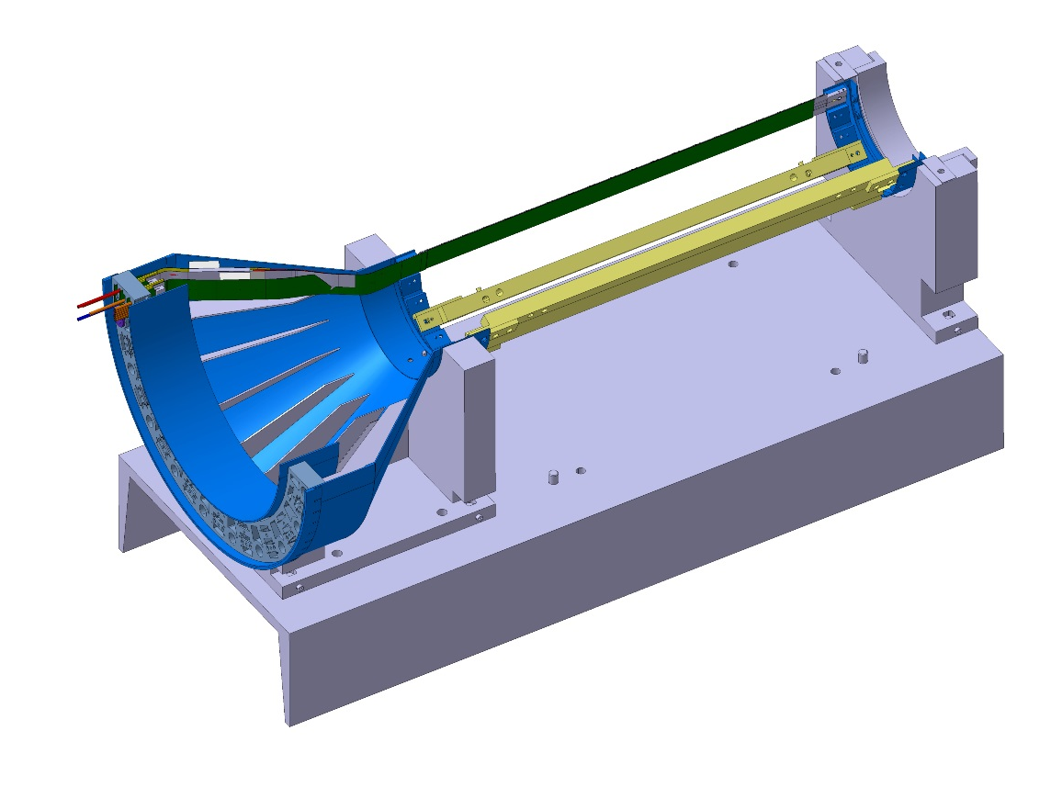
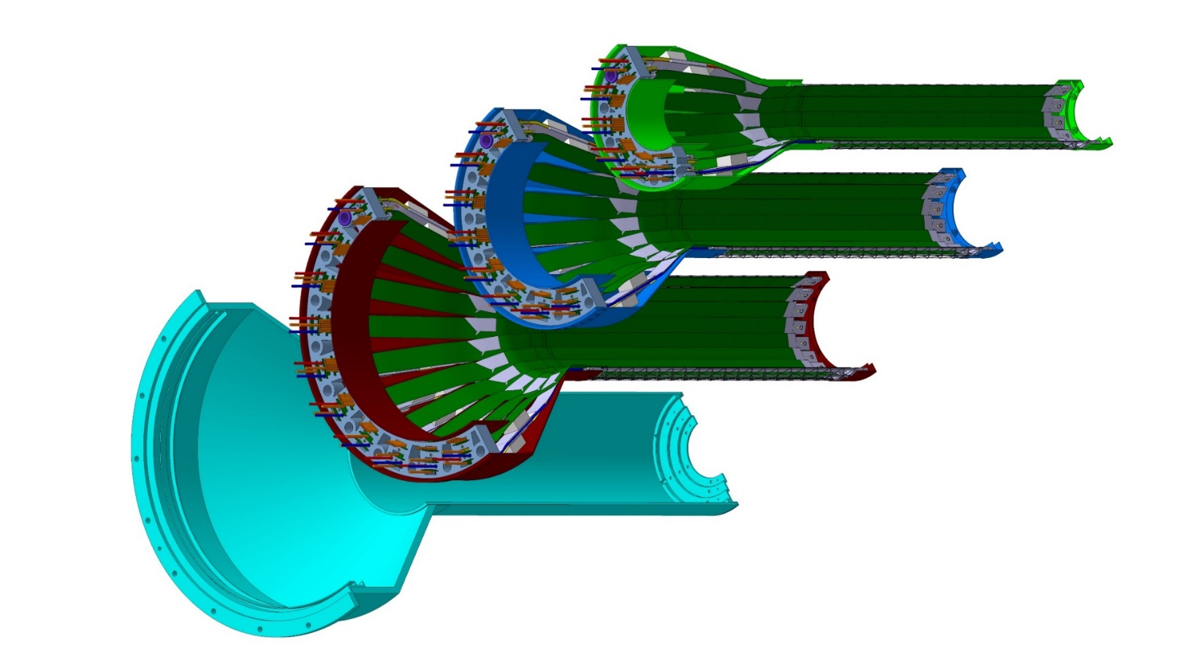
Detector Assembly
Precision positioning and installation of staves on end-wheels
Layer 0
Layer 1
Assembly of layers and carbon fiber structure into half-detector
Stave testing at each step
Metrology survey
Layer 2
IB CYSS

Slide 28
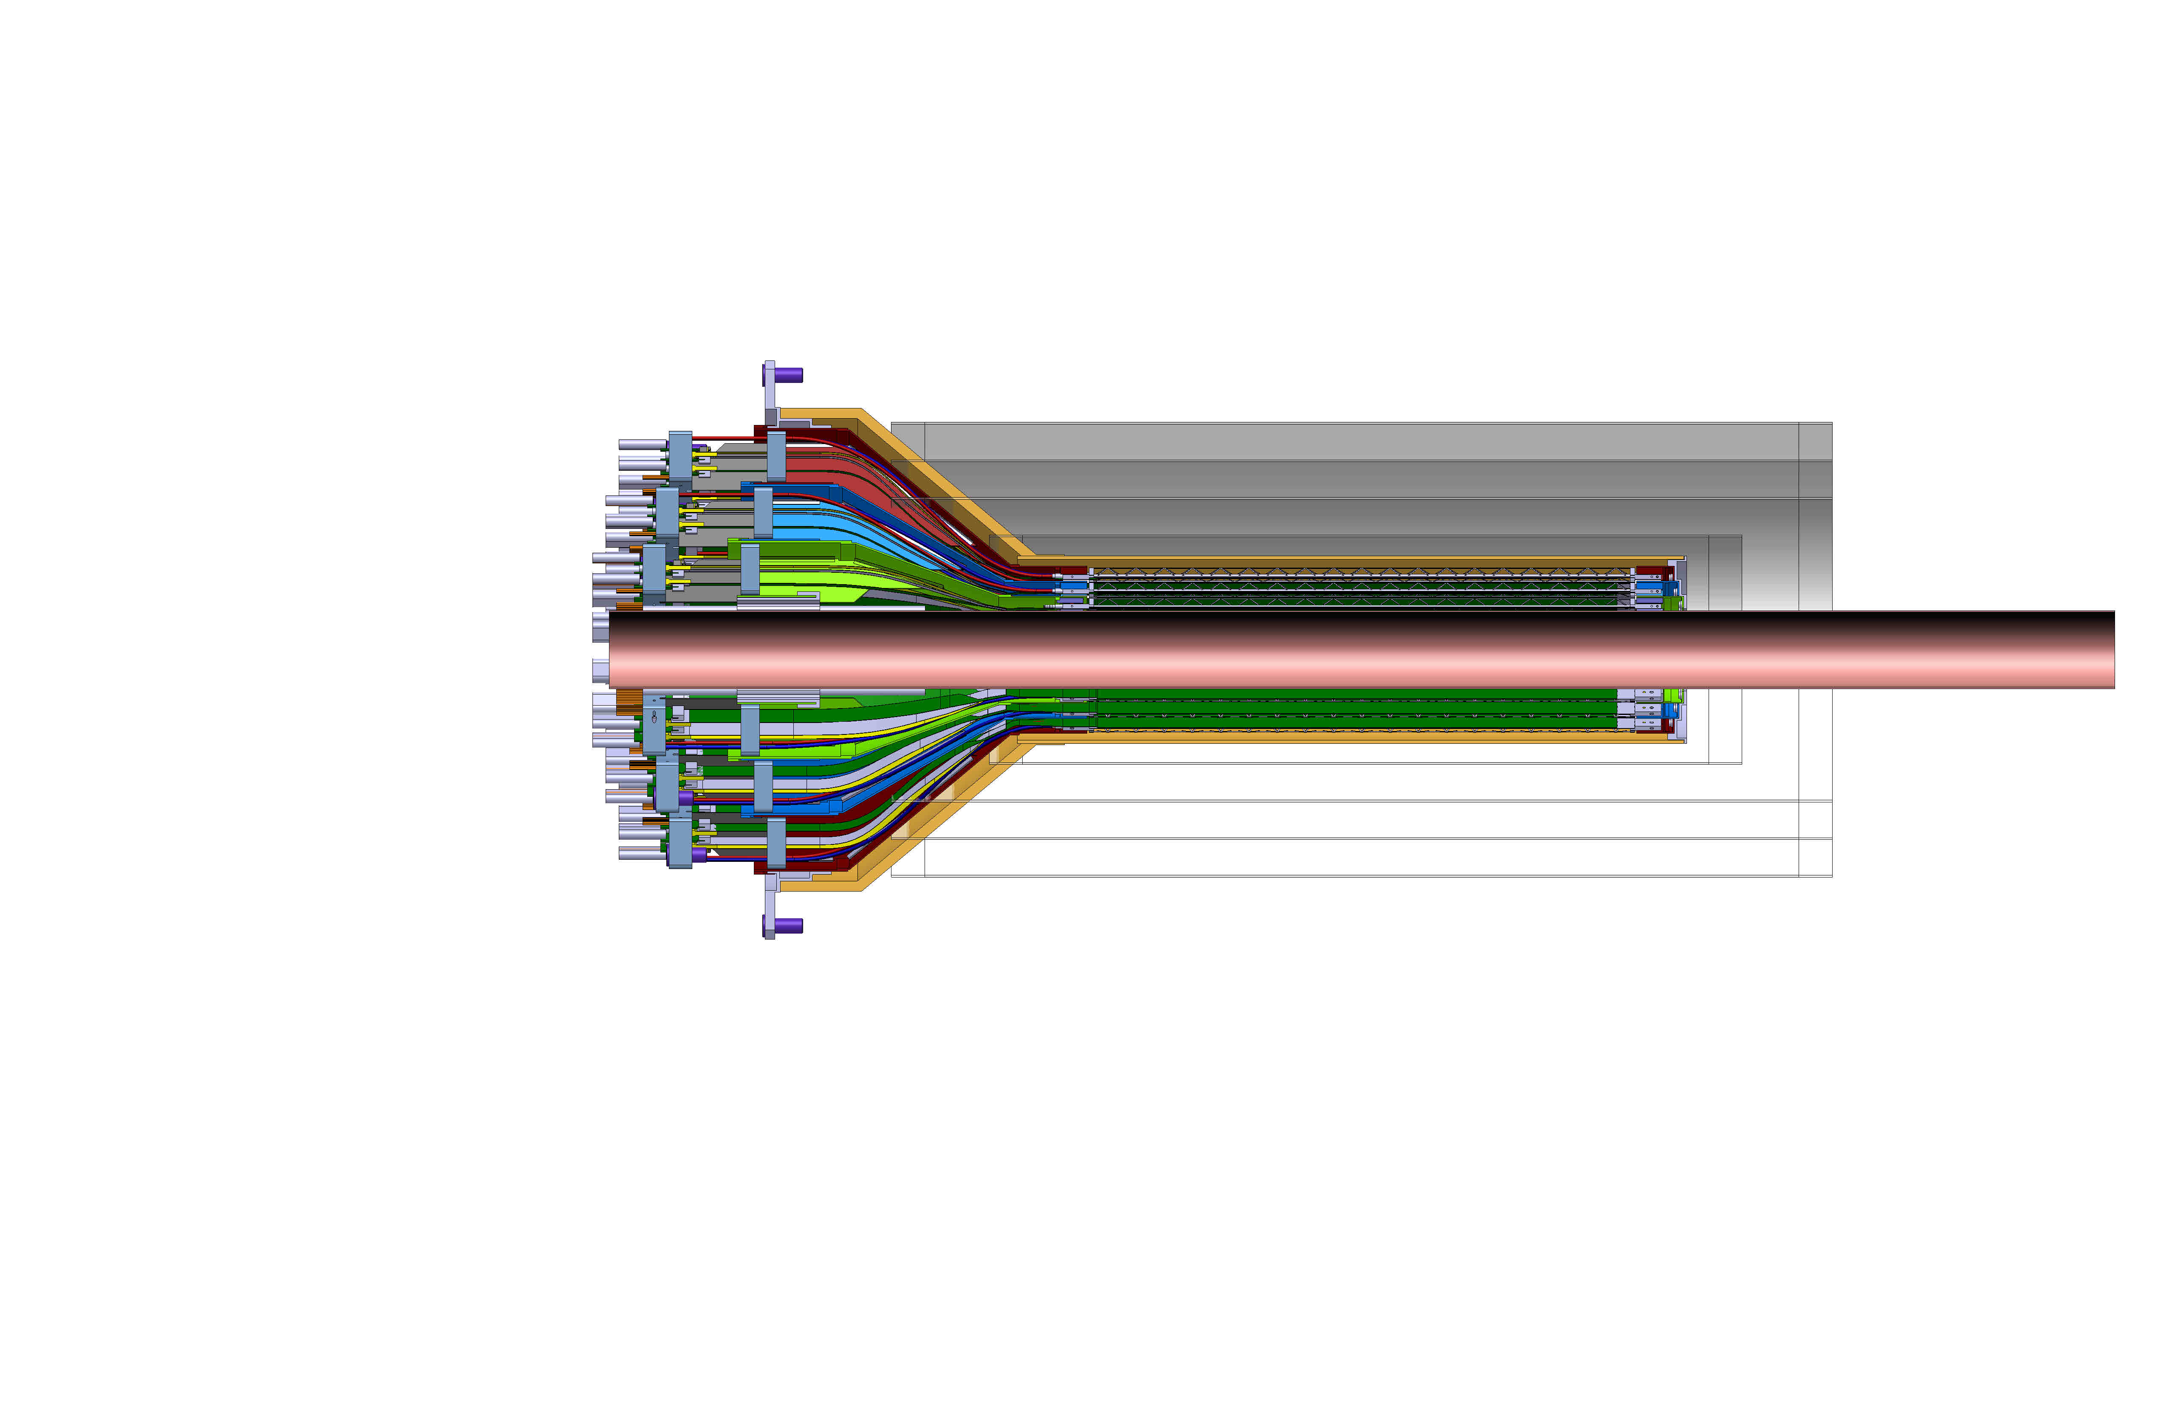
INTT-MVTX Conflict
INTT Acceptance
@ |z|=10
INTT 4-layers
|η|<0.95
|η|<1.09
|η|<1.28
|η|<1.12
Currently a clear conflict between the INTT and MVTX
  INTT only includes ladder, no connectors, cooling barbs, etc
R&D items: 1) Extend cables to move the conical structure further out in z-direction; 2) Design/optimize INTT layers to fit current MVTX geometry;
  FPC data cable is the HDI and can’t be easily extended, short “firefly” cables possible?
  Reduce angle of cone – redesign C-structures and connectors

Slide 29
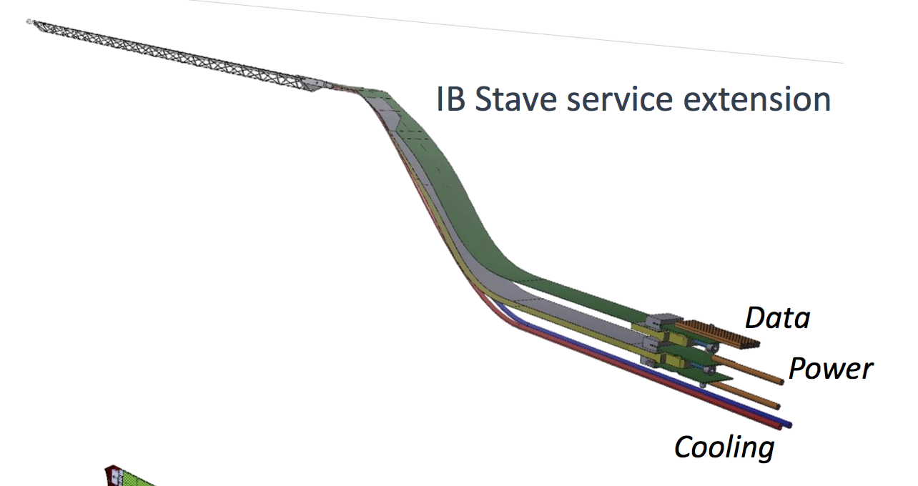
INTT-MVTX Conflict
INTT 4-layers
Extend cables to move the conical structure further out in z-direction
  FPC data cable is the HDI and can’t be easily extended
  Possibly add short “firefly” cables to hook up to patch panel, R&D needed
Reduce angle of cone – redesign

Slide 30
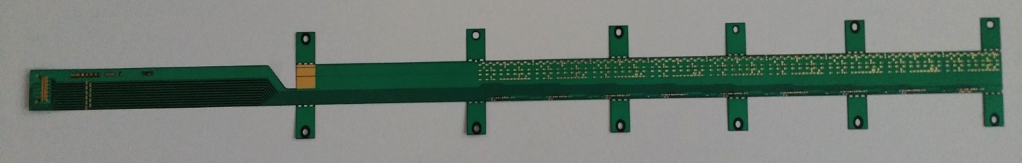
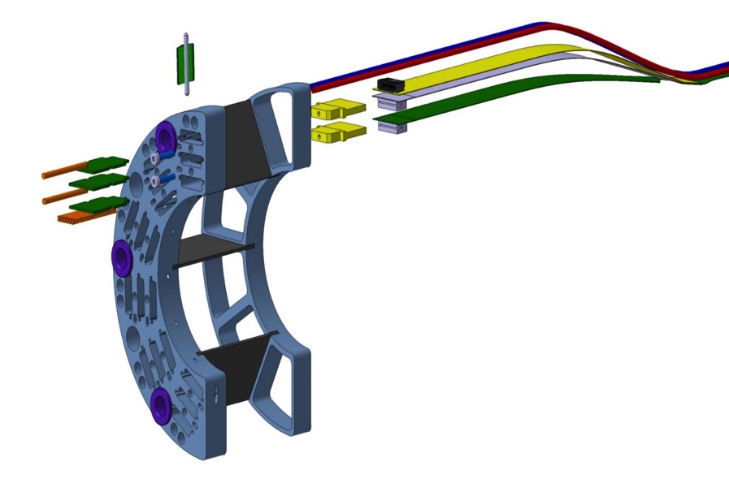
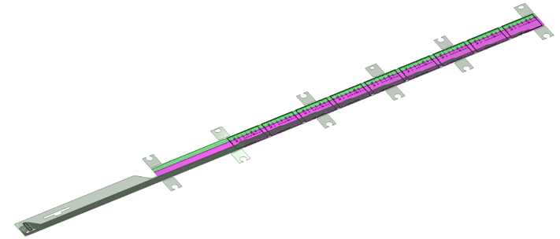
MVTX/INTT Integration
Extend MVTX Service Cables?
506.2 mm
16 mm
16.15 mm
41.9 mm
CHIP 9
……
CHIP 2
CHIP 1
The 9 silicon chips are read out in parallel: each chip sends its data stream to the end of Stave by a dedicated differential pair, 100 μm wide. Two additional differential pairs distribute the clock and configuration signals.

Slide 32
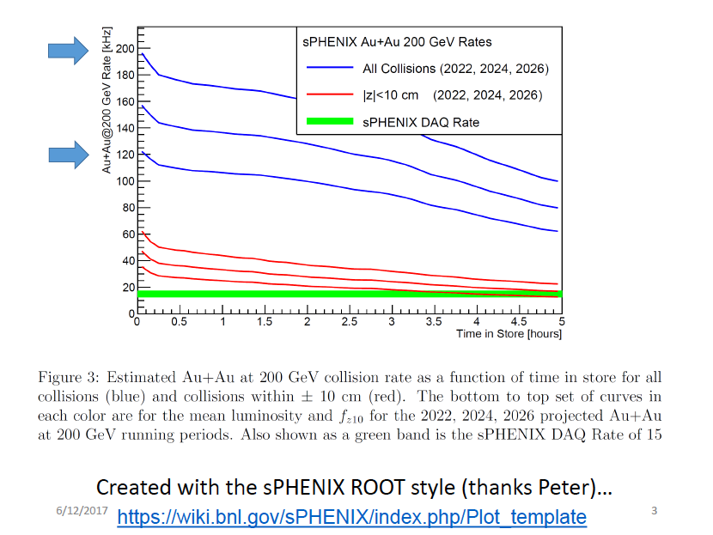
Expected Luminosities and Collision Rates

Slide 33
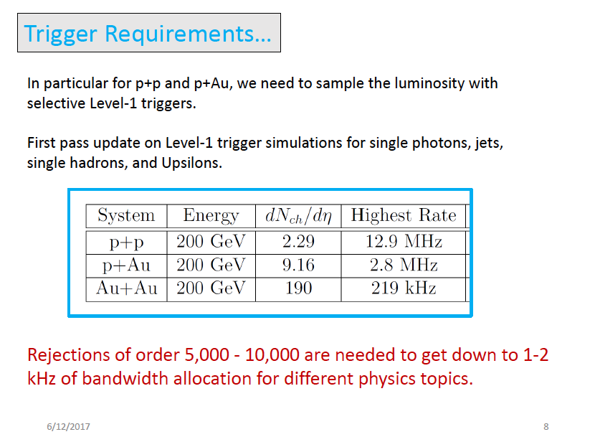

Slide 34
dN/dη in p+p collisions
With |η|<2.0 region, dN(ALICE) ~2.9*dN(sPHENIX).
sPHENIX
ALICE

Slide 35
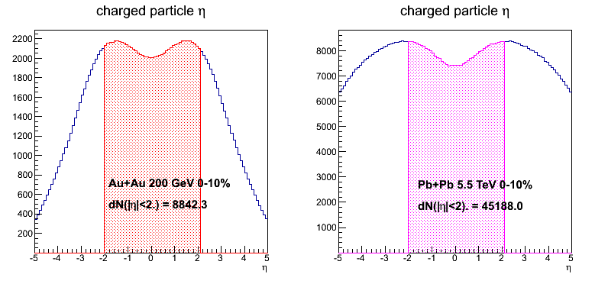
dN/dη in 0-10% Au+Au/Pb+Pb collisions
With |η|<2.0 region, dN(ALICE) ~5.1*dN(sPHENIX).
Ncoll(Au+Au)=962, Ncoll(Pb+Pb)=1670.
sPHENIX
ALICE

Slide 36
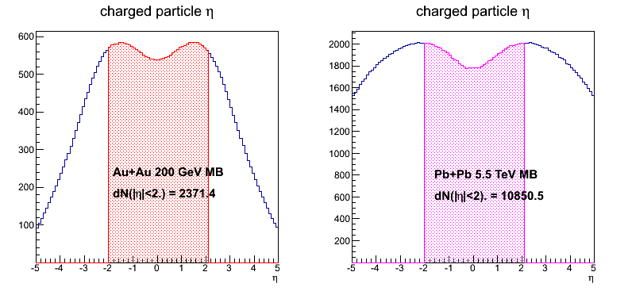
dN/dη in MB Au+Au/Pb+Pb collisions
With |η|<2.0 region, dN(ALICE) ~4.6*dN(sPHENIX).
Ncoll(Au+Au)=258, Ncoll(Pb+Pb)=401.
sPHENIX
ALICE

Slide 37
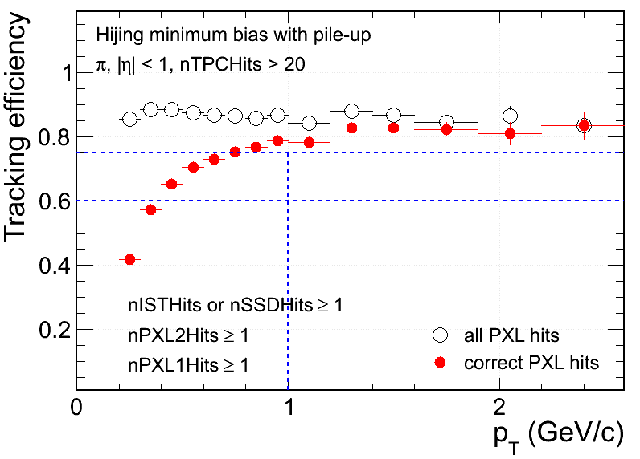
Hit Density on STAR PXL at RHIC Environment
 | PXL inner | PXL outer
Radius (cm) | 2.8 | 8
MB pileup hits (cm⁻²) | 13 | ~3
UPC electrons (cm⁻²) | 33 | ~3
Total bkgd hits (cm⁻²) | 46 | ~6
MB signal Au+Au (cm⁻²) | ~8 | ~1
Xin’s talk
- Ming’s note:
With ~5uS integration time, BG rate can be reduced by a factor of,
5/200 = 1/40
S/B ~ 8/1 for sPHENIX
Simulation@50kHz
Au+Au MB real data (cm⁻²) | ~50 | ~5
Simulation
Signal hits fraction in MB (Central) events:
~15% (~30%) at PXL inner
Increasing fake matches in low p_{T}
Technology chosen considering both physics and technology readiness

Slide 38
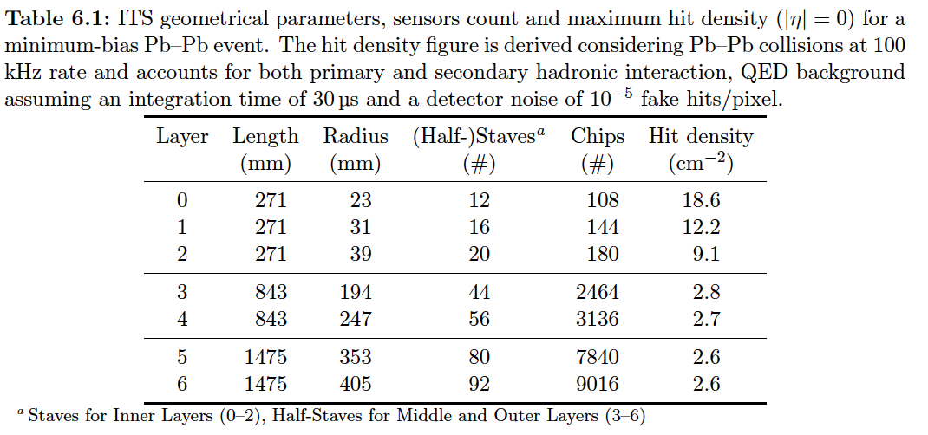
Hits and Event Data Rate
Event size: sPHENIX = 1/3 ALICE
Identical geometry for MVTX and ITS/IB(layer 0-2)
sPHENIX integration time ~5uS, less noise compared with ALICE with 10~20uS.

Slide 39
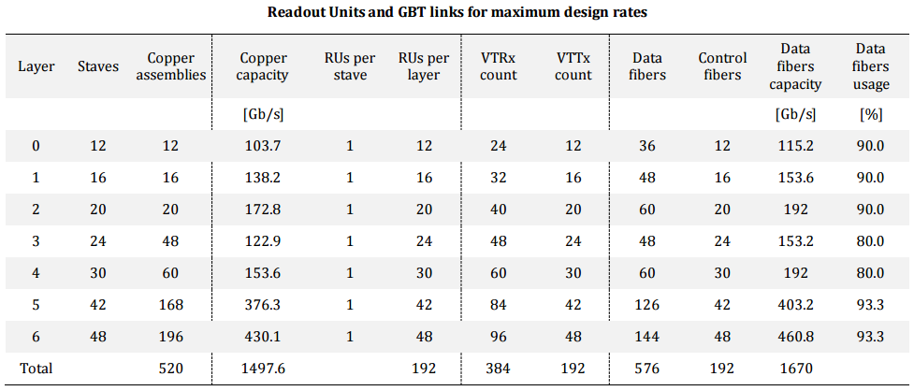
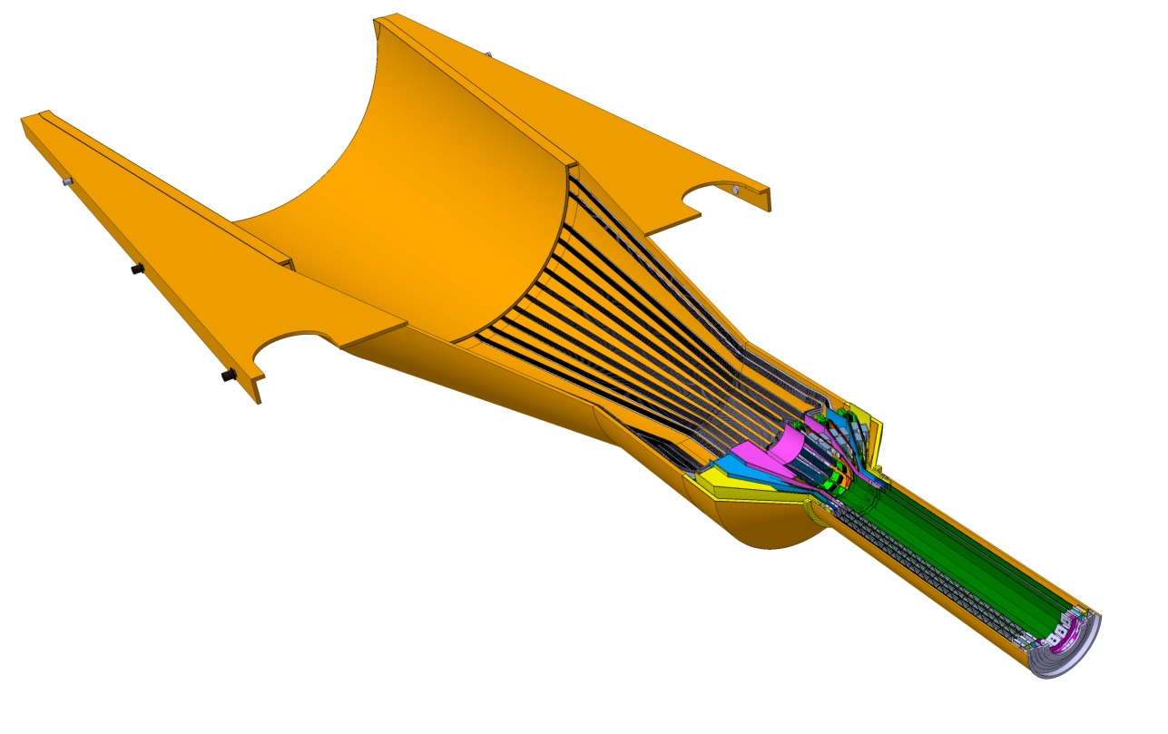
Readout Units Required for ITS & sPHENIX
48 inner staves;
48 RU boards;
6 FELIX boards;
- 8RU ->1 FELIX

Slide 40
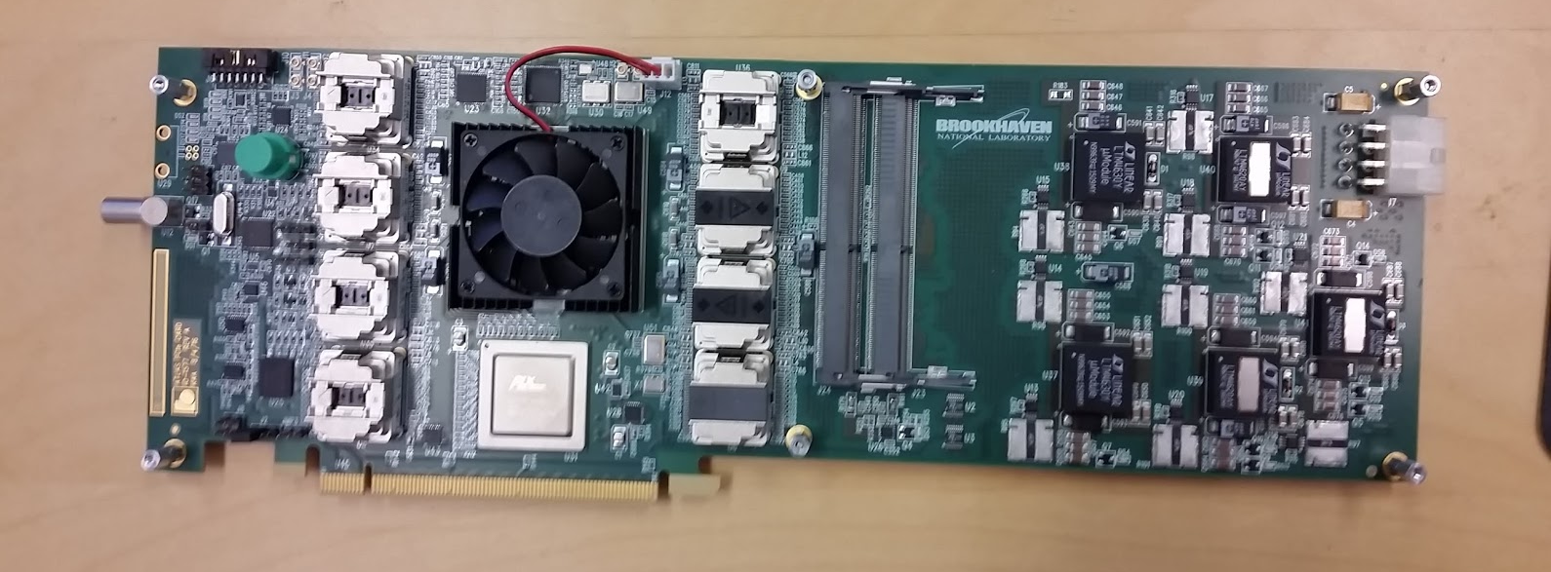
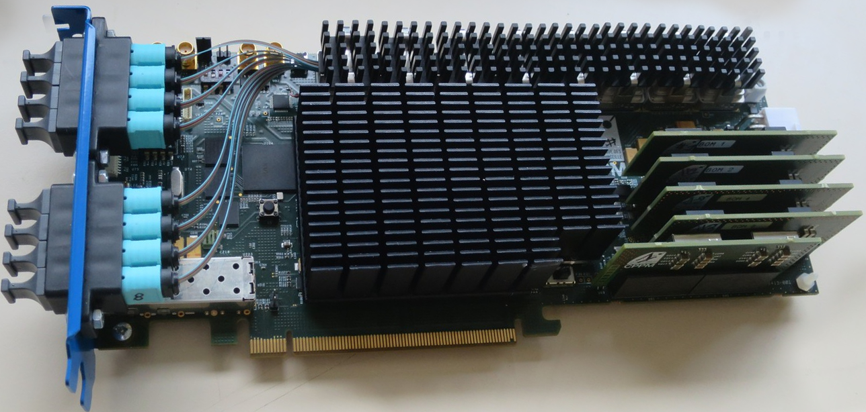
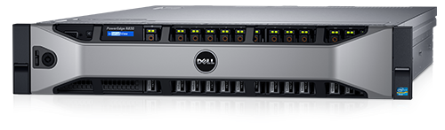
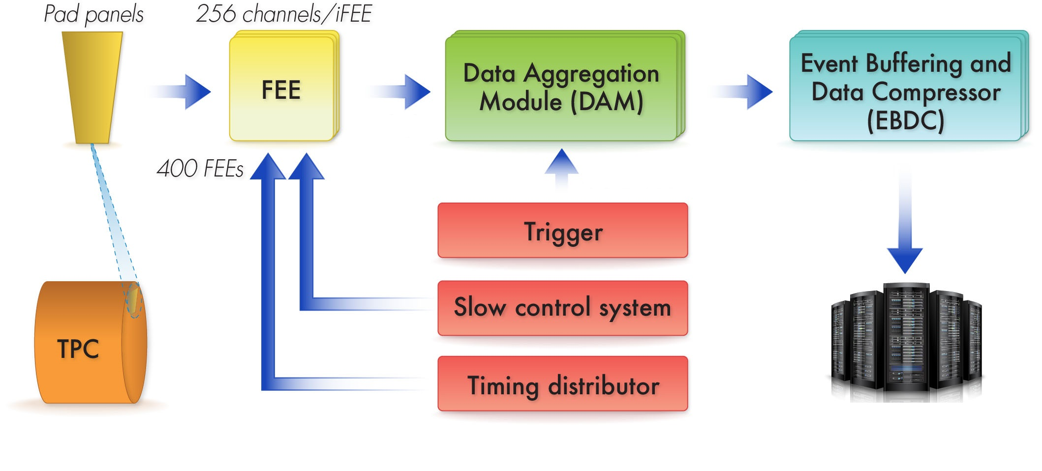
MVTX options: 6x (PCIe card + server)
Data Aggregation Module (DAM):
PCIex8 or x16 card with multiple (48x) GBT fiber IO
Event Buffering and Data Compressor (EBDC): Rack server that can host at 1x PCIex16 cards + 2x 10 Gbps Ethernet port
Option 1: ATLAS FELIX
Option 2: LHCb/ALICE CRU
Option 3: build our own based on ALICE/ATLAS exp.
Example: Dell PowerEdge R830
2x12 cores, 2x10 GBps, ~ 10k$
MVTX
MVTX/TPC
Buffer box

Slide 41
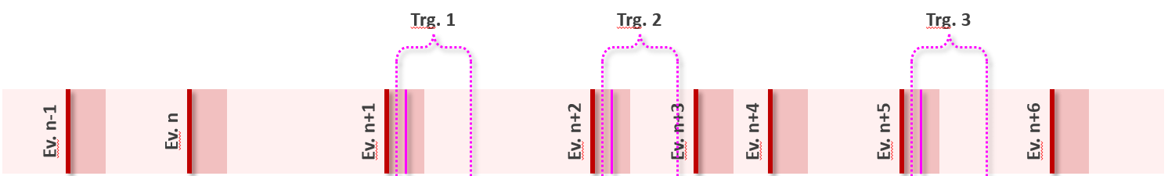

ALPIDE Modes of Operation
The ITS is planned to be operated in two modes:
  Triggered mode: Pixels are latched with a short strobe window and read out based on an external trigger.
  Continuous mode: Pixels are latched using a long, periodic strobe window and read out.

Slide 42
Multi-Event buffering
This is what makes the DAQ as fast as it is
Or, in other words: that keeps the dead time in the low 90%’s
Comes down to dealing with your data from various events in parallel
Our hardware is designed to deal with 5-event buffering
More is a diminishing return for $$$
We actually mostly ran 4-event buffering in PHENIX

Slide 43

ALICE Data Rate and Dead Time

Slide 44
ITS Readout - Radiation Load
Position respect to beam |  |  | Radiation levels (total)
r | z | Name | TID | 1 MeV neq fluence | High energy hadron flux* | Charged particle flux
[cm] | [cm] |  | [krad] | [cm⁻²] | [kHz cm⁻²] | [kHz cm⁻²]
2.2 | [-13.5 ÷ 13.5] | ITS L0 | 2734 | 1.7 × 10¹³ | 765 (770) | 890 (910)
43 | [-73.7 ÷ 73.7] | ITS L6 | 20 | 8.1 × 10¹¹ | 3.4 (4.9) | 4.5 (6.7)
79 | [-260 ÷ 260] | TPC In | 5.6 | 7.0 × 10¹¹ | 1.35 (1.8) | 1.7 (3.45)
100 | 330 | RE | ≈ 5 | ≈ 1.6 × 10¹¹ | 0.86 | 1.7
258 | [-260 ÷ 260] | TPC Out | 0.86 | 1.4 × 10¹¹ | 0.27 (0.37) | 0.2 (0.3)
290 | [-290 ÷ 290] | TRD | 0.6 | 1.2 × 10¹¹ | 0.23 (0.31) | 0.15 (0.23)
TID & fluence = (table 1 × 1.3_{data taking efficiency} + Table 2 / 10_{better vacuum}) × 10_{safety factor}
Safety factor of 10 on top of TID and fluence calculated as in the above line.
Hadrons and charged particles as for 50 kHz Pb-Pb collisions (table 1, worst case scenario).
The average value within the z span is reported first, in brackets the peak value within the z interval.
* Momentum > 20 MeV.

