Slide 1
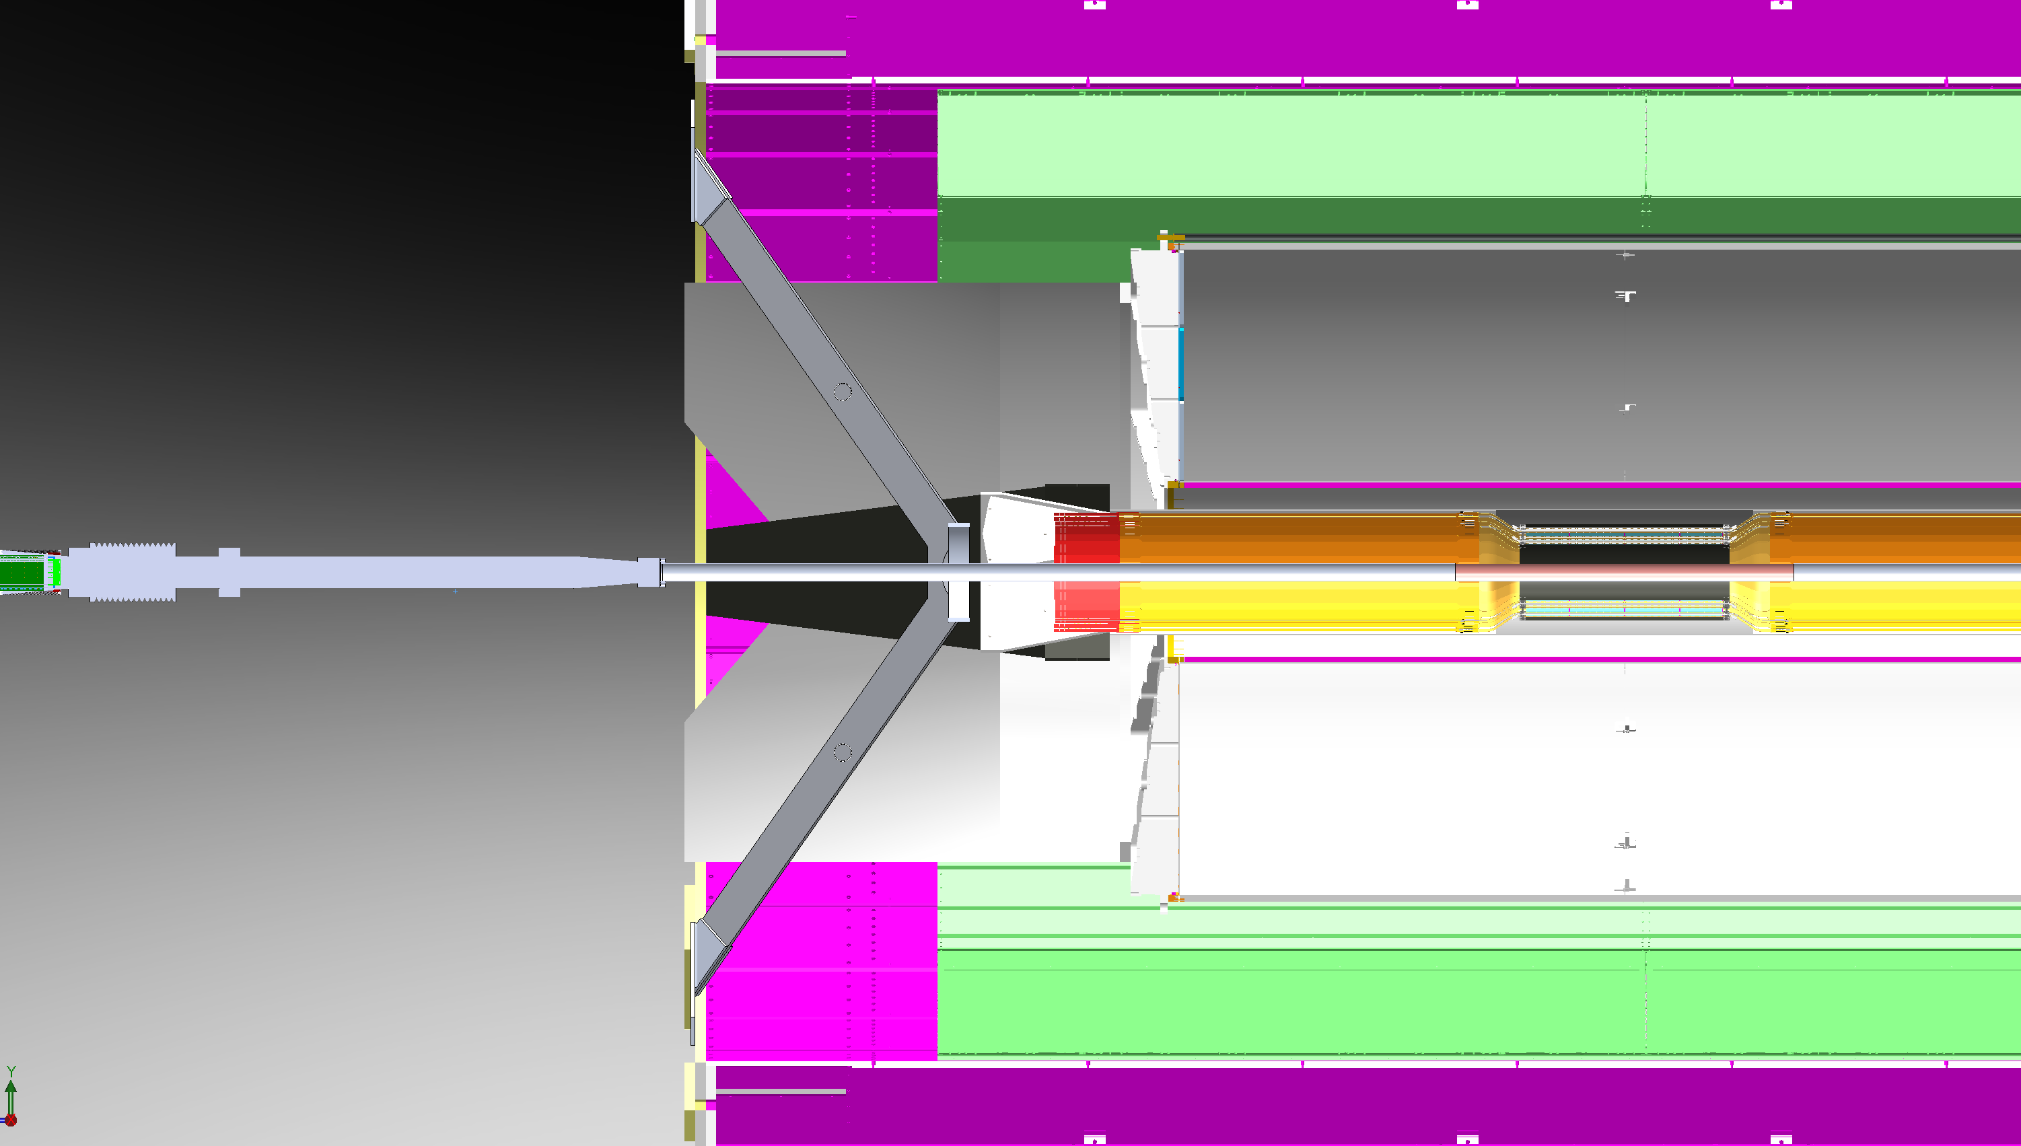
1
xxx
N
TPC
South Beampipe
INTT

Slide 2
2
xxx
Permanent BP support consisting of collar and thin (~1mm) vertical composite plates
Temporary BP support introduced from north end, brought as near to Be section as possible
MVTX support flange

Slide 3
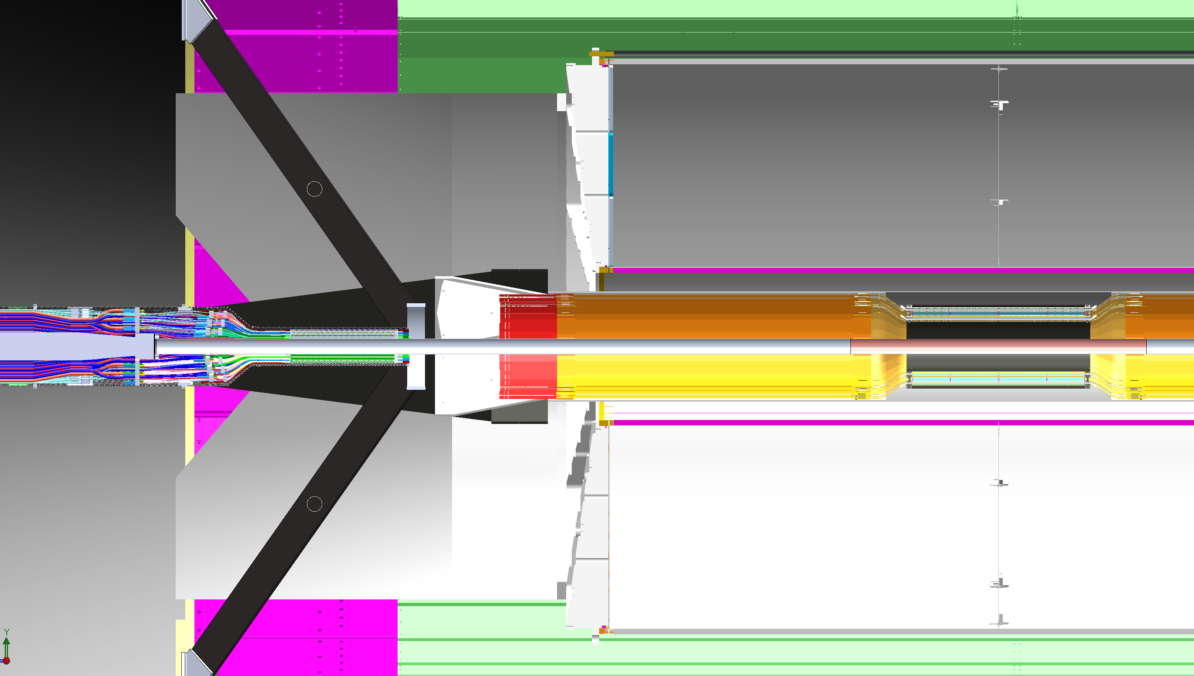
3
Introduce both MVTX Halves (already serviced and coupled to service barrel halves). They are mounted on movable inversion rails and separated horizontally by several inches to clear large beampipe
xxx

Slide 4
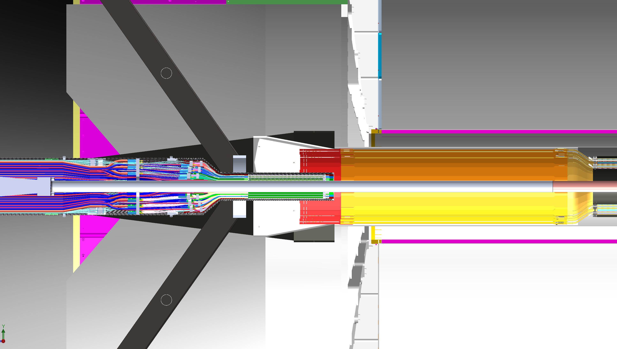
4
xxx
Clamshell MVTX halves, make first interconnections

Slide 5
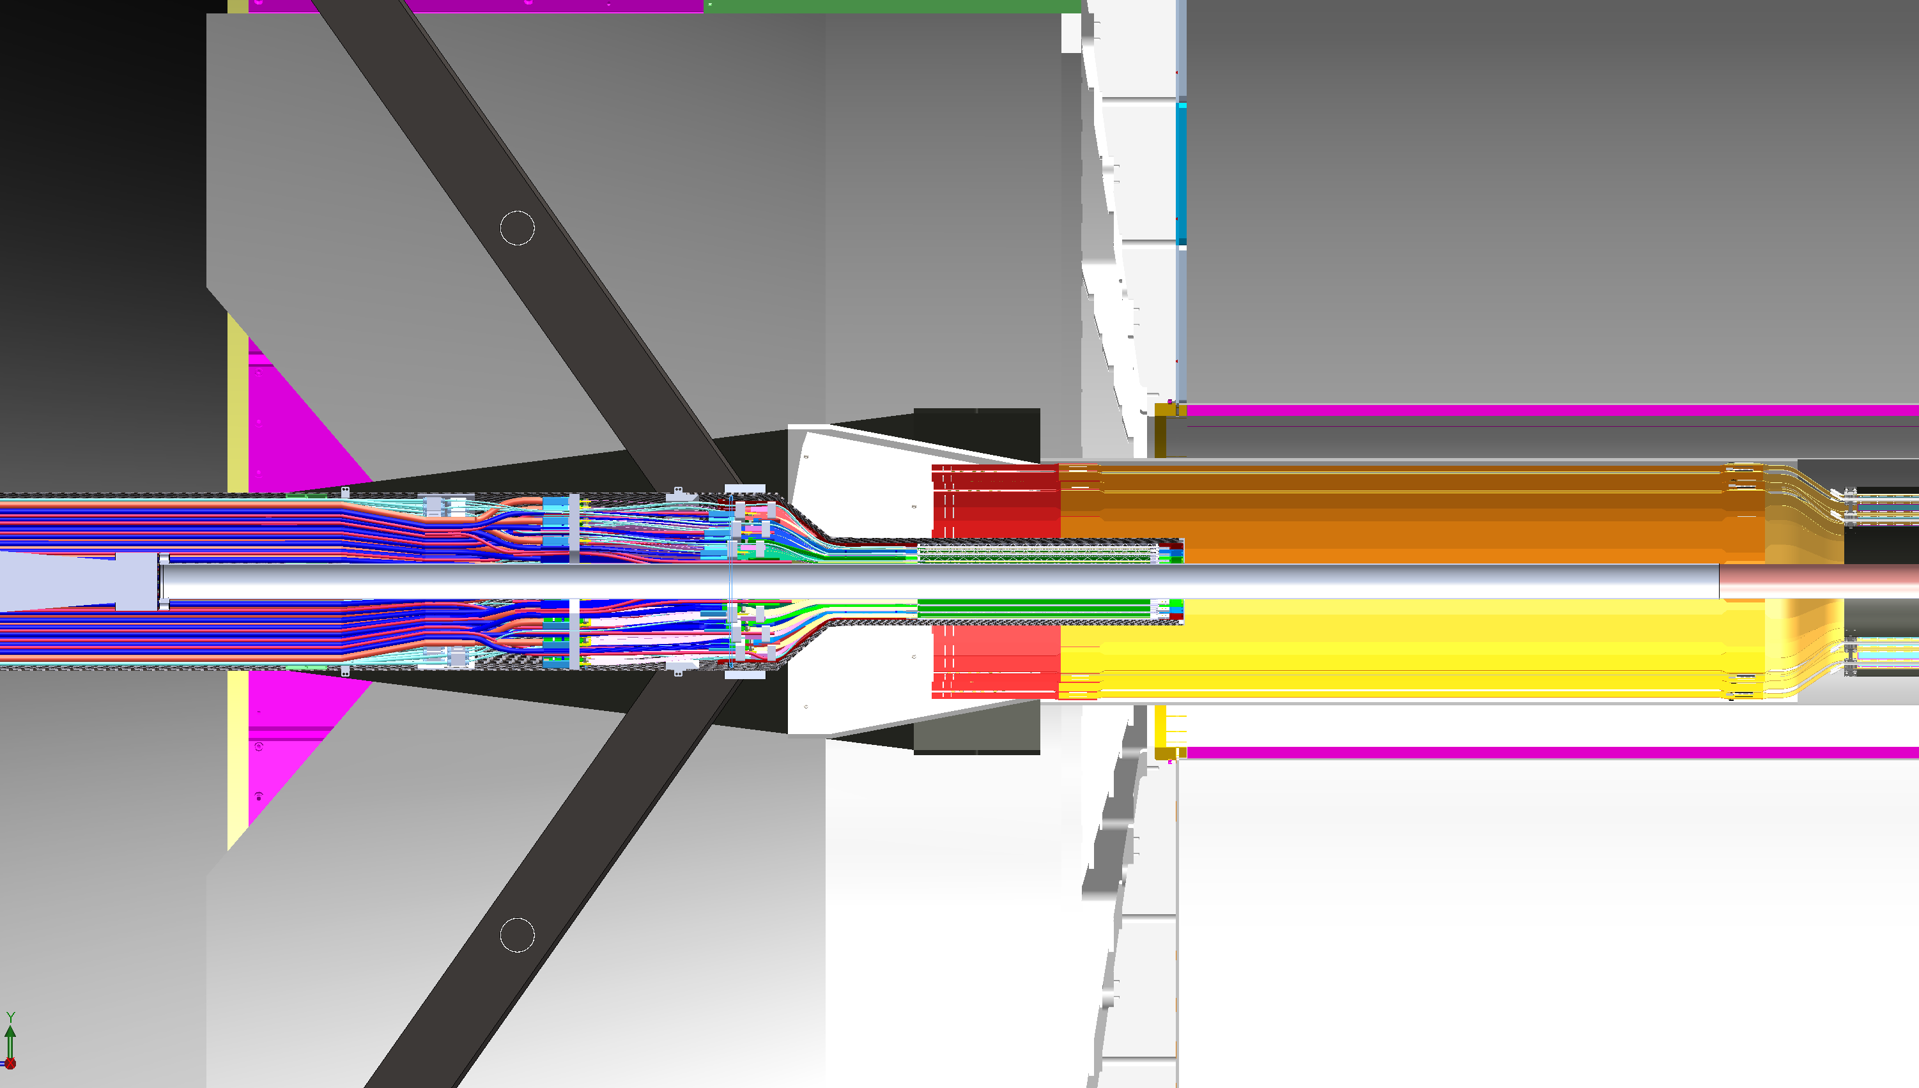
5
Make second interconnections (new location shown; 4 intercon will be changed to 3 total)

Slide 6
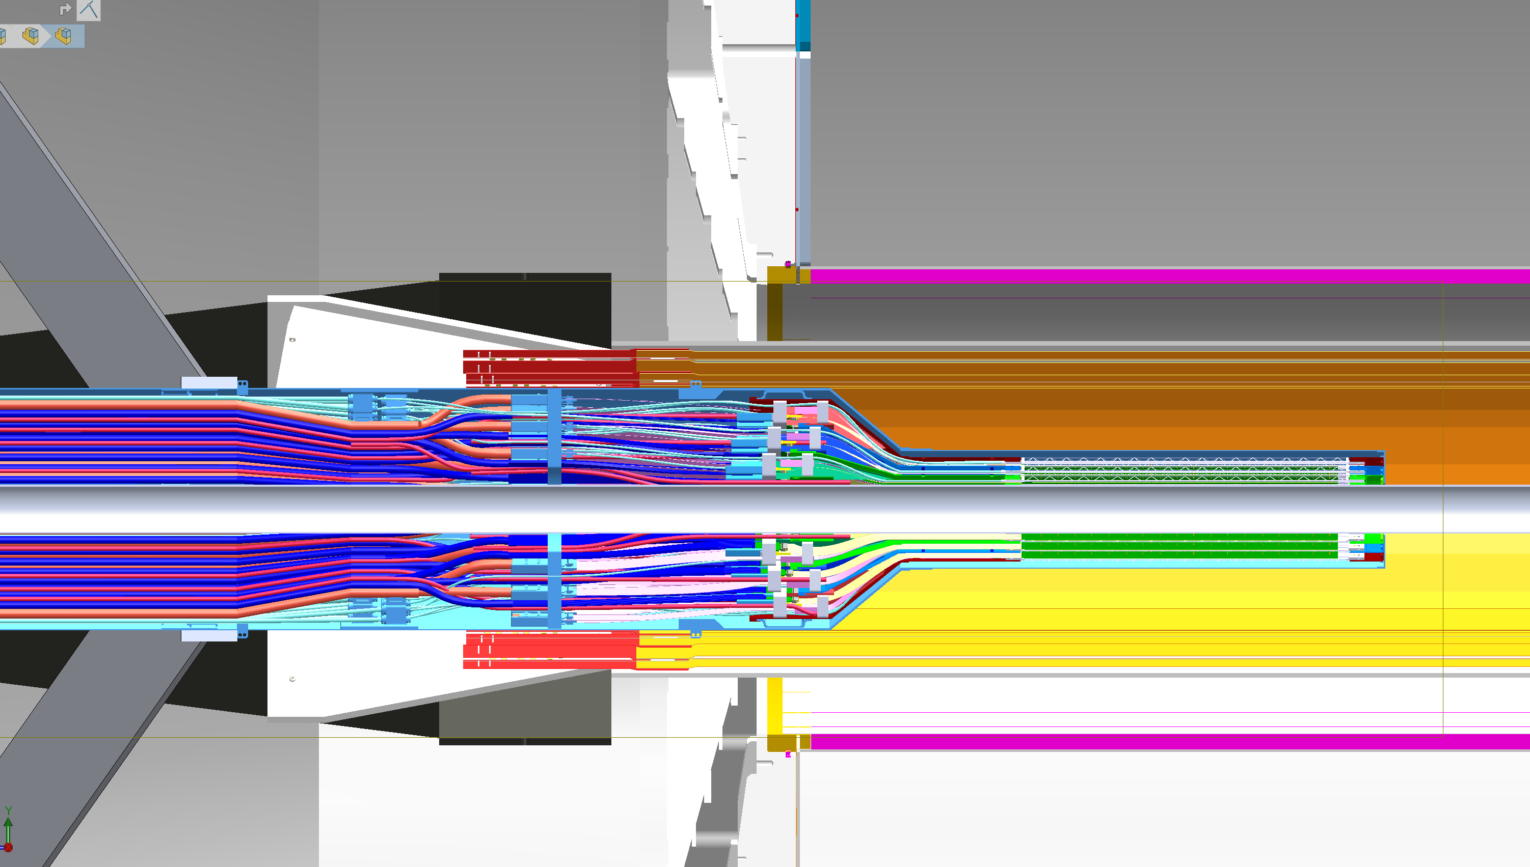
6
xxx
Install permanent beampipe sling

Slide 7
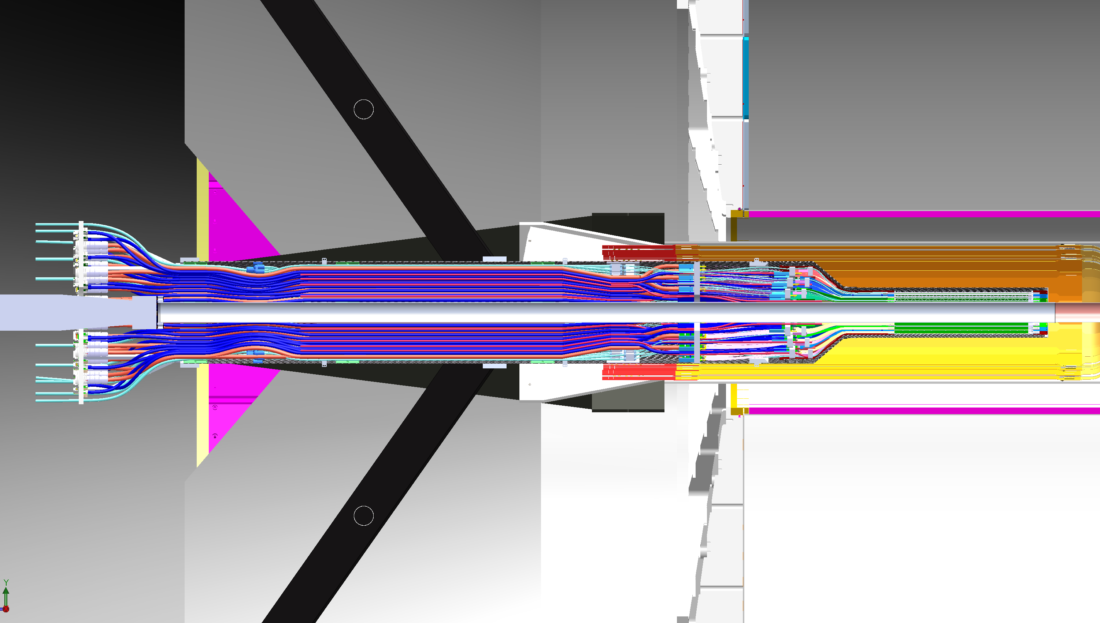
7
Make final interconnections

Slide 8
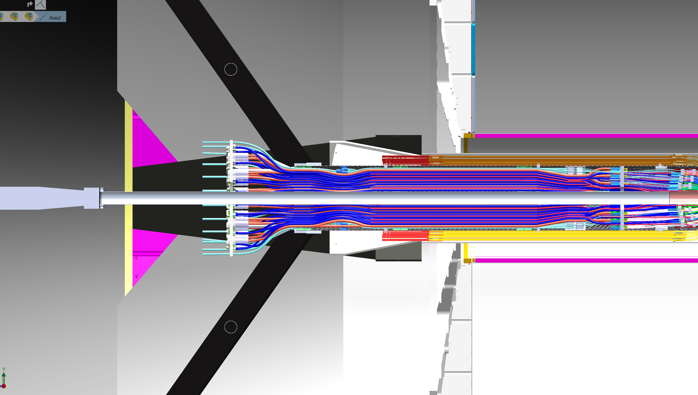
8
xxx
Connect Service Barrel to X-Wing (MVTX Support)

