Slide 1
sPHENIX MVTX Cost and Schedule Review
MVTX Mechanical Design
Walter Sondheim LANL, Joe Dodge, Jason Bessuille, Jim Kelsey, Ross Corliss, Camelia Mironov MIT
July 29-30, 2019 - BNL

Slide 2
Focus scope from WBS structure:
  WBS number: WBS Title:
  3.02.03.02.01 Mechanical detector design
  3.02.03.01.02 End Wheels
  3.02.03.01.03 Mechanical Fabrication
  3.02.03.02.03.01 Cylindrical Support Structure CYSS

Slide 3
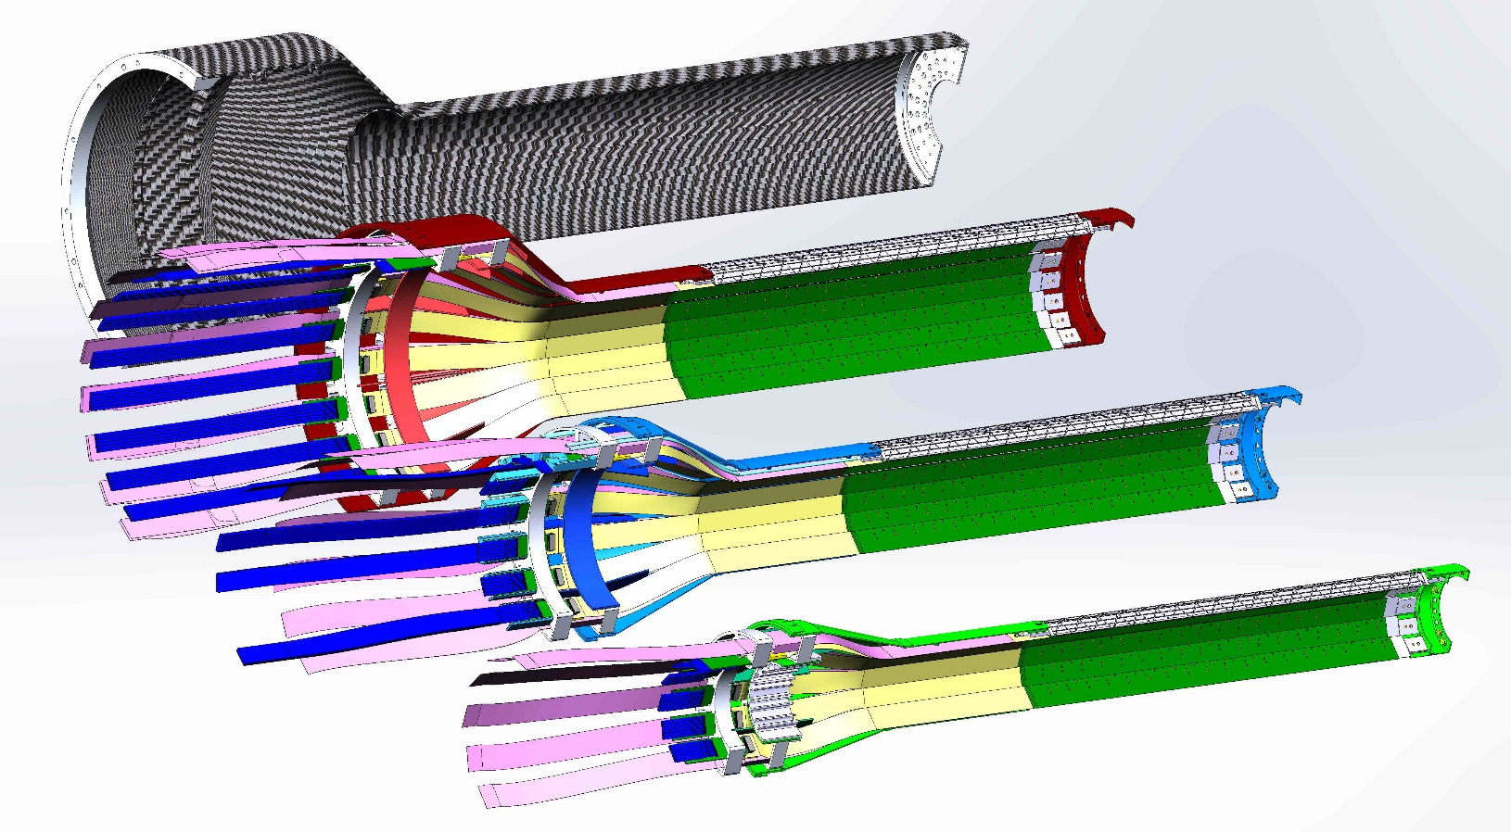
MVTX Detector nomenclature:
Layer 3, outer shell
Layer 2
Layer 1
Layer 0
staves
Analog and digital power pig-tails, FPC
Patch panels, (PP1)

Slide 4
MVTX detector parameters:
Estimated total weight for four layer half assembly – 1.1 kg
Estimated total power for four layer half assembly – 90 watts
  24 staves, 9 MAPS chips, 180 mW/chip
CYSS – cylindrical support structure (layer 3)
  Radius cylindrical end to service barrel – 107.50 mm
  Overall length – 606.42 mm
  radius cylindrical end wheel – 52.7 mm
Survey markers: CYSS aluminum end flange and CYSS large aluminum half ring – location for pins
Cooling – room temp, water, negative pressure
  Flow: 3 liters/hour/stave

Slide 5
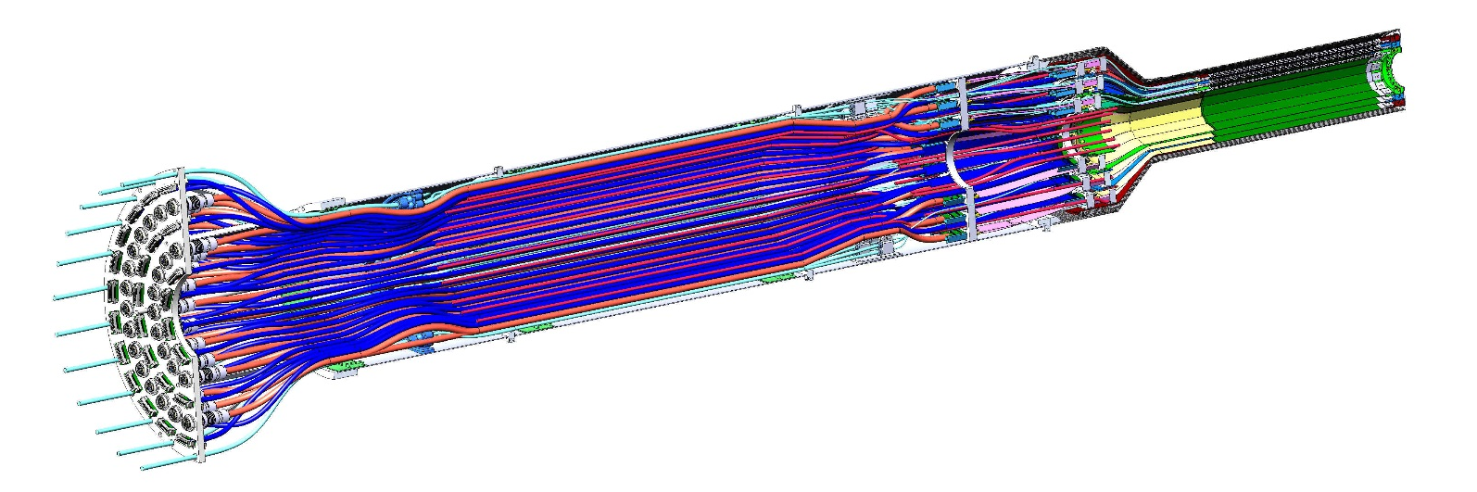
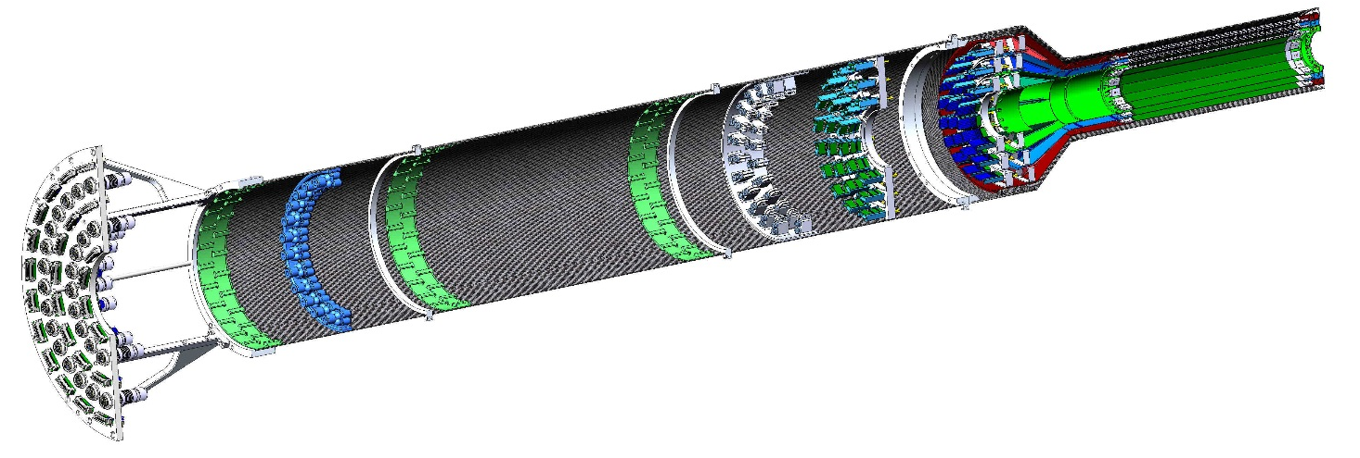
MVTX half assembly:
MVTX half detector with cables, cooling lines interconnection patch panel at the end of the service barrel
Detector
MVTX half detector without services

Slide 6
MVTX Detector – stave mounts:
Carbon composite end flange
Carbon composite conical shell
Ruby sphere mounted in carbon-PEEK block, matching socket at end of stave,
Secured with a screw.
Ruby sphere mounted in PEEK block, matching slot at end of stave assembly, secured with a screw.
Prior to mounting staves, both end flange and conical shell are mounted in a precision assembly fixture where the spacing is set using a master stave - locate mounting blocks.

Slide 7
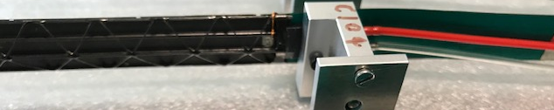
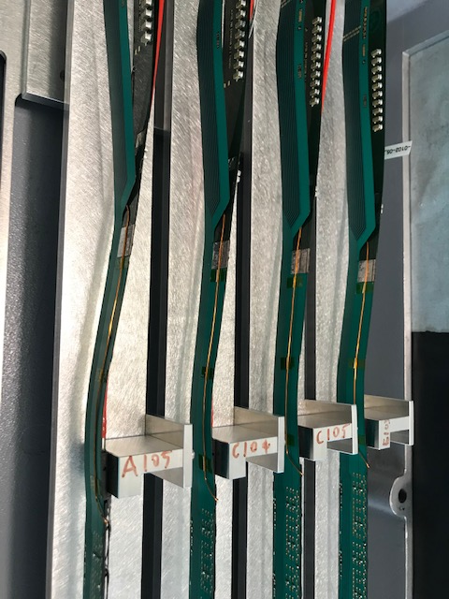
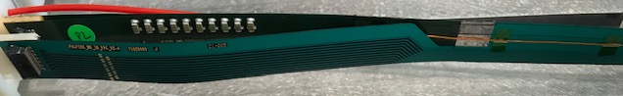
Integrated stave grounding:
Stave cold plate is Parylene coated to isolate the glued MAPS chips.
A nickel foil embedded in the cold plate has a wire attached using conductive epoxy. This wire runs comes out along the digital FPC, where it is soldered. This ground appears on a separate pin on the digital power SAMTEC connector.
Ground wire coming out from cold plate
Ground wire running along digital FPC from stave
Ground wire soldered into digital FPC brought out through SAMTEC connector

Slide 8
MVTX, end wheel assembly:
End wheels
Each detector layer’s end flange is registered in the precision aluminum end flange of the outer shell.
Each of these detector layers is registered in this flange by two pins and secured with screws. Additional holes are to allow for dry air to pass through, air flow ~ 200. l/hour.
Carbon composite shell
Aluminum end flange, air vent holes can be used for survey

Slide 9
Start producing detailed drawings:
Detailed production drawings for layer 0 end flange composite pieces for prototype fabrication -

Slide 10
MVTX Detector beryllium beam-pipe:
R=20.765 mm sPHENIX
Beryllium beam-pipe.
ALICE beam-pipe R=19.0 mm
R=22.75 mm, layer 0
end flange, the delta is 1.985 mm
Note; the Inner Radius for the outer shell end flange is also 22.75 mm

Slide 11
MVTX Detector stave positioning:
In order to accommodate for the larger beam-pipe in sPHEINX vs the ALICE detector and maintain hermeticity in all three layers, the staves were translated in radius and slightly rotated.
Detail A
Gap 370 microns,
Detail A

Slide 12
MVTX Detector beryllium & aluminum:
R=21.605 mm, aluminum beam-pipe extensions to sPHENIX beryllium beam-pipe
R=22.75 mm, layer 0 end flange, this delta = 1.145 mm

Slide 13
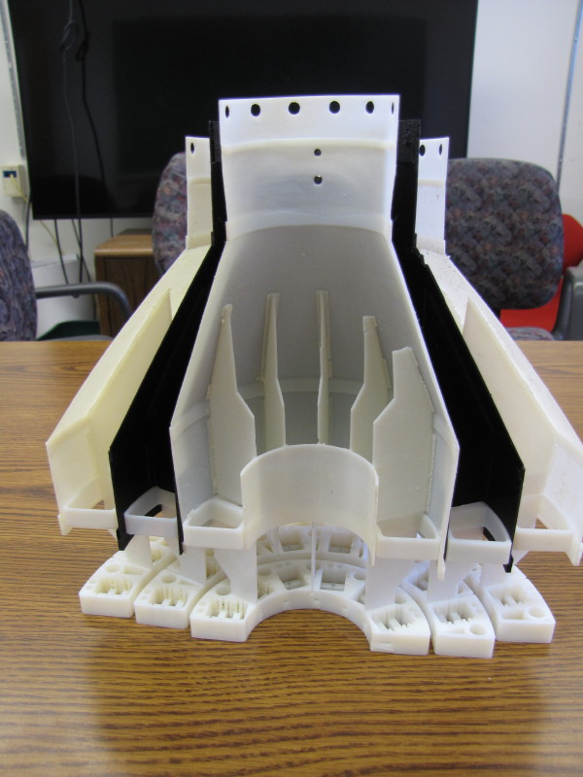
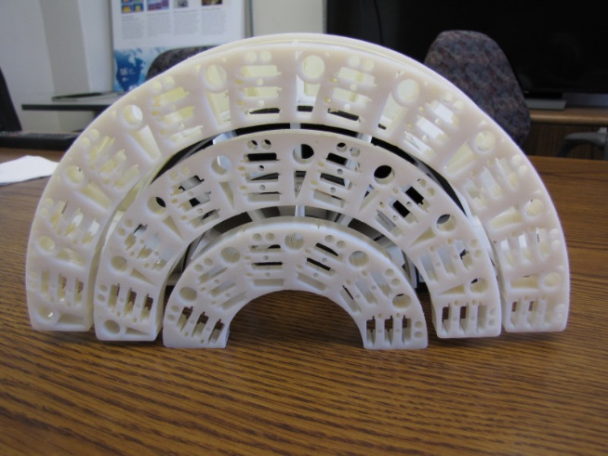
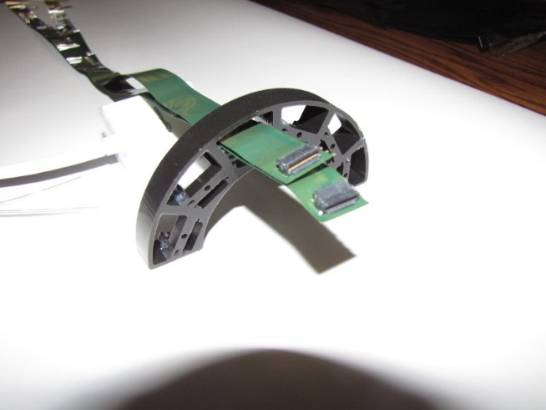
3D mock-ups used to aid design phase:
Patch panels #1
Verification of pass-through concept for power cables from stave

Slide 14
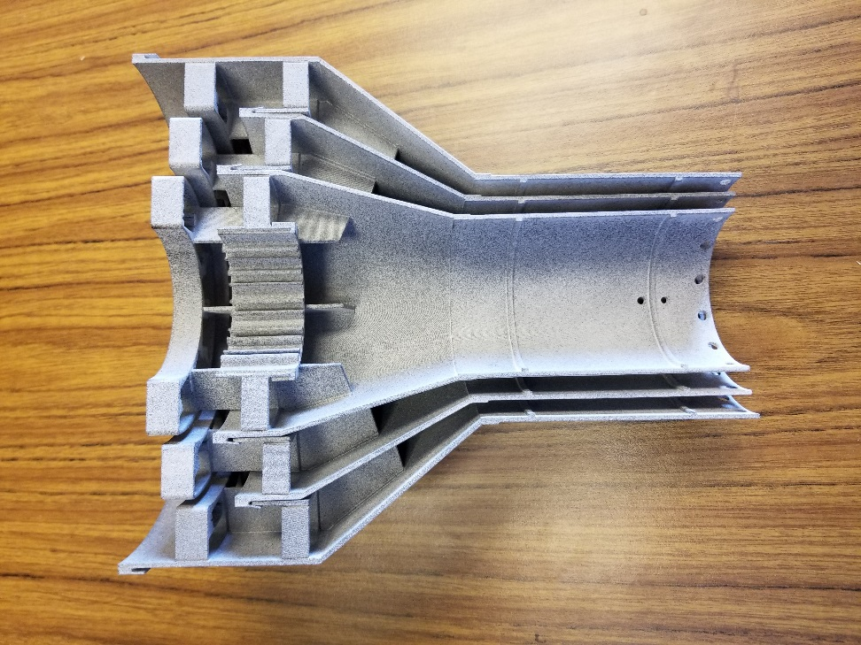
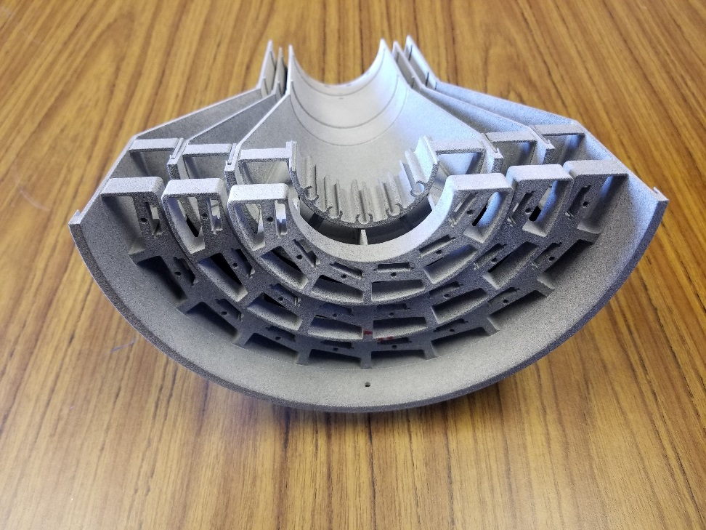
MIT 3D prints of MVTX shell assembly:
Verification of smaller diameter to fit with in INTT detector envelope as well as verifying that the shells nestle together

Slide 15
MVTX conical ends assembly & CYSS:
As the MVTX detector is assembled from the outer shell to the inner layer; the next layer’s shell is captured by the previous layer’s inner cylindrical ring – attached to the aluminum pass-through panels
CYSS
Aluminum pass-through patch panels in PP1, maintain structure between detector layers
PP1 patch panel

Slide 16
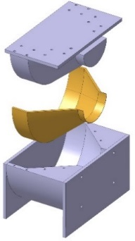
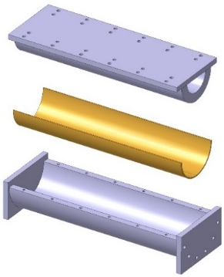
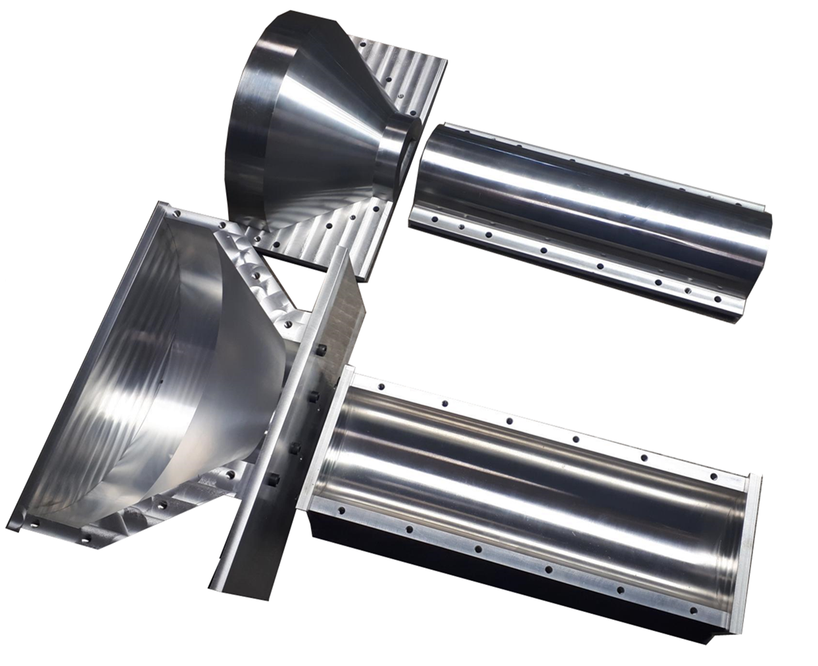
Composite fabrication, CYSS:
CYSS – cylindrical support structure
  Detailed drawing
  Vendor qualification
    Molds and fixtures
    Material selection
    Tolerance requirements
  Two possible vendors in Europe;
    Loson, in Milan, Italy
    Work-Shape, in Les Serres, France
  US fabrication
    LBNL Composite Shop, Berkeley, California

Slide 17
FEA study of current MVTX design:
Detailed FEA analysis has already been carried out on all elements of the ALICE ITS design, which in scope is very similar to the MVTX detector. Similar analysis will be studied at MIT on the latest CAD model/assembly.
The goal of the structural analysis will be to minimize the maximum sag of the detector and maximize the first natural frequency
  ALICE conical shell design max sag of 115 microns, 1st natural frequency 46 hertz, note; ALICE half detectors are mounted horizontally, MVTX detector halves are vertical

Slide 18
Patch panel design:
Using layer 0 the signal cables transition from the stave FPC to a SAMTEC firefly cable, which runs the length of the service barrel to PP2
PP2
The power extension of the stave FPC terminates 400. mm further away in Z in a patch panel that is a part of the service barrel
Steve water cooling lines

Slide 19
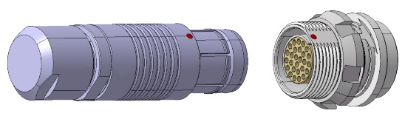
PP3 patch panel at end of service barrel:
Fisher S105 + DPB 105
Analog and Digital power + stave cooling plate carbon ground
Data cable interconnection,
Samtec Fire-Fly high density
connection
Pass through hole for water line

Slide 20
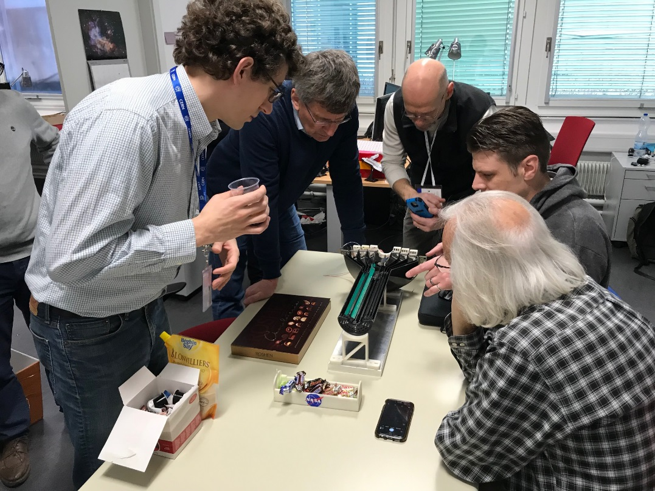
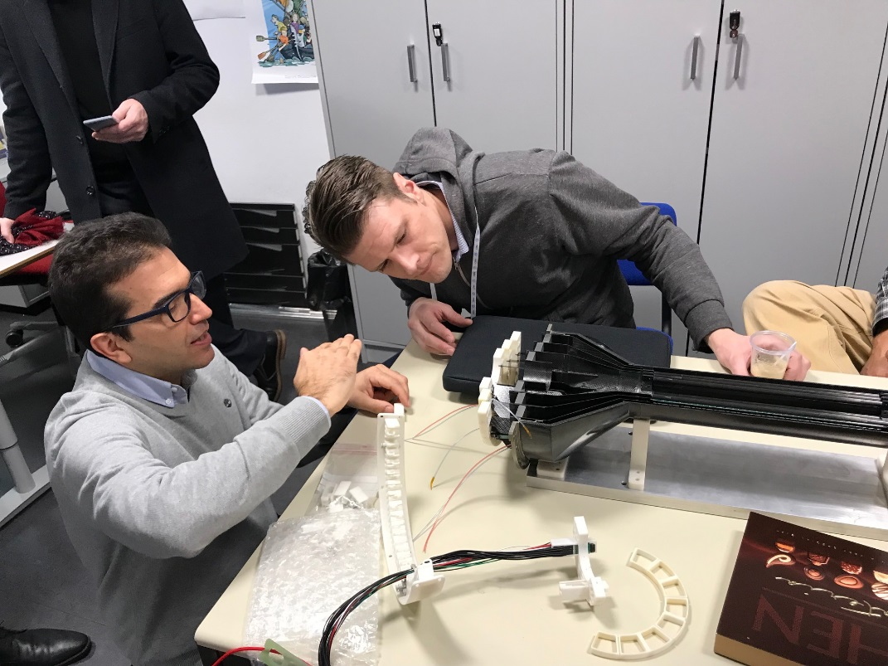
MIT and LANL engineers at CERN:
It was to our great benefit to be able to work with Corrado Gargiulo, the chief engineer for the ALICE ITS upgrade project, his sharing of information has been invaluable.

Slide 21
Schedules & Milestones
WBS 3.02.03.02.01
WBS 3.02.03.02.03
WBS 3.02.03.02.02
WBS 3.02.03.02.03.01

Slide 22
L3 Technical Overview
Current CAD model for the MVTX detector and service barrel are near completion
Work on producing detailed drawings for both composite and aluminum pieces are in production
Demonstration of current design for patch panels has been shown to work with stave cabling, using 3D printed models
On-going integration issues with other tracking detector systems have been addressed through the sPHEINX Office of System Integration (OSI)

Slide 23
Schedule Drivers
Integration management – ongoing
FEA studies – next six months
Detail drawings for shell components – next four months
CYSS production – next three months prototype
Stave testing and qualifying – production beginning at CERN
Jigs and fixtures for assembly – design and fabrication next eight months

Slide 24
Status and Highlights
Update completed for MVTX CAD model, compatible with other sPHEINX tracking detectors (INTT and TPC)
Negotiate with BNL CAD department on extending the current PHENIX beam-pipe
Looking at commercial vendors to produce carbon composite pieces for assembly, produce prototype for evaluation

Slide 25
Back Up

Slide 26
Precision layer assembly fixture:

Slide 27
Layer 1 with dummy staves
Layer 0 with master stave, fixture used for gluing ruby pads

Slide 28
ALICE layer 0 assembly

Slide 29
MVTX stave cooling circuit:
PP2b,
Transition from, 4 to
6 mm
Dia.
PP2a
Service barrel
Detector stave

Slide 30
Metrology and survey, stave alignment in layer

Slide 31
ALICE FEA optimized carbon lay-up, CYSS:
Sag ~ 115μm

Slide 32
FEA stave static and modal:

