Slide 1
sPHENIX MVTX Cost and Schedule Review
Summary
Ming Liu, LANL
July 29-30, 2019
BNL

Slide 2
Presentation Summary
Overview of the MVTX's Place in sPHENIX- Ed
MVTX Overview – Ming, #1-4
Cost & Schedule – Dave, #1-4
MVTX in sPHENIX P6 and Risk Registry – Irina, #2, 3
MVTX mechanical design – Walt, #1,2
MVTX Service Barrel and Integration – Camelia, #1,2
MVTX Detector QA and Assembly – Yuan, #1,2
MVTX Readout – Jo, #1,2
R&D and Beam Test Results – Cameron, #1
Summary – Ming, #4

Slide 3
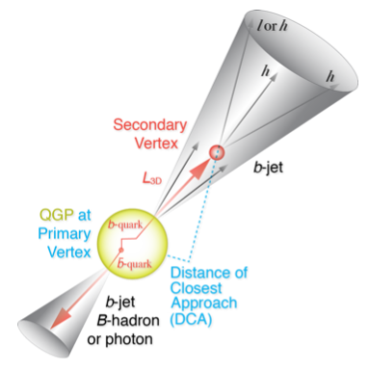
MVTX Enabled the 3rd Science Pillar
From measurements to
physics understandings
Open heavy flavor hadron & jet modification
Open heavy flavor hadron & jet flow

Slide 4
MVTX Performance Parameters: KPPs & UPPs
KPPs from
MVTX PMP
UPPs from
MVTX PMP

Slide 5
MVTX Deliverables in PMP
Detectors + Services
*: The staves and RUs are from BNL contribution, no cost to MVTX project.

Slide 6
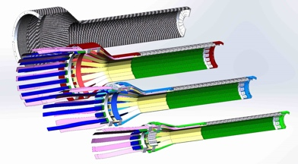
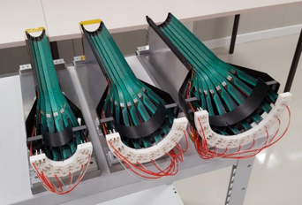
Very Successful R&D
Jo, Cameron, Walt,
Camelia, Yuan et al.
MVTX sensor/stave & readout integration
  Full stave readout chain demonstrated with final electronics RU, PU, FELIX
  Stave modified for better MVTX/INTT integration; MVTX-INTT space-conflict resolved
  Long readout cables tested
  Verify MVTX KPP
MVTX mechanical design & system integration
  Preliminary detector design completed, 3D mockup demonstrated
  MVTX + INTT/sPHENIX integration design developed
  Assembly and installation plan developed

Slide 7
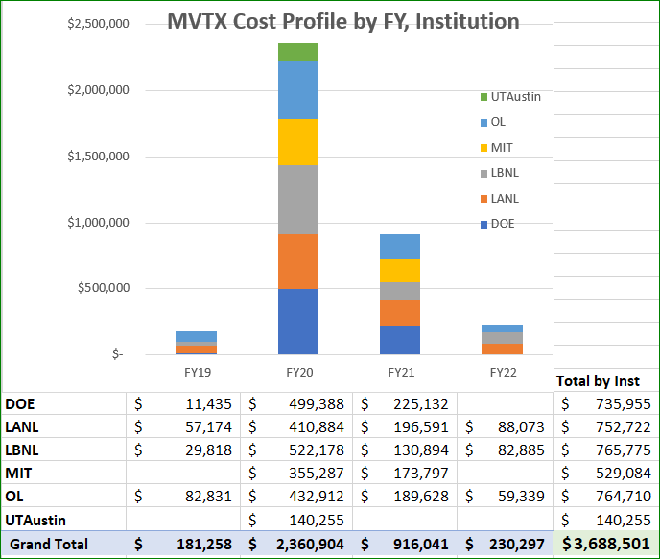
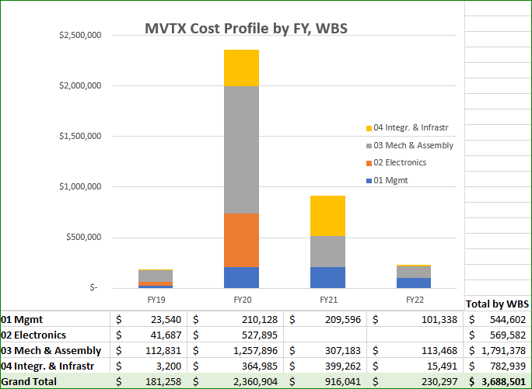
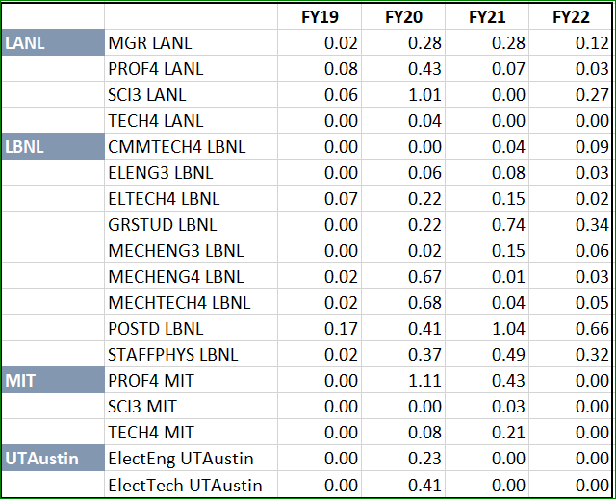
Yes.
WBS, Institution & labor cost profile etc. in P6
  Electrical system
  Detector mechanical design
  MVTX mechanical integration

Slide 8
Yes.
Electrical system
Detector assembly
MVTX mechanical integration
Milestones defined in PMP

Slide 9
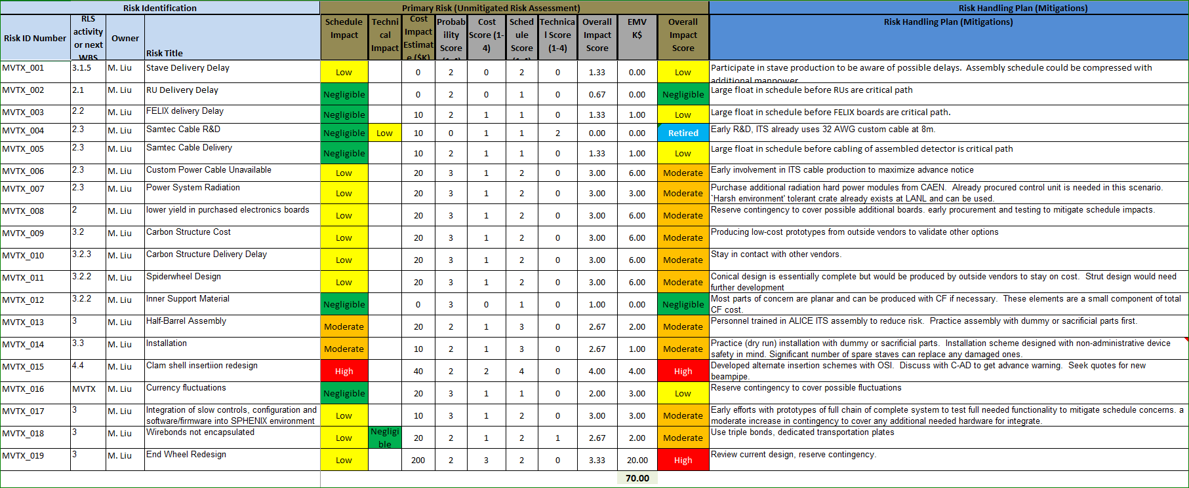
Yes.
Risk register in sPHENIX
Major risks identified and mitigation plan developed
MVTX Risk Register in sPHENIX

Slide 10
Yes.
Draft PMP document completed
  Project baseline
    Physics
    Functional requirements/KPP/UPP
    Technical scope
    Cost breakdown
    Schedule
    Funding profile
    Planned BNL funding
    Baseline change control
  Management structure
    Organization and team
    Management responsibilities
    Participating institutions
  Project management and oversight
    Risk management
    Project reporting
    Engineering and technology readiness
    Quality assurance and configuration/document management
    Operation readiness plan
    ESSH plans and fabrication
    Project closeout
Project fully integrated into sPHENIX P6
  Costs, schedules and risk register
Deliver MVTX on schedule/budget for day-1 physics!

Slide 11
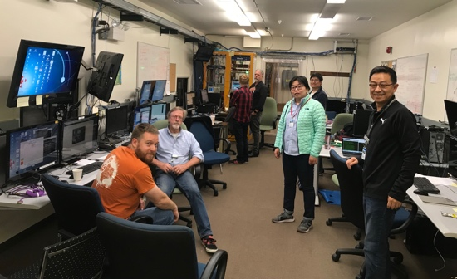
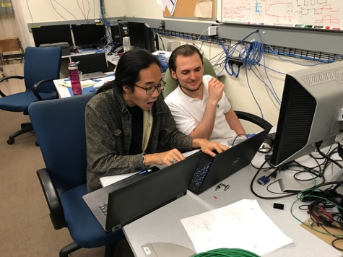
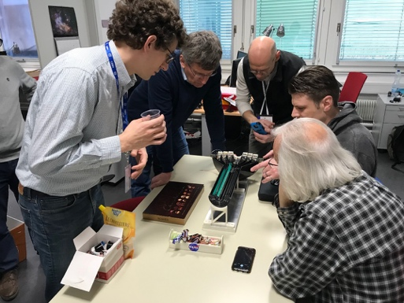
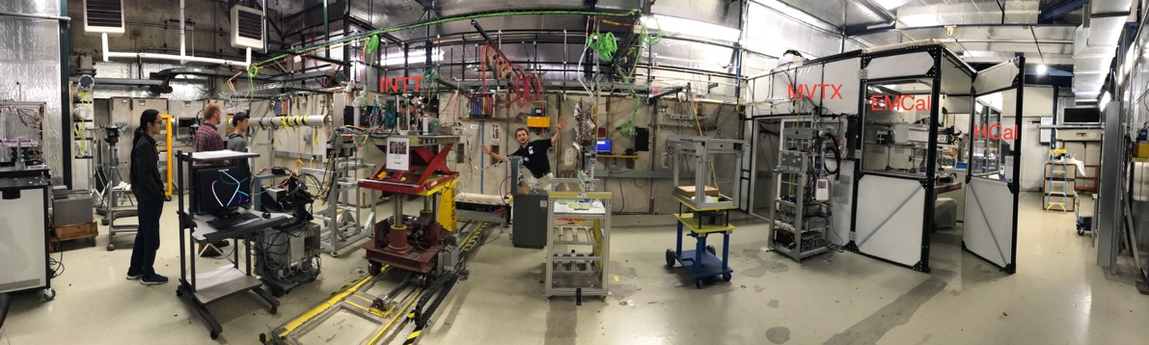
We are ready to start the project!

Slide 12
Back Up

Slide 13
MVTX WBS List

