Slide 1
sPHENIX MVTX Cost and Schedule Review
Summary
Ming Liu, LANL
July 29-30, 2019
BNL

Slide 2
Summary
Physics of MVTX established
  KPP
Technology readiness
  Key R& D to reduce risk and contingency
  Readiness of readout system
  Readiness of mechanical system
Review charge
  Cost & schedules, Risk Registry
  Project Management Plan
Overview of the MVTX's Place in sPHENIX- Ed
MVTX Overview – Ming, #1-4
Cost & Schedule – Dave, #1-4
MVTX in sPHENIX P6 and Risk Registry – Irina, #2, 3
MVTX Readout – Jo, #1,2
MVTX mechanical design – Walt, #1,2
MVTX Service Barrel and Integration – Camelia, #1,2
MVTX Detector QA and Assembly – Yuan, #1,2
R&D and Beam Test Results – Cameron, #1
Summary – Ming, #4

Slide 3
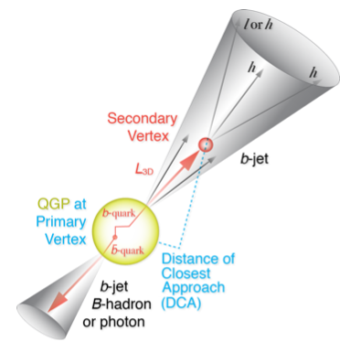
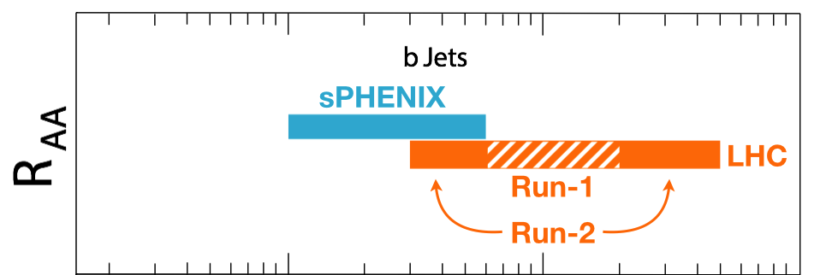
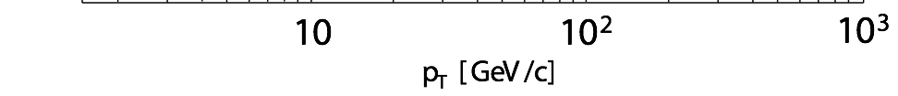
MVTX Enabled the 3rd Science Pillar
complement & extend current and future RHIC and LHC QGP programs
“Open heavy flavor hadron & jet modification”
“Open heavy flavor hadron & jet flow”

Slide 4
KPP in PMP
from
MVTX Proposal

Slide 5
Deliverables in PMP
*: staves and RUs from BNL contribution, no cost to MVTX project.

Slide 6
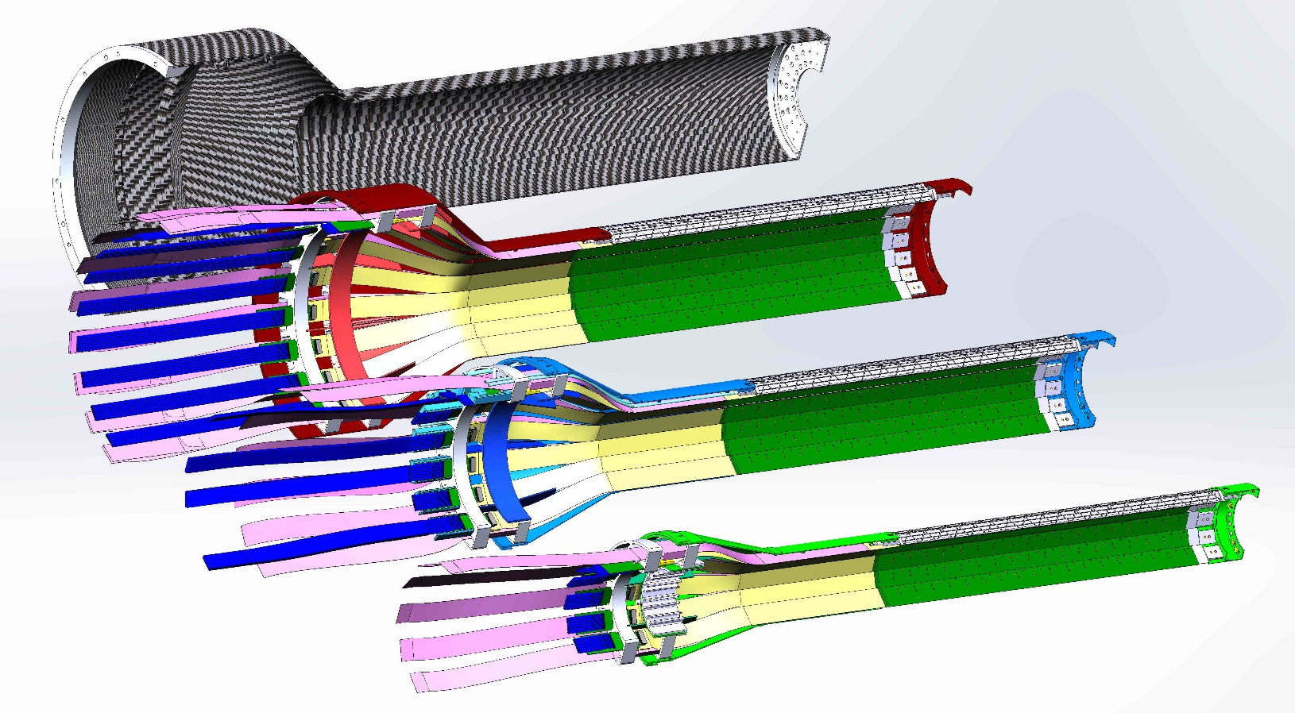
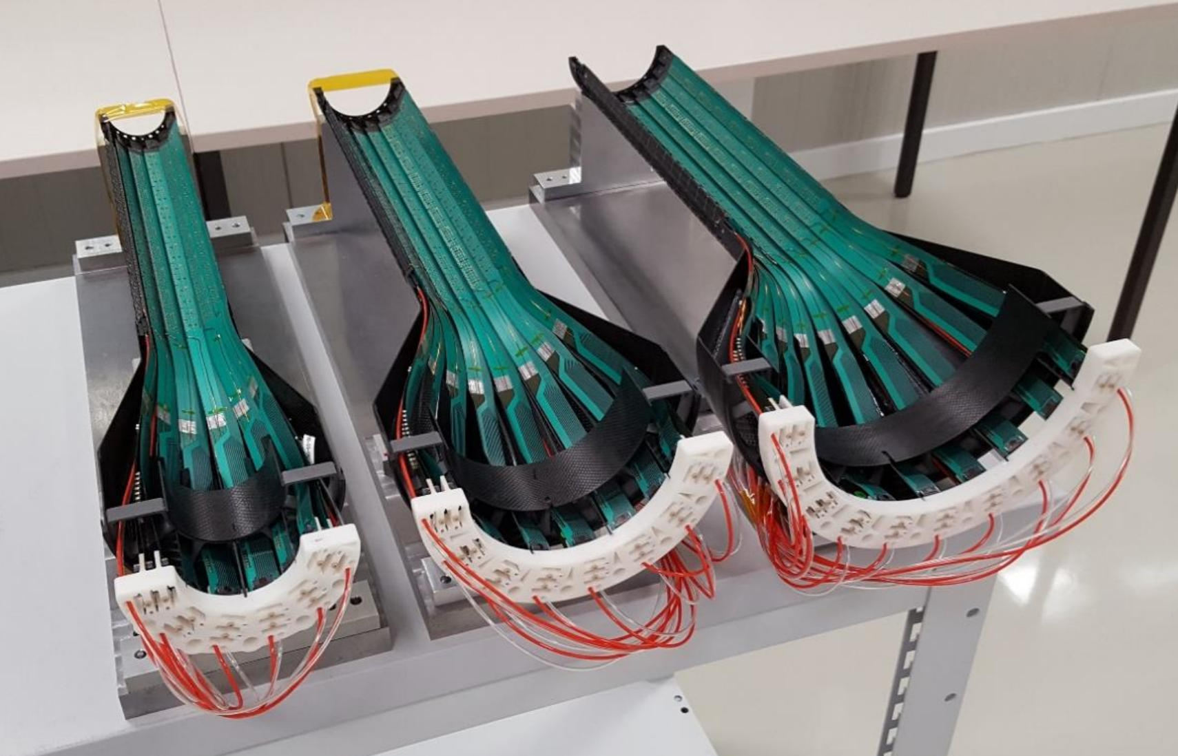
Successfully Carried out Key R&D
Jo, Cameron, Walt,
Camelia, Yuan et al.
sPHENIX sensor & readout integration
  Full stave readout chain demonstrated with final electronics RU, PU, FELIX
  Stave modified for better MVTX/INTT integration; MVTX-INTT space-conflict resolved
  Long readout cables tested
  Verify MVTX KPP
sPHENIX mechanical system integration
  Preliminary detector design completed, 3D mockup demonstrated
  MVTX + INTT/sPHENIX integration design developed
  Assembly and installation plan developed

Slide 7
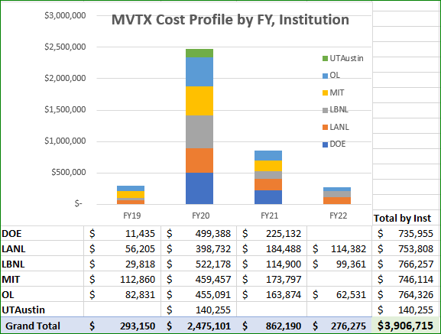
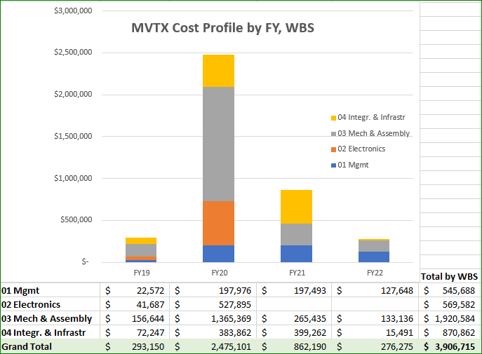
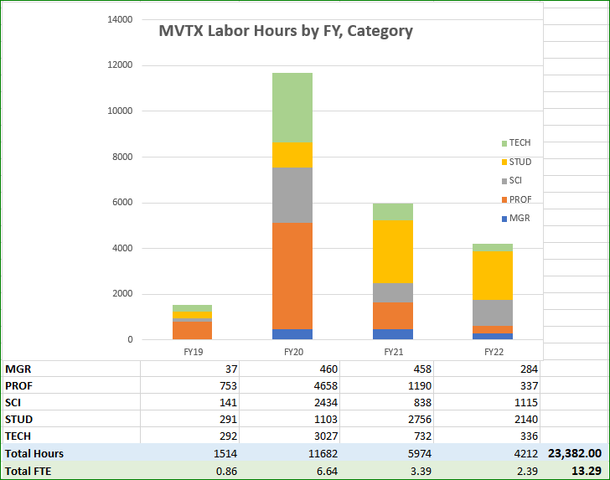
Yes.
WBS, Institution labor profile etc. in P6
  Electrical system
  Detector mechanical design
  MVTX mechanical integration

Slide 8
Yes.
Electrical system
Detector assembly
MVTX mechanical integration

Slide 9
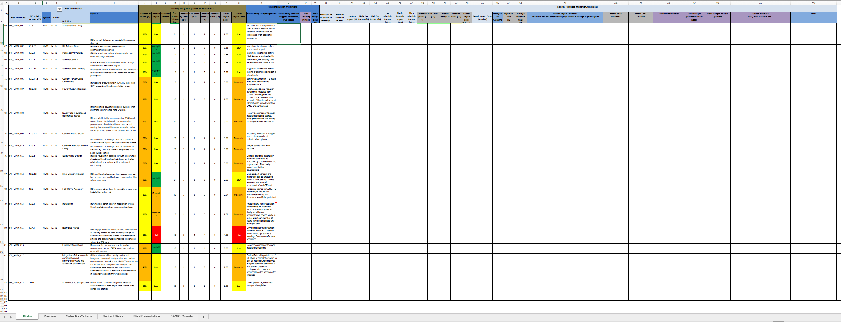
Yes.
Risk registry in sPHENIX
Major risks identified and mitigation plan developed
MVTX Risk Registry in sPHENIX

Slide 10
Yes.
Draft PMP document completed
  Project baseline
    Physics
    Functional requirements/KPP
    Technical scope
    Cost breakdown
    Schedule
    Funding profile
    Planned BNL funding
    Baseline change control
  Management structure
    Organization and team
    Management responsibilities
    Participating institutions
  Project management and oversight
    Risk management
    Project reporting
    Engineering and technology readiness
    Quality assurance and configuration/document management
    Operation readiness plan
    ESSH plans and fabrication
    Project closeout
Project fully integrated into sPHENIX P6
  Costs, schedules and risk register
Deliver MVTX on schedule/budget for day-1 physics!

Slide 11
We are ready to start the project!

Slide 12
backup

Slide 13
The L3 Component

Slide 14
L3 Technical Overview
Emphasize any technical issues that still need to be resolved. If all has been decided put it on the slide.

Slide 15
L3 Scope
What are you building?
Where you fit in the L2

Slide 16
L3 Collaborators

Slide 17
Schedule Drivers

Slide 18
Cost Drivers

Slide 19
Status and Highlights
Recent technical accomplishments

Slide 20
Issues and Concerns

Slide 21
Back Up

