Slide 1
sPHENIX MVTX Cost and Schedule Review
Summary
Ming Liu, LANL
July 29-30, 2019
BNL

Slide 2
Presentation Summary
Overview of the MVTX's Place in sPHENIX- Ed
MVTX Overview – Ming, #1-4
Cost & Schedule – Dave, #1-4
MVTX in sPHENIX P6 and Risk Registry – Irina, #2-4
MVTX mechanical design – Walt, #1-3
MVTX Service Barrel and Integration – Camelia, #1-3
MVTX Detector QA and Assembly – Yuan, #1-3
MVTX Readout – Jo, #1-3
R&D and Beam Test Results – Cameron, #1,2
Summary – Ming, #4

Slide 3
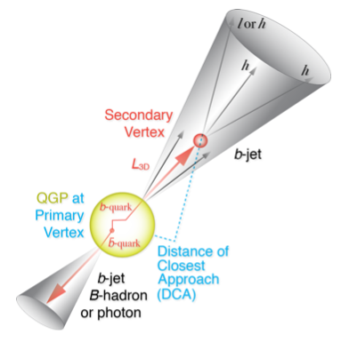
MVTX Enables the 3rd Science Pillar
From measurements to
physics understandings
Open heavy flavor hadron & jet modification
Open heavy flavor hadron & jet flow

Slide 4
MVTX Performance Parameters: KPPs & UPPs
KPPs from
MVTX PMP
UPPs from
MVTX PMP

Slide 5
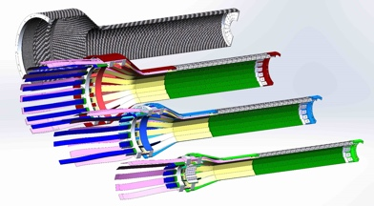
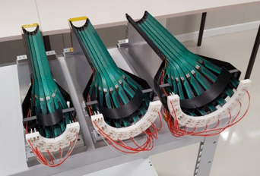
Very Successful R&D
Jo, Cameron, Walt,
Camelia, Yuan et al.
MVTX sensor/stave & readout integration
  Full stave readout chain demonstrated with final electronics RU, PU, FELIX
  Stave modified for better MVTX/INTT integration; MVTX-INTT space-conflict resolved
  Long readout cables tested
  Verify MVTX KPP
MVTX mechanical design & system integration
  Preliminary detector design completed, 3D mockup demonstrated
  MVTX + INTT/sPHENIX integration design developed
  Assembly and installation plan developed

Slide 6
MVTX Deliverables in PMP
Detectors + Services
*: The staves and RUs are from BNL contribution, no cost to MVTX project.

Slide 7
Review Charge

Slide 8
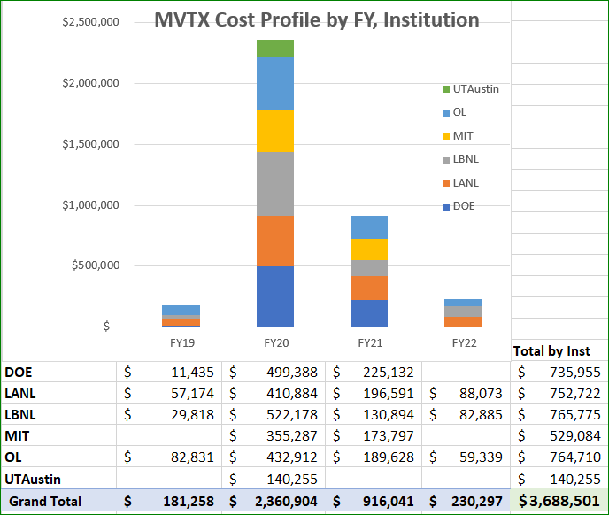
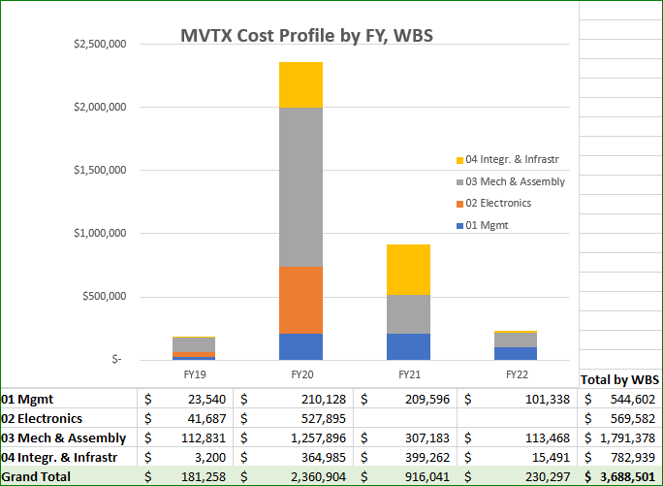
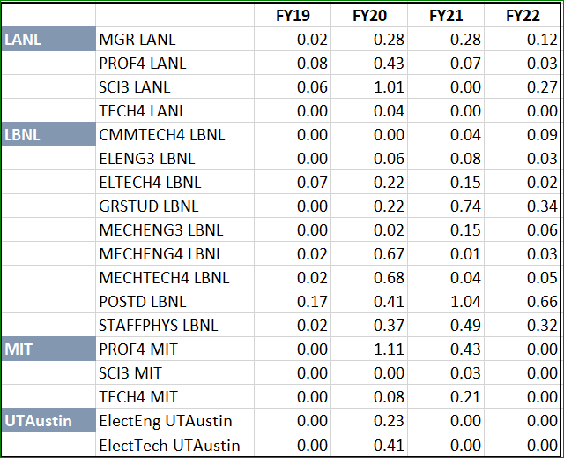
All previous talks
Yes.
Based on R&D, quotes and experience
M&S and labor cost profile in P6
  Electrical system
  Detector mechanical system
  MVTX mechanical system integration

Slide 9
See Dave and Irina’s talks;
and all technical presentations
Yes.
Based on R&D and experience
Milestones defined in PMP
Critical path identified

Slide 10
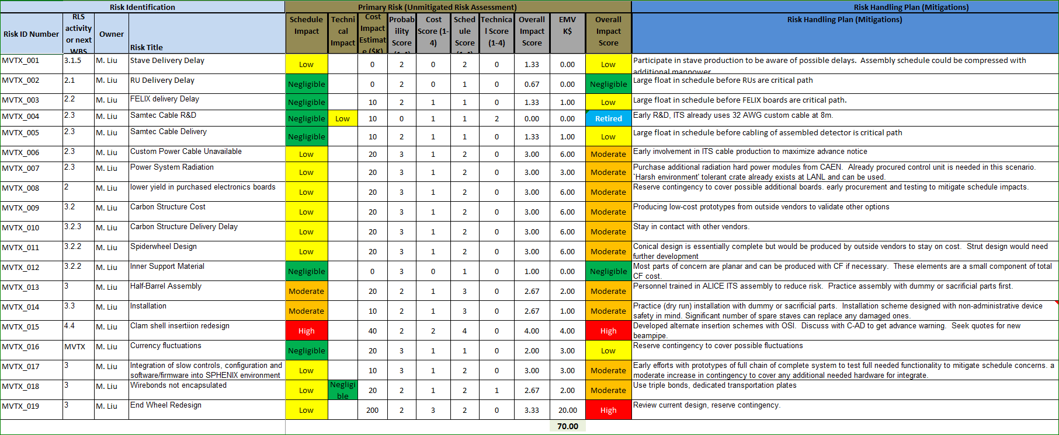
Yes.
MVTX risk register in sPHENIX
Major risks identified and mitigation strategies developed
See Dave and Irina’s talks;
and all technical presentations
MVTX Risk Register in sPHENIX

Slide 11
Yes.
PMP document completed
  Project baseline
    Physics
    Functional requirements/KPP/UPP
    Technical scope
    Cost breakdown
    Schedule
    Funding profile
    Planned BNL funding
    Baseline change control
  Management structure
    Organization and team
    Management responsibilities
    Participating institutions
  Project management and oversight
    Risk management
    Project reporting
    Engineering and technology readiness
    Quality assurance and configuration/document management
    Operation readiness plan
    ESSH plans and fabrication
    Project closeout
Project fully integrated into sPHENIX P6
  Costs, schedules and risk register
Ming and Dave’s talks
Ready to deliver MVTX on schedule and on budget!

Slide 12
Summary
MVTX is ready to receive fund for the project
  Electrical system is ready for production
  Preliminary detector mechanical design completed
  Preliminary sPHENIX mechanical system integration developed
LANL LDRD support critical for early key R&D
Costs, schedules and risk register integrated into sPHENIX P6, RLS aligned with sPHENIX
Project management plan developed, TPC $4.7M (Cost + EU + Risk), ready for installation on time for Day-1 physics
We are ready to start the project!

Slide 13
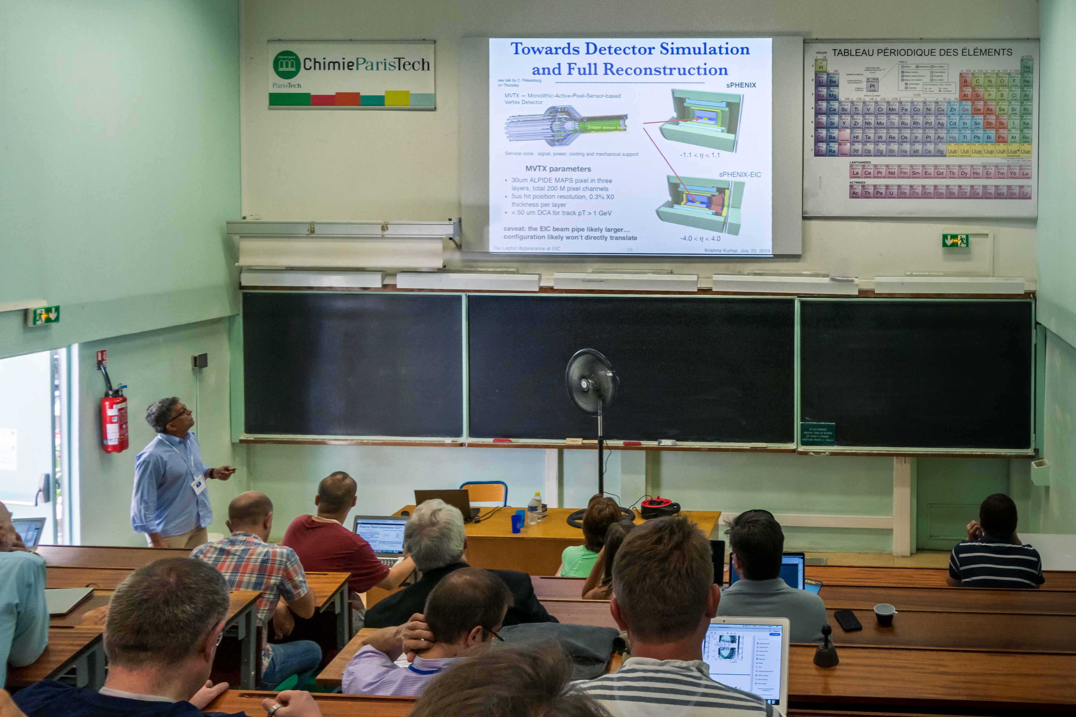
MVTX for EIC Physics?!
Krishna Kumar is talking about Lepto-quark search in EIC, with MVTX @EICUG 07/2019
https://indico.in2p3.fr/event/18281/contributions/71617/

Slide 14
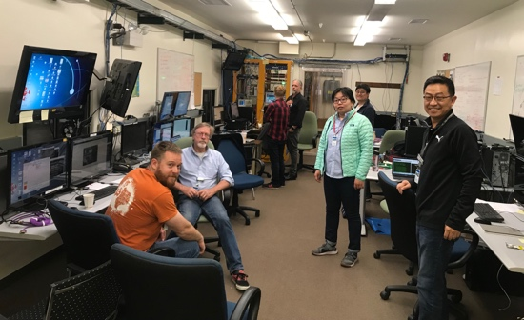
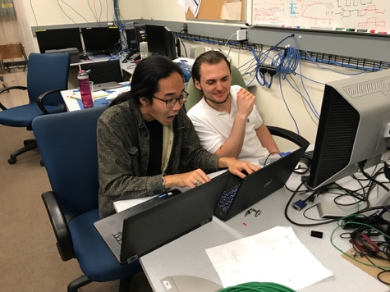
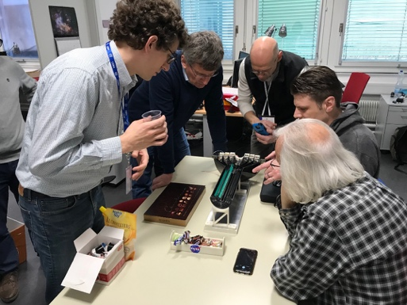
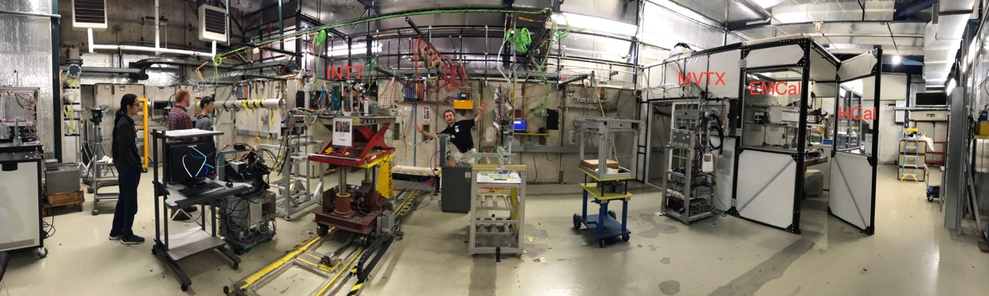
Yes, we are ready!

Slide 15
Back Up

Slide 16
MVTX WBS

Slide 17
Critical Path

Slide 18
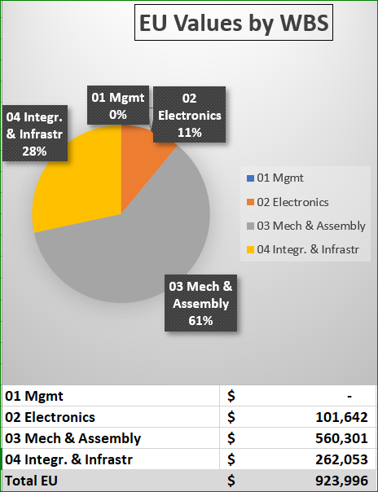
Estimate Uncertainty
EU tables are identical to those used by sPHENIX for establishing baseline cost
Labor
L1 - Actual - 0%
L2 - Level of Effort Tasks - 5%
L3 - Advanced - 10%
L4 - Preliminary - 25%
L5 - Conceptual - 40%
L6 - Pre-conceptual - 60%
L7 - Rough Estimate - 80%
L8 - Beyond state of the art - 100%
M&S
M1 - Existing Purchase Order (Actual) - 0%
M2 - Travel, supplies, software - 5%
M3 - Advanced, Quote or Catalog Price - 10%
M4 - Preliminary Engineering Judgment - 25%
M5 - Conceptual Design - 40%
M6 - Pre-conceptual Design - 60%
M7 - Pre-conceptual - Uncommon work - 80%
M8 - Beyond state of the art - 100%

Slide 19
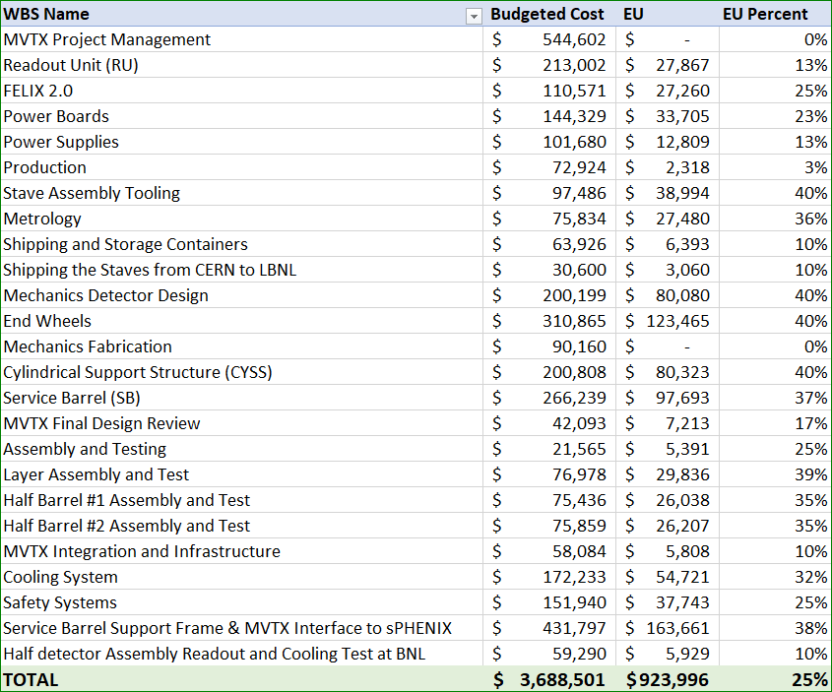
Estimate Uncertainty by WBS

Slide 20
Risk Register

