Slide 1
Review Documents Available on the Agenda Page
https://indico.bnl.gov/event/6544/
WBS/BOE
PMP
sPHENIX/MVTX Risk Register
MVTX P6, w/ Gantt Chart
MVTX full proposal
RU acceptance QA plan
Stave acceptance QA plan
Review charge
Previous Review reports
  4/2019
  7/2018

Slide 2
Today’s Presentations
Overview of the MVTX's Place in sPHENIX- Ed
MVTX Overview – Ming, #1-4
Cost & Schedule – Dave, #1-4
MVTX in sPHENIX P6 and Risk Registry – Irina, #2, 3
MVTX mechanical design – Walt, #1,2
MVTX Service Barrel and Integration – Camelia, #1,2
MVTX Detector QA and Assembly – Yuan, #1,2
MVTX Readout – Jo, #1,2
R&D and Beam Test Results – Cameron, #1
Summary – Ming, #4

Slide 3
sPHENIX MVTX Cost and Schedule Review
MVTX Overview
Ming Liu, LANL
July 29-30, 2019
BNL

Slide 4
Outline
Physics of MVTX
Project scope
Costs, schedules & risk register
R&D highlights and risk mitigations
Previous review recommendations
Issues and concerns

Slide 5
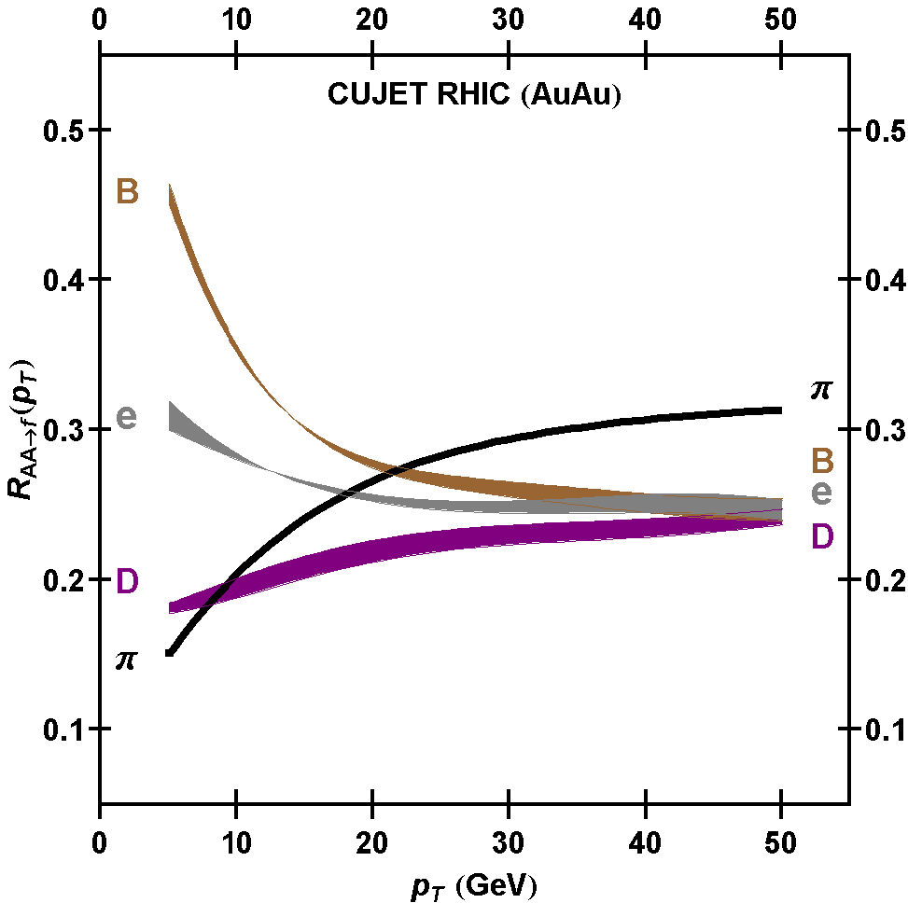
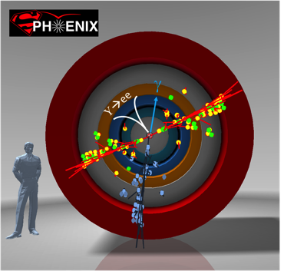
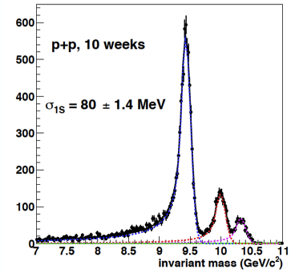
MVTX Enables Exciting Science
sPHENIX is the next flagship heavy ion physics experiment in the US (NSAC LRP2015)
  Jets
  Upsilons
Open heavy flavors – the 3rd physics pillar
  Precision study of the “inner workings of QGP”(LRP15)
  Quantitative determination of key parameters of QGP properties and interactions
sPHENIX 3 Physics Pillars
http://arxiv.org/pdf/1501.06197v1.pdf
Jets
Upsilons
PRL 108 (2012) 022301
B
D

Slide 6
The sPHENIX 3rd Science Pillar
“B meson and b-jet modification”
Heavy quarks – unique probe of QGP w/ new scales, m_{c}, m_{b}
Study mass dependence
  Jet quenching & energy loss
  Flow – interaction with medium
Access QGP properties
  temperature and momentum dependence of QGP transport parameters
“B meson and b-jet flow”
m_{u} m_{d}
m_{s}
Λ_{QCD}
m_{c}
m_{b}
MeV
1
10
10²
T_{c}
T_{QGP}
10³
10⁴

Slide 7


Monolithic-Active-Pixel-Sensors (MAPS)
The next Generation State of the Art Pixel Tracker
Advantages of ALICE MAPS/ALPIDE:
  Very fine pitch (28x28 μm)
  High efficiency (>99%) and low noise (<10⁻⁶)
  Time resolution, as high as ~5 μs
  Ultra-thin/low mass, 50μm (~0.3% X₀)
  On-pixel digitization, low power dissipation
An ideal detector for QGP physics!
FPC
9 Chips
Cooling plate
Power density < 40 mW/cm²
A 9-chip MAPS stave, 1.5 x 27cm²
ALPIDE design
50 μm
28 μm

Slide 8

MVTX Detector – Modified from ALICE/ITS Design
CYSS: Cylindrical
Shell Structure
End-Wheels
Service Barrel
3-layer sensor barrel
- 48 staves, 432 chips
MVTX parameters: L = 271 mm

Slide 9
Scope of the MVTX Project – WBS 3.02
Mechanical system (3.02.03, 3.02.04)
  MVTX detector mechanical structures
    Design & simulations
    End Wheels
    Cylindrical support structure
    Service barrels
  Mechanical system integration
    Service barrel support & interface to sPHENIX
    Installation tooling etc.
    Adopt ALICE cooling parameters
    Detector safety
  Detector assembly
    Stave QA & detector assembly @LBNL
Electronics (3.02.02)
  Readout Integration
    RU QA & assembly @UT-A
    Backend: ATLAS FELIX
    FELIX boards @LANL/BNL
    Frontend RU services: daughter cards, transition boards, cables etc.
  Ancillary systems - “adopt” ALICE ITS system
    Power, slow control & monitoring etc.
Jo’s talk
Walt’s talk
Camelia’s talk
Yuan’s talk
BNL provides Staves & RUs, w/o cost to MVTX project:
- 84 ALICE/ITS-IB (modified) staves from CERN;
48+spares(2-inner layers+10%)
- 60 ALICE/ITS-RU from CERN
48+spares(12, 25%)

Slide 10
Project Management Plan
Yes.
Draft PMP document completed
  Project baseline
    Physics
    Functional requirements/KPP
    Technical scope
    Cost breakdown
    Schedule
    Funding profile
    Planned BNL funding
    Baseline change control
  Management structure
    Organization and team
    Management responsibilities
    Participating institutions
  Project management and oversight
    Risk management
    Project reporting
    Engineering and technology readiness
    Quality assurance and configuration/document management
    Operation readiness plan
    ESSH plans and fabrication
    Project closeout
Project fully integrated into sPHENIX P6
  Costs, schedules and risk register
Deliver MVTX on schedule/budget for day-1 physics!

Slide 11
MVTX Scope WBS

Slide 12
MVTX Deliverables in PMP
Detectors + Services
*: The staves and RUs are from BNL contribution, no cost to MVTX project.

Slide 13
MVTX Key Performance Parameters
KPPs from
MVTX PMP
UPPs from
MVTX PMP

Slide 14
Baseline Change Control in PMP
MVTX
MVTX

Slide 15
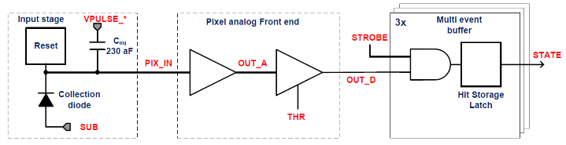
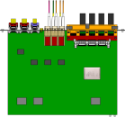

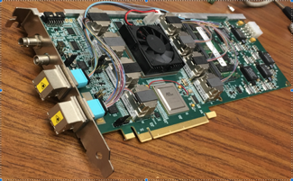

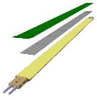
MVTX Readout, Power and Controls
CAN bus
DCS
Jo’s talk
Trigger & Clock
Readout Unit
Front End
GBT Optical Links
one pixel
9 Data (1.2Gbps)
1 Clock, 1 Control/Trigger
Control
Data (9.6 Gb/s max)
Trigger
9-sensor Stave
Samtec Twinax “FireFly”, ~10m
FELIX
Back End
FPC
Power
ATLAS Front-End Link eXchange (FELIX):
sPHENIX Data Aggregation Module(DAM)
Alpide Sensors
Flex PCB Filtering Capacitors
regulators
Power
Regulated Power
CAEN Power supplies
Cold Plate
ALPIDE pixel:
Shaping
Digitization
Zero-suppression
3x buffer
Power Board
Interaction Region
Experimental Hall
Counting House
MVTX Detector Electronics consists of three parts
Sensor-Stave (9 ALPIDE chips) | Front End-Readout Unit | Back End-FELIX/DAM
(BNL provides staves and RUs at no cost to MVTX project)

Slide 16
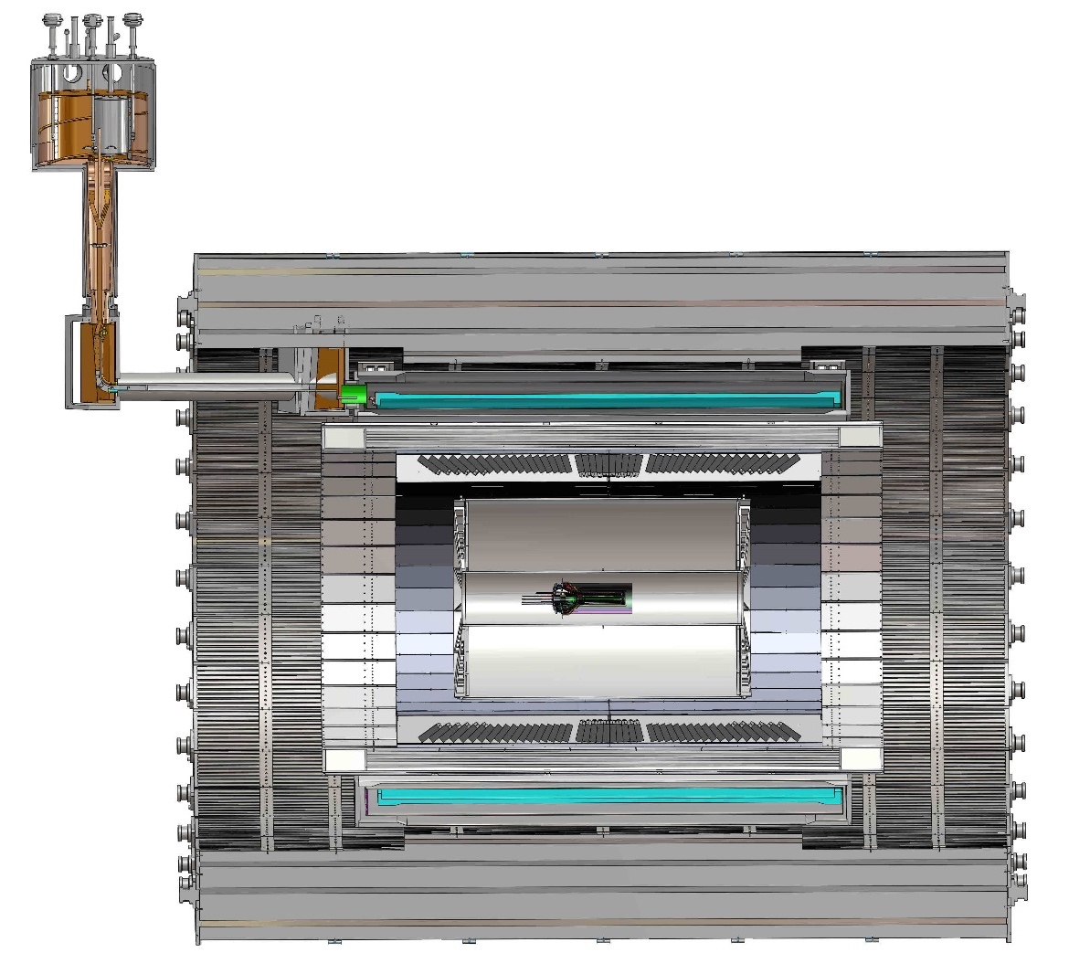
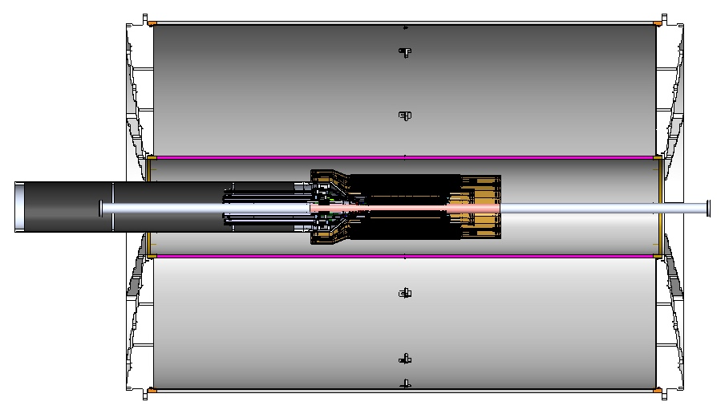
MVTX Global Mechanical System Integration
MVTX system preliminary design, with two parts:
  Part-1: from MVTX to PP-2, all power PCB, 40cm
  Part-2: length TBD later, from PP-2 to PP-3
Walt and Camelia’ talks
Service Barrel
TPC
TPC
INTT
MVTX
PP-1:
short signal cables
PP-3:
Signal and power cables
R= 209.6cm
PP-2:
power cables
L = 350.0 cm

Slide 17
MVTX Organization Chart

Slide 18
Collaborators & Responsibilities
22+ institutions and growing,
from US and abroad
Active joint efforts with
ALICE ITS group
LANL
LBNL
CCNU
MIT
Yonsei
…
Photos of MIT helping ITS commission
LANL – ITS upgrate

Slide 19
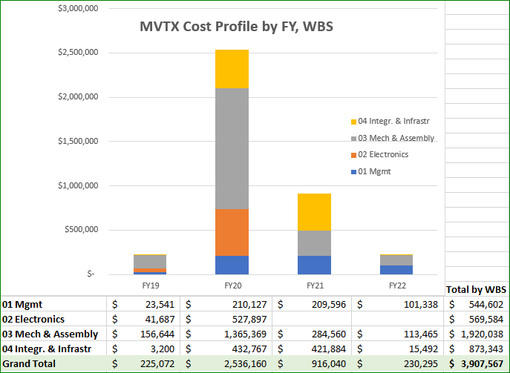
Cost Drivers
Dave talk
Mechanical system:
Detector carbon structures
Service & integration
Electronics:
Backend
Power system
LANL LDRD for early R&D:
$5M, FY17-19
Readout
detector conceptual design
Simulations

Slide 20
Schedules & Milestones
Technically driven schedule
  Day-1 physics
  CERN production
  Fund available as needed
Funding delay
  R&D
  Production
  Preparation
Low schedule contingency
Early R&D by LANL LDRD
“CD4” closeout
12/2023

Slide 21
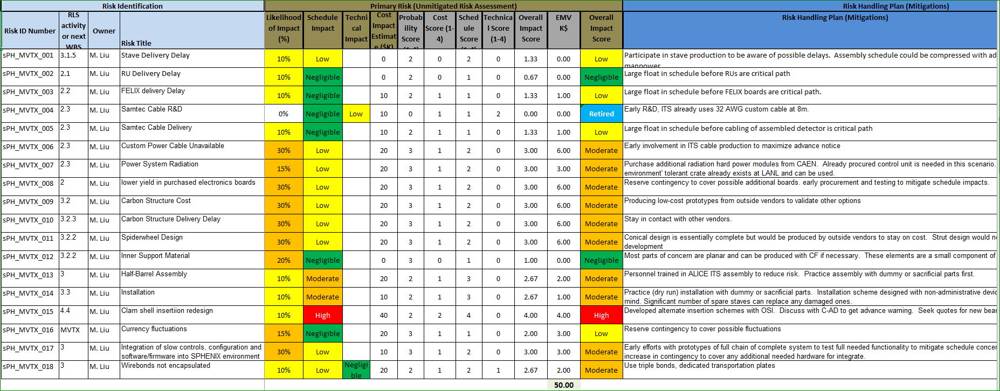
MVTX Risk Register in sPHENIX

Slide 22
Project Status & Highlights
Tested full stave readout chain with the final electronics at Fermilab Test Beam
  Tested long SamTec readout cables recently – last key integration R&D
  11.4m long cables, 10m desired
MVTX mechanical design: excellent progress
  Asked for quotes from outside companies based on preliminary designs
  sPHENIX integration workfest held 7/10 @BNL, MVTX/INTT/TPC
Early R&D achieved through LANL LDRD, $5M, FY17-19
  Readout integration
  Conceptual mechanical system design
Release of early BNL R&D fund in progress
  MVTX mechanical engineering design, MIT/LANL
  Preparation for Stave and RU acceptance test, LBNL, UT-Austin
We are ready to start the project
  WBS, PMP, Risk Registry updated
  Fully integrated into sPHENIX P6, aligned with sPHENIX schedule
  Will deliver MVTX on time and on budget under $5M

Slide 23
Engineering & Technology Readiness
Stave modification and system integration - done
  MVTX & INTT integration
Readout Electronics - done
  RU, PU, FELIX, Readout cable
  Power system
Mechanical system – preliminary design available
  Detector design
  Service & integration
Detector assembly and installation – plan developed
  Follow ALICE ITS procedures

Slide 24
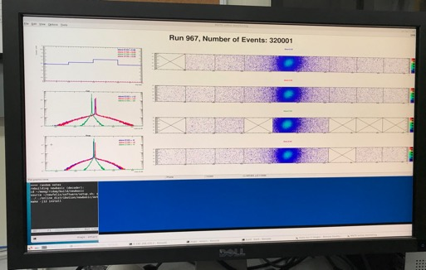
Very Successful Test Beam @Fermilab
5/20-25, 6/17-22, 2019
SamTec: 11.4m
(2.6m+8.8m)
4-stave telescope
RU-2: 1 stave
- 1 fully functioning
9-chip stave;
- 3 staves with a few
broken sensors
4 staves
2 RUv1.1
1 PU
1 FELIX Server + RCDAQ
sPHENIX GTM
11.4m Custom SamTec Cable
Negative pressured cooling for staves
RU-1: 3 staves
5m SamTec
120GeV p-beam
10kHz (30kHz)
Beam intensity:
30k ~ 120k ppp
Data & Control
Beam Trigger
Timing & Trigger
GTM
FELIX
A full system with final sensor/readout* hardware:
Multi-Stave + Multi-RU -> FELIX readout demonstrated
sPHENIX GTM integrated
Long readout SamTec cable certified
Cooling system demonstrated
* RUv1.1 identical to the final RUv2 electrically
Online Monitoring
sPHENIX
RCDAQ

Slide 25
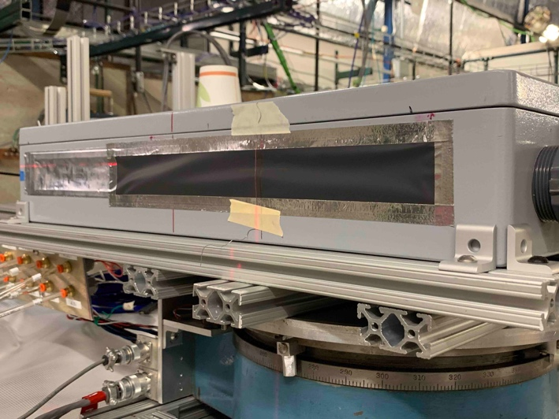
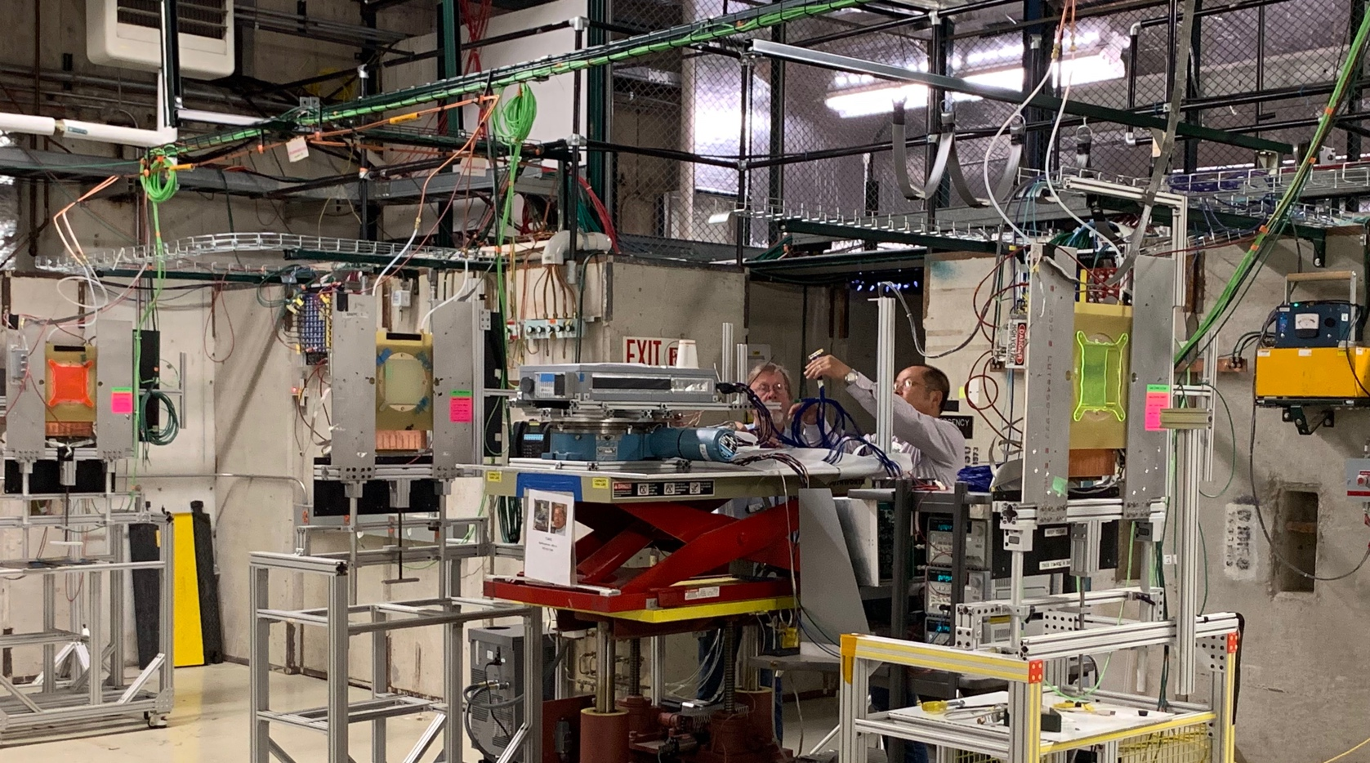
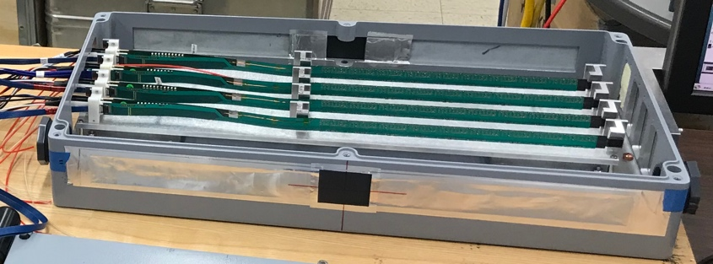
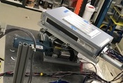
2019 MVTX Test Beam Setup @Fermilab
From view
beam
Stave housing (four staves)
Stave housing sits on a motion table which can be moved in (x, y) plane perpendicular to the nominal beam direction. It can also be rotated (+40, -40) degrees (see photo on right). Operation was done at counting house.

Slide 26
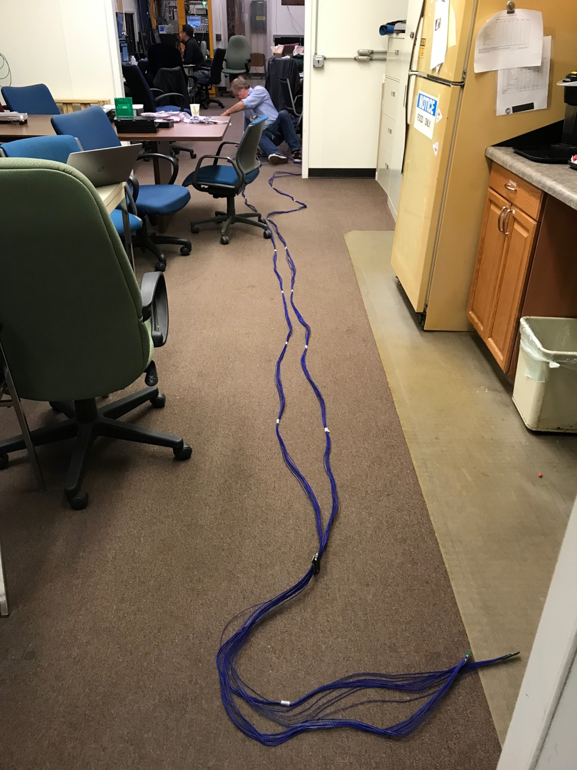
Long Custom MVTX Readout Cables Tested
PWR
RU
PU
Desired <~10m;
Tested 11.4m
BNL has approved “non-halogen free” cables for sPHENIX
sPHENIX MVTX: 7.9+m
  Cable-A: 1.4 m
  Cable-B: 6.5+ m
  Power cable:4.7+ m

Slide 27
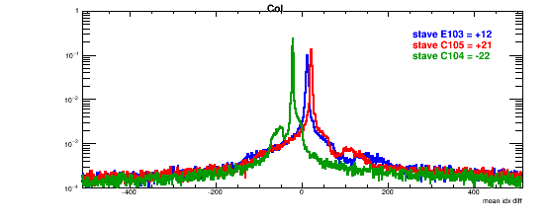
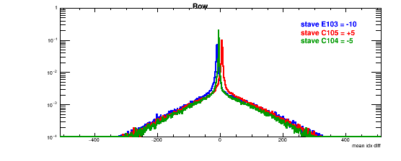
Detector Misalignment & Hit Spatial Resolution Study
Typically staves offset by,
Horizontally: 20 x 30um = 600 um
Vertically: 5 x 30 um = 150 um
Hit spatial resolution: (w/o clustering)
Peak_sigma_core = 0.55 (pixel size ) =15 um
Chip spatial resolution = 15/sqrt(2) = 11 um
(same as 2018 TB results)
120GeV proton beam
Delta_X/Y
Ref. Plane

Slide 28
Recommendations from April Director’s Review
Review Report posted on the agenda page

Slide 29
Report from April BNL Director’s PD2/3 Reviews: Silicon Detectors - MVTX, INTT (1)
1. Yes. MVTX design is sound and will meet the requirements.
  Readout electroncs is ready for production;
  Preliminary mechanical system design
2. Yes. Now MVTX project is fully integrated into sPHENIX P6.
Cost & Schedule, WBS, Risks registry.
Irina’s talk
3. Yes. Now MVTX project is fully integrated into sPHENIX P6,
and Risks registry.
Irina’s talk
4. Yes. Now MVTX project is fully integrated into sPHENIX P6,
MVTX baseline is define and PMP is complete.
- Dave and Irina’s talks

Slide 30
Report from April BNL Director’s PD2/3 Reviews: Silicon Detectors - MVTX, INTT (2)
5. Yes. MVTX is fully integrated into sPHENIX P6, and PMP is complete
6. Yes. ES&H document is complete.
1. sPHENIX follows the same ITS/IB stave QA Gold/Silver standard, about 50-50 for ITS;
Latest production had higher yield of gold, ~>70%
2. MVTX is fully integrated into sPHENIX P6, a list of milestones and critical paths are identified in P6.
- Irina’s talk
3. MVTX is produced based on MS Project file that was used to integrate MVTX into the sPHENIX P6. WBS and Critical paths are defined in P6
- Irina’s talk
4. Detailed 3-D mockup was built and used to develop the MVTX mechanical design.
- Walt’s talk
5. MVTX is fully integrated into sPHENIX P6, cost and labor profiles are produced in P6
- Irina’s talk
1. Now MVTX Risk Registry is fully integrated into sPHENIX,
- Irina’s talk

Slide 31
Report from April BNL Director’s PD2/3 Reviews: Silicon Detectors - MVTX, INTT (3)
Now MVTX project RLS is fully integrated into sPHENIX P6.
-Dave and Irina’s talks
BNL has agreed to provide early R&D fund to MIT and LBNL to
support mechanical system design work.
4. Much of the MVTX software work is based on the common
sPHENIX online and offline frameworks, work is mostly carried out
by collaborators without cost to the project.
5. Based on current RLS, MVTX detector will be ready for installation in May 2022;
It is the last detector to go into IR, currently scheduled in 9/2022.
-Dave and Irina’s talks
7. MVTX reporting is defined in PMP.
Quarterly cost and schedule reviews and report the results to the sPHENIX Project Office.
We will hold monthly phone calls with DOE-NP and provide them with
Quarterly progress reports.
8. WBS, BOE and Risk Registry are intereged into sPHENIX P6.
Irina’s talk
9. MVTX is now integrated into sPHENIX P6.
Irina’s talk
11. Beam pipe modification is under discussion btwn CAD and sPHENIX Project Office.
1,2,3 – MVTX is integrated into sPHENIX P6, same methodology will be used for MVTX
4. MVTX PMP completed, including change control and configuration control methods.

Slide 32
Report from April BNL Director’s PD2/3 Reviews: Silicon Detectors - MVTX, INTT (4)
5. MVTX early funding request submitted, and BNL has agreed to provide R&D fund to
MIT and LBNL to carry out key R&D.
Institution roles are developed in the PMP.
BNL will own and oversee the spending of the contingency.
MVTX risk register developed, included in the sPHENIX Risk Registry, Irina’s talk
Will follow the same procedures developed by ITS for stave and detector assembly;
KPPs and UPPs are documented in MVTX PMP.
The MVTX science case is well documented in the MVXT full proposal.
New developments are documented through sPHENIX physics and technical notes.

Slide 33
Issues and Concerns
Carbon structure production cost and schedule
  LBNL, other production activities/ATLAS
  Explore other production sites, Italy, France, Korea, US …
  High contingency in cost, ~40%
Funding delay in stave/RU production
  Stave and RU production delayed
  Delays in preparation for Stave and RU test

Slide 34
Summary
MVTX is ready to receive fund for the project
  Electrical system is ready for production
  Preliminary detector mechanical design completed
  Preliminary sPHENIX mechanical system integration developed
Costs, schedules and risk register integrated into sPHENIX P6
Project management plan developed, baseline change control etc. defined
MVTX RLS is aligned with sPHENIX and will be ready for installation on time. We are ready to start the project!

Slide 35
Back Up & References

Slide 36
Critical Path

Slide 37
MVTX WBS 3.02 Preliminary Baseline in P6

Slide 39
Report from April BNL Director’s PD2/3 Reviews: Silicon Detectors - MVTX, INTT
MVTX PMP fully
developed
sPHENIX follows the same ITS/IB stave QA Gold/Silver standard, about 50-50 for ITS;
Latest production had higher yield of gold, ~>65%
WBS & Critical Paths etc. documented in P6
- 3-D mock-up demonstrated;
- Detailed FTE profile in P6
MVTX Risks fully integrated into sPHENIX,
- Irina’s talk

Slide 40
Need project funding NOW!
MVTX Risks, WBS/BOE integrated into sPHENIX
Critical path and milestones in P6
PMP documents updated, change control et.
Schedule & Labor profile updated in P6
Early R&D funding needs submitted to BNL,
MIT, LBNL, LANL, UT-A, work in progress
BNL owns/oversees the contingency
Stave handling follows ITS practice to avoid
possible metal particulate generation
- Report to sPHENIX office on progress and issues

Slide 41
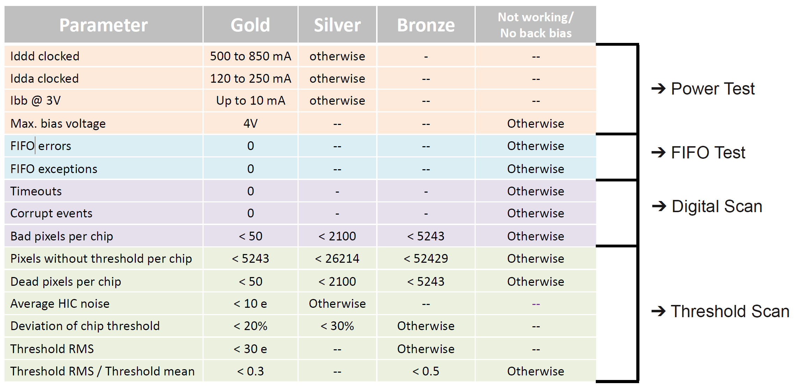
Staves – QA plan
Tests run on sensors / staves
Example for building ML/OL modules but the tests run are the same for all sensors

Slide 42
MVTX Full Proposal
Pre-proposal submitted to DOE, 2/2017
  Follow-up discussions with DOE and BNL managers
  Weekly proj. leaders’ meeting, BNL/LANL/LBNL/MIT
Full proposal submitted to BNL ALD, Feb 2018
  Expanded science + Cost & Schedule
  Assumed funding starts in FY18
A growing collaboration
  22+ institutions from US and abroad
Adapt ALICE ITS Upgrade Inner Barrel 3-layer MAPS detector
  Mini. risk, Max. Physics
Precision vertexing for b-jet/B-hadron tagging in HI with high efficiency and high purity
B-jet modification in QGP at low-medium pT to determine QGP properties, study mass-dependence on collisional vs radiative energy loss, flow etc.
Early R&D by LANL LDRD, $5M, FY17-19, readout, mechanical design and physics; established LANL-ALICE MoU in 12/2016 for joint R&D and training

Slide 43
MVTX Schedules and Milestones (3/2019)
sPHENIX: CD1/3a PD2/3
Installation
1st collisions
CY-2018 | 2019 | 2020 | 2021 | 2022 | 2023
MVTX
Stave & RU
production
FELIX
production
Funding delays –
Stave production delayed at CERN
- Impact on following test & assembly
- preparation work @LBNL, UT-A
Lack of R&D $ for mech. desgin work
- MIT, LBNL, LANL
- “advanced cash” running out MIT, LANL
Detector mechanics design & production, global interface to sPHENIX
End Wheels
CYSS
Global integration
/interface design
Service barrel
design & production
Ready for beam;
sPHENIX day-1 run
Barrel Assembly & Testing @LBNL
Install half barrels
@sPHENIX IR
Half barrel #1
Power system
production
Half barrel #2
Half barrels
arrive @BNL
design & procure
interface to
sPHENIX rails
Running low in schedule contingency …
Design & procure
sPHENIX rails
MVTX installation & commissioning @BNL
RU, FELIX, PS, cables etc.

Slide 44
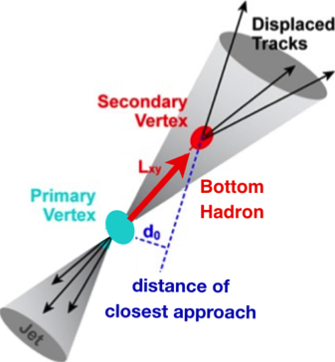

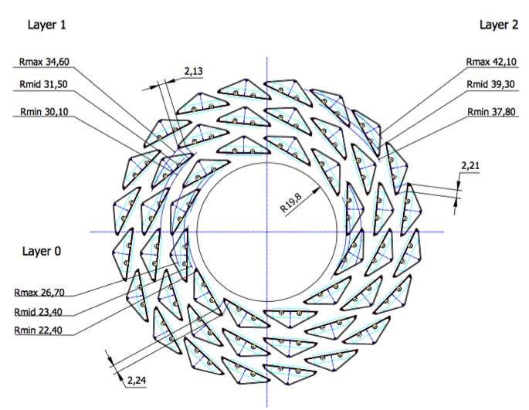
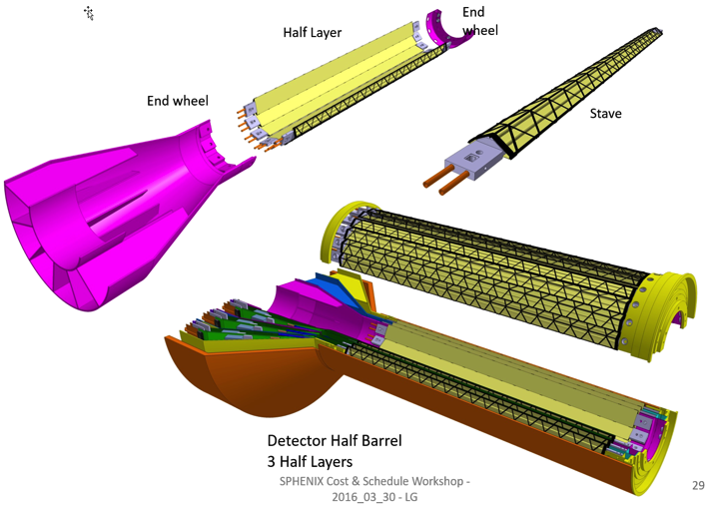
MVTX: Monolithic-Active-Pixel-Sensor-based VerTeX Detector
sPHENIX@RHIC (2023+)
Key integration tasks:
Readout
Mechanics
ALICE ITS Upgrade @CERN;
Inner Tracker System (2021+)
sPHENIX Inner Tracking
“Adopt” ALICE/ITS
Mini. risk,
Max. physics
MVTX could also be a day-1 EIC detector

Slide 45
Preliminary Mechanical Design Completed
Camelia’ talk
https://indico.bnl.gov/event/6377/
MVTX, INTT, TPC …

Slide 46

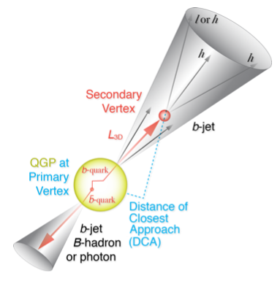
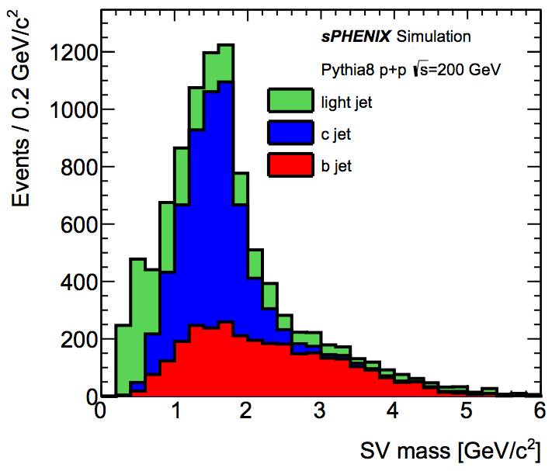
B-Hadron & b-Jet Tagging
Physics Reminder
Detected using the long lifetime of bottom quark hadrons:
  Displaced tracks
  Large 2nd vertex invariant mass
Need high precision tracking and vertex determination – MVTX!
Need excellent jet detection capabilities – sPHENIX!

Slide 47
ALPIDE/MAPS Operation
Well fit sPHENIX/RHIC environment, 10MHz Clock (LHC 40MHz)
shaping time: 2, 5, 10 … μs
v
PIX_IN
v
OUT_A
~5-6 μs
t_{f}~= 10 ns
OUT_D
ΔV=Q/C
threshold
t_{r}> 100 μs
~5-6 μs
STROBE
t
t
sPHENIX trigger latency: ~4 μs

Slide 48
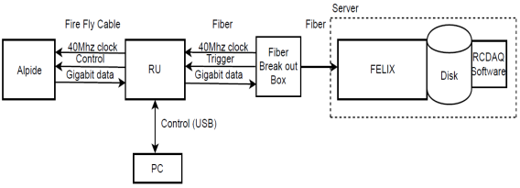
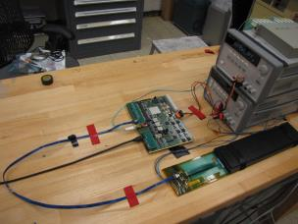
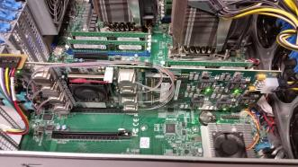
MVTX Full Readout Chain Demonstrated 2018 TB@Fermilab
Stave
Readout
Unit
FELIX
Readout Unit configures Stave using USB interface
FELIX distributes clock to Readout Unit
Readout Unit distributes clock to the Stave
Stave is triggered, sends data at 1.2Gb/s
Configured GBT link to recover clock from FELIX
Readout Unit receives the data and sends the data to FELIX over fiber using GBT link
FELIX packs data, stores it on disk using RCDAQ - the sPHENIX data format and software
Readout Unit + Stave
Server + FELIX

Slide 49
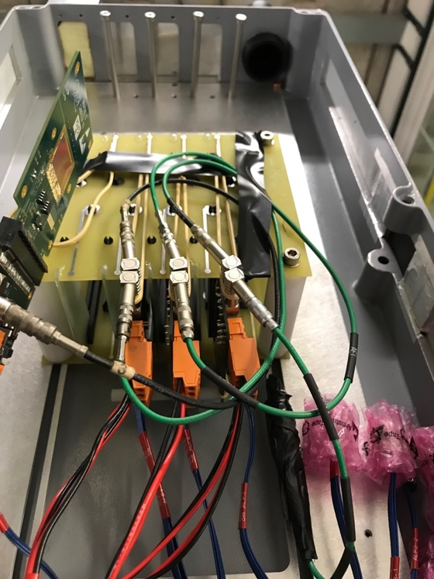
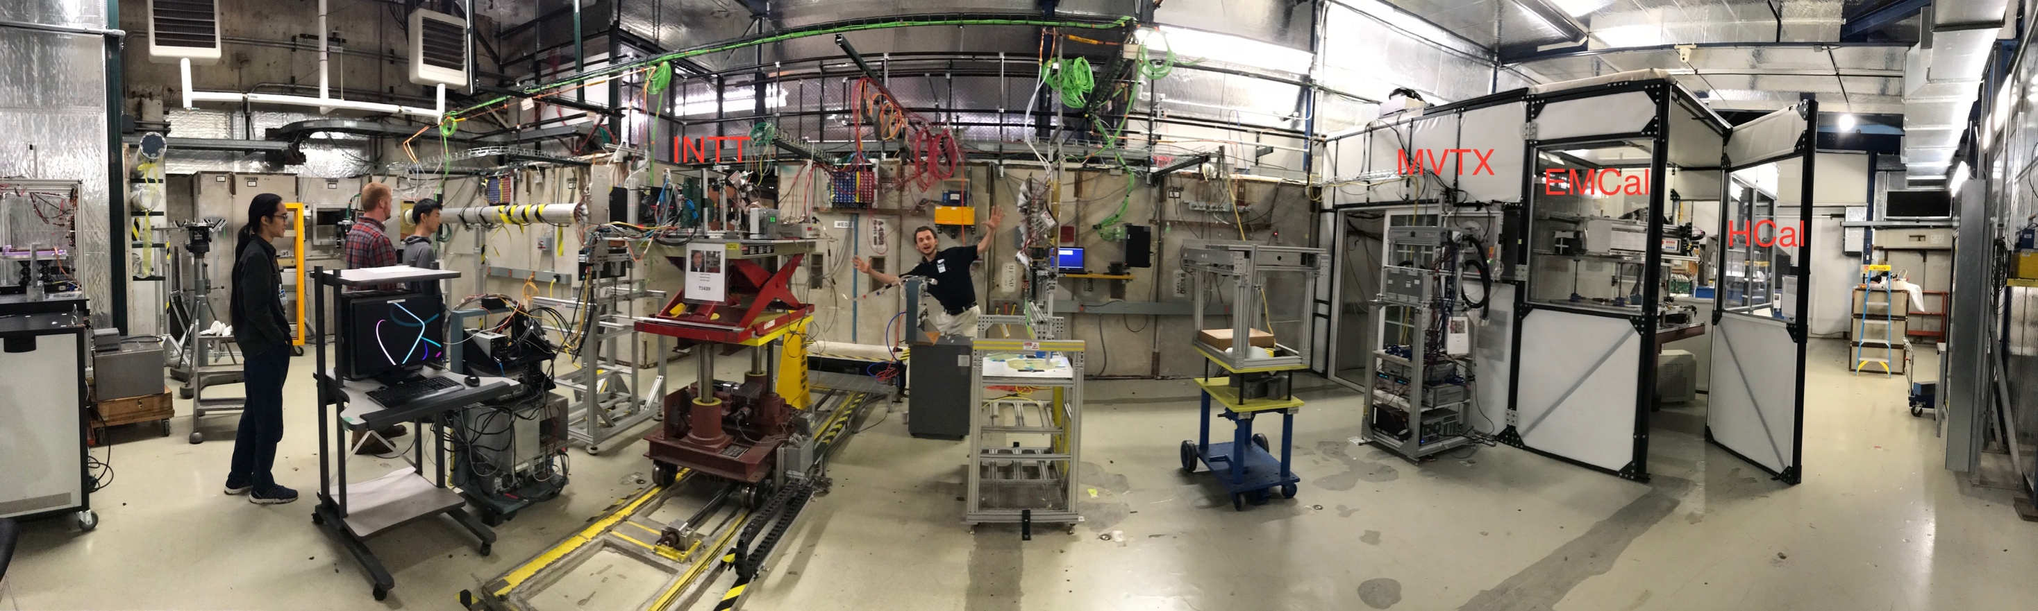
MVTX Test Beam at Fermilab 02/20-03/10, 2018
Goals:
  Test full readout chain
  Evaluate ALPIDE sensor performance
Experimental setup
  A 4-sensor telescope
  Full readout chain: MAPS+RU+FELIX+RCDAQ
120 GeV
proton
Parasitic with INTT run
Very productive & collaborative
4-sensor
Telescope

Slide 50
Fermilab Test Beam Results (I)
4-hit track
120 GeV proton beam
4-sensor telescope
Mostly single tracks
Cluster size: 2.1 ~ 2.4
# of tracks per event
Cluster size
Beautiful analysis done by Sanghoon and Darren + others

Slide 51
Fermilab Test Beam Results (II)
Hit Spatial Resolution: < 5 um
Hit Efficiency > 99.5%
Pixel size (~28um)

Slide 52
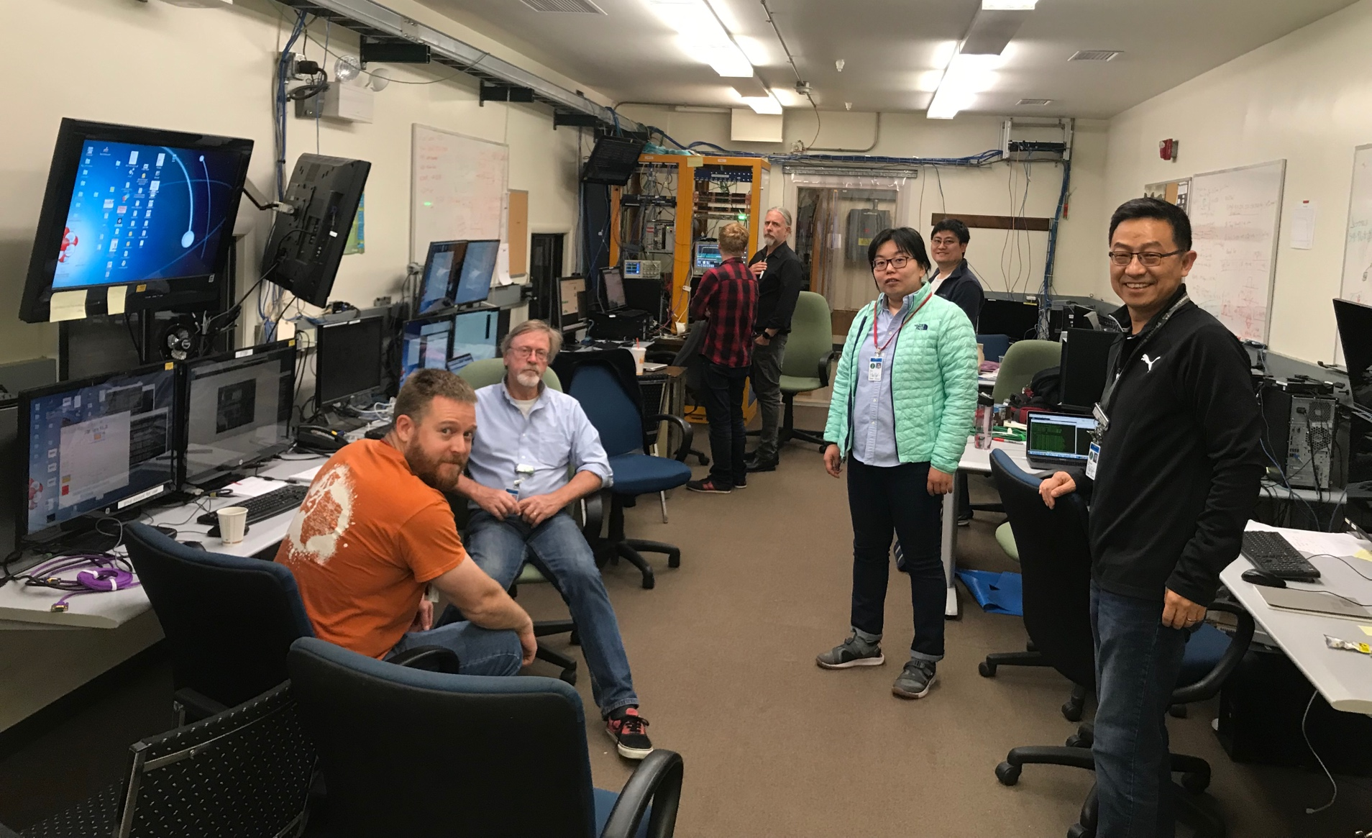
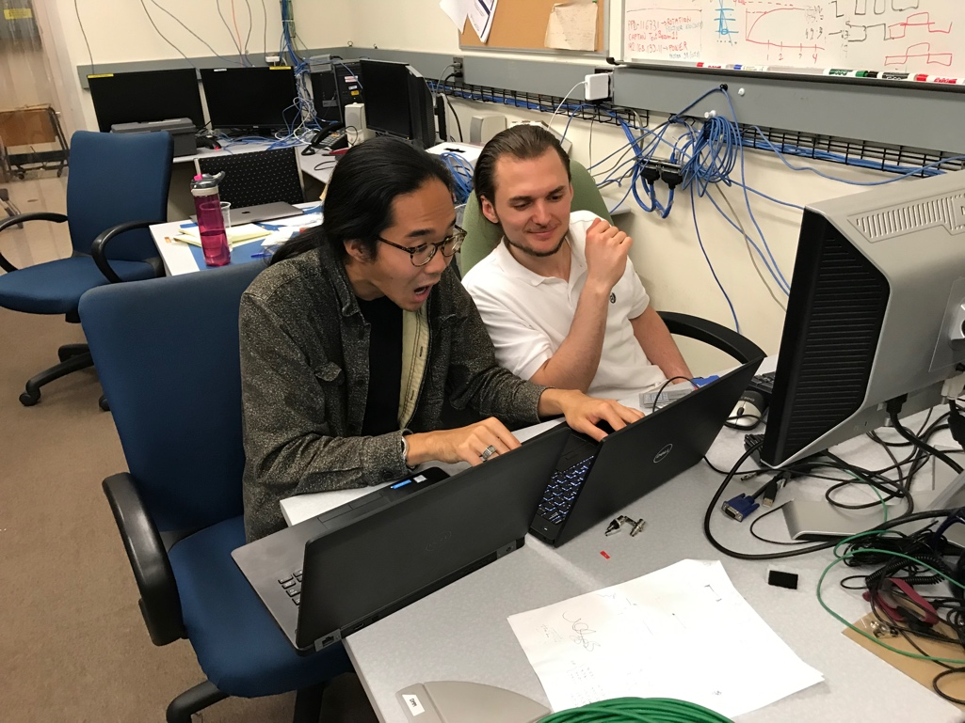
The TB Team @Fermilab, 2019
Data taking shift in the evenings: 7PM – 7AM
Beam: every other Monday –Friday 8:00AM – 8AM
Matt, Hubert, Cameron, Gerd, Zongze,
Xuan, Xiaochun, photo by Ming
Sho, AlexT
Not shown: Sanghoon, Yasser, Martin, Walt,
Abel. Chris …

Slide 53
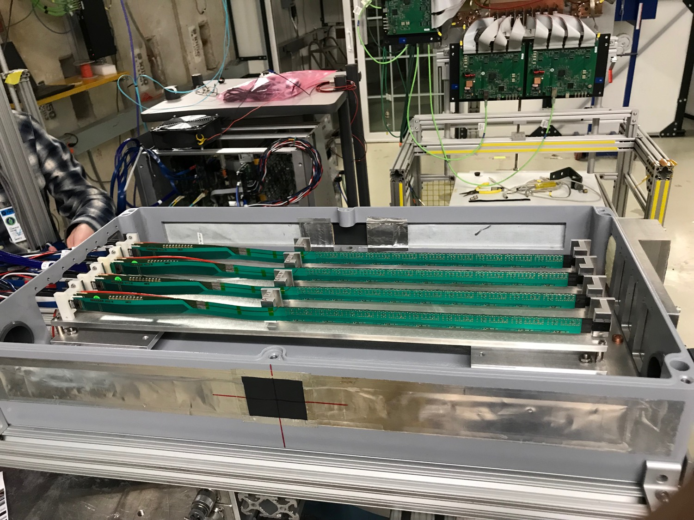
MVTX 4-Stave Telescope

Slide 54
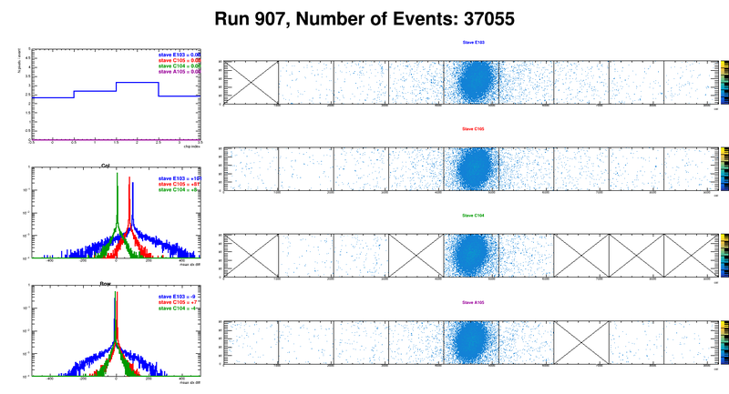
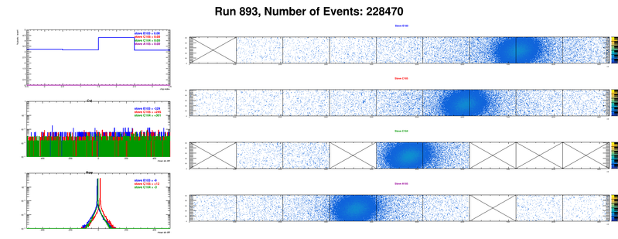
Offline analysis in progress: all TB data in RCF
https://wiki.bnl.gov/sPHENIX/index.php/MAPS-based_Vertex_Detector_(MVTX)
Beam angle: 0
(eta ~0)
MVTX 4-Stave Telescope
Beam angle: 40
(eta ~1)

Slide 55
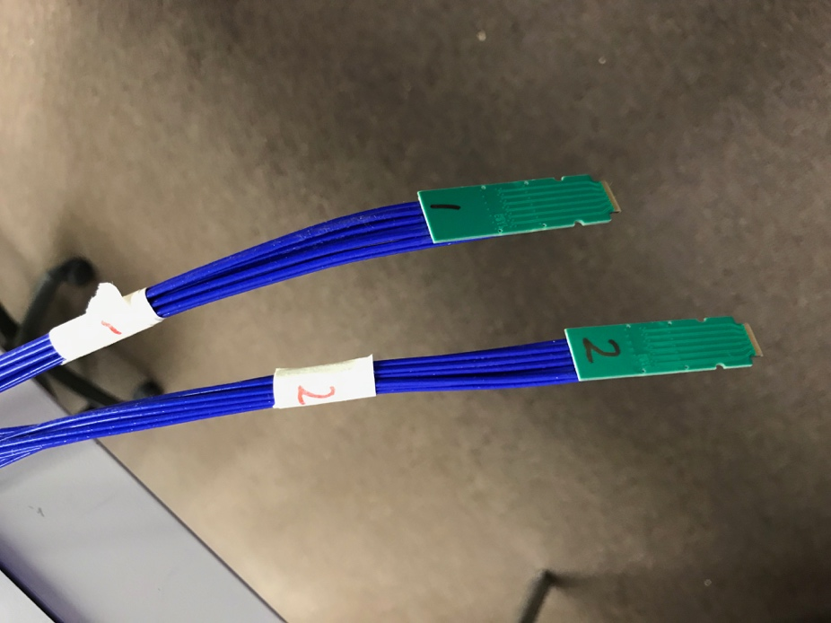
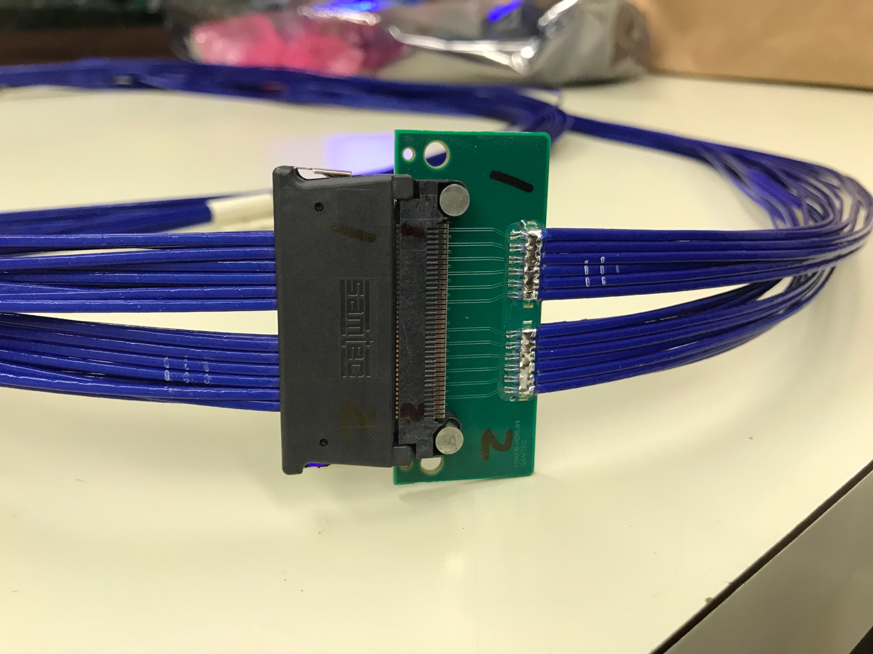
Tested New MVTX Long SamTec Readout Cables
8.8m + 2.6m = 11.4m (10m desired for sPHENIX; ALICE 8m cables)

Slide 56
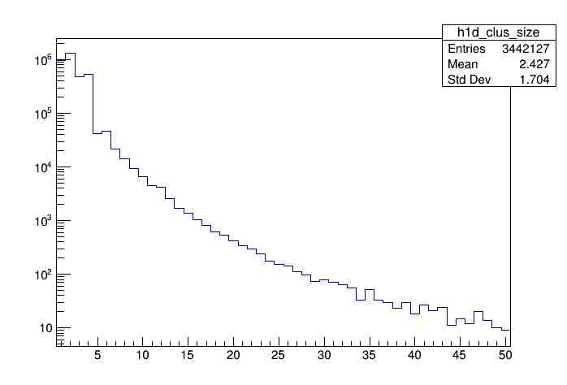
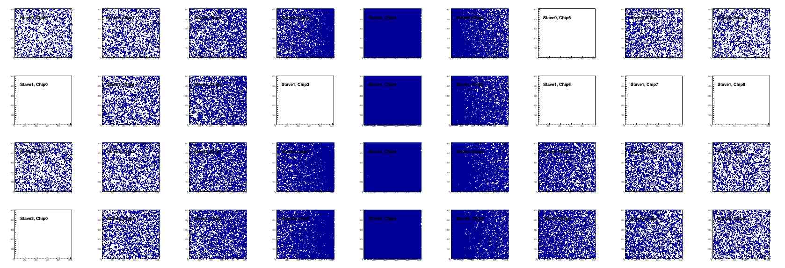
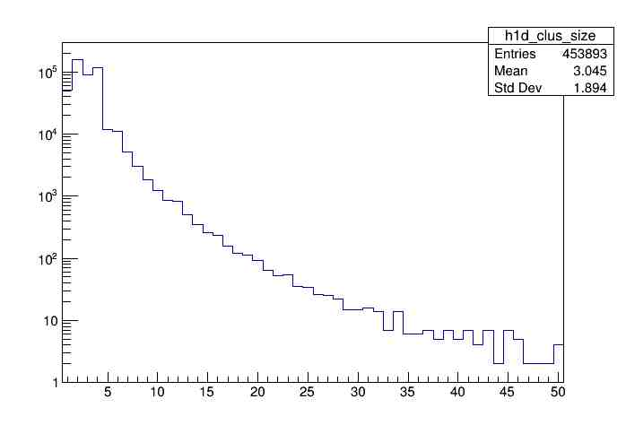
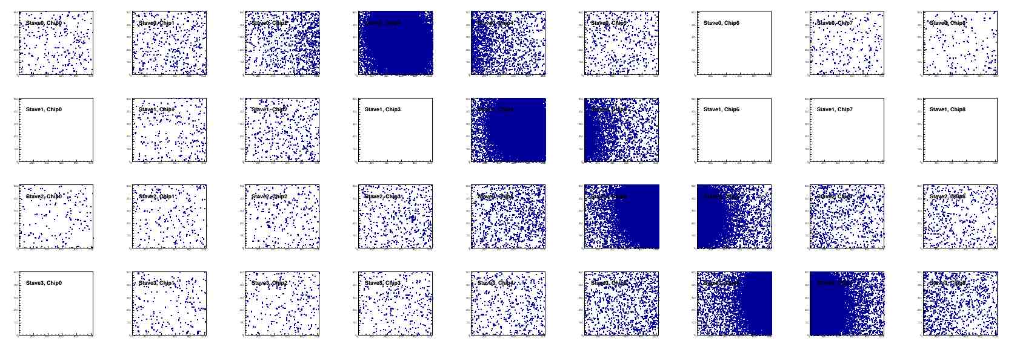
Offline Analysis: Cluster size vs Angle
To calibrate MC simulations and tracking
Stave geometry, alignment
Clustering
@ 0-degree
Cluster Size ~ 2.4
@ 40-deg
Cluster Size ~ 3.0

Slide 57

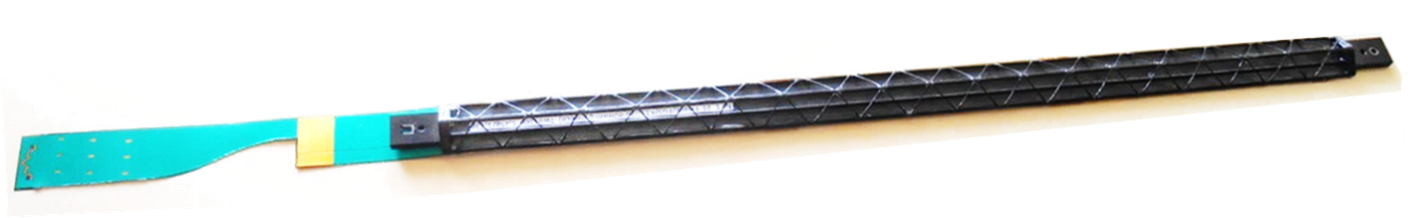
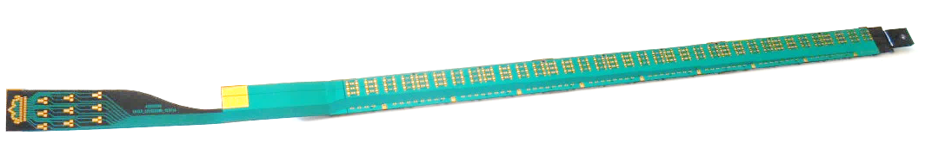
Staves - General layout
Stave design developed by ALICE at no cost for MVTX project
Possible modifications (see Walter’s talk)
Staves: detector modules consisting of a Hybrid Integrated Circuit (HIC) mounted on carbon fiber mechanical support structure
HIC: a row of 9 ALPIDE sensors wire-bonded to a Flexible Printed Circuit (FPC). Area covered by the chips: 15x271.2 mm², including a gap of 150 μm between adjacent chips.
Mechanical support: single light structure composed of a Space Frame, providing the required stiffness, and a Cold Plate, high-thermal conductivity carbon fiber sheet with embedded polyamide cooling pipes.
Heat Dissipation – The ALPIDE sensors dissipate only 40 mW/cm².
FPC
Cold plate
9 sensors
Space frame
Stave prototype

Slide 58
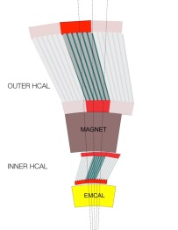
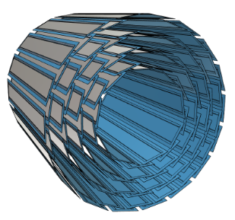
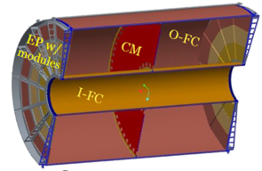
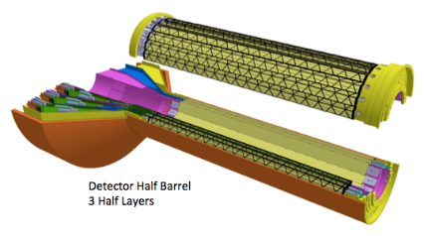
sPHENIX DAQ Architecture
Event Builder
FEM
DCM
DCM2
DCM
DCM
DCM
DCM
Network
Switch
Buffer Box
FEM
DCM
SEB
ATP
DCM
DCM
DCM2
DCM
DCM
ATP
DCM
Buffer Box
FEM
DCM
SEB
ATP
DCM
DCM
DCM
DCM2
ATP
Buffer Box
Calorimeters,
INTT, MBD
DCM
SEB
DCM
To the
RACF/HPSS
DCM
ATP
ATP
Buffer Box
FEE
ATP
DCM
DCM
FELIX
EBDC
ATP
DCM
Buffer Box
FEE
ATP
TPC, MVTX
DCM
DCM
FELIX
EBDC
ATP
Buffer Box
DCM
FEE
ATP
DCM
FELIX
EBDC
DCM
ATP
Buffer Box
DCM
Rack Room
SEB Sub-Event Buffer
EBDC Event Buffer and Data Compressor
ATP Assembles events and compresses data
Buffer Box data interim storage before sending data to the computing center

Slide 59
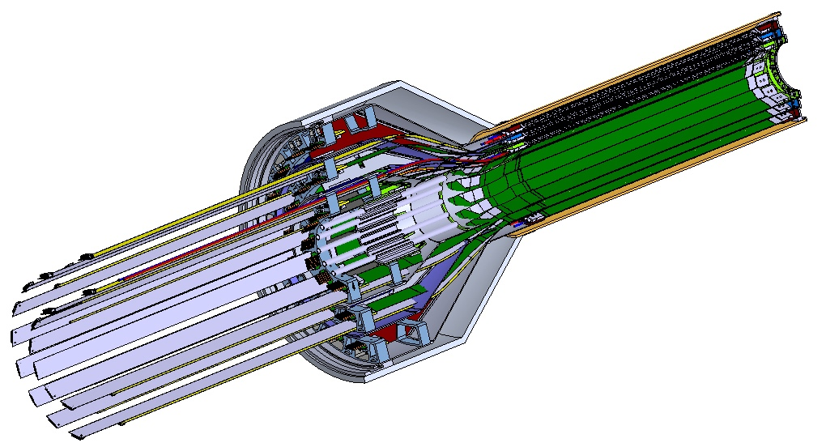
MVTX Detector – Modified from ALICE/ITS Design
Service cone: signal, power, cooling
and mechanical support
CYSS: Cylindrical Shell Structure
End-Wheel
Extended power FPC
3-layer sensor barrel
- 48 staves, 432 chips
MVTX
parameters

Slide 60
MVTX Cost Profile by WBS
7/24/2019
Final version

Slide 61
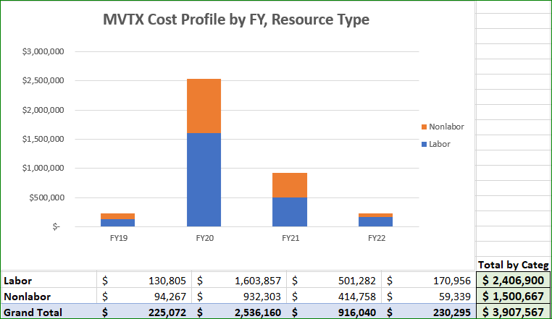
MVTX Cost Profile by Resource Type

Slide 62
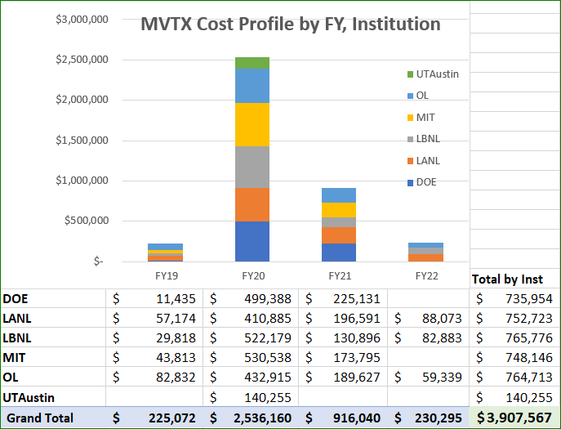
MVTX Cost Profile by Institution

Slide 63

MVTX Labor Hours by Category

Slide 64

MVTX Labor FTE by FY, Institution

Slide 65
Critical Path

Slide 66

Estimate Uncertainty
EU tables are the same as used in sPHENIX and other BNL projects
EU Values
Labor
L1 - Actual - 0%
L2 - Level of Effort Tasks - 5%
L3 - Advanced - 10%
L4 - Preliminary - 25%
L5 - Conceptual - 40%
L6 - Pre-conceptual - 60%
L7 - Rough Estimate - 80%
L8 - Beyond state of the art - 100%
M&S
M1 - Existing Purchase Order (Actual) - 0%
M2 - Travel, supplies, software - 5%
M3 - Advanced, Quote or Catalog Price - 10%
M4 - Preliminary Engineering Judgment - 25%
M5 - Conceptual Design - 40%
M6 - Pre-conceptual Design - 60%
M7 - Pre-conceptual - Uncommon work - 80%
M8 - Beyond state of the art - 100%

Slide 67

Estimate Uncertainty by WBS

Slide 68
Risk Register

