Slide 1
Review Documents
WBS, BOE
PMP
sPHENIX/MVTX Risk Register
MVTX P6
MVTX full proposal
Review charge
Previous Review reports
  4/2019
  7/2018

Slide 2
sPHENIX MVTX Cost and Schedule Review
MVTX Overview
Ming Liu, LANL
July 29-30, 2019
BNL

Slide 3
Outline
Physics of MVTX
Project scope
Costs, schedules & risk register
R&D highlights and risk mitigations
Previous review recommendations
Issues and concerns

Slide 4
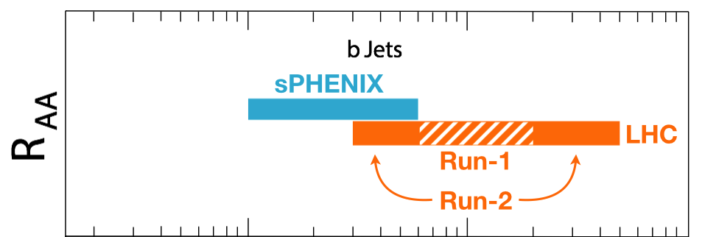
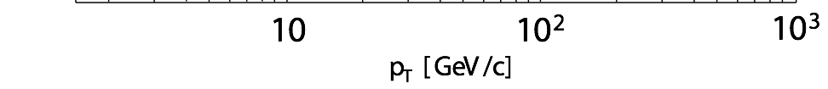
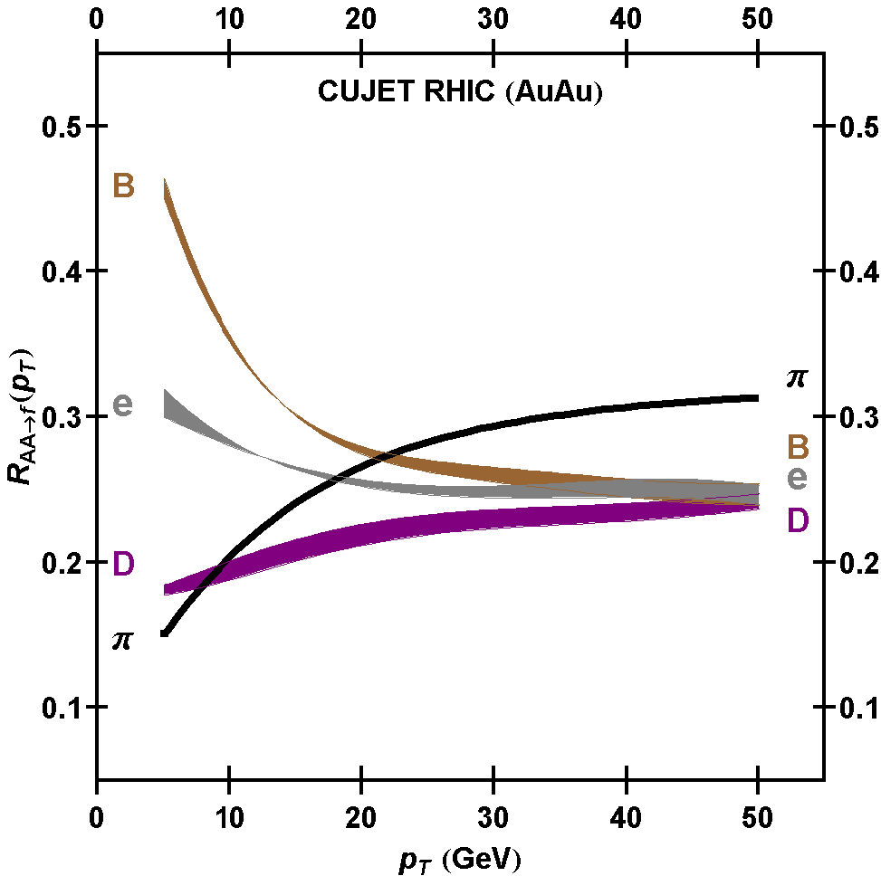
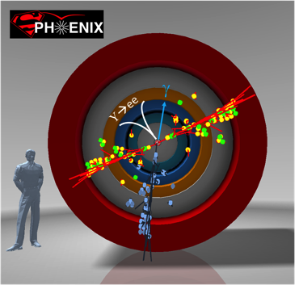
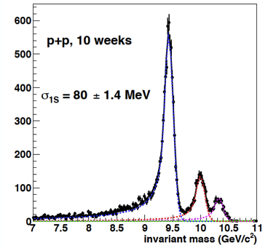
MVTX Enables Exciting Science
sPHENIX is the next flagship heavy ion physics experiment in the US (NSAC LRP2015)
  Jets
  Upsilons
  B-jets and B hadrons
MVTX will complete QGP heavy flavor physics
  Precision study of the “inner workings of QGP”(LRP15)
  Unambiguous determination of key parameters of QGP properties and interactions
complement & extend current and future RHIC and LHC QGP programs
sPHENIX 3 Physics Pillars
http://arxiv.org/pdf/1501.06197v1.pdf
Jets
Upsilons
PRL 108 (2012) 022301
B
D

Slide 5
The sPHENIX 3rd Science Pillar
“B meson and b-jet modification”
Heavy quarks – unique probe of QGP w/ new scales, m_{c}, m_{b}
  Study mass dependence
    Jet quenching & energy loss
    Flow – interaction with medium
  Access QGP properties
    Temperature, density, coupling, transport coefficients, viscosity etc.
“B meson and b-jet flow”
m_{u} m_{d}
m_{s}
Λ_{QCD}
m_{c}
m_{b}
MeV
1
10
10²
T_{c}
T_{QGP}
10³
10⁴

Slide 6

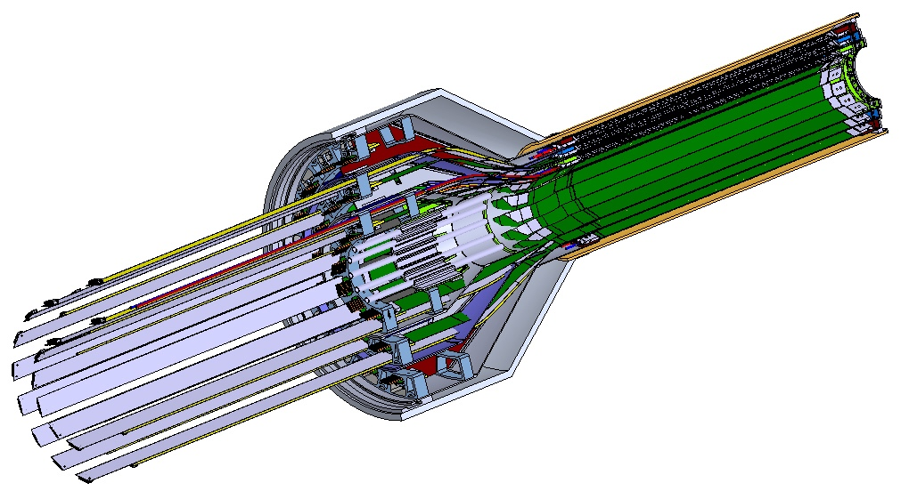
MVTX Detector – Modified from ALICE/ITS Design
Service cone: signal, power, cooling
and mechanical support
CYSS: Cylindrical Shell Structure
End-Wheel
Extended power FPC
3-layer sensor barrel
- 48 staves, 432 chips
MVTX
parameters

Slide 7
Scope of the MVTX Project – WBS 3.2
Mechanical system
  Modify ALICE/ITS mechanical structures
    End Wheels
    Cylindrical structure shells
    Service half barrels
  Mechanical system integration,
    Design & simulations, MIT/LANL
    Composite structure production, LBNL
    Non-composite structure, MIT
    Installation tooling etc., BNL/LANL/MIT/LBNL
  Adopt ALICE cooling plant design
    Modifications to fit sPHENIX, MIT/BNL
MVTX sensor & Electronics
  Readout Integration
    Frontend: ALICE/ITS RU
    Backend: ATLAS FELIX
  Detector assembly in US: ~$5M
    QA & assembly
      RU boards @UT-A
      Half detectors @LBNL
      FELIX boards @LANL/BNL,
  Ancillary systems - “adopt” ALICE ITS system
    Power, slow control & monitoring etc.
  Stave & RU Production @CERN: a separate BNL project
  - 84 ALICE/ITS-IB (modified) staves from CERN;
  48+spares(2-inner layers+10%)
  - 60 ALICE/ITS-RU from CERN
  48+spares(12, 25%)

Slide 8
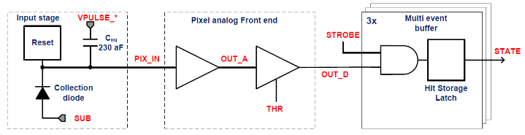
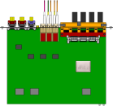

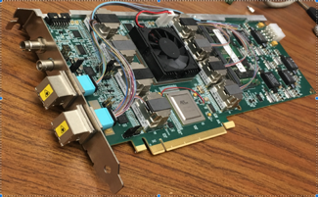

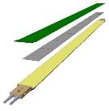
MVTX Readout, Power and Controls
CAN bus
DCS
Jo’s talk
Trigger & Clock
Readout Unit
Front End
GBT Optical Links
one pixel
9 Data (1.2Gbps)
1 Clock, 1 Control/Trigger
Control
Data (9.6 Gb/s max)
Trigger
9-sensor Stave
Samtec Twinax “FireFly”, ~10m
FELIX
Back End
FPC
Power
ATLAS Front-End Link eXchange (FELIX):
sPHENIX Data Aggregation Module(DAM)
Alpide Sensors
Flex PCB Filtering Capacitors
regulators
Power
Regulated Power
CAEN Power supplies
Cold Plate
ALPIDE pixel:
Shaping
Digitization
Zero-suppression
3x buffer
Power Board
Interaction Region
Experimental Hall
Counting House
MVTX Detector Electronics consists of three parts
Sensor-Stave (9 ALPIDE chips) | Front End-Readout Unit | Back End-FELIX/DAM

Slide 9
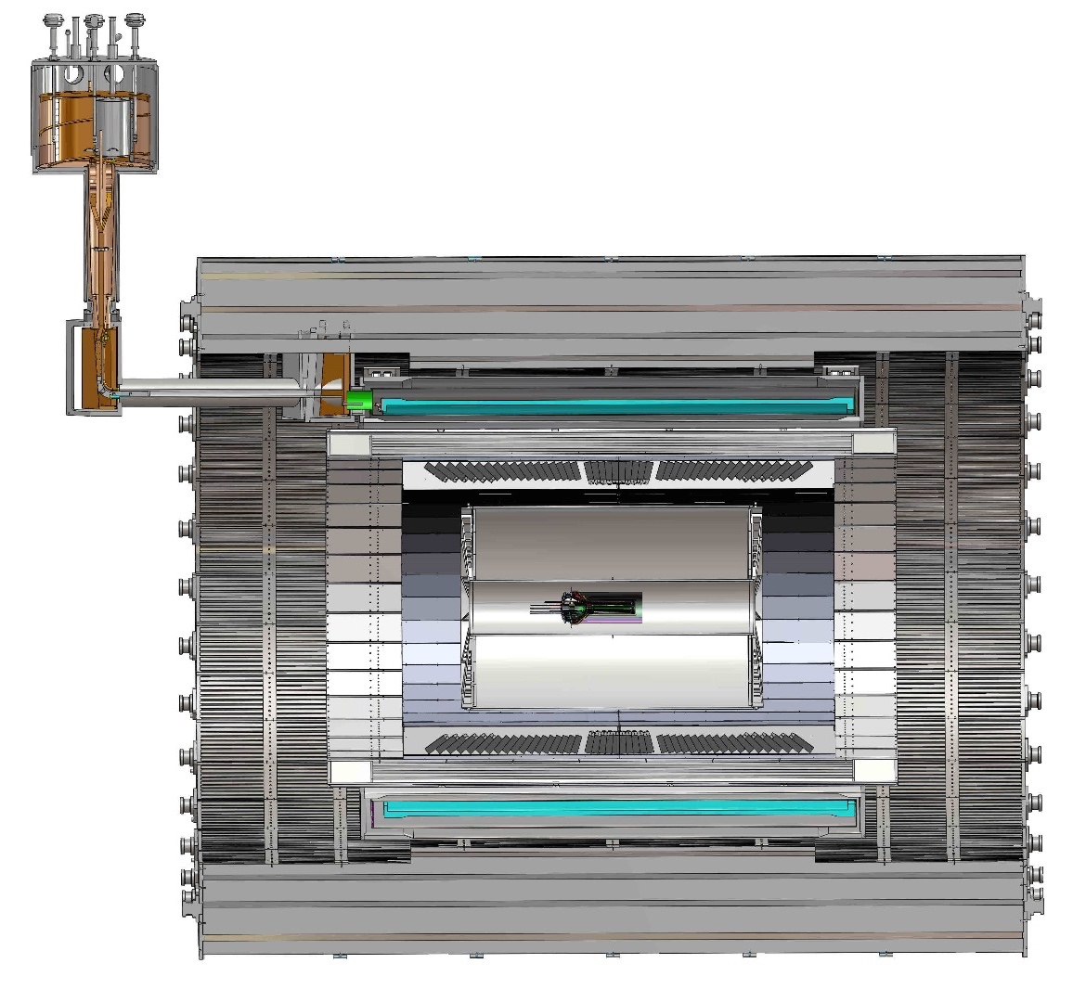
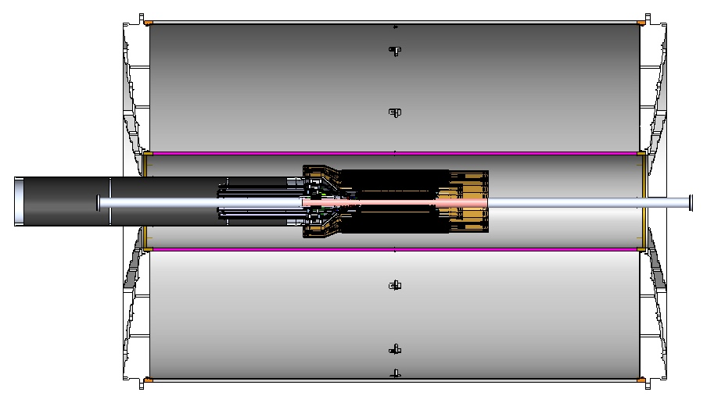
MVTX Global Mechanical System Integration
MVTX system preliminary design, with two parts:
  Part-1: from MVTX to PP-2, all power PCB, 40cm
  Part-2: length TBD later, from PP-2 to PP-3
Walt and Camelia’ talks
Service Barrel
TPC
TPC
INTT
MVTX
PP-1:
short signal cables
PP-3:
Signal and power cables
R= 209.6cm
PP-2:
power cables
L = 350.0 cm

Slide 10
Preliminary Mechanical Design Completed
Camelia’ talk
https://indico.bnl.gov/event/6377/
MVTX, INTT, TPC …

Slide 11
MVTX Organization Chart

Slide 12
Collaborators
22+ institutions,
US and abroad
Active joint efforts with
ALICE ITS group
LANL
LBNL
CCNU
MIT
Yonsei
…

Slide 13
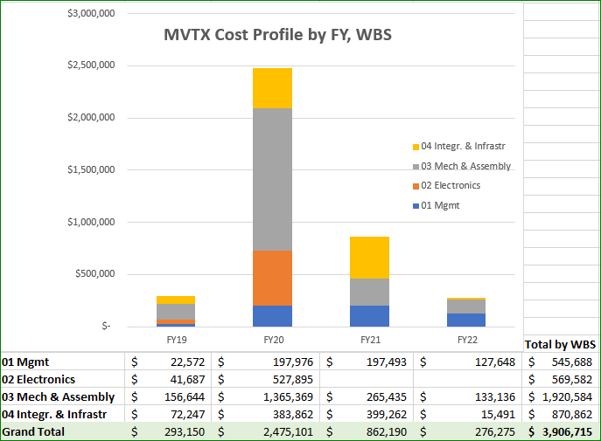
Cost Drivers
Dave talk
Mechanical system:
Detector carbon structures
Service & integration
Electronics:
Backend
Power system

Slide 14
Schedules & Milestones
Technically driven schedule
  Day-1 physics
  CERN production
  Fund available as needed
Funding delay
  R&D
  Production
  Preparation
Low schedule contingency
Early R&D by LANL LDRD

Slide 15
Project Status & Highlights
Tested full stave readout chain with the final electronics at Fermilab Test Beam
  Tested long SamTec readout cables recently – last key integration R&D
  11.4m long cables, 10m desired
MVTX mechanical design: excellent progress
  Asked for quotes from outside companies based on preliminary designs
  sPHENIX integration workfest held 7/10 @BNL, MVTX/INTT/TPC
Release of early R&D fund in progress
  MVTX mechanical engineering design, MIT/LANL
  Preparation for Stave and RU acceptance test, LBNL, UT-Austin
MVTX Cost & Schedule Review – we are ready for full production
  WBS, PMP, Risk Registry updated
  Fully integrated into sPHENIX P6
Stave and RU production at CERN, in progress
  DOE Fund arrived at UTK/US-ALICE
  Procurement in progress
    CERN is ready to proceed with stave production
    60 MVTX/sPHENIX RUs delivered to CERN
  Power mezzanine and transition boards produced at UT-A

Slide 16
Engineering & Technology Readiness
Stave modification and system integration - done
  MVTX & INTT integration
Readout Electronics - done
  RU, PU, FELIX, Readout cable
  Power system
Mechanical system – preliminary design available
  Detector design
  Service & integration
Detector assembly and installation – plan developed
  Follow ALICE ITS procedures

Slide 17
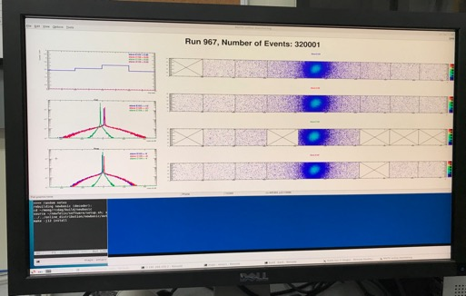
Very Successful Test Beam @Fermilab
5/20-25, 6/17-22, 2019
SamTec: 11.4m
(2.6m+8.8m)
4-stave telescope
RU-2: 1 stave
- 1 fully functioning
9-chip stave;
- 3 staves with a few
broken sensors
4 staves
2 RUv1.1
1 PU
1 FELIX Server + RCDAQ
sPHENIX GTM
11.4m Custom SamTec Cable
Negative pressured cooling for staves
RU-1: 3 staves
5m SamTec
120GeV p-beam
10kHz (30kHz)
Beam intensity:
30k ~ 120k ppp
Data & Control
Beam Trigger
Timing & Trigger
GTM
FELIX
A full system with final sensor/readout* hardware:
Multi-Stave + Multi-RU -> FELIX readout demonstrated
sPHENIX GTM integrated
Long readout SamTec cable certified
Cooling system demonstrated
* RUv1.1 identical to the final RUv2 electrically
Online Monitoring
sPHENIX
RCDAQ

Slide 18
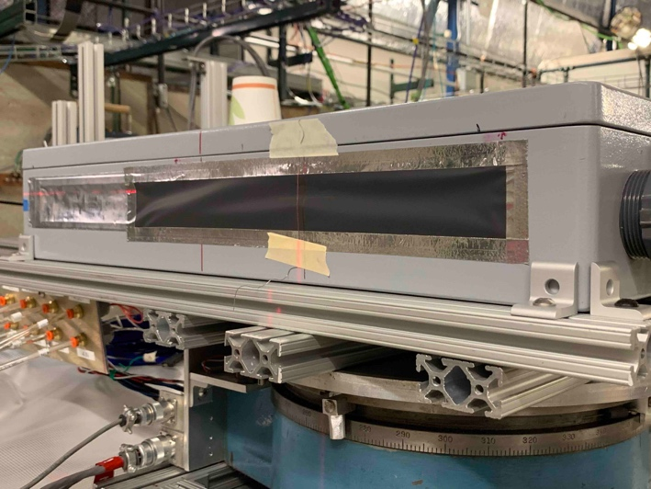
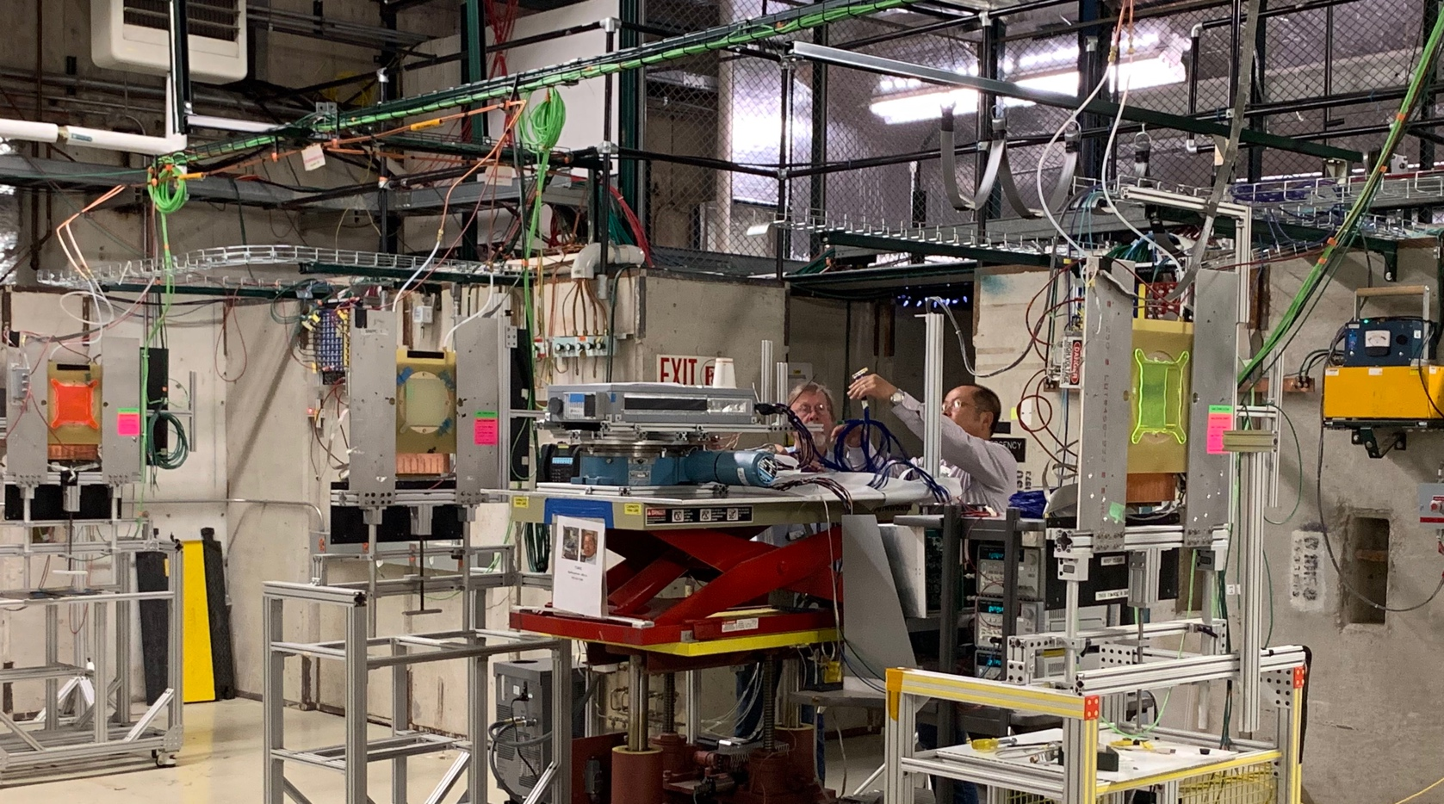
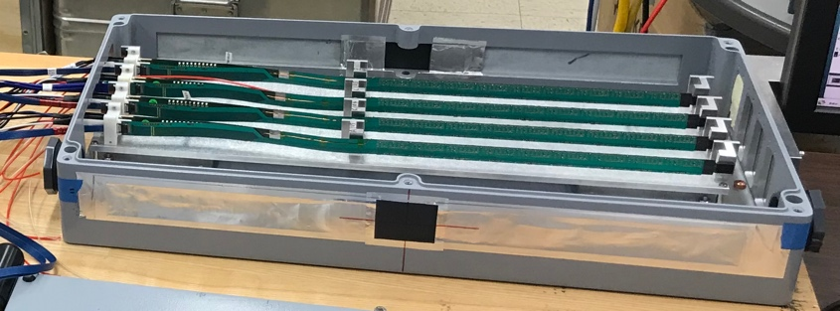
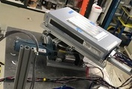
2019 MVTX Test Beam Setup @Fermilab
From view
beam
Stave housing (four staves)
Stave housing sits on a motion table which can be moved in (x, y) plane perpendicular to the nominal beam direction. It can also be rotated (+40, -40) degrees (see photo on right). Operation was done at counting house.

Slide 19
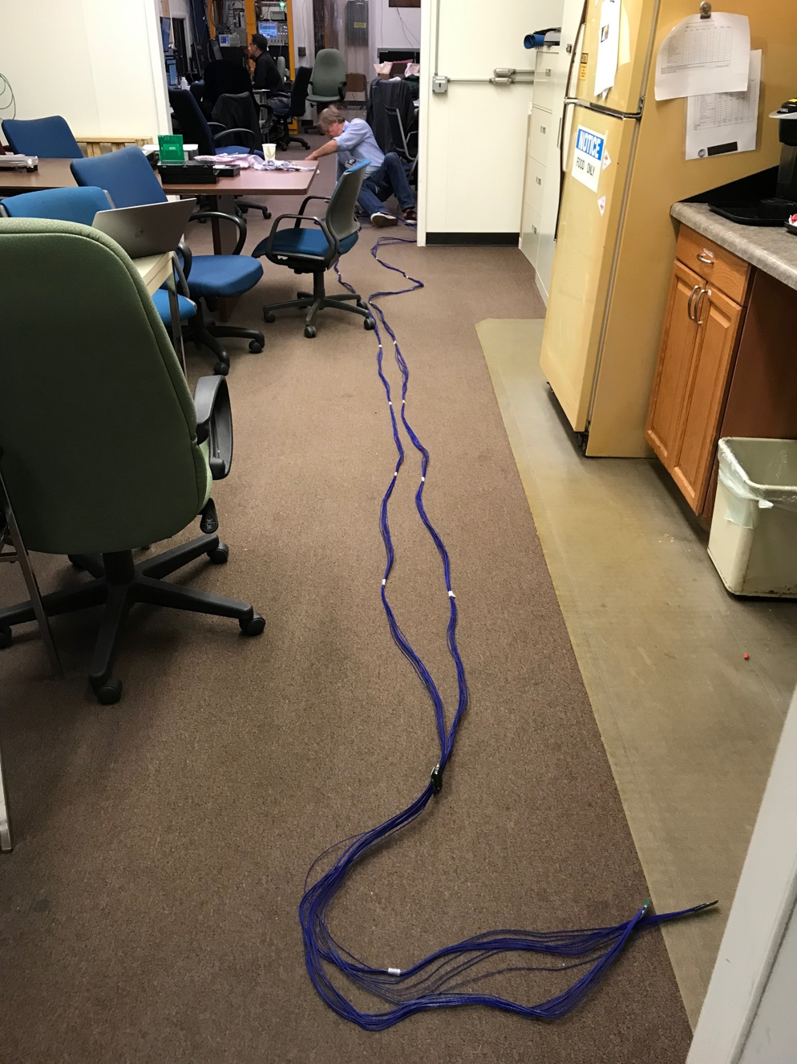
Long Custom MVTX Readout Cables Tested
PWR
RU
PU
Desired <~10m;
Tested 11.4m
BNL has approved “non-halogen free” cables for sPHENIX
sPHENIX MVTX: 7.9+m
  Cable-A: 1.4 m
  Cable-B: 6.5+ m
  Power cable:4.7+ m

Slide 20
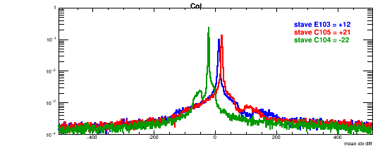
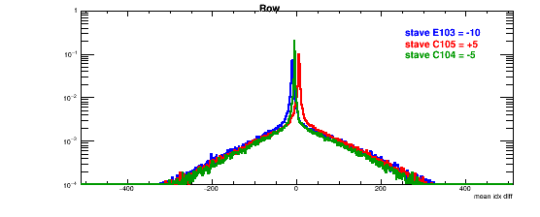
Detector Misalignment & Hit Spatial Resolution Study
Typically staves offset by,
Horizontally: 20 x 30um = 600 um
Vertically: 5 x 30 um = 150 um
Hit spatial resolution:
Peak_sigma_core = 0.55 (pixel size ) =15 um
Chip spatial resolution = 15/sqrt(2) = 11 um
(same as 2018 TB results)
Delta_X/Y
Ref plane

Slide 21
Recommendations from April Director’s Review

Slide 22
Report from April BNL Director’s PD2/3 Reviews: Silicon Detectors - MVTX, INTT
MVTX PMP fully
developed
sPHENIX follows the same ITS/IB stave QA Gold/Silver standard, about 50-50 for ITS;
Latest production had higher yield of gold, ~>65%
WBS & Critical Paths etc. documented in P6
- 3-D mock-up demonstrated;
- Detailed FTE profile in P6
MVTX Risks fully integrated into sPHENIX,
- Irina’s talk

Slide 23
Need project funding NOW!
MVTX Risks, WBS/BOE integrated into sPHENIX
Critical path and milestones in P6
PMP documents updated, change control et.
Schedule & Labor profile updated in P6
Early R&D funding needs submitted to BNL,
MIT, LBNL, LANL, UT-A, work in progress
BNL owns/oversees the contingency
Stave handling follows ITS practice to avoid
possible metal particulate generation
- Report to sPHENIX office on progress and issues

Slide 24
Issues and Concerns
Lack of early funding for critical R&D to reduce risk & contingency
  Carbon structure design, MIT, LANL
  Carbon structure cost estimate, LBNL
  Preparation for Stave and RU acceptance and QA in US, LBNL, UT-Austin
Funding delay and reduced schedule contingency
  Stave and RU production delayed
  Delays in preparation for Stave and RU test
Carbon structure production cost and schedule
  LBNL, other production activities/ATLAS
  Explore other production sites, Italy, France, Korea, US …
  High contingency in cost, ~40%
MVTX mechanical integration
  Beam pipe modification
  High contingency in design cost, ~40%
MVTX readout integration
  sPHENIX DAQ and Trigger system not final yet

Slide 25
Summary
MVTX is ready to receive fund for the project
  Electrical system is ready for production
  Preliminary detector mechanical design completed
  Preliminary sPHENIX mechanical system integration developed
Costs, schedules and risk register integrated into sPHENIX P6
Project management plan developed, baseline change control etc. defined
Funding is critical to meet the day-1 goal
We are ready to start the project

Slide 26
Back Up & References

Slide 27
MVTX Full Proposal
Pre-proposal submitted to DOE, 2/2017
  Follow-up discussions with DOE and BNL managers
  Weekly proj. leaders’ meeting, BNL/LANL/LBNL/MIT
Full proposal submitted to BNL ALD, Feb 2018
  Expanded science + Cost & Schedule
  Assumed funding starts in FY18
A growing collaboration
  22+ institutions from US and abroad
Adapt ALICE ITS Upgrade Inner Barrel 3-layer MAPS detector
  Mini. risk, Max. Physics
Precision vertexing for b-jet/B-hadron tagging in HI with high efficiency and high purity
B-jet modification in QGP at low-medium pT to determine QGP properties, study mass-dependence on collisional vs radiative energy loss, flow etc.
Early R&D by LANL LDRD, $5M, FY17-19, readout, mechanical design and physics; established LANL-ALICE MoU in 12/2016 for joint R&D and training

Slide 28
7/23/2019, V3

Slide 29
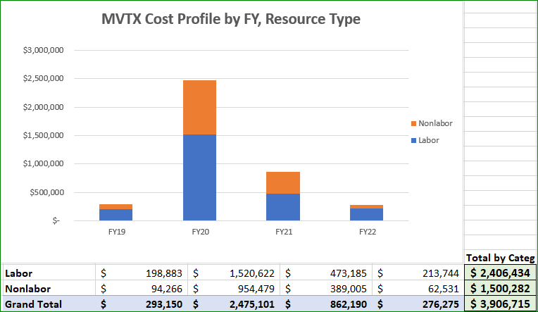

Slide 30
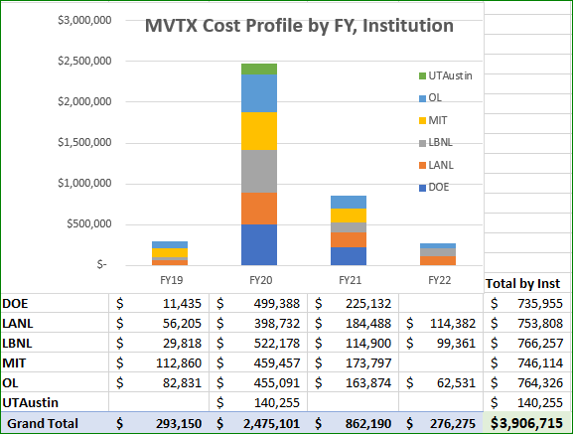

Slide 31
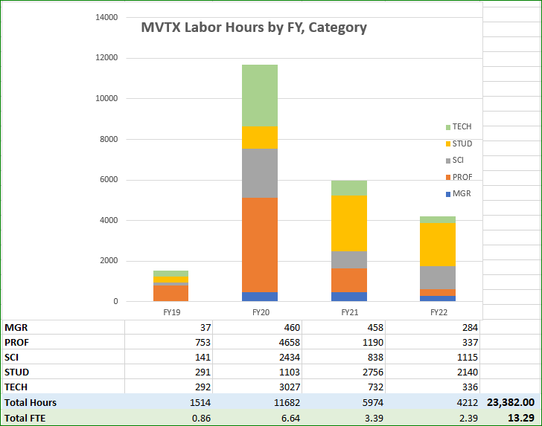

Slide 32
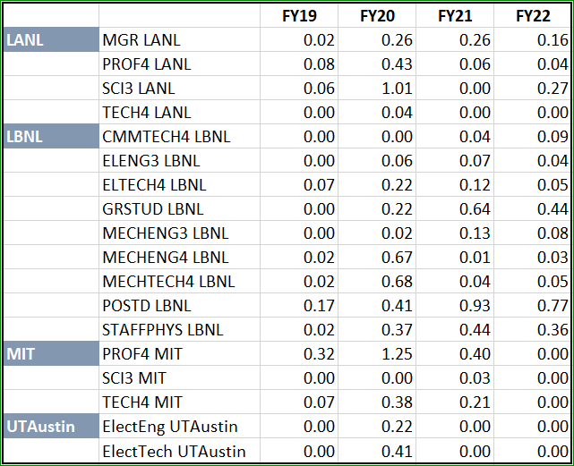
MVTX Labor FTE by FY, Institution

Slide 33
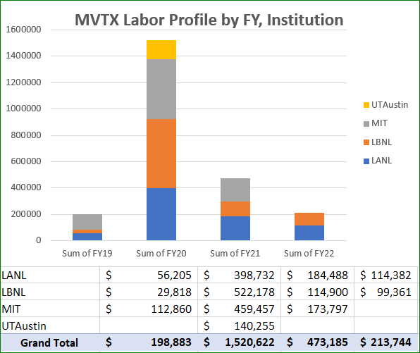

Slide 34
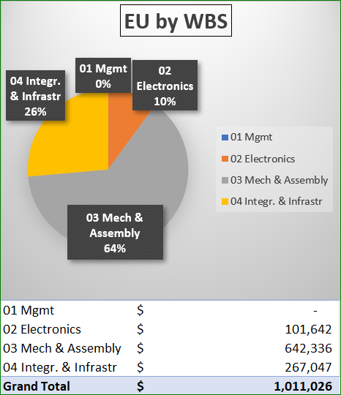

Slide 35
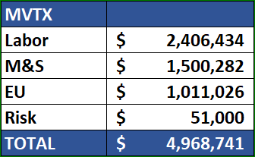

Slide 36
MVTX
MVTX

Slide 37
MVTX Schedules and Milestones (3/2019)
sPHENIX: CD1/3a PD2/3
Installation
1st collisions
CY-2018 | 2019 | 2020 | 2021 | 2022 | 2023
MVTX
Stave & RU
production
FELIX
production
Funding delays –
Stave production delayed at CERN
- Impact on following test & assembly
- preparation work @LBNL, UT-A
Lack of R&D $ for mech. desgin work
- MIT, LBNL, LANL
- “advanced cash” running out MIT, LANL
Detector mechanics design & production, global interface to sPHENIX
End Wheels
CYSS
Global integration
/interface design
Service barrel
design & production
Ready for beam;
sPHENIX day-1 run
Barrel Assembly & Testing @LBNL
Install half barrels
@sPHENIX IR
Half barrel #1
Power system
production
Half barrel #2
Half barrels
arrive @BNL
design & procure
interface to
sPHENIX rails
Running low in schedule contingency …
Design & procure
sPHENIX rails
MVTX installation & commissioning @BNL
RU, FELIX, PS, cables etc.

Slide 38
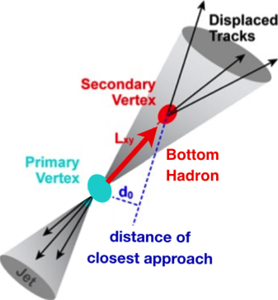

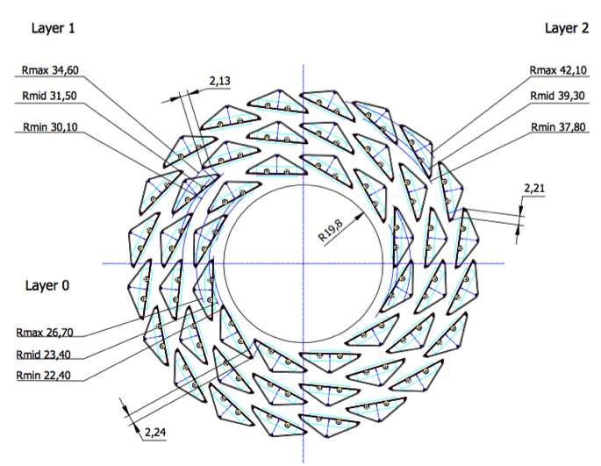
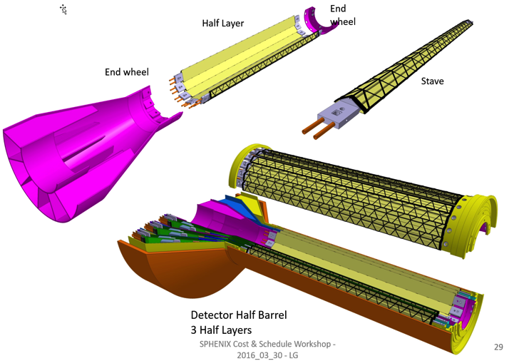
MVTX: Monolithic-Active-Pixel-Sensor-based VerTeX Detector
sPHENIX@RHIC (2023+)
Key integration tasks:
Readout
Mechanics
ALICE ITS Upgrade @CERN;
Inner Tracker System (2021+)
sPHENIX Inner Tracking
“Adopt” ALICE/ITS
Mini. risk,
Max. physics
MVTX could also be a day-1 EIC detector

Slide 39

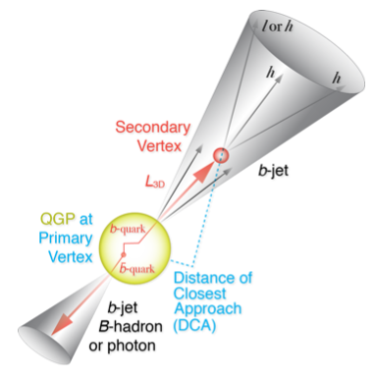
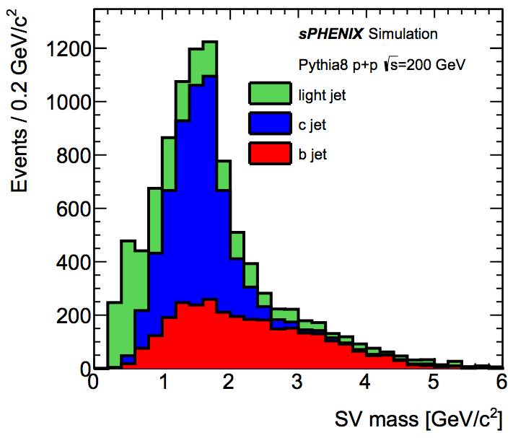
B-Hadron & b-Jet Tagging
Physics Reminder
Detected using the long lifetime of bottom quark hadrons:
  Displaced tracks
  Large 2nd vertex invariant mass
Need high precision tracking and vertex determination – MVTX!
Need excellent jet detection capabilities – sPHENIX!

Slide 40


Monolithic-Active-Pixel-Sensors (MAPS)
The next Generation State of the Art Pixel Tracker
Advantages of ALICE MAPS/ALPIDE:
  Very fine pitch (28x28 μm)
  High efficiency (>99%) and low noise (<10⁻⁶)
  Time resolution, as high as ~5 μs
  Ultra-thin/low mass, 50μm (~0.3% X₀)
  On-pixel digitization, low power dissipation
An ideal detector for QGP physics!
FPC
9 Chips
Cooling plate
A 9-chip MAPS stave, 1.5 x 27cm²
ALPIDE design
50 μm
28 μm

Slide 41
ALPIDE/MAPS Operation
Well fit sPHENIX/RHIC environment, 10MHz Clock (LHC 40MHz)
shaping time: 2, 5, 10 … μs
v
PIX_IN
v
OUT_A
~5-6 μs
t_{f}~= 10 ns
OUT_D
ΔV=Q/C
threshold
t_{r}> 100 μs
~5-6 μs
STROBE
t
t
sPHENIX trigger latency: ~4 μs

Slide 42
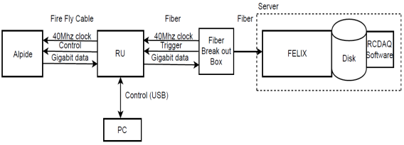
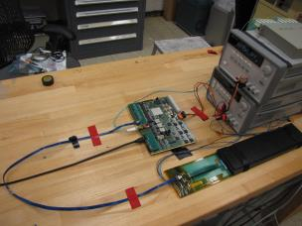
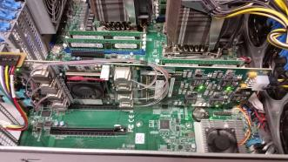
MVTX Full Readout Chain Demonstrated 2018 TB@Fermilab
Stave
Readout
Unit
FELIX
Readout Unit configures Stave using USB interface
FELIX distributes clock to Readout Unit
Readout Unit distributes clock to the Stave
Stave is triggered, sends data at 1.2Gb/s
Configured GBT link to recover clock from FELIX
Readout Unit receives the data and sends the data to FELIX over fiber using GBT link
FELIX packs data, stores it on disk using RCDAQ - the sPHENIX data format and software
Readout Unit + Stave
Server + FELIX

Slide 43
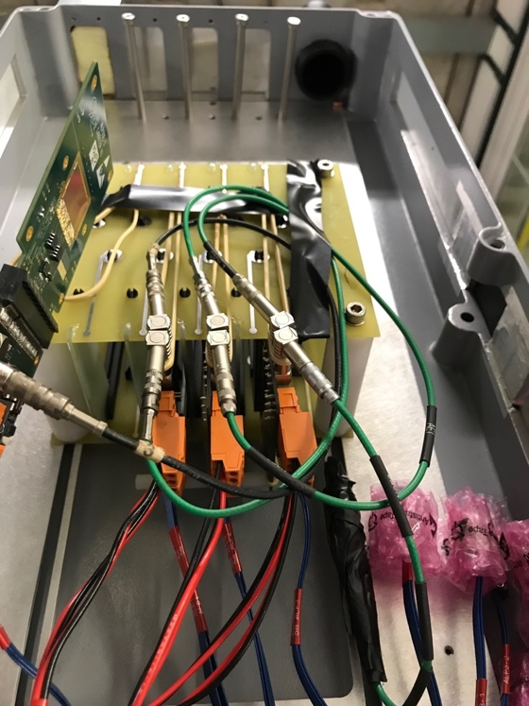
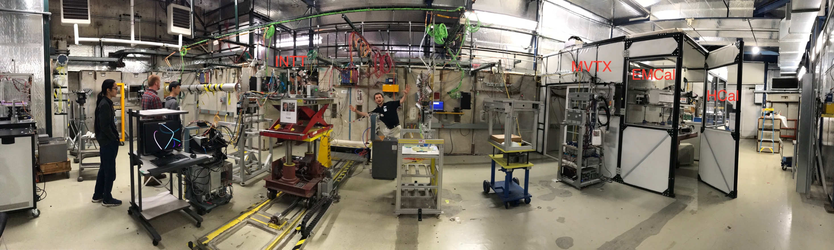
MVTX Test Beam at Fermilab 02/20-03/10, 2018
Goals:
  Test full readout chain
  Evaluate ALPIDE sensor performance
Experimental setup
  A 4-sensor telescope
  Full readout chain: MAPS+RU+FELIX+RCDAQ
120 GeV
proton
Parasitic with INTT run
Very productive & collaborative
4-sensor
Telescope

Slide 44
Fermilab Test Beam Results (I)
4-hit track
120 GeV proton beam
4-sensor telescope
Mostly single tracks
Cluster size: 2.1 ~ 2.4
# of tracks per event
Cluster size
Beautiful analysis done by Sanghoon and Darren + others

Slide 45
Fermilab Test Beam Results (II)
Hit Spatial Resolution: < 5 um
Hit Efficiency > 99.5%
Pixel size (~28um)

Slide 46
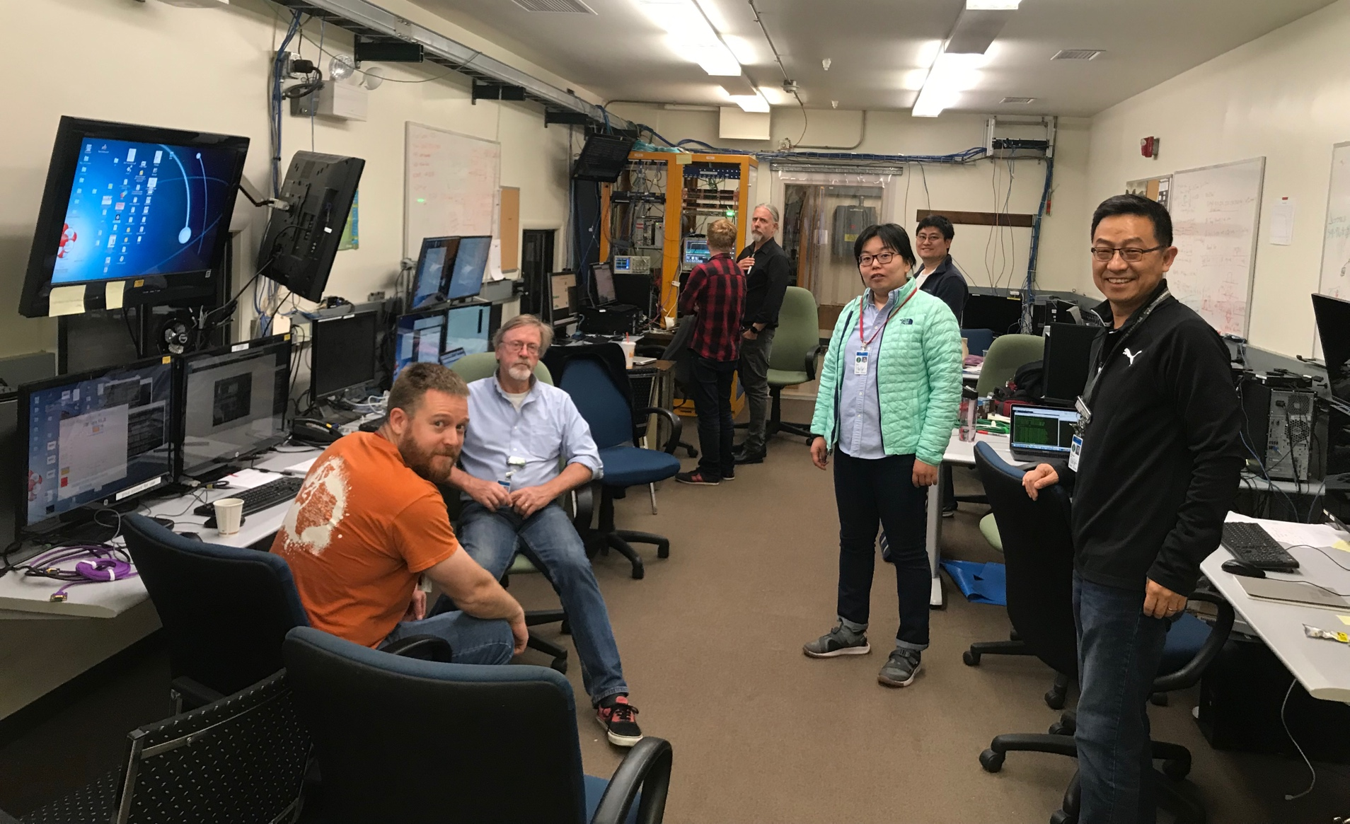
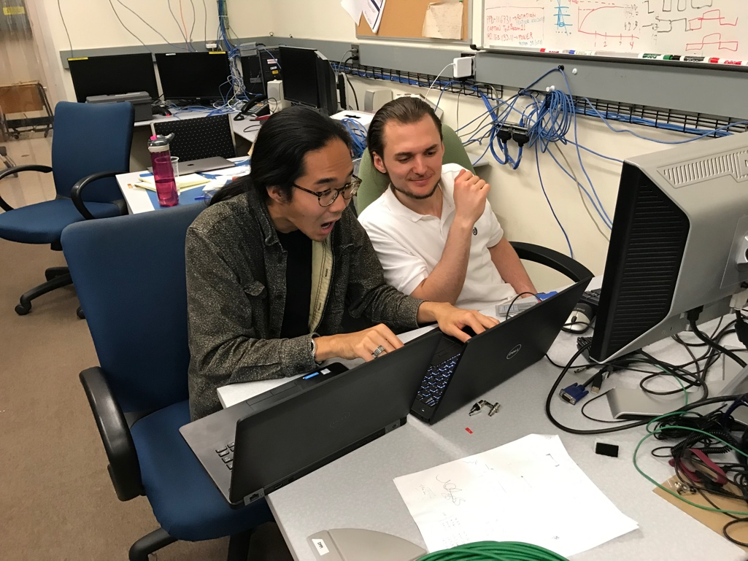
The TB Team @Fermilab, 2019
Data taking shift in the evenings: 7PM – 7AM
Beam: every other Monday –Friday 8:00AM – 8AM
Matt, Hubert, Cameron, Gerd, Zongze,
Xuan, Xiaochun, photo by Ming
Sho, AlexT
Not shown: Sanghoon, Yasser, Martin, Walt,
Abel. Chris …

Slide 47
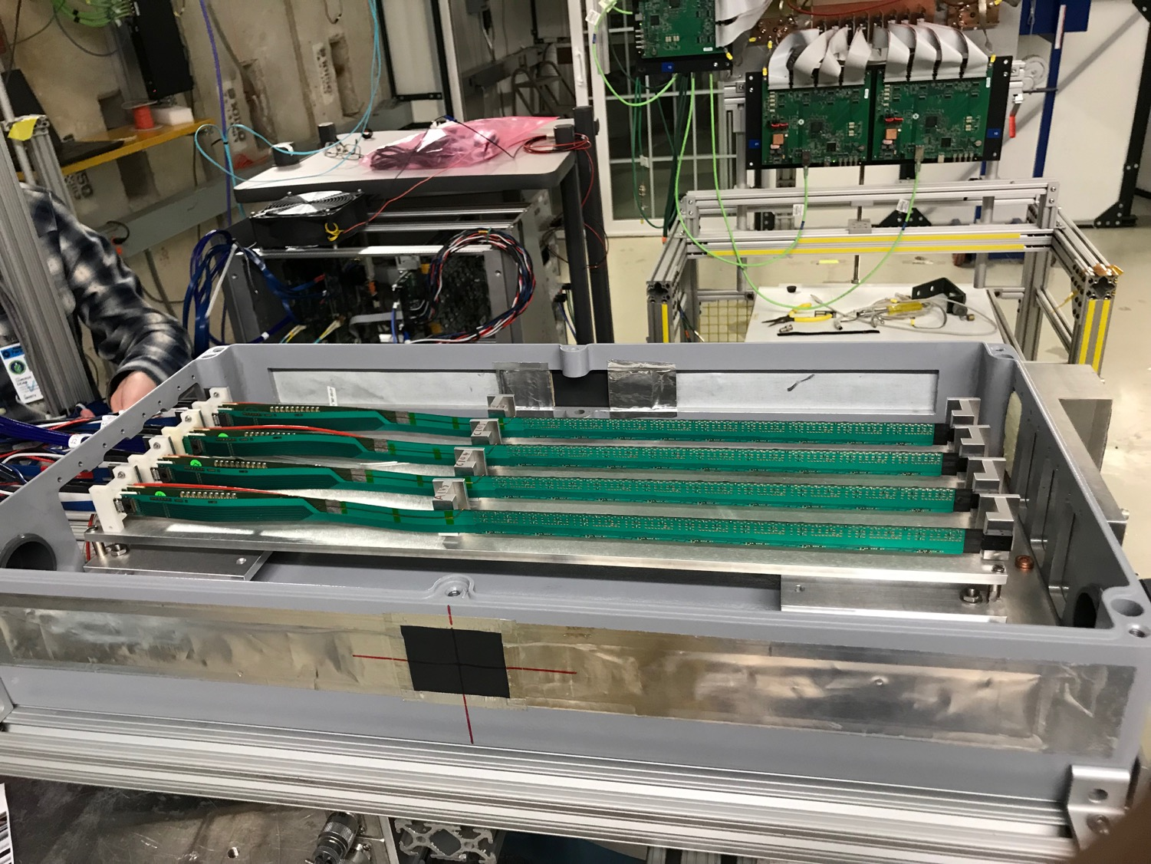
MVTX 4-Stave Telescope

Slide 48
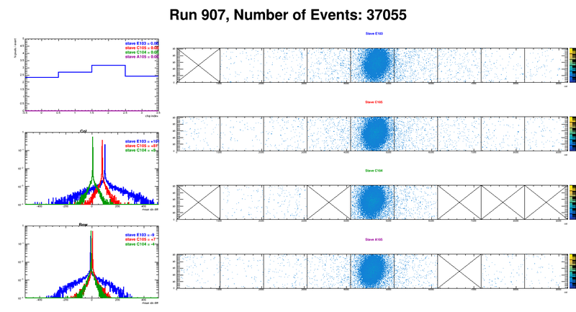
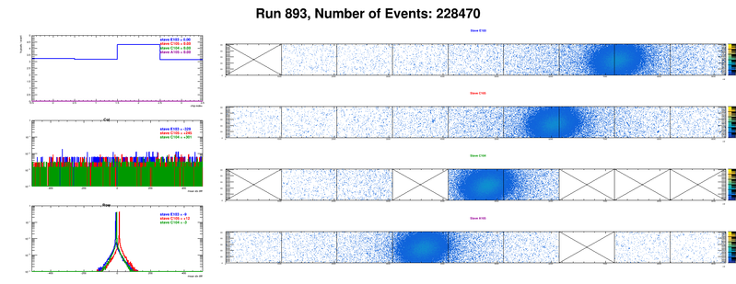
Offline analysis in progress: all TB data in RCF
https://wiki.bnl.gov/sPHENIX/index.php/MAPS-based_Vertex_Detector_(MVTX)
Beam angle: 0
(eta ~0)
MVTX 4-Stave Telescope
Beam angle: 40
(eta ~1)

Slide 49
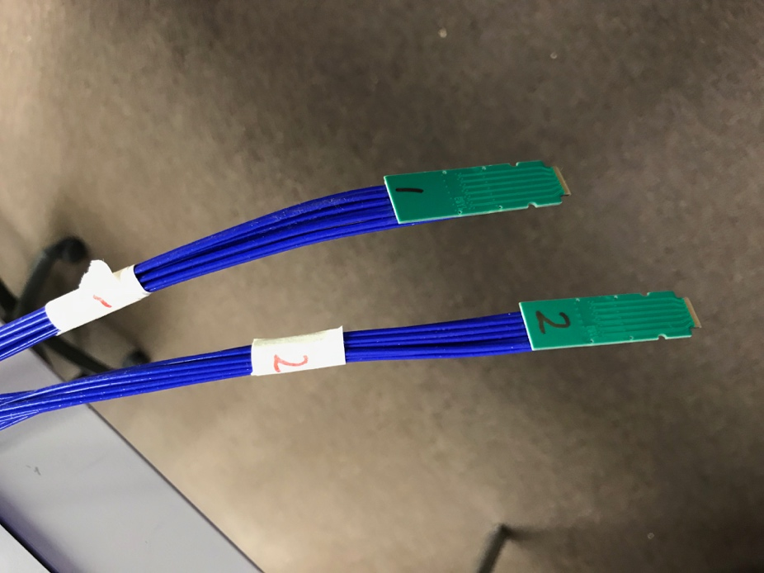
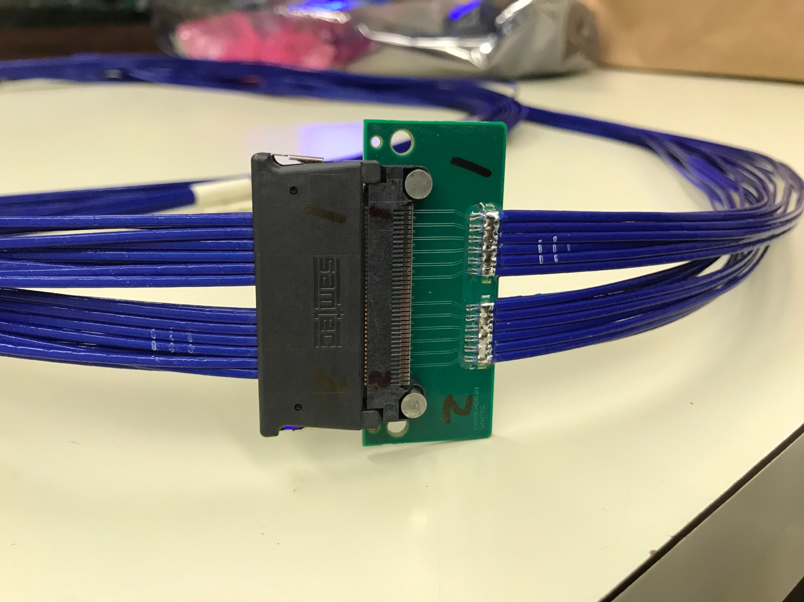
Tested New MVTX Long SamTec Readout Cables
8.8m + 2.6m = 11.4m (10m desired for sPHENIX; ALICE 8m cables)

Slide 50
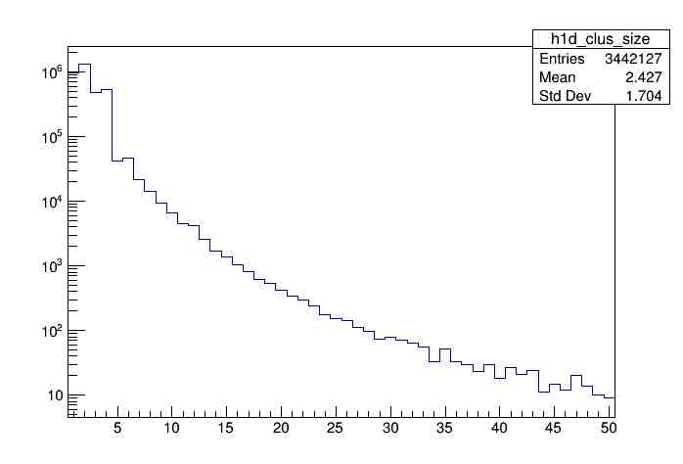
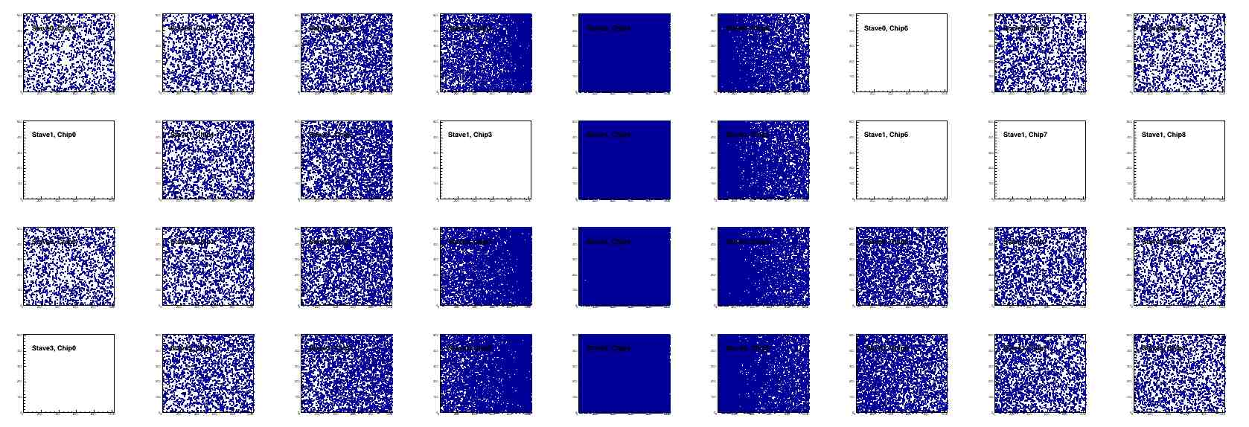
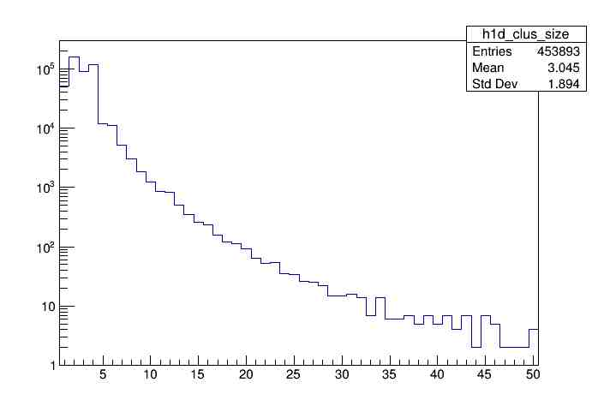
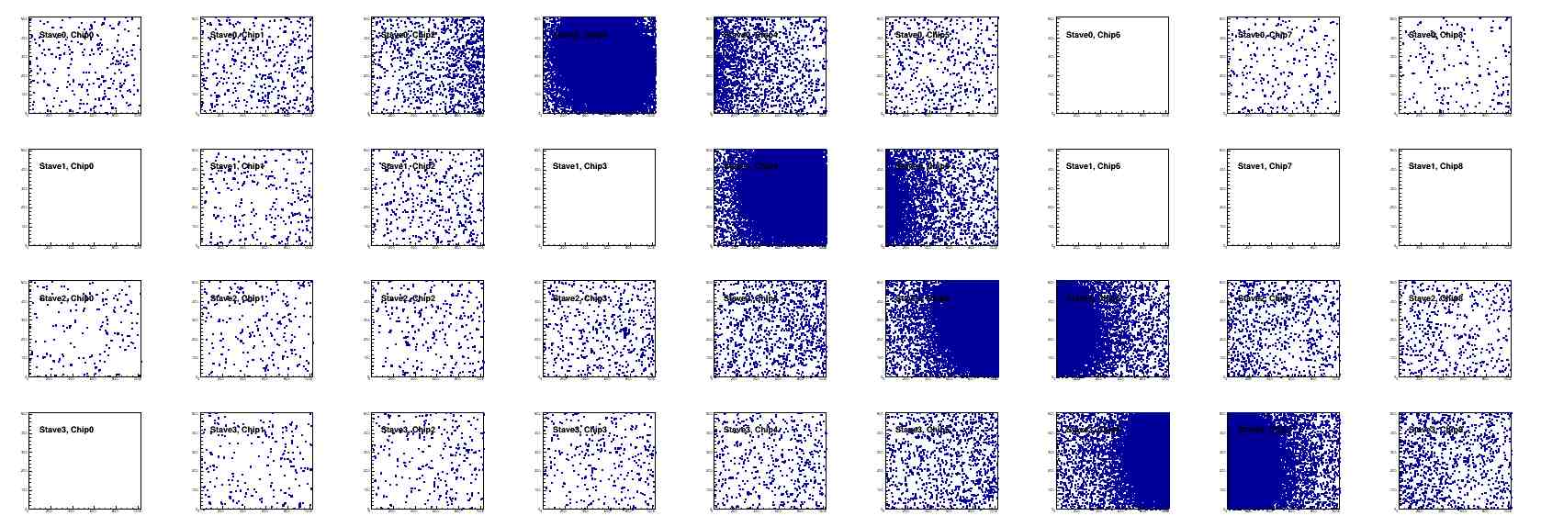
Offline Analysis: Cluster size vs Angle
To calibrate MC simulations and tracking
Stave geometry, alignment
Clustering
@ 0-degree
Cluster Size ~ 2.4
@ 40-deg
Cluster Size ~ 3.0

Slide 51

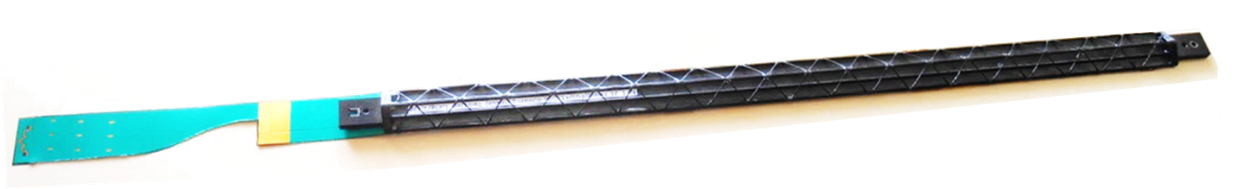

Staves - General layout
Stave design developed by ALICE at no cost for MVTX project
Possible modifications (see Walter’s talk)
Staves: detector modules consisting of a Hybrid Integrated Circuit (HIC) mounted on carbon fiber mechanical support structure
HIC: a row of 9 ALPIDE sensors wire-bonded to a Flexible Printed Circuit (FPC). Area covered by the chips: 15x271.2 mm², including a gap of 150 μm between adjacent chips.
Mechanical support: single light structure composed of a Space Frame, providing the required stiffness, and a Cold Plate, high-thermal conductivity carbon fiber sheet with embedded polyamide cooling pipes.
Heat Dissipation – The ALPIDE sensors dissipate only 40 mW/cm².
FPC
Cold plate
9 sensors
Space frame
Stave prototype

Slide 52




sPHENIX DAQ Architecture
Event Builder
FEM
DCM
DCM2
DCM
DCM
DCM
DCM
Network
Switch
Buffer Box
FEM
DCM
SEB
ATP
DCM
DCM
DCM2
DCM
DCM
ATP
DCM
Buffer Box
FEM
DCM
SEB
ATP
DCM
DCM
DCM
DCM2
ATP
Buffer Box
Calorimeters,
INTT, MBD
DCM
SEB
DCM
To the
RACF/HPSS
DCM
ATP
ATP
Buffer Box
FEE
ATP
DCM
DCM
FELIX
EBDC
ATP
DCM
Buffer Box
FEE
ATP
TPC, MVTX
DCM
DCM
FELIX
EBDC
ATP
Buffer Box
DCM
FEE
ATP
DCM
FELIX
EBDC
DCM
ATP
Buffer Box
DCM
Rack Room
SEB Sub-Event Buffer
EBDC Event Buffer and Data Compressor
ATP Assembles events and compresses data
Buffer Box data interim storage before sending data to the computing center

Slide 53
Backup - 2

Slide 54
The L3 Component

Slide 55
L3 Technical Overview
Emphasize any technical issues that still need to be resolved. If all has been decided put it on the slide.

Slide 56
L3 Scope
What are you building?
Where you fit in the L2

Slide 57
L3 Collaborators

Slide 58
Schedule Drivers

Slide 59
Cost Drivers

Slide 60
Status and Highlights
Recent technical accomplishments

Slide 61
Issues and Concerns

