Slide 1
Review Documents
WBS, BOE
PMP
sPHENIX/MVTX Risk Register
MVTX P6
MVTX full proposal
Review charge
Previous Review reports
4/2019
7/2018

Slide 2
sPHENIX MVTX Cost and Schedule Review MVTX Overview
Ming Liu, LANL
July 29-30, 2019
BNL

Slide 3
Outline
Physics of MVTX
Project scope
Costs, schedules & risk register
R&D highlights and risk mitigations
Previous review recommendations
Issues and concerns

Slide 4
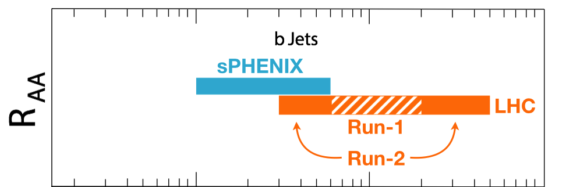
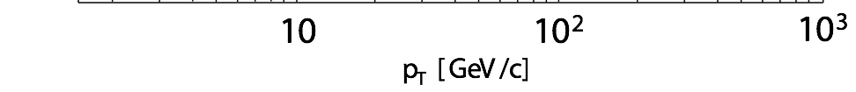
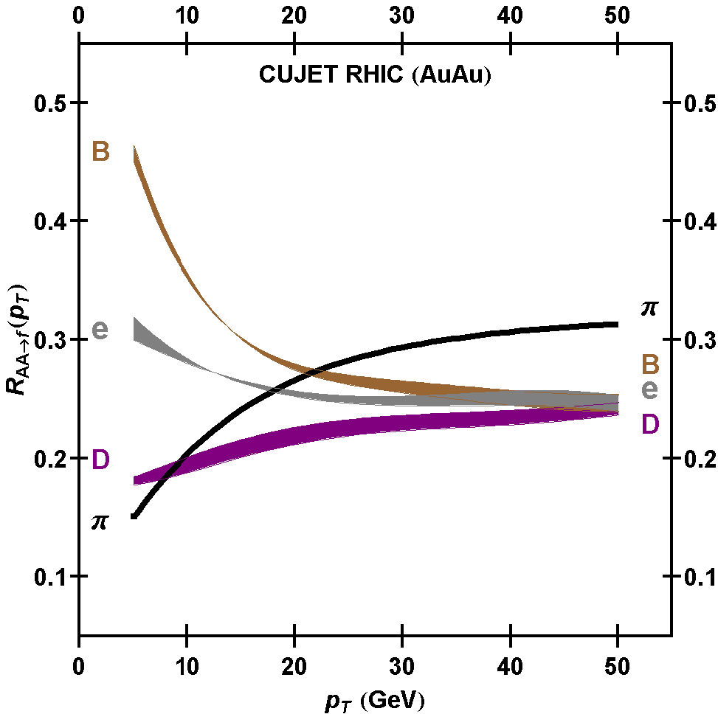
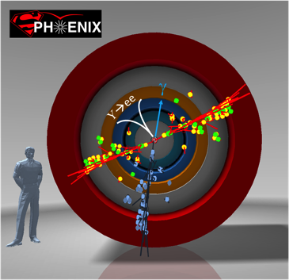
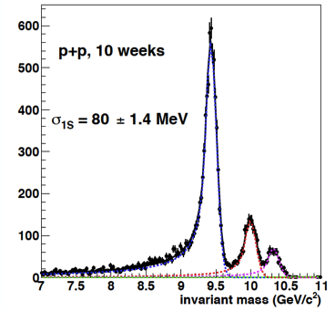
MVTX Enabes Exciting Science
sPHENIX is the next flagship heavy ion physics experiment in the US (NSAC LRP2015)
Jets
Upsilons
B-jets and B hadrons
MVTX will complete QGP heavy flavor physics
Precision study of the “inner workings of QGP”(LRP15)
Unambiguous determination of key parameters of QGP properties and interactions
complement & extend current and future RHIC and LHC QGP programs
sPHENIX 3 Physics Pillars
http://arxiv.org/pdf/1501.06197v1.pdf
Jets
Upsilons
PRL 108 (2012) 022301
B
D

Slide 5
The sPHENIX 3rd Science Pillar
“B meson and b-jet modification”
Heavy quarks – unique probe of QGP w/ new scales, m_{c}, m_{b}
Study mass dependence
Jet quenching & energy loss
Flow – interaction with medium
Access QGP properties
Temperature, density, coupling, transport coefficients, viscosity etc.
“B meson and b-jet flow”
m_{u} m_{d}
m_{s}
Λ_{QCD}
m_{c}
m_{b}
MeV
1
10
10²
T_{c}
T_{QGP}
10³
10⁴

Slide 6
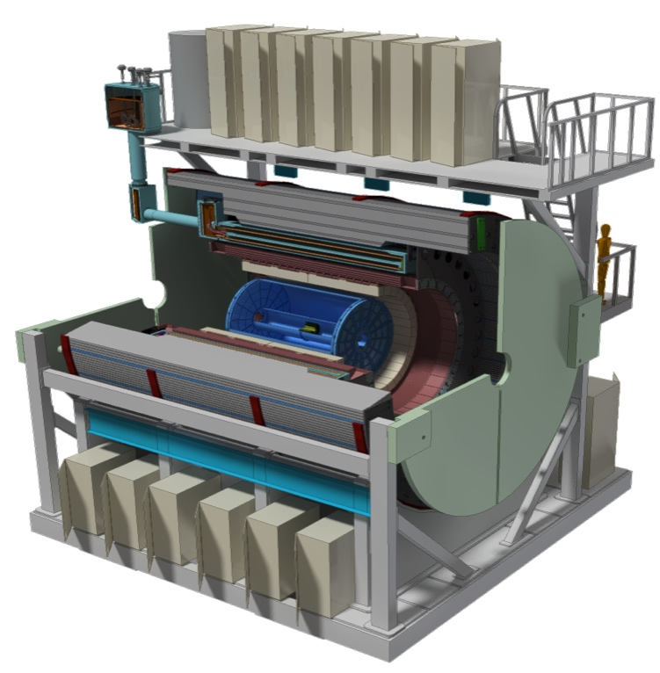
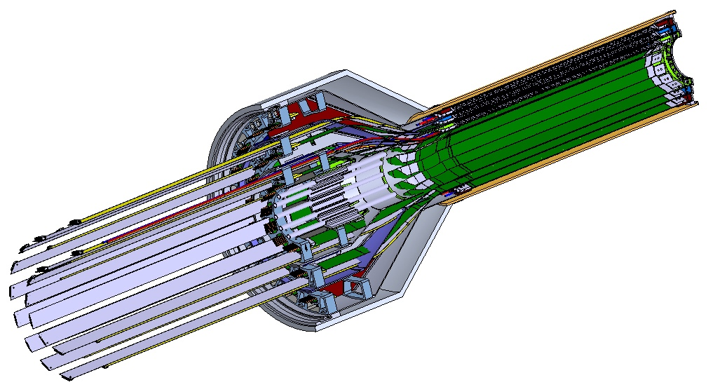
MVTX Detector – Modified from ALICE/ITS Design
Service cone: signal, power, cooling
and mechanical support
CYSS: Cylindrical Shell Structure
End-Wheel
Extended power FPC
3-layer sensor barrel
- 48 staves, 432 chips
MVTX
parameters

Slide 7
Scope of the MVTX Project – WBS 3.2
MVTX sensor & Electronics
Readout Integration
Frontend: ALICE/ITS RU
Backend: ATLAS FELIX
Detector assembly in US: ~$5M
QA & assembly
RU boards @UT-A
Half detectors @LBNL
FELIX boards @LANL/BNL,
Ancillary systems - “adopt” ALICE ITS system
Power, slow control & monitoring etc.
Mechanical system
Modify ALICE/ITS mechanical structures
End Wheels
Cylindrical structure shells
Service half barrels
Mechanical system integration,
Design & simulations, MIT/LANL
Composite structure production, LBNL
Non-composite structure, MIT
Installation tooling etc., BNL/LANL/MIT/LBNL
Adopt ALICE cooling plant design
Modifications to fit sPHENIX, MIT/BNL
Production @CERN: $1.36M, a separate BNL project
- 84 ALICE/ITS-IB (modified) staves from CERN
Acceptance test @LBNL, 48+spares(2-inner layers+)
- 60 ALICE/ITS-RU from CERN
Acceptance test @UT-Austin, 48+spares(12)

Slide 8
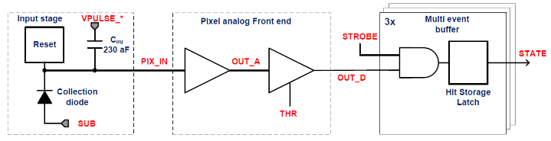
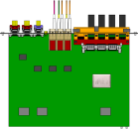
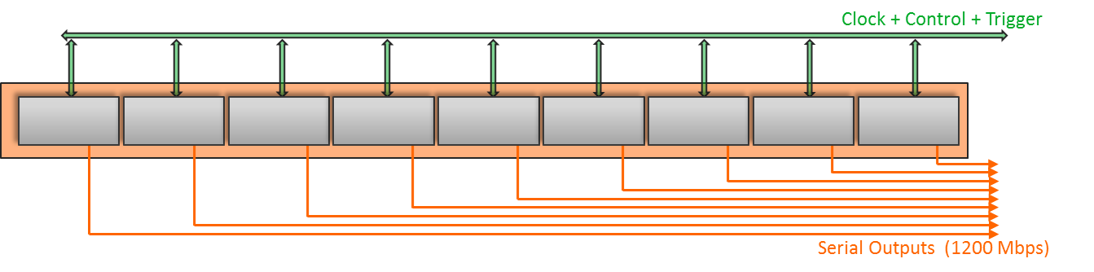
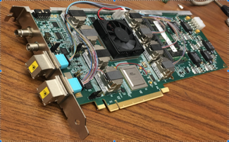

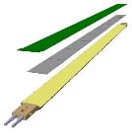
MVTX Readout, Power and Controls
CAN bus
DCS
Jo’s talk
Trigger & Clock
Readout Unit
Front End
GBT Optical Links
one pixel
9 Data (1.2Gbps)
1 Clock, 1 Control/Trigger
Control
Data (9.6 Gb/s max)
Trigger
9-sensor Stave
Samtec Twinax “FireFly”, ~10m
FELIX
Back End
FPC
Power
ATLAS Front-End Link eXchange (FELIX):
sPHENIX Data Aggregation Module(DAM)
Alpide Sensors
Flex PCB Filtering Capacitors
regulators
Power
Regulated Power
CAEN Power supplies
Cold Plate
ALPIDE pixel:
Shaping
Digitization
Zero-suppression
3x buffer
Power Board
Interaction Region
Experimental Hall
Counting House
MVTX Detector Electronics consists of three parts
Sensor-Stave (9 ALPIDE chips) | Front End-Readout Unit | Back End-FELIX/DAM

Slide 9
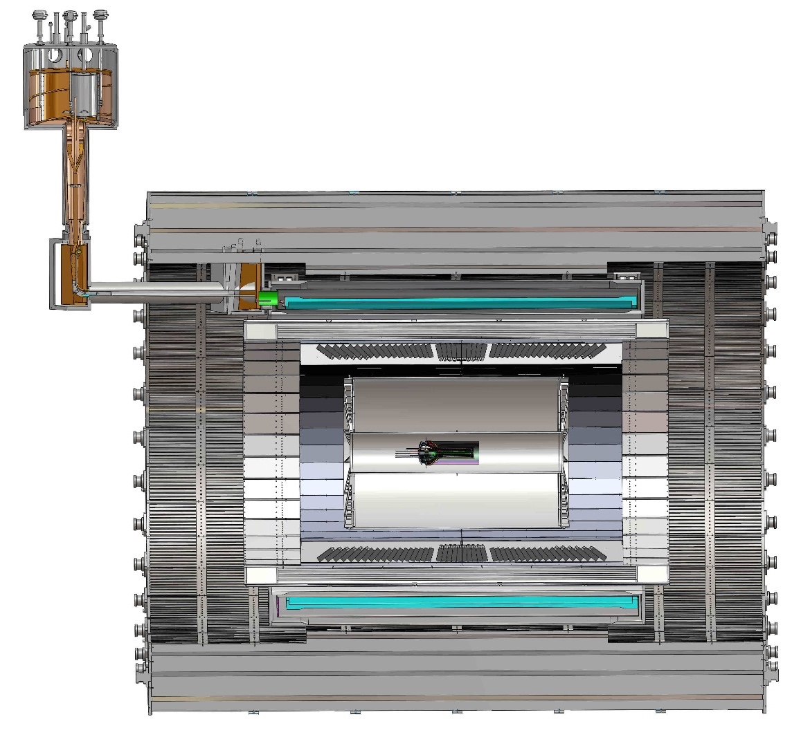
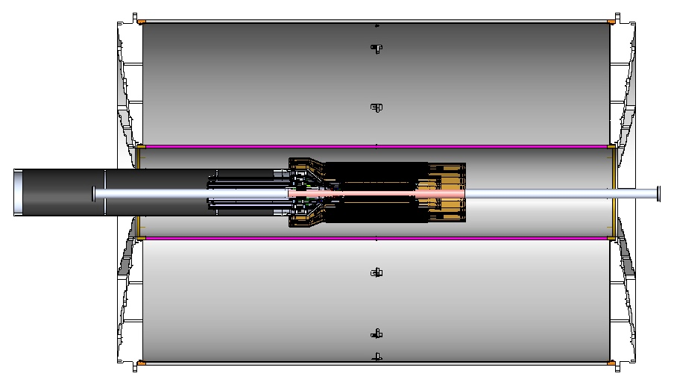
MVTX Global Mechanical System Integration
MVTX system preliminary design, with two parts:
Part-1: from MVTX to PP-1b, all power PCB, 40cm
Part-2: length TBD later, from PP-1b to PP-2
Walt and Camelia’ talks
Service Barrel
TPC
TPC
INTT
MVTX
PP-1a:
short signal cables
PP-2:
Signal and power cables
R= 209.6cm
PP-1b:
power cables
L = 350.0 cm

Slide 10
Preliminary Mechanical Design Completed
Camelia’ talk
https://indico.bnl.gov/event/6377/
MVTX, INTT, TPC …

Slide 11
MVTX Organization Chart

Slide 12
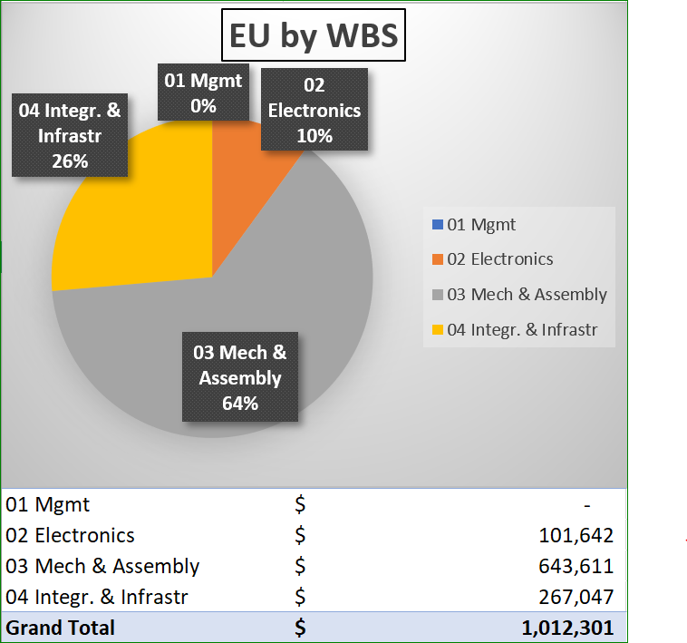
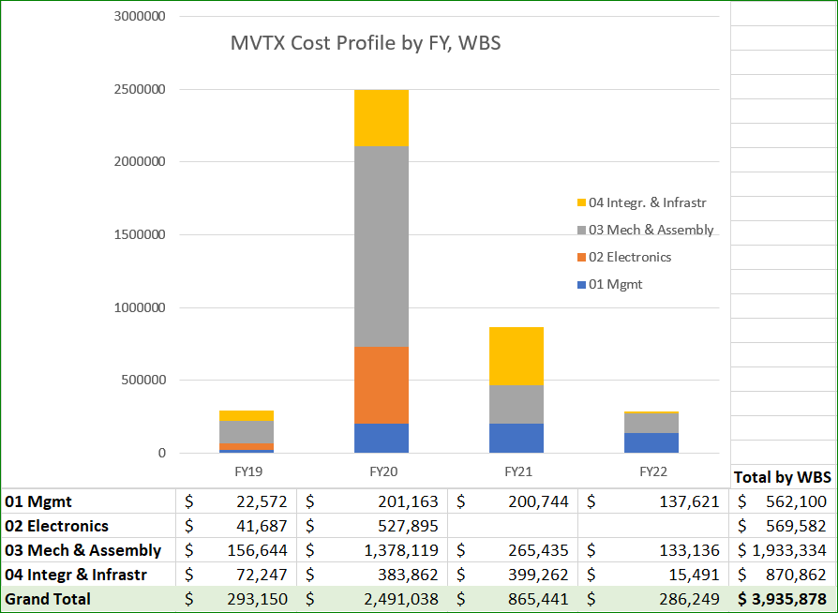
Cost Drivers
Dave and Irina’s talks

Slide 13
Schedules & Milestones

Slide 14
MVTX Schedules and Milestones (3/2019)
sPHENIX: CD1/3a PD2/3
Installation
1st collisions
CY-2018 | 2019 | 2020 | 2021 | 2022 | 2023
MVTX
Stave & RU
production
FELIX
production
Funding delays –
Stave production delayed at CERN
- Impact on following test & assembly
- preparation work @LBNL, UT-A
Lack of R&D $ for mech. design work
- MIT, LBNL, LANL
- “advanced cash” running out MIT, LANL
Detector mechanics design & production, global interface to sPHENIX
End Wheels
CYSS
Global integration
/interface design
Service barrel
design & production
Ready for beam;
sPHENIX day-1 run
Barrel Assembly & Testing @LBNL
Install half barrels
@sPHENIX IR
Half barrel #1
Power system
production
Half barrel #2
Half barrels
arrive @BNL
design & procure
interface to
sPHENIX rails
Running low in schedule contingency …
Design & procure
sPHENIX rails
MVTX installation & commissioning @BNL
RU, FELIX, PS, cables etc.

Slide 15
Project Status & Highlights
Confirmed long SamTec readout cables recently – last key integration R&D
11.4m long cables, > 10m desired length
MVTX mechanical design: excellent progress
Asked for quotes from outside companies based on preliminary designs
sPHENIX integration workfest scheduled 7/10 @BNL, MVTX/INTT/TPC…
Release of early R&D fund in progress
MVTX mechanical engineering design, MIT/LANL
Preparation for Stave and RU acceptance test, LBNL, UT-Austin
MVTX Cost & Schedule Review – we are ready for full production
July 29-30 @BNL
WBS, PMP, Risk Registry, P6 being updated
Stave and RU production at CERN
DOE Fund arrived at UTK/US-ALICE
Procurement in progress
CERN is ready to proceed with stave production
60 MVTX/sPHENIX RUs delivered to CERN
Power mezzanine and transition boards produced at UT-A

Slide 16
Engineering & Technology Readiness
Sensor modification and system integration
MVTX & INTT integration
Readout Electronics
RU, PU, FELIX, Readout cable
Power system
Mechanical system
Detector design
Service & integration
Detector assembly

Slide 17
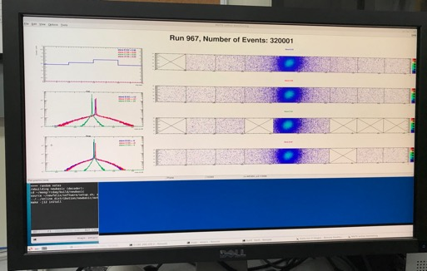
Very Successful Test Beam @Fermilab 5/20-25, 6/17-22, 2019
SamTec: 11.4m
(2.6m+8.8m)
4-stave telescope
RU-2: 1 stave
- 1 fully functioning
9-chip stave;
- 3 staves with a few
broken sensors
4 staves
2 RUv1.1
1 PU
1 FELIX Server + RCDAQ
sPHENIX GTM
11.4m Custom SamTec Cable
Negative pressured cooling for staves
RU-1: 3 staves
5m SamTec
120GeV p-beam
10kHz (30kHz)
Beam intensity:
30k ~ 120k ppp
Data & Control
Beam Trigger
Timing & Trigger
GTM
FELIX
A full system with final sensor/readout* hardware:
Multi-Stave + Multi-RU -> FELIX readout demonstrated
sPHENIX GTM integrated
Long readout SamTec cable certified
Cooling system demonstrated
* RUv1.1 identical to the final RUv2 electrically
Online Monitoring
RCDAQ

Slide 18
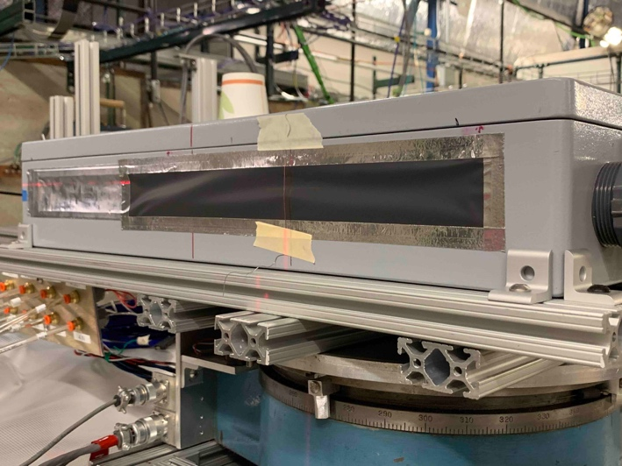
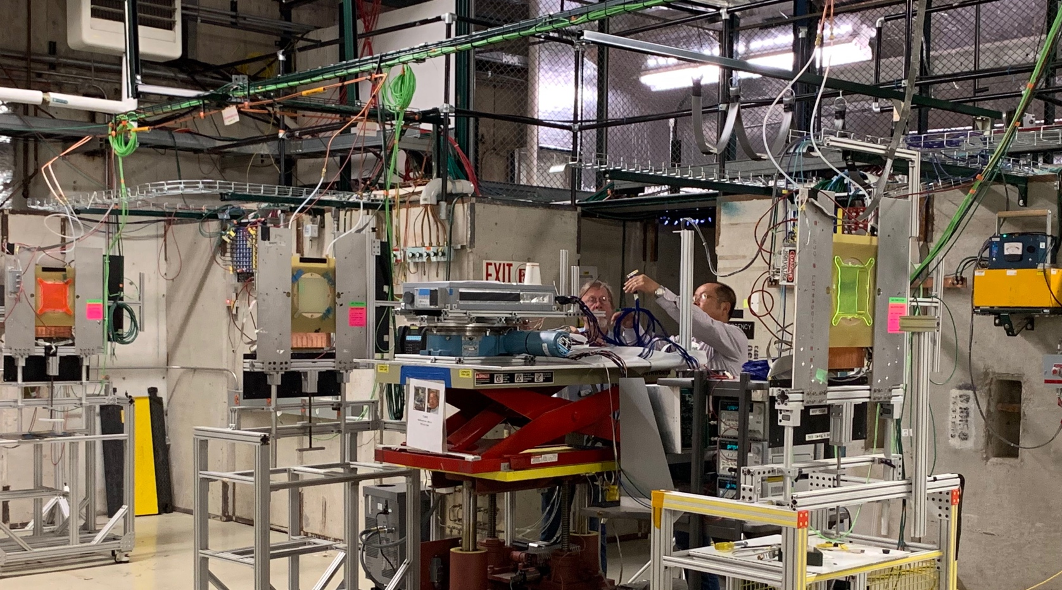
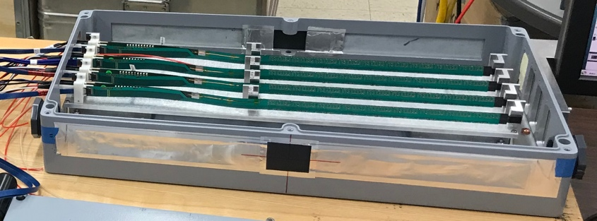
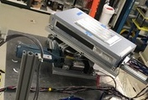
2019 MVTX Test Setup
From view
beam
Stave housing (four staves)
Stave housing sits on a motion table which can be moved in (x, y) plane perpendicular to the nominal beam direction. It can also be rotated (+40, -40) degrees (see photo on right). Operation was done at counting house.

Slide 19
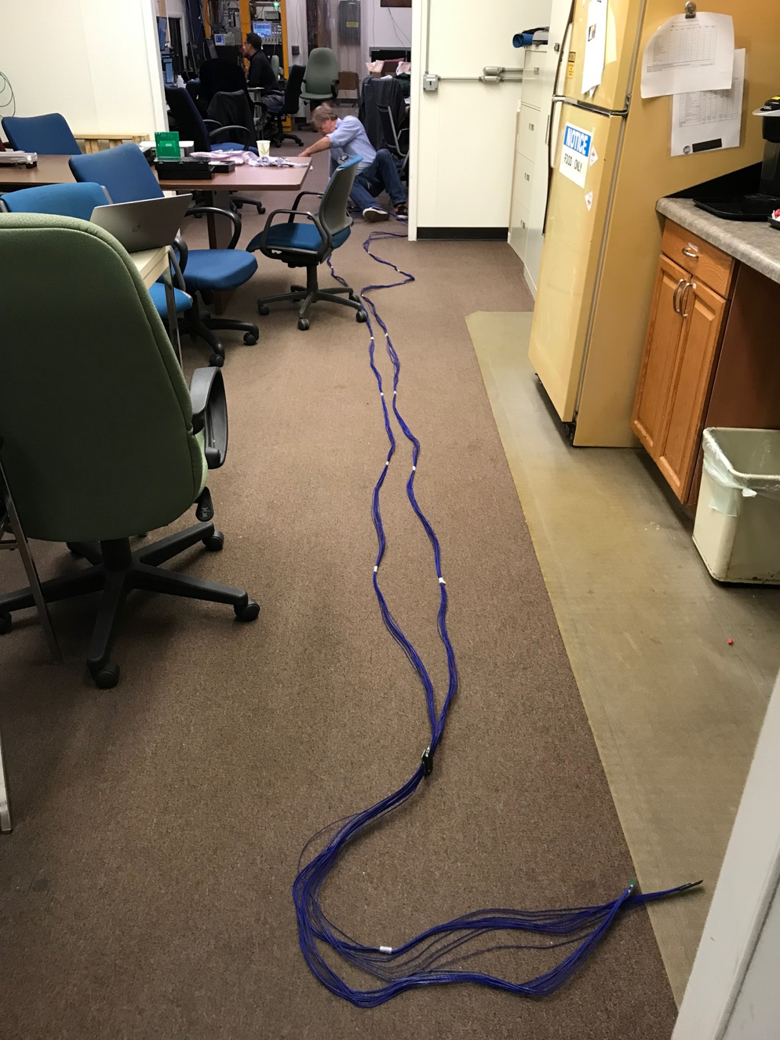
MVTX Readout and Power Cable Route
PWR
RU
PU
Desired <~10m;
Tested 11.4m
BNL has approved “non-halogen free” cables for sPHENIX
sPHENIX MVTX: 7.9+m
Cable-A: 1.4 m
Cable-B: 6.5+ m
Power cable:4.7+ m

Slide 20
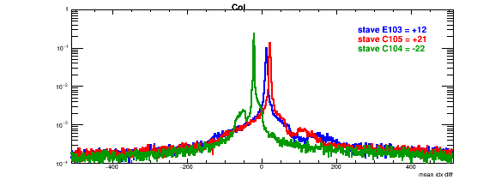
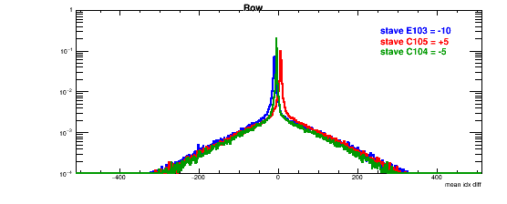
Detector Misalignment & Hit Spatial Resolution
Typically staves offset by,
Horizontally: 20 x 30um = 600 um
Vertically: 5 x 30 um = 150 um
Hit spatial resolution:
peak_sigma_core = 0.55 (pixel size ) =15 um
Chip spatial resolution = 15/sqrt(2) = 11 um
Delta_X/Y
Ref plane

Slide 21
Recommendations from April Director’s Review

Slide 22
Report from April BNL PD2/3 Reviews: Silicon Detectors - MVTX, INTT

Slide 23
MVTX Risks - all in P6 now
WBS, PMP documents updated
Schedule & Labor profile updated in P6
(Glenn, Irina )
Need project fund NOW to meet the goals!

Slide 24
Issues and Concerns
Need project fund NOW to meet the goals!

Slide 25
Summary
MVTX is ready to receive fund for the project
Electrical system is ready for production
Preliminary detector mechanical design completed
Preliminary sPHENIX mechanical system integration developed
Costs, schedules and risk register integrated into sPHENIX P6
Project management plan developed

Slide 26
Back Up

Slide 27
MVTX Schedules and Milestones (3/2019)
sPHENIX: CD1/3a PD2/3
Installation
1st collisions
CY-2018 | 2019 | 2020 | 2021 | 2022 | 2023
MVTX
Stave & RU
production
FELIX
production
Funding delays –
Stave production delayed at CERN
- Impact on following test & assembly
- preparation work @LBNL, UT-A
Lack of R&D $ for mech. desgin work
- MIT, LBNL, LANL
- “advanced cash” running out MIT, LANL
Detector mechanics design & production, global interface to sPHENIX
End Wheels
CYSS
Global integration
/interface design
Service barrel
design & production
Ready for beam;
sPHENIX day-1 run
Barrel Assembly & Testing @LBNL
Install half barrels
@sPHENIX IR
Half barrel #1
Power system
production
Half barrel #2
Half barrels
arrive @BNL
design & procure
interface to
sPHENIX rails
Running low in schedule contingency …
Design & procure
sPHENIX rails
MVTX installation & commissioning @BNL
RU, FELIX, PS, cables etc.

Slide 28
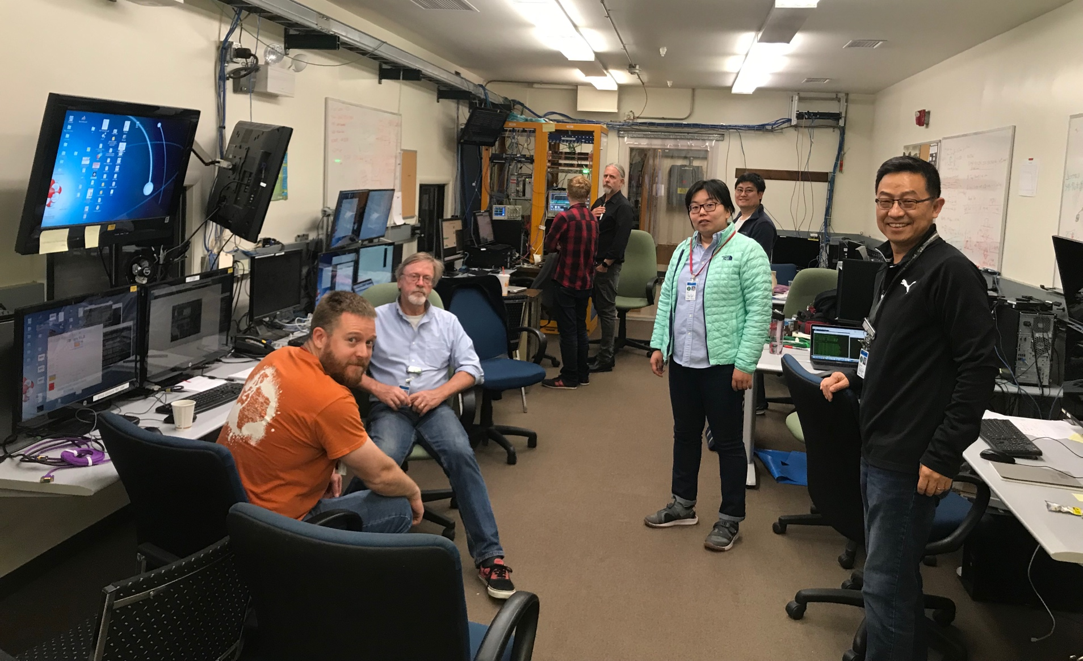
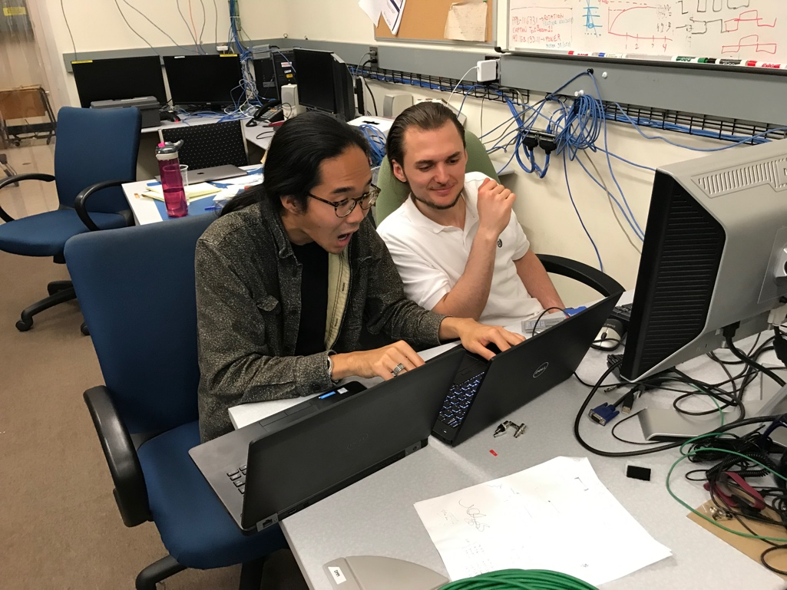
The TB Team @Fermilab
Data taking shift in the evenings: 7PM – 7AM
Beam: every other Monday –Friday 8:00AM – 8AM
Matt, Hubert, Cameron, Gerd, Zongze,
Xuan, Xiaochun, photo by Ming
Sho, AlexT
Not shown: Sanghoon, Yasser, Martin, Walt,
Abel. Chris …

Slide 29
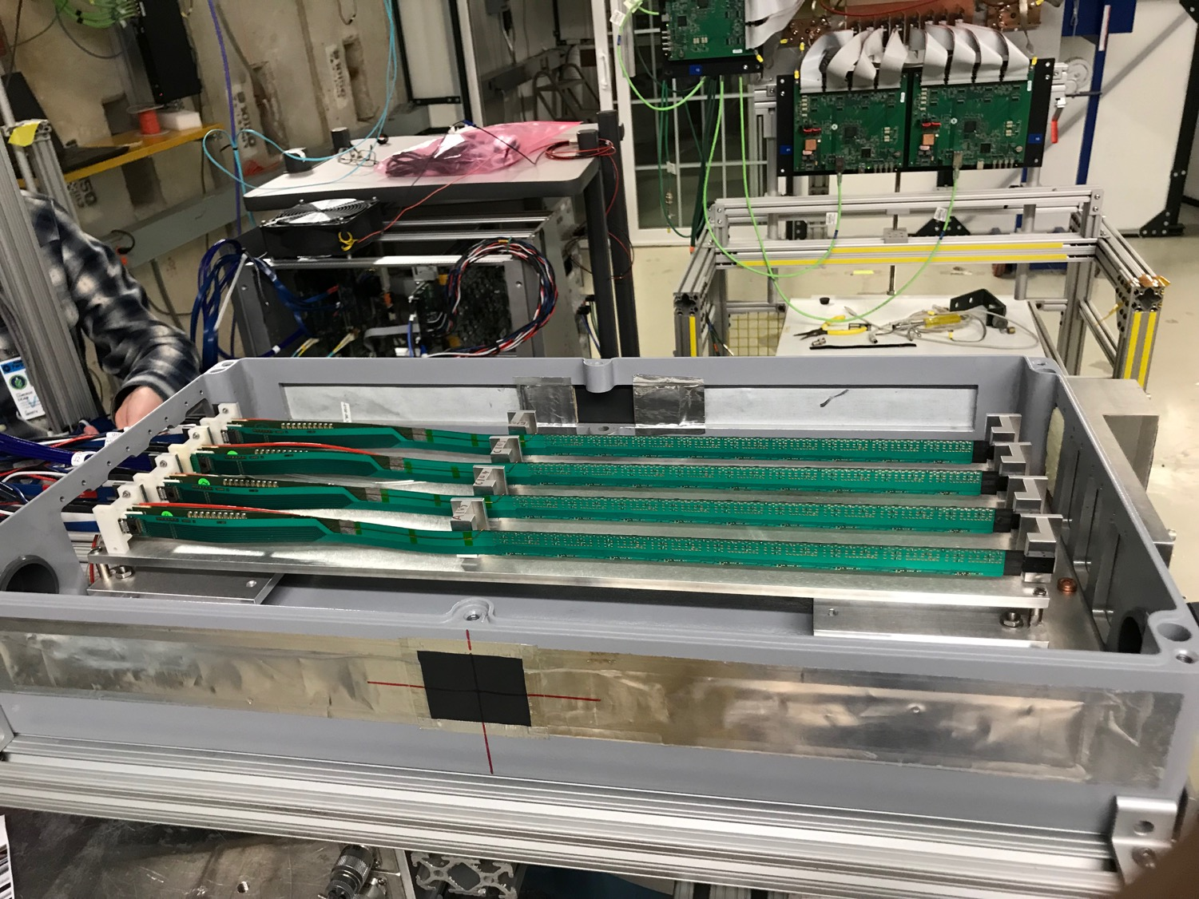
MVTX 4-Stave Telescope

Slide 30
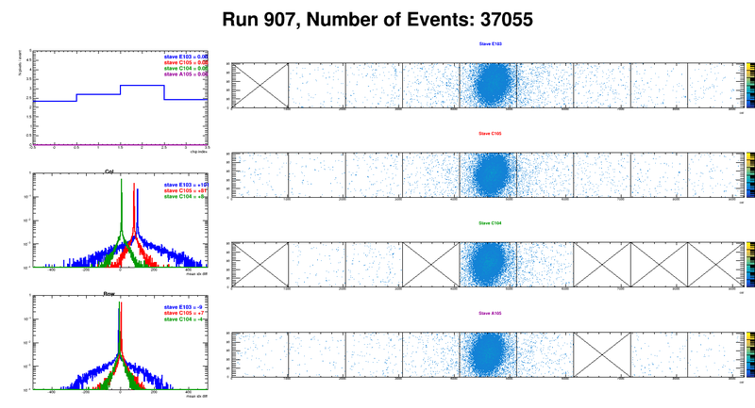
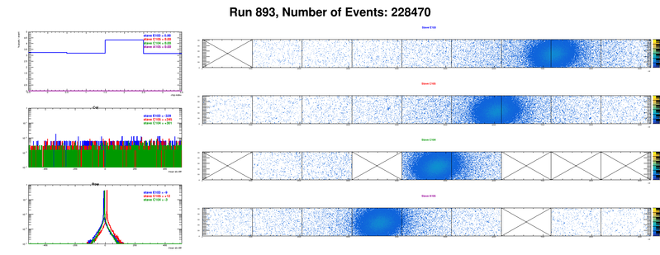
Offline analysis in progress: all TB data in RCF
https://wiki.bnl.gov/sPHENIX/index.php/MAPS-based_Vertex_Detector_(MVTX)
Beam angle: 0
(eta ~0)
MVTX 4-Stave Telescope
Beam angle: 40
(eta ~1)

Slide 31
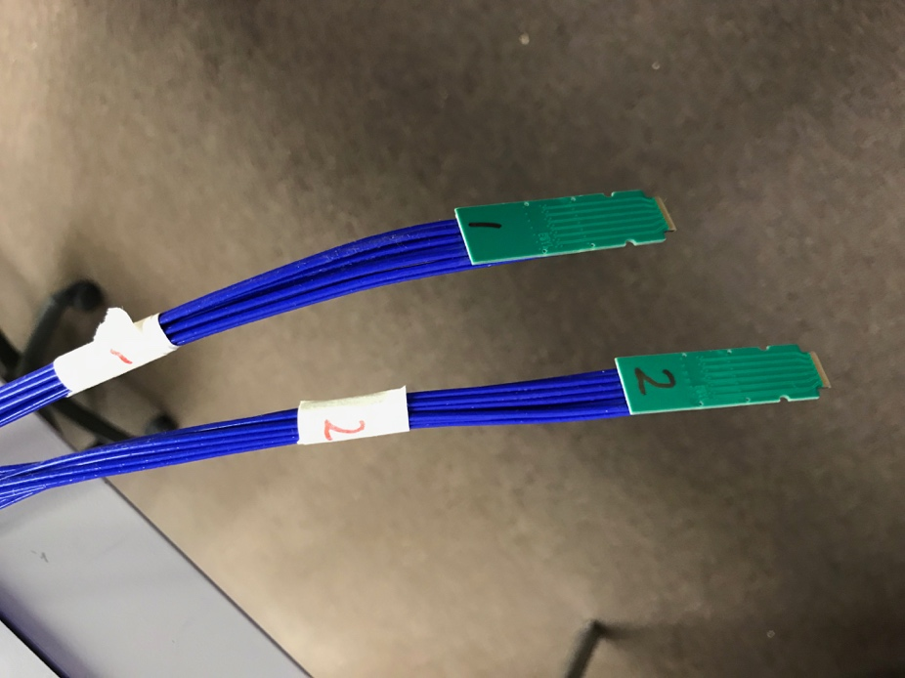
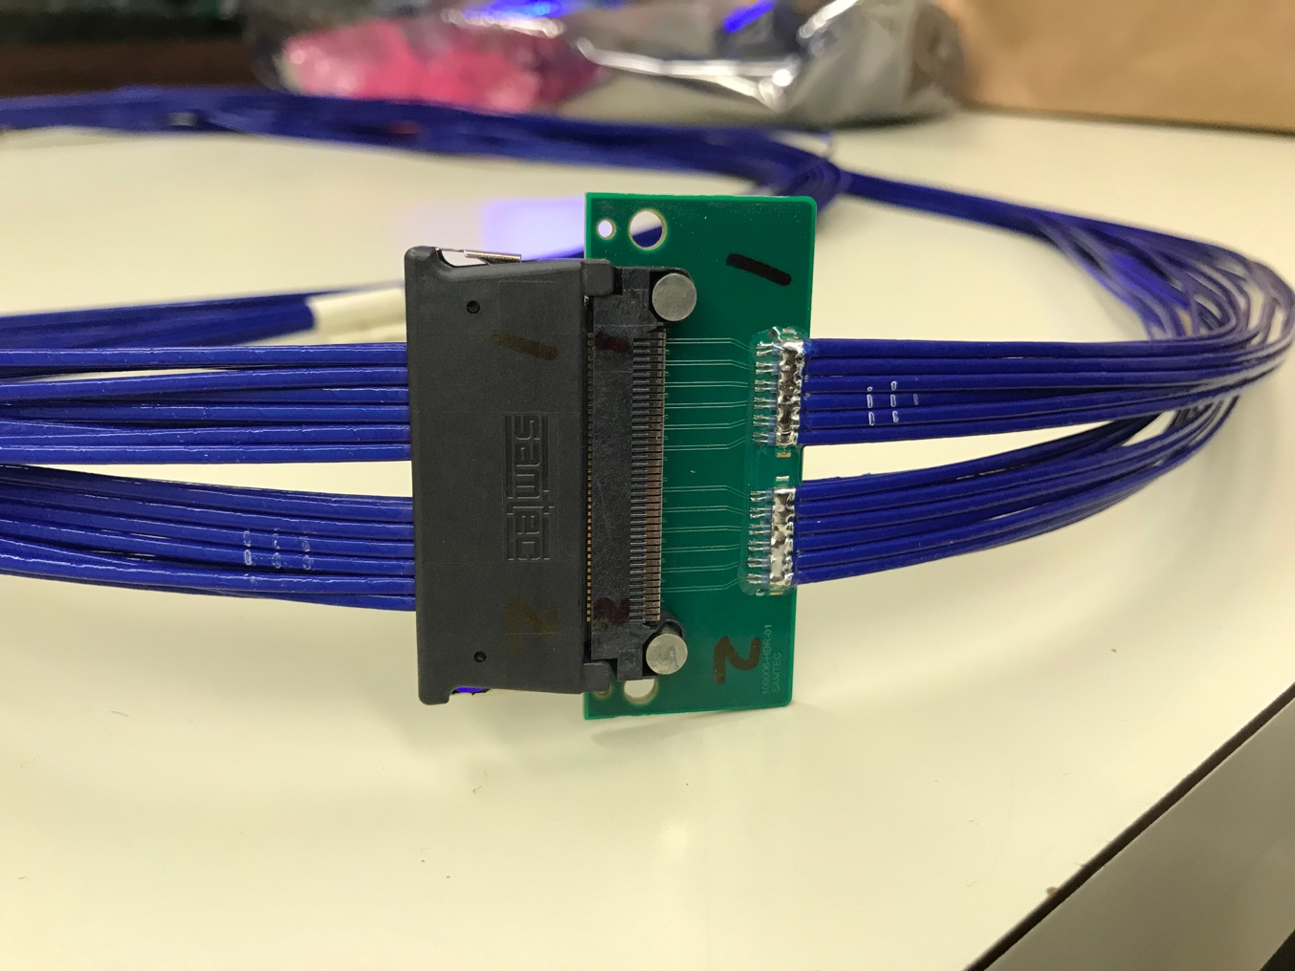
Tested New MVTX Long SamTec Readout Cables 8.8m + 2.6m = 11.4m (10m desired for sPHENIX; ALICE 8m cables)

Slide 33
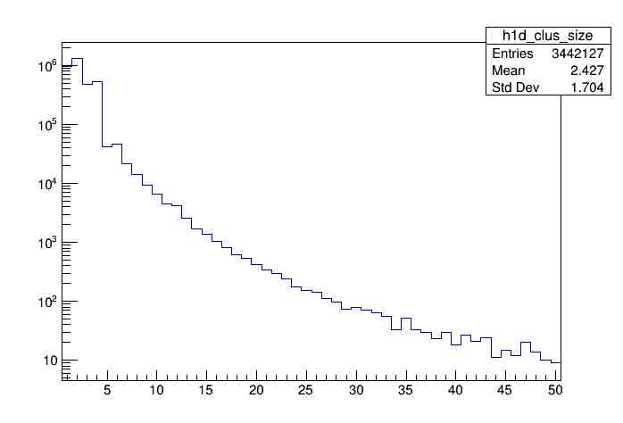
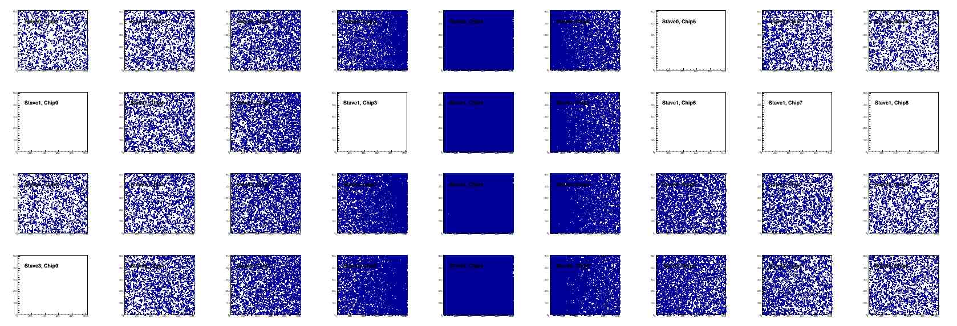
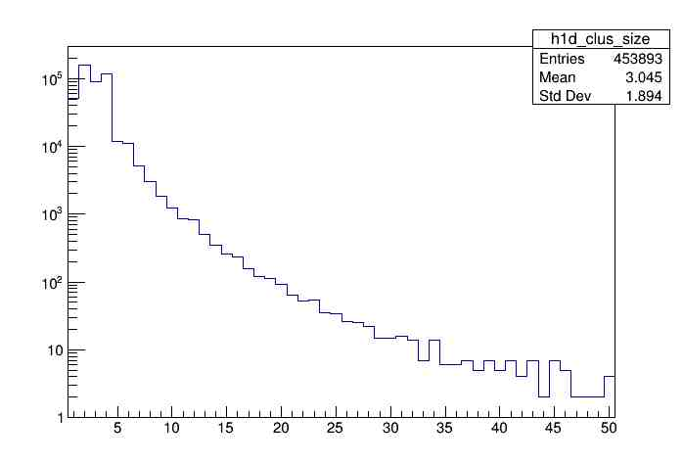
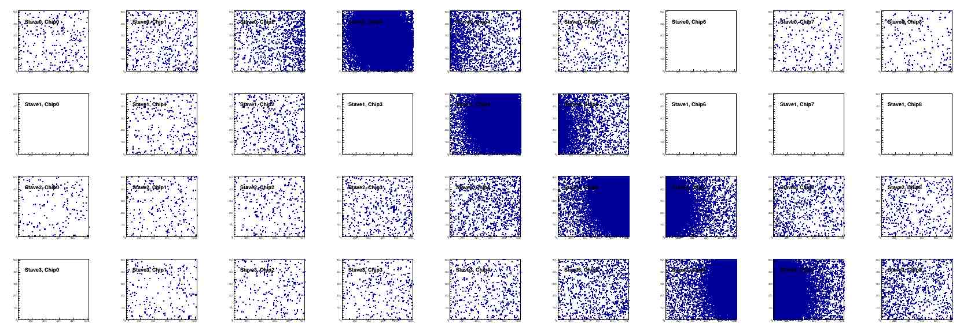
Offline Analysis: Cluster size vs Angle
To calibrate MC simulations and tracking
Stave geometry, alignment
Clustering
@ 0-degree
Cluster Size ~ 2.4
@ 40-deg
Cluster Size ~ 3.0

Slide 34
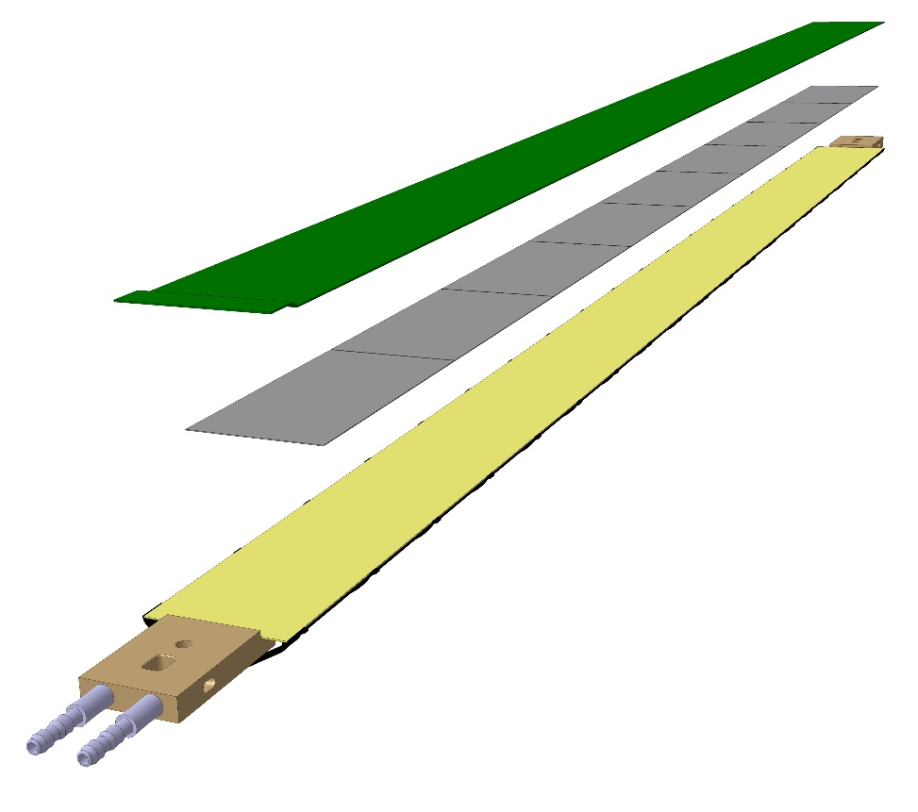
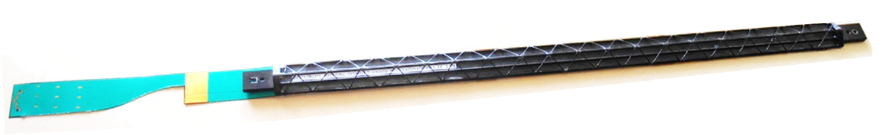
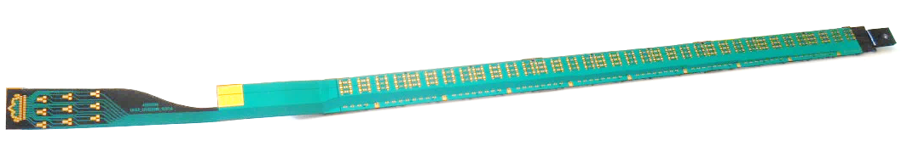
Staves - General layout
Stave design developed by ALICE at no cost for MVTX project
Possible modifications (see Walter’s talk)
Staves: detector modules consisting of a Hybrid Integrated Circuit (HIC) mounted on carbon fiber mechanical support structure
HIC: a row of 9 ALPIDE sensors wire-bonded to a Flexible Printed Circuit (FPC). Area covered by the chips: 15x271.2 mm², including a gap of 150 μm between adjacent chips.
Mechanical support: single light structure composed of a Space Frame, providing the required stiffness, and a Cold Plate, high-thermal conductivity carbon fiber sheet with embedded polyamide cooling pipes.
Heat Dissipation – The ALPIDE sensors dissipate only 40 mW/cm².
FPC
Cold plate
9 sensors
Space frame
Stave prototype

Slide 35
backup

Slide 36
The L3 Component

Slide 37
L3 Technical Overview
Emphasize any technical issues that still need to be resolved. If all has been decided put it on the slide.

Slide 38
L3 Scope
What are you building?
Where you fit in the L2

Slide 39
L3 Collaborators

Slide 40
Schedule Drivers

Slide 41
Cost Drivers

Slide 42
Status and Highlights
Recent technical accomplishments

Slide 43
Issues and Concerns

