Slide 1
Review Documents Available on the Agenda Page
https://indico.bnl.gov/event/6544/
MVTX BOE
MVTX PMP
sPHENIX/MVTX Risk Register
MVTX P6 dump, w/ Gantt Chart
MVTX full proposal
RU acceptance QA plan
Stave acceptance QA plan
MVTX Pre-P6 WBS Dictionary
MVTX C&S Review Charge
Previous Review report
  BNL Director’s Review 4/2019

Slide 2
Today’s Presentations
Overview of the MVTX's Place in sPHENIX- Ed
MVTX Overview – Ming, #1-4
Cost & Schedule – Dave, #1-4
MVTX in sPHENIX P6 and Risk Registry – Irina, #2-4
MVTX mechanical design – Walt, #1-3
MVTX Service Barrel and Integration – Camelia, #1-3
MVTX Detector QA and Assembly – Yuan, #1-3
MVTX Readout – Jo, #1-3
R&D and Beam Test Results – Cameron, #1,2
Summary – Ming, #4

Slide 3
sPHENIX MVTX Cost and Schedule Review
MVTX Overview
Ming Liu, LANL
July 29-30, 2019
BNL

Slide 4
Outline
Physics of MVTX
Project scope, PMP
Costs, schedules & risk register
R&D highlights
Previous review recommendations
Issues and concerns

Slide 5
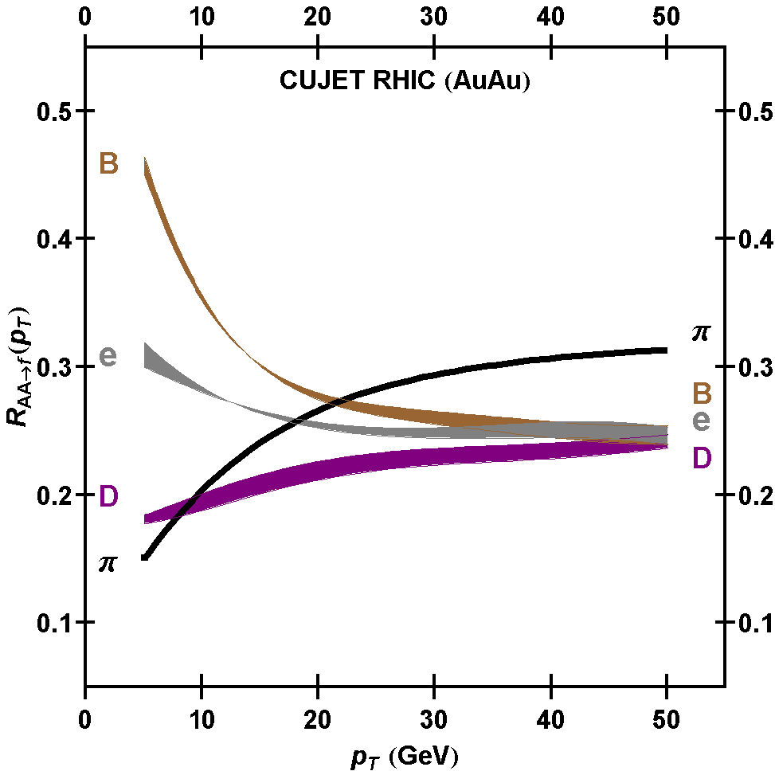
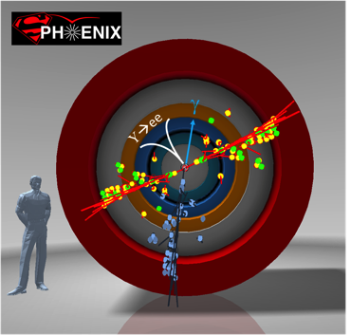
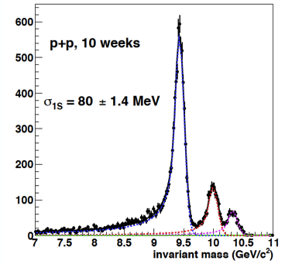
MVTX Enables Exciting Science
sPHENIX is the next flagship heavy ion physics experiment in the US (NSAC LRP2015)
  Jets
  Upsilons
MVTX: Open heavy flavor physics – the 3rd physics pillar
  Precision study of the “inner workings of QGP”(LRP15)
  Quantitative determination of key parameters of QGP properties and interactions
sPHENIX 3 Physics Pillars
http://arxiv.org/pdf/1501.06197v1.pdf
Jets
Upsilons
PRL 108 (2012) 022301
B
D

Slide 6
The sPHENIX 3rd Science Pillar
“B meson and b-jet modification”
Heavy quarks – unique probe of QGP w/ new scales, m_{c}, m_{b}
Study mass dependence
  Jet quenching & energy loss
  Flow – interaction with medium
Access QGP properties
  Temperature and momentum dependence of QGP transport parameters
From MVTX
proposal
“B meson and b-jet flow”
m_{u} m_{d}
m_{s}
Λ_{QCD}
m_{c}
m_{b}
MeV
1
10
10²
T_{c}
T_{QGP}
10³
10⁴

Slide 7


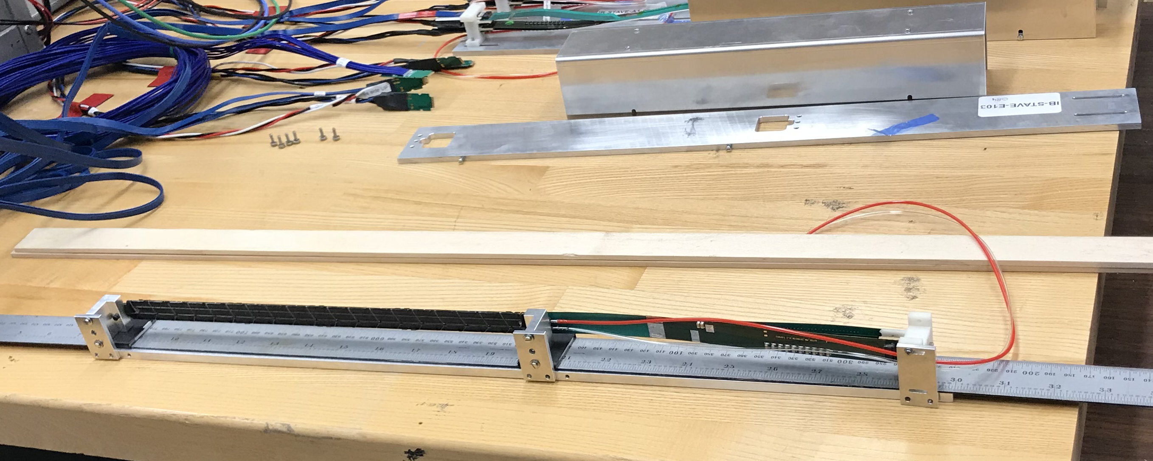
Monolithic-Active-Pixel-Sensors (MAPS)
The next Generation State of the Art Pixel Tracker
Advantages of ALICE MAPS/ALPIDE:
  Very fine pitch (27x29 μm)
  High efficiency (>99%) and low noise (<10⁻⁶)
  Time resolution, ~5 μs
  Ultra-thin/low mass, 50μm (~0.3% X₀)
  On-pixel digitization, low power dissipation
An ideal detector for QGP physics!
FPC
Chip:
1.5 x3 cm²
9 Chips
Cooling plate
Power density < 40 mW/cm²
A 9-chip MAPS stave, (1.5 x 3)x9cm²
ALPIDE design
50 μm
28 μm

Slide 8

MVTX Detector – Modified from ALICE/ITS Design
All electronics are “as built” by ALICE/ATLAS
Modify the ALICE mechanics to fit it in sPHENIX
CYSS: Cylindrical
Shell Structure
End-Wheels
Service Barrel
3-layer sensor barrel
- 48 staves, 432 chips
MVTX parameters: L = 271 mm
3 Layers:
12/16/20 staves

Slide 9
Scope of the MVTX Project – WBS 3.02
Mechanical system
  MVTX detector mechanical structures (3.02.03)
    Design & simulations
    End Wheels
    Cylindrical support structure
    Service barrels
  Mechanical system integration (3.02.04)
    Service barrel support & interface to sPHENIX
    Installation tooling etc.
    Adopt ALICE cooling parameters
    Detector safety
  Detector assembly (3.02.03.03)
    Stave QA & detector assembly @LBNL
Electronics (3.02.02)
  Readout Integration
    RU QA & assembly @UT-A
    Backend: ATLAS FELIX
    FELIX boards @LANL/BNL
    Frontend RU services: daughter cards, transition boards, cables etc.
  Ancillary systems - “adopt” ALICE ITS system
    Power, slow control & monitoring etc.
Jo’s talk
Walt’s talk
Camelia’s talk
Status: Advanced CAD models
Status: Ready for production
Status: Advanced CAD models
BNL provides Staves & RUs, no cost to MVTX project:
- 84 ALICE/ITS-IB (modified) staves from CERN;
48+spares(2-inner layers+10%)
- 60 ALICE/ITS-RU from CERN
48+spares(12, 25%)
Early R&D by LANL LDRD $5M, FY17-19
Yuan’s talk
Off-project
Status: Mature, following ITS

Slide 10
MVTX Scope – WBS Summary
Major Challenge: Mechanical System

Slide 11
Project Management Plan
Draft PMP document completed
  Project baseline
    Physics
    Functional requirements/KPP
    Technical scope
    Cost breakdown
    Schedule
    Funding profile
    Planned BNL funding
    Baseline change control
  Management structure
    Organization and team
    Management responsibilities
    Participating institutions
  Project management and oversight
    Risk management
    Project reporting
    Engineering and technology readiness
    Quality assurance and configuration/document management
    Operation readiness plan
    ESSH plans and fabrication
    Project closeout
Project fully integrated into sPHENIX P6
  Costs, schedules and risk register

Slide 12
MVTX Deliverables in PMP
Detectors + Services
*: The staves and RUs are from BNL contribution, no cost to MVTX project.

Slide 13
MVTX Performance Parameters: KPPs & UPPs
KPPs from
MVTX PMP
UPPs from
MVTX PMP

Slide 14
Baseline Change Control in PMP
MVTX
MVTX

Slide 15
MVTX Organization Chart

Slide 16
Collaborators & Responsibilities
22+ institutions and growing
- “MOU” through sPHENIX collaboration
- Active joint efforts with ALICE ITS group

Slide 17
MVTX Detector, Cost & Schedule

Slide 18
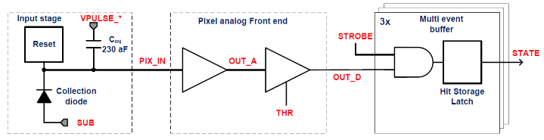
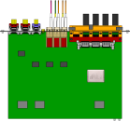

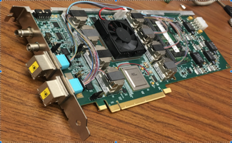

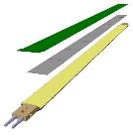
MVTX Readout, Power and Controls
CAN bus
DCS
Jo’s talk
Trigger & Clock
Readout Unit
Front End
GBT Optical Links
one pixel
9 Data (1.2Gbps)
1 Clock, 1 Control/Trigger
Control
Data (9.6 Gb/s max)
Trigger
9-sensor Stave
Samtec Twinax “FireFly”, ~10m
FELIX
Back End
FPC
Power
ATLAS Front-End Link eXchange (FELIX):
sPHENIX Data Aggregation Module(DAM)
Alpide Sensors
Flex PCB Filtering Capacitors
regulators
Power
Regulated Power
CAEN Power supplies
Cold Plate
ALPIDE pixel:
Shaping
Digitization
Zero-suppression
3x buffer
Power Board
Interaction Region
Experimental Hall
Counting House
MVTX Detector Electronics consists of three parts
Sensor-Stave (9 ALPIDE chips) | Front End-Readout Unit | Back End-FELIX/DAM
(BNL provides staves and RUs, at no cost to MVTX project)

Slide 19
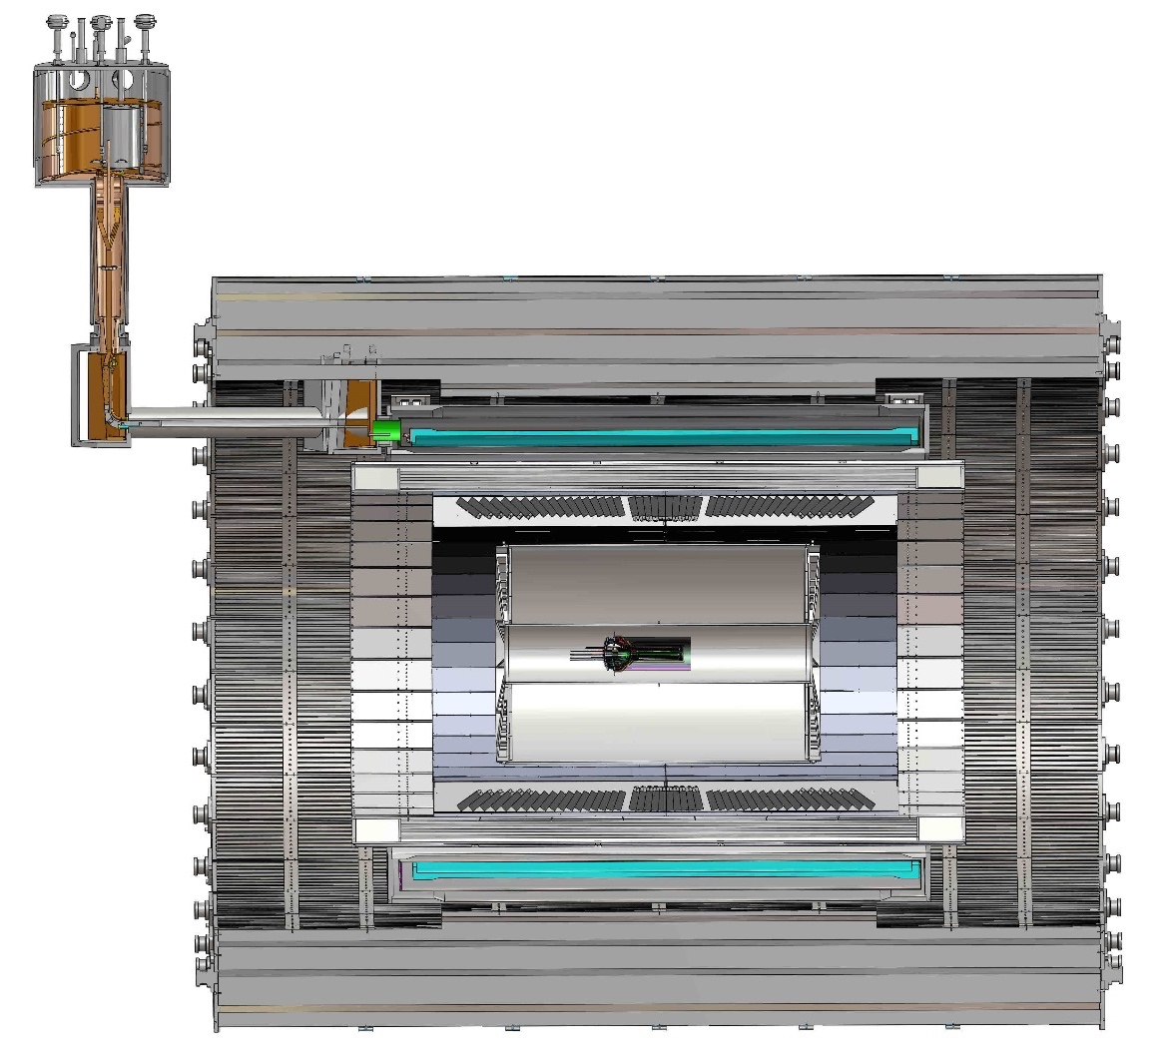
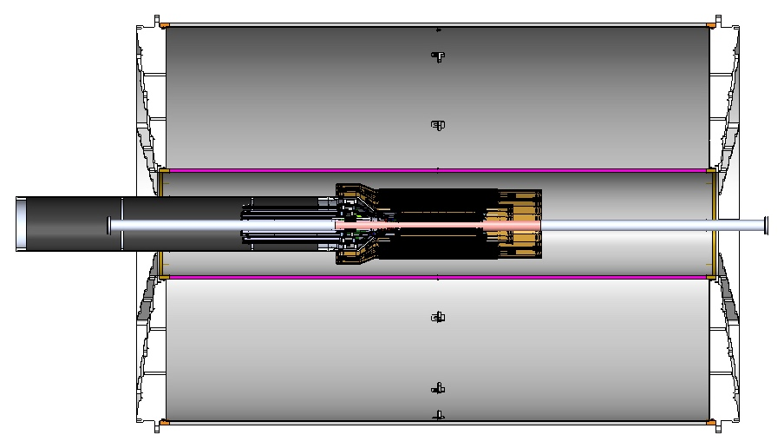
MVTX Global Mechanical System Integration
MVTX system preliminary design, with two parts:
  Part-1: from MVTX to PP-2, all power PCB, 40cm
  Part-2: length TBD later, from PP-2 to PP-3
Walt and Camelia’ talks
Service Barrel
TPC
TPC
INTT
MVTX
PP-1:
short signal cables
PP-3:
Signal and power cables
R= 209.6cm
PP-2:
power cables
L = 350.0 cm

Slide 20
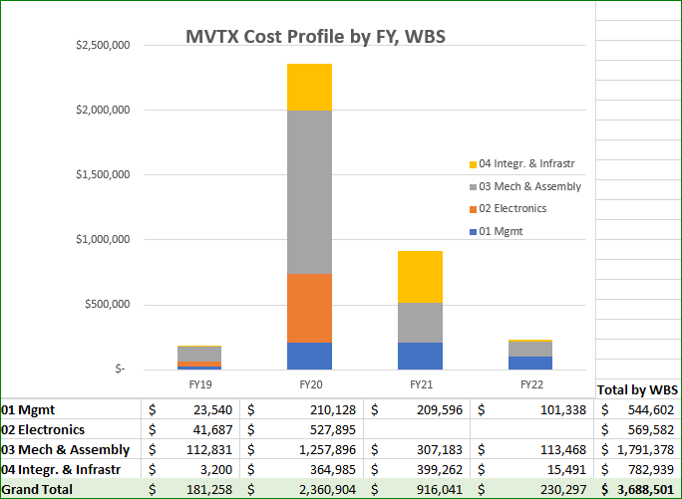
Cost Drivers
Mechanical system:
Detector carbon structures
Service & integration
Electronics:
Backend
Power system
LANL LDRD for early R&D
(off-project)
$5M, FY17-19
Readout integration
Detector conceptual design
Physics & simulations
Dave’s talk

Slide 21
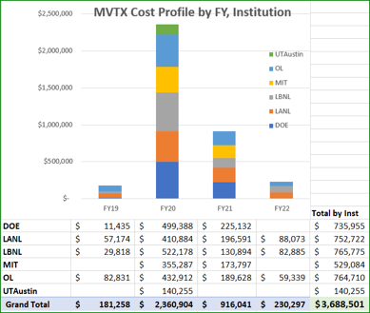
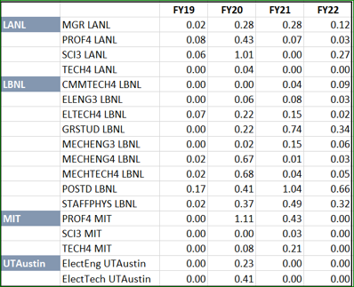
Labor Profile in P6
Irina’s talk

Slide 22
Schedules & Milestones
Dave & Irina’s talks
Schedule drivers
  Day-1 physics
  CERN production
  Carbon structures
Early R&D by LANL LDRD
Fully aligned with sPHENIX via external milestones

Slide 23
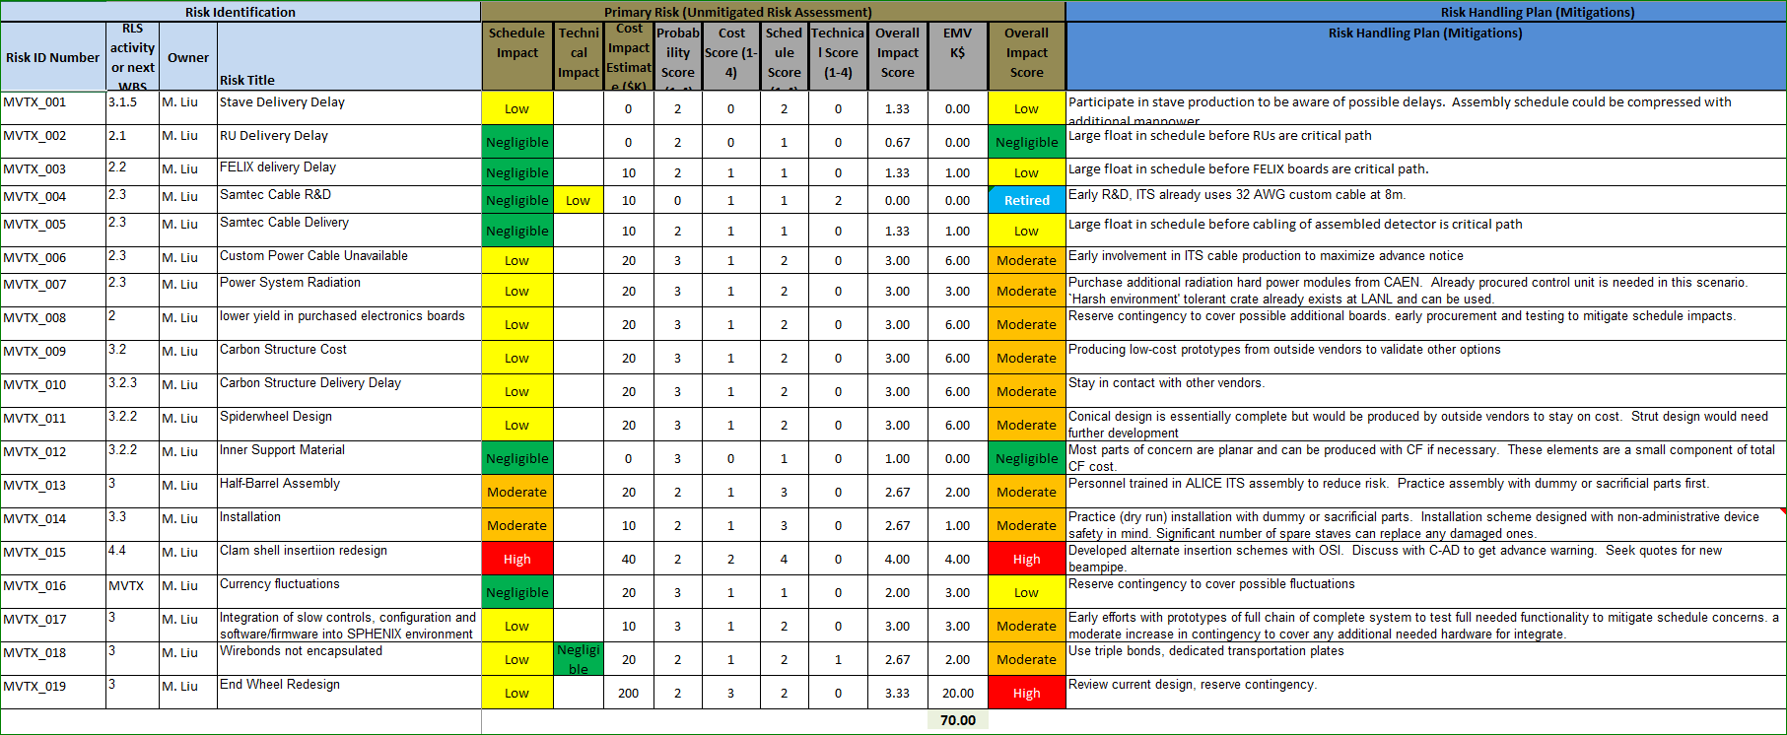
Risk Register

Slide 24
Project Status & Highlights
Tested full stave readout chain with the final electronics at Fermilab Test Beam
  Tested long SamTec readout cables recently – last key detector integration R&D
  11.4m long cables, 10m desired
MVTX mechanical design: excellent progress
  Asked for quotes from outside companies based on preliminary designs
  sPHENIX integration workfest held 7/10 @BNL, MVTX/INTT/TPC
Early R&D achieved through LANL LDRD, $5M, FY17-19
  Readout integration
  Mechanical system conceptual design
Release of early BNL R&D fund in progress
  MVTX mechanical engineering design, MIT/LBNL
Project Management
  WBS, PMP, Risk Register updated
  Fully integrated into sPHENIX P6, aligned with sPHENIX schedule
  Will deliver MVTX on time and on budget under $5M
  We are ready to start the project

Slide 25
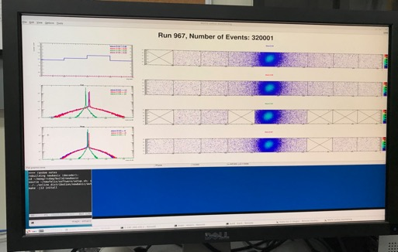
Very Successful Test Beam @Fermilab
5/20-25, 6/17-22, 2019
SamTec: 11.4m
(2.6m+8.8m)
4-stave telescope
RU-2: 1 stave
- 1 fully functioning
9-chip stave;
- 3 staves with a few
broken sensors
4 staves
2 RUv1.1
1 PU
1 FELIX Server + RCDAQ
sPHENIX GTM
11.4m Custom SamTec Cable
Negative pressured cooling for staves
RU-1: 3 staves
5m SamTec
120GeV p-beam
10kHz (30kHz)
Beam intensity:
30k ~ 120k ppp
Data & Control
Beam Trigger
Timing & Trigger
GTM
FELIX
A full system with final sensor/readout* hardware:
Multi-Stave + Multi-RU -> FELIX readout demonstrated
sPHENIX GTM integrated
Long readout SamTec cable certified
Cooling system demonstrated
* RUv1.1 identical to the final RUv2 electrically
Online Monitoring
sPHENIX
RCDAQ

Slide 26
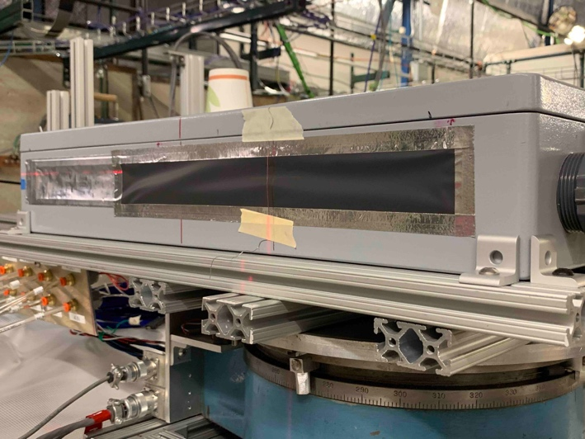
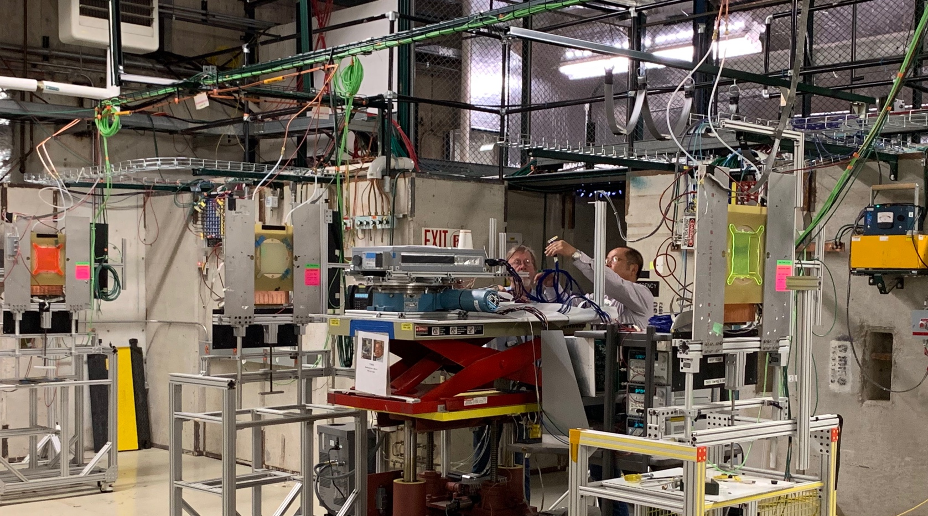
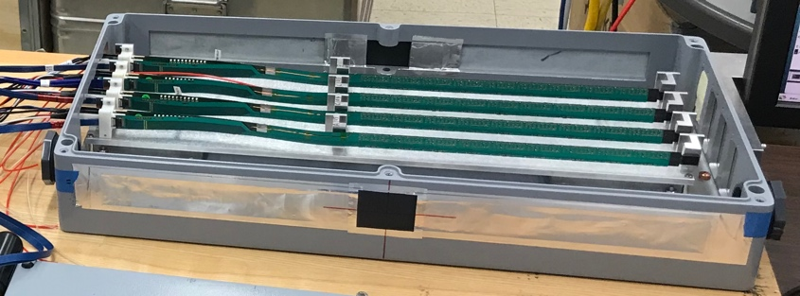
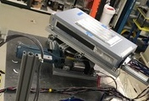
2019 MVTX Test Beam Setup @Fermilab
Cameron’s talk
From view
beam
Stave housing sits on a motion table which can be moved in (x, y) plane perpendicular to the nominal beam direction. It can also be rotated (+40, -40) degrees (see photo on right). Operation was done at counting house.

Slide 27
Recommendations from Last April Director’s Review
(Review Report posted on the agenda page)

Slide 28
Report from April BNL Director’s PD2/3 Reviews: Silicon Detectors - MVTX, INTT (1)
Yes. MVTX design is sound and will meet the requirements.
- Readout electronics is ready for production;
- Preliminary mechanical system design completed
2. Yes. MVTX project is fully integrated into sPHENIX P6.
- Cost & Schedule, WBS, Risks register.
- RLS fully aligned with sPHENIX via external milestones
See Irina’s talk
3. Yes. MVTX risk register integrated into sPHENIX Risks registry.
See Irina’s talk
4. Yes. MVTX project is fully integrated into sPHENIX P6,
- MVTX baseline is define and PMP is completed.
- RLS fully aligned with sPHENIX via external milestones
See Dave and Irina’s talks

Slide 29
Report from April BNL Director’s PD2/3 Reviews: Silicon Detectors - MVTX, INTT (2)
5. Yes. MVTX is fully integrated into sPHENIX P6, and PMP completed
6. Yes. ES&H document completed.
1. sPHENIX follows the same ITS/IB stave QA Gold/Silver standard (about 50-50 for ITS/IB); Latest production had higher yield of gold, ~>70%
2. MVTX is fully integrated into sPHENIX P6, a list of milestones and critical paths are identified in P6.
- Irina’s talk
3. Pre-P6 MVTX WBS Dictionary was produced based on MS Project file that is used to integrate MVTX into the sPHENIX P6. Latest MVTX WBS and Critical paths are in P6. WBS Dictionary will be updated after this review.
- Irina’s talk
4. Detailed 3-D mockup was built and used to develop the MVTX mechanical design.
- Walt’s talk
5. MVTX is fully integrated into sPHENIX P6, cost and labor profiles are in P6
- Dave and Irina’s talks
1. MVTX Risk Register is fully integrated into sPHENIX,
- Irina’s talk

Slide 30
Report from April BNL Director’s PD2/3 Reviews: Silicon Detectors - MVTX, INTT (3)
2. MVTX project RLS is fully integrated into sPHENIX P6, Dave and Irina’s talks
3. BNL has agreed to provide early R&D fund to MIT and LBNL to
support mechanical system early R&D design work.
4. Much of the MVTX software work is based on the common
sPHENIX online and offline frameworks, work is mostly carried out
by collaborators without cost to the MVTX project.
Based on current RLS, MVTX detector will be ready for installation in March 2022; MVTX is the last detector to go into IR (9/2022)
7. MVTX project reporting is in PMP.
“Quarterly cost and schedule reviews and report the results to the sPHENIX Project Office. We will
hold monthly phone calls with DOE-NP and provide them with Quarterly progress reports.”
WBS, BOE and Risk Register are integrated into sPHENIX P6. Pre-P6 WBS
Dictionary will be updated after this review.
MVTX project is integrated into sPHENIX P6, PMP developed.
11. Beam pipe modification is under discussion between sPHENIX Project
Office and C-AD. This risk is in the MVTX/sPHENIX Risk Register.
1,2,3. MVTX is fully integrated into sPHENIX P6, milestone and critical paths
identified in P6; same methodology used for MVTX
MVTX PMP completed, including change control and configuration
control methods.

Slide 31
Report from April BNL Director’s PD2/3 Reviews: Silicon Detectors - MVTX, INTT (4)
MVTX early funding request submitted, and BNL has agreed to provide
R&D fund to MIT and LBNL to carry out early R&D on mechanical
structure design and fabrication estimate
Institution roles are defined in the PMP. “MOU” to be established through sPHENIX collaboration.
Contingency policy in PMP, BNL will own and oversee the spending of the project contingency.
MVTX risk register developed, integrated into the sPHENIX Risk Registry
MVTX project will follow exactly the same stave/sensor handling procedures developed by ITS for stave and detector assembly; no major issues found in ITS/IB project on this matter.
KPPs and UPPs are documented in MVTX PMP.
The MVTX science case is well documented in the MVXT full proposal.
New developments are documented through sPHENIX physics and
technical notes.

Slide 32
Issues and Concerns
Carbon structure production cost and schedule
  LBNL, other production activities/ATLAS
  Explore other production sites, Italy, France, Korea, US …
  High contingency in cost, ~40%
Mechanical system integration
  Potential clamp shell re-design for insertion - beampipe modification
  High contingency in design cost, ~40%
Mitigations:
  Early R&D in mechanical design and fabrication to reduce uncertainties
  Work with OSI on integration, following up closely with C-AD on the beampipe issue

Slide 33
Summary
MVTX is ready to receive fund for the project
  Electrical system is ready for production
  Preliminary detector mechanical design completed
  Preliminary sPHENIX mechanical system integration developed
LANL LDRD support critical for early key R&D
Costs, schedules and risk register integrated into sPHENIX P6, RLS aligned with sPHENIX
Project management plan developed, TPC $4.7M (Cost + EU + Risk), ready for installation on time for Day-1 physics
We are ready to start the project!

Slide 34
Back Up & References

Slide 35
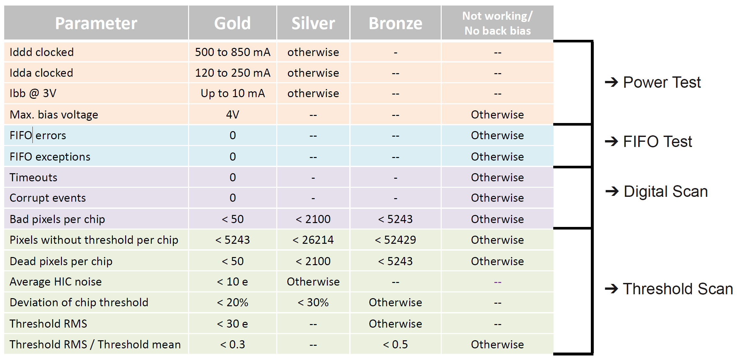
Staves – QA plan
Tests run on sensors / staves
Example for building ML/OL modules but the tests run are the same for all sensors

Slide 36
Critical Path

Slide 37
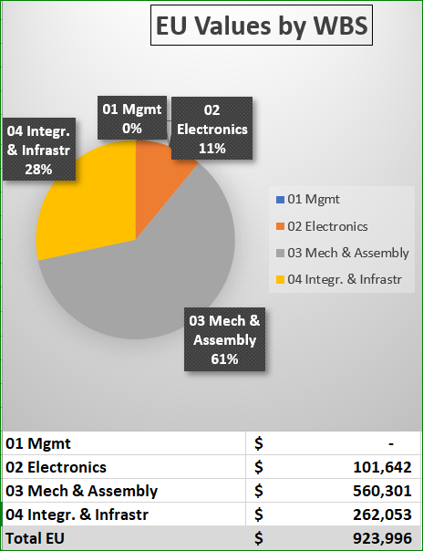
Estimate Uncertainty
EU tables are identical to those used by sPHENIX for establishing baseline cost
Labor
L1 - Actual - 0%
L2 - Level of Effort Tasks - 5%
L3 - Advanced - 10%
L4 - Preliminary - 25%
L5 - Conceptual - 40%
L6 - Pre-conceptual - 60%
L7 - Rough Estimate - 80%
L8 - Beyond state of the art - 100%
M&S
M1 - Existing Purchase Order (Actual) - 0%
M2 - Travel, supplies, software - 5%
M3 - Advanced, Quote or Catalog Price - 10%
M4 - Preliminary Engineering Judgment - 25%
M5 - Conceptual Design - 40%
M6 - Pre-conceptual Design - 60%
M7 - Pre-conceptual - Uncommon work - 80%
M8 - Beyond state of the art - 100%

Slide 38
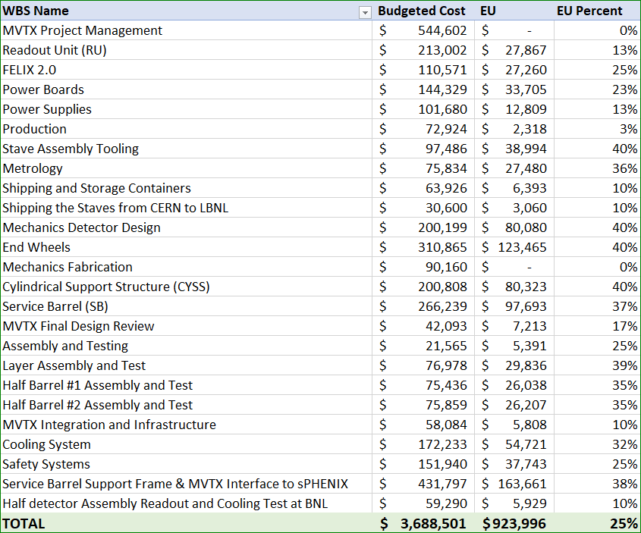
Estimate Uncertainty by WBS

Slide 39
Engineering & Technology Readiness
Stave modification and system integration - done
  MVTX & INTT integration
Readout Electronics - done
  RU, PU, FELIX, Readout cable
  Power system
Mechanical system – preliminary design available
  Detector design
  Service & integration
Detector assembly and installation – plan developed
  Follow ALICE ITS procedures

Slide 40
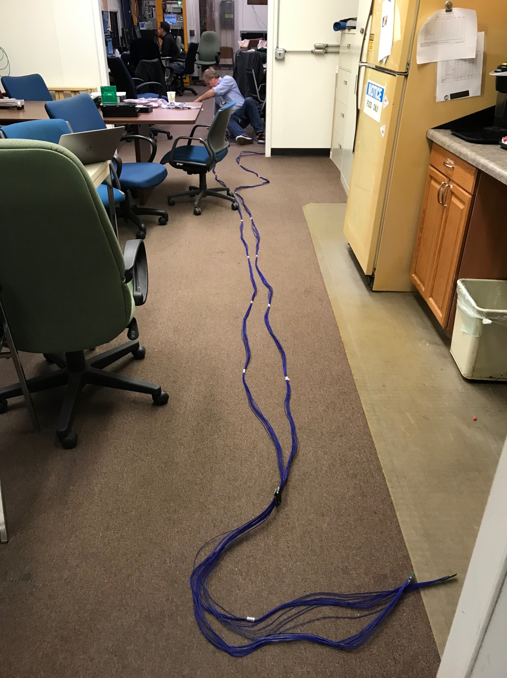
Long Custom MVTX Readout Cables Tested
PWR
RU
PU
Desired <~10m;
Tested 11.4m
BNL has approved “non-halogen free” cables for sPHENIX
sPHENIX MVTX: 7.9+m
  Cable-A: 1.4 m
  Cable-B: 6.5+ m
  Power cable:4.7+ m

Slide 41
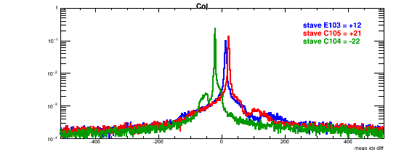
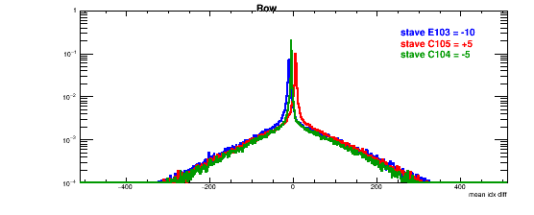
Detector Misalignment & Hit Spatial Resolution Study
Typically staves offset by,
Horizontally: 20 x 30um = 600 um
Vertically: 5 x 30 um = 150 um
Hit spatial resolution: (w/o clustering)
Peak_sigma_core = 0.55 (pixel size ) =15 um
Chip spatial resolution = 15/sqrt(2) = 11 um
(same as 2018 TB results)
120GeV proton beam
Delta_X/Y
Ref. Plane

Slide 42
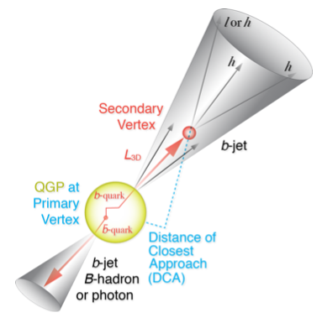
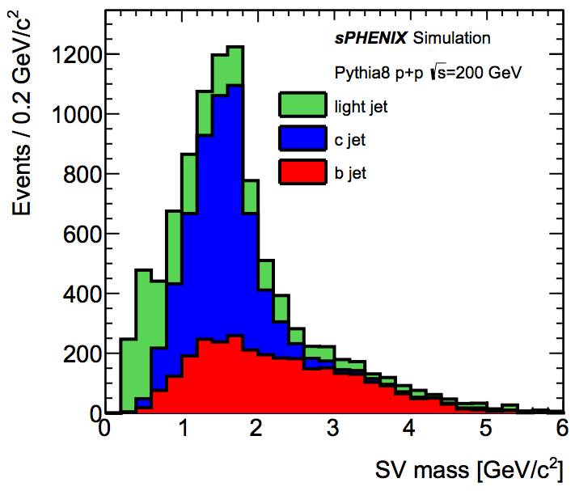
B-Hadron & b-Jet Tagging
Physics Reminder
Detected using the long lifetime of bottom quark hadrons:
  Displaced tracks
  Large 2nd vertex invariant mass
Need high precision tracking and vertex determination – MVTX!
Need excellent jet detection capabilities – sPHENIX!

Slide 43
ALPIDE/MAPS Operation
Well fit sPHENIX/RHIC environment, 10MHz Clock (LHC 40MHz)
shaping time: 2, 5, 10 … μs
v
PIX_IN
v
OUT_A
~5-6 μs
t_{f}~= 10 ns
OUT_D
ΔV=Q/C
threshold
t_{r}> 100 μs
~5-6 μs
STROBE
t
t
sPHENIX trigger latency: ~4 μs

Slide 44

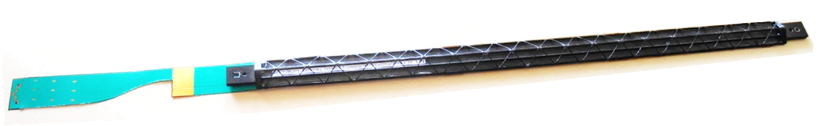
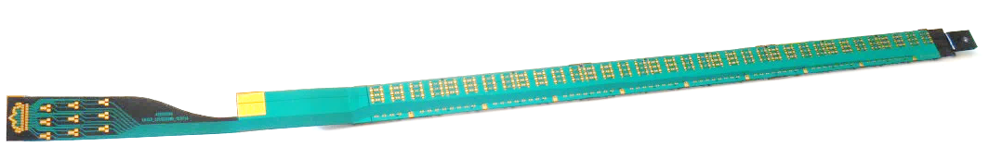
Staves - General layout
Stave design developed by ALICE at no cost for MVTX project
Possible modifications (see Walter’s talk)
Staves: detector modules consisting of a Hybrid Integrated Circuit (HIC) mounted on carbon fiber mechanical support structure
HIC: a row of 9 ALPIDE sensors wire-bonded to a Flexible Printed Circuit (FPC). Area covered by the chips: 15x271.2 mm², including a gap of 150 μm between adjacent chips.
Mechanical support: single light structure composed of a Space Frame, providing the required stiffness, and a Cold Plate, high-thermal conductivity carbon fiber sheet with embedded polyamide cooling pipes.
Heat Dissipation – The ALPIDE sensors dissipate only 40 mW/cm².
FPC
Cold plate
9 sensors
Space frame
Stave prototype

Slide 45
ITS/IB Production Stave @LANL

Slide 46
ALICE ITS/IB Assembly

Slide 47
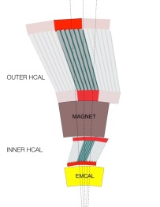
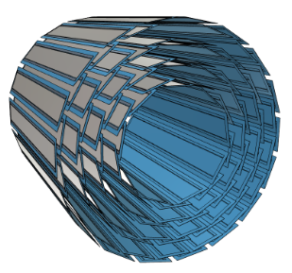
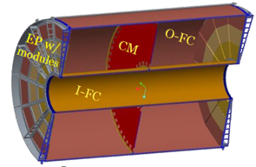
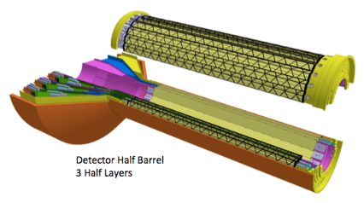
sPHENIX DAQ Architecture
Event Builder
FEM
DCM
DCM2
DCM
DCM
DCM
DCM
Network
Switch
Buffer Box
FEM
DCM
SEB
ATP
DCM
DCM
DCM2
DCM
DCM
ATP
DCM
Buffer Box
FEM
DCM
SEB
ATP
DCM
DCM
DCM
DCM2
ATP
Buffer Box
Calorimeters,
INTT, MBD
DCM
SEB
DCM
To the
RACF/HPSS
DCM
ATP
ATP
Buffer Box
FEE
ATP
DCM
DCM
FELIX
EBDC
ATP
DCM
Buffer Box
FEE
ATP
TPC, MVTX
DCM
DCM
FELIX
EBDC
ATP
Buffer Box
DCM
FEE
ATP
DCM
FELIX
EBDC
DCM
ATP
Buffer Box
DCM
Rack Room
SEB Sub-Event Buffer
EBDC Event Buffer and Data Compressor
ATP Assembles events and compresses data
Buffer Box data interim storage before sending data to the computing center

