Slide 1
sPHENIX MVTX
Cost and Schedule Review
Project Overview
Ming Liu
July 29-30, 2019
BNL

Slide 2
Outline
Physics of MVTX (3)
Project scope (~5)
Cost & schedules (~5)
R&D highlights (~5)
  Stave extension
  Readout cable
  Readout integration, test beam runs
  Mechanical system design
Recommendations from last April Review (~5)
Summary

Slide 3
The 3rd Science Pillar by MVTX
Physics

Slide 4

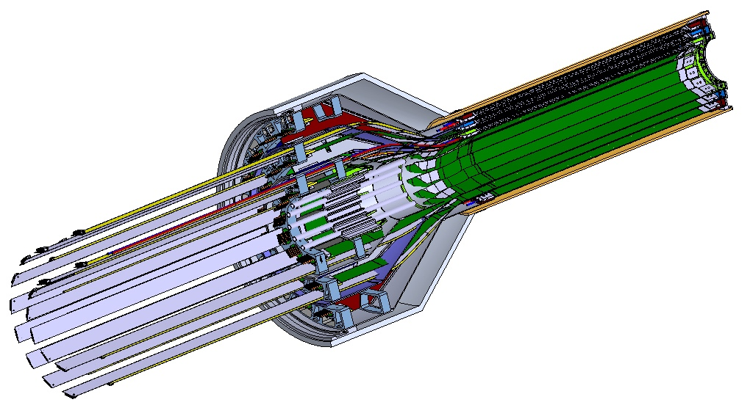
MVTX Detector – Modified from ALICE/ITS Design
Service cone: signal, power, cooling
and mechanical support
CYSS: Cylindrical Shell Structure
End-Wheel
Extended power FPC
3-layer sensor barrel
- 48 staves, 432 chips
MVTX
parameters

Slide 5
Scope of the MVTX Project - WBS3.2
MVTX sensor & Electronics
  Readout Integration
    Frontend: ALICE/ITS RU
    Backend: ATLAS FELIX
  Assembly & production @US: ~$5M
    QA & assembly
      RU boards @UT-A
      Half detectors @LBNL
      FELIX boards @LANL/BNL, 6+spares(2)
    Ancillary systems - “adopt” ALICE ITS system
      Power, slow control & monitoring etc.
Mechanical system
  Modify ALICE/ITS mechanical structures
    End Wheels
    Cylindrical structure shells
    Service half barrels
  Mechanical system integration,
    Design & simulations, MIT/LANL
    Composite structure production, LBNL
    Non-composite structure, MIT
    Installation tooling etc., BNL/LANL/MIT/LBNL
  Adopt ALICE cooling plant design
    Modifications to fit sPHENIX, MIT/BNL
  Production @CERN: $1.36M, a separate BNL project
    - 84 ALICE/ITS-IB (modified) staves from CERN
      Acceptance test @LBNL, 48+spares(2-inner layers+)
    - 60 ALICE/ITS-RU from CERN
      Acceptance test @UT-Austin, 48+spares(12)

Slide 6
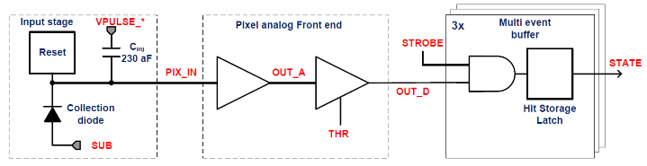
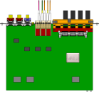

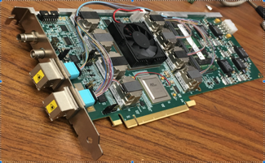

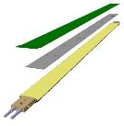
MVTX Readout, Power and Controls
CAN bus
DCS
Jo’s talk
Trigger & Clock
Readout Unit
Front End
GBT Optical Links
one pixel
9 Data (1.2Gbps)
1 Clock, 1 Control/Trigger
Control
Data (9.6 Gb/s max)
Trigger
9-sensor Stave
Samtec Twinax “FireFly”, ~10m
FELIX
Back End
FPC
Power
ATLAS Front-End Link eXchange (FELIX):
sPHENIX Data Aggregation Module(DAM)
Alpide Sensors
Flex PCB Filtering Capacitors
regulators
Power
Regulated Power
CAEN Power supplies
Cold Plate
ALPIDE pixel:
Shaping
Digitization
Zero-suppression
3x buffer
Power Board
Interaction Region
Experimental Hall
Counting House
MVTX Detector Electronics consists of three parts
Sensor-Stave (9 ALPIDE chips) | Front End-Readout Unit | Back End-FELIX/DAM

Slide 7
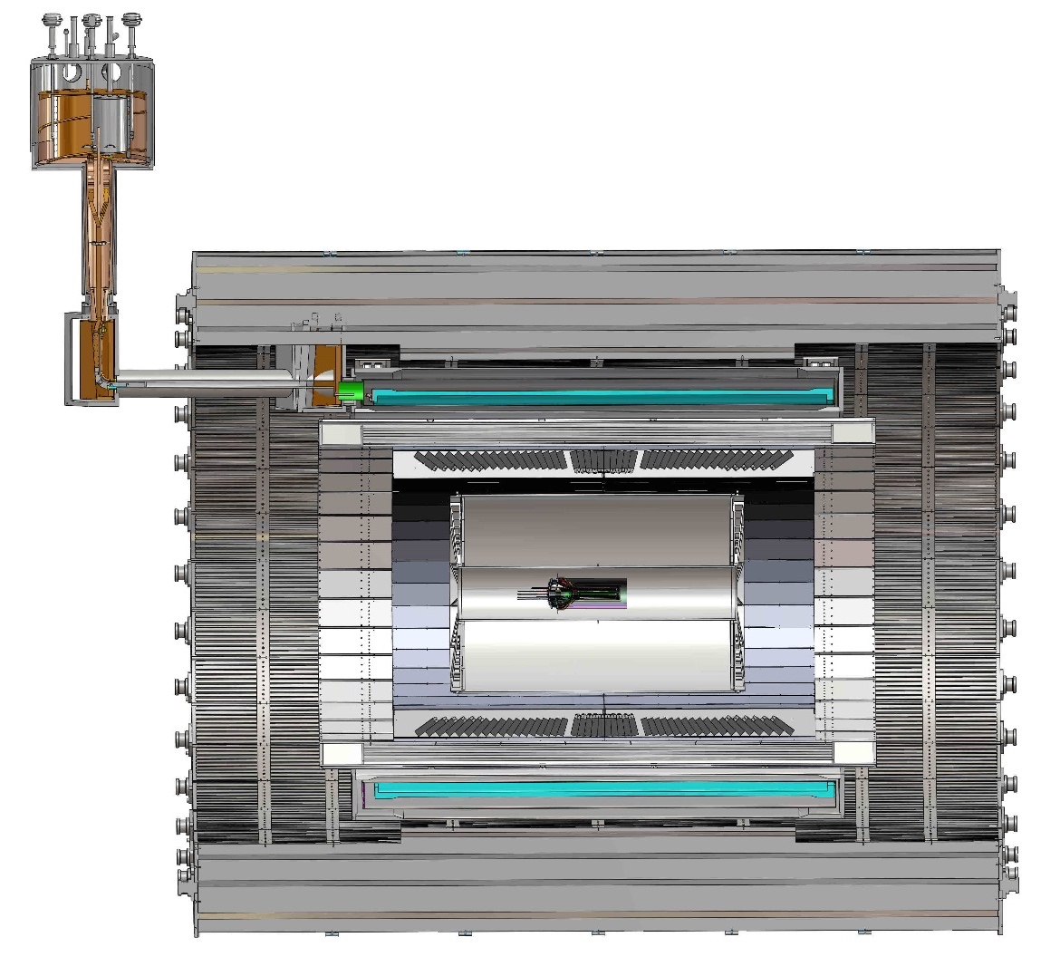
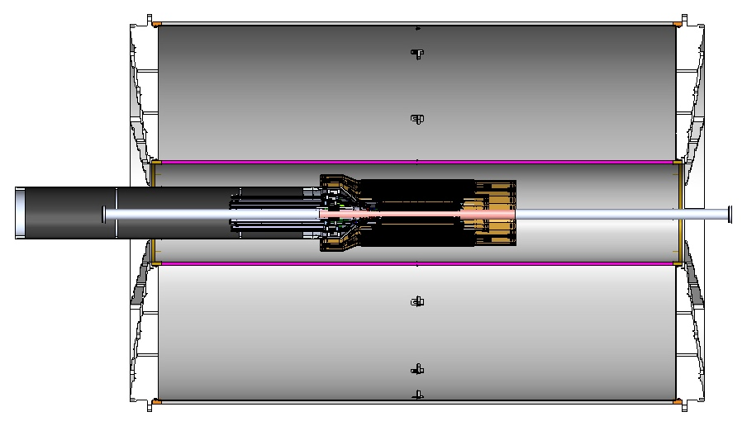
MVTX Global Mechanical System Integration
MVTX system preliminary design, with two parts:
  Part-1: from MVTX to PP-1b, all power PCB, 40cm
  Part-2: length TBD later, from PP-1b to PP-2
Service Barrel
TPC
TPC
INTT
MVTX
PP-1a:
short signal cables
PP-2:
Signal and power cables
R= 209.6cm
PP-1b:
power cables
L = 350.0 cm

Slide 8
Preliminary Mechanical Design Completed
Camelia’ talk
https://indico.bnl.gov/event/6377/
MVTX, INTT, TPC …

Slide 9
Cost of Major Items

Slide 10
Schedule & Milestones

Slide 11
MVTX Schedules and Milestones (3/2019)
sPHENIX: CD1/3a PD2/3
Installation
1st collisions
CY-2018 | 2019 | 2020 | 2021 | 2022 | 2023
MVTX
Stave & RU
production
FELIX
production
Funding delays –
Stave production delayed at CERN
- Impact on following test & assembly
- preparation work @LBNL, UT-A
Lack of R&D $ for mech. desgin work
- MIT, LBNL, LANL
- “advanced cash” running out MIT, LANL
Detector mechanics design & production, global interface to sPHENIX
End Wheels
CYSS
Global integration
/interface design
Service barrel
design & production
Ready for beam;
sPHENIX day-1 run
Barrel Assembly & Testing @LBNL
Install half barrels
@sPHENIX IR
Half barrel #1
Power system
production
Half barrel #2
Half barrels
arrive @BNL
design & procure
interface to
sPHENIX rails
Running low in schedule contingency …
Design & procure
sPHENIX rails
MVTX installation & commissioning @BNL
RU, FELIX, PS, cables etc.

Slide 12
R&D Highlights

Slide 13
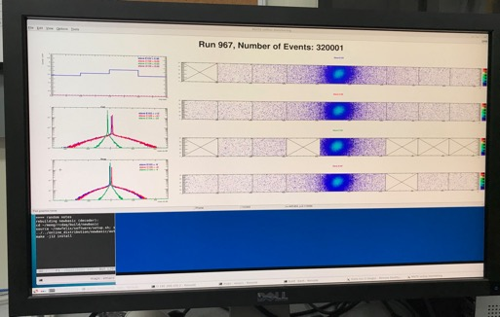
Very Successful Test Beam @Fermilab
5/20-25, 6/17-22, 2019
SamTec: 11.4m
(2.6m+8.8m)
4-stave telescope
RU-2: 1 stave
- 1 fully functioning
9-chip stave;
- 3 staves with a few
broken sensors
4 staves
2 RUv1.1
1 PU
1 FELIX Server + RCDAQ
sPHENIX GTM
11.4m Custom SamTec Cable
Negative pressured cooling for staves
RU-1: 3 staves
5m SamTec
120GeV p-beam
10kHz (30kHz)
Beam intensity:
30k ~ 120k ppp
Data & Control
Beam Trigger
Timing & Trigger
GTM
FELIX
Online Monitoring
RCDAQ
A full system with final sensor/readout* hardware:
Multi-Stave + Multi-RU -> FELIX readout demonstrated
sPHENIX GTM integrated
Long readout SamTec cable certified
Cooling system demonstrated
* RUv1.1 identical to the final RUv2 electrically

Slide 14
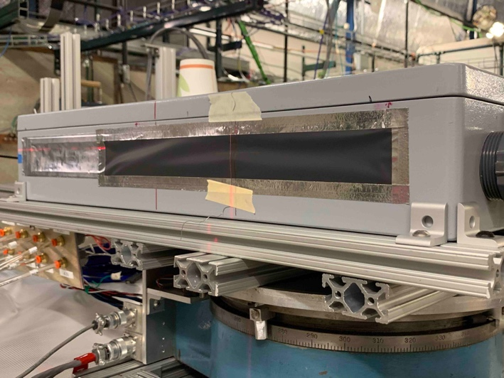
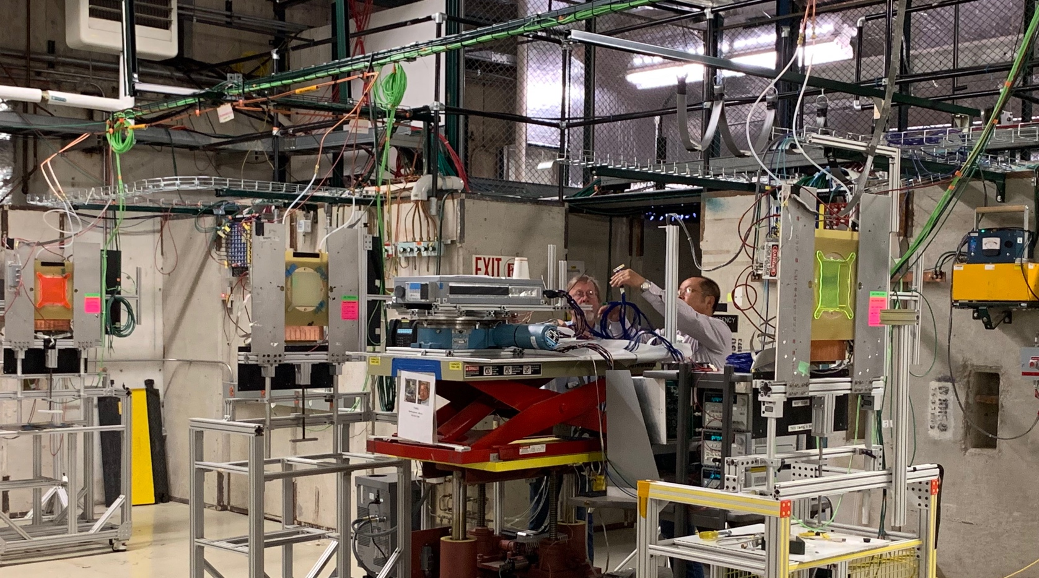
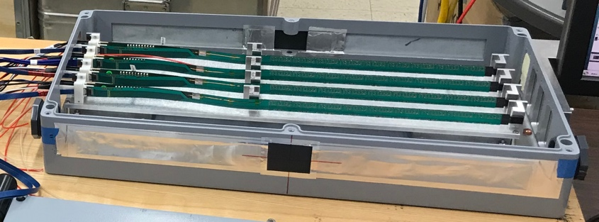
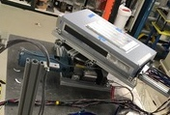
2019 MVTX Test Setup
From view
beam
Stave housing (four staves)
Stave housing sits on a motion table which can be moved in (x, y) plane perpendicular to the nominal beam direction. It can also be rotated (+40, -40) degrees (see photo on right). Operation was done at counting house.

Slide 15
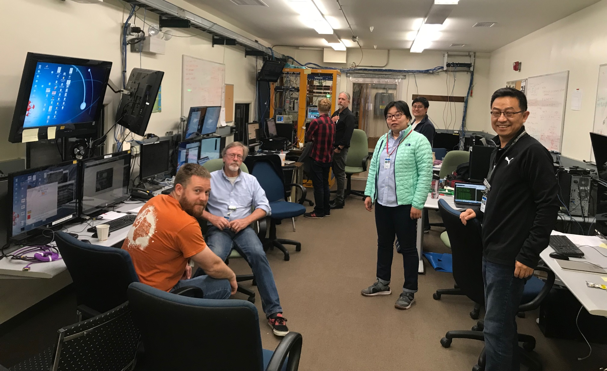
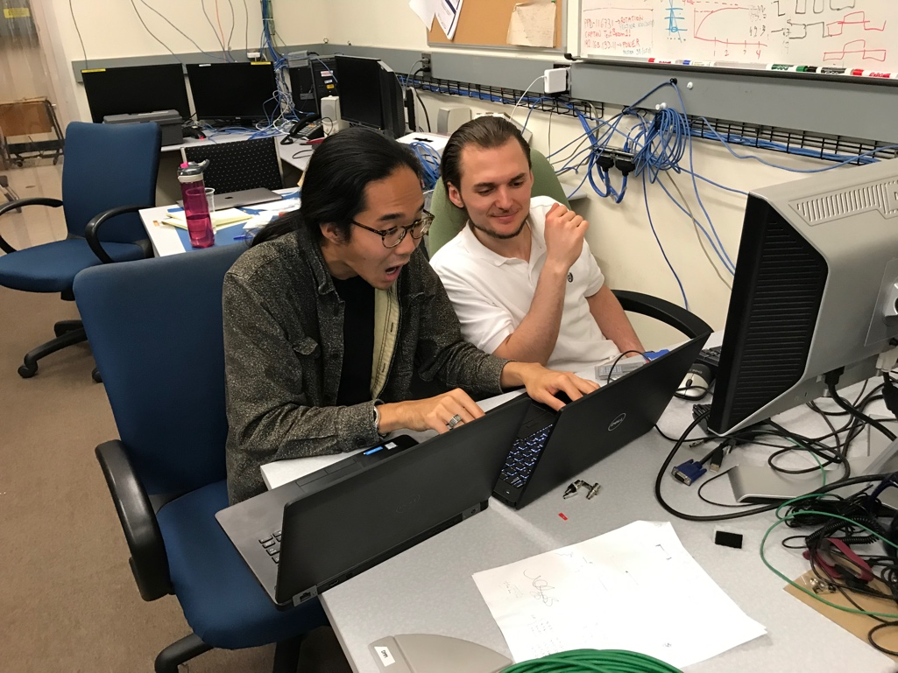
The TB Team @Fermilab
Data taking shift in the evenings: 7PM – 7AM
Beam: every other Monday –Friday 8:00AM – 8AM
Matt, Hubert, Cameron, Gerd, Zongze,
Xuan, Xiaochun, photo by Ming
Sho, AlexT
Not shown: Sanghoon, Yasser, Martin, Walt,
Abel. Chris …

Slide 16
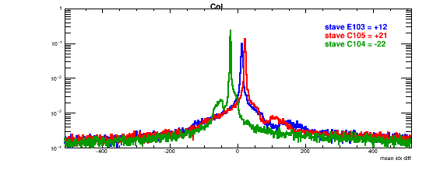
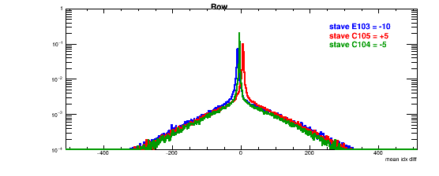
Detector Misalignment & Hit Spatial Resolution
Typically staves offset by,
Horizontally: 20 x 30um = 600 um
Vertically: 5 x 30 um = 150 um
Hit spatial resolution:
peak_sigma_core = 0.55 (pixel size ) =15 um
Chip spatial resolution = 15/sqrt(2) = 11 um
Delta_X/Y
Ref plane

Slide 17
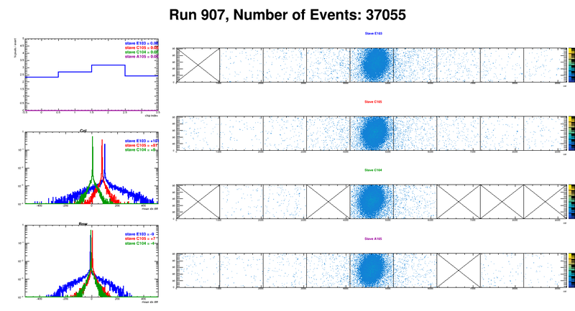
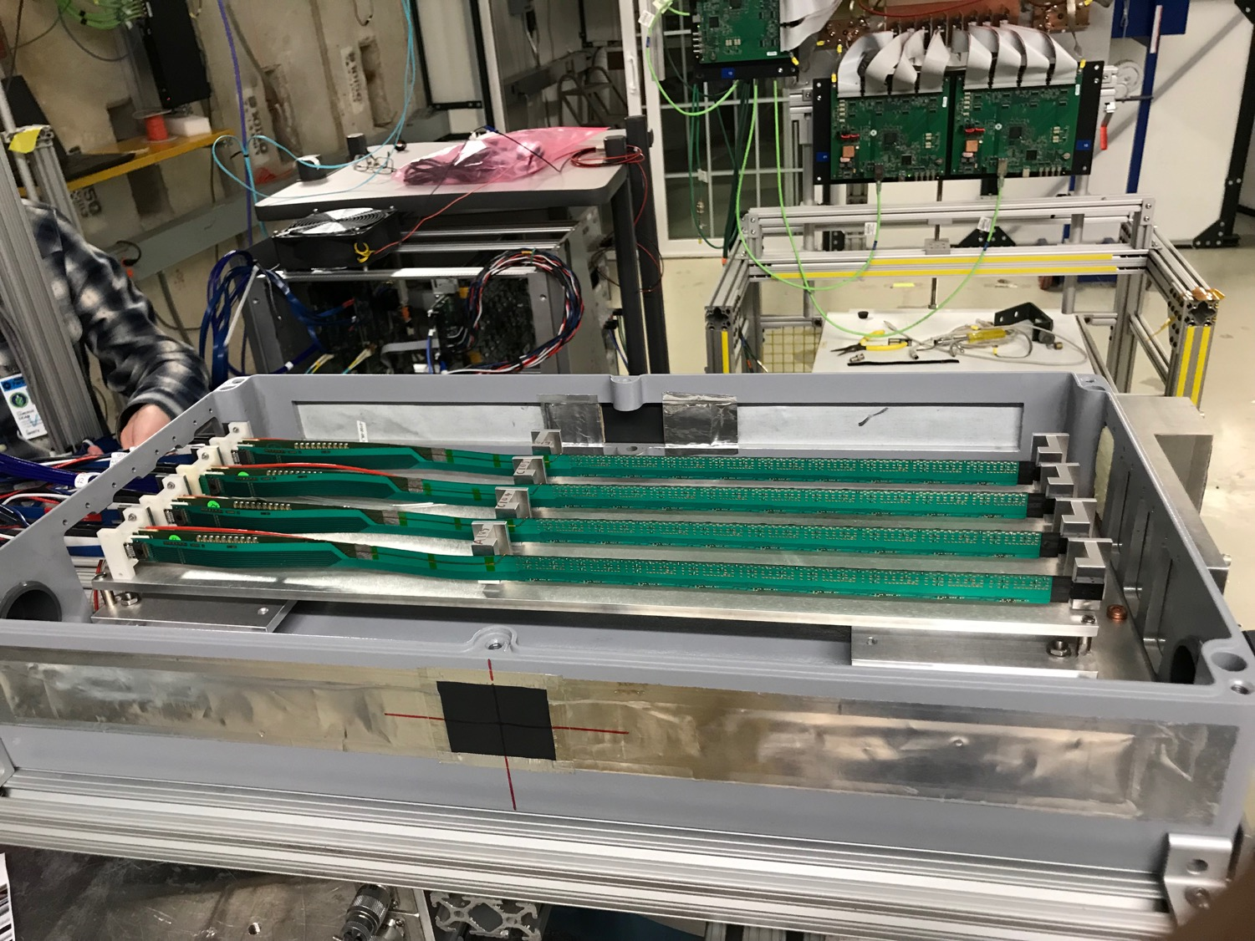
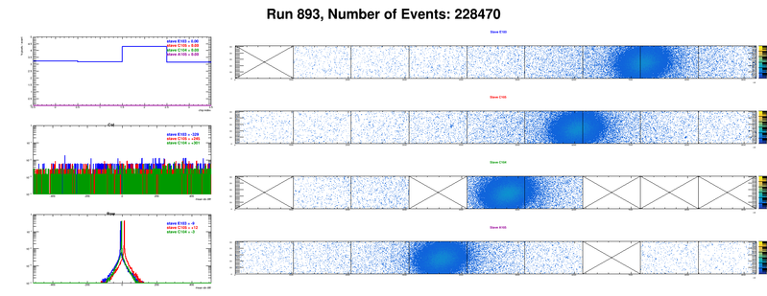
Offline analysis in progress: all TB data in RCF
https://wiki.bnl.gov/sPHENIX/index.php/MAPS-based_Vertex_Detector_(MVTX)
Beam angle: 0
(eta ~0)
MVTX 4-Stave Telescope
Beam angle: 40
(eta ~1)

Slide 18
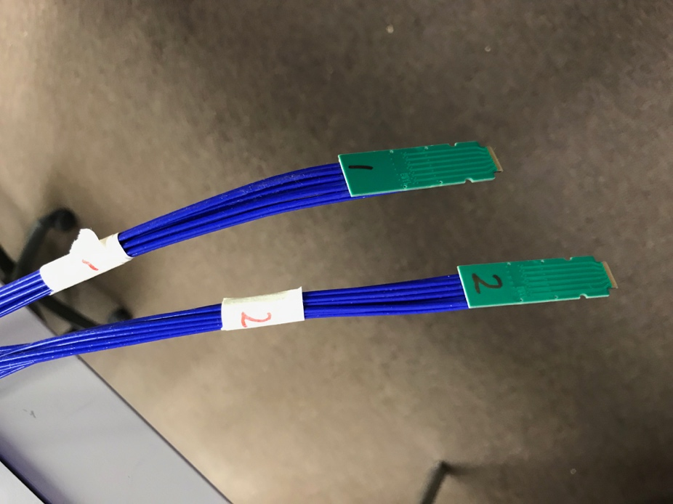
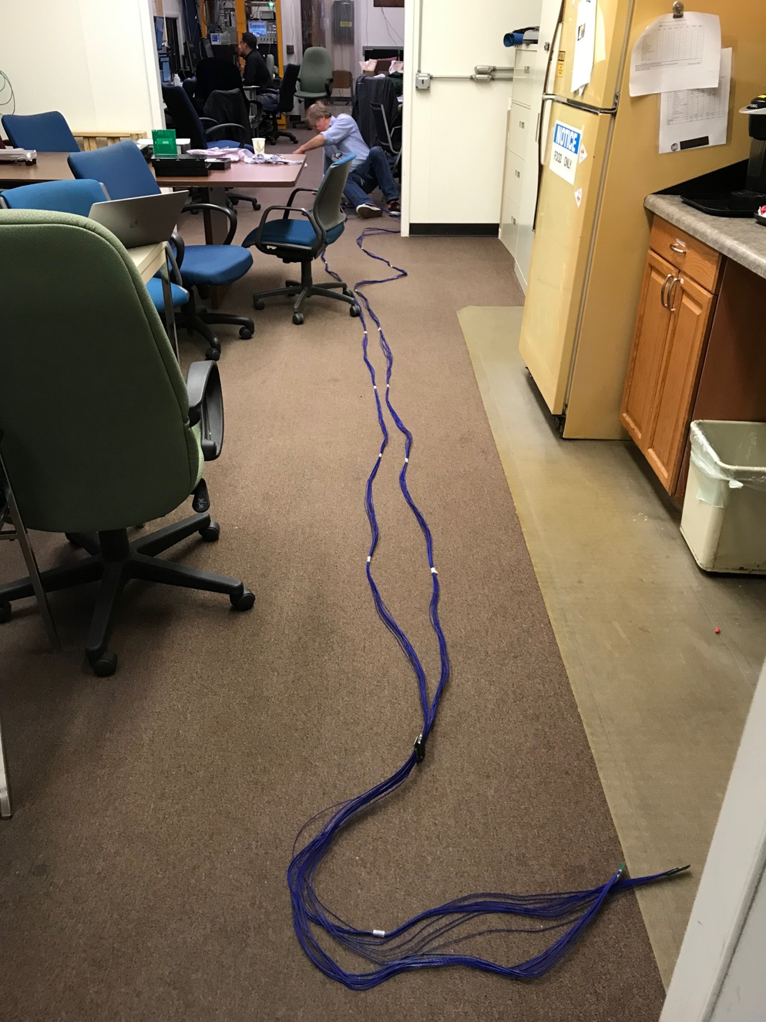
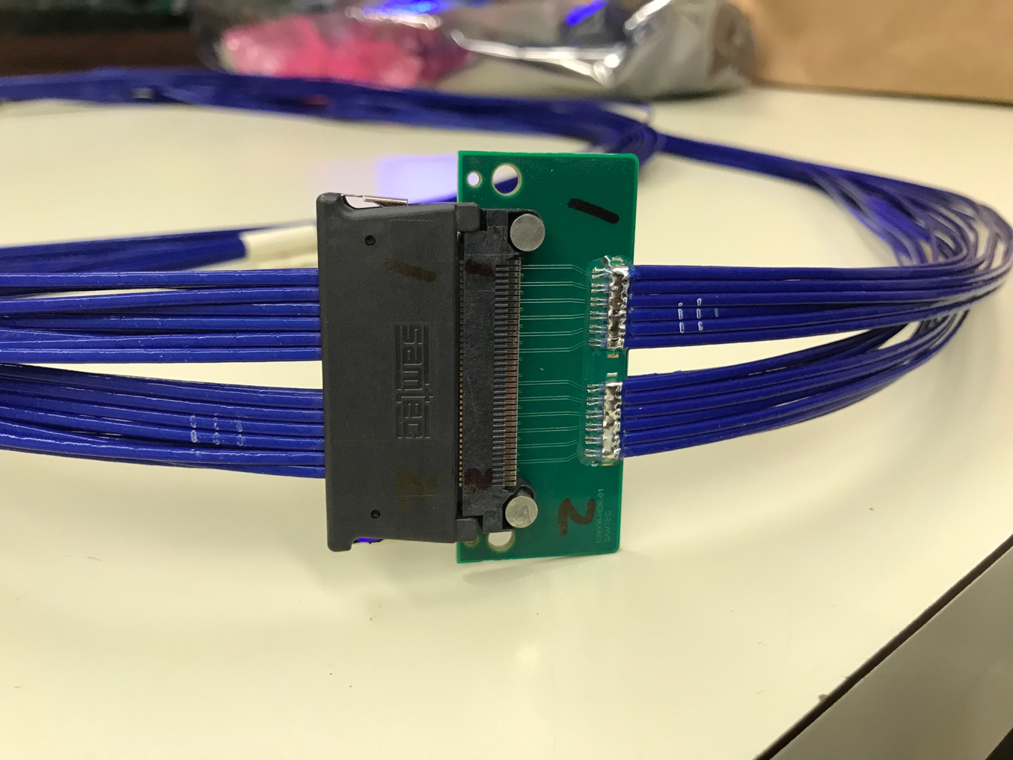
Tested New MVTX Long SamTec Readout Cables
8.8m + 2.6m = 11.4m (10m desired for sPHENIX; ALICE 8m cables)

Slide 19
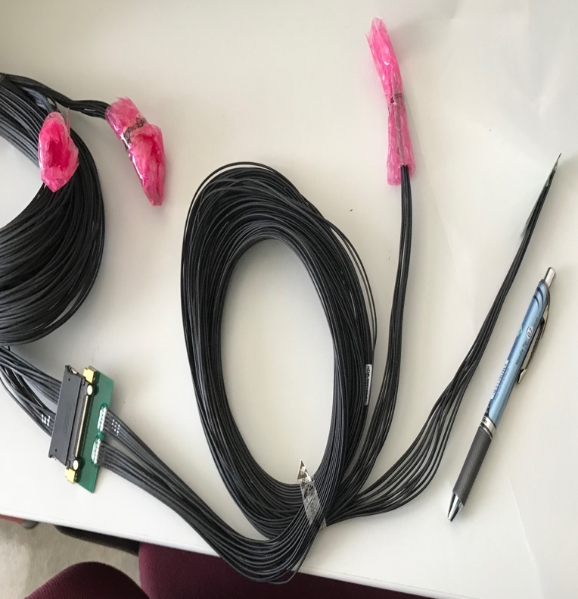
MVTX Readout and Power Cable Route
ALICE ITS/IB final readout cables: ~8m
Cable-B: 5.3m
Cable-A: 2.65m
PWR
RU
PU
sPHENIX MVTX: 7.9+m
  Cable-A: 1.4 m
  Cable-B: 6.5+ m
  Power cable:4.7+ m
Desired ~10m
BNL has approved “non-halogen free” cables for sPHENIX

Slide 20
Recommendations from April Director’s Review

Slide 21
Report from April BNL PD2/3 Reviews: Silicon Detectors - MVTX, INTT

Slide 22
MVTX Risks - all in P6 now
WBS, PMP documents updated
Schedule & Labor profile updated in P6
(Glenn, Irina )
Need project fund NOW to meet the goals!

Slide 23
Technical Readiness
Sensor modification and system integration
  MVTX & INTT integration
Readout Electronics
  RU, PU, FELIX, Readout cable
Mechanical integration
  Detector
  Service

Slide 24
Project Status
Confirmed long SamTec readout cables recently – last key integration R&D
  11.4m long cables, > 10m desired length
MVTX mechanical design: excellent progress
  Asked for quotes from outside companies based on preliminary designs
  sPHENIX integration workfest scheduled 7/10 @BNL, MVTX/INTT/TPC…
Release of early R&D fund in progress
  MVTX mechanical engineering design, MIT/LANL
  Preparation for Stave and RU acceptance test, LBNL, UT-Austin
MVTX Cost & Schedule Review – we are ready for full production
  July 29-30 @BNL
  WBS, PMP, Risk Registry, P6 being updated
Stave and RU production at CERN
  DOE Fund arrived at UTK/US-ALICE
  Procurement in progress
    CERN is ready to proceed with stave production
    60 MVTX RUs delivered to CERN
  Power mezzanine and transition boards produced at UT-A

Slide 25
Summary

Slide 26
Back Up

Slide 27
MVTX 4-Stave Telescope

Slide 29
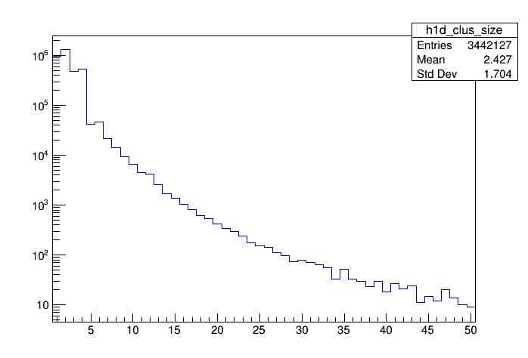
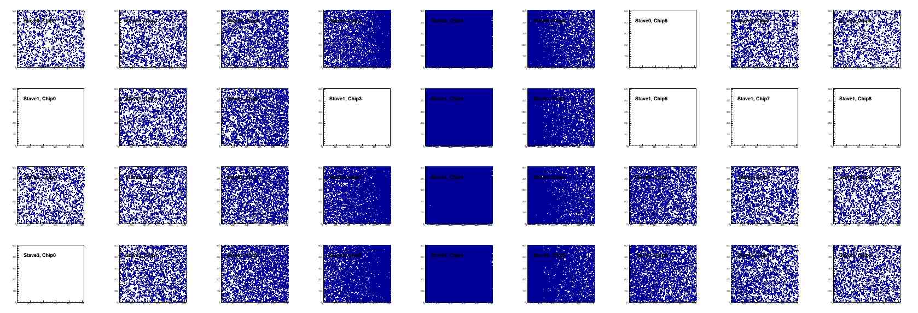
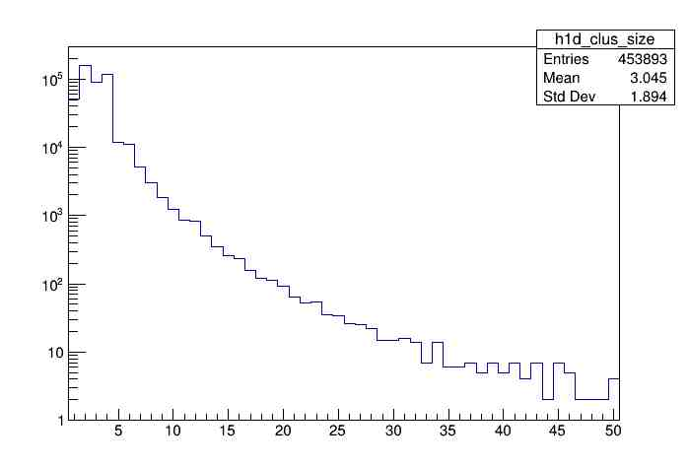
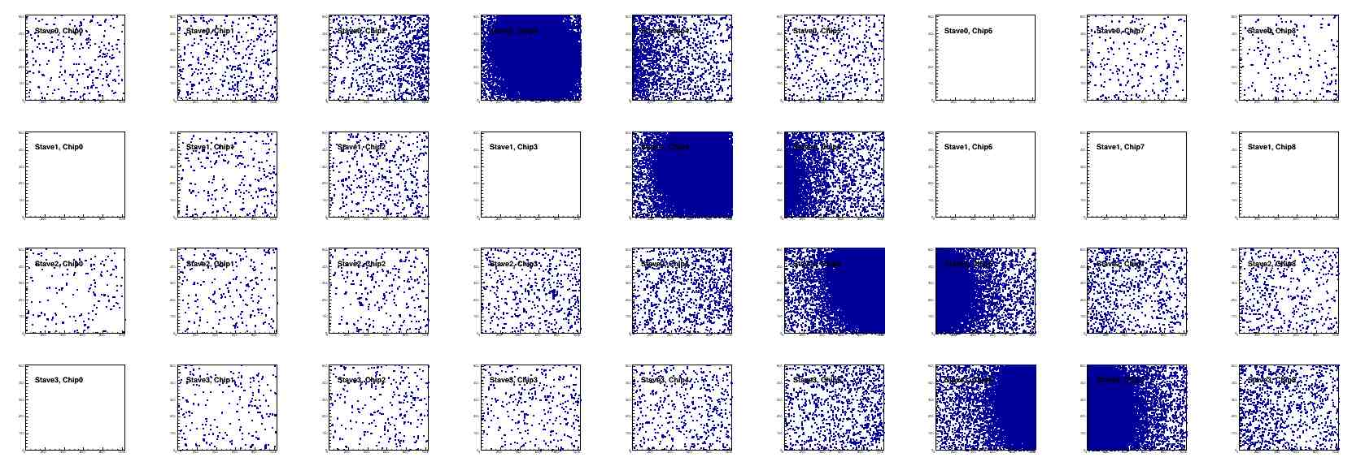
Offline Analysis: Cluster size vs Angle
To calibrate MC simulations and tracking
Stave geometry, alignment
Clustering
@ 0-degree
Cluster Size ~ 2.4
@ 40-deg
Cluster Size ~ 3.0

