Slide 1
MVTX C&S Review Homework
Ming Liu
for the MVTX Group
July 29-30, 2019

Slide 2
Homework Questions
A: Insertion of MVTX
Can we see all 8 steps of the insertion i.e. step 1-8 slide 13 in Mironov’s presentation.
Do you have a drawing of the beam pipe and the proposed extension?
Are there plans to test insertion of MVTX with a mockup beam pipe?
B: Carbon fiber work
We would like to hear more details on usage of the carbon fiber shop at LBNL:
please highlight the entries in WBS that involves work at the CF shop.
Discuss possible conflict with other activities in the carbon fiber shop (e.g. ATLAS,…).
How many iterations of CYSS, LO-L2 shells, and service barrel are permitted in schedule?
What is your plan for evaluating the commercial carbon fiber vendors while simultaneously engaging with LBNL as vendor?

Slide 3
Insertion of MVTX
Q1. Can we see all 8 steps of the insertion i.e. step 1-8 slide 13 in Mironov’s presentation?
A: Yes: ppt link

Slide 4
Insertion of MVTX
Q2: Do you have a drawing of the beam pipe and the proposed extension?
Yes: The beam pipe drawings of both existing and proposed modification have been posted to the review Indico page in the Beam Pipe Drawings directory.
Russ Feder and Jim Mills will elaborate the details and the current status

Slide 5
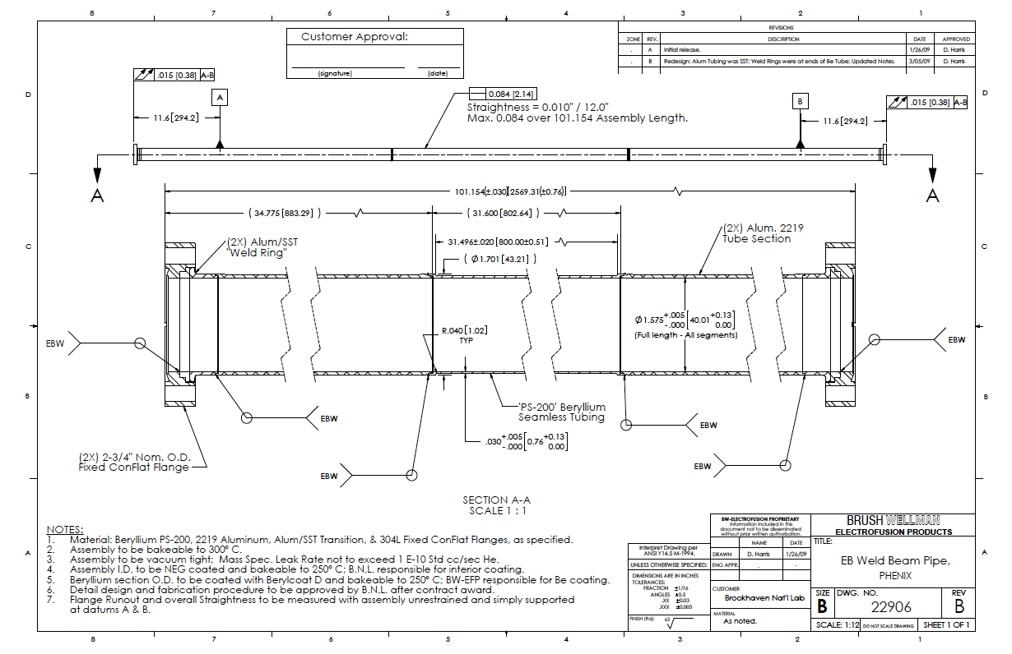
Drawing of the existing beam pipe.

Slide 6
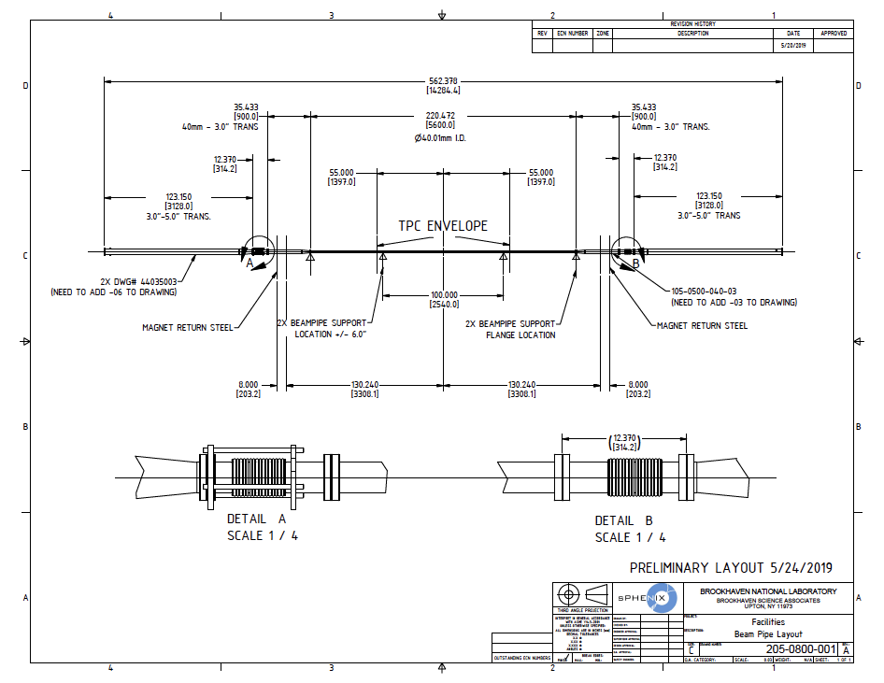
Drawing of the proposed modified beam pipe with supports

Slide 7
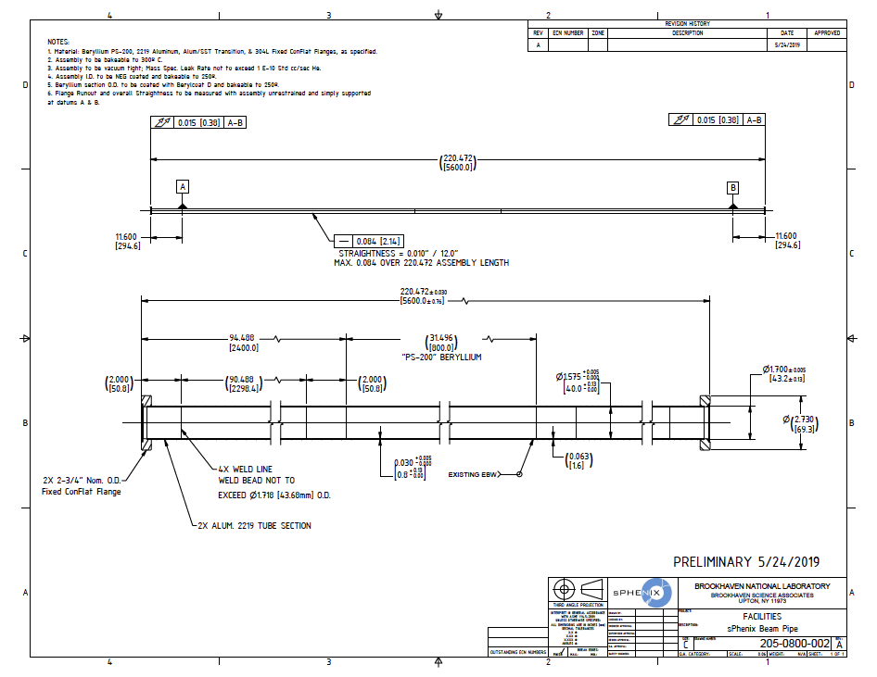
Drawing of the modified beam pipe.

Slide 8
Insertion of MVTX
Q3: Are there plans to test insertion of MVTX with a mockup beam pipe?
A: Yes, we will design a full-scale mockup at BNL to check that there are no space constraints or contentions associated with the MVTX installation inside the TPC/INTT and around the beam pipe.
The mock-up installation exercise should be carried out once the detector installation design plans are mature enough to allow for a viable test. We expect that the mock-up installation test can be carried out at BNL within the next 6-9 months. The results will be used to guide the development of the final installation scheme for the sPHENIX inner components including the TPC support services (cables and plumbing), INTT, MVTX, and beam pipe.

Slide 9
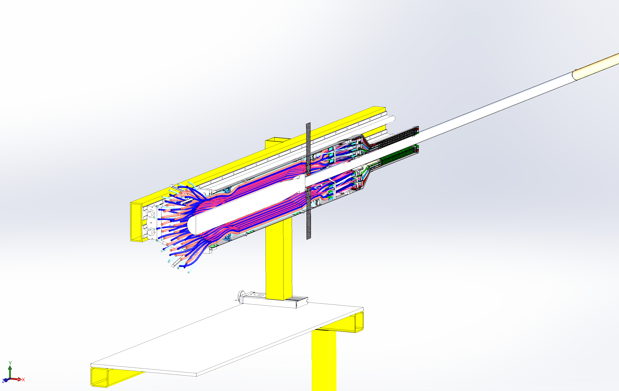

Slide 10
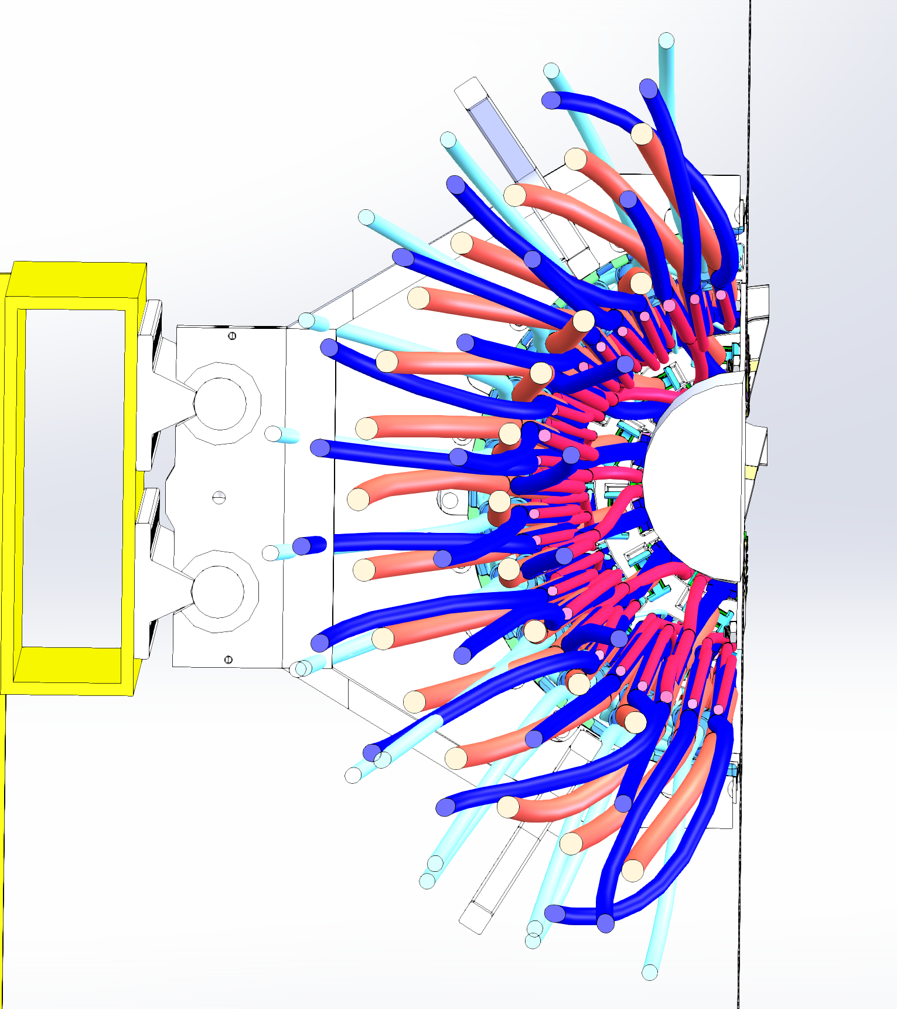

Slide 11
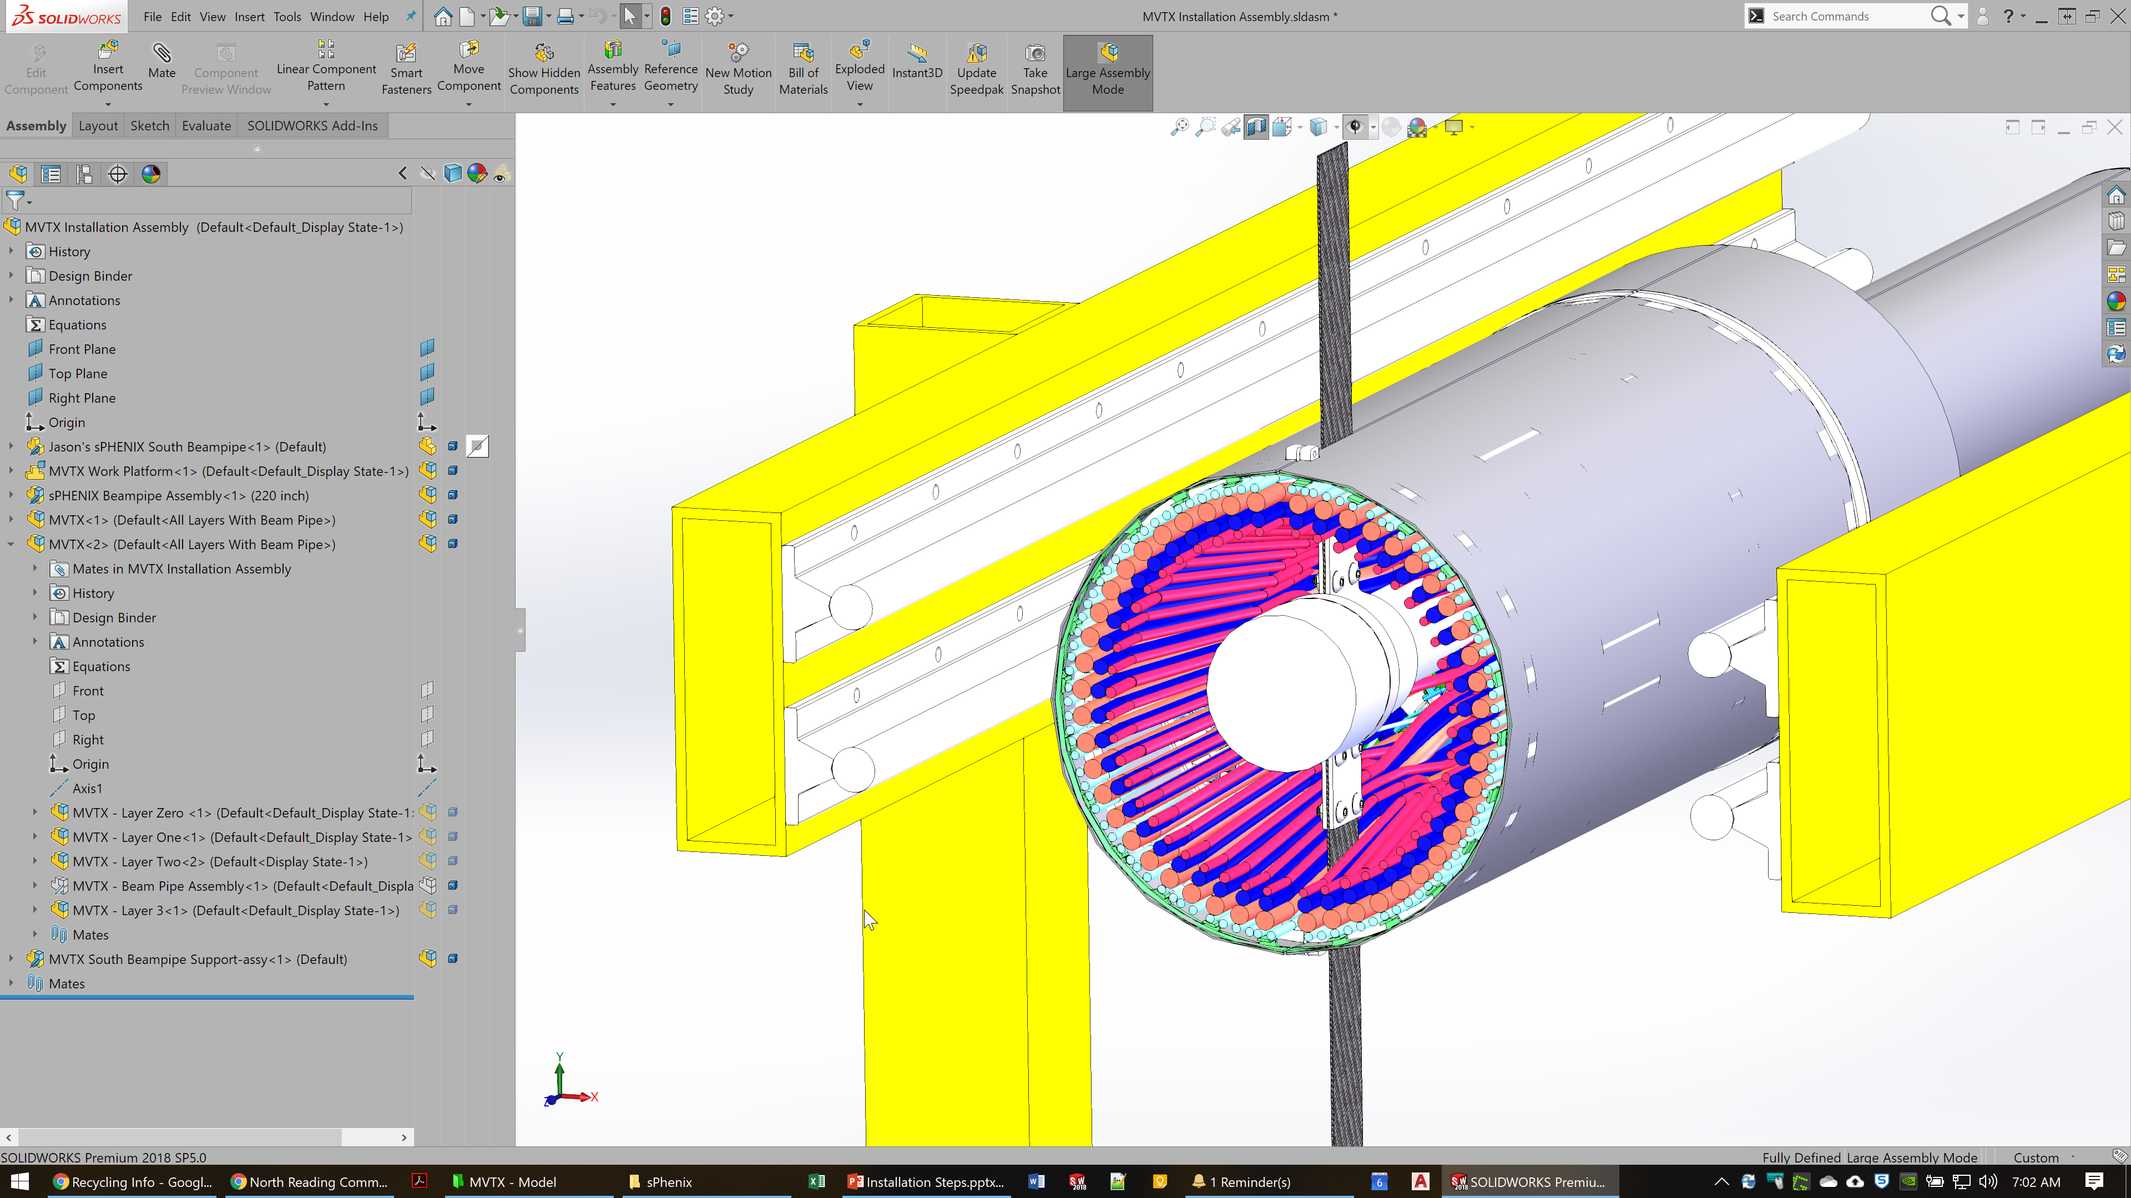

Slide 12
Carbon fiber work
Q1. Please highlight the entries in WBS that involves work at the CF shop.
A:
- End-Wheels production: 1/30/2020 - 8/19/2020
S110900--- S111600
- CYSS production: 1/30/2020 - 9/2/2020
S113000 --- S113800
- Service Barrel production:
S113900 - 114600
MVTX PRR: 7/28/20200

Slide 13
Carbon fiber work
Q2. Discuss possible conflict with other activities in the carbon fiber shop (e.g. ATLAS,…).
A:
Based on Eric Anderssen’s estimate, MVTX carbon composite structure production has no conflict with current LBNL CF activities.
- End-Wheels production: 1/30/2020 - 8/19/2020
- CYSS production: 1/30/2020 - 9/2/2020
- Service Barrel: 4/10/2020 - 10/8/2020

Slide 14
Carbon fiber work
Q3: How many iterations of CYSS, LO-L2 shells, and service barrel are permitted in schedule?
A:
Conical carbon composite structures require a number of trial-and-error iterations in modifying the mold to compensate for the structural relaxation of carbon composite in order to meet the specification. The exact number of iterations needed depends on the details of the structure. The shop at LBNL is experienced with this production procedure.
As discussed, the LBNL shop engineers will receive advanced funding to perform manufacturability studies and the number of iterations, the cost, and the schedule will be included in the updates to the estimates.
Cylindrical structures do not need such iterations.
Eric Anderssen’s past experience:
“For the ATLAS Hat Stiffener, we machined a first tool, pulled 3 parts off of it (for statistics), then re-machined. Due to a calculation error, we had to re-machine again.
In the end, I think 2 re-machining steps should be in base plan with the 'opportunity' that the second re-machining is not required. Note: we leave enough meat on the tool to simply re-machine the same part, not a whole new tool i.e. material is free for the iterations.”

Slide 15
Carbon fiber work
Q4: What is your plan for evaluating the commercial carbon fiber vendors while simultaneously engaging with LBNL as vendor?
A: We are already in process of discussing to produce a prototype set of CYSS and Layer-2 End-Wheels, if successful, they could also be used as part of production.
Evaluation process:
requested preliminary quotes -- DONE (received already from 1 vendor - did not take into account desired final tolerances)
send vendors an updated set of detail drawing for revised quotation
they have to provide prototypes and proof they can deliver the desired specs
Q&A has to be performed on any prototype piece delivered, example CMM at LBNL
Decide (considering also costs) on the vendors

Slide 16
backup

