Slide 1
sPHENIX MVTX Cost & Schedule Review
MVTX Cost and Schedule
Dave Lee/Ming Liu, LANL
July 29-30, 2019
BNL

Slide 2
Scope of the MVTX Project – WBS 3.02
Mechanical system (3.02.03, 3.02.04)
  MVTX detector mechanical structures
    Design & simulations, MIT/LANL
    End Wheels
    Cylindrical support structure
    Service barrels
  Mechanical system integration
    Service barrel support & interface to sPHENIX
    Installation tooling etc., BNL/LANL/MIT/LBNL
    Adopt ALICE cooling plant design
  Detector assembly
    Stave QA & detector assembly @LBNL
Electronics (3.02.02)
  Readout Integration
    RU QA & assembly @UT-A
    Backend: ATLAS FELIX
    FELIX boards @LANL/BNL
    Frontend RU services: daughter cards, transition boards, cables etc.
  Ancillary systems - “adopt” ALICE ITS system
    Power, slow control & monitoring etc.
Jo’s talk
Walt’s talk
Camelia’s talk
BNL provides Staves & RUs, w/o cost to MVTX project:
- 84 ALICE/ITS-IB (modified) staves from CERN;
48+spares(2-inner layers+10%)
- 60 ALICE/ITS-RU from CERN
48+spares(12, 25%)
Early R&D by LANL LDRD $5M, FY17-19
Yuan’s talk
2

Slide 3
MVTX C & S - Assumptions
Fully Integrated into the sPHENIX schedule (P6)
Self contained project, funding from BNL
Up-to-date Institutional resource hourly rates, fully burdened
Implement Risk Based Contingency
Schedule smoothed, ~6 months float in P6 prior to sPHENIX installation
Electronics ready for production on start of project to the successful LDRD effort, cost based on as built experience, FELIX and RU service boards, power system etc.
Linkages to Stave and RU in the schedule
LANL 04/10/19
3

Slide 4
MVTX in sPHENIX P6 (fully Burd. & Esca.)
Budget cost = $3.688M

Slide 5
Simplified MVTX Schedule
CY-2018 | 2019 | 2020 | 2021 | 2022 | 2023
Stave & RU production @CERN
Construction
Detector mechanics design & production, global interface to sPHENIX
MVTX final
review
Detector & interface design
End Wheels
cooling & safety
system @BNL
CYSS
SB production
Service barrel &
global system design
Stave testing, half-barrel assembly @LBNL
Stave Testing
Half Barrel #1
MVTX ready for Installation
FELIX production(7)
Half Barrel #2
8/25 MVTX start
Installation
sPHENIX interface & global support design
Power system
production
Cooling & Safety System
Full detector
system test @BNL Lab
“PD-4-like”
Closeout 12/2023
Pre-installation commissioning @BNL
RU, FELIX, PS, cables etc.

Slide 6
Milestones
Milestone | Date
Start Construction | 4th Qtr FY 2019
MVTX Final Design Review | 3rd Qtr FY 2020
Half Barrels Assembled | 1st Qtr FY 2022
Installation Finished | 4th Qtr FY 2022
Ready for Beam | 1st Qtr FY 2023

Slide 7
Lower Level Milestones
Management
 | Project Start | Sept 3, 2019
Electronics
 | Procure Samtec Cables | Feb 5, 2020
 | Procure Transition Board | Nov 13, 2019
 | Procure Power Mezzanine for RU | Nov 13, 2019
 | Procure FELIX units(7) | Apr 14,2020
 | Procure Power Boards | Feb 12, 2020
 | Fab Cooling plates | Sep 16, 2019
 | Fab breakout boards | Sep 30,2019
 | Procure Power Distributioin | Sep 30, 2019
 | Ship Power System to BNL | Apr 23, 2020
 | Procure CAEN Power Supplies | April 20 2020

Slide 8
Lower Level Milestones
MVTX Mechanics and Detector Assembly
 | Stave Assembly Tooling | Jan 22, 2020
 | Metrology design and produce | Dec 30, 2020
 | Ship stave container to CERN | Sep 30, 2019
 | Ship first batch staves to LBNL | Dec 12, 2019
 | Ship last batch staves to LBNL | Sep 3, 2020
 | End Wheels production and test | Aug 17, 2020
 | CYSS Production and test | Sep 1, 2020
 | Production and test SB | Oct 7, 2020
 | Test and rework staves batch 1 | Apr 9, 2020
 | Test and rework staves batch 4 | Sep 29, 2020
 | Hold half detector Assembly review | Mar 1, 2021
 | Perform half detector metrology on layers | Jul 30, 2021
 | Install staves onto end wheels | Jun 8, 2021
 | Assemble layers and CYSS into half barrel 1,2 | Aug 27, 2021 , Sep 23, 2021
 | Perform half barrel 1,2 metrology | Oct 5 , 2021 , Nov 3, 2021

Slide 9
Lower Level Milestones
MVTX Integration and Infrastructure
 | Design cooling system | Aug 25,2020
 | Procure cooling system | Mar 1, 2021
 | Ship to BNL | Mar 8, 2021
 | Review Sensors and Interlocks with BNL ES&H | Oct 15, 2020
 | Design Electronics Safety System | Nov 13, 2020
 | Tet safety system at BNL | Apr 12, 2021
 | Design interface to sPHENIX | June 22, 2020
 | Design insertion system | Oct 7, 2020
 | Test half barrel 1 at BNL | Dec 27, 2021
 | Test half barrel 2 at BNL | Jan 19, 2022
 | MVTX Full system test at BNL | Mar 29, 2022

Slide 10
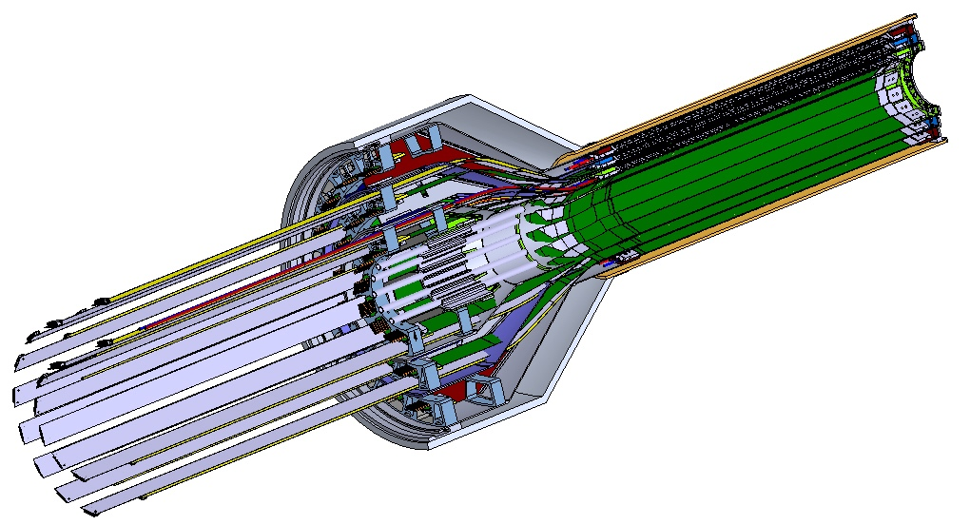
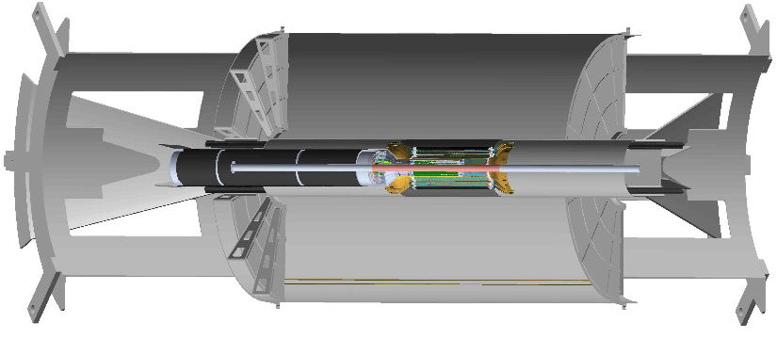
Schedule Drivers
Budget availability
  Final engineering design of the mechanical system
  Production of support structures
Mechanical structures
  Detector and interface system design
  Carbon structure fabrication
Detector assembly and test
  Assembly jigs design and fabrication
  Detector assembly & QA
  Metrology
Final installation in IR
  Currently, last detector to be installed

Slide 11
High Level Costs
WBS | Level 2 WBS Description | Burdened AY$ labor | Burdened AY$ M&S | Burdened AY$ Total
3.02.01 | MVTX Project Management | $498.8k | $46.8k | $544.6k
3.02.02 | MVTX Electronics | $211.2k | $358.4k | $569.6k
3.02.03 | MVTX Mechanics and Detector Assembly | $1241.6k | $667.0k | $1908.6k
3.02.04 | MVTX Integration and Installation | $456.8k | $416.5k | $873.3k
 | Total | $2187.8k | $1500.6k | $3688.5k
Mechanical design and fabrication
CYSS
End wheels
Service barrel
Global interface
Electronics
Readout Unit
Felix
Maps Power System
Integration and Infrastructure
Cooling System
Safety System
Service Barrel Support
Assembly and cooling tests

Slide 12
Basis of Estimate & Resource-Loaded Schedules
Electronics: production
  FELIX: ATLAS/sPHENIX production, LANL/LDRD
  RU services, cables: ALICE/ITS production, LANL/LDRD
  Power boards: ALICE/ITS production , LANL/LDRD
  CAEN bulk PS: Quotes from CAEN, ALICE/ITS production, LANL/LDRD
Mechanics & Integration: design and production
  CYSS, End wheels, Service barrel: ALICE/ITS Engineers
  Integration: Recent experience at RHIC, HFT/STAR, FVTX/PHENIX

Slide 13
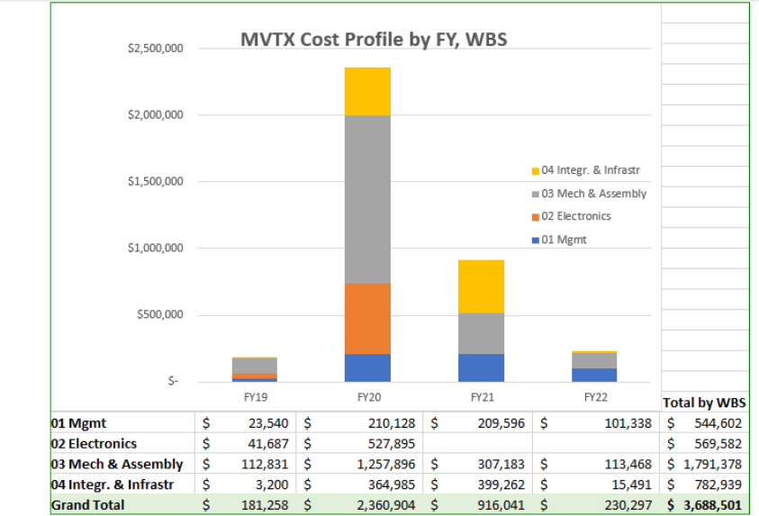
Cost Profile

Slide 14
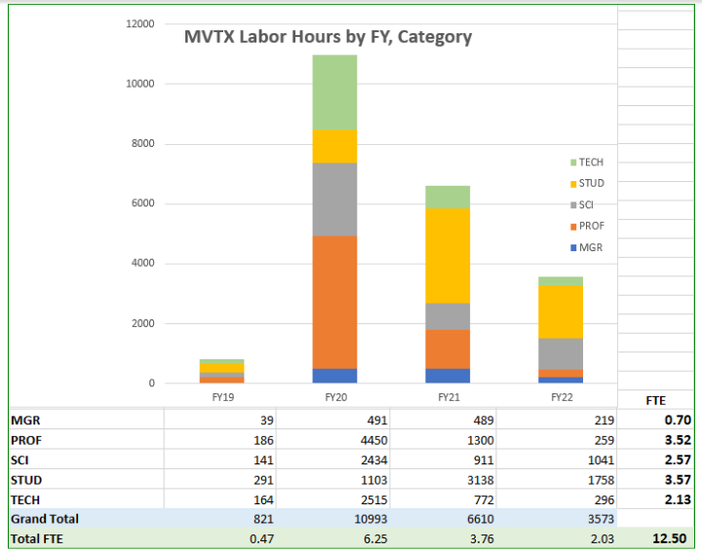
Resource Hours

Slide 15
Major Cost Items
WBS | Task Name | Cost (K)
03.02.02 | End Wheels (EW) | $311
03.02.03.01 | Cylindrical Structure(CYSS) | $201
03.02.03.02 | Service Barrel (SB) | $266
02.01 | RU Services | $213
02.02 | FELIX | $111
02.03 | Power System (PS) | $246

Slide 16
Carbon Structures
Example of low contingency items
 | WBS | Cost (K) | Contingency | Basis
RU Services | 03.02.01 Line 31 | $213 | 25% | As Built*
FELIX | 03.02.02 Line 51 | $111 | 25% | As Built*
Power Board | 03.02.03.01 Line 70 | $144 | 25% | As Built*
Power Supply | 03.02.03.02 Line 90 | $102 | 25% | CAEN quote
“As Built” means item is a vendor quote for production unit

Slide 17
Carbon Structures
Examples of high contingency
 | WBS | Cost (K) | Contingency | Basis
End Wheels | 03.02.02 Line 143 | $311 | 40% | Previous experience
Cylindrical Structure | 03.02.03.01 Line 158 | $201 | 40% | Previous experience
Service Barrel | 03.02.03.02 Line 169 | $266 | 40% | Previous experience

Slide 18
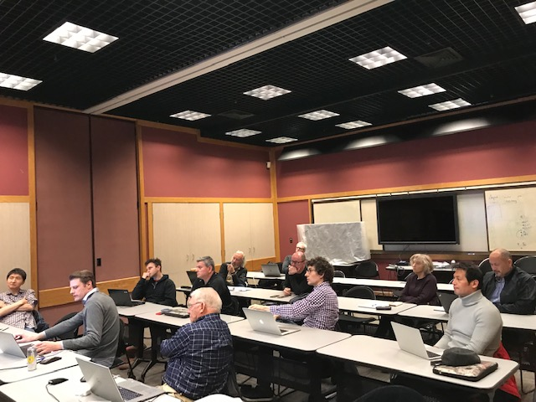
Status and Highlights
MVTX integrated into P6 (2/2019)
  TPC $4.6 M
Latest Cost & Schedule update - following MVTX workshop at LBNL in 3/2019
  Carbon structures
    Design
    Production
    Schedule
  Power system
  Contingency
    Electronics
    Mechanics design
    Mechanics fabrication
  Rebalance work load among collaborators
    LANL, MIT, LBNL, UT-A, BNL et al
MVTX TPC updated
MVTX Workshop @LBNL, 2/28-3/2,2019
Mechanical System Discussion Session:
- Discussed and updated major carbon structures’
design & production cost & schedule, risks etc.
- LANL, MIT, BNL and LBNL engineers and physicists

Slide 19
Issues and Concerns
Budget availability
  Final mechanical system design work, at MIT, LANL and LBNL
  Early R&D required to reduce the high production contingency
Carbon structure production cost & schedule
  LBNL busy schedule for carbon lab
  Exploring other companies in Italy, France, Other USA vendors …
  High contingency in design and production cost ~40%
Global mechanical system integration
  MVTX design has good progress but not final
  High contingency in design and production, ~ 40%

Slide 20
Summary
TPC in P6, $4.6 M, w/ burden and escalation and contingency
About 6 months float in schedule
Implemented Risk Based Contingency
Plan to update P6 after this review
Mechanical engineering design in progress
  Need budget now for the final engineering design work
Collaboration institutions ready to receive the project fund

Slide 21
backup

