Slide 1
MVTX cable length studies
Xuan Li (LANL)

Slide 2
Motivation
Check if extend the readout cable length from 5m to 7-10m can fit the particle flux at sPHENIX.
ALICE readout speed 1.2Gb/s at 5m, we would like to run at 600Mb/s at around 7-10m.
Run PYTHIA6 MB in 200 GeV and 5 TeV p+p collisions and check the number of charged tracks versus pseudorapidity.

Slide 3
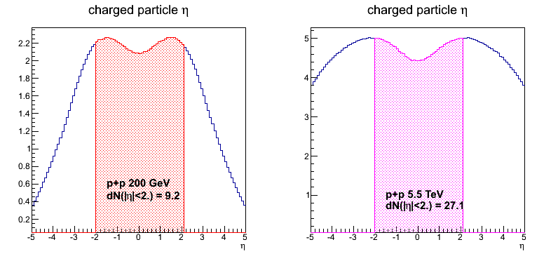
dN/dη in p+p collisions
With |η|<2.0 region, dN(ALICE) ~2.9*dN(sPHENIX).

Slide 4
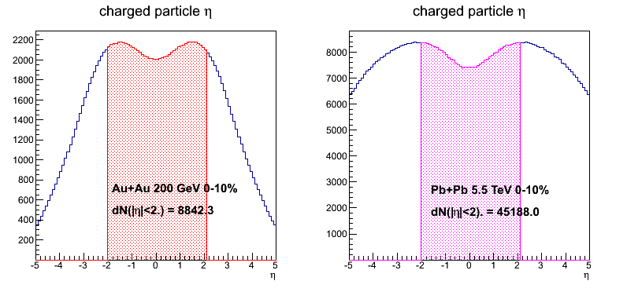
dN/dη in 0-10% Au+Au/Pb+Pb collisions
With |η|<2.0 region, dN(ALICE) ~5.1*dN(sPHENIX).
Ncoll(Au+Au)=962, Ncoll(Pb+Pb)=1670.

Slide 5
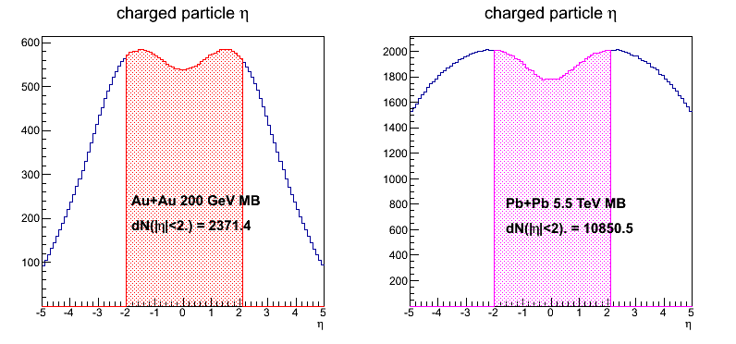
dN/dη in MB Au+Au/Pb+Pb collisions
With |η|<2.0 region, dN(ALICE) ~4.6*dN(sPHENIX).
Ncoll(Au+Au)=258, Ncoll(Pb+Pb)=401.

Slide 6
Conclusions
The sPHENIX particle flux within |η|<2.0 region in p+p and heavy ion collisions is less than 33% than the collisions at ALICE. It will be fine if we reduce the data readout speed by around 33%.

