Slide 1
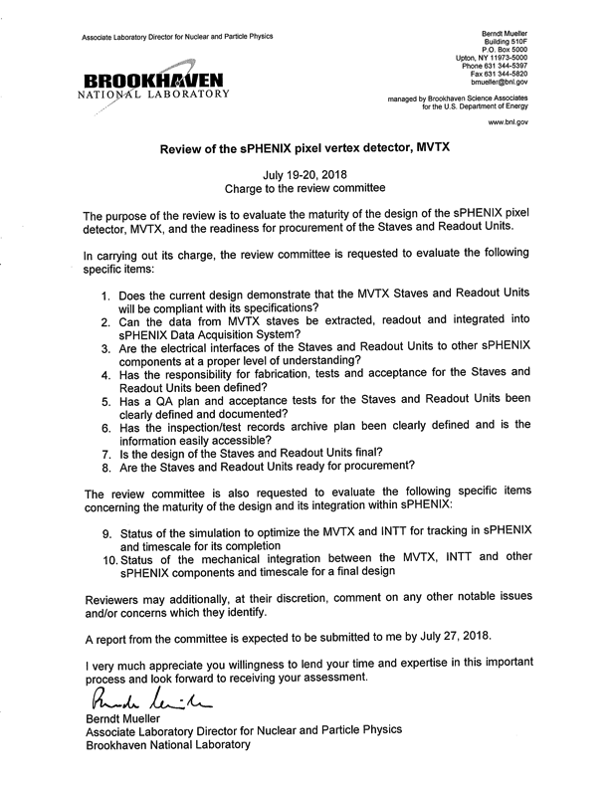
Draft agenda:
sPHENIX overview – Dave/Gunther
MVTX Overview - Ming
INTT overview - TBD
Simulation overview -TBD
Stave production and QA plan - Leo
RU production and QA plan -Jo
Integration of staves + RU + FELIX into sPHENIX – Alex/Sho
Mechanical integration of INTT and MVTX – Walt, Dan, Mickey
Additional talks?
ALICE ITS status talk – Luciano, Leo/Jo?
MVTX mechanical design – Walt?
Carbon structure and detector assembly – Leo/LBNL?

Slide 2
Preparing for July 19-20 Directors Review
sPHENIX internal rehearsal – July 9, chaired by John H
All potential speakers noticed, final agenda fixed soon
BlueJeans
Production acceptance quality assurance plan documents
Stave production QA plan – LBNL, Leo, Grazyna et al
RU production QA plan – UT-Austin/LANL, Jo, Sho, Alex et al
Use the same template – EMCal QA Plan
Simulation & integration efforts
A simulation task force with well defined goals and deadline?
Mechanical integration under OSI, Mickey & Bob, Walt, Dan et al
Personnel update:
Bob Redwine steps down as Director of Bates, and Ross Corliss leads the MIT/Bates efforts on MVTX project

Slide 3
Backup slides – more details

Slide 4
Yes. Fermilab test beam results have shown the detector will meet the design specs.
To be covered by:
-overview
-RU
-FELIX
-Mechanical

Slide 5
Yes. Fermilab TB data were taken through the sPHENIX DAQ framework, with sPHENIX data format.
Sensor + RU + FELIX + RCDAQ -> sPHENIX PRDF data ->offline analysis ->resolution results
-FELIX talk
-Overview

Slide 6
Yes. We have demonstrated the full readout chain, from sensor, RU, FELIX to sPHENIX RCDAQ,
and produced MVTX data in the sPHENIX format for offline analysis.
Overview
RU talk
FELIX talk

Slide 7
Yes.
Stave production at CERN: LANL
Stave QA in US: LBNL
RU production: UT-Austin
QA documents are in progress.
We will follow exactly the same QA procedures defined for the ALICE ITS stave and RU production
Stave talk
RU talk
Overview talk

Slide 8
QA documents are in preparation.
We will follow exactly the same procedures used by ALICE ITS stave and RU production.
RU talk
Stave talk

Slide 9
ALICE has the production database for every steps, from sensor to final staves.
We will follow exactly the same procedures.
RU talk
Stave talk

Slide 10
Stave design is final.
Stave production is in progress, will be finished late this year.
RU final design (v2) completed, first piolet boards produced at CERN and being tested.
The BNL FELIX boards (v2.0) will be available later this summer (digitally ~ v1.5 tested at LANL)
RU talk
Stave talk

Slide 11
Yes for staves.
For RU, once the test boards pass the QA, ALICE will go forward with full production,
and sPHENIX could join the production
Overview
RU talk
Stave talk

Slide 12
Simulations: work in progress. Form a task force with well defined goals and deadline
Mechanical integration: work in progress, under OSI, Mickey & Bob
Simulation talk
Mechanical integration talk

