Slide 1
Integration of staves + RU + FELIX into sPHENIX

Slide 2
Charge
Does the current design demonstrate that the MVTX Staves and Readout Units will be compliant with its specifications?
Can the data from MVTX staves be extracted, readout and integrated into sPHENIX Data Acquisition System?
Are the electrical interfaces of the Staves and Readout Units to the other sPHENIX components at a proper level of understanding?

Slide 3
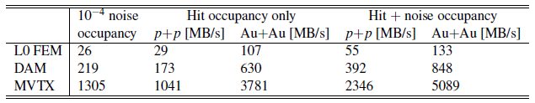
Specifications
Trigger rate: 15 kHz
Data rate:
  133 MB/s per stave
  5089 MB/s for MVTX worst-case

Slide 4
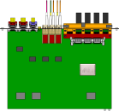

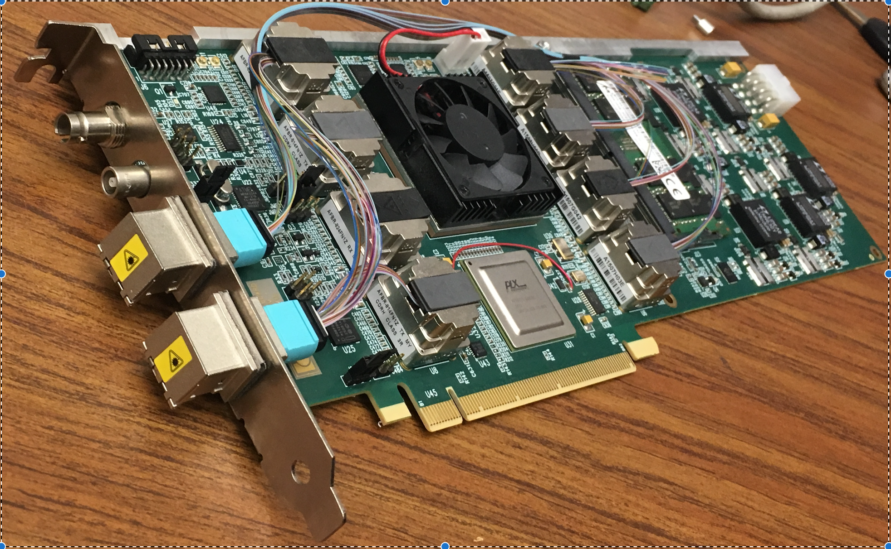
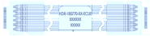
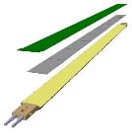

MVTX Electronics Overview
CAN bus
DCS
5-10 m
Trigger & Clock
Readout Unit
Front End
GBT Optical Links
9-sensor Stave
9 Data (1.2Gbps)
1 Clock, 1 Control/Trigger
Control
Data (9.6 Gb/s max)
Trigger
Samtec Twinax “FireFly”
FELIX
Back End
FPC
Power
Alpide Sensors
Power
Filtering Capacitors
regulators
Power supplies
Cold Plate
Regulated Power
Power Board
Interaction Region
Experimental Hall
Counting House
MVTX Detector Electronics consists of three parts
Sensor-Stave (9 ALPIDE chips) | Front End-Readout Unit | Back End-FELIX

Slide 5
Sensor
CAN bus
DCS
5-10 m
Trigger & Clock
Readout Unit
Front End
GBT Optical Links
9-sensor Stave
9 Data (1.2Gbps)
1 Clock, 1 Control/Trigger
Control
Data (9.6 Gb/s max)
Trigger
Samtec Twinax “FireFly”
FELIX
Back End
FPC
Power
Alpide Sensors
Power
Filtering Capacitors
regulators
Power supplies
Cold Plate
Regulated Power
Power Board
Interaction Region
Experimental Hall
Counting House
MVTX Detector Electronics consists of three parts
Sensor-Stave (9 ALPIDE chips) | Front End-Readout Unit | Back End-FELIX

Slide 6
Stave
Stave– 9 chips, common clock and control, independent data lines
Clock
Control+Trigger
Chip1
Chip2
Chip3
Chip4
Chip5
Chip6
Chip7
Chip8
Chip9
1024 pixel columns
Serial Outputs (1.200 Gbps)
State Of the Art:
In pixel:
Amplification
Discrimination
3 hit storage registers (MEB)
AMP
COMP
THR
512 pixel rows
ALPIDE Architecture Highlights
Multi-event buffering capability
-reduces Readout data throughput requirements
Digital data output
Data output rate at 1.2 Gb/s, 0.6Gb/s, or 0.4Gb/s
Pixel pitch 28x28μm²
Material budget:~0.3%/layer
Readout rate: continuous or triggered
Readout (zero suppression)
Readout (zero suppression)
Readout (zero suppression)
Readout (zero suppression)
Bias, Readout, Control

Slide 7
MVTX Overview Readout Unit
CAN bus
DCS
5-10 m
Trigger & Clock
Readout Unit
Front End
GBT Optical Links
9-sensor Stave
9 Data (1.2Gbps)
1 Clock, 1 Control/Trigger
Control
Data (9.6 Gb/s max)
Trigger
Samtec Twinax “FireFly”
FELIX
Back End
FPC
Power
Alpide Sensors
Power supplies
Filtering Capacitors
regulators
Power
Cold Plate
Regulated Power
Power Board
Experimental Hall
Front End-Readout Unit
Data readout from Stave
Stave status and power control
Control and monitoring to/from the sensors
Trigger & busy management
Data building and transmission through the rad-hard Gigabit Transceivers

Slide 8
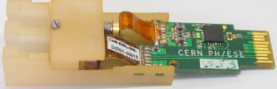
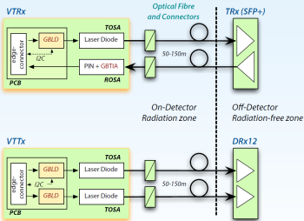
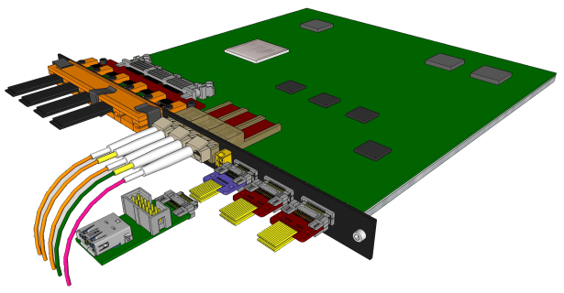

Readout Unit
State Of the Art:
Xilinx Kintex Ultrascale FPGA
ProAsic FPGA (Manage Radiation Upsets)
GBT ASIC (Rad. Tolerant Giga Bit Transceiver)
  VTRx: Transciver up & down link
  VTTx: Double Transmitter 2 * up link:
Special order (Halogen Free) Samtec firefly copper twinax cable interface
  9 independent 1.2Gb/s data streams
  1 40MHz Clock
  1 Control Line
Transition Board
Samtec Firefly cable
VTTx
VTRx
VTRx sm
Power Boards link
2 uplink (data) to FELIX
1 uplinks (data/CTRL) to FELIX
1 downlink (CTRL) from FELIX
CAN bus
1 trigger downlink directly
to ensure low latency
Diagnostic / busy IO
Notes:
Bla foo this is a test

Slide 9
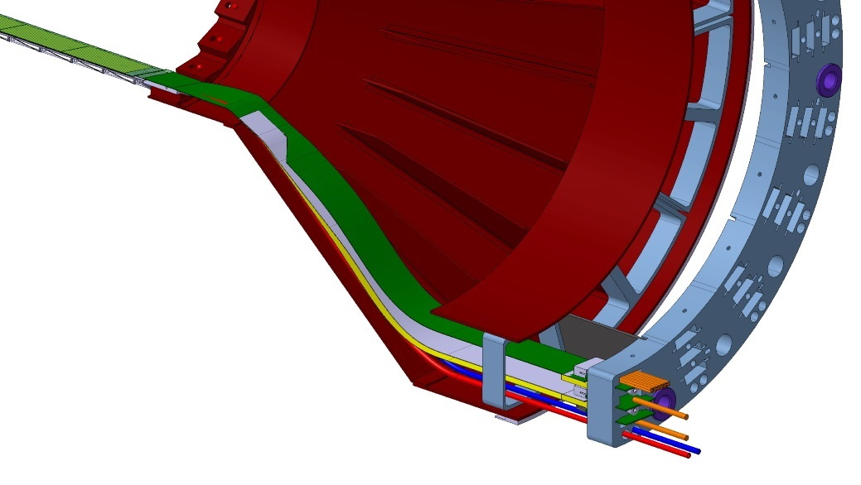
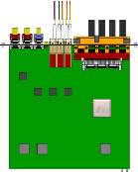
System Power Overview
Readout
Unit
Infrastructure GND
to VME backplane
I2C control
CANbus
Breakout Boards
Bias daisy chain
to next PB
x8
reg
reg
reg
32 reg
switch
reg
reg
reg
V adjust
reg
V, I mon/buffer
V, I mon/buffer
CAEN
bias
CAEN
power
RDO
interface
Overcurrent
detection
Isolated bias section
PT100 interface
Overcurrent
reset
Overcurrent
threshold
Power in
Power Board

Slide 10
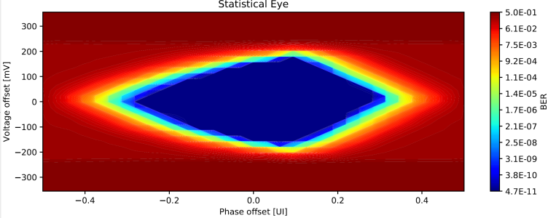
Halogen-Free Samtec cables
From CERN Team:
2.3 m + 6 m long
Test run so far (over 48 h-equivalent of a single chip) show no PRBS errors
BER < 2.22 · 10−14 with CL = 0.99
Both side of the cable tested with comparable performance
Transmission is reliable down to minimum Driver strength
  DAC = 1 and Pre-emphasis DAC = 1

Slide 11
MVTX Overview FELIX
CAN bus
DCS
5-10 m
Trigger & Clock
Readout Unit
Front End
GBT Optical Links
9-sensor Stave
9 Data (1.2Gbps)
1 Clock, 1 Control/Trigger
Control
Data (9.6 Gb/s max)
Trigger
Samtec Twinax “FireFly”
FELIX Back End
FPC
Power
Alpide Sensors
Power supplies
Filtering Capacitors
regulators
Power
Cold Plate
Regulated Power
Power Board
Counting House
Back End-FELIX:
Data readout from 8 Readout Units
Slow Control and Monitoring to/from sensors
Trigger and Timing systems interface
Data aggregation and sub-event packaging
Data transmission through the PCIe to Server CPU

Slide 12
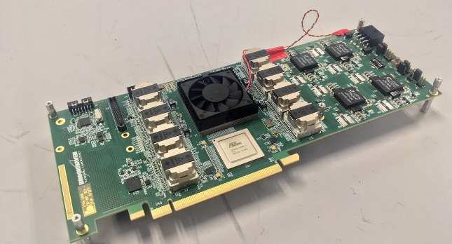
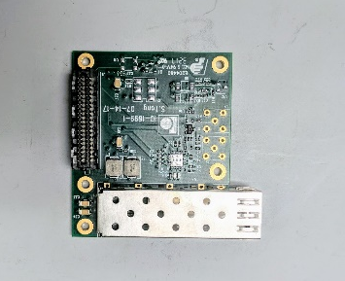
FELIX
Xilinx Kintex Ultrascale FPGA
48 bi-directional GBT links
16 lane Gen3 PCIe
All connections to other sPHENIX components are optical
Mezzanine was designed to be used with sPHENIX timing system

Slide 13
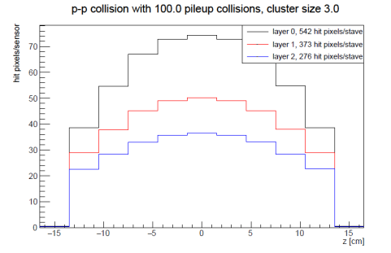
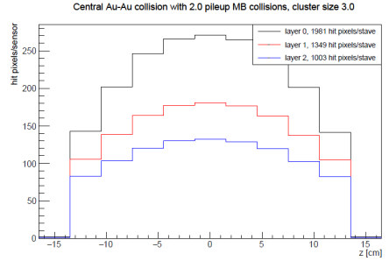
Data Rate Requirements
Meets specification (charge 1)
Readout Units 3 GBTX @ 0.4 GB/s = 1.2 GB/s >133MB/s
GBTx: 3.2-4.48Gb/s, 0.4 GB/s
FELIX (48 input on FELIX, twice the number needed to support 8 RUs (3 links))
2x 8-lane PCIe Gen 3 @ 7880 MB/s = 15760 MB/s > 848 MB/s

Slide 14
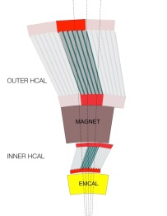
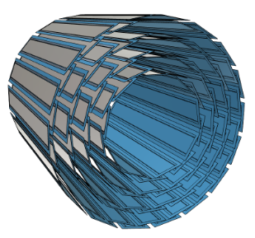
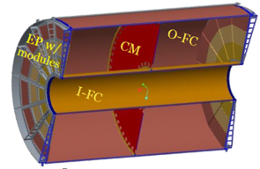
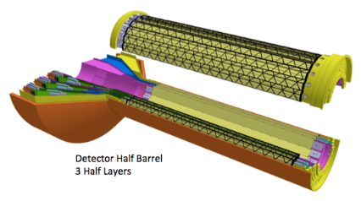
sPHENIX DAQ Architecture
Event Builder
FEM
DCM
DCM2
DCM
DCM
DCM
DCM
Network
Switch
Buffer Box
FEM
DCM
SEB
ATP
DCM
DCM
DCM2
DCM
DCM
ATP
DCM
Buffer Box
FEM
DCM
SEB
ATP
DCM
DCM
DCM
DCM2
ATP
Buffer Box
Calorimeters,
INTT, MBD
DCM
SEB
DCM
To the
RACF/HPSS
DCM
ATP
ATP
Buffer Box
FEE
ATP
DCM
DCM
FELIX
EBDC
ATP
DCM
Buffer Box
FEE
ATP
TPC, MVTX
DCM
DCM
FELIX
EBDC
ATP
Buffer Box
DCM
FEE
ATP
DCM
FELIX
EBDC
DCM
ATP
Buffer Box
DCM
Rack Room
SEB Sub-Event Buffer
EBDC Event Buffer and Data Compressor
ATP Assembles events and compresses data
Buffer Box data interim storage before sending data to the computing center

Slide 15
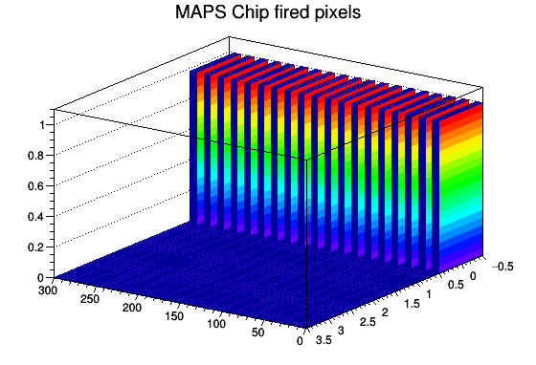
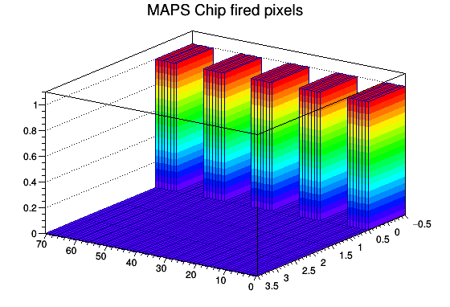
RCDAQ
RCDAQ = sPHENIX Data Acquisition framework
  rcdaq plugin developed which will serve as a conduit between the FPGA DMA PCIE endpoint and the software used to transfer the data to the sPHENIX framework
  Plots generated by RCDAQ in the initial stage of integration using pulsed mode of the ALPIDE Pixels readout by Readout Unit and FELIX in the lab.
Full MVTX integrated with sPHENIX DAQ
(charge 2)

Slide 16
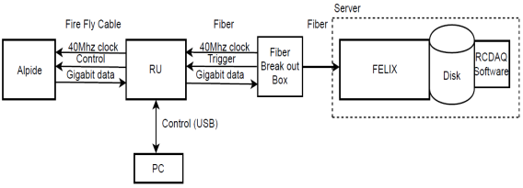
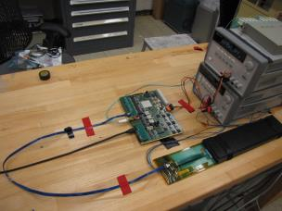
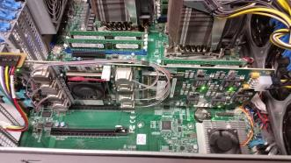
MVTX Full Chain
Stave
Readout
Unit
FELIX
Demonstrated Full MVTX Chain Readout
(charge 2 & charge 3)
Readout Unit + Stave
Successfully configured, triggered and readout Stave:
  Readout Unit configures Stave
  FELIX distributes clock to Readout Unit
  Readout Unit distributes clock to the Stave
  Stave is triggered, sends data at 1.2Gb/s
  Configured GBT link to recover clock from FELIX
  Readout Unit receives the data and sends the data to FELIX over optical interface using GBT link
  FELIX packs data, stores it on disk using RCDAQ
  ALPIDE triggered and read out at 15kHz, 448 hits
  Emulated 8 RU’s using 1 fiber link per RU on FELIX, 15kHz
Server + FELIX

Slide 17
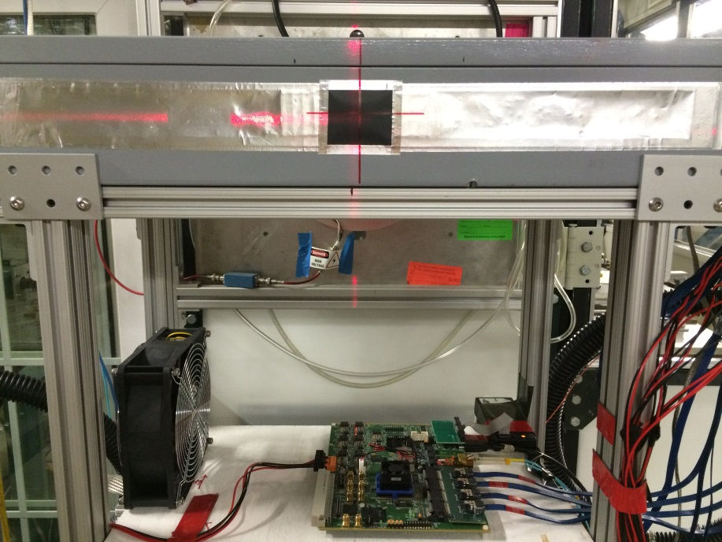
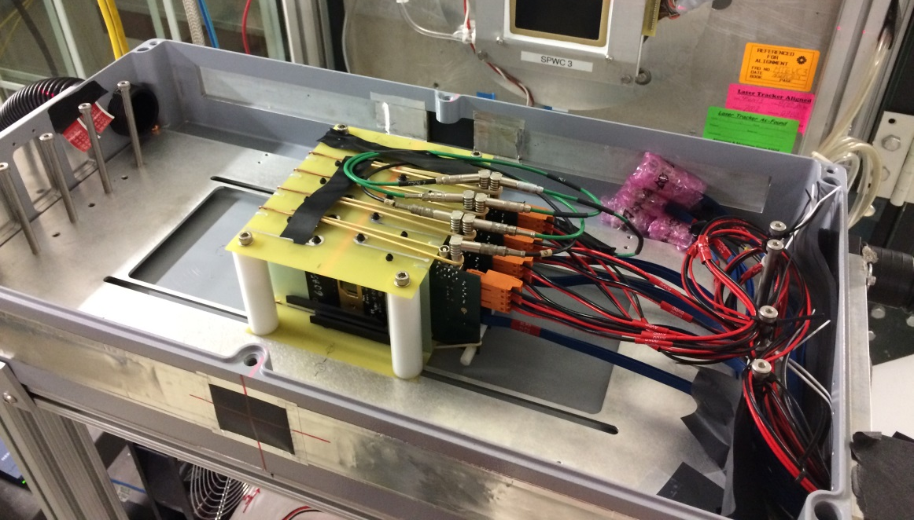
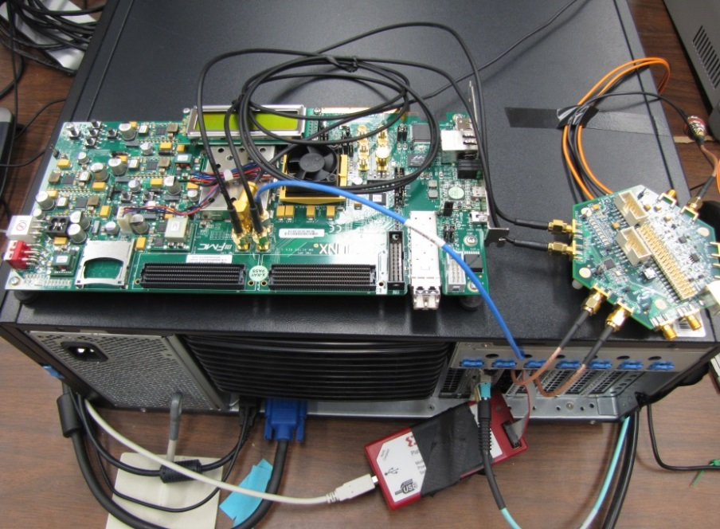
4-ALPIDE Telescope at Test Beam
4-ALPIDE Telescope;
5m long SamTec cables
RU
Highlights:
Primarily 120GeV proton beam; also with low energy pion beams
Beam trigger rate ~7kHz
Tested High ALPIDE occupancy runs, with 10cm lead bricks in front of the sensors
FELIX in Server
KC705
To process
Scintillating Paddle
Trigger
40 Mhz
Clock

Slide 18
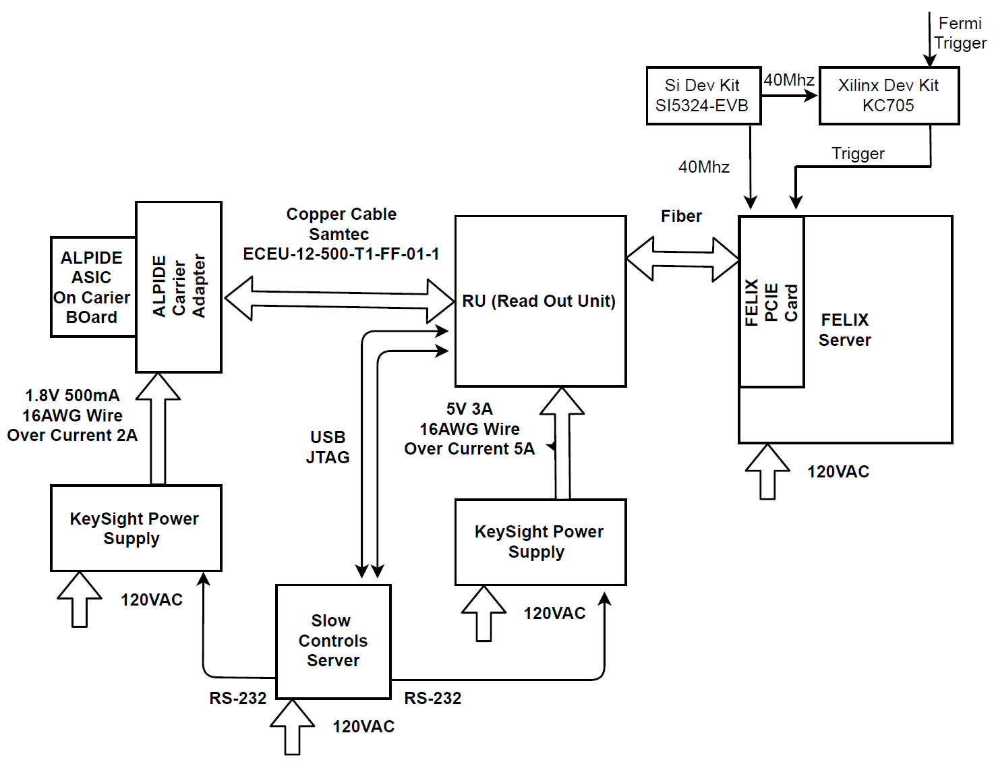
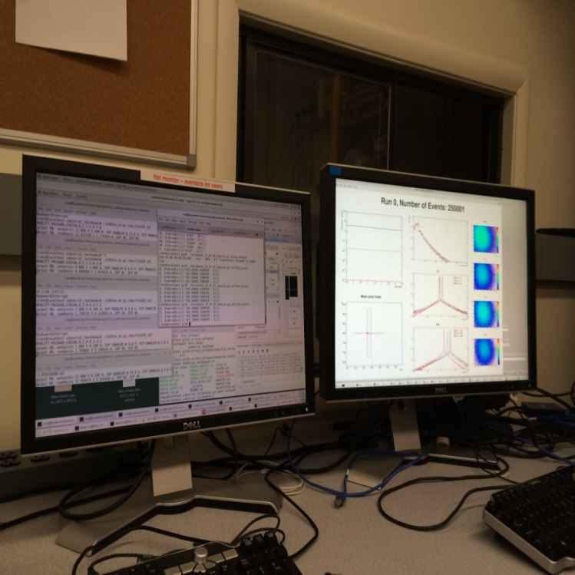
Fermilab Test Beam Block Diagram
4-ALPIDE Telescope
4 5m SamTec Cables, 1.2Gbps
CLK recovered from
FELIX through GBT link;
Trigger from FELIX

Slide 19
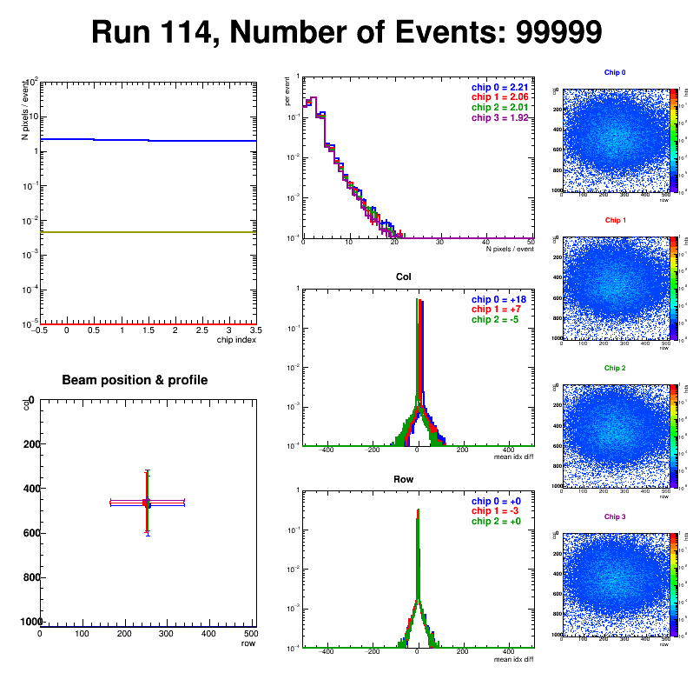
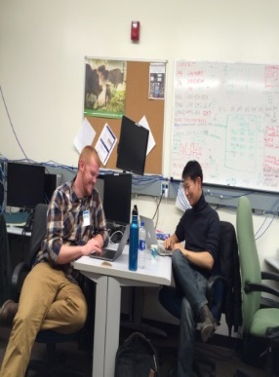
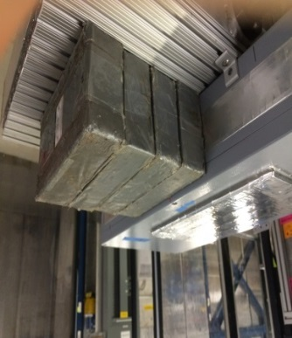
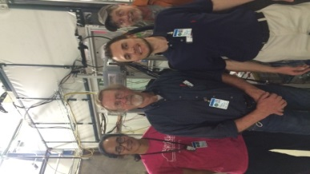
Test Beam Results
Successfully operated the full readout chain
  RU Configured and readout 4 ALPIDEs
  FELIX successfully integrated into RCDAQ
Sensor Performance
  Cluster Size
  Threshold parameters
  trigger delay
High multiplicity events
  ALPIDE occupancy runs with 10cm lead bricks
Online Monitoring
  Hit distribution, relative alignment
Analysis confirmed telescope performance
  Hit resolution < 5 um
Online Monitoring and offline data analysis
using rcdaq and Fun4All (sPHENIX framework)
(charge 2)

Slide 20

Summary
Does the current design demonstrate that the MVTX Staves and Readout Units will be compliant with its specifications?
  Triggered system at 15kHz at full data rate validating system specification.
Can the data from MVTX staves be extracted, readout and integrated into sPHENIX Data Acquisition System?
  Test beam data from ALPIDE sensors was taken using full MVTX readout chain (ALPIDE Sensor->Readout Unit->FELIX ) and rcdaq (sPHENIX daq).
  Data was recorded in PRDF data format and currently being analyzed in the Fun4All framework.
Are the electrical interfaces of the Staves and Readout Units to the other sPHENIX components at a proper level of understanding.
The optical interface from the Readout unit to the other sPHENIX components has been validated with FELIX.
Demonstrated clock and trigger and gigabit data transmission
Power System is well understood.

