Slide 1
Integration of staves + RU + FELIX into sPHENIX

Slide 2
Charge
Does the current design demonstrate that the MVTX Staves and Readout Units will be compliant with its specifications?
Can the data from MVTX staves be extracted, readout and integrated into sPHENIX Data Acquisition System?
Are the electrical interfaces of the Staves and Readout Units to the other sPHENIX components at a proper level of understanding

Slide 3
Outline
Specifications/system description
Integration
Beam test Results

Slide 4
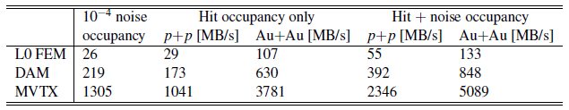
Specifications
Trigger rate: 15KHz
Data rate:
  133 MB/s per stave
  5089 MB/s for MVTX worst-case
Resolutions: ask Darren

Slide 5
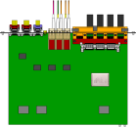

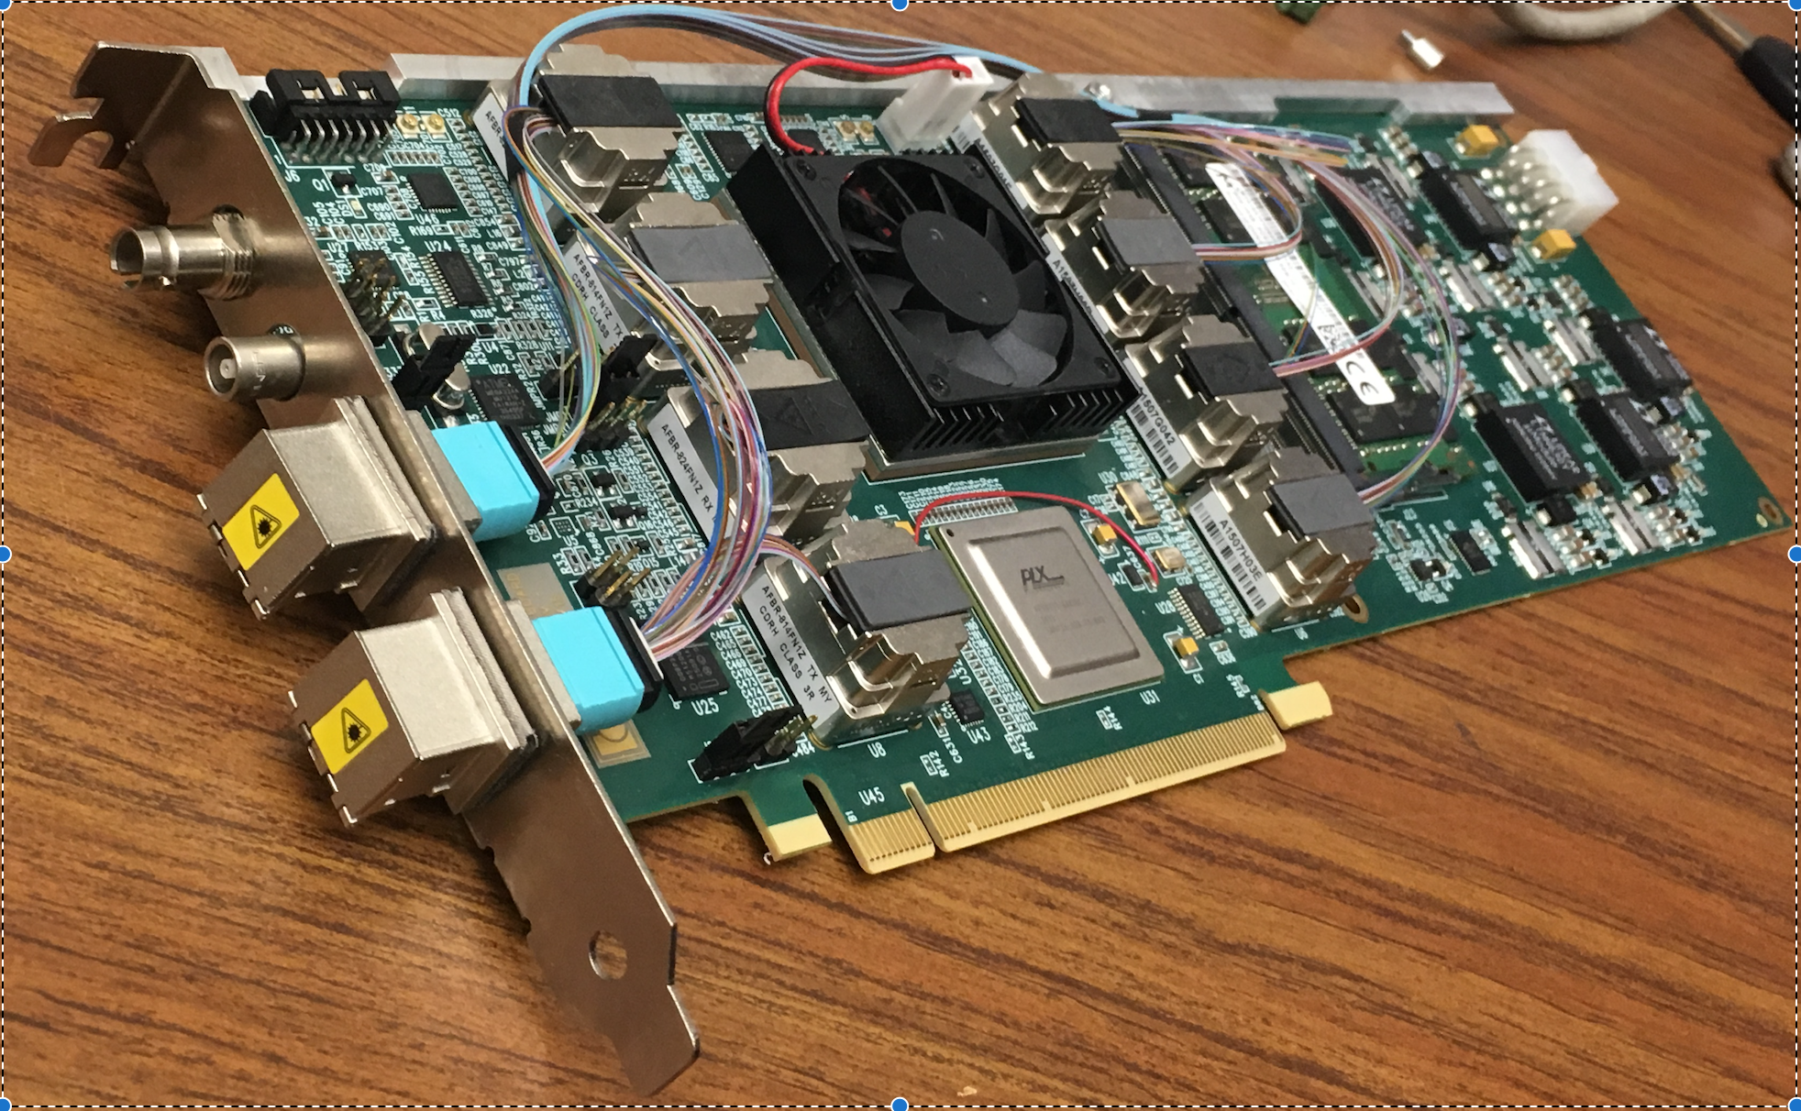
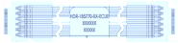
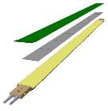

MVTX Electronics Overview
CAN bus
DCS
5-10 m
Trigger & Clock
Readout Unit
Front End
GBT Optical Links
9-sensor Stave
9 Data (1.2Gbps)
1 Clock, 1 Control/Trigger
Control
Data (9.6 Gb/s max)
Trigger
Samtec Twinax “FireFly”
FELIX
Back End
FPC
Power
Alpide Sensors
Power
Filtering Capacitors
regulators
Power supplies
Cold Plate
Regulated Power
Power Board
Interaction Region
Experimental Hall
Counting House
MVTX Detector Electronics consists of three parts
Sensor-Stave (9 ALPIDE chips) | Front End-Readout Unit | Back End-FELIX

Slide 6
Sensor
CAN bus
DCS
5-10 m
Trigger & Clock
Readout Unit
Front End
GBT Optical Links
9-sensor Stave
9 Data (1.2Gbps)
1 Clock, 1 Control/Trigger
Control
Data (9.6 Gb/s max)
Trigger
Samtec Twinax “FireFly”
FELIX
Back End
FPC
Power
Alpide Sensors
Power
Filtering Capacitors
regulators
Power supplies
Cold Plate
Regulated Power
Power Board
Interaction Region
Experimental Hall
Counting House
MVTX Detector Electronics consists of three parts
Sensor-Stave (9 ALPIDE chips) | Front End-Readout Unit | Back End-FELIX

Slide 7
Stave
Stave– 9 chips, common clock and control, independent data lines
Clock
Control+Trigger
Chip1
Chip2
Chip3
Chip4
Chip5
Chip6
Chip7
Chip8
Chip9
1024 pixel columns
Serial Outputs (1.200 Gbps)
State Of the Art:
In pixel:
Amplification
Discrimination
3 hit storage registers (MEB)
AMP
COMP
THR
512 pixel rows
ALPIDE Architecture Highlights
Multi-event buffering capability
-reduces Readout data throughput requirements
Digital data output
Data output rate at 1.2 Gb/s, 0.6Gb/s, or 0.4Gb/s
Pixel pitch 28x28μm²
Material budget:~0.3%/layer
Readout rate: continuous or triggered
Readout (zero suppression)
Readout (zero suppression)
Readout (zero suppression)
Readout (zero suppression)
Bias, Readout, Control

Slide 8
MVTX Overview Readout Unit
CAN bus
DCS
5-10 m
Trigger & Clock
Readout Unit
Front End
GBT Optical Links
9-sensor Stave
9 Data (1.2Gbps)
1 Clock, 1 Control/Trigger
Control
Data (9.6 Gb/s max)
Trigger
Samtec Twinax “FireFly”
FELIX
Back End
FPC
Power
Alpide Sensors
Power supplies
Filtering Capacitors
regulators
Power
Cold Plate
Regulated Power
Power Board
Experimental Hall
Front End-Readout Unit
Data readout from Stave
Stave status and power control
Control and monitoring to/from the sensors
Trigger & busy management
Data building and transmission through the rad-hard Giga Bit Transceivers
8

Slide 9
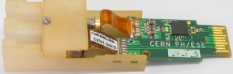
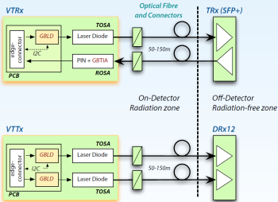
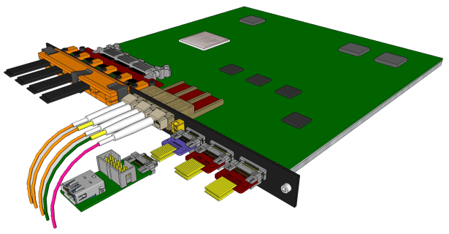

Readout Unit
State Of the Art:
Xilinx Kintex Ultrascale FPGA
ProAsic FPGA (Manage Radiation Upsets)
GBT ASIC (Rad. Tolerant Giga Bit Transceiver)
  VTRx: Transciver up & down link
  VTTx: Double Transmitter 2 * up link:
Special order (Halogen Free) Samtec firefly copper twinax cable interface
  9 independent 1.2Gb/s data streams
  1 40MHz Clock
  1 Control Line
Transition Board
Samtec Firefly cable
VTTx
VTRx
VTRx sm
Power Boards link
2 uplink (data) to FELIX
1 uplinks (data/CTRL) to FELIX
1 downlink (CTRL) from FELIX
CAN bus
1 trigger downlink directly
to ensure low latency
Diagnostic / busy IO
Notes:
Bla foo this is a test

Slide 10
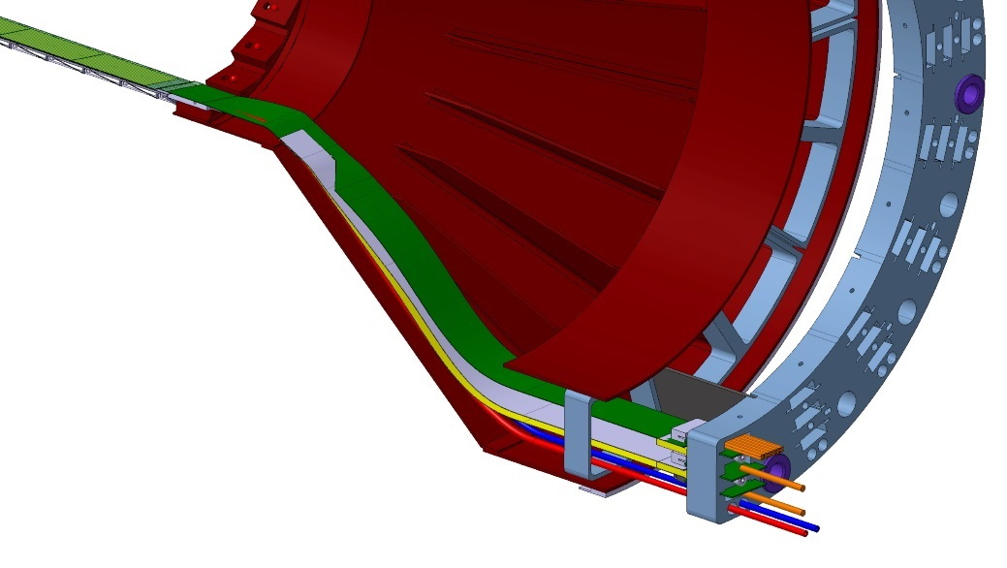
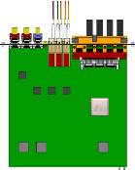
System Power Overview
Readout
Unit
Infrastructure GND
to VME backplane
I2C control
CANbus
Breakout Boards
Bias daisy chain
to next PB
x8
reg
reg
reg
32 reg
switch
reg
reg
reg
V adjust
reg
V, I mon/buffer
V, I mon/buffer
CAEN
bias
CAEN
power
RDO
interface
Overcurrent
detection
Isolated bias section
PT100 interface
Overcurrent
reset
Overcurrent
threshold
Power in
Power Board
10

Slide 11
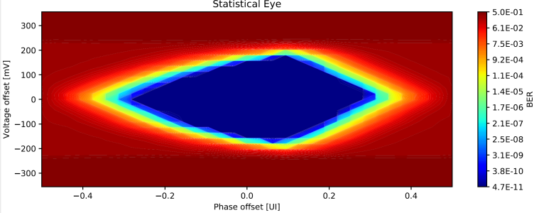
cables

Slide 12
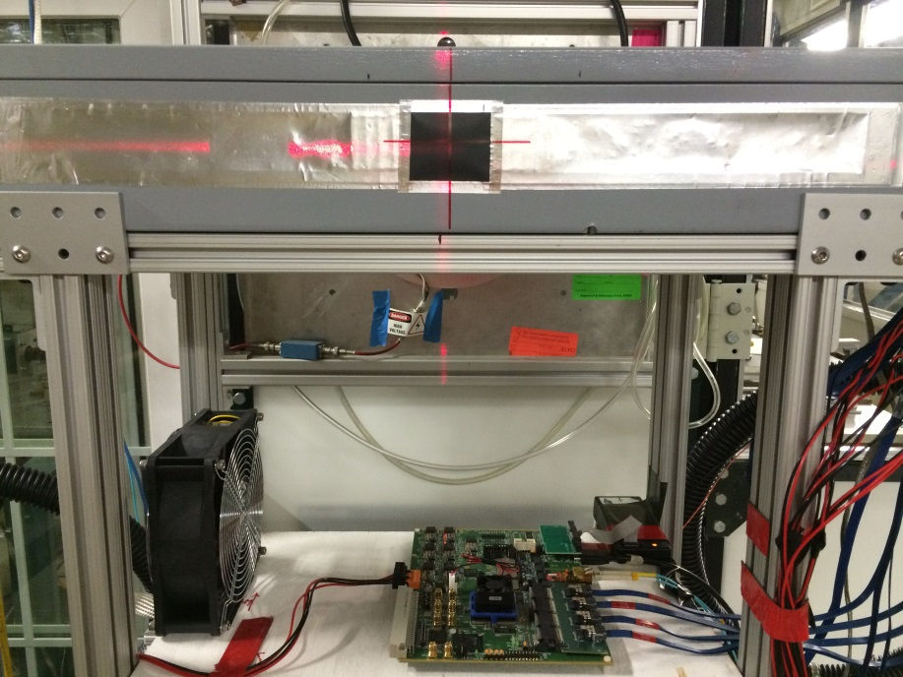
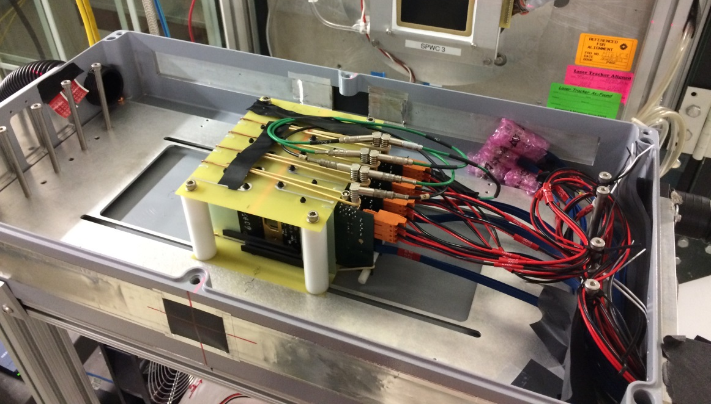
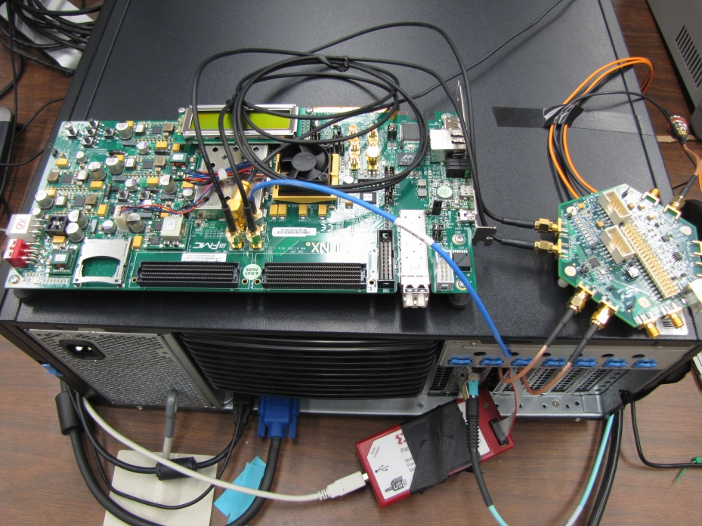
4-ALPIDE Telescope Setup at Fermilab Test Beam
4-ALPIDE Telescope;
5m long SamTec cables
RU
Summary:
Successfully operated the full readout chain
Confirmed all communications links and data path
Confirmed telescope performance
  Primarily 120GeV proton beam; also with low energy pion beams
  Beam trigger rate ~7kHz
  Tested High ALPIDE occupancy runs, with 10cm lead bricks in front of the sensors
FELIX(“CRU”) in Server
KC705
LHC 40MHz
Mockup

Slide 13
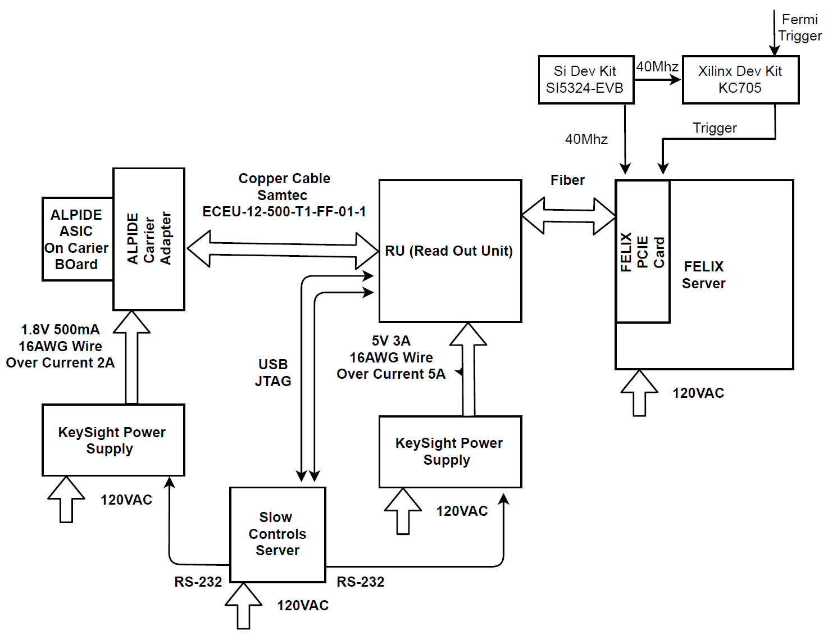
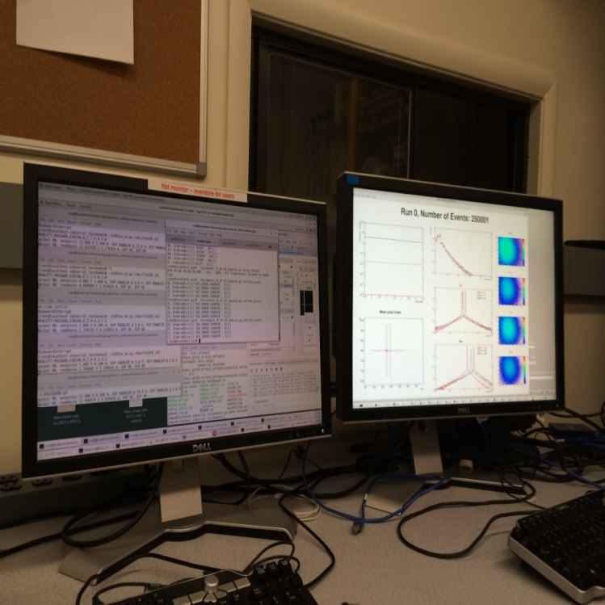
Fermilab Beam Test Block Diagram
4-ALPIDE Telescope
4 5m SamTec Cables, 1.2Gbps
CLK recovered from
FELIX through GBT link;
Trigger from FELIX

Slide 14
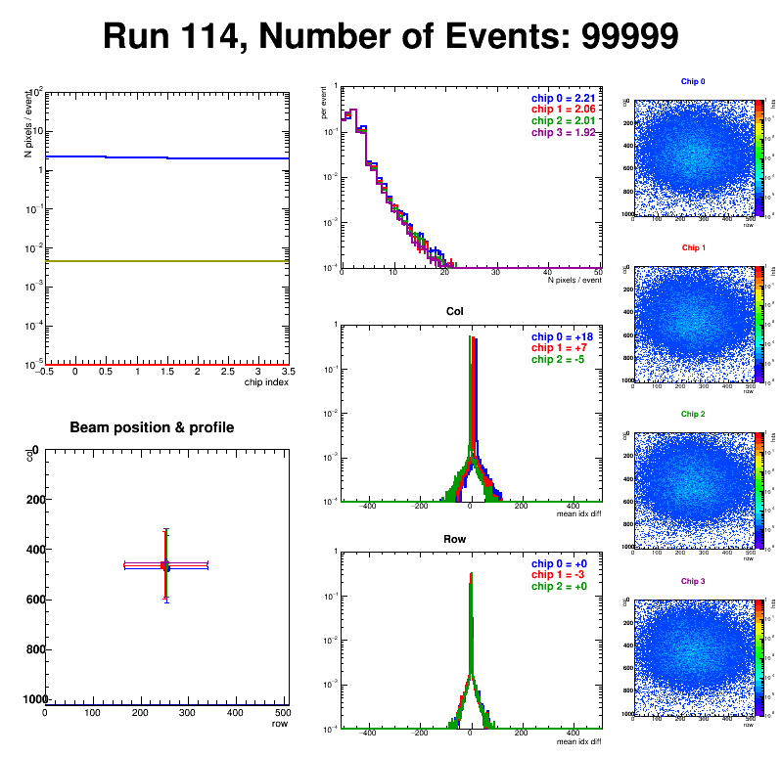
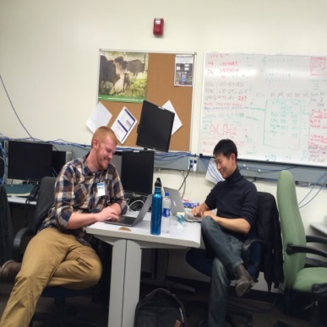
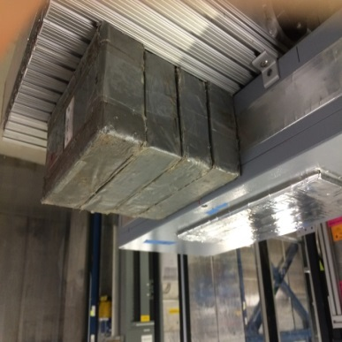
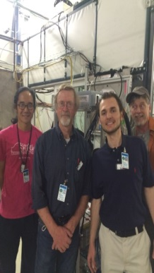
Summary
Successfully operated the full readout chain
  RU Configured and readout 4 ALPIDEs
  FELIX successfully integrated into RCDAQ
Sensor Performance
  Cluster Size
  Threshold parameters
  trigger delay
High multiplicity events
  ALPIDE occupancy runs with 10cm lead bricks
Online Monitoring
  Hit distribution, relative alignment
Analysis confirmed telescope performance
  Hit resolution < 5 um

Slide 15
MVTX Overview FELIX
CAN bus
DCS
5-10 m
Trigger & Clock
Readout Unit
Front End
GBT Optical Links
9-sensor Stave
9 Data (1.2Gbps)
1 Clock, 1 Control/Trigger
Control
Data (9.6 Gb/s max)
Trigger
Samtec Twinax “FireFly”
FELIX Back End
FPC
Power
Alpide Sensors
Power supplies
Filtering Capacitors
regulators
Power
Cold Plate
Regulated Power
Power Board
Counting House
Back End-FELIX:
Data readout from 8 Readout Units
Slow Control and Monitoring to/from sensors
Trigger and Timing systems interface
Data aggregation and sub-event packaging
Data transmission through the PCIe to Server CPU

Slide 16
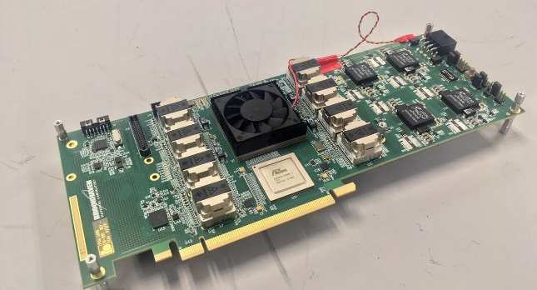
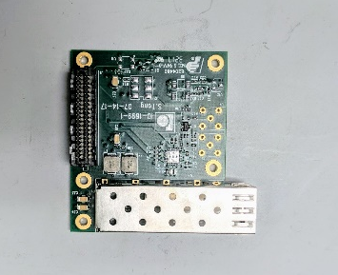
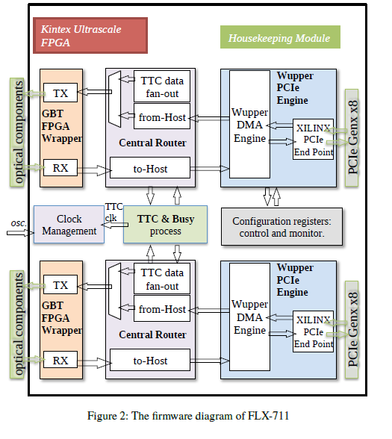
FELIX
State Of the Art:
Xilinx Kintex Ultrascale FPGA
48 bi-directional GBT links
16 lane Gen3 PCIe
Performance Summary:
PCIe Tx > 101.7 Gb/s
FEE Rx < 80 Gb/s

Slide 17
Put picture here of the Rus conneted to felix and emphasize connection to the outside world of MVTX are all optical!

Slide 18
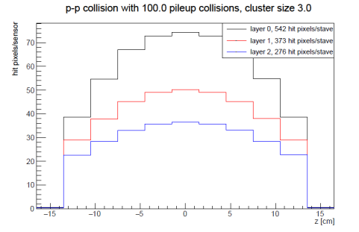
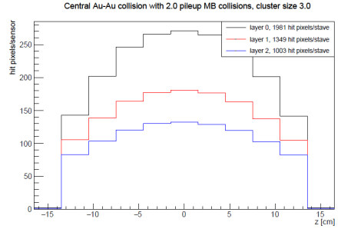
Data Rate Requirements
Readout Units 3 GBTX @ 0.4 GB/s = 1.2 GB/s >133MB/s
GBTx: 3.2-4.48Gb/s, 0.4 GB/s
FELIX (48 input on FELIX, twice the number needed to support 8 RUs (3 links))
2x 8-lane PCIe Gen 3 @ 7880 MB/s = 15760 MB/s > 848 MB/s
DAREN BOX

Slide 19
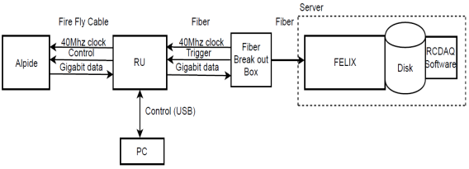
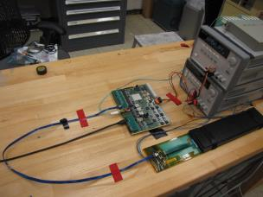
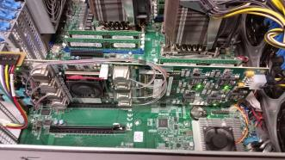
MVTX Full Chain
Stave
Readout
Unit
FELIX
Demonstrated Full MVTX Chain Readout
Once the Readout Unit arrived, successfully configured, triggered and readout Stave:
  Readout Unit configures Stave using USB interface
  FELIX distributes clock to Readout Unit
  Readout Unit distributes clock to the Stave
  Stave is triggered, sends data at 1.2Gb/s
  Configured GBT link to recover clock from FELIX
  Readout Unit receives the data and sends the data to FELIX over fiber using GBT link
  FELIX packs data, stores it on disk using RCDAQ
  ALPIDE triggered and read out at 15kHz, 448 hits
  Developed prototype RCDAQ plugin
  FELIX packs and places ALPIDE data on disk
  Emulated 8 RU’s using 1 fiber link per RU on FELIX, 15kHz
Readout Unit + Stave
Server + FELIX

Slide 20
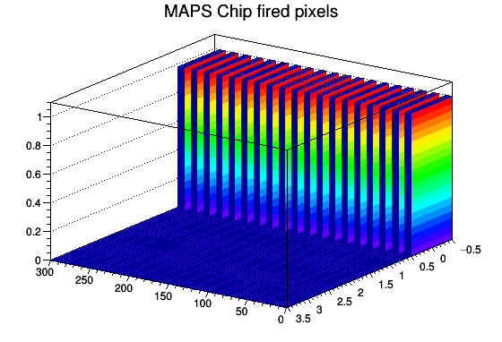
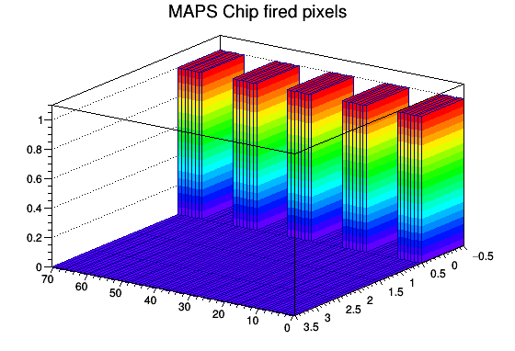

RCDAQ
RCDAQ = sPHENIX DAQ
  Our accomplishments of integrating FELIX with RCDAQ prove that MVTX should tie into sPHENIX day one.
  Plots generated by RCDAQ show pulsed Pixels readout by Readout Unit and FELIX
Full MVTX Readout Chain integrated with sPHENIX DAQ

Slide 21
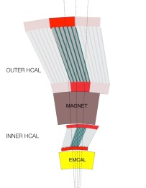
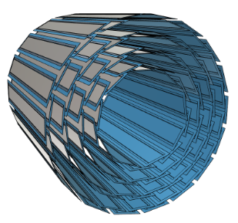
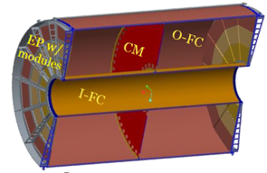
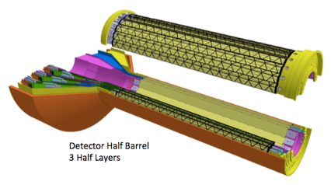
sPHENIX DAQ Architecture
Event Builder
FEM
DCM
DCM2
DCM
DCM
DCM
DCM
Network
Switch
Buffer Box
FEM
DCM
SEB
ATP
DCM
DCM
DCM2
DCM
DCM
ATP
DCM
Buffer Box
FEM
DCM
SEB
ATP
DCM
DCM
DCM
DCM2
ATP
Buffer Box
Calorimeters,
INTT, MBD
DCM
SEB
DCM
To the
RACF/HPSS
DCM
ATP
ATP
Buffer Box
FEE
ATP
DCM
DCM
FELIX
EBDC
ATP
DCM
Buffer Box
FEE
ATP
TPC, MVTX
DCM
DCM
FELIX
EBDC
ATP
Buffer Box
DCM
FEE
ATP
DCM
FELIX
EBDC
DCM
ATP
Buffer Box
DCM
Rack Room
SEB Sub-Event Buffer
EBDC Event Buffer and Data Compressor
ATP Assembles events and compresses data
Buffer Box data interim storage before sending data to the computing center

Slide 22
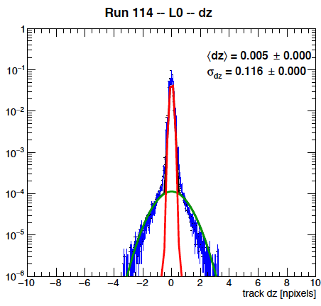
Summary
Successfully operated the full readout chain
  RU Configured and readout 4 ALPIDEs
  FELIX successfully integrated into RCDAQ
Sensor Performance
  Cluster Size
  Threshold parameters
  trigger delay
High multiplicity events
  ALPIDE occupancy runs with 10cm lead bricks
Online Monitoring
  Hit distribution, relative alignment
Analysis confirmed telescope performance
  Hit resolution < 5 um

Slide 23


Risk Mitigation
Risks:
Previous LDRD Review
Custom Electronics concerns
CRU FELIX finalization
BNL Directors Review
MVTX readout scheme integration into sPHENIX DAQ
Achievements
Successfully demonstrated full readout chain:
  STAVE->Readout Unit->FELIX
  Successfully integrated readout chain with RCDAQ (sPHENIX DAQ)
  Validated FELIX and Readout Unit performance for MVTX
    System triggered at 15Khz
    emulating 8 RU’s on FELIX
  Power System at LANL
Reduced cost of LDRD Contingencies

Slide 24
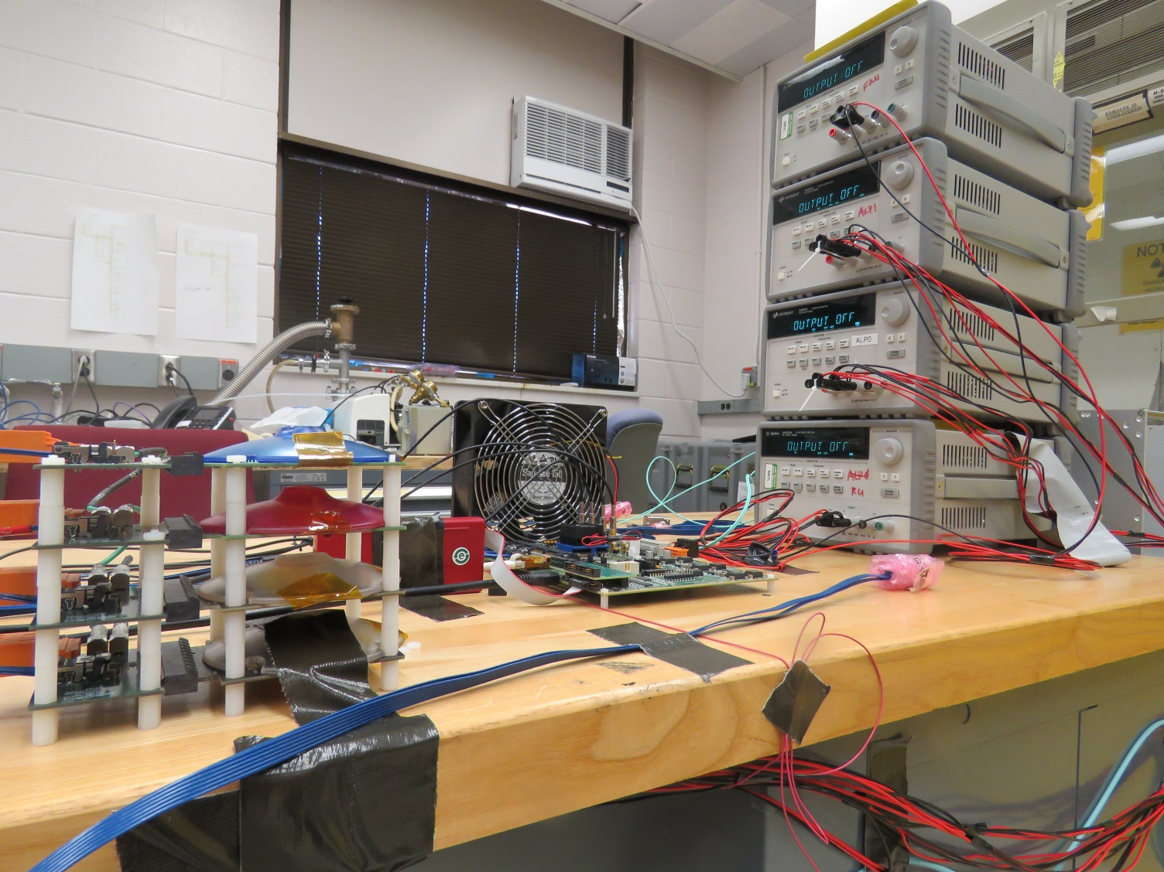
azv

