Slide 1
MVTX Review
INTT and MVTX Mechanical Integration
Dan Cacace

Slide 2
INTT Changes
Layers shifted out radially
More ladders per layer (relative to original simulated proposal)
More readout cards needed
Larger size pipe for INTT services
INTT no longer clam-shells inside the TPC, but outside the TPC
Additional clearance between MVTX and INTT
HDI connections to extension cables are staggered
Custom rails

Slide 3
INTT Layout
Air Outlet
Air Inlet
Layer 123
Layer 0
Layer | Radius (mm) | Pseudo rapidity | Quantity of Ladders | Angle (deg) | PHI Coverage (%) | Overlap (%) | Clearance (mm)
0 | 70 | 1.02 | 38 | 20.2 | 100 | 9 | 1.5
1 | 90 | 1.18 | 32 | 17.4 | 100 | 7.5 | 1.5
2 | 110 | 1.02 | 38 | 15.7 | 100 | 5.5 | 1.5
3 | 130 | 0.90 | 44 | 14.5 | 100 | 3.9 | 1.5
Stave 2.61 mm thick.
Total Quantity: 152

Slide 4
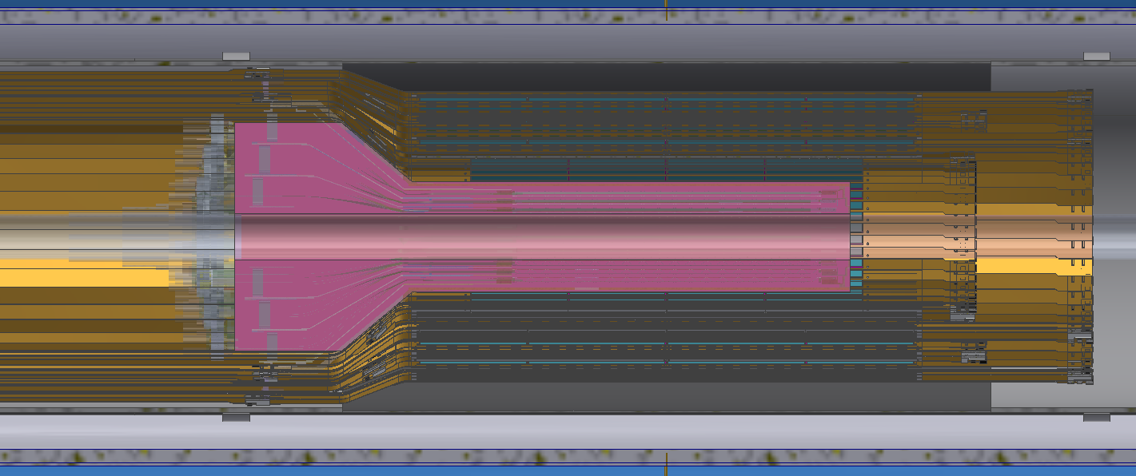
INTT
Extensions (flexible)
Space for support rail
Clearance
HDI (flexible)
HDI connector (rigid)
INTT Service
Pipe (rigid)
TPC inner
Edge (r=20cm)
MVTX Envelope (rigid)
Ladders (rigid)
INTT Outer Shell (rigid)
INTT Space for Air cooling lines (only north) (flexible)

Slide 5
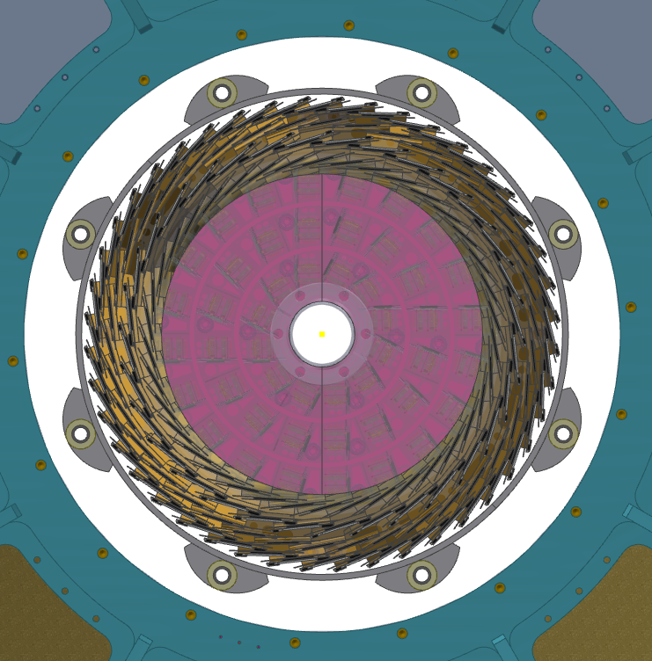
INTT
Support rail
HDI connector (rigid)
TPC inner
Edge (r=20cm)
MVTX Envelope (rigid)
INTT Service
Pipe (rigid)
Clearance

Slide 6
Backup

