Slide 1
Integration of staves + RU + FELIX into sPHENIX
Alex Tkatchev, Sho Uemura
Los Alamos National Laboratory
July 19-20, 2018

Slide 2
Charge
Does the current design demonstrate that the MVTX Staves and Readout Units will be compliant with its specifications?
Can the data from MVTX staves be extracted, readout and integrated into sPHENIX Data Acquisition System?
Are the electrical interfaces of the Staves and Readout Units to the other sPHENIX components at a proper level of understanding?

Slide 3
Acronyms
ALICE – A Large Ion Collider Experiment
ITS – Inner Tracking System
ALPIDE – ALICE Pixel Detector
RU – Readout Unit, designed for ALICE
GBTx – Radiation Tolerant Gigabit Transceivers, designed by CERN
GBT-SCA – Radiation Tolerant Slow Control Adapter
FELIX – Front End Link Exchange, designed for ATLAS
RCDAQ – Really Cool Data Acquisition
BER – Bit Error Rate, used for testing
PRBS – Pseudo-Random Binary Sequence, used for testing
TMR – Triple Modular Redundancy
SEU – Single Event Upset
SEL – Single Event Latch-up
TID – Total Ionizing Dose
LET – Linear Energy Transfer
DMA – Direct Memory Access
PCIe - Peripheral Component Interconnect Express

Slide 4
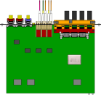

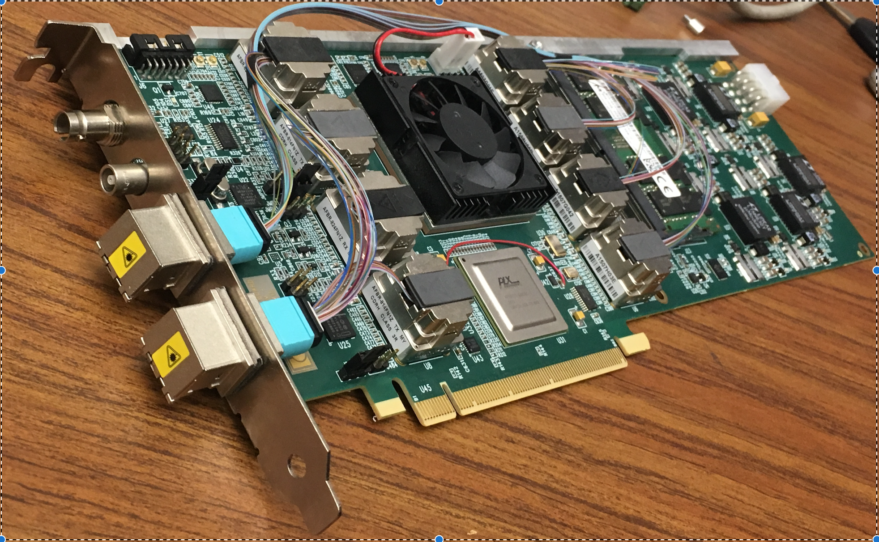
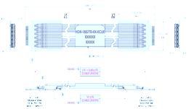
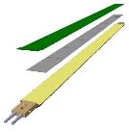

MVTX Electronics Overview
CAN bus
DCS
Readout Unit
Front End
Trigger & Clock
GBT Optical Links
9-sensor Stave
9 Data (1.2Gbps)
1 Clock, 1 Control/Trigger
Control
Data (9.6 Gb/s max)
Trigger
Samtec Twinax “FireFly”
FELIX
Back End
FPC
Power
ALPIDE
Sensors
Power
Filtering Capacitors
regulators
Power supplies
Cold Plate
Regulated Power
Power Board
Interaction Region
Experimental Hall
Counting House
MVTX Detector Electronics consists of three parts
Sensor-Stave (9 ALPIDE chips) | Front End-Readout Unit | Back End-FELIX

Slide 5
9-sensor Stave Highlights
CAN bus
DCS
Readout Unit
Front End
Trigger & Clock
GBT Optical Links
9-sensor Stave
9 Data (1.2Gbps)
1 Clock, 1 Control/Trigger
Control
Data (9.6 Gb/s max)
Trigger
Samtec Twinax “FireFly”
FELIX
Back End
FPC
Power
ALPIDE Sensors
Power
Filtering Capacitors
regulators
Power supplies
Cold Plate
Regulated Power
Power Board
Interaction Region
Experimental Hall
Counting House
MVTX Detector Electronics consists of three parts
Sensor-Stave (9 ALPIDE chips) | Front End-Readout Unit | Back End-FELIX

Slide 6
9-sensor Stave Highlights
Stave– 9 chips, common clock and control, independent data lines
Clock
Control+Trigger
Chip1
Chip2
Chip3
Chip4
Chip5
Chip6
Chip7
Chip8
Chip9
Serial Outputs (1.200 Gbps)
1024 pixel columns
In pixel: Amplification
Discrimination
3 hit storage registers (MEB)
AMP
COMP
THR
ALPIDE Architecture Highlights:
Multi-event buffering
Data output rate:1.2 Gb/s, 0.6Gb/s, or 0.4Gb/s
Zero suppression on ALPIDE
Readout modes: triggered or continuous
Calibration: Internal charge injection (pulsing logic)
Static Pattern Generation and PRBS
Pixel masking functionality
MVTX will use triggered mode at 1.2Gb/s
512 pixel rows
Readout (zero suppression)
Readout (zero suppression)
Readout (zero suppression)
Readout (zero suppression)
Bias, Readout, Control

Slide 7
Timing
Pixel cell
Time
Sensing node
Signal
Analog “slow” shaping time acts as a memory (µs order) to buffer the signal until the trigger arrives.
Called “pulse length”
Amplifier
Threshold
Threshold
Amp. out
Comparator
Only pixel with signal higher than threshold DURING the strobe window will get latched in memory
Strobe window
Cmp. out
And
Strobe window
Confirmed at LANL: pulse length can be extended to meet sPHENIX trigger latency requirement
(Charge 1)
Pixel memory
Latch set

Slide 8
ALPIDE in triggered mode, RU trigger filtering
Triggers from the
Timing System (GTM)
From GTM to RU
Time [µs]
-1
0
1
2
3
4
5
6
7
≈ trg latency
Triggers to the sensor
Labeled with trgID, through the Ctrl line.
Multiple GTM triggers can be grouped into a single trigger, sent to the sensor from the RU.
From RU to sensor
0001
0010
0011
0100
Time [µs]
-1
0
1
2
3
4
5
6
7
Busy flag
The RU can retrieve which trigger has failed even if the trailer is corrupted/missing
Data from the sensor
Trailers labeled with trgID, through the Data line.
From sensor to RU
0001
0010
0011
0100
Time [µs]
-1
0
1
2
3
4
5
6
7
The RU labels the data frame with all the triggers associated to its trgID
Triggers close in time re-record the same information, and the sensor can handle a minimum trigger spacing of about 1 µs. The RU will therefore “filter” close-in-time (< 1 µs) triggers.

Slide 9
ALPIDE Data format and BUSY
Hit Data
Chip Header
Data Short
Data Long
Chip Trailer
TIME
HEADER 0
HEADER 1
IDLE
REGION
HEADER
IDLE
IDLE
DS0
DS1
IDLE
DL0
DL1
DL2
DS0
DS1
IDLE
TRAILER
IDLE
IDLE
Time
Data Bytes
Busy is the way the ALPIDE informs the RU of close-in-time triggers.
ALPIDE simulations by ALICE show <10⁻⁶ deadtime (busy asserted, events flagged) at 100 kHz trigger rate.
BUSY- chip near saturation of its data processing capabilities (multi-event buffers full).
BUSY
CHIP HEADER
DATA SHORT
DATA LONG
TIME
CHIP TRAILER
HEADER 0
HEADER 1
REGION
HEADER
BUSY
ON
DS0
DS1
IDLE
DL0
DL1
DL2
DS0
DS1
BUSY
OFF
TRAILER
IDLE

Slide 10
TMR protection on ALPIDE
ALPIDE elements potentially SEU sensitive
1. Pixel Logic: mask and pulse registers (not protected)
Mitigation : Refresh pixel mask bits in background
2. Periphery logic: state machine, FIFO pointers, counters and configuration registers with TMR
3. Top readout unit and data management unit FIFO with Hamming protection
4. Region Readout DPRAM partially protected
format protected
hit data not protected
5. Data Transmission Unit: PLL and Serializer with TMR
1
32 readout regions
16 double columns
8b DACs
Pixels Config
4
2
Region Readout (1)
RR (2)
RR (3)
RR (32)
Configuration Registers
128x24b DPRAM
24b×40MHz
11b ADC
32:1 DATA MUX
Basic Triple Modular Redundancy register cell
Readout Sequencing
3
Top Readout Unit
Bandgap +
Temp Sens
24b×40MHz
FF0
RESET_VALUE
Data Management Unit
SEU_ERROR
8b/10b
IN
FF1
Control Bus Logic
Triggers
30b×40MHz
VOTING
LOGIC
OUT
Data Transmission Unit
FF2
PLL
Serializer
Driver
Differential Control Port
(40 Mbps)
5
Serial Out Port
(1200 Mbps / 600 Mbps/ 400 Mbps)
AUTO CORRECTION

Slide 11
ALPIDE Radiation Upsets
SEU impact estimates for elements in chip matrix and periphery (based on cross section values measured using CERN beam tests):
  Operation-critical registers protected using TMR
  Probability of corrupted single hit clusters below 1×10⁻¹⁰ s⁻¹
  <0.1% of pixel mask bits toggled each hour
Pixel mask bits will be refreshed periodically in the background (10 ms deadtime to refresh all pixels in MVTX)
SEL cross section measured per ALPIDE
  About 1 SEL per day in MVTX, automatically recovered
The measured SEU and SEL cross sections are not a risk for the operational stability of MVTX
TID effects will be discussed in the stave presentation by Leo Greiner

Slide 12
Readout Unit Highlights
CAN bus
DCS
Readout Unit
Front End
Trigger & Clock
GBT Optical Links
9-sensor Stave
9 Data (1.2Gbps)
1 Clock, 1 Control/Trigger
Control
Data (9.6 Gb/s max)
Trigger
Samtec Twinax “FireFly”
FELIX
Back End
FPC
Power
ALPIDE Sensors
Power
Filtering Capacitors
regulators
Power supplies
Cold Plate
Regulated Power
Power Board
Front End-Readout Unit
Data readout from Stave
Stave control and monitoring
Trigger & busy management
Power control and monitoring
Data building and transmission through the rad-hard Gigabit Transceivers

Slide 13
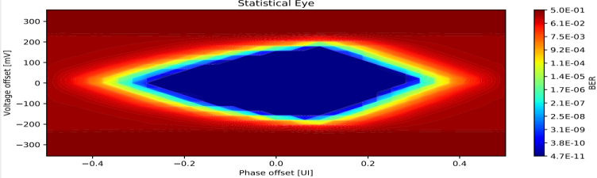
Samtec cables
From CERN Team:
2.3 m + 6 m long (meets MVTX requirements)
Tests show no PRBS errors over 48 h-equivalent of a single chip
BER < 2.22 * 10⁻¹⁴
Transmission is reliable (eye diagram is open) down to minimum ALPIDE driver strength
Readout Unit
6 m
Patch Panel
2.3 m
Stave
Eye diagram

Slide 14
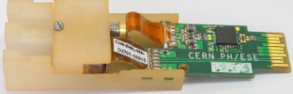
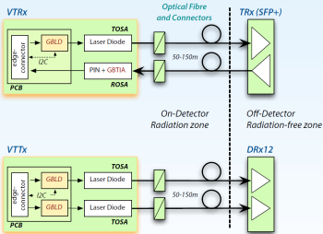
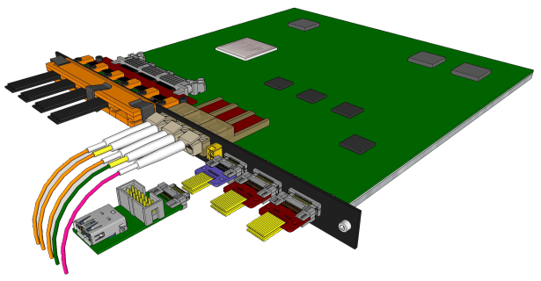

Readout Unit
Architecture Highlights:
Xilinx Kintex Ultrascale FPGA
ProAsic FPGA (Detect and Mitigate Radiation Upsets; Scrubbing)
GBTx ASIC (Radiation hard Giga Bit Transceiver) to FELIX
  VTRx: Transceiver up & down link
  VTTx: Double Transmitter 2 * up link
GBT-SCA: Rad. hard Slow Controls Adapter for monitor and control
Samtec “FireFly” copper twinax cable to the stave
Transition Board
Samtec Firefly cable
Covered in more detail in
Readout Unit Overview
by Jo Schambach
VTTx
VTRx
VTRx sm
Power Boards link
2 uplink (data) to FELIX
1 uplinks (data/CTRL) to FELIX
CAN bus
1 downlink (CTRL) from FELIX
Diagnostic / busy IO
1 trigger downlink directly
Notes:
Bla foo this is a test

Slide 15
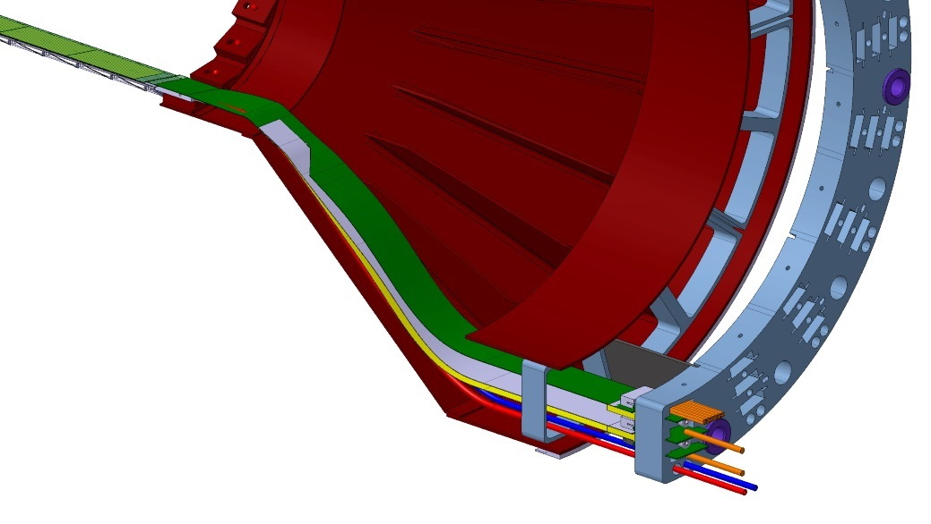
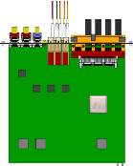
System Power Overview
Power Board designed by
LBNL
Power Board
MVTX staves
Positive voltage domains
x3
RU configures and monitors
stave current and voltage
through I2C interface of power board
V adjust (DP)
x16
PT100 Interface
PT100 Interface
PT100 Interface
LDO
LDO
LDO
LDO
LDO
LDO
V, I monitor
LDO
LDO
Readout Unit
LDO
LDO
LDO
LDO
LDO
LDO
LDO
LDO
Overcurrent
detection
Detector
RDO
Interface
(I²C)
Bias section
Overcurrent
reset
x4
FET Switch
FET Switch
FET Switch
Overcurrent
threshold
FET Switch
Readout Unit
Power in (3.3V)
Negative LDO
Bulk Power
V control /
V, I monitor
Power in (-5V)
I²C isolator

Slide 16
Power Board Radiation
Power Boards located alongside RUs, same environment
Power channels tested to 17 krad, bias channels to 20 krad
  Good stability (no self oscillations)
  No degradation of noise
  Negligible shifts of voltages and currents
Full production Power Board tested at CERN to 14.8 krad TID, no significant effect
Single Event Upsets observed on current DAC and negative voltage regulator;
  expect weeks of operation between power system interrupts
Radiation studies by
LBNL

Slide 17
FELIX Highlights
CAN bus
DCS
Readout Unit
Front End
Trigger & Clock
GBT Optical Links
9-sensor Stave
9 Data (1.2Gbps)
1 Clock, 1 Control/Trigger
Control
Data (9.6 Gb/s max)
Trigger
Samtec Twinax “FireFly”
FELIX
Back End
FPC
Power
ALPIDE Sensors
Power
Filtering Capacitors
regulators
Power supplies
Cold Plate
Regulated Power
Power Board
Back End-FELIX:
Data readout from 8 Readout Units
Slow Control and Monitoring of Stave and RU
Trigger and Timing systems interface
Data aggregation and sub-event packaging
Data transmission through the PCIe to Server CPU

Slide 18
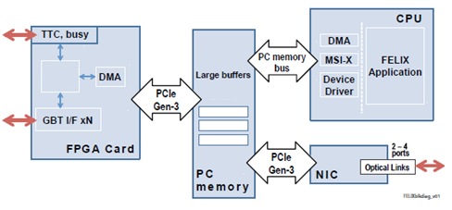
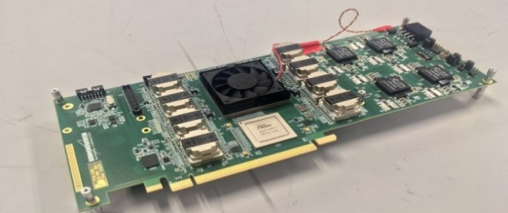
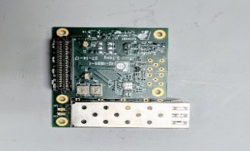
FELIX (also used by sPHENIX TPC)
FELIX v1.5
Architecture Highlights:
Xilinx Kintex Ultrascale KU115 FPGA
48 bi-directional GBT links
16 lane Gen3 PCIe
Mezzanine site for sPHENIX timing system card
Performance:
PCIe Tx > 100Gb/s
FELIX Block Diagram
FELIX v2.0
sPHENIX Timing Mezzanine
FELIX designed by BNL

Slide 19
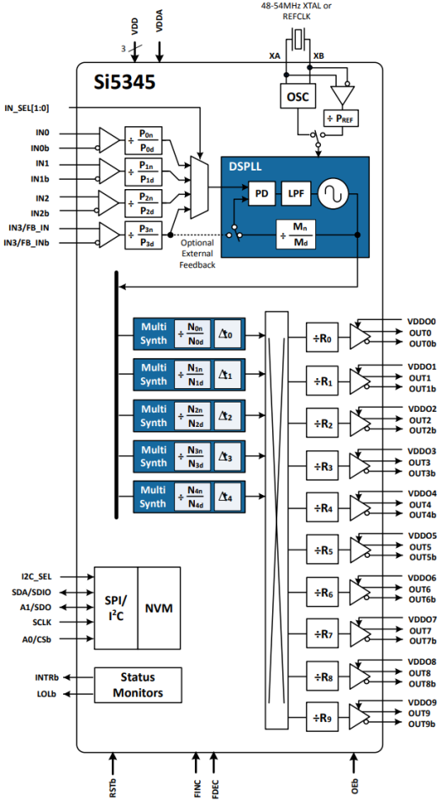
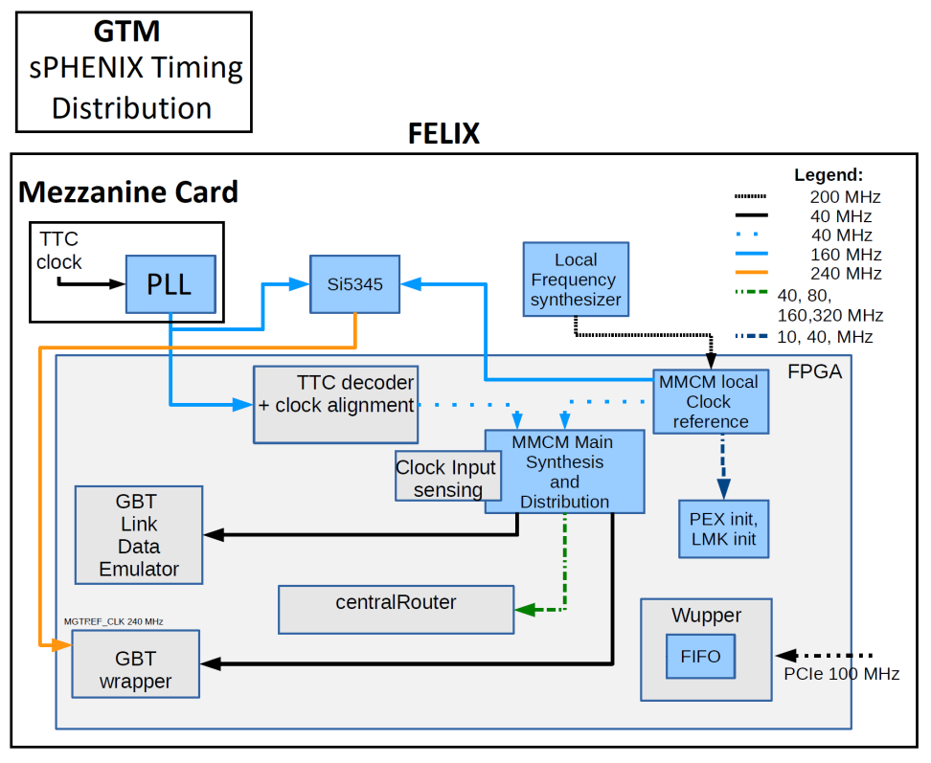
FELIX Clock Distribution
Test point
Current lab setup: External clock taken as input on test points, and sent to an on-board si5345 (configurable PLL) to generate the 40Mhz clock required by FELIX.
sPHENIX: FELIX will take the RHIC 9.362 MHz clock from the sPHENIX Timing System. Mezzanine Card will convert the 40Mhz clock required by FELIX.
FELIX Clock Block Diagram
Si5345 Block Diagram

Slide 20
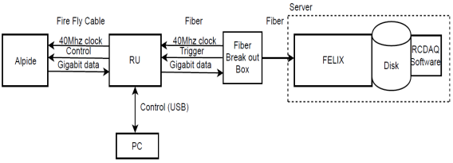
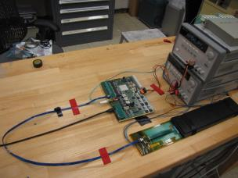
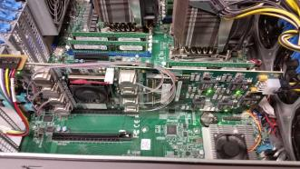
MVTX Full Chain
Stave
Readout
Unit
FELIX
Demonstrated Full MVTX Chain Readout
(charge 1 & charge 2 & charge 3)
Readout Unit + Stave
Successfully configured, triggered and readout Stave:
  Readout Unit configures Stave
  FELIX distributes clock to Readout Unit
  Readout Unit distributes clock to the Stave
  Stave is triggered, sends data at 1.2Gb/s
  Configured GBT link to recover clock from FELIX
  RU receives data and sends it to FELIX over GBT optical link
  FELIX packs data, stores it on disk using RCDAQ
  ALPIDE triggered and read out at 15kHz, 448 hits
  Emulated 8 RU’s using 1 fiber link per RU on FELIX, 15kHz
Server + FELIX

Slide 21
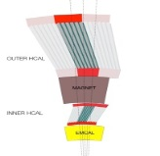
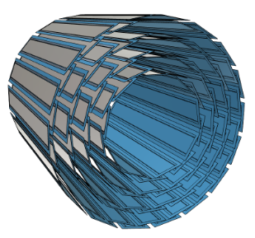
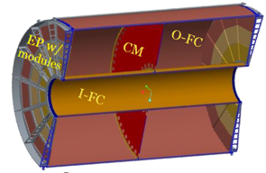
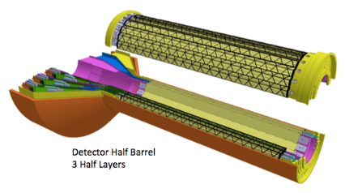
sPHENIX DAQ Architecture
Event Builder
FEM
DCM
DCM2
DCM
DCM
DCM
DCM
Network
Switch
Buffer Box
FEM
DCM
SEB
ATP
DCM
DCM
DCM2
DCM
DCM
ATP
DCM
Buffer Box
FEM
DCM
SEB
ATP
DCM
DCM
Calorimeters, INTT, MBD
DCM
DCM2
ATP
Buffer Box
DCM
SEB
DCM
To the
RACF/HPSS
DCM
ATP
TPC
ATP
Buffer Box
FEE
ATP
DCM
DCM
FELIX
EBDC
ATP
DCM
Buffer Box
FEE
ATP
DCM
DCM
FELIX
EBDC
ATP
Buffer Box
DCM
MVTX
FEE
ATP
DCM
FELIX
EBDC
DCM
ATP
Buffer Box
DCM
Rack Room
Acronyms:
FEE Front End Electronics
FELIX FrontEnd LInk eXchange
EBDC Event Buffer and Data Compressor
ATP Assembly and Trigger Processors
Buffer Box Interim storage
FEM Front End Module
DCM2 Data Collection Module
SEB Sub-Event Buffer
MVTX Hardware:
  48 Staves
  48 FEE (Readout Units v2.0)
  6 FELIX v2.0
  6 EBDC servers

Slide 22
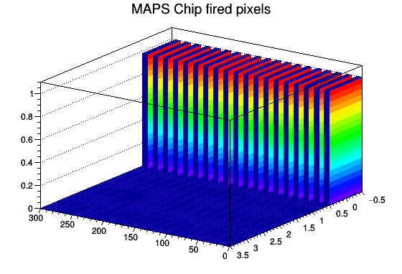
RCDAQ
RCDAQ = sPHENIX Data Acquisition framework
  rcdaq plugin developed which will serve as a conduit between the FPGA DMA PCIe endpoint and software used to transfer data to sPHENIX Data Acquisition framework
  Plots generated by RCDAQ in the initial stage of integration using pulsed mode of the ALPIDE Pixels readout by Readout Unit and FELIX in the lab.
RCDAQ developed by Martin Purschke, BNL
Full MVTX integrated with sPHENIX DAQ
(charge 2)

Slide 23
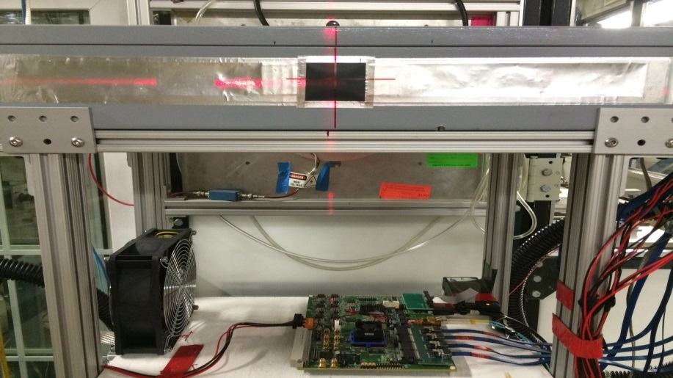
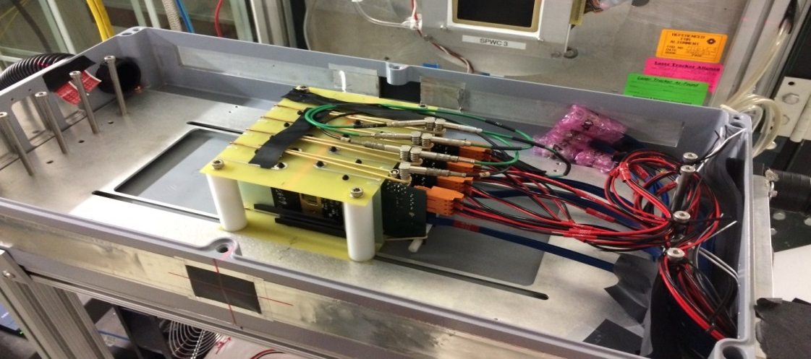
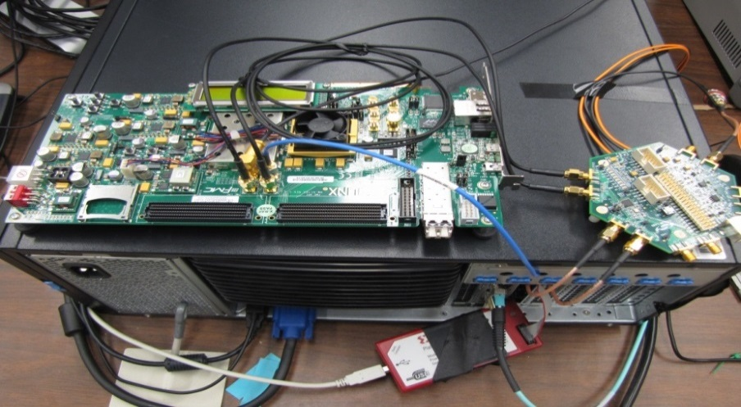
4-ALPIDE Telescope at Test Beam
4-ALPIDE Telescope;
5m long SamTec cables
RUv1.0
Fermilab Beam:
Primarily 120GeV proton beam
  also with low energy pion beams
Approximate beam trigger rate 7kHz
FELIX in Server
KC705
Process Scintillator Trigger
40 Mhz
Clock

Slide 24
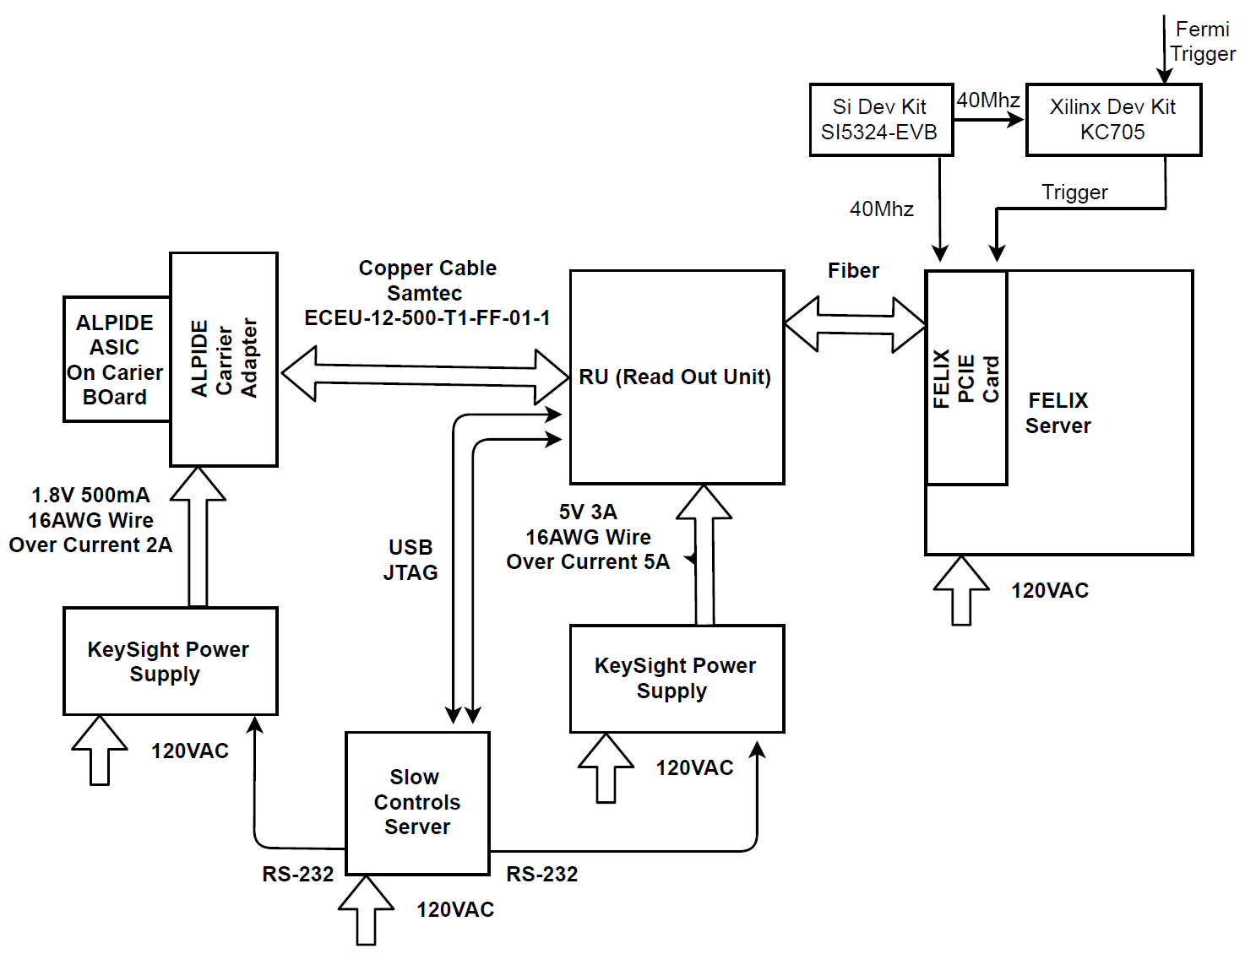
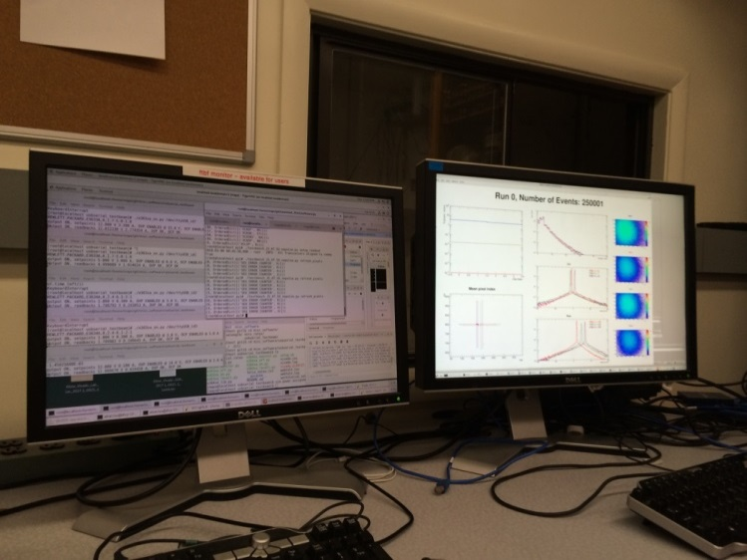
Test Beam Block Diagram
4-ALPIDE Telescope
4 5m SamTec Cables, 1.2Gbps
CLK recovered from
FELIX through GBT link;
Trigger from FELIX
Slow Controls
Online Monitoring
On Carrier
Board

Slide 25
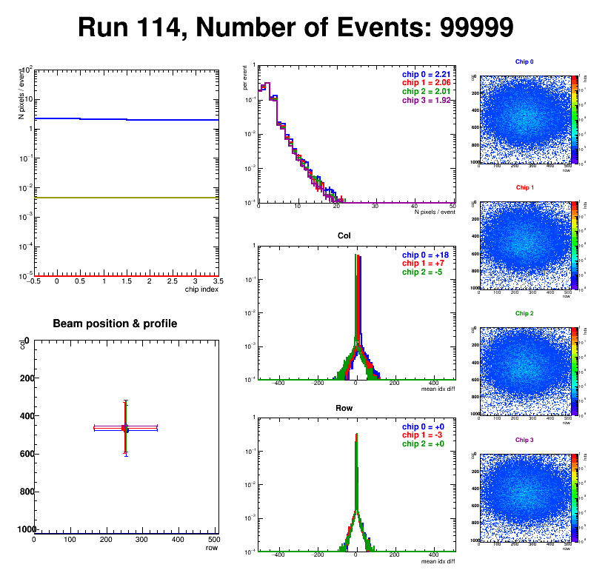
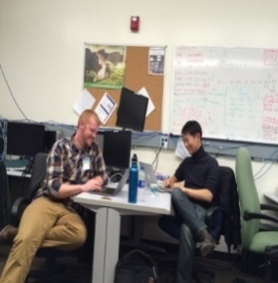
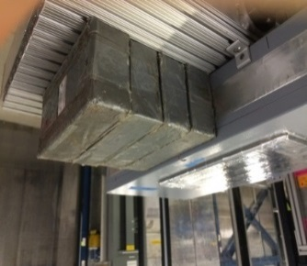
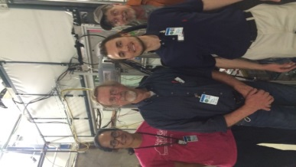
Test Beam Results
Successfully operated the full readout chain
  RU configured and readout 4 ALPIDEs
  FELIX successfully integrated into RCDAQ
Online monitoring
  Hit distribution, relative alignment
Sensor performance
  Cluster size
  Threshold parameters
  Trigger delay
High multiplicity events
  ALPIDE occupancy runs with 10cm of lead
Analysis confirmed telescope performance
  Hit resolution < 5 um
Online monitoring and offline data analysis
using RCDAQ and Fun4All (sPHENIX framework)
(charge 2)

Slide 26
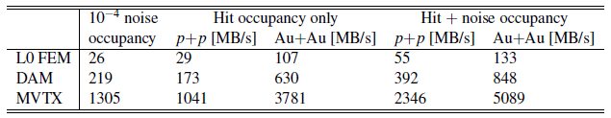
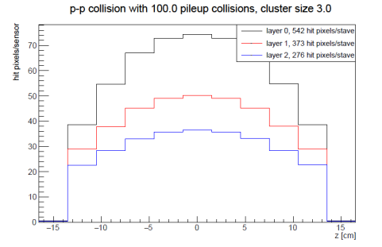
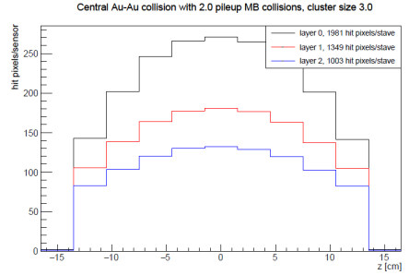
Estimated Data Rate
RU
FELIX
MVTX
Readout Units 3 GBTX @ 400 MB/s = 1200 MB/s >133MB/s
FELIX (48 input on FELIX, twice the number needed to support 8 RUs (3 links each))
2x 8-lane PCIe Gen3 @ 7880 MB/s = 15760 MB/s > 848 MB/s
Meets specification (charge 1)
Worst Case Conservative Estimates

Slide 27

Summary
Does the current design demonstrate that the MVTX Staves and Readout Units will be compliant with its specifications? Yes.
  Triggered system at 15kHz using pulser at expected MVTX data rate, and approximately 7Khz at random during beam test.
Can the data from MVTX staves be extracted, readout and integrated into sPHENIX Data Acquisition System? Yes.
  Test beam data from ALPIDE sensors was taken using full MVTX readout chain:
    ALPIDE Sensor->Readout Unit->FELIX->rcdaq (sPHENIX daq).
  Data was recorded in PRDF (sPHENIX data format) and is being analyzed in Fun4All (sPHENIX analysis framework).
Are the electrical interfaces of the Staves and Readout Units to the other sPHENIX components at a proper level of understanding? Yes.
  The optical interface from the Readout Unit to the other sPHENIX components has been validated with FELIX.
    Demonstrated clock and trigger and gigabit data transmission.
  Power System is well understood.

