Slide 1
sPHENIX MVTX Radiation Dosage after 5 years
Layer | <R> cm | TID, krad | NIEL (1), 10¹²N_{eq}/cm² | NIEL(2), 10¹²N_{eq}/cm²
0 (scaling =1) | 2.6 | 1060 | 6.6 | 17
1 (scaling = 0.61) | 3.4 | 650 | 4.0 | 10
2 (scaling=0.43) | 4.1 | 460 | 2.8 | 7.3
ALICE L0 | 2.2(Min.) | 273 (tested OK up to 500) | 1.7 (tested OK up to 17) | -
Note:
- TID scales with Dosage, high energy particles
- NIEL(1): cross section scaling, from ALICE
- NIEL(2): phenix measurements, scaled to sPHENIX
N_{part}(sPHENIX, 200GeV) = 109.1, (0-92.2%)
N_coll = 4.1
N_{part}(ALICE, 5.5TeV) = 113.9 (0-100%)
N_coll(ALICE) = 5.58

Slide 2
Radiation Level in sPHENIX (I): TID/NIEL (high energy particles) - by flux cross section scaling: LHC vs RHIC
http://dde.web.cern.ch/dde/glauber_lhc.htm
LHC: Pb-Pb 5.5TeV,
sigma_NN = 72mb
Sigma_PbPb = 7750mb
L = 13nb⁻¹
N_evts = 7750mb x 13nb^-1
= 100 x10⁹
RHIC: AuAu 200GeV
Sigma_NN = 42mb
Sigma_AuAu = 7000mb
L = 214nb⁻¹
N_evts = 7000mb x 214nb^-1
= 1,500 x 10⁹
RHIC (AuAu) dN/deta = 1/4.5 LHC(PbPb):
Flux (RHIC, AuAu) = 1/4.5 x 1500/100 = 3.3 x LHC(PbPb)
Flux (RHIC, pp) = 0.32 x Flux (RHIC, AuAu), R_Npart = 0.5
Total flux(RHIC: AuAu+pp+pA) = 3.3 x (1+0.32) x LHC(PbPb)
= 4.4 ALICE(PbPb) Flux
sPHENIX/MVTX L0:
- NIEL = 0.88 x 4.4 x (1.7 x10^12) =6.6 x10¹² N_{eq}/cm²
- TID = 0.88 x 4.4 x (273 krad) = 1060 krad = 1.1 Mrad
ALICE Note: PUB-2443
ALICE L0: 13n⁻¹PbPb + 50nb⁻¹ + 6pb⁻¹
(PbPb: 97% Lum_total, dominant)
@L0 R=2.2cm, sPHENIX: dR=+1.25mm
R_factor = (2.2/2.35)^2 =0.88
TID = 273 krad
NIEL = 1.7 x 10¹² N_{eq}/cm²

Slide 3
Radiation Level in sPHENIX (II): NIEL - by PHENIX measurements
Projected sPHENIX radiation level after 5-year operation
AuAu: L = 214 nb⁻¹ = 8,300 pb⁻¹
@R=10cm, D_AA = 214/50 x 0.2x10¹² = 0.86x10¹² N_{eq}/cm²
pp/pA: L = 1340 pb⁻¹
@R=10cm, D_pp = 1340/700 x 0.3x10¹² = 0.57x10¹² N_{eq}/cm²
N_{eq} = 1MeV Neutron Equivalent
MVTX:
R0/R1/R2 = 2.6/3.4/4.1cm
R-factor:
(10/2.6)^{1.83} = 11.8
(10/3.4)^{1.83} = 7.2
(10/4.1)^{1.83} = 5.1
Fluence from AuAu runs:
- L0 = 10 x 10¹² N_{eq}/cm²
Fluence from pp runs:
- L0 = 6.7 x 10¹² N_{eq}/cm²
Totals:
L0 = 1.7 x 10¹³ N_{eq}/cm²
L1 = 1.0 x 10¹³ N_{eq}/cm²
L2 = 0.7 x 10¹³ N_{eq}/cm²
RHIC-II projected dosage based
on PHENIX measurements:
arXiv: 0710.2676 [nucl-ex]

Slide 4
Radiation Level in sPHENIX: TID/Flux - by PHENIX measurements
Projected sPHENIX radiation level after 5-year operation
AuAu: L_AuAu = 214 nb⁻¹ = 8,300 pb⁻¹
pp+pA: L_pp = 1,340 pb⁻¹
R_Npart = 0.5, low pT @RHIC,
Effective AuAu-equivalent luminosity (for TID/flux) = L_AuAu + L_pp/R_Npart = 214nb⁻¹ (1 + 1340/8300/R_Npart) = 214 (1+0.32) nb-1 = 282nb⁻¹
AuAu equivalent collisions = 1,500 x 109 x (1 + 0.32)
ALICE PbPb: 100 x 10^9 collisions:
Flux ratio: sPHENIX/ALICE = 1/4.5 x (1500 x 1.32)/100 = 4.4
sPHENIX TID L0 = (R: 2.2/2.35)^2 x 4.4 x 273 krad = 1050 krad
MVTX:
R0/R1/R2 = 2.6/3.4/4.1cm
R-factor:
(10/2.6)^{1.83} = 11.8
(10/3.4)^{1.83} = 7.2
(10/4.1)^{1.83} = 5.1
Fluence from AuAu runs:
- L0 = 10 x 10¹²
Fluence from pp runs:
- L0 = 6.7 x 10¹² N_{eq}/cm²
Totals:
L0 = 1.7 x 10¹³ N_{eq}/cm²
L1 = 1.0 x 10¹³ N_{eq}/cm²
L2 = 0.7 x 10¹³ N_{eq}/cm²
RHIC-II projected dosage based
on PHENIX measurements:
arXiv: 0710.2676 [nucl-ex]
http://dde.web.cern.ch/dde/glauber_lhc.htm
ALICE Note: PUB-2443
ALICE L0: 13n⁻¹PbPb + 50nb⁻¹ + 6pb⁻¹
(PbPb: 97% Lum_total, dominent)
TID = 273 krad
NIEL = 1.7 x 10¹² N_{eq}/cm²

Slide 5
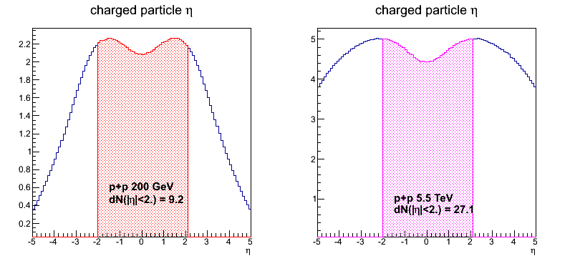
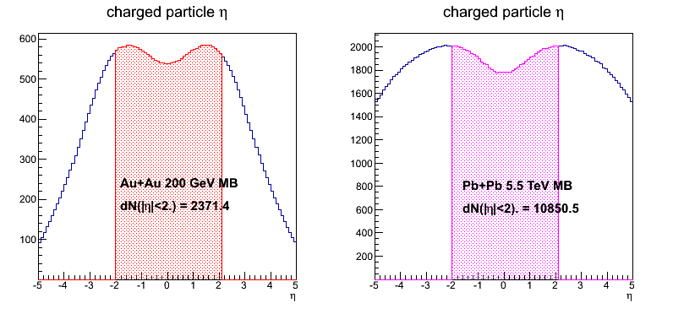
Event Multiplicity and Collision Rates: sPHENIX vs ALICE
 | ALICE (Run3) | sPHENIX (Max) | Ratio of data rates sPHENX/ALICE
Pb+Pb / Au+Au | 50kHz | 200 kHz | 0.27
p+p | 200kHz | 13 MHz | 6.5
Trigger/Readout | 50 kHz | 15 kHz | -
MB Event track multiplicity dN/dη: sPHENIX = 1/3 ALICE (pp), 1/4.5 ALICE(AA)
sPHENIX triggered data rate well within readout specs
sPHENIX
ALICE
sPHENIX
ALICE
p+p collisions
sPHENIX/ALICE ~1/3
A+A collisions
sPHENIX/ALICE ~1/4.5

Slide 6
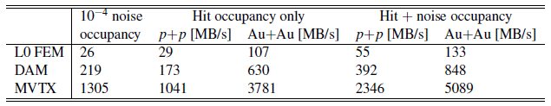
Projected sPHENIX Data Rates
Alex & Sho
#1,2,3
(FELIX)
Note: test beam showed noise < 10⁻⁵
Readout Units: 3 GBTX @ 0.4 GB/s = 1.2 GB/s >133MB/s
GBTx: 3.2-4.48Gb/s, 0.4 GB/s
FELIX/DAM: 48 input on FELIX, twice the number needed to support 8 RUs (3 links)
2x 8-lane PCIe Gen 3 @ 7880 MB/s = 15,760 MB/s > 848 MB/s
MVTX readout hardware capacity > 10 x Expected data rate

Slide 7
Expected Radiation Level after 5-year Runs
sPH-TRG-2018-001
Leo
#1
Projected sPHENIX integrated luminosities after 5-year operation
AuAu: Lum. = 214 nb⁻¹
pp+pAu: Lum. = 1340 pb⁻¹
Projected sPHENIX MVTX fluence, L0 = 0.6 ~ 1.7 x10¹³ N_{eq}/cm²
Fluences of outer layers:
L1 = 0.6 x L0
L2 = 0.4 x L0
- Within the ALPIDE performance specs. (1.7 x10¹³ N_{eq}/cm²)
- Risk mitigation: 36 spare staves (75%) to replace damaged ones
TID: sPHENIX ~ 4.5 ALICE
Staves per layer:
L0 = 12
L1 = 16
L2 = 20

Slide 8
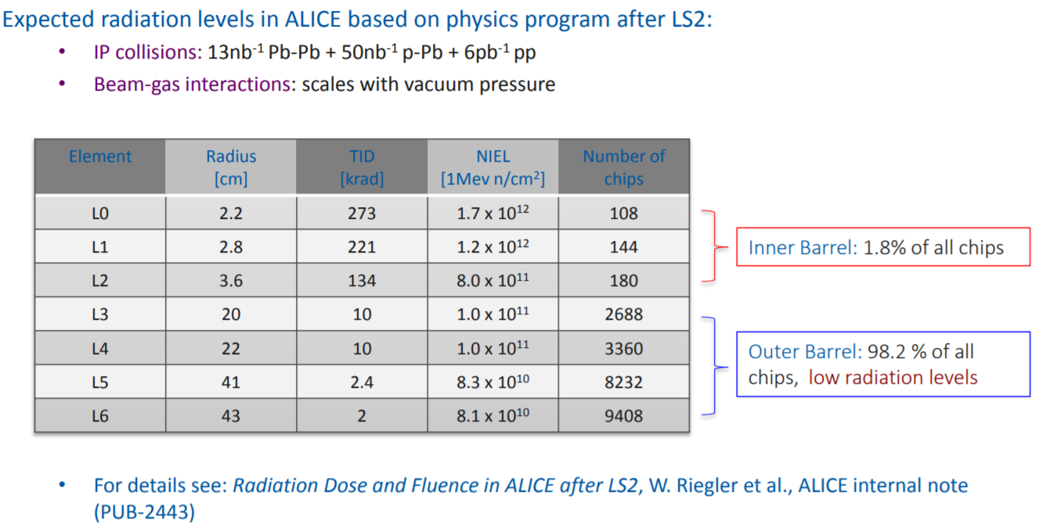
Staves – Specification/radiation tolerance
sPhenix TID radiation levels (5 years) are expected to be 4.5 times this.
NIEL levels are expected to be 1.7 x 10¹³ 1 MeV N_{eq}

Slide 9
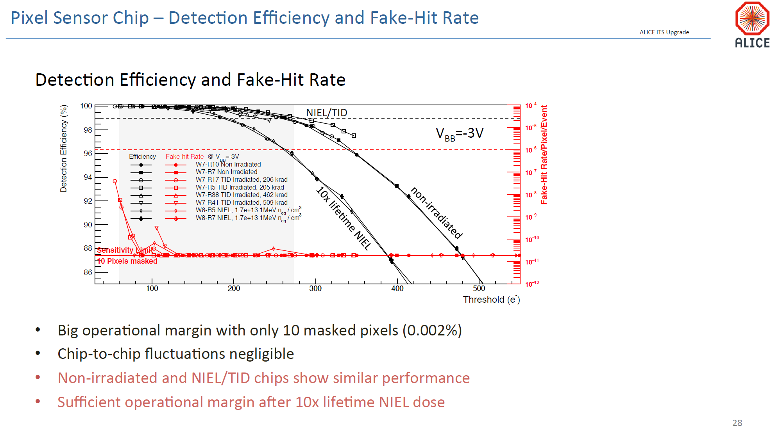
Staves – Specification/radiation tolerance
From L. Musa – 7/26/2017 DOE review
Sensors have been tested to full MVTX NIEL levels and 1/5.4 of the TID.
Spare staves are available for replacement of staves that show degradation.

Slide 10
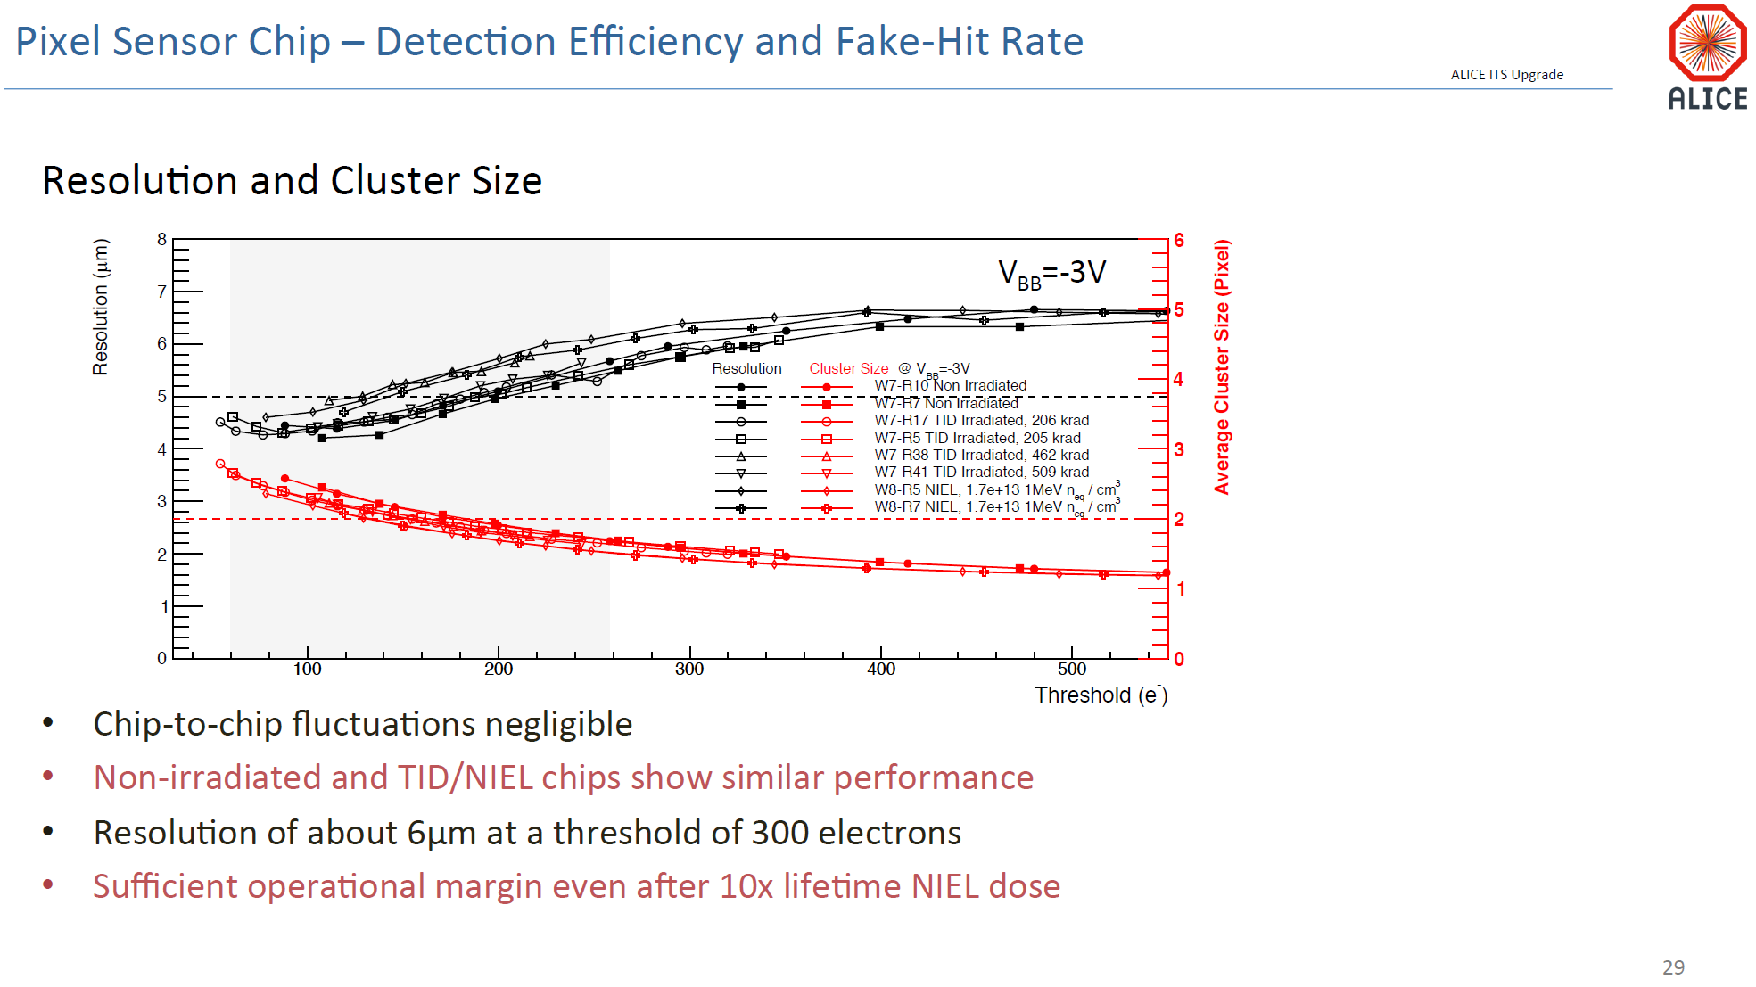
Staves – Specification/radiation tolerance
From L. Musa – 7/26/2017 DOE review
Pixel Sensor Chip – Resolution and Cluster Size

Slide 11
Expected Radiation Level after 5-year Runs
sPH-TRG-2018-001
Projected sPHENIX radiation level after 5-year operation
AuAu: Lum = 214 nb⁻¹
@R=10cm, D_AA = 214/50 x 0.2x10¹² = 0.86x10¹² N_{eq}/cm²
pp/pA: Lum = 1340 pb⁻¹
@R=10cm, D_pp = 1340/700 x 0.3x10¹² = 0.57x10¹² N_{eq}/cm²
Projected sPHENIX MVTX fluence, L0 = 0.6 ~ 1.7 x10¹³ N_{eq}/cm²
Fluences:
L1 = 0.6 x L0
L2 = 0.4 x L0
Within the ALIPDE performance specs.

Slide 12
ITS Radiation Load
Position respect to beam |  |  | Radiation levels (total)
r | z | Name | TID | 1 MeV neq fluence | High energy hadron flux* | Charged particle flux
[cm] | [cm] |  | [krad] | [cm⁻²] | [kHz cm⁻²] | [kHz cm⁻²]
2.2 | [-13.5 ÷ 13.5] | ITS L0 | 2734 | 1.7 × 10¹³ | 765 (770) | 890 (910)
43 | [-73.7 ÷ 73.7] | ITS L6 | 20 | 8.1 × 10¹¹ | 3.4 (4.9) | 4.5 (6.7)
79 | [-260 ÷ 260] | TPC In | 5.6 | 7.0 × 10¹¹ | 1.35 (1.8) | 1.7 (3.45)
100 | 330 | RE | ≈ 5 | ≈ 1.6 × 10¹¹ | 0.86 | 1.7
258 | [-260 ÷ 260] | TPC Out | 0.86 | 1.4 × 10¹¹ | 0.27 (0.37) | 0.2 (0.3)
290 | [-290 ÷ 290] | TRD | 0.6 | 1.2 × 10¹¹ | 0.23 (0.31) | 0.15 (0.23)
Hadrons and charged particles as for 50 kHz Pb-Pb collisions

Slide 13
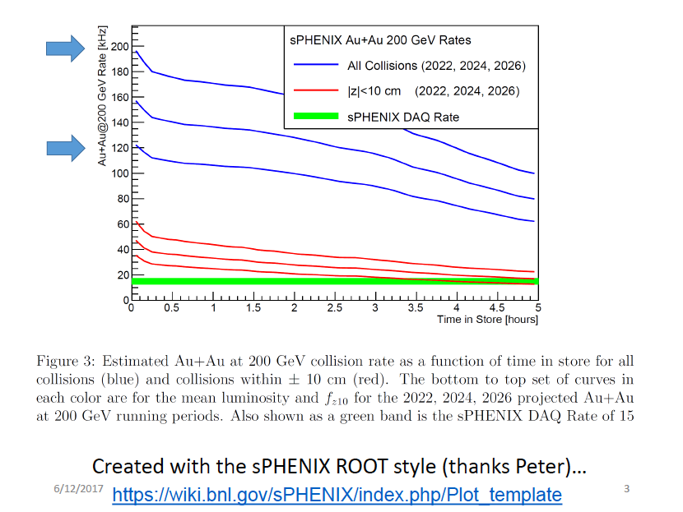
Expected Luminosities and Collision Rates

Slide 14
dN/dη in p+p collisions
With |η|<2.0 region, dN(ALICE) ~2.9*dN(sPHENIX).
sPHENIX
ALICE

Slide 15
dN/dη in MB Au+Au/Pb+Pb collisions
With |η|<2.0 region, dN(ALICE) ~4.6*dN(sPHENIX).
Ncoll(Au+Au)=258, Ncoll(Pb+Pb)=401.
sPHENIX
ALICE

Slide 16
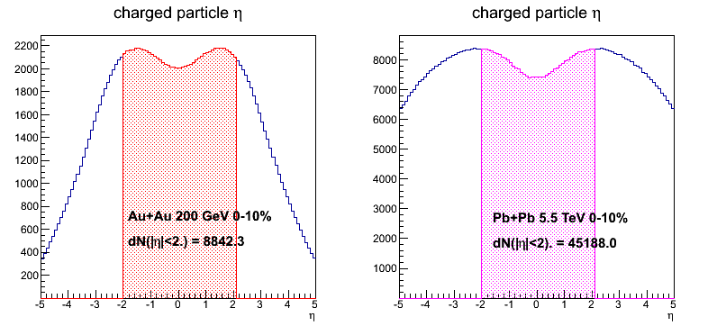
dN/dη in 0-10% Au+Au/Pb+Pb collisions
With |η|<2.0 region, dN(ALICE) ~5.1*dN(sPHENIX).
Ncoll(Au+Au)=962, Ncoll(Pb+Pb)=1670.
sPHENIX
ALICE

Slide 17
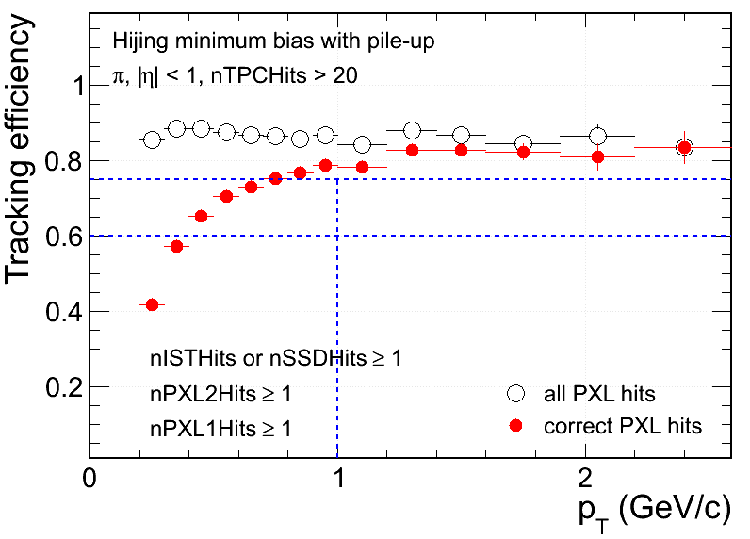
Hit Density on STAR PXL at RHIC Environment
 | PXL inner | PXL outer
Radius (cm) | 2.8 | 8
MB pileup hits (cm⁻²) | 13 | ~3
UPC electrons (cm⁻²) | 33 | ~3
Total bkgd hits (cm⁻²) | 46 | ~6
MB signal Au+Au (cm⁻²) | ~8 | ~1
- Ming’s note:
With 5uS integration time, BG rate can be reduced by,
5/200 = 1/40
S/B ~ 8/1 for sPHENIX
Simulation@50kHz
Au+Au MB real data (cm⁻²) | ~50 | ~5
Simulation
Signal hits fraction in MB (Central) events:
~15% (~30%) at PXL inner
Increasing fake matches in low p_{T}
Technology chosen considering both physics and technology readiness

Slide 18
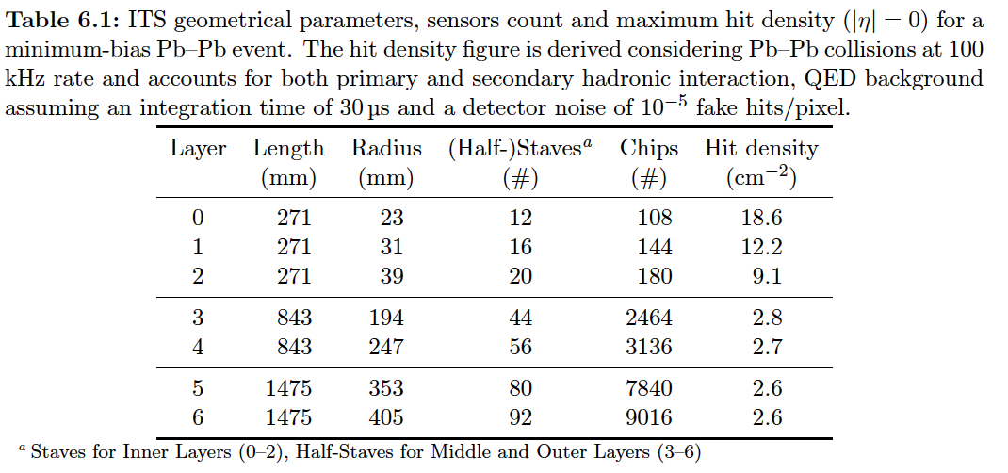
Hits and Event Data Rate
Event size: sPHENIX = 1/3 ALICE
Identical geometry for MVTX and ITS/IB(layer 0-2)
sPHENIX integration time ~5uS, less noise compared with ALICE with 10~20uS.

Slide 19
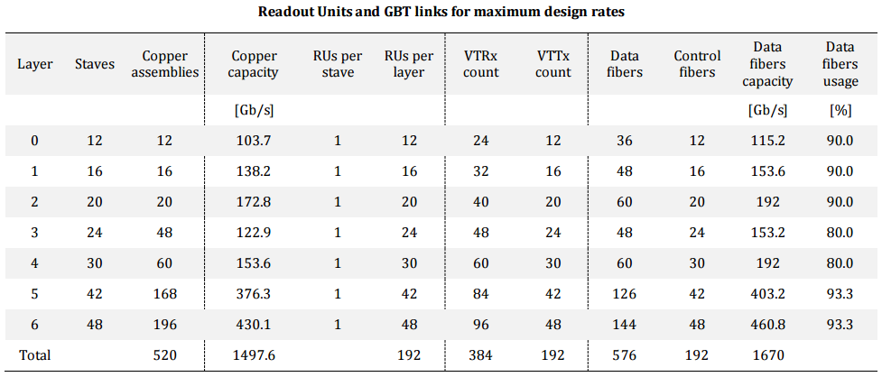
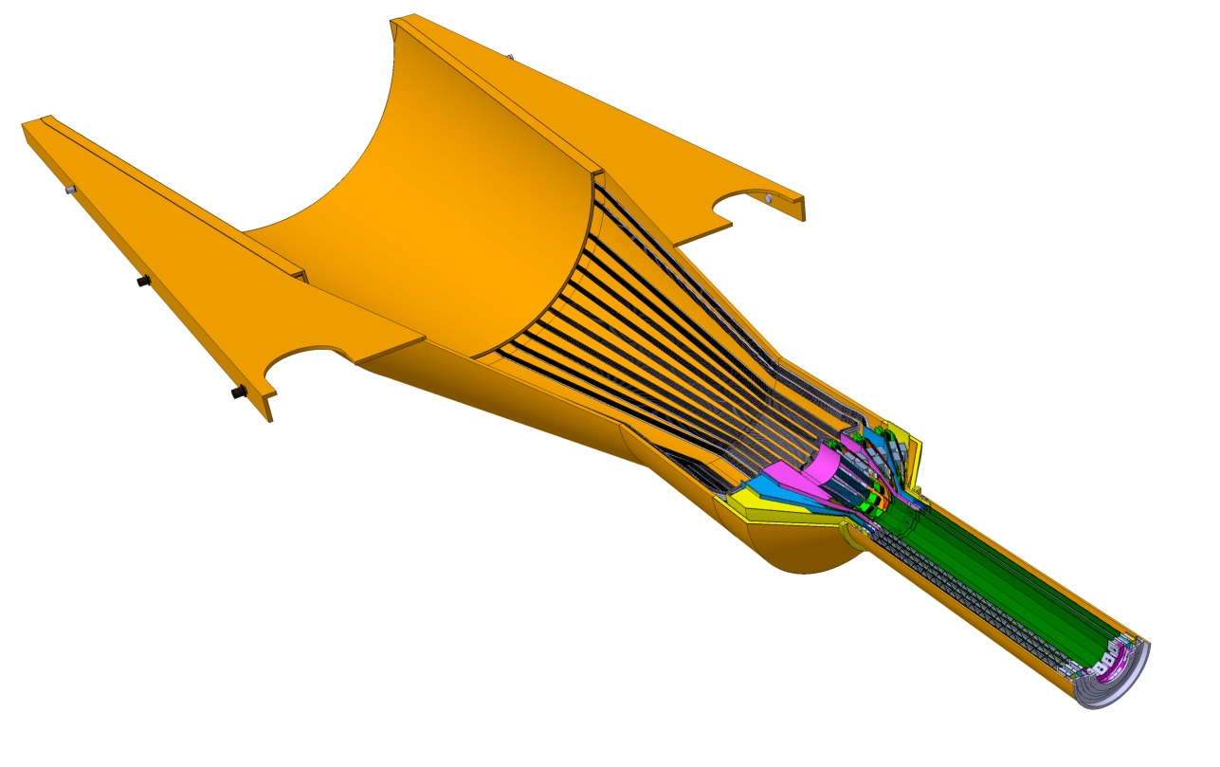
Readout Units Required for ITS & sPHENIX
48 inner staves;
48 RU boards;
6 FELIX boards;
- 8RU ->1 FELIX

Slide 20
Radiation Measurements in PHENIX
Used RadMons from CERN
RadFET sensitive primarily to ionizing radiation
Pin Diode sensitive to neutrons
Both are integrating devices
Placed in the IR for RUNs 13-16
Run 13: 510 GeV p-p
Run 14: Mixed Heavy Ion Running
Run 15: 100 GeV p-p
Run 16: 200 GeV Au-Au
Locations:
3 positioned on North Nose Cone @ ~ 3cm, ~8 cm and ~16 cm (shown)
Others positioned inside the pistons, used for SiPM damage, … (Not shown)
From Eric Mannel
sPHENIX Directors Review, 3/2018

Slide 21
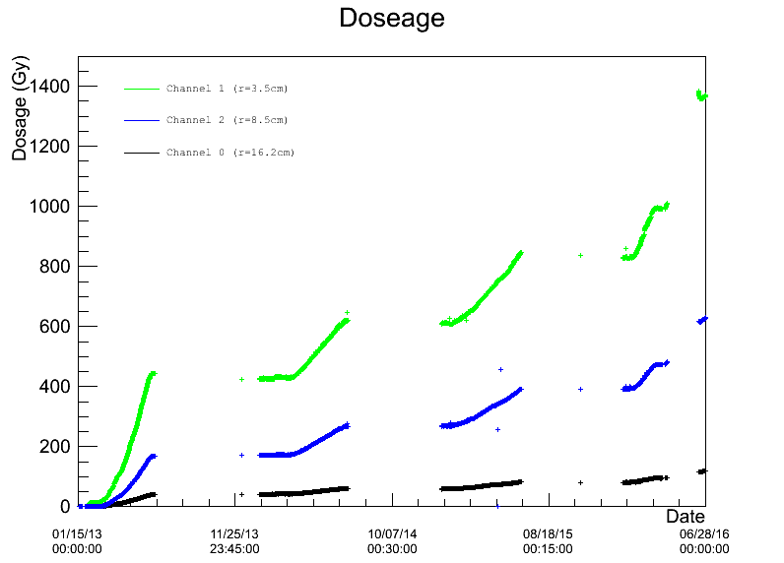
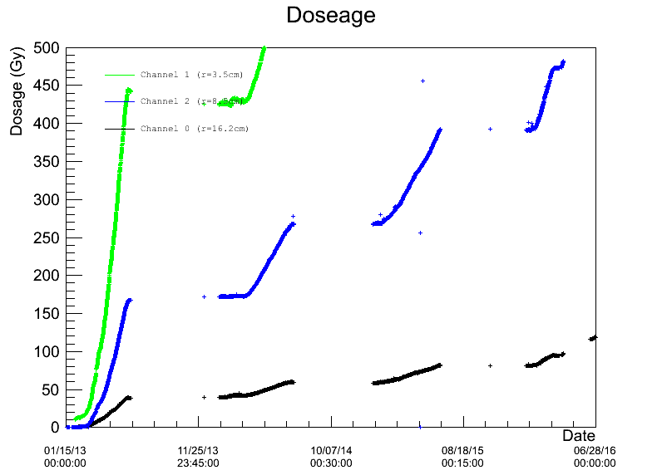
RadFET Results
1 Gy = 100 rad
200 GeV Au-Au
100 GeV p-p
Mixed Heavy Ion
510 GeV p-p

Slide 22
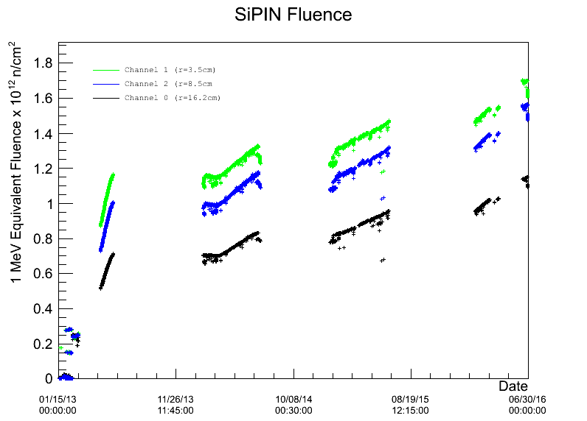
Pin Diode Fluence Measurements @PHENIX
For Au-Au running we expect @ sPHENIX EMCal:
Integrated ionizing radiation dosages of order 10’s of kRad/run
Integrated neutron fluences of order 2x10¹¹ n/cm²
MVTX: <R>_0/1/2 = 2.6/3.4/4.1cm
MVTX R_0 fluence = 6~17 x10¹² nEq/cm²
The dose due to collisions @PHENIX:
D_collisions / D_total = 61% @Run6
arXiv:0710.2676 [nucl-ex]

Slide 23
ALICE ITS Upgrade – PRR 4/13/2018
RU/PU location

Slide 24
ALICE ITS Upgrade
RU/PU location

Slide 25
ALICE ITS Upgrade
RU/PU location

Slide 26
ITS Readout - Radiation Load
Position respect to beam |  |  | Radiation levels (total)
r | z | Name | TID | 1 MeV neq fluence | High energy hadron flux* | Charged particle flux
[cm] | [cm] |  | [krad] | [cm⁻²] | [kHz cm⁻²] | [kHz cm⁻²]
2.2 | [-13.5 ÷ 13.5] | ITS L0 | 2734 | 1.7 × 10¹³ | 765 (770) | 890 (910)
43 | [-73.7 ÷ 73.7] | ITS L6 | 20 | 8.1 × 10¹¹ | 3.4 (4.9) | 4.5 (6.7)
79 | [-260 ÷ 260] | TPC In | 5.6 | 7.0 × 10¹¹ | 1.35 (1.8) | 1.7 (3.45)
100 | 330 | RE | ≈ 5 | ≈ 1.6 × 10¹¹ | 0.86 | 1.7
258 | [-260 ÷ 260] | TPC Out | 0.86 | 1.4 × 10¹¹ | 0.27 (0.37) | 0.2 (0.3)
290 | [-290 ÷ 290] | TRD | 0.6 | 1.2 × 10¹¹ | 0.23 (0.31) | 0.15 (0.23)
TID & fluence = (table 1 × 1.3_{data taking efficiency} + Table 2 / 10_{better vacuum}) × 10_{safety factor}
Safety factor of 10 on top of TID and fluence calculated as in the above line.
Hadrons and charged particles as for 50 kHz Pb-Pb collisions (table 1, worst case scenario).
The average value within the z span is reported first, in brackets the peak value within the z interval.
* Momentum > 20 MeV.

Slide 27
ALICE ITS Upgrade

Slide 28
ALICE ITS Upgrade

Slide 29
ALICE ITS Upgrade

