Slide 1
sPHENIX Director’s Review;
MVTX Detector,
Mechanical Integration
Walter Sondheim, P-25
July 9th, 2018
LA-UR-16-XXXXX

Slide 2
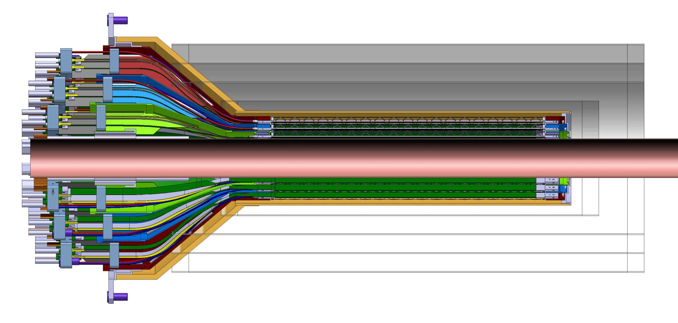
INTT-MVTX Conflict, Director’s Review 7/13/2017
INTT 4-layers
Interconnect patch-panels
Original design for the ALICE ITS inner tracker; three layers of MAPS type detectors
At the previous MVTX director’s review a space conflict between the INTT and MVTX was pointed out by Ed O’Brien. The INTT shown only includes ladder, but no extension cables, connectors, cooling barbs, etc.

Slide 3
sPHEINX tracking detector geometry; July 10th, 2017
SECTION A-A
Scale 1:20
2555.24
2299.11
307.57
241
Conical section offset along beam axis by 180.0mm
TPC
Ø399.80
DETAIL B
Scale 1:10
275.91 MVTX
364.64 INTT layer 0
464.52 INTT layers 1,2&3
800 beryllium pipe

Slide 4
Recent CAD model for the INTT with extension cables and ROC boards;
ROC boards
ROC boards
All services for MVTX come in from one end
Area of immediate conflict between the INTT and the MVTX detectors

Slide 5
It’s all a question of space:
Dan Cacace has provided a current envelope for the INTT detector;
  The extension cables connect to the HDI’s, from each ladder, at an inner radius of ~ 108.0mm, they have a corresponding outer radius of ~148.0mm.
There will need to be a stay clear area between the MVTX and the sPHENIX beam-pipe of ~2.0mm, this has already been integrated into the three layers of ladders for the MVTX.
It has been requested that the MVTX envelope for the conical section (4 layers) be extended by 60.0 mm, and decrease the radial dimension for the larger barrel region by a total of 20.0 mm

Slide 6
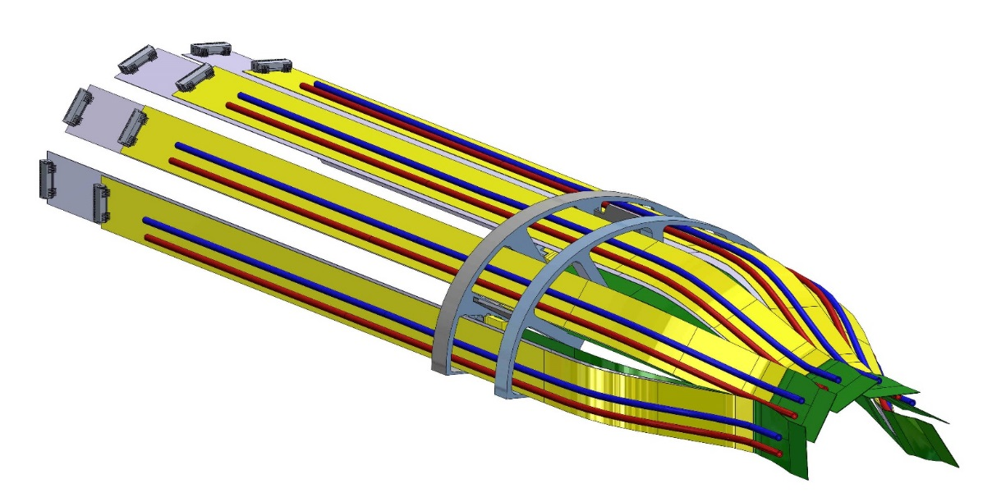
Integrating requested changes to the MVTX;
Before starting to change the inner layer for the MVTX, work with the following assumptions:
  The length for the extension cables, for the signal lines, from the end of the ladder is fixed by the manufactured FPC at 222.0mm, a longer flat cable will degrade signal integrity at expected operational frequency.
  The two power extension FPC’s can be made longer – suggestion 300 – 350 mm, in addition to the 222.0 mm
  Reduce the diameter of the patch panel to include a pass-through for the power flat cables and two cooling lines.
Longer extension cables for AC, DC power and cooling
Samtec connectors to mate with Firefly cables
Extension cables from end of MAPS ladders

Slide 7
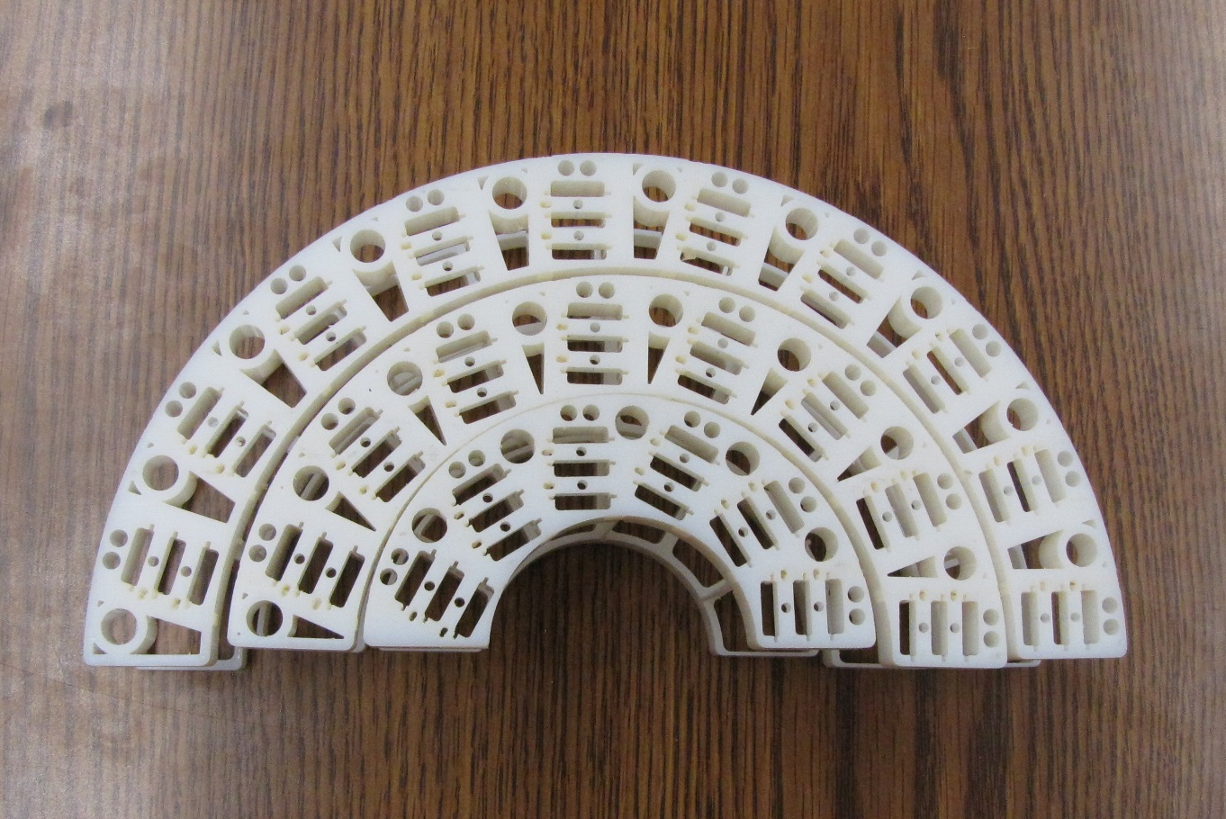
MVTX three layers of patch-panels, unmodified;
3D models of ALICE inner tracker patch-panels
Outer layer
Middle layer
Inner layer

Slide 8
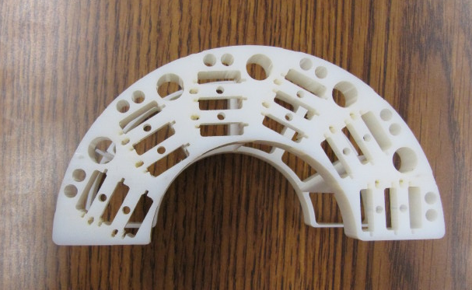
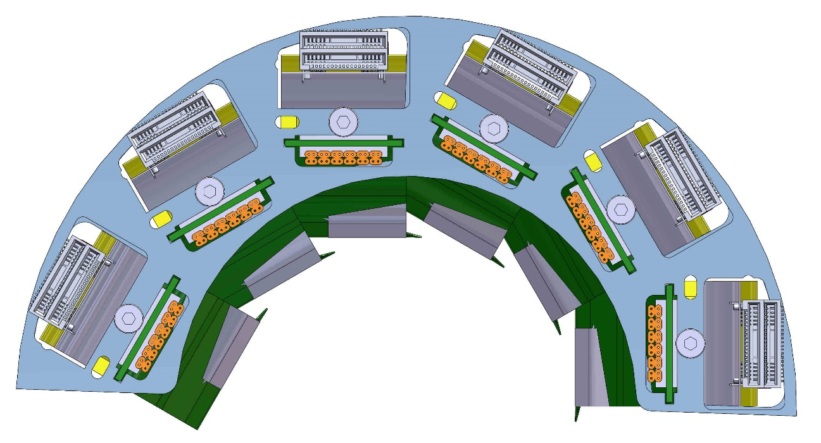
Inner layer:
Cooling line
Power cable interconnect
Signal cable interconnect
To reduce the OD of the two piece patch-panel -
Cut back original OD, added pass-through slots for the power flex cables and cooling lines
Outer radius 53.0 mm, original outer radius 59.5mm,
Inner radius 29.5 mm

Slide 9
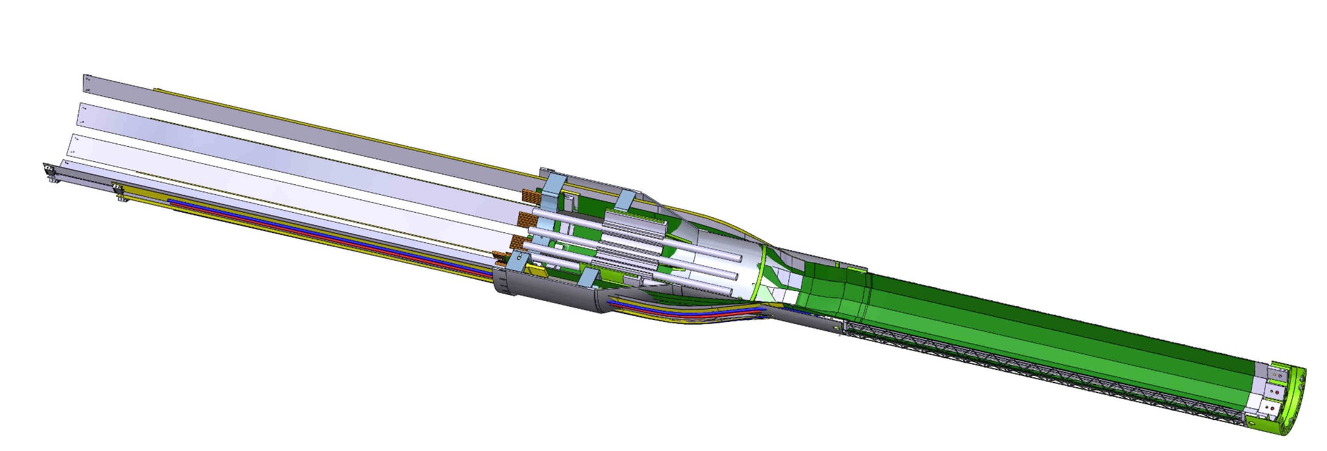
Inner layer continued;
Smaller large barrel radius, gained 6.5 mm (previous slide)
New longer power flex circuit cables
Longer inner shell – small diameter section – by a total of 75.0 mm, keep same length signal FPC to patch-panel assembly
Similar mechanical modifications need to be made to each detector layer and the outer shell structure.

Slide 10
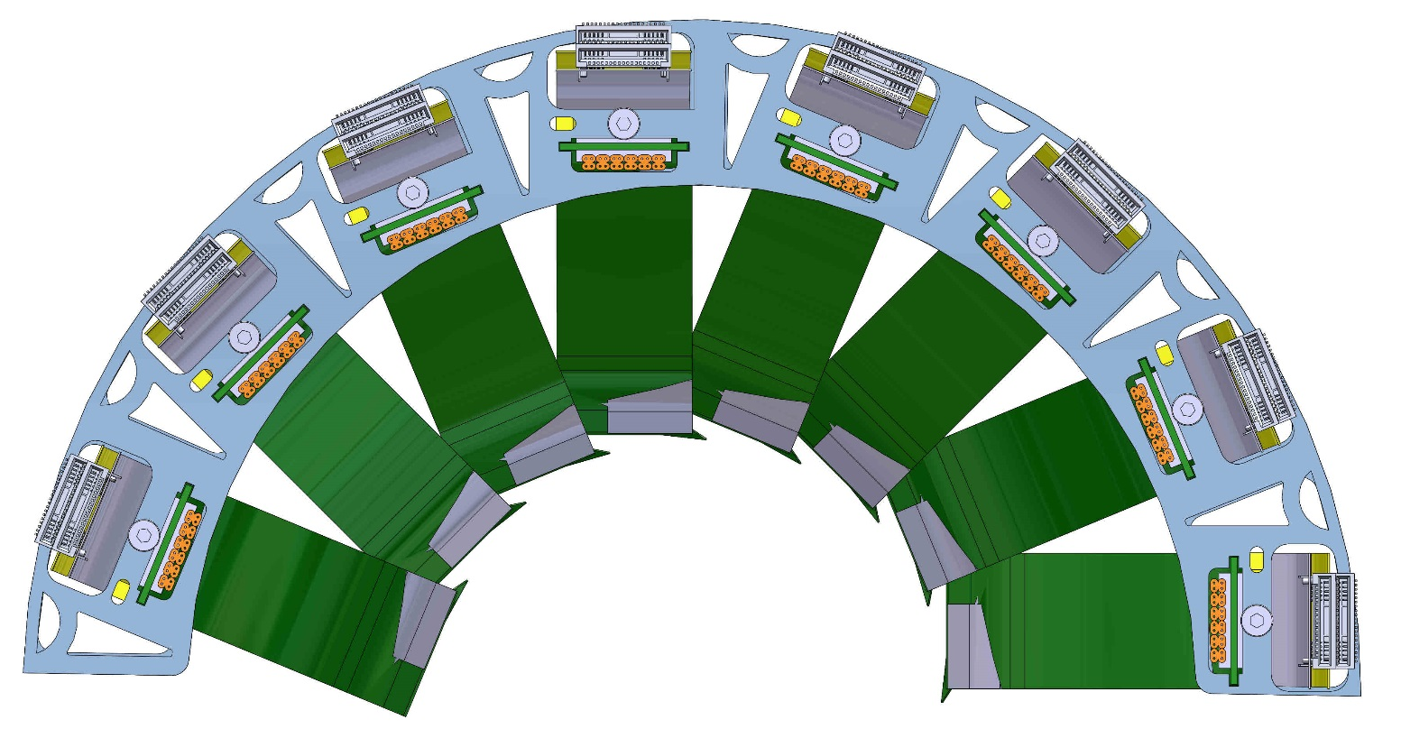
Middle layer;
Outer radius 81.5mm,
Original radius
Inner radius 59.5mm
Modified middle layer patch panel assembly

Slide 11
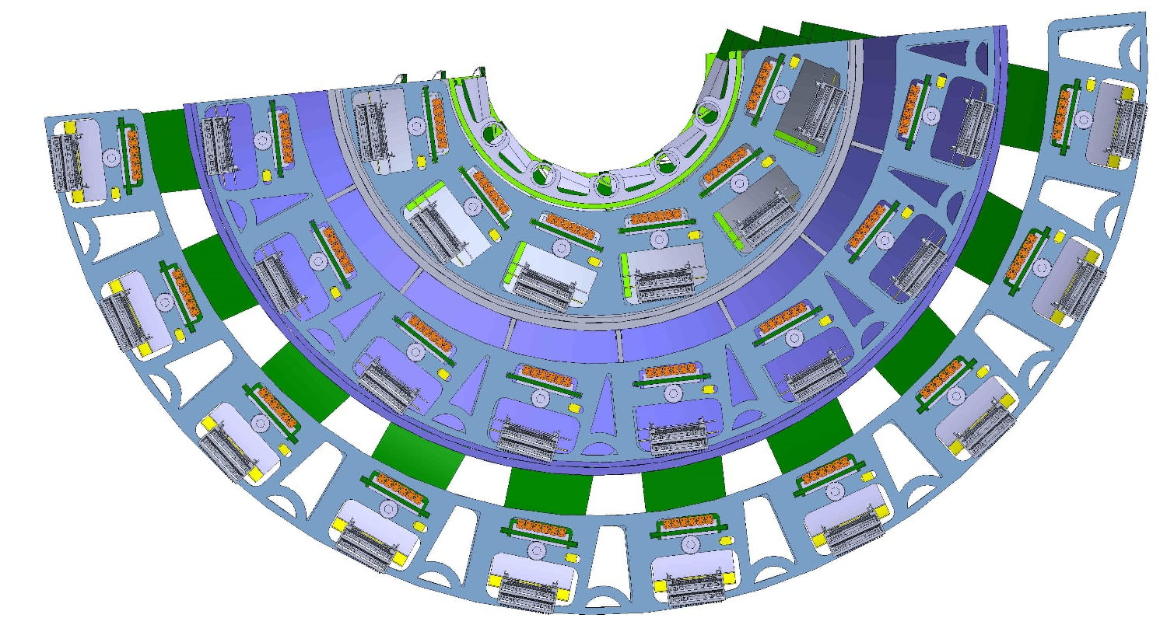
Patch panels for all three layers;
Delta between outer layer ID and middle layer OD 8.0 mm
Delta between middle layer ID and inner layer OD 6.5mm
In this CAD model the outer layer patch-panel radius 109.0mm
Next step is to redesign these layer to eliminate these gaps between layers, major redesign of patch-panel interconnection ring for signal cables

Slide 12
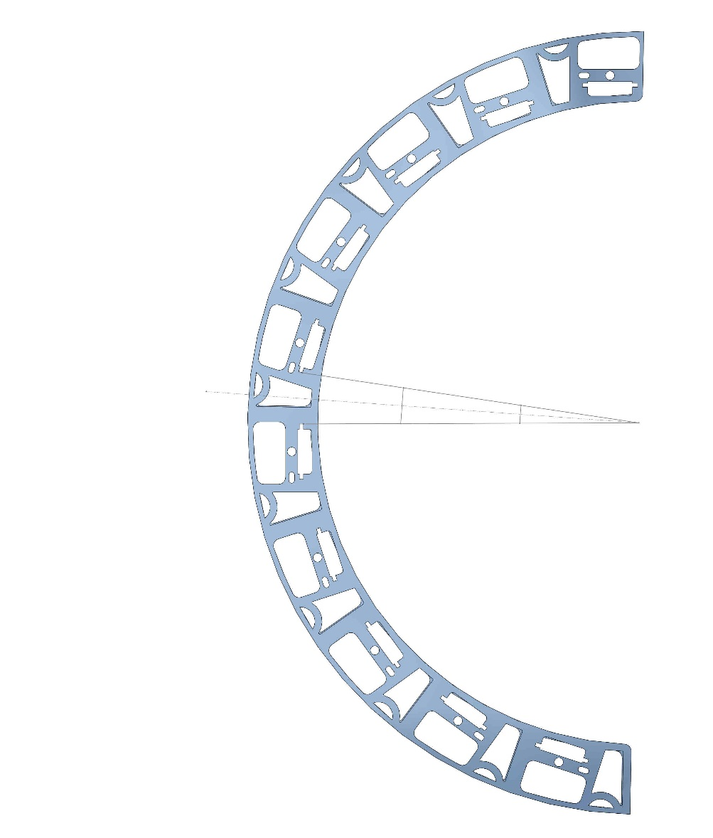
Outer layer patch panel modified to allow signal extension cable to terminate, let power extension cables to pass through:
7.5mm already removed from outer radius
Pass-through hole for power and cooling lines
Distance between two adjacent signal readout connectors from FPC
Termination point for signal extension cable from stave, interconnect with Firefly cable
10.0mm
5.0mm
14.25mm
23.3mm
This geometry shown indicates if you may be able to modify the inner radius for the middle and outer layers and maintain the integration of the signal cables with the patch-panel:
Angle 4.33 deg

Slide 13
What can we gain and where:
From the previous slide-
  If we maintain a minimum spacing of 10.0mm between connectors for the signal cables, we can bring the radius in by 23.37 mm, from geometry shown in slide 12.
  This will translate to an overall reduction in the radial dimension for the MVTX detector.
  Structural analysis will need to be made to verify the integrity of new shell structures.

Slide 14
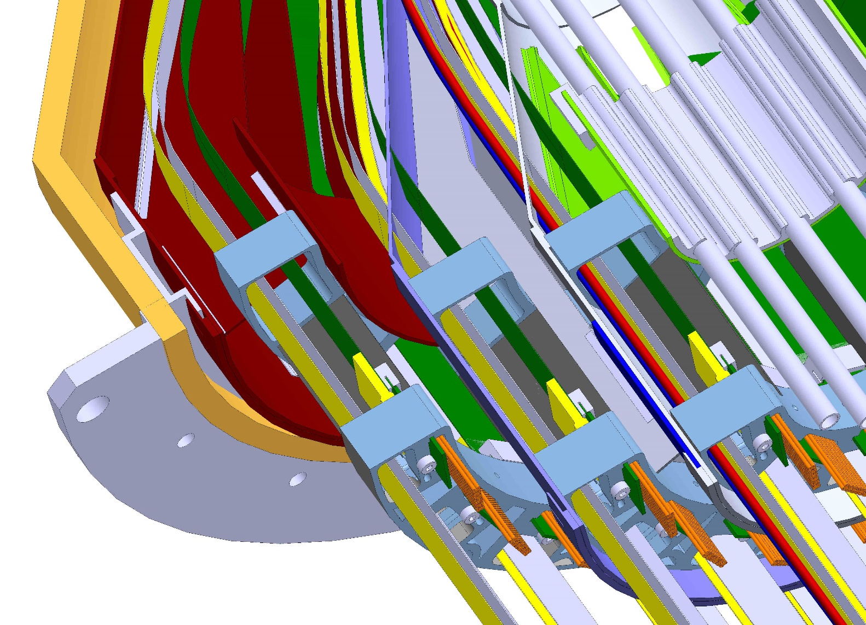
Future mechanical modifications to reduce MVTX radial envelope;
1, reduce inner radius patch-panel gaps
2, reduce outer diameter od all three shells
3, redesign and reduce gap between outer shell and outer detector layer
4, redesign outer shell to integrate with longer, similar OD service shell to bring out MVTX cables, cooling lines and air flow supply
5, develop insertion mechanism to install MVTX

Slide 15
Back up:

Slide 16
CERN May 22nd, 2018, assembly of ALICE Its inner tracker inner layer;

Slide 17
CERN May 22nd, 2018, assembly of ALICE ITS inner tracker, inner layer;

Slide 18
CERN, May 22nd, 2018, completed assembly of ALICE ITS inner tracker, inner layer;

Slide 19
CERN June 19th, 2018, complete assembly of first half ALICE ITS inner tracker:

Slide 20
CERN June 19th, 2018, second half;

Slide 21
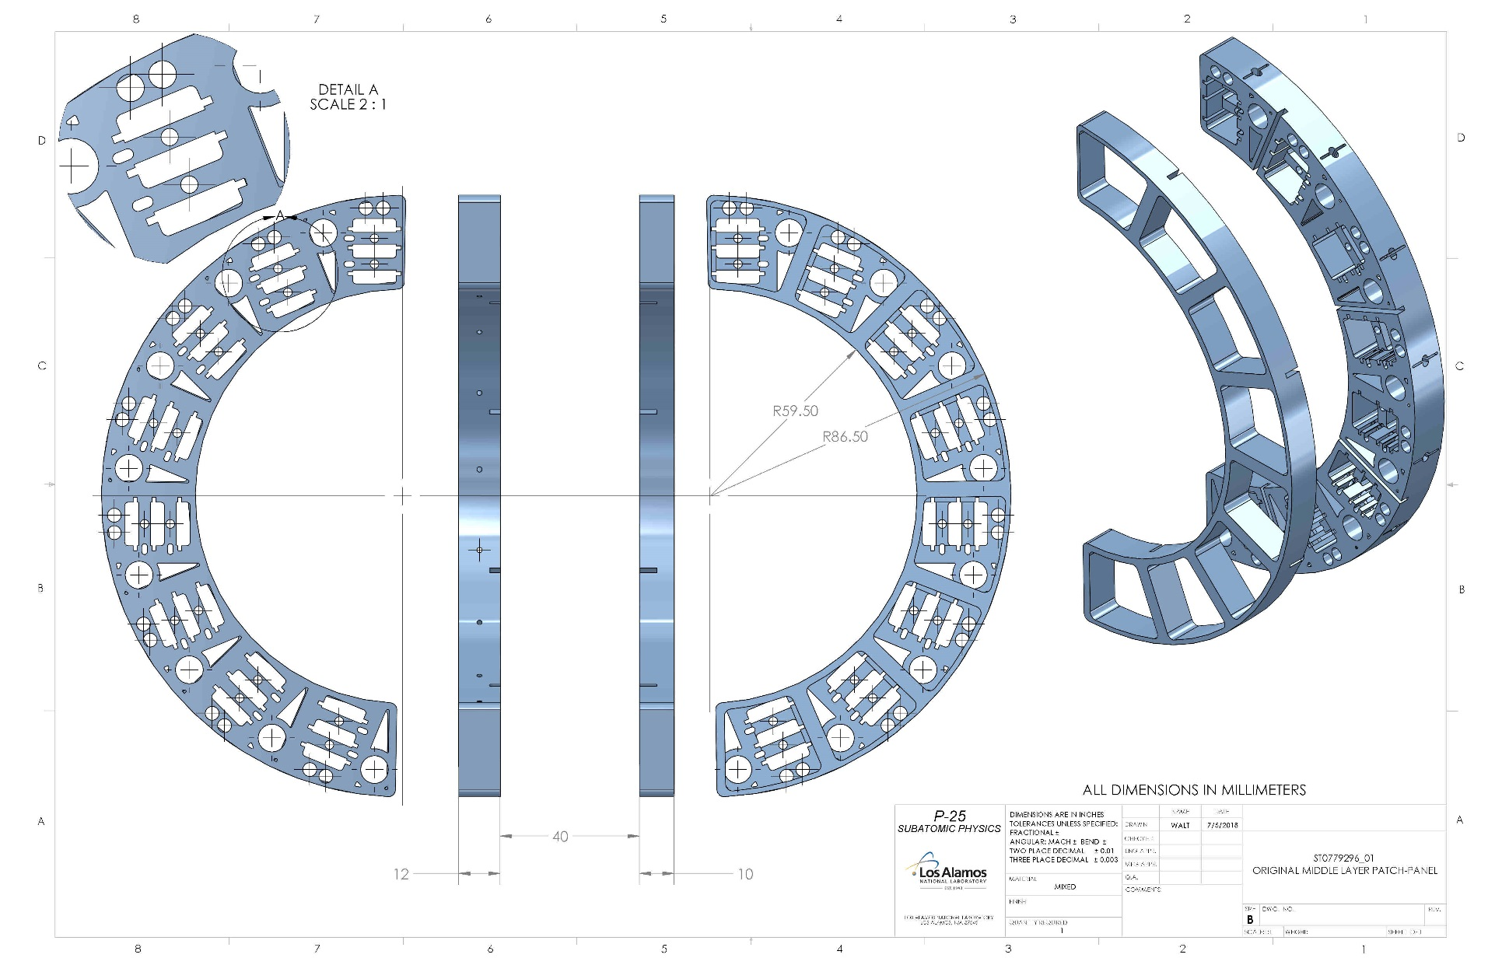
Original ALICE inner tracker, middle layer, patch -panel

Slide 22
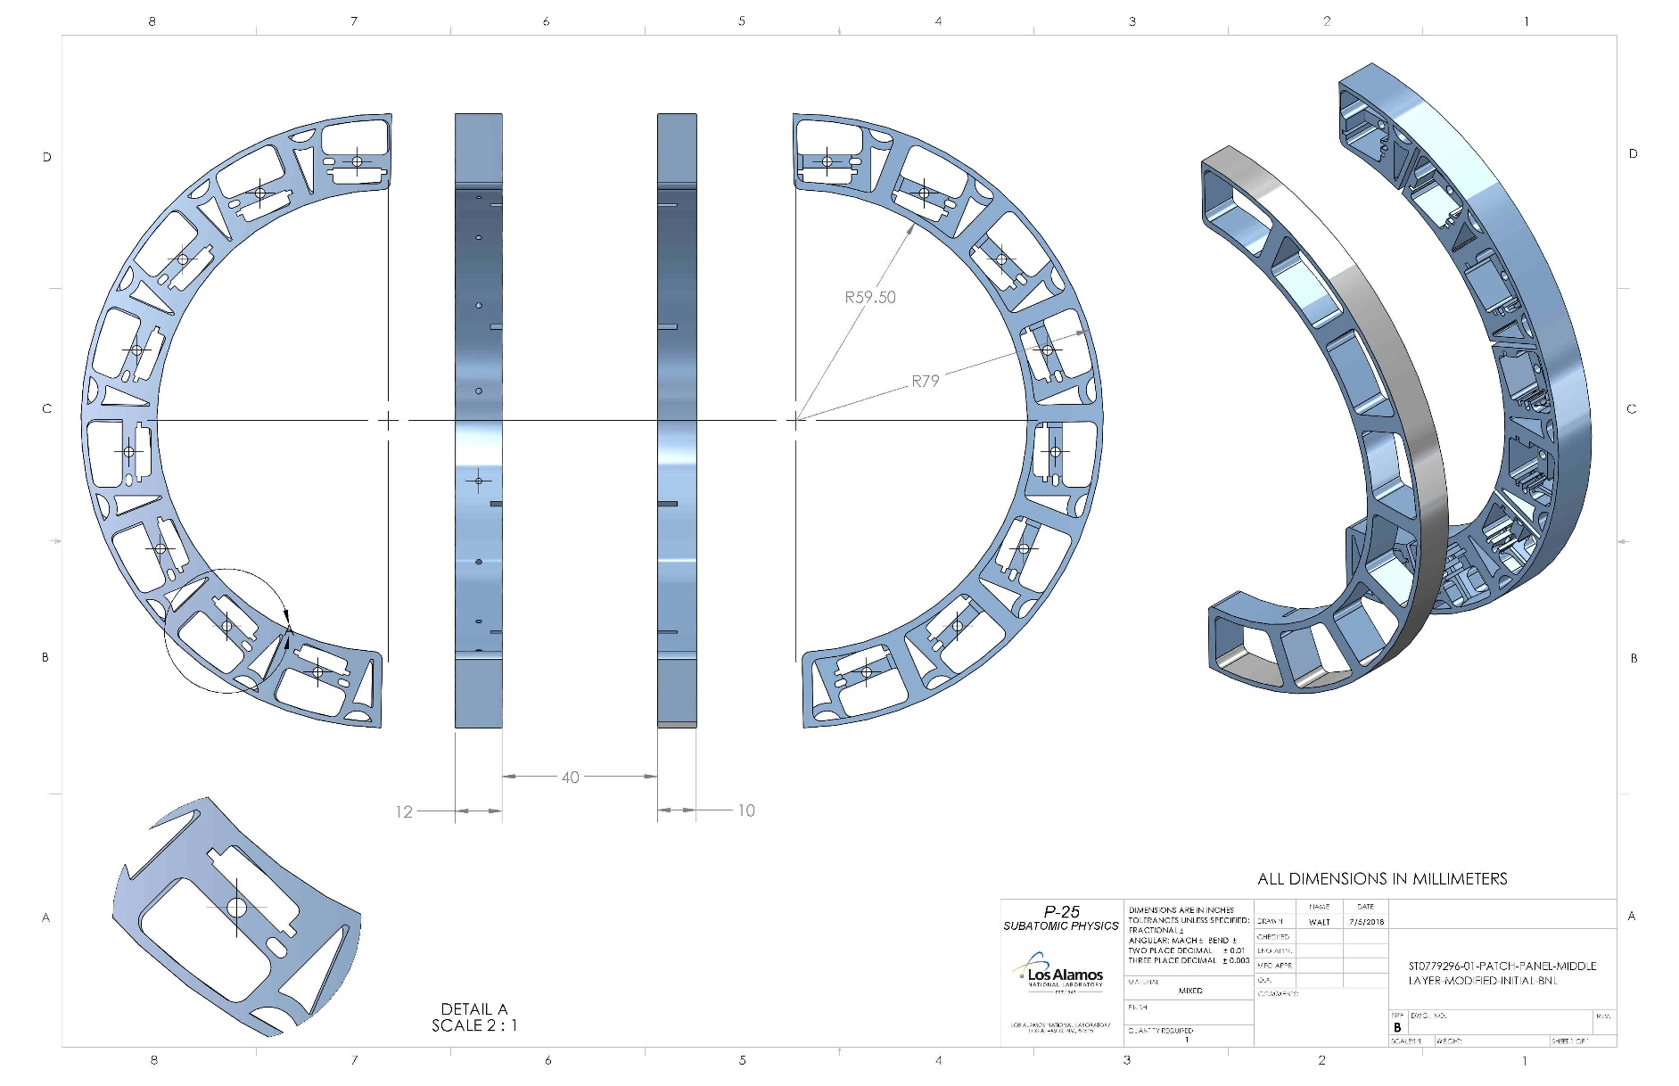
MVTX middle layer, patch-panel, reducing the OD only, delta on OD 7.5mm

Slide 23
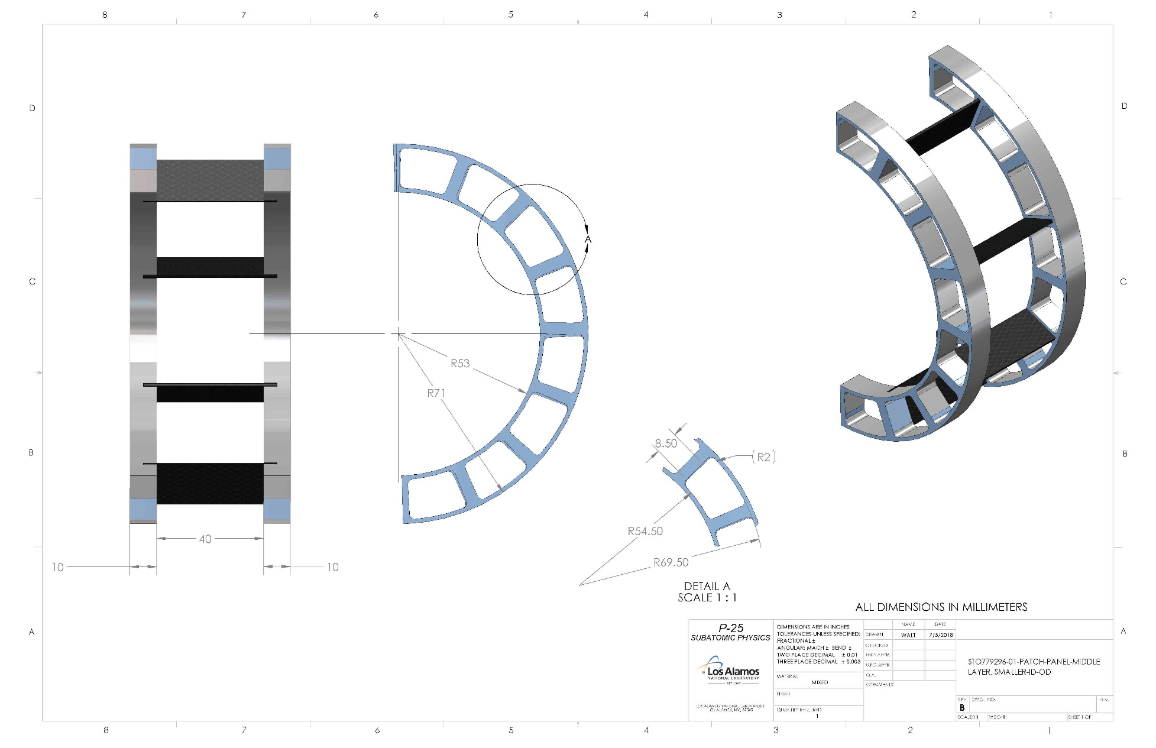
MVTX middle layer, patch-panel, reduced ID & OD, delta on OD 15.5mm

Slide 24
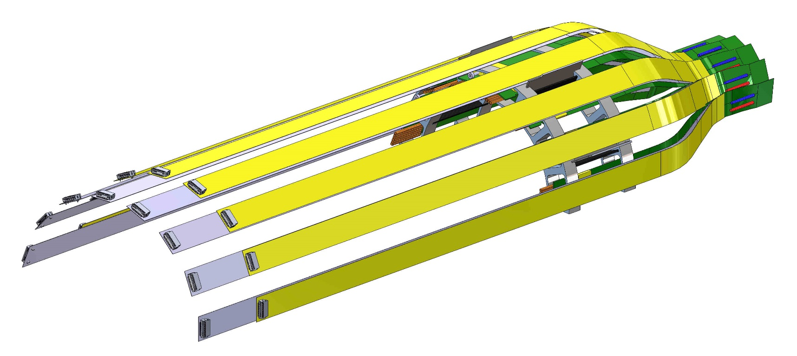
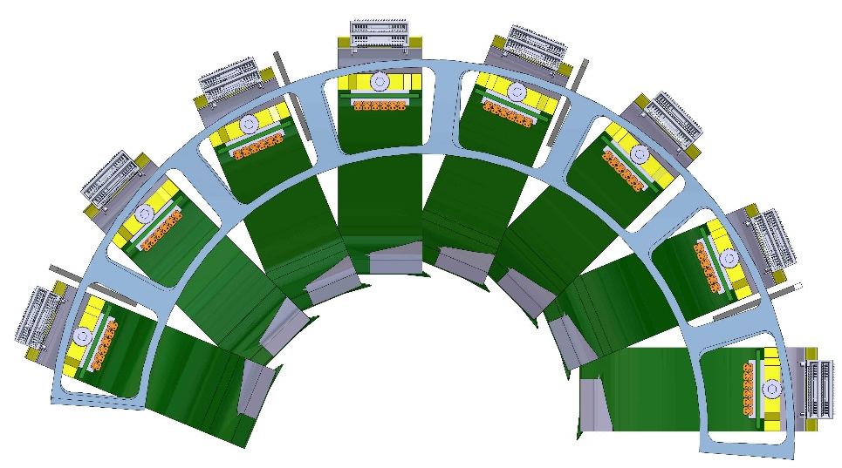
MVTX middle layer – extension cable assembly including the reduced ID & OD patch-panel

Slide 25
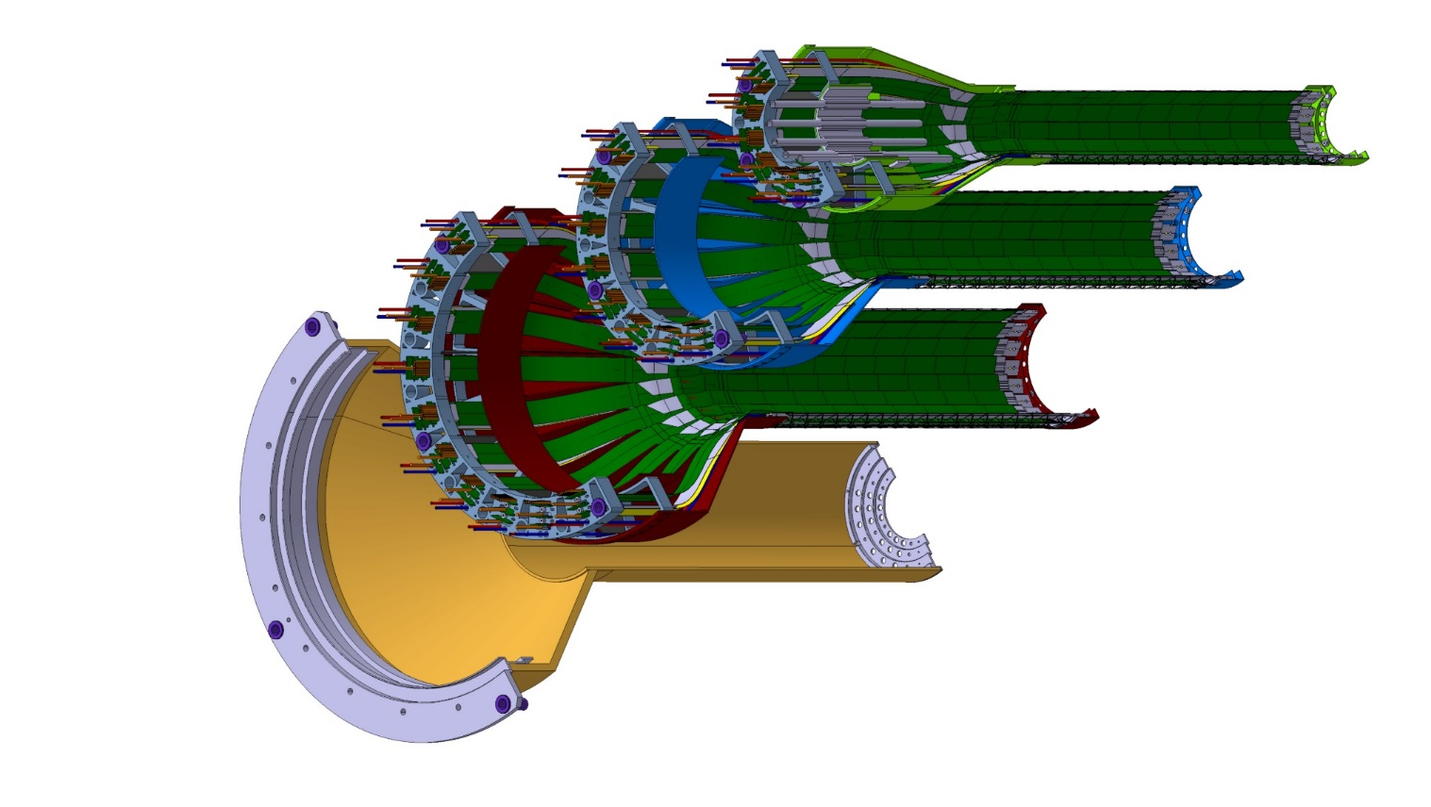
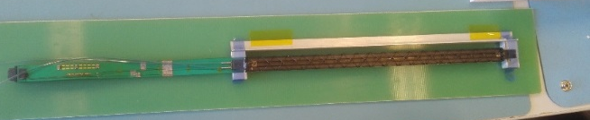
Inner Detector Barrel: weight estimation
Cooling Pipe 20 g
IB Stave full =15.1 g
Cooling Pipe support= 9.6 g
H-L0+ PP1 = 95.9 g
IB Staves (x24) =362.4 g
H-L1+ PP1 = 149.6 g
H-L2+ PP1 = 240.7 g
End Flange CYSS = 18.9 g
Cylindrical part-CYSS = 26 g
Conical part- CYSS = 94.2 g
A-Flange CYSS = 82
Half – Inner Detector = 1099.3 g
Inner Detector = 2198.6 g

