Slide 1
sPHENIX Director’s Review;
MVTX Detector,
Mechanical Integration
Walter Sondheim, P-25
July 9th, 2018
LA-UR-16-XXXXX

Slide 2
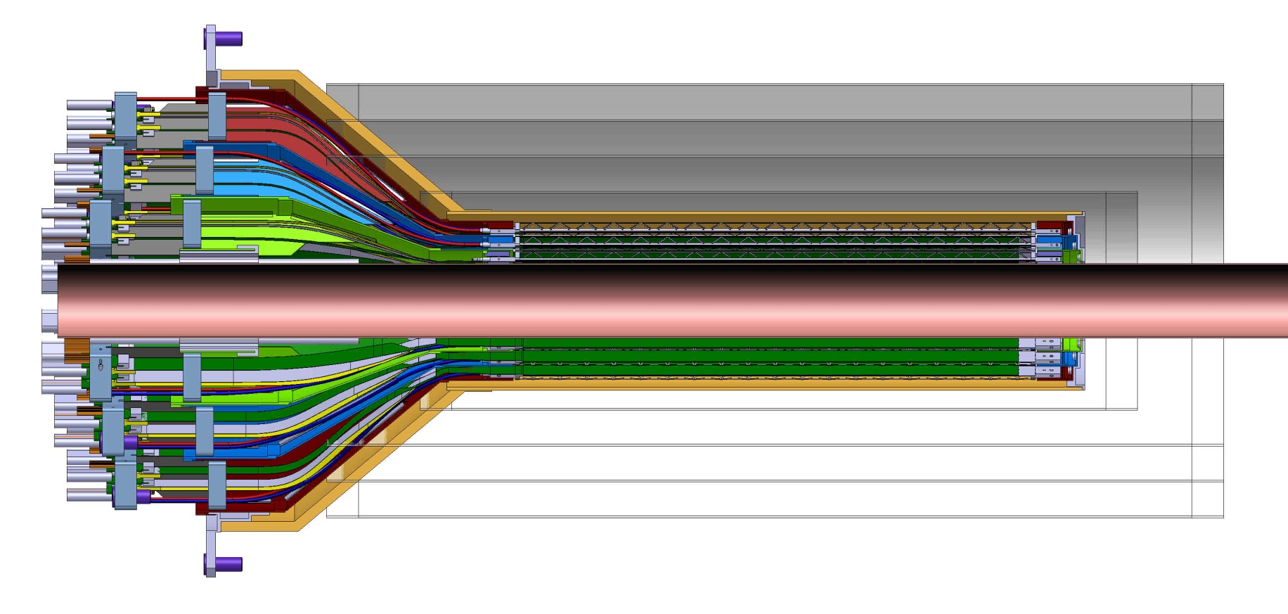
INTT-MVTX Conflict, Director’s Review 7/13/2017
INTT 4-layers
Interconnect patch-panels
Original design for the ALICE ITS inner tracker; three layers of MAPS type detectors
There’s currently a space conflict between the INTT and MVTX
INTT above only includes ladder, but not connectors, cooling barbs, etc

Slide 3
sPHEINX tracking detector geometry;
SECTION A-A
Scale 1:20
2555.24
2299.11
307.57
241
Conical section offset along beam axis by 180.0mm
Ø399.80
DETAIL B
Scale 1:10
275.91 MVTX
364.64 INTT layer 0
464.52 INTT layers 1,2&3
800 beryllium pipe

Slide 4
CAD model for the INTT with extension cables and ROC boards;
All services for MVTX come in from one end
Area of immediate conflict between the INTT and the MVTX detectors

Slide 5
It’s all a question of room:
Dan Cacace has provided a current envelope for the INTT detector;
  The extension cables connect to the HDI’s from a ladder at an inner radius of ~ 108.0mm, they have a corresponding outer radius of ~148.0mm.
There will need to be a stay clear area between the MVTX and the sPHENIX beam-pipe of >2.0mm, this has already been integrated into the three layers od ladders for the MVTX.
It has been requested that the MVTX envelope for the conical section (4 layers) be extended by 60.0 mm, and decrease the radial dimension for the larger barrel region by a total of 20.0 mm

Slide 6
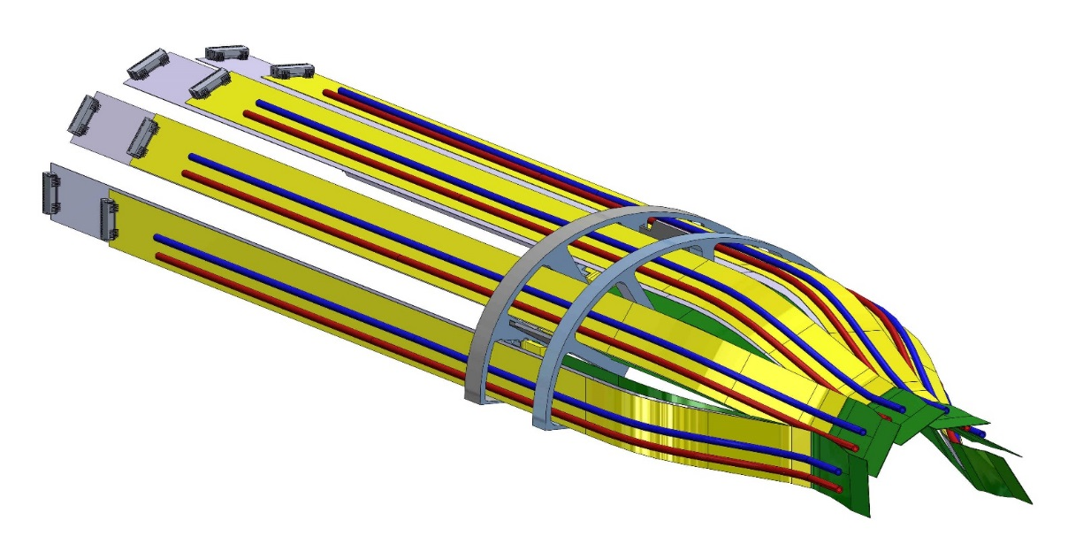
Integrating requested changes to the MVTX;
Starting with the inner layer for the MVTX, along with the following assumptions:
  The length for the extension on the signal lines from the ladder is fixed by the manufactured FPC, 222.0mm beyond the end of the stave, maintain signal integrity.
  The two power extension FPC’s can be made longer – suggestion 300 – 350 mm, in addition to the 222.0 mm
  Reduce the diameter of the patch panel to include a pass-through for the power flat cables and two cooling lines.
Longer extension cables for AC, DC power and cooling
Extension cables from end of MAPS ladders

Slide 7
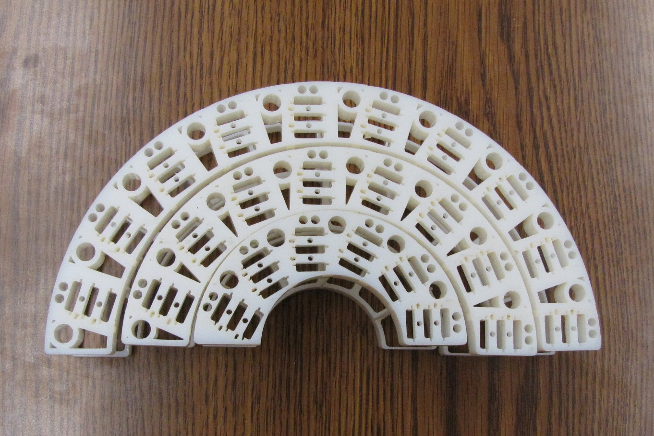
MVTX three layers of patch panels, unmodified;
3D models of ALICE inner tracker patch-panels
Outer layer
Middle layer
Inner layer

Slide 8
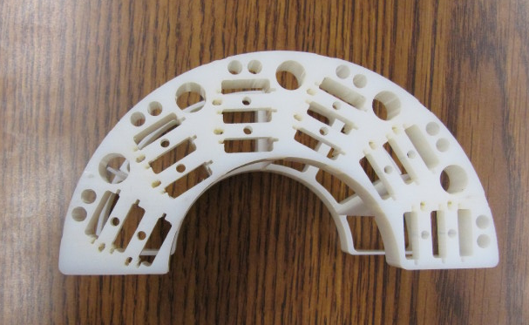
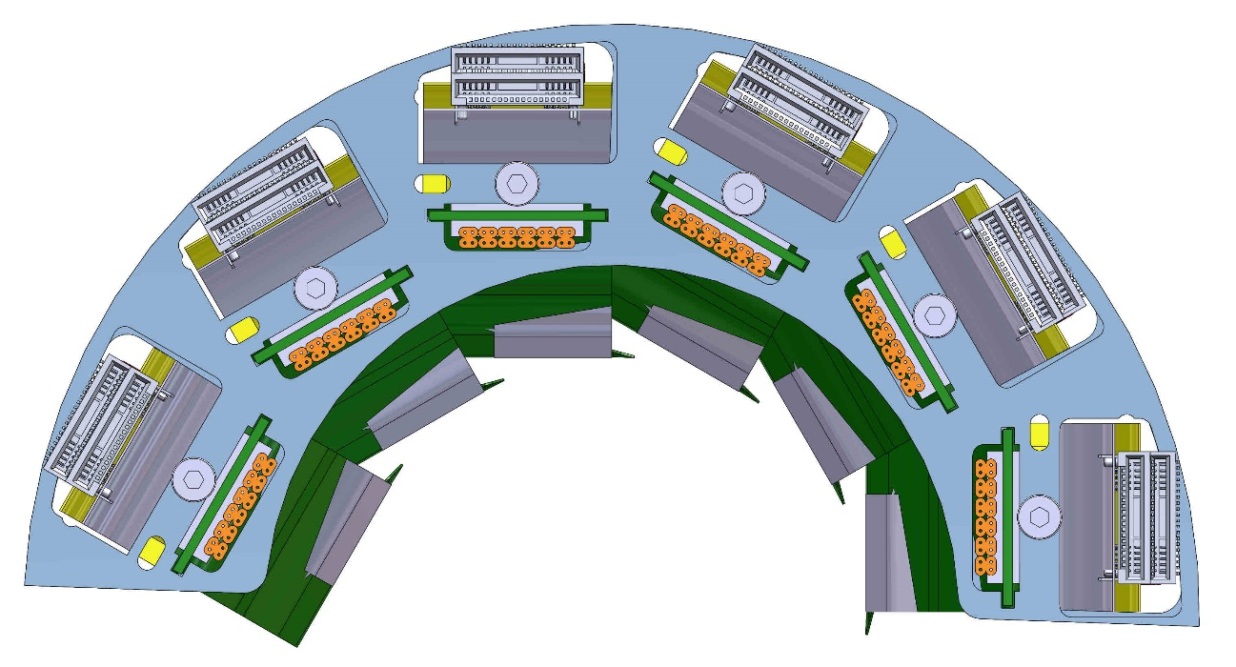
Inner layer:
Cooling line
Power cable interconnect
Signal cable interconnect
To reduce the OD of the two piece patch-panel -
Cut back original OD and added slots for the power flex cables and cooling lines
Outer radius 53.0 mm,
Inner radius 29.5 mm

Slide 9
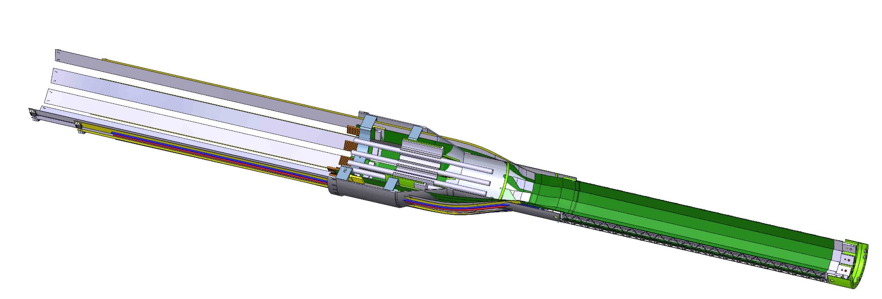
Inner layer continued;
Smaller large barrel radius, gained 6.5 mm
New longer power flex circuit cables
Longer inner shell – small diameter section – by a total of 75.0 mm, keep same length signal FPC to patch-panel assembly
Similar mechanical modifications need to be made to each detector layer and the outer shell structure.

Slide 10
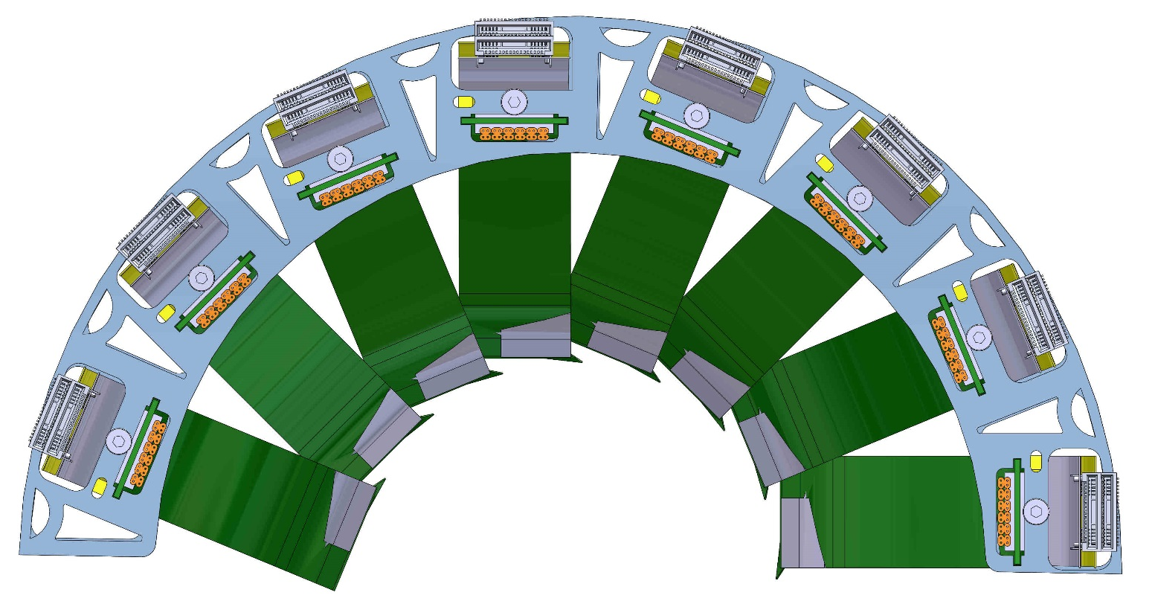
Middle layer;
Outer radius 81.5mm
Inner radius 59.5mm
Modified middle layer patch panel assembly

Slide 11
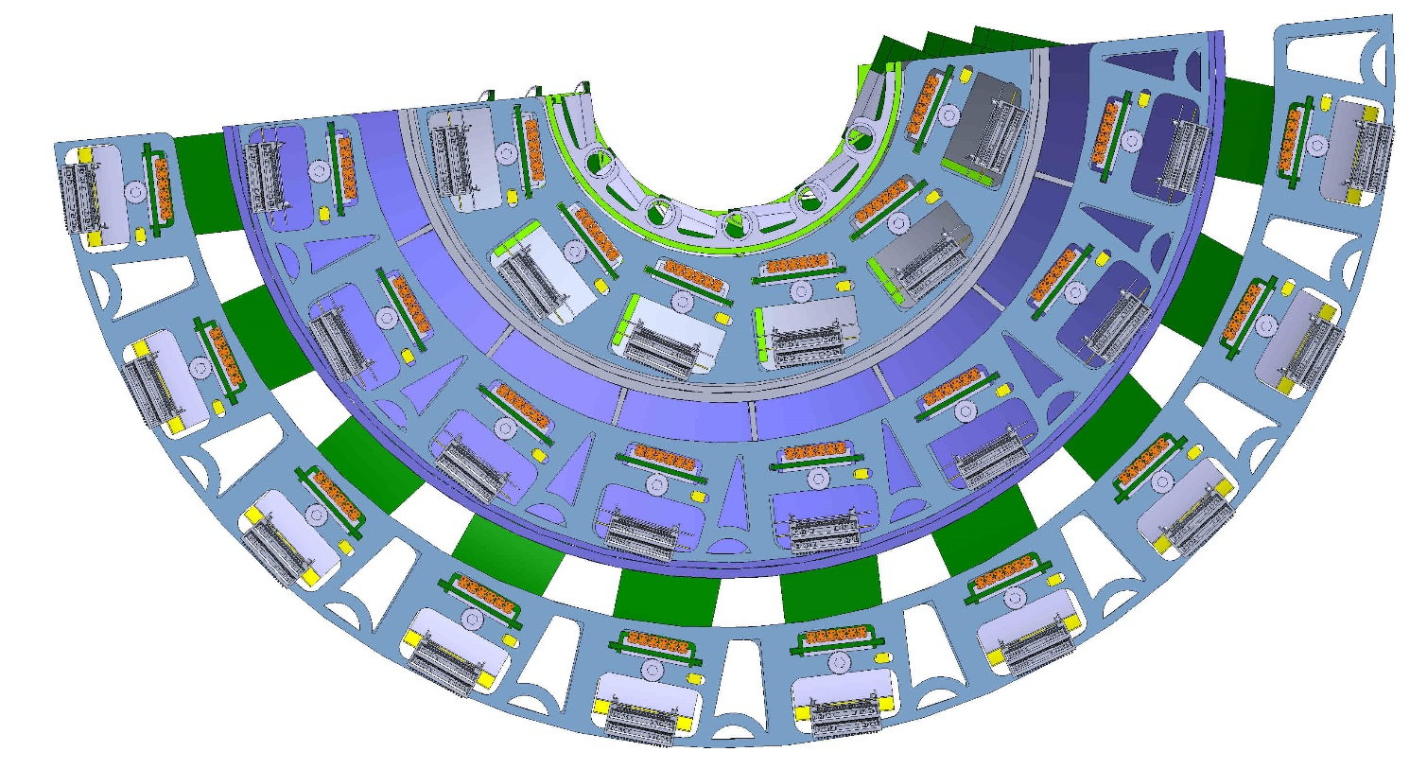
Patch panels for all three layers;
Delta between outer and middle layer 8.0 mm
Delta between middle and inner layer 6.5mm
Outer layer patch-panel radius 109.0mm

Slide 12
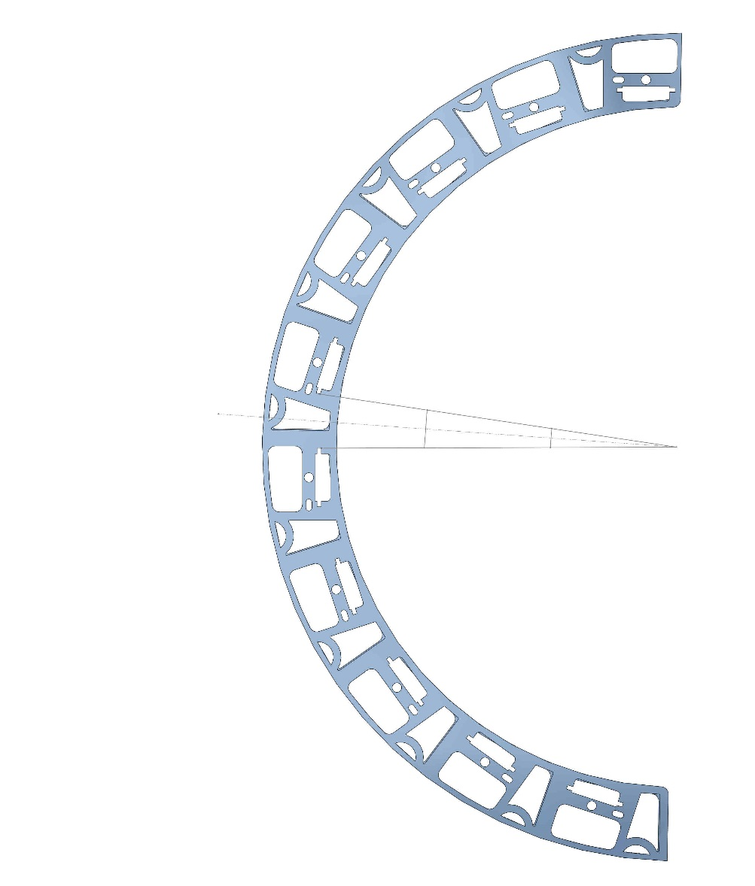
Outer layer patch panel modified to allow signal extension cable to terminate, let power extension cables to pass through:
7.5mm already removed from outer radius
Pass-through hole for power and cooling lines
Distance between two adjacent signal readout connectors from FPC
Termination point for signal extension cable from stave, interconnect with Firefly cable
10.0mm
5.0mm
14.25mm
23.3mm
This geometry shown indicates if you may be able to modify the inner radius for the middle and outer layers and maintain the integration of the signal cables with the patch-panel:
Angle 4.33 deg

Slide 13
What can we gain:
From the previous slide-
  If we maintain a minimum spacing of 10.0mm between connectors for the signal cables, we can bring the radius in by 23.37 mm.
  Taking this number into account and looking at the current gaps between layers – even after the outer radius for each layer has been modified –
Overall with shell (thickness 5.6 mm gap between outer layer and shell 3.5mm) = 106.1mm radius

Slide 14
Back up:

Slide 15
What can we gain, the numbers:
The math table:
Inner layer: outer radius = 53.0mm
inner radius = 29.5mm
Middle layer: outer radius = 81.5mm
inner radius = 59.5mm
Outer layer: outer radius = 111.5mm
inner radius = 89.5mm
DELTA between outer radius
of inner layer and inner
radius of middle layer = 6.5mm
Delta between outer radius
of middle layer and inner
radius of outer layer = 8.0mm
Reduction in outer radius
Of outer layer = 8.0mm
Thickness of MVTX outer
Shell = 5.6mm
Gap (ALICE design) between
outer layer and inner surface
of shell = 3.5mm

Slide 16
CERN May 22nd, 2018, assembly of ALICE Its inner tracker inner layer;

Slide 17
CERN May 22nd, 2018, assembly of ALICE ITS inner tracker, inner layer;

Slide 18
CERN, May 22nd, 2018, completed assembly of ALICE ITS inner tracker, inner layer;

Slide 19
CERN June 28th, 2018, complete assembly of one half ALICE ITS inner tracker:

Slide 20
Corrado’s 6-28-2018

Slide 21
Antonello’s talk 6-28-2018

Slide 22
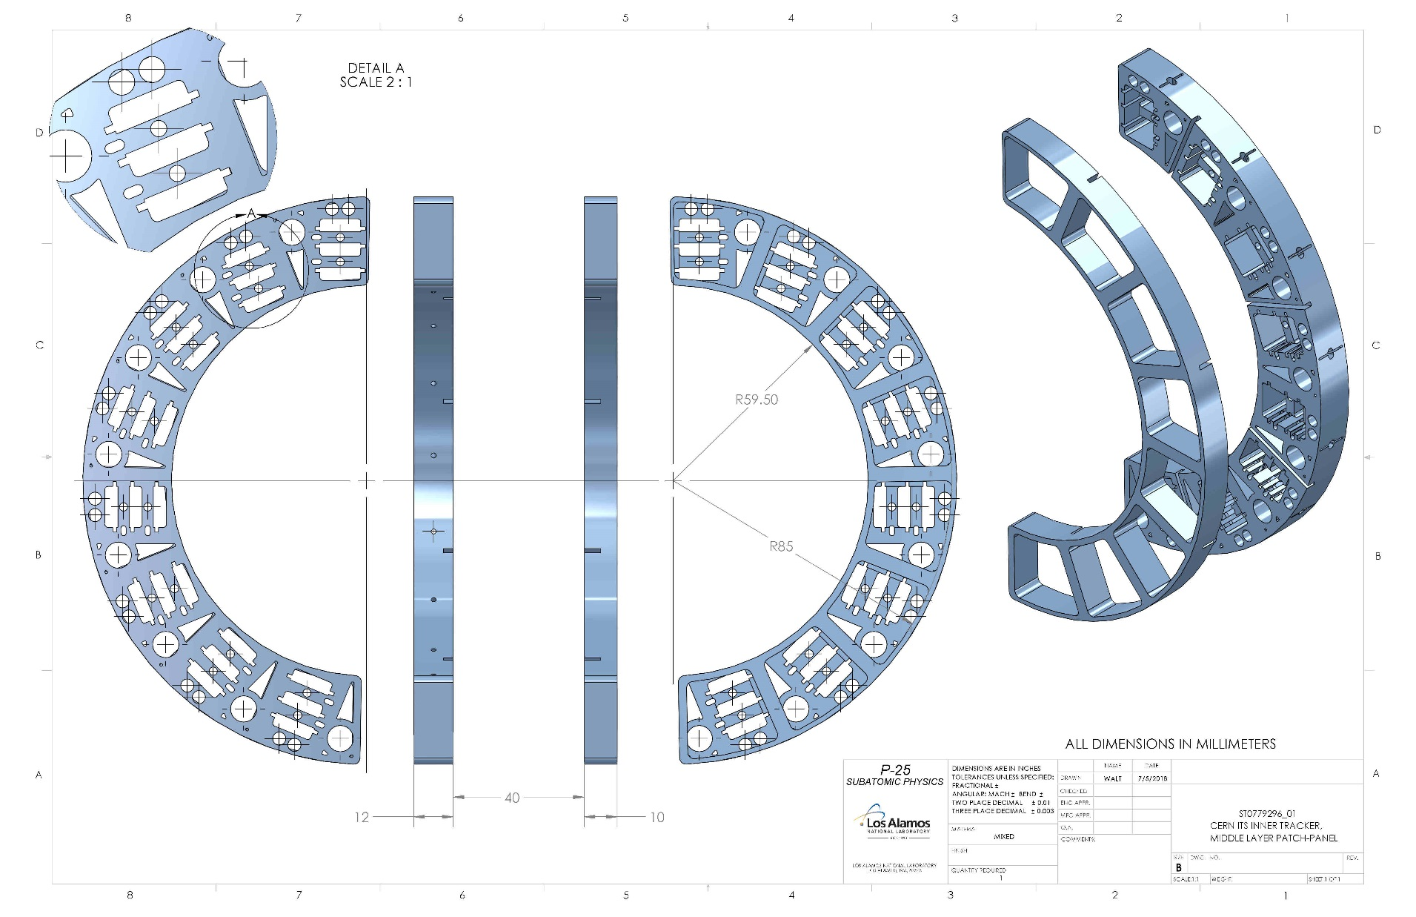
Original ALICE inner tracker, middle layer, patch -panel

Slide 23
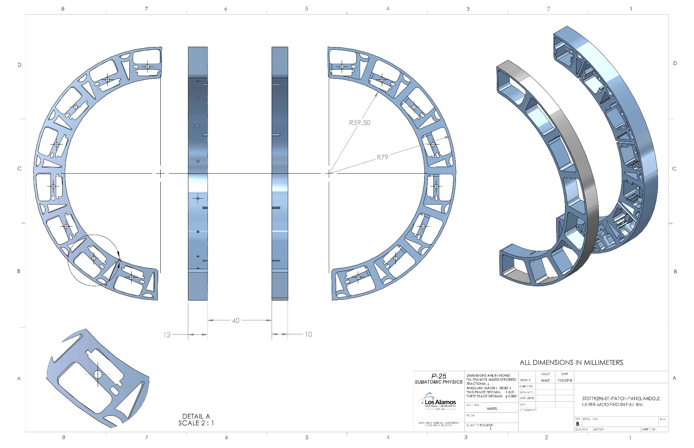
MVTX middle layer, patch-panel, reducing the OD only

Slide 24
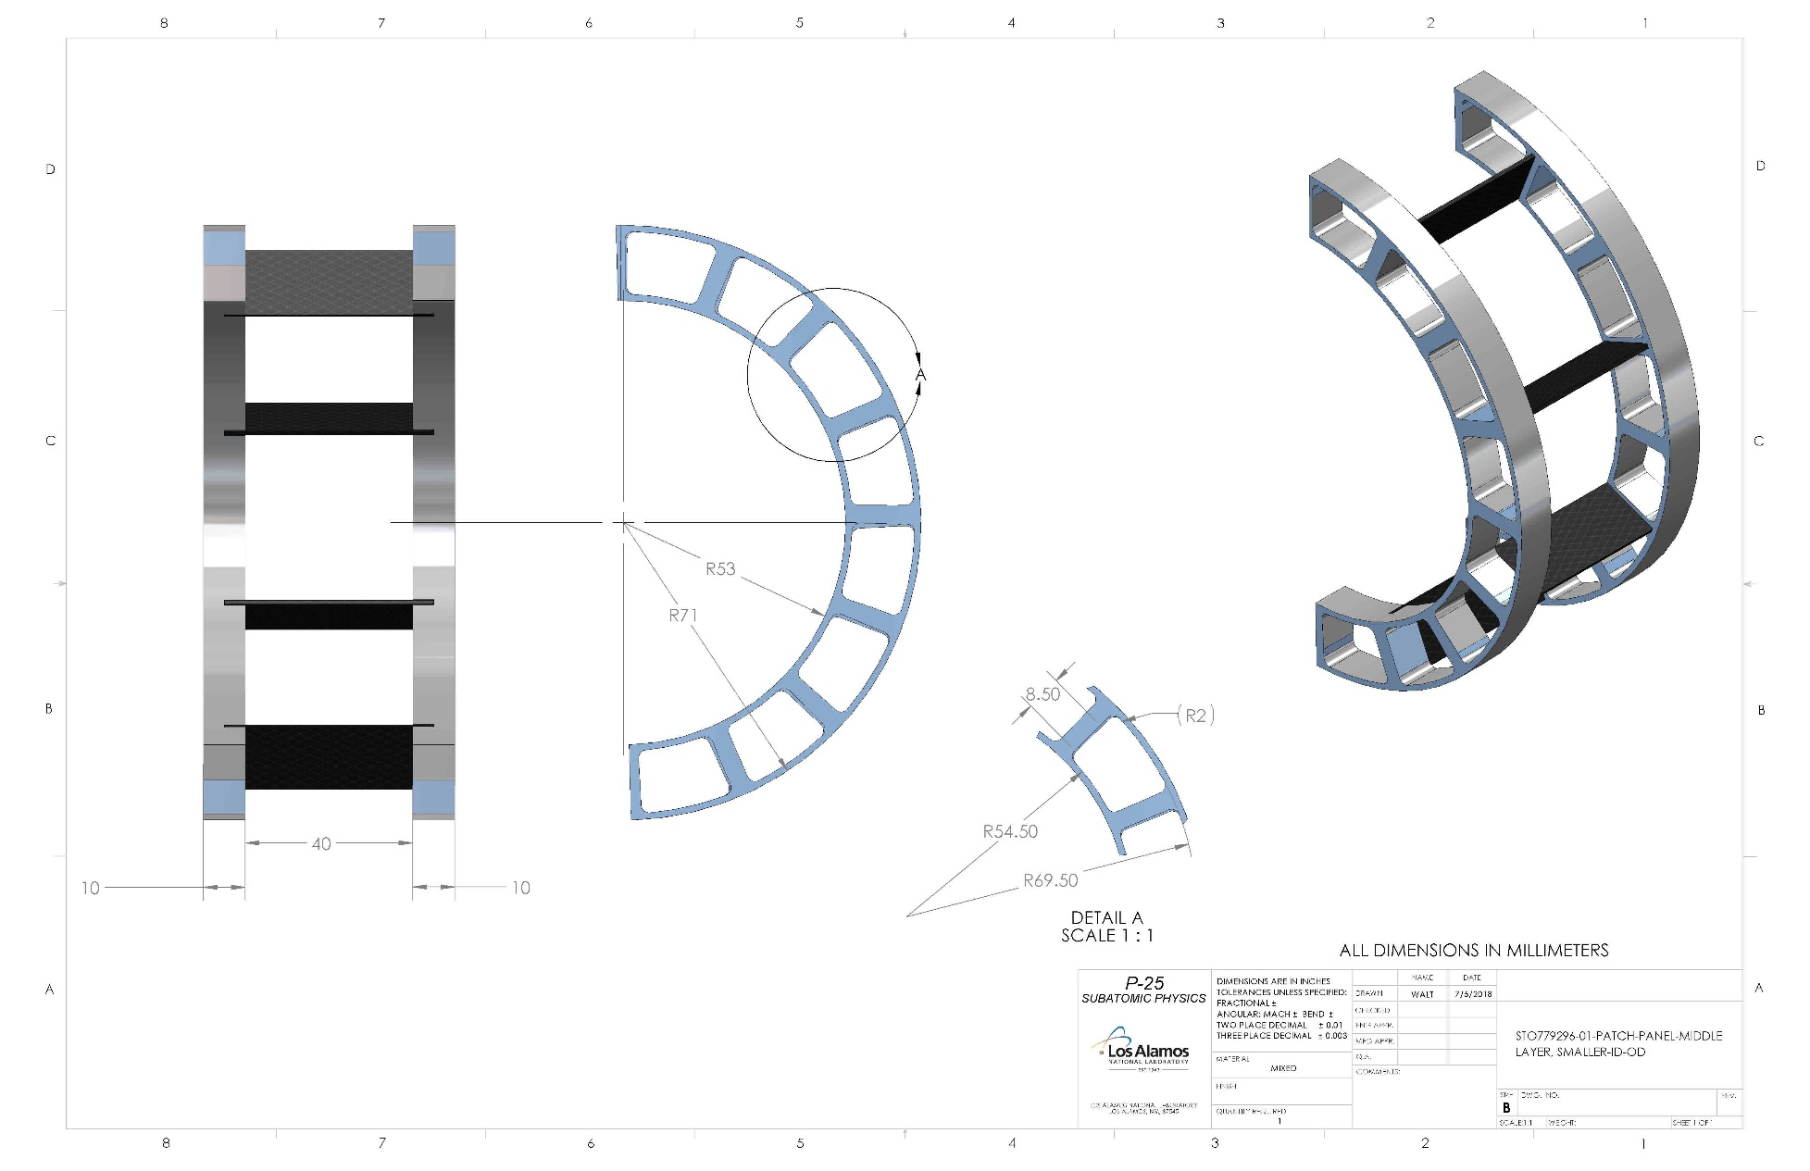
MVTX middle layer, patch-panel, reduced ID & OD

Slide 25
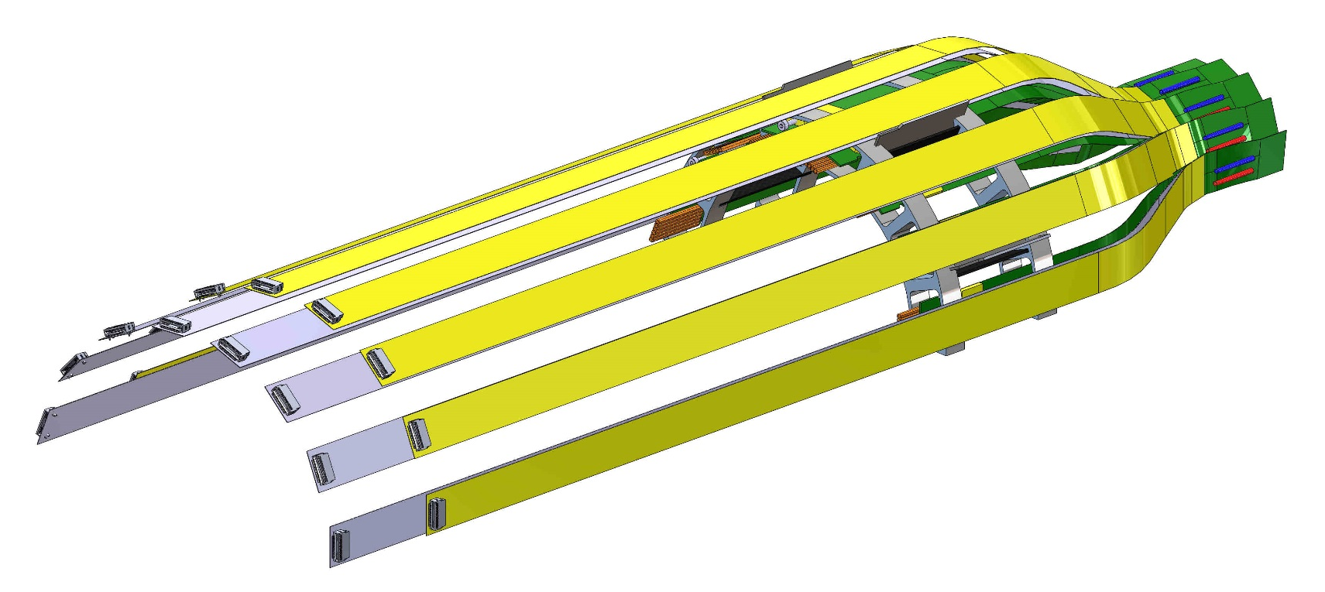
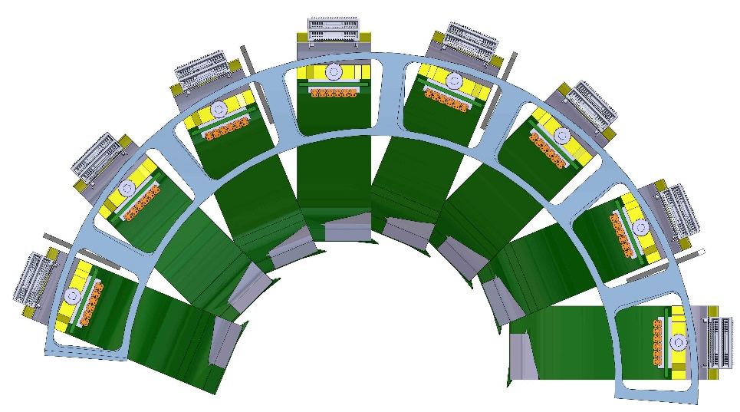
MVTX middle layer – extension cable assembly including the reduced ID & OD patch-panel

