Slide 1
MVTX Summary
Ming Liu
Los Alamos National Laboratory
MVTX BNL Director’s Review
July 19-20, 2018

Slide 2
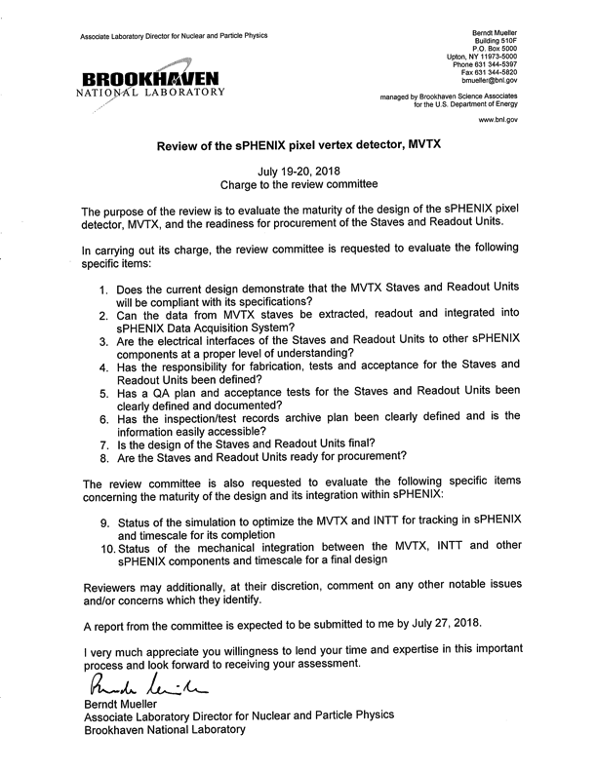
Summary
sPHENIX overview – Dave/Gunther
Compelling science
MVTX overview –Ming
Status and highlights
Readout integration – Alex/Sho
#1, 2, 3
Staves – Leo/Grazyna
#1, 3, 4, 5, 6, 7, 8
Readout Units – Jo
#1, 3, 4, 5, 6, 7, 8
INTT overview – Rachid
Important for tracking
Mechanical integration – Walt/Dan
#10
Tracking simulation – Tony
#9
Summary – Ming
YES, we are ready, #1, 8

Slide 3
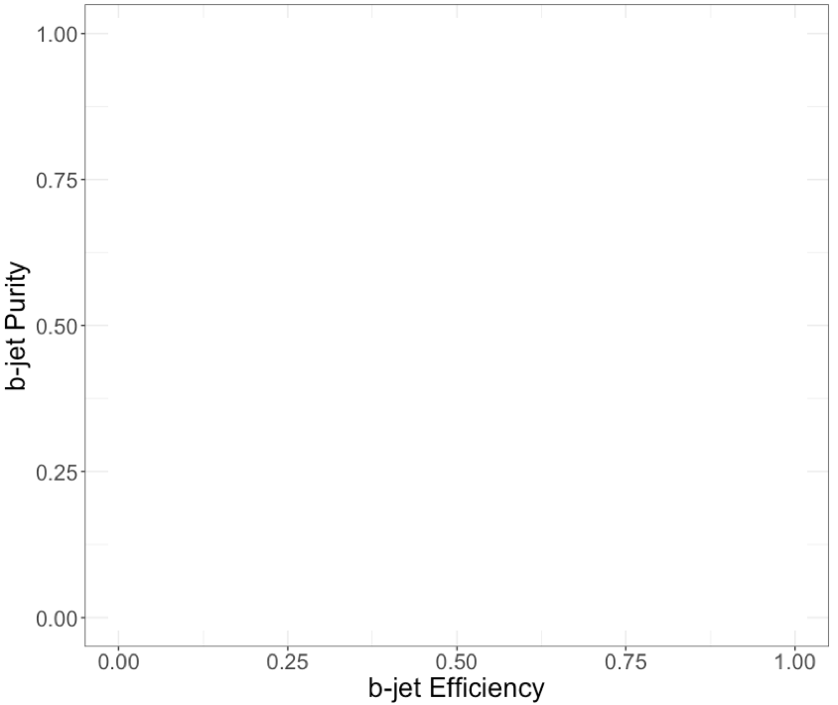
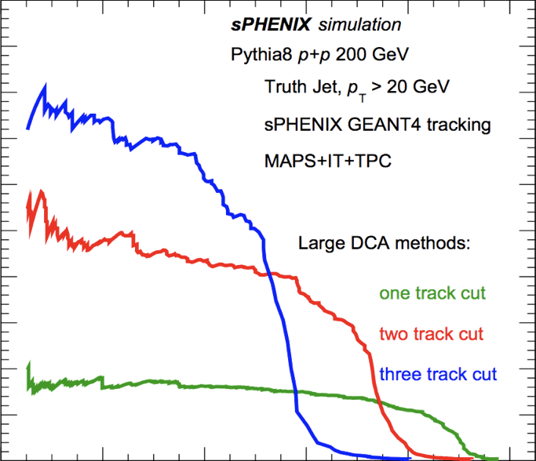
#1: Does the current design demonstrate that the MVTX staves and readout units will be compliant with their specifications?
Yes!
Acceptance
Readout speed
Spatial resolution
Hit efficiency
Noise and occupancy
Radiation tolerance
Presentations from all
Simulation: Excellent b-jet tagging
Data: Hit spatial resolution: < 5 um
Data: Hit efficiency > 99.5%
Data: Impacts of radiation
Pixel size (27um x 29um)

Slide 4
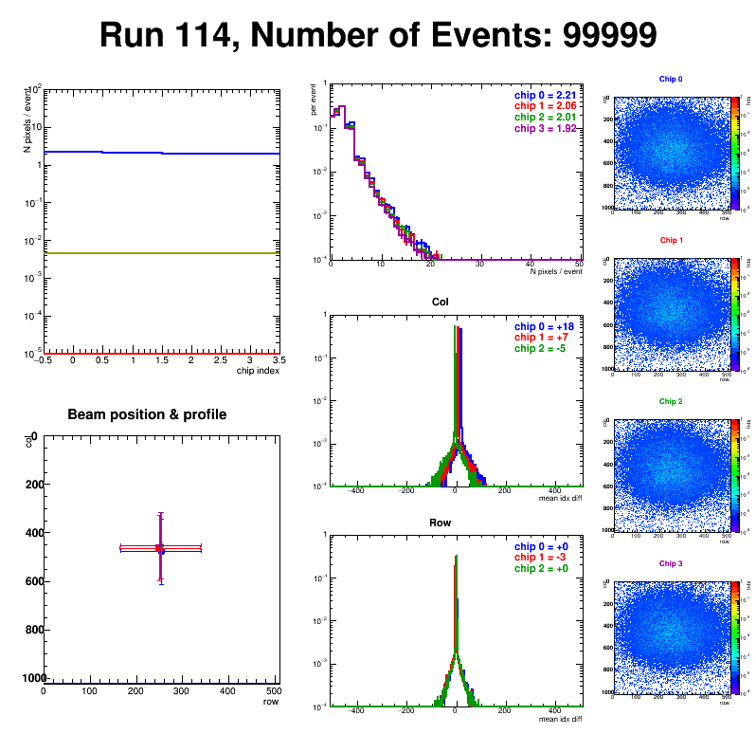
#2: Can the data from MVTX staves be extracted, readout and integrated into sPHENIX DAQ?
Sho, Alex, Jo
Yes!
Test beam online monitoring and data analysis are carried out in the sPHENIX online and offline framework
Online display:
Hit Spatial Resolution: < 5 um
Hit Efficiency > 99.5%
Pixel size (~28um)

Slide 5
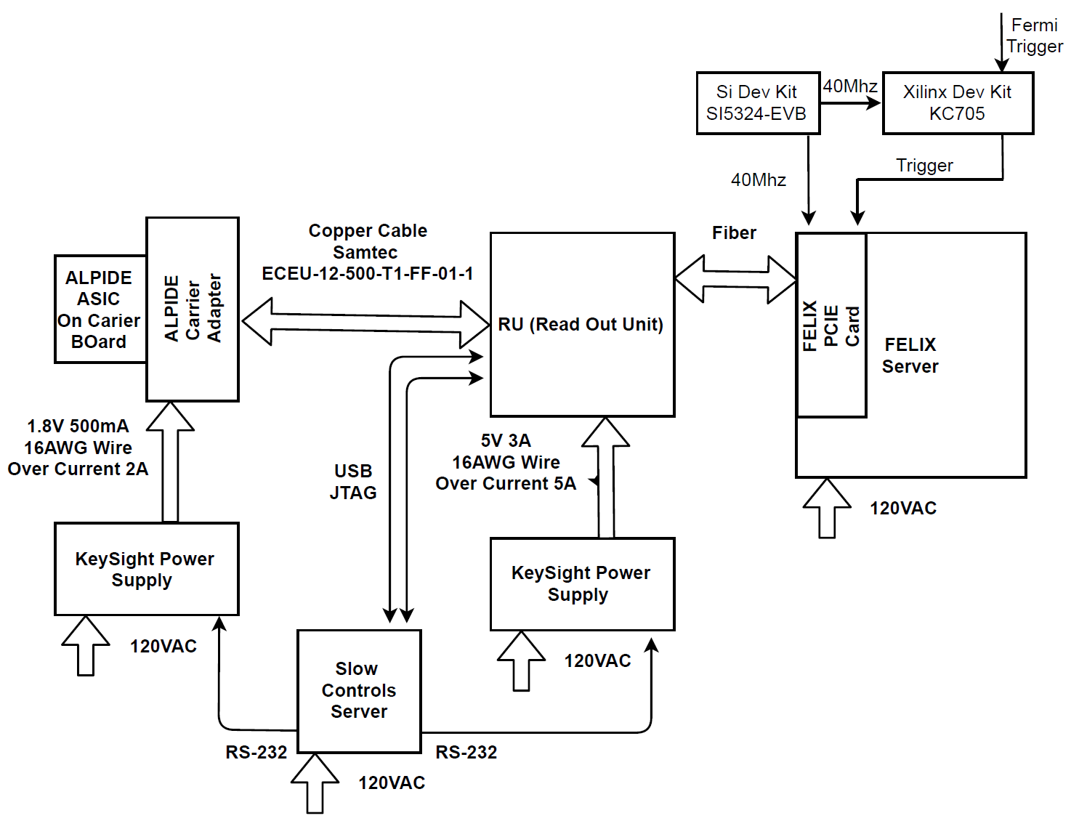
#3: Are the electrical interfaces of the Staves ad Readout Units to other sPHENIX components at a proper level of understanding?
Sho, Alex, Jo
Yes!
- We have exercised the full readout chain and controls at Fermilab test beam

Slide 6
#4, Has the responsibility for fabrication, tests for the Staves and Readout Units been defined? #5, Has a QA plan and acceptance tests for the Staves and Readout Units been defined?
Leo & Jo
Yes!
ALICE/CERN will produce staves and RU for sPHENIX.
sPHENIX/MVTX group does the acceptance test and QA in US.
L3: Grazyna Odyniec/LBNL
L3: Joachim J. Schambach/UT-Austin

Slide 7
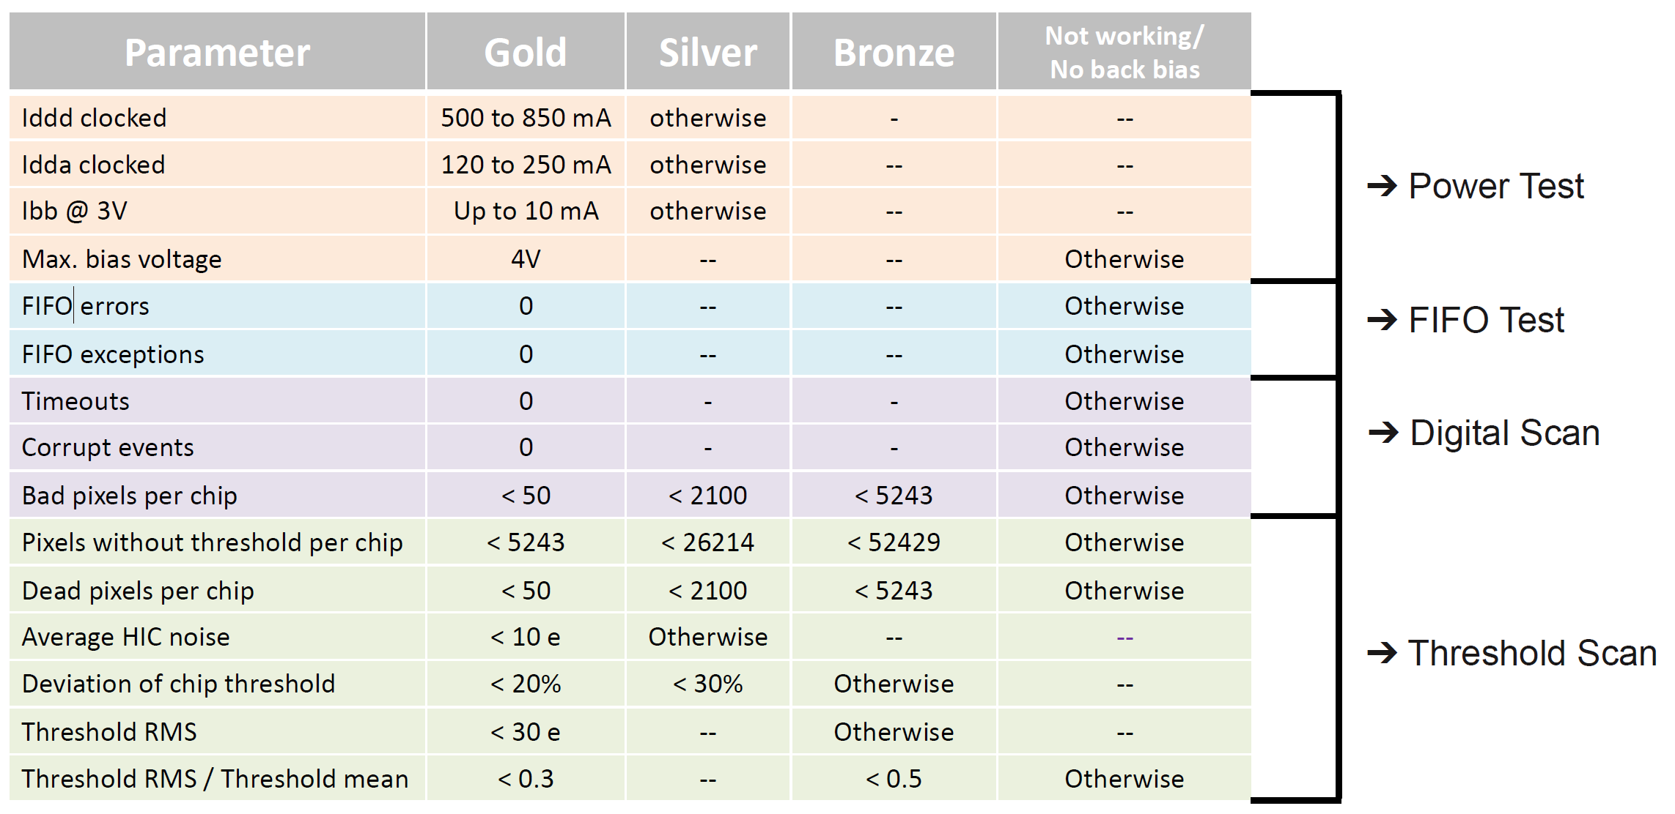
#6, Has the inspection/test records archive plan been defined and is the information easily accessible?
Yes!
Follow the same QA procedures being used for ALICE ITS/IB production at CERN
Use ALICE DB for initial sPHENIX production
Move to sPHENIX DB later when available
Leo & Jo
An example from
ALICE ITS stave electrical
QA characterization

Slide 8
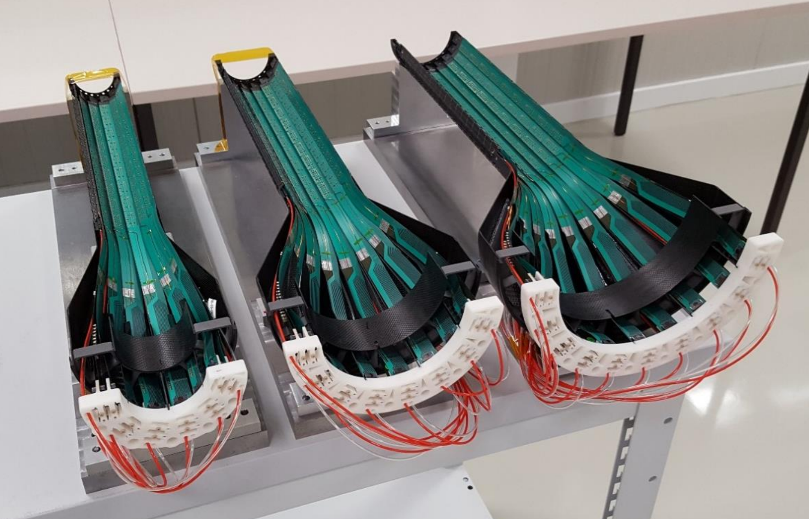
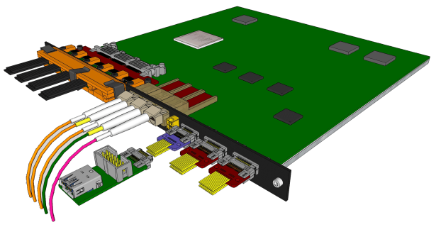
#7: Is the design of the Stave and Readout Units final?
Leo & Jo
Stave: Yes!
- Minor modification of power extension cable
for FPC, MVTX 35cm cables (ALICE, 15cm)
- ALICE ITS/IB staves production in progress
RU: Yes!
- Pre-production boards (v2.0) being tested at CERN
- ALICE ITS RU production follows after the test.

Slide 9
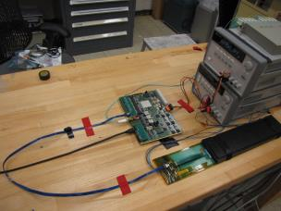
#8, Are the staves and readout units ready for procurement?
Leo, Jo, Walt
Staves: Yes!
High-speed line, no change
Longer (15cm ->35cm) power extension cables, Prototype power extension cables produced at LANL for testing.
RU: Yes!
Once the final v2 pre-production boards pass the test, full production will proceed
RU v1 meets readout integration requirements
RU v1.0
FPC power extension
Sensor barrel
Stave/HIC

Slide 10
#9, Status of the simulation to optimize the MVTX and INTT for tacking in sPHENIX and timescale for its completion
Tony, Dave & Gunther
All essential sPHENIX simulation tools are available to verify tracking performance with various layers of INTT configurations
A simulation task force formed, with charge and targeted due date

Slide 11
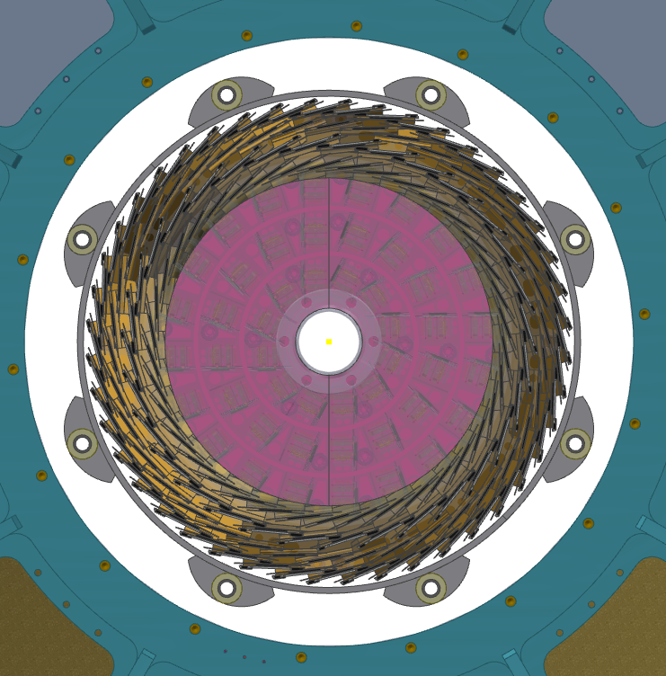
#10, Status of the mechanical integration between the MVTX, INTT and other sPHENIX components and timescale for a final design?
Walt & Dan
sPHENIX Office of System Integration coordinates integration effort
Significant progress on the integration in the past few months - the integration issues of inner tracking system appear manageable
Detailed 3-D models being developed, a mock up to confirm the final design

