Slide 1
MVTX Director’s Review
Q&A
Ming Liu, for the MVTX Group
LANL
July 19-20, 2018

Slide 2
Review Questions
1. How exactly do you propose to extend the power cable so the patch panel can be further out in z? Illustrate this change.
2. What is the estimated total cost of the Readout units if you join the Alice order, or if you do it later? How many units? Are there other users who plan to join the order? Give us total breakdown.
3. What is the prioritized plan for the layout simulations? What are the configurations and estimated timescale for completion.
4. What is the timeline to do the full 1 Mrad irradiation of a number of Alpide sensors to determine the fake hit rate. Do you intend to go to 2 Mrad or higher?
5. How quickly do you think you could do a mockup that while not being the final design, would serve as a proof of principle that the INTT and Mvtx can co-exist in their separate envelopes?

Slide 3
ALICE power extensions added on to stave FPC
IB fpc assembly after power extensions soldered on

Slide 4
FPC extension interface with patch panel:
Patch panel

Slide 5
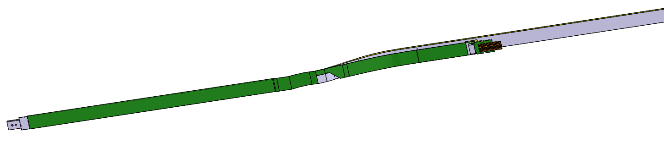
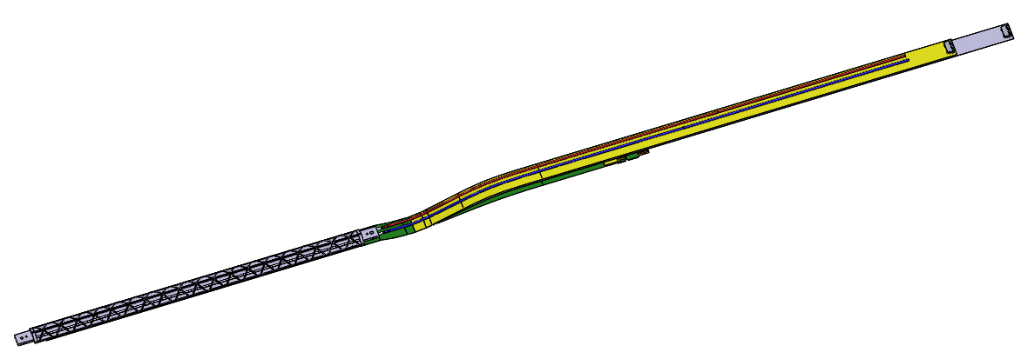
Extended FPC:
Stave side with FPC and signal cable connection original length
Stave truss support side showing FPC power extension cables and cooling lines

Slide 6
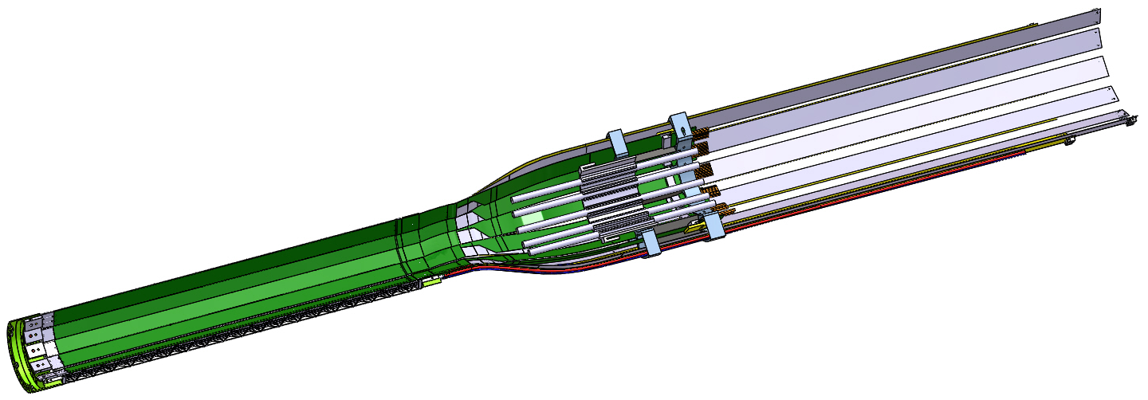
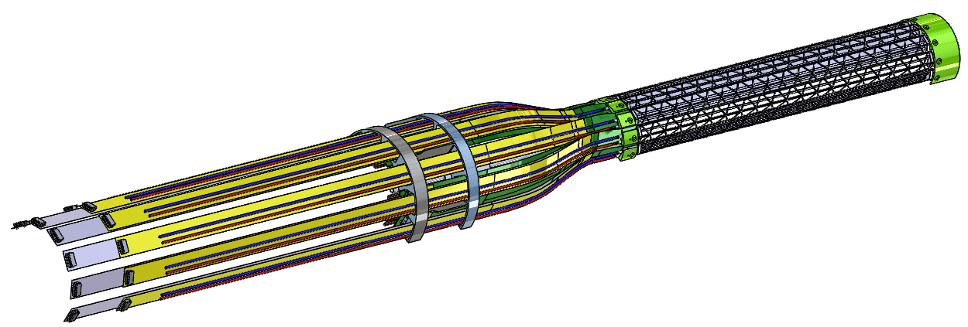
MVTX inner layer extended staves:

Slide 7
2. What is the estimated total cost of the Readout units if you join the Alice order, or if you do it later? How many units? Are there other users who plan to join the order? Give us total breakdown.
The cost for a few test boards was about US$5K each (LANL paid) for RU1.1.
For ALICE production, a total of CHF 740K for 310 RUv2, or $2400/RU
(US $1.00 = CHF $1.00)
sPHENIX needs 58 RUv2, a total of US $140K. AT $5K per board, the total cost = $290K
All w/o contingency (~20% assumed in the project)
•ITS + MFT production: 310 boards
•XCKU060: 390kCHF (~ 1260 CHF per FPGA vs $2600 for small qty)
•APFL600: 50 kCHF
•GBT chipset: 150 kCHF
•RU production (includes passives and other components): 150 kCHF
•Total: 740 kCHF
•Per board: ~2400 CHF
•58 boards = ~140 kCHF
Additional cost for small qty FPGA: $75,400
Additional cost for small qty board fab: $???

Slide 8
3. What is the prioritized plan for the layout simulations? What are the configurations and estimated timescale for completion.
The task force plans to update the inner tracker simulation to the most
recent detector design, including sensor geometry, material distribution,
and possible dead areas (time scale: 1 month).
Then we will run a series of studies as listed below. Each study will consider various inner tracker layout configurations, and will compare performance between these configurations. Possible inner tracker layout configurations to be studied are
3-layer MVTX + 4-layer INTT: current baseline configuration
3-layer MVTX + 3- or 2-layer INTT
INTT inner layer with phi-sensitive strips VS z-sensitive strips
2-layer MVTX + 2 layer INTT
INTT only, with the 1st layer radius reduced
priority | Planned studies | ETA
0 | Update the inner tracker simulation up to the most recent detector design | 1 Month
1 | Tracking performance in high rate p+p collisions and quantifying INTT’s capability of beam-crossing tagging | 3 Months
2 | HF performance under high pile up conditions | 5 Months?
3 | TPC calibration and distortion control using the inner trackers | 8 months

Slide 9
4. What is the timeline to do the full 1 Mrad irradiation of a number of Alpide sensors to determine the fake hit rate. Do you intend to go to 2 Mrad or higher?
We intend to do this test in the next few months time frame. We have the materials available:
- 5 ALPIDE sensors
- 1 MOSAIC RDO board
- Existing ALICE software and firmware
We are investigating irradiation facilities. The first option would be the BASE facility at LBNL for proton (50 MeV). Depending on availability we will investigate other TID exposure facilities. We expect to irradiate to 2 MRad measuring fake hit rate during the full exposure to verify the ALICE measurements and to extend them into the higher exposure level.

Slide 10
5. How quickly do you think you could do a mockup that while not being the final design, would serve as a proof of principle that the INTT and Mvtx can co-exist in their separate envelopes?
Los Alamos and BNL engineers will work on MVTX and INTT mechanical designs, respectively, in the coming ~6 weeks to produce a preliminary 3-D physical mockup based on the current understanding of the integration envelope to confirm the feasibility of the proposed integration design.
BNL/OSI will make sure two of them will fit together;

Slide 11
#5, Cont. - toward a final design
At the present time we believe we have clearance between these two tracking systems, because these modifications have recently been made a better understanding of each system needs further modeling.
The current plan for the MVTX is to complete the integration of the reduced size patch-panel assemblies and incorporate new smaller composite shells, along with a new – possibly extended outer shell.
The next step would be to perform an analysis on this structure to verify its stability in the small volume allowed for this assembly around the beam-pipe..
Because of this level of work, a realistic final mock-up will take place at a later time.

