Slide 1
MVTX Overview
Ming Liu
Los Alamos National Laboratory

Slide 2
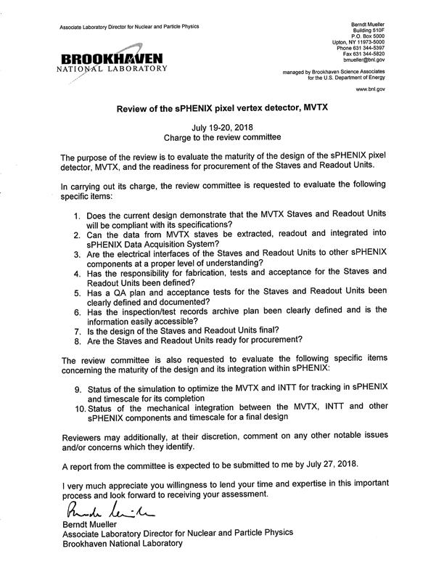
Presentations:
sPHENIX overview
MVTX project overview
Readout integration & test beam
Stave production & QA
RU production & QA
INTT overview
Mechanical integration
Tracking simulations
Summary

Slide 3
Outline
Document: sPH-HF-2018-001
https://indico.bnl.gov/event/4072/
Science of MVTX
Scope of MVTX project
R&D highlights
Project Status & Plan

Slide 4
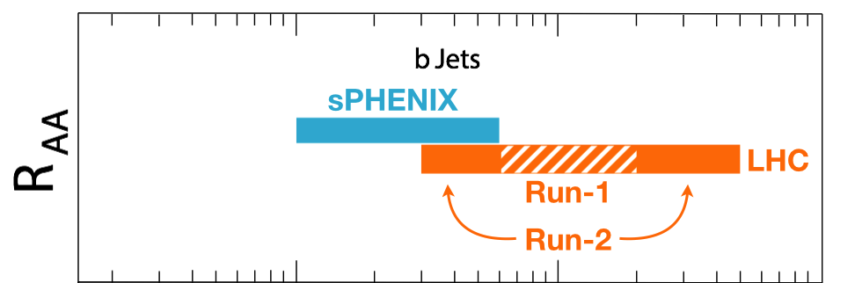
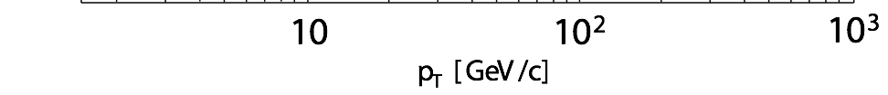
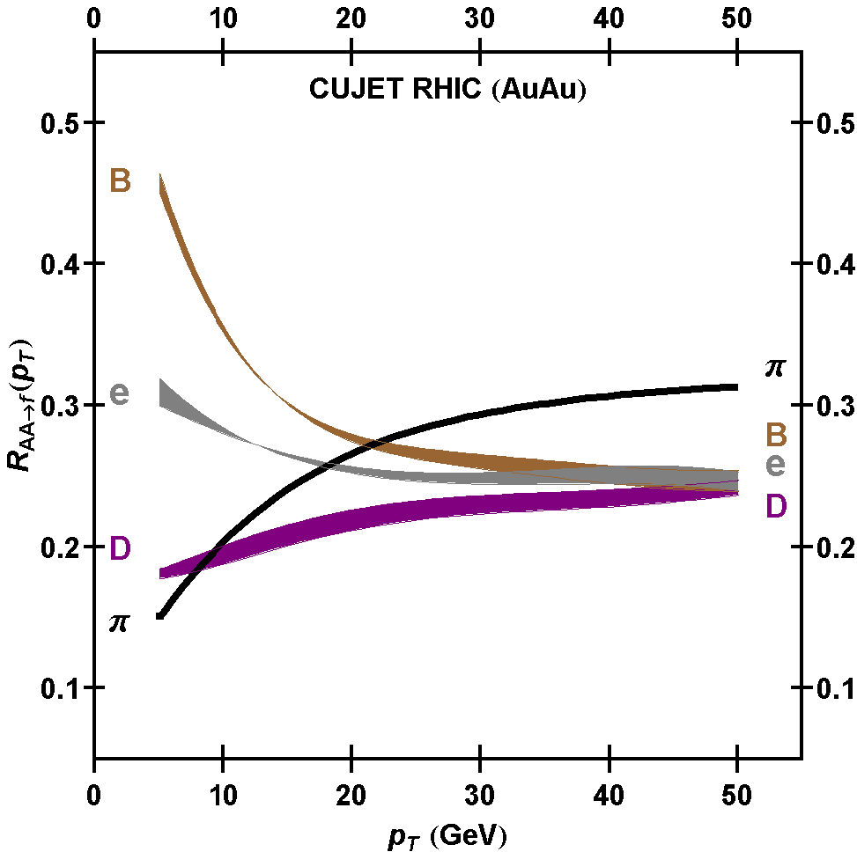
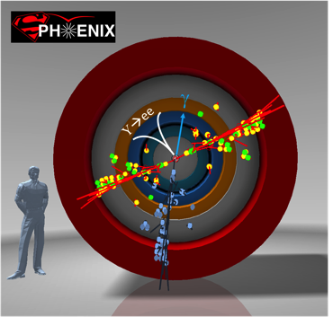
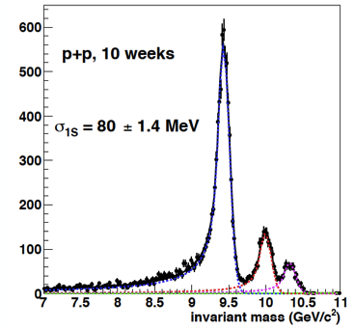
Exciting Science
sPHENIX is the next flagship heavy ion physics experiment in the US (NSAC LRP2015)
  Jets
  Upsilons
  B-jets and B hadrons
MVTX will complete QGP heavy flavor physics
  Precision study of the “inner workings of QGP”(LRP15)
  Unambiguous determination of key parameters of QGP properties and interactions
complement & extend current and future RHIC and LHC QGP programs
sPHENIX 3 Physics Pillars
http://arxiv.org/pdf/1501.06197v1.pdf
Jets
Upsilons
PRL 108 (2012) 022301
B
D

Slide 5

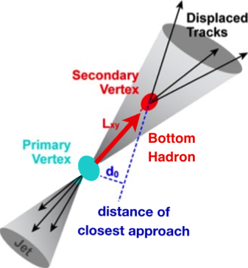

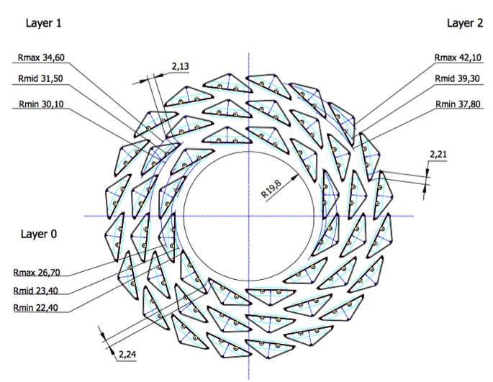
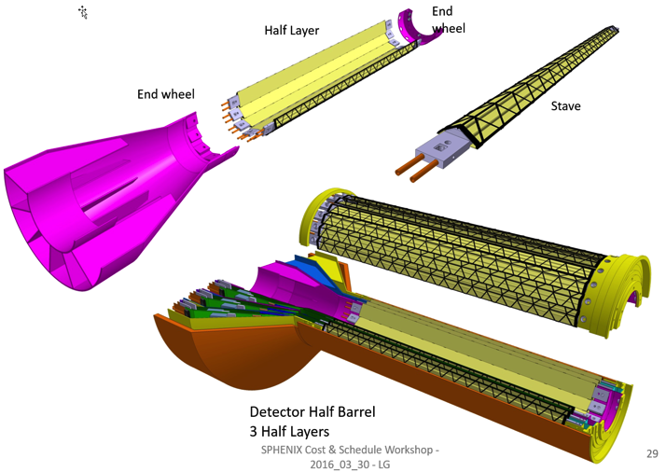
MVTX: Monolithic-Active-Pixel-Sensor-based VerTeX Detector
sPHENIX@RHIC (2023+)
Key integration tasks:
Readout
Mechanics
ALICE ITS Upgrade @CERN;
Inner Tracker System (2021+)
sPHENIX Inner Tracking
“Adopt” ALICE/ITS
Mini. risk,
Max. physics
MVTX could also be a day-1 EIC detector

Slide 6

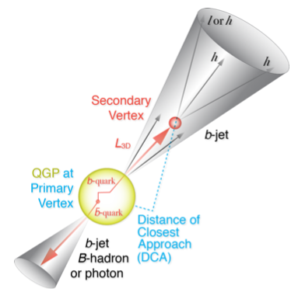
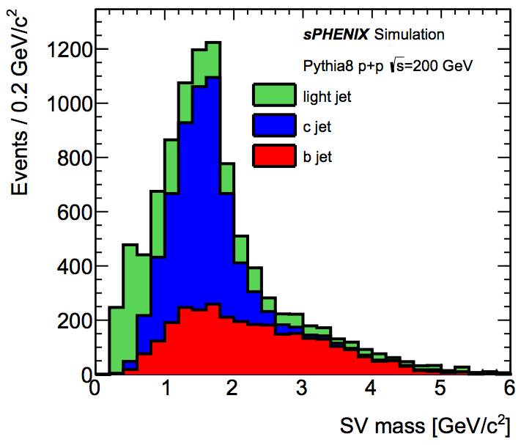
B-Hadron & b-Jet Tagging
Physics Reminder
Detected using the long lifetime of bottom quark hadrons:
  Displaced tracks
  Large 2nd vertex invariant mass
Need high precision tracking and vertex determination – MVTX!
Need excellent jet detection capabilities – sPHENIX!

Slide 7
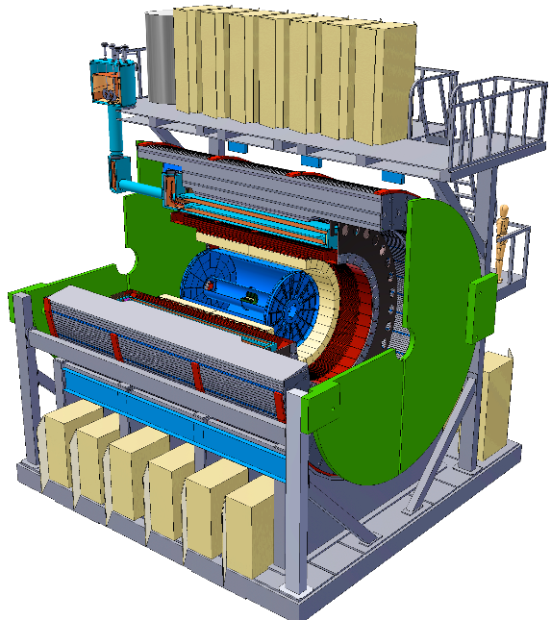
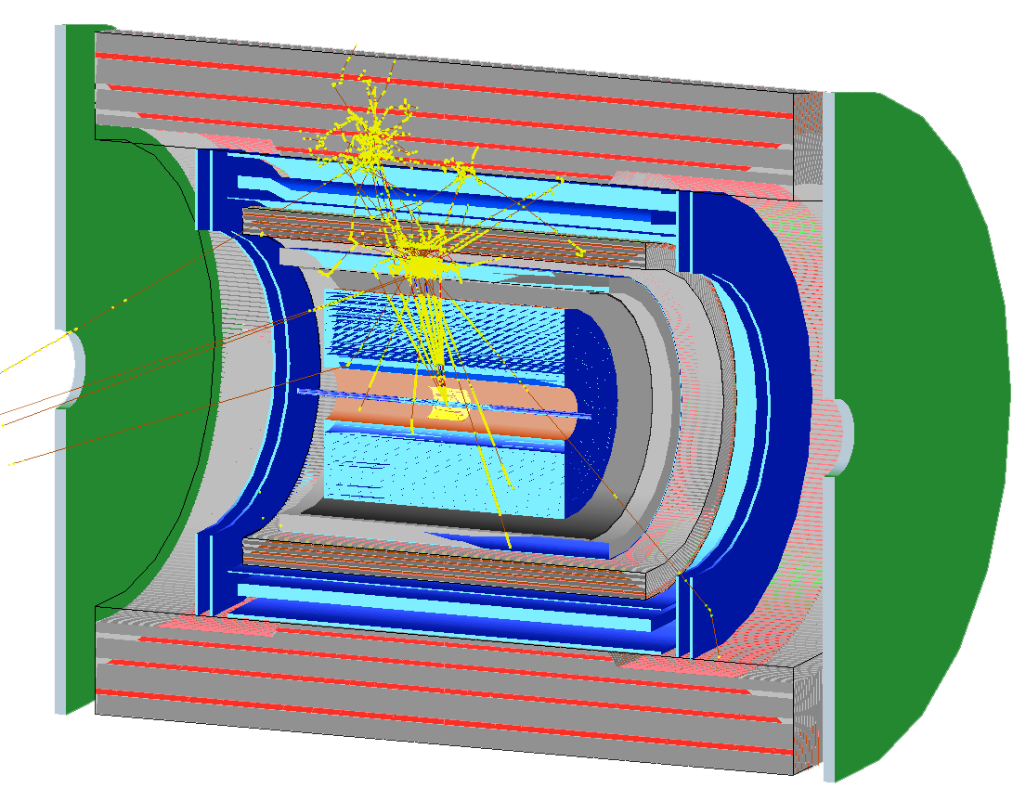
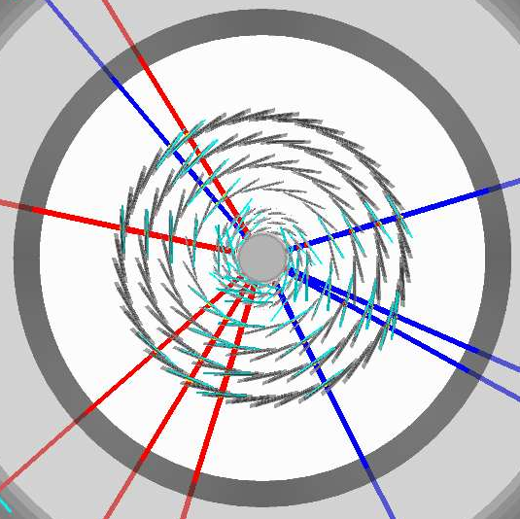
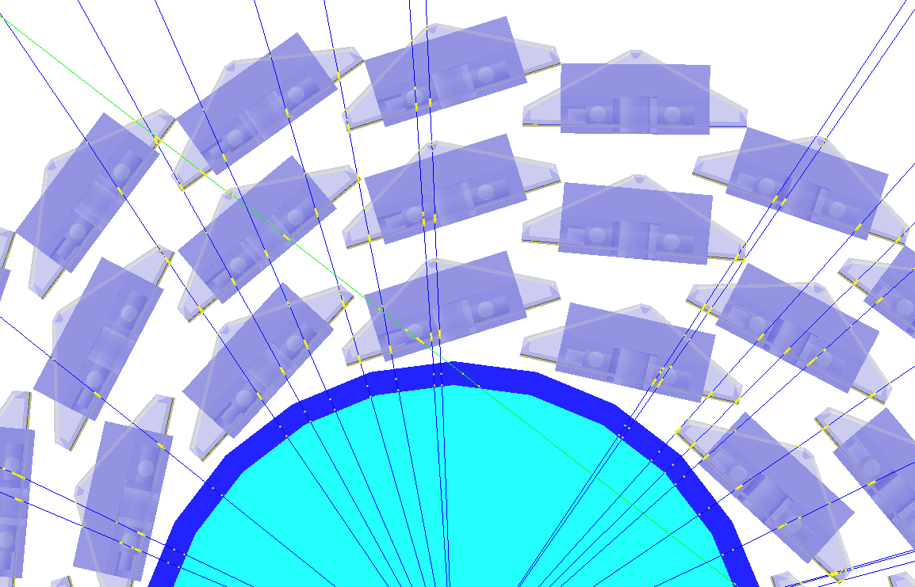
Simulation for b-jet and B-meson tagging
sPHENIX Geant4 display of p_{T}=30 GeV/c B⁺-hadron
Design to Simulation
MVTX and INTT _
_ MVTX Ladders modeled in details
MVTX sensors

Slide 8
Expected Performance
Tony’s talk

Slide 9
MVTX Physics Highlights
“B meson and b-jet modification”
Heavy quarks – unique probe of QGP w/ new scales, m_{c}, m_{b}
  Study mass dependence
    Jet quenching & energy loss
    Flow – interaction with medium
  Access QGP properties
    Temperature, density, coupling, transport coefficients, viscosity etc.
“B meson and b-jet flow”
m_{u} m_{d}
m_{s}
Λ_{QCD}
m_{c}
m_{b}
MeV
1
10
10²
T_{c}
T_{QGP}
10³
10⁴

Slide 10


Monolithic-Active-Pixel-Sensors (MAPS)
The next Generation State of the Art Pixel Tracker
Advantages of ALICE MAPS/ALPIDE:
  Very fine pitch (28x28 μm)
  High efficiency (>99%) and low noise (<10⁻⁶)
  Time resolution, as high as ~5 μs
  Ultra-thin/low mass, 50μm (~0.3% X₀)
  On-pixel digitization, low power dissipation
An ideal detector for QGP physics!
FPC
9 Chips
Cooling plate
A 9-chip MAPS stave, 1.5 x 27cm²
ALPIDE design
50 μm
28 μm

Slide 11
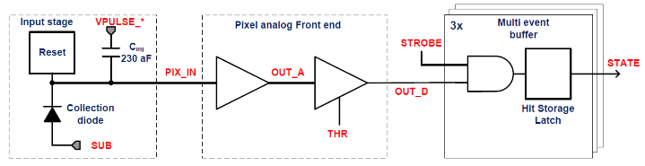
ALPIDE/MAPS Operation
Well fit sPHENIX/RHIC environment, 10MHz Clock (LHC 40MHz)
shaping time: 2, 5, 10 … μs
v
PIX_IN
v
OUT_A
~5-6 μs
t_{f}~= 10 ns
OUT_D
ΔV=Q/C
threshold
t_{r}> 100 μs
~5-6 μs
STROBE
t
t
sPHENIX trigger latency: ~4 μs

Slide 12
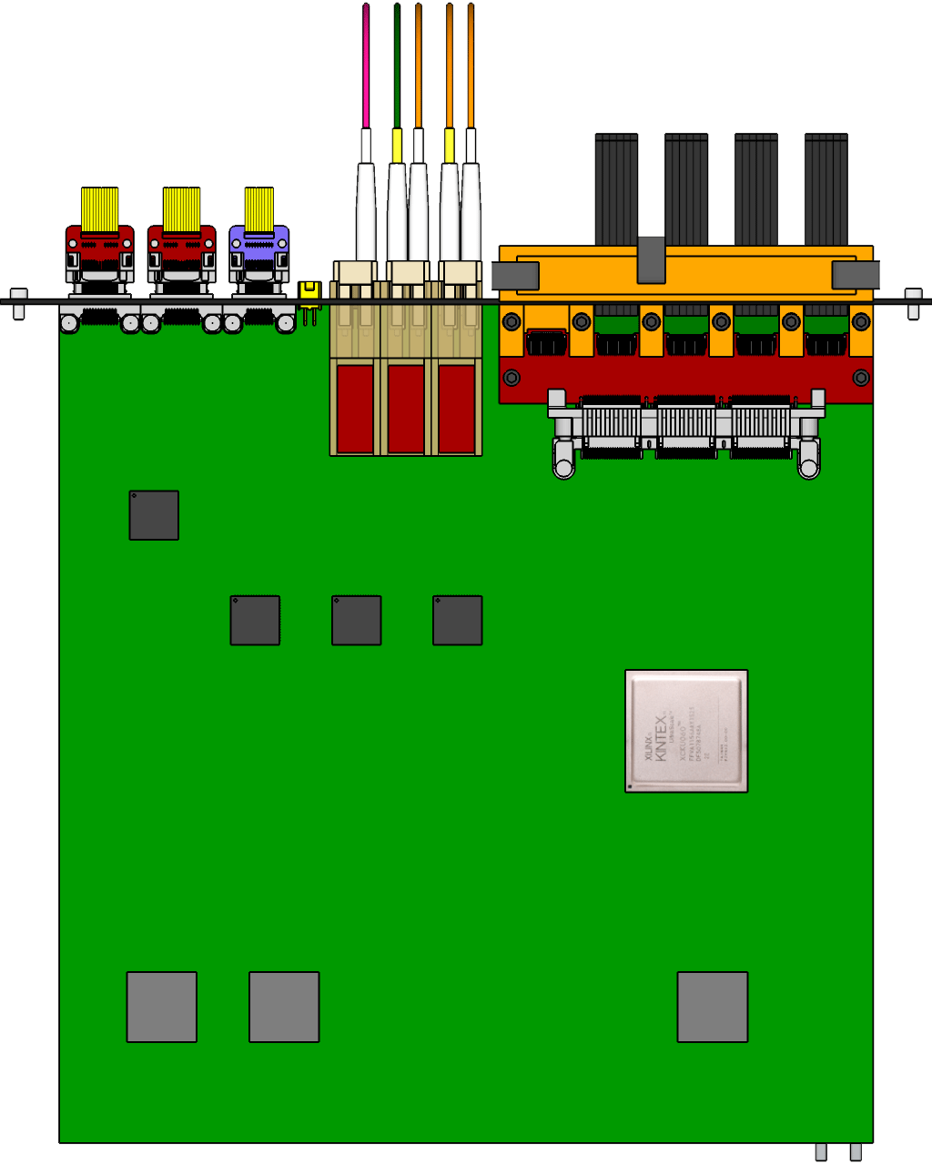

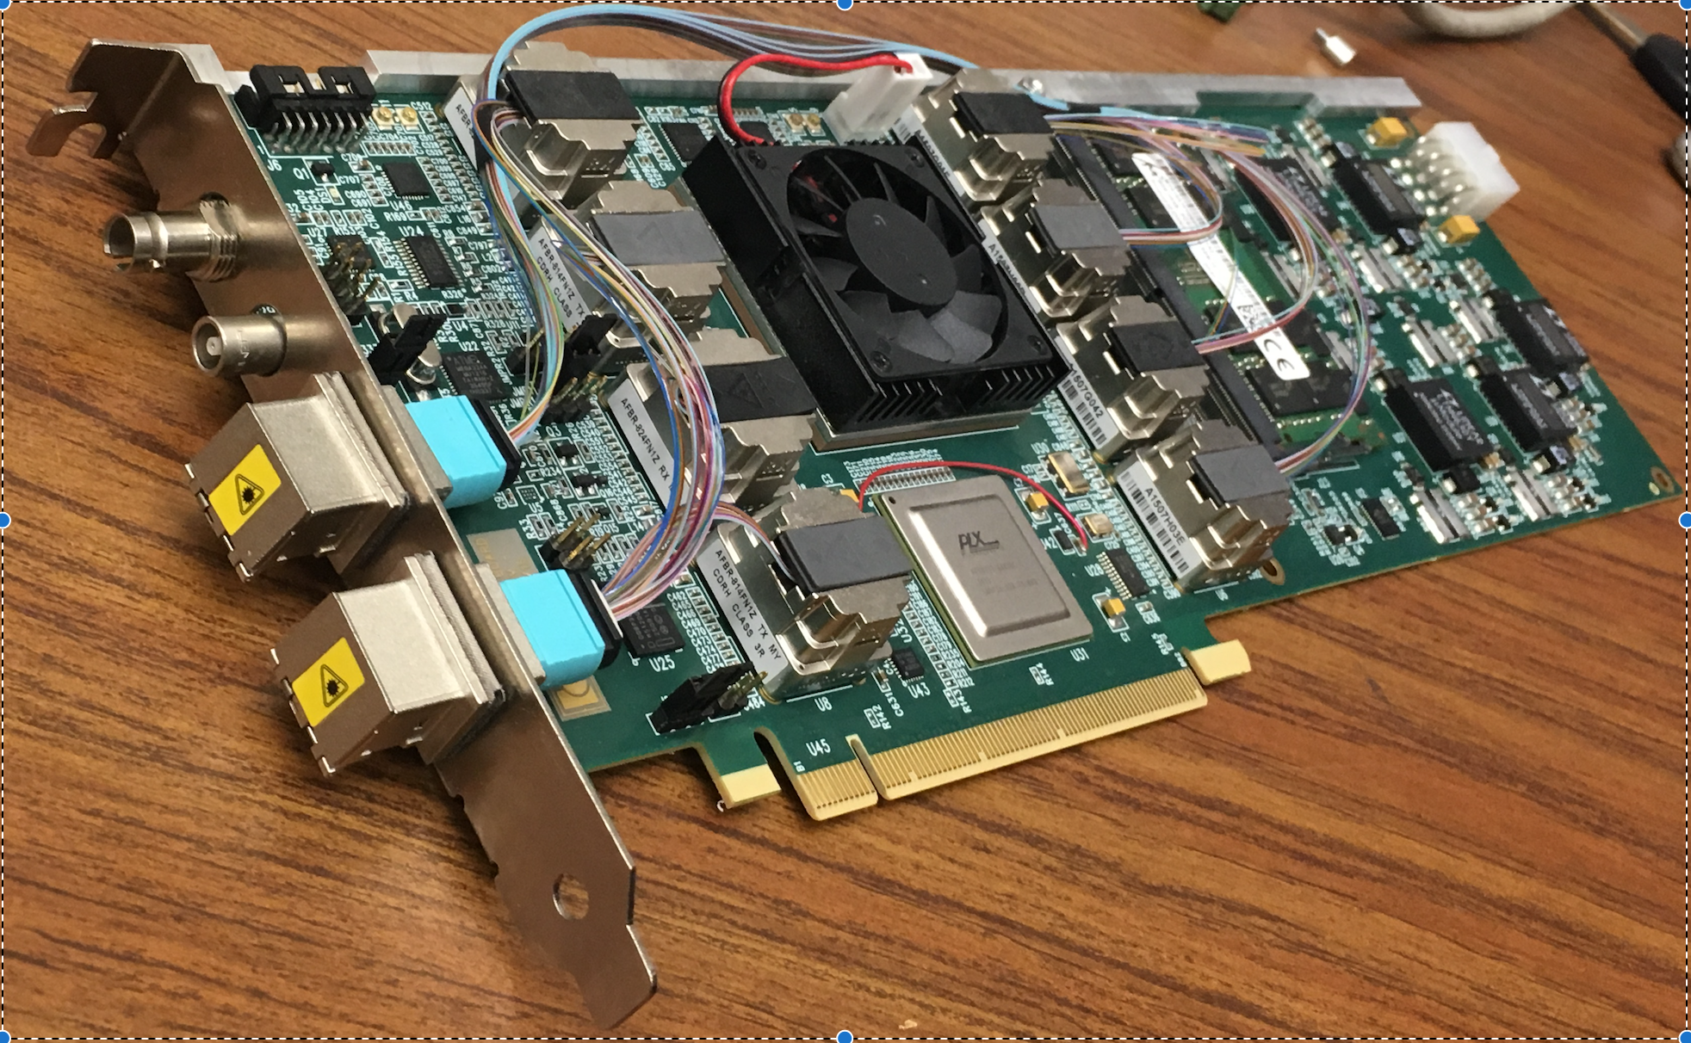
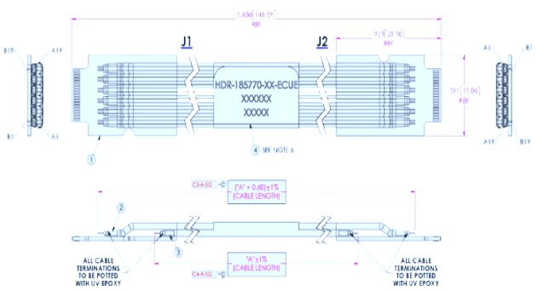

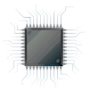
MVTX Readout and Control System
Jo, Sho, Alex’s talks
sPHENIX GL-1 & GTM
ALPIDE Sensor
CAN bus
DCS
5~10 m
Trigger & Clock
Readout Unit
GBT Optical Links
9 Data (1.2Gbps)
1 Clock, 1 Control/Trigger
Control
9-sensor Stave
Data (9.6 Gb/s max)
Trigger
Samtec Twinax “FireFly”
FELIX
FPC
Power
9 ALPIDE Sensors
Power
Filtering
Capacitors
regulators
Power supplies
Cold Plate
Regulated Power
Power Board
LANL, UT-Austin, LBNL, BNL, ALICE/ITS …

Slide 13
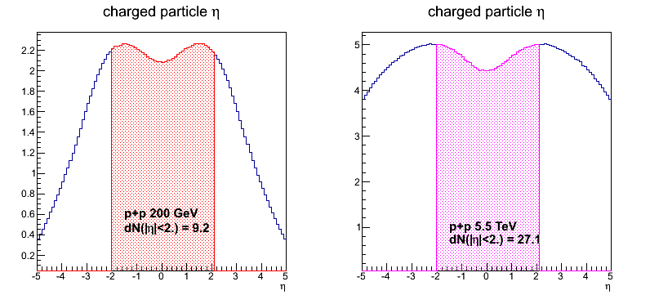
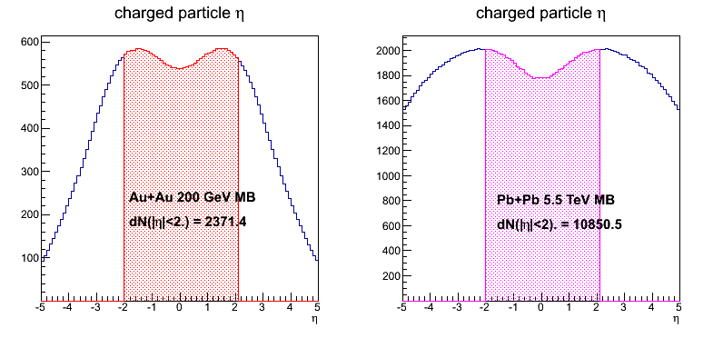
sPHENIX MVTX vs ALICE ITS/IB Hit Rates
 | ALICE (Run3) | sPHENIX (Max)
Pb+Pb / Au+Au | 100 kHz (50kHz) | 200 kHz
p+p | 400 kHz (200kHz) | 13 MHz
Trigger/Readout | >50 kHz | 15 kHz
MB Event track multiplicity dN/dη: sPHENIX = 1/3 ALICE (pp), 1/4.5 ALICE(AA)
sPHENIX
ALICE
p+p collisions
A+A collisions

Slide 14
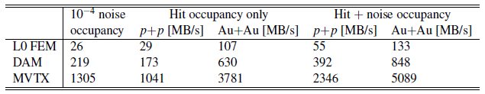
Projected sPHENIX Data Rates @15kHz Trigger
Sho & Alex
Note: test beam showed noise < 10⁻⁵
Readout Units: 3 GBTX @ 0.4 GB/s = 1.2 GB/s >133MB/s
GBTx: 3.2-4.48Gb/s, 0.4 GB/s
FELIX: 48 input on FELIX, twice the number needed to support 8 RUs (3 links)
2x 8-lane PCIe Gen 3 @ 7880 MB/s = 15760 MB/s > 848 MB/s

Slide 15
Expected Radiation Level after 5-year Runs
sPH-TRG-2018-001
Projected sPHENIX radiation level after 5-year operation
  AuAu: L = 214 nb⁻¹
    @R=10cm, D_AA = 214/50 x 0.2x10¹² = 0.86x10¹² nEq/cm²
  pp/pA: L = 1340 pb⁻¹
    @R=10cm, D_pp = 1340/700 x 0.3x10¹² = 0.57x10¹² nEq/cm²
Projected sPHENIX MVTX L0 received fluence = 0.6 ~ 1.7 x10¹³ nEq/cm²
Within the ALIPDE performance specs.

Slide 16
ITS Radiation Load
Position respect to beam |  |  | Radiation levels (total)
r | z | Name | TID | 1 MeV neq fluence | High energy hadron flux* | Charged particle flux
[cm] | [cm] |  | [krad] | [cm⁻²] | [kHz cm⁻²] | [kHz cm⁻²]
2.2 | [-13.5 ÷ 13.5] | ITS L0 | 2734 | 1.7 × 10¹³ | 765 (770) | 890 (910)
43 | [-73.7 ÷ 73.7] | ITS L6 | 20 | 8.1 × 10¹¹ | 3.4 (4.9) | 4.5 (6.7)
79 | [-260 ÷ 260] | TPC In | 5.6 | 7.0 × 10¹¹ | 1.35 (1.8) | 1.7 (3.45)
100 | 330 | RE | ≈ 5 | ≈ 1.6 × 10¹¹ | 0.86 | 1.7
258 | [-260 ÷ 260] | TPC Out | 0.86 | 1.4 × 10¹¹ | 0.27 (0.37) | 0.2 (0.3)
290 | [-290 ÷ 290] | TRD | 0.6 | 1.2 × 10¹¹ | 0.23 (0.31) | 0.15 (0.23)
Hadrons and charged particles as for 50 kHz Pb-Pb collisions

Slide 17
Radiation Level in sPHENIX (I):
- by cross section scaling: LHC vs RHIC
LHC: Pb-Pb 5.5TeV,
  sigma_NN = 72mb
  Sigma_PbPb = 7750mb
  L = 13nb⁻¹
N_evts = 7750mb x 13nb^-1
= 100 x10⁹
RHIC: AuAu 200GeV
  Sigma_NN = 42mb
  Sigma_AuAu = 7000mb
  L = 214nb⁻¹
N_evts = 7000mb x 214nb^-1
= 1,500 x 10⁹
RHIC (AuAu) dN/deta = 1/4.5 LHC(PbPb):
Fluence (RHIC, AuAu) = 1/4.5 x 1500/100 = 3.3 x LHC(PbPb)
Fluence (RHIC, pp) = 6/9 x Fluence (RHIC, AuAu)
Total (RHIC: AuAu+pp+pA) = 3.3 x (1+6/9) x LHC(PbPb)
= 5.5 ALICE(PbPb) L0
= 5.5 x 10¹² nEq/cm²
MVTX: at slightly larger R,
dR = +1.3mm

Slide 18
Radiation Level in sPHENIX (II)
- by PHENIX measurements
Projected sPHENIX radiation level after 5-year operation
  AuAu: L = 214 nb⁻¹
    @R=10cm, D_AA = 214/50 x 0.2x10¹² = 0.86x10¹² nEq/cm²
  pp/pA: L = 1340 pb⁻¹
    @R=10cm, D_pp = 1340/700 x 0.3x10¹² = 0.57x10¹² nEq/cm²
RHIC-II projected dosage based
on PHENIX measurements:
MVTX R_0 = 2.6cm
R-factor:
(10/2.6)^{1.83} = 11.8
Fluence from AuAu runs:
- 10 x 10¹² nEq/cm²
Fluence from pp runs:
- 6.7 x 10¹² nEq/cm²
Total: 1.7 x 10¹³ nEq/cm²
arXiv: 0710.2676 [nucl-ex]

Slide 19
MVTX Full Proposal
Pre-proposal submitted to DOE, 2/2017
  Follow-up discussions with DOE and BNL managers
  Weekly proj. leaders’ meeting, BNL/LANL/LBNL/MIT
Full proposal submitted to BNL ALD, Feb 2018
  Expanded science + Cost & Schedule
  Assumed funding starts in FY18
A growing collaboration
  15+ institutions from US and abroad
Adapt ALICE ITS Upgrade Inner Barrel 3-layer MAPS detector
  Mini. risk, Max. Physics
Precision vertexing for b-jet/B-hadron tagging in HI with high efficiency and high purity
B-jet modification in QGP at low-medium pT to determine QGP properties, study mass-dependence on collisional vs radiative energy loss, flow etc.
Early R&D by LANL LDRD, $5M, FY17-19, readout, mechanical design and physics; established LANL-ALICE MoU in 12/2016 for joint R&D and training

Slide 20
Updated Funding & Schedule, July 2018
Tied to sPHENIX and ALICE schedule
  Stave production
  Readout electronics
  To minimize technical risk and also for cost saving
Cost based on ALICE/ITS and recent STAR & PHENIX upgrade projects at RHIC
  STAR HFT
  PHENIX FVTX

Slide 21
Scope of the MVTX Project
MAPS Staves & Electronics
  Produce 84 ITS inner Barrel Staves
    No modification on high-speed
    Extended power cables
  Readout Electronics R&D (LANL LDRD)
    Frontend: ALICE/ITS, RU
    Backend: ATLAS FELIX
    Reprogram RU & FELIX for sPHENIX
  Production:
    Extend ALICE/ITS MAPS stave production
      WBS 1.5.3.1, LANL, LBNL
      sPHENIX personnel help at CERN
    Reproduce additional ALICE/RU & ATLAS/FELIX
      WBS 1.5.2.2, UT-Austin, RU
      WBS 1.5.2.3 , LANL, FELIX
    Final assembly and test in US
      WBS 1.5.3, LBNL
  Ancillary systems, “adopt” ALICE system
    Power distribution, cables, crates, racks etc.,
      WBS 1.5.2.3, LBNL
    Slow control, safety and monitoring
Mechanics & Cooling
  Some changes to ALICE/ITS inner tracker mechanical structures,
    End Wheels
    Cylindrical structure shells
    Detector half barrels
    Detector and Service half barrels
  Mechanical Integration,
    Conceptual design by LANL LDRD
    Prototype by sPHENIX R&D, MIT/LANL
    Design integration frames
    Carbon frames etc., LBNL
    Installation tooling etc.
  Adopt ALICE cooling plant design
    Minor modification to fit sPHENIX
    Smaller heat load than ALICE ITS
  Metrology and Survey

Slide 22
Schedules and Milestones
2018 | 2019 | 2020 | 2021 | 2022 | 2023
Stave & RU
production
FELIX
production
Detector mechanics design & production, global interface to sPHENIX
End Wheels
CYSS
Service barrel
design & production
MVTX final
design review
Ready for beam
Barrel Assembly & Testing
Install half barrel
#1, 2@IR
Half barrel #1
Half barrel #2
Test half barrels
#1, 2@BNL
Power system
production
MVTX installation & commissioning @BNL
RU, FELIX, PS, cables etc.

Slide 23
Readout Integration into sPHENIX

Slide 24
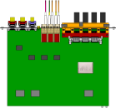
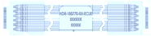
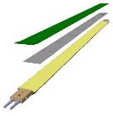

MVTX Electronics, Power and Controls
CAN bus
DCS
5-10 m
Trigger & Clock
Readout Unit
Front End
GBT Optical Links
9-sensor Stave
9 Data (1.2Gbps)
1 Clock, 1 Control/Trigger
Control
Data (9.6 Gb/s max)
Trigger
Samtec Twinax “FireFly”
FELIX
Back End
FPC
Power
Alpide Sensors
Power
Filtering Capacitors
regulators
Power supplies
Cold Plate
Regulated Power
Power Board
Interaction Region
Experimental Hall
Counting House
MVTX Detector Electronics consists of three parts
Sensor-Stave (9 ALPIDE chips) | Front End-Readout Unit | Back End-FELIX

Slide 25
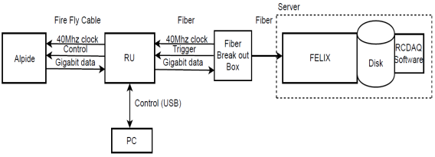
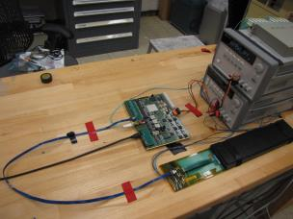
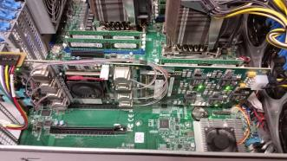
MVTX Full Readout Chain Demonstrated
Stave
Readout
Unit
FELIX
Readout Unit configures Stave using USB interface
FELIX distributes clock to Readout Unit
Readout Unit distributes clock to the Stave
Stave is triggered, sends data at 1.2Gb/s
Configured GBT link to recover clock from FELIX
Readout Unit receives the data and sends the data to FELIX over fiber using GBT link
FELIX packs data, stores it on disk using RCDAQ - the sPHENIX data format and software
Readout Unit + Stave
Server + FELIX

Slide 26
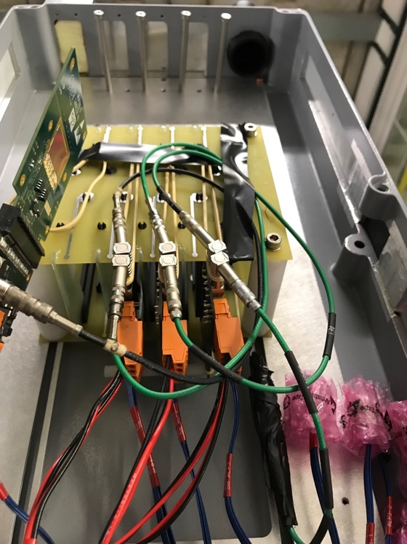
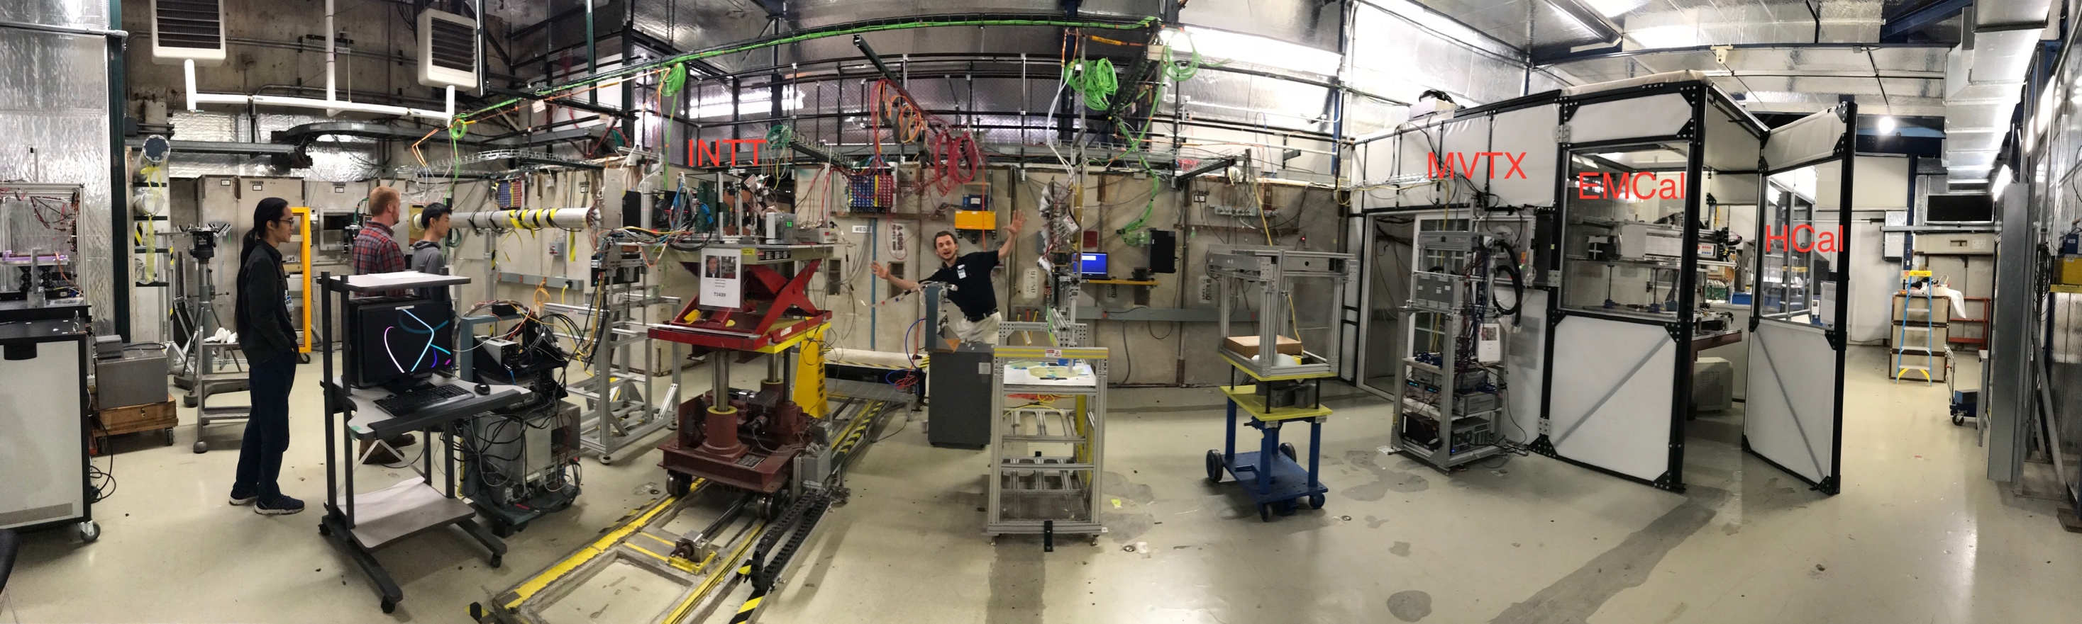
MVTX Test Beam at Fermilab 02/20-03/10, 2018
Goals:
  Test full readout chain
  Evaluate ALPIDE sensor performance
Experimental setup
  A 4-sensor telescope
  Full readout chain: MAPS+RU+FELIX+RCDAQ
120 GeV
proton
Parasitic with INTT run
Very productive & collaborative
4-sensor
Telescope

Slide 27
Fermilab Test Beam Results (I)
4-hit track
120 GeV proton beam
4-sensor telescope
Mostly single tracks
Cluster size: 2.1 ~ 2.4
# of tracks per event
Cluster size
Beautiful analysis done by Sanghoon and Darren + others

Slide 28
Fermilab Test Beam Results (II)
Hit Spatial Resolution: < 5 um
Hit Efficiency > 99.5%
Pixel size (~28um)

Slide 29
Staves Production and QA Plan
Leo’s talk
Purchase 84 staves from ALICE Production
  48 + full 2 inner layers(28) + 8 spares
  Production following the completion of ALICE ITS/IB
  Starting ~Oct. 2018, last 6-12 months (TBD)
  Fully tested at CERN before shipping to US
    All Gold/Silver staves or allow some Silvers? (same ~ALICE IB standard)
    A LANL postdoc (Dr. Yasser Morales) oversees QA at CERN
Acceptance QA at LBNL
  Full test and QA at LBNL
    Electrical
    Mechanical
  Detector assembly at LBNL
ALICE status
  IB stave in full production

Slide 30
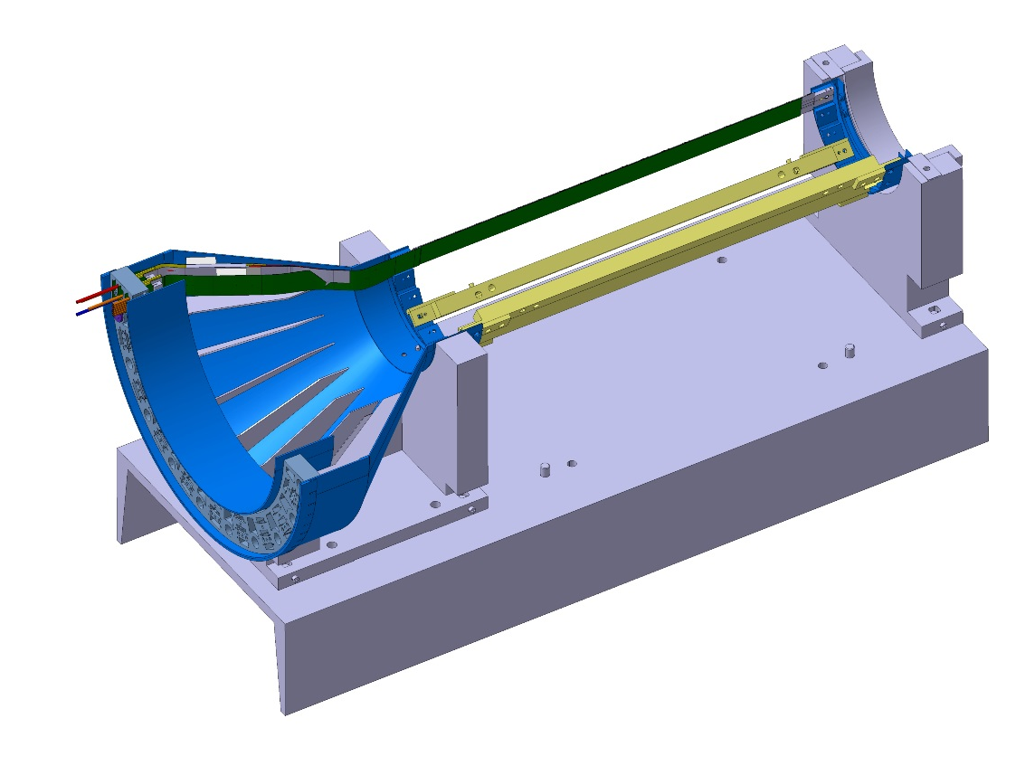
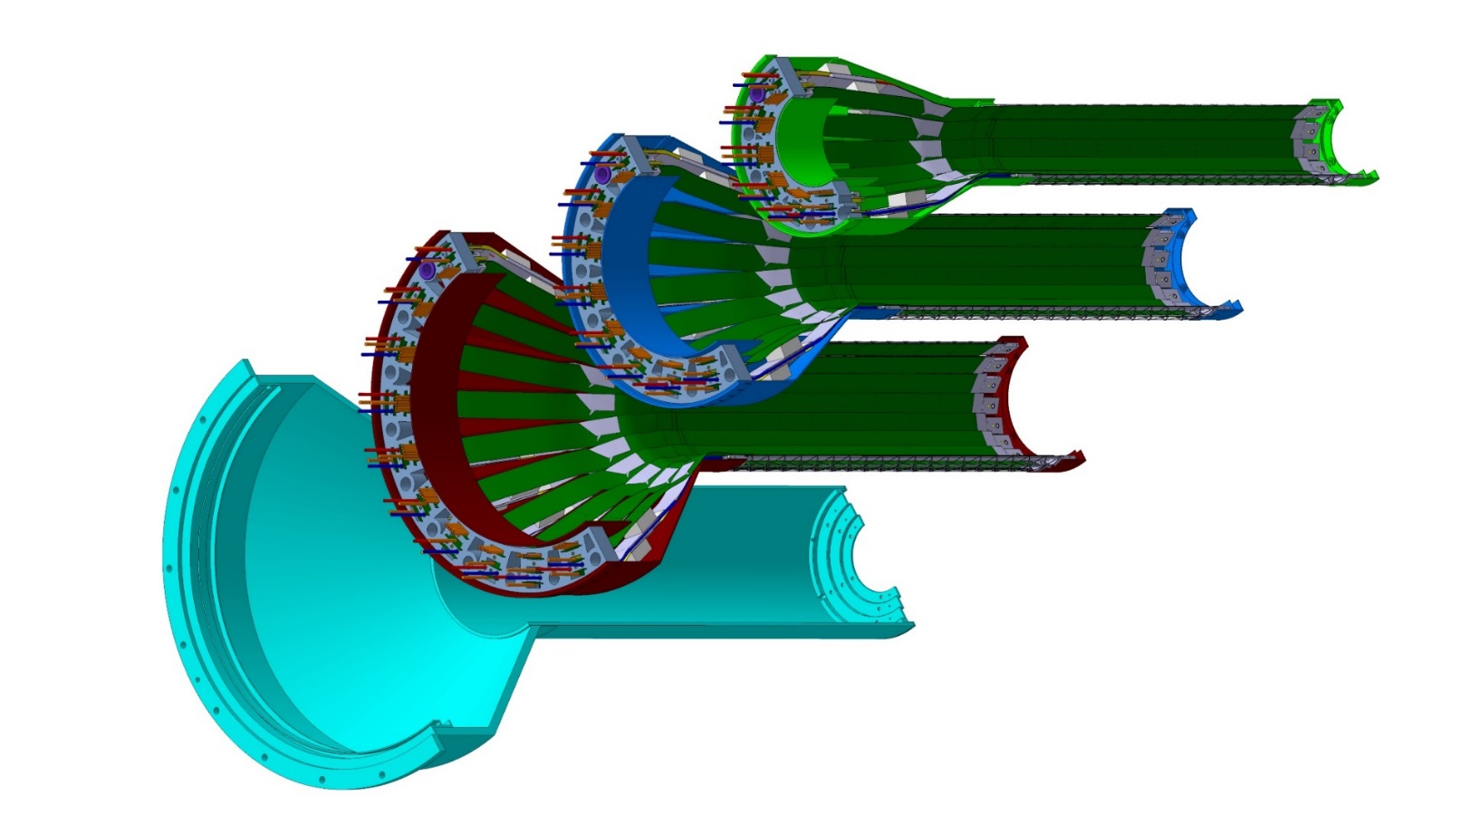
Detector Assembly
Leo’s talk
Precision positioning and installation of staves on end-wheels
Layer 0
Layer 1
Assembly of layers and carbon fiber structure into half-detector
Stave testing at each step
Metrology survey
Layer 2
IB CYSS

Slide 31
Readout Unit Production and QA Plan
Jo’s talk
Purchase 58 RUs from ALICE at CERN
  48 + 10 spares(20%)
  To be part of ALICE production
    Cost saving
    Minimize technical risks
  Initial test at CERN
QA at UT-Austin
  Full test
  LANL as the 2nd test site

Slide 32
Mechanical Integration
MVTX and INTT
Walt, Dan & Mickey’s talk

Slide 33
Simulations for Optimization
Tony’s talk
Task force formed
  Goals and deadline defined
  Details TBD soon?
Complementary roles in global tracking:
  MVTX:
    Precision DCA and vertexing
  INTT:
    Matching in-time hits of MVTX and TPC
    Important for p+p and p+A

Slide 34
Summary
Compelling science
Demonstrated full readout and control chain in sPHENIX framework
  ALPIDE + RU + FELIX + RCDAQ
  Trigger rate > 15kHz
  sPHENIX raw data format defined
Demonstrated detector performance with test beam data
  Spatial resolution better than 5um
  Hit efficiency > 99%
QA plan developed for RU and Staves
  QAP documents ready for review
  Follow ALICE ITS QA procedures
Preliminary design of mechanical integration
  MVTX + INTT + (TPC/sPHENIX)
Ready for stave and RU production

Slide 35
Backup slides

Slide 41
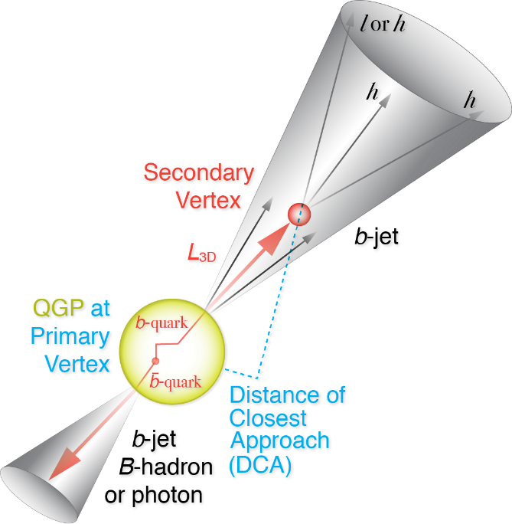
A Multi-Year Plan for sPHENIX 2023+
sPH-TRG-2018-001
Projected maximum collision rates:
  Au+Au: 240 kHz ( ~70 kHz, |Z|<10cm)
  p+p: 13 MHz ( ~2.4 MHz, |Z|<10cm)
  p+A: 2.8 MHz ( ~0.7 MHz,|Z|<10cm)
  sPHENIX DAQ: 15kHz
Precision vertexing for B-tagging:
  Tracking resolution better than 60um @pT=1GeV
  High multiplicity HI collisions
  Low multiplicity but high rate p+p collisions
  High efficiency and high purity
B hadrons/pT<15GeV: O(1M)
b-jets/pT>15GeV: O(100K)

Slide 42
MVTX Status: Where do we stand?
Full proposal submitted to BNL Associate Laboratory Director Dr. Berndt Mueller in Feb. 2018
March 27, a meeting of ALD, MVTX principals, co-SP and sPHENIX project office. Given improved DOE funding fiscal outlook, ALD recommended to bring MVTX into MIE baseline:
  This would be post-OPC/CD-1 Review(5/23-25, 2018), MIE baseline will be defined in the CD-2 (~summer 2019); MS Project -> P6 in progress
  Exploring advance-funding options to procure Readout Units ($250K, now) and staves from ALICE at CERN ($1.2M, fall 2018)
    Cost saving and reduce technical and schedule risks
  ALD seeks DOE agreement to proceed
MVTX workfest at MIT 4/30-5/1, 2018
  Refine MVTX roadmap – cost & schedule etc
  Prepare for sPHENIX integration mini review (~summer 18)
    MVTX+INTT+TPC…
    Both electrical and mechanical systems
https://indico.bnl.gov/event/4380/

Slide 43
MVTX Eta Coverage
Eta = - ln(tan(theta/2))
Layer | Eta @Z=0 | Eta @Z=10cm | Eta @Z=9.0cm | Eta @Z=0/10cm (ALICE <R>) | <R> (mm) | dLz (mm)
1 | 2.36 | 1.12 | 1.33 | 2.41/1.16 | 25.85 | 135.5
2 | 2.10 | 0.92 | 1.11 | 2.14/0.95 | 33.65 | Lz–100 = 35.5
3 | 1.90 | 0.78 | 0.95 | 1.94/0.80 | 41.25 | Lz – 90 = 45.5
Note: MVTX radius increased by 1.3mm to fit sPHENIX beam pine, from the full proposal, 2/4/2018
R1 = 23.7 – 28.0 mm <R1> = 25.85 mm
R2 = 31.4 – 35.9 mm <R2> = 33.65 mm
R3 = 39.1 – 43.4 mm <R3> = 41.25 mm, dZ’ = 4.85cm, Lz’ = 135.5 – 48.5 = 87mm; R3 -> eta = 1.0

Slide 44
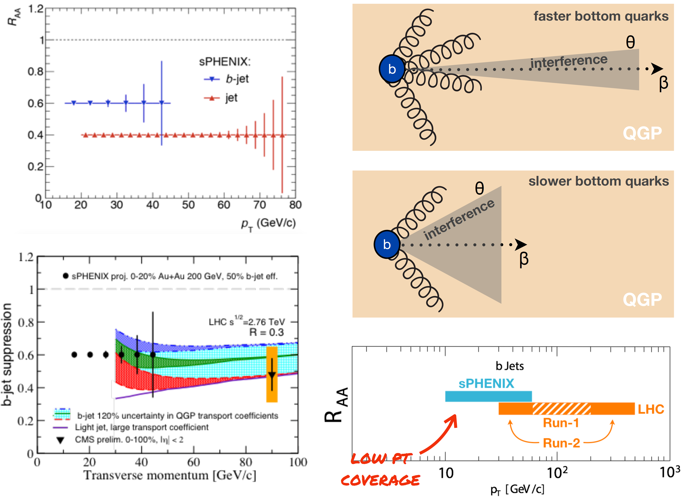
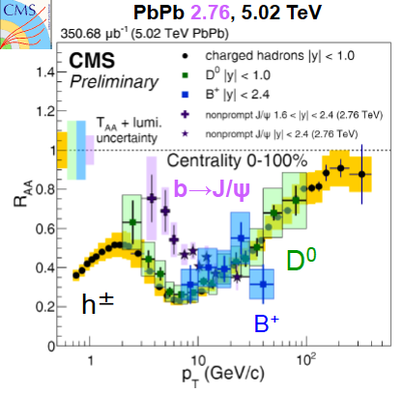
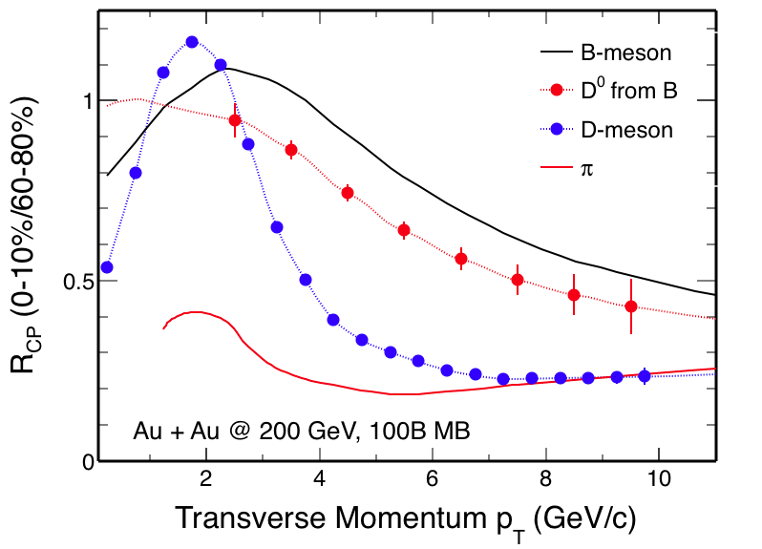
MVTX – Bring sPHENIX to a New Horizon
Unambiguously determine quark energy loss mechanisms, particularly over the interesting transition region, pT ~ M
  Radiative dE/dX
  Collisional dE/dX
  Other effects
pT >> M
pT << M
Expectations @sPHENIX
Learned @CERN
sPH-HF-2017-002
sPH-HF-2017-001
QM’17
B-hadron
sPHENIX
sPHENIX
B-jet

Slide 45
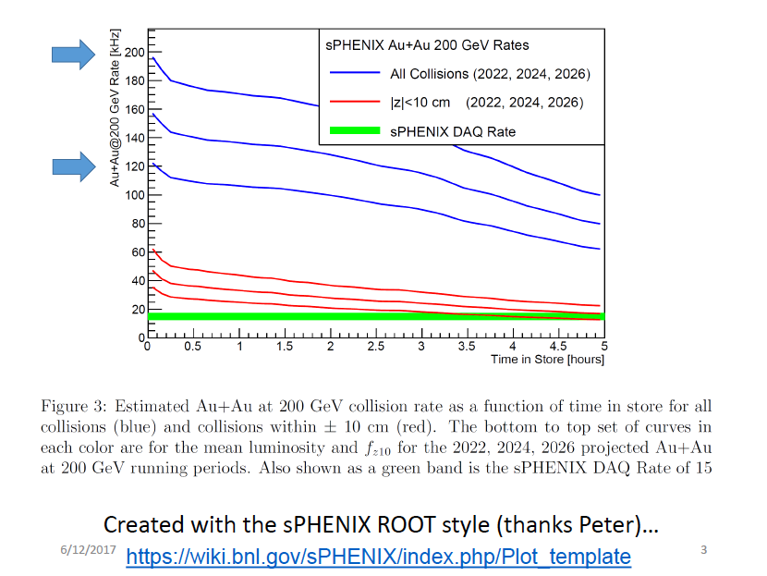
Expected Luminosities and Collision Rates

Slide 46
dN/dη in p+p collisions
With |η|<2.0 region, dN(ALICE) ~2.9*dN(sPHENIX).
sPHENIX
ALICE

Slide 47
dN/dη in MB Au+Au/Pb+Pb collisions
With |η|<2.0 region, dN(ALICE) ~4.6*dN(sPHENIX).
Ncoll(Au+Au)=258, Ncoll(Pb+Pb)=401.
sPHENIX
ALICE

Slide 48
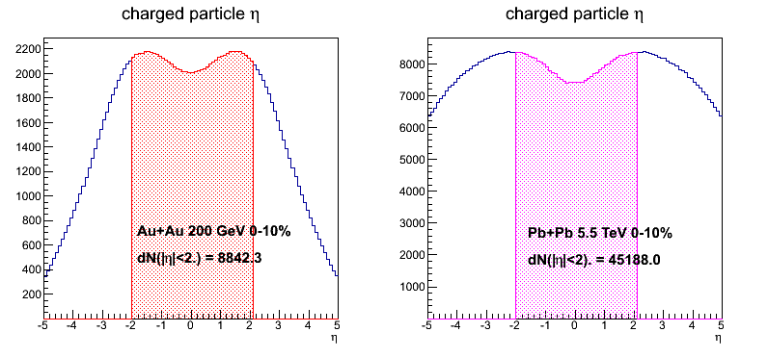
dN/dη in 0-10% Au+Au/Pb+Pb collisions
With |η|<2.0 region, dN(ALICE) ~5.1*dN(sPHENIX).
Ncoll(Au+Au)=962, Ncoll(Pb+Pb)=1670.
sPHENIX
ALICE

Slide 49
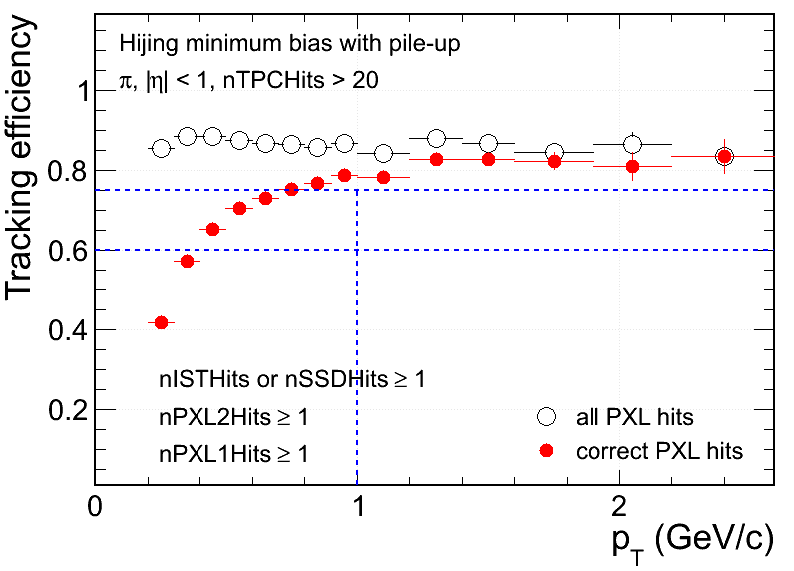
Hit Density on STAR PXL at RHIC Environment
 | PXL inner | PXL outer
Radius (cm) | 2.8 | 8
MB pileup hits (cm⁻²) | 13 | ~3
UPC electrons (cm⁻²) | 33 | ~3
Total bkgd hits (cm⁻²) | 46 | ~6
MB signal Au+Au (cm⁻²) | ~8 | ~1
- Ming’s note:
With 5uS integration time, BG rate can be reduced by,
5/200 = 1/40
S/B ~ 8/1 for sPHENIX
Simulation@50kHz
Au+Au MB real data (cm⁻²) | ~50 | ~5
Simulation
Signal hits fraction in MB (Central) events:
~15% (~30%) at PXL inner
Increasing fake matches in low p_{T}
Technology chosen considering both physics and technology readiness

Slide 50
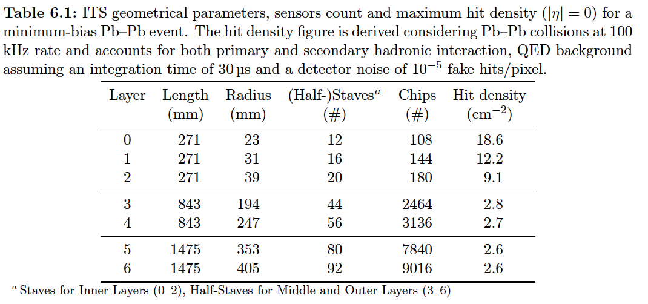
Hits and Event Data Rate
Event size: sPHENIX = 1/3 ALICE
Identical geometry for MVTX and ITS/IB(layer 0-2)
sPHENIX integration time ~5uS, less noise compared with ALICE with 10~20uS.

Slide 51
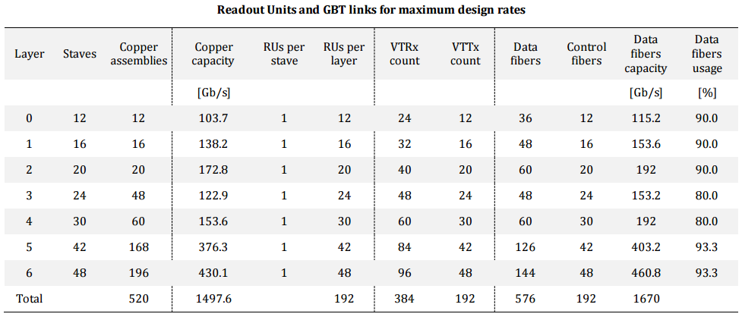
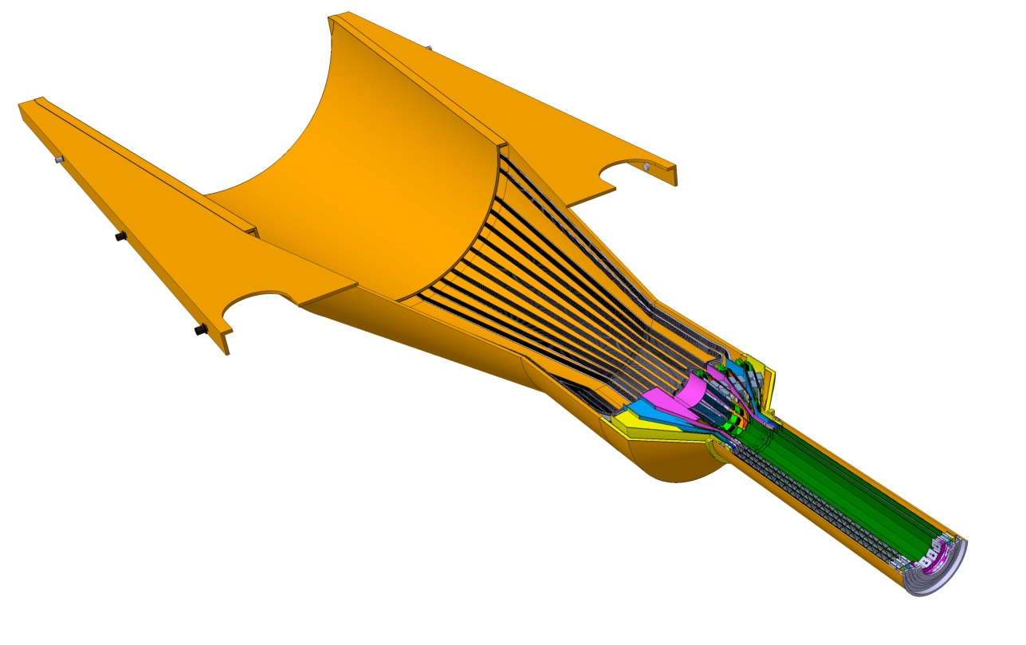
Readout Units Required for ITS & sPHENIX
48 inner staves;
48 RU boards;
6 FELIX boards;
- 8RU ->1 FELIX

Slide 52
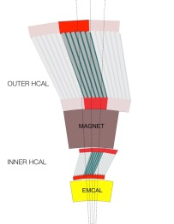
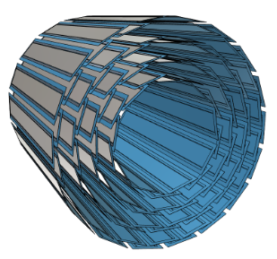
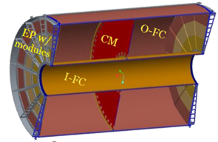
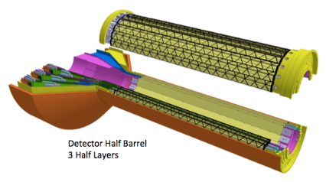
sPHENIX DAQ Architecture
Event Builder
FEM
DCM
DCM2
DCM
DCM
DCM
DCM
Network
Switch
Buffer Box
FEM
DCM
SEB
ATP
DCM
DCM
DCM2
DCM
DCM
ATP
DCM
Buffer Box
FEM
DCM
SEB
ATP
DCM
DCM
DCM
DCM2
ATP
Buffer Box
Calorimeters,
INTT, MBD
DCM
SEB
DCM
To the
RACF/HPSS
DCM
ATP
ATP
Buffer Box
FEE
ATP
DCM
DCM
FELIX
EBDC
ATP
DCM
Buffer Box
FEE
ATP
TPC, MVTX
DCM
DCM
FELIX
EBDC
ATP
Buffer Box
DCM
FEE
ATP
DCM
FELIX
EBDC
DCM
ATP
Buffer Box
DCM
Rack Room
SEB Sub-Event Buffer
EBDC Event Buffer and Data Compressor
ATP Assembles events and compresses data
Buffer Box data interim storage before sending data to the computing center

Slide 53
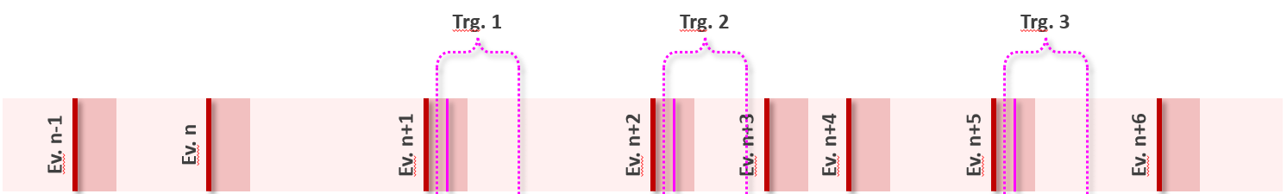
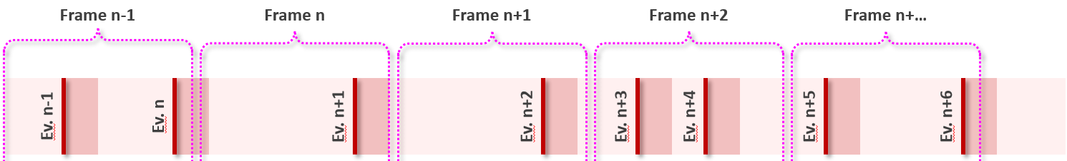
ALPIDE Modes of Operation
The ITS is planned to be operated in two modes:
  Triggered mode: Pixels are latched with a short strobe window and read out based on an external trigger.
  Continuous mode: Pixels are latched using a long, periodic strobe window and read out.

Slide 54
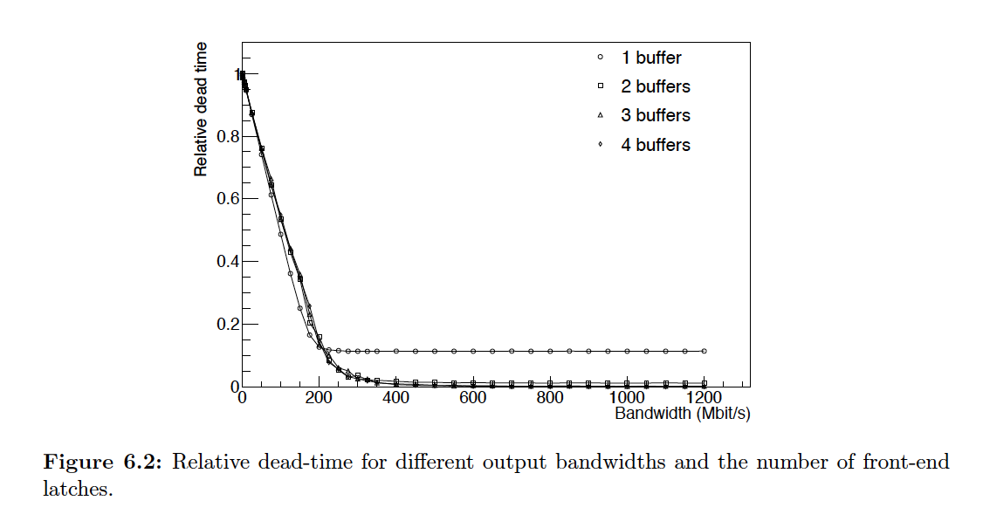
ALICE Data Rate and Dead Time

Slide 55
sPHENIX Radiation Level

Slide 56
Radiation Measurements in PHENIX
Used RadMons from CERN
  RadFET sensitive primarily to ionizing radiation
  Pin Diode sensitive to neutrons
  Both are integrating devices
Placed in the IR for RUNs 13-16
  Run 13: 510 GeV p-p
  Run 14: Mixed Heavy Ion Running
  Run 15: 100 GeV p-p
  Run 16: 200 GeV Au-Au
Locations:
  3 positioned on North Nose Cone @ ~ 3cm, ~8 cm and ~16 cm (shown)
  Others positioned inside the pistons, used for SiPM damage, … (Not shown)
From Eric Mannel
sPHENIX Directors Review, 3/2018

Slide 57


RadFET Results
200 GeV Au-Au
100 GeV p-p
Mixed Heavy Ion
510 GeV p-p

Slide 58

Pin Diode Fluence Measurements @PHENIX
For Au-Au running we expect @ sPHENIX EMCal:
  Integrated ionizing radiation dosages of order 10’s of kRad/run
  Integrated neutron fluences of order 2x10¹¹ n/cm²
MVTX: <R>_0/1/2 = 2.6/3.4/4.1cm
MVTX R_0 fluence = 6~17 x10¹² nEq/cm²
The dose due to collisions @PHENIX:
D_collisions / D_total = 61% @Run6
arXiv:0710.2676 [nucl-ex]

Slide 59
ALICE ITS Upgrade – PRR 4/13/2018
RU/PU location

Slide 60
ALICE ITS Upgrade
RU/PU location

Slide 61
ALICE ITS Upgrade
RU/PU location

Slide 62
ITS Readout - Radiation Load
Position respect to beam |  |  | Radiation levels (total)
r | z | Name | TID | 1 MeV neq fluence | High energy hadron flux* | Charged particle flux
[cm] | [cm] |  | [krad] | [cm⁻²] | [kHz cm⁻²] | [kHz cm⁻²]
2.2 | [-13.5 ÷ 13.5] | ITS L0 | 2734 | 1.7 × 10¹³ | 765 (770) | 890 (910)
43 | [-73.7 ÷ 73.7] | ITS L6 | 20 | 8.1 × 10¹¹ | 3.4 (4.9) | 4.5 (6.7)
79 | [-260 ÷ 260] | TPC In | 5.6 | 7.0 × 10¹¹ | 1.35 (1.8) | 1.7 (3.45)
100 | 330 | RE | ≈ 5 | ≈ 1.6 × 10¹¹ | 0.86 | 1.7
258 | [-260 ÷ 260] | TPC Out | 0.86 | 1.4 × 10¹¹ | 0.27 (0.37) | 0.2 (0.3)
290 | [-290 ÷ 290] | TRD | 0.6 | 1.2 × 10¹¹ | 0.23 (0.31) | 0.15 (0.23)
TID & fluence = (table 1 × 1.3_{data taking efficiency} + Table 2 / 10_{better vacuum}) × 10_{safety factor}
Safety factor of 10 on top of TID and fluence calculated as in the above line.
Hadrons and charged particles as for 50 kHz Pb-Pb collisions (table 1, worst case scenario).
The average value within the z span is reported first, in brackets the peak value within the z interval.
* Momentum > 20 MeV.

Slide 63
ALICE ITS Upgrade

Slide 64
ALICE ITS Upgrade

Slide 65
ALICE ITS Upgrade

Slide 66
Fermilab Test Beam Results

Slide 67


LHC 40MHz
mockup
LANL Fermilab Test Beam Setup 03/2018
4-ALPIDE Telescope + 4-SamTec cables + 1 RU + 1 FELIX(“CRU”)
4-ALPIDE Telescope
4 5-m SamTec Cables, 1.2Gbps
CLK recovered from
FELIX through GBT link;
Trigger from FELIX
FELIX (“CRU”)
Online Display

Slide 68



4-ALPIDE Telescope Setup at Fermilab Test Beam
4-ALPIDE Telescope;
5m long SamTec cables
RU
Summary:
Successfully operated the full readout chain
Confirmed all communications links and data path
Confirmed telescope performance
  Primarily 120GeV proton beam; also with low energy pion beams
  Beam trigger rate ~7kHz
  Tested High ALPIDE occupancy runs, with 10cm lead bricks in front of the sensors
FELIX(“CRU”) in Server
KC705
LHC 40MHz
Mockup
Nice work by Sho, Alex, Hubert, Chris + others

