Slide 1
MVTX Overview
Ming Liu, for the MVTX Group
Los Alamos National Laboratory
July 19-20, 2018

Slide 2
Outline
Document: sPH-HF-2018-001
https://indico.bnl.gov/event/4072/
Science by MVTX
MVTX project scope
R&D highlights
Status and Plan

Slide 3
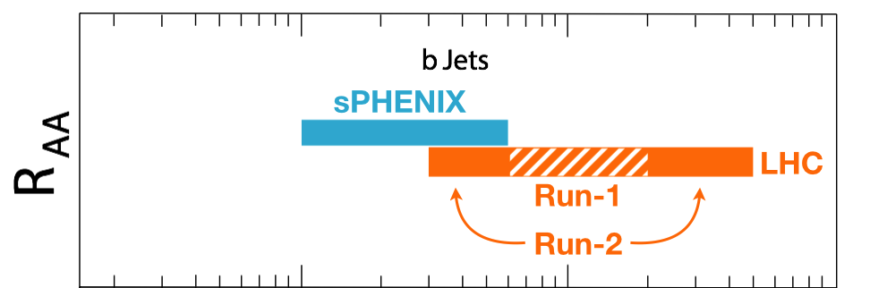
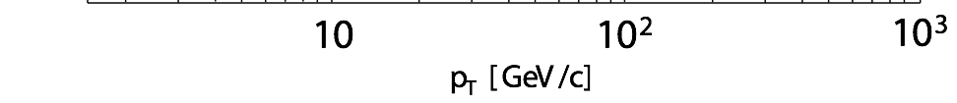
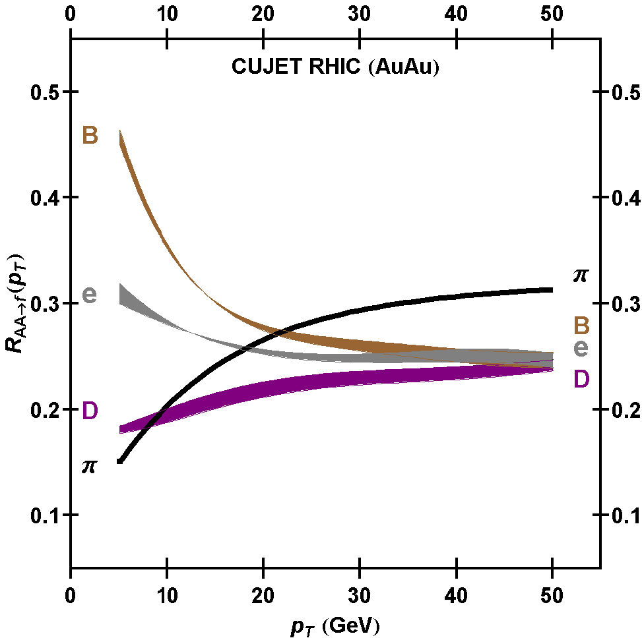
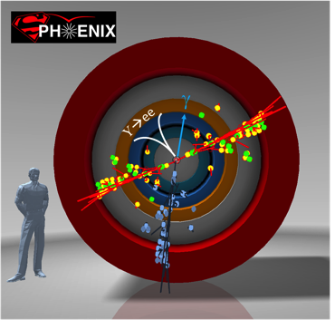
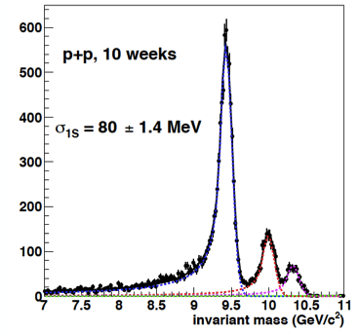
Exciting Science Enabled by MVTX
Dave & Gunther
sPHENIX is the next flagship heavy ion physics experiment in the US (NSAC LRP2015)
  Jets
  Upsilons
  B-jets and B hadrons
MVTX will complete QGP heavy flavor physics
  Precision study of the “inner workings of QGP”(LRP15)
  Unambiguous determination of key parameters of QGP properties and interactions
complement & extend current and future RHIC and LHC QGP programs
sPHENIX 3 Physics Pillars
http://arxiv.org/pdf/1501.06197v1.pdf
Jets
Upsilons
PRL 108 (2012) 022301
B
D

Slide 4


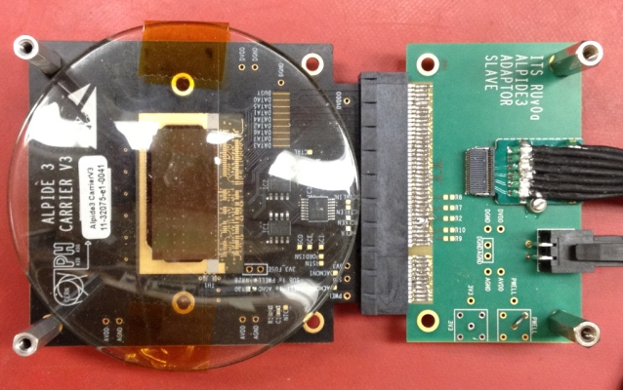
Monolithic Active Pixel Sensors (MAPS)
The Next-Generation, State-of-the-Art Pixel Tracker
Advantages of ALICE PIxel DEtector (ALPIDE) sensor:
Very fine pitch (27μm x 29μm), for superb spatial resolution
High efficiency (>99%) and low noise (<10⁻⁶), for excellent tracking
Time resolution, as low as ~5 μs, for less pileup
Ultra-thin/low mass, 50μm (~0.3% X₀), for less multiple scatterings
0.5M channels with on-pixel digitization, for zero-suppression and fast readout
Low power dissipation, 40mW/cm², for minimal service materials
An ideal detector for QGP physics!
Flexible Printed Circuit(FPC)
9 Chips
Cold plate
A 9-chip MAPS stave, 1.5cm x 27cm
ALPIDE design
ALICE ITS ALPIDE sensor:
1.5cm x 3.0cm, 0.5M channels
50 μm
~28 μm

Slide 5

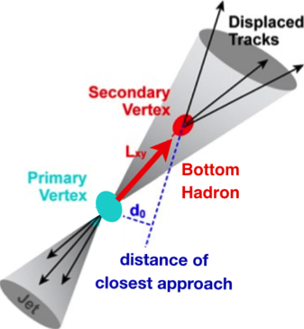

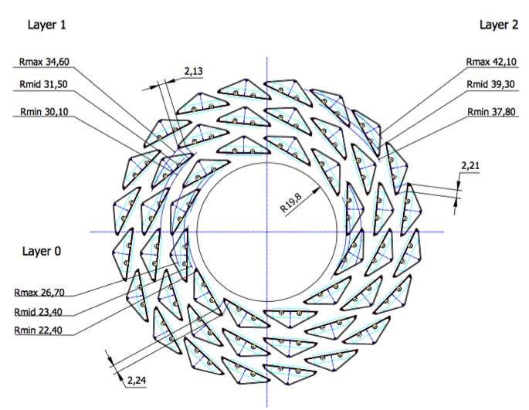
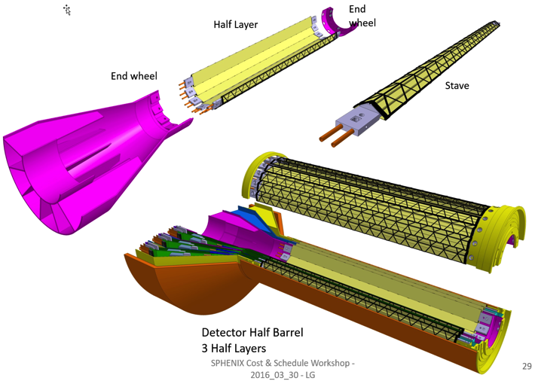
MVTX: MAPS-based VerTeX Detector
sPHENIX@RHIC
(2023+)
Key integration tasks:
Readout
Mechanics
ALICE ITS Upgrade @CERN;
Inner Tracker System (2021+)
sPHENIX Inner Tracking: MVTX
“Adopt” ALICE/ITS:
- Minimum risk,
- Maximum physics
Leveraging on extensive R&D and design work by ALICE

Slide 6
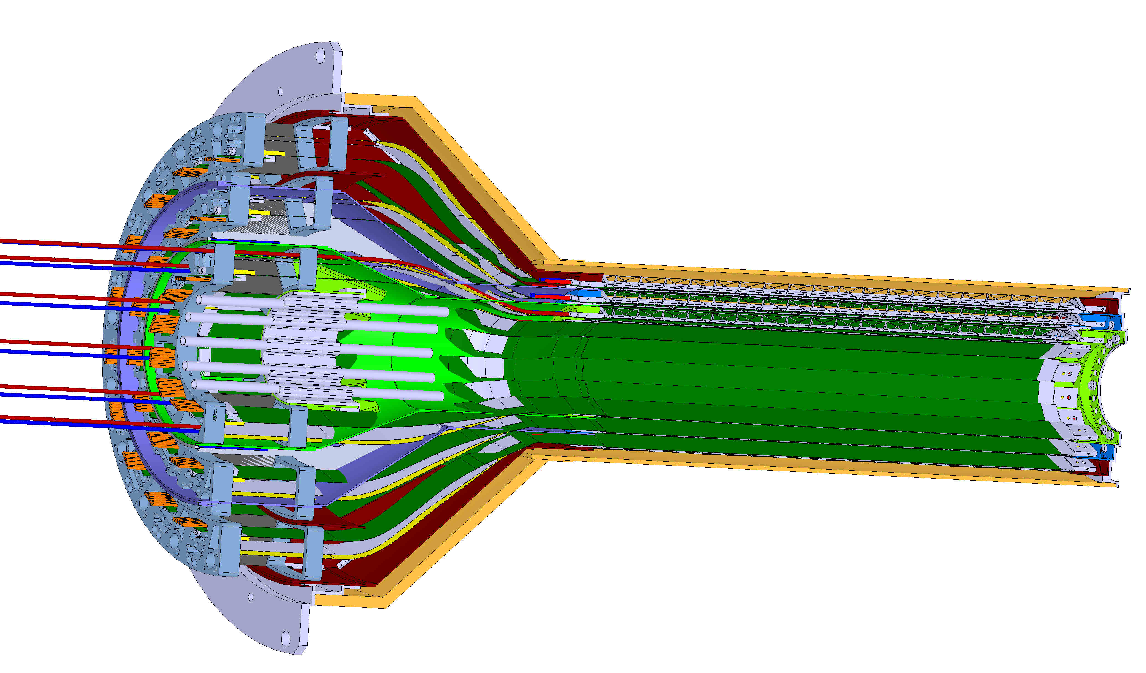
MVTX Detector
Service cone: signal, power, cooling
and mechanical support
CYSS: Cylindrical Shell Structure
End-Wheel
3-layer sensor barrel
Figure for ALICE ITS/IB Design
(slightly modified for sPHENIX)
MVTX
parameters
MVTX RUs, PUs & services

Slide 7
Scope of the MVTX Project
MAPS Staves & Electronics
  Readout Integration R&D (LANL LDRD)
    Frontend: ALICE/ITS, RU
    Backend: ATLAS FELIX
    Reprogram RU & FELIX for sPHENIX
  Production:
    84 ALICE/ITS-IB staves from CERN
      Acceptance test @LBNL
      48+spares(36)
    58 ALICE/ITS-RU from CERN
      Acceptance test @UT-Austin, 48+spares(10)
    Reproduce 8 ATLAS/FELIX
      Acceptance @LANL
    Final assembly and test in US
      LBNL and BNL
  Ancillary systems, “adopt” ALICE system
Mechanics & Cooling
  Some changes to ALICE/ITS inner tracker mechanical structures,
    End Wheels
    Cylindrical structure shells
    Detector half barrels
    Detector and Service half barrels
  Mechanical Integration,
    Conceptual design by LANL LDRD
    Prototype by sPHENIX R&D, MIT/LANL
    Design integration frames
    Carbon frames etc., LBNL
    Installation tooling etc.
  Adopt ALICE cooling plant design
    Minor modification to fit sPHENIX
    Smaller heat load than ALICE ITS
Alex & Sho
Walt
Leo
Walt & Dan
Jo
- Early R&D by LANL LDRD, $5M, FY17-19, readout, mechanical design and physics
- Established LANL-ALICE MoU in 12/2016 for joint R&D for MVTX

Slide 8
Updated Cost & Schedule, July 2018
Tied to sPHENIX and ALICE schedule
  Ready for sPHENIX day-1
  Stave production at CERN, following ALICE
  Readout unit production at CERN, following ALICE
  To minimize technical risk, and also for cost saving
Cost based on ALICE/ITS production and recent STAR & PHENIX silicon detector upgrade projects at RHIC
  STAR HFT
  PHENIX FVTX

Slide 9
Schedules and Milestones
sPHENIX: CD1 CD2
Installation
1st collisions
2018 | 2019 | 2020 | 2021 | 2022 | 2023
MVTX
ALICE IB stave done;
Facilities available for
sPHENIX production;
Window of opportunity
Stave & RU
production
FELIX
production
Detector mechanics design & production, global interface to sPHENIX
End Wheels
CYSS
Service barrel
design & production
Ready for beam;
sPHENIX day-1 run
MVTX final
design review
Barrel Assembly & Testing
Install half barrel
#1, 2@sPHENIX IR;
Half barrel #1
Half barrel #2
Test half barrels
#1, 2@BNL
Power system
production
MVTX installation & commissioning @BNL
RU, FELIX, PS, cables etc.

Slide 10
sPHENIX MVTX Group: Institution Roles
Growing number of institutions
  Major institutions lead key tasks

Slide 11
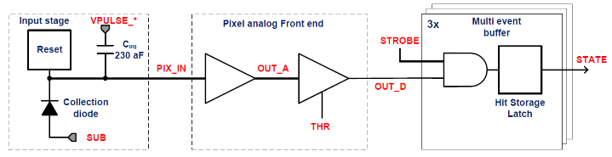
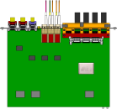

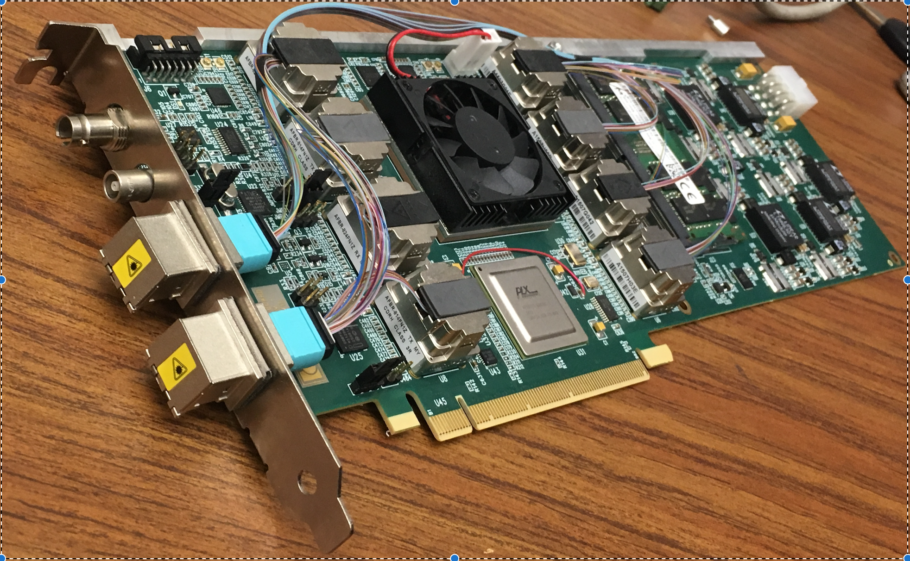
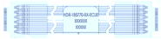
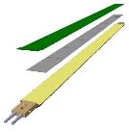

MVTX Readout, Power and Controls
Alex,Sho, Jo, Leo
#1,2,3
CAN bus
DCS
Trigger & Clock
Readout Unit
Front End
GBT Optical Links
one pixel
9 Data (1.2Gbps)
1 Clock, 1 Control/Trigger
Control
Data (9.6 Gb/s max)
Trigger
9-sensor Stave
Samtec Twinax “FireFly”
FELIX
Back End
FPC
Power
ATLAS Front-End Link eXchange (FELIX):
sPHENIX Data Aggregation Module (DAM)
Alpide Sensors
Power
Filtering Capacitors
regulators
Power supplies
Cold Plate
Regulated Power
ALPIDE pixel:
Shaping
Digitization
Zero-suppression
3x buffer
Power Board
Interaction Region
Experimental Hall
Counting House
MVTX Detector Electronics consists of three parts
Sensor-Stave (9 ALPIDE chips) | Front End-Readout Unit | Back End-FELIX/DAM

Slide 12
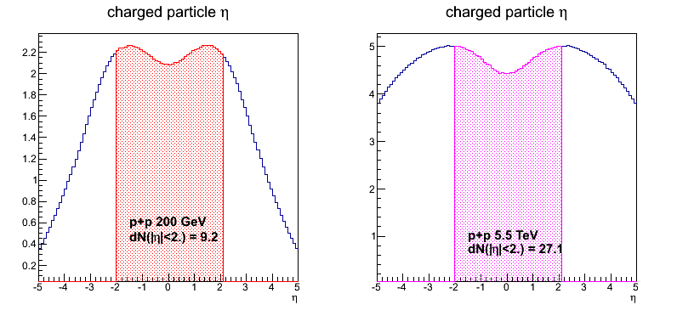
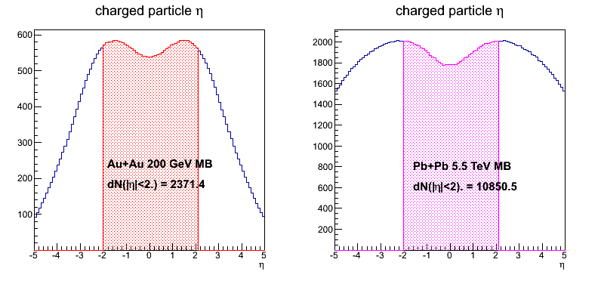
Event Multiplicity and Collision Rates: sPHENIX vs ALICE
 | ALICE (Run3) | sPHENIX (Max) | Ratio of data rates sPHENX/ALICE
Pb+Pb / Au+Au | 50kHz | 200 kHz | 0.3
p+p | 200kHz | 13 MHz | 6.5
Trigger/Readout | 50 kHz | 15 kHz | -
MB Event track multiplicity dN/dη: sPHENIX = 1/3 ALICE (pp), 1/4.5 ALICE(AA)
sPHENIX triggered data rate well within readout specs
sPHENIX
ALICE
sPHENIX
ALICE
p+p collisions
sPHENIX/ALICE ~1/3
A+A collisions
sPHENIX/ALICE ~1/4.5

Slide 13
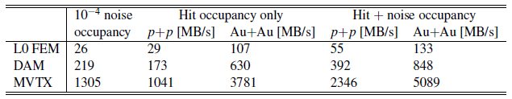
Projected sPHENIX Data Rates
Alex & Sho
#1,2,3
(FELIX)
Note: test beam showed noise < 10⁻⁵
Readout Units: 3 GBTX @ 0.4 GB/s = 1.2 GB/s >133MB/s *
GBTx: 3.2-4.48Gb/s, 0.4 GB/s
FELIX/DAM: 48 input on FELIX, twice the number needed to support 8 RUs (3 links)
2x 8-lane PCIe Gen 3 @ 7880 MB/s = 15,760 MB/s > 848 MB/s
MVTX readout hardware capacity > 10 x Expected data rate
* Note: one central collision + 2 pileup MB events, cluster size 3.0

Slide 14
Expected Radiation Level after 5-year Runs
sPH-TRG-2018-001
Leo
#1
Projected sPHENIX integrated luminosities after 5-year operation
  AuAu: Lum. = 214 nb⁻¹
  pp+pAu: Lum. = 1340 pb⁻¹
PHENIX study
arXiv: 0710.2676 [nucl-ex]
Projected sPHENIX MVTX L0 fluence:
Outer layers:
L1 = 0.6 x L0; L2 = 0.4 x L0
TID = 1060krad
NIEL = 6x10¹² N_{eq}/cm²
Sensors tested to full MVTX NIEL and ~1/2 TID @ALICE

Slide 15
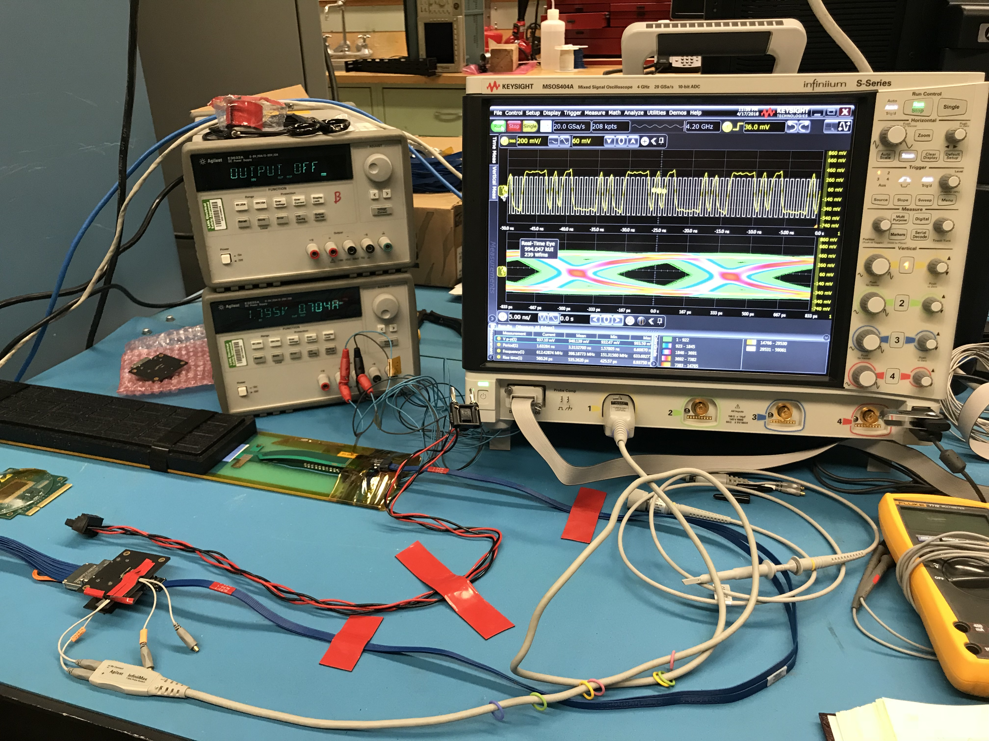
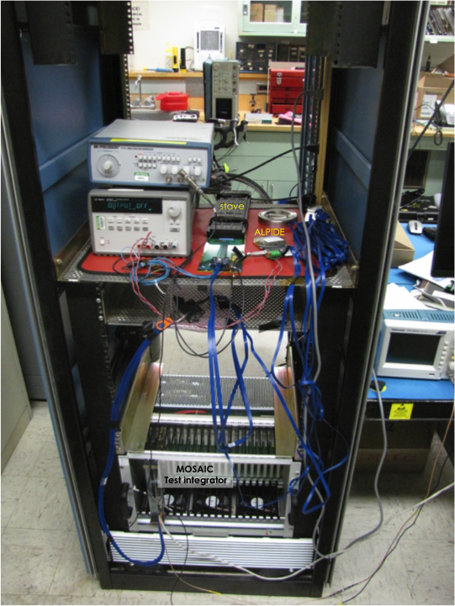
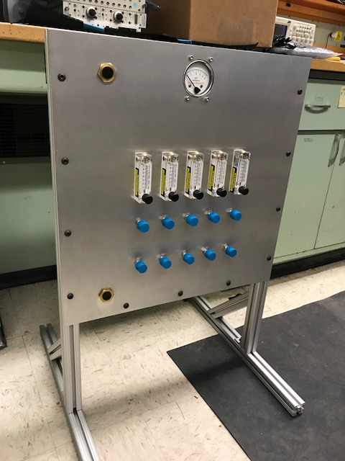
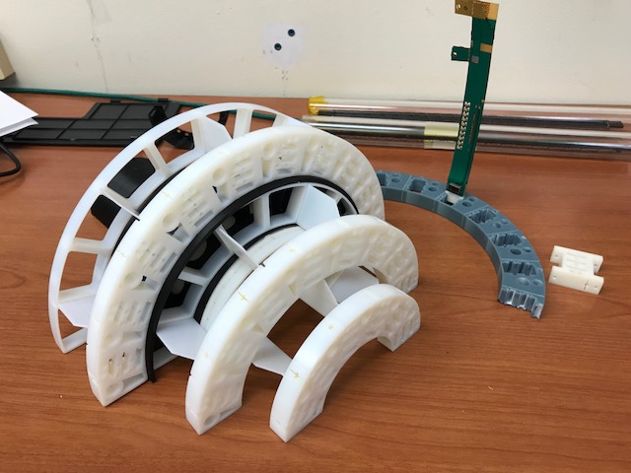
LANL LDRD Activity Highlights
Signal integrity
Sensor source test
MAPS evaluation
Readout integration
4-sensor telescope
Test beam at Fermilab
Mechanical & cooling
cooling test
9-chip
stave
A MAPS
chip
FireFly cables
MOSAIC
test bench
FPC power extension R&D
Service cone R&D

Slide 16
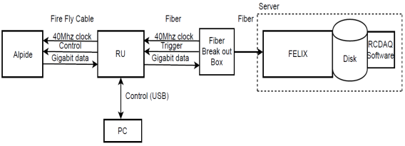
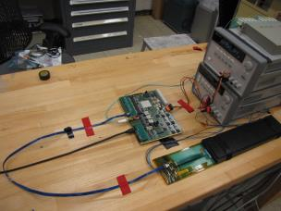
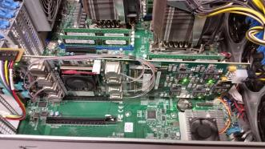
MVTX Full Readout Chain Demonstrated
Alex & Sho
#1,2,3
Stave
Readout
Unit
FELIX
Fermilab Test Beam: Feb-Mar, 2018
Readout Unit + Stave
4-hit track
120 GeV proton
beam
4-MAPS telescope
Tracking spatial resolution
achieved: <5 um
Server + FELIX

Slide 17
Stave and RU Production QA Plan
Leo & Jo
#4,5,6,7,8
Staves
Purchase 84 staves from ALICE production
  48 + 28(spares for 2 inner layers) + 8 spares
  Production following the completion of ALICE ITS/IB
  Starting ~Oct. 2018, last 6-12 months
  Fully tested at CERN before shipping to US
    All Gold/Silver staves (same ~ALICE IB standard)
    A LANL postdoc (Dr. Yasser Morales) oversees production QA at CERN
Acceptance QA at LBNL
  Full test and QA
    Electrical
    Mechanical
  Detector assembly at LBNL
Readout Units
Purchase 58 RUs from ALICE
  48 + 10 spares(20%)
  To be part of ALICE production
    Cost saving
    Minimize technical risks
  Initial test at CERN
QA at UT-Austin
  Full test
  LANL as the 2nd test site

Slide 18
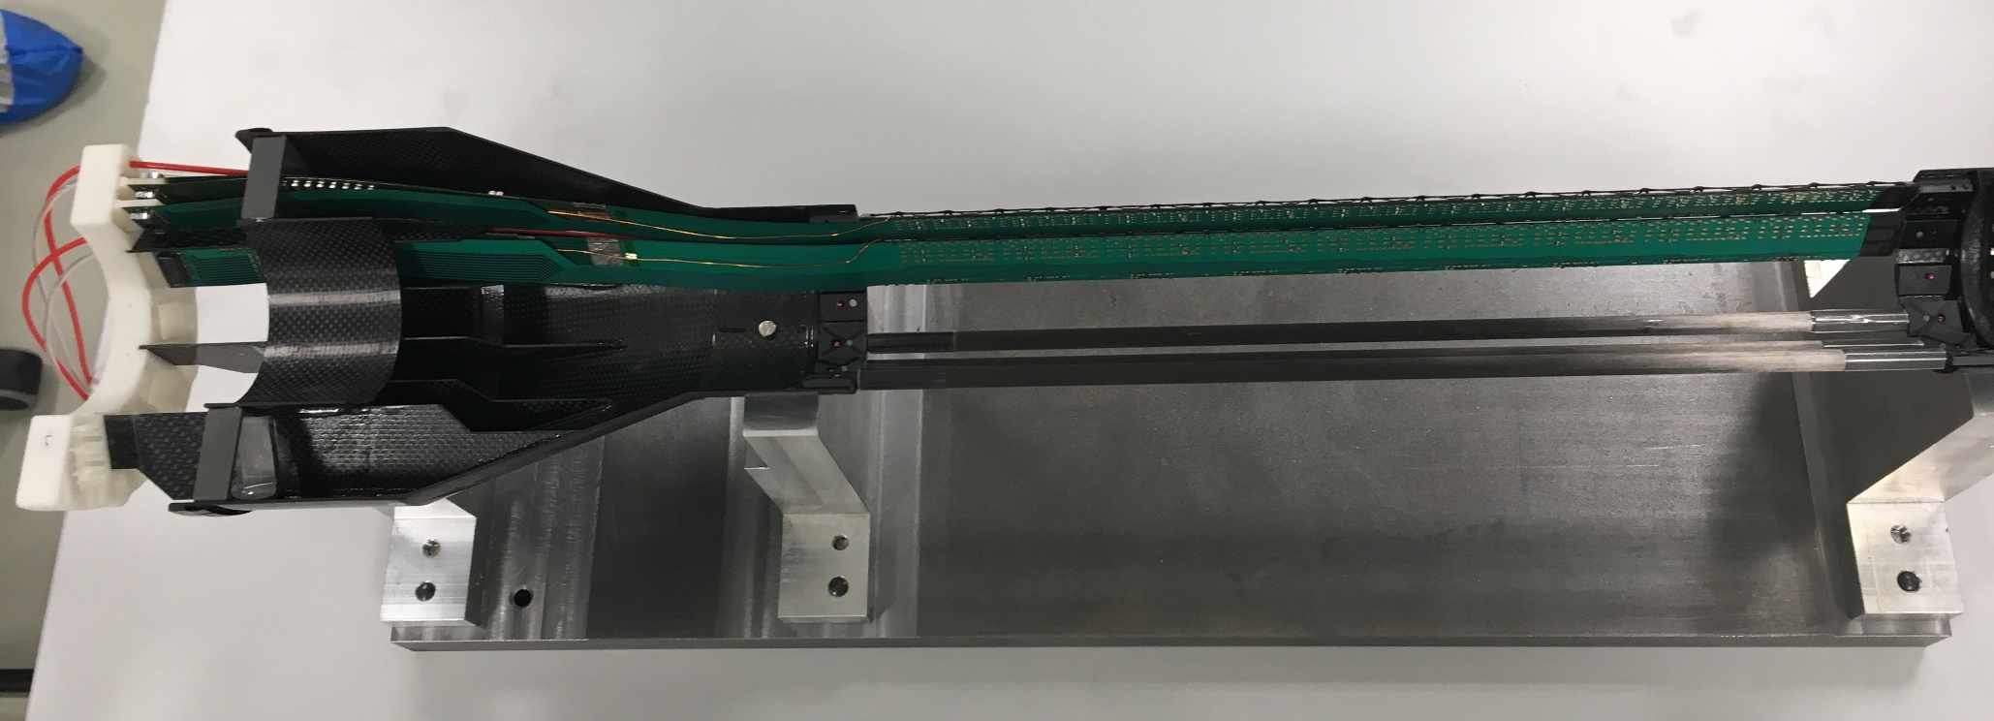
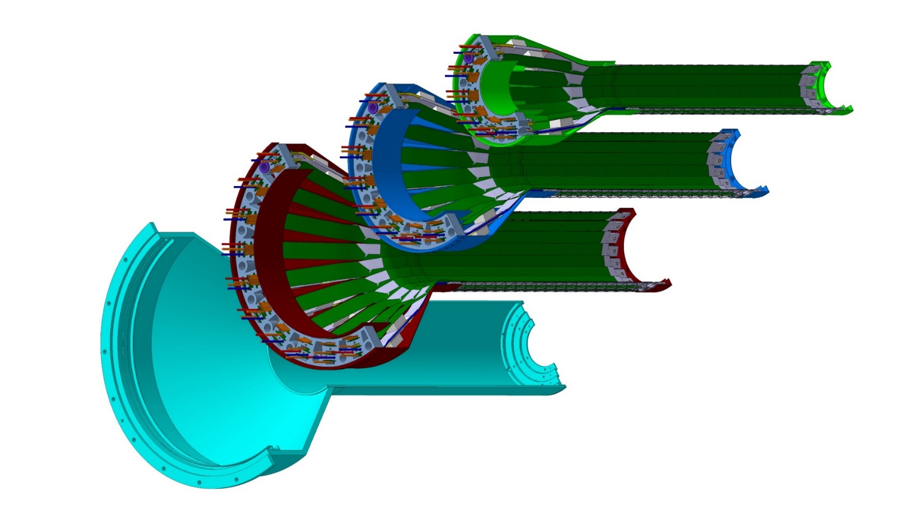
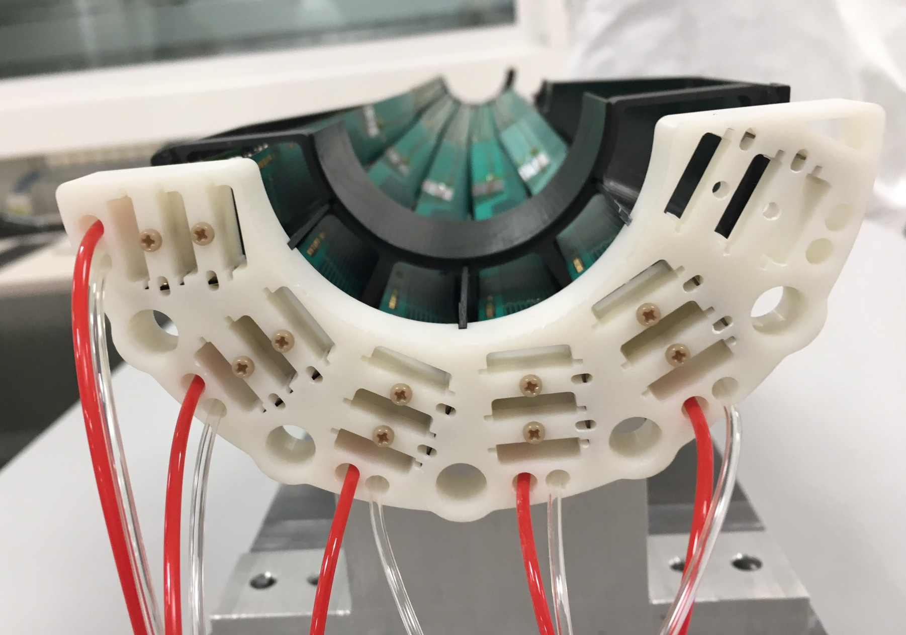
Detector Assembly Plan at LBNL
Leo’s talk
#4,5,6,7,8
Precision positioning and installation of staves on end-wheels
staves
ALICE 1st half inner layer being assembled
6/2018@CERN
Layer 0
Layer 1
Modified jigs for MVTX
Follow ALICE assembly procedures to build half-detectors
QA records in DB
Layer 2
ALICE 1st half inner layer,
6/2018@CERN
IB CYSS

Slide 19
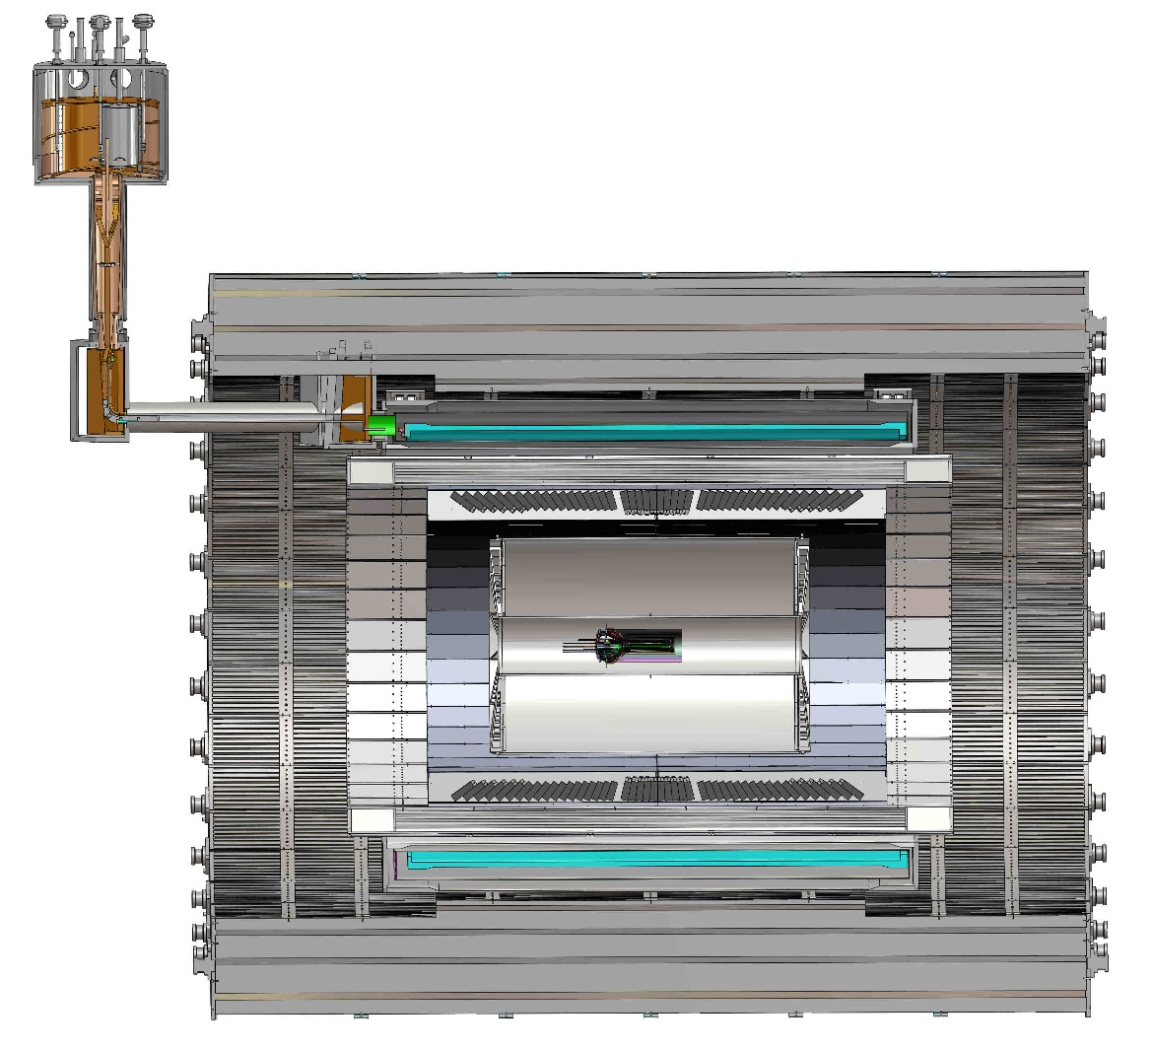
Mechanical Integration
MVTX, INTT and TPC
  MVTX detector design modified
  Global interface being developed
Walt & Dan
#10
TPC
TPC
INTT
MVTX
R= 209.6cm
L = 350.0 cm

Slide 20
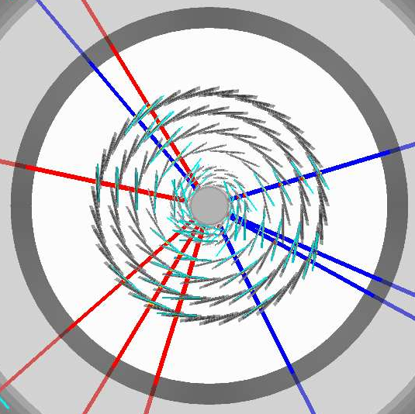
Simulations for Optimization
Tony & Rachid
#9, 10
Task force formed
  Goals and deadline defined
  Evaluate tracking with different INTT layers & geometry
Complementary roles in global tracking:
  MVTX:
    Precision DCA and vertexing
  INTT:
    Matching in-time hits of MVTX and TPC
    Important for p+p and p+A, pileups

Slide 21
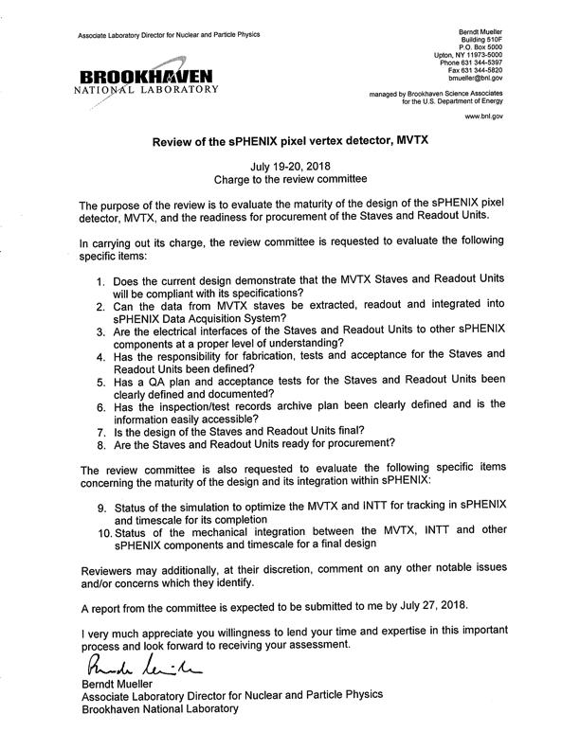
Summary
Compelling science established
Demonstrated full readout and control chain in sPHENIX framework
  Charge #1,2,3
Demonstrated detector performance with test beam data
  Charge #1,2,3
QA plan developed for RU and Staves
  Charge #4,5,6,7,8
3D design of mechanical integration
  Charge #10
Simulation to optimize INTT geometry
  Charge #9, 10
Dave & Gunther
Alex & Sho
Leo & Jo
Leo & Jo
Walt & Dan
Rachid & Tony

Slide 22
backup

Slide 23
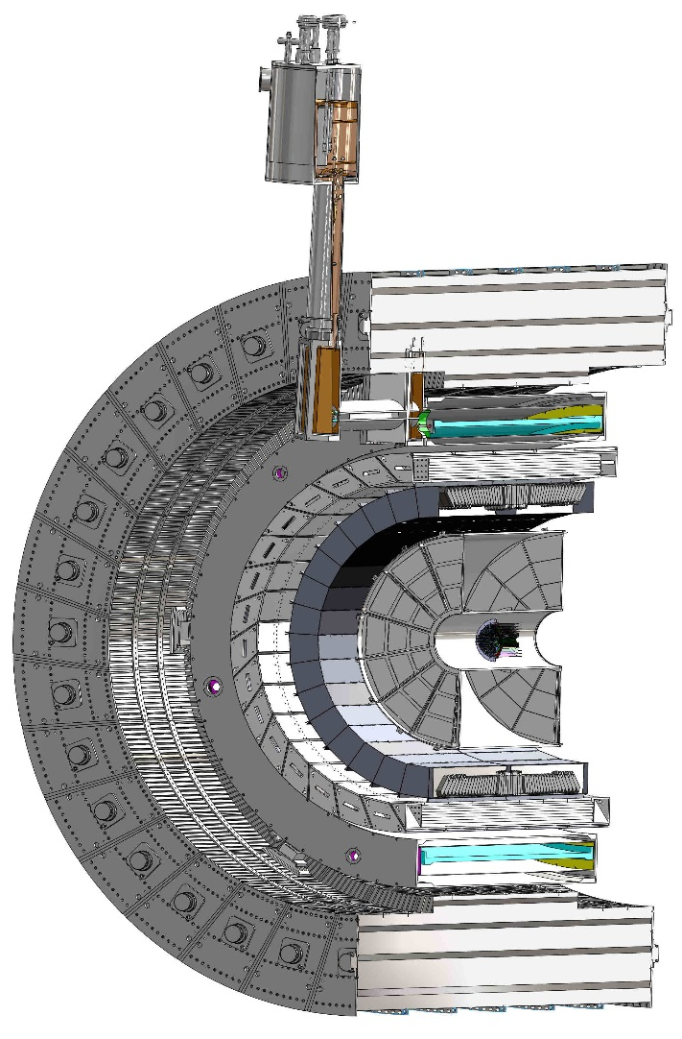
Cable routing
L 3500.0 mm
R= 209.6cm
R 2,096.0mm

Slide 24
Radiation Level Outside of HCal: for Electronics
Simulation from Jin Huang, 7/2018
R = 274 cm
Z =0
AuAu 200kHz
Flux = 0.002/cm^2 x 200kHz x190/650
= 120 Hz/cm^2 << 1kHz/cm^2(ALICE)
RU tested OK to 1kHz/cm^2 at ALICE

Slide 25
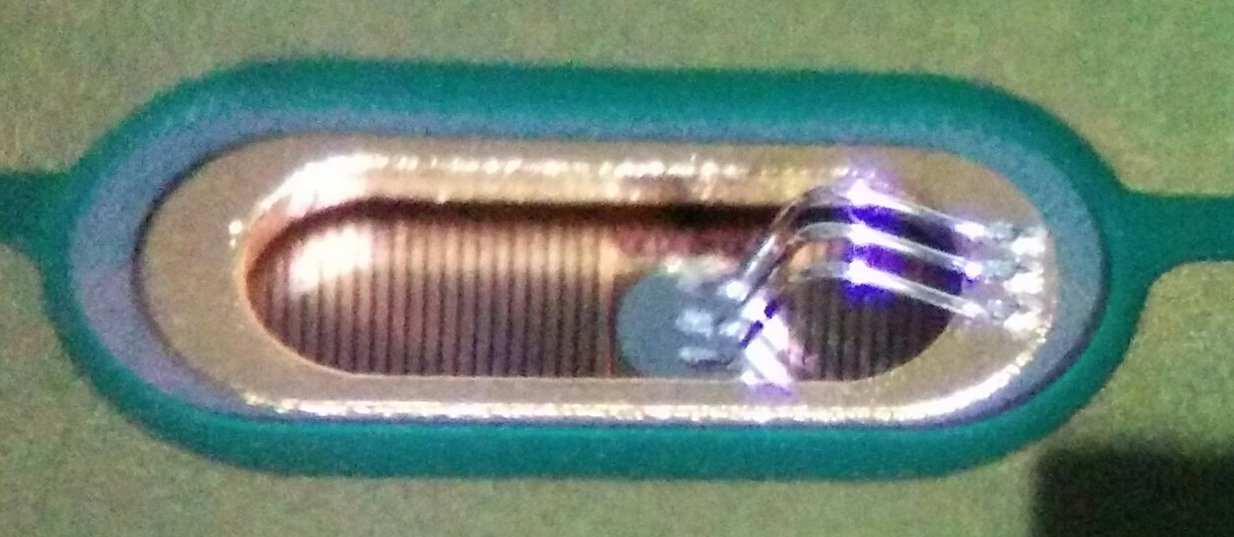
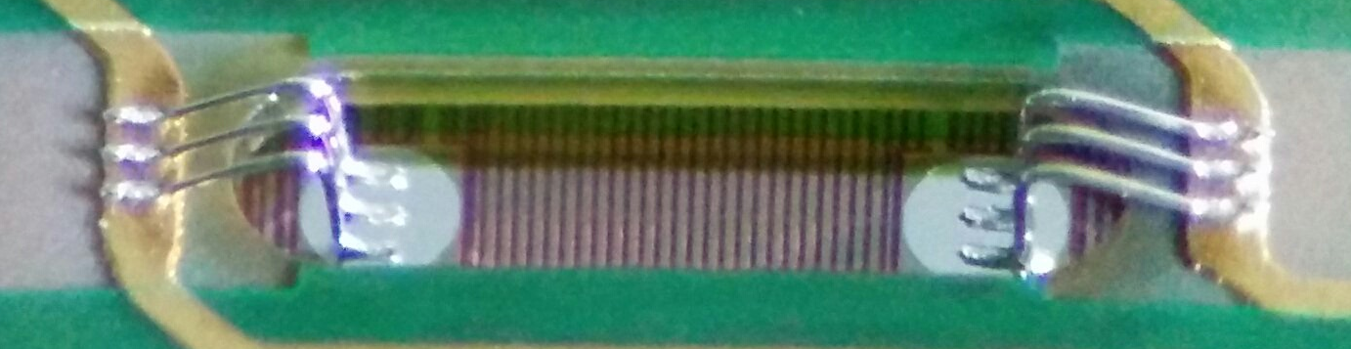
Main parameters: Loop shape
All connections (signal excluded)
Signal connections

Slide 26
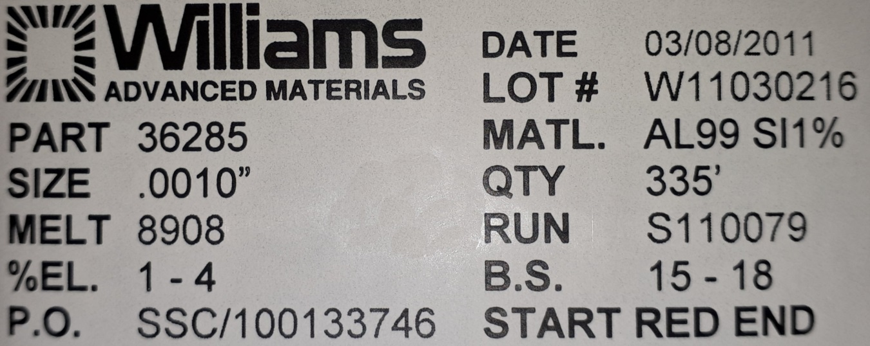
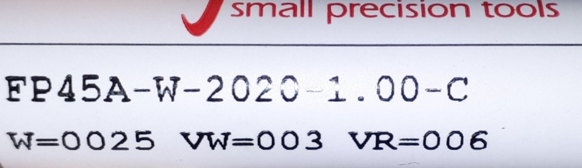
Bonding wire/Wedge
Wire 25 uM
Wedge

Slide 27
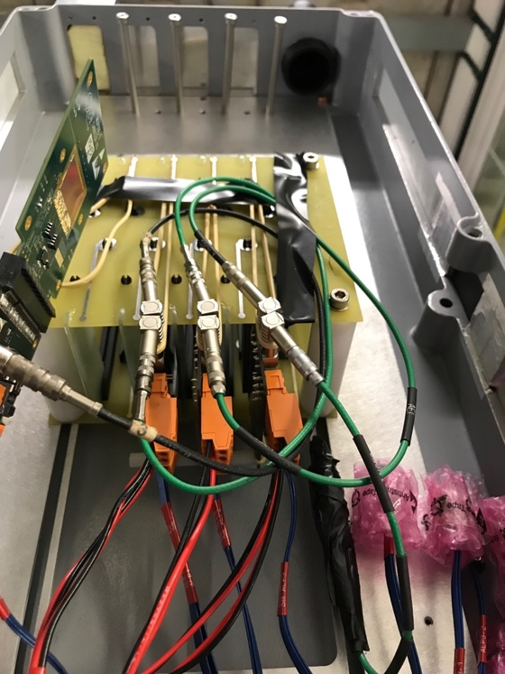
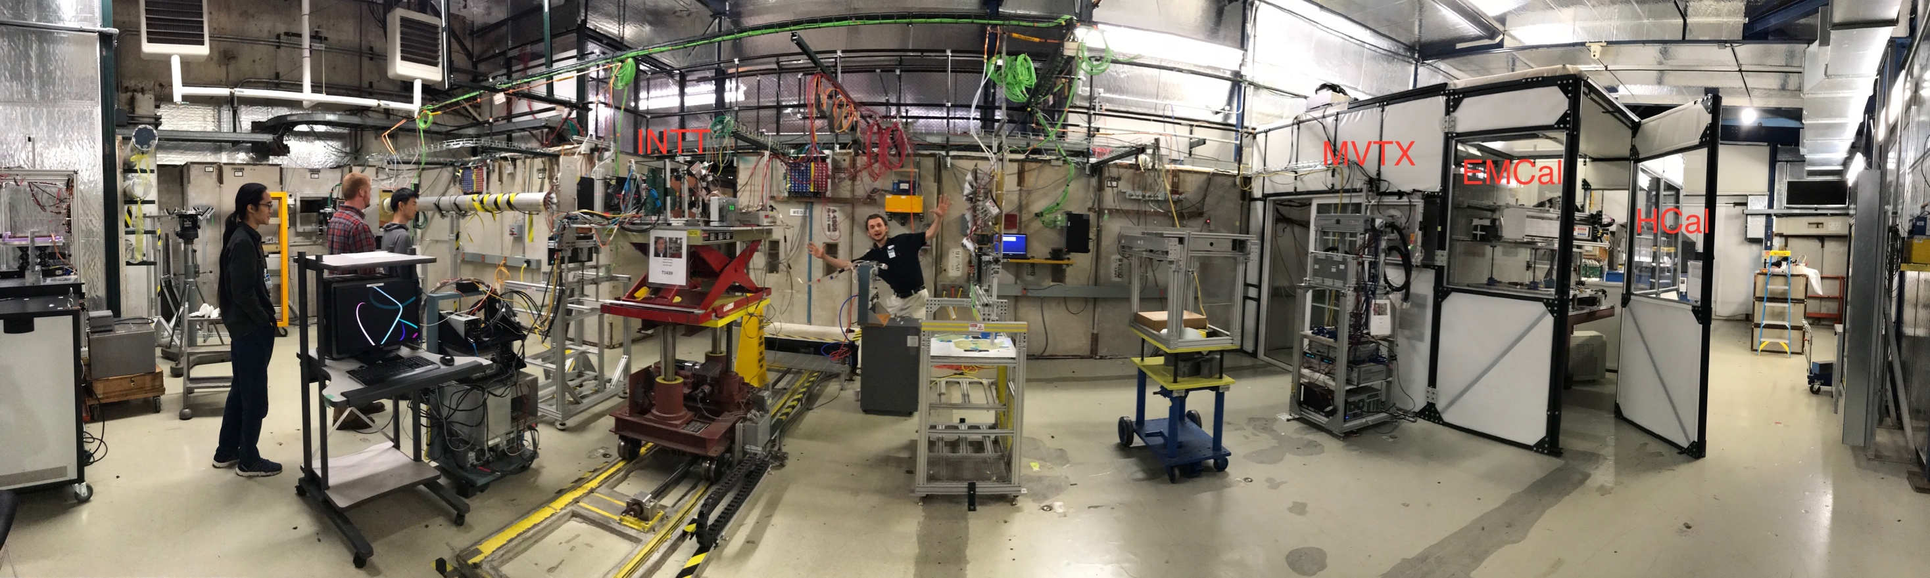
MVTX Telescope Test Beam at Fermilab
Goals:
  Test full readout chain
  Evaluate ALPIDE sensor performance
Experimental setup
  A 4-sensor telescope
  Full readout chain: MAPS+RU+FELIX+RCDAQ
Alex & Sho
#1,2,3
120 GeV
proton
4-sensor
Telescope
Parasitic with INTT run
Very productive & collaborative

Slide 28
Fermilab Test Beam Results
4-hit track
Alex & Sho
#1,2,3
120 GeV proton
beam
Detector performance consistent
with expectations
4-MAPS telescope
Mostly single tracks
Cluster size: 2.1 ~ 2.4
Spatial Resolution: < 5 um
Hit Efficiency > 99.5%
# of tracks per event
Cluster size
Pixel size (~28um)

