Slide 1
MVTX Overview
Ming Liu, for the MVTX Group
Los Alamos National Laboratory
MVTX BNL Director’s Review
July 19-20, 2018

Slide 2
Outline
Document: sPH-HF-2018-001
https://indico.bnl.gov/event/4072/
Submitted to BNL ALD 2/2018
MVTX technology
MVTX project scope
Detector design and R&D
Status and Plan

Slide 3
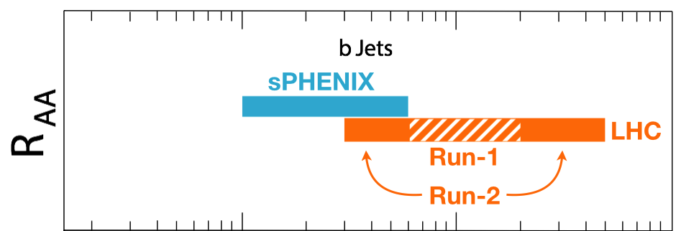
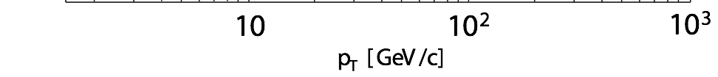
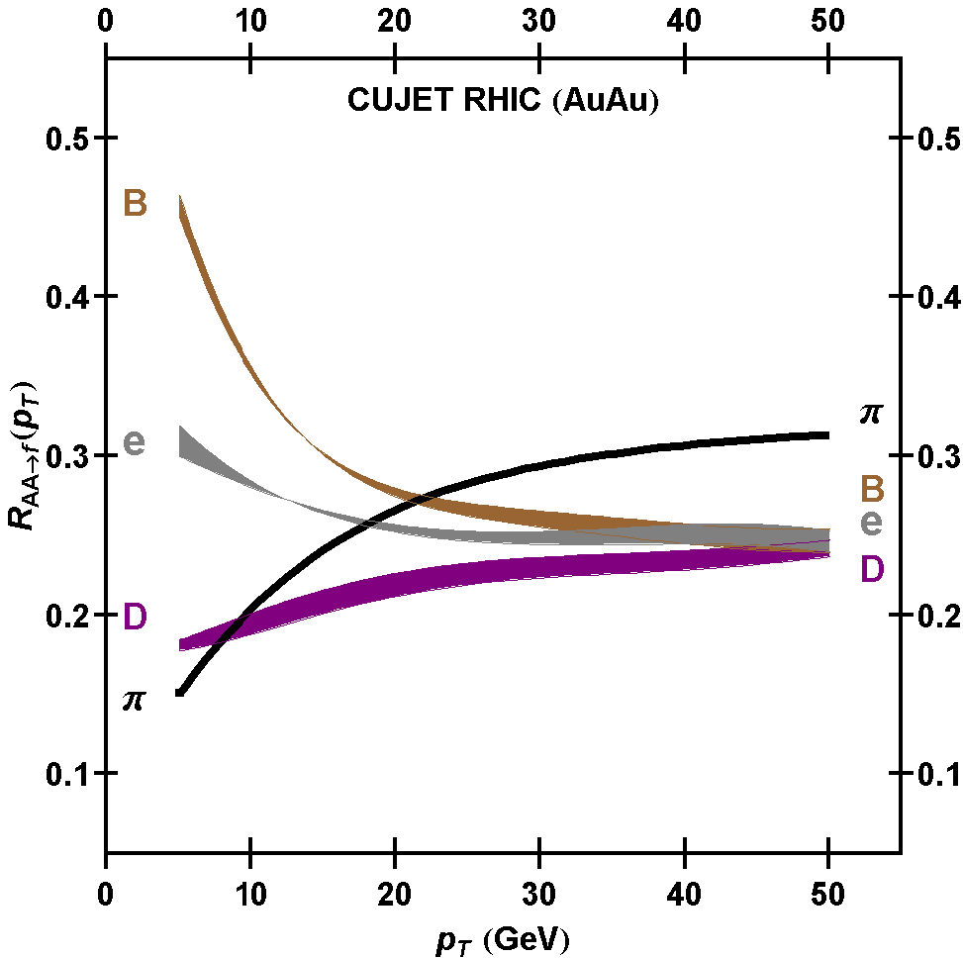
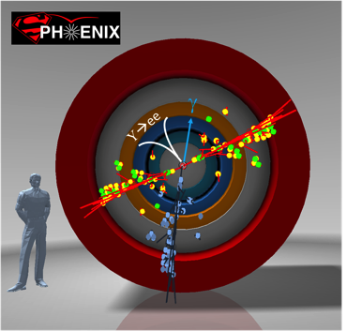
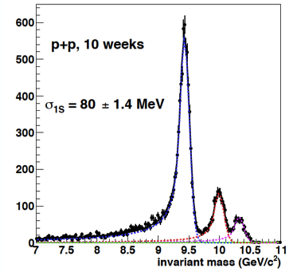
Exciting Science Enabled by MVTX
Dave & Gunther
sPHENIX is the next flagship heavy ion physics experiment in the US (NSAC LRP2015)
  Jets
  Upsilons
  B-jets and B hadrons
MVTX will complete QGP heavy flavor physics
  Precision study of the “inner workings of QGP”(LRP15)
  Unambiguous determination of key parameters of QGP properties and interactions
complement & extend current and future RHIC and LHC QGP programs
sPHENIX 3 Physics Pillars
http://arxiv.org/pdf/1501.06197v1.pdf
Jets
Upsilons
PRL 108 (2012) 022301
B
D

Slide 4


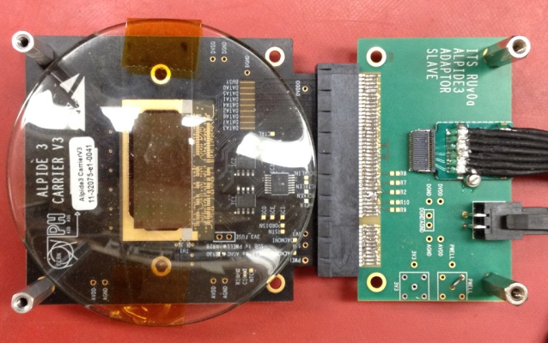
Monolithic Active Pixel Sensors (MAPS)
The Next-Generation, State-of-the-Art Pixel Tracker
Advantages of ALICE PIxel DEtector (ALPIDE) sensor:
Very fine pitch (27μm x 29μm), for superb spatial resolution
High efficiency (>99%) and low noise (<10⁻⁶), for excellent tracking
Time resolution, as low as ~5 μs, for less pileup
Ultra-thin/low mass, 50μm (~0.3% X₀), for less multiple scatterings
0.5M channels with on-pixel digitization, for zero-suppression and fast readout
Low power dissipation, 40mW/cm², for minimal service materials
An ideal detector for QGP physics!
Flexible Printed Circuit(FPC)
9 Chips
Cold plate
A 9-chip MAPS stave, 1.5cm x 27cm
ALPIDE design
ALPIDE sensor:
1.5cm x 3.0cm, 0.5M channels
50 μm
~28 μm

Slide 5

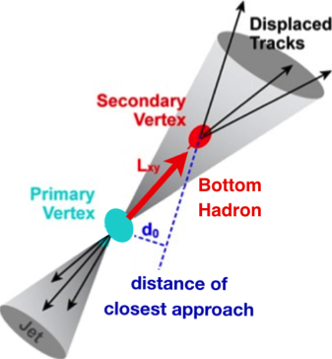

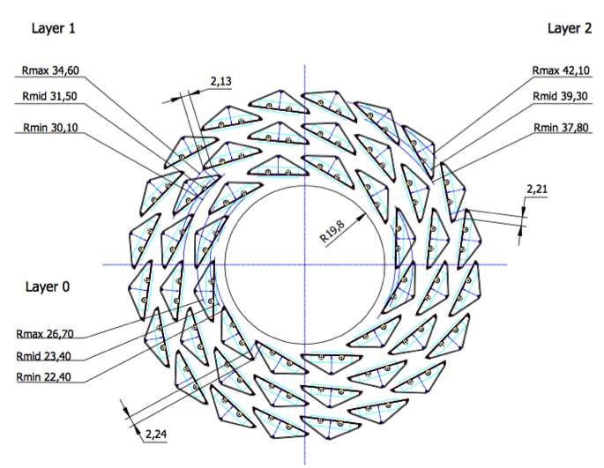
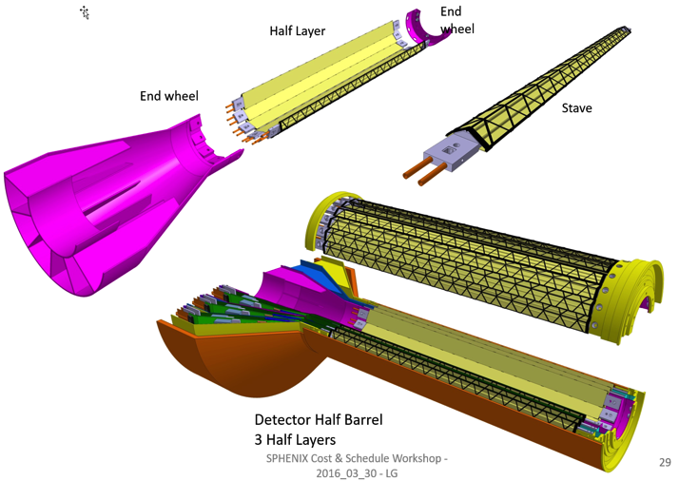
MVTX: MAPS-based VerTeX Detector
sPHENIX@RHIC
(2023+)
Key integration tasks:
Readout
Mechanics
ALICE ITS Upgrade @CERN;
Inner Tracker System (2021+)
sPHENIX Inner Tracking: MVTX
“Adopt” ALICE ITS/IB:
- Minimum risk
- Maximum physics
Leveraging on extensive R&D and design work by ALICE

Slide 6
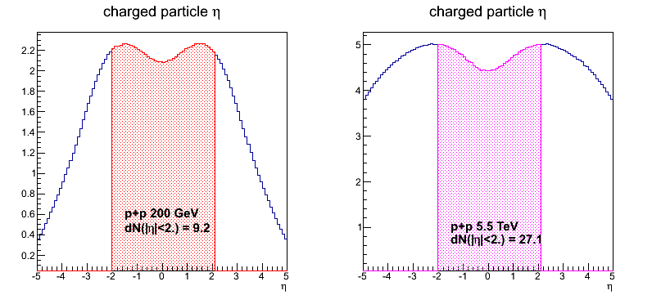
sPHENIX vs ALICE
 | ALICE (Run3) | sPHENIX (Max) | Ratio of data rates sPHENX/ALICE
Pb+Pb / Au+Au | 50kHz | 200 kHz | 0.3
p+p | 200kHz | 13 MHz | (1.6)
Trigger/Readout | 50 kHz/(Continues) | 15 kHz | -
MB Event track multiplicity dN/dη
  sPHENIX = 1/3 ALICE (pp)
  sPHENIX = 1/5 ALICE (AA)
sPHENIX triggered data rate fits well within ALICE readout hardware specs;
sPHENIX
ALICE

Slide 7
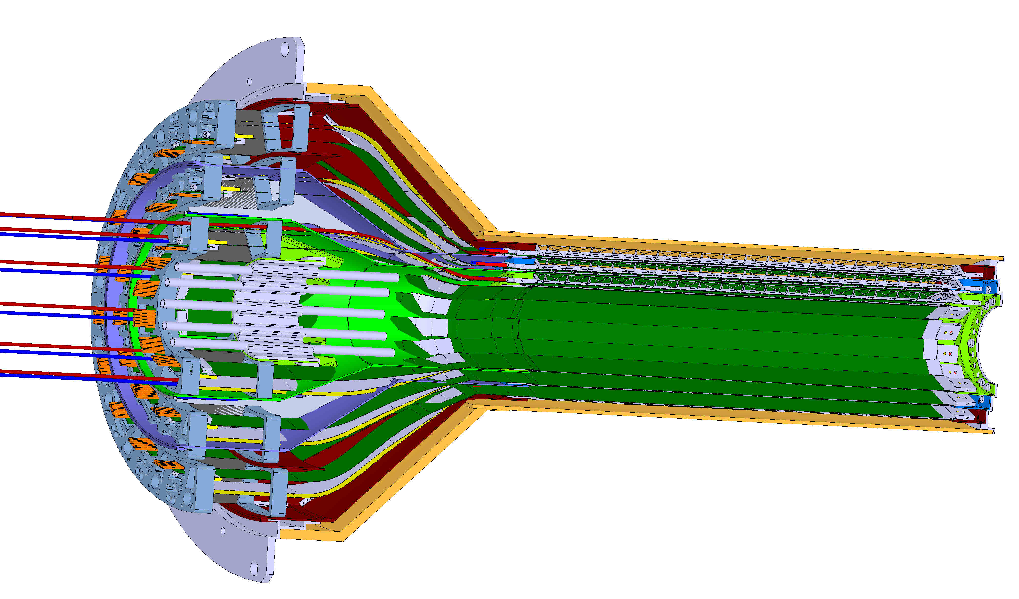
MVTX Detector
Service cone: signal, power, cooling
and mechanical support
CYSS: Cylindrical Shell Structure
End-Wheel
3-layer sensor barrel
- 48 staves, 432 chips
Figure for ALICE ITS/IB design
(slightly modified mechanically for sPHENIX)
MVTX
parameters
MVTX RUs, PUs & other services

Slide 8
Scope of the MVTX Project
MAPS Staves & Electronics
  Readout Integration R&D (LANL LDRD)
    Frontend: ALICE/ITS, RU
    Backend: ATLAS FELIX
    Reprogram RU & FELIX for sPHENIX
  Production:
    84 ALICE/ITS-IB staves from CERN
      Acceptance test @LBNL
      48+spares(36)
    58 ALICE/ITS-RU from CERN
      Acceptance test @UT-Austin, 48+spares(10)
    Reproduce 8 ATLAS/FELIX
      Acceptance @LANL
    Final assembly and test in US
      LBNL and BNL
  Ancillary systems, “adopt” ALICE system
Mechanics & Cooling
  Some changes to ALICE/ITS inner tracker mechanical structures,
    End Wheels
    Cylindrical structure shells
    Detector half barrels
    Detector and Service half barrels
  Mechanical Integration,
    Conceptual design by LANL LDRD
    Prototype by sPHENIX R&D, MIT/LANL
    Design integration frames
    Carbon frames etc., LBNL
    Installation tooling etc.
  Adopt ALICE cooling plant design
    Minor modification to fit sPHENIX
    Much smaller heat load than ALICE ITS
Alex Tkatchev &
Sho Uemura
Walt Sondheim
Leo Greiner
Walt Sondheim
&
Dan Cacace
Jo Schambach
- Early R&D by LANL LDRD, $5M, FY17-19, readout, mechanical design and physics
- Established LANL-ALICE MoU in 12/2016 for joint R&D for MVTX

Slide 9
Schedules and Milestones
sPHENIX: CD1 CD2
Installation
1st collisions
2018 | 2019 | 2020 | 2021 | 2022 | 2023
MVTX
ALICE IB stave done;
Facilities available for
sPHENIX production;
Window of opportunity:
Low technical risk
Cost saving
Stave & RU
production
FELIX
production
Detector mechanics design & production, global interface to sPHENIX
End Wheels
CYSS
Service barrel
design & production
Ready for beam;
sPHENIX day-1 run
MVTX final
design review
Barrel Assembly & Testing @LBNL
Install half barrels
@sPHENIX IR
Half barrel #1
Half barrel #2
Half barrels
arrive @BNL
Power system
production
MVTX installation & commissioning @BNL
RU, FELIX, PS, cables etc.

Slide 10
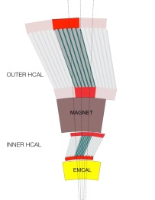
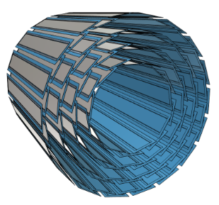
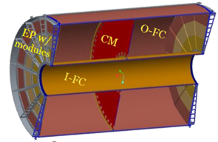
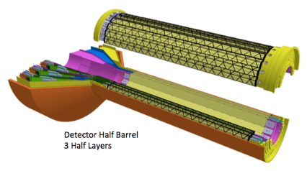
sPHENIX DAQ Architecture
Event Builder
FEM
DCM
DCM2
DCM
DCM
DCM
DCM
Network
Switch
Buffer Box
FEM
DCM
SEB
ATP
DCM
DCM
DCM2
DCM
DCM
ATP
DCM
Buffer Box
FEM
DCM
SEB
ATP
DCM
DCM
DCM
DCM2
ATP
Buffer Box
Calorimeters,
INTT, MBD
DCM
SEB
To the
RACF/HPSS
DCM
DCM
ATP
ATP
Buffer Box
FEE
ATP
DCM
DCM
FELIX
EBDC
ATP
TPC
MVTX
DCM
Buffer Box
FEE
ATP
DCM
DCM
FELIX
EBDC
ATP
Buffer Box
DCM
FEE
ATP
DCM
FELIX
EBDC
DCM
ATP
Buffer Box
DCM
Rack Room
SEB Sub-Event Buffer
EBDC Event Buffer and Data Compressor
ATP Assembles events and compresses data
Buffer Box Data interim storage before sending data to the computing center

Slide 11
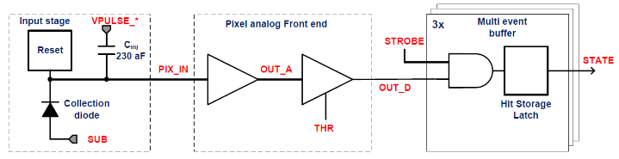
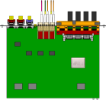

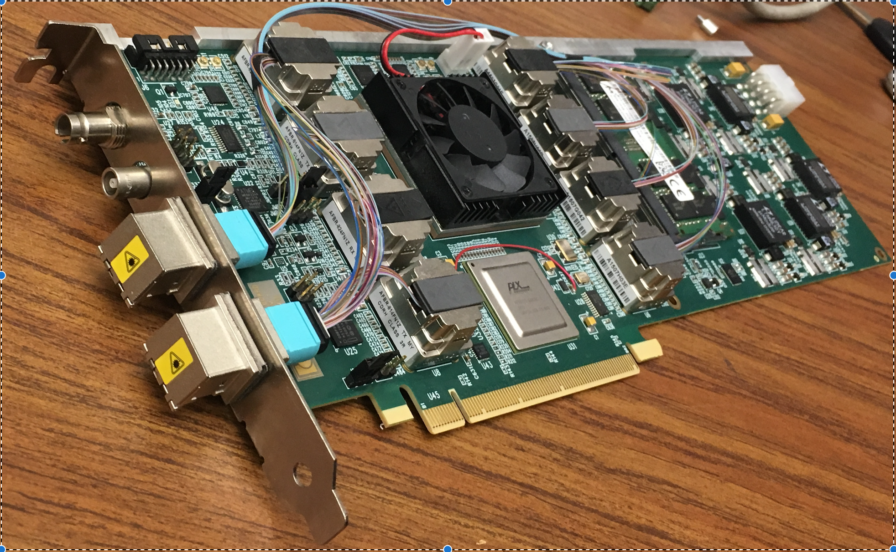
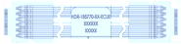
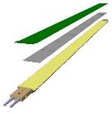

MVTX Readout, Power and Controls
Alex,Sho, Jo, Leo
#1,2,3
CAN bus
DCS
Trigger & Clock
Readout Unit
Front End
GBT Optical Links
one pixel
9 Data (1.2Gbps)
1 Clock, 1 Control/Trigger
Control
Data (9.6 Gb/s max)
Trigger
9-sensor Stave
Samtec Twinax “FireFly”
FELIX
Back End
FPC
Power
ATLAS Front-End Link eXchange (FELIX):
sPHENIX Data Aggregation Module(DAM)
Alpide Sensors
Power
Filtering Capacitors
regulators
Power supplies
Cold Plate
Regulated Power
ALPIDE pixel:
Shaping
Digitization
Zero-suppression
3x buffer
Power Board
Interaction Region
Experimental Hall
Counting House
MVTX Detector Electronics consists of three parts
Sensor-Stave (9 ALPIDE chips) | Front End-Readout Unit | Back End-FELIX/DAM

Slide 12
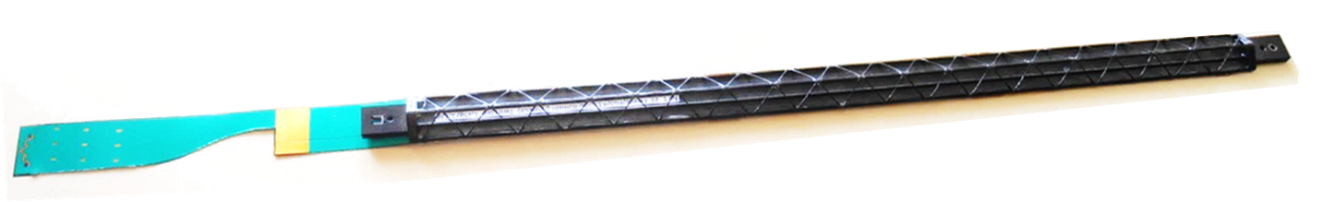
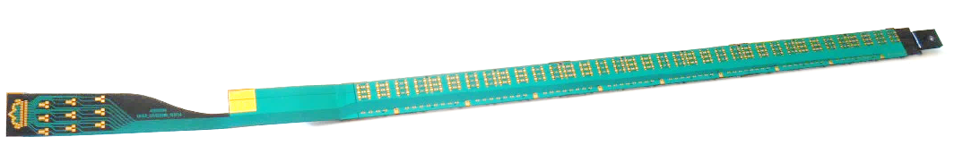
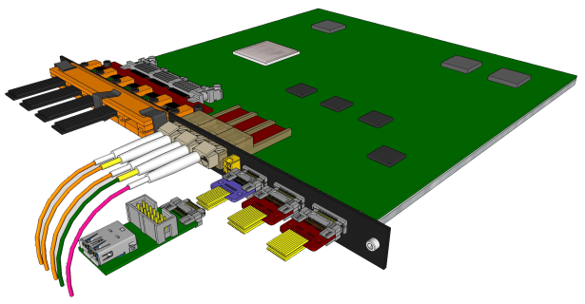
MVTX Sensors and Electronics
Alex, Sho, Leo, Jo
Major hardware:
  48 ALICE ALPIDE Staves + Interface Cables
  48 Front End Electronics (ALICE RUv2)
  6 Back End Electronics (ATLAS FELIX v2)
  6 EBDC Linux servers
  24 Power Boards + CEAN Supplies + Cables
  48 Stave to RU cables
  144 data fiber optic cables (3 fibers x 48 FEE)
Stave production spares: 75%
Electronics production spares: 20%
ALICE ITS/IB stave
ALICE ITS RU

Slide 13
Projected Radiation Level after 5-year Runs
sPH-TRG-2018-001
Leo
#1
Projected sPHENIX integrated luminosities after 5-year operation
  AuAu: Lum. = 214 nb⁻¹
  pp+pAu: Lum. = 1340 pb⁻¹
PHENIX study
arXiv: 0710.2676 [nucl-ex]
Projected sPHENIX MVTX L0 fluence:
Outer layers:
L1 = 0.6 x L0; L2 = 0.4 x L0
TID = 1060krad
NIEL = 6x10¹² N_{eq}/cm²
Sensors tested to full MVTX NIEL and ~1/2 TID @ALICE

Slide 14
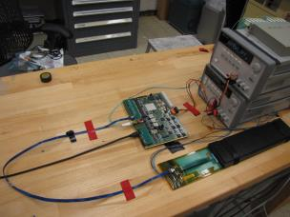
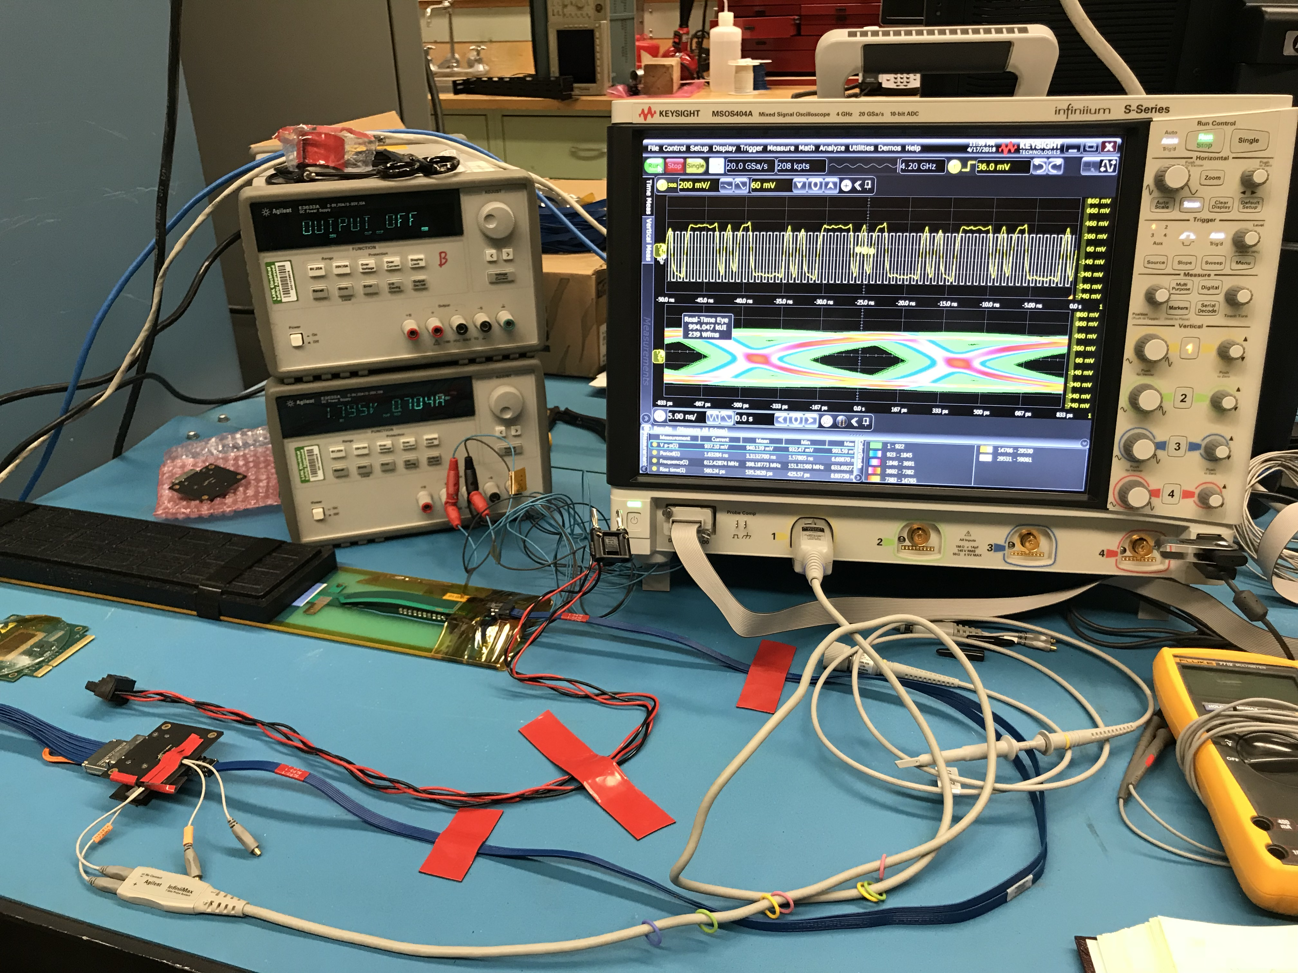
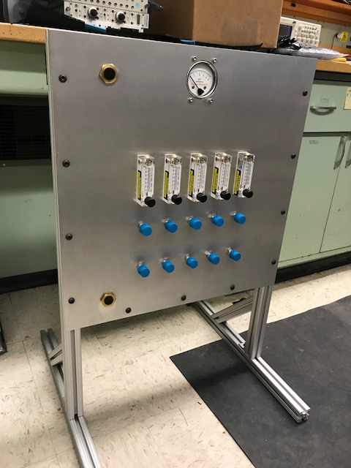
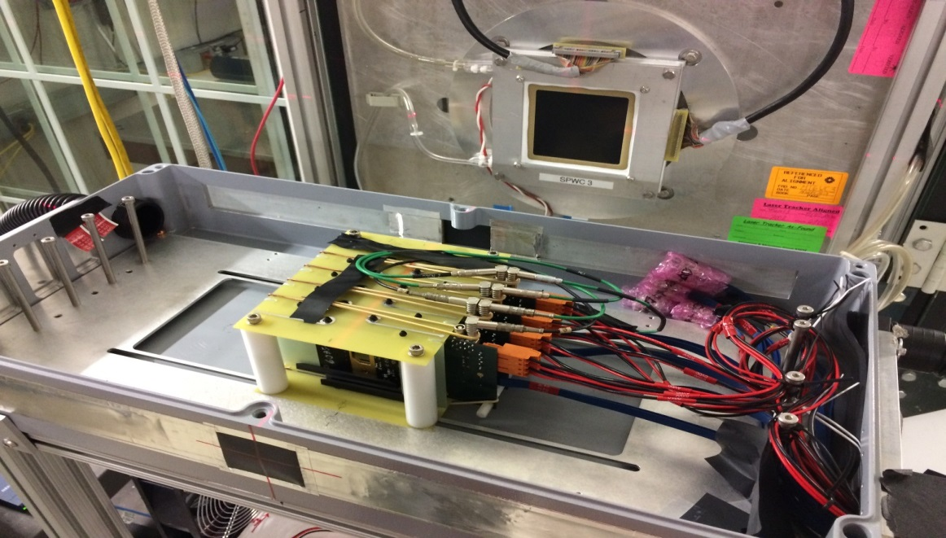
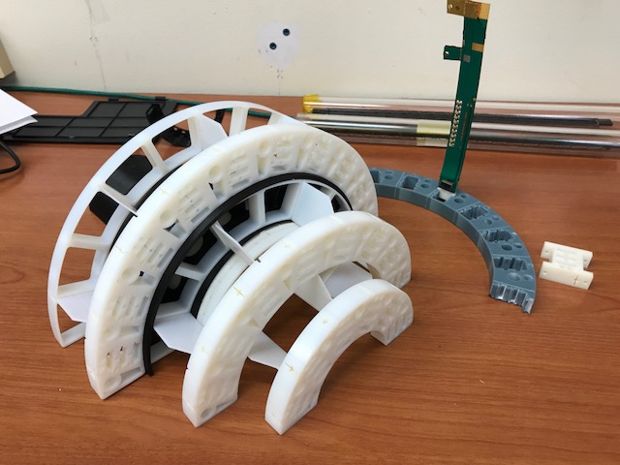
LANL LDRD Activity Highlights
MAPS evaluation
Readout integration
4-sensor telescope
Test beam at Fermilab
Mechanical & cooling
Readout R&D
Signal integrity
RU
Cooling system
prototype
stave
4-ALPIDE Telescope;
5m-long SamTec cables
Service cone R&D
Sensor source test
FPC power extension R&D

Slide 15
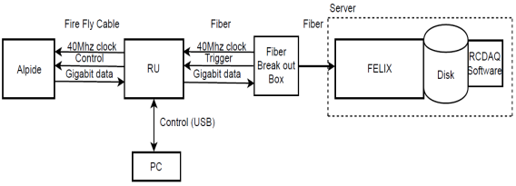
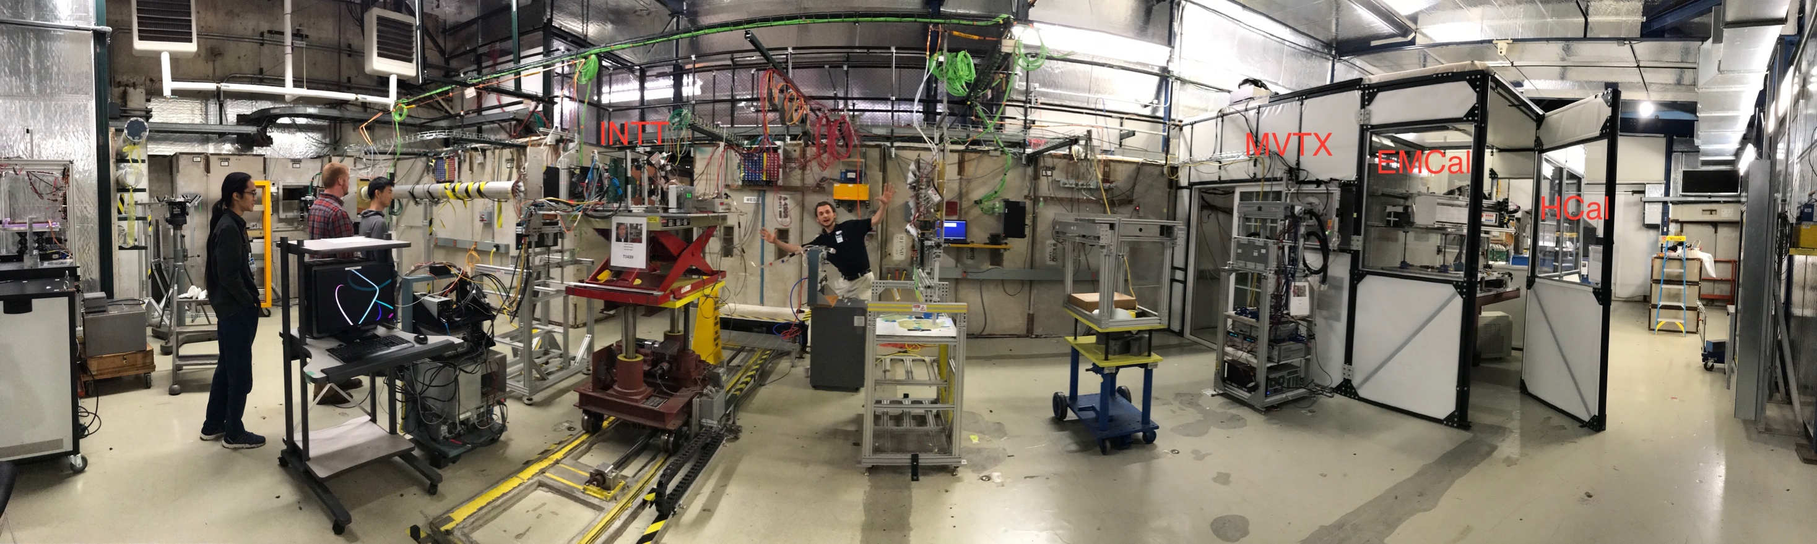
MVTX Full Readout Chain Demonstrated
Alex & Sho
#1,2,3
4-MAPS
telescope
Fermilab Test Beam: Feb-Mar, 2018
Tracking spatial resolution
achieved: <5 um
120 GeV proton
beam
4-hit track
4-MAPS telescope

Slide 16
Stave and RU Production QA Plan
Leo & Jo
#4,5,6,7,8
Staves
Purchase 84 staves from ALICE/CERN
  48 + 28(spares for 2 inner layers) + 8 spares
  Production following the completion of ALICE ITS/IB
  Starting ~Oct. 2018, will last 6-12 months
  Fully tested at CERN before shipping to US
    All Gold/Silver staves (same as ALICE IB)
    A LANL postdoc (Dr. Yasser Morales) oversees production QA at CERN
Acceptance QA at LBNL
  Full test and QA
    Electrical
    Mechanical
  Detector assembly at LBNL
Readout Units
Purchase 58 RUs from ALICE/CERN
  48 + 10 spares(20%)
  To be part of ALICE production
    Cost saving
    Minimize technical risks
  Initial test at CERN
Acceptance QA at UT-Austin
  Full test
  LANL as the 2nd test site

Slide 17
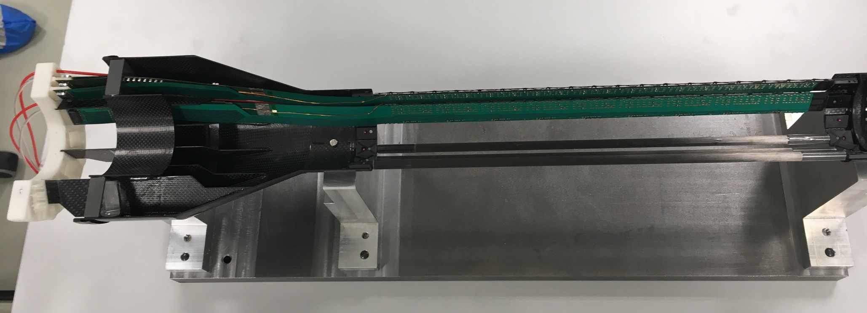
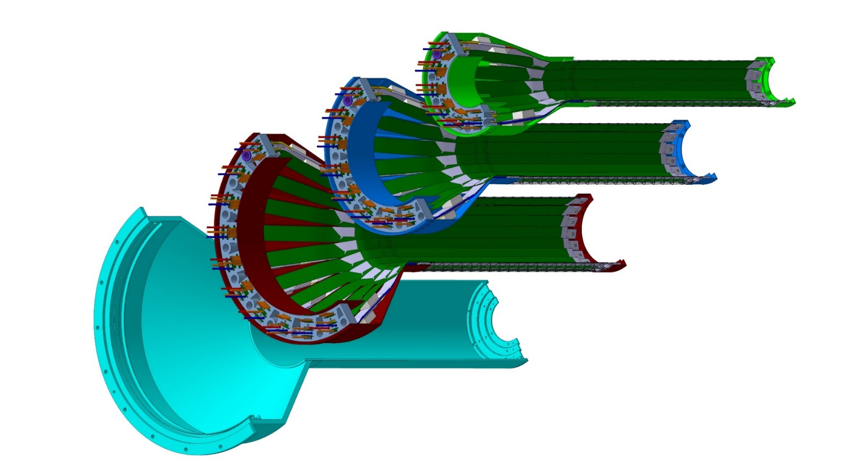
Detector Assembly Plan at LBNL
Leo’s talk
#4,5,6,7,8
staves
Precision positioning and installation of staves on end-wheels
ALICE 1st half inner layer being assembled
6/2018@CERN
Layer 0
Layer 1
Follow ALICE IB assembly procedures to build half-detectors for MVTX
QA records in DB, travelers
Modified jigs for MVTX
Layer 2
IB CYSS

Slide 18
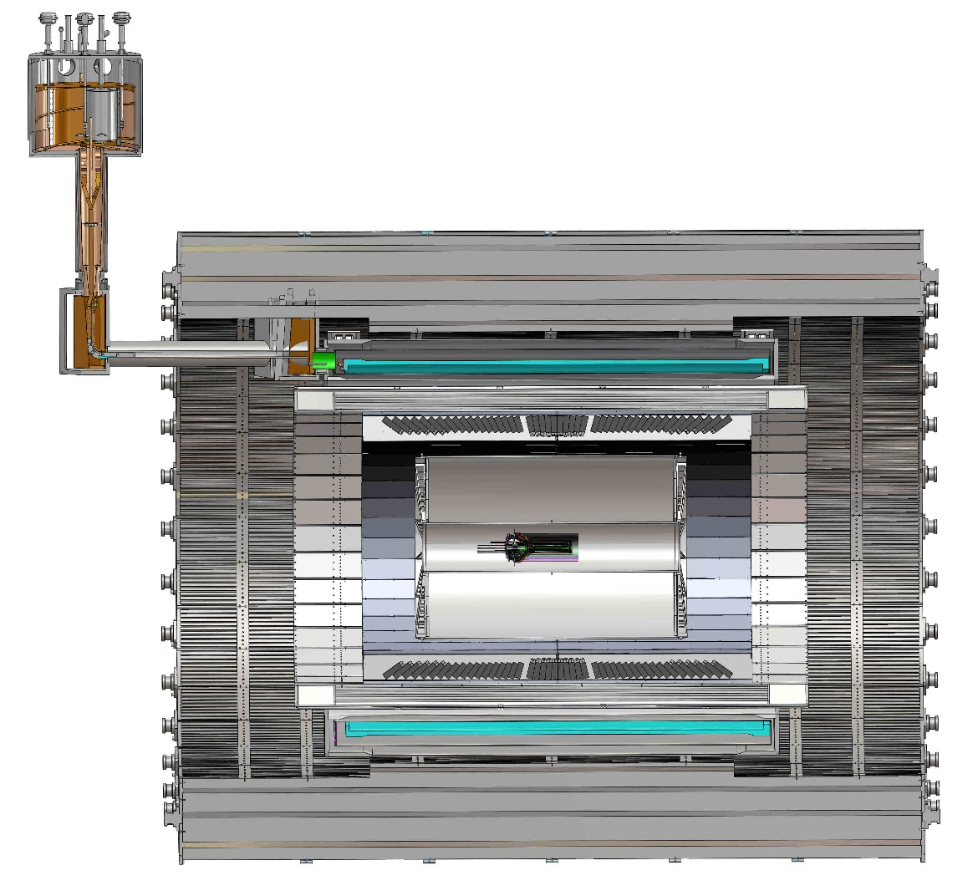
Mechanical Integration
MVTX, INTT and TPC/HCal
  MVTX/INTT detector designs modified
  Global interface being developed
Walt & Dan
#10
TPC
TPC
INTT
MVTX
R= 209.6cm
L = 350.0 cm

Slide 19
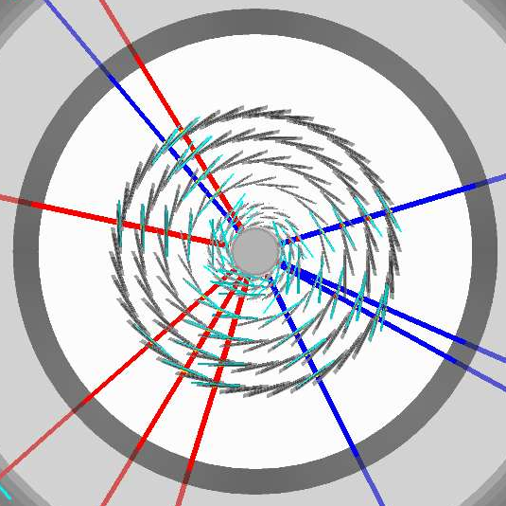
Simulations for Optimization
Tony & Rachid
#9, 10
Task force formed
  Goals and deadline defined
  Evaluate tracking with different INTT layers & geometry
Complementary roles in global tracking:
  MVTX:
    Precision DCA and vertexing
  INTT:
    Matching in-time hits of MVTX and TPC
    Important for p+p and p+A, pileups

Slide 20
sPHENIX MVTX Group: Institution Roles
Growing number of institutions
  Major institutions lead key tasks

Slide 21
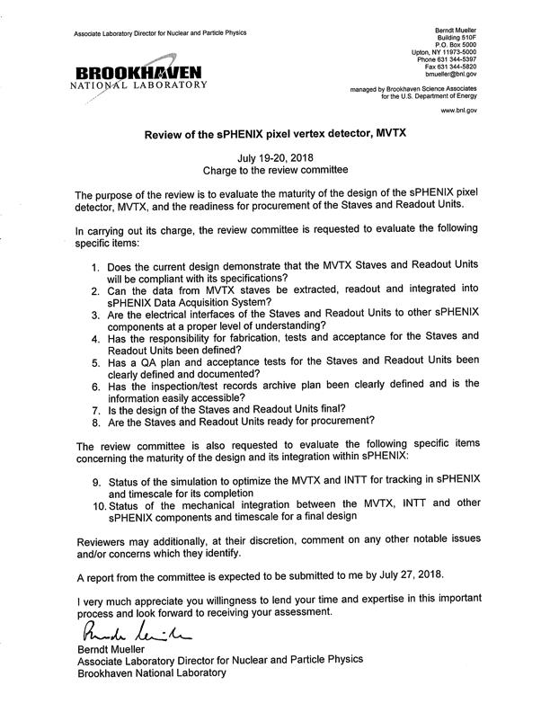
Summary
Compelling science established
Demonstrated full readout and control chain in sPHENIX framework
  Charge #1,2,3
Demonstrated detector performance with test beam data
  Charge #1,2,3
QA plan developed for RUs and Staves
  Charge #4,5,6,7,8
3D design of mechanical integration
  Charge #10
Simulation to optimize INTT geometry
  Charge #9, 10
Dave & Gunther
Alex & Sho
Alex & Sho
Leo & Jo
Walt & Dan
Rachid & Tony

