Slide 1
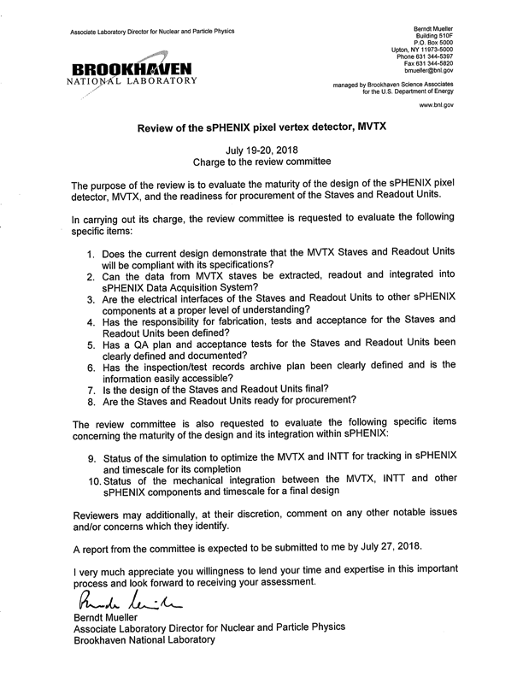
Summary
sPHENIX overview – Dave/Gunther
Compelling science
MVTX overview –Ming
Status and highlights
Readout integration – Alex/Sho
#1, 2, 3
Staves – Leo/Grazyna
#1, 3, 4, 5, 6, 7, 8
Readout Units – Jo
#1, 3, 4, 5, 6, 7, 8
INTT overview – Rachid
Important for tracking
Mechanical integration – Walt/Dan
#10
Tracking simulation – Tony
#9
Project summary – Ming
YES, we are ready, #1, 8

Slide 2
#1, Does the current design demonstrate that the MVTX staves and readout units will be compliant with their specifications?
Sho, Alex, Leo, Jo et al
YES!
Spatial resolution
Hit efficiency
Readout speed
Trigger rate
Occupancy
Radiation tolerance
Hit Spatial Resolution: < 5 um
Hit Efficiency > 99.5%
Pixel size (~28um)

Slide 3
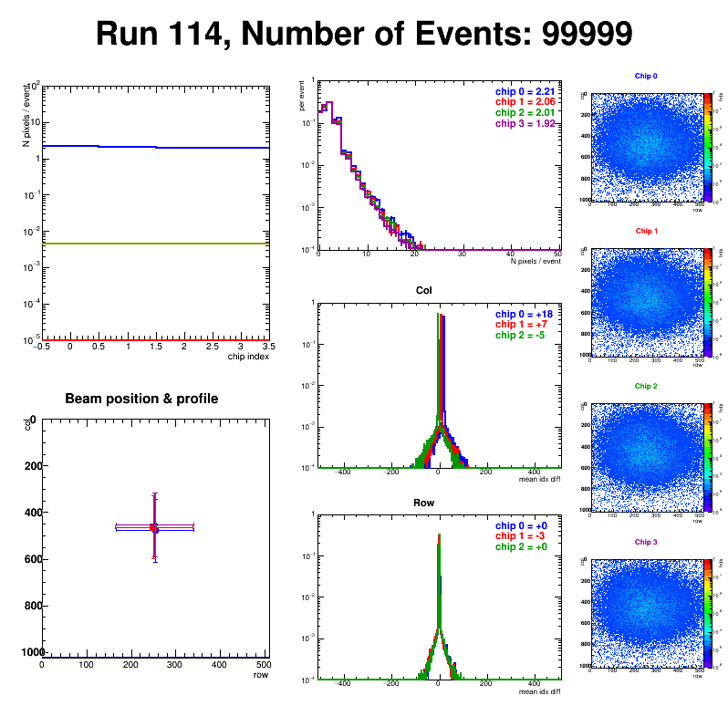
#2, Can the data from MVTX staves be extracted, readout and integrated into sPHENIX DAQ?
Sho, Alex, Jo
Yes!
Test beam data monitoring and analysis are carried out in the sPHENIX online and offline framework
Online display:
Hit Spatial Resolution: < 5 um
Hit Efficiency > 99.5%
Pixel size (~28um)

Slide 4
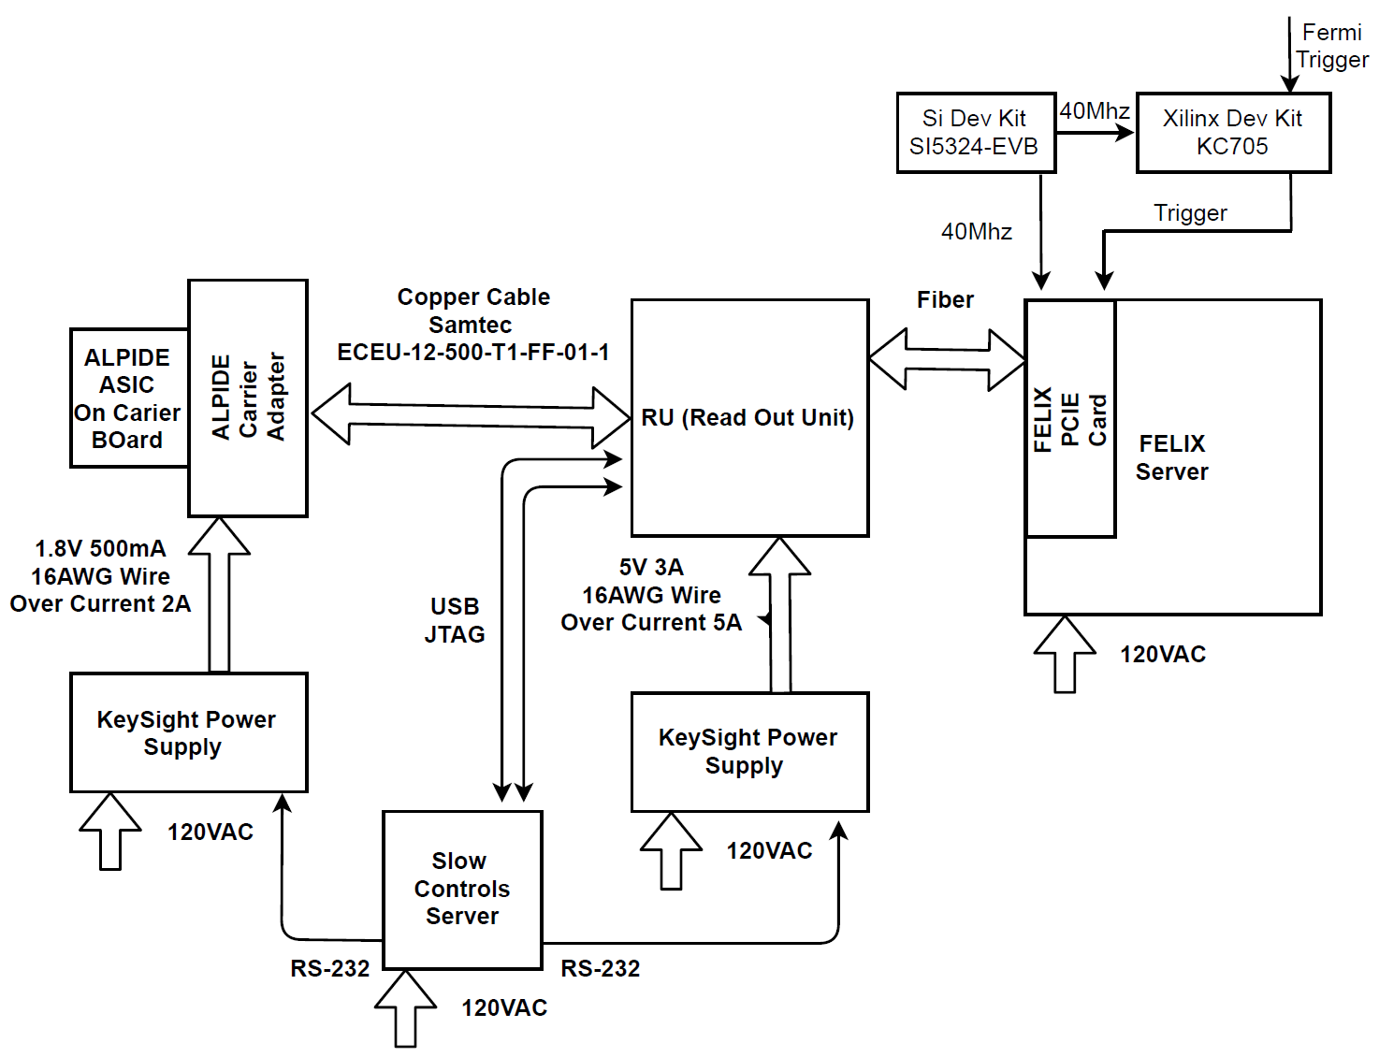
#3, Are the electrical interfaces of the Staves ad Readout Units to other sPHENIX components at a proper level of understanding?
Yes!
We have exercised the full readout chain and controls at Fermilab test beam
Sho, Alex, Jo

Slide 5
#4, Has the responsibility for fabrication, tests for the Staves and Readout Units been defined? #5, Has a QA plan and acceptance tests for the Staves and Readout Units been defined?
Yes!
ALICE/CERN will produce staves and RU for sPHENIX.
sPHENIX/MVTX group does the acceptance test and QA in US.
Leo & Jo
L3: Joachim J. Schambach/UT-Austin
L3: Grazyna Odyniec/LBNL

Slide 6
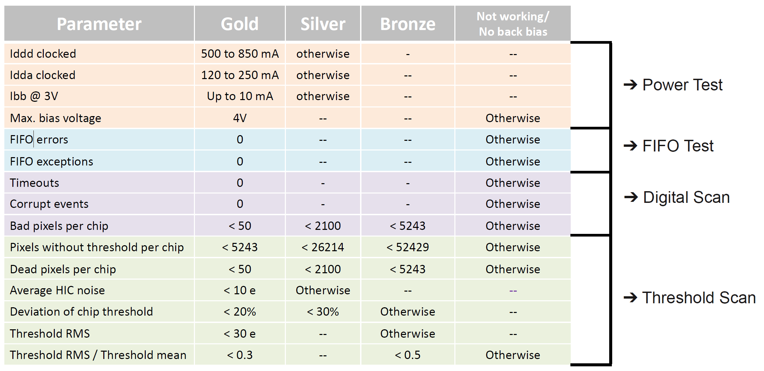
#6, Has the inspection/test records archive plan been defined and is the information easily accessible?
Leo & Jo
Yes!
Follow the same QA procedures being used for ALICE ITS/IB production at CERN
Use ALICE DB for initial sPHENIX production
Move to sPHENIX DB when available
ALICE ITS stave QA

Slide 7
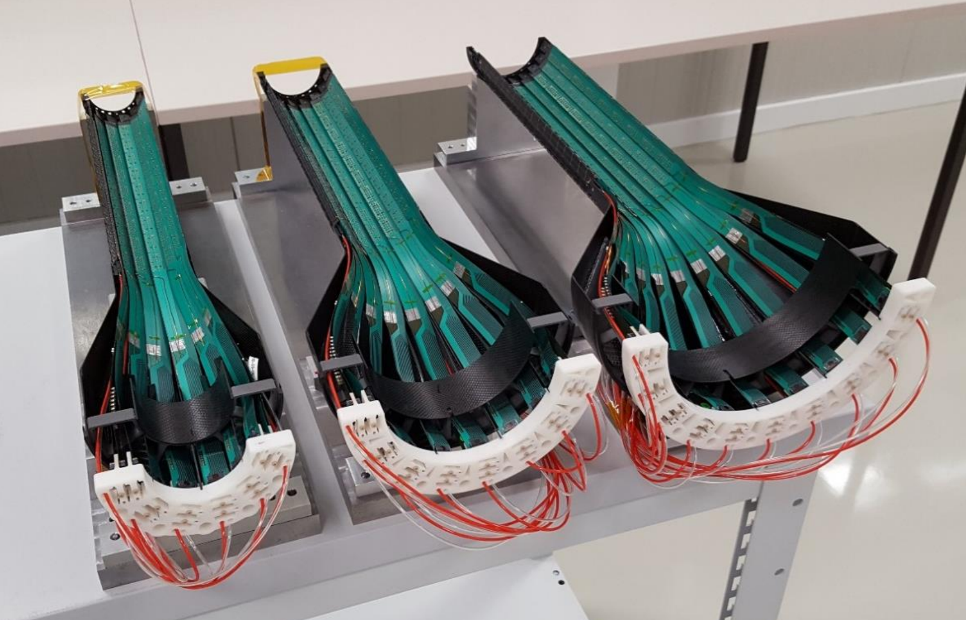
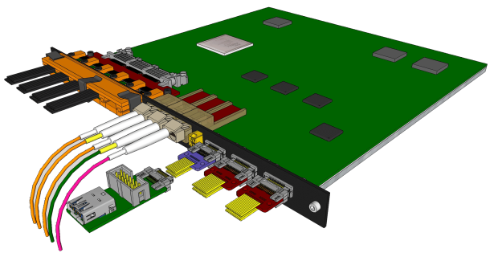
#7, Is the design of the Stave and Readout Units final?
Leo & Jo
Stave: Yes!
With a minor modification of power extension cable for FPC. - MVTX will use long 35cm cables (ALICE, 15cm)
ALICE ITS/IB staves production in progress
RU: Yes!
Pre-production boards (v2.0) being tested at CERN
ALICE ITS RU production ready to proceed after the test.

Slide 8
#8, Are the staves and readout units ready for procurement?
Leo, Jo, Walt
Staves: Yes!
High-speed line, no change
Longer (15cm ->35cm) power extension cables, Prototype power extension cables produced at LANL for testing.
RU: Yes!
Once the final v2 pre-production boards pass the test, full production will proceed
RU v1 meets readout integration requirements
FPC power extension

Slide 9
#9, Status of the simulation to optimize the MVTX and INTT for tacking in sPHENIX and timescale for its completion
Tony, Dave & Gunther
Key simulation tools are available to verify tracking performance with various MVTX and INTT configurations
A simulation task force is formed, with charge and targeted due date

Slide 10
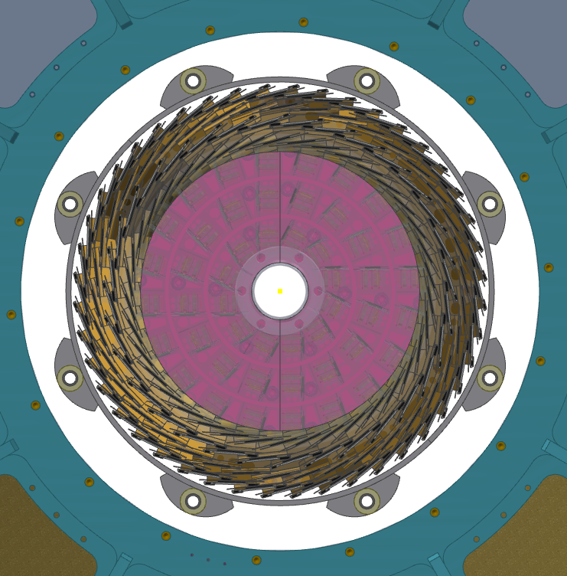
#10, Status of the mechanical integration between the MVTX, INTT and other sPHENIX components and timescale for a final design?
Walt & Dan
Integration effort under OSI, chaired by Mickey & Dan
Integration issues appear manageable
Detailed 3-D models being developed, mock-up to confirm the final design

