Slide 1
MVTX Review Summary
Compelling science
Demonstrated full readout and control chain in sPHENIX framework
  ALPIDE + RU + FELIX + RCDAQ
  Trigger rate > 15kHz
  sPHENIX raw data format
Demonstrated detector performance with Fermilab test beam
  Spatial resolution better than 5um
  Hit efficiency > 99%
  High occupancy
  Noise level
QA plan developed for RU and Staves, documents ready for review
  Follow ALICE ITS QA procedures
Preliminary design of mechanical integration
  MVTX + INTT + (TPC/sPHENIX)

Slide 2
#1, Does the current design demonstrate that the MVTX staves and readout units will be compliant with their specifications?
YES.
  Spatial resolution
  Hit efficiency
  Readout speed
  Trigger rate
  Occupancy
  Radiation level
Sho, Alex, Leo et al
Hit Spatial Resolution: < 5 um
Hit Efficiency > 99.5%
Pixel size (~28um)

Slide 3
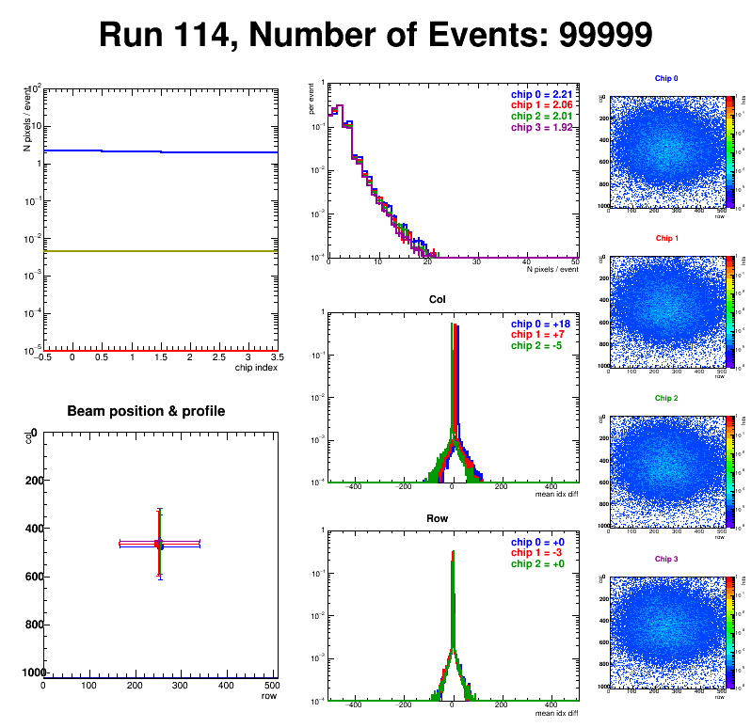
#2, Can the data from MVTX staves be extracted, readout and integrated into sPHENIX DAQ?
Sho, Alex, Jo
YES.
  Test beam data monitoring and analysis are carried out in the sPHENIX online and offline framework
Online display:
Hit Spatial Resolution: < 5 um
Hit Efficiency > 99.5%
Pixel size (~28um)

Slide 4
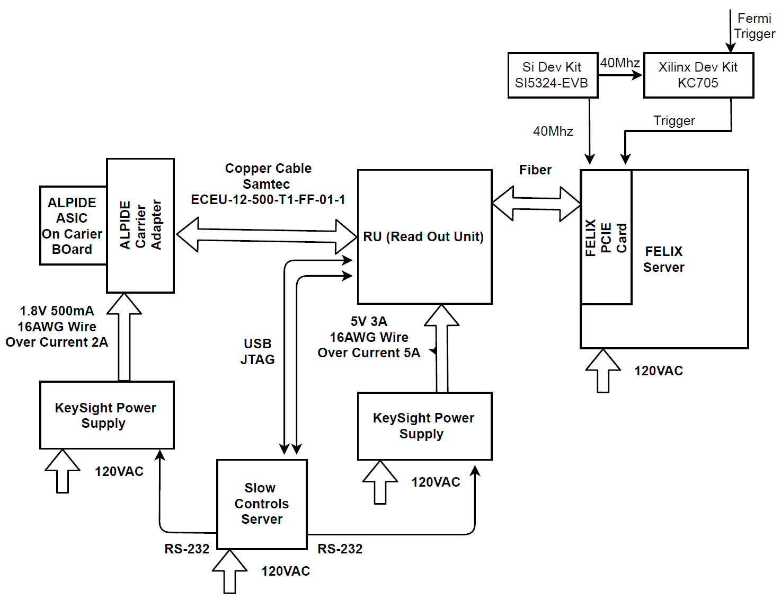
#3, Are the electrical interfaces of the Staves ad Readout Units to other sPHENIX components at a proper level of understanding?
YES.
We have exercised the full readout chain and controls at Fermilab beam test
Sho, Alex, Jo

Slide 5
#4, Has the responsibility for fabrication, tests for the Staves and Readout Units been defined?
YES.
  ALICE/CERN will produce staves and RU for sPHENIX.
  sPHENIX/MVTX group does the acceptance test and QA in US.
Leo & Jo
L3: Grazyna Odyniec/LBNL
L3: Joachim J. Schambach/UT-Austin

Slide 6
#5, Has a QA plan and acceptance tests for the Staves and Readout Units been defined?
YES.
QA Plan documents available for stave and RU production.
Leo & Jo

Slide 7
#6, Has the inspection/test records archive plan been defined and is the information easily accessible?
Leo & Jo
Work in progress, will be ready for production
Follow the same QA procedures defined & used for ALICE ITS/IB production at CERN.
Plan to use the sPHENIX DB for records once available

Slide 8
#7, Is the design of the Stave and Readout Units final?
Leo & Jo
Stave:
  Yes, with a minor modification of power extension cable for FPC. sPHENIX/MVTX will use long 30~50cm cables (ALICE/IB power extension cable, 15cm long)
  ALICE ITS/IB stave is in production
RU:
  Yes, pre-production piolet boards (v2.0) being tested at CERN
  ALICE ITS RU production ready to proceed after the test.

Slide 9
#8, Are the staves and readout units ready for procurement?
Leo & Jo
Staves: YES
  High-speed line, no change
  Longer (15cm ->50cm) power extension cables, cable length optimization in progress for mechanical integration. Prototype power extension cables produced at LANL for testing.
RU: YES
  Once the final v2 pre-production piolet boards pass the test, full production will proceed
  RU v1 meets readout integration requirements

Slide 10
#9,Status of the simulation to optimize the MVTX and INTT for tacking in sPHENIX and timescale for its completion
Tony, Dave & Gunther
A simulation task force is formed with targeted due date ~XX months from now. (December 2018?)
  Study tracking performance with various layers of INTT in p+p collisions

Slide 11
#10, Status of the mechanical integration between the MVTX, INTT and other sPHENIX components and timescale for a final design?
Walt, Dan, Mickey et al
Integration effort under OSI
Schedule and milestones well defined in the project
Preliminary design in progress
MVTX Project 6/28/2018

