Slide 1
MVTX Overview
Ming Liu, for the MVTX Group
Los Alamos National Laboratory
July 19-20, 2018

Slide 2
backup
Cable routing, FPC power extension etc
Radiation level
Wire bonds
FPC power extension

Slide 3
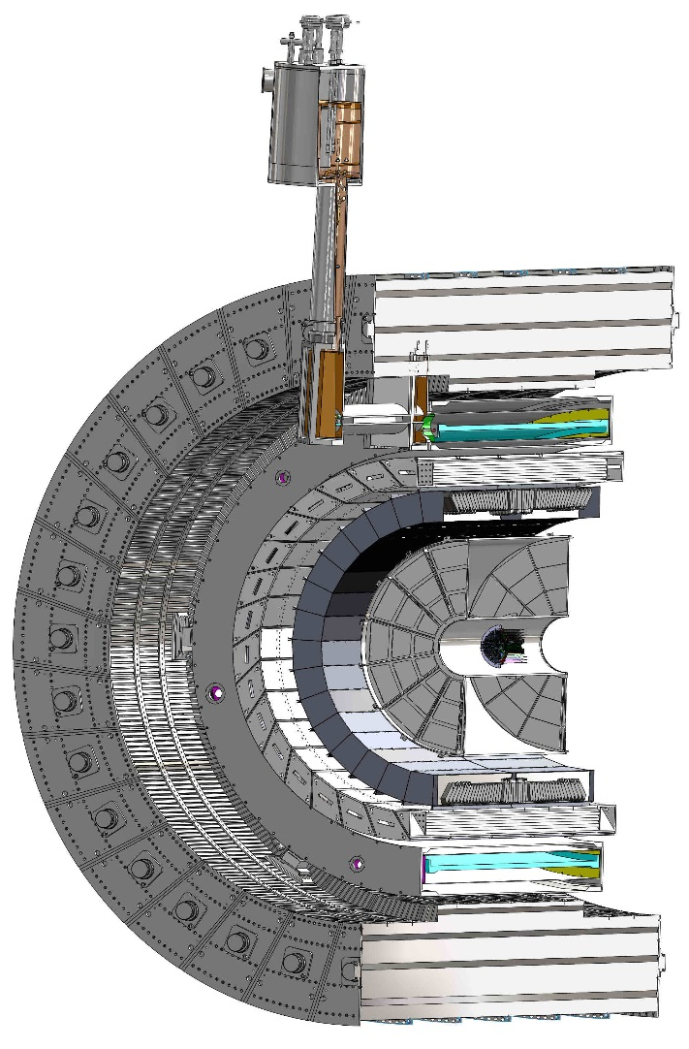
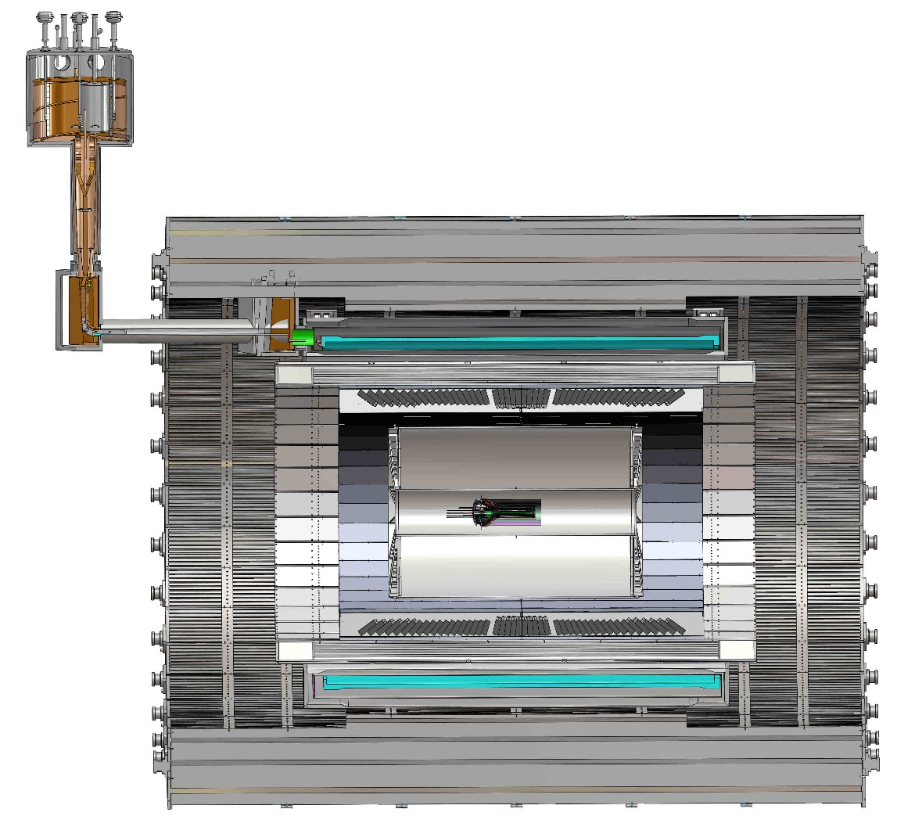
Cable routing
ALICE: 2.3+6 = 8.3m
sPHENIX: ~6m
L 3500.0 mm
R= 209.6cm
R 2,096.0mm

Slide 4
SamTec cables, FPC power extension
MVTX Plan: ~ September 2018 @CERN
  Reproduce ALICE test results at CERN in September 2018
  Produce a few HICs with extended power cables (~35cm), confirm signal integrity etc.

Slide 5
Stave Signal: ~20% difference observed at LANL
dV ~ 100mV/10cm

Slide 6
ALICE Noise performance

Slide 7
Radiation Level - Summary
RUs
  Flux << 1kHz/cm² outside of sPHENIX Hcal, all Z
  ALICE tested OK to 1kHz/cm²
Staves
  ALICE NIEF fully tested to 1.7 x 10¹³N_{eq}/cm²
  ALICE ITD fully tested to 509kRad
  Instant rate tested >20x, OK
MVTX Plan:
  Spares, 2-full inner layers + 8
  Continue testing sensors to higher level in US/LANL, in FY19

Slide 8
Radiation Level Outside of HCal: for Electronics
Simulation from Jin Huang, 7/2018
R = 274 cm
Z =0
AuAu 200kHz
Flux = 0.002/cm^2 x 200kHz x190/650
= 120 Hz/cm^2 << 1kHz/cm^2(ALICE)
RU tested OK to 1kHz/cm^2 at ALICE

Slide 9
Dose rates in ALICE experiment
Dose-rate distribution over experimental program:
IP collisions: 13nb⁻¹ Pb-Pb + 50nb⁻¹ p-Pb + 6pb⁻¹ pp
  90 krad over 6 years
  Pb-Pb runs dominant, responsible for 92% of the dose
    15 krad at L0 over about 4 weeks every year -> about 0.4 krad/min at L0
Beam-gas interactions:
  170 krad over 8 years (70 krad in first 4 years, 100 krad in the 4 years thereafter)
  Scales with vacuum pressure (8.3x10⁻⁹ mbar assumed)
  Background from p runs dominant:
    Max. 25 krad at L0 over about 8 months every year -> about 0.08 rad/min at L0
Max dose rate at 50kHz Pb-Pb collisions in L0 expected to be <0.1 krad/h ≈ 1.7 rad/min

Slide 10
ALICE TID Summary
  Extensive test program performed on sample with >10 chips, at various dose rates, going to various doses (currently up to 500 krad)
    Study of behaviour during irradiation and annealing
    Program started with aim to validate sufficient radiation tolerance for Outer Barrel (98.2% of detector surface), since then going to increasingly larger doses
  At doses up to 500 krad the chip remains fully functional without a degradation of peformance (see also in presentation on Summary of Results of Beam Test Campaign)
  Safety factor ≥50 for Outer Barrel (expected dose: ≤10krad, 98.2 % of detector surface)
  Safety factor ≥1.8 for Inner Barrel (expected dose: ≤273krad, 1.8 % of detector surface)
At dose rates >20 times larger than max expected in experiment, no effect of TID observed on digital and analog supply currents up to 320krad
At dose rates >20 times larger than max expected in experiment, no effect of TID observed on DACs up to 320krad
Threshold change with dose can be efficiently readjusted by according DAC settings
  Fake-hit rate remains almost unchanged after up to 500krad with readjusted thresholds

Slide 11
Stave Wire Bonds
25um wire length ~<1.0mm, triple-bond
  Resonance frequency ~53.5kHz
  ALICE tested 40-400kHz, no issue observed @B=0.5T
Plan:
  Join ALICE on-going work on this at CERN
    Corrosion, coating/encapsulation
    Resonances
  Test low frequency region 5~20kHz @CERN in September 18, sPHENIX 15kHz trigger
    Possible test at 1.5T using ATLAS lab?
  Possible encapsulation and impact on cost/schedule
    Stave production contingency (20%)
    R&D done at LBNL
f0 ~ 23.77x(1.5mm)^2 = 53.5kHz
12.75x(2mm)^2 = 51kHz
8.92 x (2.8mm)^2 = 64.3kHz

Slide 12
ALICE Stave PRR 4/2017

Slide 13
ALICE Stave PRR

Slide 14
B-field test
sPHENIX: B = 1.5 T

Slide 15
ALICE B-field
Additional cost
for encapsulation?

Slide 16
ALICE Stave PRR

Slide 17
ATLAS Wire Bonds Study - ref
25 um diameter IBL-like FE-flex wires with dierent lengths2 l (1.5 mm, 2.0 mm, 2.8 mm)
Resonance frequency:

Slide 18
ATLAS Wire Bonds Study

Slide 19
ALICE IB Stave

Slide 20
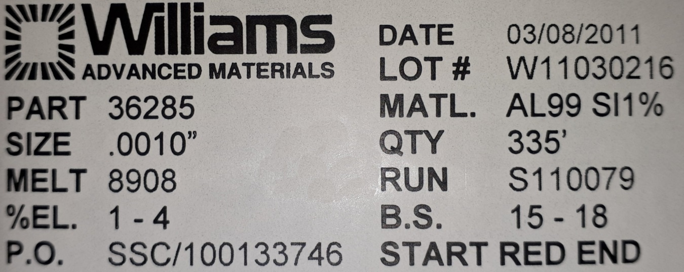
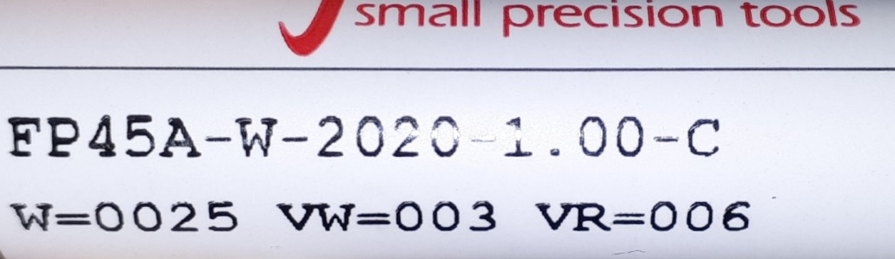
Bonding wire/Wedge
Wire 25 uM
Wedge

Slide 21
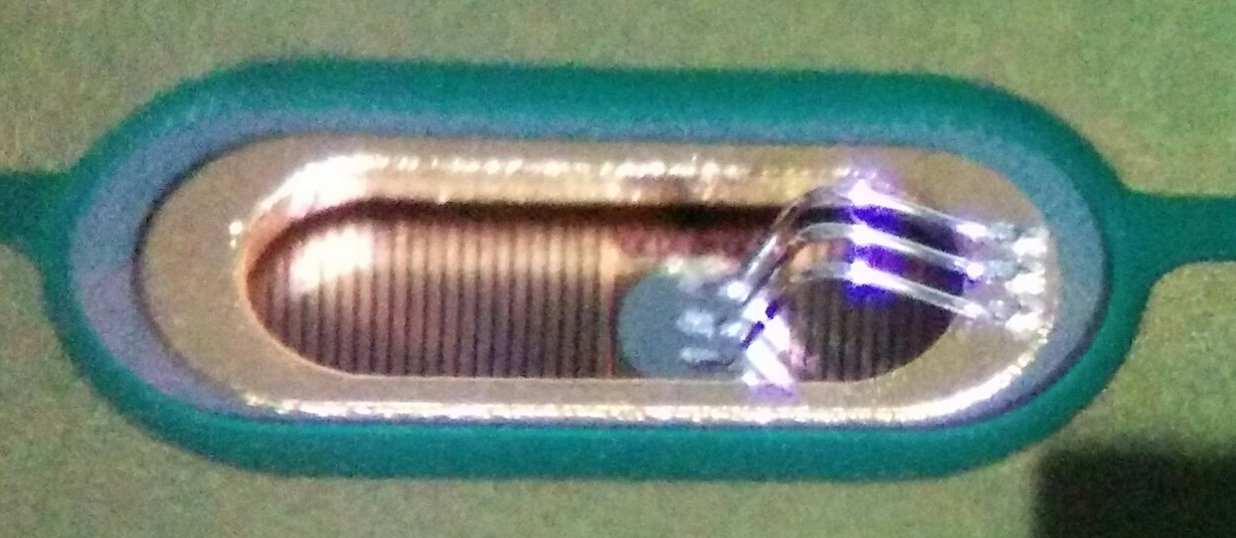
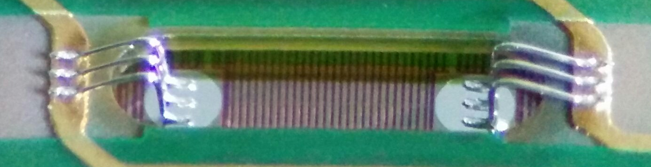
Main parameters: Loop shape
All connections (signal excluded)
ITS Outer layer
Signal connections

