Slide 1
Readout Unit Overview
J. Schambach
University of Texas at Austin
July 19–20, 2018

Slide 2
MVTX Readout Electronics – Technology Choice
Based on ALICE ITS Upgrade electronics
Requirement: Less than 5% additional dead time @ 15 kHz average trigger rate and simulated occupancy
Same Readout Units as ITS, but different Data Aggregation Module (ATLAS FELIX)
Trigger Rate: 15 kHz
Comparison ITS – MVTX:
  Peak Au+Au collision rate: 200kHz (sPHENIX) : 50kHz (ALICE)
  Peak p+p collision rate: 13 MHz (sPHENIX) : 200kHz (ALICE)
  Event size, dN/dy : sPHENIX = 1/3 ALICE(pp), 1/5 ALICE(AA MB), 1.1 ALICE(AA central)
  Trigger/readout rate: 15kHz (sPHENIX) : 50kHz (ALICE)
  Expected average data rate: MVTX = 30% of ALICE (mostly central AA events, lower trigger rate)

Slide 3
sPhenix Readout Electronics System
Hardware
  48 ALICE ALPIDE Staves + Interface Cables
  48 Front End Electronics (ALICE RUv2)
  6 Back End Electronics (ATLAS FELIX v2.x)
  6 EBDC server
  24 Power Boards + Supplies + Cables
  48 Stave to RU cables
  144 data fiber optic cables (3 fibers x 48 FEE)
Electronics Spares ~20%
Stave Spares ~75%

Slide 4
Readout Unit Design

Slide 5
ALICE Readout and O2 System Overview
GBT & TTC
(192 + 80) &1
GBT
data links
(9215)
Trigger links
(4039)
PON
TTS links
(500)
PCIe

Slide 6
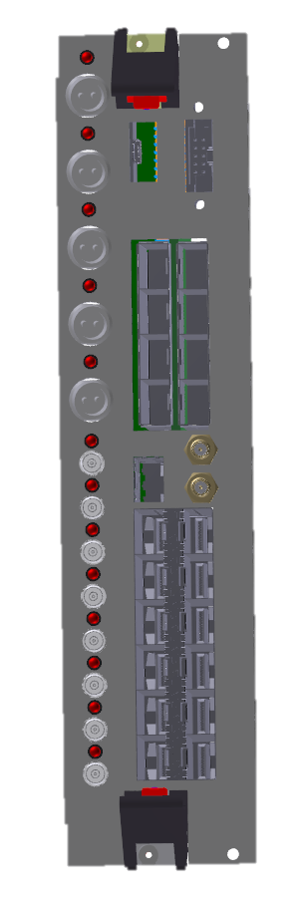
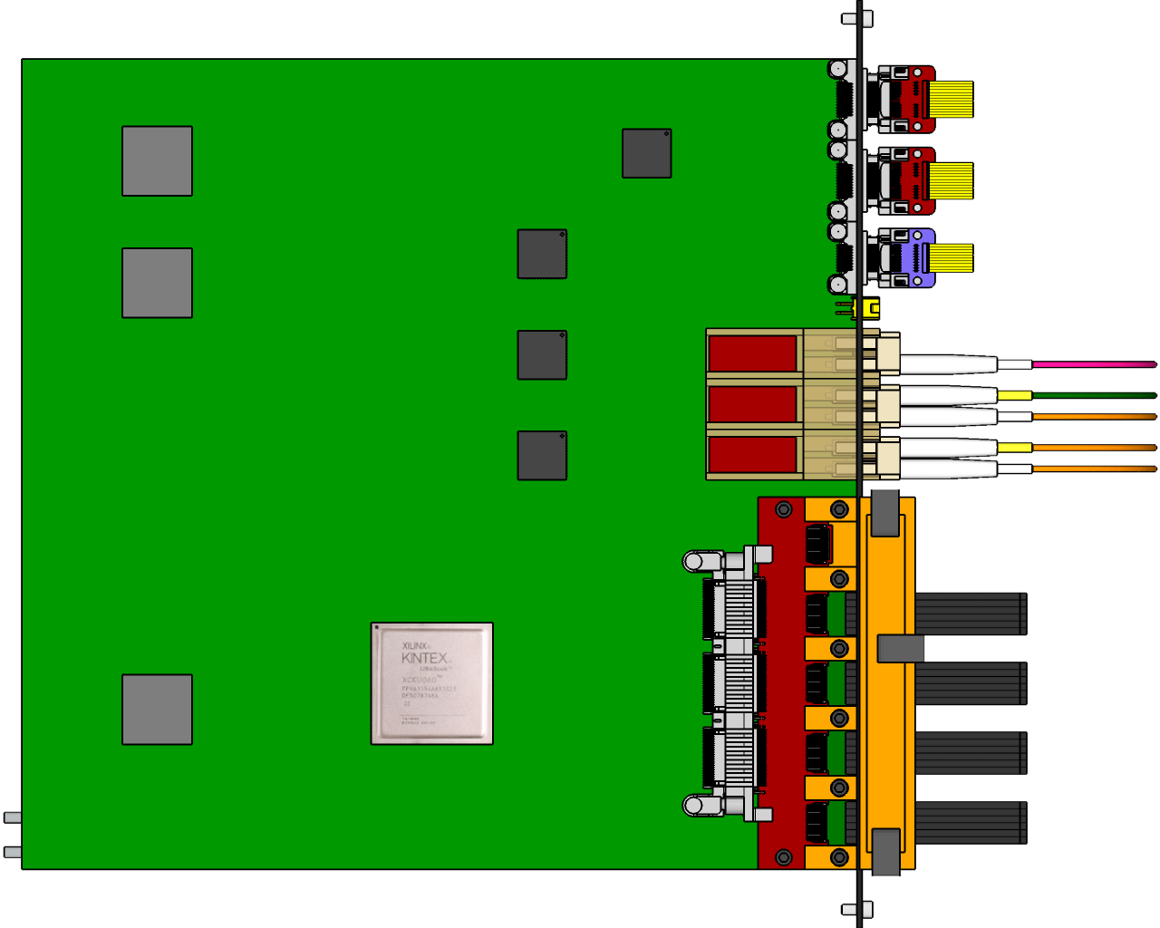
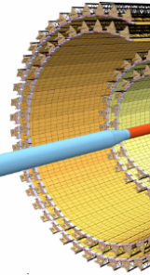
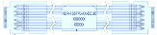
ALICE ITS Readout System
Central Trigger Processor (CTP)
LTU
Cavern
Counting Room
Detector Control System (DCS)
< 10 krad
< 10¹² 1 MeV n_{eq}/cm²
< 1 kHz/cm² Hadrons (>20 MeV)
0.5 T
1 Mrad
10¹³ 1 MeV n_{eq}/cm²
Trigger
(GBT Link)
NO RADIATION
First Level
Processor (FLP)
PCIe
Common Readout
Units (CRU)
GBT links
…
…
x 192
~8 m
Copper Links
GBT links
One READOUT UNIT
for each STAVE
~150 m
Optical Links

Slide 7
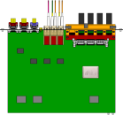

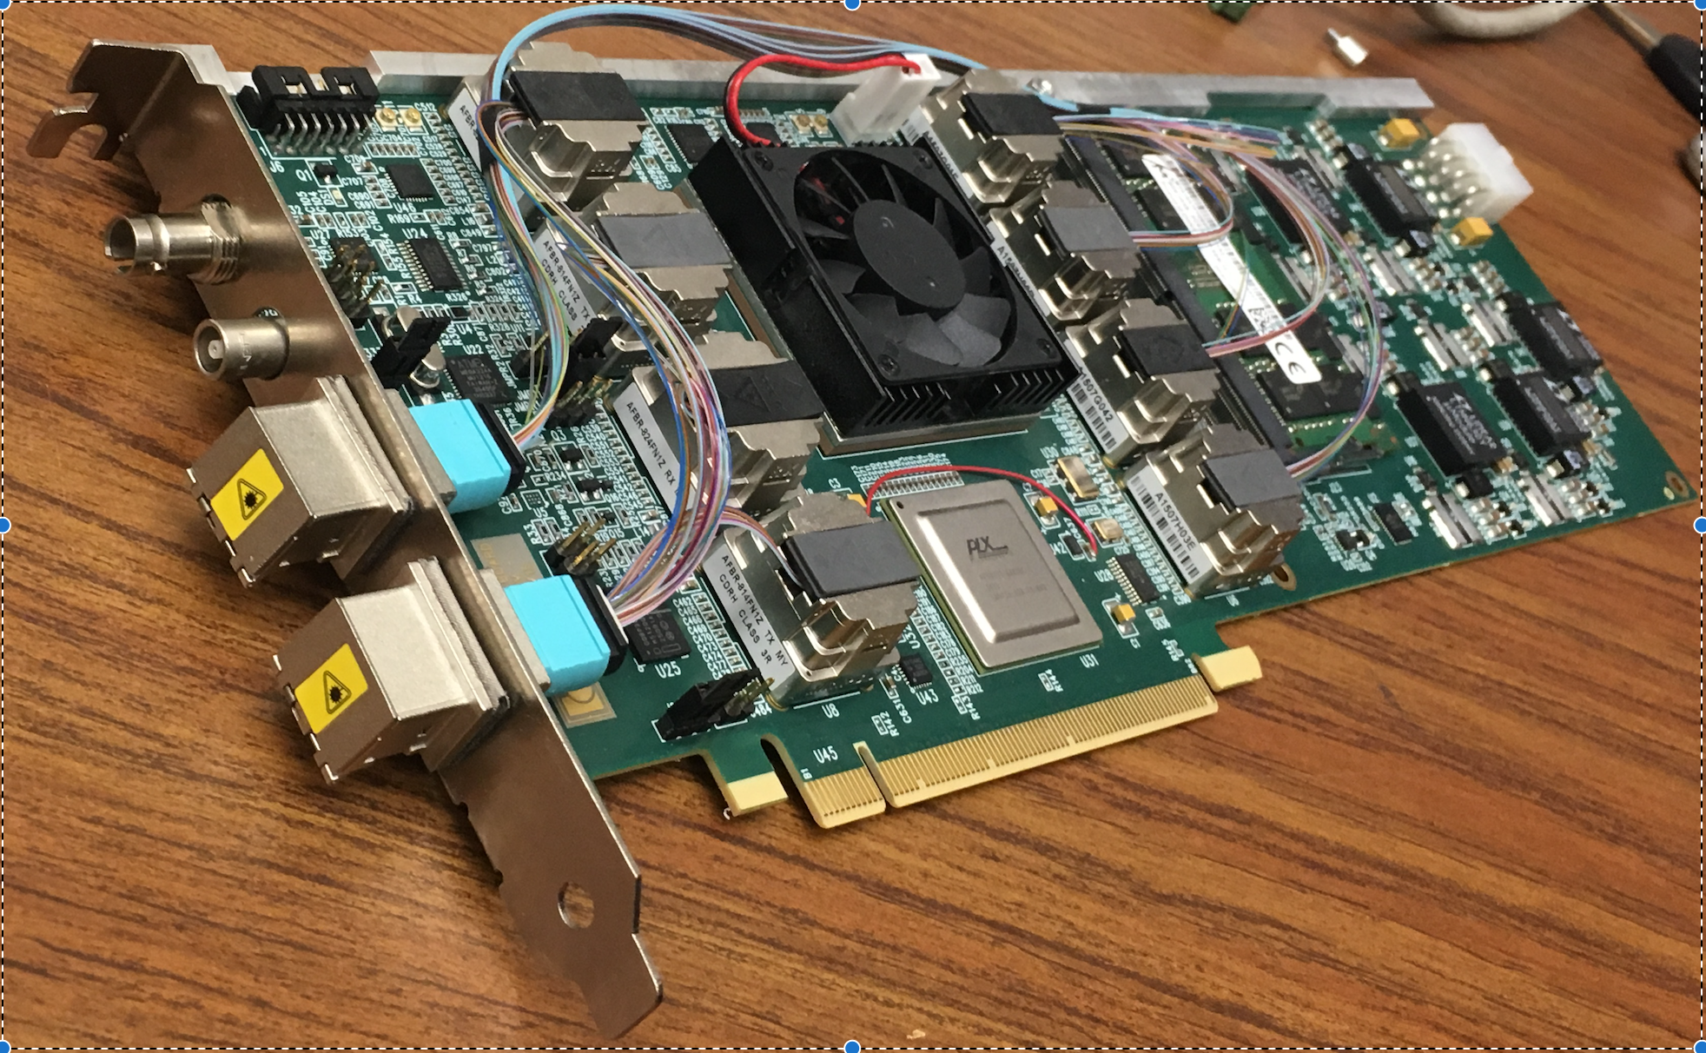
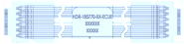
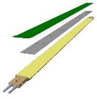

MVTX Readout System
CAN bus
DCS
5-10 m
Trigger & Clock
Readout Unit
Front End
GBT Optical Links
9-sensor Stave
9 Data (1.2Gbps)
1 Clock, 1 Control/Trigger
Control
Data (9.6 Gb/s max)
Trigger
Samtec Twinax “FireFly”
FELIX
Back End
FPC
Power
Alpide Sensors
Power
Filtering Capacitors
regulators
Power supplies
Cold Plate
Regulated Power
Power Board
Interaction Region
Experimental Hall
Counting House

Slide 8
Readout Unit – Top Level Block Diagram
CAN
Bus
Main SRAM
FPGA
FLASH
FPGA
FLASH
Memory
3 × GBTx
Rad-hard by design
Low cross section per bit (not zero!)
GBT
SCA
Rad-hard CRAM
(but SEFI possible)
USB
3.0
4 × I²C
Hardware includes:
Xilinx Kintex Ultrascale KCU060 FPGA
4 Rad Hard GBT Fiber Optic Transmitters (3.2 Gb/s)
2 Rad Hard GBT Fiber Optic Receivers (3.2 Gb/s)
12 channel twinax copper interconnects to stave
CANbus interface
Power board control interface
Sensors

Slide 9
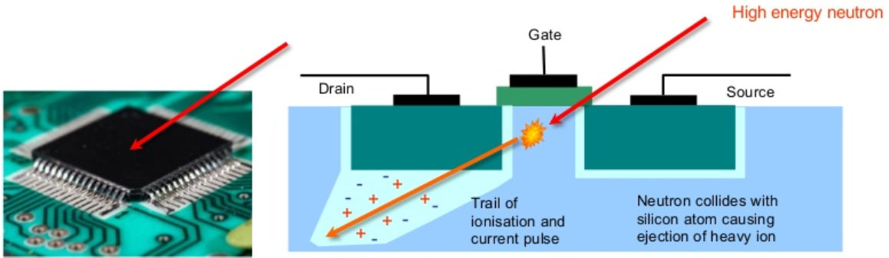
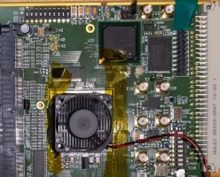
Scrubbing
Scrubbing is an error correction technique that uses a background task to periodically inspect/correct errors in a data memory.
  Data memory = Config mem of Xilinx Ultrascale
  Errors caused by single event upsets
Relevant scrubbing techniques for the RU:
  Xilinx Soft Error Mitigation Core (sem IP) ¹
    Supported by Xilinx
    Detection and correction
    Fast
    Black box design
    Sem IP core only partially mitigated
    Scan starts from zero upon an upset
  External Scrubbing network
    Proven solution (ALICE TPC RCU1) ²
    Full control of design
    No support by Xilinx
    Substantially slower than sem IP
    Mitigation of Flash and aux FPGA is needed
Aux FPGA
¹ https://www.xilinx.com/support/documentation/ip_documentation/sem_ultra/v3_1/pg187-ultrascale-sem.pdf
² https://cds.cern.ch/record/1141616, chapter 4

Slide 10
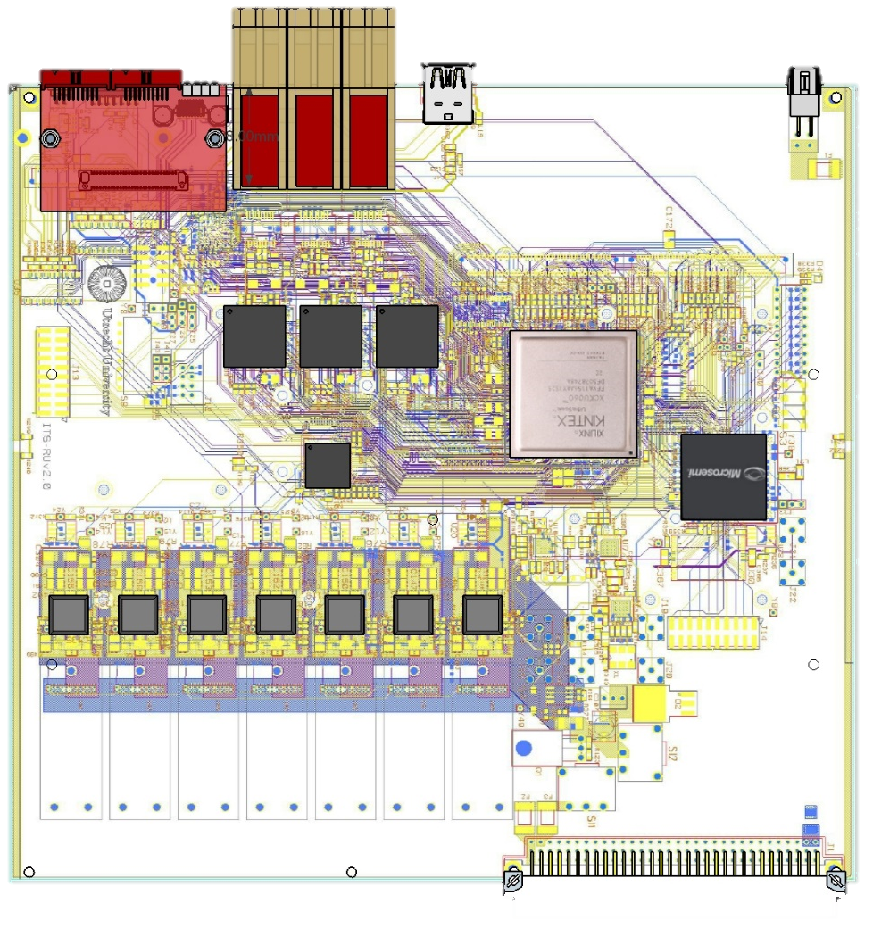
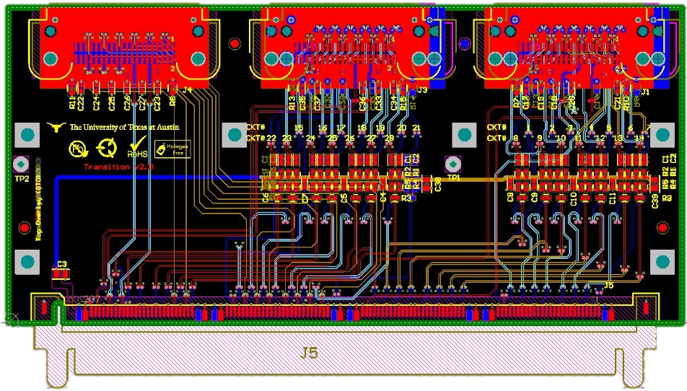
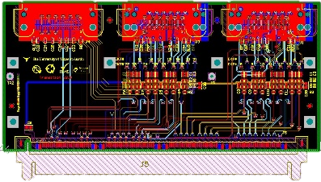
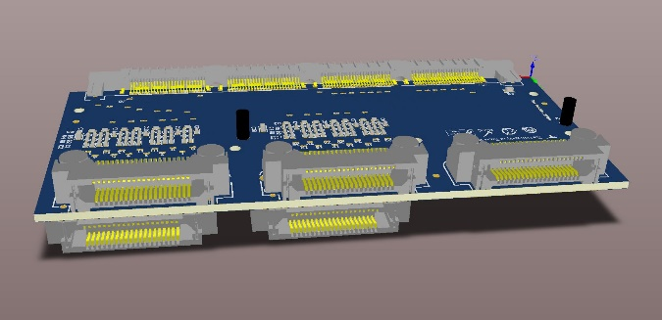
Readout Unit – Connection to Staves
The RU must comply with MFT and sPhenix specifications, which require using 25 and 27 GTX lanes, respectively, for reading the sensors. To solve the routing, an interchangeable mezzanine card solution (Transition Board) has been adopted.
5 connectors (A,B,C,D,E), 12 pairs each
Connector
A
B
C
D
E
ITS IL
used
ITS ML/OL
unused
1.2 Gb/s
400 or 600 Mb/s
MFT ID
Unconnected
MFT OD

Slide 11
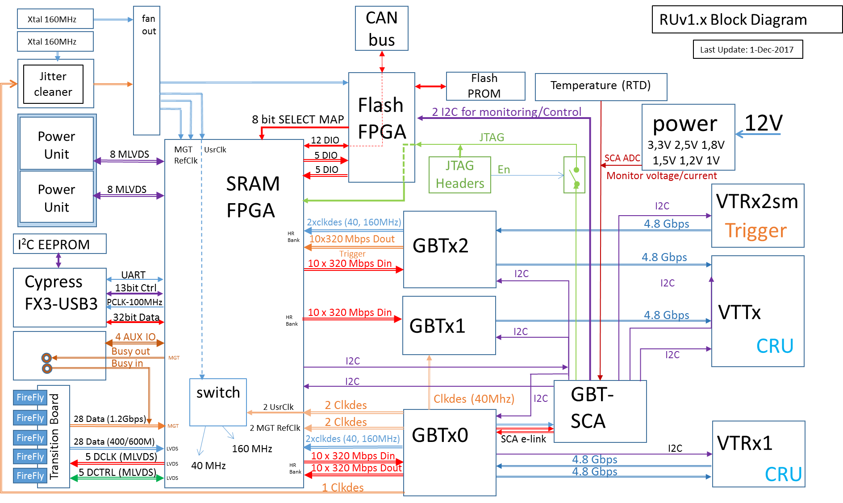
Readout Unit – Detailed Block Diagram

Slide 12
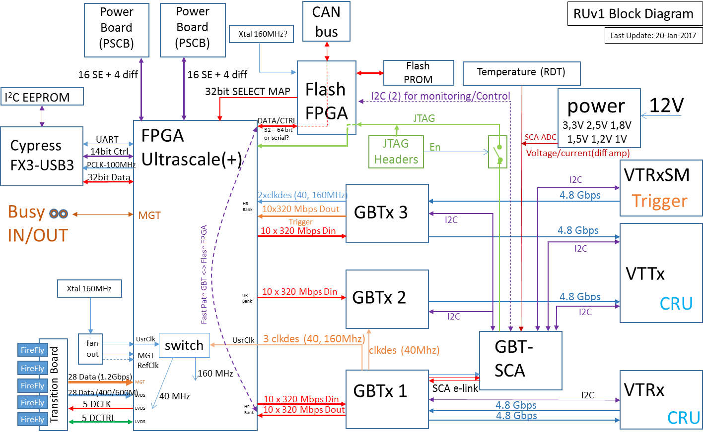
Readout Unit – Data Path

Slide 13
Readout Unit – Trigger Path

Slide 14
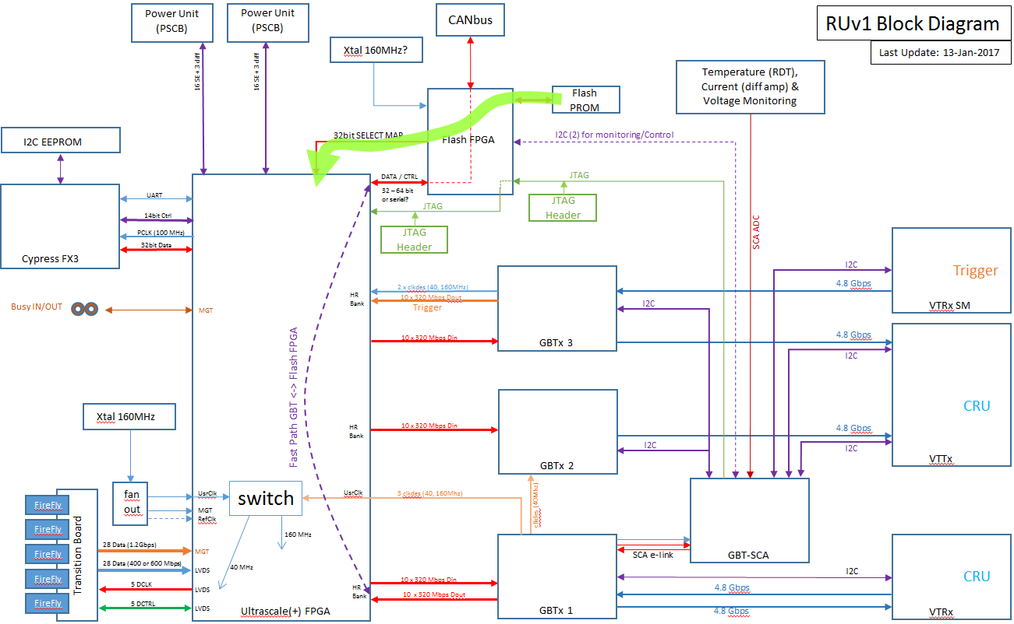
Scrubbing via Flash FPGA
Flash Prom=>PA3=>US(+)select map

Slide 15
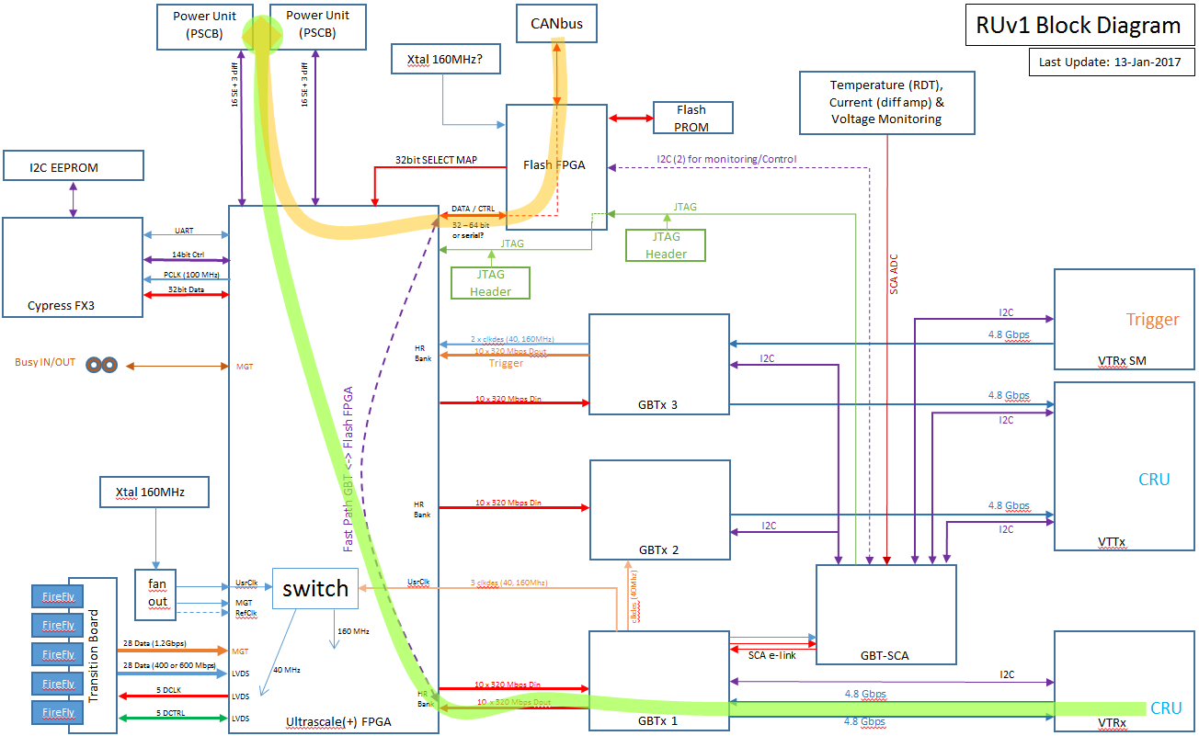
Power Unit Control via GBT or CANbus
Main: CRU=>GBT=>US(+)=>Power Board (2*16SE+2*I2C)
Alternative: CAN=>PA3=>US(+)=>Power Board (2*16SE+2*I2C)

Slide 16
ITS Upgrade Master Plan
2016
2017
2018
2019
2020
PRR
Sensor Series Production
CMOS processing, thinning & dicing, test
Advantage of fabricating MVTX RUs as part of the ITS RU production:
technical risk can be reduced
Cost savings due to the volume of parts of as much as 50%
OB Stave Develop
PRR
Stave Mechanics
HIC Production
Outer Barrel
Stave Production
Mechanical Support Structures
Dry Assembly Test
Development
Production
EDR
PRR
Readout Electronics
Global Assembly
Commissioning @ Surface
Design & Prototyping
Design & Prototyping
Production & Test
Installation
EDR
PRR
Commissioning
Commissioning in ALICE
14 months

Slide 17
Prototypes and Tests

Slide 18
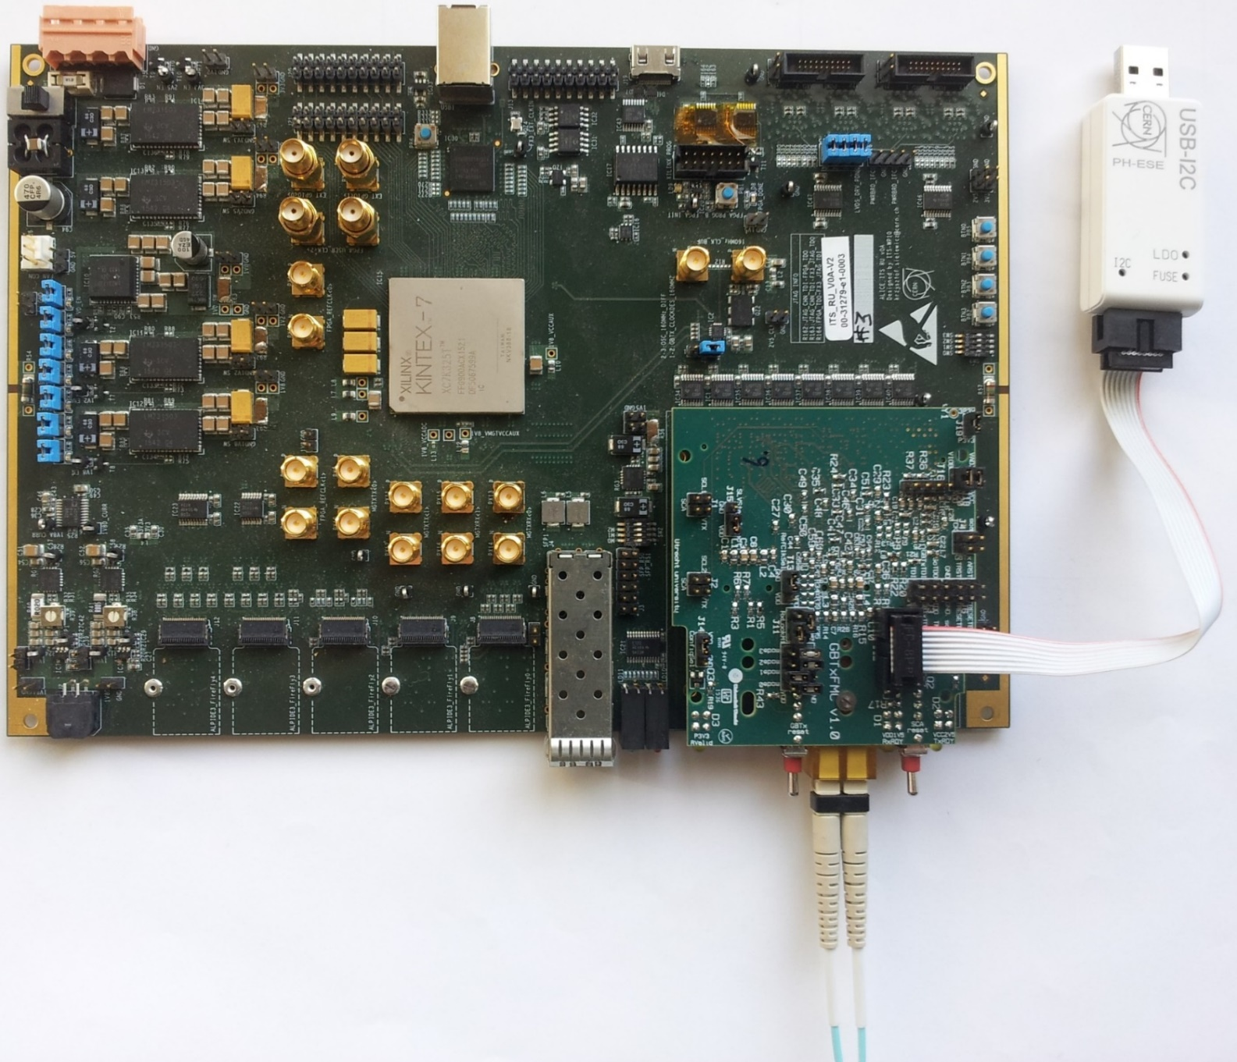
First Readout Unit Prototype: RU Version 0 (“RUv0”) and GBTxFMC
Separate Boards for FPGA and GBT
Based on Xilinx Kintex-7 FPGA
Integrated USB Interface for debug
Separate Fiber connection for emulation of the CRU
Integrated Power Supply to power sensors independent of Power Unit
GBT components on separate board connected via FMC
Various sensor connector configuration to prototype both Inner & Outer Barrel
VME 6U form factor
Used for initial verification of electrical interfaces
Initial experience with GBT parts
Used for radiation testing of fundamental firmware components and initial testing of mitigation techniques

Slide 19
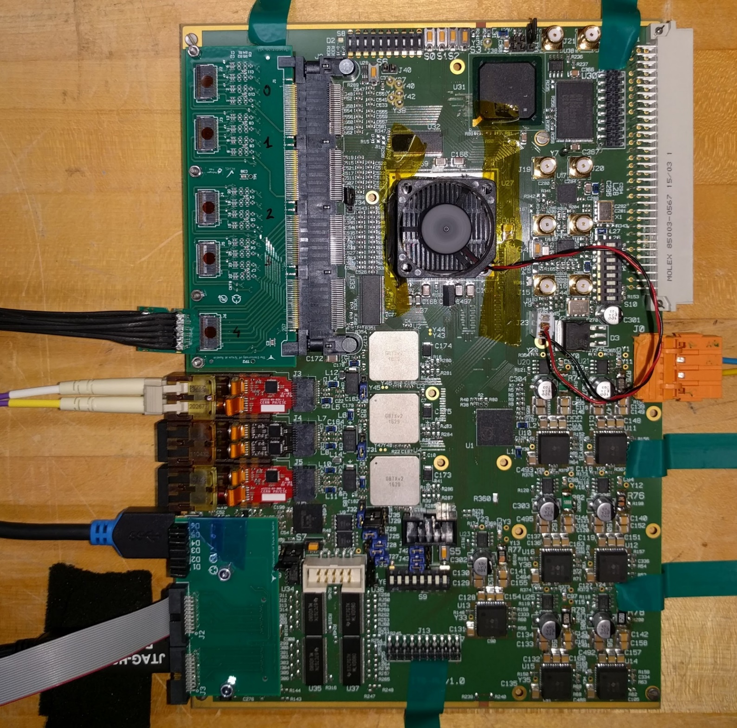
Readout Unit Prototype Version 1: “RUv1”
6U VME size
Based on Xilinx Kintex Ultrascale FPGA (better radiation performance, more resources)
Eliminate all extra components from RUv0
Use close to final component types and numbers
Layout close to final design
8* RUv1.0 boards produced
  2 * August 2017
  6 * September 2017
13* RUv1.1 boards produced (minor modifications and bug fixes)
  6 * November 2017
  7 * March 2018
Power
PA3
Ultra Scale
GBTx
GBT
Fibers
Transition Board
Power Mezz
To
Sensors
USB
To
Power
Board

Slide 20
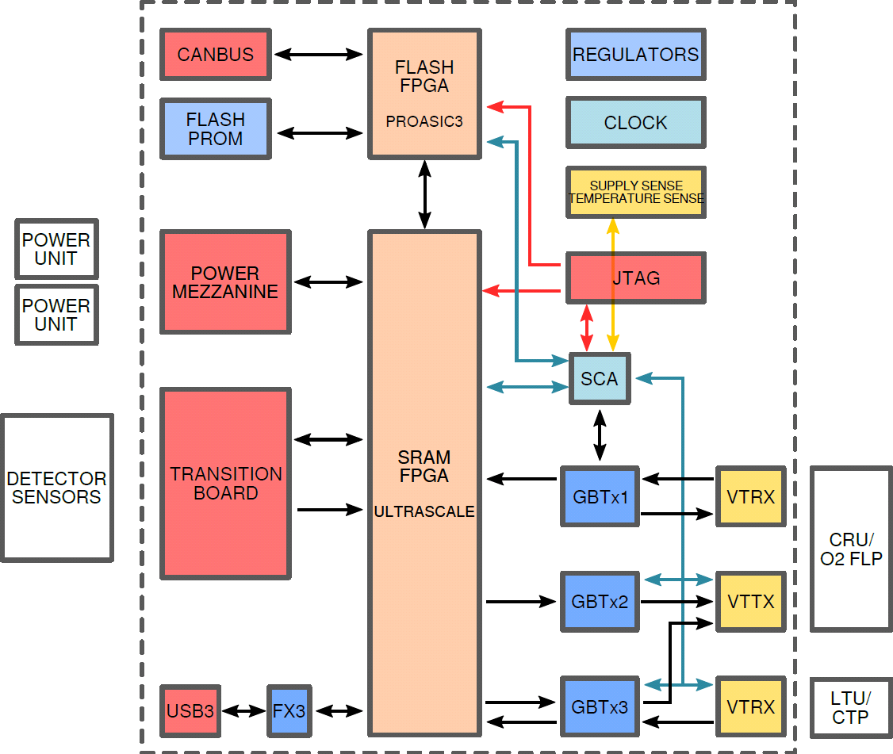
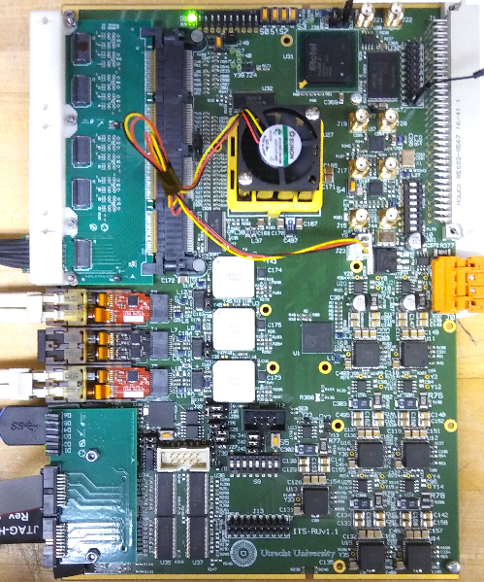
Prototype Version 1: “RUv1”

Slide 21
RUv1 Tests Completed
RU power section
  7 DCDC regulators (accuracy, noise, ripple, Inrush, sequencing)
  I_{SENSE} offset problem solved by replacing amp AD626=>AD8418
Communication with sensors/Alpide using transition board & firefly
  CLOCK, CONRTOL, DATA @ 1.2Gbps and 400 Mbps
Communication via 4.8 Gbps GBT links (GBTx/1/2, VTRx/VTTx)
  Access & program GBTx using Cern USBI2C dongle (connector bug)
Communication with the SCA-chip
  monitor voltage/current, temperature, VTRx optical power
  I2C, JTAG, GPIO interface
Clock distribution: jitter/levels on crystal oscillators, jitter cleaner and clock buffer
USB3 (using FX3 chip) communication & boot from I2C PROM
JTAG chain (primary US & PA3 program, secondary FX3 & GBTX/1/2)
Program Xilinx US with PA3 via select map interface
Communication with the PU using front pannel I2C
FLASH PROM (access, read-ID, read & write)
CAN transceiver

Slide 22
Radiation Validation – Latest Beam Tests
Facility | Date | Goal | DUT | Particles | Flux¹ [p cm⁻² s⁻¹] | Fluence² [p cm⁻²] | Duration [hours] | Notes
Prague | 2015-2017 | Firmware protection | RUv0 | Protons 30 MeV | 1×10⁷ | 4×10¹² | 4×48 | Beam limited to the FPGA only. Most effective way to check firmware design.
CHARM | Oct 2017 | Cavern spectrum overall evaluation | RUv1 | Mixed field | 5 kRad/day (≈5×10⁷ n/day) | 10 kRad (≈1×10⁸ n cm⁻²) | 48 ÷ 96 | CHARM gives ≈2×10⁷ HEH (30% to 80% being neutron) for each delivered kRad of TID. Destructive test due to TID.
Louvain | Nov 2017 | High statistics DCDC test | DCDC boards | Neutron 23 MeV | 1×10⁸ | ≈1×10¹³ | 8 | Extended reliability test sor SEL/SEU only (no TID effects at first order). Neutron spectrum > 10 MeV. NON destructive.
Prague | Dec 2017 | Firmware protection | RUv1 | Protons 30 MeV | 1×10⁷ | 1×10¹² | 24 | Beam limited to the FPGA only. Most effective way to check firmware design.
Prague | Jan 2018 | Firmware protection | RUv1 | Protons 30 MeV | 1×10⁷ | 1×10¹² | 24 | Beam limited to the FPGA only. Most effective way to check firmware design.
ChipIR (Oxford) | March 2018 | SEE with no TID on PA3 | RUv1 | Neutron ≤ 500 MeV | ≈1×10⁶ | ≈1×10¹¹ | 12 | Further verification of the system without destroying PA3 programmability (which dies around 10 kRad).
GIF (CERN) | 2018 | TID, scrubbing with realistic flux | RUv2 | Mixed | 1×10⁴ | ≈1×10⁶ | 62 | Easily accessible verification tool for TID and scrubbing behavior testing/verification.
Prague | 2018 | Further FLASH / Firmware tests | RUv2 | Protons 30 MeV | 1×10⁷ | ≈1×10¹² | 24 | Further investigation about the FLASH (flux threshold effect?). Benchmarking of extra TMR in key firmware blocks.
# Readout unit number is that one registered in the WP10 material inventory. They are rotated to account for appropriate cool-down periods and/or damage. ¹ Realistic flux obtainable at the specific facility ² Integrated flux over the irradiation time AND number of DUTs

Slide 23
Radiation Validation – Current Status
The system will operate in the ALICE cavern radiation environment, with a total TID of about 10 kRad (safety factor 10) and a high energy ionizing particle flux of 1 kHz cm⁻². Upsets in the logic are the main concern, while TID is extensively tested.
The Readout Electronics has been designed to incorporate hardware (hardware TMR and scrubbing subsystem) and firmware protection (TMR, ECC, etc.) against SEE effects.
So far tested in
6 specific test beams at the Rez facility in Prague (30 MeV proton) for firmware and scrubbing verification.
1 test beam at the CHARM facility (including the Power Unit) in a realistic mixed radiation field.
1 neutron test beam in Louvain (23 Mev Neutrons) specifically intended to further verify DCDC (LMZ31710RVQ)
1 neutron test beam at Oxford ChipIR (up to 500 MeV Neutrons) for whole system testing
Scrubbing from auxiliary FPGA working and effective.
In Any Case: even without using the scrubbing, the firmware proved resilient enough to SEE to operate on average for 1300 hours (29 h full IB or 10 h full OB) before experiencing any upset which would require recovery.
Data interruption in case of firmware upset has been measured and lasts on average one second for the affected lane, or a few seconds if a reset of the FPGA is necessary.
Errors on clock resources or other key subsystem are negligible (too rare to gather any significant statistics).
Commercial DCDC proved compliant with the task, one power glitch every 72 hours foreseen within the whole ITS.

Slide 24
Radiation Validation – Overall Summary
Failure mode | Affected section | Estimated occurrence in ITS operations (average MTBF) |  |  | Corrective action | Downtime per occurrence
 |  | IB | OB | Whole ITS
Sensor data lane | 1 sensor for IB ½ module for OB | 22 - 40 h | 4 - 6 h | 3 - 5 h | Self-repairing | < 1 s >
GBT data* | 1 full stave | 29 h | 10 h | 7 h | 30% self repairing, 70% reset by slow control | < 5 s >
Clock resources | 1 full stave | Negligible | Negligible | Negligible | Reset by slow control | < 5 s >
Transceiver settings | 1 sensor, IB only | > 932 h | – | – | Reset by slow control | < 5 s>
Flash memory | 1 full stave | Negligible | Negligible | Negligible | FLASH reprogramming (30 s beam off, 30m beam on) | 30 s – 30 m
¹PA3 | 1 full stave | 172 h | 58 h | 43 h | Reset by slow control | < 0 s>
²DCDC power glitch | 1 full stave | 294 h | 98 h | 71 h | Power cycle | < 10 s >
* Data for the non-TMR block, final version will use TMR protected block. This failure mode also include sensor control and clock failures. ¹ When PA3 get stuck the main FPGA is not compromised, and therefore no downtime occurs. TMR of key block in PA3 firmware will further improve that. ² Considering 200 RU with 8 DCDC each (20% overestimation)

Slide 25
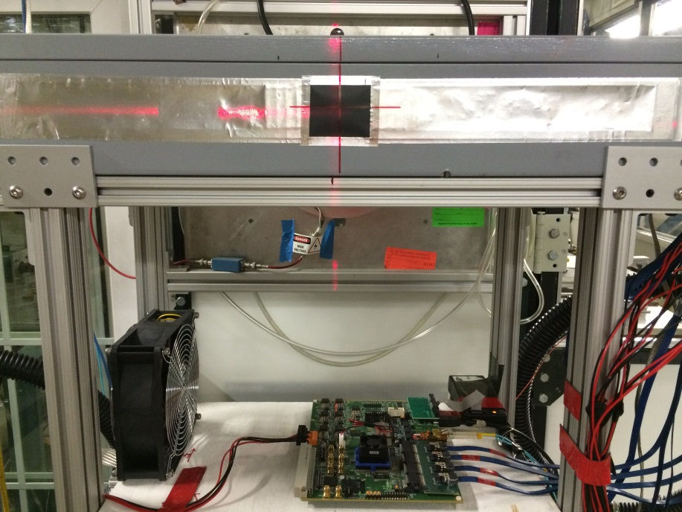
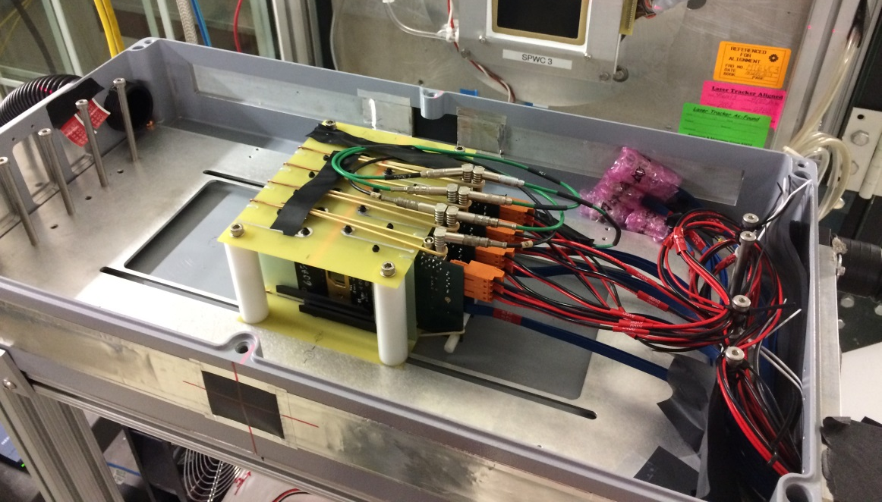
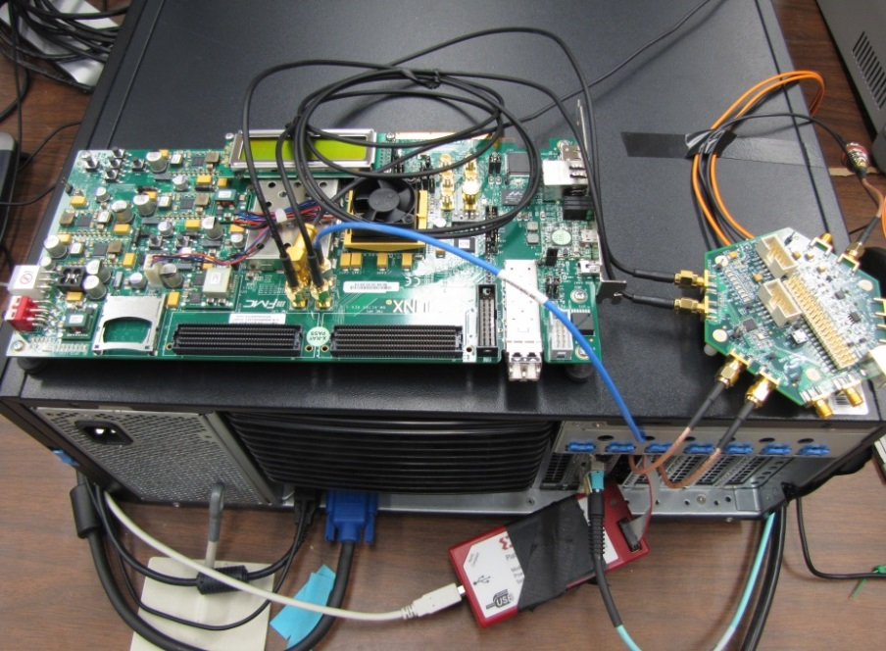
4-Alpide Telescope with RUv1 at Fermilab Beam Test
4-ALPIDE Telescope;
5m long SamTec cables
RU
Highlights:
Primarily 120GeV proton beam; also with low energy pion beams
Beam trigger rate ~7kHz
Tested High ALPIDE occupancy runs, with 10cm lead bricks in front of the sensors
See Sho’s talk for details
FELIX in Server
KC705
To process
Scintillating Paddle
Trigger
40 Mhz
Clock

Slide 26
RU Production Version “RUv2”

Slide 27
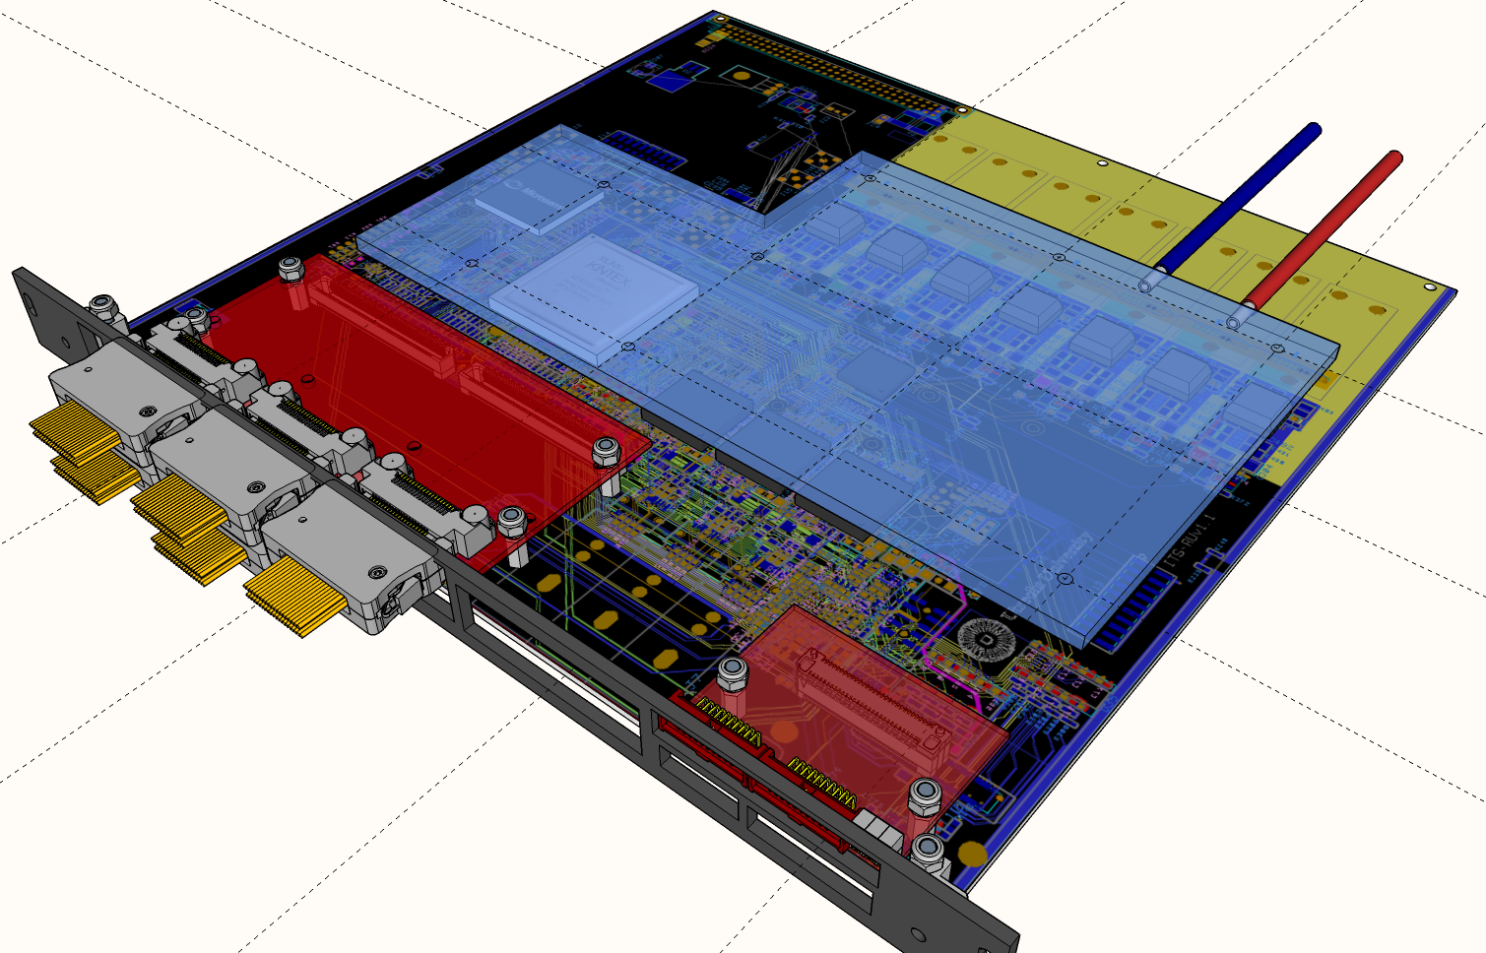
Readout Unit Version 2 – 3D rendering of the Production Version

Slide 28
Main differences RUv1 -> RUv2
 |  | RUv1_x | RUv2
1 | Dimensions | 160x233 mm | 220x233 mm
2 | Power connector | J0 (Weidmuller BL/SL 5.08) on back | J0 (MOLEX 172316) to front (J1 stays as it is + switch to select between J0 & J1)
3 | Transistion board connector | Samtec QFS/QMS type | 2 * Samtec ERF8-50... (USB3 connector also moved)
4 | Power Converters | Only COTS DCDC | Besides COTS also FEASTMP_CLP placeholder Updated DCDC placement for improved PI Use of blind via’s to further improve PI
5 | Removal high compements from the cold plate area, aiming for same cold plate power board
6 | Change Clock distribution with PA3 clock independent from jitter cleaner
7 | Remove secondary JTAG chain
Logic and layout of the board is mostly the same as RUv1.1

Slide 29
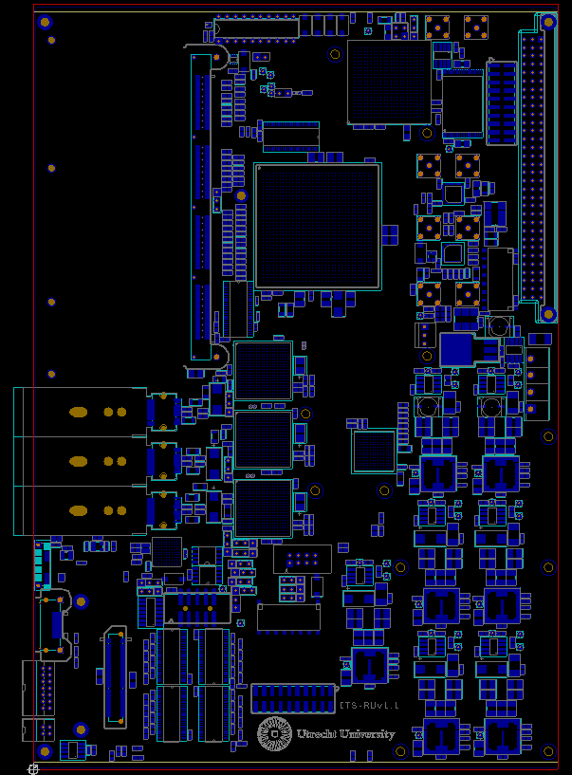
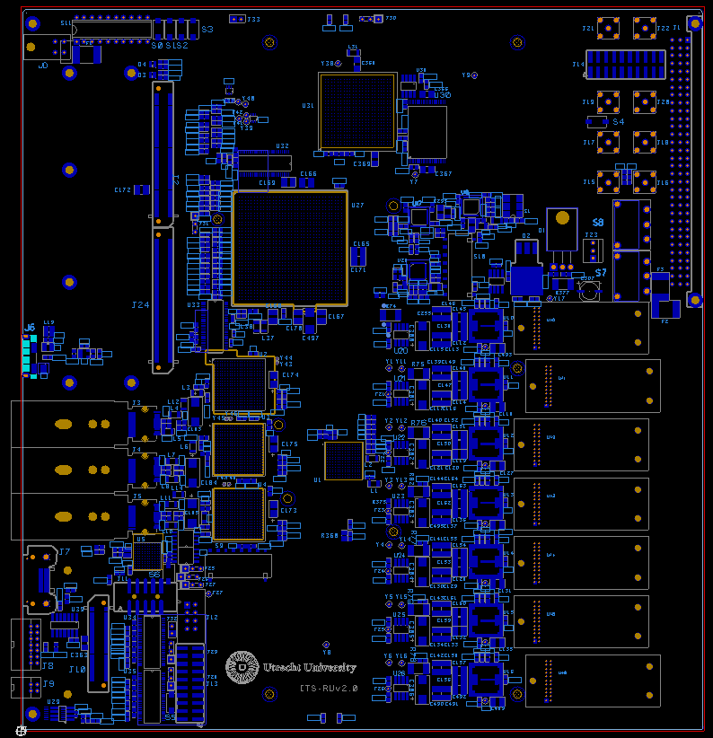
Main Differences RUv1 -> RUv2
1
5
2
3
4
5

Slide 30
Firmware

Slide 31
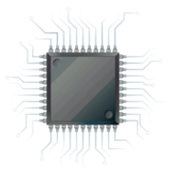
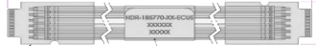
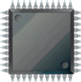

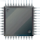
Firmware Overview
From/To ITS
SCA
From/To CRU
Copper Links
GBT Links
Programmable Logic
3.2 Gb/s
GBTx
Control
FLASH
Memory
3.2 Gb/s
Optical transceiver
VTRx
Data @ 3.2 Gb/s
FLASH
Memory
Data: 9 x 960 Mb/s
or 16/28 x 320 Mb/s
Firmware is mostly complete (see backup slides for an overview of the various firmware components) to accomplish these tasks and to mitigate SEEs; it has been used in various radiation campaigns and readout tests
FLASH
FPGA
3.2 Gb/s
GBTx
Optical transceiver
VTTx
Data @ 3.2 Gb/s
Control (80 Mb/s)
Data @ 3.2 Gb/s
SRAM
FPGA
Clock (40MHz)
3.2 Gb/s
3.2 Gb/s
GBTx
Optical transceiver
VTRx
Trigger
Main Tasks of the Readout Unit:
Receive triggers (heartbeat & physics) from CTP & decode
Receive “control” information from CRU
Deliver triggers to stave sensors
Control, configure and monitor stave sensors
Receive data from stave; decode & compress
Deliver monitoring information to CRU (forwarded to DCS)
Deliver CRU framed data packets to CRU
Determine and handle busy information
Monitor and control Power Board
Handle radiation upsets in programmable logic (& sensors)
Power Board
Power Unit (PU)

Slide 32
MVTX Production & QA

Slide 33
Readout Unit v2 Production
The RUv2 CERN tendering document is ready, including testing procedures (see following slides). Production is foreseen in batches and will last approximately 3-4 months. 4 Initial prototypes have been produced, and are currently being verified
  Activities at the Contractor’s premises
Quality control of the PCBs.
Ordering of passive and active components.
Input quality control of all components.
Assembly of the components on the PCBs and soldering.
Quality control of the assembled boards.
Packing, and shipping.
Batches
A pre-series totaling 10 boards;
A first batch totaling 106 series production modules;
A second batch totaling 106 series production modules;
A third batch totaling 88 series production modules.
Option for 80 more boards for sPhenix
    Hardware components
1 Xilinx XCKU060-1FFVA1156C (1156 pin BGA package)
1 A3PE600L-FGG484M FP (484 pin BGA package)
3 CERN custom GBTx chip (434 pin BGA package)
1 CERN custom made SCA chip (196 pin LFBGA package)
3 SFP+ pod connectors
2 ERF8-050-05.0-L-DV-TR connectors (100 pins, 0.8mm pitch)
Miniaturized passive components (0201 minimum)
    Key technical PCB parameters
10 layers low-loss material (Er < 3.7 at 5 GHz, Df < 0.012 at 5 GHz)
Maximum overall thickness of (1.57±0.13) mm
Copper Outer layer: 35 µm, Copper Inner layer: 17.5 µm
Holes per PCB: 5000
Minimum hole diameter: 0.63 mm
Blind vias (layers): 32 (1)
Minimum track width (outer layer): 110 µm, (inner layer): 100 µm
Minimum spacing (outer layer): 110 µm, (inner layer): 100 µm

Slide 34
Testing Overview within ITS
A total of 222 boards will be manufactured for ITS, 88 for MFT, option of 80 boards for MVTX
Testing will be done in a 2+ stage approach:
  1) Hardware testing at the manufacturer (only functional smoke test).
  2) Board bring-up, initial hardware verification and short-term functional verification at Nikhef/Utrecht.
  +) Long-term functional testing at collaborator sites (sampling) & during commissioning.
  For MVTX, the second stage of testing will be performed by UT Austin in combination with LANL
Nikhef/Utrecht
Acceptance and short term testing
Commissioning
Long term testing
Manufacturer
Up to smoke test
Sampling
Special/stress testing

Slide 35
Tests at Manufacturer’s Site (from Tender Document)
The contractor shall inspect all parts individually according to the applicable standards (see backup slides). All component defects and assembly errors shall be eliminated.
The contractor shall test 10% of the boards manufactured for ionic residues
The dimensions of the mechanical parts shall be checked to ensure conformity. Items which are outside tolerance for straightness, flatness, position of holes or other reasons shall be rejected.
The contractor shall have an approved and formal process designed to monitor and record each phase of the manufacturing of the supply, such that complete conformity with the requirements of this specification is achieved.
All specified tests and measurements carried out during all stages of production, from material procurement up to delivery shall be recorded. The contractor shall provide these records in electronic form (Microsoft Word, Excel, Project or OpenDocument and in PDF).

Slide 36
Summary
ITS Readout Unit satisfies the requirements of the MVTX Readout
ITS Readout Unit prototyping is successfully completed for electrical, functional and radiation performance
A Manufacturing Plan that includes RU production and assembly for MVTX is completed
Tender document will be posted after initial RUv2 prototype testing
A testing plan is in place and test components are being designed and fabricated
UT Austin will take responsibility for organization with ITS of the board manufacture and testing
Board testing after delivery will be performed by UT Austin in combination with LANL

