Slide 1
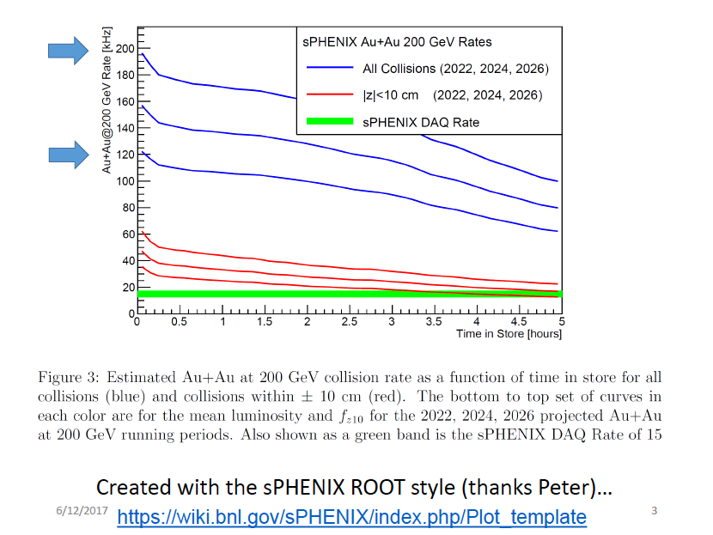
Expected Luminosities and Collision Rates

Slide 3
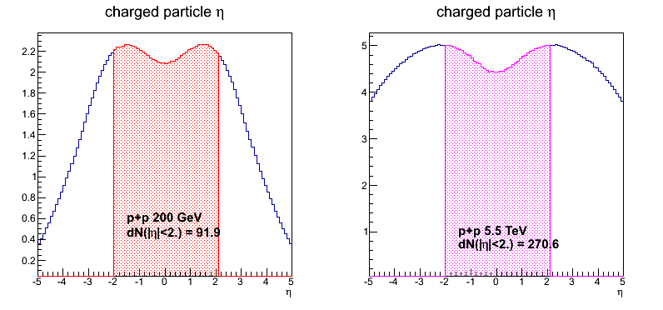
dN/dη in p+p collisions
With |η|<2.0 region, dN(ALICE) ~2.9*dN(sPHENIX).
sPHENIX
ALICE

Slide 4
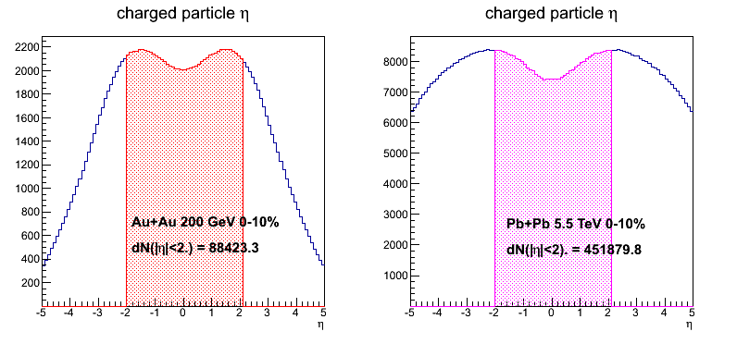
dN/dη in 0-10% Au+Au/Pb+Pb collisions
With |η|<2.0 region, dN(ALICE) ~5.1*dN(sPHENIX).
Ncoll(Au+Au)=962, Ncoll(Pb+Pb)=1670.

Slide 5
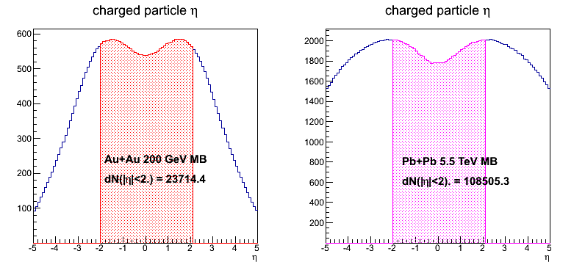
dN/dη in MB Au+Au/Pb+Pb collisions
With |η|<2.0 region, dN(ALICE) ~4.6*dN(sPHENIX).
Ncoll(Au+Au)=258, Ncoll(Pb+Pb)=401.

Slide 6
ALPIDE Modes of Operation
The ITS is planned to be operated in two modes:
Triggered mode: Pixels are latched with a short strobe window and read out based on an external trigger.
Continuous mode: Pixels are latched using a long, periodic strobe window and read out.

Slide 7
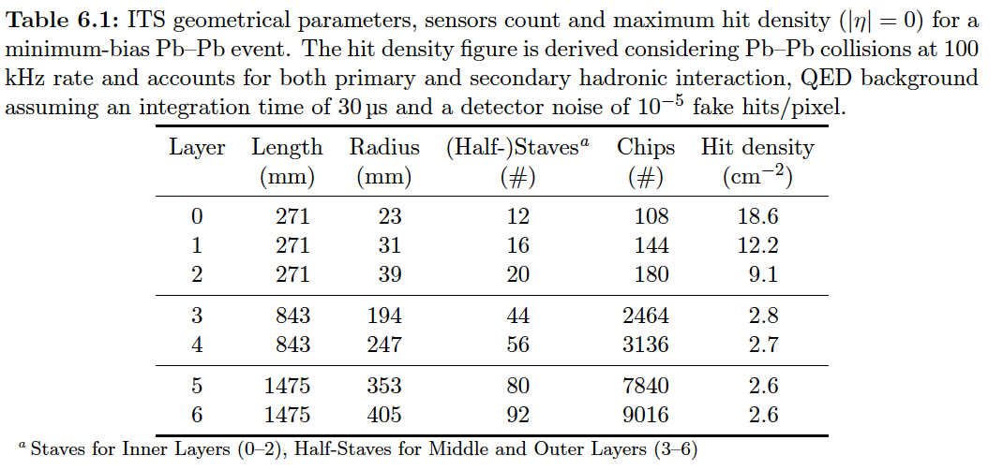
Hits and Event Data Rate
sPHENIX = 1/3 ALICE
Identical geometry for MVTX and ITS/IB(layer 0-2)
sPHENIX integration time ~5uS, less noise compared with ALICE with 10~20uS.

Slide 8
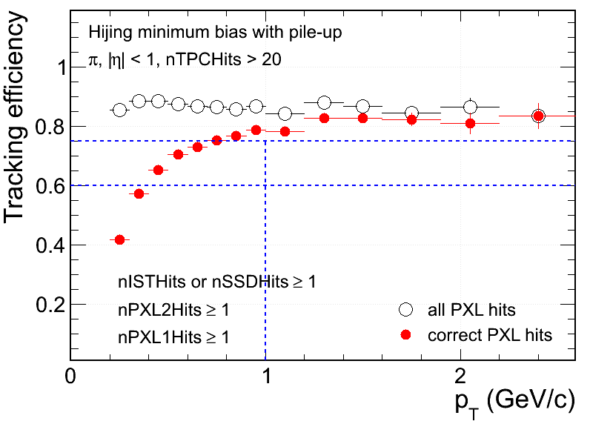
Hit Density on STAR PXL at RHIC Environment
 | PXL inner | PXL outer
Radius (cm) | 2.8 | 8
MB pileup hits (cm⁻²) | 13 | ~3
UPC electrons (cm⁻²) | 33 | ~3
Total bkgd hits (cm⁻²) | 46 | ~6
MB signal Au+Au (cm⁻²) | ~8 | ~1
Xin’s talk
- Ming’s note:
With 5uS integration time,
BG rate can be reduced by
5/200 = 1/40
Simulation@50kHz
Au+Au MB real data (cm⁻²) | ~50 | ~5
Simulation
Signal hits fraction in MB (Central) events:
~15% (~30%) at PXL inner
Increasing fake matches in low p_{T}
Technology chosen considering both physics and technology readiness

Slide 9
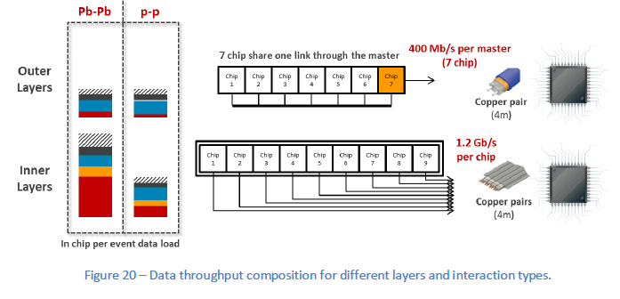
MVTX Hits vs Noise
RED = collisions;
Yellow = background & trapped particles;
Blue = noise (10⁻⁵, 10⁻⁶) per pixel

Slide 10
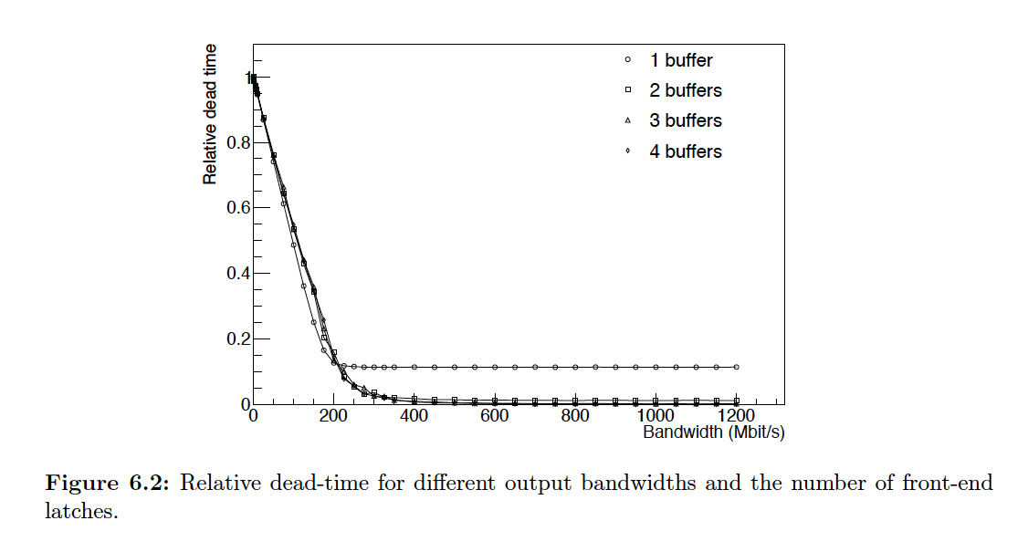
ALICE Data Rate and Dead Time

Slide 11
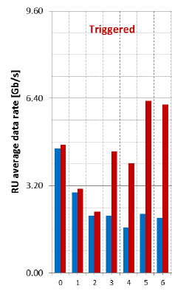
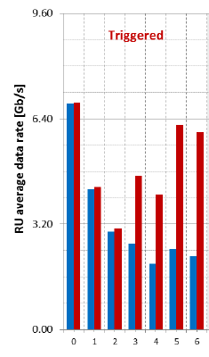
ALICE Data Rate per RU Pb+Pb @200 kHz, 2, 5 μs shaping
Noise:
10⁻⁵
10⁻⁶
← RU 3 data fibers capacity
Triggered mode:
- ALICE: 50kHz
- sPHENIX: 15 kHz
sPHENIX (AuAu 200kHz) data rate per RU, 2us shaping,
1/1 x 1/4 x 15/50 = 0.08 ALICE (IB)
sPHENIX MVT data rate:
0.08x(12x4.8+16x3.2+20x2.4)
= 12.5 Gb/s
2 μs shaping
5 μs shaping
MVTX
MVTX
layer

Slide 12
ALICE Data Rate per RU p+p @1MHz, 5 μs shaping
← RU 3 data fibers capacity
Triggered mode:
ALICE: 50kHz
sPHENIX: 15kHz
sPHENIX (pp 13MHz) data rate per RU
(more complicated situation)
Collision dominant (noise = 10⁻⁶):
(Sig + BG) =0.7; Noise = 0.1
- sPHENIX MVT data rate(2us shaping, 10⁻⁶):
2/5x13/1x15/50x(1/3x0.7 + 0.1) = 0.47 Gb/s
total = 48 x 0.47 = 23Gb/s
Collision-Noise: 50/50 (noise = 10⁻⁵)
(Sig + BG) =0.7; Noise = 1.0
sPHENIX MVT data rate per RU(2us shaping, 10⁻⁵):
2/5x13/1x15/50x(1/3*[Sig+BG]+1.0) = 1.9 Gb/s
total = 48 x 1.9 = 90Gb/s
In pp (1MHz, 5us): (Sig+BG) =0.7, Noise(10⁻⁶) = 0.1 Gb/s
In AuAu(200kHz, 5us): Collision hit dominant, (Sig) =4.8Gb/s
5 μs shaping
Noise:
10⁻⁵
10⁻⁶
MVTX
ITS layer

Slide 13
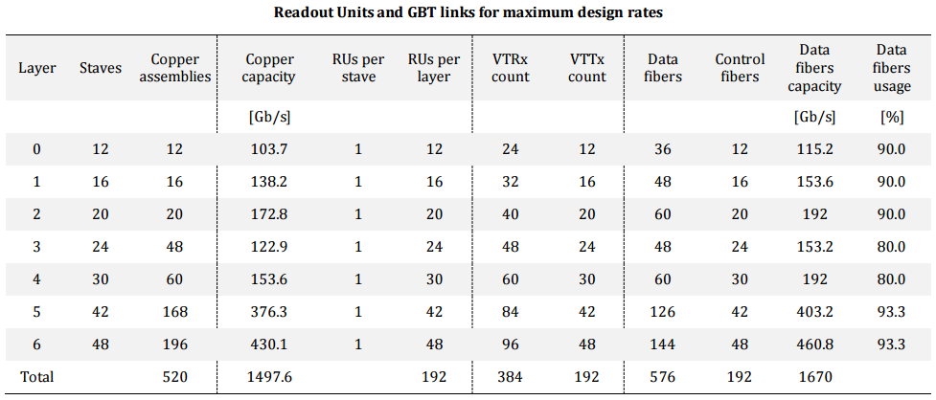
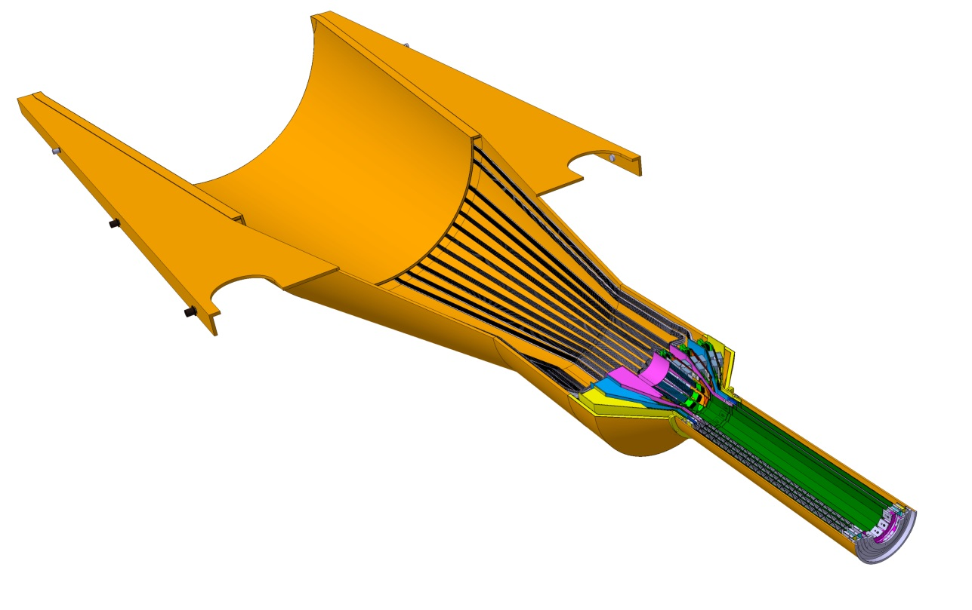
Readout Units Required for ITS & sPHENIX
ITS IB:
Produce 120 staves in one year
120% contingency
48 RU boards
48 inner staves
sPHENIX: 48 +40% = 68

