Slide 1
Homework Questions 07/11/2017
MVTX BNL Director’s Review

Slide 2
1.) Please provide an MVTX Management plan and clarify the responsibilities of the management team.
Project Office (PI, co-PIs, Lead Coordinator and ES&H) oversee the overall project planning, execution and report, and Lead Coordinator will coordinate all activities with BNL management, budget and procurement office, as well as with the CERN management and MVTX team.
Electronics: LANL oversees the front-end, back-end and PS, and interfaces with sPHENIX DAQ group.
Front-end ALICE Readout Units production and test: UT-Austin
Back-end ATLAS FELIX production and test: LANL
Power supply and control production and test: LBNL
Mechanical & detector assembly: LBNL oversees stave production, c-stru production and barrel assembly.
Stave production and test: LANL
Carbon structure production & QA: LBNL
Detector assembly & test: LBNL
Integration & infrastructures: MIT oversees cooling, safety, global support and interfaces with sPHENIX other inner tracker (INTT).
Cooling system design and integration: MIT
Safety system and interlock design and integration: MIT
Global support frame design and production: MIT
Installation: LANL, LBNL, MIT, UT-Austin and all

Slide 3
MVTX
Principal Investigator: M. Liu (LANL)
Lead Coordinator: M. Chamizo-Llatas (BNL)
Co-investigators: G. Odyniec (LBNL),R. Redwine(MIT)
ES&H Liason: W. Sondheim (LANL)
sPHENIX DAQ
sPHENIX integration
Electronics
LANL
WBS - 1.5.2
Mechanics & Detector Assembly
LBNL - WBS 1.5.3
Integration & Infrastructures
MIT - WBS 1.5.4
Readout Units
UT Austin WBS 1.5.2.1
Staves
LANL WBS 1.5.3.1
Cooling
MIT WBS 1.5.4.2
Back-end
LANL WBS 1.5.2.2
Carbon Structures
LBNL WBS 1.5.3.2
Safety System
MIT WBS 1.5.4.3
Power systems
LBNL WBS 1.5.2.3
Barrel Assembly
LBNL WBS 1.5.3.3
Global Support
MIT WBS 1.5.4.4
Major institutions lead key tasks
Installation & Commissioning
LBNL/BNL WBS 1.5.4.6

Slide 4
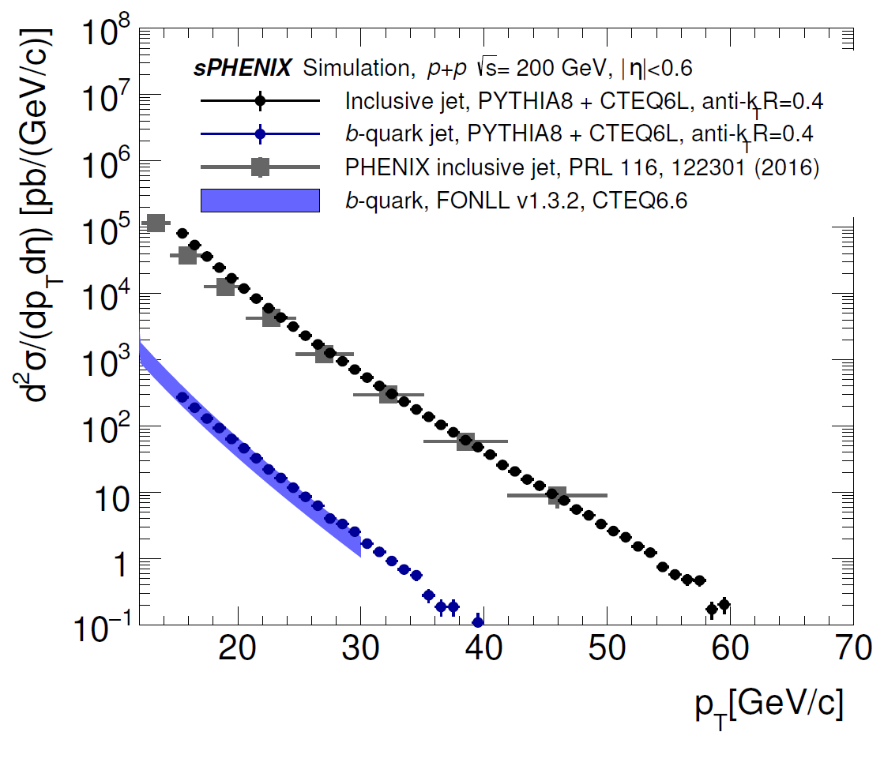
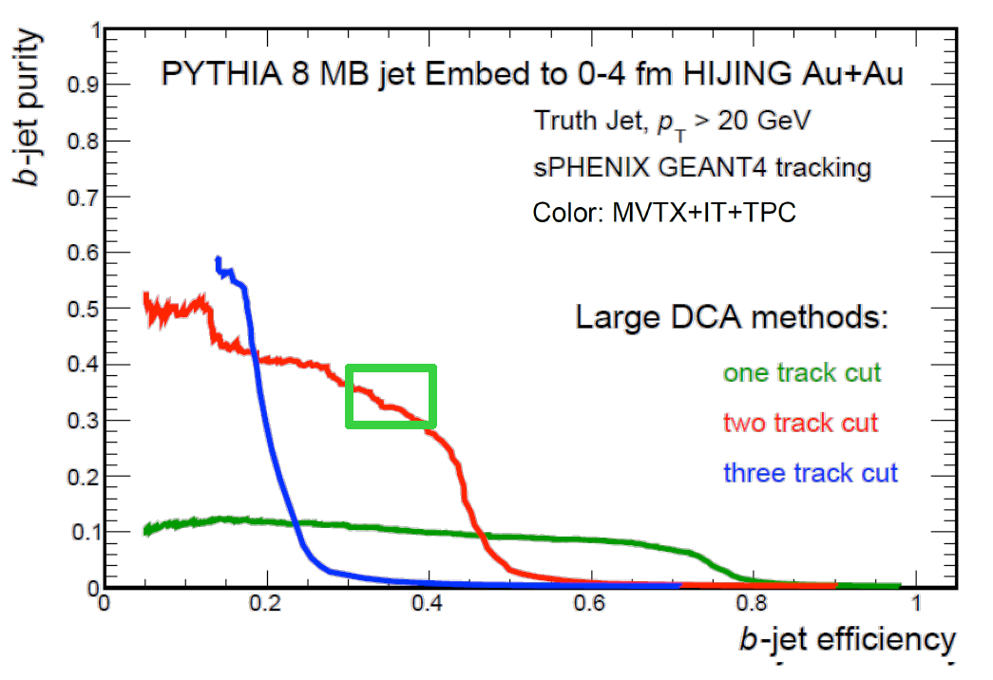
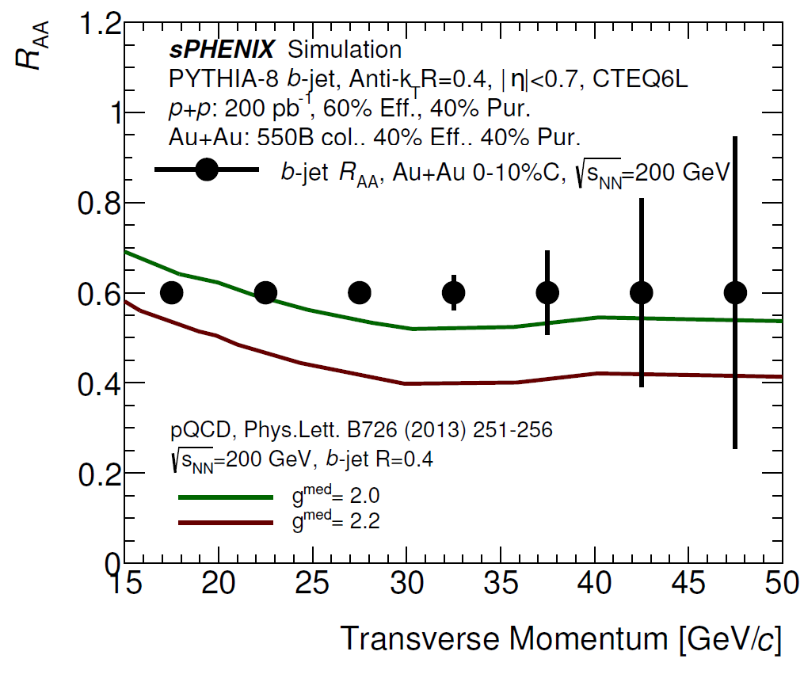
2.) The physics impact plots on the last page of Xin's talk are very important. Middle plot: is it a simulation or a calculation? We would like to see event generator input and simulated output for B tagged jets. Do you have such a plot? Please provide 1 short paragraph about each plot for an executive summary.
The error bars on the data points are statistical uncertainty projections based on a few simulation components:
b-jet cross section was estimated using PYTHIA8 + CTEQ6L generator, with truth particle . The cross section is shown as blue point in left bottom plot.
b-jet purity and efficiency is from the Geant4 simulation of the above PYTHIA event embedded in HIJING 0-10% Central Au+Au collisions, and reconstructed with b-jet tagging analysis software.
The final R_AA statistical projection combines b-jet cross section, p+p and Au+Au integrated luminosity, assumed R_AA of 0.6, and Geant4-based purity and efficiency. The projection is compared with model calculation [Vitev] supported by LANL LDRD.
Details can be found in physics analysis note [sPH-HF-2017-001] as linked on agenda

Slide 5
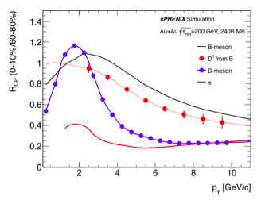
Statistical error projection for Rcp (0-10%/60-80%) of non-prompt and prompt D^0 measurements
with sPHENIX MVTX using 240B 0-100% minimum bias triggered events. The data points are placed
on the curves from recently theoretical model calculations. The estimated statistical uncertainties
show with sPHENIX MVTX one can make these measurements up to ~10 GeV/c and one can
unambiguously distinguish the non-prompt D^0 Rcp from that of prompt D^0, therefore establish
the mass dependence of parton energy loss.

Slide 6
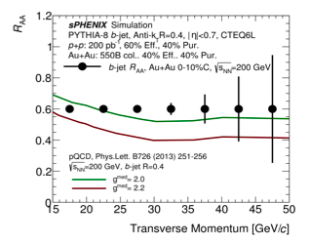
The middle plot shows statistical uncertainty projections for the inclusive b-jet measurement with
the p+p and Au+Au datasets collected with sPHENIX MVTX. The two curves are theoretical
calculations for b-jet RAA with two different medium coupling parameters from I. Vitev. The inclusive
jet pT nicely covers the transition region where the mass hierarchy of parton energy loss gradually
disappear. Together the low pT non-prompt D^0 measurement, it will allow us to systematically
study the mass dependence of parton energy loss mechanism.

Slide 7
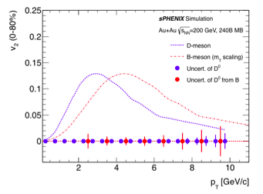
The plot shows the statistical error projection for v2 measurements with the same dataset as the left
plot. The blue curve is a fit to the D0 v2 measurement from the STAR HFT and the red curve is a
predicted non-prompt D^0 v2 assuming the parent B-hadron v2 follows the same mT scaling as light
and charm hadrons. The estimated statistical uncertainties show with sPHENIX MVTX one can
precisely determine non-prompt D^0 v2 therefore the bottom quark collectivity in medium, which
will help constrain our understanding of the heavy quark diffusion coefficient.

Slide 8
3.) Discuss complimentary of the RIHC MVTX program to the LHC program. What has the LHC provided, to date, and what doesn't the LHC program provide. Is there a plan to run other beam species at RHIC?
From various model calculations, one expects that the QGP medium created in central Pb+Pb
collisions at LHC can reach a higher initial temperature compared to that at central Au+Au at RHIC.
This allows us to constrain the temperature dependence of QGP transport parameters. Besides the
complementarity, measuring bottom production at RHIC has also a uniqueness due to much less
gluon splitting contribution which allows cleaner interpretation of physics measurements.
The current CMS measurements include b-jet down to ~70 GeV/c, B-hadron from ~10~40 GeV/c and
non-prompt J/psi ~6.5 - 30 GeV/c, mostly for 0-100% minimum bias collisions. CMS will have
improved statistics in these measurements in LHC Run3 (2021+).
sPHENIX will further extend the pT reach for non-prompt D0 down to ~2 GeV/c, and for b-jet down
to 15 GeV/c.
The ALICE experiment with the ITS and TPC upgrades at Run3 will have the similar B-hadron tagging
capability as the sPHENIX MVTX does. However their jet capabilities are not fully exploited because
of no HCAL and limited acceptance of EMCAL.
Running other beam species is not included in the current 5-year running plan laid out by the
sPHENIX program. However, if there is a strong and compelling physics argument to run different
species or energies, sPHENIX would like to re-consider the priorities or expand the running plan.

Slide 9
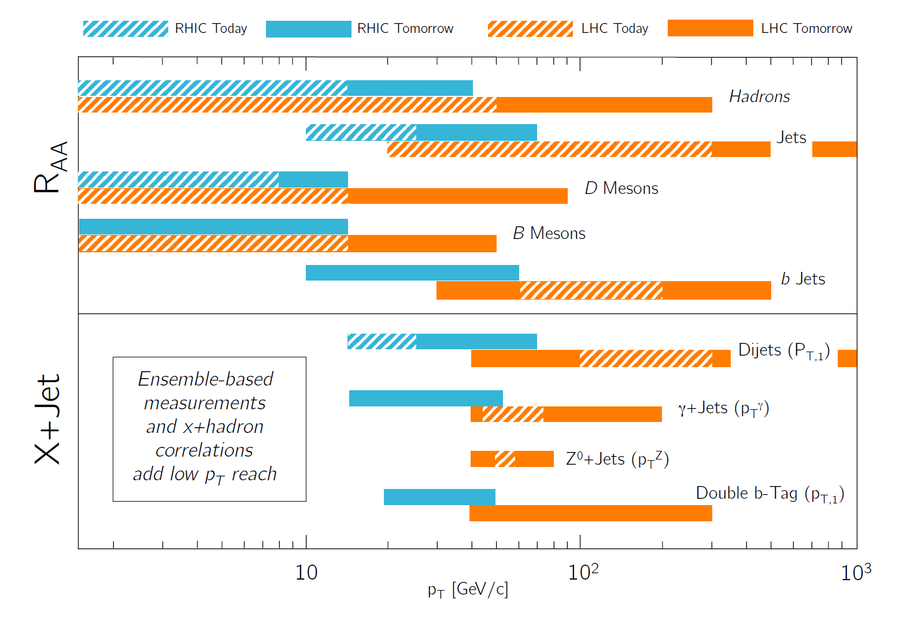

Slide 10
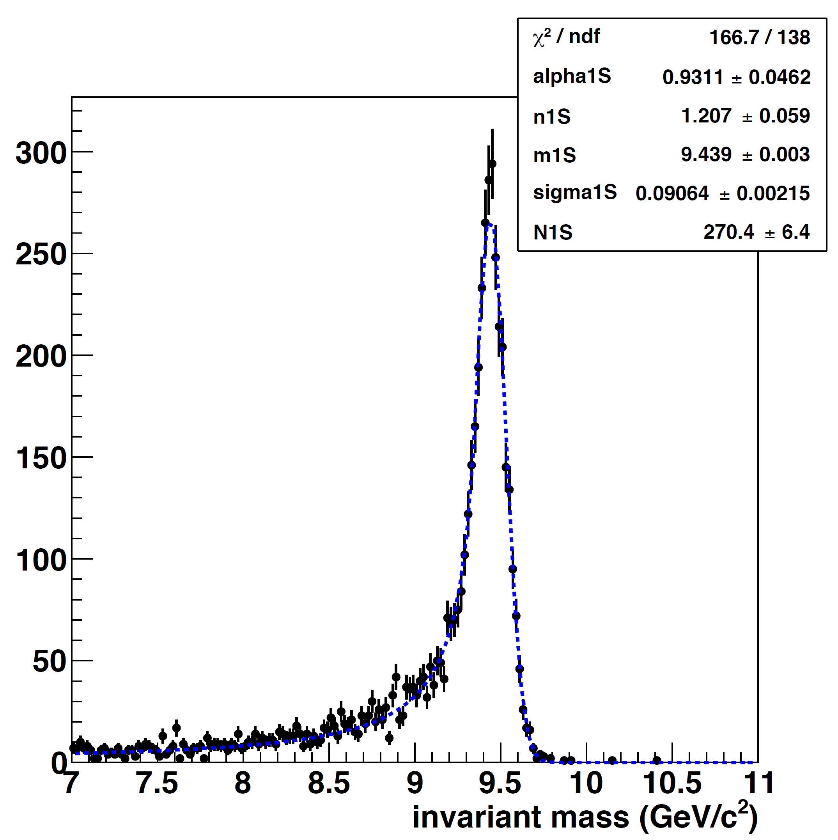
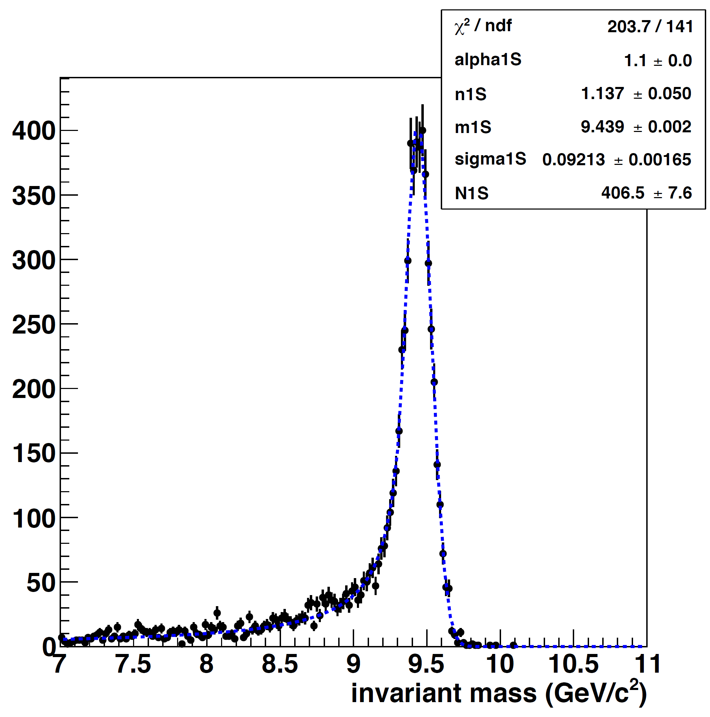
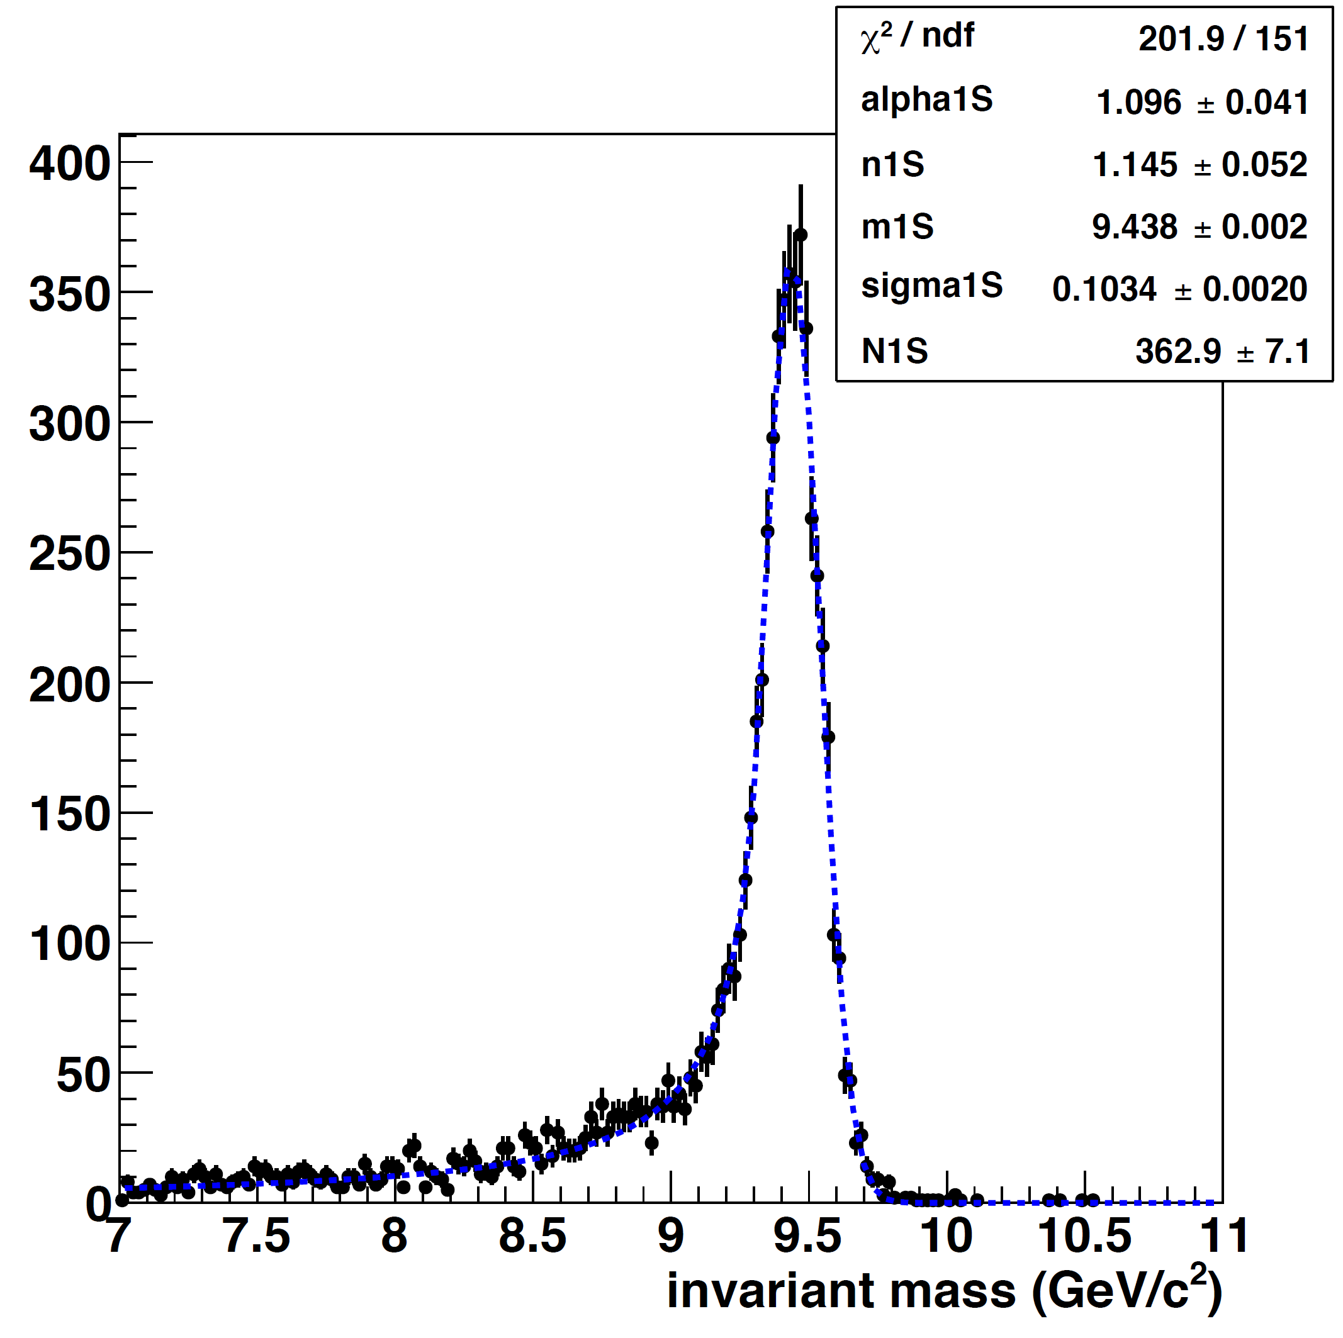
4.) Do the Si detectors affect the Upsilon program (MCS).
MVTX has positive impact on the Upsilon program, with slightly improved mass resolution, 91MeV vs 92MeV, as shown bellow.
Primary vertex is very important for upsilon signal identification, and is provided only by Si detectors, particularly in low multiplicity events, such as in p+p. Without precision primary vertex, the Upsiloon mass resolution is poor, ~103MeV (13% worse)
Open beauty cross section provides the important baseline for Upsilon suppression interpretation, and only possible w/ MVTX.
Vertex + MVTX + INTT+TPC Width = 91 MeV/c2
Vertex + NO MVTX + INTT+TPC Width = 92 MeV/c2
NO Vertex + NO MVTX + INTT+TPC Width = 103 MeV/c2

Slide 11
5.) Explain the scenarios that justify the addition of 20 additional staves in the baseline cost. And how would you actually use them in case of a damaged detector? Is a group of 4, 24 or 48 better?
To mitigate risk, we would like to have enough staves to fully replace the inner two layers (12+16=28), plus 10% spares
(48+28)+ 8(10%) = 84
CHF$11,600x84 = CHF$974,400 = US$ 1,008,300
Budget: 2.5%+35% : total 1.40M
The budget in the current project file: 1.40M

Slide 12
6.) Would it be better to build a spare half barrel? Or even a full detector?
NO.
Prefer a full 2 inner layer detector replacement staves(28) over a half barrel replacement assembly(24staves + mechanical support).
A full detector is cost prohibitive.

Slide 13
7.) What is the basis for choosing 35% overall project contingency?
For a project at this stage, one would assign ~40% contingency. Given a lot of work has been done by ALICE and ATLAS, plus LANL LDRD, we estimate a smaller contingency of 35%.

Slide 14
8.) Who does mechanical mount design after final design choices have been made? (LANL LDRD or Project funds)
MIT and LANL will do the final design of mechanical mount as part of MVTX task.

Slide 15
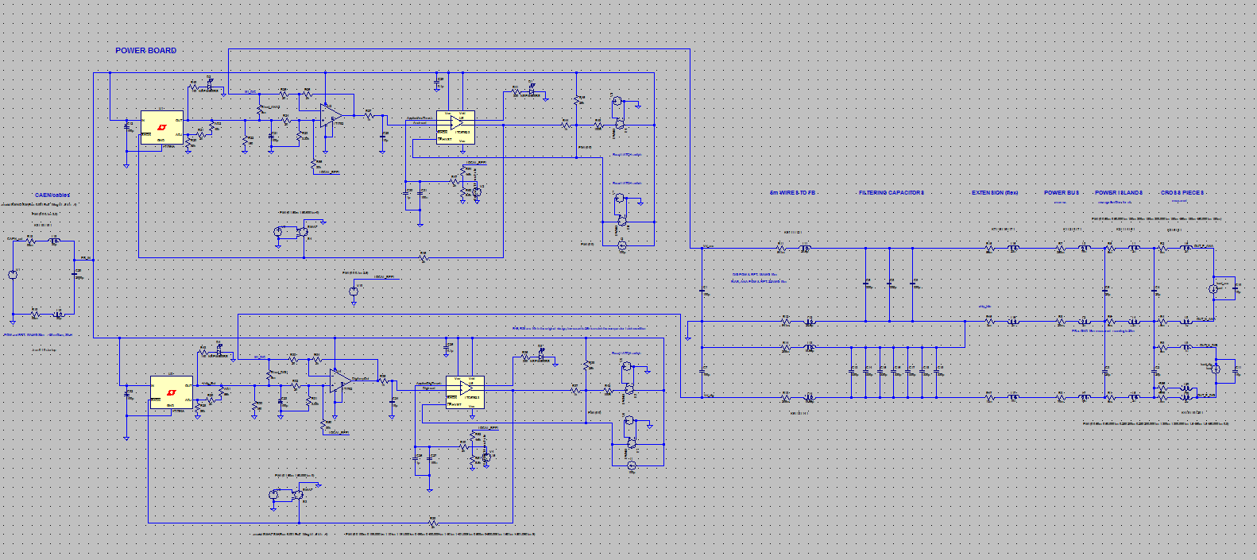
9) LV power over 10 m cables. Please provide a link to the modelling to show that load transients are effectively mitigated by their filter network.
Power distribution system for VDDA, VDDD simulated in SPICE, including filtering capacitors and 10 m long cables. The Response looks as expected and reasonable.
Model and plot settings available at https://drive.google.com/drive/folders/0B46PW6jNNLe6NDNVUFpCbXZRdWc?usp=sharing
The simulation refers to a ITS outer barrel module, with current and electrical characteristics of the cables very similar to the inner stave.

Slide 16
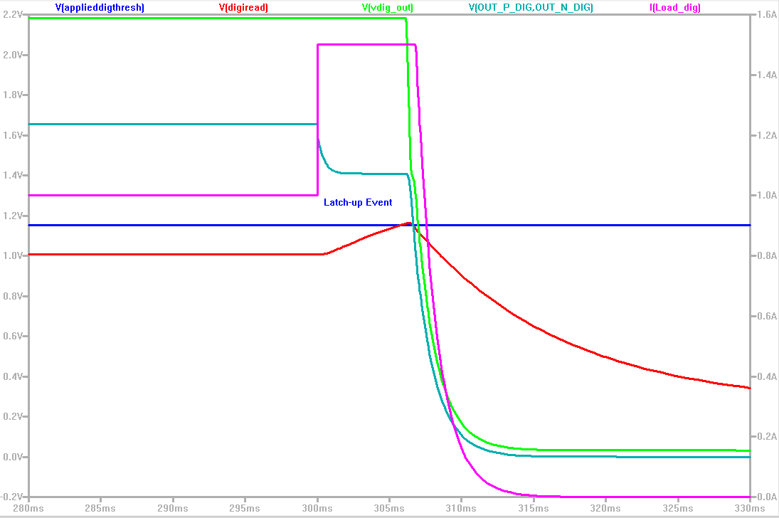
SPICE model response to latch-up overcurrent. Note that the response time of the current measured in the shunt lags the current applied in the module by 1.5 ms. The power (green) is removed after 10 ms (to 0.5V). No over/under shooting in the Voltage seen by the sensor.
V_out
I_load
LU event
V @ sensor
threshold
I measured

Slide 17
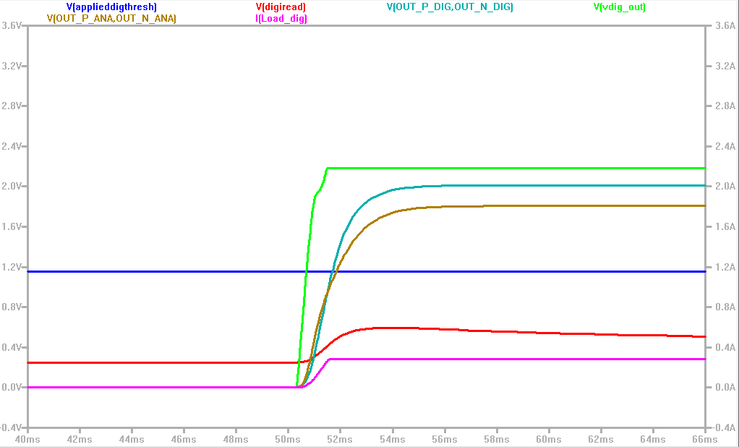
SPICE model response to Start-up sequence. Note that there are no overshoots in the voltage delivered to the sensor (cyan). Similar response for simulated power glitches.
V_sensor

Slide 18
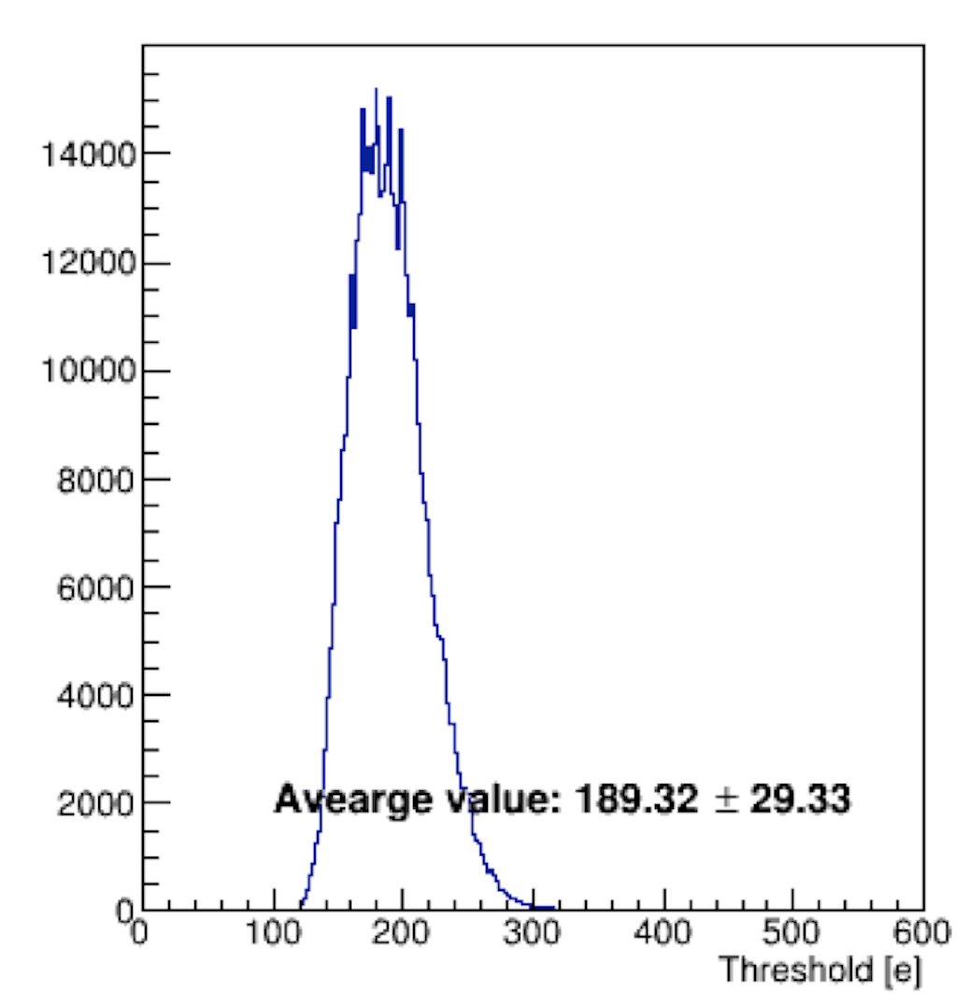
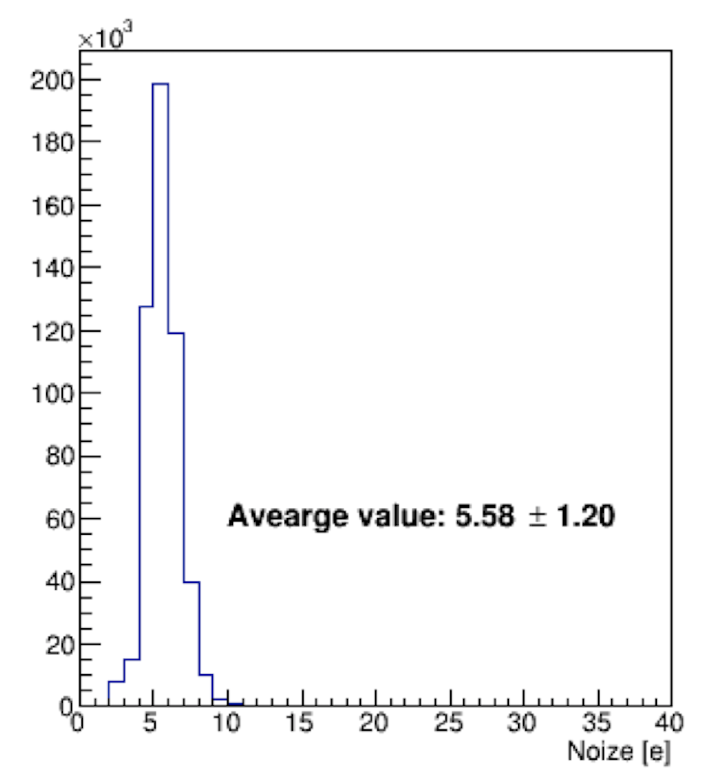
10.) Cesar slide 8: LANL test stand - noise and signal shown. What was the signal for this test?
Signal is injected charge from MOSAIC test bench. Threshold is 50% of the signal.
Scan the threshold per pixel and the average value is 189.32±29.33 (e), which is 35 times of the noise level.
The signal is twice of the threshold, thus Signal/Noise ~ 70
Scan the noise per pixel and the average value is 5.58±1.20 (e).

Slide 19
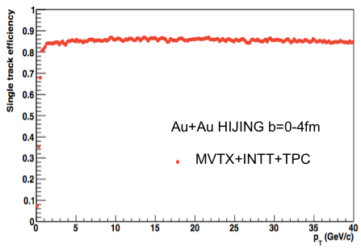
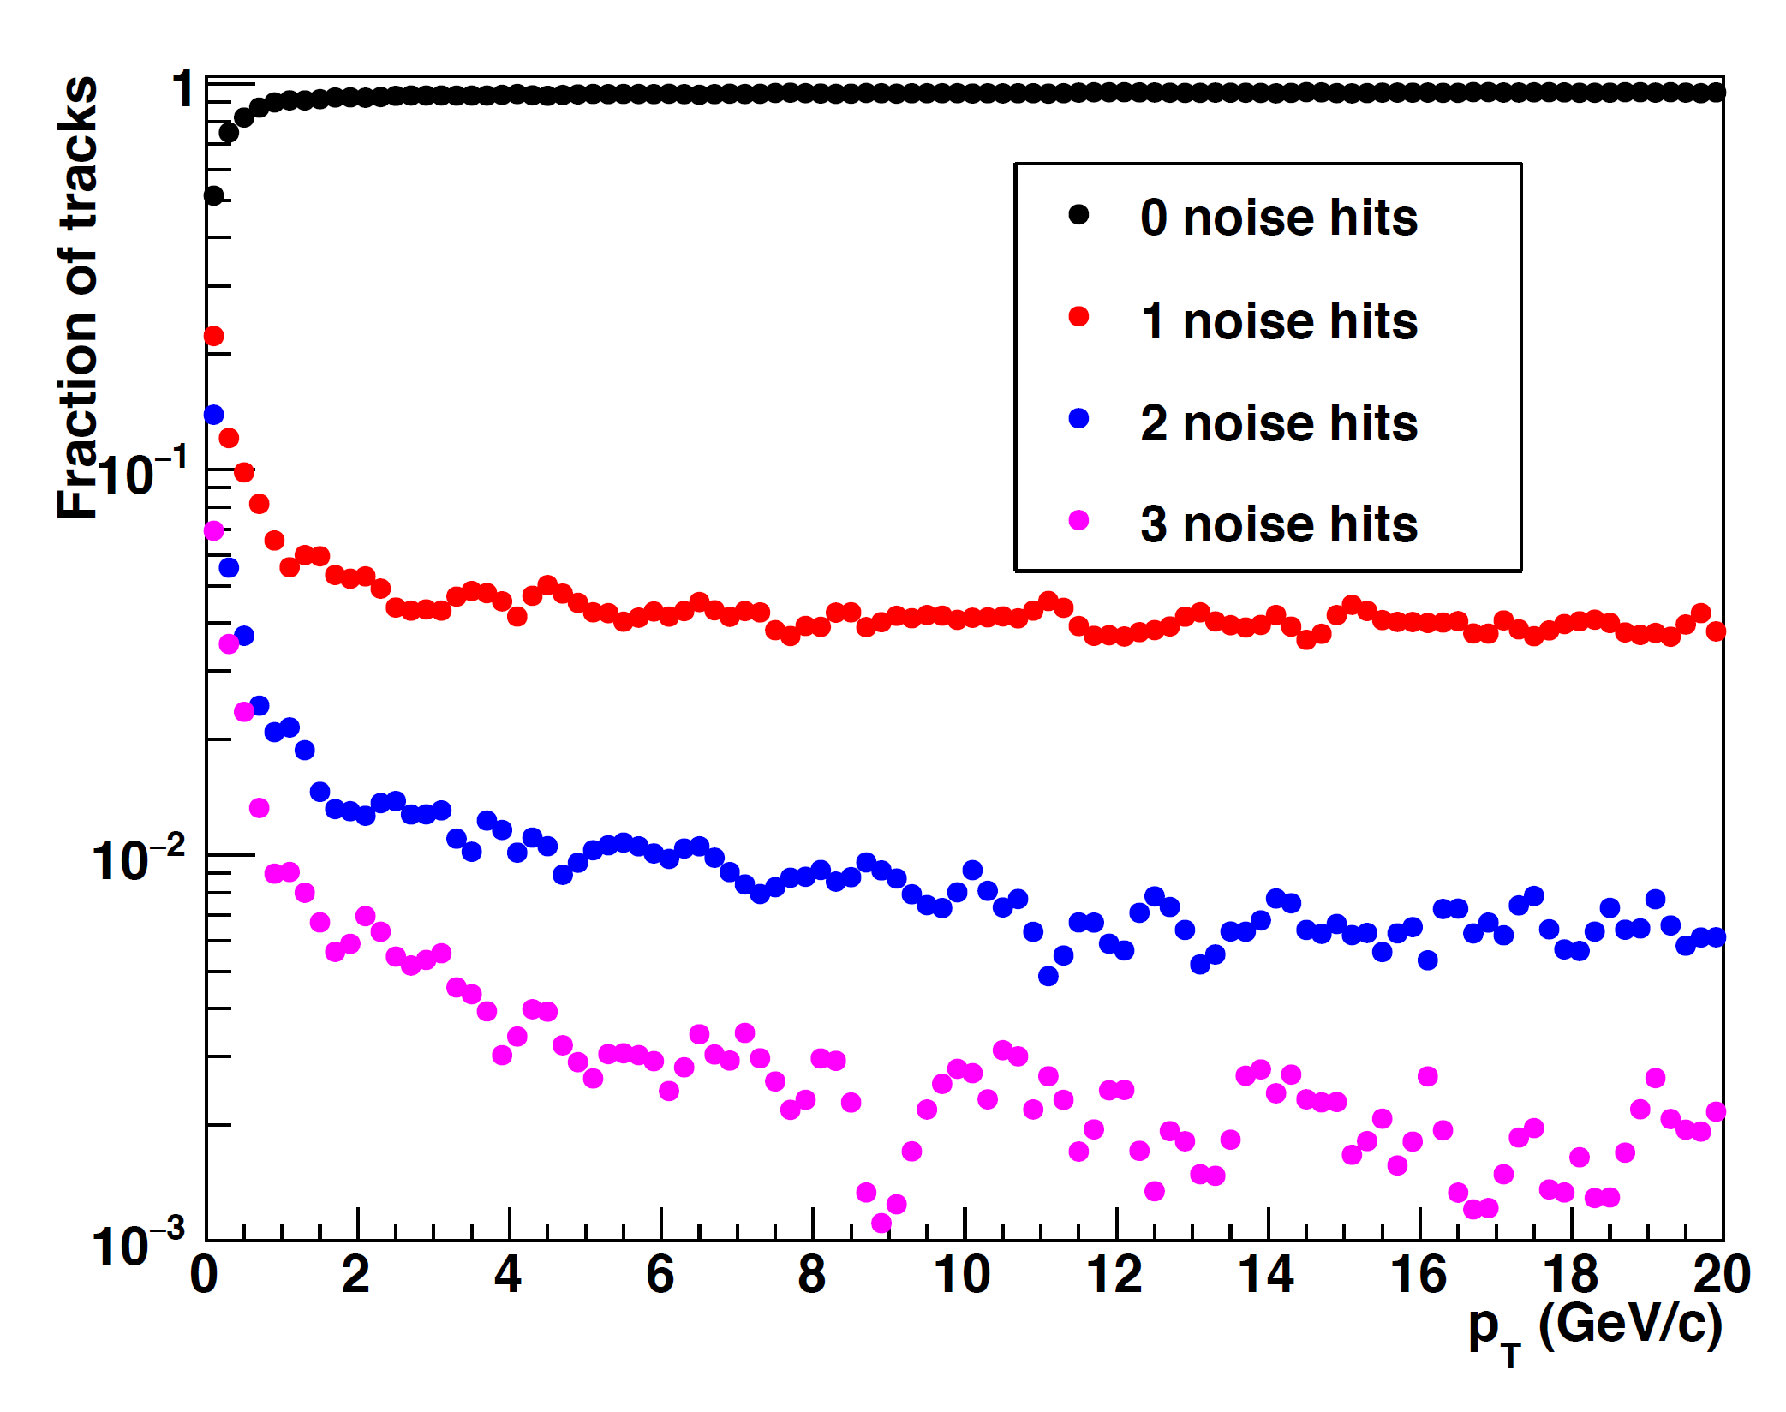
11.) Who is working on tracking software to connect TPC tracks with the Si?
This work needs to start early and finish early so that you can debug the
detector during the first days of detector operations.
The sPHENIX tracking task force has been formed early this
Year and the task force has been continuously developing
the tracking software for the integrated tracking system
(TPC+INTT+MVTX). The team is lead by Anthony Frawley
(FSU) and Christof Roland (MIT), together with manpower
of 4-5 postdocs/students.
Currently, the team has implemented a Kalman filter-based
tracking software, which offers a reasonable tracking
efficiency and low mis-match rate in central AuAu collision
(see plots on page 12) . The team is further optimizing the
software for TPC - Si matching.
We expect this software to become mature in the next half
year.

Slide 20
12.) Who is responsible MVTX installation? Is it sPHENIX or MVTX personnel. Who pays for the cost of the installation tooling?
MVTX group will work with BNL techs on the installation.
MVTX project pays for the installation tooling that mount MVTX to the rail system.
Overall coordination will be done by Don Lynch/sPHENIX and the tracker integration task force
Further integration effort is needed

