Slide 1
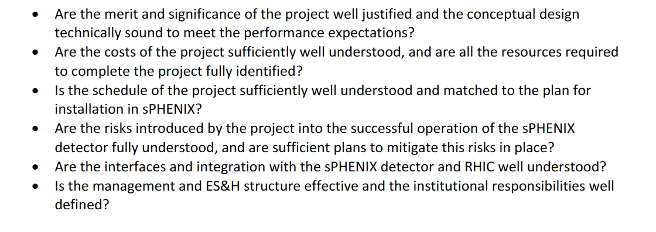
Review Charge

Slide 2
Topics for Today
https://indico.bnl.gov/conferenceDisplay.py?confId=3270
Overview
  Ming et al
Physics and detector simulations
  Xin
Coffee break
LDRD status and plan
  Cesar
Mechanics and detector assembly
  Giacomo
MVTX electronics
  Mark
Lunch break
MVTX support and infrastructure
  Walt
Integration of MVTX and sPHENIX
  Ed
Cost & schedule & risk
  Dave et al
Executive session (closed)

Slide 3
MVTX Overview
Ming Liu
Los Alamos National Laboratory
For the sPHENIX MVTX Upgrade Group
BNL Director’s Review
07/10/2017

Slide 4
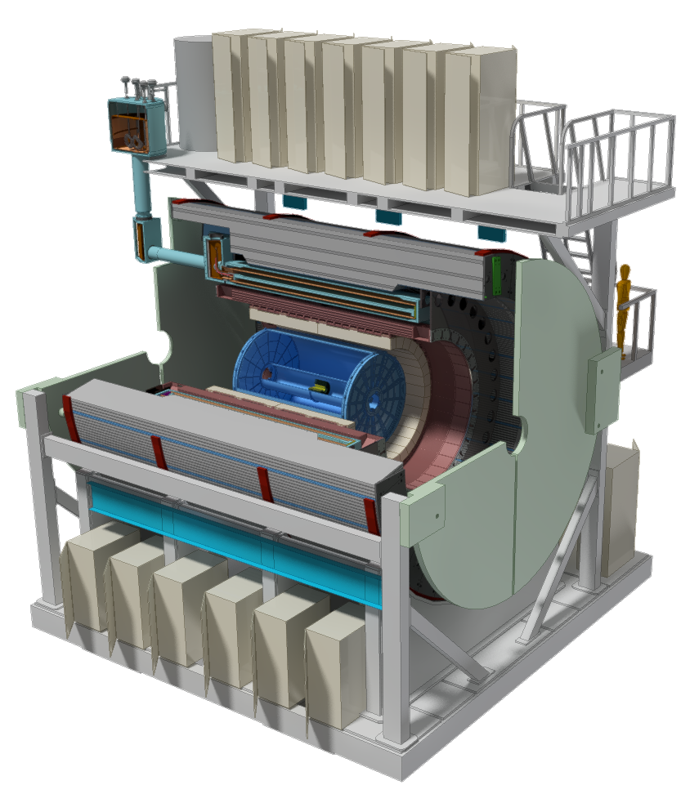
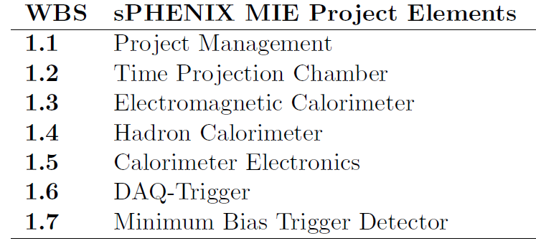
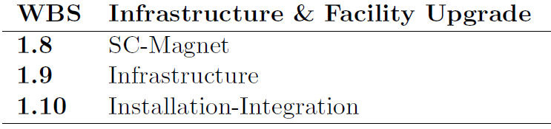
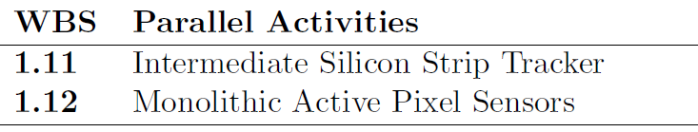
MVTX: MAPS-based Vertex Detector for sPHENIX
A separate upgrade project for the baseline sPHENIX experiment, with
Compelling Science and;
Feasible cost & schedule

Slide 5
Outline
Science of MVTX upgrade
Scope of MVTX proposal
  Readout
  Integration
  Cost & schedule
Organization & plan

Slide 6
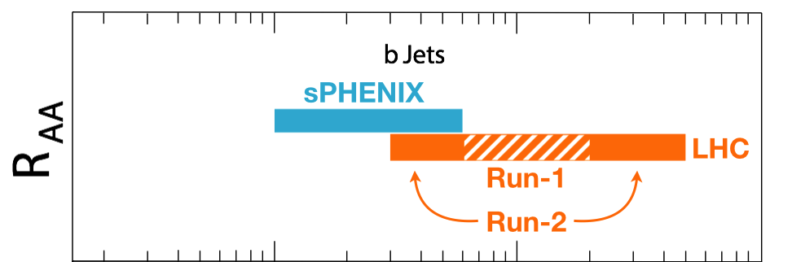
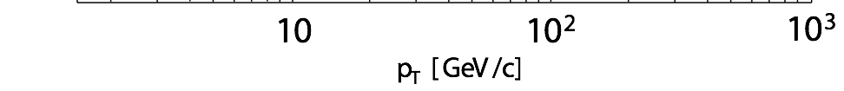
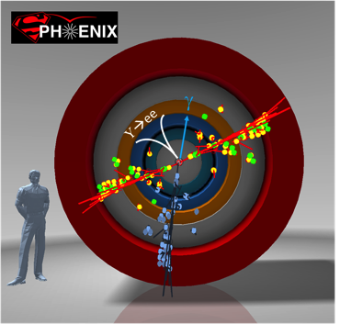
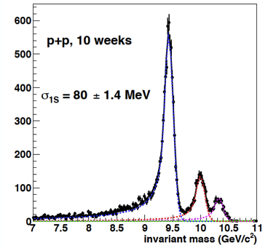
Exciting Science: Physics of the 3rd Pillar
sPHENIX is the next flagship heavy ion physics experiment in the US (NSAC LRP2015)
  Jets
  Upsilons
  B-jets and B hadrons
MVTX will complete B physics
  Unambiguous determination of key parameters of QGP properties and interactions
  Precision study of the “inner workings of QGP”
Cannot be done easily at the LHC for lack of low pT reach and huge backgrounds
sPHENIX Three Physics Pillars
Jets
Upsilons
B Physics!

Slide 7
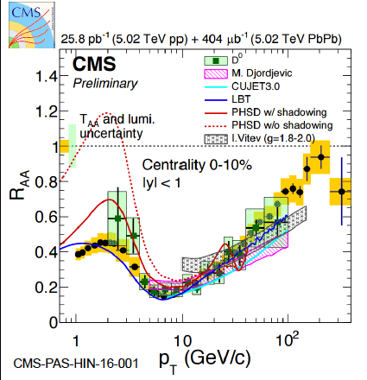
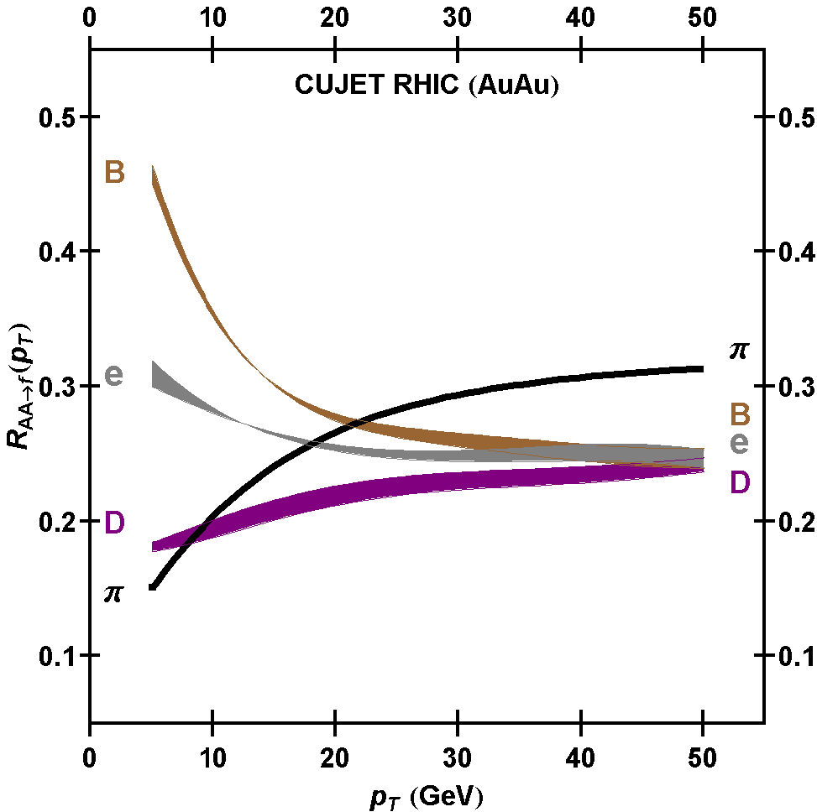
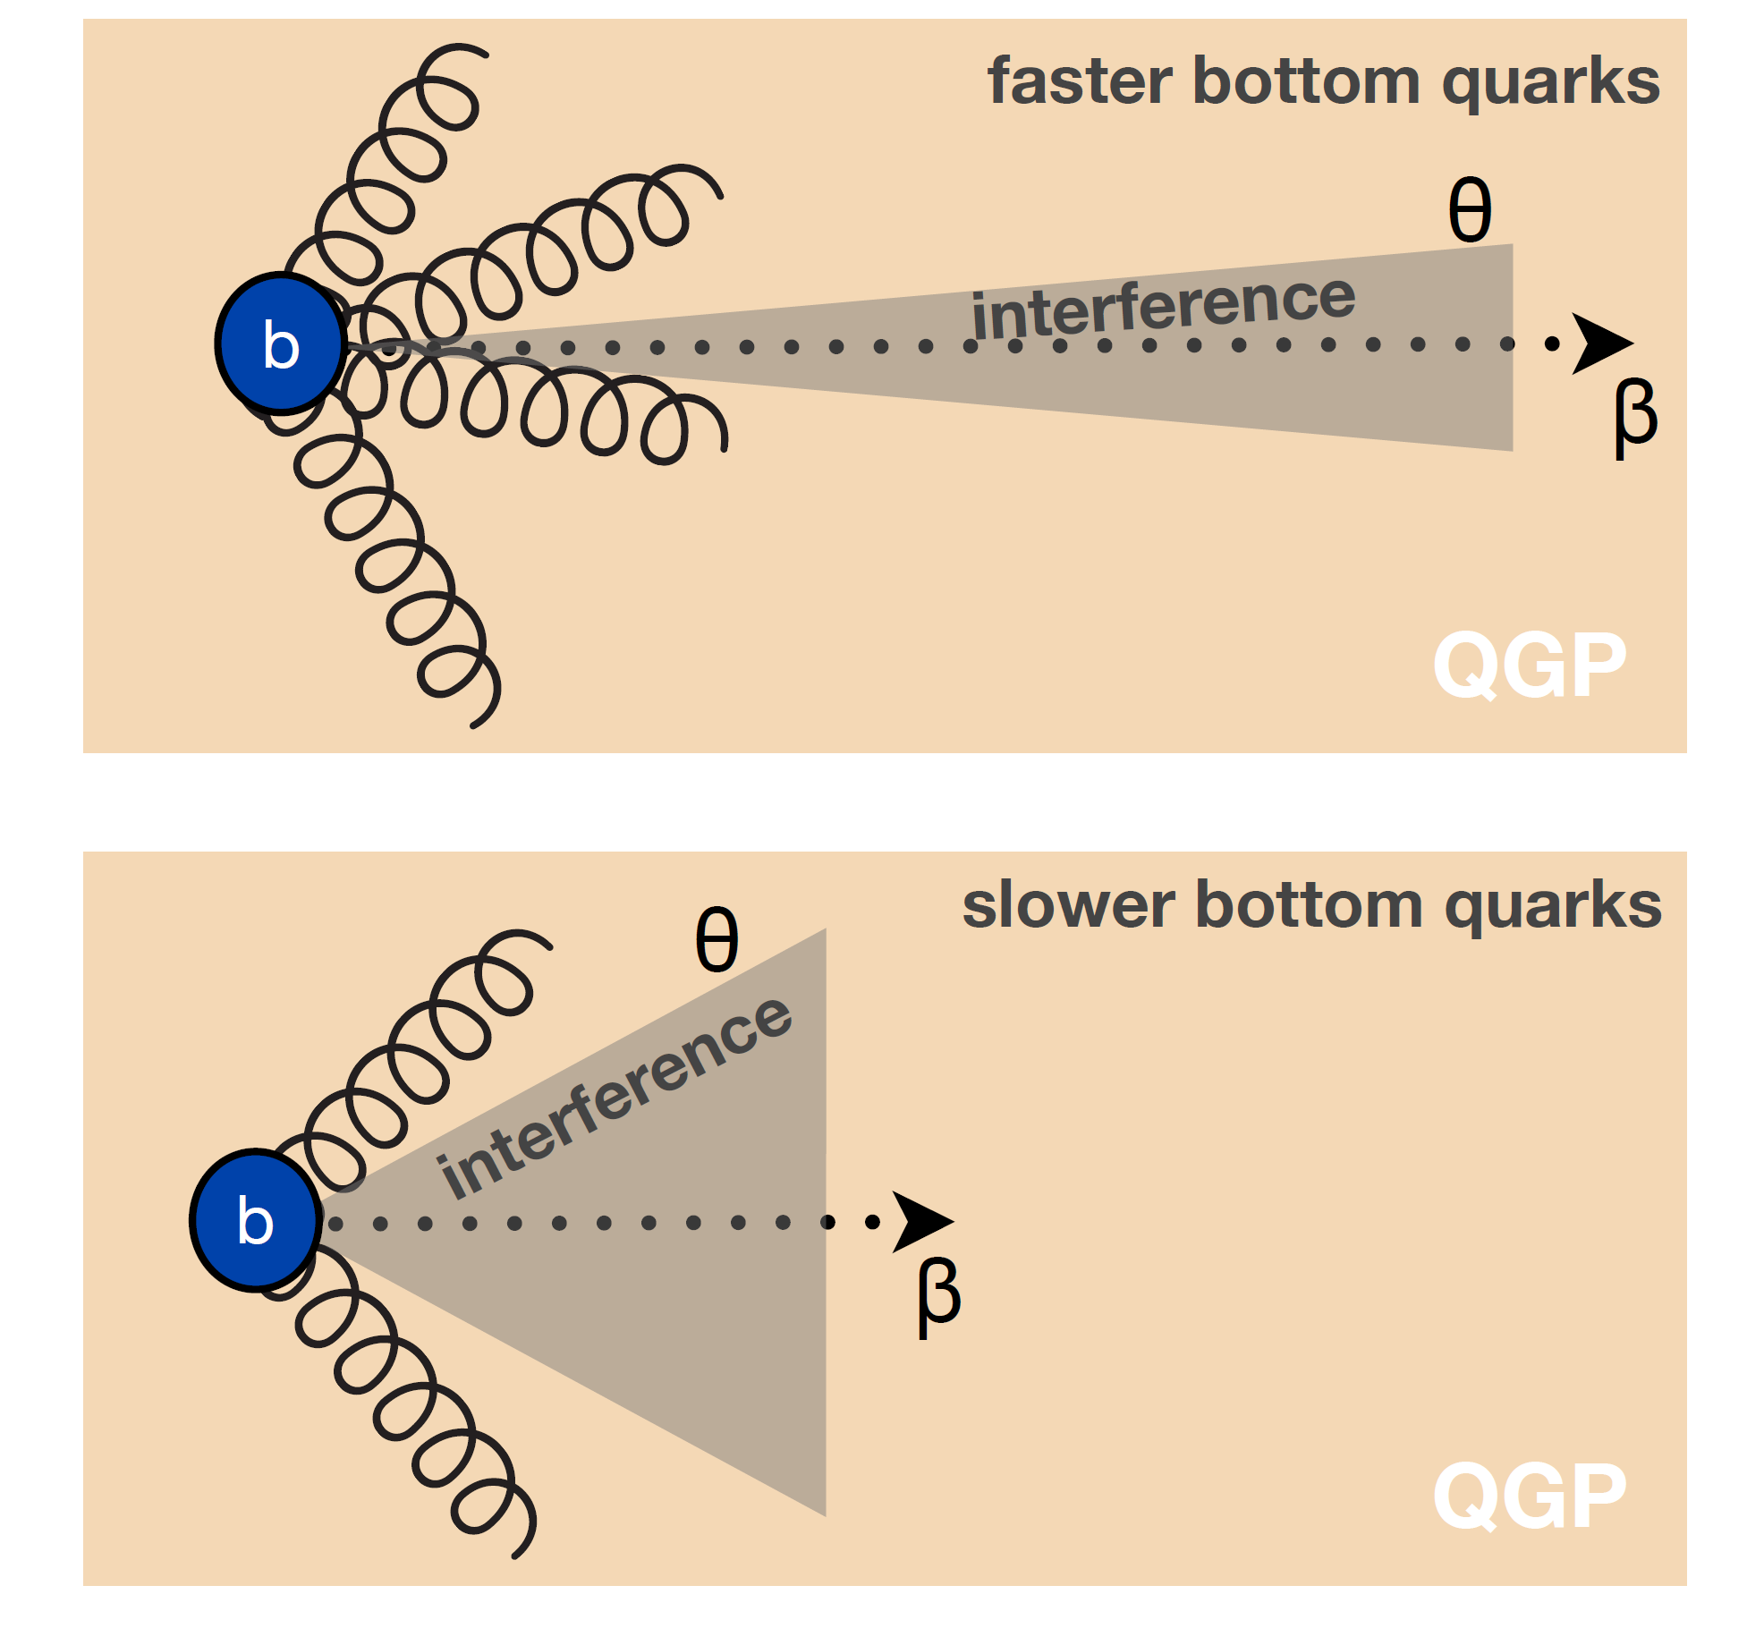
MVTX – a highly desired new Tool bring sPHENIX physics reach to a new horizon
Xin’s talk
Probe quark energy loss mechanisms in QGP over the full phase space
  Radiative dE/dX
  Collisional dE/dX
  Other effects
Expectation @RHIC
What learnt @CERN

Slide 8
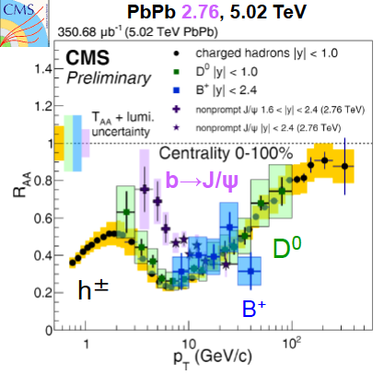
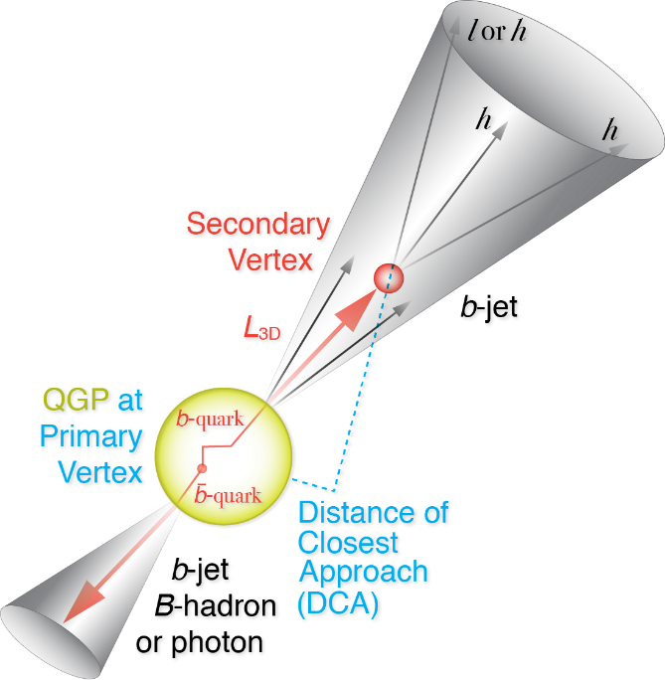
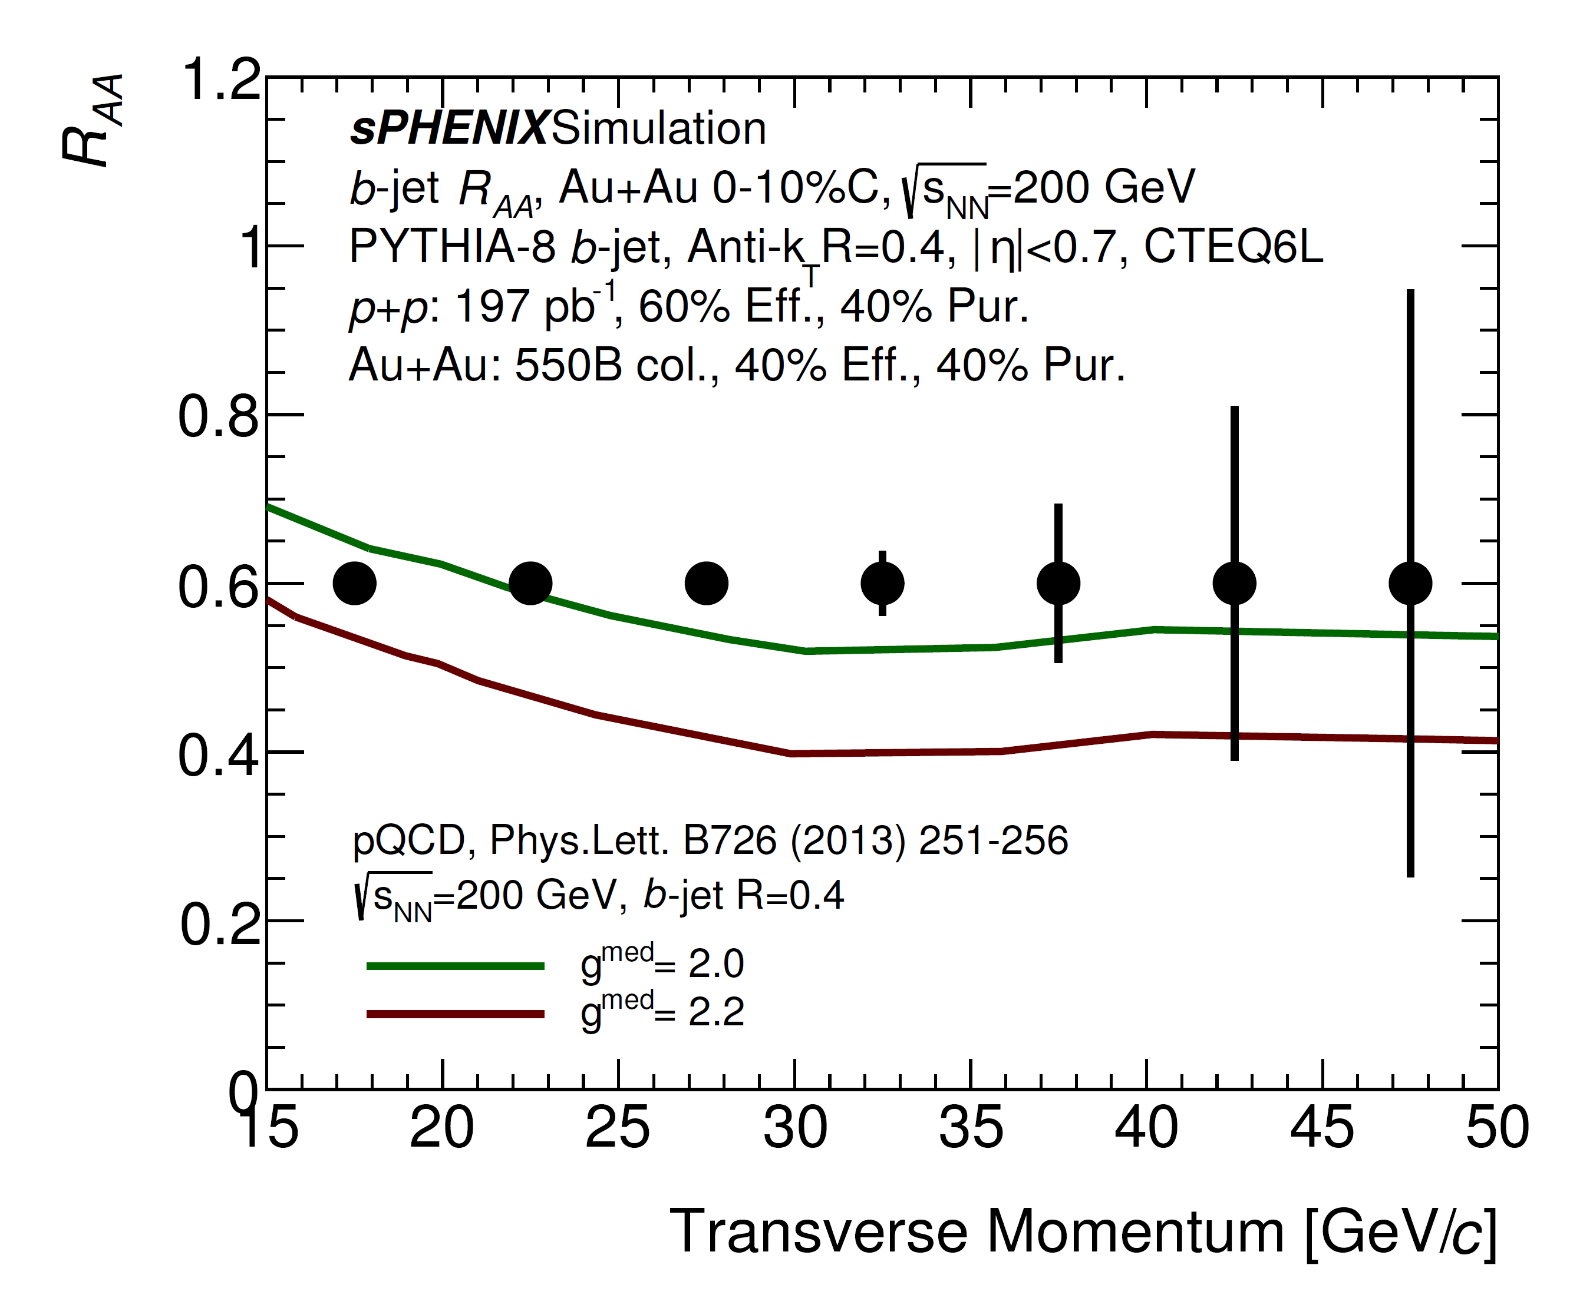
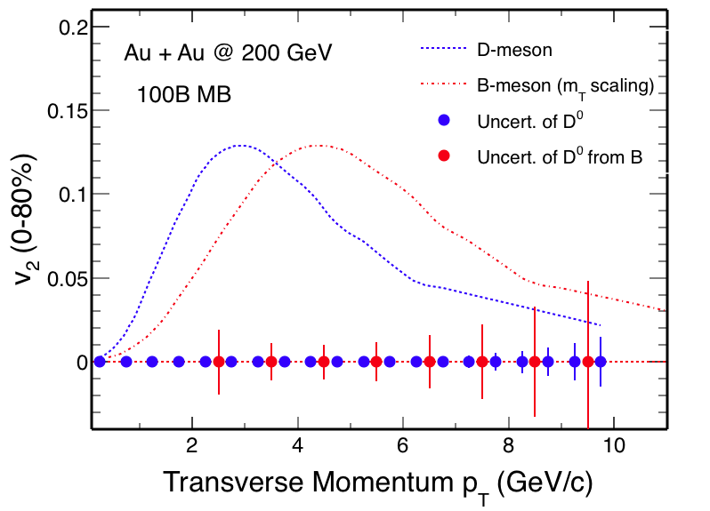
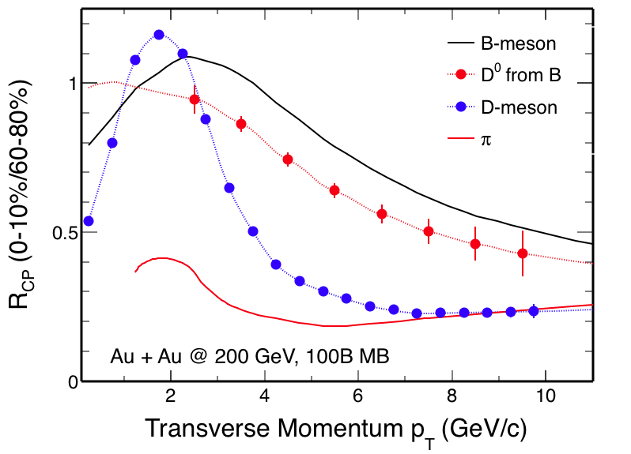
Key Observables w/ MVTX @sPHENX
B-jet quenching & correlations
  Energy loss mechanisms
  QGP density
B-hadron “flow”
  Bulk viscosity
  Coupling & collectivity
  Diffusion
- Detailed study of QGP properties: T, density, viscosity, couplings etc.

Slide 9
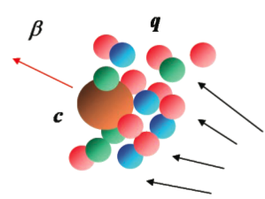
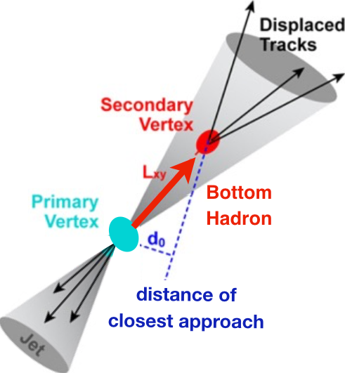
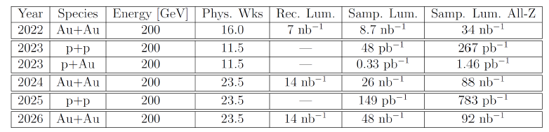
Key Experimental Capability
Heavy Flavor Tagging
Precision vertexing requires:
  Tracking resolution better than 60um
  High multiplicity HI collisions -> high segmentation
  Low multiplicity but high rate p+p collisions -> high speed
A latest five-year run plan (2022-2026), projected maximum rates:
  AuAu collisions: ~200kHz ( ~50kHz, |Z|<10cm)
  p+p collisions: ~13MHz ( ~3.2MHz, |Z|<10cm)
  P+A collisions: ~ 2.8MHz (0.7MHz, |Z|<10cm)
sPHENIX DAQ: 15kHz

Slide 10
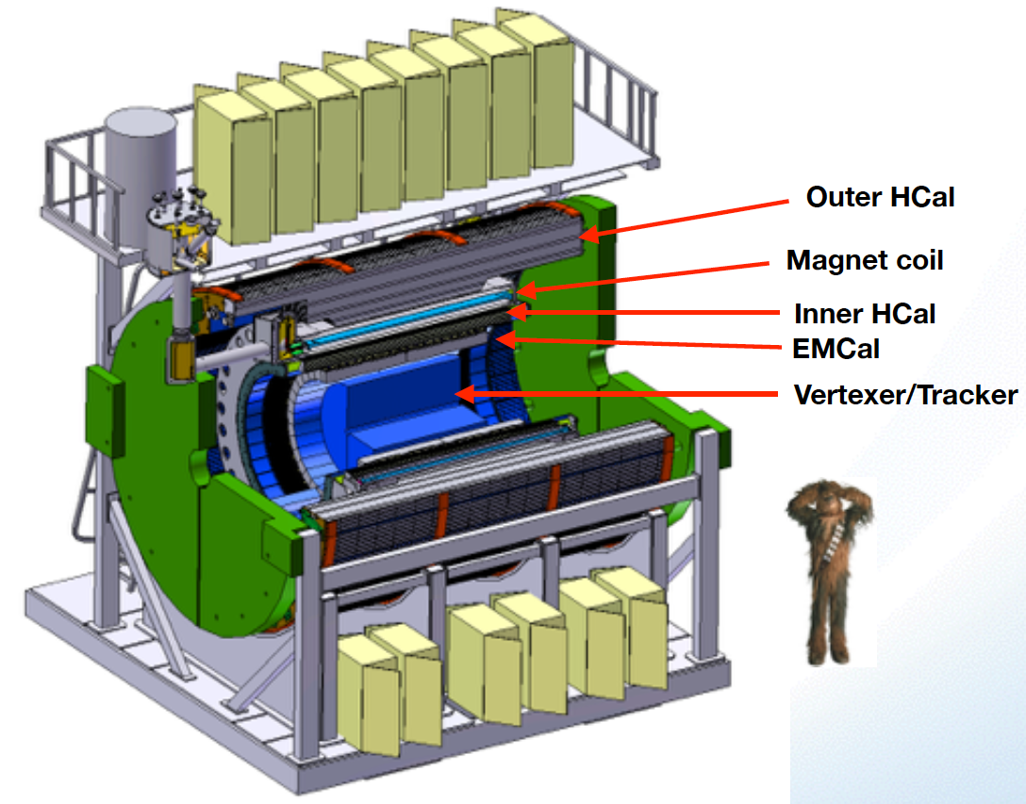

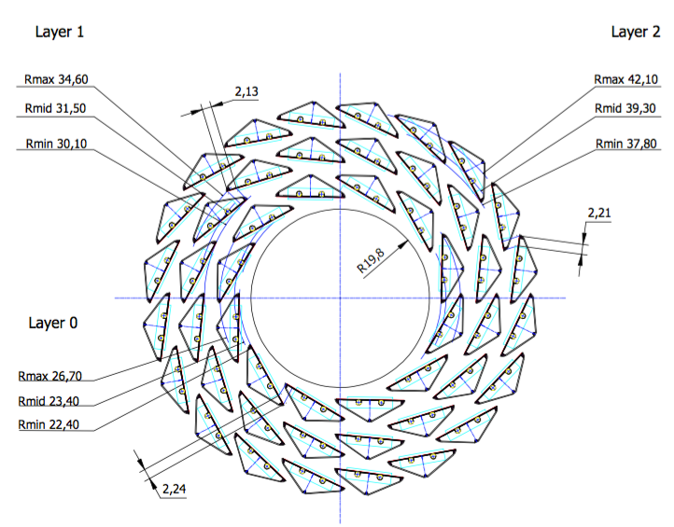
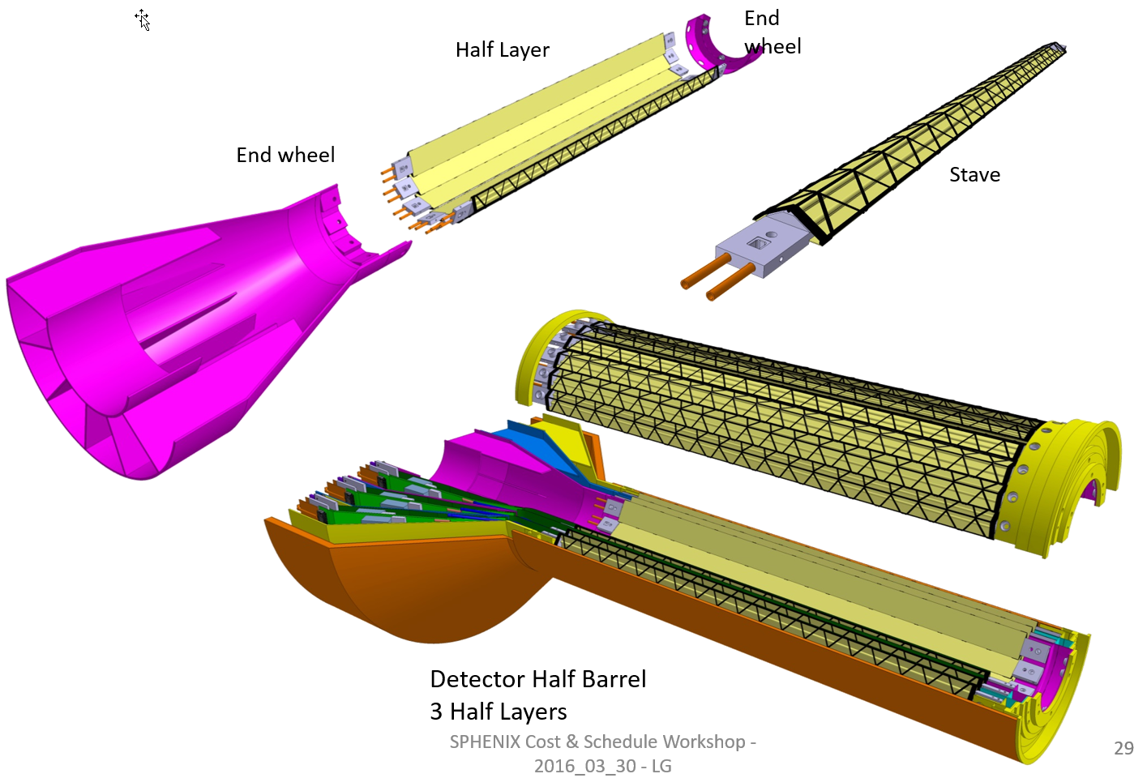
Our Approach
ALICE ITS;
Inner Tracker System
Key challenges:
- Readout
- Mechanics
sPHENIX Inner Tracking
“Adopt” ITS Inner Tracker
- Min. Risk
- Max. Phys.

Slide 11


Monolithic-Active-Pixel-Sensors (MAPS)
A State of the Art Tracker
A 9-chip MAPS stave, ITS/IB
Advantages of ALICE MAPS/ALPIDE:
  Very fine pitch (28x28 μm)
  High efficiency (>99%) and low noise (<10⁻⁶)
  Fast readout, ~4 μS
  Ultra-thin/low mass, 50μm (~0.3% X₀)
  On-pixel digitization, low power dissipation
An ideal detector for QGP b-jet physics!
FPC
9 Chips
Cooling plate
ALPIDE design
50 μm
28 μm

Slide 12
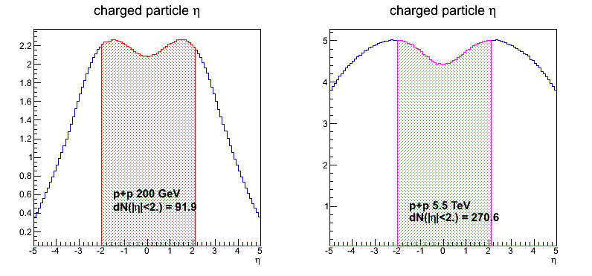
sPHENIX MVTX vs ALICE ITS/IB Specifications from ALICE ITS & sPHENIX design
MVTX functional requirements:
  First detection layer as close to the beam pipe as possible, to achieve better than 60um DCA resolution @pT=1GeV
  Reduction of material budget to minimize multiple scattering
  15kHz triggered readout capable of 200kHz for Au+Au and 12MHz for p+p collisions
  Full coverage of collisions within |Z|<10cm, charged track acceptance |eta|<1
Comparison between ALICE/ITS-IB and sPHENIX/MVTX Specs
  Peak A+A collision rate: 200kHz(ALICE): 200kHz(sPHENIX)
  Peak p+p collision rate: 1MHz(ALICE):12MHz(sPHENIX)
  Event hit size per collision: sPHENIX = 1/3 ALICE
  Trigger/readout rate: 50kHz (ALICE): 15kHz(sPHENIX)
Hardware:
  3-layer of MAPS staves: identical ALICE/IB and MVTX
  Stave readout: 1 stave/RU(ITS/IB, sPHENIX)
  RU links: 8 RU/CRU(ITS/IB), 8RU/FELIX(sPHENIX)
dN/dη: sPHENIX = 1/3 ALICE (pp)

Slide 13
MVTX Pre-proposal Submitted!
Pre-proposal submitted to DOE, 2/2017
  Follow-up discussions with DOE and BNL managers
  Weekly proj. leaders meeting BNL/LANL/LBNL/MIT
Plan to update proposal to DOE, late 2017
  Expanded science “CD0” + Cost & Schedule “CD1”
  Assumed funding starts in FY18
A growing collaboration
  15+ institutions from US and abroad
“Adopt” ALICE ITS Upgrade Inner Barrel 3-layer MAPS detector
  Mini. risk, Max. Physics
Precision vertexing for b-jet/B-hadron tagging in HI with high efficiency and high purity
B-jet modification in QGP at low-medium pT to determine QGP properties, study mass-dependence on collisional vs radiative energy loss, flow etc.
A separate DOE upgrade fund to build the full detector, WBS 1.12, ~$5M for construction
Early R&D by LANL LDRD, $5M, FY17-19, readout, mechanical design and physics

Slide 14
Scope of the MVTX Project
MAPS staves & Electronics
  MAPS staves “MoU” to build 68 ITS inner Barrel Staves
    No modification
  Readout Electronics
    Frontend: ALICE/ITS, RU
    Backend: ATLAS FELIX
    Modify/reprogram RU & FELIX for sPHENIX
    R&D by LANL LDRD, in collab. w/ LBNL/UT-Austin et al
  Production:
    Extend ALICE/ITS MAPS stave production
      WBS 1.5.3.1
      sPHENIX personnel help at CERN
    Reproduce additional ALICE RU & FELIX for sPHENIX
      WBS 1.5.2.1, UT-Austin
      WBS 1.5.2.2 , LANL
    Final assembly and test in US
      WBS 1.5.3, LBNL
  Ancillary systems, “adopt” ALICE system
    Power distribution, cables, crates, racks etc.,
      WBS 1.5.2.3, LBNL
    Slow control, safety and monitoring
Mechanics & Cooling
  Some changes to ALICE/ITS inner tracker mechanical structures, WBS 1.5.3
    End Wheels
    Cylindrical structure shells
    Detector half barrels
    Detector and Service half barrels
  Mechanical Integration, WBS 1.5.4
    Conceptual design by LANL LDRD
    Prototype by sPHENIX R&D, MIT/LANL
    Design integration frames
    Carbon frames etc., LBNL
    Installation tooling etc.
  Adopt ALICE cooling plant design
    Minor modification to fit sPHENIX
    Smaller heat load than ALICE ITS
  Metrology and Survey

Slide 15
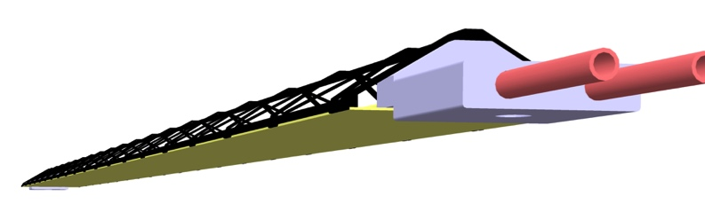
Stave Production at CERN: WBS 1.5.3.1
48+20 (spares) ALICE/ITS IB staves for sPHENIX
  To be produced at CERN using ALICE ITS/IB facilities
  CERN technicians and sPHENIX students/postdocs
Production cost & schedule
  08/2018 - 4/2019 after ALICE/IB prod.
  Material Cost: 0.45M
  Full cost recovery: 0.5M
  add 35% contingency
One assembled stave:
  1 FPC
  9 MAPS chips
  Cooling plate
  Carbon space frame
  Wire bonded
FPC
Chips
Cooling plate

Slide 16
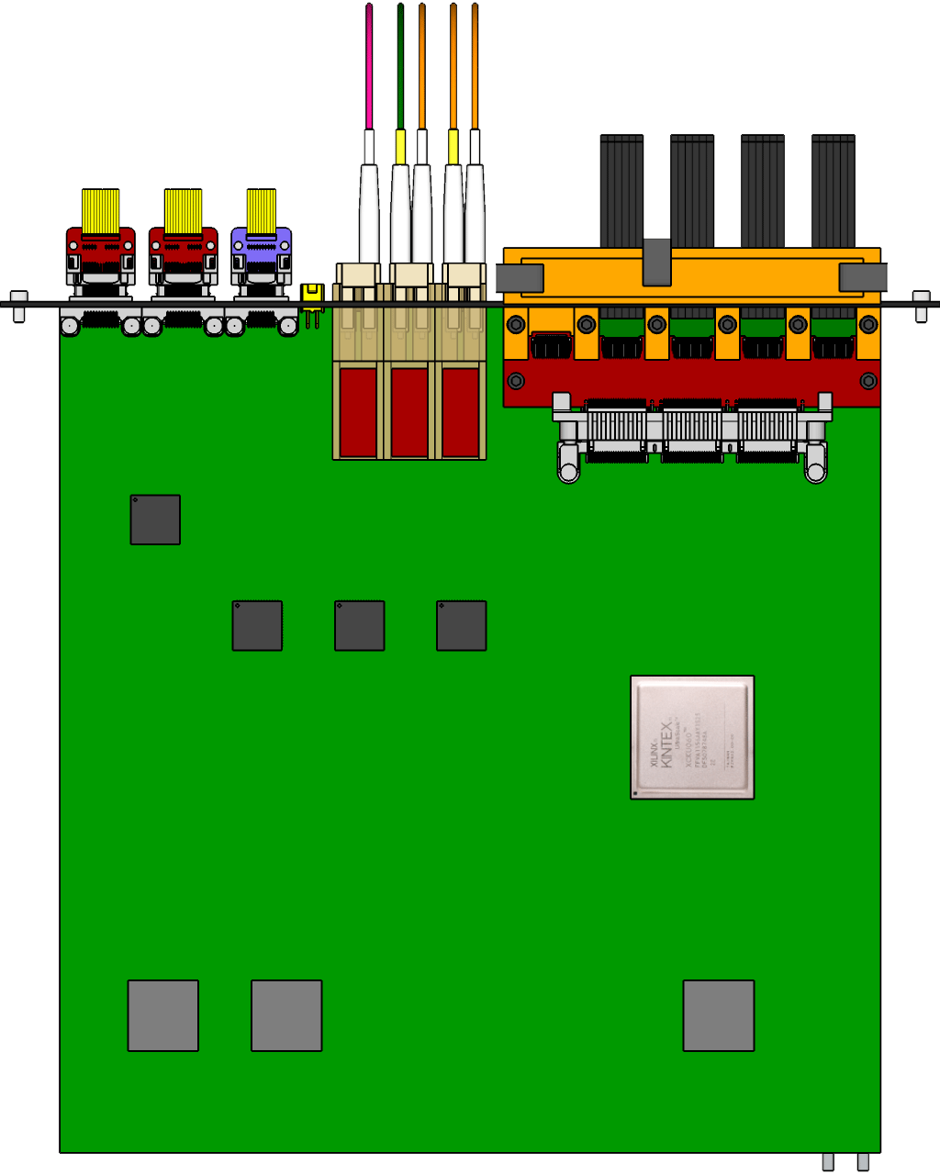

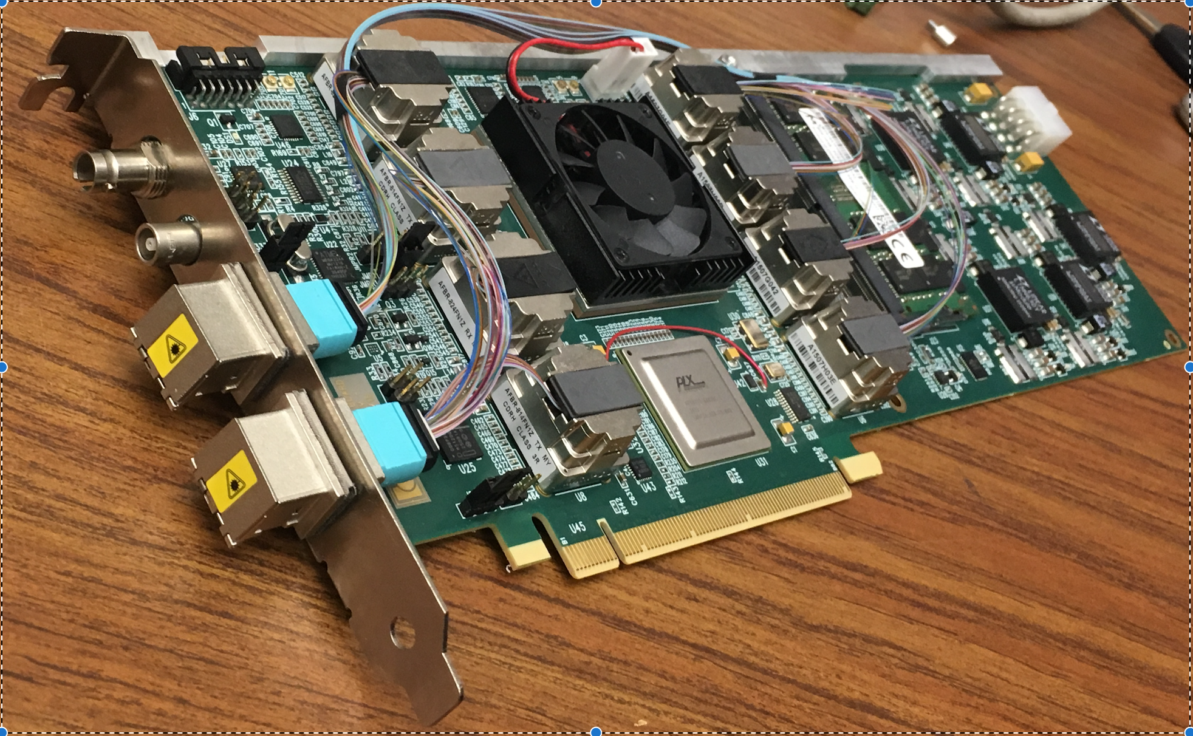
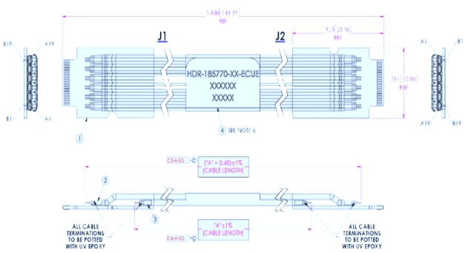

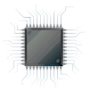
MVTX Readout and Control System
RUv1 prototype:
available: ~Aug/Sep.
sPHENIX GL-1 & GTM
Prototype stave:
Arrived: June
CAN bus
DCS
5 m
Trigger & Clock
Readout Unit
GBT Optical Links
9-sensor Stave
9 Data (1.2Gbps)
1 Clock, 1 Control/Trigger
Control
Data (9.6 Gb/s max)
Trigger
Samtec Twinax “FireFly”
FELIX (or CRU)
FPC
Power
Alpide Sensors
FELIX v1.5:
Arrived June
Power
Filtering Board
(Capacitors)
regulators
Power supplies
Cold Plate
Regulated Power
Power Board
Available:
~August

Slide 17
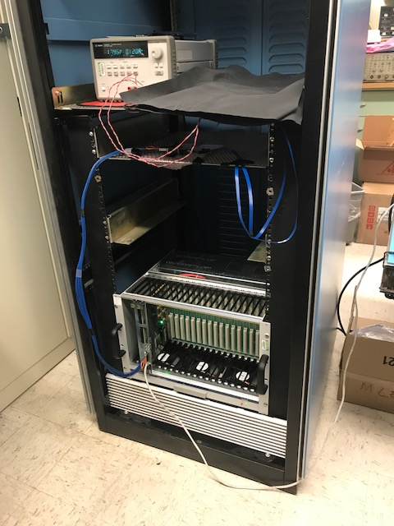
Readout R&D Progress @LANL
Cesar’s talk
MAPS chip
MOSAIC test bench in operation
  Single MAPS chip with high-speed readout
  Threshold scan
  Noise scan
  External trigger
  Test data readout performance
    1.2Gb/sec
    0.6Gb/sec
    0.4Gb/sec
Test firefly cable performance
  5m (ALICE default)
  7m, 10m
  Short extension cables, +20~30cm
10m FireFly cable
MOSAIC test bench

Slide 18
LDRD – MVTX Key Tasks/Milestones
7/17
10/17
10/18
10/19
Today
RUv1.0/FELIX1.5 Integration
40MHz, 7/17-12/17
LDRD
RUv1.x/FELIX2.0, 10MHz,
10/17 – 6/18
MVTX Design Review 7/6/2018
System test, cosmic & source
6/18 - 1/19
Test Beam, tracking performance
analysis, physics sim, NIM paper etc.
1/19 – 9/19
MVTX: 1/1/2018 – 1/1/2022
Stave Production, procure FPGA, GBT etc.
8/18-4/19
BNL Director Review
7/10-11, 2017
Electronics Production
1/19-8/19

Slide 19
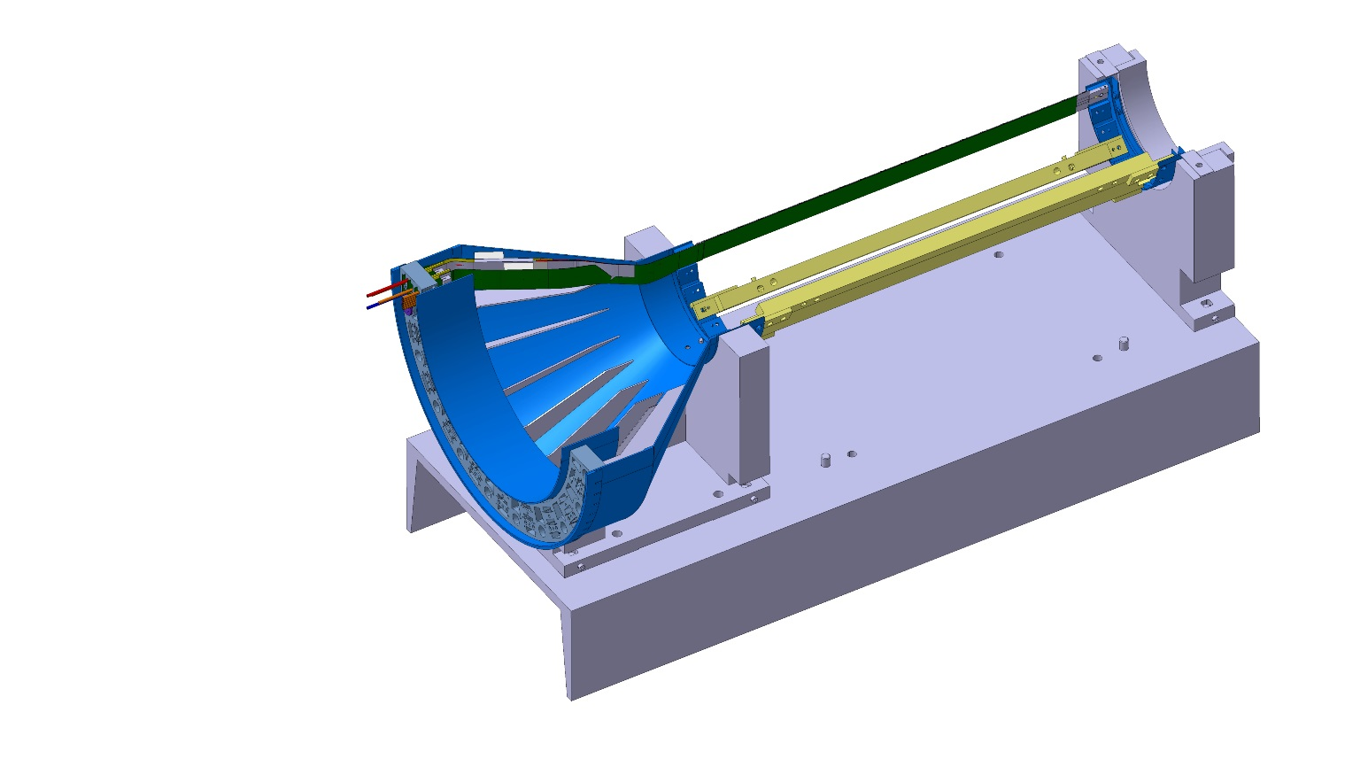
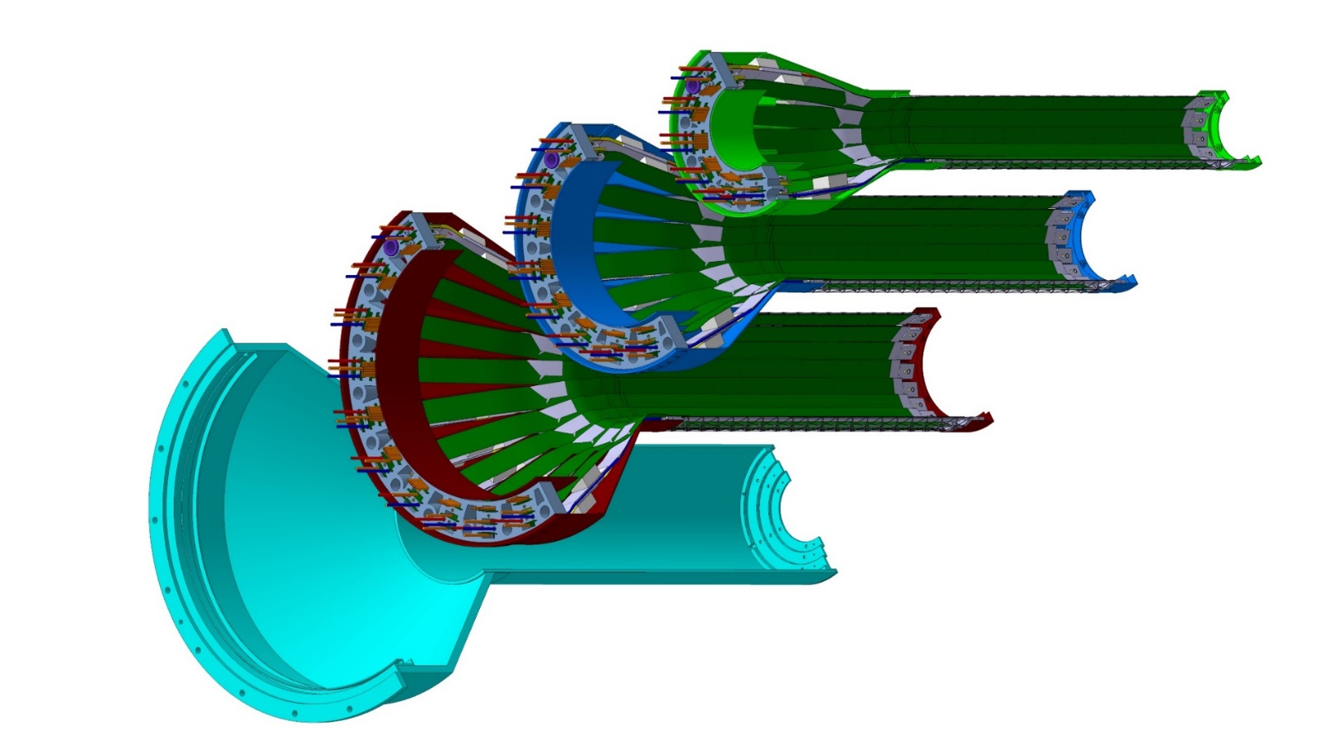
Detector Assembly
Giacomo’s talk
Precision positioning and installation of staves on end-wheels
Layer 0
Layer 1
Assembly of layers and carbon fiber structure into half-detector
Stave testing at each step
Metrology survey
Layer 2
IB CYSS

Slide 20
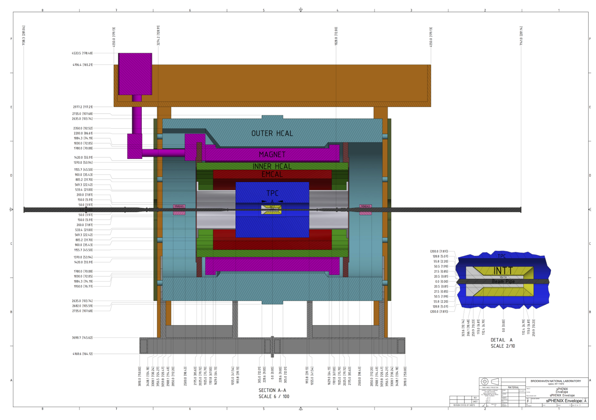
System Integration
Walt’s talk
MVTX+INTT

Slide 21
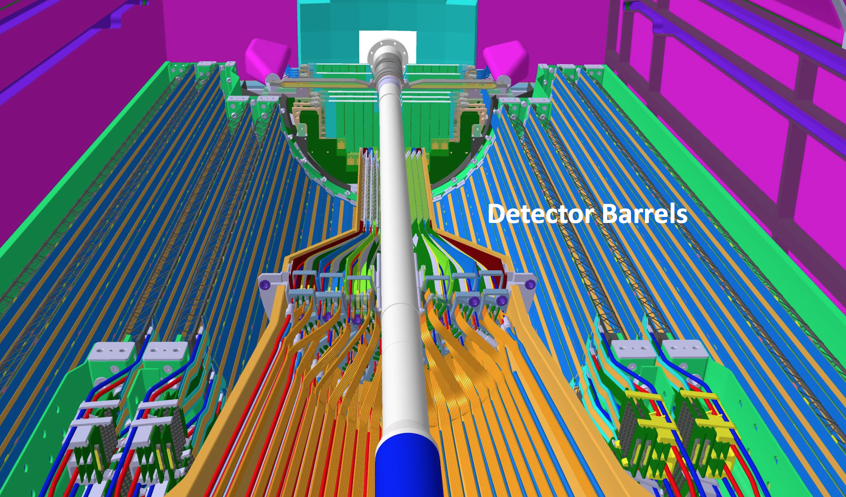
Alice ITS Cabling & Support similar for sPHENIX

Slide 22
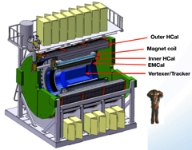
Project Tasks and Timeline
Dave’s talk
FY2016
FY2017
FY2018
FY2019
FY2020
FY2021
sPHENIX
baseline
CD-0
9/2016
CD-1
CD-2/3
8/1
Ready for
Beam
6/1
ALICE ITS/IB
Prod. ends
Readout R&D
Mech. design
@LANL/ALICE
A schedule driven project!
Key R&D
LDRD@LANL
Mech. Integr.
& Prototype
@LANL/MIT/LBNL
Stave prod.&test @CERN;
C-Stru. Prod.
@LBNL
“RU” prod @CERN
“FELIX” Prod. @US
Production
MAPS Prod. & QA
@ALICE
Detector Assembly
& Test @LBNL
Det. Install.
@BNL
+2%
+50%
“MoU” w/ ALICE/ITS: 11/2016
- Produce MAPS chips and Stave Space frames for sPHENIX as part of ALICE production!
- Full staves and RU & CRU production cost & schedule → MVTX MIE

Slide 23
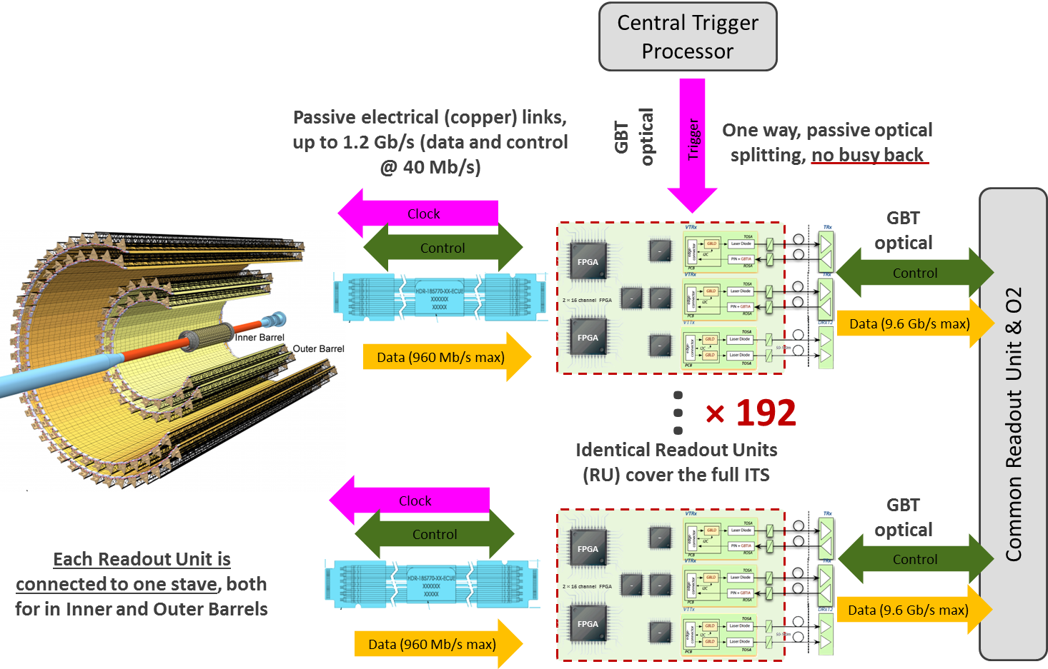
Cost Basis – Major Items
Dave Lee’s talk
MAPS and Staves: ~$xx
  ALICE ITS production
Readout: ~$xx
  ALICE ITS RDO
  ATLAS FELIX (ALICE CRU)
  FVTX/PHENIX experience
PS and slow control etc. ~$xx
  ALICE ITS design
  FVTX/PHENIX experience
Mechanical structures and cooling: $xx
  ALICE ITS inner tracker design
  FVTX/PHENIX, HFT/STAR experience
x48

Slide 24
MVTX
Principal Investigator: M. Liu (LANL)
Lead Coordinator: M. Chamizo-Llatas (BNL)
Co-investigators: G.Odyenic (LBNL),R.Redwine(MIT)
ES&H liason: TBC
6/20/17
sPHENIX DAQ
sPHENIX integration
Electronics
LANL
WBS 1.x
Mechanics & Detector Assembly
LBNL - WBS 1.y
Integration & Infrastructures
MIT - WBS 1.z
Readout Units
UT Austin -WBS 1.xx
Staves
LANL- WBS 1.yy
Cooling
MIT - WBS 1.zz
Back-end
LANL - WBS 1.xx
Carbon Structures
LBNL- WBS 1.yy
Safety System
MIT - WBS 1.zz
Power systems
LBNL - WBS 1.xx
Barrel Assembly
LBNL- WBS 1.yy
Global Support
MIT - WBS 1.zz
Installation & Commissioning
LBNL/BNL - WBS 1.zz

Slide 25
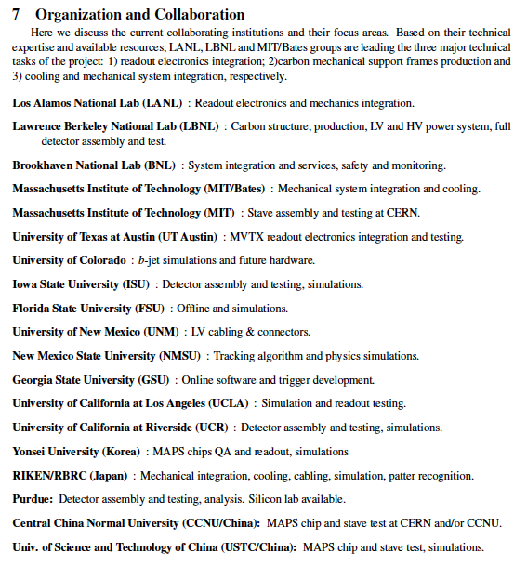
A growing collaboration!
new sPHENIX/MVTX members:
Czech groups
CCNU – lab
USTC
Peking Univ.

Slide 26
Status, Plans and Issues
Agreement with ALICE/CERN
  Obtained ALICE readout test stand, MAPS and electronics for early R&D
  Obtained design files, electronics and mechanics
  Training sPHENIX personnel
  ALICE produces MAPS and stave space frames for sPHENIX as part of the contingency
  Provide prototype and final staves
  Availability of CERN facilities after ITS/IB production
Potential schedule/funding gap of stave production
  ITS/IB production: ~7/2017 - 6/2018
  Risk Mitigation:
    Early training through LDRD effort, maintain activity at low level
    Possible mortgage for sPHENIX production from ALICE/CERN with MoU
    External foreign funding, CCNU Si Lab etc
sPHENIX readout and mechanical integration R&D
  Possible delay due to unavailability of key elements like staves and readout for R&D
  MVTX/INTT integration
  Risk mitigation:
    Early joint R&D with ALICE as associate members
    Start with prototype RDO and FELIX/CRU
    Early system integration R&D and mechanical system mockup

Slide 27
Summary
Exciting science
No high risk R&D
Strong support from ALICE
LANL LDRD very important
Ready for beam summer 2021
Project has ~6 months float

Slide 28
Backup

Slide 29
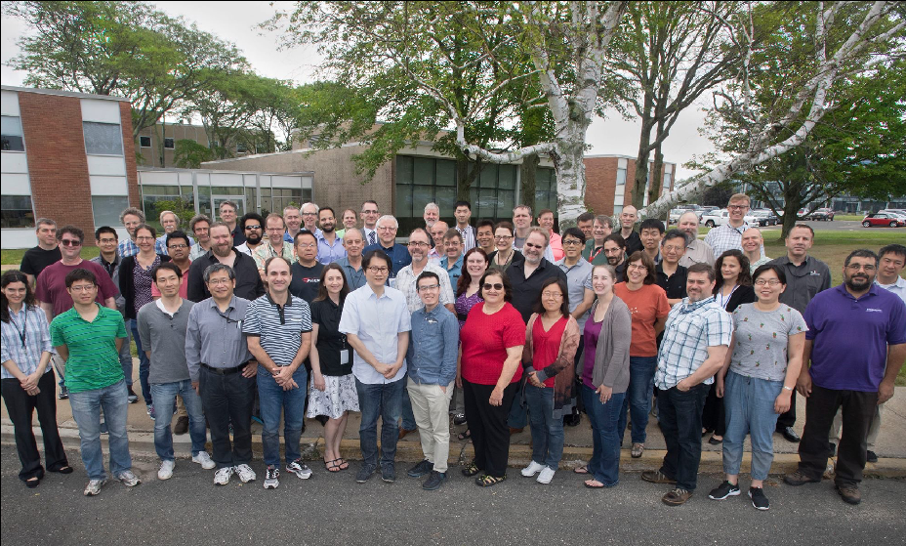
4th sPHENIX Collaboaration Meeting at BNL, June 2017

Slide 30

MAPS-based Vertex Detector (MVTX) for sPHENIX
|eta| < 2.0
R = 2.4; 3.2; 3.9cm;
L = 27.1cm; @Z=|10|cm, eta =(1.2,0.94,0.81)
“Adopt” ALICE ITS Upgrade Inner Barrel 3-layer MAPS detector
  Mini. risk, Max. Physics
Precision vertexing for b-jet/B-hadron tagging in HI with high efficiency and high purity
B-jet modification in QGP at low-medium pT to determine QGP properties, study mass-dependence on collisional vs radiative energy loss, flow etc.
A separate DOE MIE to build the full detector, WBS 1.12, ~$5M for construction;
Early R&D by LANL LDRD, $5M, FY17-19, readout and mechanical integration;

Slide 31
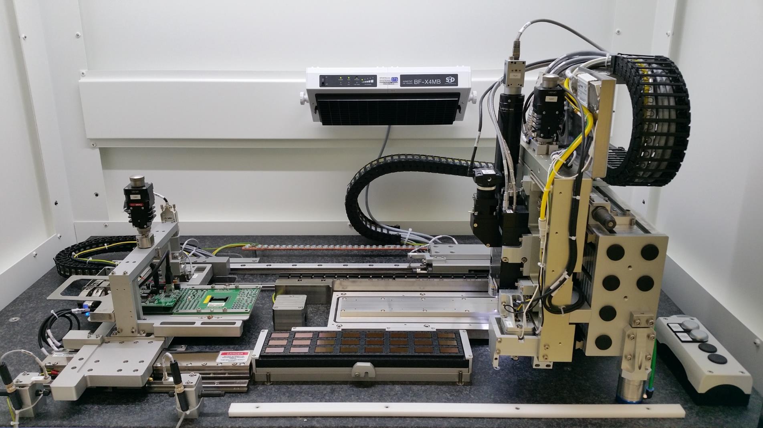
Stave Production & Test @ CERN
Cesar’s talk
Preparation for final stave production
  Successful ITS Stave production readiness review on Apr/27, 2017
  Optimization of final configuration is underway
Final stave production: July 2017 – June 2018
  One stave per day
  1st set of full staves complete in Jan. 2018
FPC
Chips
Cooling plate
Chip test and HIC assembly machine
Chip
pre-position
Chuck (PPC)
HIC assembly table
Probe-card
Chips tray
Chip gripper

Slide 32
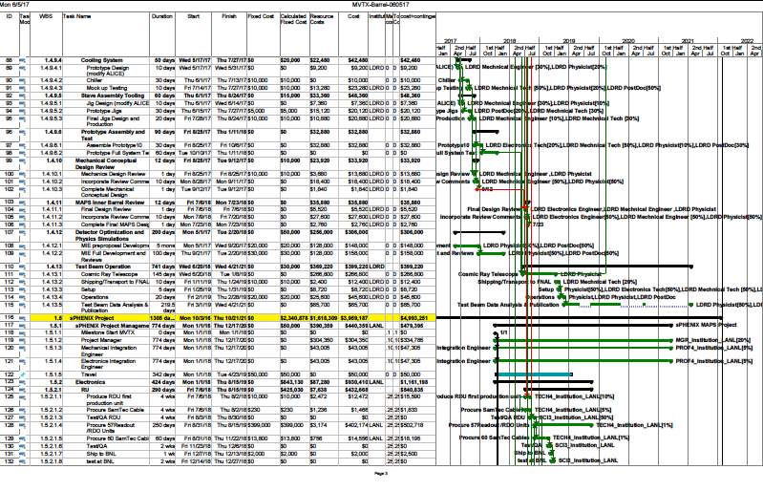
Updated Cost and Schedule WBS: 6/5/2017

Slide 33

Overall ITS Planning (Simplified Global View)
ALICE ITS Upgrade
2016
2017
2018
2019
2020
PRR
Sensor Series Production
CMOS processing, thinning & dicing, test
From L. Musa, 4/27/2017
Stave PRR Presentation
Stave Develop
PRR
Stave Mechanics
HIC Production
HIC and Stave
Stave Production
Mechanical Support Structures
Dry Assembly Test
Development
Production
EDR
PRR
Readout Electronics
Global Assembly
Commissioning @ Surface
Design & Prototyping
Design & Prototyping
Production & Test
Installation
EDR
PRR
Commissioning
11 months
Commissioning in ALICE
2016
2017
2018
2019
2020

Slide 34
Project Review Milestones
ALICE ITS Upgrade
From L. Musa, 4/27/2017
  Pixel Sensor Chip - EDR (Oct’ 15)
  Stave - EDR (May’ 16)
  Detector Barrel Mechanics - EDR (Jul ’16)
  Cooling – EDR (Jul ’16)
  Pixel Sensor Chip - PRR (Nov ’16)
  Detector Barrel Mechanics - PRR (Dec ’16)
  Service Barrel Mechanics - EDR (Dec ‘16): done
  Cooling – PRR (Dec ’16): done
  Readout Electronics – EDR (Jan ‘17): done
  Stave - PRR (Apr ‘17)
  Service Barrel Mechanics – PRR (May ‘17)
  Readout Electronics – PRR (Dec ’17)
Stave Production Readiness Review:
4/27/2017
Stave production starts ~May/June;
1st set of IB by Jan 2018;
2nd set of IB by July 2018
LANL people + others/MVTX work on stave production from May 2017 at CERN, prototype available soon at LANL
Fully working staves for R&D available ~Jan 2018;
Near final readout RU/CRU: ~12/2017

Slide 35
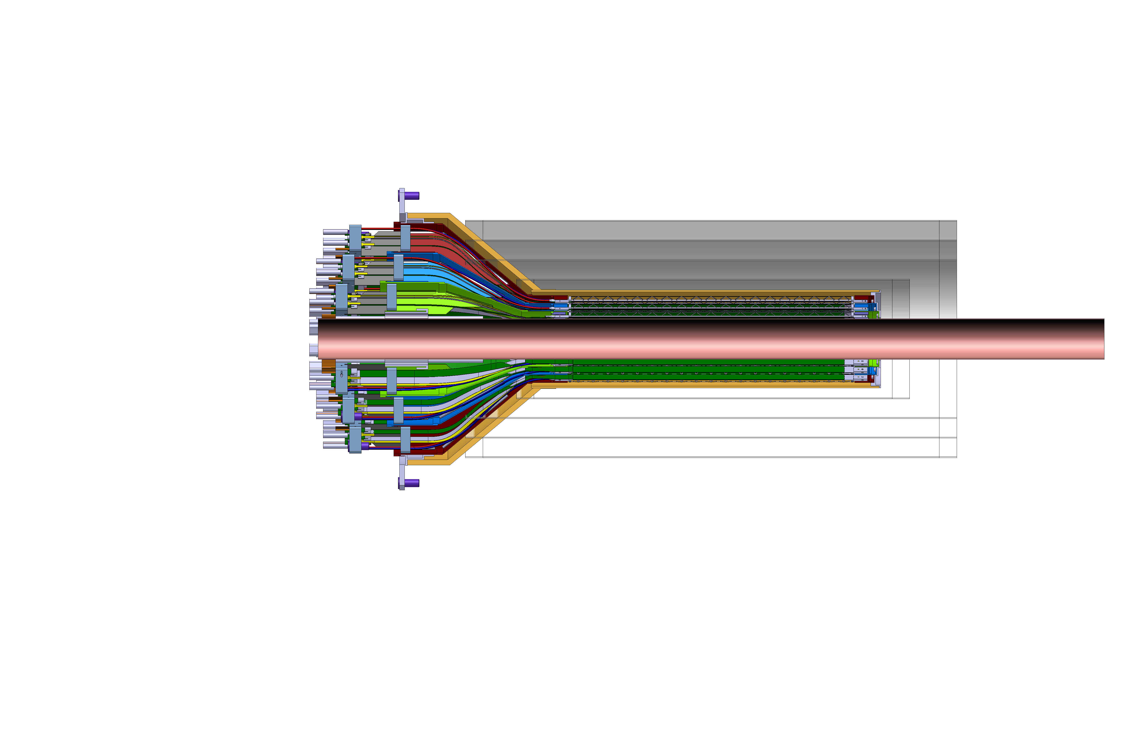
Detector Assembly
Giacomo’s talk
Carbon supporting structures
Stave assembly & test
Side view of MVTX

Slide 36
Integration

Slide 37
INTT-MVTX Conflict
INTT Acceptance
@ |z|=10
INTT 4-layers
|η|<0.95
|η|<1.09
|η|<1.28
|η|<1.12
Currently a clear conflict between the INTT and MVTX
  INTT only includes ladder, no connectors, cooling barbs, etc
R&D items: 1) Extend cables to move the conical structure further out in z-direction; 2) Design/optimize INTT layers to fit current MVTX geometry;
  FPC data cable is the HDI and can’t be easily extended, short “firefly” cables possible?
  Reduce angle of cone – redesign C-structures and connectors

Slide 38
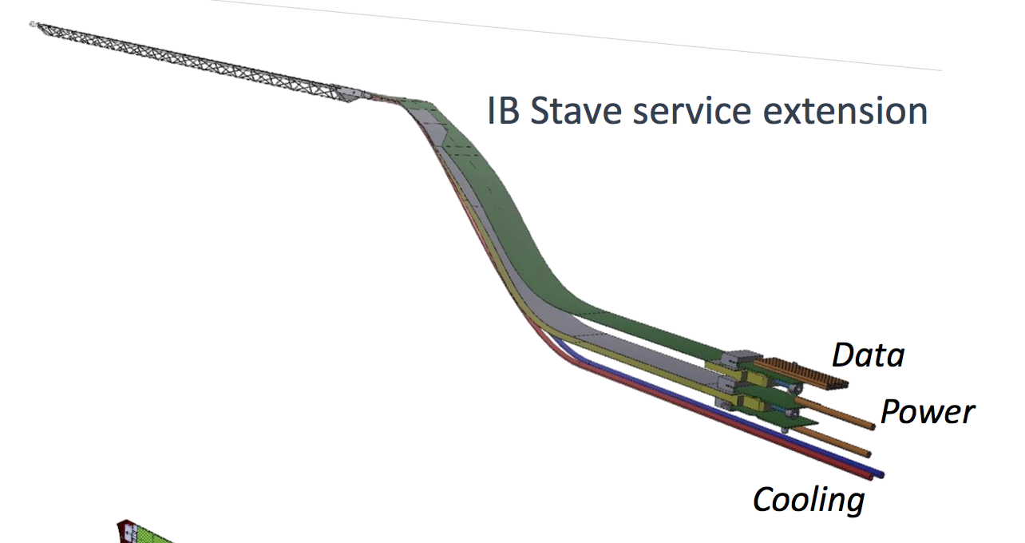
INTT-MVTX Conflict
INTT 4-layers
Extend cables to move the conical structure further out in z-direction
  FPC data cable is the HDI and can’t be easily extended
  Possibly add short “firefly” cables to hook up to patch panel, R&D needed
Reduce angle of cone – redesign

Slide 39
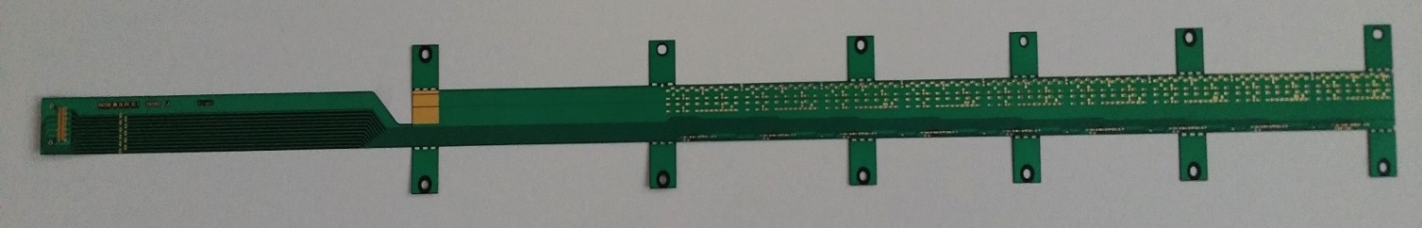
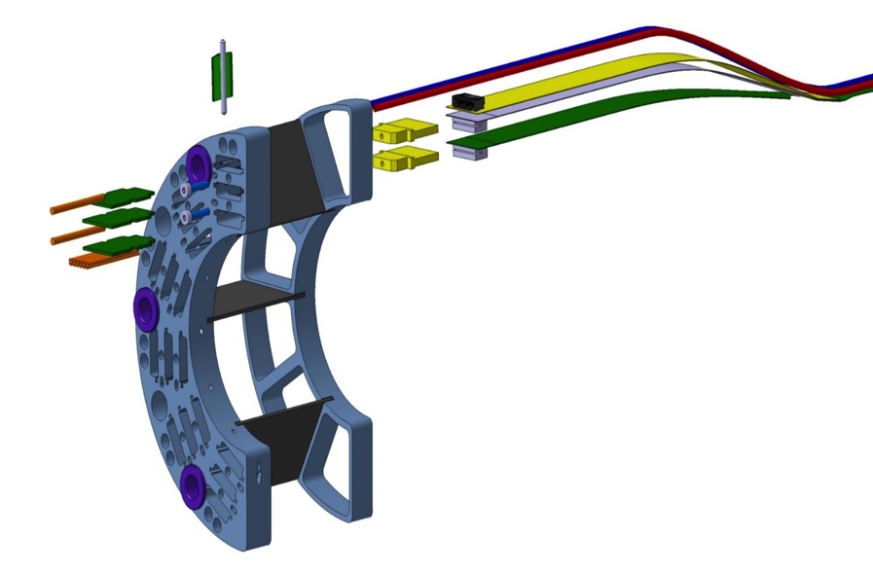
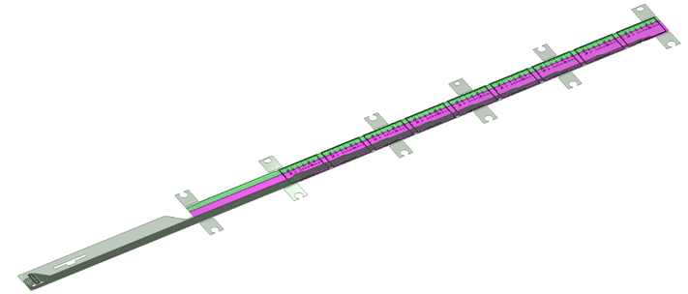
MVTX/INTT Integration
Extend MVTX Service Cables?
506.2 mm
16 mm
16.15 mm
41.9 mm
CHIP 9
……
CHIP 2
CHIP 1
The 9 silicon chips are read out in parallel: each chip sends its data stream to the end of Stave by a dedicated differential pair, 100 μm wide. Two additional differential pairs distribute the clock and configuration signals.

Slide 40
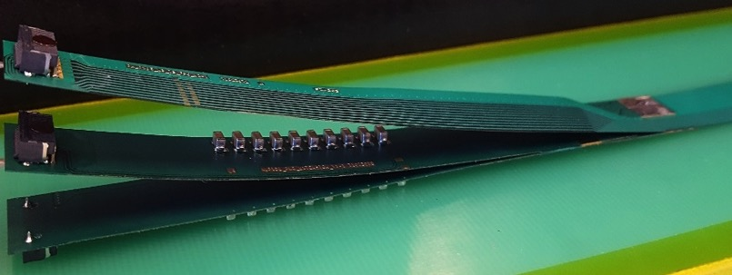
FPC Extension for Connection to Electrical Services
Antonello Di Mauro, Stave PRR 4/27/2017
The connection to the service cables is achieved by a double FPC extension which is soldered to the HIC
x-section at interconnection between FPC and extensions
AVDD
AVDD
AVDD
AVDD
DVDD
FPC
AVDD
DVDD
AGND
AGND
Flex power extension
AVDD
DVDD
AGND
FPC
AGND
DGND
DVDD
DVDD
AGND
DGND
DVDD
AGND
DGND
FPC
DGND
DGND
Flex power extension
DGND
signal lines (FPC)
digital power
analogue power

Slide 43
Cost & Schedule

Slide 44
Cost Basis For Electronics
J. Phys. G: Nucl. Part. Phys. 41 (2014) 087002
48(+40%)
sPHENIX

Slide 45
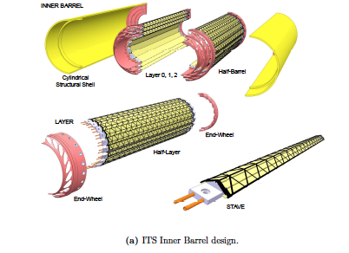
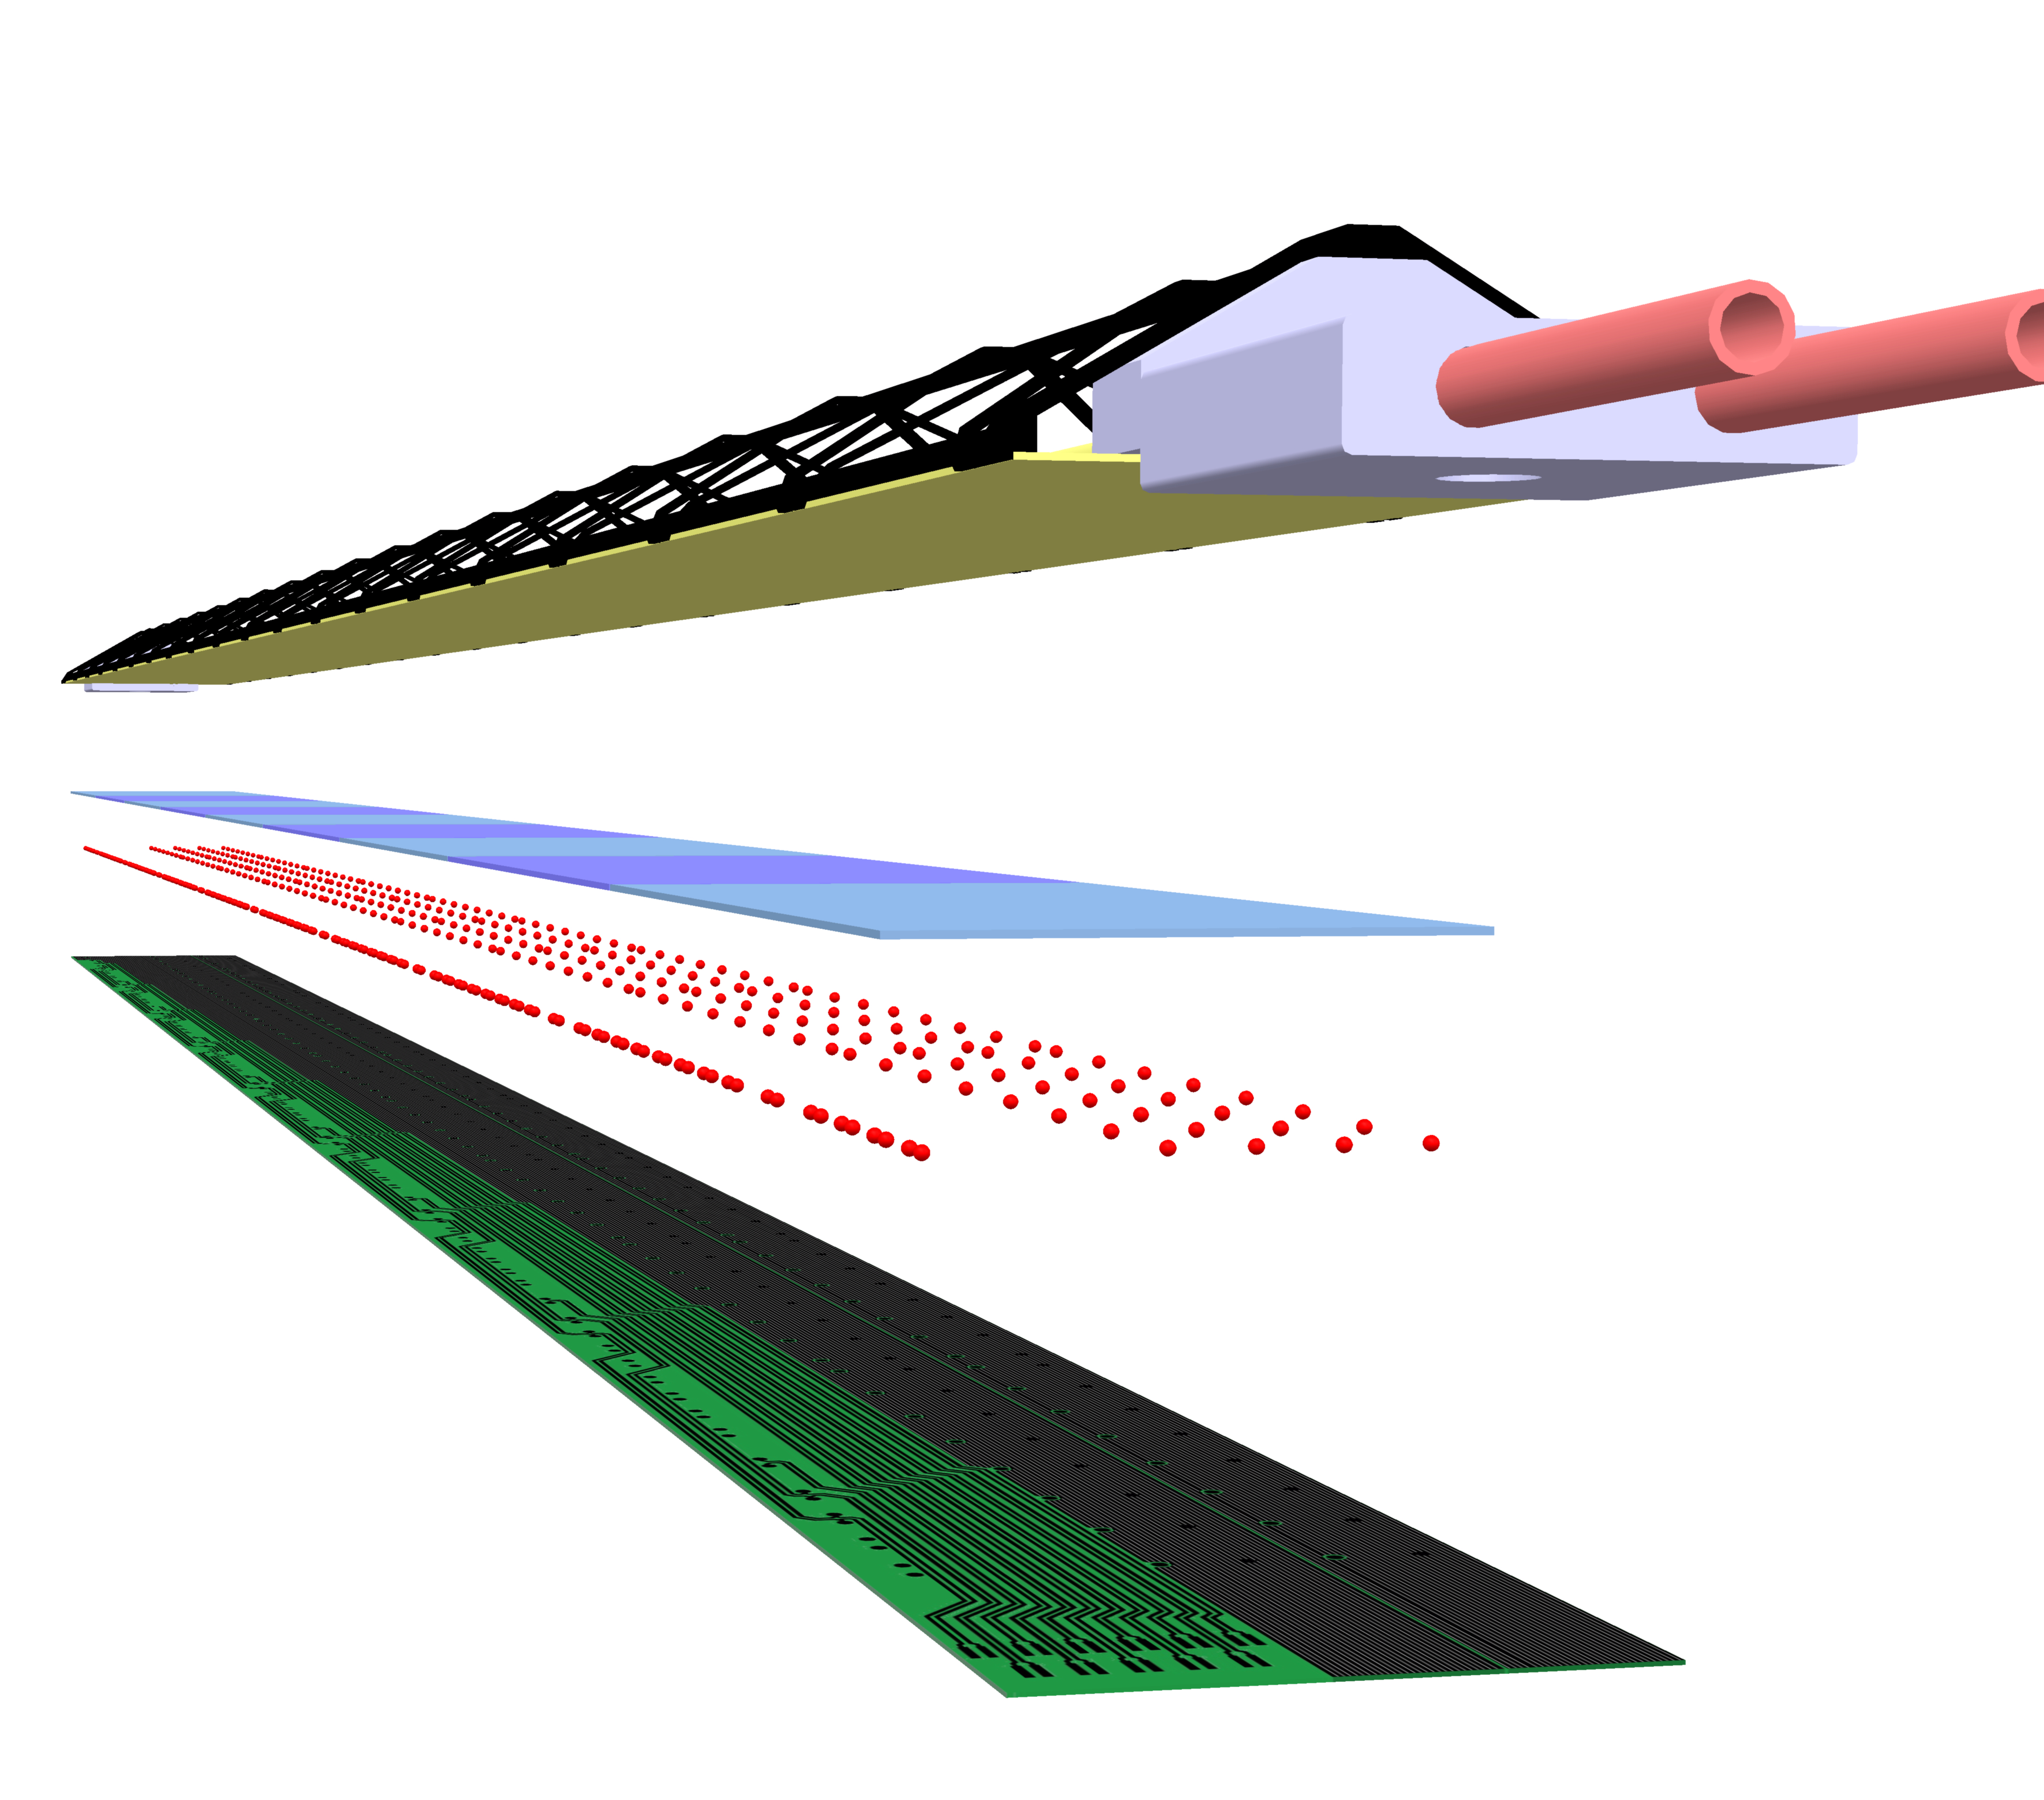
ALICE Stave and Global Support Structure
Cost and Schedule Basis
ALICE Stave
J. Phys. G: Nucl. Part. Phys. 41 (2014) 087002

Slide 47
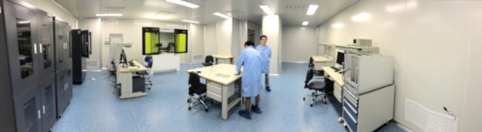
HICs Assembly Lab @CCNU space ~ 70m² (1K clean room); 20m² (10K clean room, 2.9m head room)
Chip and FPC gluing
Gluing FPC/MAPS
Chip mounting
Wire Bonding
Electrical circuit testing
Storage
Machine shop: (Sun, Daming, Tech.)
CNC etc.
Simple mechanical structures
Not Doing at present:
Stave assembly
No carbon structures
Chip mounting
Wire bonding
Test bench
storage
Gluing & assembly
tables

Slide 48
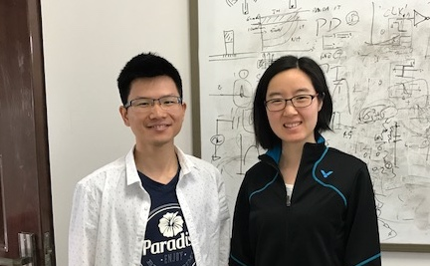

CCNU Plan – Cont.
Gao
Yang
Experts and Designers of ALICE MAPS/ALPIDE on-chip electronics
  Analogy circuit – Dr. Chaosong Gao
  Digital circuit – Dr. Ping Yang
  They will help us!
PLAC – Pixel Lab At CCNU
  Also interested in mechanical system integration
  Plan to hire a full time engineer to work on sPHENIX integration effort
    Visit LANL 6-12 months, work on preliminary conceptual design for the MVTX/INTT/TPC
Physics simulation and analysis
  Many students
PLAC Ass. Director
Dr. Xiangming Sun

Slide 49
MVTX R&D Status and Plan
Readout R&D
  5 single-chip MAPS tested at LANL
  Workfest @UT-Austin, 4/19-20
  RUv1 available in July, will be used for LDRD telescope
  BNL/ATLAS FELIX being evaluated as the default backend
    Computer arrived, fibers/cables ordered
    Obtain one FELIX in a few weeks
    “CRU” being prototyped with Altera evaluation boards, able to communicate with the RUv0 board @ UT-Austin;
  LANL MOSAIC test bench in operation!
Tracker integration task force
  MVTX + INTT + TPC mechanical system integration
  Identified the major tasks
Stave production @CERN
  ALICE Stave Production Readiness Review 4/27, prod. Starts in June/July
  LANL people do assembly and testing at CERN, May – Sept. 2017
  MVTX plan

Slide 50
Data Flow and Control

Slide 51
MVTX Readout and Control System
Mark’s talk
RUv1 prototype:
available: ~July/Aug
sPHENIX GL-1 & GTM
Prototype stave:
Arrived: June
CAN bus
DCS
5 m
Trigger & Clock
Readout Unit
GBT Optical Links
9-sensor Stave
9 Data (1.2Gbps)
1 Clock, 1 Control/Trigger
Control
Data (9.6 Gb/s max)
Trigger
Samtec Twinax “FireFly”
FELIX (or CRU)
FPC
Power
Alpide Sensors
FELIX v1.5:
Arrived June
Power
Filtering Board
(Capacitors)
regulators
Power supplies
Cold Plate
Regulated Power
Power Board
Available:
~August

Slide 52

sPHENX Data Flow (TPC)
Plan to have a very similar system for MVTX, but in the triggered mode
FEE = RU;
DAM/EBDC = FELIX;
The TPC features a continuous readout which is conceptually different from the calorimeter triggered readout
FEE
DAM
EBDC
10+ Gigabit
Crossbar
Switch
DCM
DCM
DCM
FEE
DCM
DAM
EBDC
Buffer Box
DCM
DCM
FEE
DCM
EBDC
Buffer Box
Not in 1.7 Scope
DAM
DCM
DCM
Buffer Box
FEE
DCM
EBDC
Buffer Box
To RCF/
HPSS
DCM
DAM
DCM
Buffer Box
TPC
FEE
DCM
Buffer Box
DCM
DAM
EBDC
DCM
FEE
DCM
Buffer Box
DCM
DAM
EBDC
DCM
Data Concentration
We currently envision the DAM to be a PCIe card in a generic computer that acts as EBDC
The demarcation line between WBS 1.2 and 1.7 runs through the EBDC – budget-wise in 1.2
Functionality-wise partially in 1.7
DAM Data Aggregation Module
EBDC Event Buffering and Data Compressor

Slide 53
sPHENIX Design Specs
A sustained DAQ rate of 15KHz
Archive 40Gbit/s to long-term storage in the RACF
Interface to various detector systems:
  Calorimeter
  TPC
  Intermediate tracker (INTT)
  MVTX detector
  Min Bias trigger detector
Global Level 1 trigger
Local level 1 trigger interface and decision-making

Slide 54

Design Specs - Components
= +
Triggered detectors (calos, INTT, MinBias) Readout
  Subevent buffers (SEB)
  ATPs (assembly and trigger processors)
Continuous Readout Detectors (TPC) Readout
  EBDC interface and functionality
MAPS detector
  EBDC-like component? Design not specified yet
High-end Network Switch ( > 150Gbit/s capacity)
Buffer boxes ( some 50+ hrs local data buffer space)
Networks to the RACF (admin/setup, fibers in place)
SEB
= +
jSEB2
A “Subevent Buffer” (SEB) refers to a Linux PC with a “jSEB2” interface card
Card receives data from the DCM2’s via another board
First time data are seen in a standard PC

Slide 55
Design Specs – channel counts
Note that this does not translate 1:1 into data volume
Calorimeters 120K o(20) SEBs
TPC 100K o(10) EBDCs
INTT ~230K o(10) ?? SEBs
MVTX ~220 million pixels* o(10) ?? PCs
(440 sensors)

Slide 56

Data compression
Buffer Boxes (7)
After all data reduction techniques (zero-suppression, bit-packing, etc) are applied, you typically find that your raw data are still gzip-compressible to a significant amount
Introduced a compressed raw data format that supports a late-stage compression
This is what a file normally looks like
buffer
buffer
buffer
buffer
buffer
buffer
LZO
algorithm
Add new
buffer hdr
New buffer with the
compressed one as payload
This is what a file then looks like
On readback:
LZO
Unpack
Original uncompressed buffer restored
All this is handled completely in the I/O layer, the higher-level routines just receive a buffer as before.

Slide 57
Data compression load
Buffer Boxes (7)
This compression buys you a lot spare bandwidth and nice features (e.g, your analysis runs faster!)
However:
A late-stage compression (think: in your tape drive in the extreme case) doesn’t really help you
The compression has to kick in before the data hit your storage system for the first time
No single machine can keep up with compressing a >2GByte/s rate

Slide 58
Local Level 1 Triggers
Receive trigger primitives from other subsystems
Form higher-level trigger decisions especially in p+p, p+A
Example: high-Pt trigger from the EmCal
Trigger primitive formation in other WBS’ scope (e.g. Calorimeter electronics)
Common format, receiver, decision-forming circuitry (very likely FPGA card)
Important to distinguish the between trigger detectors and the trigger system (the one that takes the decision and distributes this to the triggered detectors)

Slide 59
Multi-Event buffering
This is what makes the DAQ as fast as it is
Or, in other words: that keeps the dead time in the low 90%’s
Comes down to dealing with your data from various events in parallel
Our hardware is designed to deal with 5-event buffering
More is a diminishing return for $$$
We actually mostly ran 4-event buffering in PHENIX

Slide 60

5-year RHIC Run Plan

Slide 61

5-Year Run Plan

Slide 62

Expected Luminosity and Collision Rate

Slide 63


Slide 64


Slide 65
Motivation
Check if extend the readout cable length from 5m to 7-10m can fit the particle flux at sPHENIX.
ALICE readout speed 1.2Gb/s at 5m, we would like to run at 600Mb/s at around 7-10m.
Run PYTHIA6 MB in 200 GeV and 5 TeV p+p collisions and check the number of charged tracks versus pseudorapidity.

Slide 66
dN/dη in p+p collisions
With |η|<2.0 region, dN(ALICE) ~2.9*dN(sPHENIX).

Slide 67

dN/dη in 0-10% Au+Au/Pb+Pb collisions
With |η|<2.0 region, dN(ALICE) ~5.1*dN(sPHENIX).
Ncoll(Au+Au)=962, Ncoll(Pb+Pb)=1670.

Slide 68

dN/dη in MB Au+Au/Pb+Pb collisions
With |η|<2.0 region, dN(ALICE) ~4.6*dN(sPHENIX).
Ncoll(Au+Au)=258, Ncoll(Pb+Pb)=401.

Slide 69
Conclusions
The sPHENIX particle flux within |η|<2.0 region in p+p and heavy ion collisions is less than 33% than the collisions at ALICE. It will be fine if we reduce the data readout speed by around 33%.

Slide 70

Recall ALICE system– readout electronics is organized in Readout Units
The whole ITS front-end electronic is organized in modular Readout Units, with copper cables connecting each stave end with a single Readout Unit, which optically interfaces with both the Common Readout Unit and the Central Trigger Processor.
Central Trigger Processor
Passive electrical (copper) links, up to 1.2 Gb/s (data and control @ 40 Mb/s)
CAN bus
DCS
GBT optical
Trigger
Clock
Readout Units (RU)
Control
GBT optical
Control
CRU & O2
Data (9.6 Gb/s max)
Data (960 Mb/s max)
× n
Each Readout Unit is connected to one stave, both for in Inner and Outer Barrels
Power Board (PB)
Power
× 192
staves
Monitored power
Power supplies
Power

Slide 71
ALPIDE/MAPS Chip
Advantages of ALPIDE MAPS:
  Very fine pitch (28x28 μm)
  High efficiency (>99%) and low noise (<10⁻⁶)
  Fast readout, 2~4 μS
  Ultra-thin/low mass, 50μm (~0.3% X₀)
  On-pixel digitization, low power dissipation

Slide 72
Alpide Architecture
1024 pixel columns
AMP
COMP
THR
512 rows
In pixel:
  Amplification
  Discrimination
  3 hit storage registers (MEB)
Readout (zero suppression)
Readout (zero suppression)
Readout (zero suppression)
Readout (zero suppression)
Bias, Readout, Control

Slide 73

Pixel Architecture
v
PIX_IN
v
OUT_A
~5-6 μs
t_{f}~= 10 ns
OUT_D
ΔV=Q/C
threshold
t_{r}> 100 us
t
~5-6 us
STROBE
t
sPHENIX GL-1 latency: 4.0uS

Slide 74


Modes of Operation
The ITS is planned to be operated in two modes:
  Triggered mode: Pixels are latched with a short strobe window and read out based on an external trigger.
  Continuous mode: Pixels are latched using a long, periodic strobe window and read out.

Slide 75
Recall – sensor pixel cell timing
Signal can be due to an actual particle hitting the pixel (background included) or to the pixel noise
Pixel cell
Sensing node
Signal
Analog “slow” shaping time (µs order) saves power.
Called “pulse length”
Amplifier
Threshold
Threshold
Amp. out
Comparator
Strobe window
Cmp. out
Only pixel with signal higher than threshold DURING the strobe window will get latched in memory
And
Strobe window
Pixel memory
Pixel memory
Pixel buffer
Latch set
Time
Slow shaping time acts as an analogue memory buffering the signal until the arrival of the trigger (time over threshold of about 5 µs on average). Whichever signal over threshold during the strobe windows is latched into the pixel buffer.

Slide 76

Recall ALICE/ITS – Trigger distribution to FEE for ITS
ITS is a type II detector.
  Triggers are distributed to the ITS FEE (Readout Unit) directly from the LTU using the GBT protocol.
Type I detectors:
  Option would be to distribute triggers via the CRU over PON and GBT.
  This would add a latency of minimum 300 ns.
ITS

Slide 77
ALICE Timing – trigger detailed latency
Latency estimation for LM trigger / L0 trigger:
 | LM trigger [ns] | L0 trigger [ns]
Trigger inputs at CTP | 425 | 1200
CTP processing + Low latency + LTU | 100 + 65 + 25 = 190 | 100 + 65 + 25 = 190
GBT downstream latencies (using Kintex-7 FPGA) | 190 | 190
Optical fibers (35 m long) from CTP to the readout electronic | 175 | 175
Electrical cables from the readout module to detector | 250 | 250
Total | 1230 | 2005
We therefore go with the LM trigger!

Slide 78
Timing – sensor operations (triggered)
Trg. 1
Trg. 2
Trg. 3
Ev. n-1
Ev. n
Ev. n+1
Ev. n+2
Ev. n+3
Ev. n+4
Ev. n+5
Ev. n+6
Time width within signals are recorded on trigger depends on the analog shaping time (≈ 5 µs)
Time
Event rate – average number of interactions per second, Poisson distributed. Design goal is 100 kHz Pb-Pb collisions and 400 kHz p-p collisions.
Background – QED interactions, depends linearly to the beam intensity and on integration time. It significantly affects the inner layers only.
Noise – electronic pixel noise (thermal, RTS, etc.), generates fake pixel hits.
Trigger – all pixels with a signal over threshold during the strobe window (due to an event, background, noise, etc.) store an hit into their buffer.

Slide 79
Timing – detailed strobe and latching timing
Evn. #0 pulse
Comparator
output
1
Strobe window
Threshold
Evn. #0 active time (pulse length)
0
Time [µs]
-1
0
1
2
3
4
5
6
7
8
9
Time walk
≈ 0.3 µs
Hit latched in pixel memory
Hit read from pixel matrix
#1
Readout…
pixel buffer input
#2
E0
Trg. #0
#3
Trigger latency (≈ 1.2 µs)
Trigger connection
The trigger latency (to the matrix, including delay due to transmission and processing from the Readout Electronic ) will be about 1.2 µs.
Drawings are (reasonably) to scale. Timing figures are indicative, not precise.
Strobe signal is driven by trigger.
The analogue pulse duration behaves as an analogue memory, holding the hit information until the arrival of the trigger pulse. The pulse duration must therefore last enough for the trigger to arrive.

Slide 80
Timing – strobe re-latching previous strobe data
Evn. #0 pulse
Evn. #1 pulse
Comparator
output
1
Strobe window
Strobe window
Threshold
Evn. #0 active time (pulse length)
0
Evn. #1 active time (pulse length)
Time [µs]
-1
0
1
2
3
4
5
6
7
8
9
Time walk
≈ 0.3 µs
Time walk
≈ 0.3 µs
#1
pixel buffer input
Trg. #1
E0
Trg. #0
#2
E1
Readout…
#3
Trigger latency (1.2 µs)
Trigger latency (1.2 µs)
In buffer #2 are stored both Event #0 and Event #1, even if event #0 has been already stored in buffer #1
Events separation (2µs in this example)
Drawings are (reasonably) to scale. Timing figures are approximated, not precise!
Strobe signal is driven by trigger.
In this example, the second trigger (Trg. #1) actually stores Evn. #1 and Evn. #0.
For simplicity, strobe delay and width are not illustrated here.

Slide 81
Timing – trigger overlapping and storing two times the data
Evn. #0 pulse
Evn. #1 pulse
Comparator
output
1
Strobe window
Strobe window
Threshold
Evn. #0 active time (pulse length)
0
Evn. #1 active time (pulse length)
Time [µs]
-1
0
1
2
3
4
5
6
7
8
9
Time walk
≈ 0.3 µs
Time walk
≈ 0.3 µs
#1
pixel buffer input
E0
Trg. #0
Trg. #1
Readout…
#2
E1
#3
Trigger latency (1.2 µs)
In buffer #0 both Event #0 and Event #1, get stored
In buffer #1 again both Event #0 and Event #1 get stored
Events separation (1.1µs in this example)
In this example, the second trigger (Trg. #1) is useless, as both Evn. #0 and Evn. #1 are stored at the occurrence of Trg. #0 (look at the strobe window). Trg. #1 will store again both events in a new buffer. Therefore we can “filter” such trigger (see next slide).

Slide 82


Readout – trigger filtering
From timing slides: whenever a trigger arrives within a trigger latency (minus the analog signal time walk) from the previous trigger, data events associated with this trigger have been already stored by the previous one.
This happens just because the system has been designed with such equivalent “analog” memory, i.e. the long (about 5 µs) shaping time.
Therefore, no trigger are sent to the sensor within a trigger delay windows (minus all the other delays in the chain, both analog and digital).
Triggers from the CTP are filtered to a smaller (or equal) number of triggers sent to the detectors. Full trigger log is kept by the RU and associated to the outgoing data.
A trigger is passed ONLY if enough time has passed since the previous one (this time being ≈ trigger latency – active delay – other delays)
Clock
Readout
Unit
CTP main trigger
Control / trigger
Control
Data
Referenced data
Every CTP trigger is anyway stored, and associate with trigger signal sent to the sensor

Slide 83
Timing – Readout Unit trigger filtering
Triggers from the CTP
From CTP to RU
Time [µs]
-1
0
1
2
3
4
5
6
7
≈ trg latency
Multiple CTP triggers can be grouped into a single trigger sent to the sensor to the same trigger
Triggers to the chips
Logged into the RU with time and trigger ID.
From RU to sensor
Time [µs]
-1
0
1
2
3
4
5
6
7
Busy condition
The RU can retrieve which trigger has failed even if the trailer is corrupted/missing
From sensor to RU
Data from the sensor
Matched to logged triggers into the RU.
0001
0010
0011
0100
Time [µs]
-1
0
1
2
3
4
5
6
7
The RU labels the data frame with all the CTP triggers associated to its trgID
Triggers close in time re-record the same information, and the sensor can handle a minimum trigger spacing of about 1 µs (less than 0.1% probability at 100 kHz). The RU will therefore “filter” close-in-time (≈ < 1 µs) triggers. This also allow for the busy flag to be propagated to the readout unit before another trigger is issued (see next slide).

Slide 84

Hits and Event Data Rate
sPHENIX = 1/3 ALICE
Identical geometry for MVTX and ITS/IB(layer 0-2)
sPHENIX integration time ~5uS, less noise compared with ALICE with 30uS.
PYTHIA Sim

Slide 85

ALICE Data Rate and Dead Time

Slide 86
Readout Unit
Interface the sensors and powering system on the staves;
Control and trigger system
Implements ancillary functions like PS monitoring and control and health status of sensor operation parameters
One RU reads out 9 high-speed copper links (firefly cables)
For each sensor chip, running at 1.2Gb/s.
Located about 5m from MVTX in the IR
Radiation tolerant, GBT chipset over the “CERN Versatile Link”, each capable of 3.2Gb/s payload bandwidth, 3 chipset required to accommodate the full 9-MAPS readout.
A total of 48 RUs requried.
Firmware functionalities include:
  MAPS chip status and power control
  Data readout from 9 sensors per RU
  Control and Monitoring to/from the sensors
  Busy management
  Trigger management
  Data building and transmission through the GBT links to FELIX (or CRU)
  Remote update of the firmware
  Data handling in the FELIX (or CRU)

Slide 87


Readout Units Required for ITS & sPHENIX
ITS IB:
Produce 120 staves in one year
120% contingency
48 RU boards
48 inner staves
sPHENIX: 48 +40% = 68

Slide 88
Expected Hits/Data Rate Per Event
sPHENIX = ~25% ALICE per event
Trigger rate: 15/50 = 30%
Collision rate: 100kHz @sPHENIX
MAPS hits = noise + physics hits (noise < phy. hits)
Expected average data rate:
  sPHENIX = 30% x 30% ALICE = 10% ALICE

Slide 89




Readout Unit – connections toward the staves
Each readout unit is connected to a stave through copper cables (5m long), which carry both bidirectional control lines and unidirectional clock and data lines.
Inner Layers
Readout Unit
9 data lines, 1 clock, 1 control
9 data pairs,
1.2 Gb/s each
Middle Layers
16 data pairs,
400 Mb/s each
Readout Unit
(4+4+4+4) data, (1+1+1+1) clock, (1+1+1+1) control
Outer Layers
28 data pairs,
400 Mb/s each
Readout Unit
(7+7+7+7) data, (1+1+1+1) clock, (1+1+1+1) control

Slide 90
ITS Readout - Radiation Load
Position respect to beam |  |  | Radiation levels (total)
r | z | Name | TID | 1 MeV neq fluence | High energy hadron flux* | Charged particle flux
[cm] | [cm] |  | [krad] | [cm⁻²] | [kHz cm⁻²] | [kHz cm⁻²]
2.2 | [-13.5 ÷ 13.5] | ITS L0 | 2734 | 1.7 × 10¹³ | 765 (770) | 890 (910)
43 | [-73.7 ÷ 73.7] | ITS L6 | 20 | 8.1 × 10¹¹ | 3.4 (4.9) | 4.5 (6.7)
79 | [-260 ÷ 260] | TPC In | 5.6 | 7.0 × 10¹¹ | 1.35 (1.8) | 1.7 (3.45)
100 | 330 | RE | ≈ 5 | ≈ 1.6 × 10¹¹ | 0.86 | 1.7
258 | [-260 ÷ 260] | TPC Out | 0.86 | 1.4 × 10¹¹ | 0.27 (0.37) | 0.2 (0.3)
290 | [-290 ÷ 290] | TRD | 0.6 | 1.2 × 10¹¹ | 0.23 (0.31) | 0.15 (0.23)
TID & fluence = (table 1 × 1.3_{data taking efficiency} + Table 2 / 10_{better vacuum}) × 10_{safety factor}
Safety factor of 10 on top of TID and fluence calculated as in the above line.
Hadrons and charged particles as for 50 kHz Pb-Pb collisions (table 1, worst case scenario).
The average value within the z span is reported first, in brackets the peak value within the z interval.
* Momentum > 20 MeV.
We will assume 1 kHz cm⁻² for simplicity as baseline.

Slide 91

ALICE DAQ – “Radiation Hard Optical Link Project” Architecture
Versatile optical link project
GBT project
GBT project
On-Detector
Radiation Hard Electronics
Off-Detector
Commercial Off-The-Shelf (COTS)
Development of a high speed bi-directional radiation hard optical link:
GBT project:
  Rad-hard ASIC design
  Verification
  Functionality testing
  Packaging
Versatile link project:
  Opto-electronics
  Radiation hardness
  Functionality testing
  Packaging
The GBTx supports three frame types:
  “GBT” Frame (3.28 Gb/s user bandwidth)
  “Wide Bus” Frame (3.52 Gb/s)
  “8B/10B” Frame (4.48 Gb/s)
GBT Frames include “Forward Error Correction”

Slide 92






Readout Unit – overall connections overview
Direct connections to sensors control, clock and data lines.
Fiber optic connection toward the CRU using the GBT chipset (3 GBTx + 1 GBT-SCA chip).
CAN bus as backup path to the DCS system (main path through CRU and GBT).
Power board monitoring and control
SCA
Temperature, voltage & current monitoring
3.2 Gb/s
Control
GBTx
3.2 Gb/s
Data @ 3.2 Gb/s
SRAM
FPGA
Data @ 3.2 Gb/s
3.2 Gb/s
GBTx
Data @ 3.2 Gb/s
FLASH
FPGA
3.2 Gb/s
Trigger
Programmable Logic
3.2 Gb/s
GBTx
Available
Redundant slow control from DCS through CAN bus

Slide 93

Readout Unit – distribution and data/control connections per layer
CRU
ITS
Trigger
Data also contain responses to control commands and status info
Control
192 × Readout Unit
Data @ 3.2 Gb/s
Data @ 3.2 Gb/s
Not mandatory for “baseline” (Pb-Pb @ 50 kHz) operations.
Data @ 3.2 Gb/s
Layout |  |  | Readout Units |  | GBT Versatile link |  |  |  | Fibers
Layer | Staves | Copper assembly | RUs × stave | RUs × layer | GBTx × layer | SCA × layer | VTRx × layer | VTTx × layer | TRG × layer | Data × layer | Ctrl × layer
0 | 12 | 12 | 1 | 12 | 36 | 12 | 24 | 12 | 12 | 36 | 12
1 | 16 | 16 | 1 | 16 | 48 | 16 | 32 | 16 | 16 | 48 | 16
2 | 20 | 20 | 1 | 20 | 60 | 20 | 40 | 20 | 20 | 60 | 20
3 | 24 | 96 | 1 | 24 | 72 | 24 | 48 | 24 | 24 | 72 | 24
4 | 30 | 120 | 1 | 30 | 90 | 30 | 60 | 30 | 30 | 90 | 30
5 | 42 | 168 | 1 | 42 | 126 | 42 | 84 | 42 | 42 | 126 | 42
6 | 48 | 192 | 1 | 48 | 144 | 48 | 96 | 48 | 48 | 144 | 48
Total |  | 624 |  | 192 | 576 | 192 | 384 | 192 | 192 | 576 | 192

Slide 94

RUv1 – Block Diagram

Slide 95

RUv1 – Mechanical Layout
“standard” VME 6U board, only J1 connector towards backplane
Grounding and power from J1 connector, it will be VME compatible for testing
Balcony dimension representative only, to be optimized for final cables routing

Slide 96

Prototype Readout System – RUv0 & GBTxFMC

Slide 97

Prototype Setup
RUv0a with GBTxFMC & SFP
Ref Clock
CERN USB-I2C dongle
Power Loads
ITS Power Board

Slide 98

Setup with two RUv0
RefClk
Sensor
Power
“CRU”
RUv0
Altera Arria10 Devkit
Alpide
FireFly Cable

Slide 99
RU – Power Board Interface

Slide 100
Schedule

Slide 101

ALICE/ITS Readout R&D
5 RUv1 available for LANL R&D ~July 2017

Slide 102
FELIX Board
Some documents available:
https://www.phenix.bnl.gov/WWW/publish/mxliu/sPHENIX/Readout/FELIX/

Slide 103

ATLAS/FELIX BNL-711 PCIe Card
Credit: Kai Chen (BNL), https://indico.bnl.gov/conferenceDisplay.py?confId=2653
BNL-711 Board chosen for ATLAS FELIX project, and used in ATLAS phase I upgrade, which is projected to complete before sPHENIX.
Readout for ATLAS Phase-I sub-system of Liquid Argon Calorimeter, Level-1 calorimeter trigger, New small wheel of the muon spectrometer

Slide 105

ATLAS/FELIX BNL-711 PCIe Card
Credit: Kai Chen (BNL), https://indico.bnl.gov/conferenceDisplay.py?confId=2653
Main features for FELIX PCIe Card
  Design: BNL/Omega group, Layout: BNL/Instrumentation, multiple users.
  A large Kintex Ultrascale FPGA, 1.5 M LC
  48 bi-directional GBT link, PCIex16 Gen3, 101 Gbps demonstrated
  2x DDR4 memory slots (v1.0, v1.5), removed v2.0
  TTC-timing input (v1.0, v1.5), allow timing mezzanine card (v2.0) – provide help design sPHENIX GTM mezzanine card
Current version: v1.5 prototype, can be ordered
Next version: v2.0 pre-production, design starts now, expect available Oct 2017
BNL/Omega group, Local expert expressed willing for help us to adapt FELIX in sPHENIX
  Boards for initial evaluation test, support firmware software development, timing mezzanine card design
  The team is also help in possible use of FELIX card in protoDune.
  The FELIX team is open for inputs in guiding the design to be more generic to various users.
FELIX v1.5 Card in server, BNL ATLAS Group

Slide 106



FPGA Choices
CRU/
PCIe40
FELIX
Xlinux - Kintex Ultrascale
Available
XCKU115
FELIX v1.5 test boards
1.451
1.3
0.66
4320
75.9
(48 input + 48 output fiber links in FELIX)
48
6

Slide 107



MVTX options: 6x (PCIe card + server)
Data Aggregation Module (DAM):
PCIex8 or x16 card with multiple (48x) GBT fiber IO
Event Buffering and Data Compressor (EBDC): Rack server that can host at 1x PCIex16 cards + 2x 10 Gbps Ethernet port
Option 1: LHCb/ALICE CRU
Option 2: ATLAS FELIX
Option 3: build our own based on ALICE/ATLAS exp.
Example: Dell PowerEdge R830
2x12 cores, 2x10 GBps, ~ 10k$
MVTX/TPC
Buffer box

Slide 108


Electronics R&D – Cont.
FELIX and MVTX Power Distribution Boards
FELIX: visited BNL Labs and had FELIX system demo
  V1.5 boards, all functionalities available- data, slow control and Timing/Trigger/Busy, w/ GBT
  Multi-channel GBT links and PCIe interface code developed, with examples of user modules
  V2.0, available ~end of 2017, sPHENIX application
  A 1.5v FELIX board produced and tested, ready for shipment to LANL; Optical cables etc. to be ordered soon for LANL test bench
Power distribution boards and PS
  LBNL PS distribution board available for R&D from CERN/LBNL ~ August. Order placed, 4wks + testing
  R&D power supply and control system ordered (CAEN), available ~August
FELIX: tested @BNL
To be shipped to LANL

Slide 109
Comm. RU

Slide 110
ALICE O2 – Detailed Layout

Slide 111

O² Data Flow

Slide 112


CRU Interfaces
CRU has three interfaces:
  1 – GBT Link (Radiation Tolerant High Speed Optical Link)
  2 – GBT/10Gigabit PON
  3 – DDL3 link ( PCIe Gen 3 x16)

Slide 113


CRU – Connections to/from ITS
The O2 First Level Processors (FLPs) manage the detectors and collect/aggregate the data streams before storage. Each FLP hosts up to two Common Readout Units (CRU), which are optically interfaced with the ITS front-end electronics (Readout Units).
Sensor
Readout Unit
CRU
O² FLP
Up to 3 GBT link per RU (3.2 Gb/s each)
< 2 CRUs per FLP
Up to 28 Data
lines per RU
8 RUs per CRU
CRU architecture
FLP architecture

Slide 114
CRU Architecture

Slide 116

ALICE DAQ – CRU Data Paths

Slide 117


Servers
2U server, capable of hosting 2 CRUs
2 initial candidates
  Dell PowerEdge R730
    Initial tests with Altera Development Kit, good results (55 Gbps)
  Asus ESC4000-G3
    To be tested
Thorough evaluation only once CRU is available
Final O² hardware to be purchased ALAP, cannot define it now
Need support with FLP purchase: contact “alice-o2-flp-prototype@cern.ch”

Slide 118

CRU – Prototype efforts
C-RORC/G-RORC
12 bi-directional links @ 6 Gb/s
PCIe Gen2 x8
2 x RAM SLOTS
FMC connector
XILINX VIRTEX6 FPGA
CRU
48 bi-directional links @ 10 Gb/s
PCIe Gen3 x16
ALTERA ARRIAX FPGA

Slide 119


Altera Arria-10 Development Kit
Arria 10 GX 1150, 4500$
1 x SFP+
1 x QSFP
2 x FMC
PCIe Gen3 x8
https://www.altera.com/products/boards_and_kits/dev-kits/altera/kit-a10-gx-fpga.html

Slide 120



Dell Servers & Readout Cards
A few comments:
Tested on a DELL server
LENGTH !!!
WIDTH !!!
It is not “easy” to install it, to be compared with the actual CRU

Slide 121
FireFly Cables

Slide 122
MOSAIC Test Bench @LANL

Slide 123

Test under internal trigger (40MHz)
From Xuan
Readout speed 1.2 Gb/s and 50 injections.
Scan the noise per pixel and the average value is 7.47±1.80 (e).

Slide 124

Test under internal trigger (40MHz)
Readout speed 600 Mb/s and 50 injections.
Scan the noise per pixel and the average value is 7.53±1.76 (e).

Slide 125

External Trigger and Source
Xuan et al
Single chip readout
Use a pulse generator as the external trigger
Use the Strontium-90 to produce beta rays.
  Vary the distance between the source and the silicon chip
Sr-90
1kHZ trigger

Slide 126
A Single-chip MAPS Telescope
Check the readout occupancy and efficiency under different internal trigger clock (10-40MHz), readout speed (400-1200Mb/s) and threshold (set up by the analog signal or the configuration file?).
Set cosmic ray triggers with scintillator bars or pads to read out single MVTX chip with the external coincidence cosmic ray trigger.
Design of single chip based telescope in progress
Efficiency tester
Simple tracker
μ⁻
μ⁻

