Slide 1
MVTX Overview
(WBS 3.2)
Ming Liu
April 9-11, 2019
BNL

Slide 2
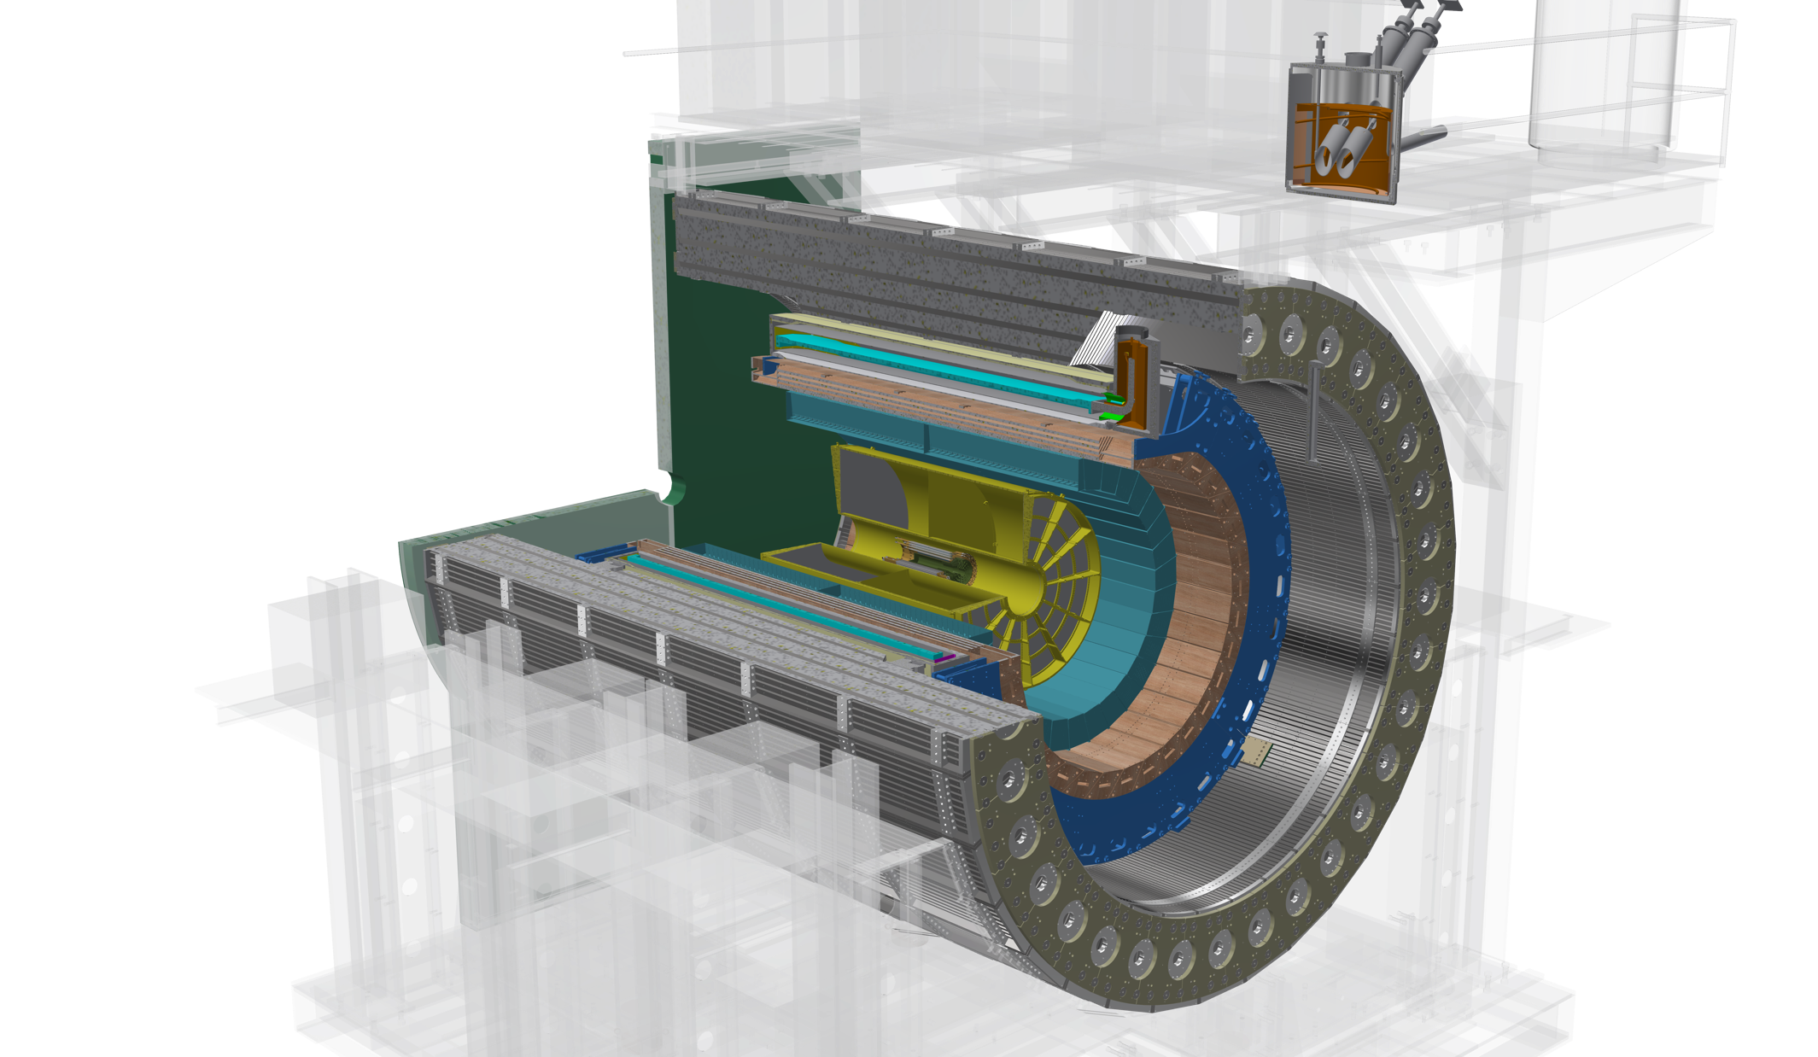
The sPHENIX Detectors
Outer HCal
SC Magnet
Inner HCal
EMCal
TPC
INTT
MVTX
Φ ~ 5m
15 kHz trigger
>10 GB/s data
Tracking system upgrade:
- MVTX (WBS3.2)
- INTT (WBS3.1)
Notes:
15kHz matched to collision rate.

Slide 3
Outline
Document: sPH-HF-2018-001
https://indico.bnl.gov/event/4072/
MVTX science & technology
MVTX scope
Cost & schedule
Status & highlights
Issues and concerns

Slide 4
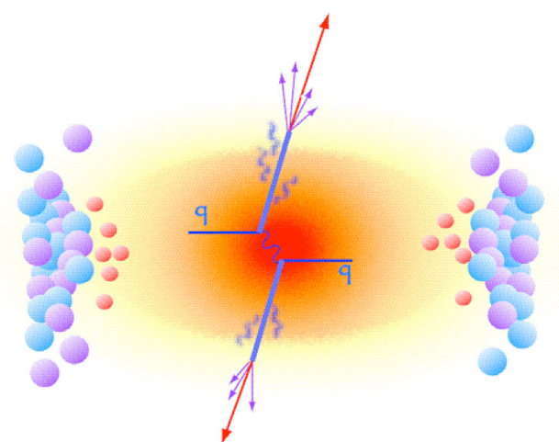
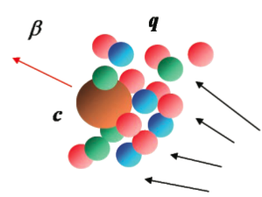
MVTX Enables the 3rd Science Pillar
Jin/Xin’s talk
Jets
Upsilons
Open Heavy Flavor
Bottom quarks are heavy (4.2 GeV)
Produced in initial collision, probe QGP evolution
Well controlled in pQCD
Access fundamental transport properties of QGP

Slide 5
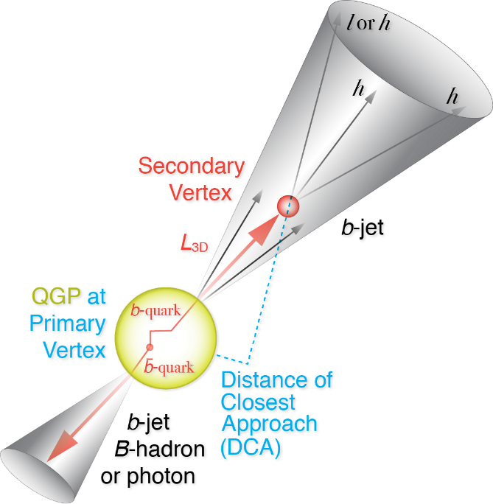
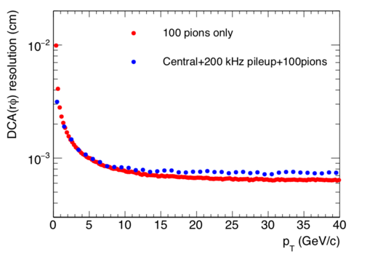
Precision Vertexing with MVTX
Precision tracker + High rate capability
→ Precision bottom observables over wide scales in p+p, p+A and A+A
Initial observables: B-meson @ 2< p_{T} <10 GeV/c, b-jet @ 15< p_{T}<35 GeV/c
Goals: Diffusion of HF quarks in QGP, differentiate collision VS radiative energy loss, HF hadronization
Notes:
D_s plot … ?
Shanshan - A multi-scale approach is required for the full picture

Slide 6
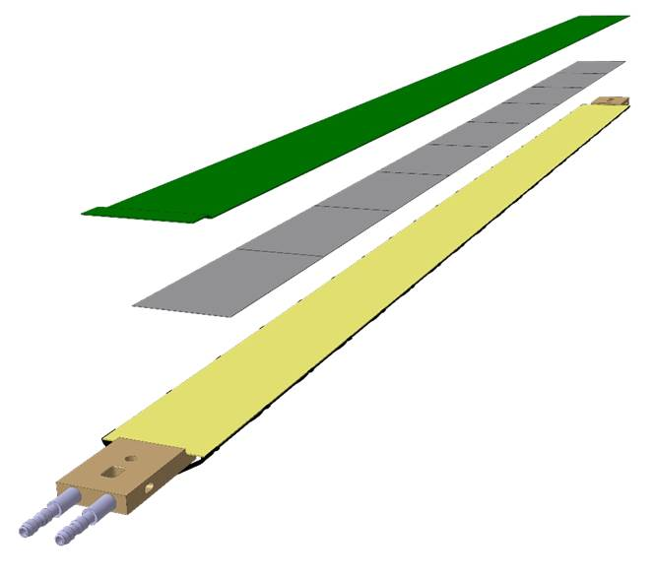
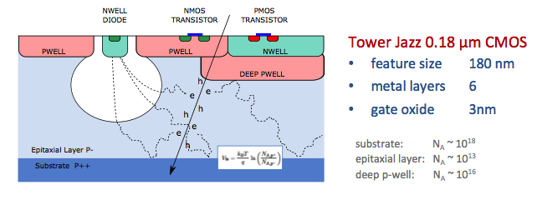
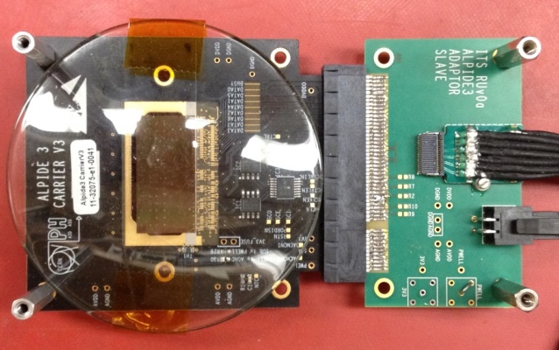
Monolithic Active Pixel Sensors (MAPS)
The Next-Generation, State-of-the-Art Pixel Tracker
Advantages of ALICE PIxel DEtector (ALPIDE) sensor:
Very fine pitch (27μm x 29μm), for superb spatial resolution
High efficiency (>99%) and low noise (<10⁻⁶), for excellent tracking
Time resolution, as low as ~5 μs, for less pileup
Ultra-thin/low mass, 50μm (~0.3% X₀), for less multiple scatterings
0.5M channels with on-pixel digitization, for zero-suppression and fast readout
Low power dissipation, 40mW/cm², for minimal service materials
An ideal detector for QGP physics!
Flexible Printed Circuit(FPC)
9 Chips
Cold plate
A 9-chip MAPS stave, 1.5cm x 27cm
ALPIDE design
ALPIDE sensor:
1.5cm x 3.0cm, 0.5M pixels
50 μm
~28 μm

Slide 7
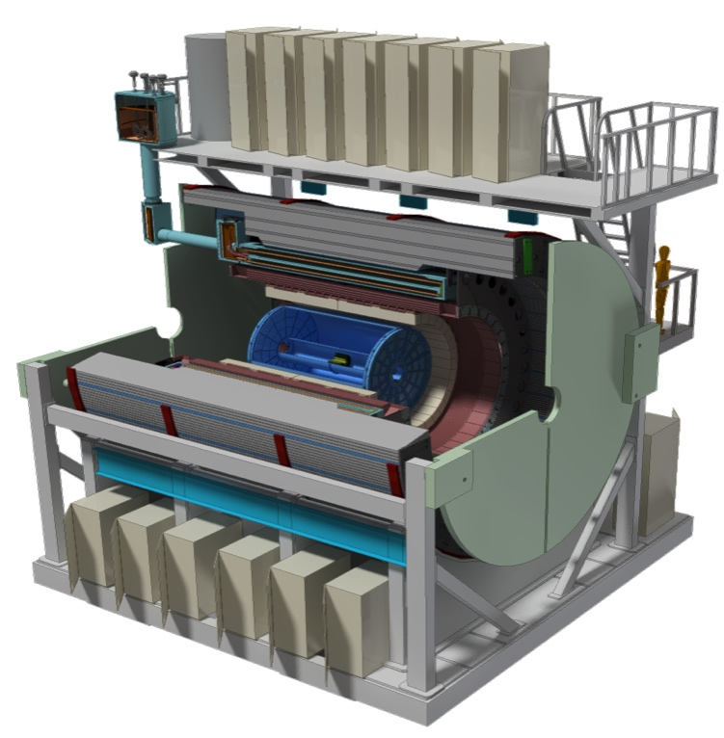
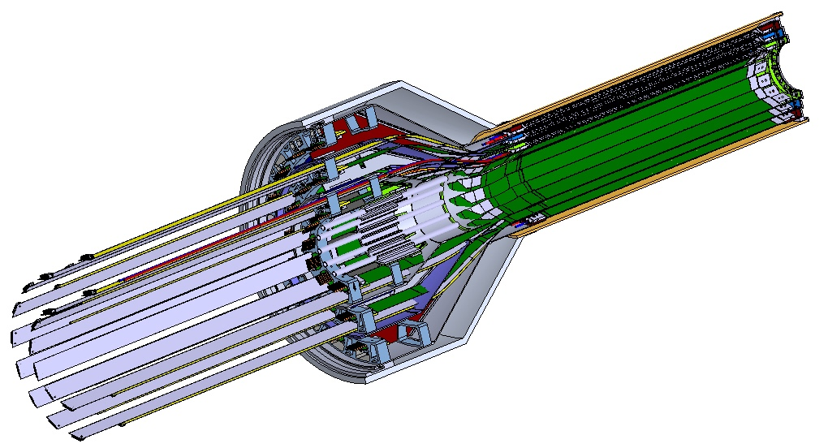
MVTX Detector
– Modified from ALICE/ITS Design
Ross’ talk
Service cone: signal, power, cooling
and mechanical support
CYSS: Cylindrical Shell Structure
End-Wheel
Extended power FPC
3-layer sensor barrel
- 48 staves, 432 chips
MVTX
parameters

Slide 8
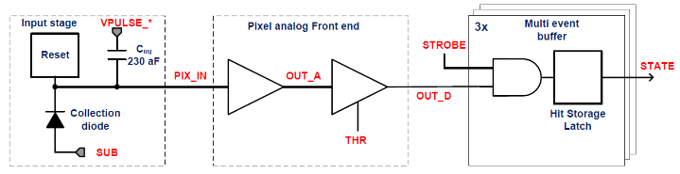
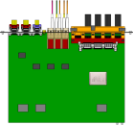
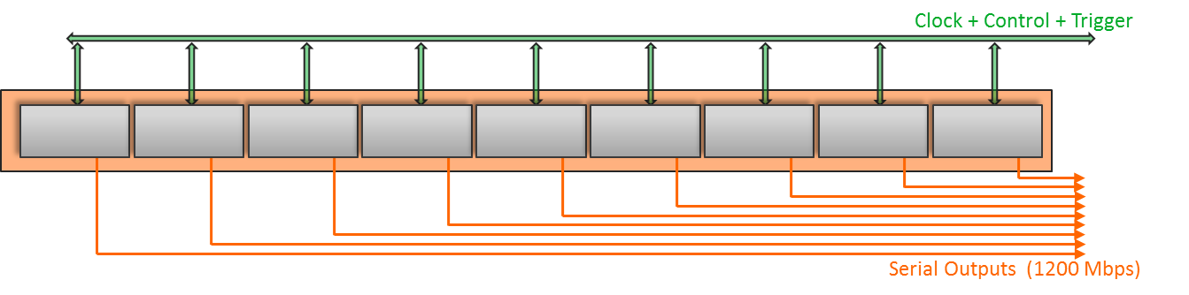
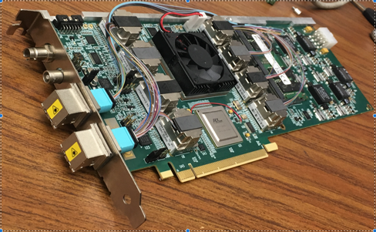

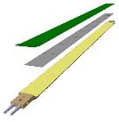
MVTX Readout, Power and Controls
CAN bus
DCS
Trigger & Clock
Readout Unit
Front End
GBT Optical Links
one pixel
9 Data (1.2Gbps)
1 Clock, 1 Control/Trigger
Control
Data (9.6 Gb/s max)
Trigger
9-sensor Stave
Samtec Twinax “FireFly”
FELIX
Back End
FPC
Power
ATLAS Front-End Link eXchange (FELIX):
sPHENIX Data Aggregation Module(DAM)
Alpide Sensors
Flex PCB Filtering Capacitors
regulators
Power
Regulated Power
CAEN Power supplies
Cold Plate
ALPIDE pixel:
Shaping
Digitization
Zero-suppression
3x buffer
Power Board
Interaction Region
Experimental Hall
Counting House
MVTX Detector Electronics consists of three parts
Sensor-Stave (9 ALPIDE chips) | Front End-Readout Unit | Back End-FELIX/DAM

Slide 9
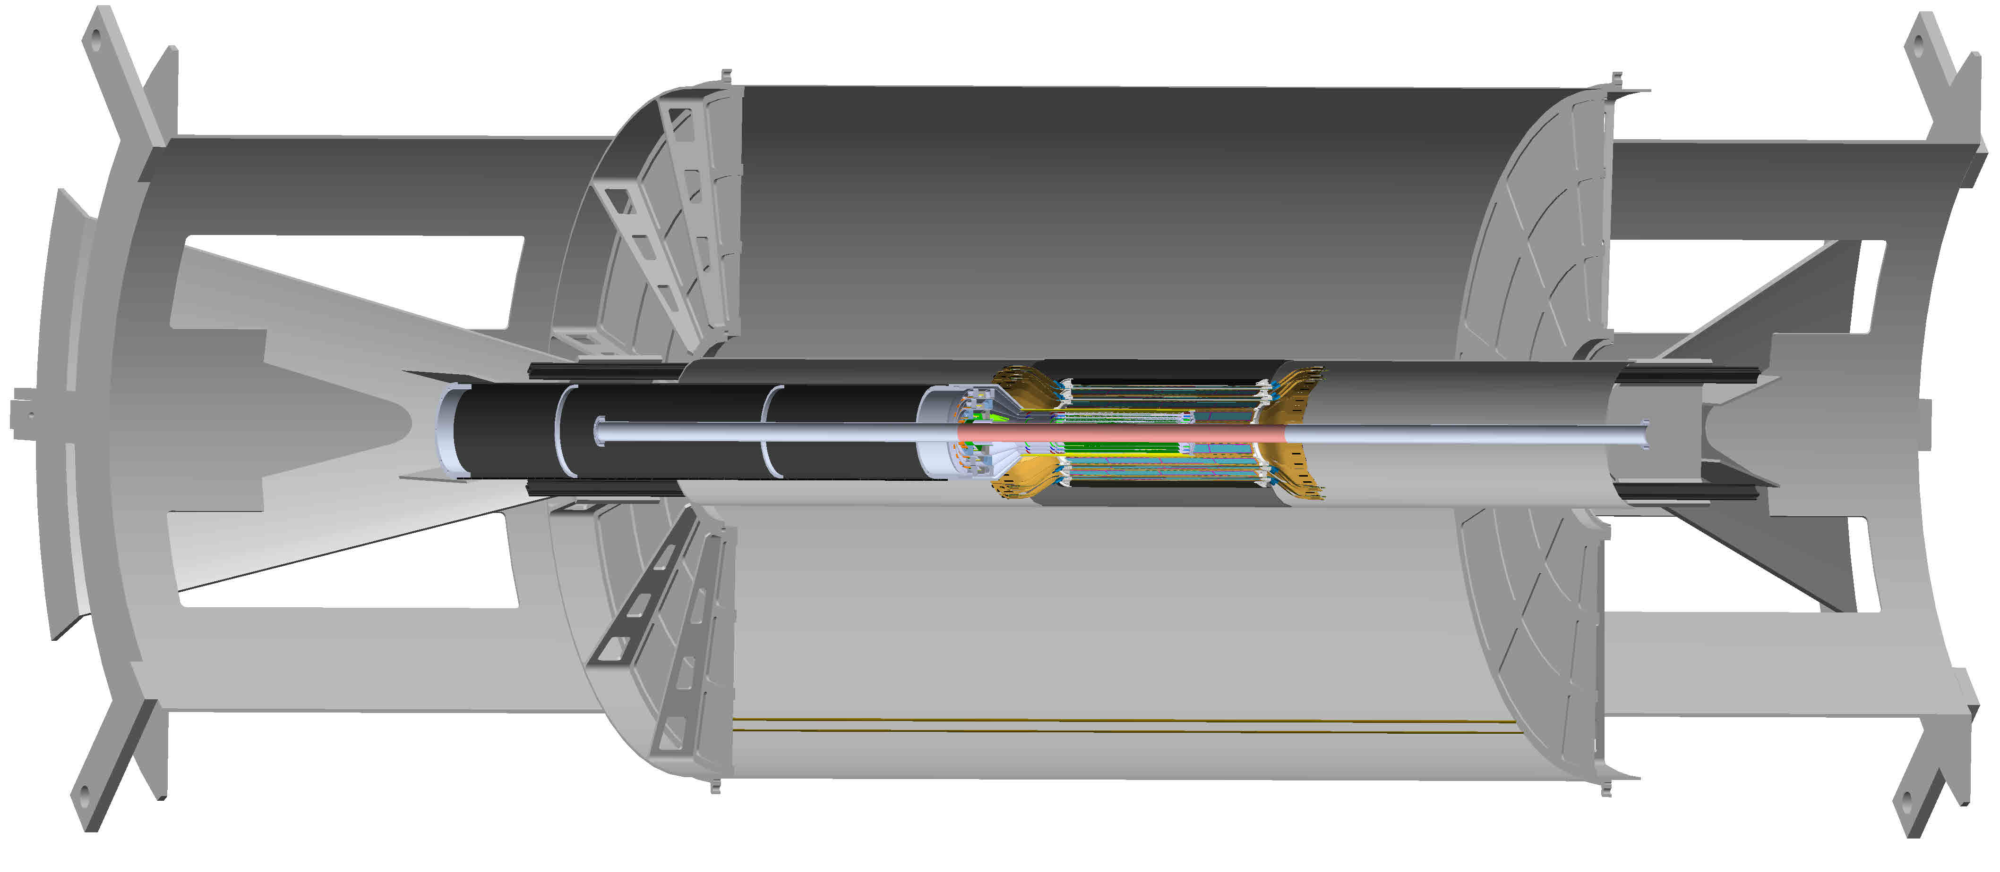
MVTX detector in sPHENIX
MVTX detector with service cylinder
Support brackets for TPC and INTT
TPC volume,
length = 2,160.0 mm
INTT detector, 2 layers

Slide 10

Scope of the MVTX Project
MAPS Staves & Electronics
  Readout Integration R&D (LANL LDRD)
    Frontend: ALICE/ITS, RU
    Backend: ATLAS FELIX
    Reprogram RU & FELIX into RCDAQ/sPHENIX
  Production @CERN: $1.36M
    84 ALICE/ITS-IB staves from CERN
      Acceptance test @LBNL, 48+spares(2-inner layers+)
    60 ALICE/ITS-RU from CERN
      Acceptance test @UT-Austin, 48+spares(12)
  Production & Assembly @US: ~$5M
    Production QA & assembly
      Half detector assembly & test @LBNL
      FELIX test & integration @LANL/BNL, 6+spares(2)
    Ancillary systems
      “adopt” ALICE ITS system
      Power, slow control & monitoring etc.
Mechanics & Cooling
  Modify ALICE/ITS inner tracker mechanical structures
    End Wheels
    Cylindrical structure shells
    Detector half barrels
    Detector and Service half barrels
  Mechanical system integration,
    Conceptual design (LANL LDRD)
    Design & simulations, MIT/LANL
    Composite structure production, LBNL
    Non-composite structure, MIT
    Installation tooling etc., BNL/LANL/MIT/LBNL
  Adopt ALICE cooling plant design
    Modified to fit sPHENIX, MIT/BNL
Final system test @BNL, Installation & commissioning (BNL + MVTX group)

Slide 11
sPHENIX MVTX Group: Institution Roles
Major institutions lead key tasks

Slide 12
MVTX Schedules and Milestones
sPHENIX: CD1/3a PD2/3
Installation
1st collisions
CY-2018 | 2019 | 2020 | 2021 | 2022 | 2023
MVTX
Stave & RU
production
FELIX
production
Construction
Detector mechanics design & production, global interface to sPHENIX
Detector & interface design
MVTX Review
End Wheels
CYSS
Ready for beam;
sPHENIX day-1 run
Service barrel
design & production
Stave testing, half-barrel assembly @LBNL
Half barrel #1
Half barrels
arrive @BNL
Power system
production
Half barrel #2
Procure & assemble
cooling system
Installed 2 half-barrels
@sPHENIX IR;
Design & procure
support structure
Complete detector
system test @BNL Lab
Procure insertion
sys to sPHENIX rails
MVTX installation & commissioning @BNL
RU, FELIX, PS, cables etc.
Today

Slide 13
Cost Drivers
Major Tasks | Cost | Cost + Contingency
Project Management | $543k | $641k
Electronics | $401k | $492k
Mechanics and Detector Assembly | $1,784k | $2,431k
Integration and Infrastructure | $970k | $1,345k

Slide 14
Basis of Estimate & Resource-Loaded Schedule
Latest update: 3/11/2019 (after LBNL workshop)
BOE:
Electronics: ALICE/ATLAS/sPHENIX production experience
Mechanics & Integration: previous experience, ITS/ALICE, HFT/STAR, FVTX/PHENIX
Stave and RU: fixed cost from ALICE production (separate cost)

Slide 15
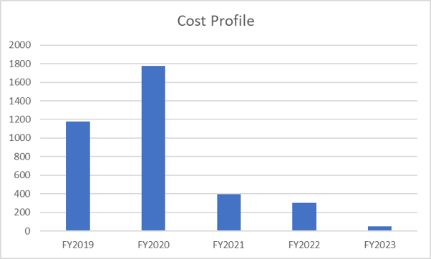
Funding Profile

Slide 16
Status and Highlights
Stave and RU production at CERN
  Completed sensor/HIC/stave evaluations at CERN
    Built, tested and confirmed two HICs with 40cm and 60cm long power FPC
    Sensors irradiated up to 2.7MRad by ALICE, no issues found(updated 9/18/2018).
  Cost are set for staves & RUs, procurement through US-ALICE/UTK
    Technical specs document completed for production, BNL/DOE agreed
    sPHENIX RU and stave production following ALICE production
  Addressed all recommendations on stave/sensor R&D from last July 2018 Director’s review
Full readout chain demonstrated
  Successful Fermilab Test Beam run in 2018
Mechanical system integration MVTX+INTT
  sPHENIX tracking optimized with 2-layer INTT configuration
  Mechanical design being updated and 3-D mockup demonstrated MVTX+INTT
Readout cables
  BNL approved the use of SamTec blue cables
    Electrically better & mechanically compact
    ALICE confirmed signal performance with 8m long readout cables. For MVTX, 10m very likely works (30AWG/sPHENIX vs 32AWG/ALICE), to be confirmed by on-going R&D at LANL
  Samples ordered for system integration mockup and test

Slide 17
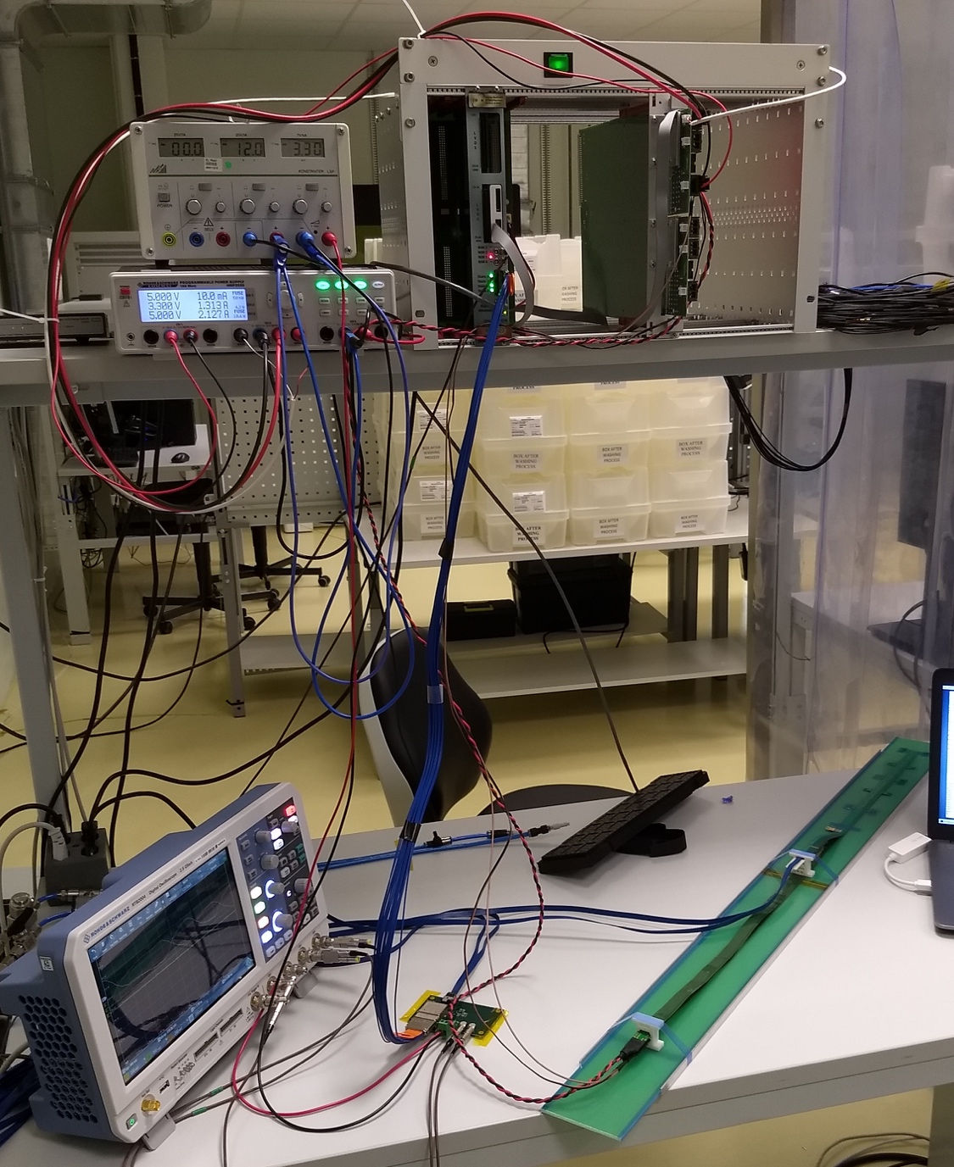
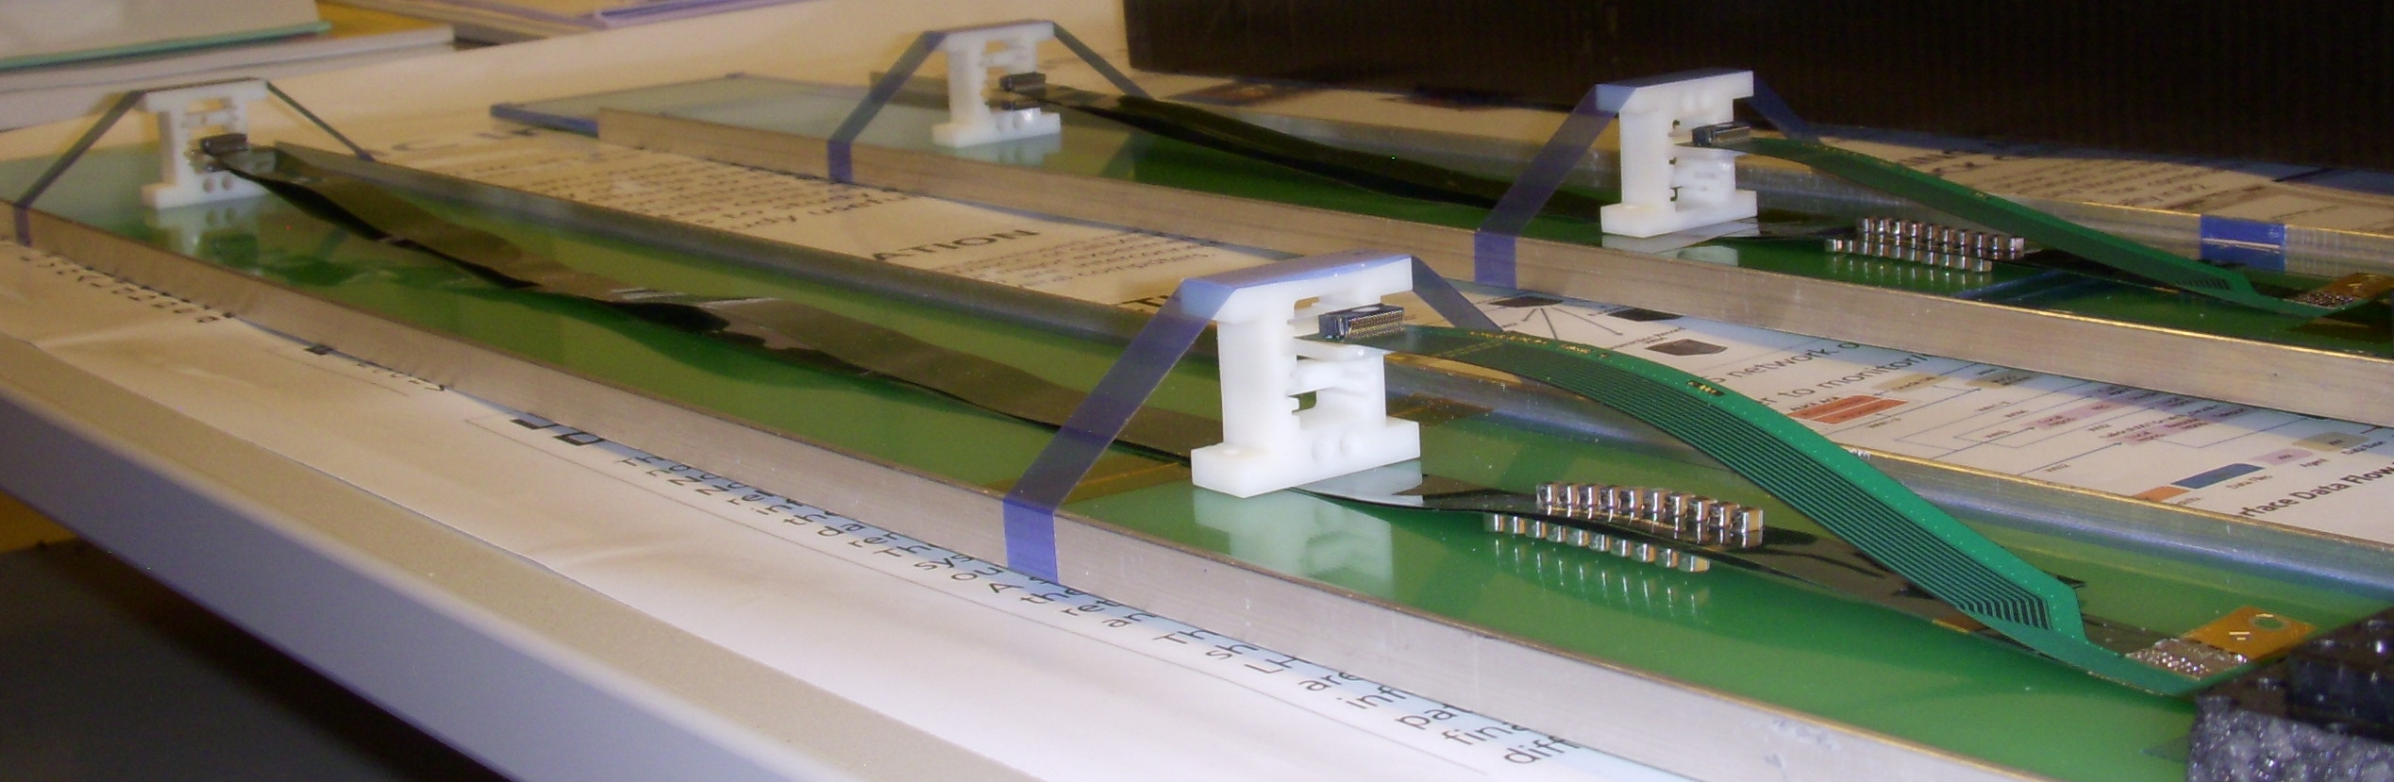
Confirmed HIC with Extended 40(60)cm Power FPC
Built and tested two HICs at CERN in the week of 9/17/2018
  No change in sensor performance (noise, threshold) observed, as expected;
40cm PWR FPC
60cm PWR FPC
ALICE: 15cm PWR FPC
Followed identical ALICE IB QA test procedure,
with a 8m SamTec cable!

Slide 18
Sensor Irradiation Test – OK at 2.7MRad
Continuous effort by ALICE (@NPI, Czech)
BNL Director’s review recommendation:
test sensor up to 1MRad
https://indico.cern.ch/event/758048/

Slide 19
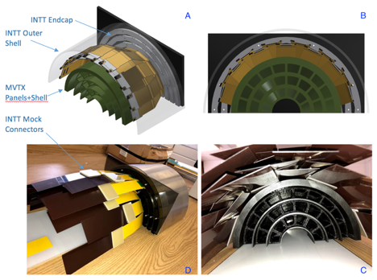
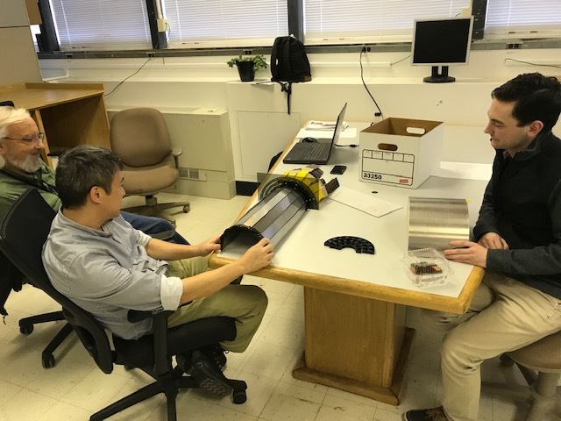
MVTX + 4-layer INTT 3-D Mockup
Office of System Integration
– led by Mickey & Bob,
a team of engineers and physicists
MVTX and INTT
Space conflict resolved!

Slide 20
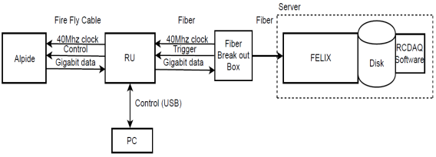
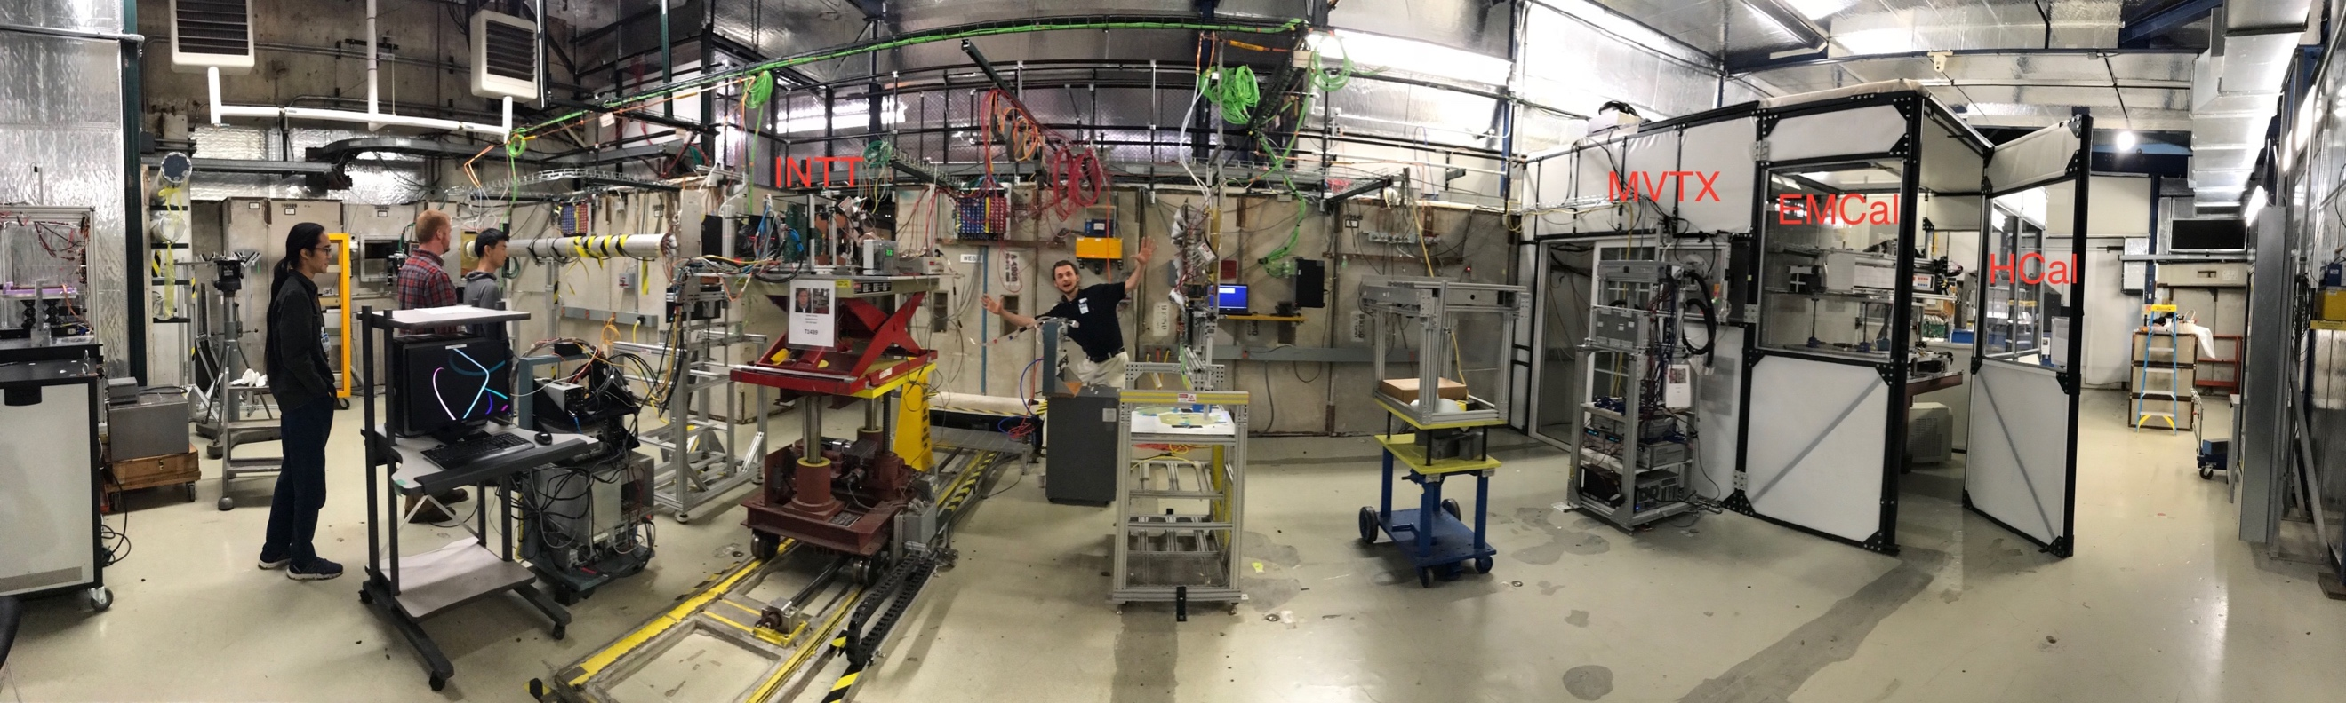
MVTX Full Readout Chain Demonstrated (3/2018)
4-MAPS
telescope
Fermilab Test Beam: Feb-Mar, 2018
- Tracking spatial resolution: <5 um
- Hit efficiency: > 99.5%
120 GeV proton
beam
4-hit track
4-MAPS telescope

Slide 21
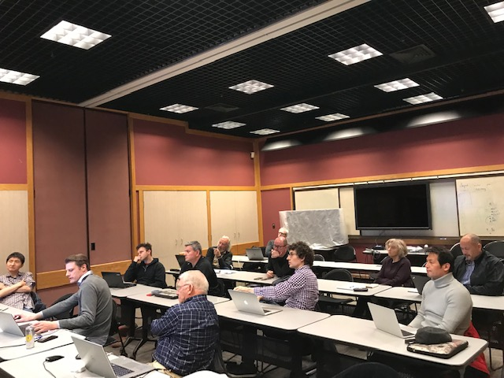
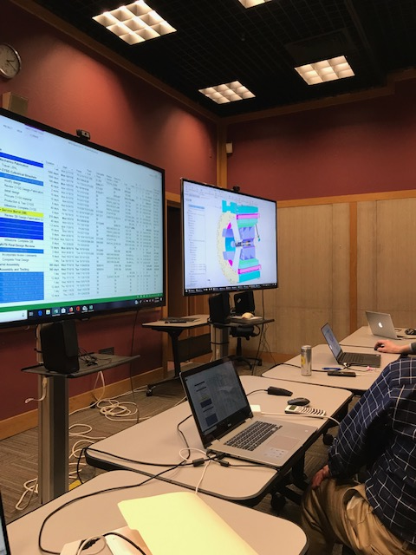
Mechanical System Discussions @LBNL
Discussed major carbon structures’
design & production cost, line by line,
also production schedule @LBNL , 3/2019

Slide 22
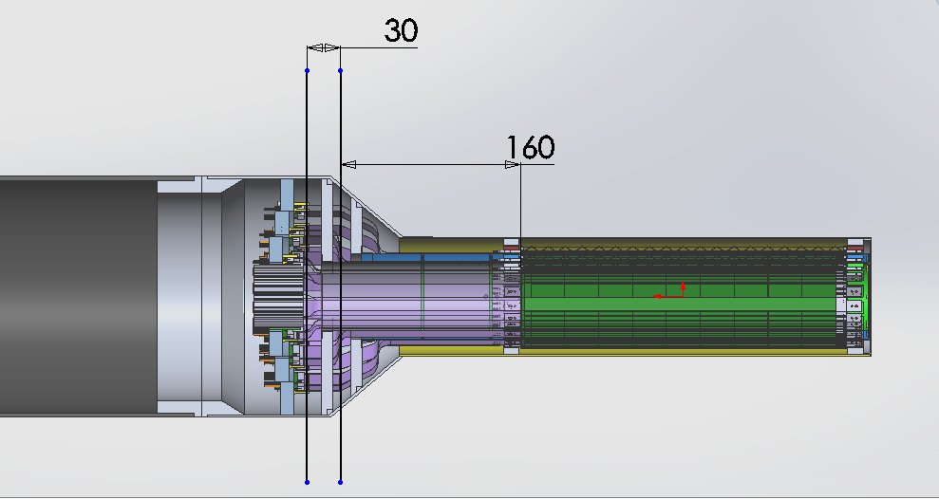
Carbon Structures – Work in Progress
Ross’ talk
Conical sectors are expensive!
A new design under development to avoid the conical structures

Slide 23
Issues and Concerns
Budget availability
  Funding for final mechanical system design work
    Early R&D to reduce high production contingency
  Preparation for Stave acceptance test/QA/storage at LBNL (3 months lead time)
  Schedule is closely tied to the funding level
Carbon structures
  Cost and schedule, high contingency now
  Good opportunity before ATLAS production at LBNL
Mechanical system integration
  Beam pipe modification
  Readout cables, cooling etc
  MVTX+INTT+TPC + HCal...

Slide 24
Summary: MVTX - WBS 3.2
Project file updated, now in the sPHENIX P6
  Latest Cost & Schedule under review, <$5M
  Schedule has not been smoothed, 9 month contingency
MVTX detector design & construction
  As a separate upgrade project from the baseline sPHENIX MIE
  Engineering design work in progress, MIT/LANL/LBNL et al
    Need budget now for the final design
  Construction and assembly work planned for late 2019
Critical R&D accomplished through LANL LDRD
  Readout integration
  Stave modification
  Mechanical system conceptual design
  Readout cable test in progress
Stave and RU production through US-ALICE (separate cost)
  Early procurements, cost saving and minimized technical risks
  Received signed letter from CERN on the cost of 60 RUs and 84 Stave, ~$1.36M
  DOE and BNL agreed, DOE directly pays UTK/US-ALICE, by May 2019

Slide 25
backup

Slide 26
Address July 2018 Review Recommendations
Stave and RU procurement readiness
Completed sensor/HIC/stave evaluations at CERN
  Built, tested and confirmed two HICs with 40cm and 60cm long power FPC
  Sensors irradiated up to 2.7MRad, no issues (updated 9/18/2018).
Addressed all recommendations on stave/sensor R&D
Cost are set for staves & RUs, procurement through US-ALICE/UTK!
  Technical specs document completed for production, BNL/DOE agreed
  sPHENIX RU and stave production starts ~April 2019, practically already in progress
MVTX/INTT mechanical integration
  Mechanical design being updated and 3-D mockup demonstrated
  Inner tracking task force completed evaluation, preferred INTT-layers =2
Readout cables
  BNL approved the use of SamTec blue cables
    Electrically better & mechanically compact
    ALICE confirmed signal performance with 8m long readout cables. For MVTX, 10m very likely works (30AWG/sPHENIX vs 32AWG/ALICE), to be confirmed by on-going R&D at LANL
  Samples ordered for system integration mockup and test
https://docs.google.com/document/d/1vsm_G7ZLgqv-kBZqK0jF69T_Nx2Uwk0Zxv86jRVxybw/edit?usp=sharing
Christof, Rachid, Itaru’s talks

Slide 27
Stave and RU Production QA Plan Documents Available
https://indico.bnl.gov/event/4729/
Staves
Purchase 84 staves from ALICE/CERN
  48 + 28(spares for 2 inner layers) + 8 spares
  Production following the completion of ALICE ITS/IB
  Starting ~Oct. 2018, will last 6-12 months
  Fully tested at CERN before shipping to US
    All Gold/Silver staves (same as ALICE IB)
    A LANL postdoc (Dr. Yasser Morales) oversees production QA at CERN
Acceptance QA at LBNL
  Full test and QA
    Electrical
    Mechanical
  Detector assembly at LBNL
Readout Units
Purchase 60 RUs from ALICE/CERN
  48 + 12 spares(20%)
  To be part of ALICE production
    Cost saving
    Minimize technical risks
  Initial test at CERN
Acceptance QA at UT-Austin
  Full test
  LANL as the 2nd test site

Slide 28
MVTX Production Schedule Update
Stave production @CERN
  May 2019- May 2020, 84 staves
  ALICE IB average: ~4 staves/wk
Stave acceptance test @LBNL
  MOSAIC system, 9/2019 – 5/2020
Final mechanical design work
  May 2019 – $$ available soon(?)
  CYSS, End wheels
  Service barrel and interface
MVTX detector assembly at LBNL
  LBNL ALICE ML stave production ends ~12/2019, a total of 60 ML staves
  Start MVTX detector assembly ~ late summer of 2019 (or after the completion of ALICE ML?)
MVTX full half-barrel detector test @LBNL
  Starts ~mid of 2021
  Using full readout system if ready: 24RU + 12PU + 3FELIX/2 servers

Slide 29
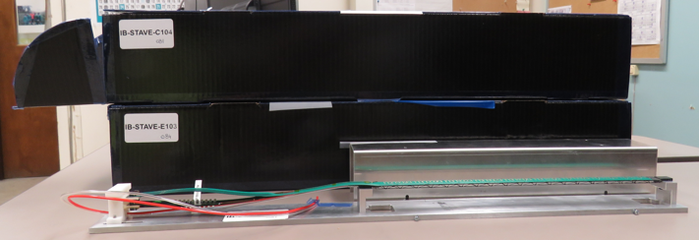
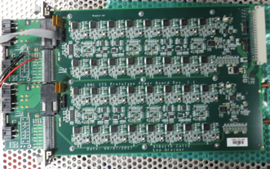
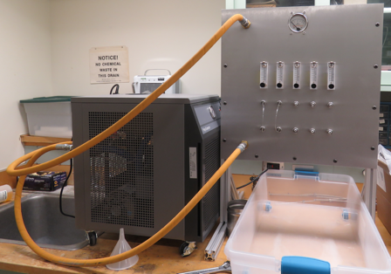
2019 Test Beam: 4-stave Telescope
Sho’s talk
Scheduled for May 22-29, at Fermilab
Additions compared to the 2018 test beam:
  Staves (from single chips)
  Full-length MVTX signal cables (from 5 m off-the-shelf cables)
  FELIX v2.0 (from v1.5)
  Cooling system
  Power board
  sPHENIX GTM
Full test of all components of the MVTX detector - LDRD “stretch goal”

Slide 30
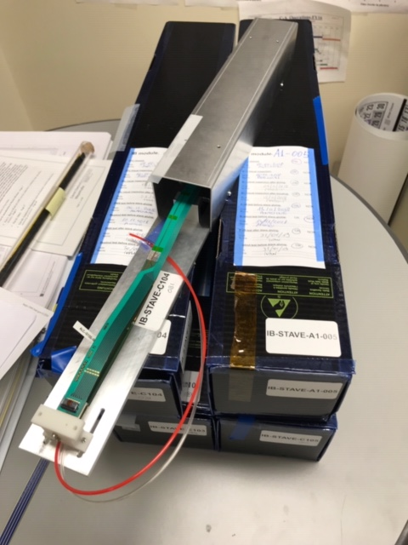
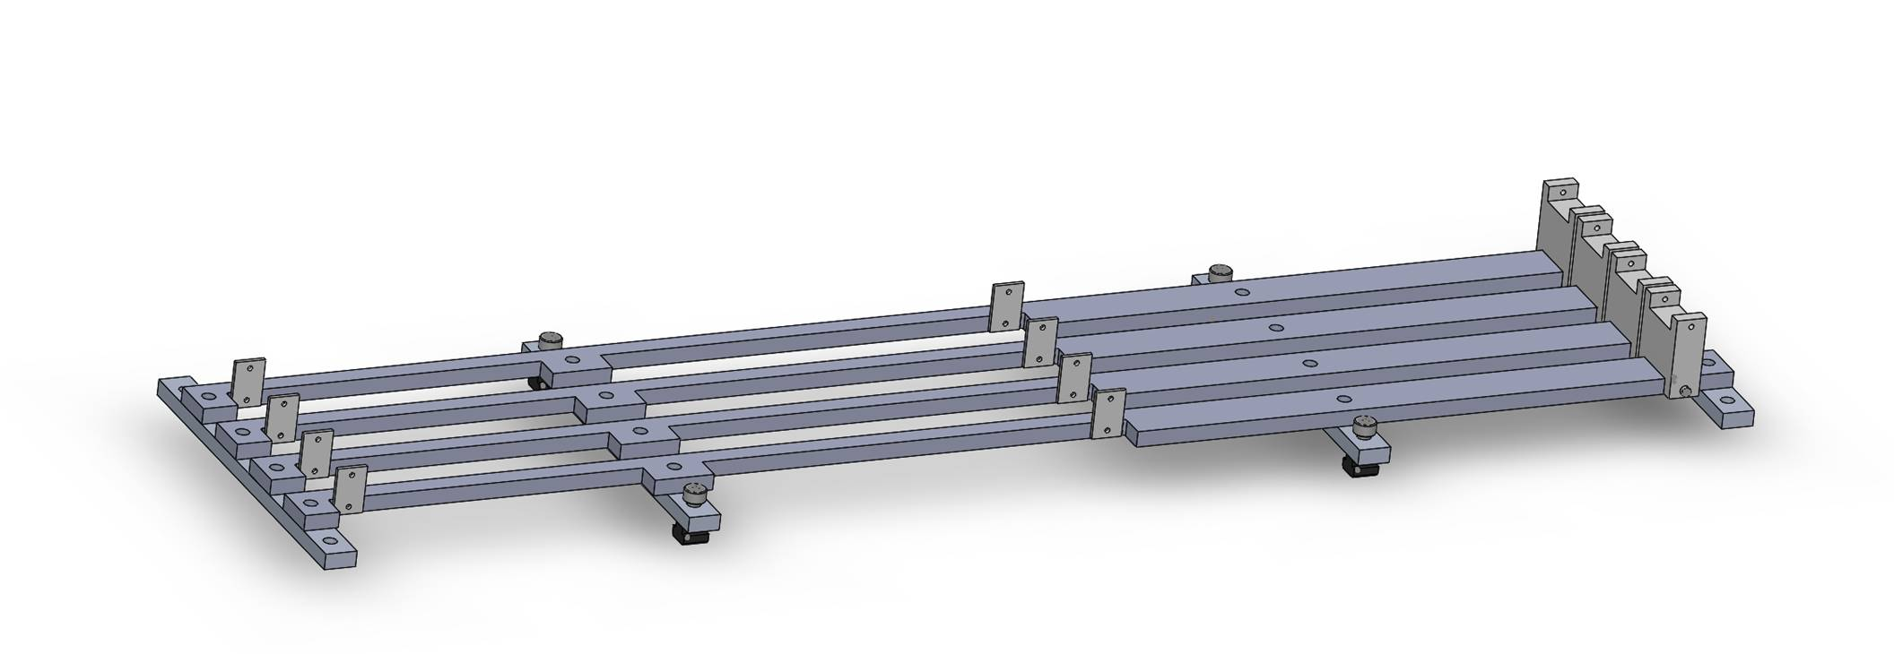
Mechanical design
Telescope box design completed, sent for fabrication
  One stave can be offset by (0.5,0.5)cm for material scanning

Slide 31
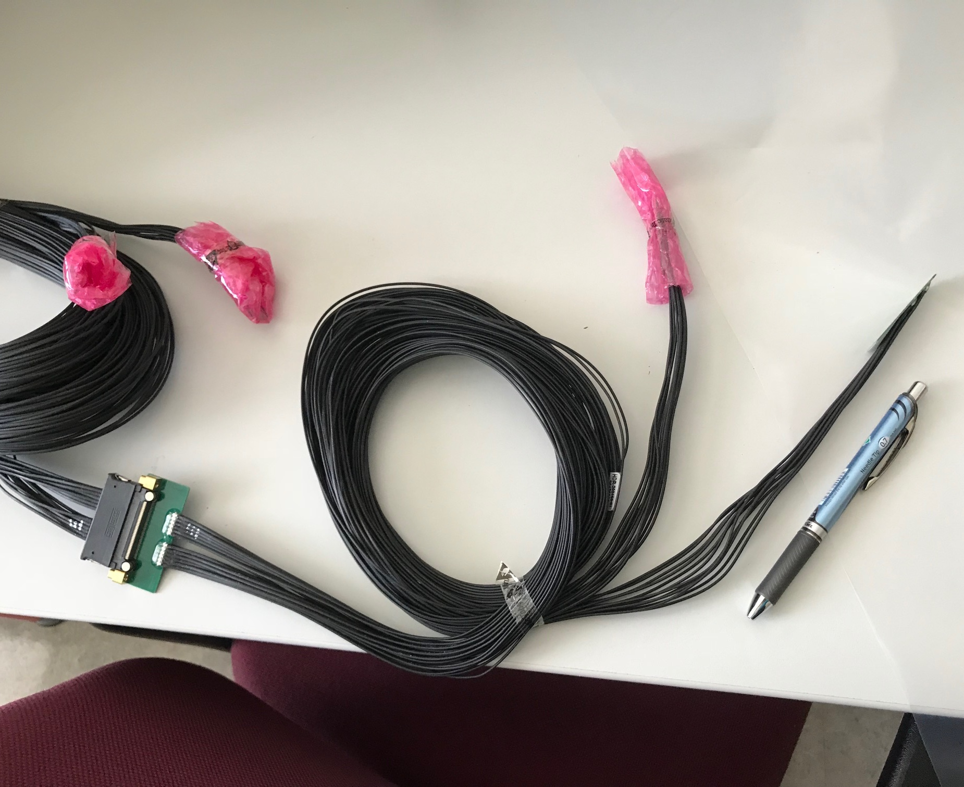
MVTX Readout and Power Cable Rout
ALICE ITS/IB final readout cables: ~8m
Cable-B: 5.3m
Cable-A: 2.65m
PWR
RU
PU
sPHENIX MVTX: 7.9+m
  Cable-A: 1.4 m
  Cable-B: 6.5+ m
  Power cable:4.7+ m
On-going R&D for ~10m
BNL has approved “non-halogen free” cables for sPHENIX

Slide 32
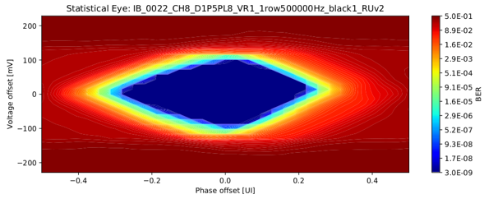
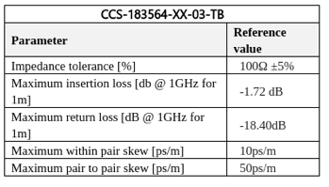
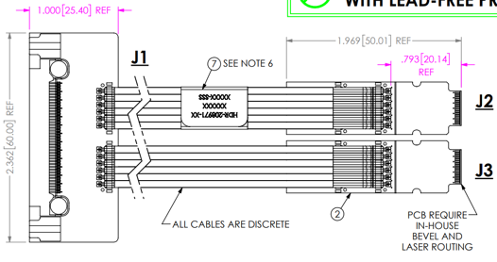
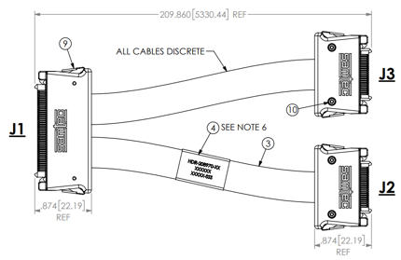
ALICE/ITS Signal Cable Design
The Samtec twinax cables carry clock (40 MHz), control (40 Mbps bidirectional), data (9x1.2 Gbps)
ALICE is using halogen-free cables (32 AWG, LDPE dielectric) due to CERN LSZH requirement; 2.65 + 5.3 m cables have been tested and are now in production
RU
RU
Stave
Stave

Slide 33
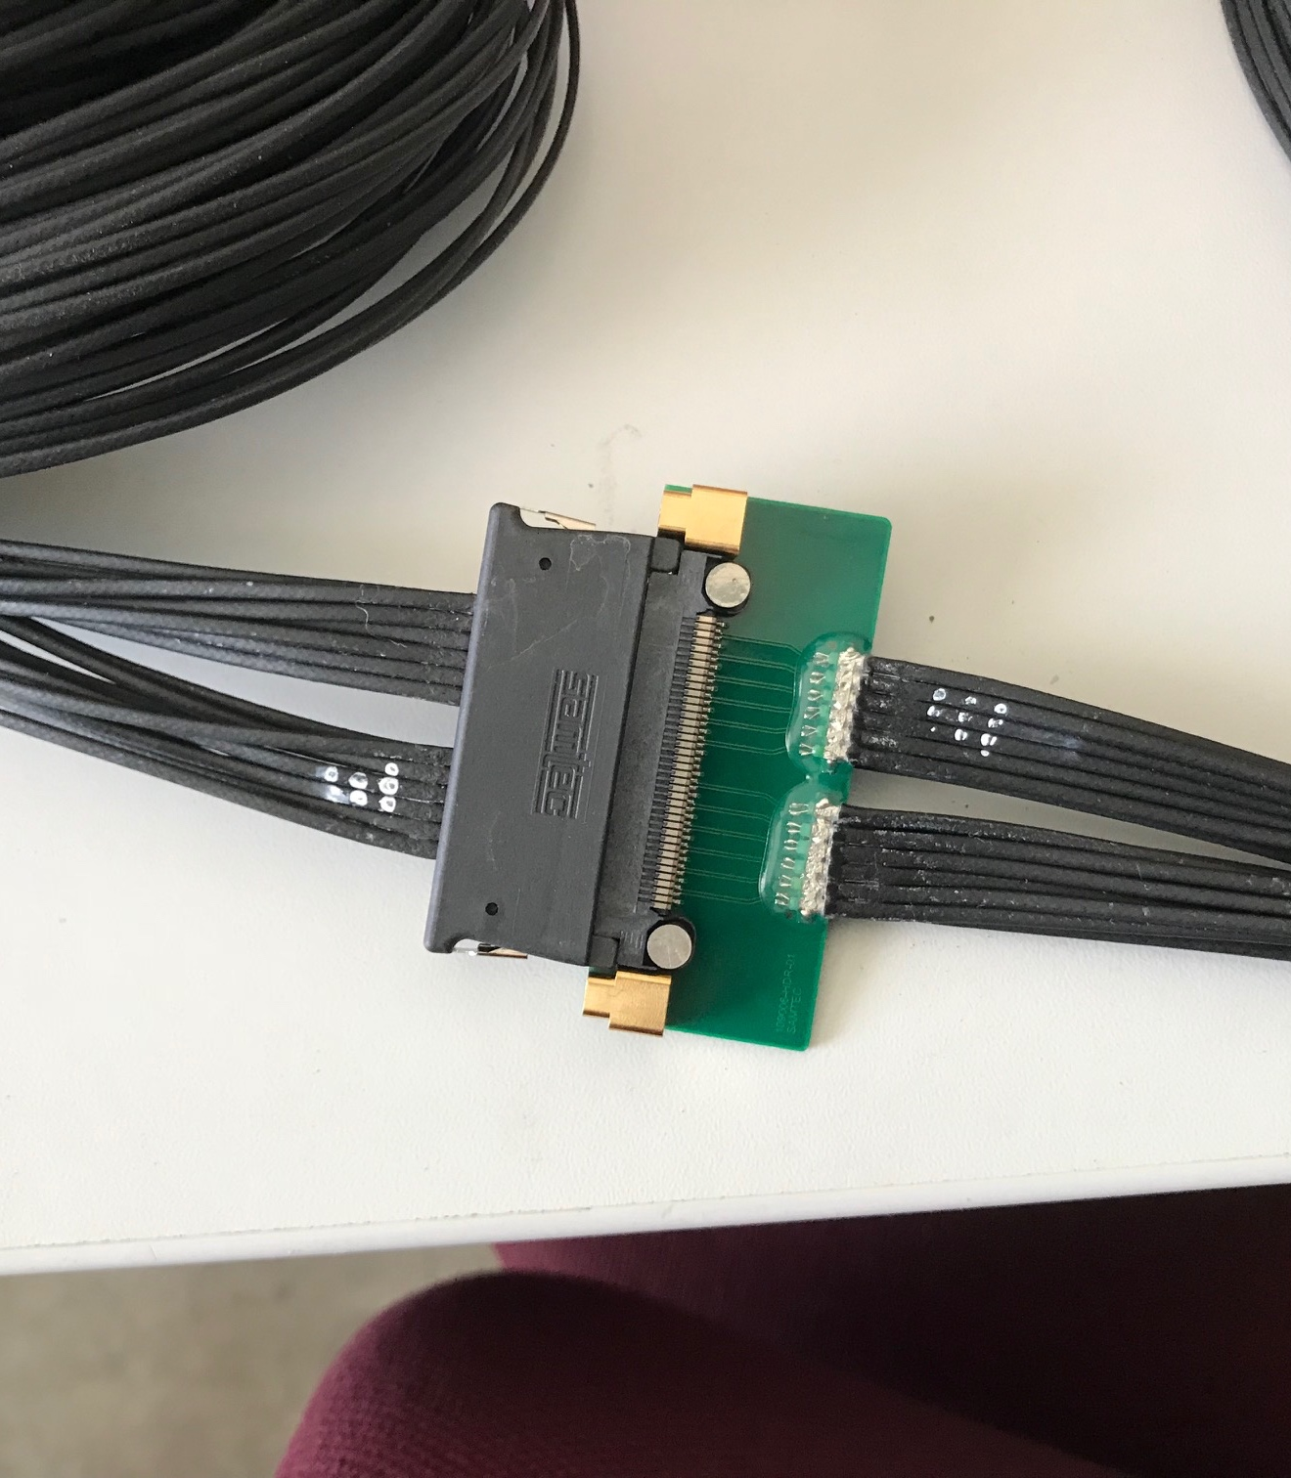
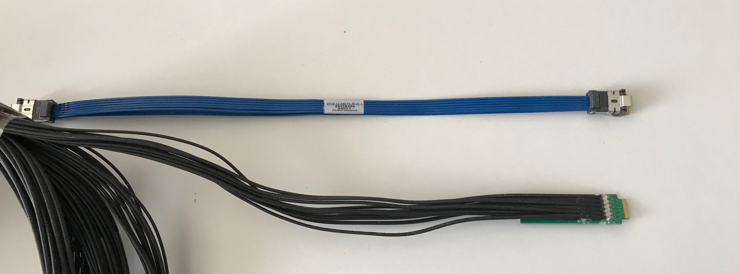
ALICE/ITS Cables
Type-A
Type-B
Type-A

Slide 34
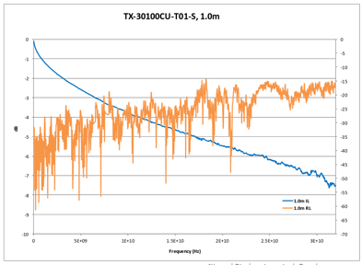
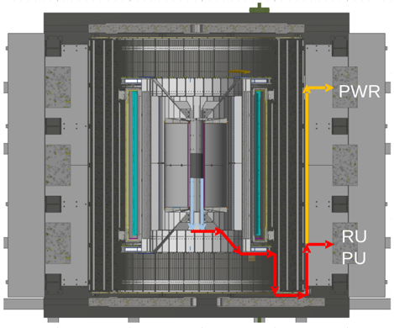
sPHENIX MVTX Cable Testing
BNL has approved non-halogen-free cables
  sPHENIX/MVTX: 30 AWG, FEP dielectric;
  Improved signal integrity
sPHENIX cable run estimates are converging
  1.4 + 6.5 m
We have ordered Samtec cables for 1.2/2.65 + 5.3/8.8 m (total length 6.5 - 11.45 m)
We will qualify these cables using stave and RU (bit error rates, statistical eye), and scope/network analyzer
We will test full-length MVTX cables in the next months

Slide 35
Stave Production and Shipping etc.
Hand carry staves from CERN to LBNL, 4 trips
Preliminary design from CERN for stave transportation plates
  To be produced at CERN, paid by LBNL/sPHENIX
Extended design from CERN
for MVTX
ALICE ITS IB

Slide 36
Guidance

Slide 37
The Subsystem

Slide 38
The Subsystem Technical Overview

Slide 39
Scope

Slide 40
Subsystem Collaborators

Slide 41
Schedule Drivers

Slide 42
Cost Drivers

Slide 43
Basis of Estimate & Resource-Loaded Schedule

Slide 44
Status and Highlights

Slide 45
Issues and Concerns

Slide 46
Summary

Slide 47
Back Up

