Slide 1
MVTX Overview
(WBS 3.2)
Ming Liu, LANL
April 9-11, 2019
BNL Director’s Review

Slide 2
Outline
Document: sPH-HF-2018-001
https://indico.bnl.gov/event/4072/
MVTX science & technology
MVTX scope
Cost & schedule
Status & highlights
Issues and concerns
MVTX:
Monolithic-active-pixel-sensor based VerTeX detector

Slide 3
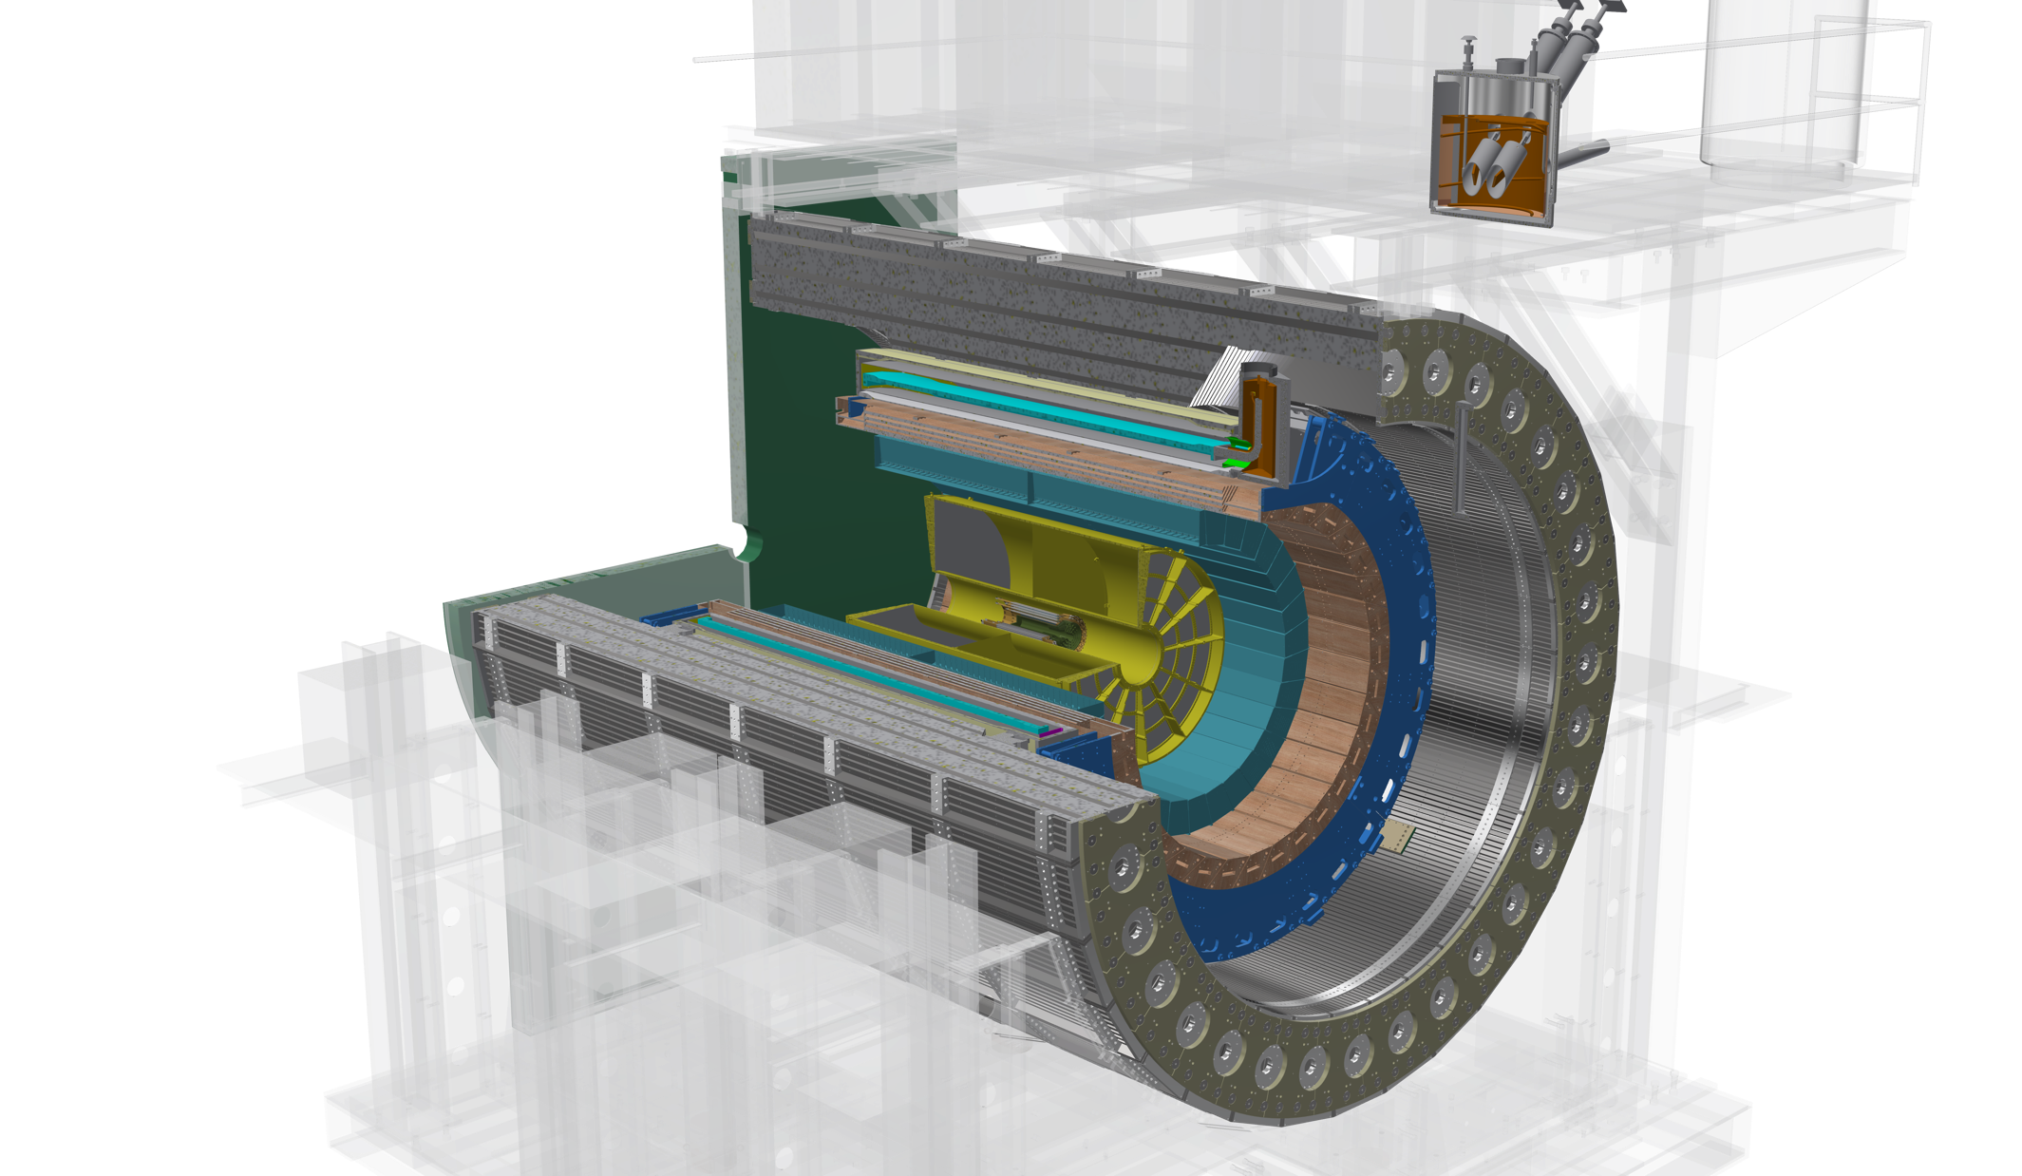
The sPHENIX Detectors
Outer HCal
SC Magnet
Inner HCal
EMCal
TPC
INTT
MVTX
Φ ~ 5m
Tracking system upgrade:
INTT (WBS 3.1)
MVTX (WBS 3.2)
Notes:
15kHz matched to collision rate.

Slide 4
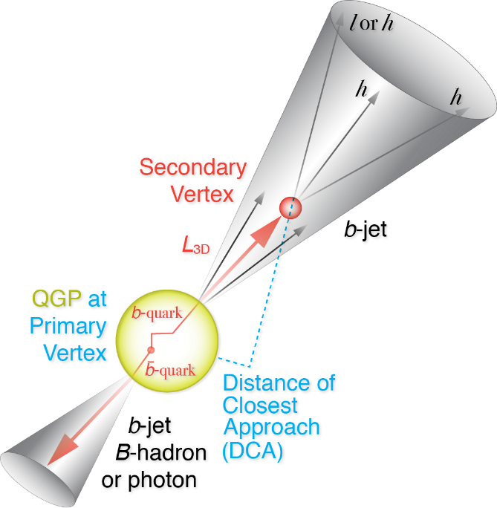
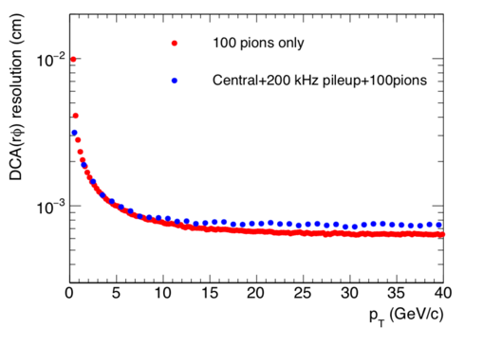
MVTX Enables the 3rd Science Pillar
Jets
Upsilons
Open Heavy Flavor
Bottom quarks are heavy (4.2 GeV)
Produced in initial collision, probe QGP evolution
Well controlled in pQCD
Access fundamental transport properties of QGP
Precision tracker + High rate capability
→ Precision bottom observables over wide scales in p+p, p+A and A+A
Initial observables:
  B-meson @ p_{T} <10 GeV/c
  b-jet @ 15< p_{T}<50 GeV/c
DCA< 25um @1GeV

Slide 5
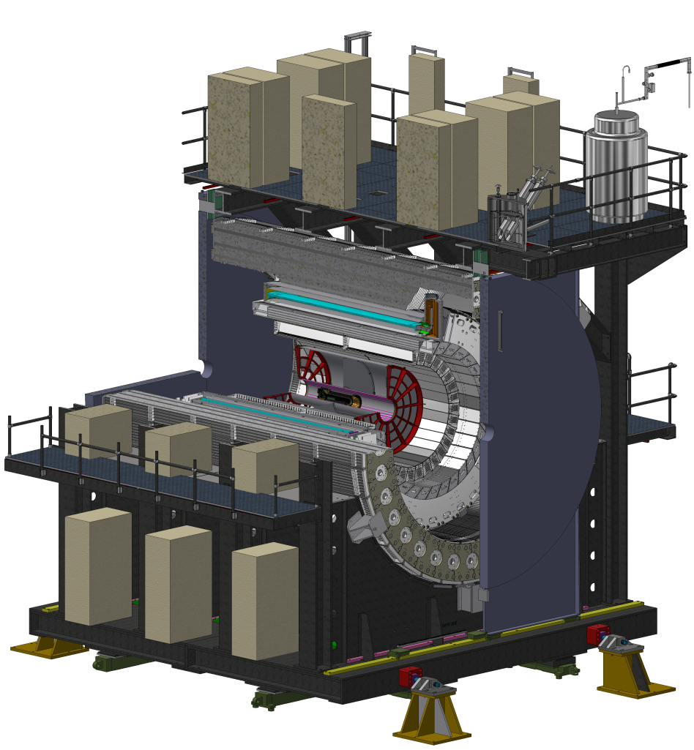
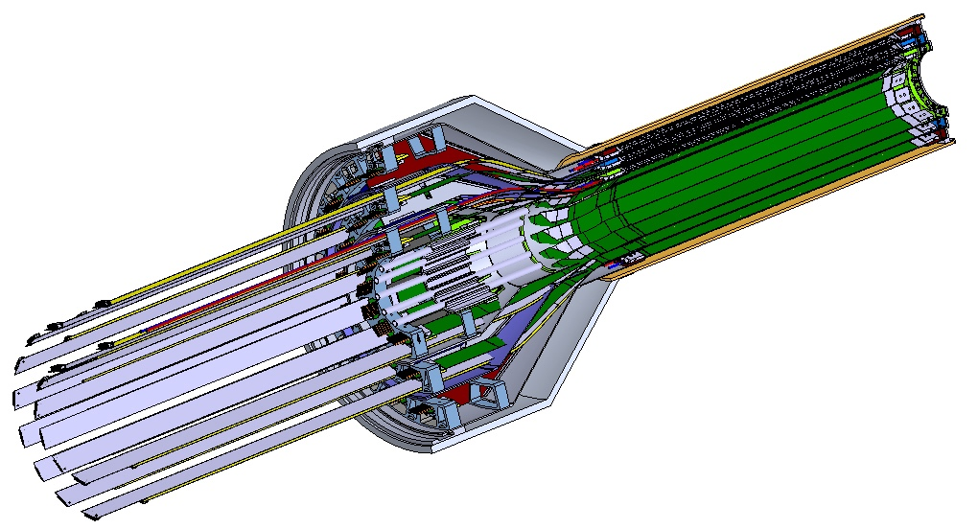
MVTX Technical Overview
Ross & Yuan’s talks
Service cone: signal, power, cooling
and mechanical support
CYSS: Cylindrical Shell Structure
End-Wheel
Extended power FPC
3-layer sensor barrel
- 48 staves, 432 chips
27cm
MVTX
parameters

Slide 6
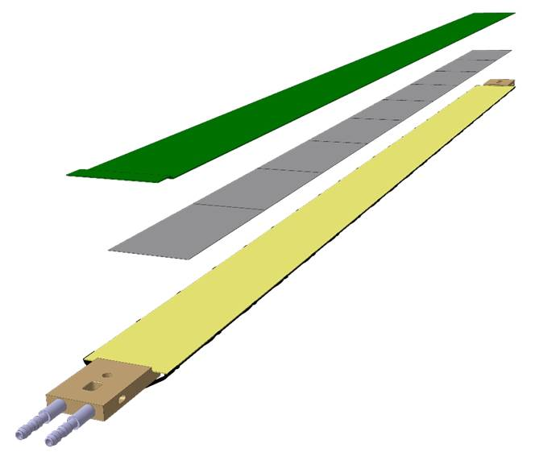
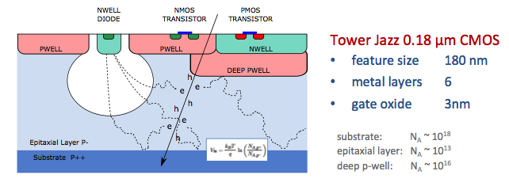
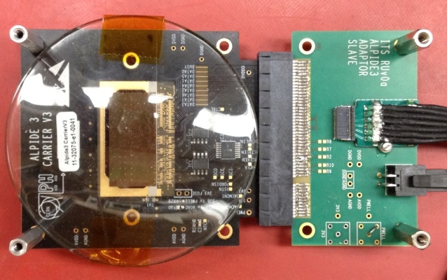
Monolithic Active Pixel Sensors (MAPS)
The Next-Generation, State-of-the-Art Pixel Tracker
Advantages of ALICE PIxel DEtector (ALPIDE) sensor:
Very fine pitch (27μm x 29μm), for superb spatial resolution
High efficiency (>99%) and low noise (<10⁻⁶), for excellent tracking
Time resolution, as low as ~5 μs, for less pileup
Ultra-thin/low mass, 50μm (~0.3% X₀), for less multiple scatterings
0.5M channels with on-pixel digitization, for zero-suppression and fast readout
Low power dissipation, 40mW/cm², for minimal service materials
An ideal detector for QGP physics!
Flexible Printed Circuit(FPC)
9 Chips
Cold plate
A 9-chip MAPS stave, 1.5cm x 27cm
ALPIDE design
ALPIDE sensor:
1.5cm x 3.0cm, 0.5M pixels
50 μm
~28 μm

Slide 7
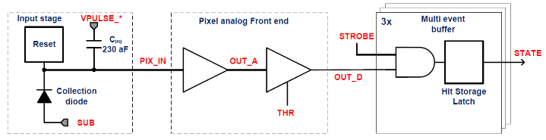
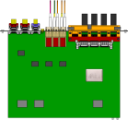
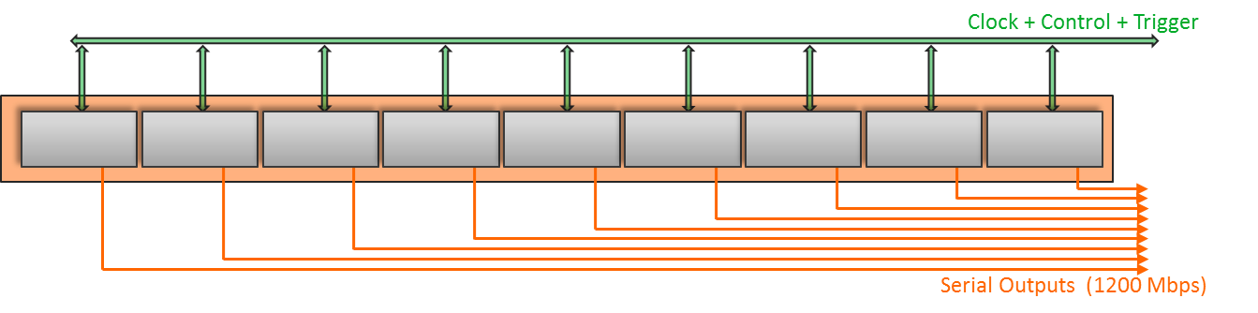
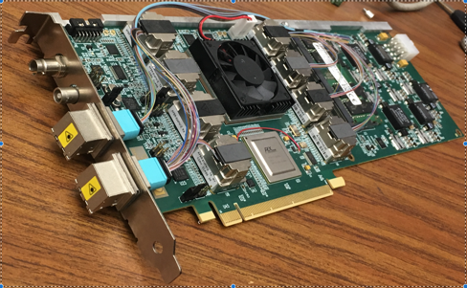

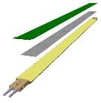
MVTX Readout, Power and Controls
Jo’s talk
CAN bus
DCS
Trigger & Clock
Readout Unit
Front End
GBT Optical Links
one pixel
9 Data (1.2Gbps)
1 Clock, 1 Control/Trigger
Control
Data (9.6 Gb/s max)
Trigger
9-sensor Stave
Samtec Twinax “FireFly”
FELIX
Back End
FPC
Power
ATLAS Front-End Link eXchange (FELIX):
sPHENIX
Data Aggregation Module(DAM)
Alpide Sensors
Flex PCB Filtering Capacitors
regulators
Power
Regulated Power
CAEN Power supplies
Cold Plate
ALPIDE pixel:
Shaping
Digitization
Zero-suppression
3x buffer
Power Board
Interaction Region
Experimental Hall
Counting House
MVTX Detector Electronics consists of three parts
Sensor-Stave (9 ALPIDE chips) | Front End-Readout Unit | Back End-FELIX/DAM

Slide 8
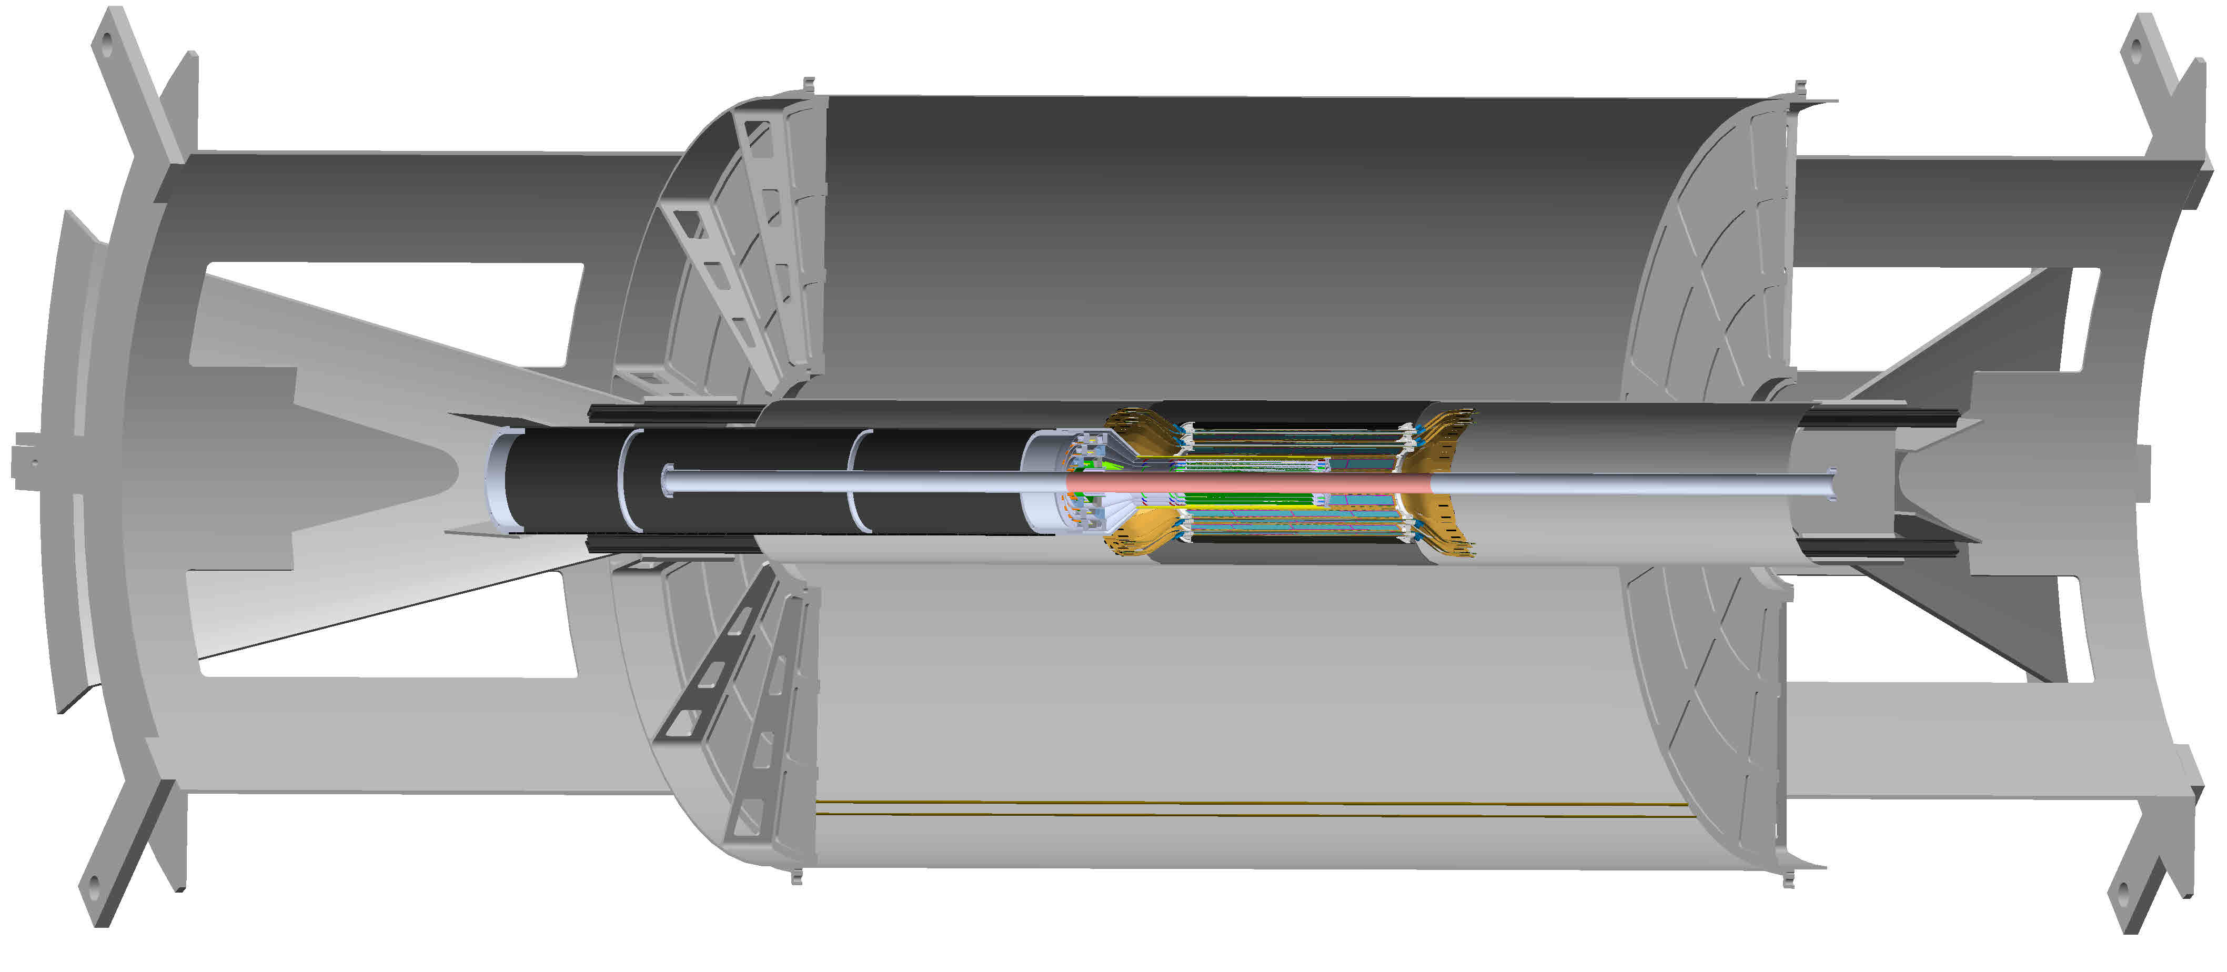
MVTX Detector in sPHENIX
Ross’ talk
MVTX detector with service cylinder
TPC volume:
Length = 216 cm
Radius = 800 cm
Support brackets for TPC and INTT
INTT detector

Slide 9
MVTX Scope
Mechanical structure design
  Design & FEA, LANL/MIT
  End Wheels
  Cylindrical structure shells
  Detector service half barrels
  Service patch panels
  Global interface
Mechanical structure fabrication
  Composite structures, LBNL
  Non-composite structures, MIT
  Installation tooling etc., MIT/LANL/LBNL/BNL
Ancillary systems – “adopt” ALICE/ITS
  Cooling plant, MIT/BNL
  Slow control & monitoring etc., MIT/GSU
MVTX electronics
  Backend FELIX and cables
  Integration into sPHENIX DAQ
  Power system
Detector assembly & test
  Stave QA & half detector assembly @LBNL
  System test & integration @LBNL/BNL
Installation & commissioning, by all
  Pre-installation commissioning @BNL
  Installation @IR
Early generic R&D accomplished through LANL LDRD
- Readout integration
- Detector conceptual design

Slide 10
MVTX Collaborators & Institution Roles

Slide 11
Schedule Drivers
Budget availability
  Final engineering design of the mechanical system
  Production of support structures
Mechanical structures
  Detector and interface system design
  Carbon structure fabrication
Detector assembly and test
  Assembly jigs design and fabrication
  Detector assembly & QA
  Metrology
Final installation in IR
  Last detector to be installed

Slide 12
Cost Drivers
Mechanical design and fabrication
CYSS
End wheels
Service barrel
Global interface

Slide 13
Basis of Estimate & Resource-Loaded Schedules
Electronics: production
  FELIX: ATLAS/sPHENIX production, LANL/LDRD
  RU services, cables: ALICE/ITS production, LANL/LDRD
  Power boards: ALICE/ITS production , LANL/LDRD
  CAEN bulk PS: Quotes from CAEN, ALICE/ITS production, LANL/LDRD
Mechanics & Integration: design and production
  CYSS, End wheels, Service barrel: ALICE/ITS
  Integrations: Recent experience at RHIC, HFT/STAR, FVTX/PHENIX
MVTX BoE Doc
FELIX
Labor, M&S
Carbon Structures
Labor, M&S

Slide 14
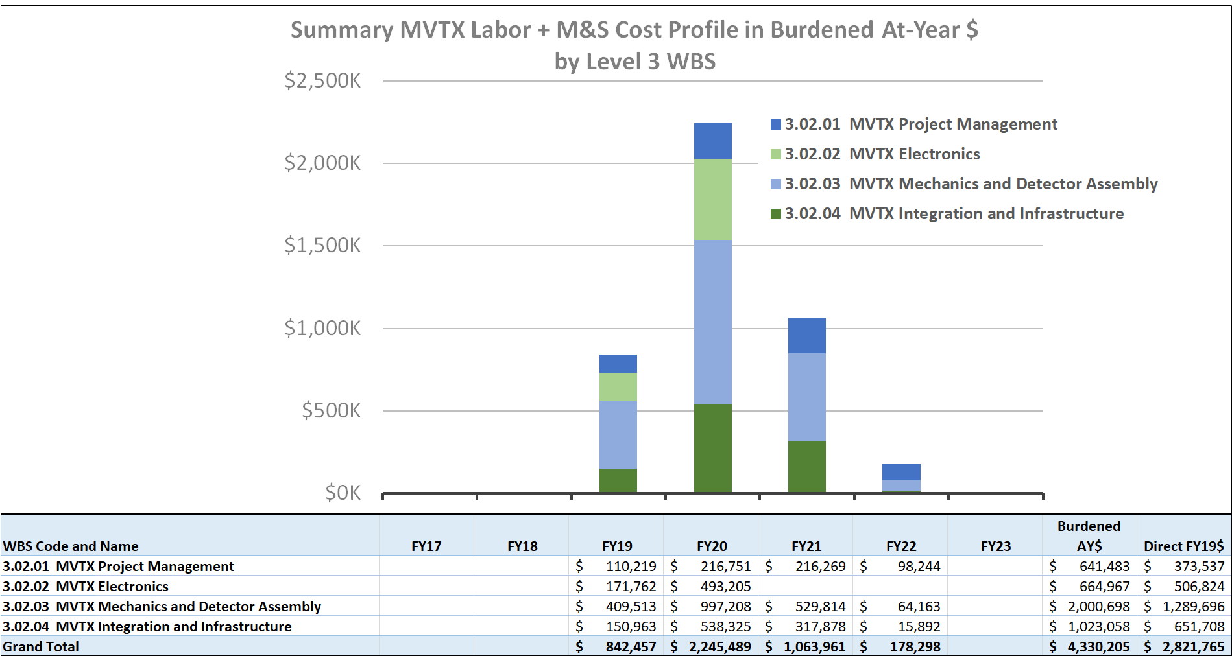
Resource Distribution
MVTX in P6

Slide 15
MVTX Schedules and Milestones
sPHENIX: CD1/3a PD2/3
Installation
1st collisions
CY-2018 | 2019 | 2020 | 2021 | 2022 | 2023
Generic R&D
Sensors for RHIC
Stave & RU production @CERN
MVTX
Construction
Detector mechanics design & production, global interface to sPHENIX
Detector & interface design
MVTX final
review
Feb. 2019, in P6
End Wheels
CYSS
Service barrel &
global system design
SB & global mech
sys production
Stave testing, half-barrel assembly @LBNL
Half barrel #1
6/15 Half barrels
arrive @BNL
FELIX production
Half barrel #2
IR installation
8/25 Installed
Ready for commissioning
sPHENIX interface & global support design
cooling & safety
system @BNL
Power system
production
Full detector
system test @BNL Lab
Pre-installation commissioning @BNL
RU, FELIX, PS, cables etc.
Ready for beam;
sPHENIX day-1 run
Today

Slide 16
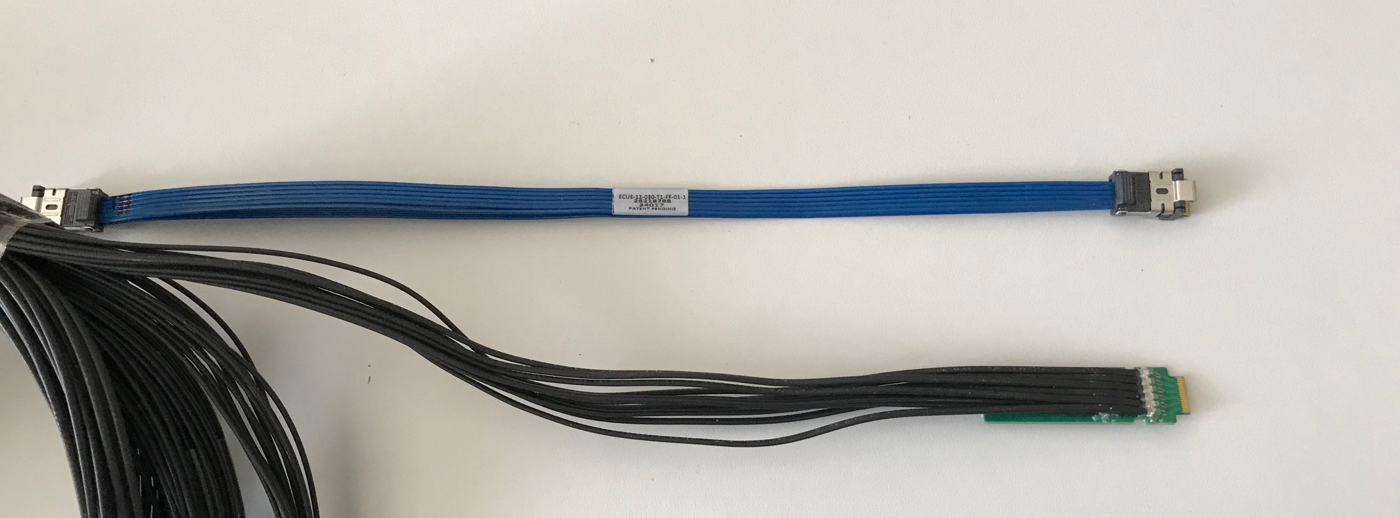
Status and Highlights
Full readout chain demonstrated through LANL LDRD
  Successful Fermilab Test Beam run in 2018
Modified stave certified through LANL LDRD
  Successfully tested at CERN
  Radiation hardness verified at CERN
Mechanical system integration MVTX+INTT
  sPHENIX tracking optimized with 2-layer INTT configuration
  Mechanical design being updated and 3-D mockup demonstrated
Readout cables
  BNL approved the use of SamTec non-Halogen-free cables
    Electrically better & mechanically compact
    ALICE confirmed performance with 8m long Halogen-free cables
    For MVTX, ~10m very likely work (30AWG/sPHENIX vs 32AWG/ALICE)
  Samples (6.5 ~ 11.5m long) ordered for R&D test at LANL
    To be tested in coming months
ALICE/ITS:
Halogen-free
readout cables
BNL approved:
Non-Halogen-free
cables for MVTX/sPHENIX

Slide 17
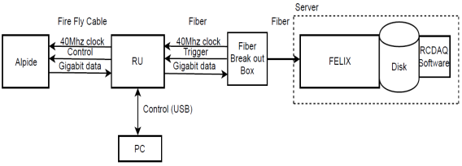
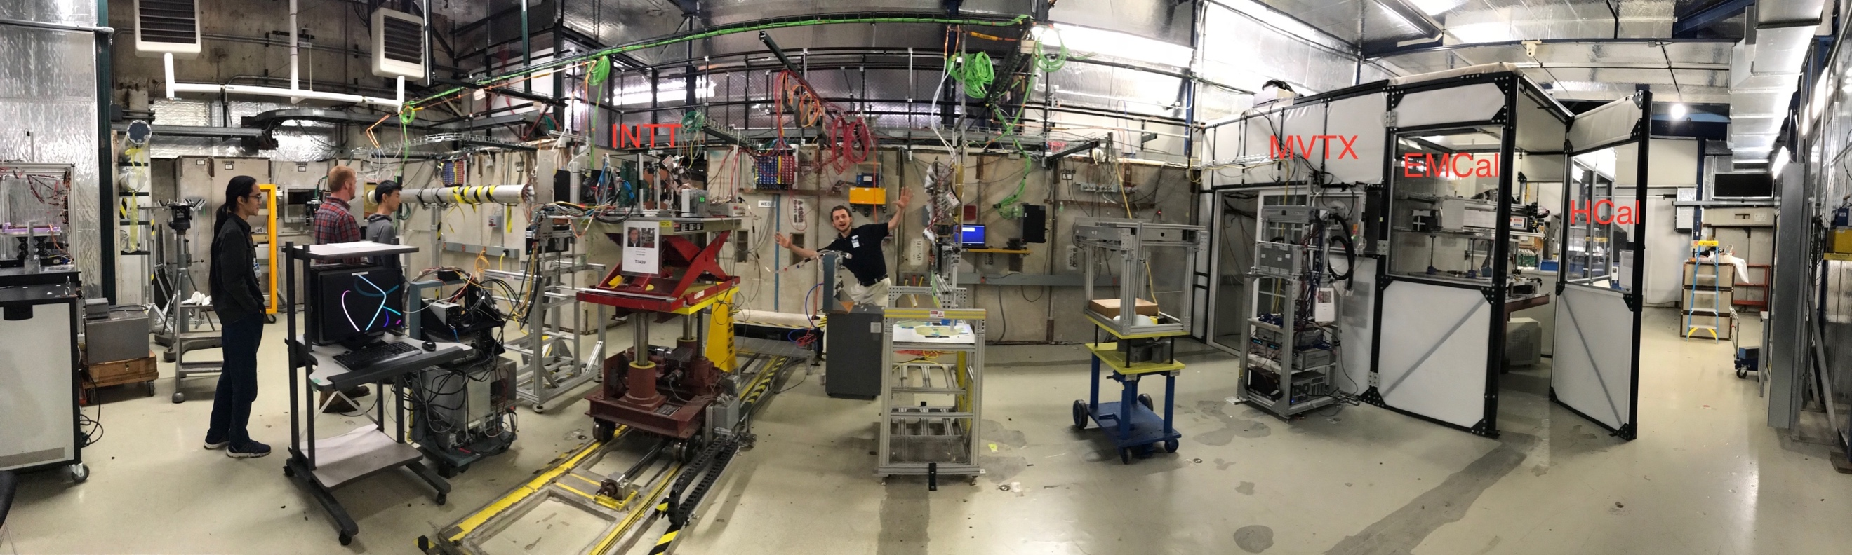
MVTX Full Readout Chain Demonstrated (3/2018)
4-MAPS
telescope
- Tracking spatial resolution: <5 um
- Hit efficiency: > 99.5%
Fermilab Test Beam: Feb-Mar, 2018
120 GeV proton
beam
4-hit track
Sho
Darren &
Sanghoon
Alex
4-MAPS telescope

Slide 18
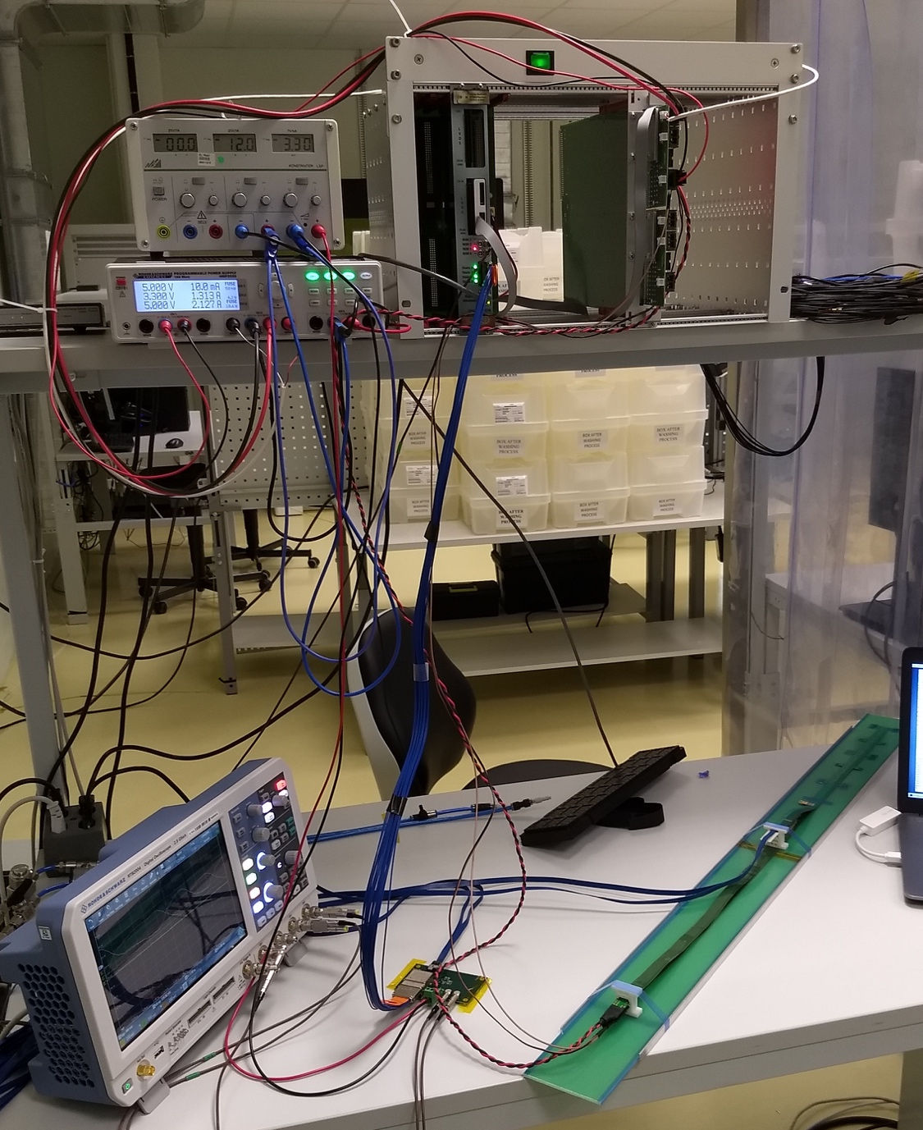
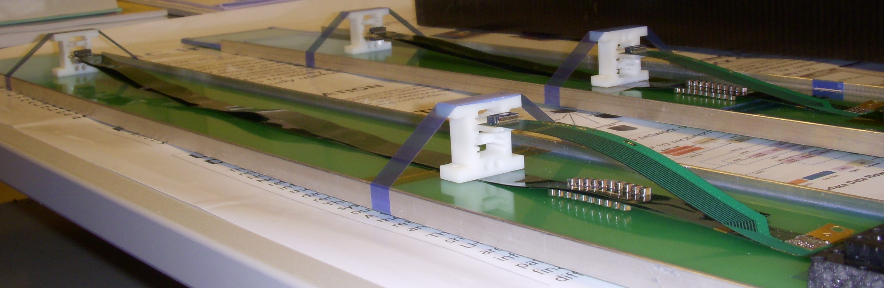
Confirmed HIC with Extended 40(60)cm Power FPC
Built and tested two HICs at CERN in 9/2018
  No change in sensor performance (noise, threshold) observed, as expected;
40cm PWR FPC
60cm PWR FPC
ALICE: 15cm PWR FPC
Followed identical ALICE IB QA test procedure, with a 8m SamTec cable!

Slide 19
Sensor Irradiation Test – OK at 2.7MRad
Continuous effort by ALICE (@NPI, Czech)
BNL Director’s review recommendation:
- Test sensors up to 1MRad
ALICE/ITS report: 2.7 MRad
https://indico.cern.ch/event/758048/
Operation
Region

Slide 20
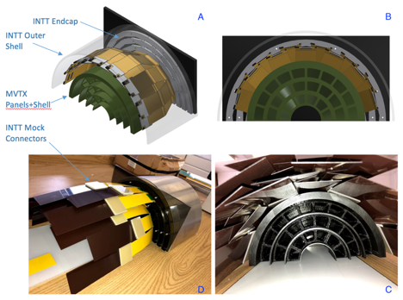
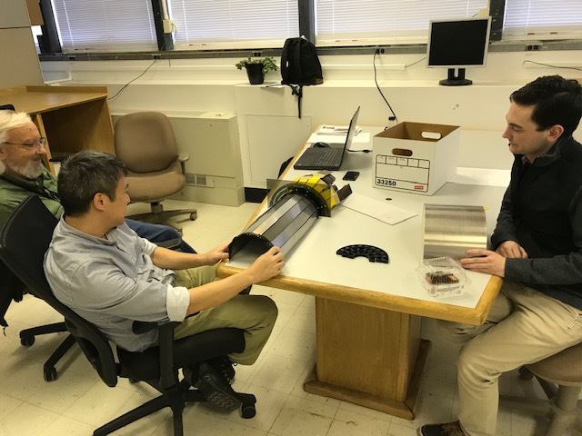
MVTX + INTT 3-D Mockup (11/2018)
Office of System Integration
– led by Mickey & Bob,
a team of engineers and physicists
MVTX and INTT
Space conflict resolved!

Slide 21
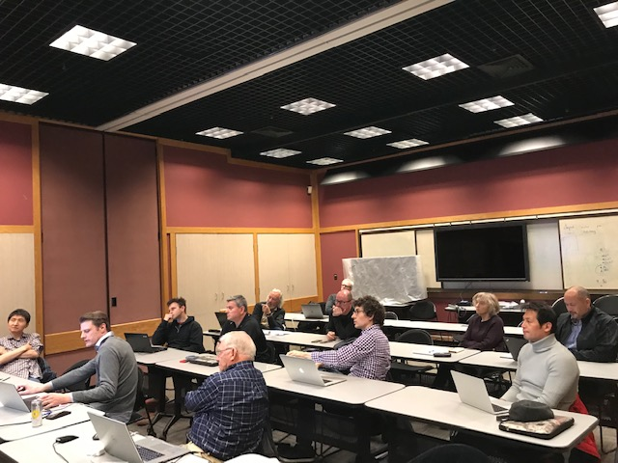
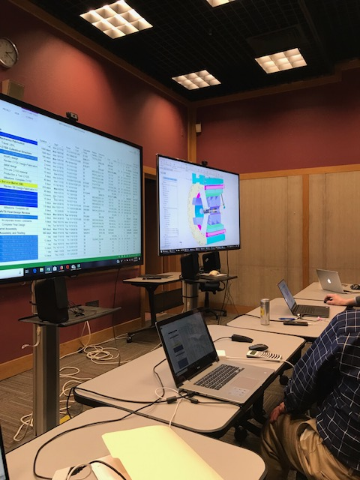
Latest Project Update: MVTX Workshop
Feb. 28 – Mar. 2, 2019, MVTX/HF Workshop @LBNL
Updated Cost & Schedule
under review;
Significant cost saving possible
Discussed major carbon structures’
design & production cost, line by line;
Also LBNL production schedule

Slide 22
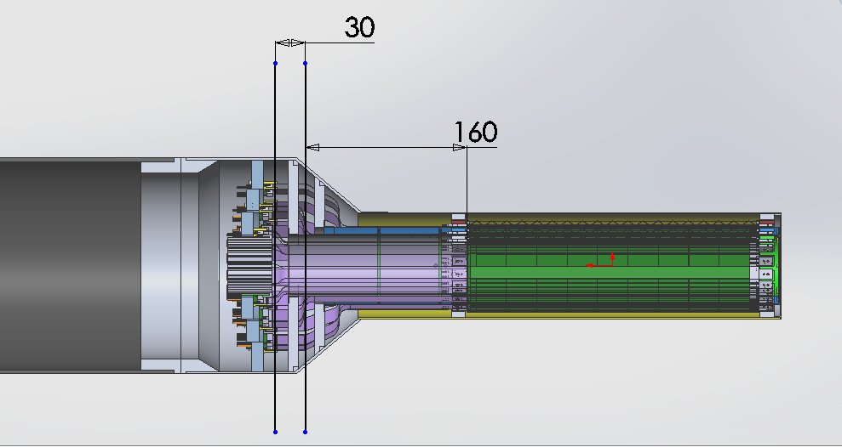
Carbon Structures – Work in Progress
Ross’ talk
Conical sectors are expensive!
A new design under development to avoid the conical structures, MIT/LANL

Slide 23
Issues and Concerns
Budget availability
  Funding for final mechanical system design work
    Early R&D to reduce high production contingency
  Preparation for Stave acceptance test/QA/storage at LBNL (3 months lead time)
  Schedule is closely tied to the funding level
Carbon structures
  Cost and schedule, high contingency in cost
  Window of opportunity at LBNL before ATLAS production
  Other possible production sites (Italy, France, Korea …)
Mechanical system integration
  sPHENIX beam pipe modification, under discussion with CAD
  Readout cables, cooling etc.
  MVTX+INTT+TPC… global support structure design

Slide 24
Summary
MVTX enables the 3rd science pillar
MVTX detector design & construction
  As a separate upgrade project from the baseline sPHENIX MIE
  Engineering design work in progress, MIT/LANL/LBNL et al
    Need budget now for the final engineering design work
  Construction and assembly work planned for late 2019
Project integrated into the sPHENIX P6
  Latest Cost & Schedule under review, significant cost saving possible
  To be implemented in P6 after this review
Successful generic R&D through LANL LDRD support
  Readout integration
  Stave modification
  Mechanical system conceptual design
MVTX is ready to receive project funding

Slide 25
backup

Slide 26
Address July 2018 Review Recommendations
Stave and RU procurement readiness
Completed sensor/HIC/stave evaluations at CERN
  Built, tested and confirmed two HICs with 40cm and 60cm long power FPC
  Sensors irradiated up to 2.7MRad, no issues (updated 9/18/2018).
Addressed all recommendations on stave/sensor R&D
Cost are set for staves & RUs, procurement through US-ALICE/UTK
  Technical specs document completed for production, BNL/DOE agreed
  sPHENIX RU and stave production starts ~May 2019
MVTX/INTT mechanical integration
  Mechanical design being updated and 3-D mockup demonstrated
  Inner tracking task force completed evaluation, preferred INTT-layers =2
Readout cables
  BNL approved the use of SamTec blue cables
    Electrically better & mechanically compact
    ALICE confirmed signal performance with 8m long readout cables. For MVTX, 10m very likely works (30AWG/sPHENIX vs 32AWG/ALICE), to be confirmed by on-going R&D at LANL
  Samples ordered for system integration mockup and test
https://docs.google.com/document/d/1vsm_G7ZLgqv-kBZqK0jF69T_Nx2Uwk0Zxv86jRVxybw/edit?usp=sharing

Slide 27
Stave and RU Production QA Plan Documents Available
https://indico.bnl.gov/event/4729/
Staves
Purchase 84 staves from ALICE/CERN
  48 + 28(spares for 2 inner layers) + 8 spares
  Production following the completion of ALICE ITS/IB
  Starting ~Oct. 2018, will last 6-12 months
  Fully tested at CERN before shipping to US
    All Gold/Silver staves (same as ALICE IB)
    A LANL postdoc (Dr. Yasser Morales) oversees production QA at CERN
Acceptance QA at LBNL
  Full test and QA
    Electrical
    Mechanical
  Detector assembly at LBNL
Readout Units
Purchase 60 RUs from ALICE/CERN
  48 + 12 spares(20%)
  To be part of ALICE production
    Cost saving
    Minimize technical risks
  Initial test at CERN
Acceptance QA at UT-Austin
  Full test
  LANL as the 2nd test site

Slide 28
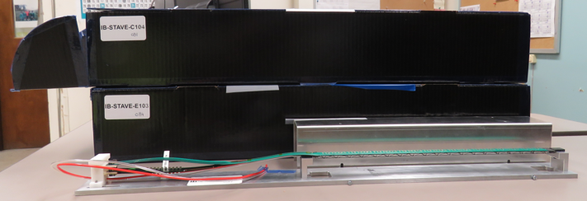
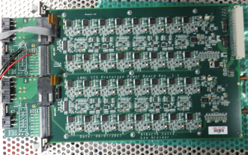
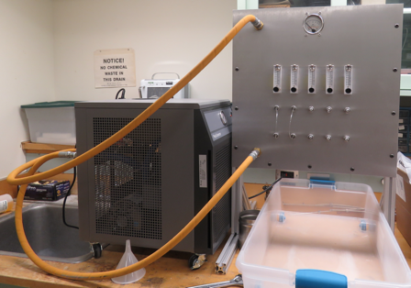
2019 Test Beam: 4-stave Telescope
Jo’s talk
Scheduled for May 22-29, at Fermilab
Additions compared to the 2018 test beam:
  Staves (from single chips)
  Full-length MVTX signal cables (from 5 m off-the-shelf cables)
  FELIX v2.0 (from v1.5)
  Cooling system
  Power board
  sPHENIX GTM
Full test of all components of the MVTX detector - LDRD “stretch goal”
28

Slide 29
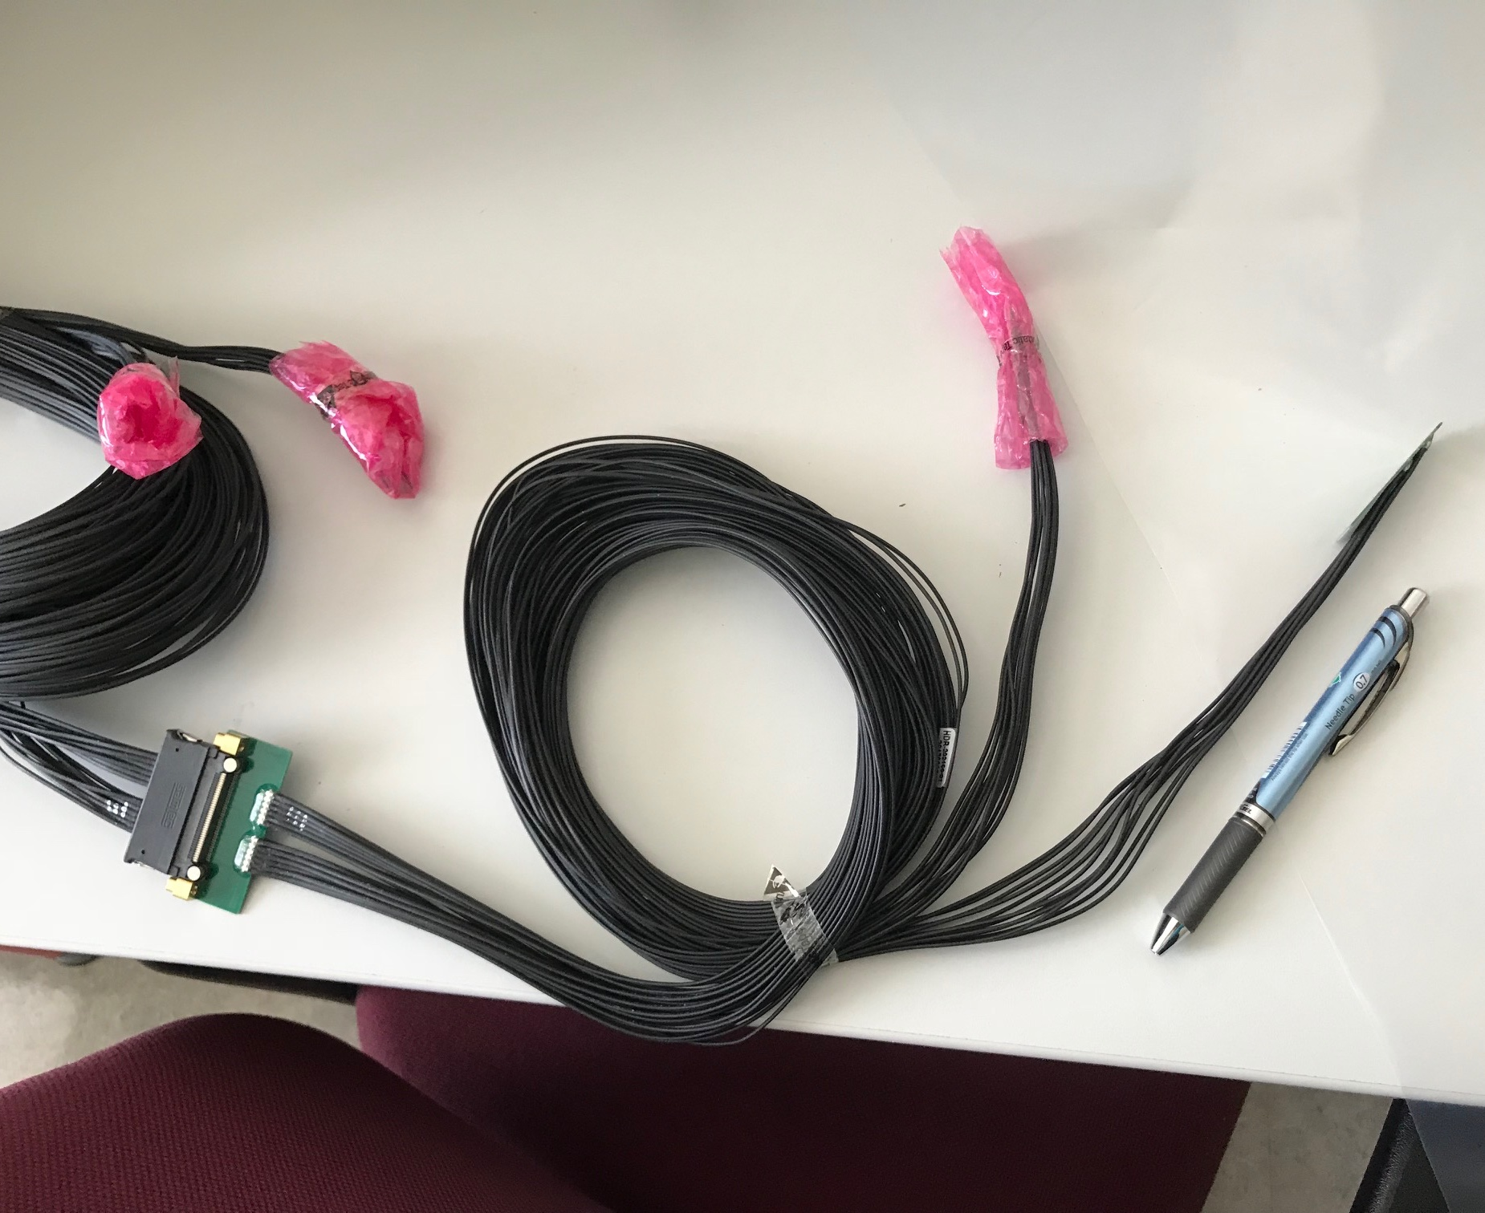
MVTX Readout and Power Cable Rout
Jo’s talk
ALICE ITS/IB final readout cables: ~8m
Cable-B: 5.3m
Cable-A: 2.65m
PWR
RU
PU
sPHENIX MVTX: 7.9+m
  Cable-A: 1.4 m
  Cable-B: 6.5+ m
  Power cable:4.7+ m
On-going R&D for ~10m
BNL has approved “non-halogen free” cables for sPHENIX

Slide 30
MVTX in P6 (fully Burd. & Esca.)

Slide 31
MVTX MS Project 1/4(for estimation)

Slide 32
MVTX MS Project 2/4

Slide 33
MVTX MS Project 3/4

Slide 34
MVTX MS Project 4/4

